Slide 1


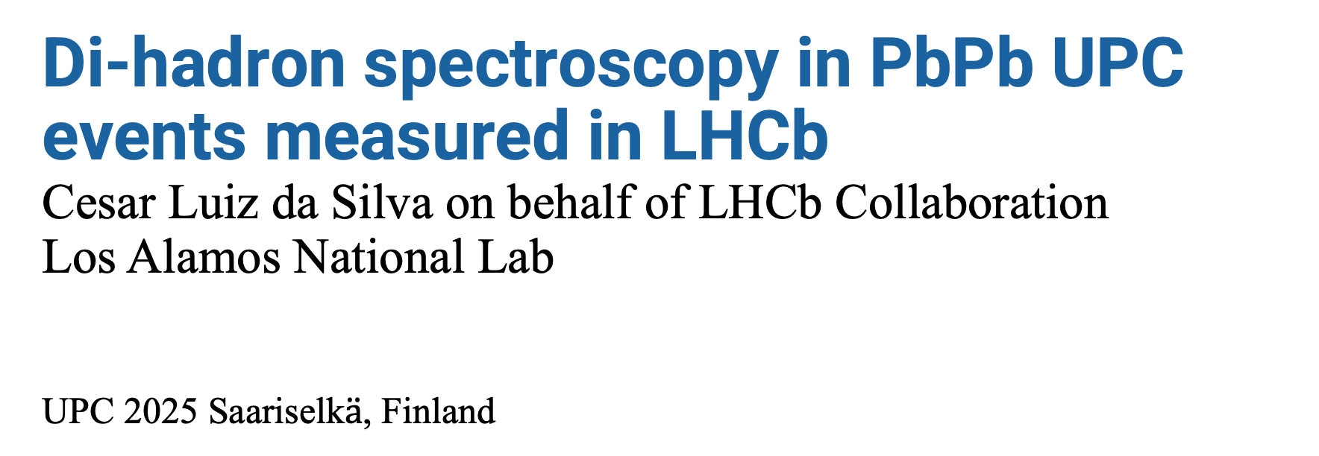
Di-hadron spectroscopy in PbPb UPC events measured in LHCb
Cesar Luiz da Silva on behalf of LHCb Collaboration
Los Alamos National Lab
UPC 2025 Saariselk$\ddot{a}$, Finland

Slide 2
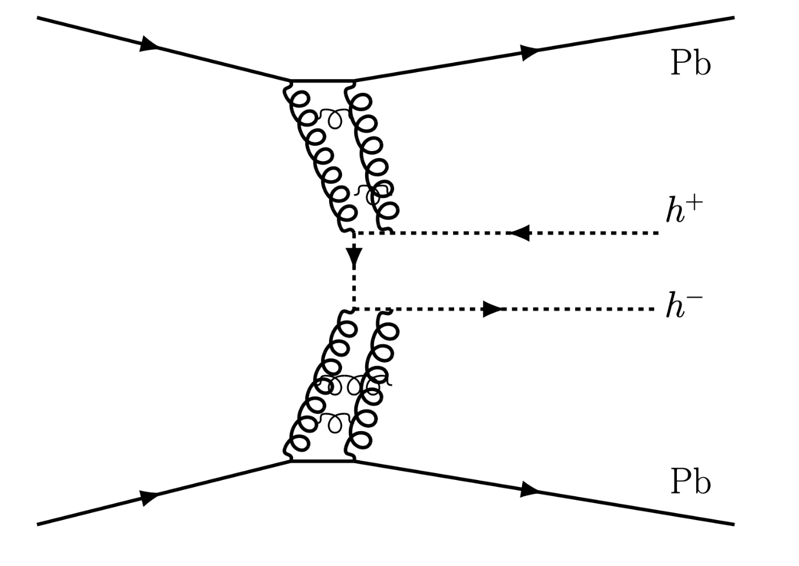
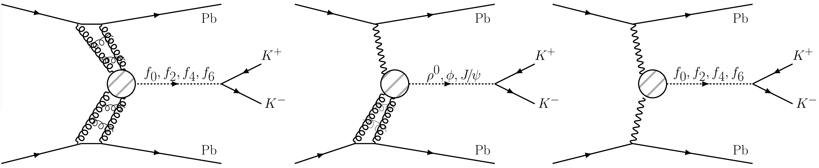


Di-hadron production in CEP and UPC
double pomeron interaction
$γ$+pomeron interaction
$γ+γ$ interaction
Non-resonant hadron pairs
Scalars and tensor mesons
Vector mesons
Scalar and tensor mesons

Slide 3
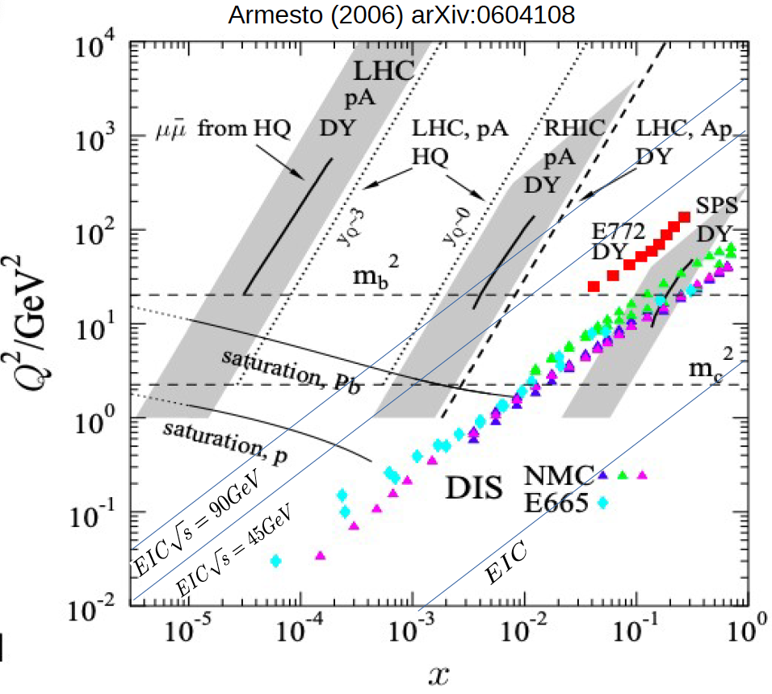

Slide 4








$$2<η<4.5$$
$$\left|η\right|<2$$
$$2<η<4.5$$
$$Υ(1S)$$
Photo-production of vector mesons probes a broad range in x and Q²
$$ψ(2S)$$
$$J/ψ$$
saturation Pb
$$ϕ$$
$$ρ^{0}$$
saturation p

Slide 5
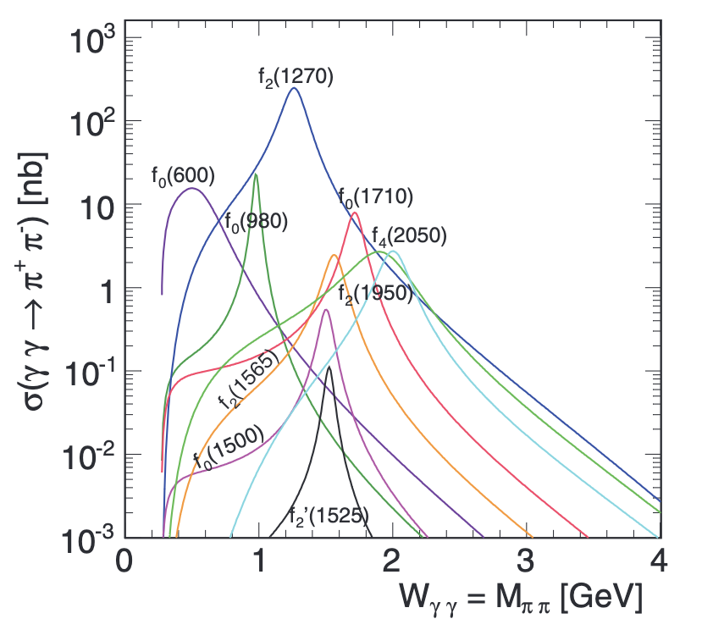
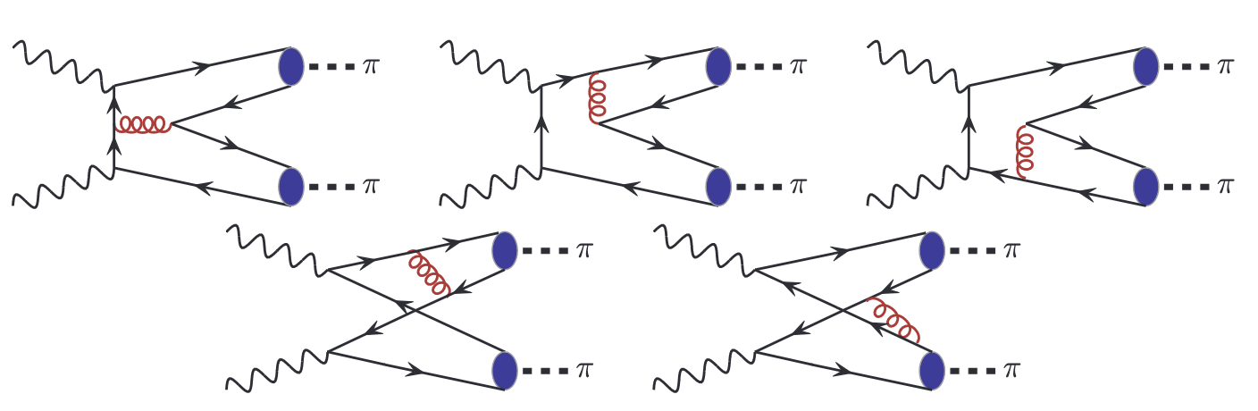
Photon + photon scattering
PRC 87, 054908 (2013)
PRC 87, 054908 (2013)

Slide 6
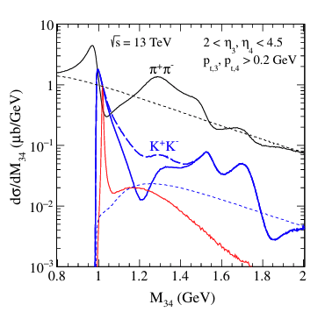
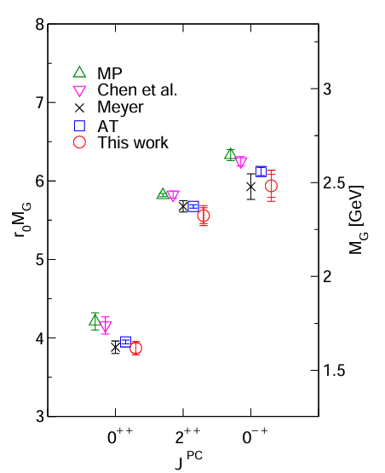
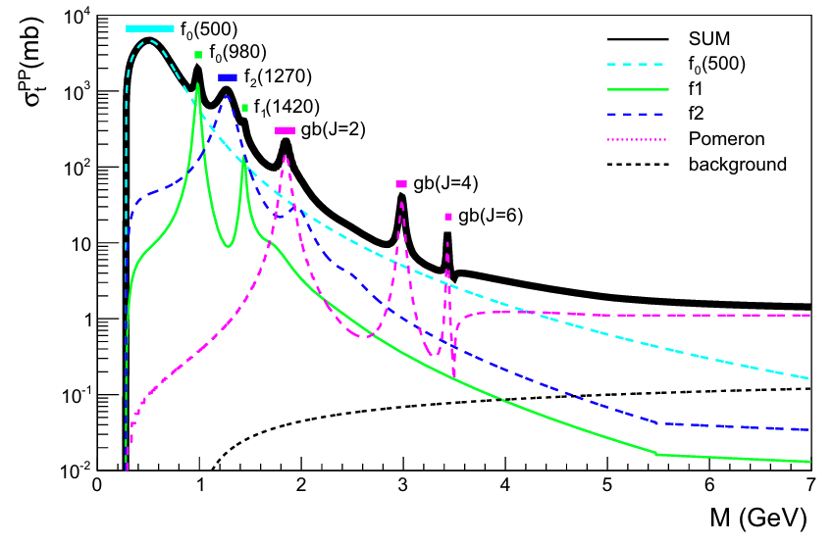
Glueball search
Pomeron+pomeron
Glueballs from Lattice
PRD98, 014001 (2018)
Eur. Phys. J. C (2016) 76:38
arXiv:2211.15176 (2023)
Gluon-rich environment in the small-x may be a nice spot to find glueballs.

Slide 7
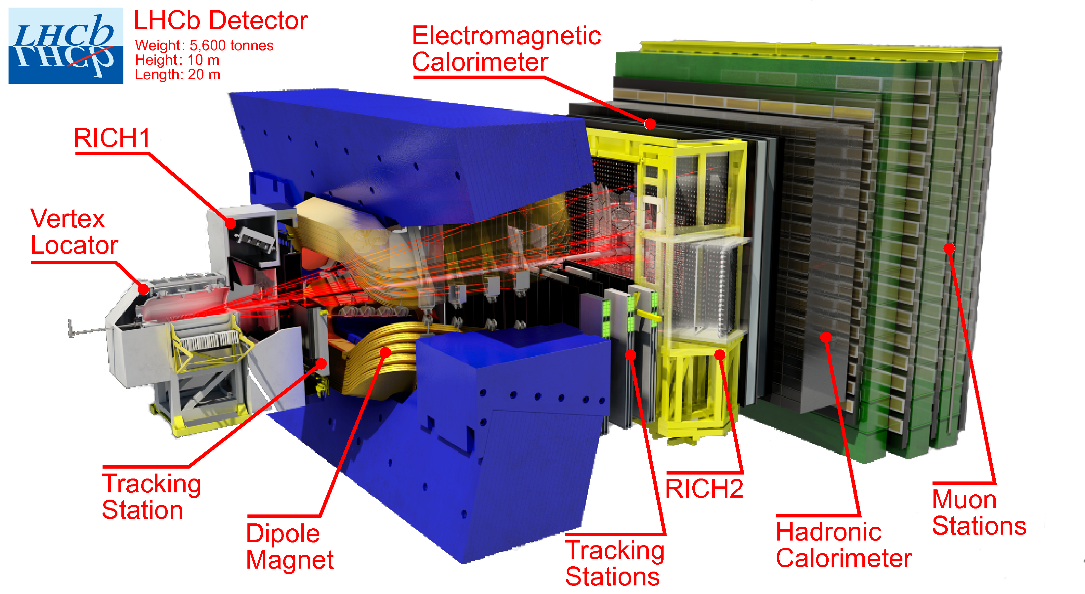


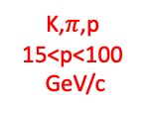



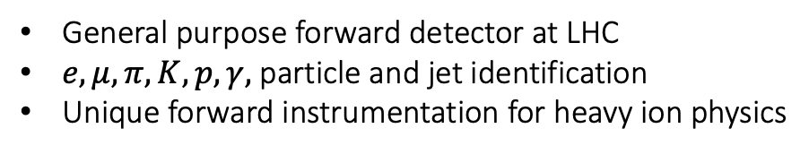
The LHC beauty detector : Run2 configuration
Converts stopping e,$γ$ energy in scintillating signal.
J. of Instr.,3(08):S08005, 2008
Int. J. Mod. Phys.457 A30 (2015) 1530022
Kaon,$π$,proton
1<p<60 GeV/c
$$\left\langle δx\right\rangle \sim 5μm$$
K,$π$,p
15<p<100
GeV/c
$$\frac{δp}{p}<0.35\%$$
Converts stopping hadron energy in scintillating signal.
General purpose forward detector at LHC
$e,μ,π,K,p,γ,$ particle and jet identification
Unique forward instrumentation for heavy ion physics
$M_{ππ}$ resolution ~ 5 MeV/c²

Slide 8
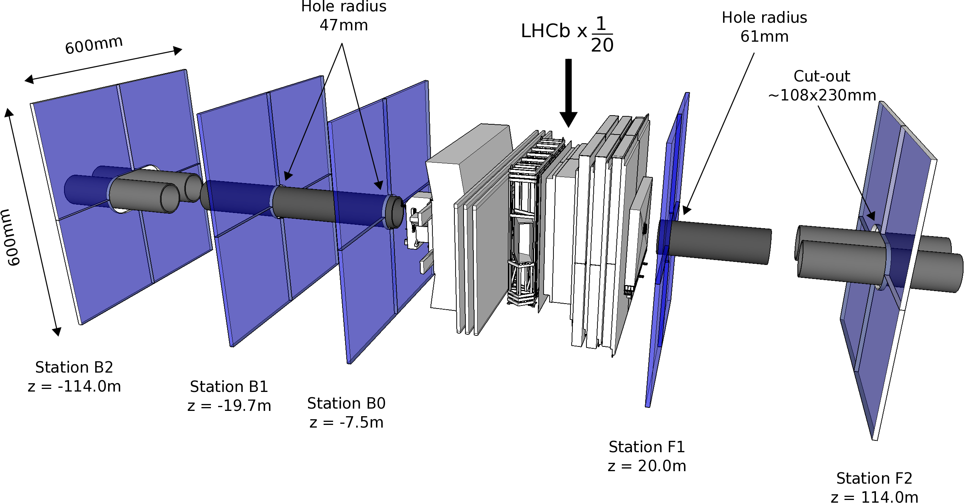

HeRSCheL detector: high-rapidity shower counters for LHCb
$$5<\left|η\right|<9$$
K. Carvalho Akiba et al 2018 JINST 13 P04017

Slide 9
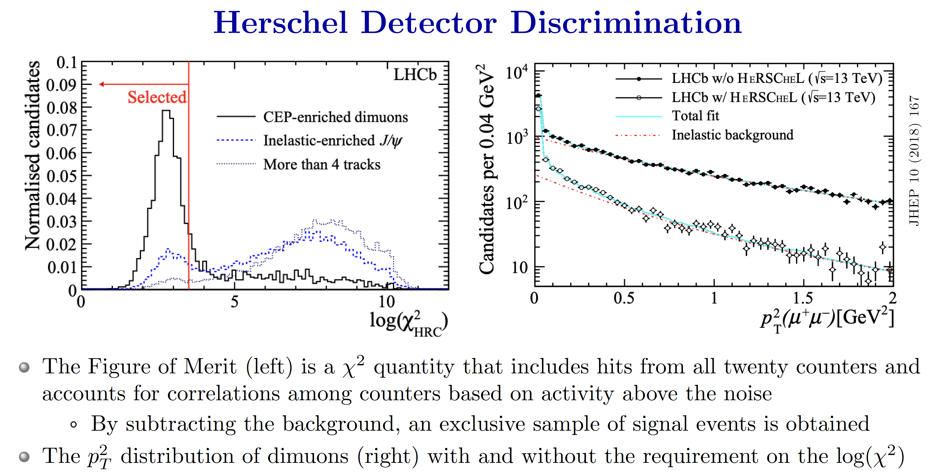
CEP

Slide 10
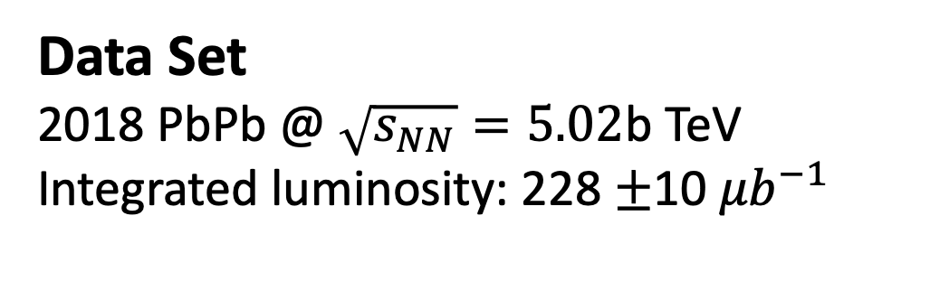
Selection Criteria
Low multiplicity events trigger
HeRSCheL selection for intact Pb ions
Only two oppositive tracks in the event
p_{T}(track) > 100 MeV/c, and 2 < η_{Track} < 5
2.0 < y(hh) < 4.5, p_{T}(hh)< 100 MeV/c²
Di-hadron distance-of-the-closest approach < 1 mm
Pion or kaon identification
Data Set
2018 PbPb @ $\sqrt{s_{NN}}=5.02$b TeV
Integrated luminosity: 228 $±$10 ${μb}^{−1}$

Slide 11
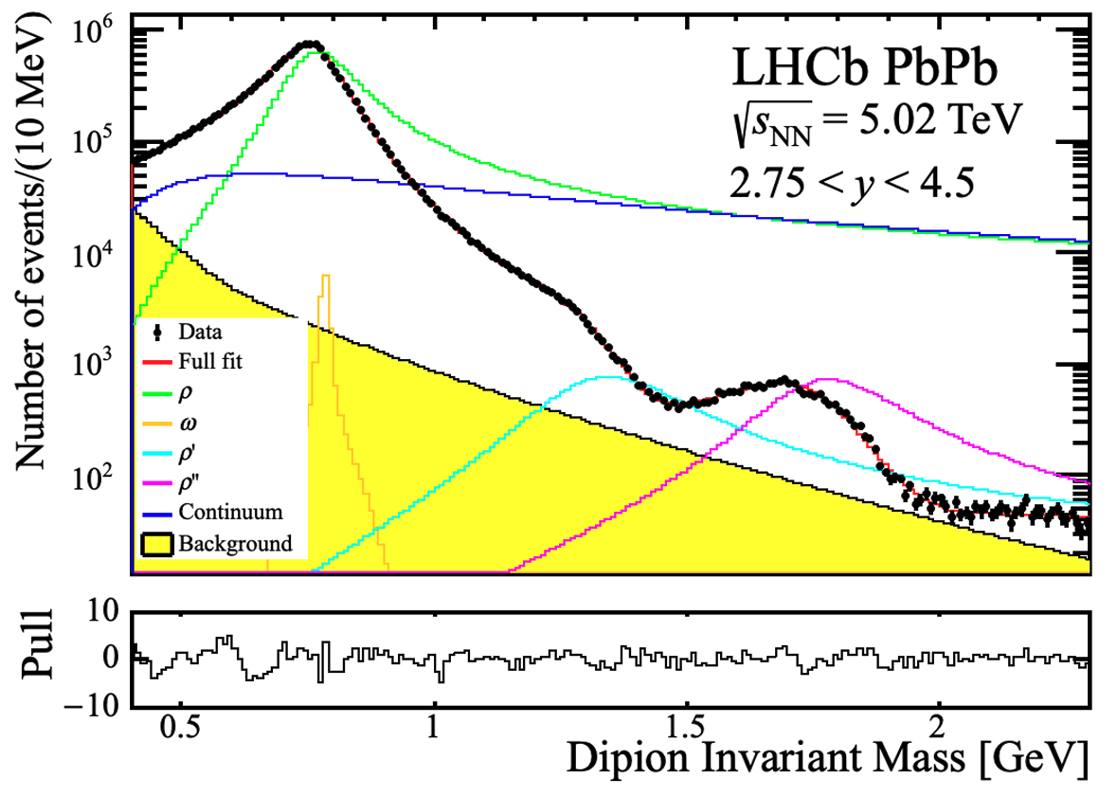
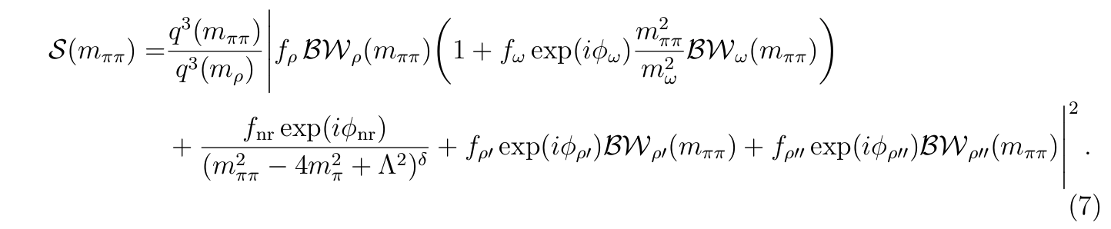
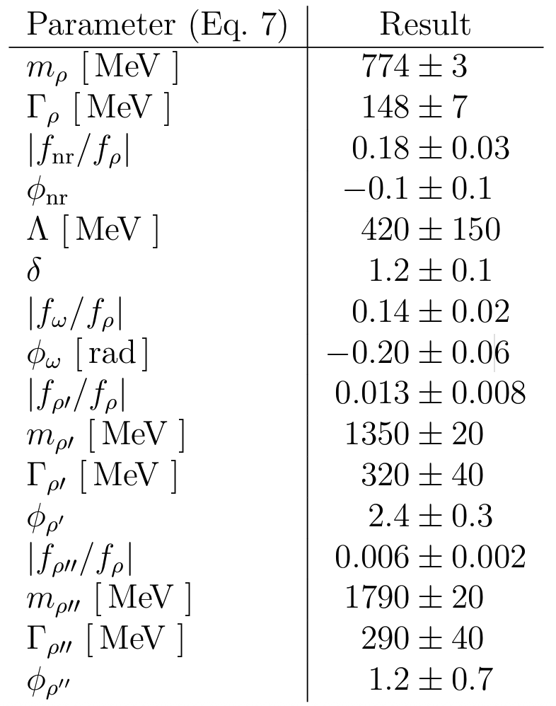
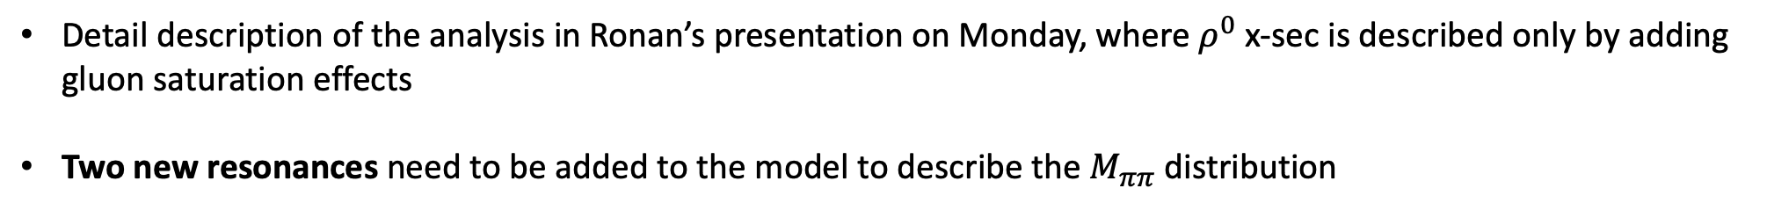
Di-pion in UPC PbPb
arXiv:2506.06250
Detail description of the analysis in Ronan’s presentation on Monday, where $ρ^{0}$ x-sec is described only by adding gluon saturation effects
Two new resonances need to be added to the model to describe the $M_{ππ}$ distribution

Slide 12
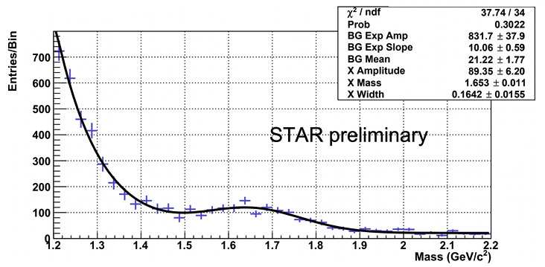
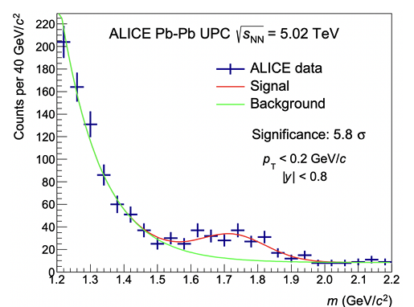





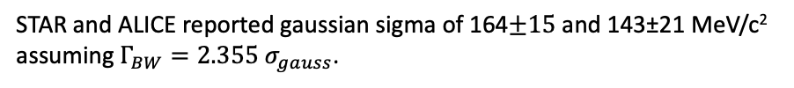
High-mass structure
arXiv:1606.02754
arXiv:2506.06250
LHCb-PAPER-2024-042 in preparation
$ρ^{0}$+gaussian fit
JHEP 06 (2020) 035
$ρ^{0}$+gaussian fit
LHCb STAR ALICE
M(MeV/c²) =
1790$±20$ 1653$±11$ 1725±17
STAR and ALICE reported gaussian sigma of 164$±15$ and 143±21 MeV/c²
assuming $Γ_{BW}=2.355{ σ}_{gauss}$.
$ΓBW$ (MeV/c²) =
290$±40$ 386$±35$ 336±49

Slide 13
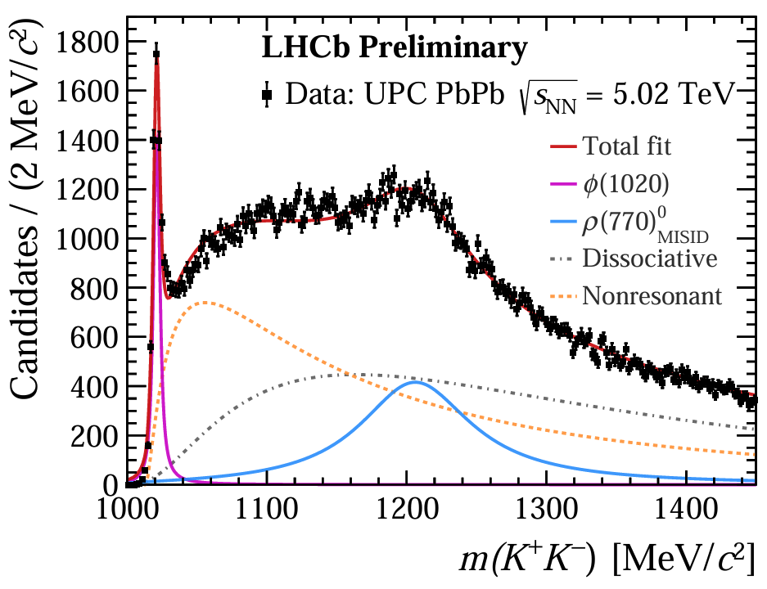
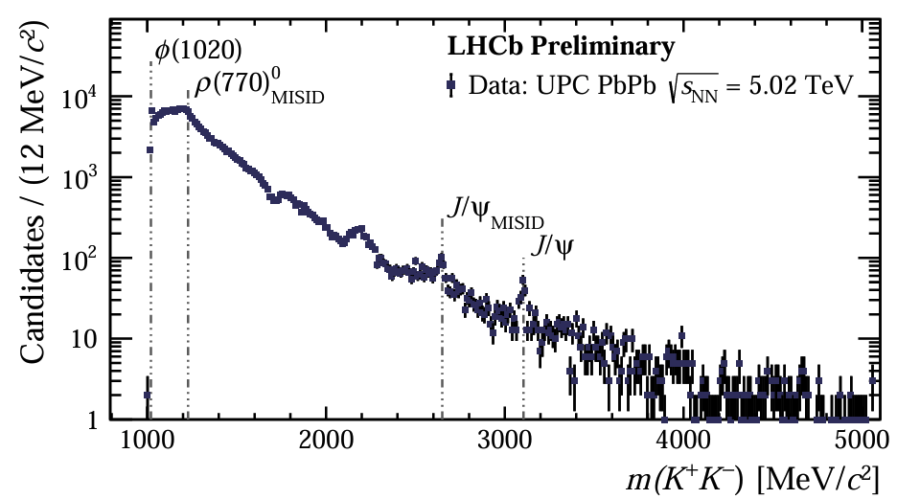
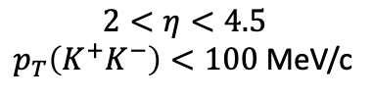
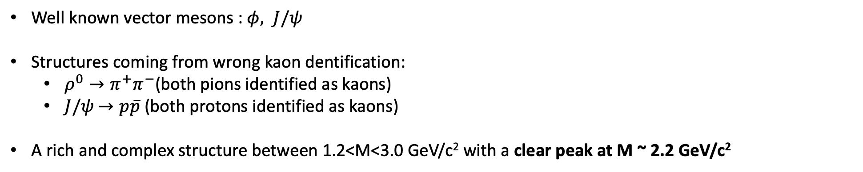
Di-kaons in PbPb UPC
LHCB-CONF-2024-006
LHCB-CONF-2024-006
$$2<η<4.5$$
$p_{T}\left(K^{+}K^{−}\right)<100$ MeV/c
Well known vector mesons : $φ, J/ψ$
Structures coming from wrong kaon dentification:
  $ρ^{0}→π^{+}π^{−}$(both pions identified as kaons)
  $J/ψ$ $→p\overline{p}$ (both protons identified as kaons)
A rich and complex structure between 1.2<M<3.0 GeV/c² with a clear peak at M ~ 2.2 GeV/c²

Slide 14
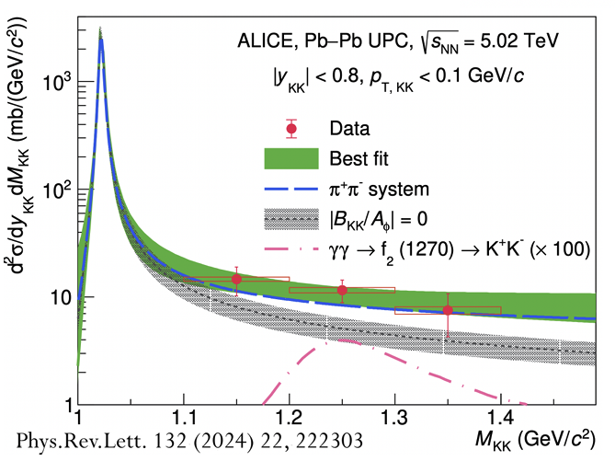
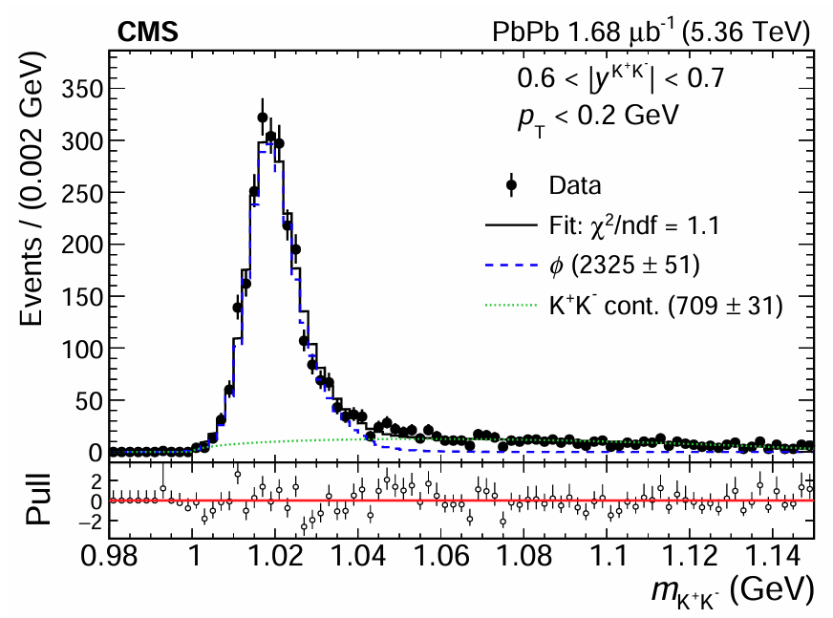
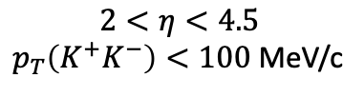
Di-kaons in PbPb UPC : comparison with other experiments
LHCB-CONF-2024-006
$$2<η<4.5$$
$p_{T}\left(K^{+}K^{−}\right)<100$ MeV/c
arXiv:6334581
LHCb can cover high-mass and has unique forward coverage to $φ$-mesons.

Slide 15
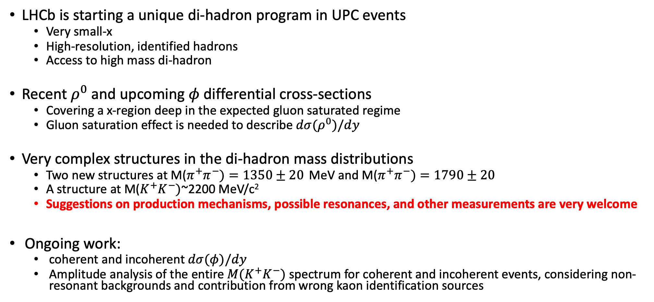
Summary and Outlook
LHCb is starting a unique di-hadron program in UPC events
  Very small-x
  High-resolution, identified hadrons
  Access to high mass di-hadron
Recent $ρ^{0}$ and upcoming $φ$ differential cross-sections
  Covering a x-region deep in the expected gluon saturated regime
  Gluon saturation effect is needed to describe $dσ(ρ^{0})/dy$
Very complex structures in the di-hadron mass distributions
  Two new structures at M($π^{+}π^{−})=1350±20$ MeV and M($π^{+}π^{−})=1790±20$
  A structure at M($K^{+}K^{−})$~2200 MeV/c²
  Suggestions on production mechanisms, possible resonances, and other measurements are very welcome
Ongoing work:
  coherent and incoherent $dσ(φ)/dy$
  Amplitude analysis of the entire $M(K^{+}K^{−})$ spectrum for coherent and incoherent events, considering non-resonant backgrounds and contribution from wrong kaon identification sources

Slide 16
EXTRAS

Slide 17
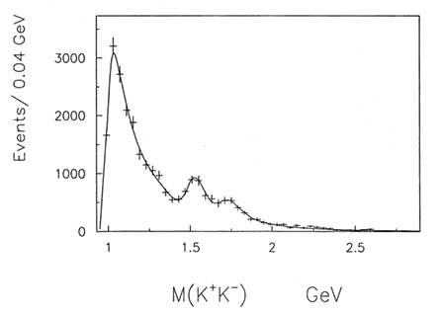
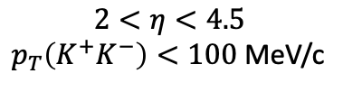
LHCB-CONF-2024-006
WA102
PLB 462 1999 462
$$2<η<4.5$$
$p_{T}\left(K^{+}K^{−}\right)<100$ MeV/c

