Slide 1
CERN-ISOLDE’s new high-resolution laser ion source PI-LIST:
Results, characteristics, and developments
Reinhard Heinke
for the PI-LIST collaboration

Slide 2
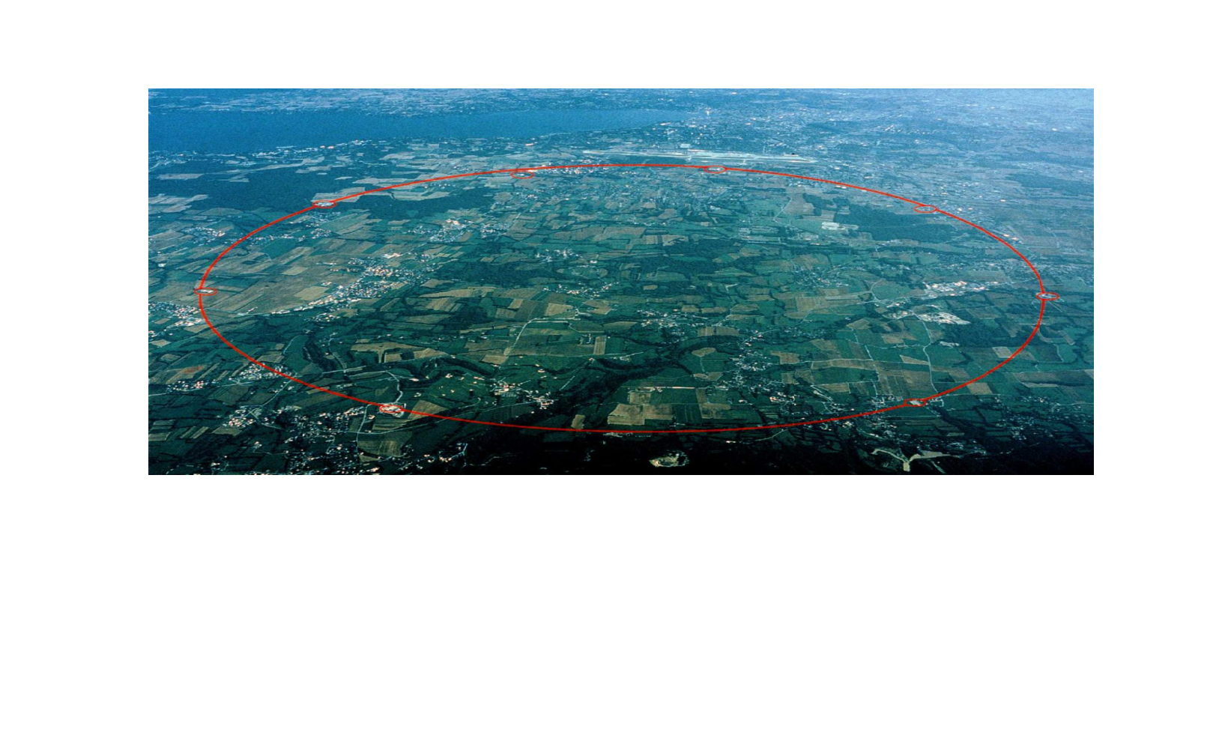
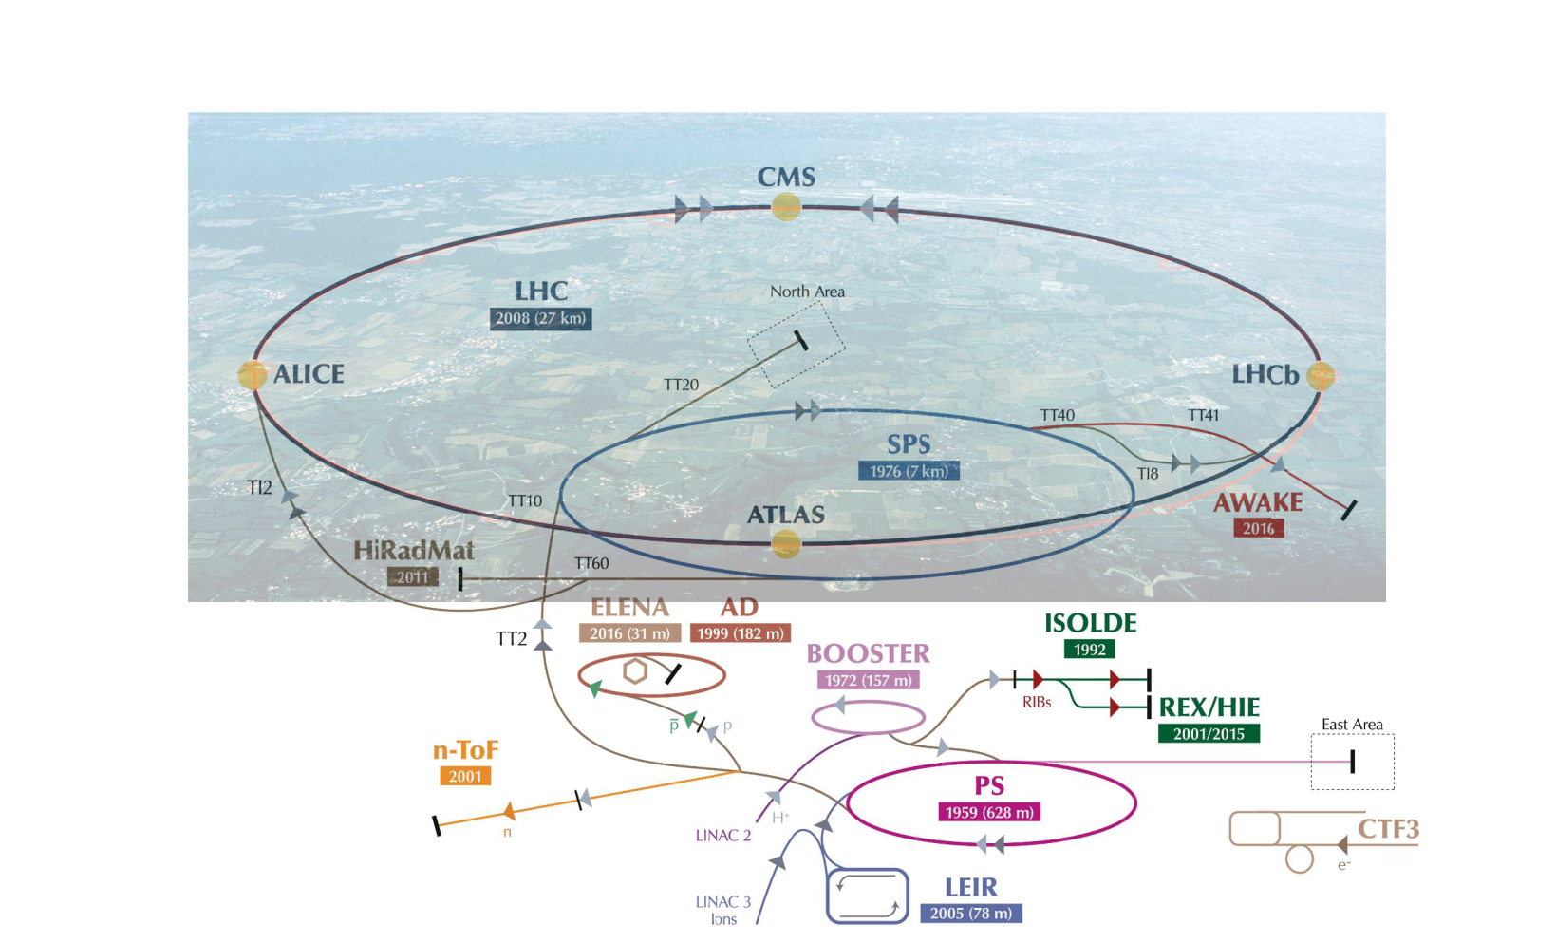
ISOLDE at CERN

Slide 3

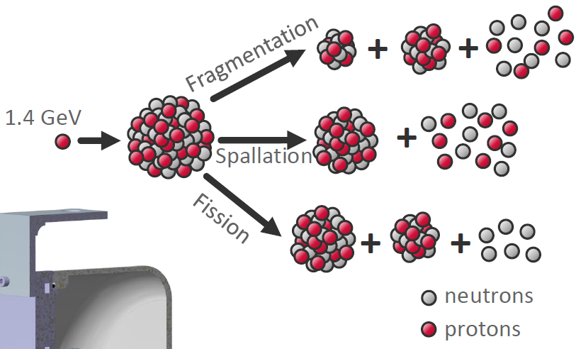
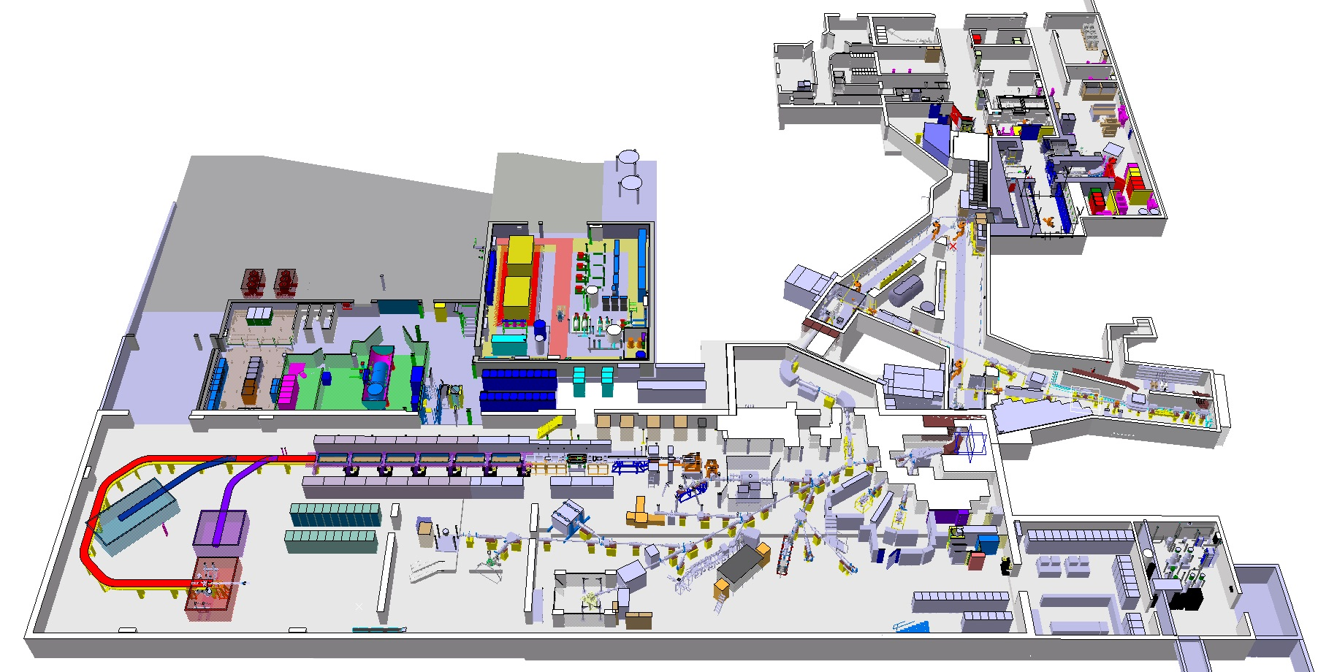




The ISOLDE facility at CERN
Radioactive laboratory
MEDICIS
HRS
High Resolution Separator
Target area
High energy RIB
GPS
General Purpose Separator
Low energy RIB

Slide 4
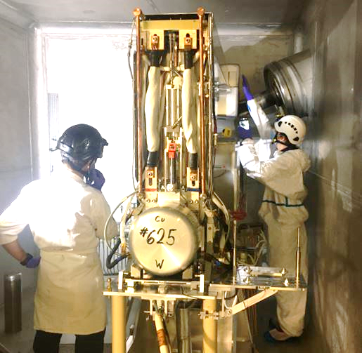
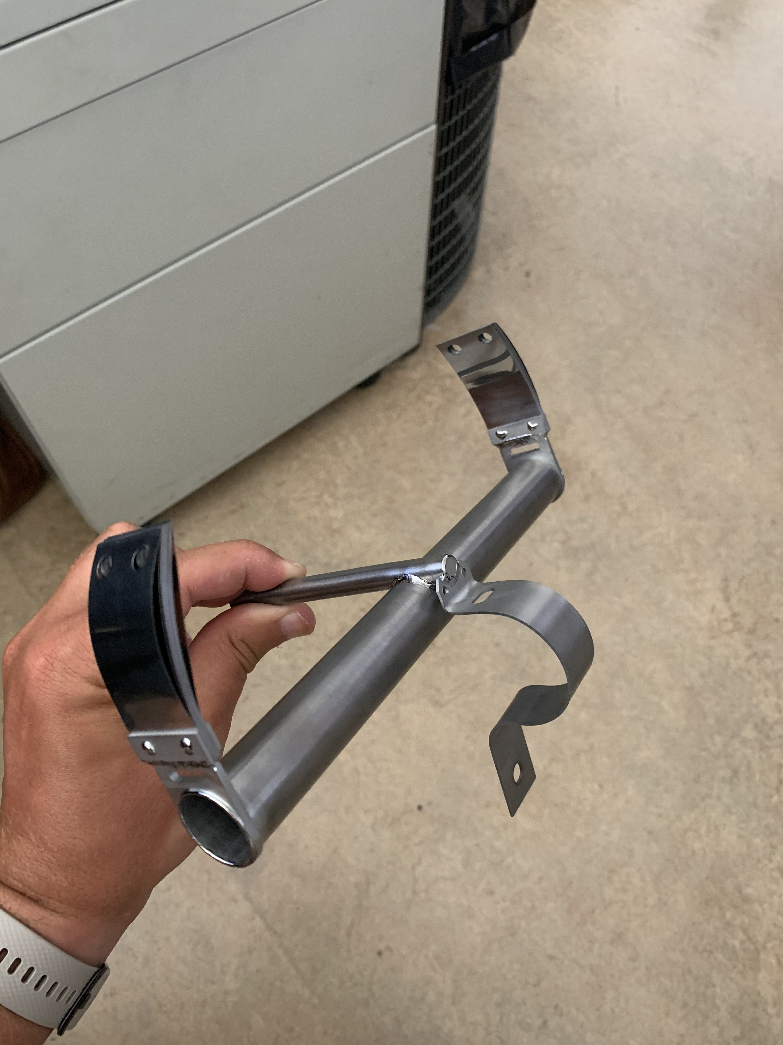
ISOLDE frontend and target/ion source unit
Ion source
Target container

Slide 5
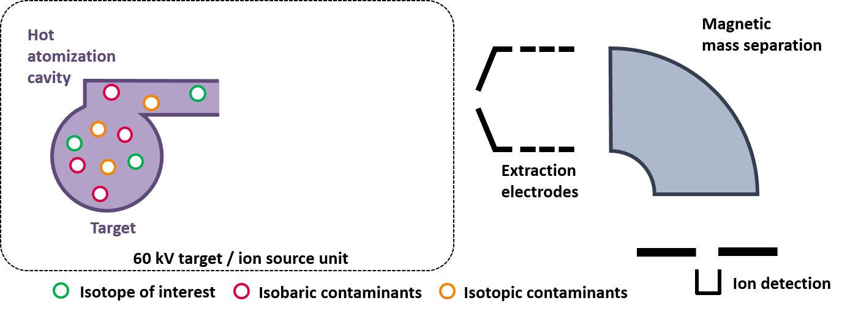

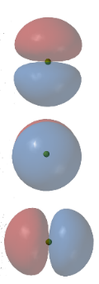
ISOLDE’s resonance ionization laser ion source RILIS
Ion
+
Ion
Ionization
lasers
Excited
states
p⁺
Energy
Production /
Reservoir
Atom
Ground
state
Effusion of reaction products provided as hot atomic vapor ( > 2000°C )
Highly efficient laser ionization of element of choice as function of laser wavelength ➔ in-source spectroscopy (<< 1pps)
Extraction and mass separation as ion beam

Slide 6
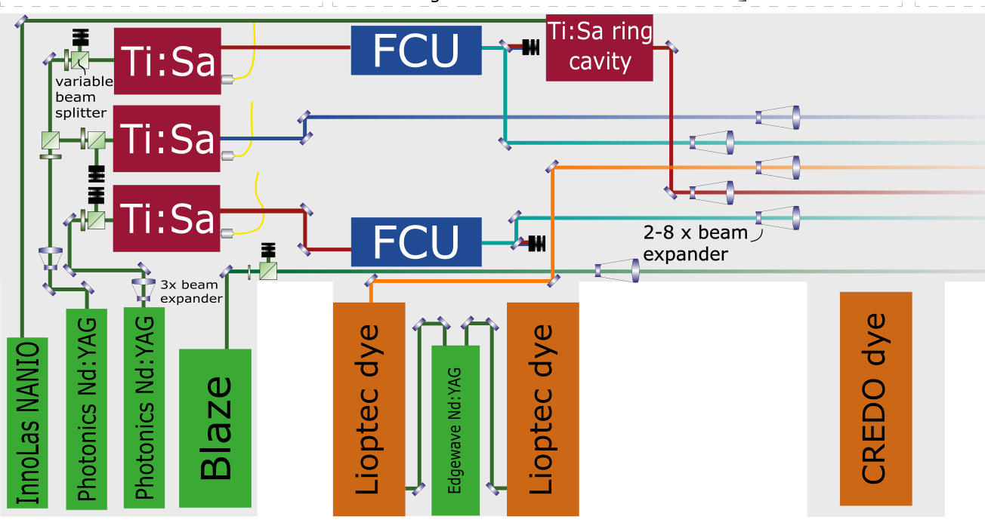

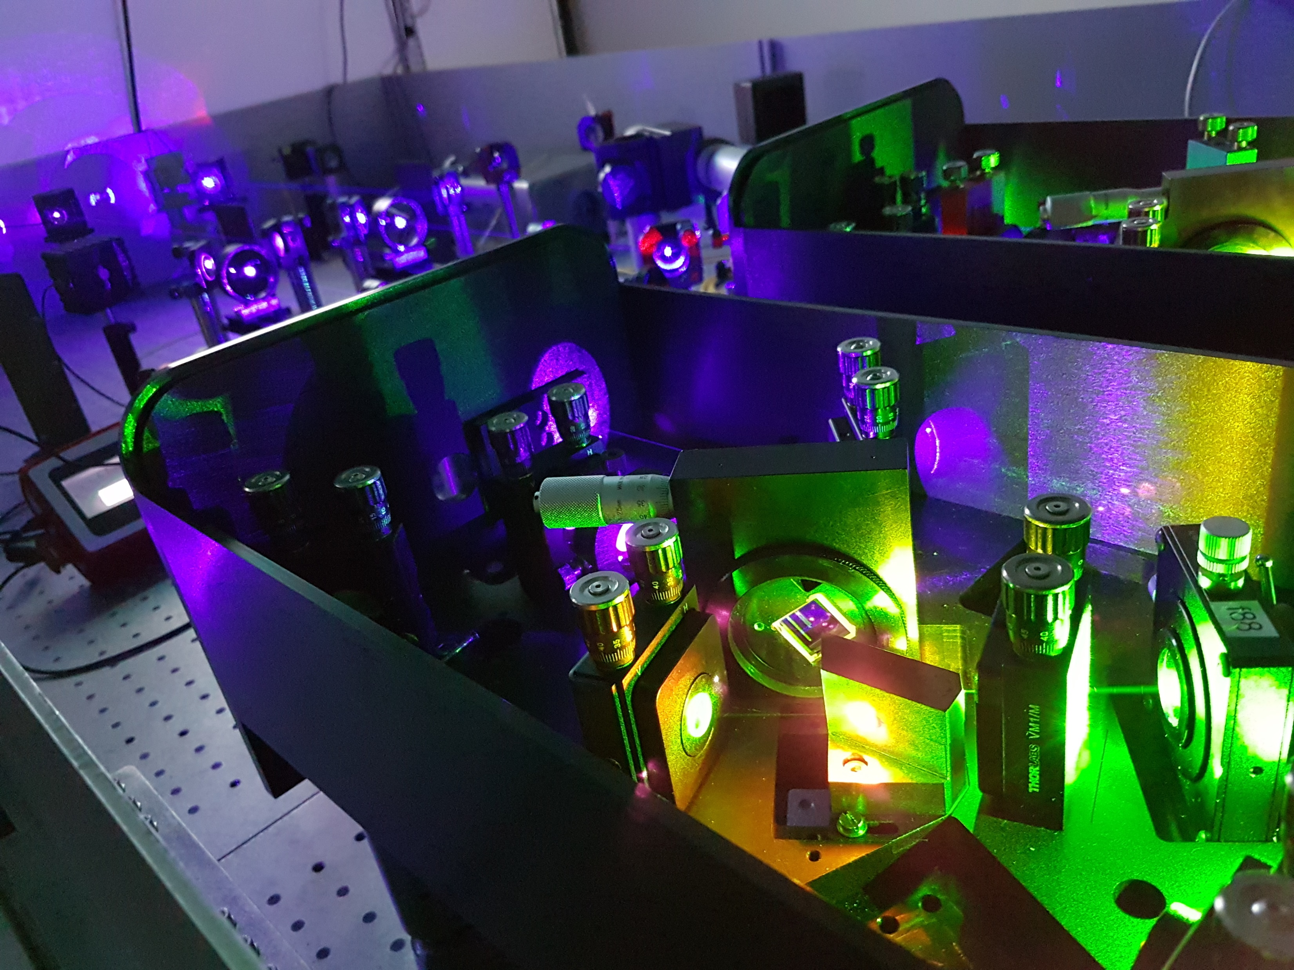
The RILIS laser setup
10kHz rep-rate wavelength-tunable systems (commercial + development)
4ω Ti:Sa
210-230 nm
3ω Ti:Sa
230-300 nm
2ω dye
300-350 nm
2ω Ti:Sa
350-475 nm
UV pumped dye
475-550 nm
dye
550-700 nm
Ti:Sa
700-950 nm
Solid state laser development:
Mixing (poster J. Wessolek), Raman shifting (poster C. Bernerd)
300-340 nm
385-545 nm
520-860 nm
Sum mixing
532nm
Raman shift
+ 2ω
Difference mixing 1064nm

Slide 7
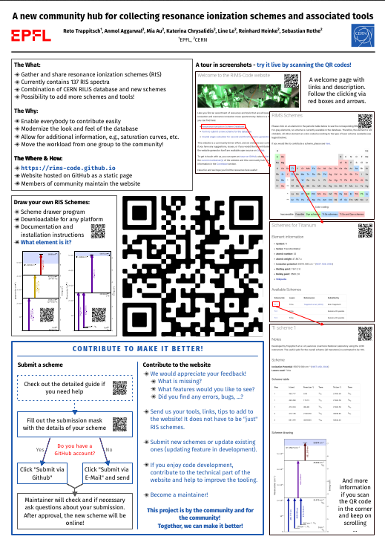
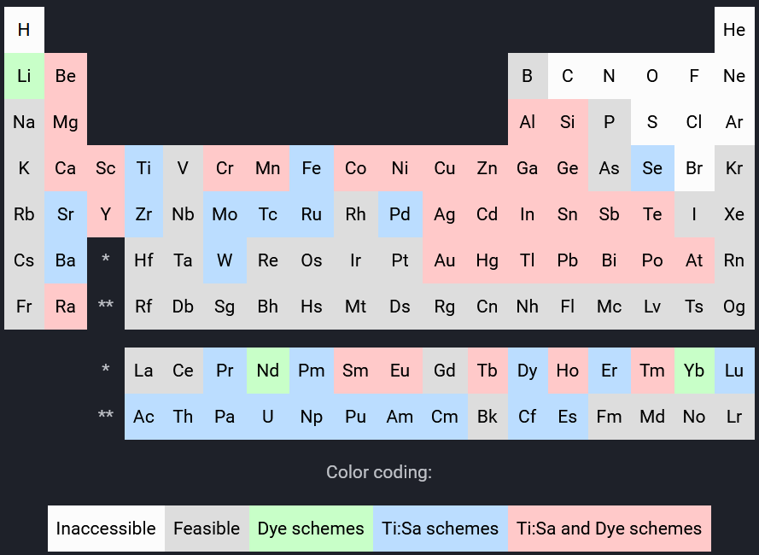
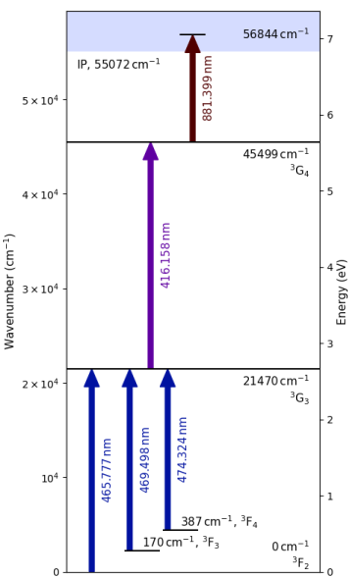
A new community-driven laser scheme database
https://rims-code.github.io
Poster
R. Trappitsch
From community for community:
Feedback, feature requests, extension to tool hub, …

Slide 8
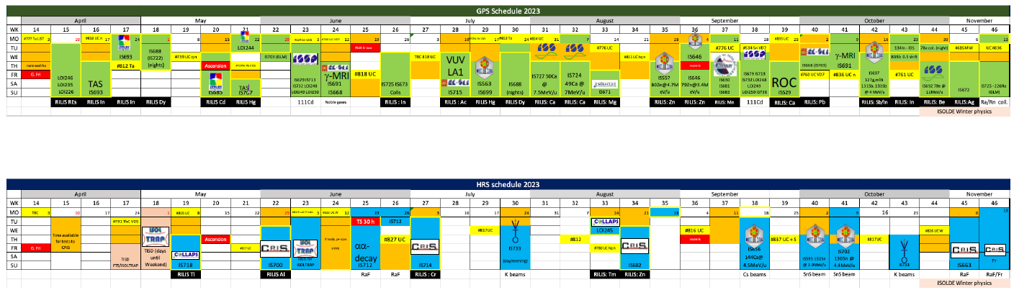
RILIS @ ISOLDE: The workhorse ion source
2023 ISOLDE operation schedule
22 elements: Pm, Er, Yb, Gd, In, Dy, Tl, Cd, Hg, Al, Cr, Ac, Ca, Mg, Tm, Zn, Mn, Pb, Sb, Be, Ag, Pr
28 out of 33 weeks (including weekends) + development
RIB delivery and nuclear structure experiments

Slide 9
ISOLDE’s resonance ionization laser ion source RILIS
Ion
+
Ion
Ionization
lasers
Excited
states
p⁺
Energy
Production /
Reservoir
Atom
Ground
state
Effusion of reaction products provided as hot atomic vapor ( > 2000°C )
Highly efficient laser ionization of element of choice as function of laser wavelength ➔ in-source spectroscopy (<< 1pps)
Extraction and mass separation as ion beam
Beam purity influenced by competing ionization mechanisms

Slide 10
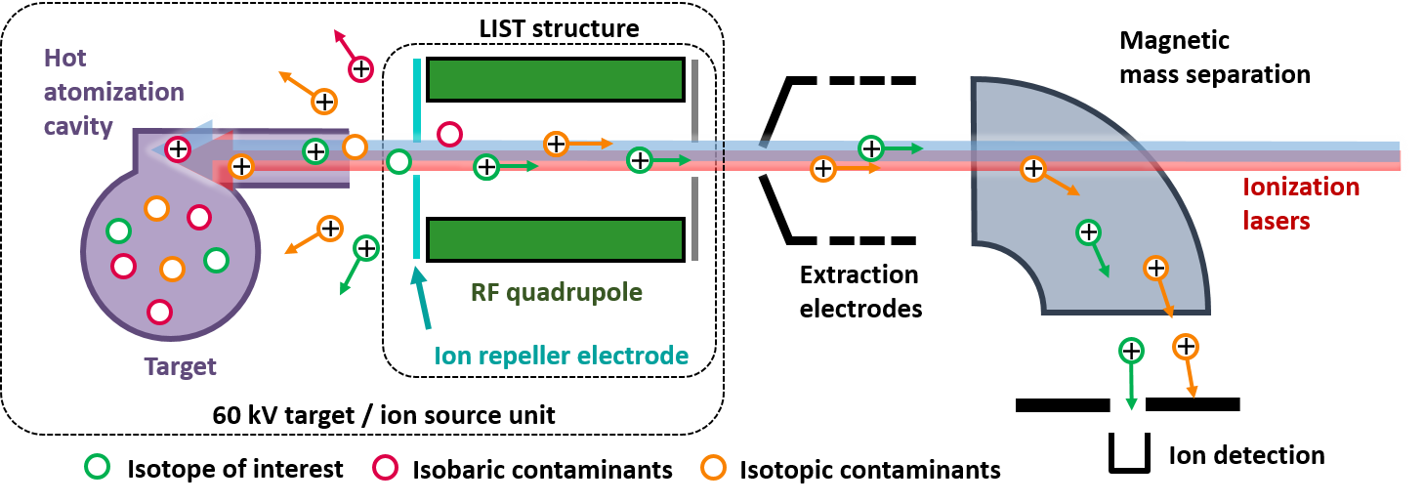
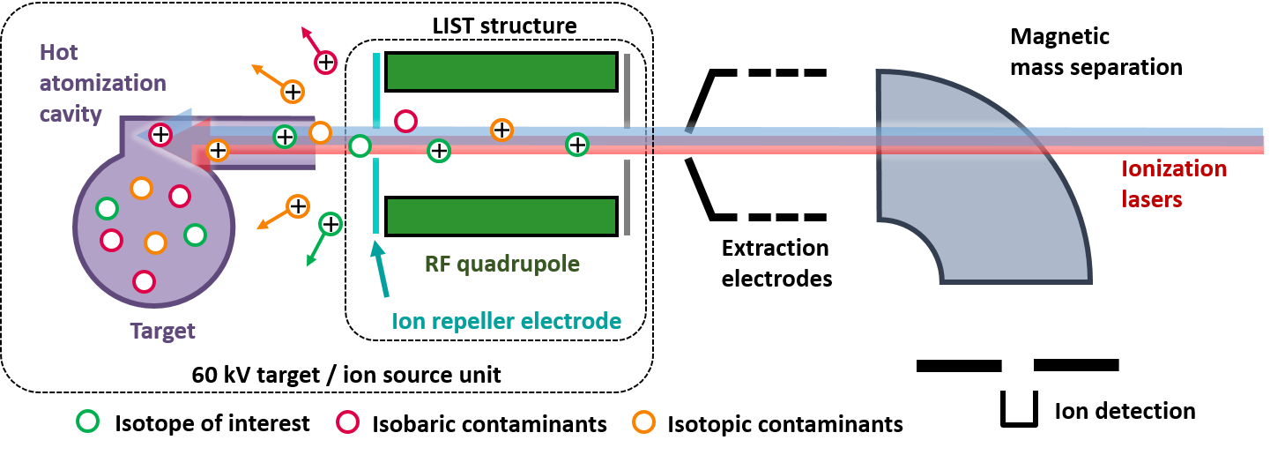
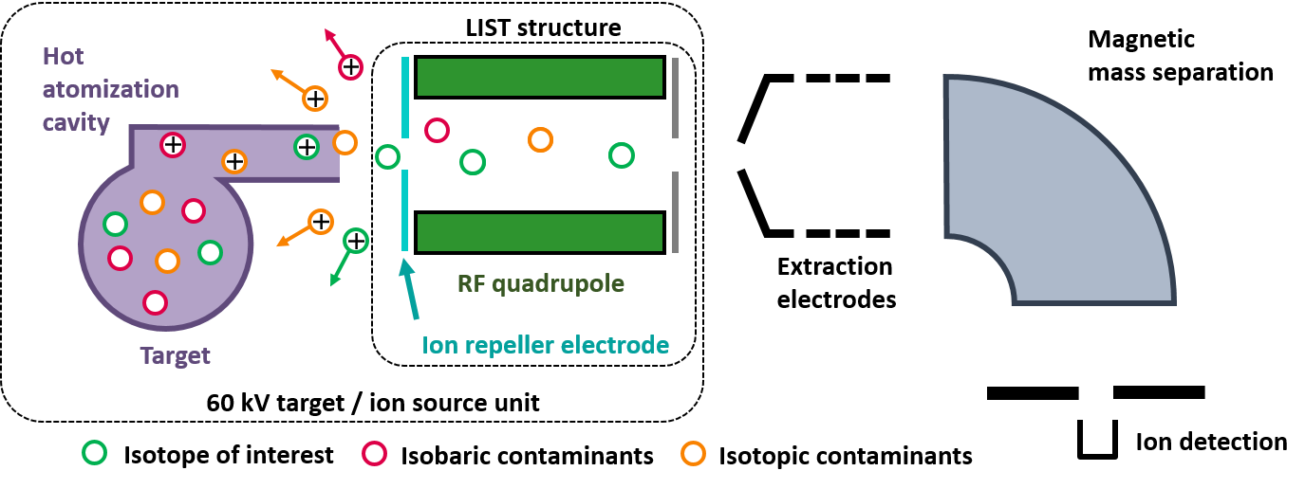

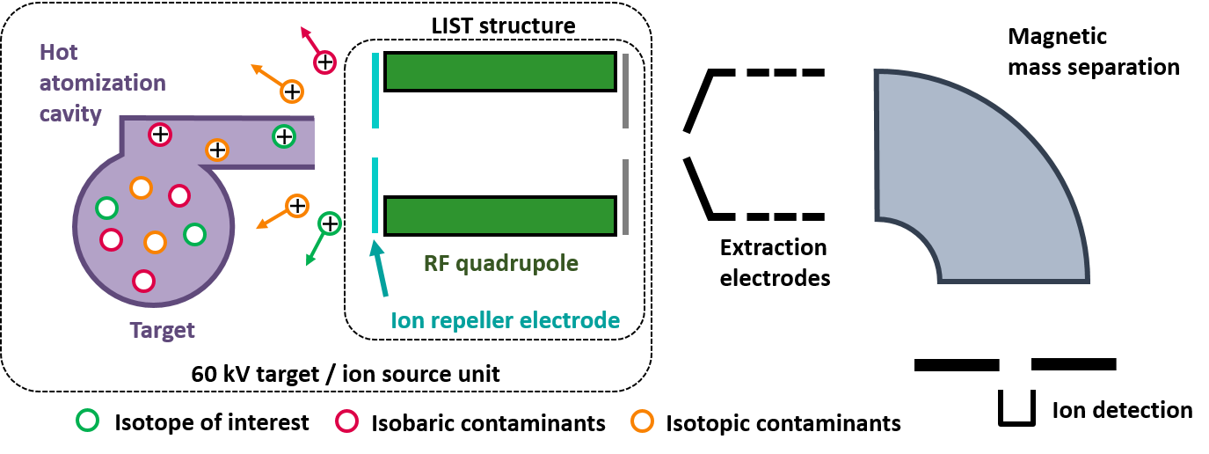
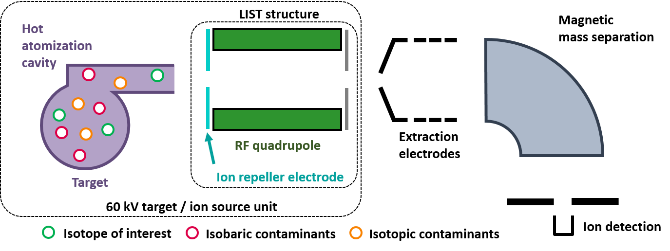
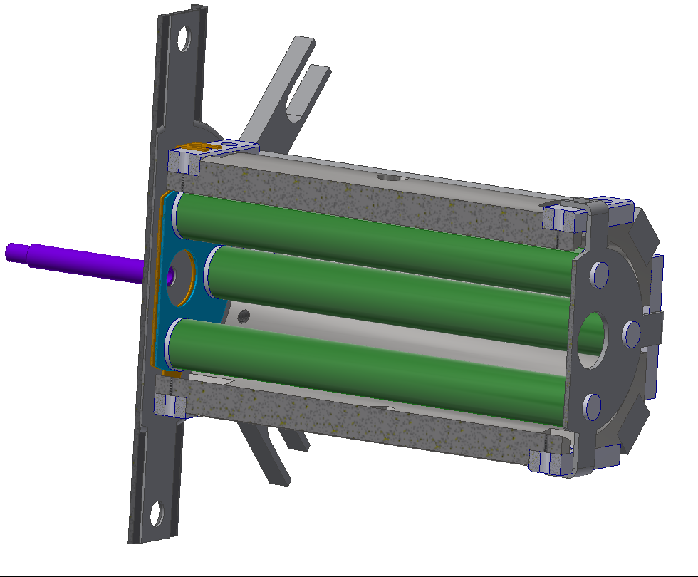
The Laser Ion Source and Trap LIST
Ion
+
Ion
Excited
states
p⁺
Energy
e⁻/
/
Atom
Ground
state
experiment
Spatial separation: hot cavity ↔ laser ionization volume
Suppression of surface ionized species
Pure laser ionization inside RF quadrupole structure
Factor up to 10⁶ in suppression ↔ Factor 20-100 reduction in beam intensity
Versatility: Mimic standard RILIS by extracting and guiding ions from hot cavity
90 mm

Slide 11
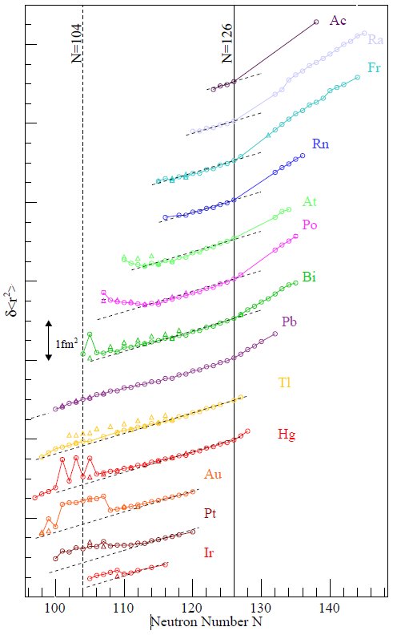

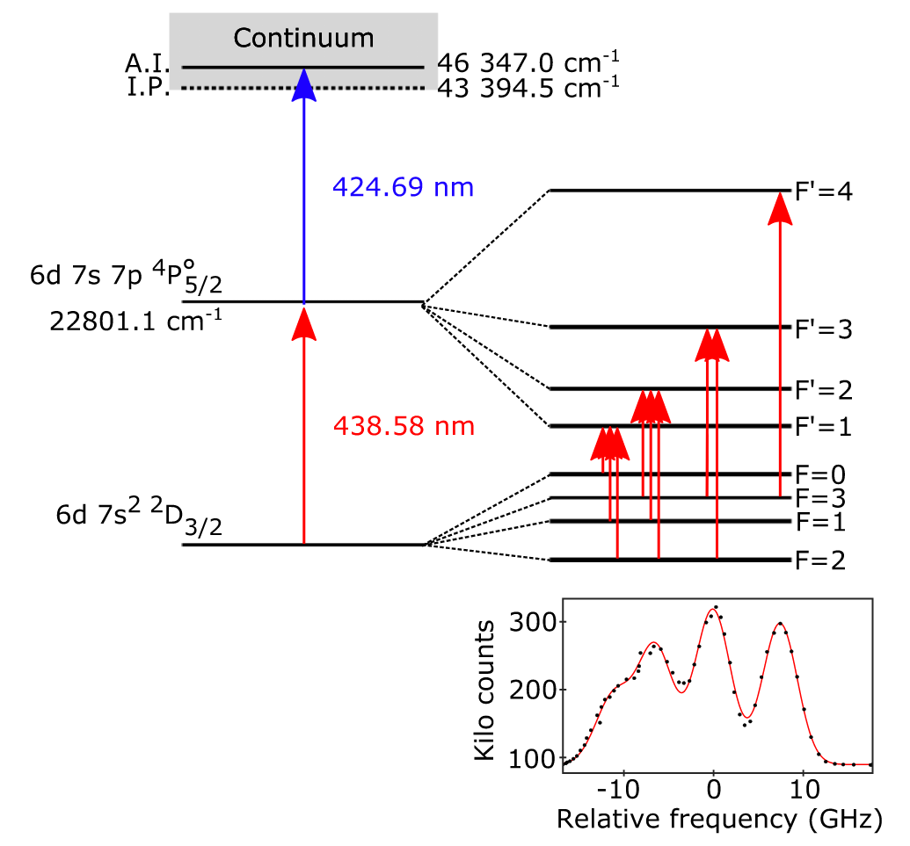

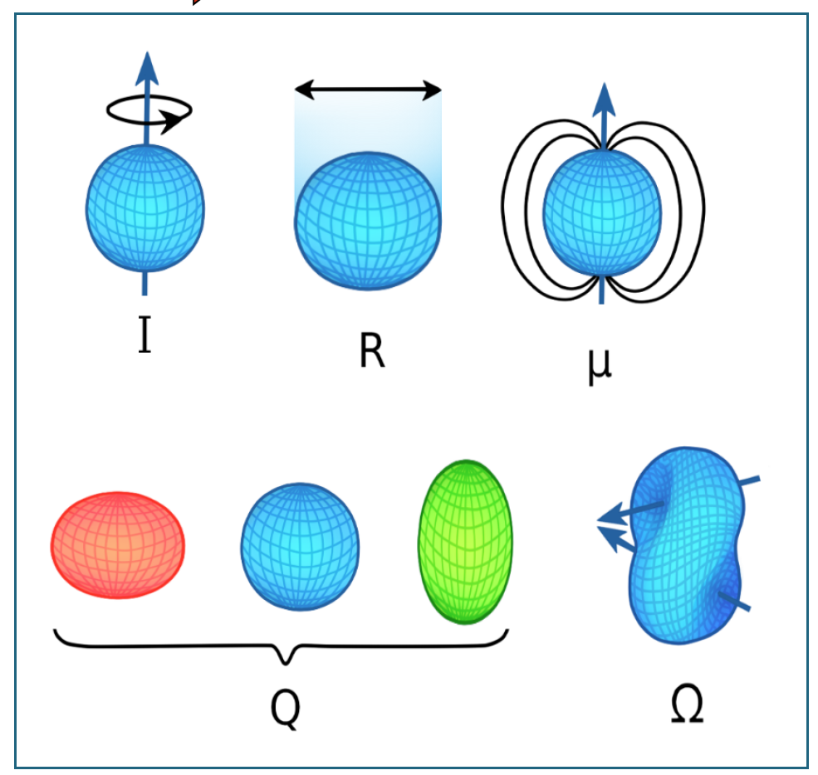
Nuclear structure laser spectroscopy
Ac laser ionization scheme
(used at LISOL, TRIUMF, ISOLDE, JGU, …)
Changes in mean square charge radii
x 10⁵
Hyperfine structure spectroscopy:
Interaction of nucleus with electron shell
Nuclear spin, deformation
Changes in charge radii
Spectroscopy on Tl with LIST:
Z. Yue, next talk!

Slide 12
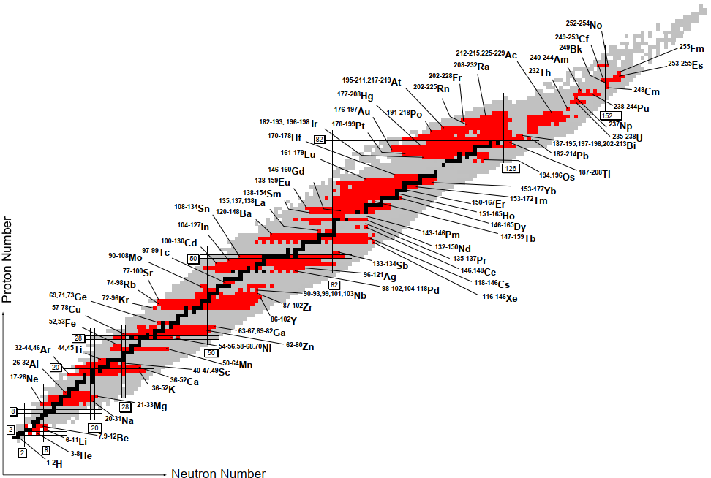

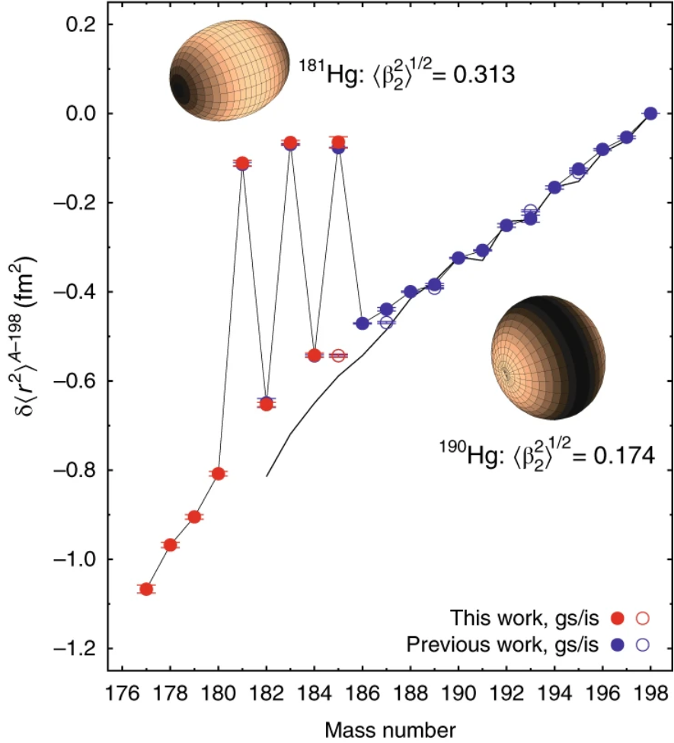
A laser spectroscopist’s playground
Collective effects of
protons and neutrons
➔ How to derive
from first principles / strong force?
https://www.ikp.tu­darmstadt.de/gruppen_ikp/ag_noertershaeuser/research_wn/exotic_nuclei_wn/
uebersicht_2/laserspectroscopy_survey.de.jsp
B. Marsh et al, Nature Physics 14, 1163–1167 (2018)
Nuclides investigated by laser spectroscopy

Slide 13
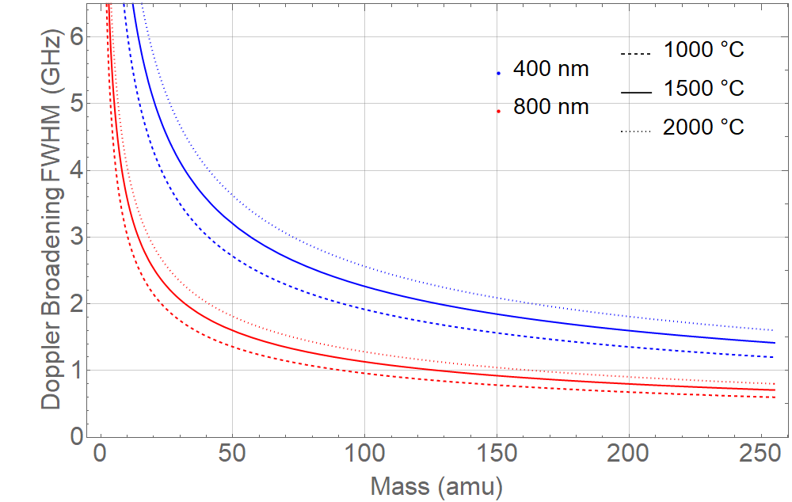

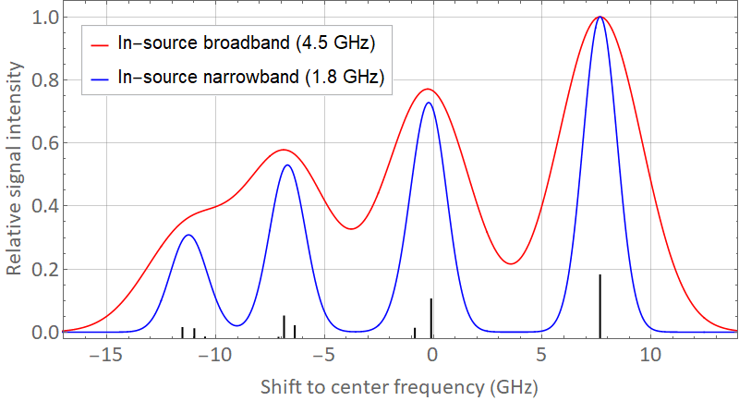
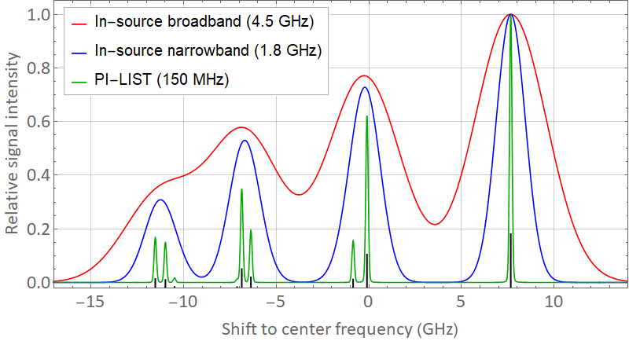



“Sub-Doppler” hot cavity in-source spectroscopy
$$\text{FWHM}= \frac{ν_{0}}{c}\sqrt{\frac{8\ln\left(2\right)k_{B} T}{m}}$$
v_{thermal}
$ν_{0}$ ≙ 400 nm
Atomic
beam cone
$ν_{0}$ ≙ 800 nm
Narrow bandwidth
spectroscopy laser
Crossed atom beam / laser geometry in LIST structure:
The Perpendicularly Illuminated PI-LIST
Selection of reduced Doppler ensemble
in laser intersection volume
Suitable narrow-band laser
  Resolution improvement by >1 order of magnitude

Slide 14


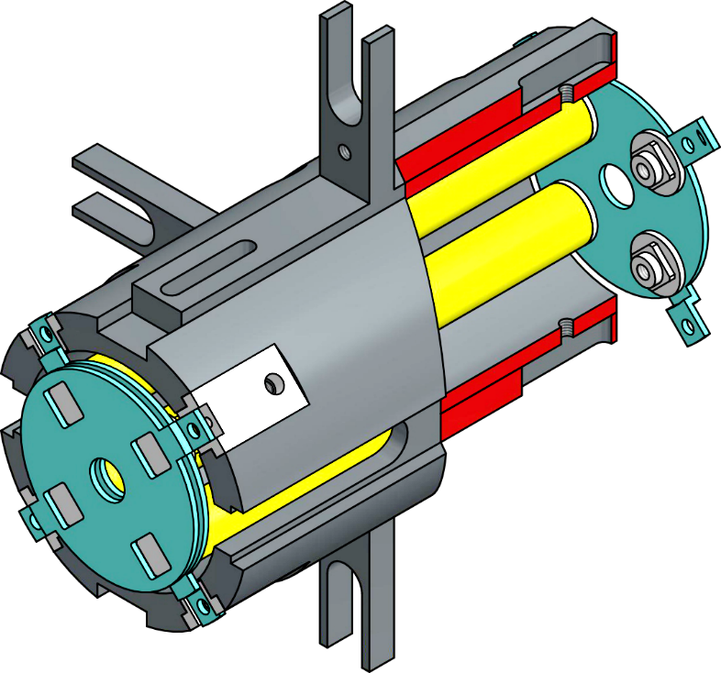

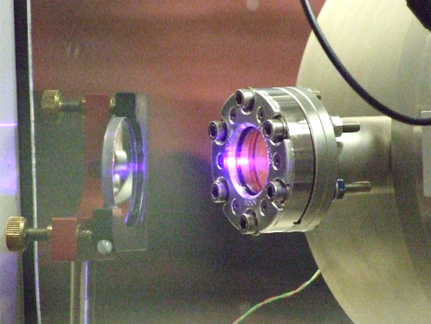
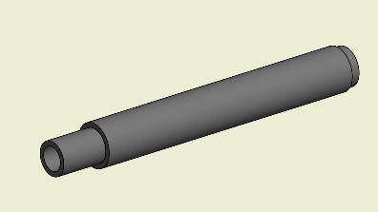
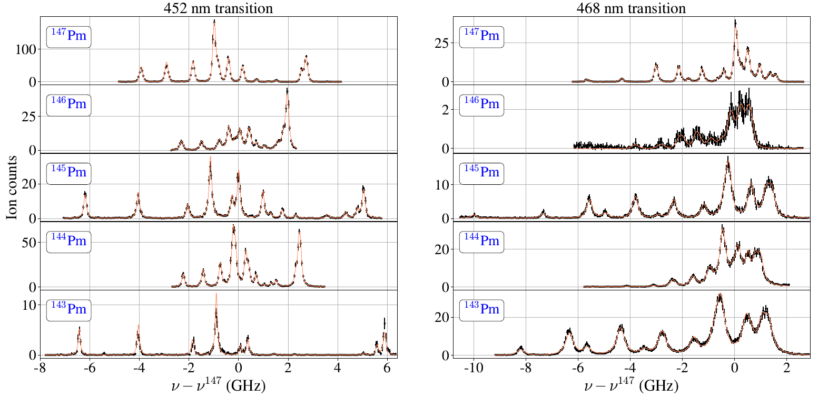
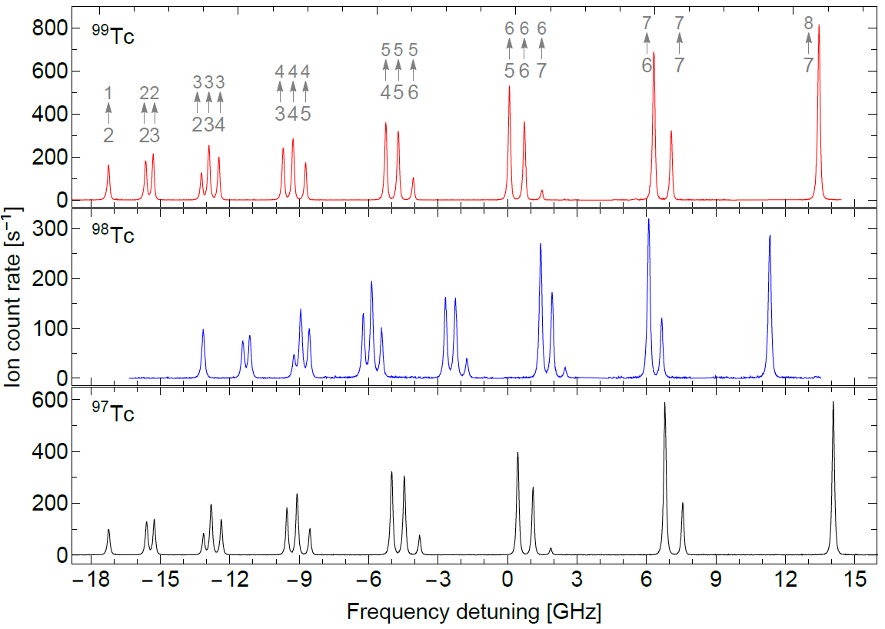
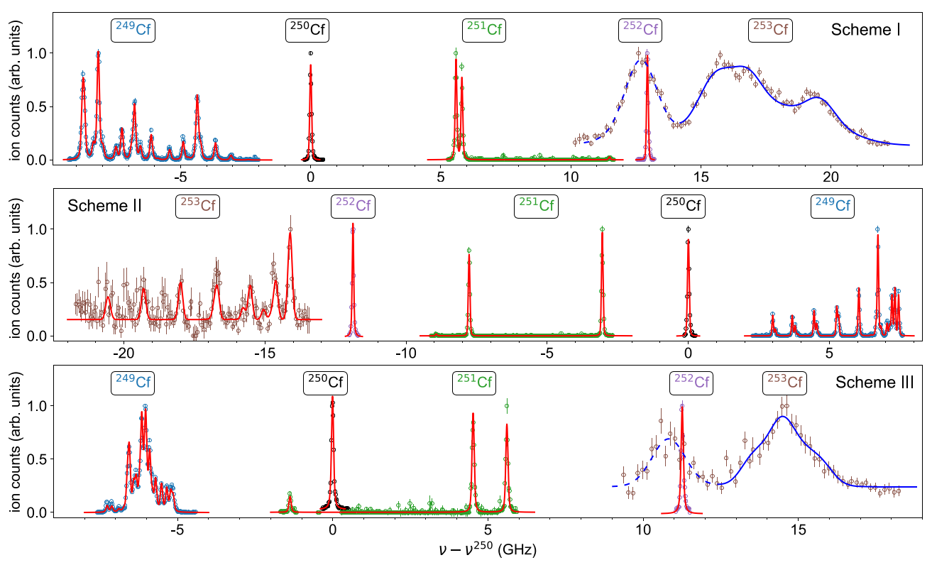
Off-line results from PI-LIST
Window not possible at ISOLDE frontend!
Lateral laser incoupling through window in vacuum vessel
Nuclear structure investigations on long-lived radioisotopes
Standard tool for high resolution spectroscopy
⁹⁷⁻⁹⁹Tc
T. Kron et al, PRC
100 – 120 MHz
²⁴⁹⁻²⁵³Cf
F. Weber et al, PRC
50 – 200 MHz
¹⁴³⁻¹⁴⁷Pm
D. Studer et al, Eur. Phys. J. A.
100 – 250 MHz
More from Mainz!
Es, Fm, … (Tuesday talks)

Slide 15
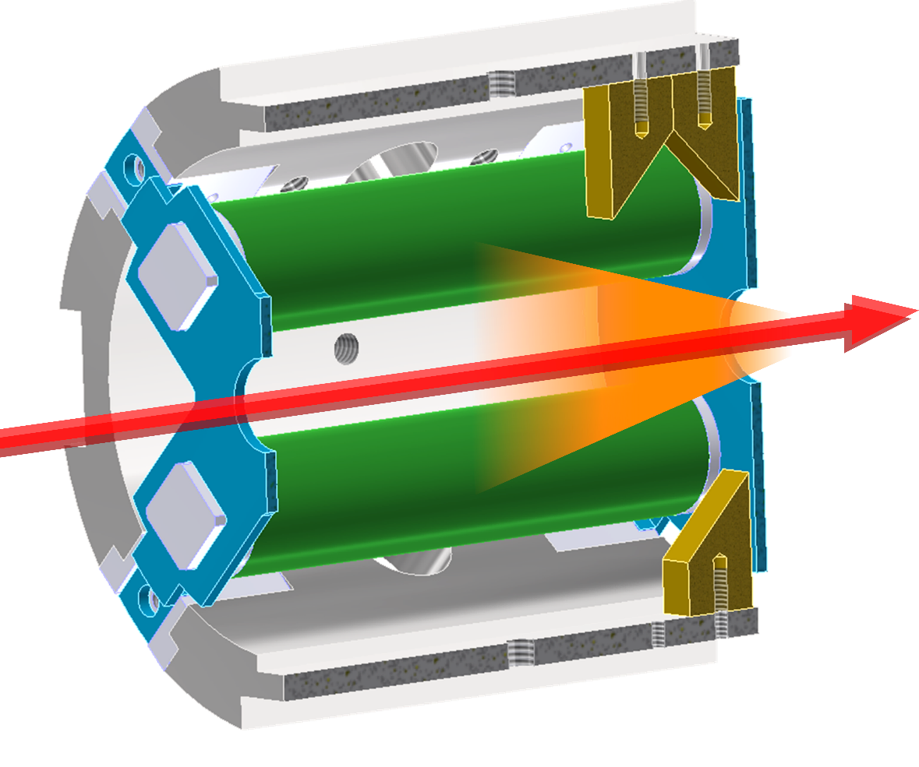
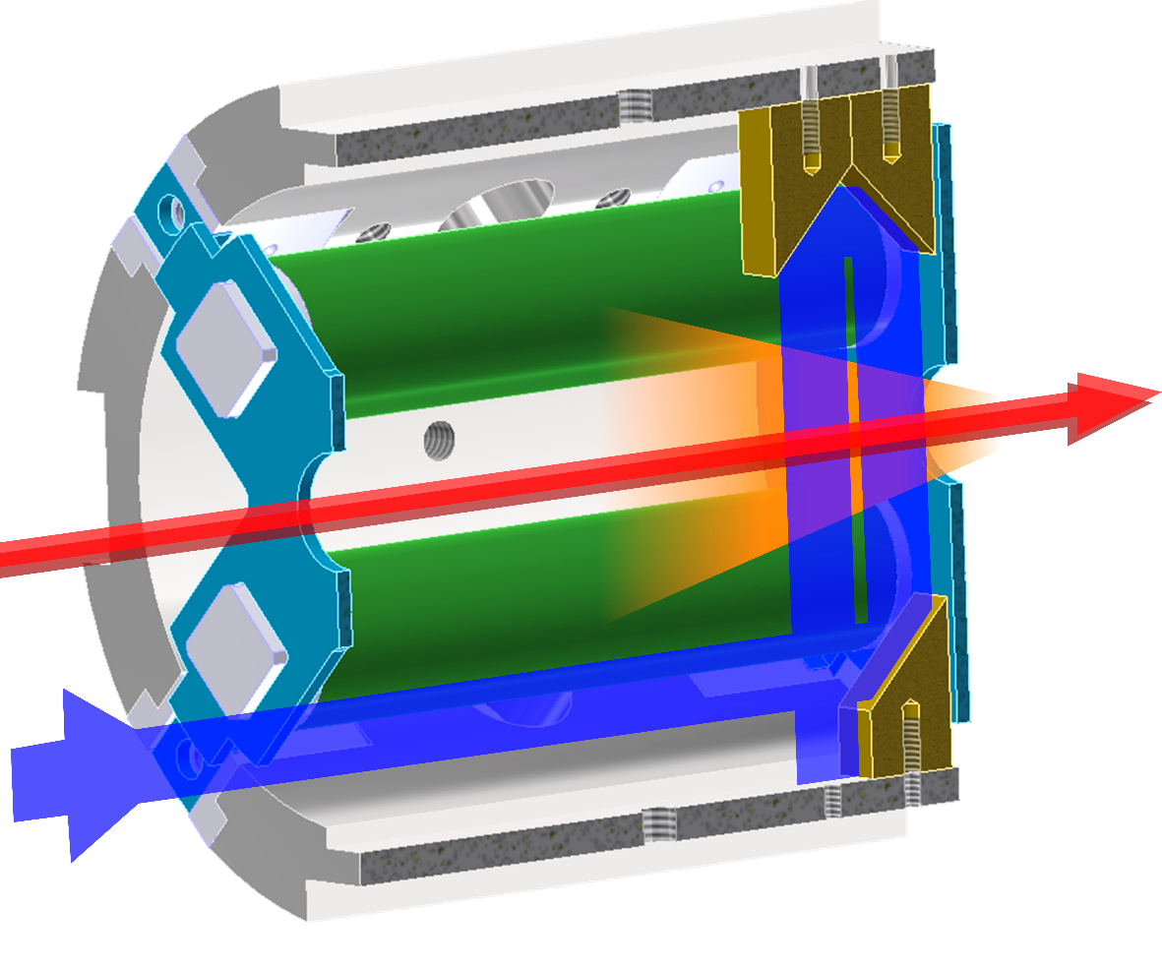
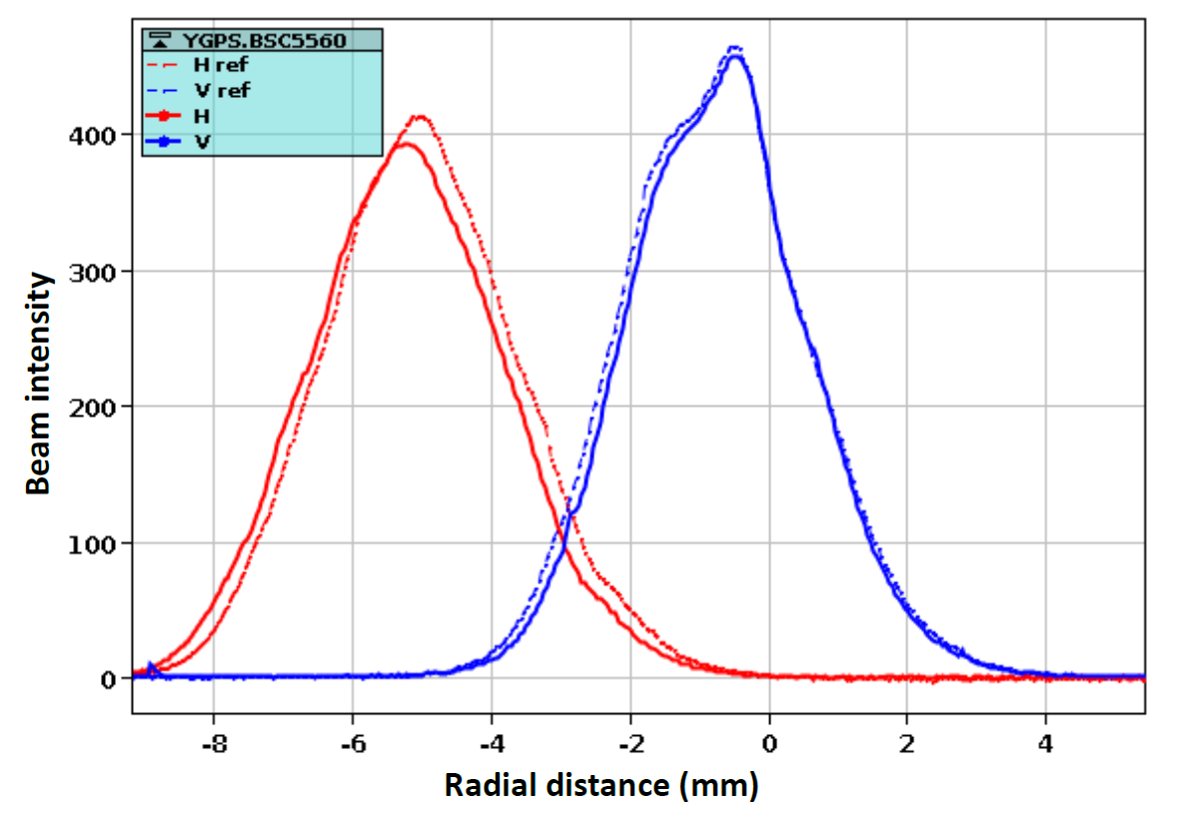
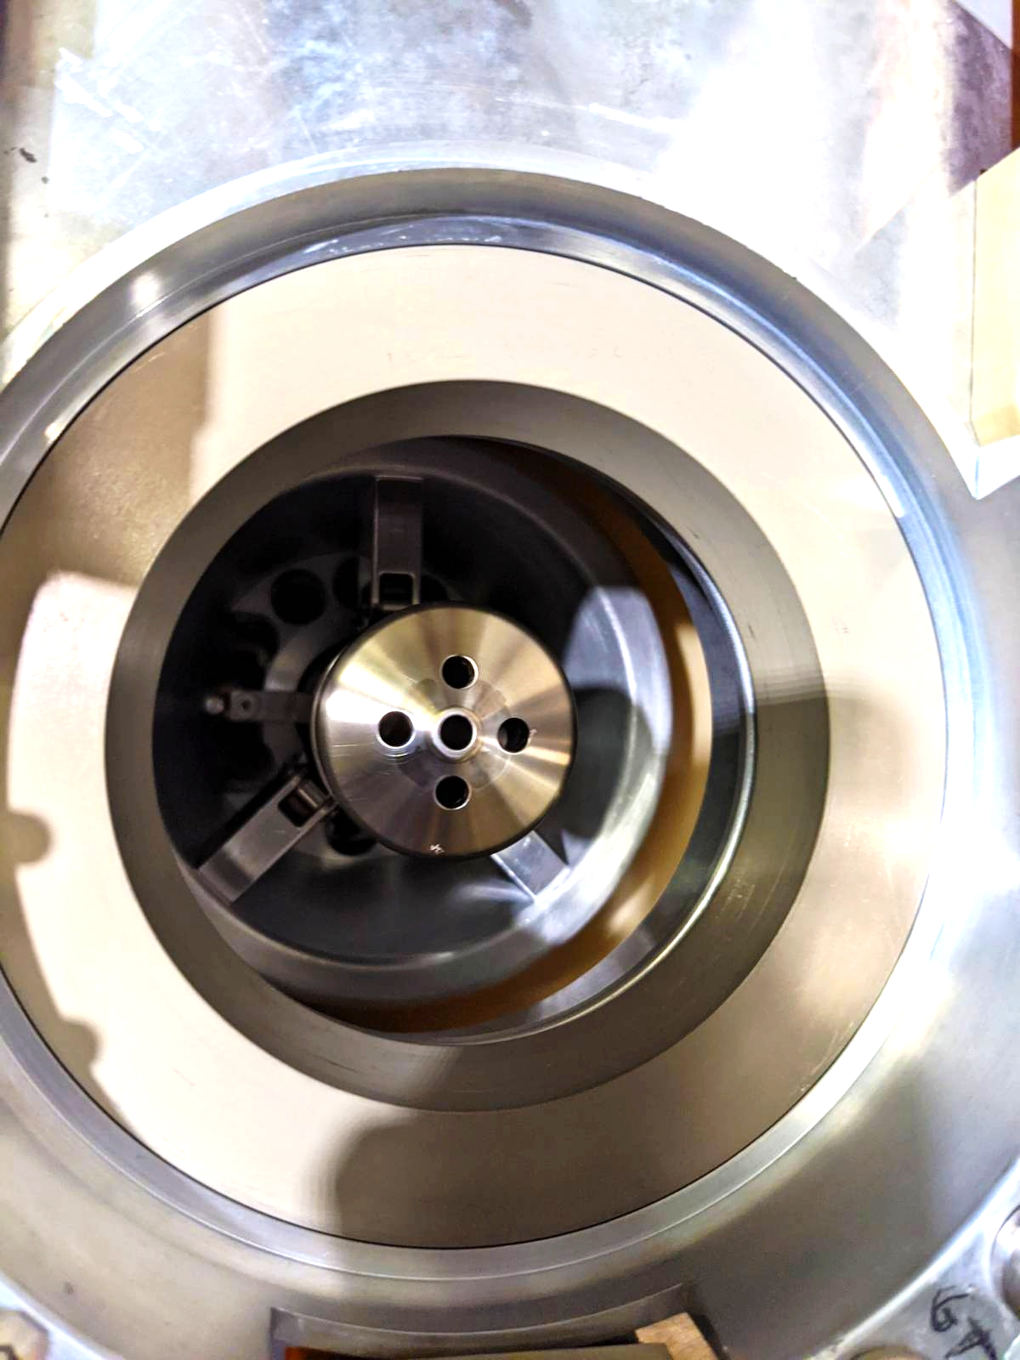
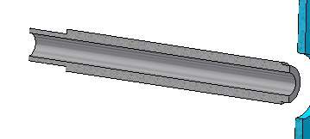
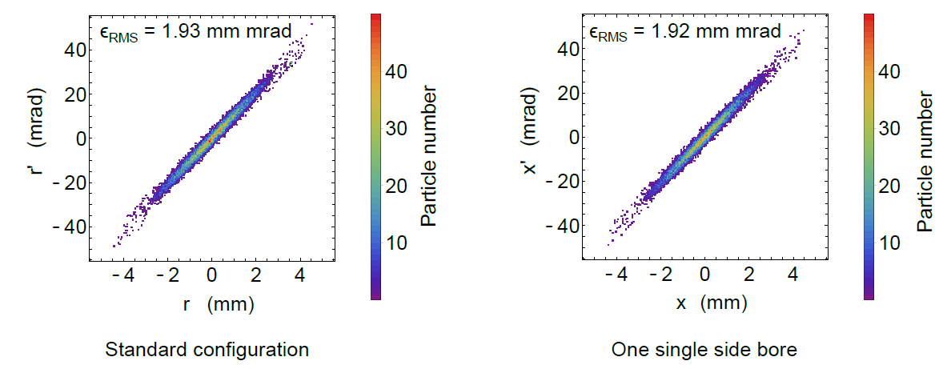
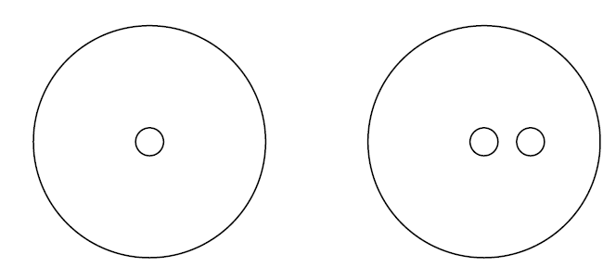
ISOLDE adaption of PI-LIST
Robust metallic mirrors
Adapted extraction electrode
Beam shape comparison
Emittance simulations
No windows possible in ISOLDE frontend
Reflection by metallic mirror surfaces
Off-axis guiding of laser through ion beam line
PI-LIST ready
for on-line experiment!

Slide 16

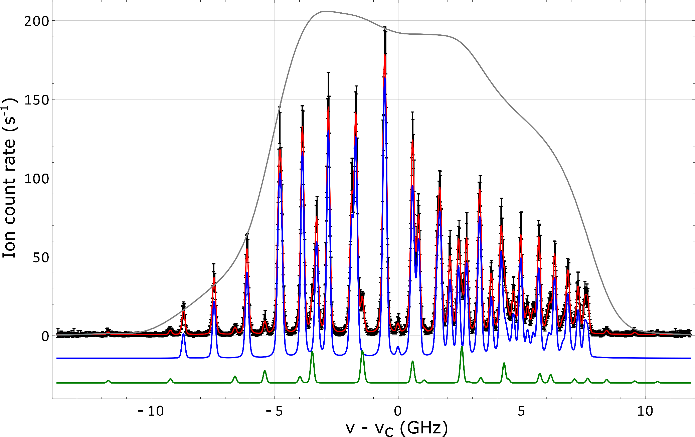
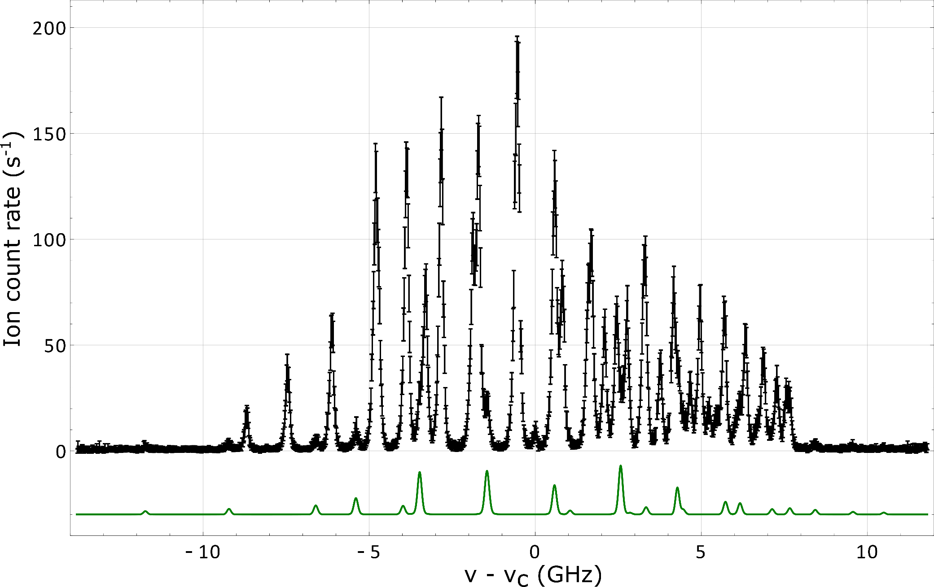
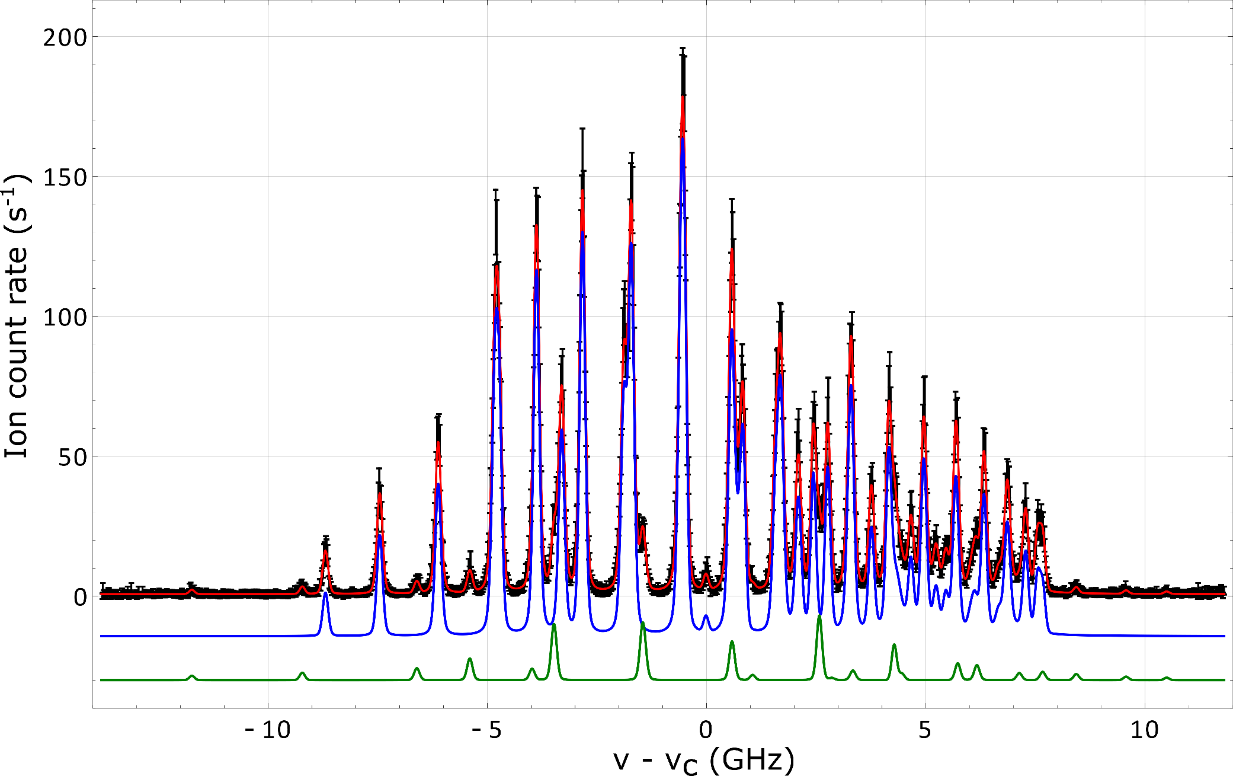
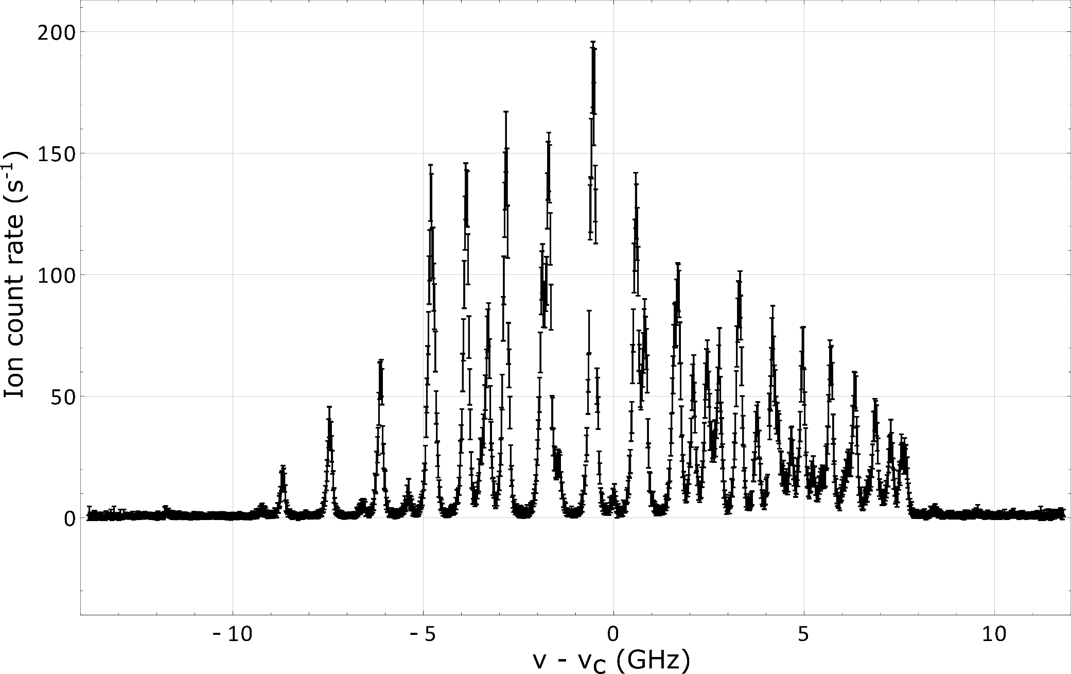
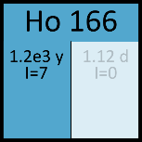
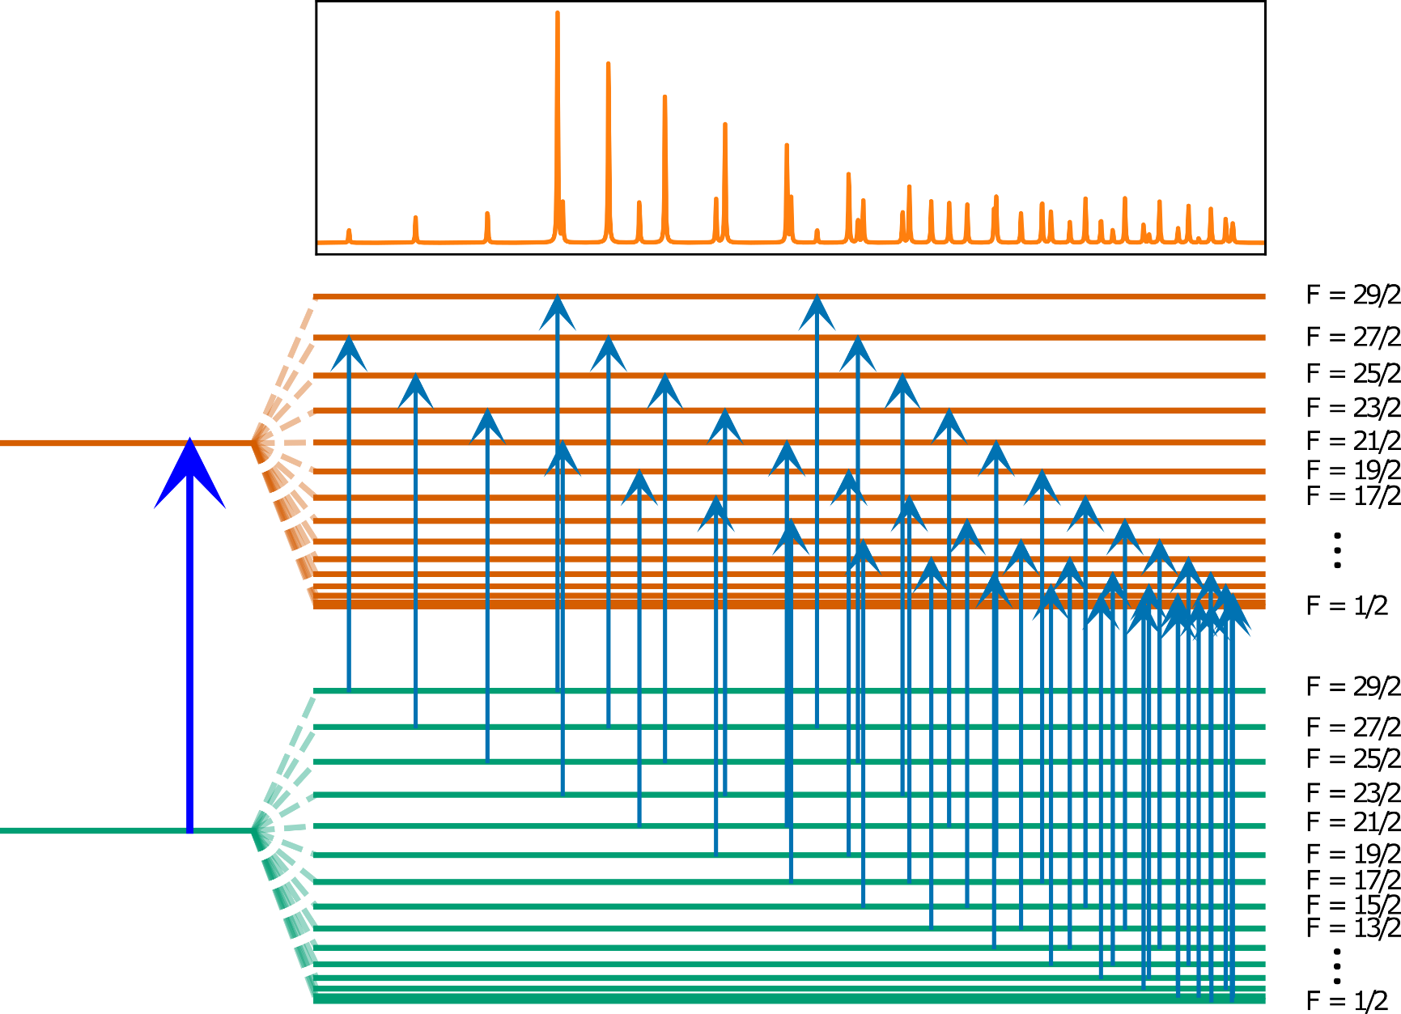
Holmium – a showcase
Hyperfine structure studies on long-lived ^{163,166m}Ho
for the ECHo project
Internal reflection
PI-LIST mode
¹⁶⁵Ho fit
^{166m}Ho fit
Cumulative fit
Standard
in-source /1000
FWHM = 160 MHz
J = 15/2
J = 15/2
43 HFS components
+ 23 from leaking ¹⁶⁵Ho

Slide 17
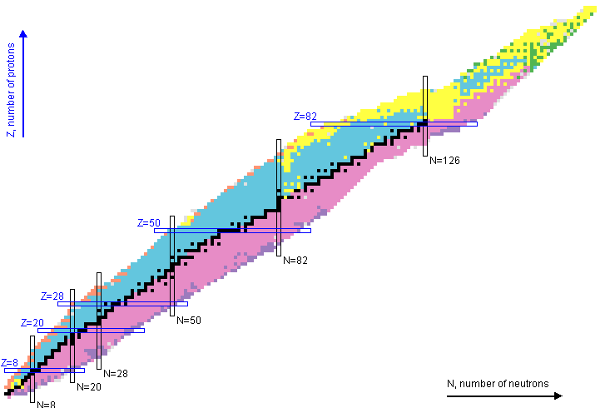

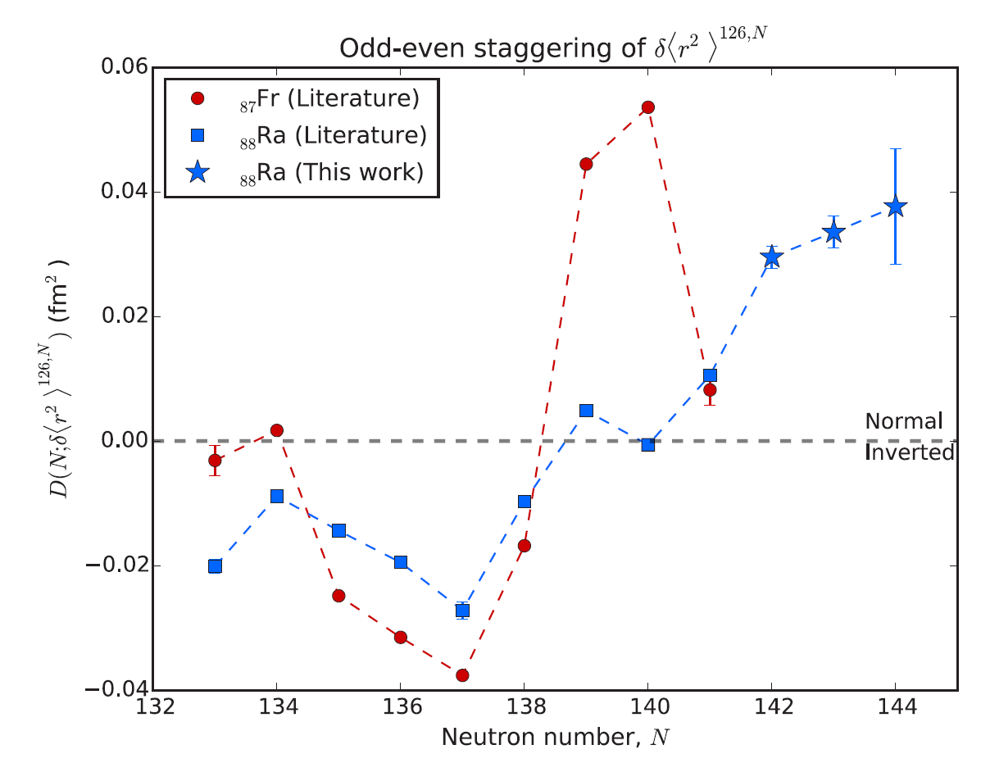
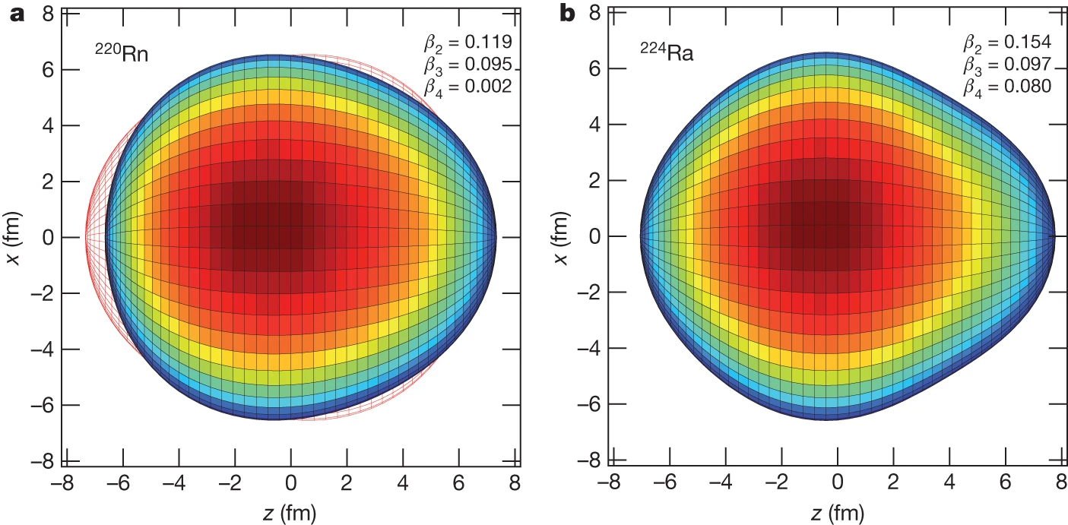
Nuclear shape effects in the heavy-element region
Pear shaped intrinsic nuclear configurations
Breaking of reflection symmetry
Prominent around ²²²Ra (Z ≈ 88, N ≈ 134)
Inverted odd-even staggering
of charge radii? (Po, At, Fr, Rn, Ra)
Within EU ITN LISA:
Laser Ionization and Spectroscopy of Actinides
Project closure conference
1 - 4 September @ CERN
Lynch et al., Phys. Rev. C 97, 024309 (2018)
Gaffney et al., Nature 497, 199–204 (2013)

Slide 18



Octupole deformation in Ac isotopes
E. Verstraelen et al, PHYSICAL REVIEW C 100, 044321 (2019)
Significant isobaric contamination ➔ LIST suppression
Recent investigations and EDF theory on Ac:
Available data matched only with octupole asymmetry
Distinct kink as benchmark case
Nuclear moments as supporting data
Low sensitivity to Q_{S} ➔ PI-LIST high resolution
Notes:
Less repetition, make physics plot bigger, show IOES

Slide 19




IS664: Experimental setup
Joined NB laser infrastructure
Detector and DAQ
MagneTOF single ion counter at GLM/LA1 beam lines
Highly sensitive
Laser-synchronized 10kHz DAQ (CRIS time tagger)
CRIS Matisse
cw Ti:Sa
Cross-hall fiber
RILIS injection-locked
pulsed ring cavity
Ions in time window (arb.u.)
Laser ions
Separator launch
Background
PI mode
referencing
Ion travel time (μs)

Slide 20


Preliminary results: Radii kink confirmed?
Lower yield ➔ Compromise on resolution
Preliminary
Preliminary
In-situ analysis by Michael Heines

Slide 21




Complementary data: Collinear laser spectroscopy at TRIUMF
COLLAPS principle: Fluorescence detection after exciting ionic transition
Deceleration
electrodes
Fluorescence monitor
²²⁶Ac⁺ (~10⁷ ions/s)
342nm
Ac-225
Ac-226
PI-LIST
best case: 220MHz
Scanned transition
Ac-228
~ 40 MHz
Ac-229
➔ Complementary high-resolution data; Systematic check of nuclear structure results
Slide content: Courtesy of Ruohong Li

Slide 22






PI-LIST for isomer-pure RIB production
Example case for inspiration
B. Cheal et al., Phys. Rev. C 82, 051302(R) (2010)
HFS known from
collinear spectroscopy
Isomer-pure RIB’s
Direct spectroscopy
in clean samples
(Spin-)Controlled
feeding
Switch ID ↔ efficiency
I = 6-
I = 3-
200 MHz
2800 MHz
Relative signal
Capabilities greatly expanded
I = 3- / 6-
Relative frequency (MHz)
Notes:
Skip?

Slide 23


PI-LIST in the landscape of laser spectroscopy
PI-LIST still “young”
“Simple” unit
instead of beamline
Versatile operation modes
Isomer-selective
RIB production
PI-LIST

Slide 24


Resolution meta-analysis
# |  | Mass (amu) | WL (nm) | Temp. (C) | LIST type | FWHM (MHz) | Opt? | Doppler (MHz) | Fraction
1 | Tc | 99 | 430 | 1700 | JGU | 98 | yes | 2230 | 4%
2 | Ho | 165 | 410 | 1000 | JGU | 104 | yes | 1455 | 7%
3 | Ho | 165 | 410 | 1000 | JGU mirror | 114 | yes | 1455 | 8%
4 | U | 238 | 830 | 1700 | JGU | 60 | yes | 745 | 8%
5 | Rb | 87 | 780 | 300 | JGU mirror | 62 | yes | 707 | 9%
6 | Ac | 225 | 418 | 1500 | JGU | 200 |  | 1442 | 14%
7 | Pm | 145 | 452 | 1500 | JGU | 150 |  | 1661 | 9%
8 | Cf | 250 | 417 | 800 | JGU | 55 | yes | 1067 | 5%
9 | Ac | 227 | 439 | 2000 | ISOLDE | 200 | yes | 1548 | 13%
$$\text{FWHM}\text{Doppler}= \frac{ν_{0}}{c}\sqrt{\frac{8\ln\left(2\right)k_{B} T}{m}}$$
No benchmark
ISOLDE

Slide 25




Efficiency considerations
Move potential
ridge closer
Loss factors
Geometric atom beam losses: Opening angle
RILIS → LIST
~ 30
LIST → PI-LIST
~ 2
PI-LIST opt.
~ 10
Total:
~ 500 - 1000
Shape
atom cone
Efficiency extrapolation with ²²⁵Ac:
~10⁻⁴ (Standard RILIS: 10%)

Slide 26



Optimization pathways
Improve active volume: Shape electric potential
Shape effusing atom cone
Simulation data
Standard
Relative atom density
3mm
1.5mm
DC -5V
Distance from atomizer (mm)
DC -10V
Multi-tube
Orifice design
DC offset of LIST corpus
Improve repeller geometry
Also facilitates ion guiding
Laser duty cycle
Multiple chances in tube vs. ~1 in atom cone
RF phase synchronization
Trapping efficiency, investigated at TRIUMF
Dedicated off-line development infrastructure highly beneficial

Slide 27





Atom beam collimation – experimental investigation
Standard
Multi-capillary
Thin
Test atomizer cross sections
Data analysis and feedback into simulation infrastructure ongoing
-
Experimental alternatives:
Planar laser induced fluorescence /
Deposition on catcher foils
A. Zadvornaya et al.,
Phys. Rev. X 8, 041008

Slide 28

Future plans: Lanthanide campaign (LoI246)
Lanthanide elements as fitting case for (PI-)LIST:
Surface-ionizable → suppression needed
Extensive laser scheme groundwork done
PI-LIST off-line spectroscopy successful
Release behavior studied (MEDICIS)
High atomic level density (open shells)
disadvantage for charge exchange
Interest in various nuclear structure phenomena,
including p+ emitters beyond dripline
Charge radii around N = 82
OES,
Vanishing
in isomers?
Strong
deformation?
Change of deformation
➔ Ta target + LIST: lanthanide yield measurement campaign up to CERN LS3

Slide 29

Summary
RILIS @ ISOLDE: The workhorse RIB source and its evolution
PI-LIST: “Sub-Doppler” resolution enhancement
  High resolution spectroscopy: Ac octupole deformation
  Isomer-selective ionization
  Ongoing developments (FI-LIST → K. Wendt later)

Slide 30







Thanks to you for LISTening…
… and to all the collaborators!

Slide 31






https://rims-code.github.io
Contribute to sharing!

Slide 32


IS664: Experimental setup
Joined NB laser infrastructure
Detector and DAQ
MagneTOF single ion counter at GLM/LA1 beam lines
Highly sensitive
Laser-synchronized 10kHz DAQ (CRIS time tagger)
CRIS Matisse
cw Ti:Sa
Cross-hall fiber
RILIS injection-locked
pulsed ring cavity
Ions in time window (arb.u.)
Laser ions
Background
Separator launch
Ion travel time (μs)
Radioactive noble gases from target on p⁺ impact
Group protons, measure later (slow release of Ac)
Detector moved to CB0
IDS/ASET on standby / parallel experiments
PI mode
referencing

Slide 33



PI-LIST at ISOLDE
PI-LIST structure
Effusing atoms
Ion extraction
electrode
4x new orifices
Ø = 6mm
Hot cavity
Metal mirror
Ionization laser
90mm
Heinke et al., NIMB 541, 8–12 (2023)
Spectroscopy laser
On-line applicable adaption
Alternative for external laser access through window
Robustness
Technical implementation
Confirmation of operation transparency of changes
Control and feedback systems (LabVIEW)
Notes:
Mass separator is workhorse.
Laser system development -> design changes
Ever-growing portion of landscape

