Slide 1
Absolute radii of chlorine and potassium:
A heavyweight solution to a small problem
Michael Heines
Supervisor: Thomas Cocolios
On behalf of the muX collaboration

Slide 2
Contents
Why do we need absolute charge radii?
Measuring charge radii with muons
Microgram targets
Experimental campaign on potassium and chlorine
Different physics cases

Slide 3
Contents
Why do we need absolute charge radii?
Measuring charge radii with muons
Microgram targets
Experimental campaign on potassium and chlorine
Different physics cases

Slide 4
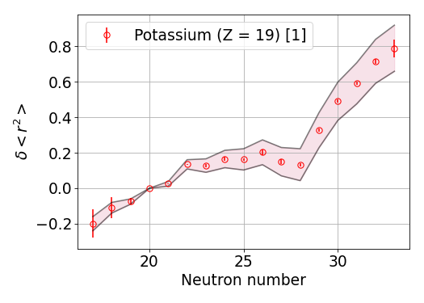
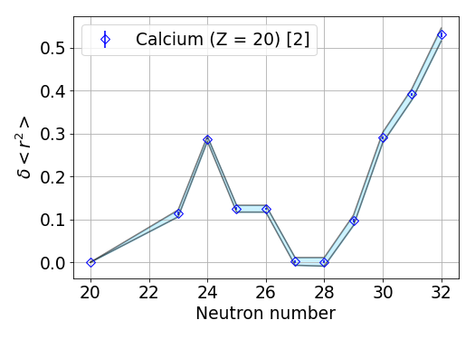
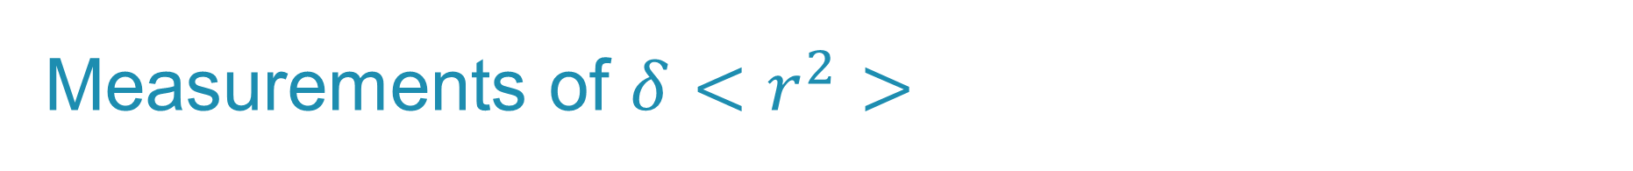
Measurements of $δ<r^{2}>$
[1] Koszorús, Á., et al. "Charge radii of exotic potassium isotopes challenge nuclear theory and the magic character of N= 32." Nature Physics 17.4 (2021): 439-443.
[2] Garcia Ruiz, R. , et al. "Unexpectedly large charge radii of neutron-rich calcium isotopes." Nature Physics 12.6 (2016): 594-598.
Notes:
Koszorús, Á., et al. "Charge radii of exotic potassium isotopes challenge nuclear theory and the magic character of N= 32." Nature Physics 17.4 (2021): 439-443.
Garcia Ruiz, Ronald Fernando, et al. "Unexpectedly large charge radii of neutron-rich calcium isotopes." Nature Physics 12.6 (2016): 594-598.

Slide 5
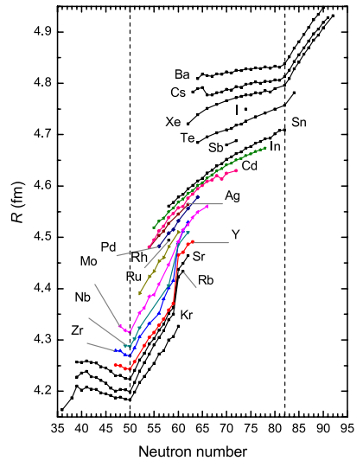
Benefit of absolute radii
[1]
Visualizing global trends
Input for other experiments
Isotone shifts
Mirror nuclei
[1] Angeli, István, and Krassimira Petrova Marinova. "Table of experimental nuclear ground state charge radii: An update." Atomic Data and Nuclear Data Tables 99.1 (2013): 69-95.

Slide 6
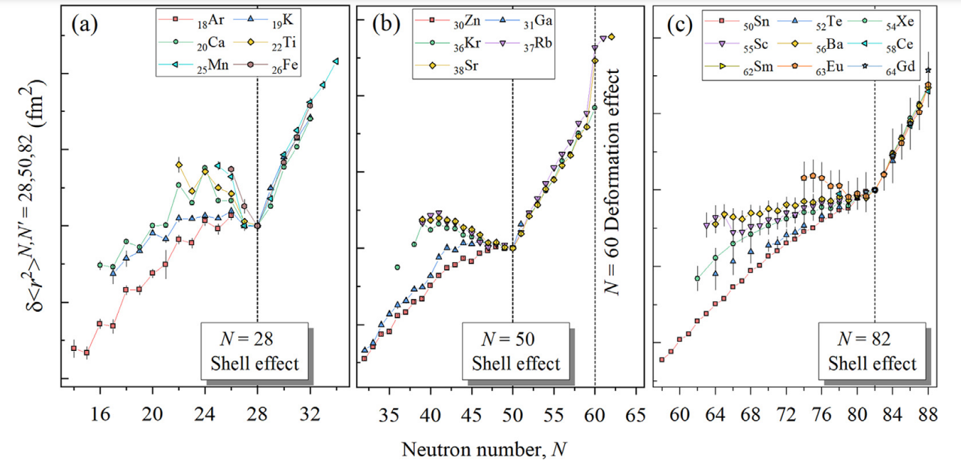
Notes:
Yang, X. F., et al. "Laser spectroscopy for the study of exotic nuclei." Progress in Particle and Nuclear Physics 129 (2023): 104005.

Slide 7
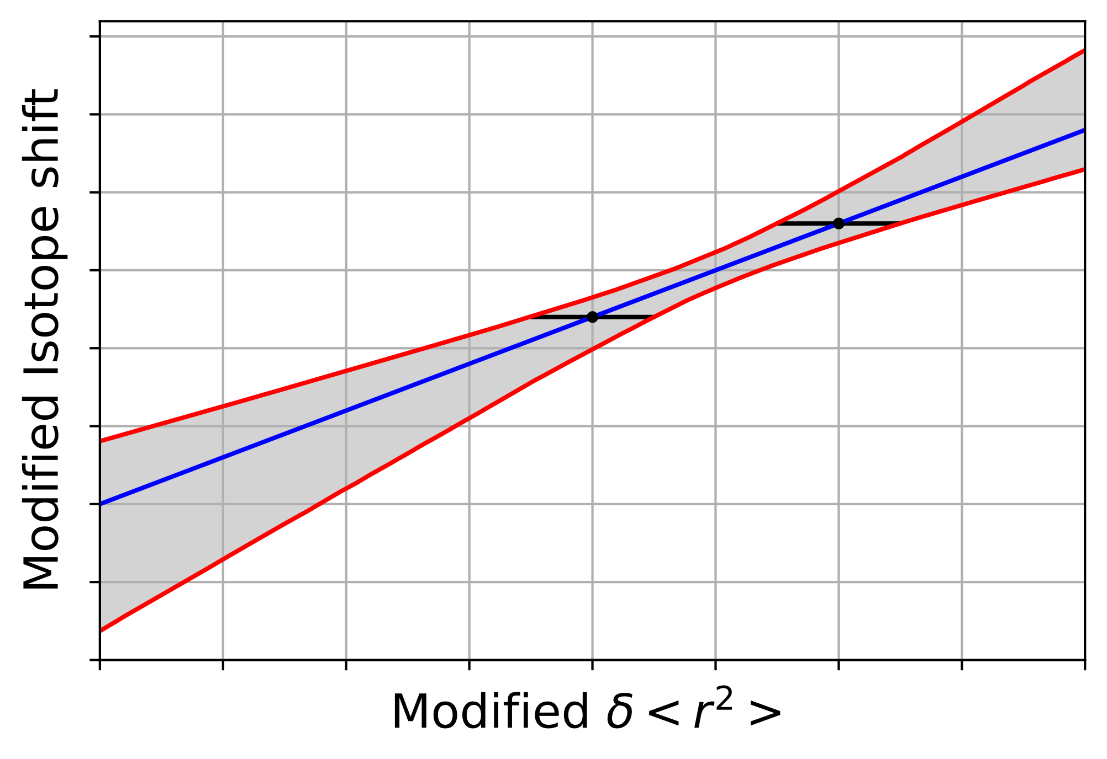
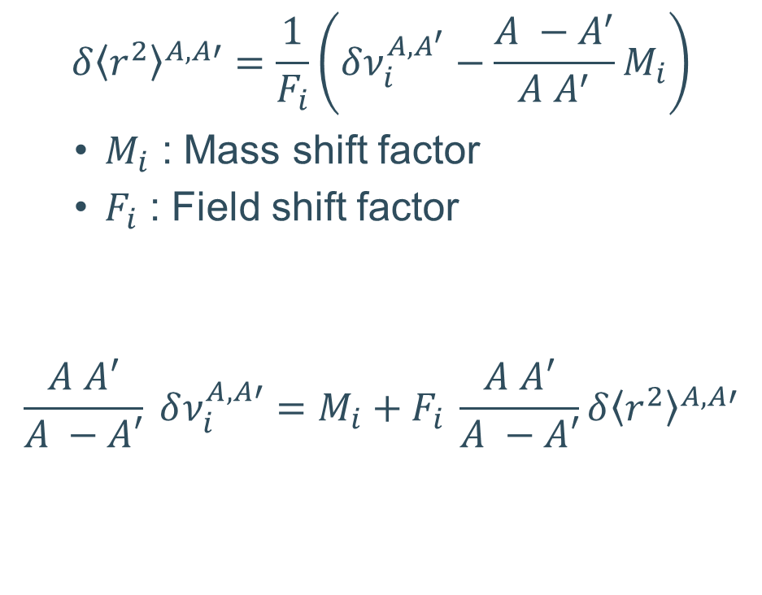
King plot
$$δ{\left\langle r^{2}\right\rangle }^{A,A′}=\frac{1}{F_{i}}\left(δν_{i}^{A, A^{′}}−\frac{A −A^{′}}{A A^{′}}M_{i}\right)$$
  $M_{i}$ : Mass shift factor
  $F_{i}$ : Field shift factor
$$\frac{A A′}{A −A′} δν_{i}^{A, A′}=M_{i}+F_{i} \frac{A A′}{A −A′}δ{\left\langle r^{2}\right\rangle }^{A,A′}$$

Slide 8
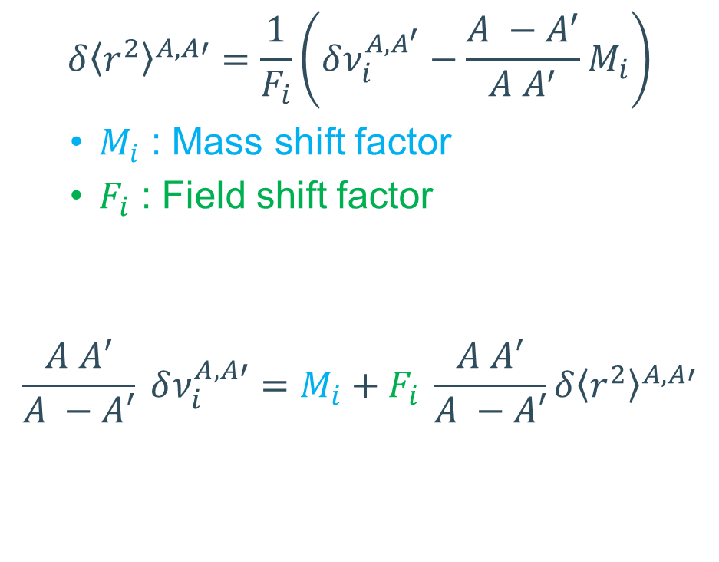
King plot
$$δ{\left\langle r^{2}\right\rangle }^{A,A′}=\frac{1}{F_{i}}\left(δν_{i}^{A, A^{′}}−\frac{A −A^{′}}{A A^{′}}M_{i}\right)$$
  $M_{i}$ : Mass shift factor
  $F_{i}$ : Field shift factor
$$\frac{A A′}{A −A′} δν_{i}^{A, A′}=M_{i}+F_{i} \frac{A A′}{A −A′}δ{\left\langle r^{2}\right\rangle }^{A,A′}$$

Slide 9
King plot
No odd-Z element with 3 stable isotopes!
$$δ{\left\langle r^{2}\right\rangle }^{A,A′}=\frac{1}{F_{i}}\left(δν_{i}^{A, A^{′}}−\frac{A −A^{′}}{A A^{′}}M_{i}\right)$$
  $M_{i}$ : Mass shift factor
  $F_{i}$ : Field shift factor
$$\frac{A A′}{A −A′} δν_{i}^{A, A′}=M_{i}+F_{i} \frac{A A′}{A −A′}δ{\left\langle r^{2}\right\rangle }^{A,A′}$$

Slide 10
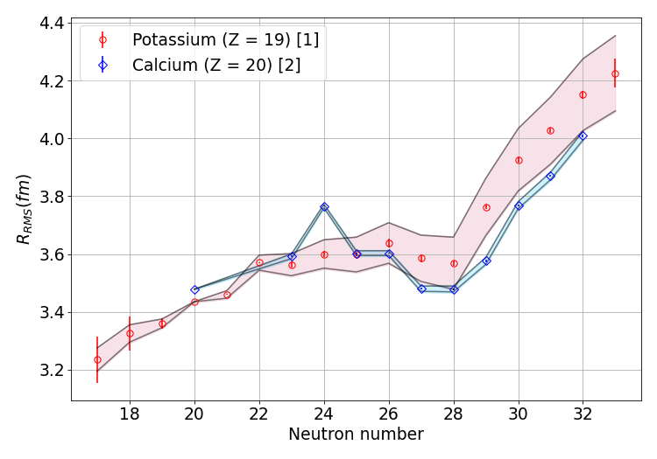
King plot
$$δ{\left\langle r^{2}\right\rangle }^{A,A′}=\frac{1}{F_{i}}\left(δν_{i}^{A, A^{′}}−\frac{A −A^{′}}{A A^{′}}M_{i}\right)$$
  $M_{i}$ : Mass shift factor
  $F_{i}$ : Field shift factor
$$\frac{A A′}{A −A′} δν_{i}^{A, A′}=M_{i}+F_{i} \frac{A A′}{A −A′}δ{\left\langle r^{2}\right\rangle }^{A,A′}$$
[1] Koszorús, Á., et al. "Charge radii of exotic potassium isotopes challenge nuclear theory and the magic character of N= 32." Nature Physics 17.4 (2021): 439-443.
[2] Garcia Ruiz, R. , et al. "Unexpectedly large charge radii of neutron-rich calcium isotopes." Nature Physics 12.6 (2016): 594-598.

Slide 11
Contents
Why do we need absolute charge radii?
Measuring charge radii with muons
Microgram targets
Experimental campaign on potassium and chlorine
Different physics cases

Slide 12



Muonic atoms
Bohr model
  $E_{n}∝\frac{mZ^{2}}{n^{2}}$
  $r_{n}∝\frac{n^{2}}{mZ}$
Muons:
  $m_{µ}≈207 m_{e}$
  $τ_{μ}≈2.2 µs$
Effect:
  Enhanced binding energy
  Closer to the nucleus → More sensitive to nuclear effects
K
$$e$$
$$μ$$

Slide 13

Muonic atoms
Bohr model
  $E_{n}∝\frac{mZ^{2}}{n^{2}}$
  $r_{n}∝\frac{n^{2}}{mZ}$
Muons:
  $m_{µ}≈207 m_{e}$
  $τ_{μ}≈2.2 µs$
Effect:
  Enhanced binding energy
  Closer to the nucleus → More sensitive to nuclear effects
K
$$e$$
$$μ$$

Slide 14

Muonic atoms
Bohr model
  $E_{n}∝\frac{mZ^{2}}{n^{2}}$
  $r_{n}∝\frac{n^{2}}{mZ}$
Muons:
  $m_{µ}≈207 m_{e}$
  $τ_{μ}≈2.2 µs$
Effect:
  Enhanced binding energy
  Closer to the nucleus → More sensitive to nuclear effects
µK
µ⁻
$$e$$
$$μ$$

Slide 15

Muonic atoms
Bohr model
  $E_{n}∝\frac{mZ^{2}}{n^{2}}$
  $r_{n}∝\frac{n^{2}}{mZ}$
Muons:
  $m_{µ}≈207 m_{e}$
  $τ_{μ}≈2.2 µs$
Effect:
  Enhanced binding energy
  Closer to the nucleus → More sensitive to nuclear effects
µK
µ⁻
$$e$$
$$μ$$
Muon n = 14 orbital is inside electron n = 1 orbital → electron correlation is negligible

Slide 16
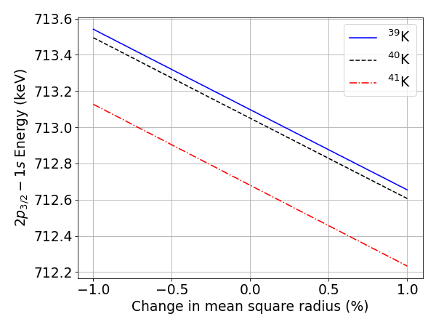
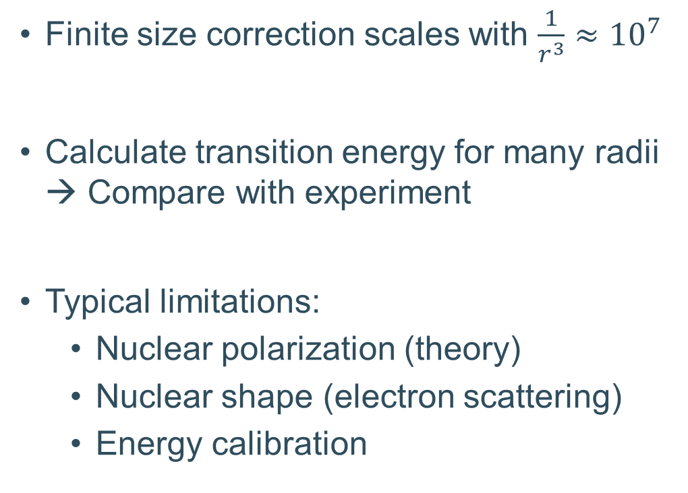
Extracting radii
Finite size correction scales with $\frac{1}{r^{3}}≈{10}^{7}$
Calculate transition energy for many radii → Compare with experiment
Typical limitations:
  Nuclear polarization (theory)
  Nuclear shape (electron scattering)
  Energy calibration
Simple calculations with mudirac code [1]
[1] Sturniolo, Simone, and Adrian Hillier. "Mudirac: A Dirac equation solver for elemental analysis with muonic X‐rays." X‐Ray Spectrometry 50.3 (2021): 180-196.

Slide 17
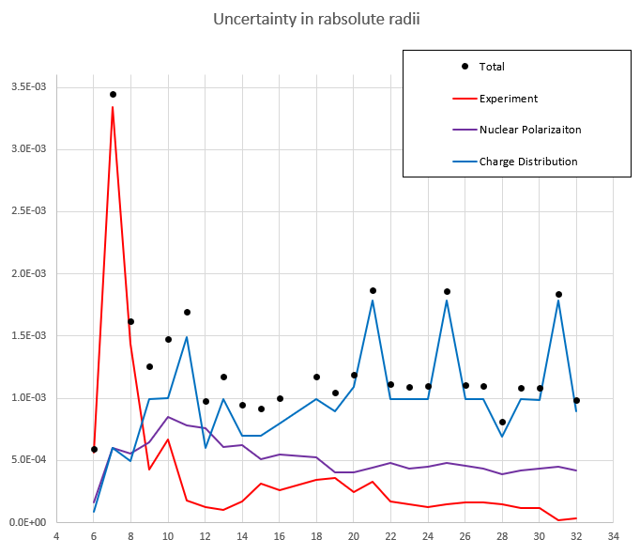
Extracting radii
Finite size correction scales with $\frac{1}{r^{3}}≈{10}^{7}$
Calculate transition energy for many radii → Compare with experiment
Typical limitations:
  Nuclear polarization (theory)
  Nuclear shape (electron scattering)
  Energy calibration
Relative precision
Proton number
Image courtesy: Ben Ohayon

Slide 18
Contents
Why do we need absolute charge radii?
Measuring charge radii with muons
Microgram targets
Experimental campaign on potassium and chlorine
Different physics cases

Slide 19
Measuring microgram materials
Traditionally: Limited to target mass O(10-100 mg)
Hydrogen gas cell (100 bars; 0.25% deuterium)
  Limited to O(5 µg)
  Down to 20 year half-life (radioprotection)
Muon veto
Muon entrance
Target
H₂
H₂
D₂
D₂
H₂
H₂
H₂
H₂
H₂
H₂
H₂
H₂
H₂
D₂
H₂
D₂
H₂
[1] Bubak, M., & Fajman, M. P. (1987). Cross sections for hydrogen muonic atomic processes in two-level approximation of the adiabatic framework (No. JINR-E--4-87-464). Joint Inst. for Nuclear Research.
[2] Adamczak, Andrzej, et al. "Muonic atom spectroscopy with microgram target material." The European Physical Journal A 59.2 (2023): 15.

Slide 20
Measuring microgram materials
Traditionally: Limited to target mass O(10-100 mg)
Hydrogen gas cell (100 bars; 0.25% deuterium)
  Limited to O(5 µg)
  Down to 20 year half-life (radioprotection)
H₂
H₂
D₂
D₂
µ⁻
H₂
H₂
H₂
H₂
H₂
H₂
H₂
H₂
H₂
D₂
H₂
D₂
H₂
[1] Bubak, M., & Fajman, M. P. (1987). Cross sections for hydrogen muonic atomic processes in two-level approximation of the adiabatic framework (No. JINR-E--4-87-464). Joint Inst. for Nuclear Research.
[2] Adamczak, Andrzej, et al. "Muonic atom spectroscopy with microgram target material." The European Physical Journal A 59.2 (2023): 15.

Slide 21
Measuring microgram materials
Traditionally: Limited to target mass O(10-100 mg)
Hydrogen gas cell (100 bars; 0.25% deuterium)
  Limited to O(5 µg)
  Down to 20 year half-life (radioprotection)
H₂
H₂
D₂
D₂
H₂
H₂
H₂
µH
H₂
H₂
H₂
H₂
H₂
D₂
H₂
D₂
H₂
[1] Bubak, M., & Fajman, M. P. (1987). Cross sections for hydrogen muonic atomic processes in two-level approximation of the adiabatic framework (No. JINR-E--4-87-464). Joint Inst. for Nuclear Research.
[2] Adamczak, Andrzej, et al. "Muonic atom spectroscopy with microgram target material." The European Physical Journal A 59.2 (2023): 15.

Slide 22
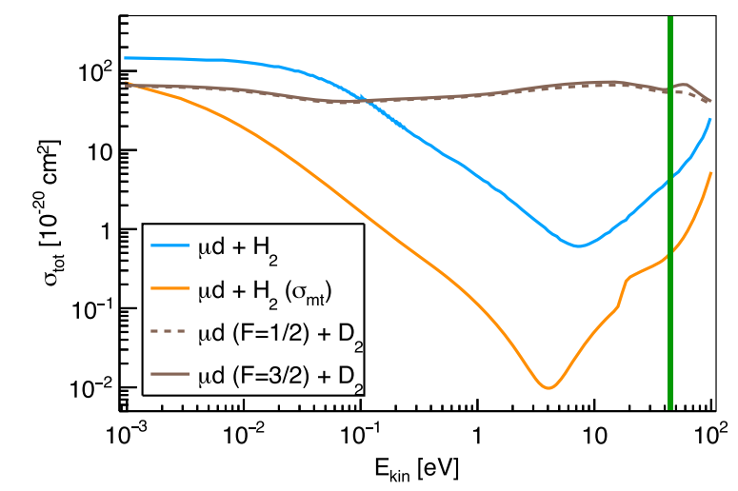
Measuring microgram materials
Traditionally: Limited to target mass O(10-100 mg)
Hydrogen gas cell (100 bars; 0.25% deuterium)
  Limited to O(5 µg)
  Down to 20 year half-life (radioprotection)
MFP_{µD} >> MFP_{µH}
H₂
H₂
D₂
D₂
H₂
H₂
H₂
H₂
H₂
H₂
H₂
H₂
H₂
D₂
H₂
µD
H₂
[1] Bubak, M., & Fajman, M. P. (1987). Cross sections for hydrogen muonic atomic processes in two-level approximation of the adiabatic framework (No. JINR-E--4-87-464). Joint Inst. for Nuclear Research.
[2] Adamczak, Andrzej, et al. "Muonic atom spectroscopy with microgram target material." The European Physical Journal A 59.2 (2023): 15.

Slide 23
Measuring microgram materials
Traditionally: Limited to target mass O(10-100 mg)
Hydrogen gas cell (100 bars; 0.25% deuterium)
  Limited to O(5 µg)
  Down to 20 year half-life (radioprotection)
H₂
H₂
D₂
D₂
H₂
H₂
H₂
H₂
H₂
µZ
H₂
H₂
H₂
H₂
D₂
H₂
D₂
H₂
[1] Bubak, M., & Fajman, M. P. (1987). Cross sections for hydrogen muonic atomic processes in two-level approximation of the adiabatic framework (No. JINR-E--4-87-464). Joint Inst. for Nuclear Research.
[2] Adamczak, Andrzej, et al. "Muonic atom spectroscopy with microgram target material." The European Physical Journal A 59.2 (2023): 15.

Slide 24
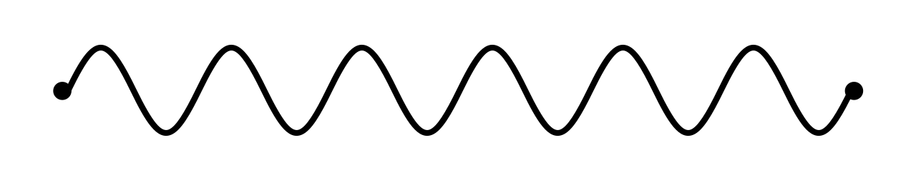
Measuring microgram materials
Traditionally: Limited to target mass O(10-100 mg)
Hydrogen gas cell (100 bars; 0.25% deuterium)
  Limited to O(5 µg)
  Down to 20 year half-life (radioprotection)
H₂
H₂
D₂
D₂
H₂
H₂
H₂
H₂
H₂
µZ
H₂
H₂
H₂
H₂
D₂
H₂
D₂
H₂
[1] Bubak, M., & Fajman, M. P. (1987). Cross sections for hydrogen muonic atomic processes in two-level approximation of the adiabatic framework (No. JINR-E--4-87-464). Joint Inst. for Nuclear Research.
[2] Adamczak, Andrzej, et al. "Muonic atom spectroscopy with microgram target material." The European Physical Journal A 59.2 (2023): 15.

Slide 25
Contents
Why do we need absolute charge radii?
Measuring charge radii with muons
Microgram targets
Experimental campaign on potassium and chlorine
Different physics cases

Slide 26
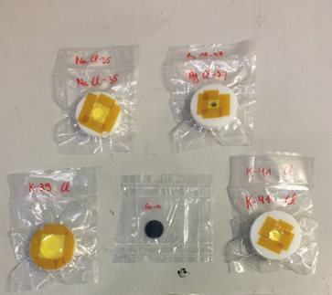



Primary goals
Remeasurement of ^{39, 41}K (macroscopic target)
First measurement of ⁴⁰K (microscopic implanted target)
a
First measurement of isotopically pure ^{35, 37}Cl (macroscopic target)
q

Slide 27
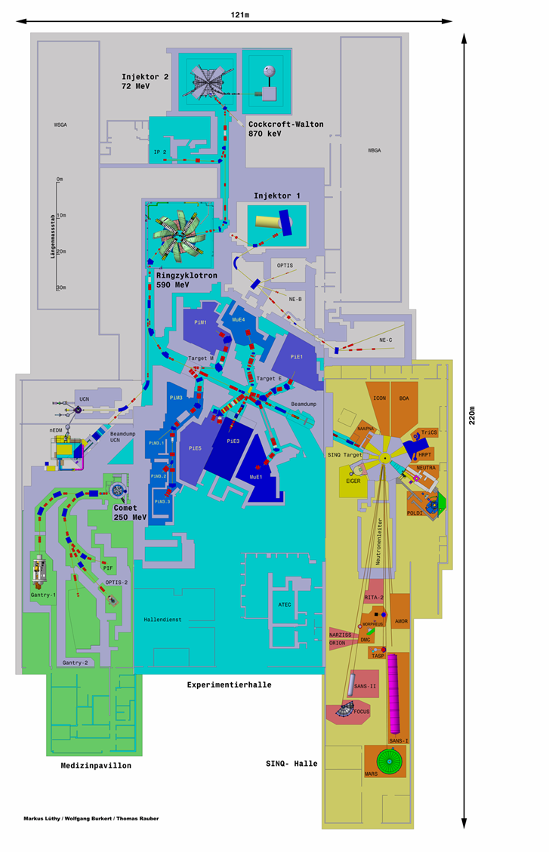
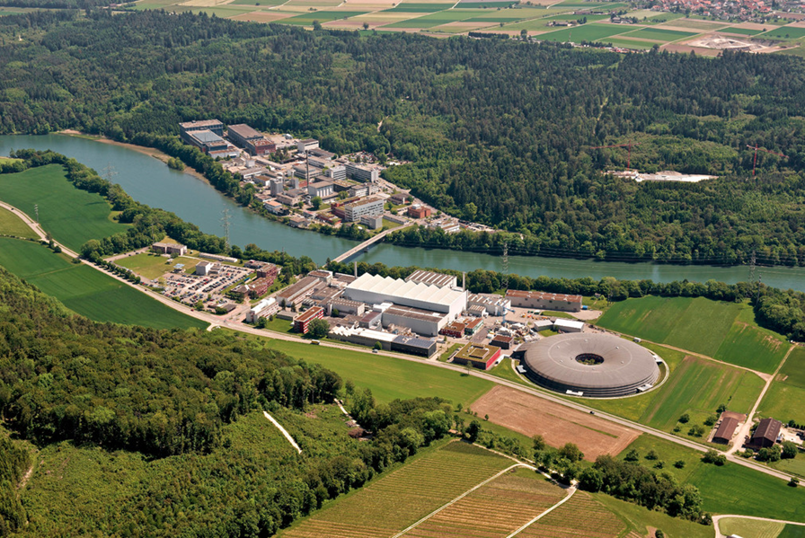
PSI – High intensity proton accelerator facility (HIPA)

Slide 28
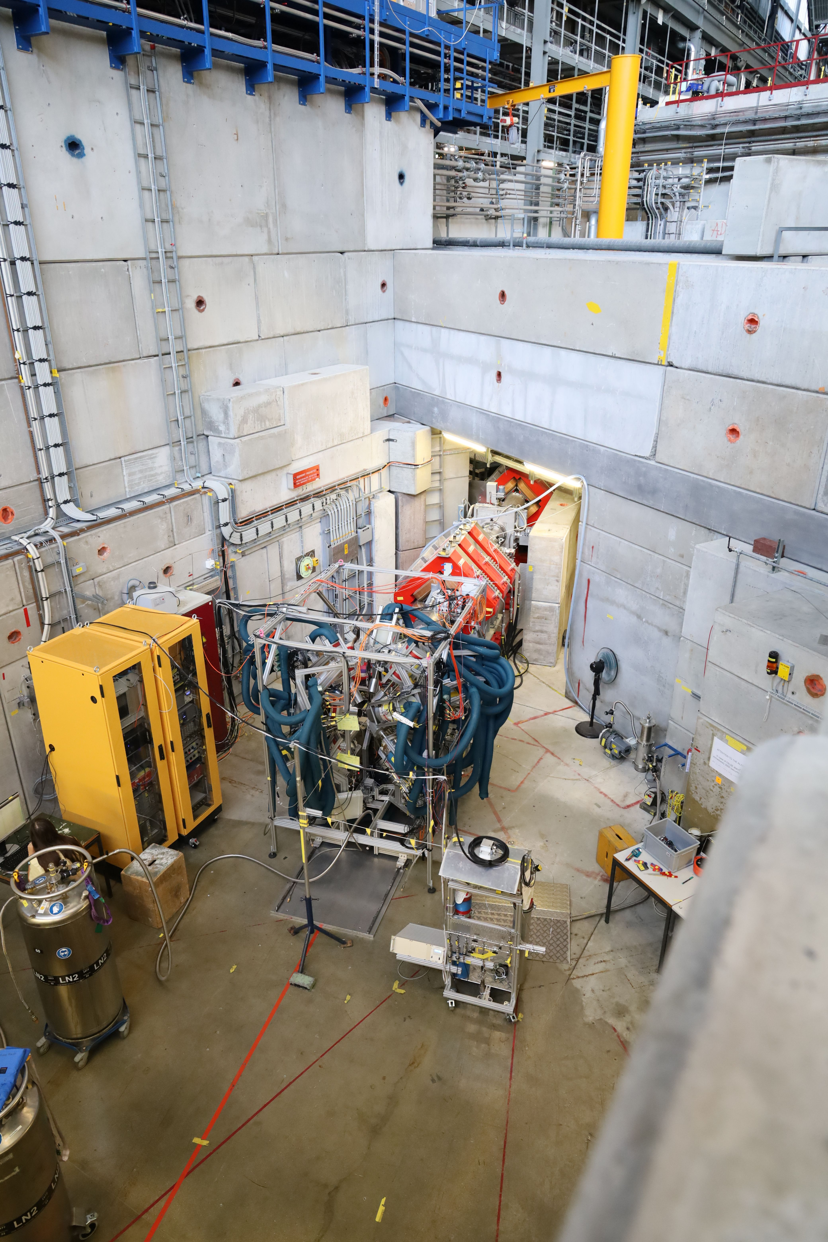
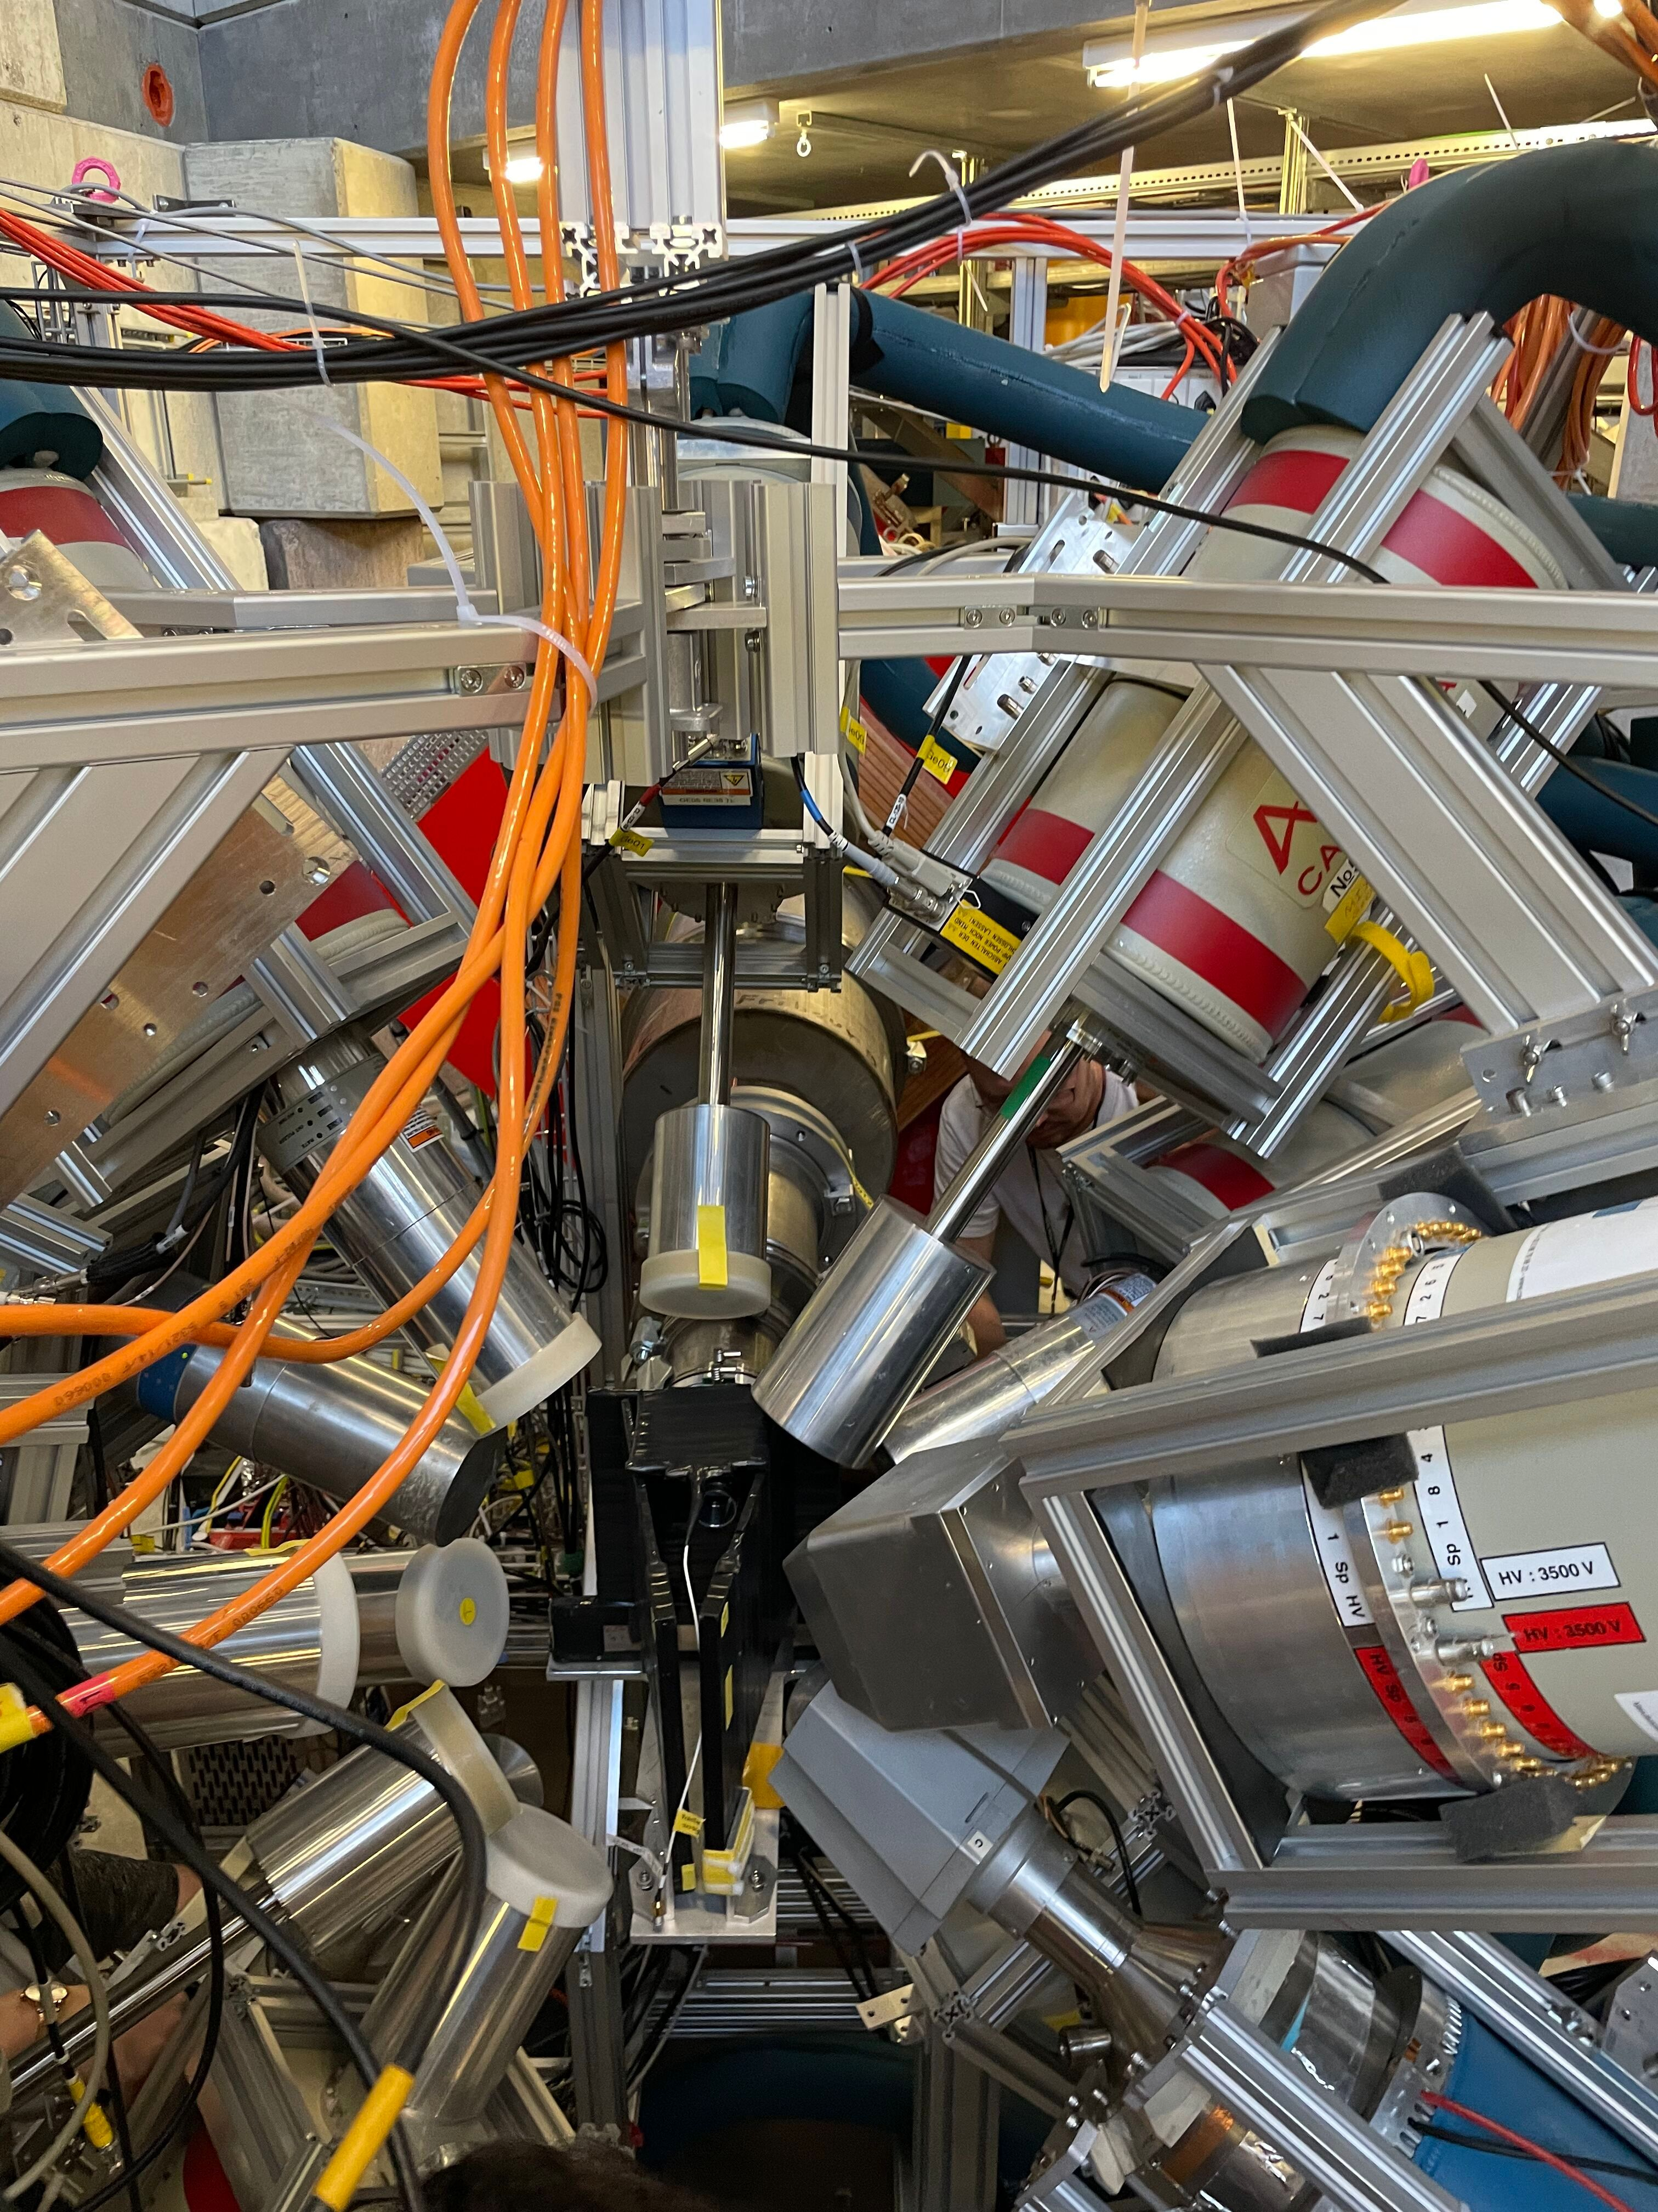
Setup

Slide 29
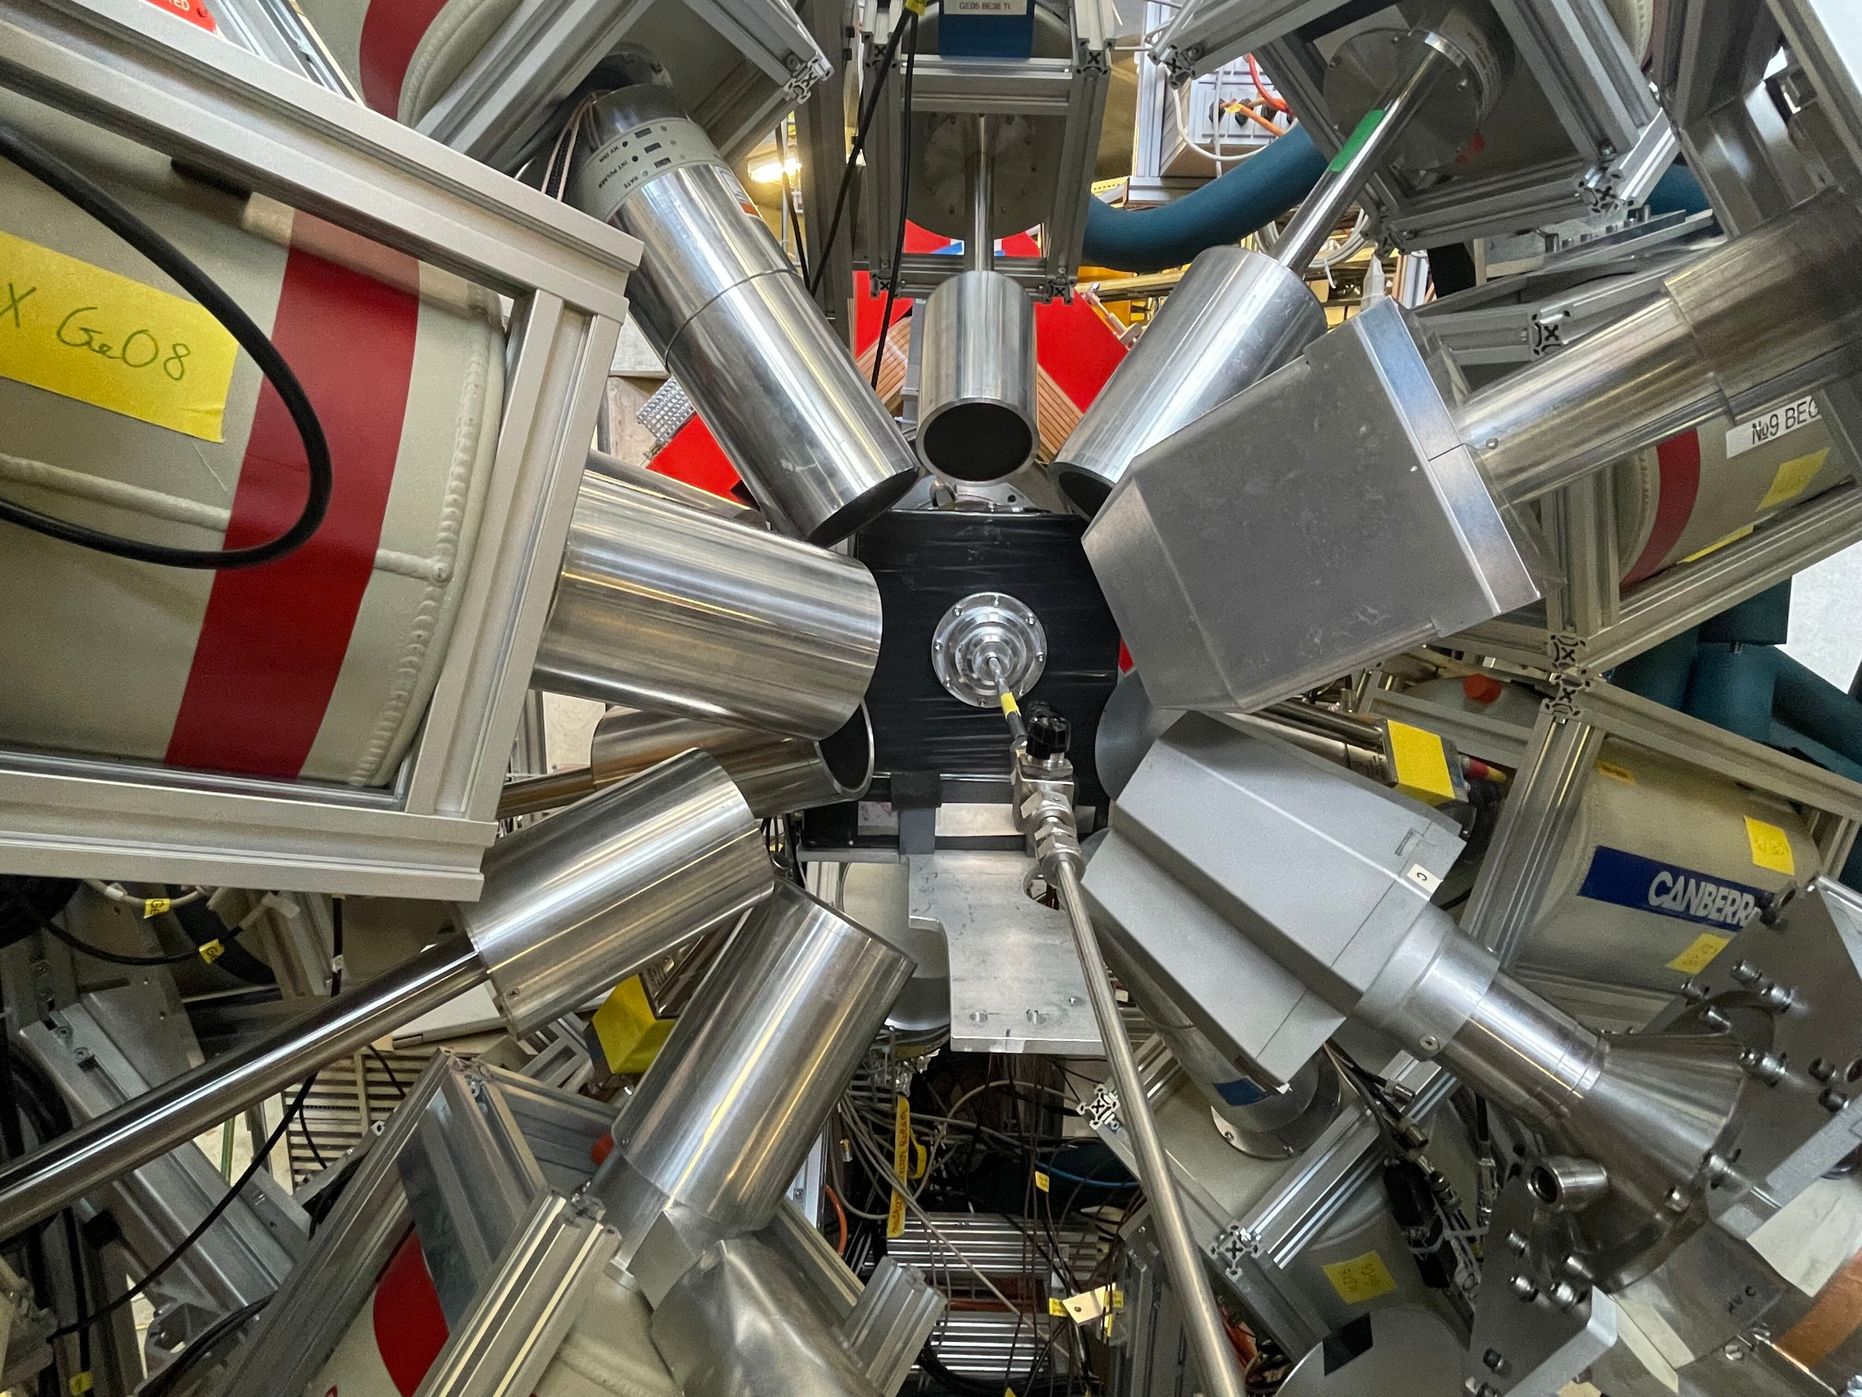
Setup
µ beam
Gas inlet

Slide 30
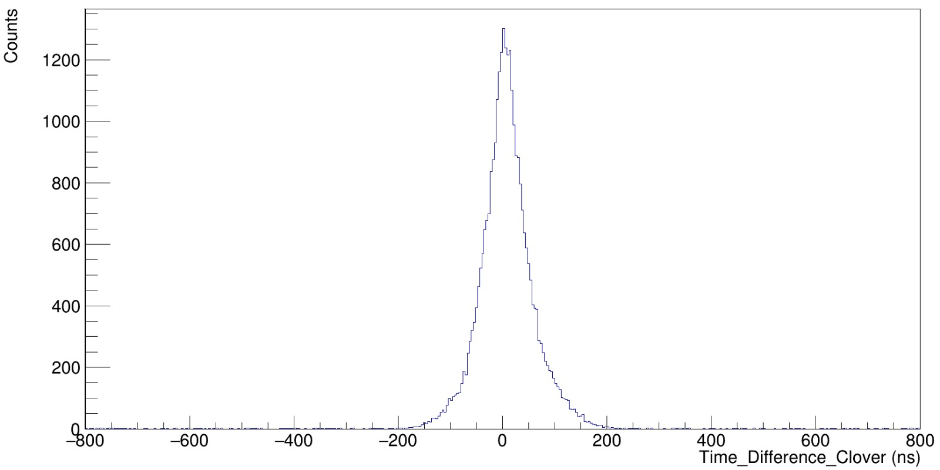
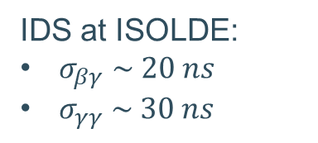
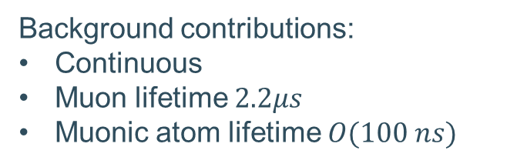
Data filtering: Timing optimization
IDS at ISOLDE:
$σ_{βγ} \sim 20 ns$
$σ_{γγ} \sim 30 ns$
Background contributions:
Continuous
Muon lifetime $2.2μs$
Muonic atom lifetime $O(100 ns)$
Image and IDS numbers from R. Lica and Z. Yue

Slide 31
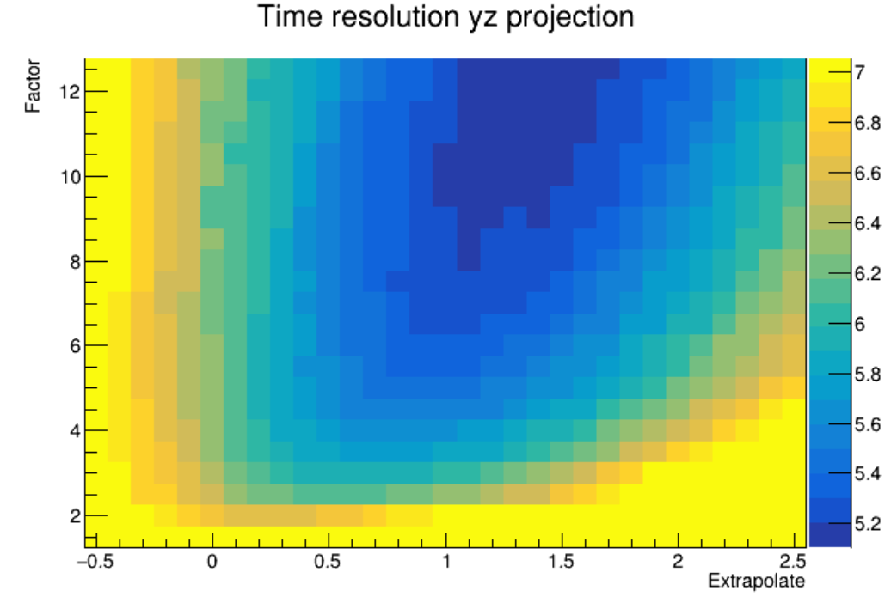
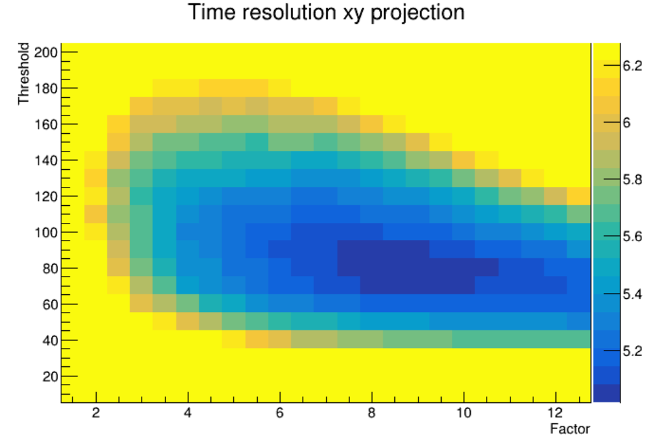
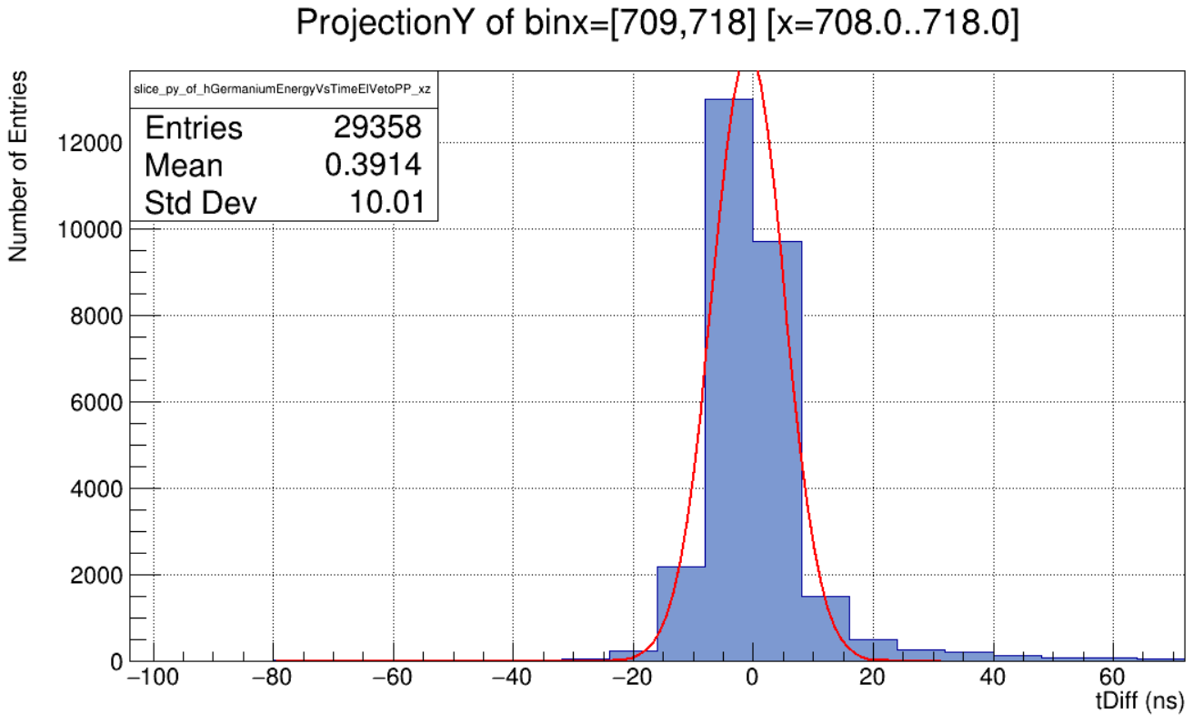
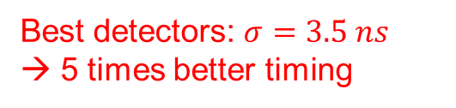

Data filtering: Timing optimization
Best detectors: $σ=3.5 ns$ → 5 times better timing
$σ=5.9$ ns

Slide 32
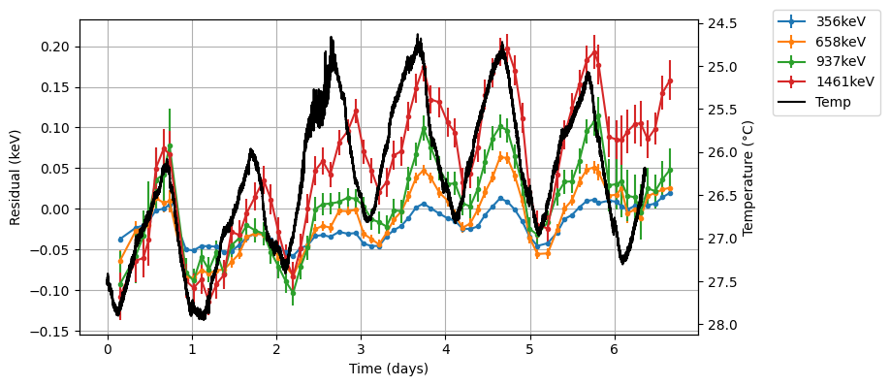
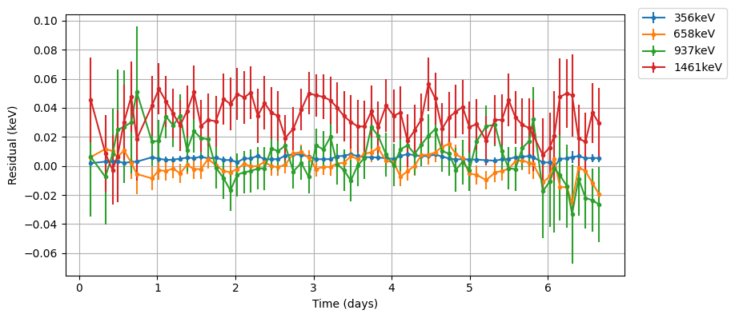
Data filtering: Gain drift correction
Before correcting
After correcting

Slide 33
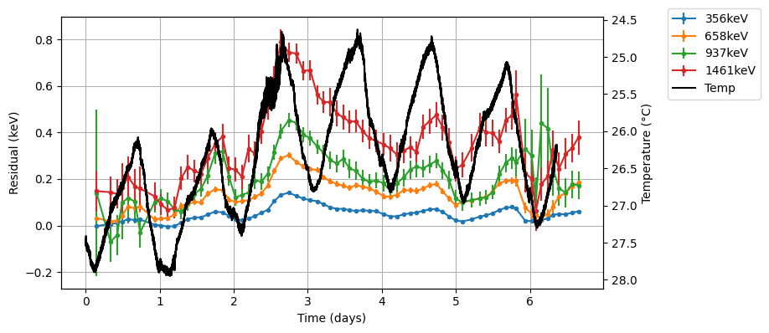
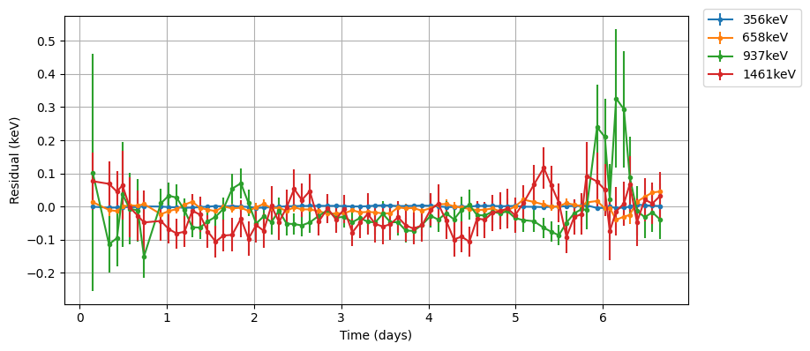
Data filtering: Gain drift correction
Before correcting
After correcting

Slide 34
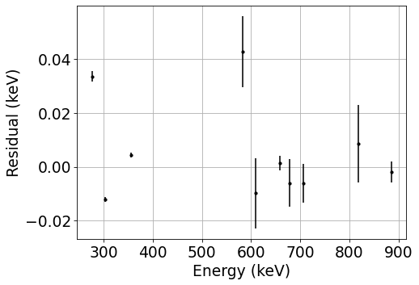
Energy calibration
Long statistics
One of the most linear detectors
Linear background (possible reason for deviations)
Still trying to improve

Slide 35
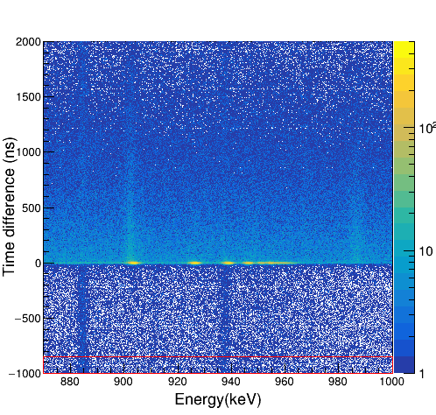
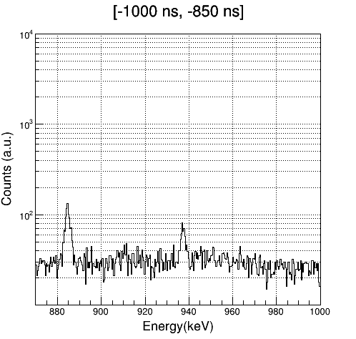
Interpreting energy Vs time plots
^{110m}Ag

Slide 36
Interpreting energy Vs time plots
^{110m}Ag

Slide 37

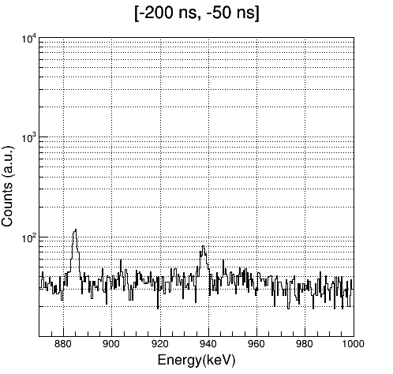
Interpreting energy Vs time plots
³⁹K np-1s

Slide 38

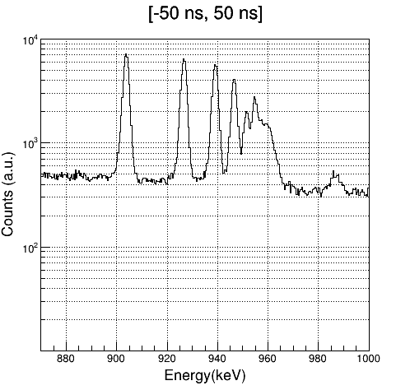
Interpreting energy Vs time plots
Muon capture
^{110m}Ag

Slide 39
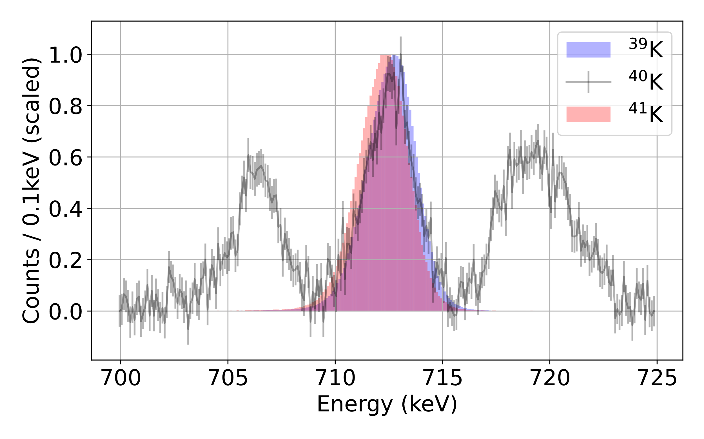

Potassium muonic isotope shift (preliminary)
10 hours
Ag-110m
5 days
10 hours
$$Ti\left(μ, νn\right)Sc$$

Slide 40
Potassium muonic isotope shift (preliminary)

Slide 41
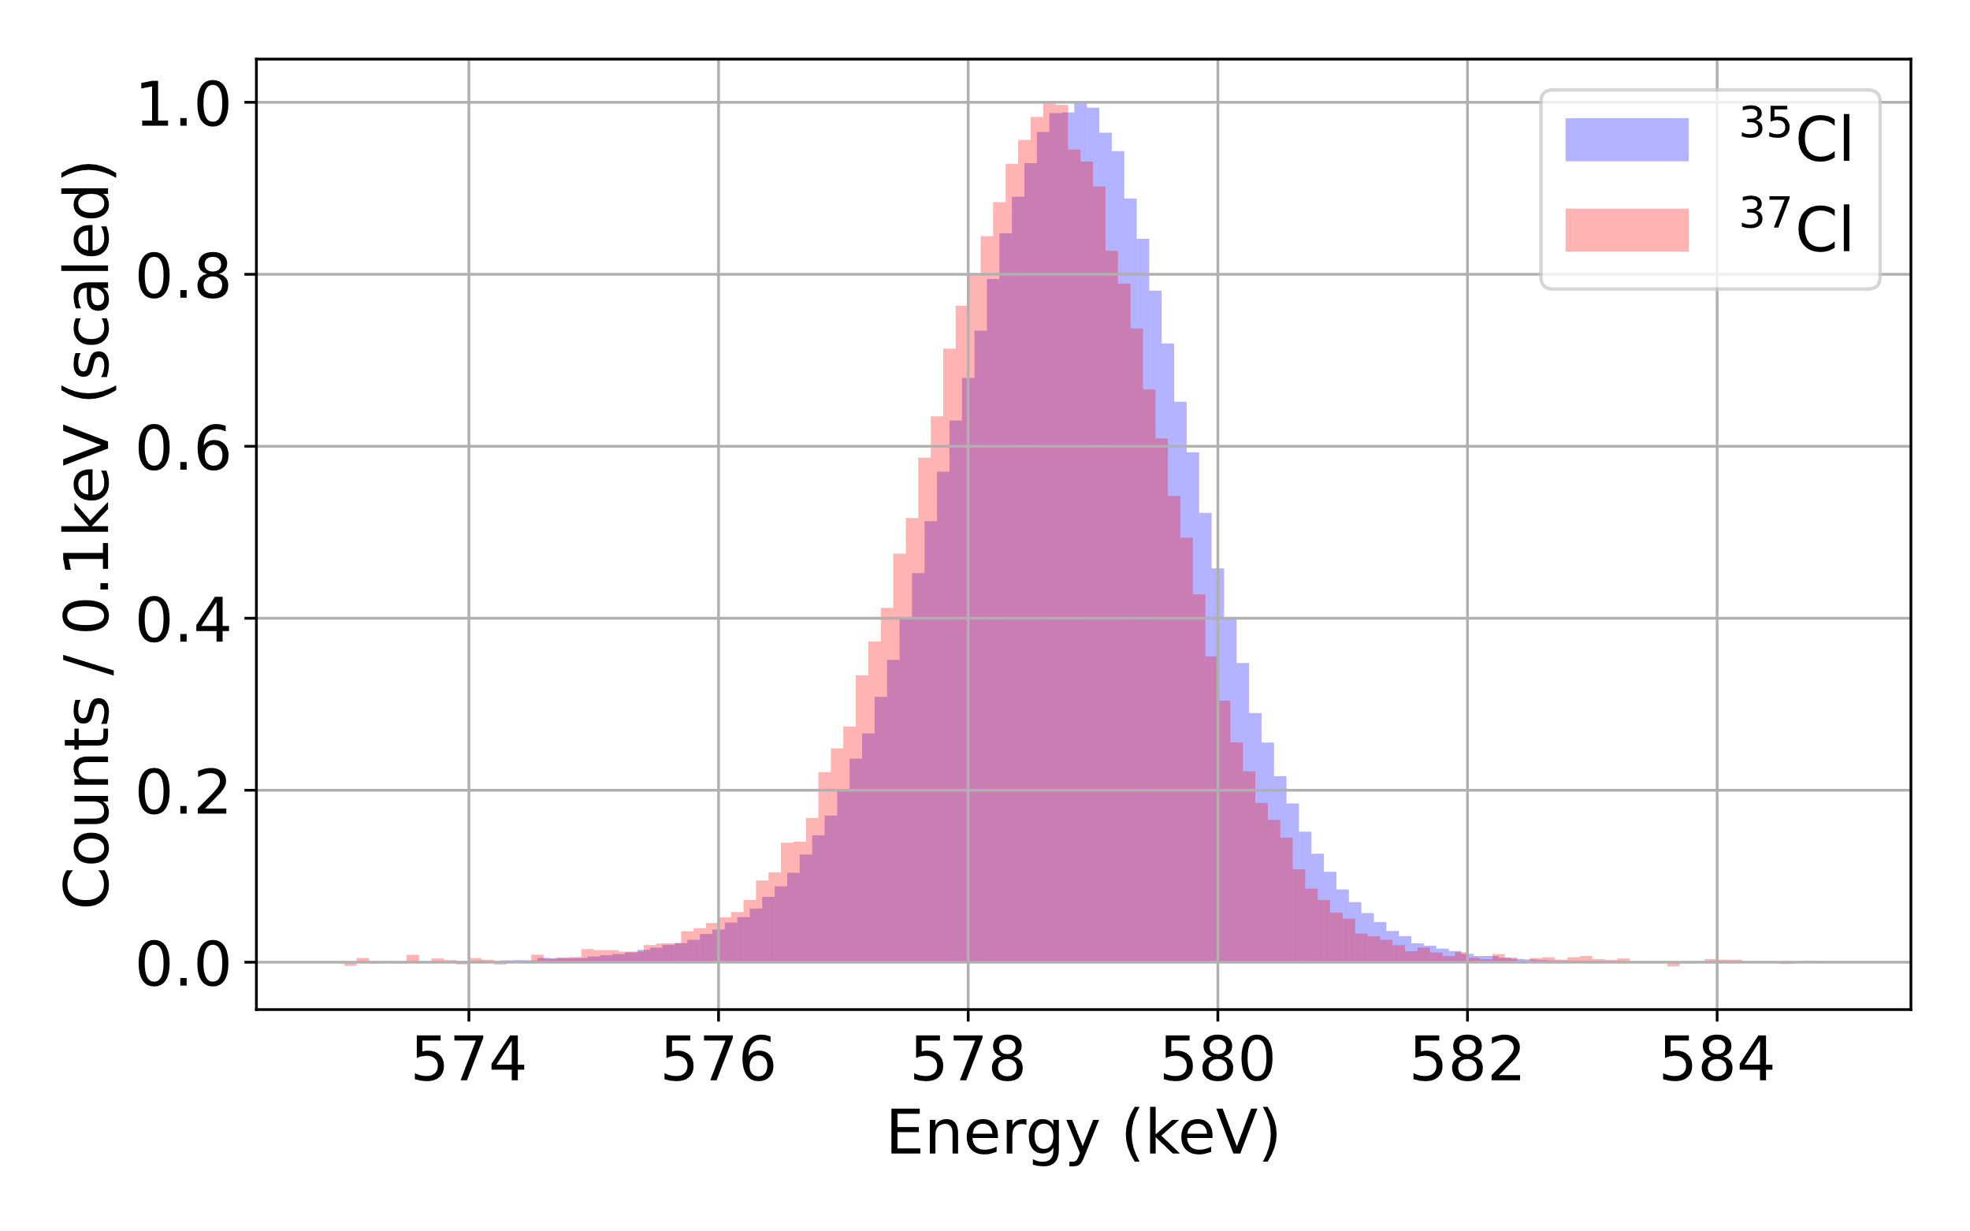

Chlorine measurement (preliminary)
Muonic 2p-1s energy:
  ^{nat}Cl: 578.56(30) keV
Expected improvement on 2p-1s transition energy:
  300 eV → Most likely < 30 eV
Expected improvement on radii:
  0.45% → ~0.10-0.15 % (including systematics)
Literature $δ<r^{2}>^{35, 37}=0.03(16)$

Slide 42
Chlorine measurement (preliminary)
Muonic 2p-1s energy:
  ^{nat}Cl: 578.56(30) keV
Expected improvement on 2p-1s transition energy:
  300 eV → Most likely < 30 eV
Expected improvement on radii:
  0.45% → ~0.10-0.15 % (including systematics)
Literature $δ<r^{2}>^{35, 37}=0.03(16)$

Slide 43
Contents
Why do we need absolute charge radii?
Measuring charge radii with muons
Microgram targets
Experimental campaign on potassium and chlorine
Different physics cases

Slide 44
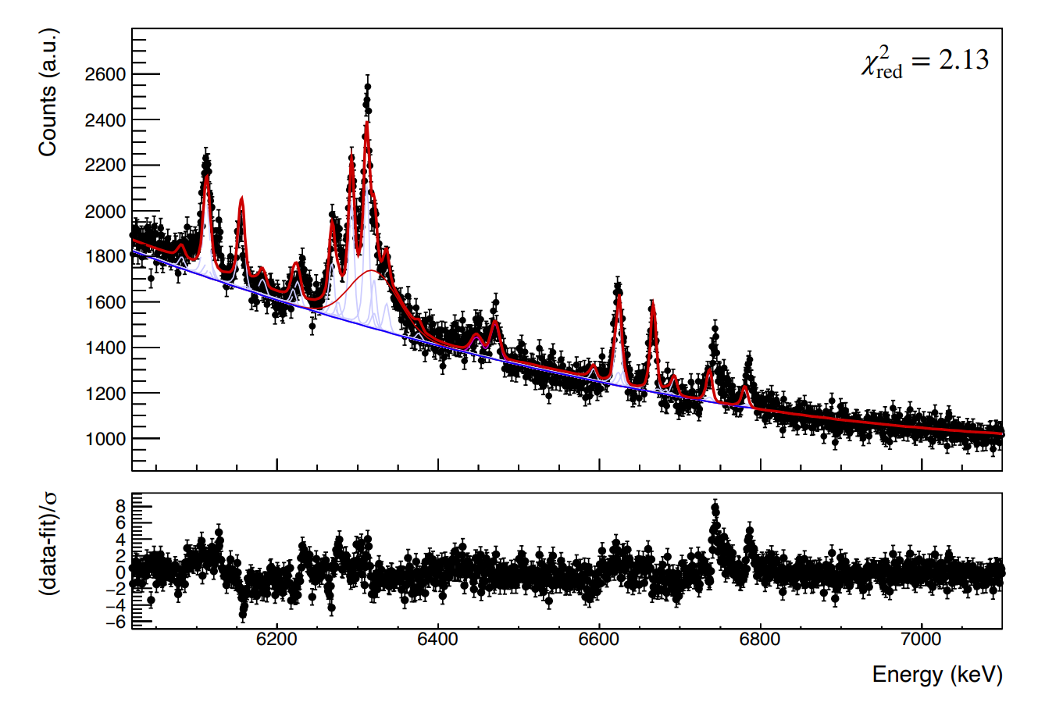
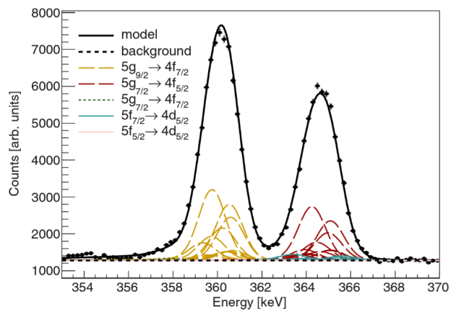
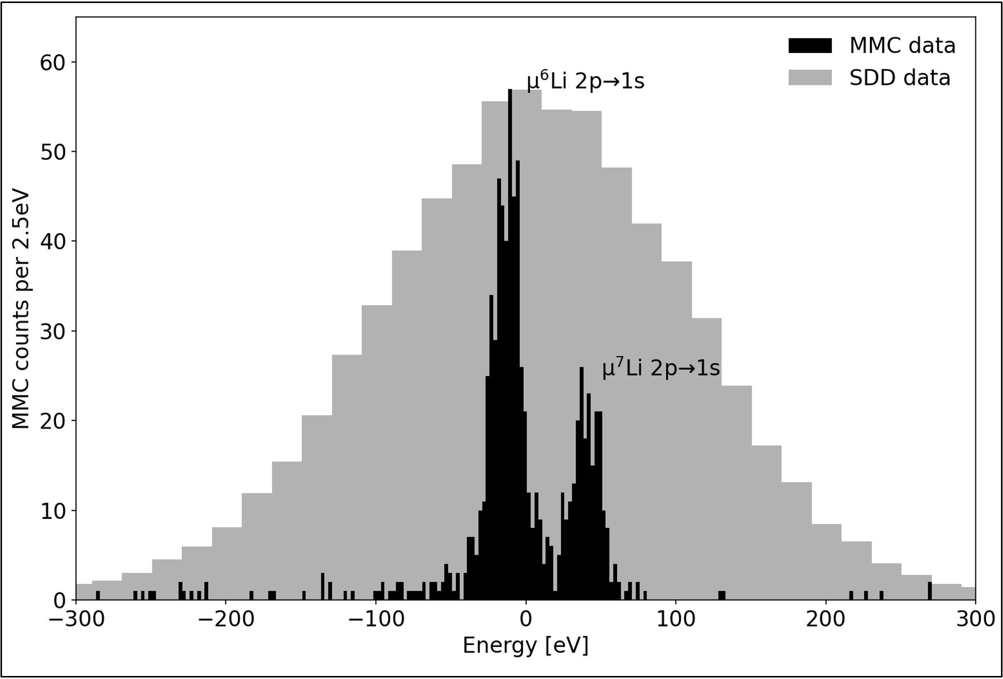
Other stuff we’ve done
²⁴⁸Cm
Quadrupoles of stable Re
Use of microcalorimeters

Slide 45
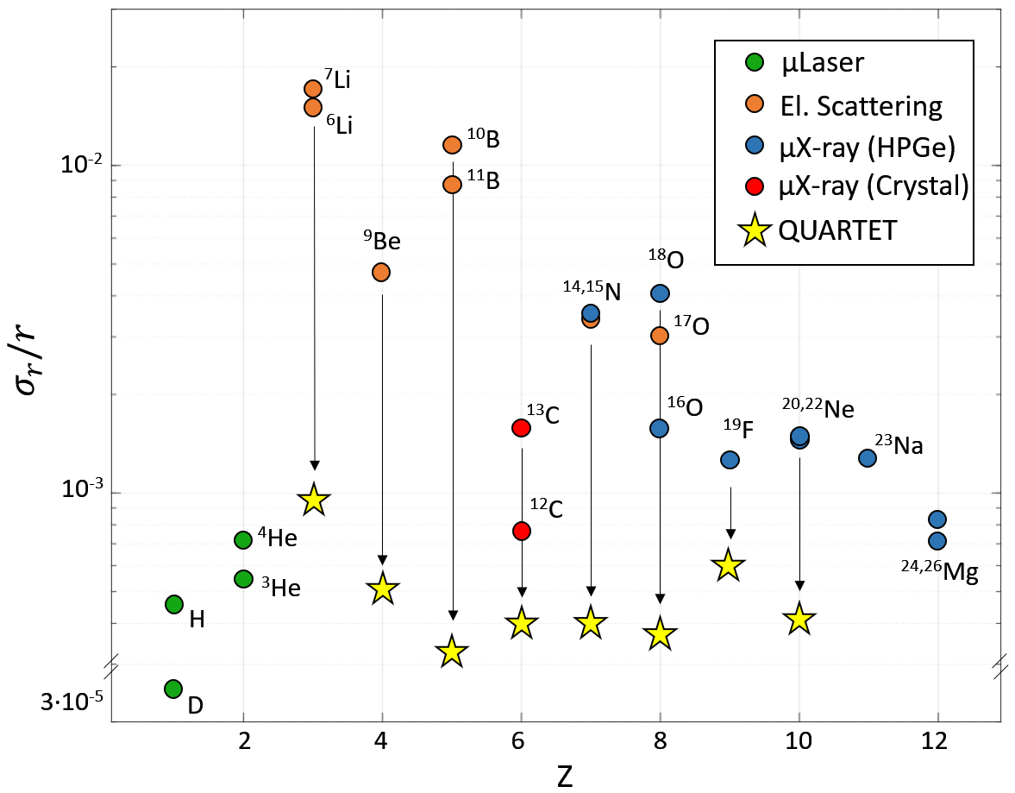
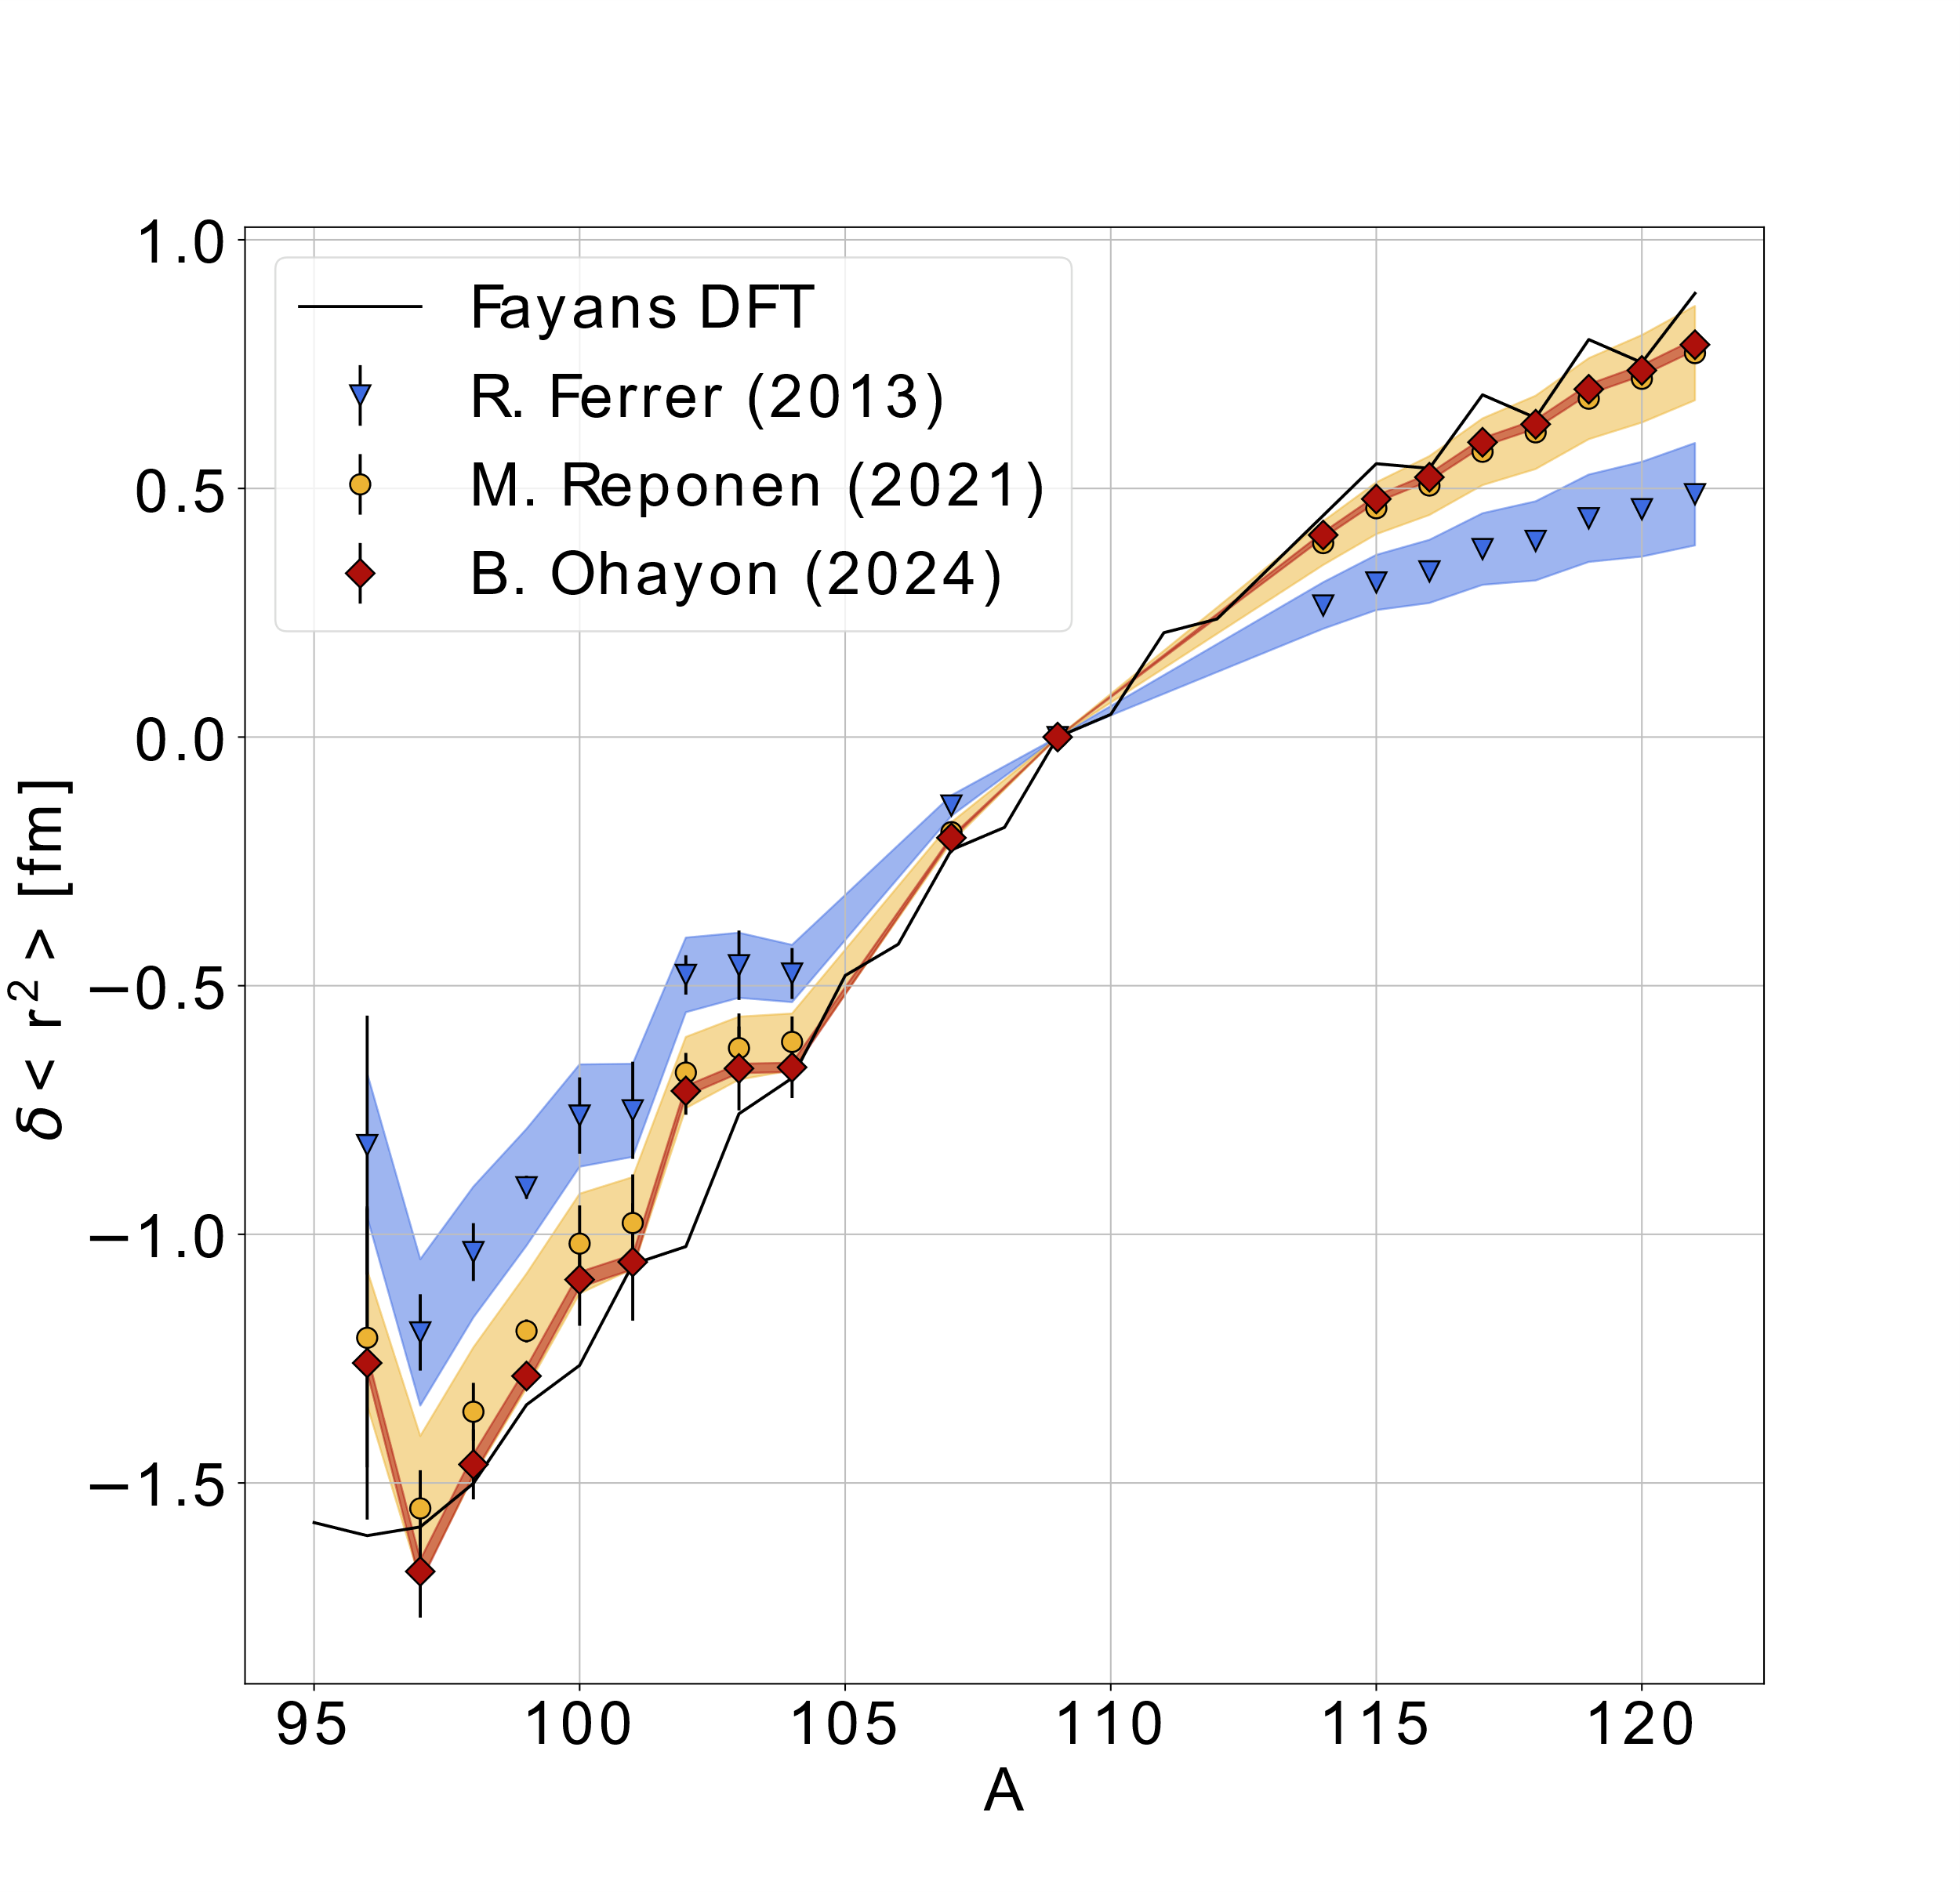
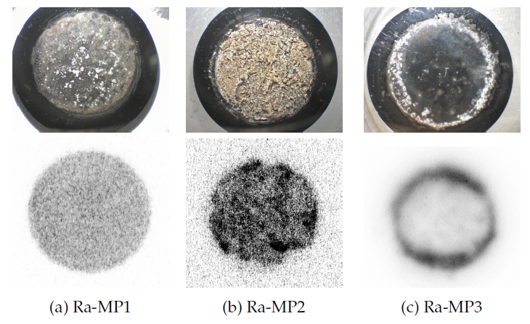
Future plans
Charge radius for Z= 3-10
Benchmarking laser spectroscopy
Charge radius of ²²⁶Ra

Slide 46
Conclusion
Muonic atoms can be used as precise probes for the nucleus
  Giving input for laser spectroscopy
  Inputs for other experiments
  Radii comparison across elements
Measured transition energies of Cl and K
  Theory calculations have been initiated
  In-depth analysis ongoing (ideal precision < 20 eV)

Slide 47















Thank you for your attention!
Thanks to the muX collaboration and the QUARTET collaboration:

Slide 48
Backup slides

Slide 49

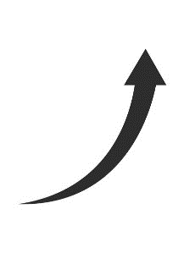

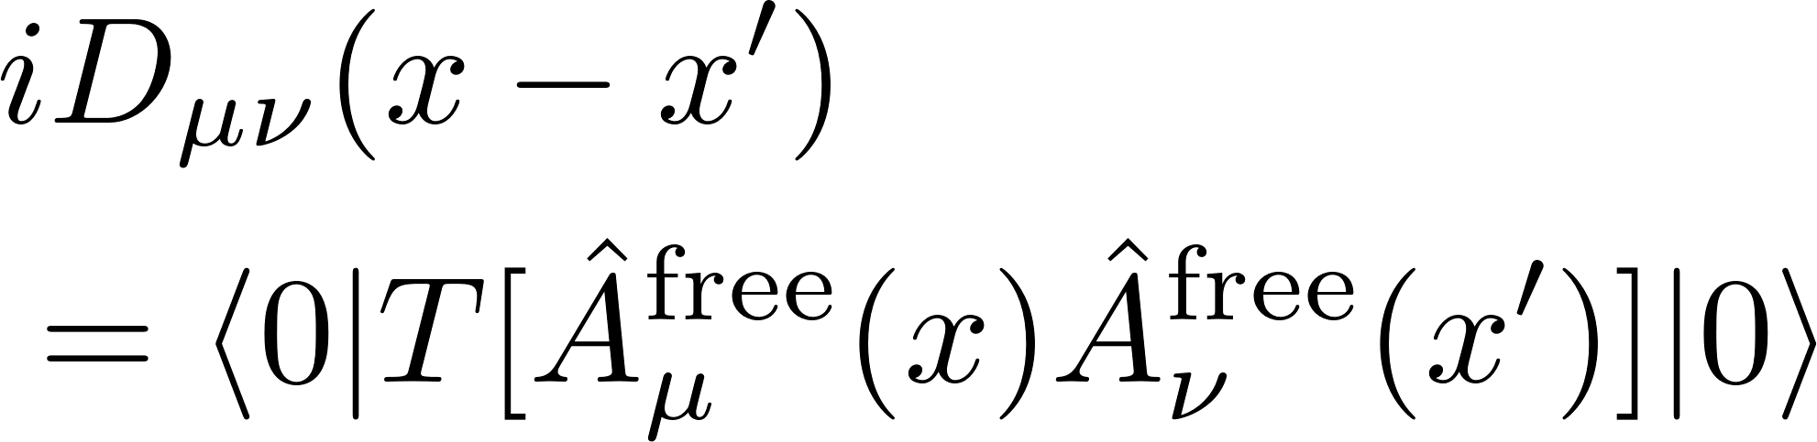

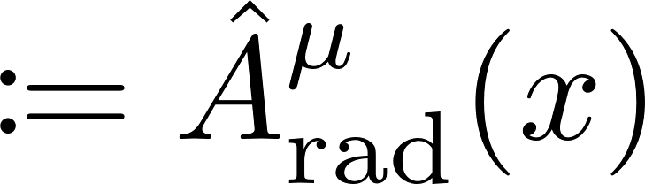
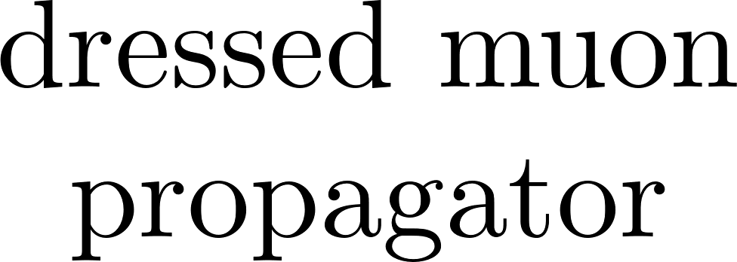
Field-theoretical approach
Slide courtesy: Igor Valuev

Slide 50







Modified photon propagator
Slide courtesy: Igor Valuev

Slide 51






What is needed from the nuclear side
Slide courtesy: Igor Valuev

Slide 52

Dynamic hyperfine splitting
Slide courtesy: Stella Vogiatzi

Slide 53

Including the quadrupole moment (²⁴⁸Cm)
Slide courtesy: Stella Vogiatzi

Slide 54


Development – anticoincidence spectrum

Slide 55
Muonic x rays
Captured in high-n state → Cascade down
X rays emitted in atomic transition
  Electronic atoms: < 100 keV
  Muonic atoms: Up to 10 MeV
Information about energy levels → Extract nuclear properties

Slide 56


How sensitive are we?
Groundstate wavefunction has sizeable overlap with the nucleus
Sensitivity increase:
  Nuclear size: ${\left(\frac{m_{μ}}{m_{e}}\right)}^{3}≈{10}^{7}$
  Quadrupole: ${\left(\frac{m_{μ}}{m_{e}}\right)}^{2}≈5×{10}^{4}$
  Octupole: ${\left(\frac{m_{µ}}{m_{e}}\right)}^{3}≈{10}^{7}$
[1]
[1] S. M. Vogiatzi. The fitting of the hyperfine splitting of the 5 -> 4 transitions in muonic Re-185. Master’s thesis, ETH Zurich, 2018.

Slide 57

How sensitive are we?
[1]
Groundstate wavefunction has sizeable overlap with the nucleus
Sensitivity increase:
  Nuclear size: ${\left(\frac{m_{μ}}{m_{e}}\right)}^{3}≈{10}^{7}$
  Quadrupole: ${\left(\frac{m_{μ}}{m_{e}}\right)}^{2}≈5×{10}^{4}$
  Octupole: ${\left(\frac{m_{µ}}{m_{e}}\right)}^{3}≈{10}^{7}$
[1] S. M. Vogiatzi. The fitting of the hyperfine splitting of the 5 -> 4 transitions in muonic Re-185. Master’s thesis, ETH Zurich, 2018.

Slide 58




Background – Producing muons
¹²C
p⁺
Protons on a graphite target
n(p, p $π^{−}$)p
$π^{−}$ → $μ^{−} + \overline{ν_{μ}}$
$7×{10}^{6}\frac{μ^{−}}{s}$
p(p, p $π^{+}$) n
$π^{+}$ → $μ^{+} +ν_{μ}$
$5×{10}^{8}\frac{μ^{+}}{s}$
p⁺
$$π^{−}$$
$$\overline{ν_{μ}}$$
$$μ^{−}$$

Slide 59

Muon half-life
Yamazaki, T., et al. "Negative moun spin rotation." Physica Scripta 11.3-4 (1975): 133.

Slide 60

Muon-catalyzed fusion
Muonic deuterium + hydrogen form a molecule
Interatomic distance ~200 times smaller
Thermal vibrations break through fusion barrier (down to 1K)
Not sufficient for net gain, but
still very cool

Slide 61


General time cut
Suboptimal time window:
  Too small → Miss significant signal
  Too large → Include additional background
Imperfect timing → [-50ns; 500ns]
Adamczak, A., et al. "Muonic atom spectroscopy with microgram target material." The European Physical Journal A 59.2 (2023): 15.

Slide 62


Fitting with Hypermet
Model
  Gaussian
  Low energy tail
  Step function
  Linear background
$$\frac{f_{G}}{\sqrt{2π}σ}×exp\left[−\frac{1}{2} {\left(\frac{E −μ}{σ}\right)}^{2}\right]+$$
$$\frac{f_{T}}{2β}exp\left[\frac{E −μ}{β}+\frac{1}{2} {\left(\frac{σ}{β}\right)}^{2}\right]erfc\left[\frac{E −μ}{\sqrt{2}σ}\right]+$$
$$\frac{S}{2}×erfc\left[\frac{E −μ}{\sqrt{2}σ}\right]+$$
$$C_{0}+C_{1}E$$

Slide 63


Online optimization – Trapezoid

Slide 64

Online optimization – Trapezoid

Slide 65


MMC detector

Slide 66

Compare to other methods
Limited to ~10⁻³
Electron scattering: A lot of disagreement → Conservative estimate 0.5-1% uncertainty on radii

