Slide 1



Future heavy ion experiment ALICE3
Sami Räsänen
Particle Physics Days in Lammi
28th November 2024

Slide 2
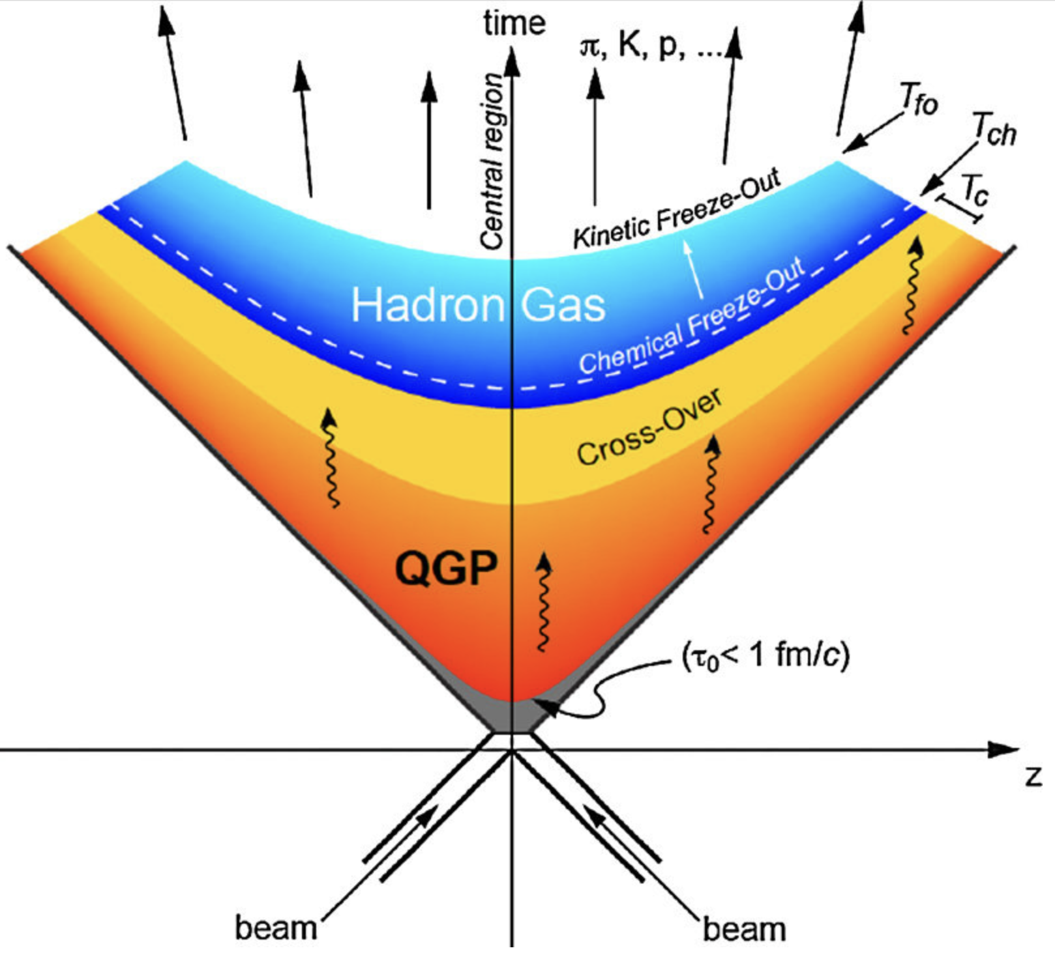
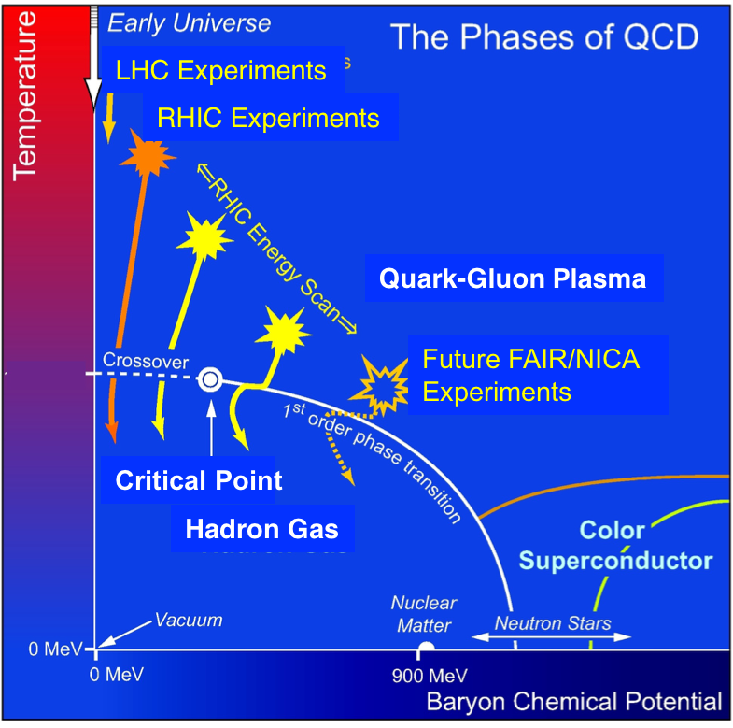
Relativistic heavy ion collisions – QGP in laboratory

Slide 3
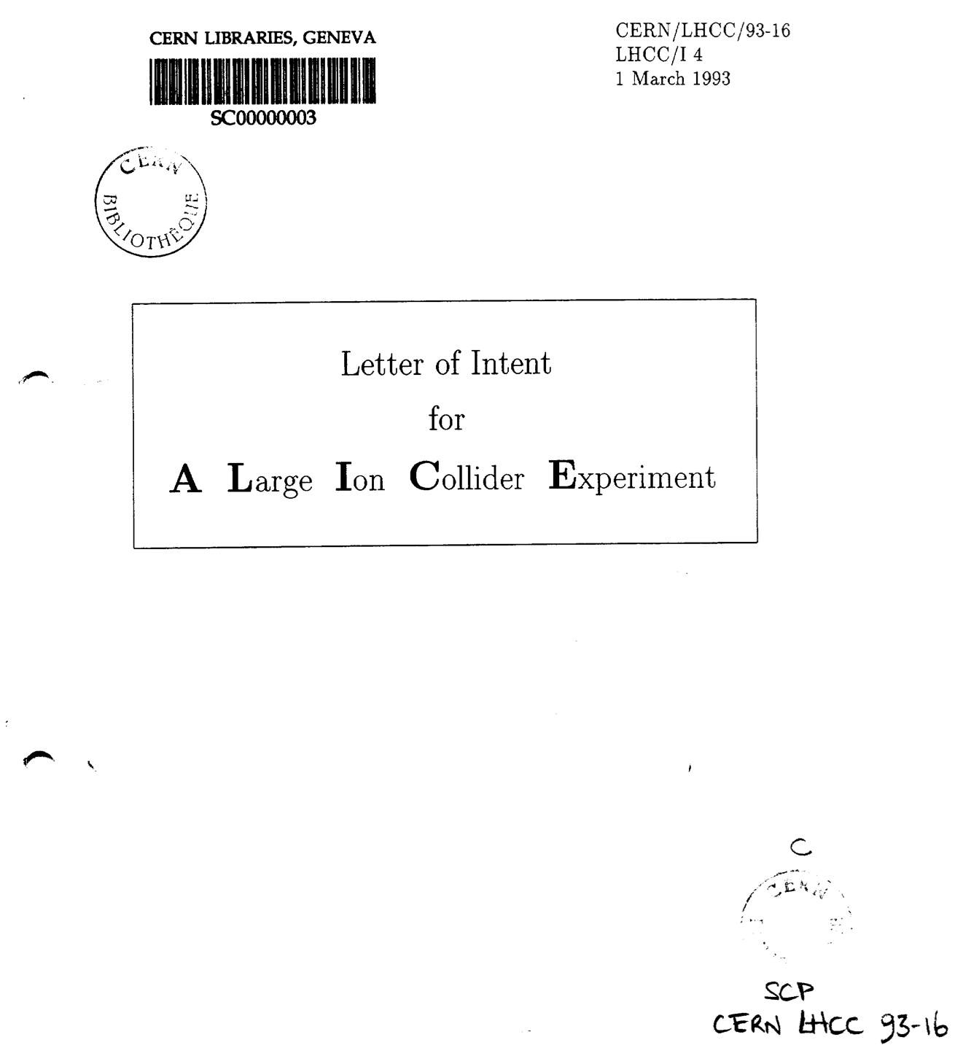
ALICE – A Large Ion Collider Experiment
Letter of Intent submitted 1993
Finland joined ALICE 1998
Physics program as presented in 1993:
Initial conditions of heavy ion collisions
- global event features, N_{part}
- produced energy density
2) Quark-gluon plasma (QGP)
-direct photons and thermal electromagnetic radiation
- energy loss of partons at QGP
- J/ψ probing the deconfinement
3) Phase transition to QGP
- strangeness production
- multiplicity fluctuations
- particle interferometry (to probe the expansion time of the mixed phase)
4) Hadronic matter
- particle ratios (chemical composition), p_{T} –distributions
- freeze-out radius of the hadronic fireball

Slide 4
ALICE – A Large Ion Collider Experiment
Letter of Intent submitted 1993
Finland joined ALICE 1998
Physics program presented in 1993:
Initial conditions of heavy ion collisions
- global event features, N_{part}
- produced energy density
2) Quark-gluon plasma (QGP)
-direct photons and thermal electromagnetic radiation
- energy loss of partons at QGP
- J/ψ probing the deconfinement
3) Phase transition to QGP
- strangeness production
- multiplicity fluctuations
- particle interferometry (to probe the expansion time of the mixed phase)
4) Hadronic matter
- particle ratios (chemical composition), p_{T} –distributions
- freeze-out radius of the hadronic fireball
!
“ […] , reflect the energy loss of partons
(before fragmentation) and this results
in striking differences in the shape of
the spectra predicted for nucleus-
nucleus and pp collisions.”
--- no citation given
!

Slide 5
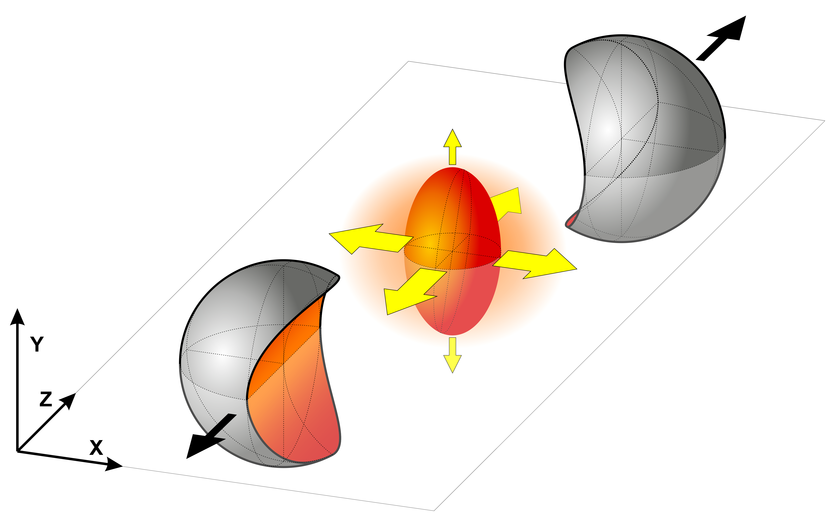
Long Shutdown 2 (LS2) upgrades:
ALICE specialty – non-triggerable observables:
Quark-medium interactions via measurements on
heavy flavoured hadrons down to low momenta
Disassociation and regeneration via measurements
of charmonium states
Medium evolution via thermal photons and dileptons
Production and degree of thermalization of light
and hyper nuclei
Based on physics targets:
Keep old:
Tracking down to low momenta
Particle identification over large momentum range
Bring something new:
Continuous readout of detectors
Large minimum bias (MB) data set with low pileup

Slide 6
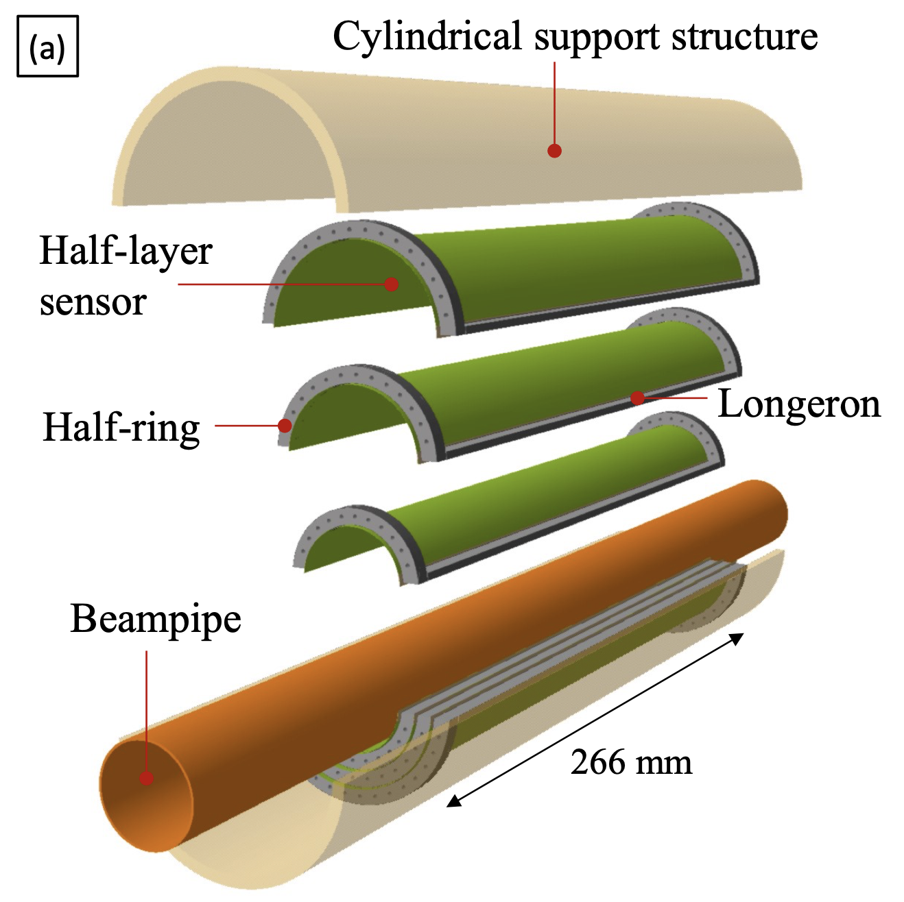
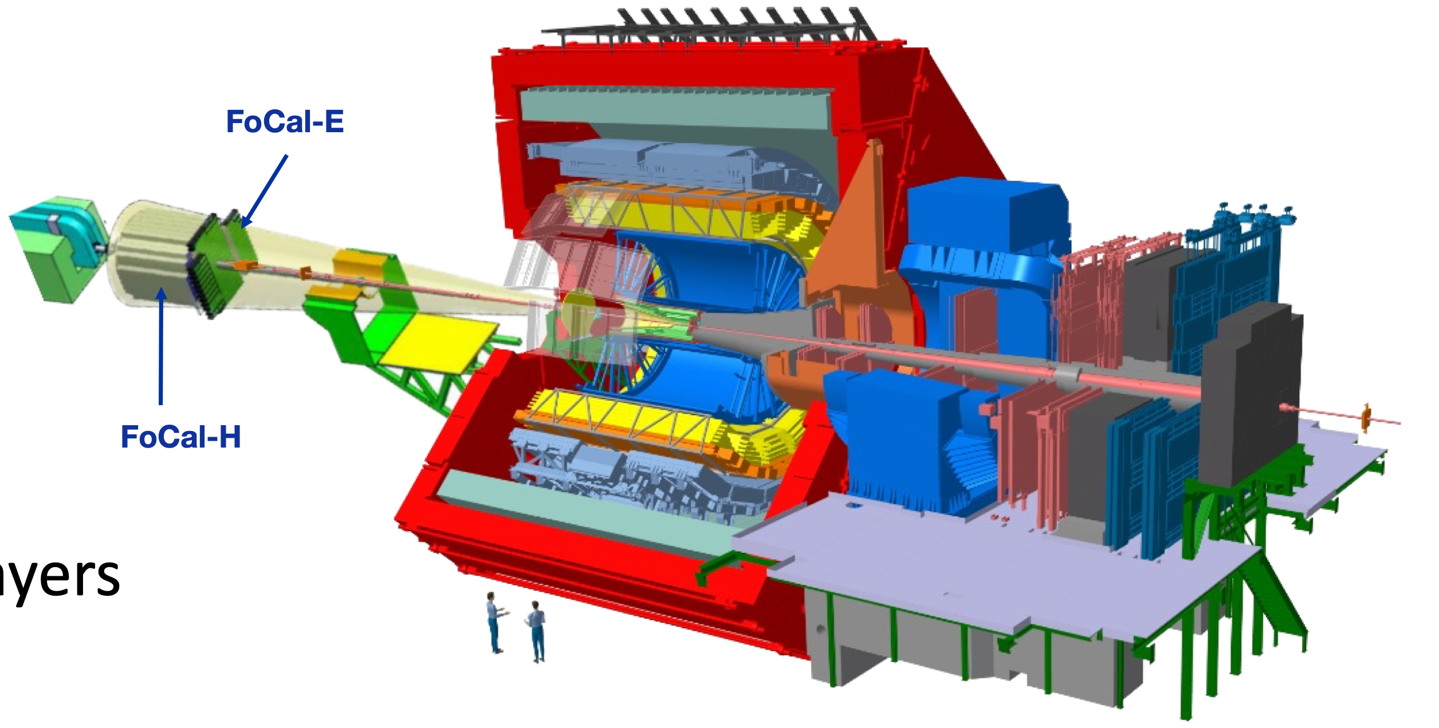
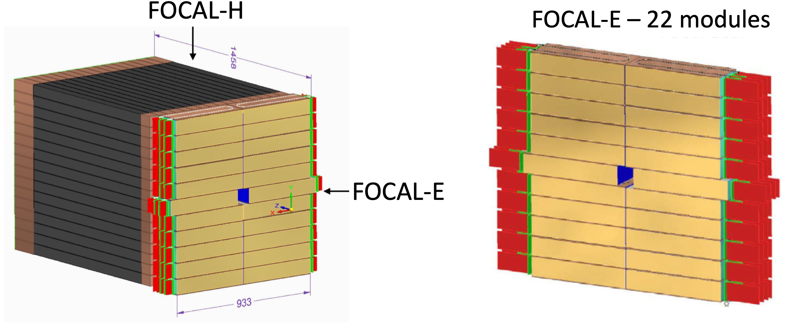

In Run4 !
LS3 Upgrades – FoCal and ITS3
New vertex detector ITS3
- improve secondary vertexing and
pointing resolution
New forward calorimeter (FoCal)
- physics of gluon saturation
ITS NOW
6

Slide 7
Future upgrades of ALICE:
ALICE1
- what we had in Run1+2
ALICE2
- present setup
- Run3, years 2022-2026
- refurbish subsystems in LS3
ALICE2.1
- Run4, years 2030-2033
- add forward calorimeter FoCal
and new vertex detector ITS3
ALICE3
- Run5, years 2036-2041
- new experiment!

Slide 8
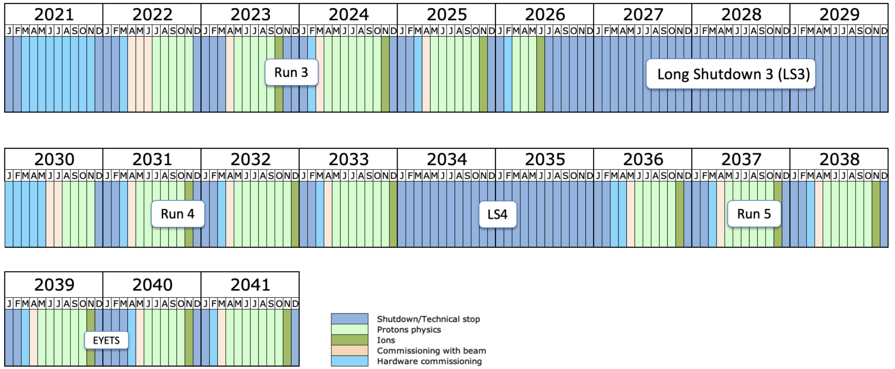
Updated LHC schedule (October 2024):
HI here, but not 2030
ALICE2
ALICE2.1
ALICE3
LS3 start 7/2026 → +7 months
Run4 starts 1/2030 → +12 months
Run 5 & Run 6 combined
→ LS5 cancelled, replaced by
extended year-end technical stop
(EYETS)
12/2041 = end of the HL-LHC
→ FCC-ee 2045-2048, FCC-pp ~2070-2075 (?)

Slide 9
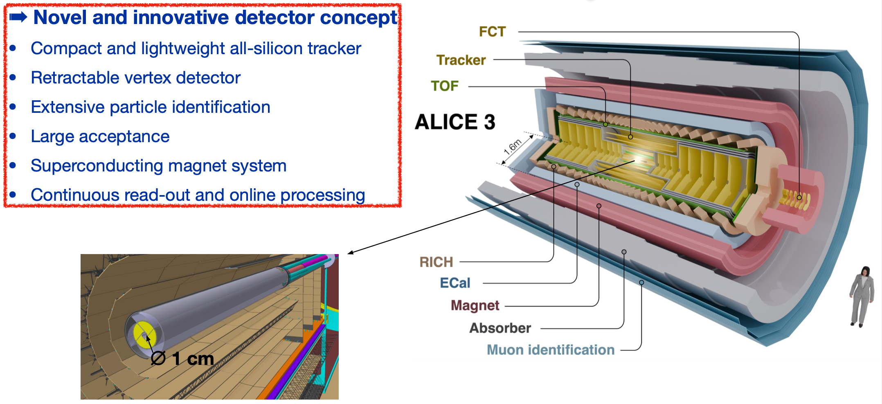
ALICE3 – Letter of Intent
What is drives the design?

Slide 10
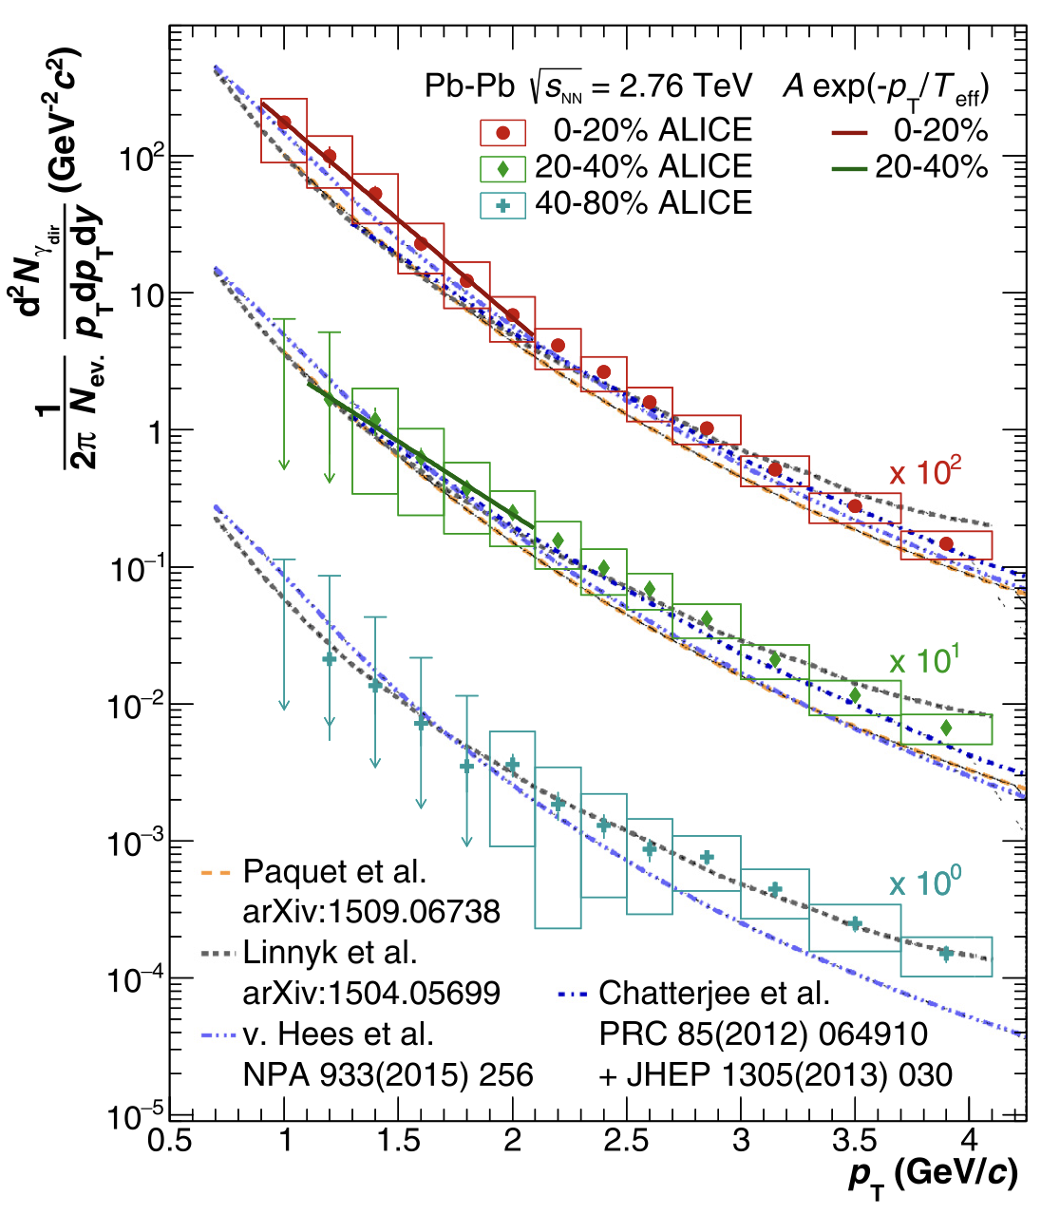
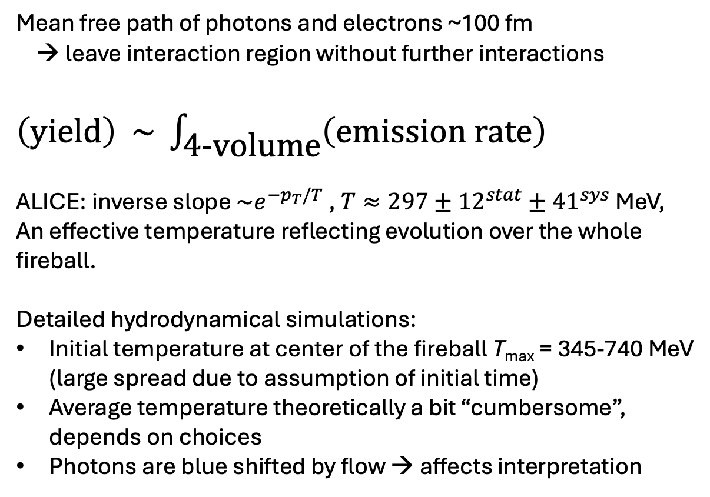
EM radiation – thermal photons:
ALICE, Physics Letters B 754 (2016) 235
Mean free path of photons and electrons ~100 fm
→ leave interaction region without further interactions
$\left(\text{yield}\right) \sim \int_{\text{4-}\text{volume}}{\left(\text{emission} \text{rate}\right)}$
ALICE: inverse slope $\sim e^{−p_{T}/T}$ , $T≈297±{12}^{stat}±{41}^{sys}$ MeV,
An effective temperature reflecting evolution over the whole
fireball.
Detailed hydrodynamical simulations:
Initial temperature at center of the fireball T_{max} = 345-740 MeV
(large spread due to assumption of initial time)
Average temperature theoretically a bit “cumbersome”,
depends on choices
Photons are blue shifted by flow → affects interpretation
This result from ALICE1

Slide 11
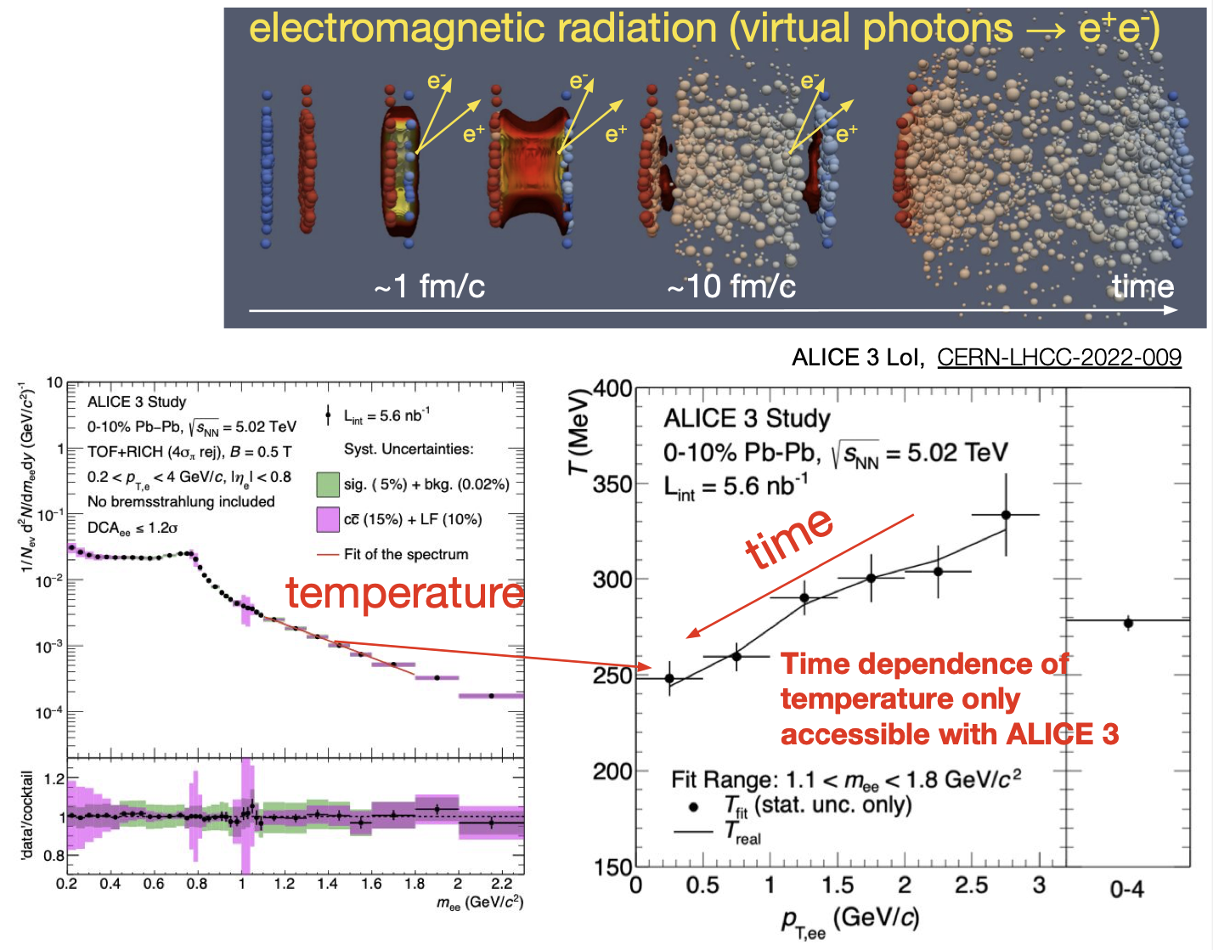
ALICE3 – Temperature evolution of QGP
Dilepton mass spectrum:
mass window dominated by the
thermal dileptons
slope of the mass spectrum
⬄ temperature
invariant mass
→ better access to T
binning in dilepton pair p_{T}
⬄ access to time
Gimmick: Precision electron identification

Slide 12
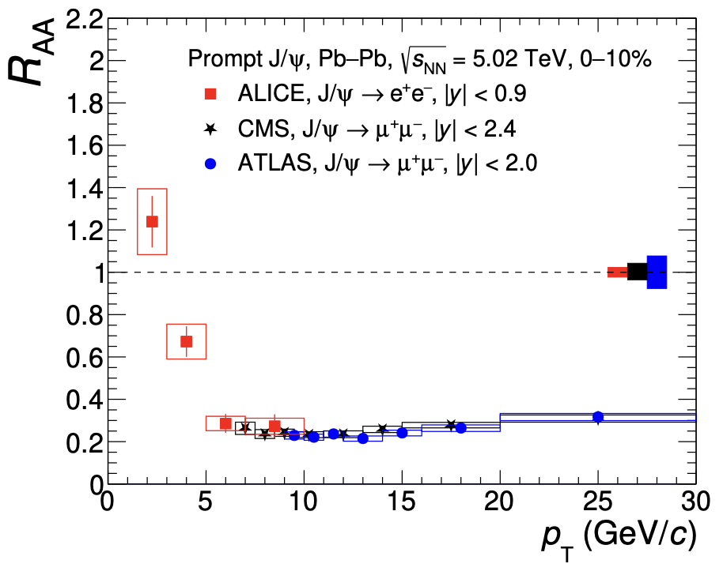
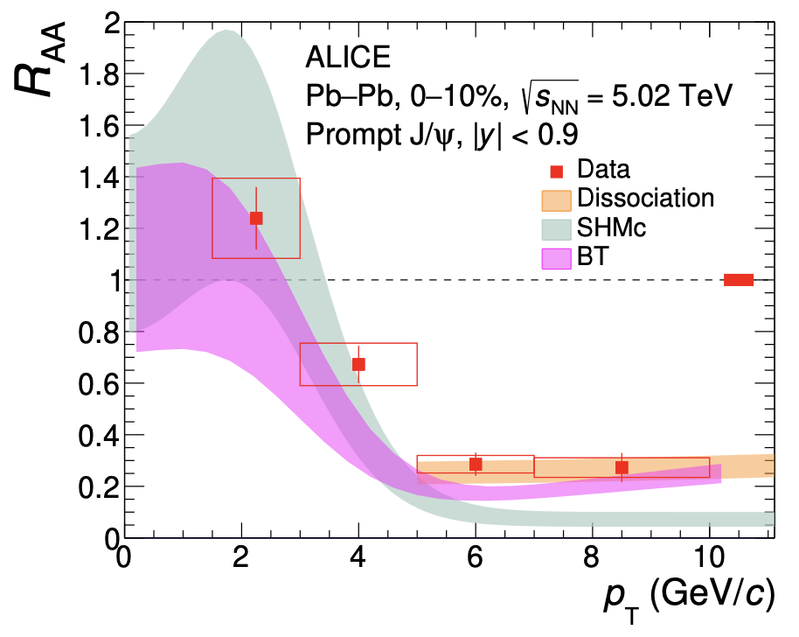
Heavy quarks at the QGP medium:
ALICE, JHEP02 (2024) 066
Dissociation = melting of bound charm states due to Debye colour screening
SHMc = statistical hadronization model with charm
BT = Boltzmann transport model, includes dissociation and regeneration in medium
These results ALICE1 → ALICE2 much better statistics

Slide 13
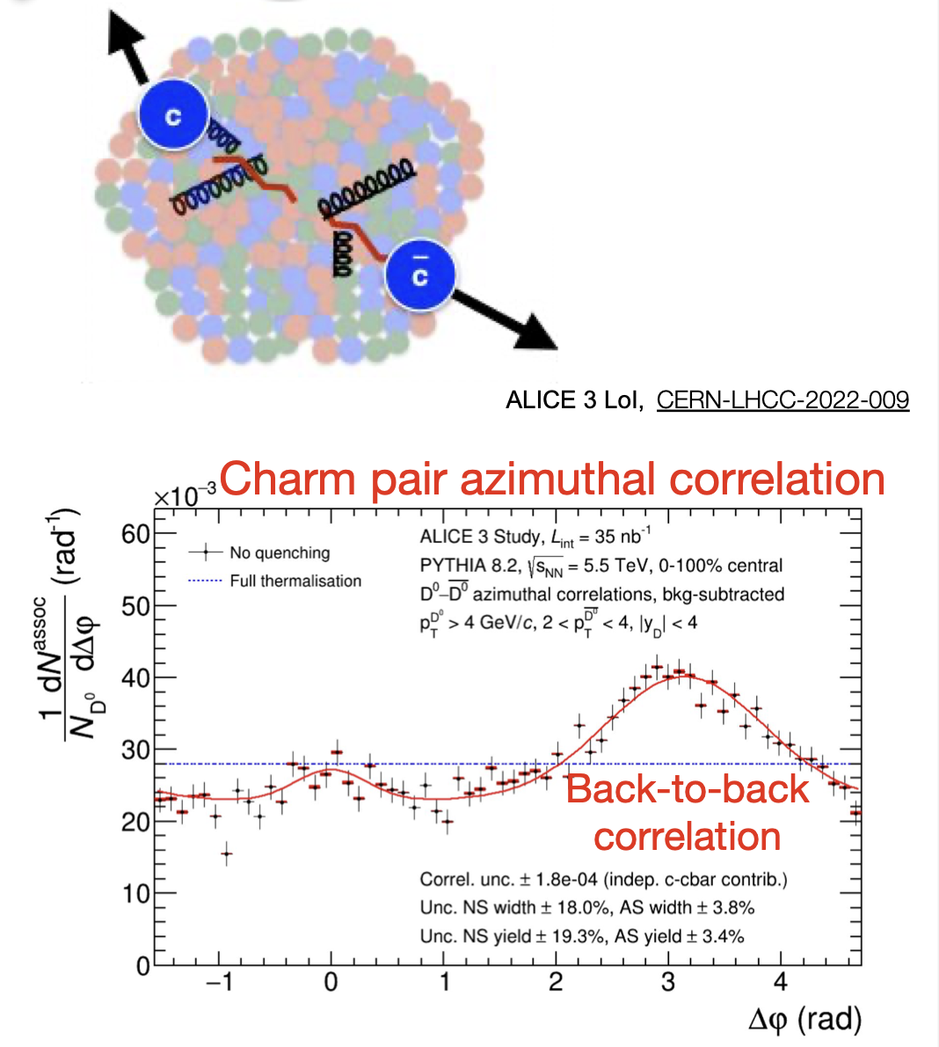
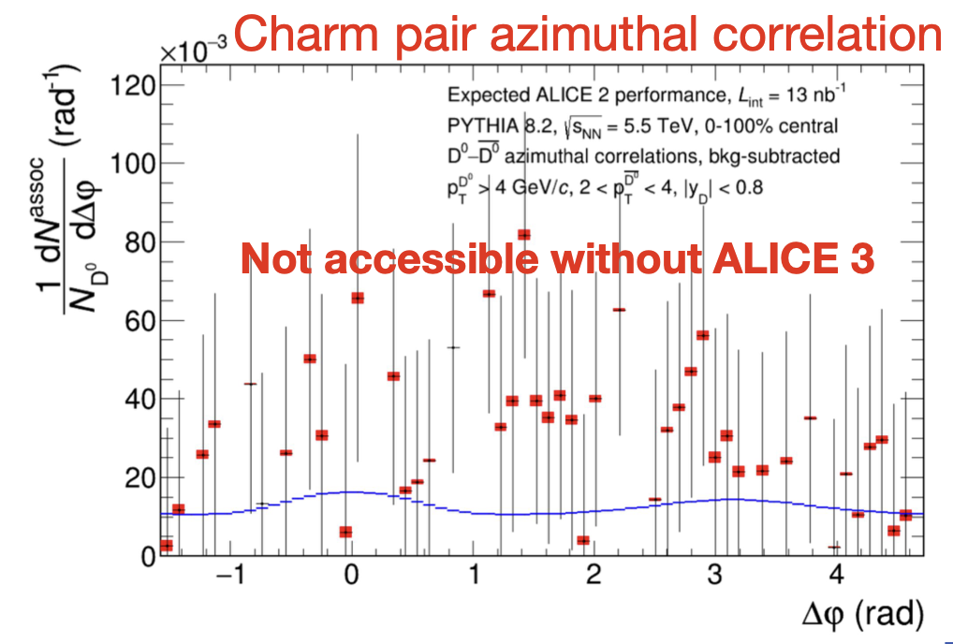
ALICE3 – two-particle correlations with charm
Charm diffusion in QGP with DD-correlations
Degree of thermalization of charm
→ Gimmick: Large acceptance, PID, high-rate
example: D⁺ → Kππ , D_{s} → KKp
ALICE
Run 3 + 4
statistics

Slide 14
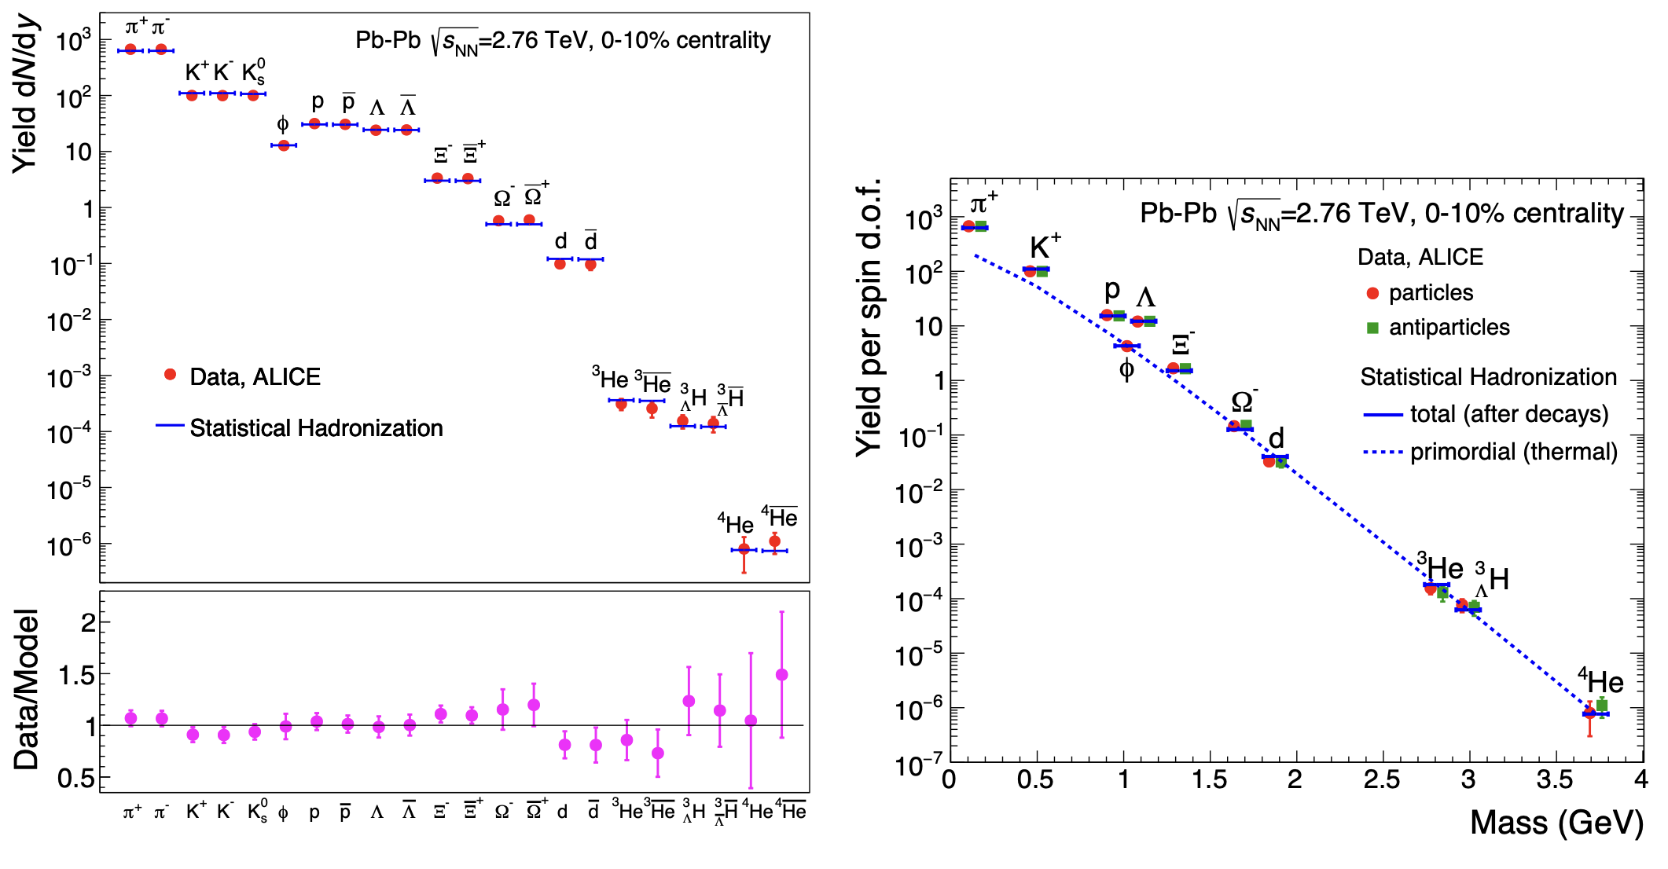
Thermal models – enhancement of heavy states:
A. Andronic, P. Braun-Munzinger, K. Redlich, J. Stachel,
Workshop proceedings, arXiv:2101.05747 [nucl-th]
Statistical hadronization model (SHM) describes observed yields well
IF charm quarks are thermalized, SHM predicts very large enhancement of multiply
charmed states compared to fragmentation based hadronization

Slide 15
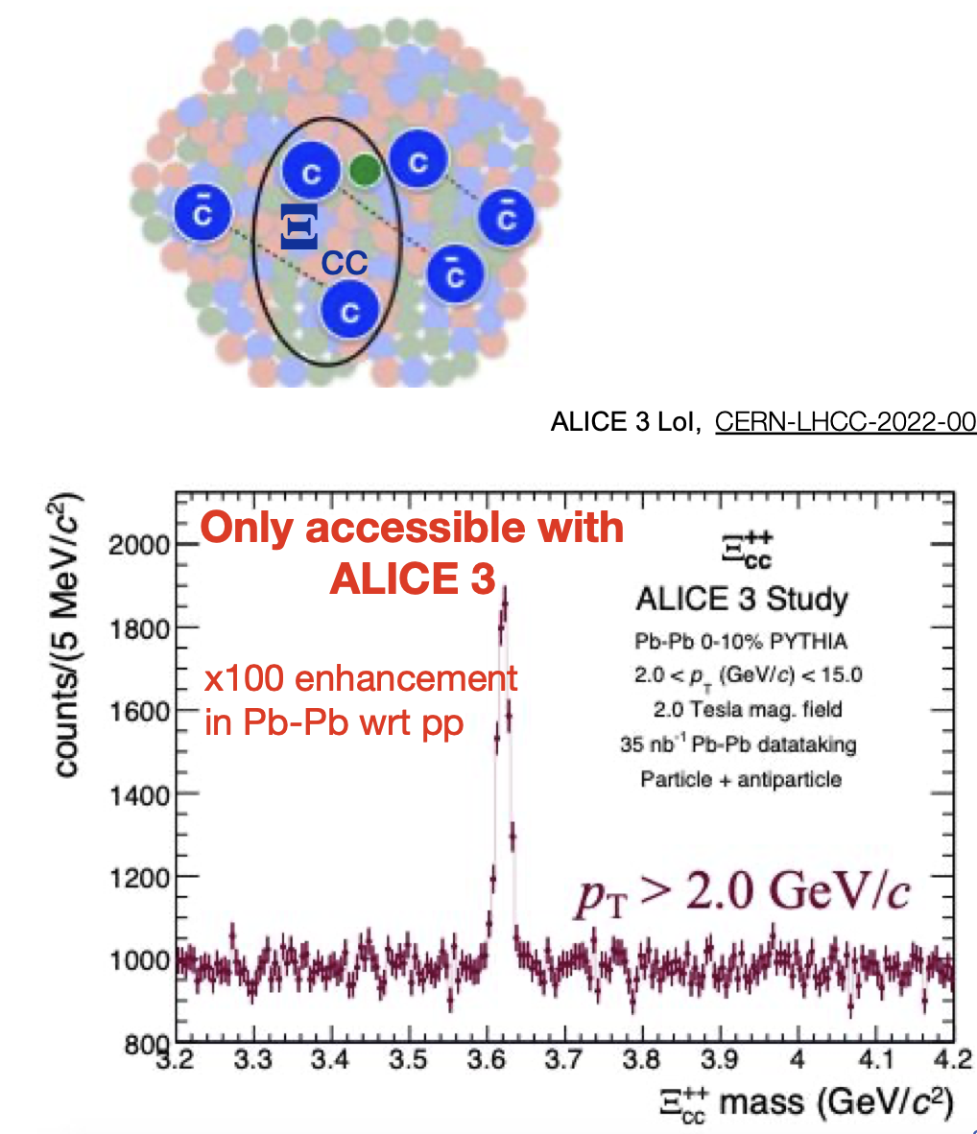
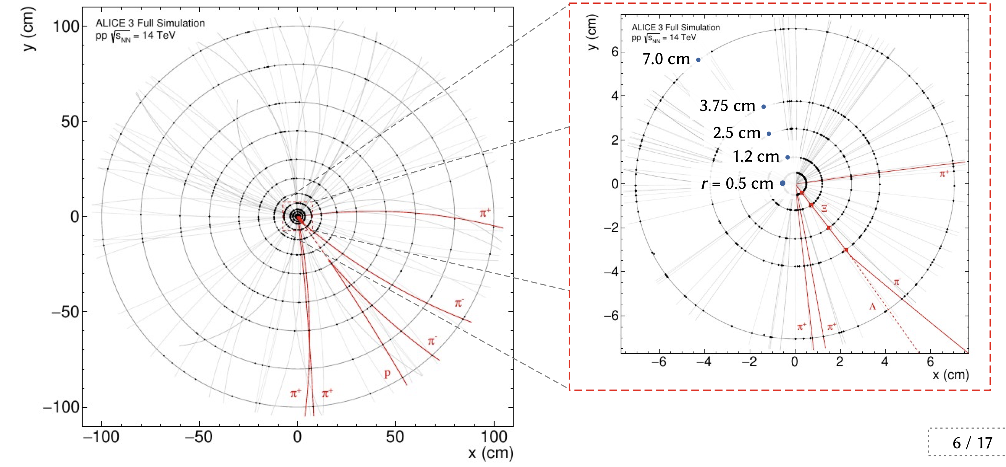
ALICE3 – studies on hadronization
Thermal models predict very large enhancements
for yields of the multi-charmed hadrons
→ Gimmick: all above + “strangeness tracking”

Slide 16
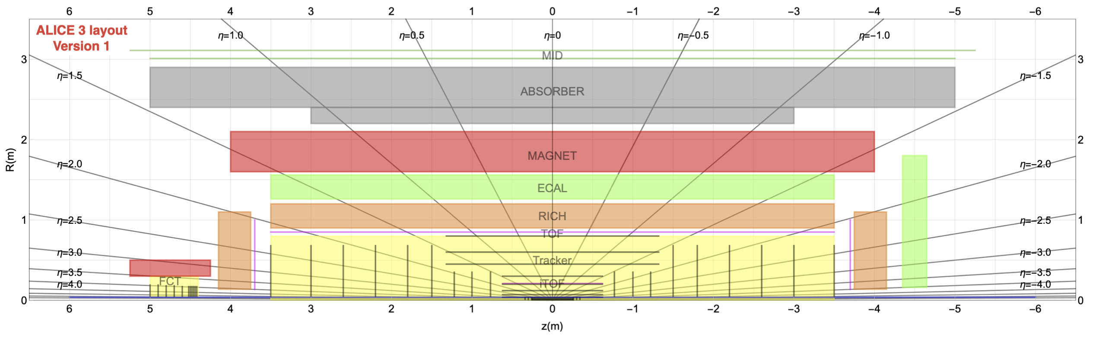
ALICE3 – a reference detector that can do it all
A large acceptance |η| < 4 and compact radius detector (length |z| < 5 m, R = 3 m)
New superconducting 2 T magnet, vertex detector inside the beam pipe
Particle identification = time of flight (TOF) + ring-imaging Cherenkov detector (RHIC)
+ electromagnetic calorimeter (ECAL) + muon identification (MID)
Fast, silicon only technology, similar readout scheme as in ALICE2
→ pp collision rate 24 MHz (up to 50x more) and Pb-Pb rate ~100 kHz (x2 up)
16

Slide 17

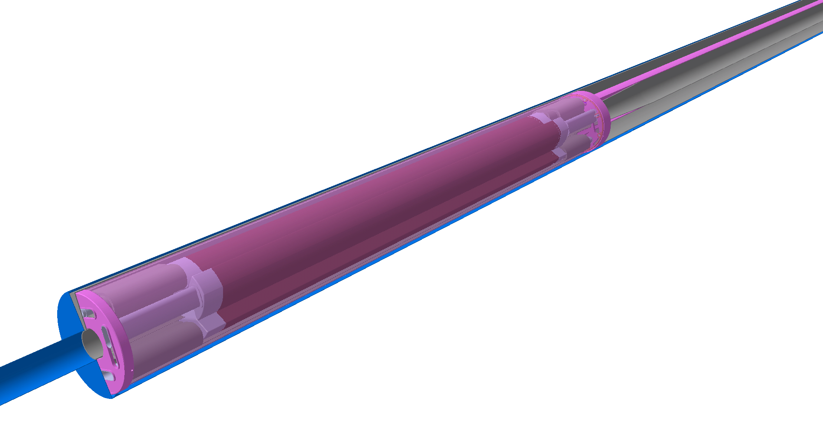

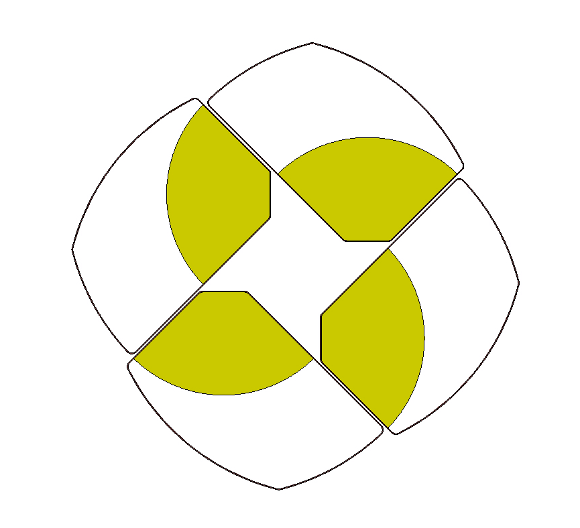


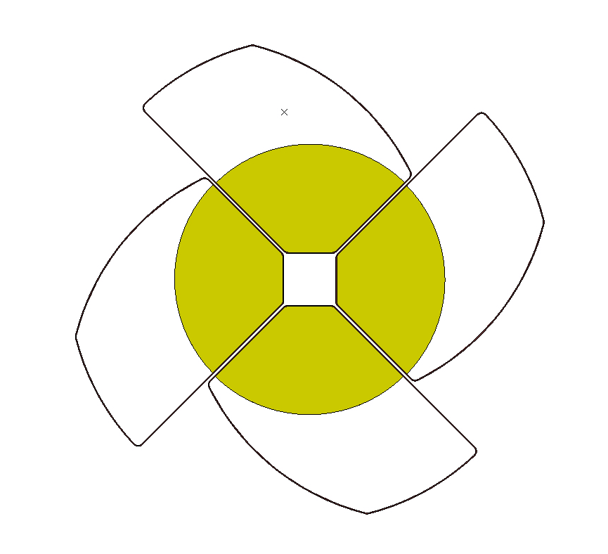
45
radius
ALICE3 – retractable vertex detector
/\/\/\/\/\/\/\
/\/\/\/\/\/\/\
/\/\/\/\/\/\/\
/\/\/\/\/\/\/\
15
Primary vacuum case
Secondary vacuum case
5
Primary vacuum case

Slide 18
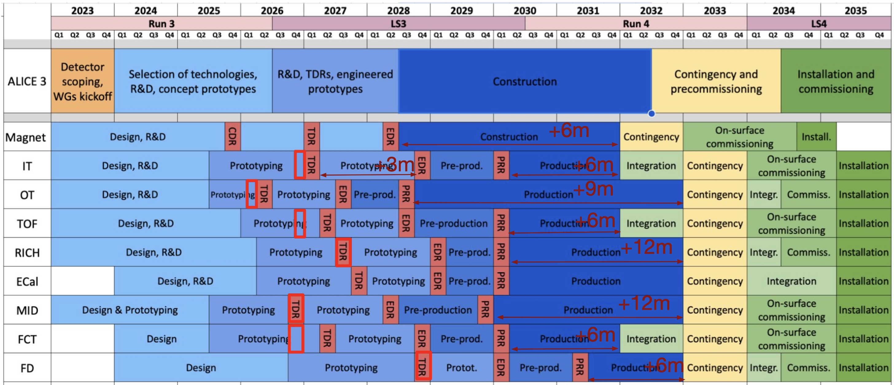
ALICE3 – current timetable of the projects

Slide 19
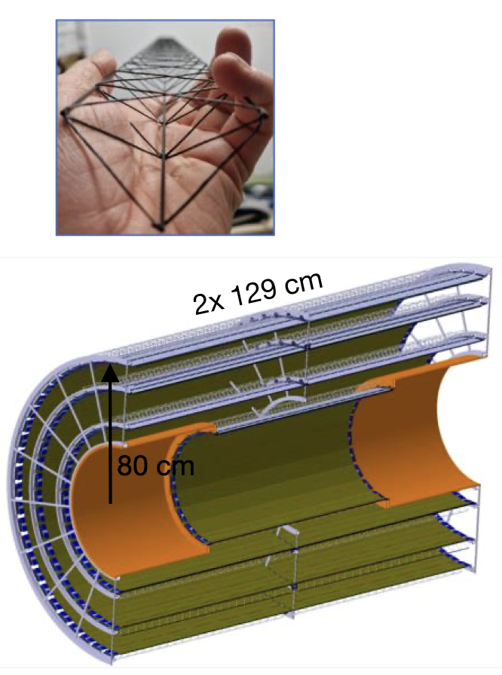
Finnish contribution to ALICE3
Outer Tracker of the new ALICE3 experiment:
ALICE3 tracking will have total of 11 layers (12 for end caps), |η| < 4
- vertex detector: 3 innermost layers inside the beam pipe
- 4 middle layers
- 4 outer tracking layers
ALICE3 Outer Tracker (OT)
- large area of ~50 m² : barrel 33 m² and disks 18 m²
- total of 10 000 OT modules, each containing 8 chips,
and each chip 60 wire bonds → 4.8 M bonds
- with an automated bonder, 3 s per wire → 4000 net hours
- 5 hour curing time for the radiation hard glue (Araldite 2011)
→ several years, if modules manufactured one-by-one
OT module production needs to be industrialized
Plan: contribute to R&D of the OT module production

Slide 20
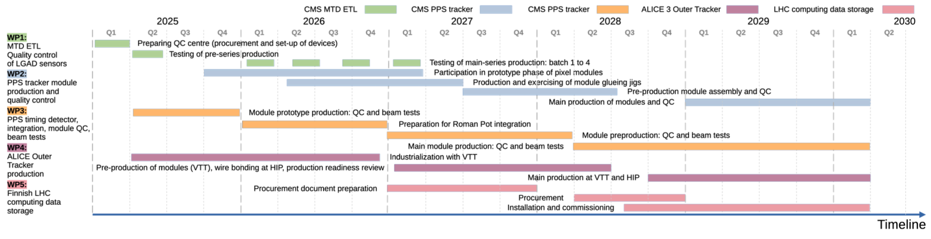
Finnish contribution to ALICE3 – where we are today?
1
ALICE3
Joint CMS-ALICE proposal to select CERN to Roadmap for Finnish research infrastructures 2025
→ decision by end of January 2025
For ALICE3, Roadmap application covers 2/3 of Finnish core contributions + our plans for the R&D
Industrialization of the Outer Tracker module production:
- Collaboration with VTT Technical Research Centre of Finland Ltd
- VTT: mass production of module production using industrial pick-and-place robots
- HIP lab: wire bonding of the tracker elements with our new automated bonder
- Inside ALICE, also Korean group works with industrialization

Slide 21
Summary:
Will we see the next generation heavy ion experiment?
We shall find out in ~2026 – hopefully even earlier:
- first parts ordered soon! – not available later
- technical design reports (TDRs) 2026-2027
- engineering design runs (EDRs) 2027-2028
- production readiness reviews (PPRs):
Outer tracker 2028
Majority of other systems 2029-2030
Forward disks 2031

Slide 22
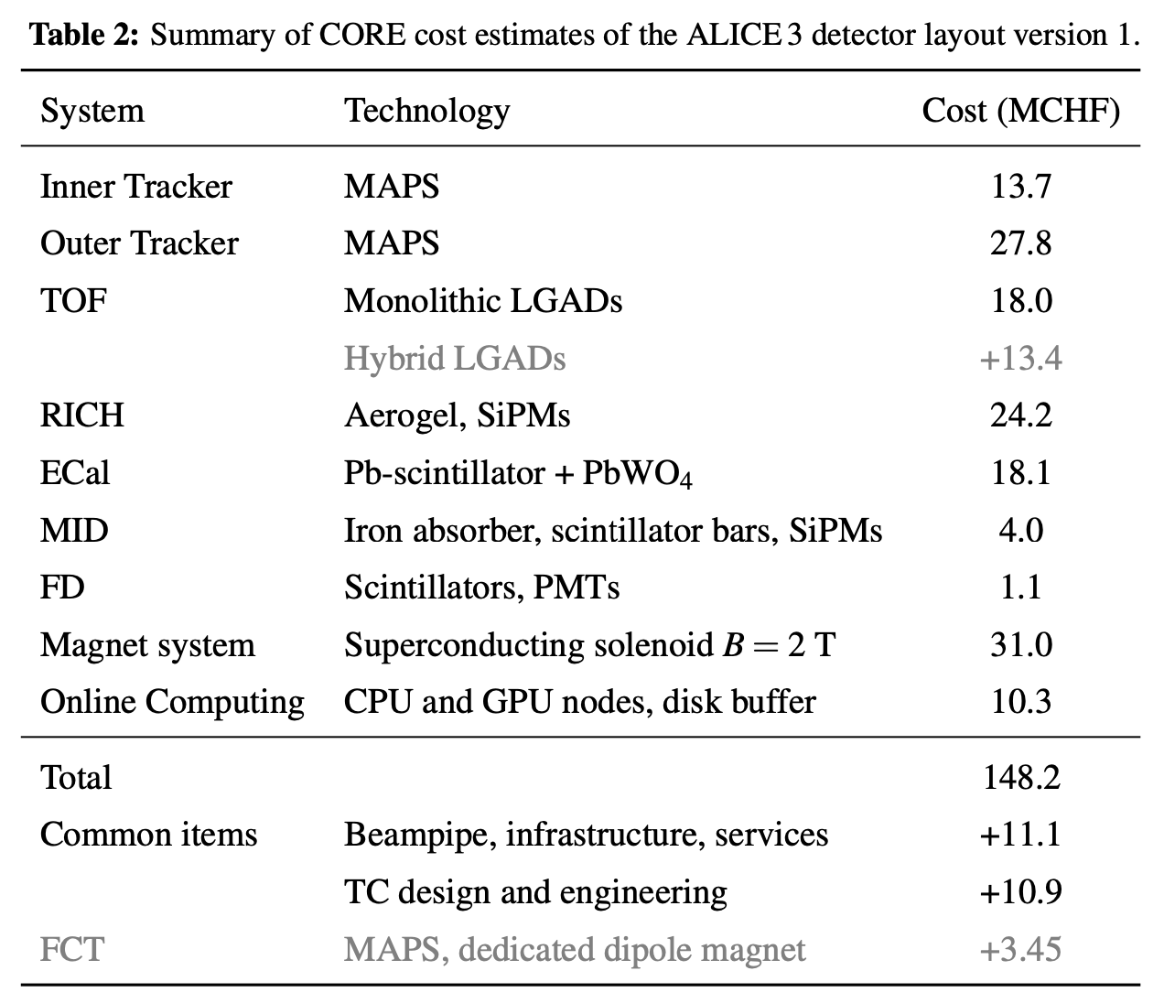
ALICE3 – what would it cost?
Default version:
Detector 149 MCHF
Common items +22 MCHF
Total > 170 MCHF
(core only)
+14 MCHF, if future R&D is not
successful and fallback needed.
+3.5 MCHF, if Forward conversion
tracker (FCT) included
+ (???) MCHF, if FoCal included
Total of 6 running years.
→ no major exp. comes cheap!

Slide 23
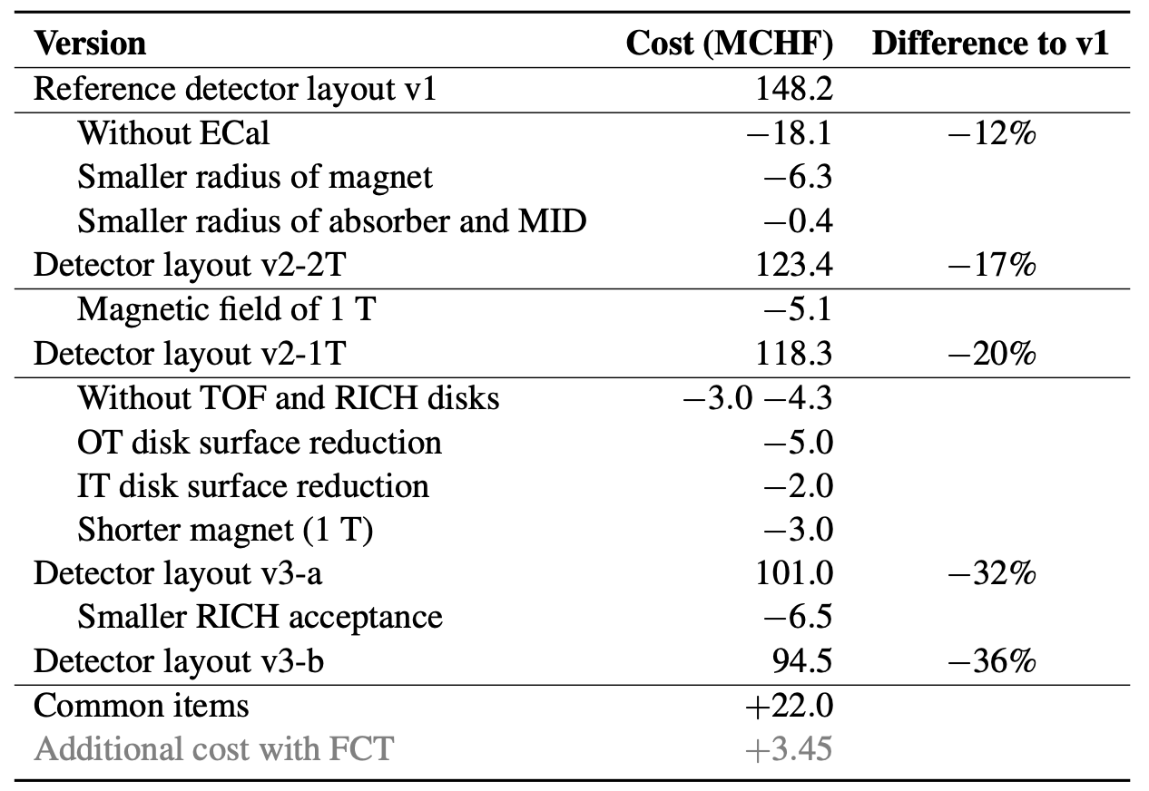
ALICE3 – descoping of the experiment
Standard procedure: prepare scenarios that are 10-30% cheaper to the LHCC.
LHCC review gives recommendations to funding agencies.
ALICE3 scoping document – public part in this link.
Reduce performance, save money:
Letter of Intent version, 149 MCHF
No electromagnetic calorimeter, 124 MCHF
Previous, and lower B-field, 119 MCHF
Even smaller B and reduce |η|, 95 MCHF
In all scenarios, +22 MCHF common items
Save money 12-36% with more and more
painful reductions on performance.
(No time to discuss details today.)

Slide 24
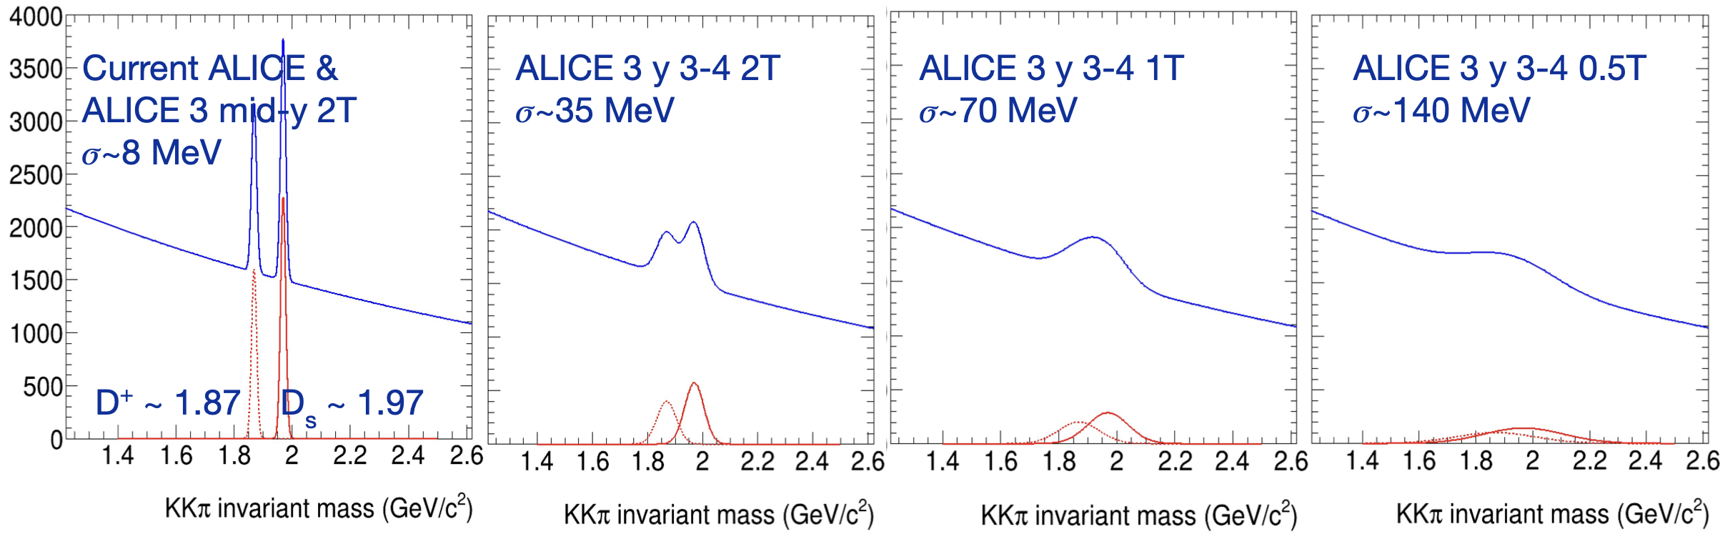
ALICE3 – descoping of the experiment
LHC experiments committee
Standard procedure: prepare scenarios that are 10-30% cheaper to the LHCC.
LHCC review gives recommendations to funding agencies.
ALICE3 scoping document – public part in this link.
Example: what if we save money by building a weaker magnet?
Mid rapidity, large field
Forward rapidity, reduce field from B = 2 T down to 0.5 T

Slide 25
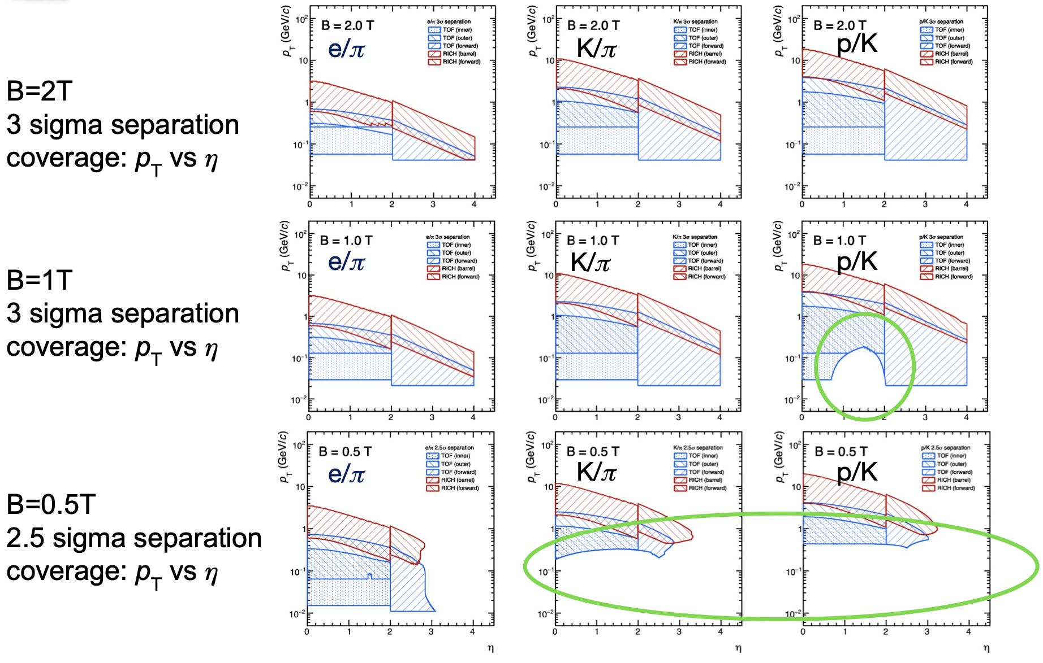
ALICE3 – what does weaker field mean for the PID?

