Slide 1
European Particle Physics Strategy update
- RECFA and DRD programs
Panja Luukka
Lappeenranta-Lahti University of Technology

Slide 2
ECFA and RECFA
ECFA - European Committee for Future Accelerators (https://ecfa.web.cern.ch/)
Membership in ECFA: all European CERN Member States and Associate Member States
Plenary ECFA
  Decides on all ECFA activities, appoints the Chairperson and Secretary, approves the final reports of the working groups and terminates their activities, decides on admission of new participating countries and observers, and makes recommendations to outside organizations.
  Appoints members for a total maximum period of six years after nomination by their country.
  Meets usually twice per year.
Restricted ECFA (RECFA)
  Composed of one member per country, appointed for at most two three-year periods.
  Assists and advises the Chair and the Secretary in the current running of ECFA, and acts as the communication channel to each participating country, its physics community and national institutes and authorities.
  Meets during country visits (4 per year), PECFA meetings and separately when needed.

Slide 3
RECFA and ECFA activities in short
Country visits to CERN Member States and Associate Member States (RECFA members).
On these visits RECFA prepares a report to the main funding agency (e.g., ministry).
  opportunity to report concerns expressed by the local community.
RECFA puts together
  ECFA Detector Panel
  ECFA Early-Career Researchers Panel
  ECFA Study on Higgs / EW / Top factories
  ECFA Training Panel
  Joint ECFA-NuPECC-APPEC (JENAA) activities.
Earlier ECFA Detector R&D Roadmap
Now working on European Particle Physics Strategy 2026.

Slide 4
From the 2020 Update of the European Strategy for Particle Physics:
"Coordination of R&D activities is critical to maximise the scientific outcomes of these activities and to make the most efficient use of resources; as such, there is a clear need to strengthen existing R&D collaborative structures, and to create new ones, to address future experimental challenges of the field beyond the HL-LHC. Organised by ECFA, a roadmap should be developed by the community to balance the detector R&D efforts in Europe, taking into account progress with emerging technologies in adjacent fields. The roadmap should identify and describe a diversified detector R&D portfolio that has the largest potential to enhance the performance of the particle physics programme in the near and long term. This community roadmap could, for example, identify the grand challenges that will guide the R&D process on the medium-and long-term timescales, and define technology nodes broad enough to be used as the basis for creating R&D platforms. This will allow concerted and efficient actions on the international scale addressing the technological challenges of future experiments while fostering an environment that stimulates innovation and collaboration with industry.”

Slide 5
ECFA Detector R&D Roadmap
The European Strategy for Particle Physics stressed the importance of a strong focus on instrumentation, and the 2020 Update mandated the European Committee for Future Accelerators (ECFA) to develop a roadmap for detector R&D with the goal to maximise the performance of the European near and long-term particle physics programme.
Under the oversight of ECFA, the process towards a roadmap was organised by the ECFA Roadmap Panel, composed of a coordination group and 9 Task Forces, 6 addressing technology areas (gaseous, liquid and solid detectors, photo-detector and particle ID, and calorimeters) and 3 addressing cross-cutting topics (electronics, integration, and training),

Slide 6
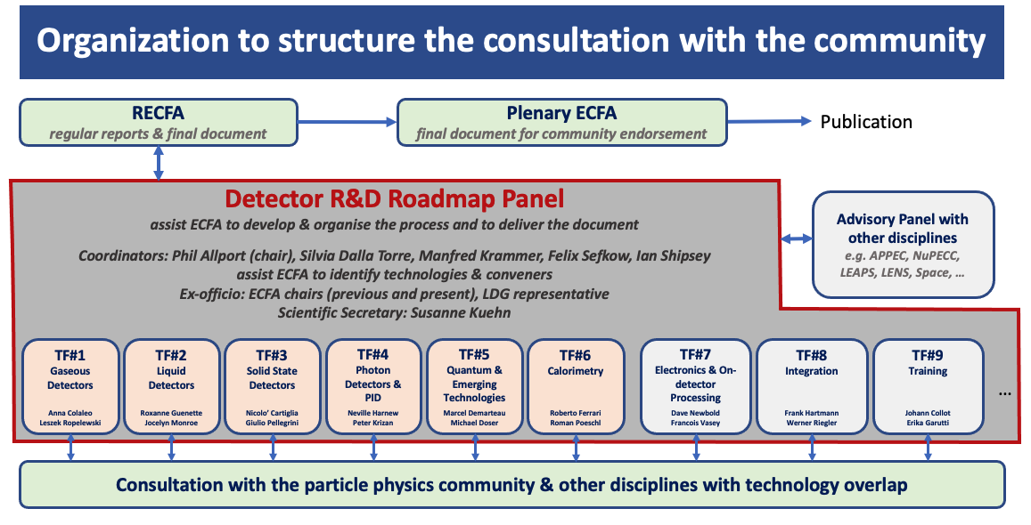
ECFA Detector R&D Roadmap
After the publication of the ECFA Detector R&D Roadmap, CERN Council requested ECFA to develop the plan for its implementation.
The document approved by the SPC and CERN Council in September 2022 can be found at https://indico.cern.ch/event/1197445/contributions/5034860/attachments/2517863/4329123/spc-e-1190-c-e-3679-Implementation_Detector_Roadmap.pdf.

Slide 7
ECFA Detector R&D Roadmap
The implementation of the roadmap rests on two pillars: the establishment of Detector R&D (DRD) Collaborations along the DRDTs (Detector R&D Themes), anchored at CERN, and dedicated measures for the implementation of the GSRs (General Strategic Requirements).
Commitments of National Funding Agencies will be sought in an MoU signature process throughout 2024.
  This is currently ongoing for the DRD collaborations.
This process shows that the high-energy particle physics community is well advanced and capable of uniting behind visons for large and long-term future projects.
The increasing time scales, complexities and technological challenges of future experiments demand a high degree of coherence and strategic resource allocation also in the field of detectors.
Coherence and strategic vision are particularly important in strengthening the co-operation and co-innovation with industrial partners.
Intensified cooperation with industry will both help maintaining the leading role of European particle physics and enhance the competitiveness of European high-tech industries

Slide 8
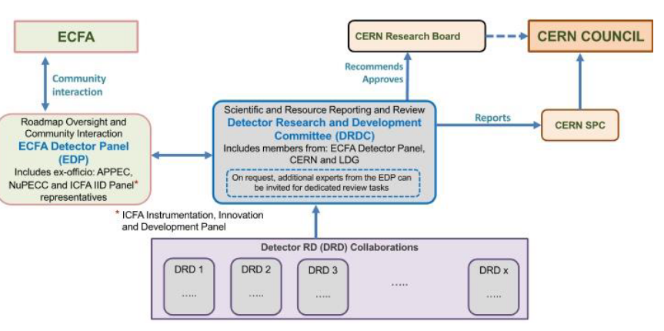
DRD Collaborations
CERN will host the DRD Collaborations.
Interaction between DRD collaborations and committees implemented through DRDC.
Interface to ECFA via ECFA Detector panel: https://ecfa-dp.desy.de
Approval of first DRD collaborations was in December 2023 RB.
Once approved, DRD collaborations started in 2024.
Collaborations have had kick-off meetings, elected management positions etc.
Currently they are setting up MoU and collecting signatures from Funding Agencies.
Finland participating to several of the DRDs.

Slide 9
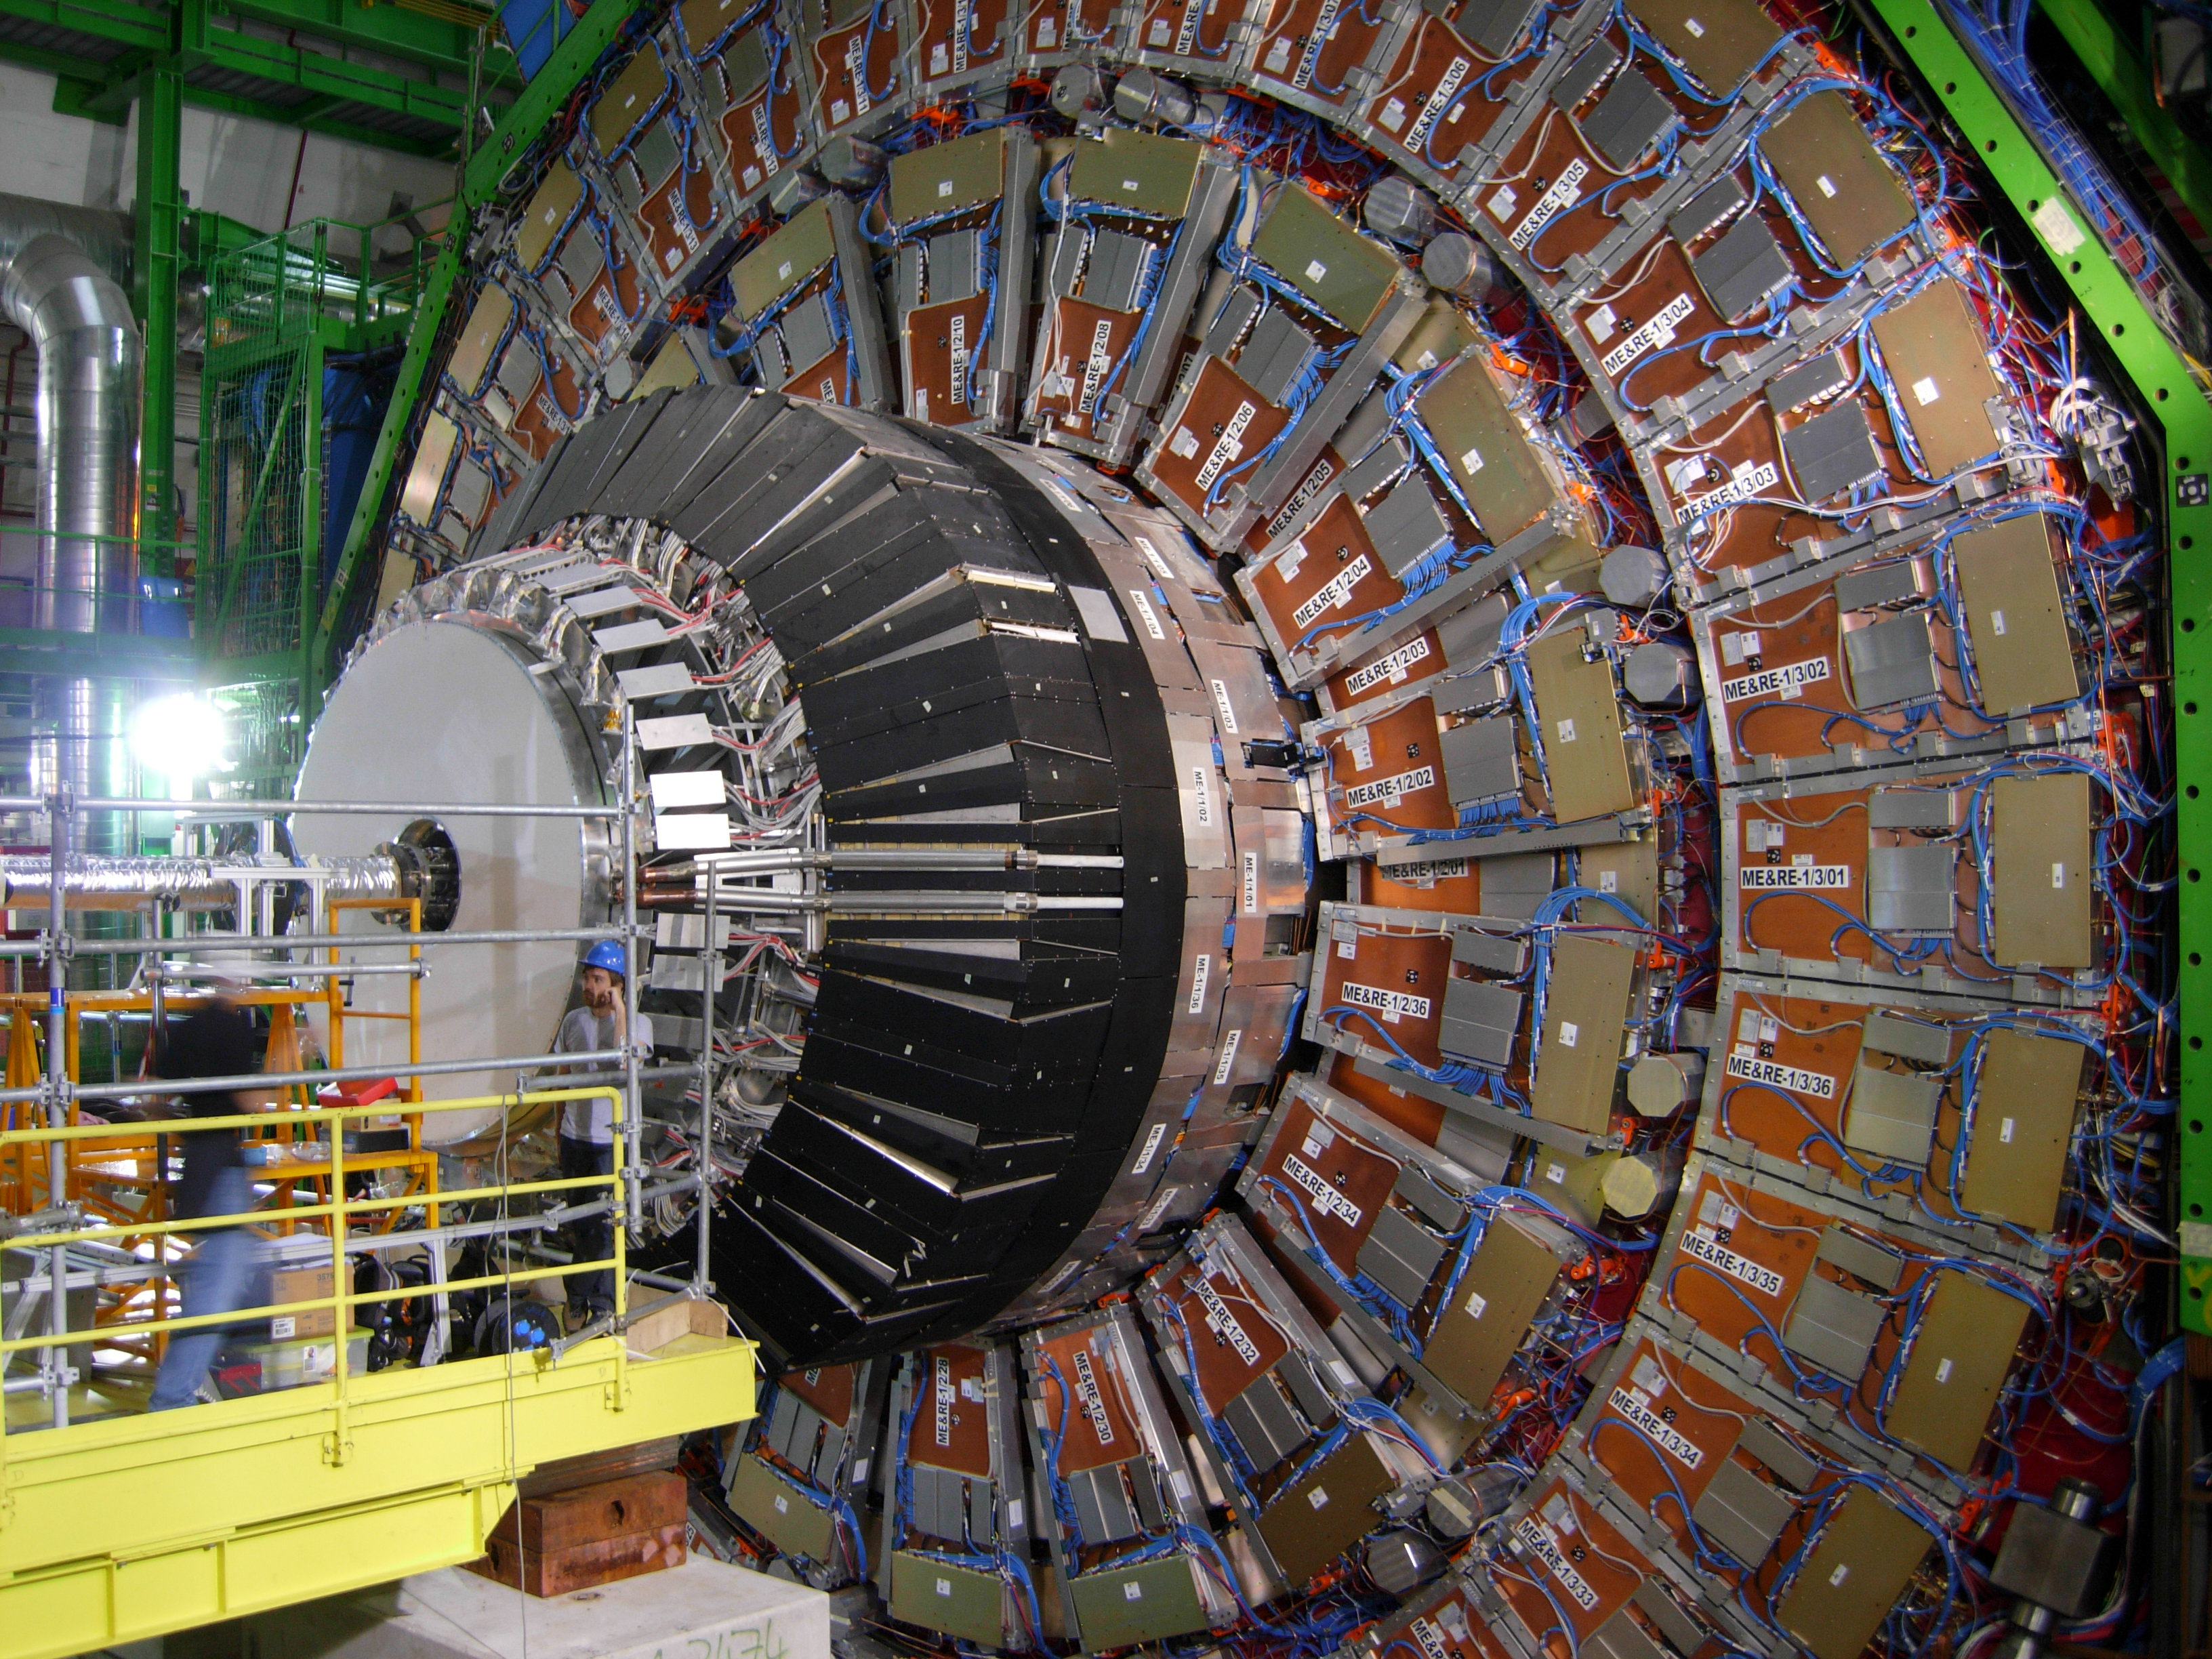
DRD Collaborations
DRD1: Gaseous Detectors
DRD2: Liquid Detectors
DRD3: Semiconductor Detectors
DRD4: Photodetectors & Particle ID
DRD5: Quantum Sensors
DRD6: Calorimetry
DRD7: Electronics
DRD8: Integration

Slide 10
General Strategic Recommendations
GSR 1: Supporting R&D facilities (test beams, large-scale generic prototyping and irradiation)
GSR 2: Engineering support for detector R&D
GSR 3: Specific software for instrumentation
GSR 4: International coordination and organisation of R&D activities
GSR 5: Distributed R&D activities with centralised facilities
GSR 6: Establish long-term strategic funding programmes
GSR 7: “Blue-sky” R&D
GSR 8: Attract, nurture, recognise and sustain the careers of R&D experts
GSR 9: Industrial partnerships
GSR 10: Open Science

Slide 11
European Strategy for Particle Physics
2006
First defined in 2006.
2013
Update in 2013 included the HL-LHC decision.
2020
Update in 2020 brought important decisions for post-HL-LHC times.
2026
In 2026 there will be the next update, for which input proposals are prepared by spring 2025.

Slide 12
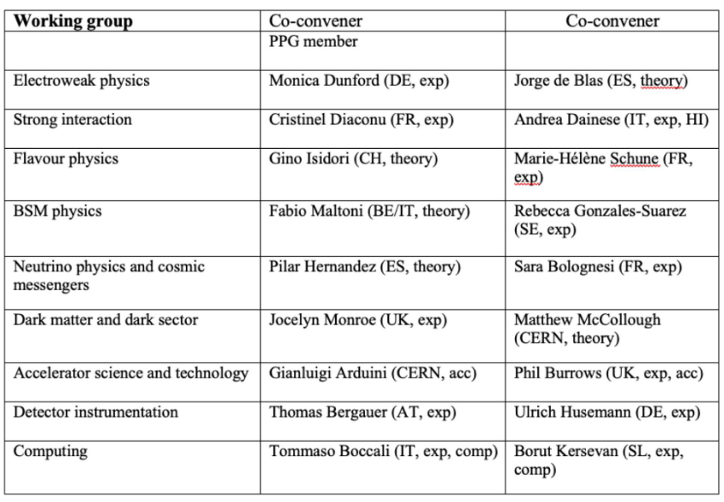
European strategy for particle physics
Charge to WG conveners:
Selection of Early Career Scientists.
Definition of sub-topics and appointment of additional WG members.
Definition of Benchmark processes.
Organisation of WG meetings.
Writing the Physics Briefing Book (supported by Roger Forty, Scientific Secretary of the Strategy update).
10 European countries and CERN represented; 12 men, 6 women; 13 experiment, 5 theory

Slide 13
ESPP: national inputs
A major component of the overall community input to the ESPP are the national inputs, which will be collected individually by each country (and in some cases by regions).
  ECFA guidelines for forming the inputs: https://ecfa.web.cern.ch/ecfa-guidelines-collecting-input-european-high-energy-physics-community-2026-update-european
National inputs to the ESPP update can be sent at different points in time:
  Prior to the March 31, 2025, deadline for submission of inputs to the ESPP;
  After the March 31, 2025, deadline but prior to the Symposium; Deadline: May 26 2025.
  After the Briefing Book is publicly available, in time for the Strategy drafting session on Dec 1-5 2025.
  Final deadline for submissions for full consideration by the latter: Nov 14, 2025.

Slide 14
a few thoughts on ESPP from paris Sphicas (RECFA CHAIR)
This time, we must, i.e., we absolutely must, converge on a crystal-clear, unambiguous choice for the next collider at CERN – with the widest possible consensus.
And then, we should converge on a clear path to the future.
There is no room for disagreements after we converge on a strategy.
The fastest way to getting no new collider is non-convergence of the community on one choice that we will all back.
There is no room for delaying the choice either. The timescales involved are such that we must start now.
Because it takes a minimum of ~20 years to get a new machine
And because our junior colleagues need a vision!

