Slide 1


News from ALICE at the start of Run 3
Yury Melikyan
Helsinki Institute of Physics
Particle Physics Day 2022 | November 24th, 2022

Slide 2
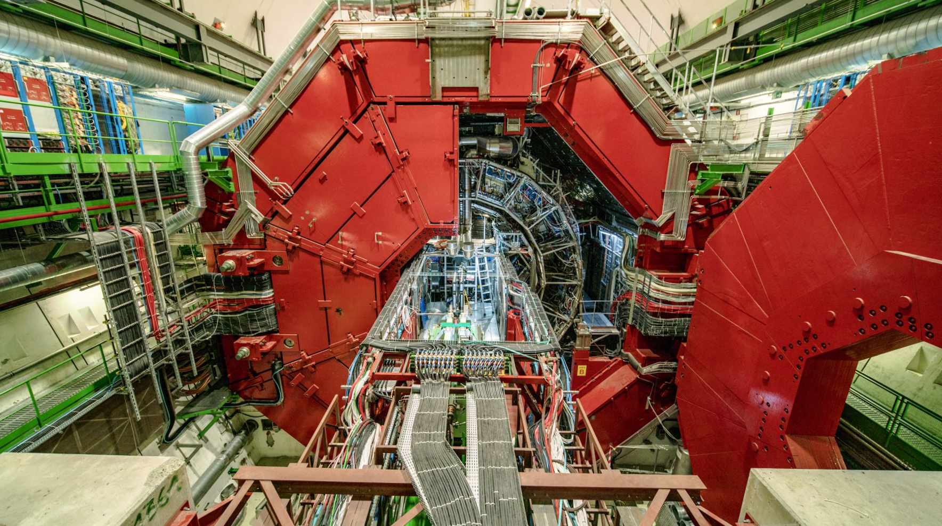
One year ago: ALICE magnet doors were closed upon the end of LS2

Slide 3
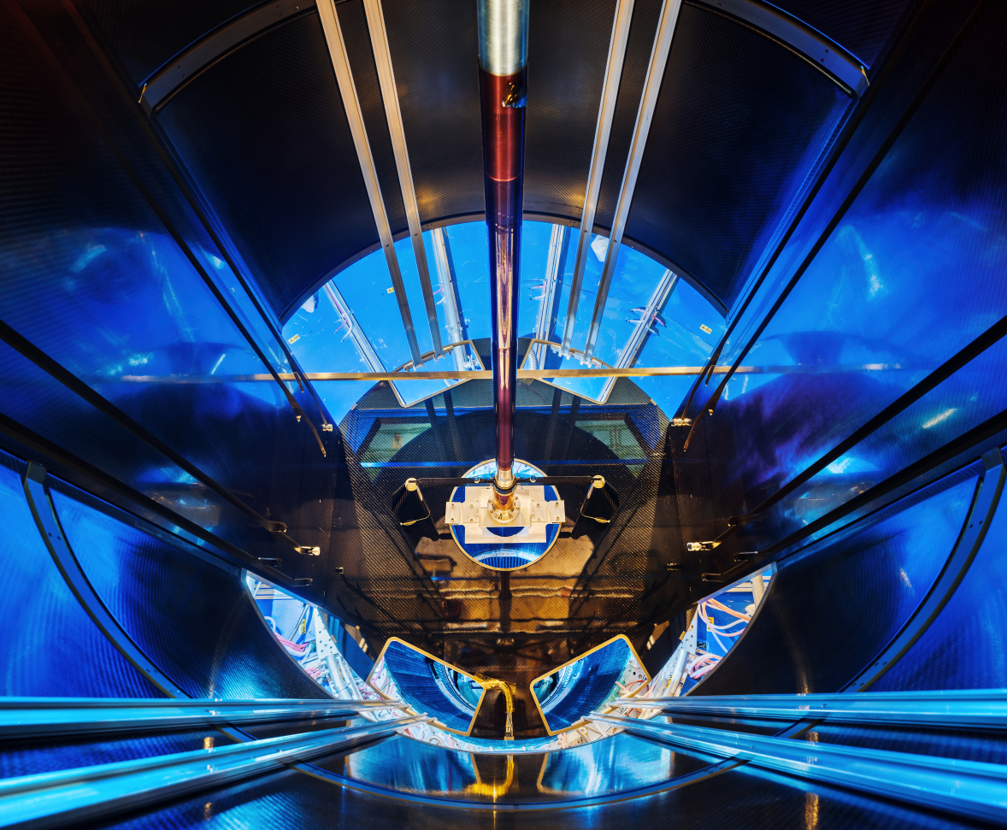
Brand new hardware of the upgraded ALICE
New beampipe;
  Ø36.4 mm (!) | 0.8 mm-thick | 870 mm-long beryllium section

Slide 4
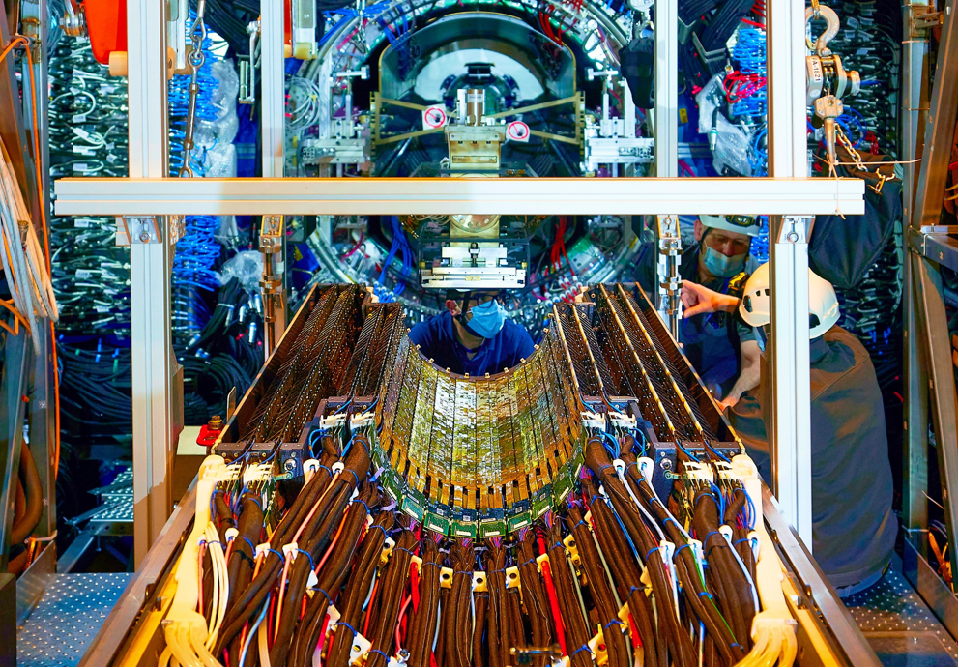
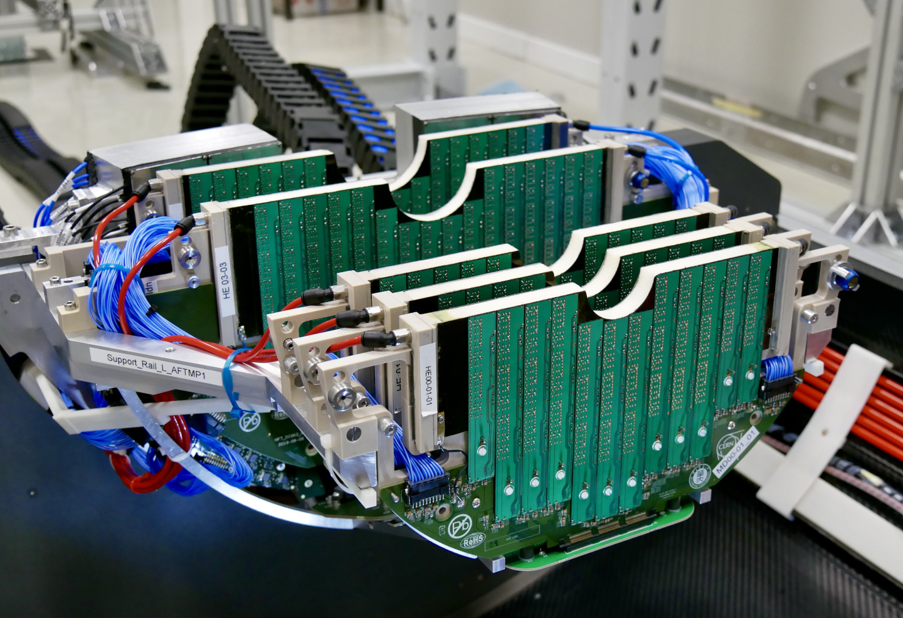
Brand new hardware of the upgraded ALICE
New beampipe;
  Ø36.4 mm (!) | 0.8 mm-thick | 870 mm-long beryllium section
New Inner Tracker System + Muon Forward Tracker
  10 m² active area – largest pixel detector ever built!
  12.5+0.5 Gpixel “high-speed camera” with ultra-low
  material budget.
MFT schematic
ITS schematic
ITS outer barrel
MFT bottom half

Slide 5
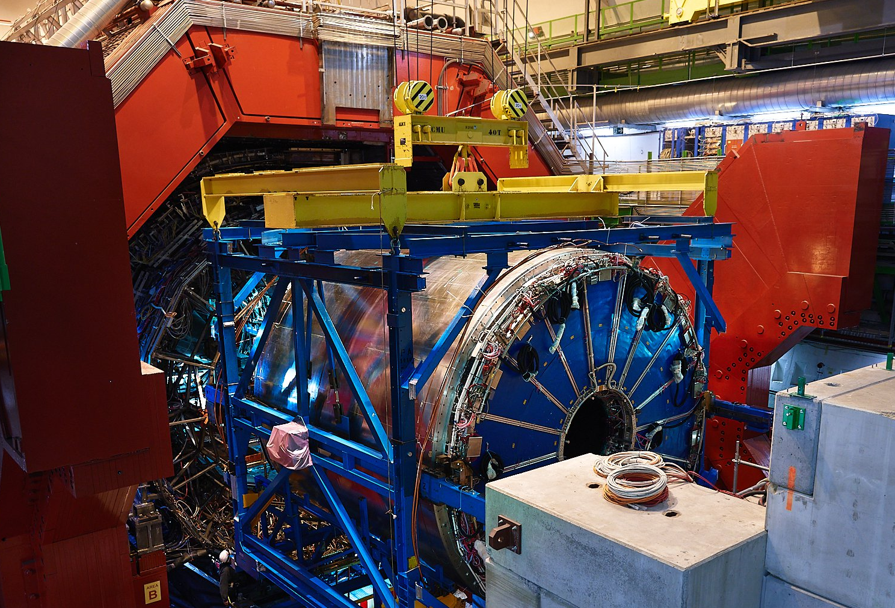
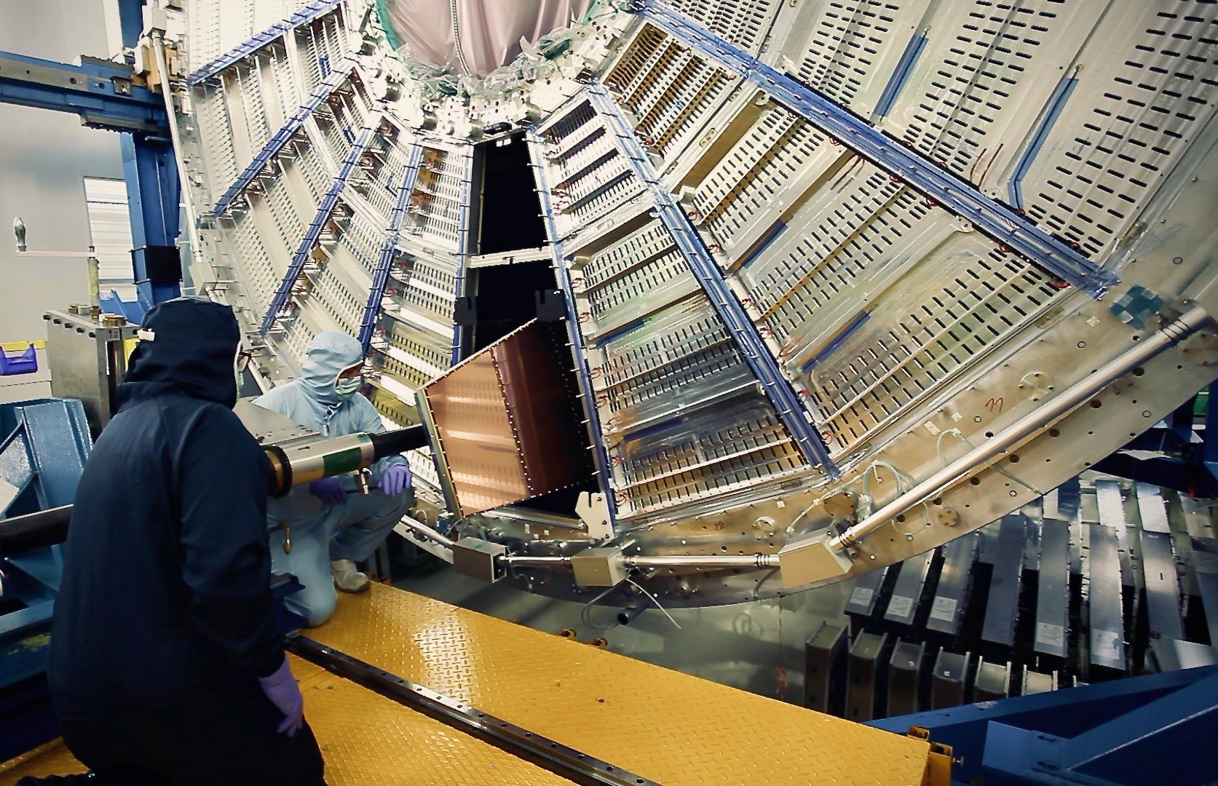
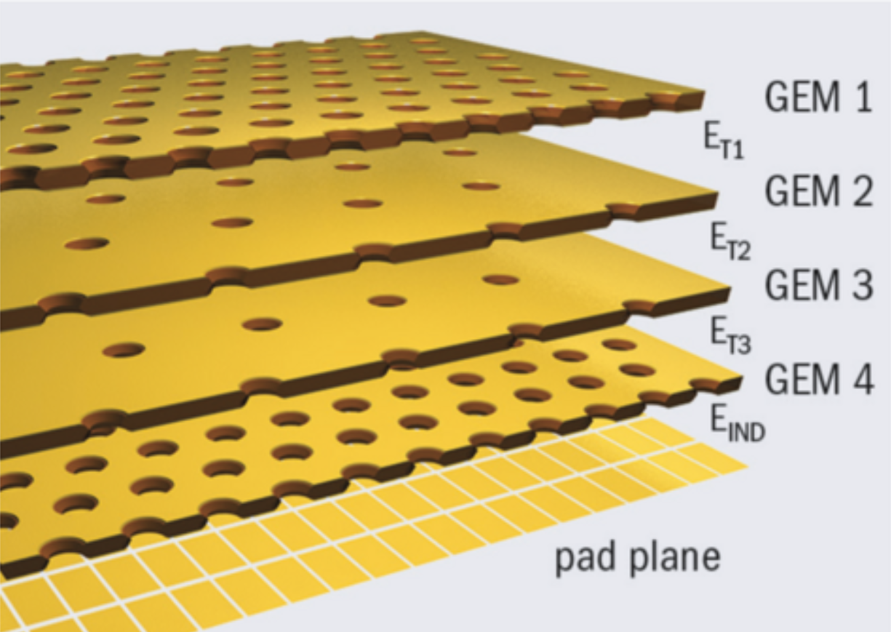
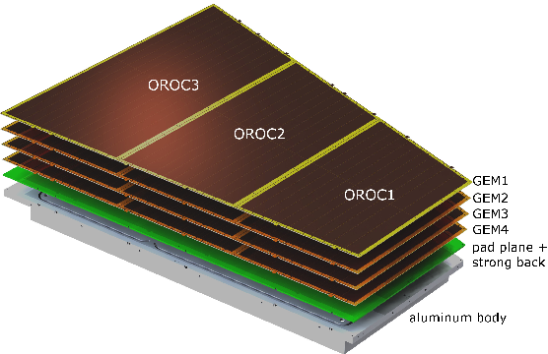
Brand new hardware of the upgraded ALICE
New beampipe;
  Ø36.4 mm (!) | 0.8 mm-thick | 870 mm-long beryllium section
New Inner Tracker System + Muon Forward Tracker
  10 m² active area – largest pixel detector ever built!
  12.5+0.5 Gpixel “high-speed camera” with ultra-low
  material budget
New Gaseous Electron Multipliers-based TPC readout
  x100 increase in signal rate w.r.t. the old MWPC readout;
  88 m³ gas volume | 4x32 m² GEM active area | 524k readout channels;
  largest GEM-based TPC ever built.
TPC being inserted to L3
Readout module installation to the TPC
Structure of GEMs custom for ALICE TPC
TPC readout module

Slide 6
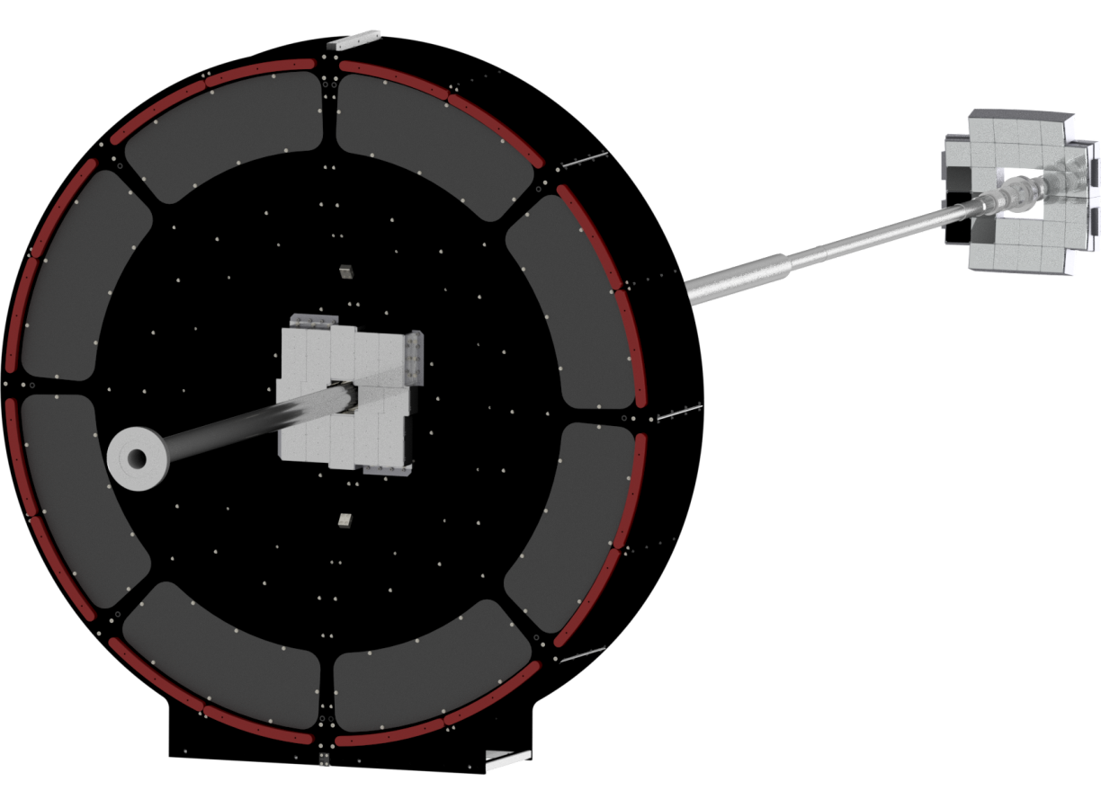
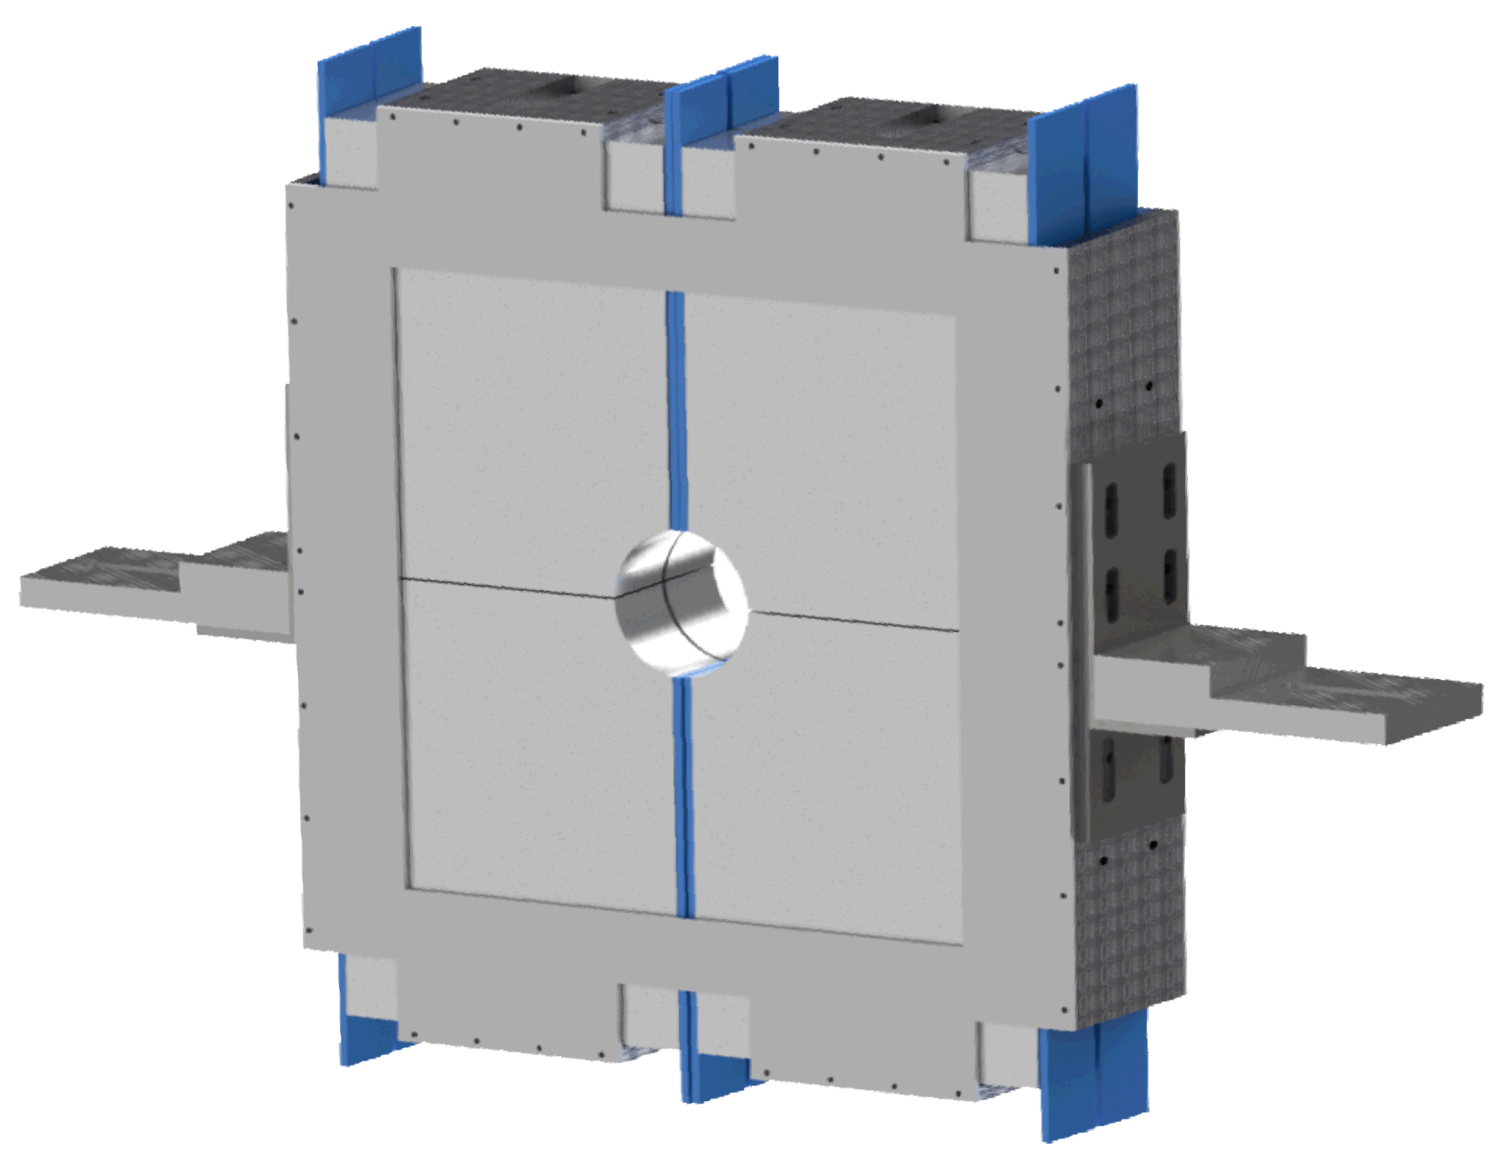
Brand new hardware of the upgraded ALICE
New Fast Interaction trigger detector!
  Real-time trigger;
  Precise time-zero detector;
  Centrality & event plane detector;
  Key ALICE luminometer;
  Key tool for diffractive physics.
FV0
2.2 < η < 5.1
3 m from IP
FDD-C
-7.0 < η < -4.9
-20 m from IP
FT0-C
-3.3 < η < -2.1
-1 m from IP
FT0-A
3.5 < η < 4.9
3 m from IP
FDD-A
4.8 < η < 6.3
17 m from IP

Slide 7
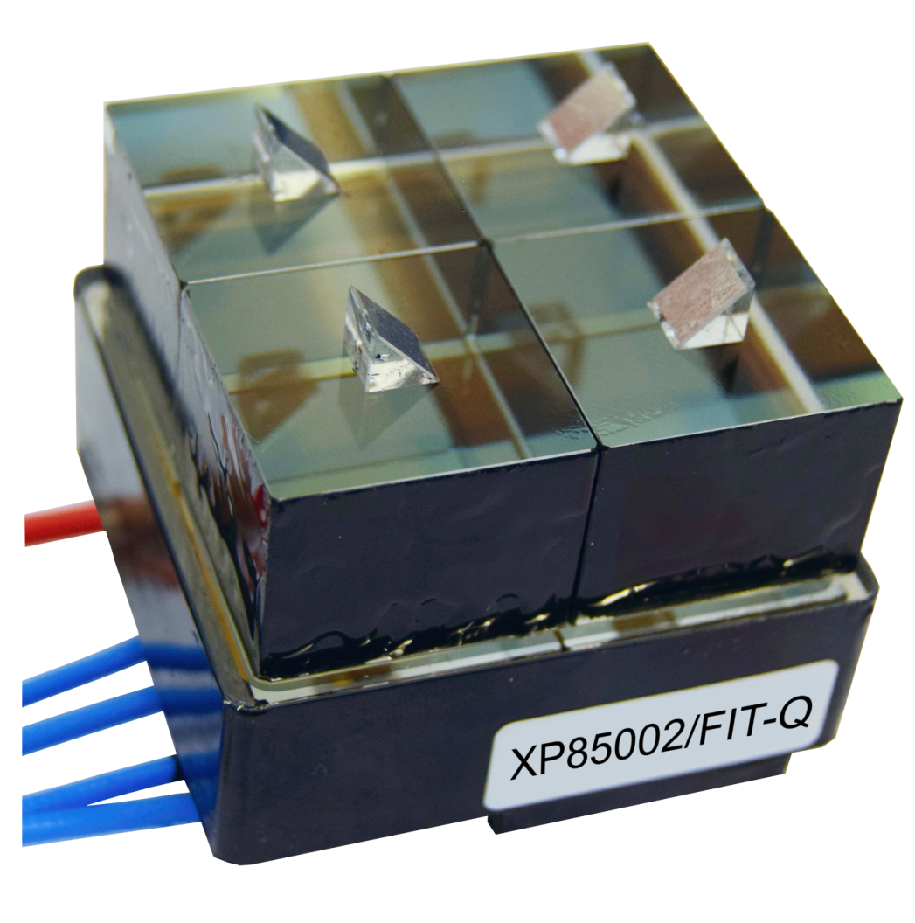
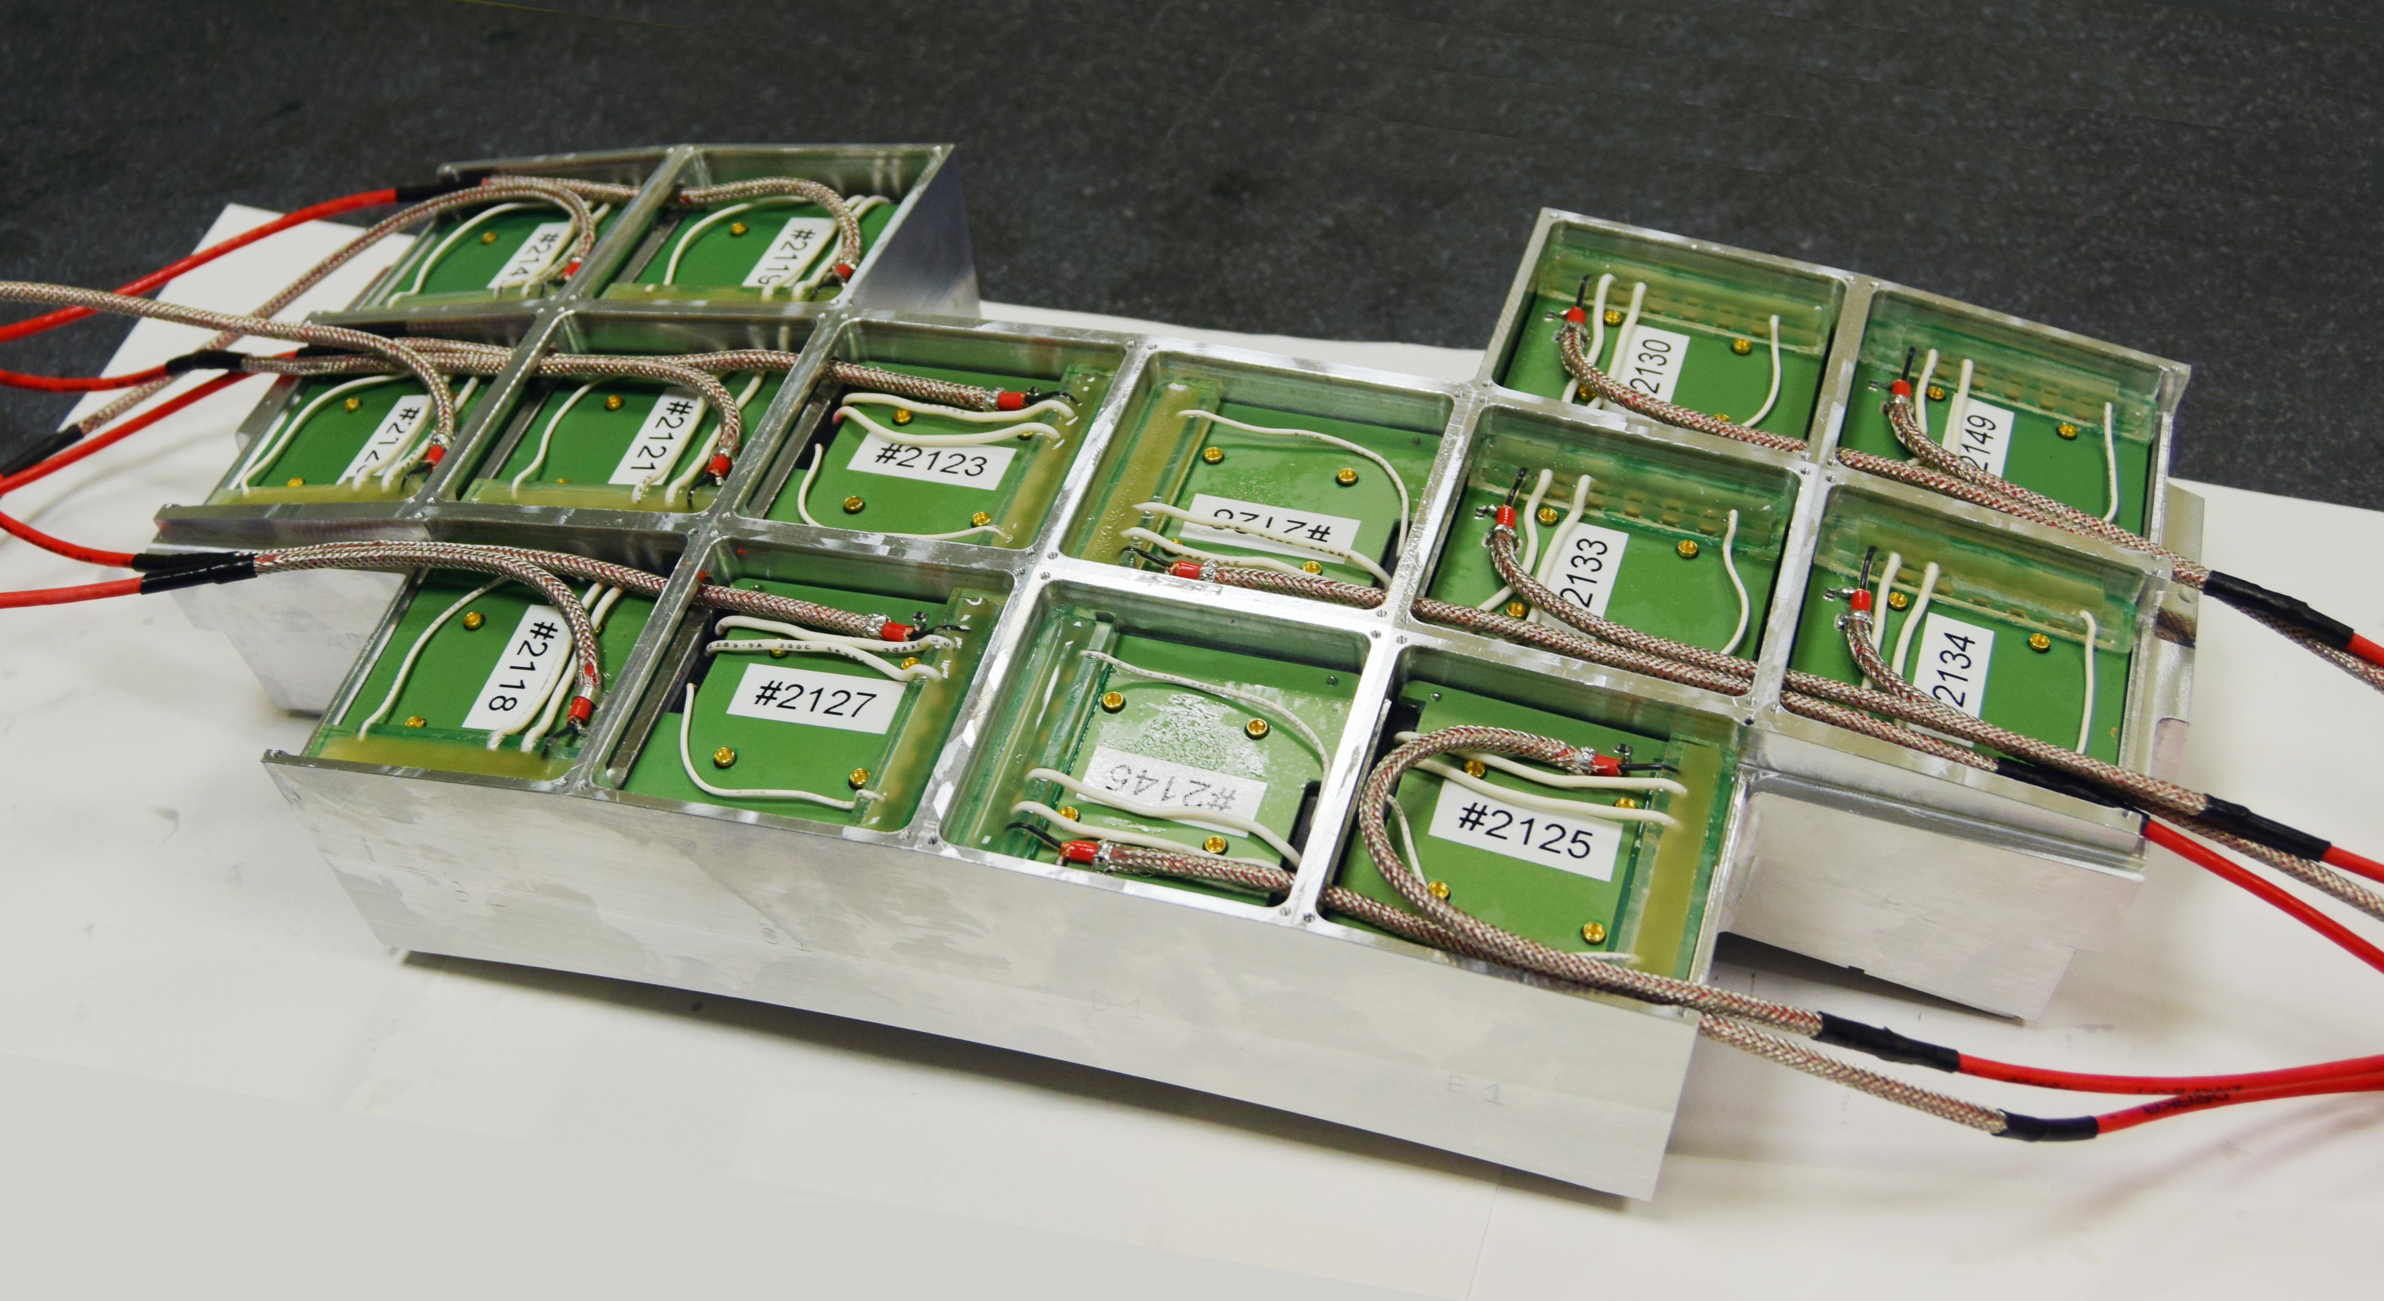
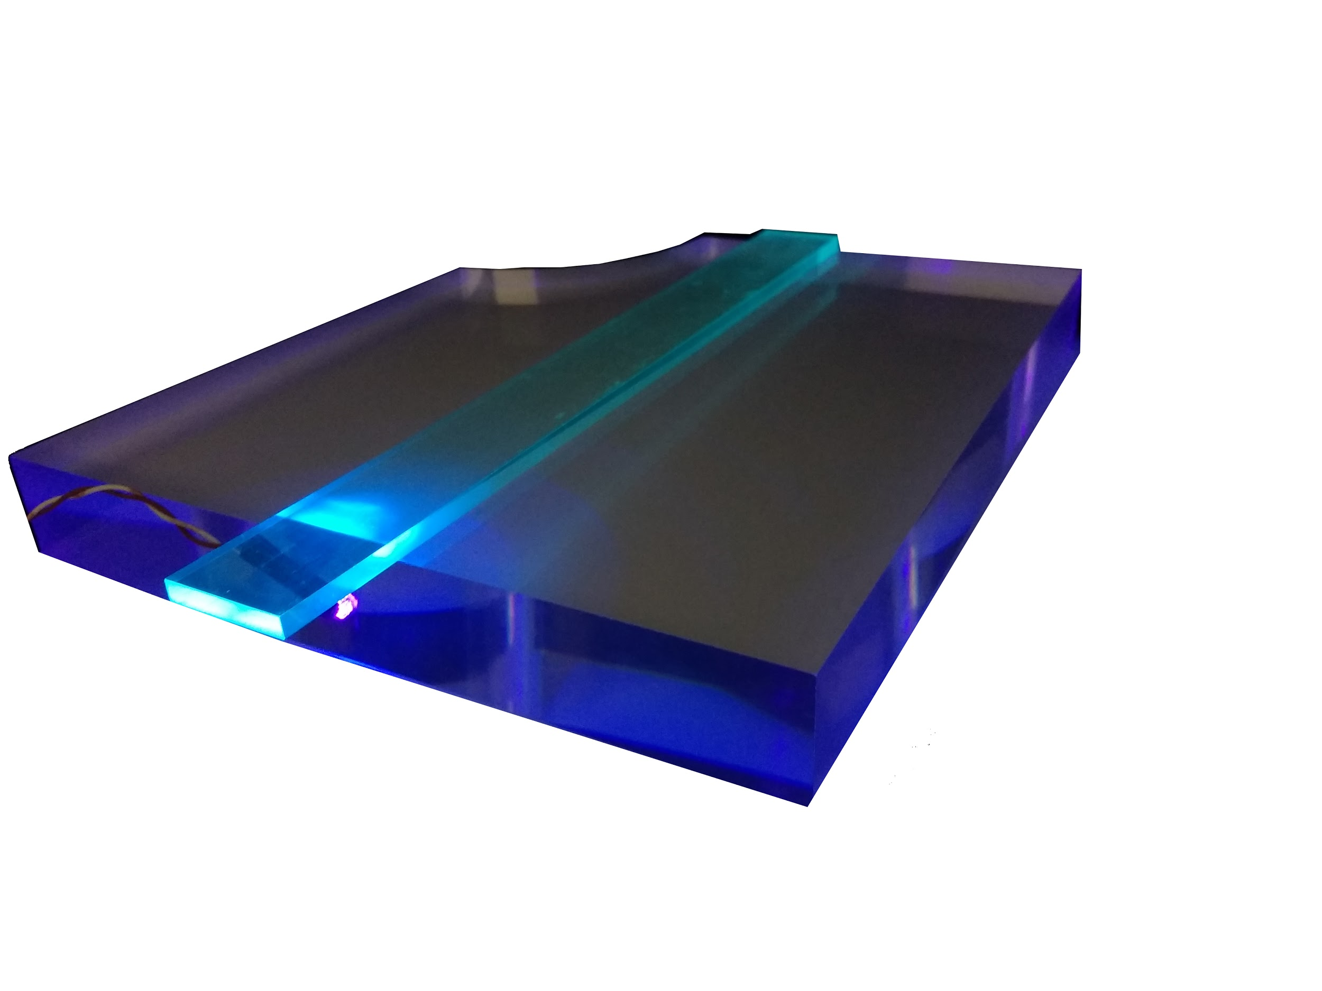
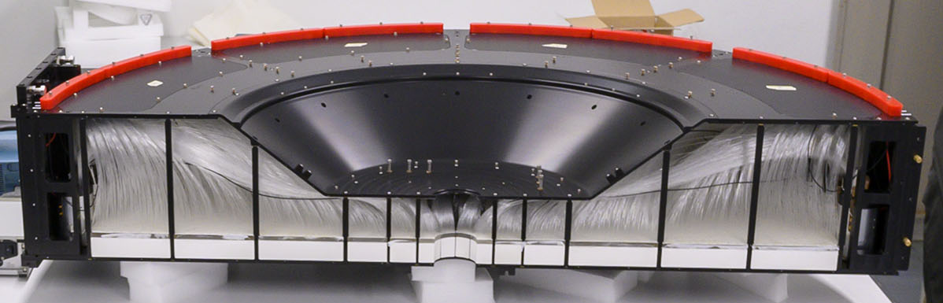
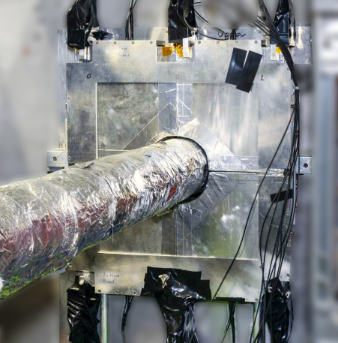
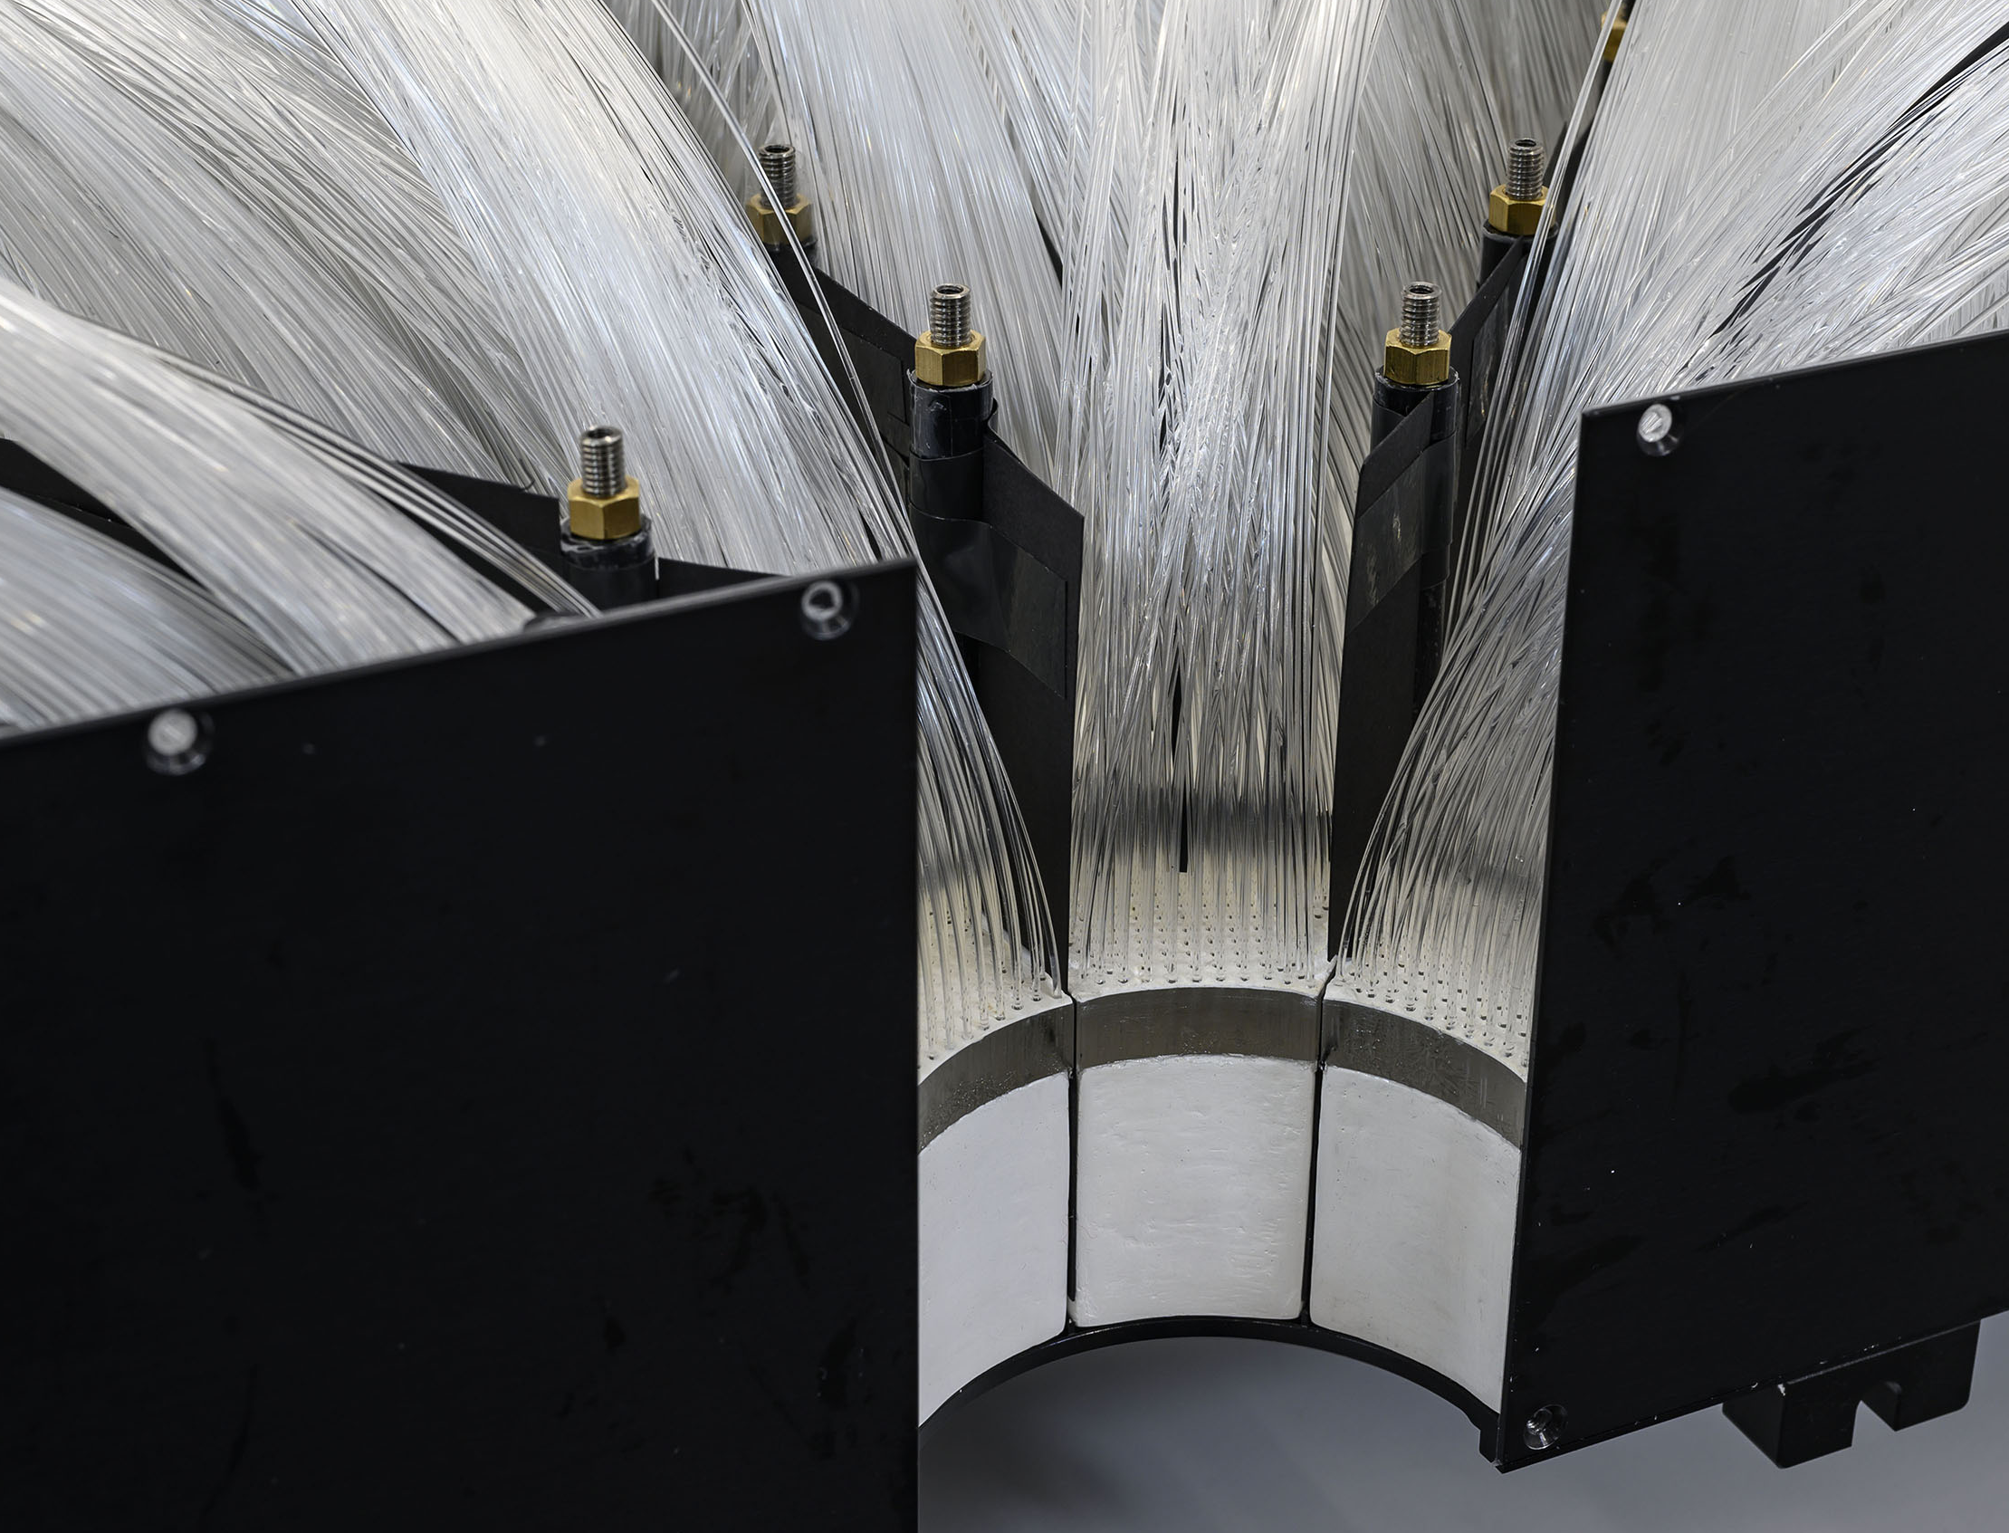
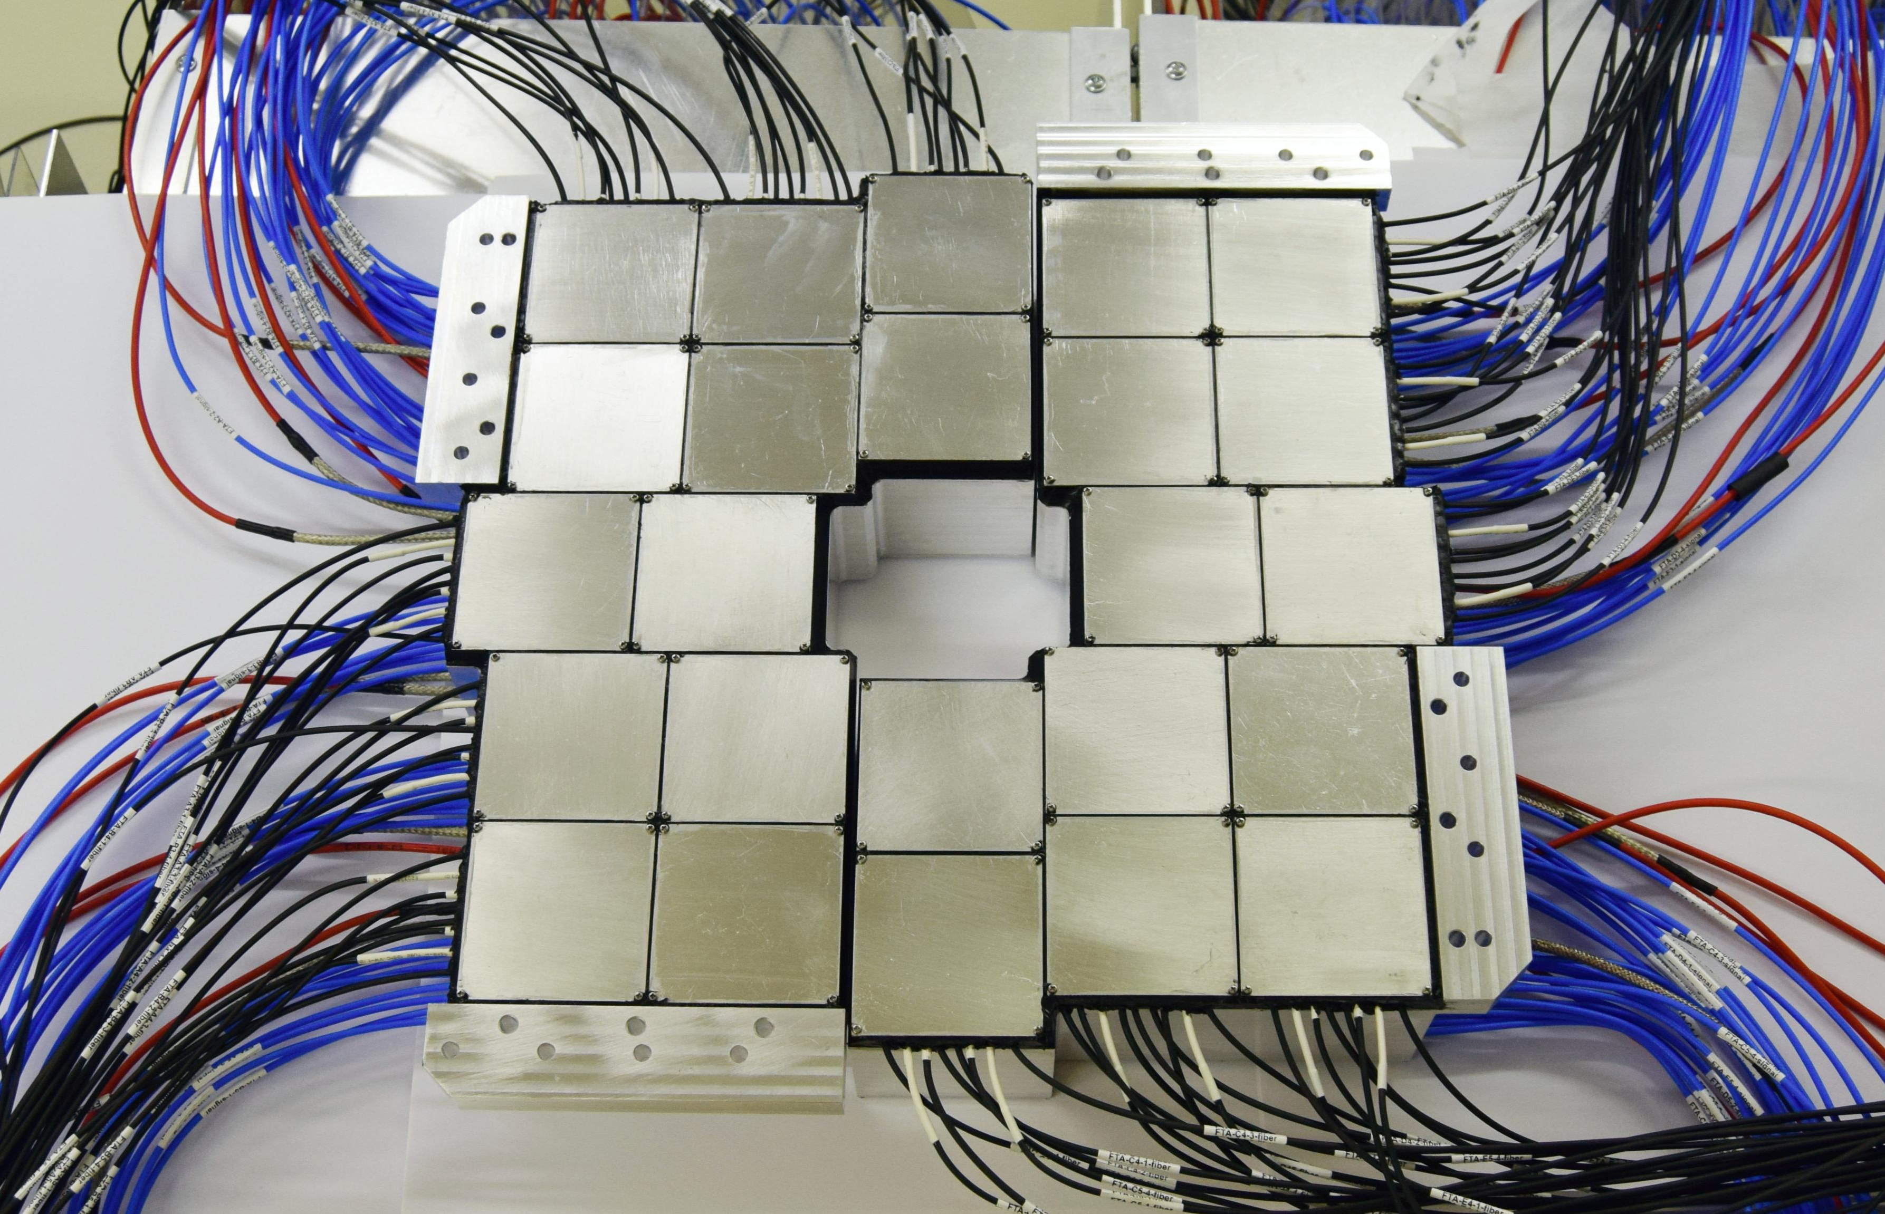
The Fast Interaction Trigger of ALICE
FT0
Cherenkov radiators directly coupled to microchannel plate-based PMTs
FDD
Plastic scintillator with a wavelength-shifting readout to fine-mesh PMTs
FV0
Plastic scintillator with novel light readout through clear fibers to fine-mesh PMTs

Slide 8
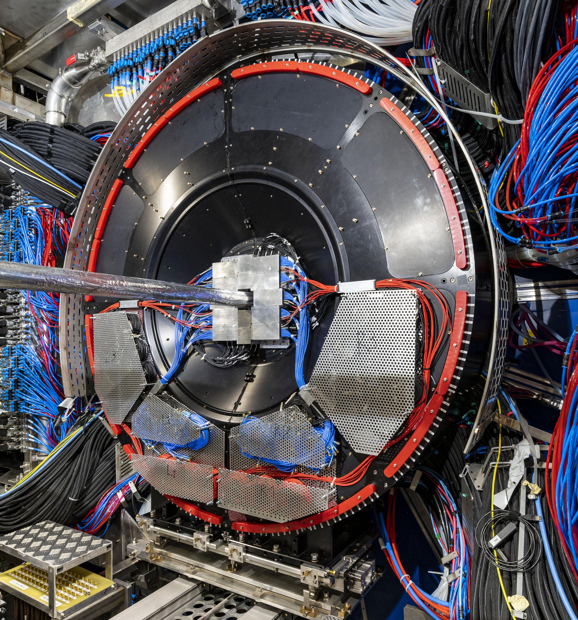
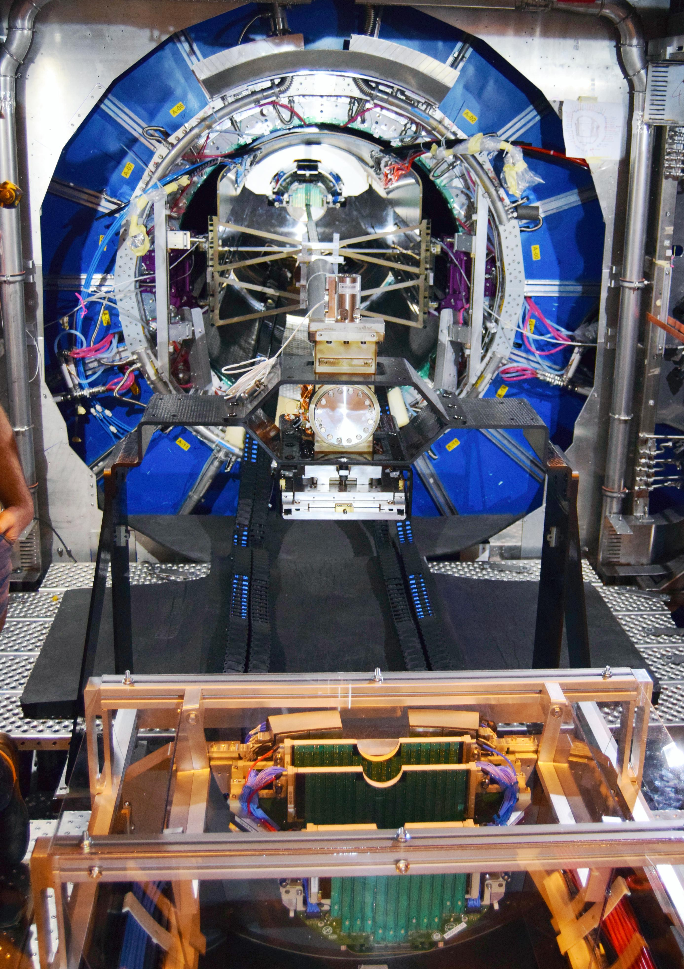
The Fast Interaction Trigger of ALICE

Slide 9
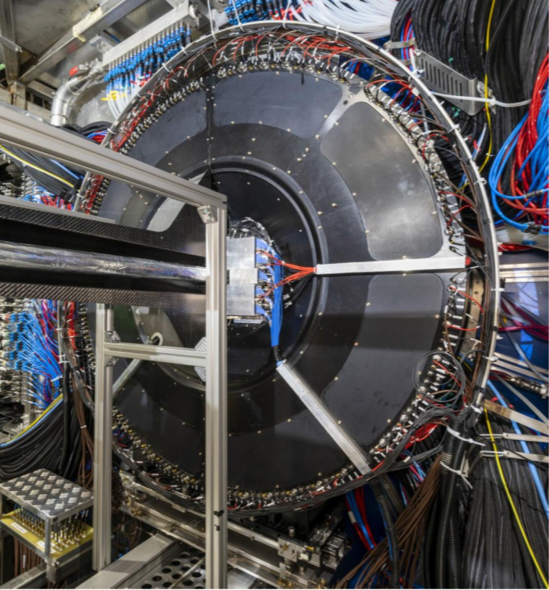
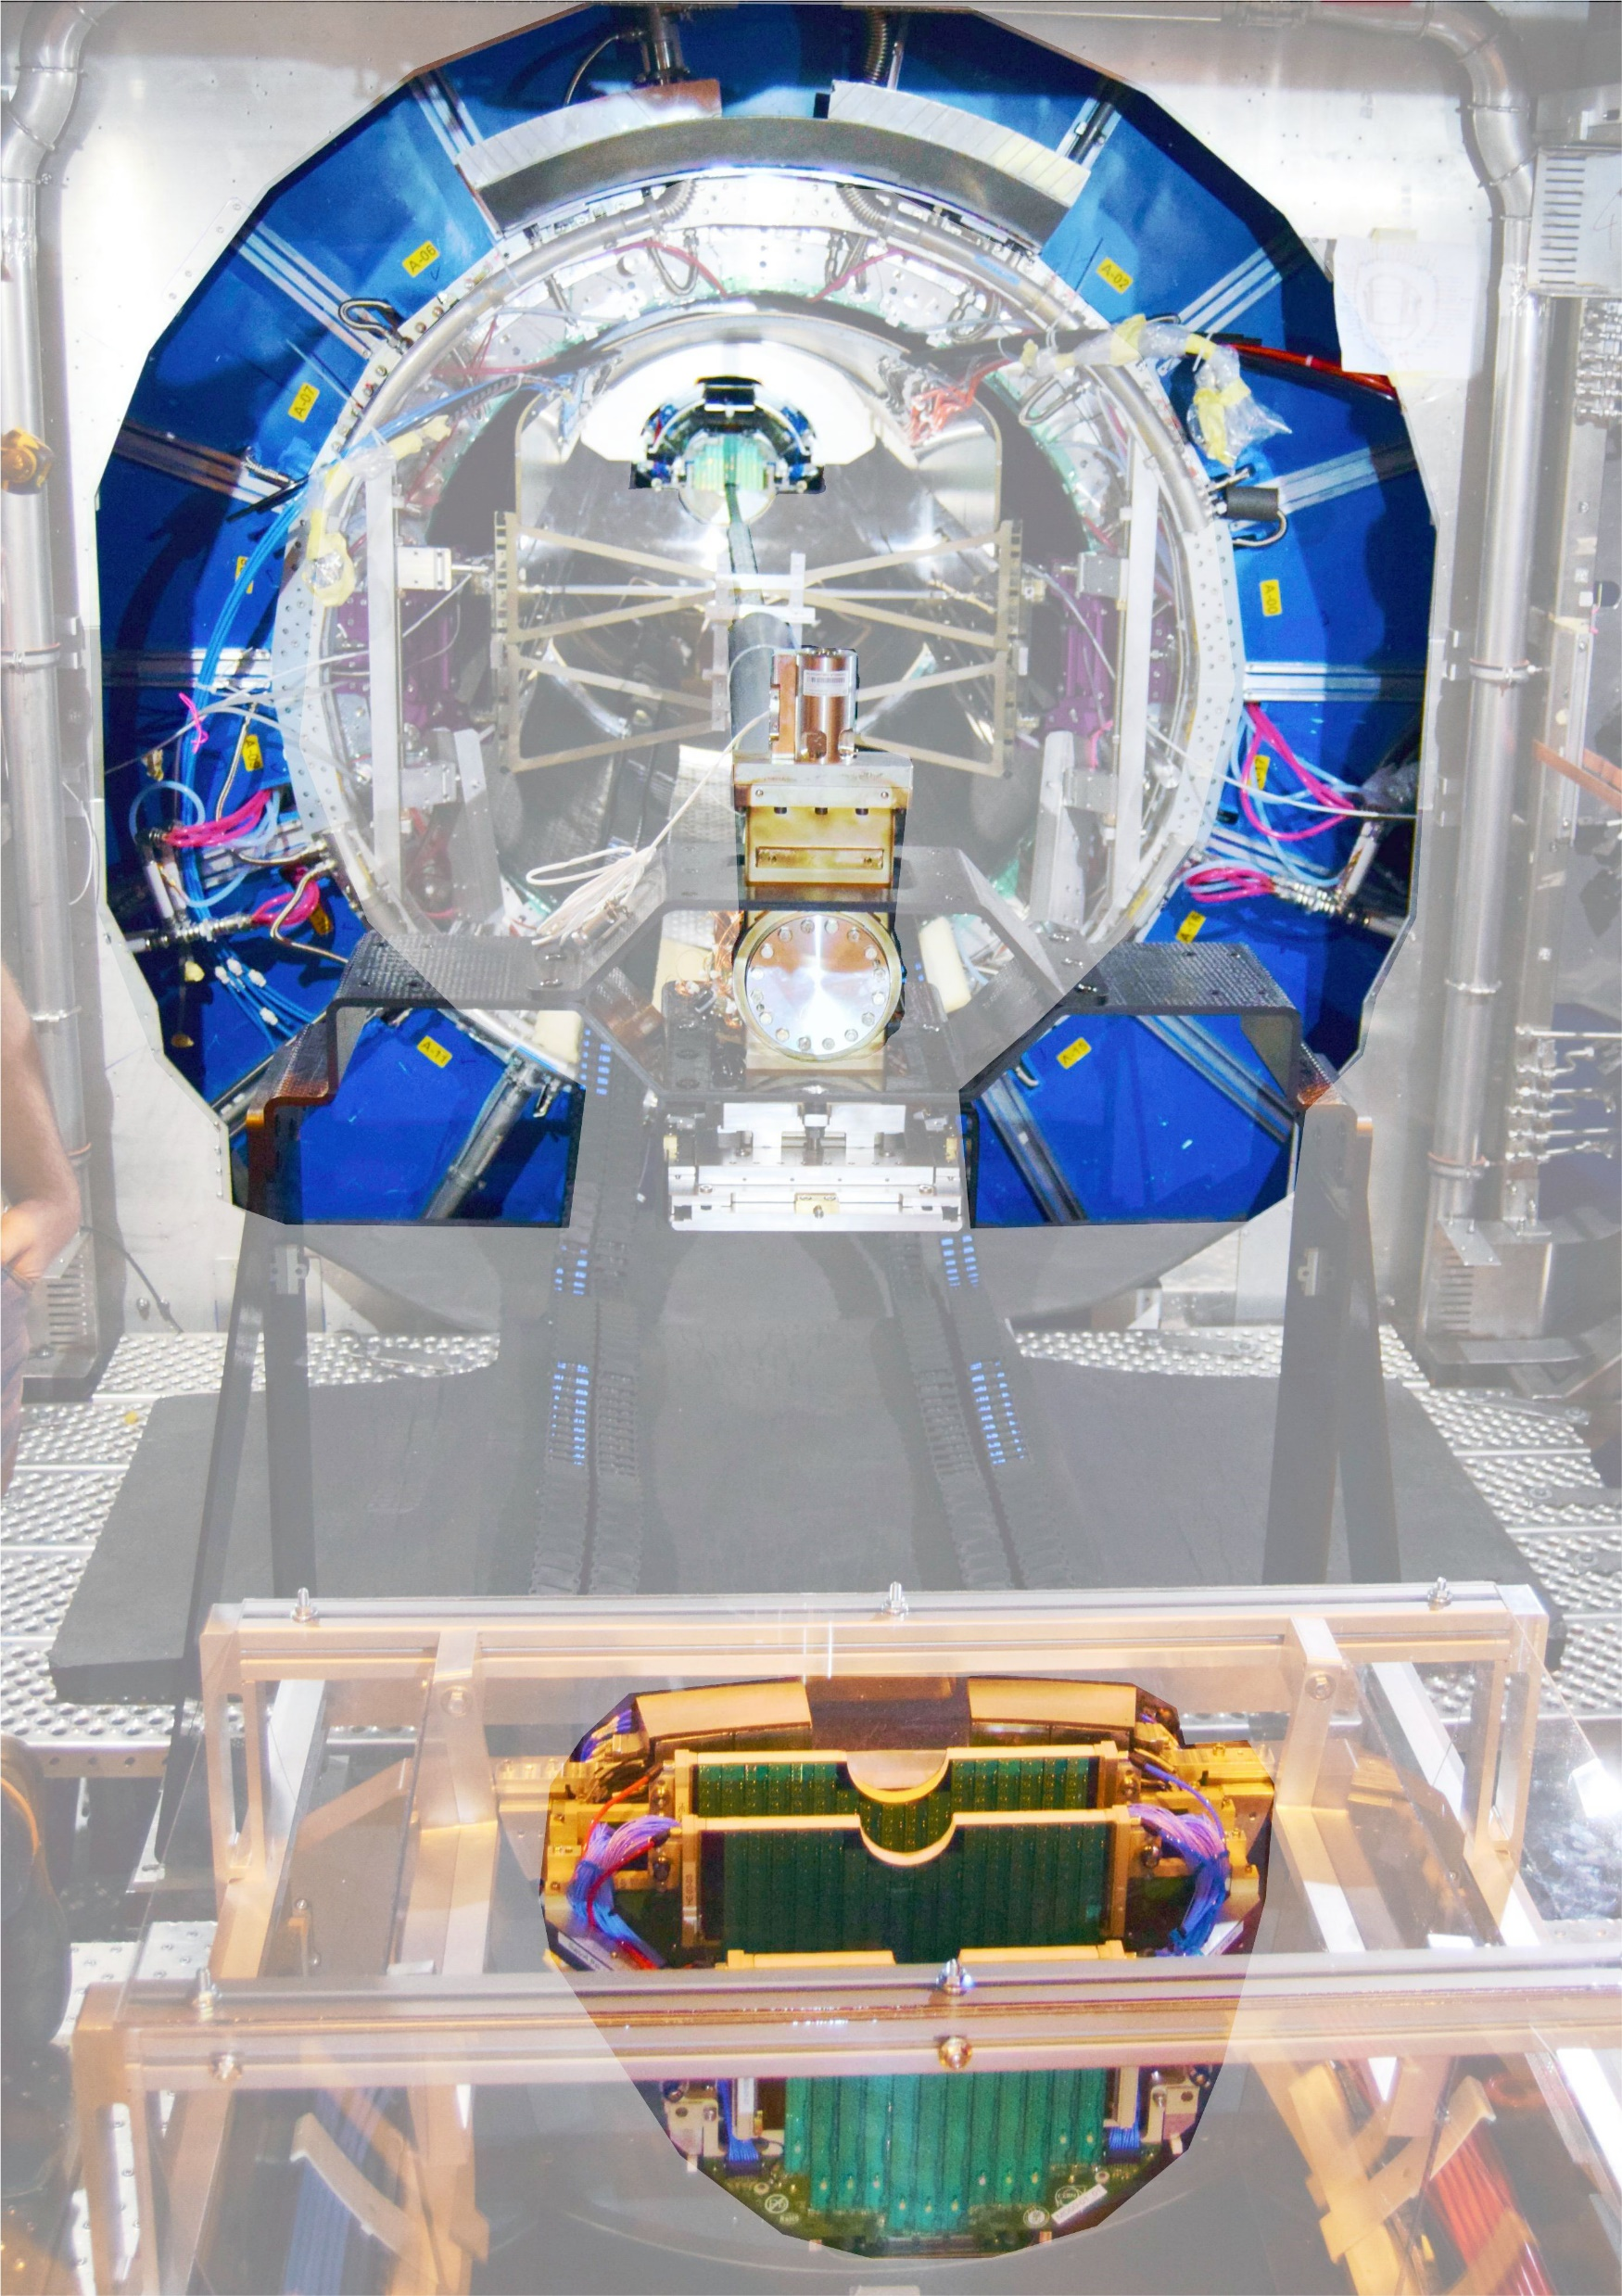
The Fast Interaction Trigger of ALICE
MFT top half +
FT0C top half
(at final position)
TPC end face
Beampipe
MFT bottom half +
FT0C bottom half
(before insertion)

Slide 10
The Fast Interaction Trigger of ALICE

Slide 11
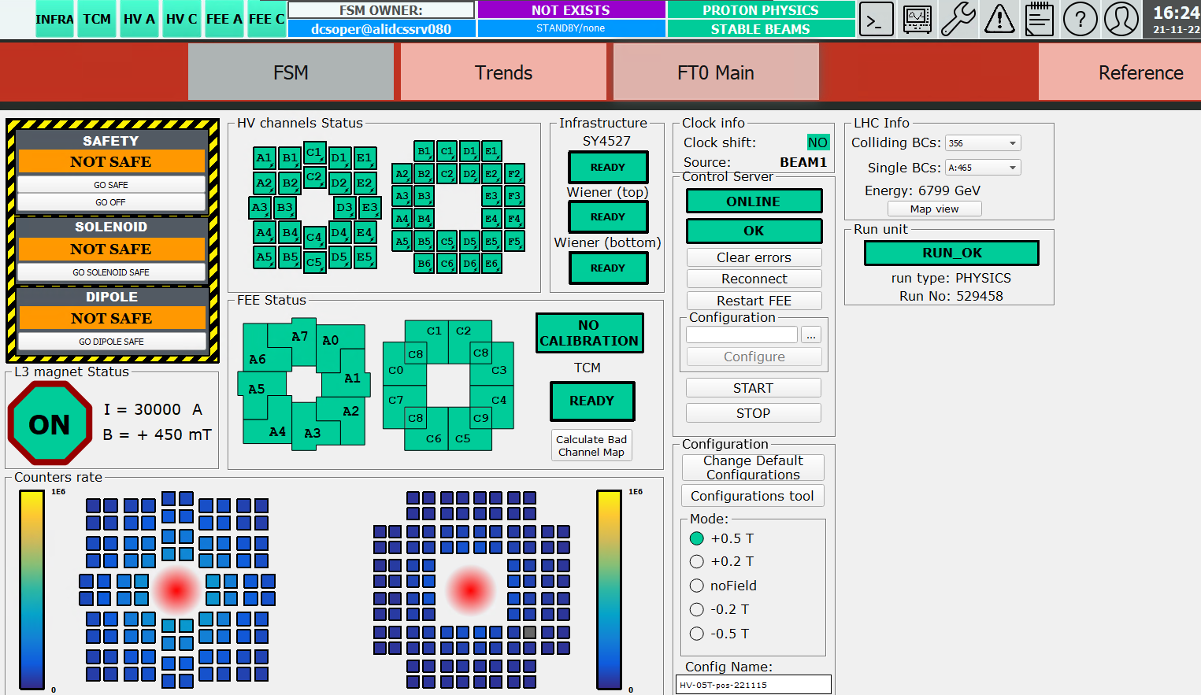
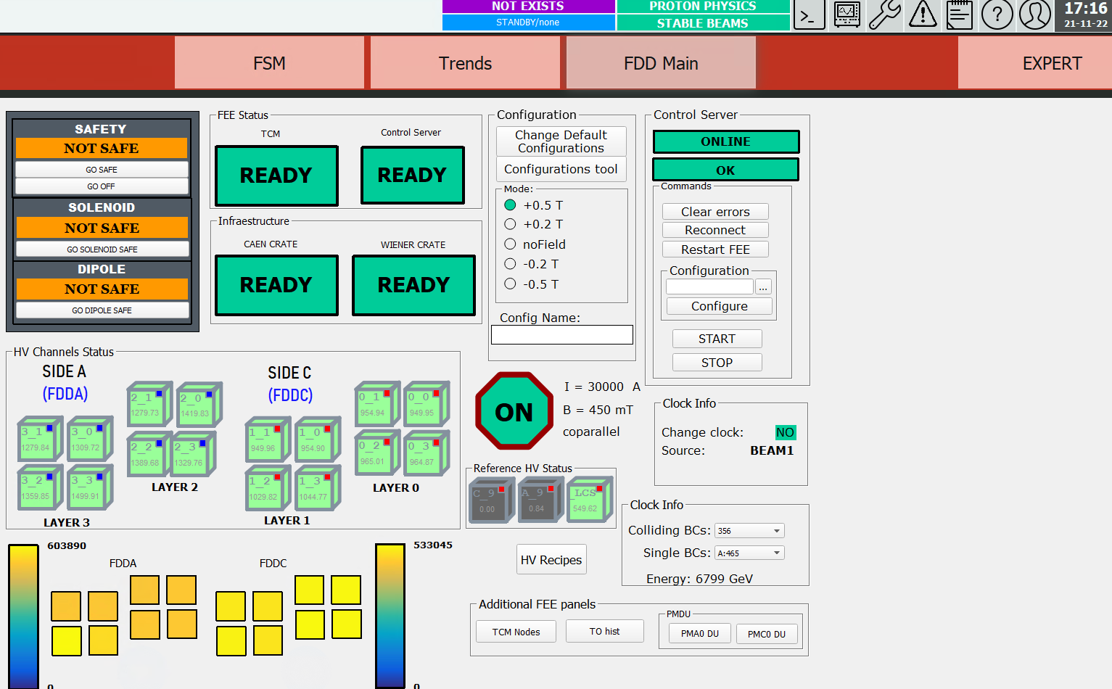
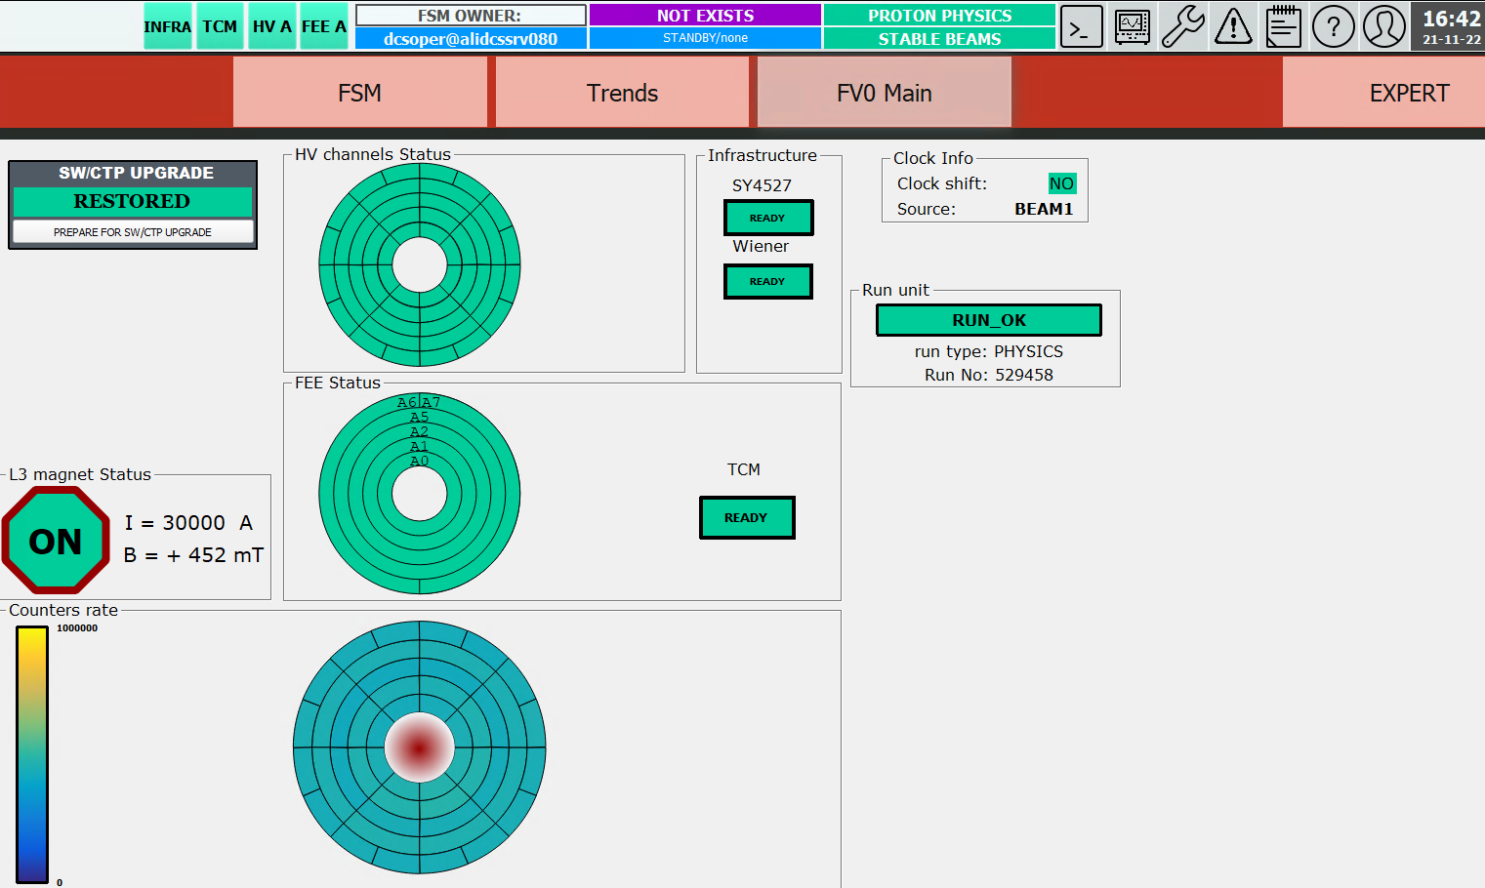
The Fast Interaction Trigger of ALICE
~One year of ~smooth operation as an integral part of ALICE;
Permanent progress in usability of the control systems;
Rare data processing bugs still being discovered and fixed.
FT0 DCS
FDD DCS
FV0 DCS

Slide 12
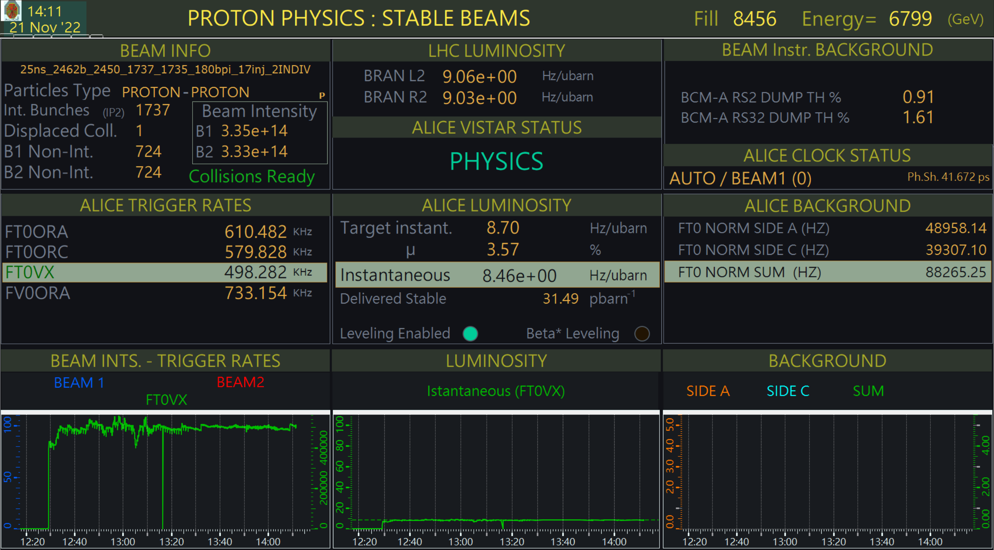
The Fast Interaction Trigger of ALICE
Key service detector of the experiment - ALICE can not collect data without FIT
Major part of the real-time experiment monitoring info is based on FIT data

Slide 13
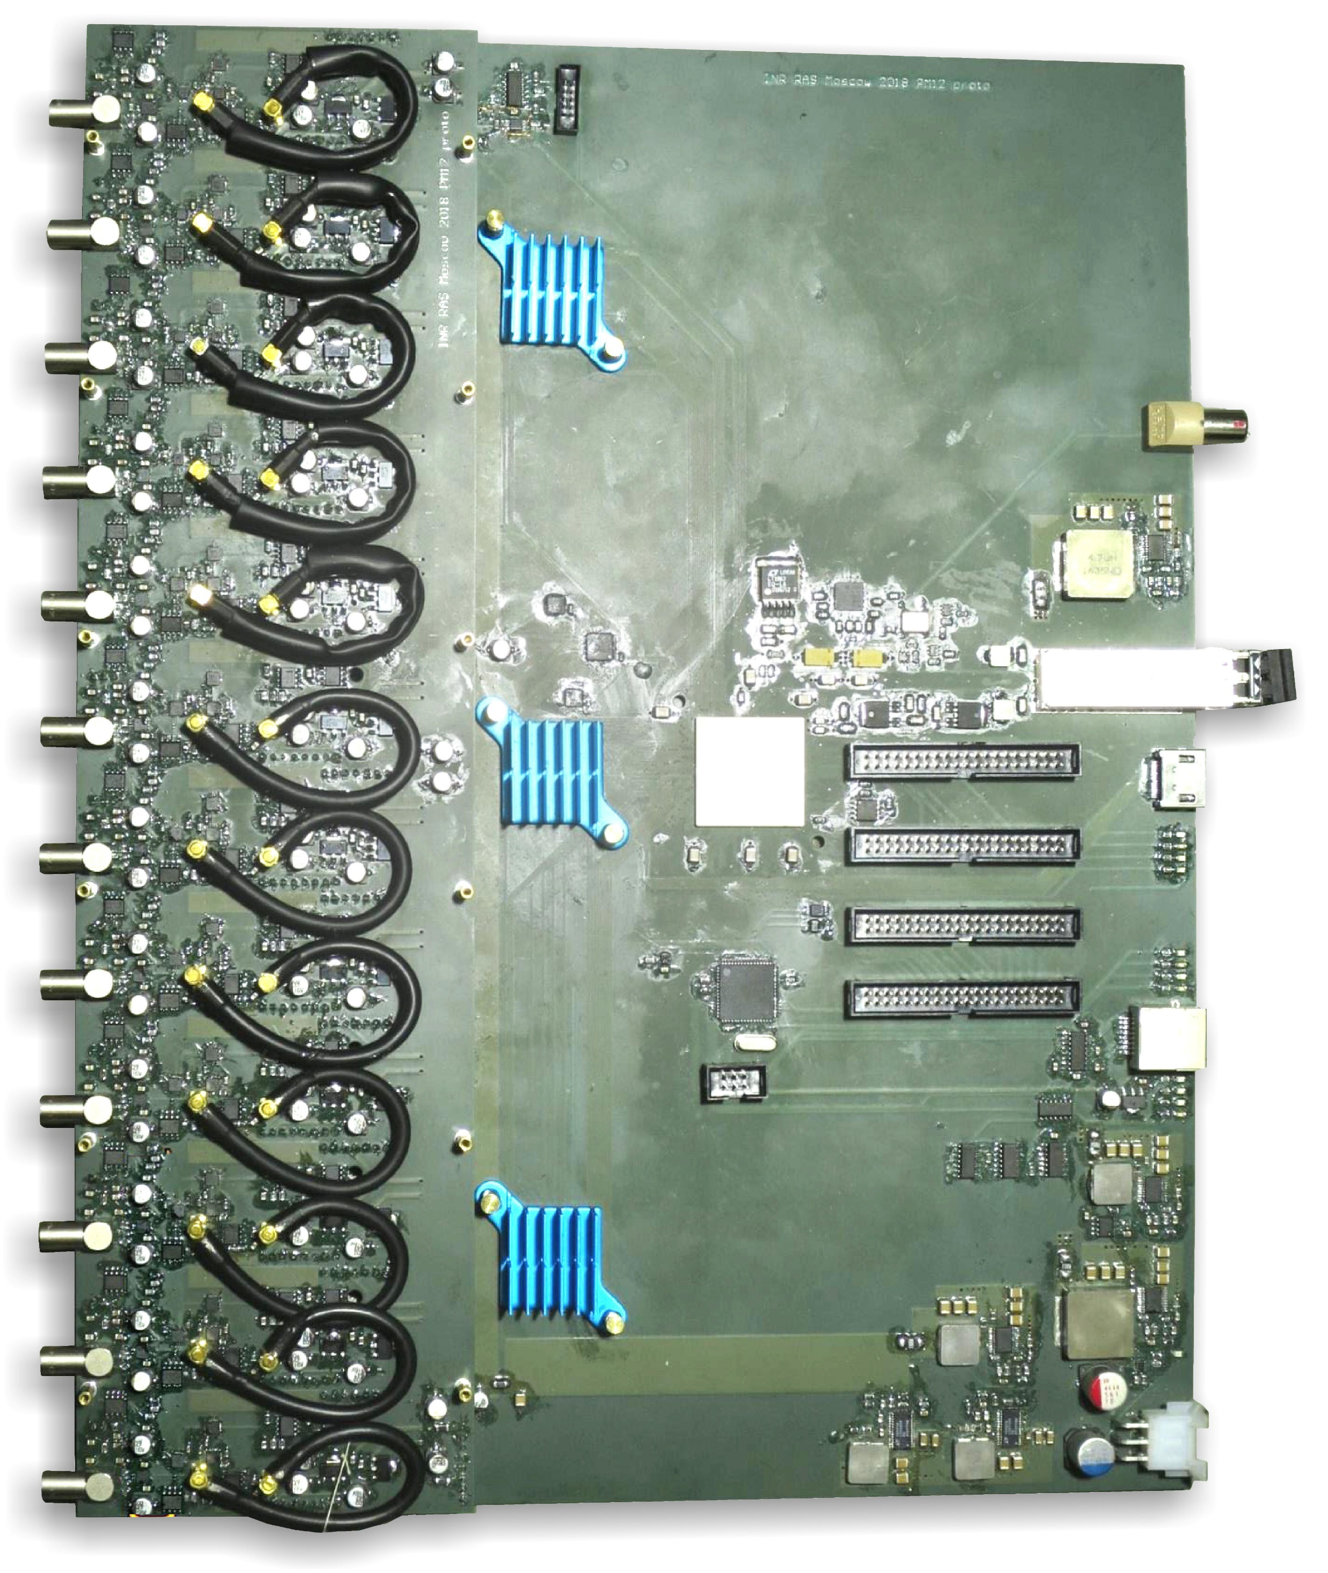
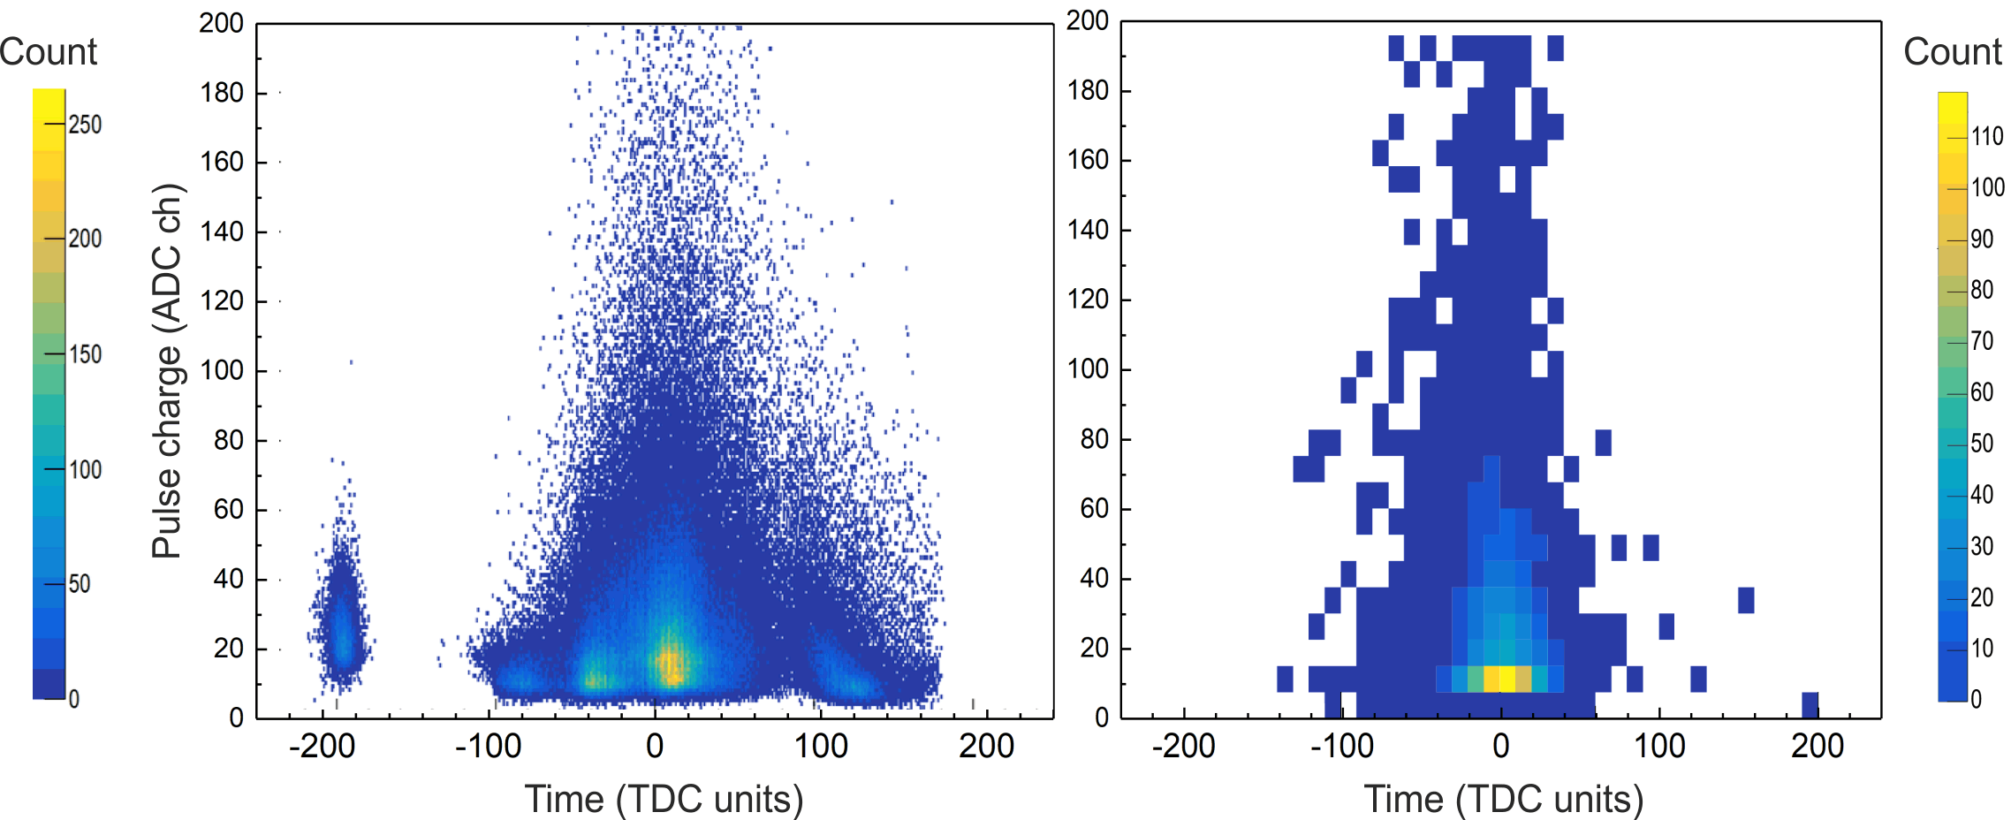
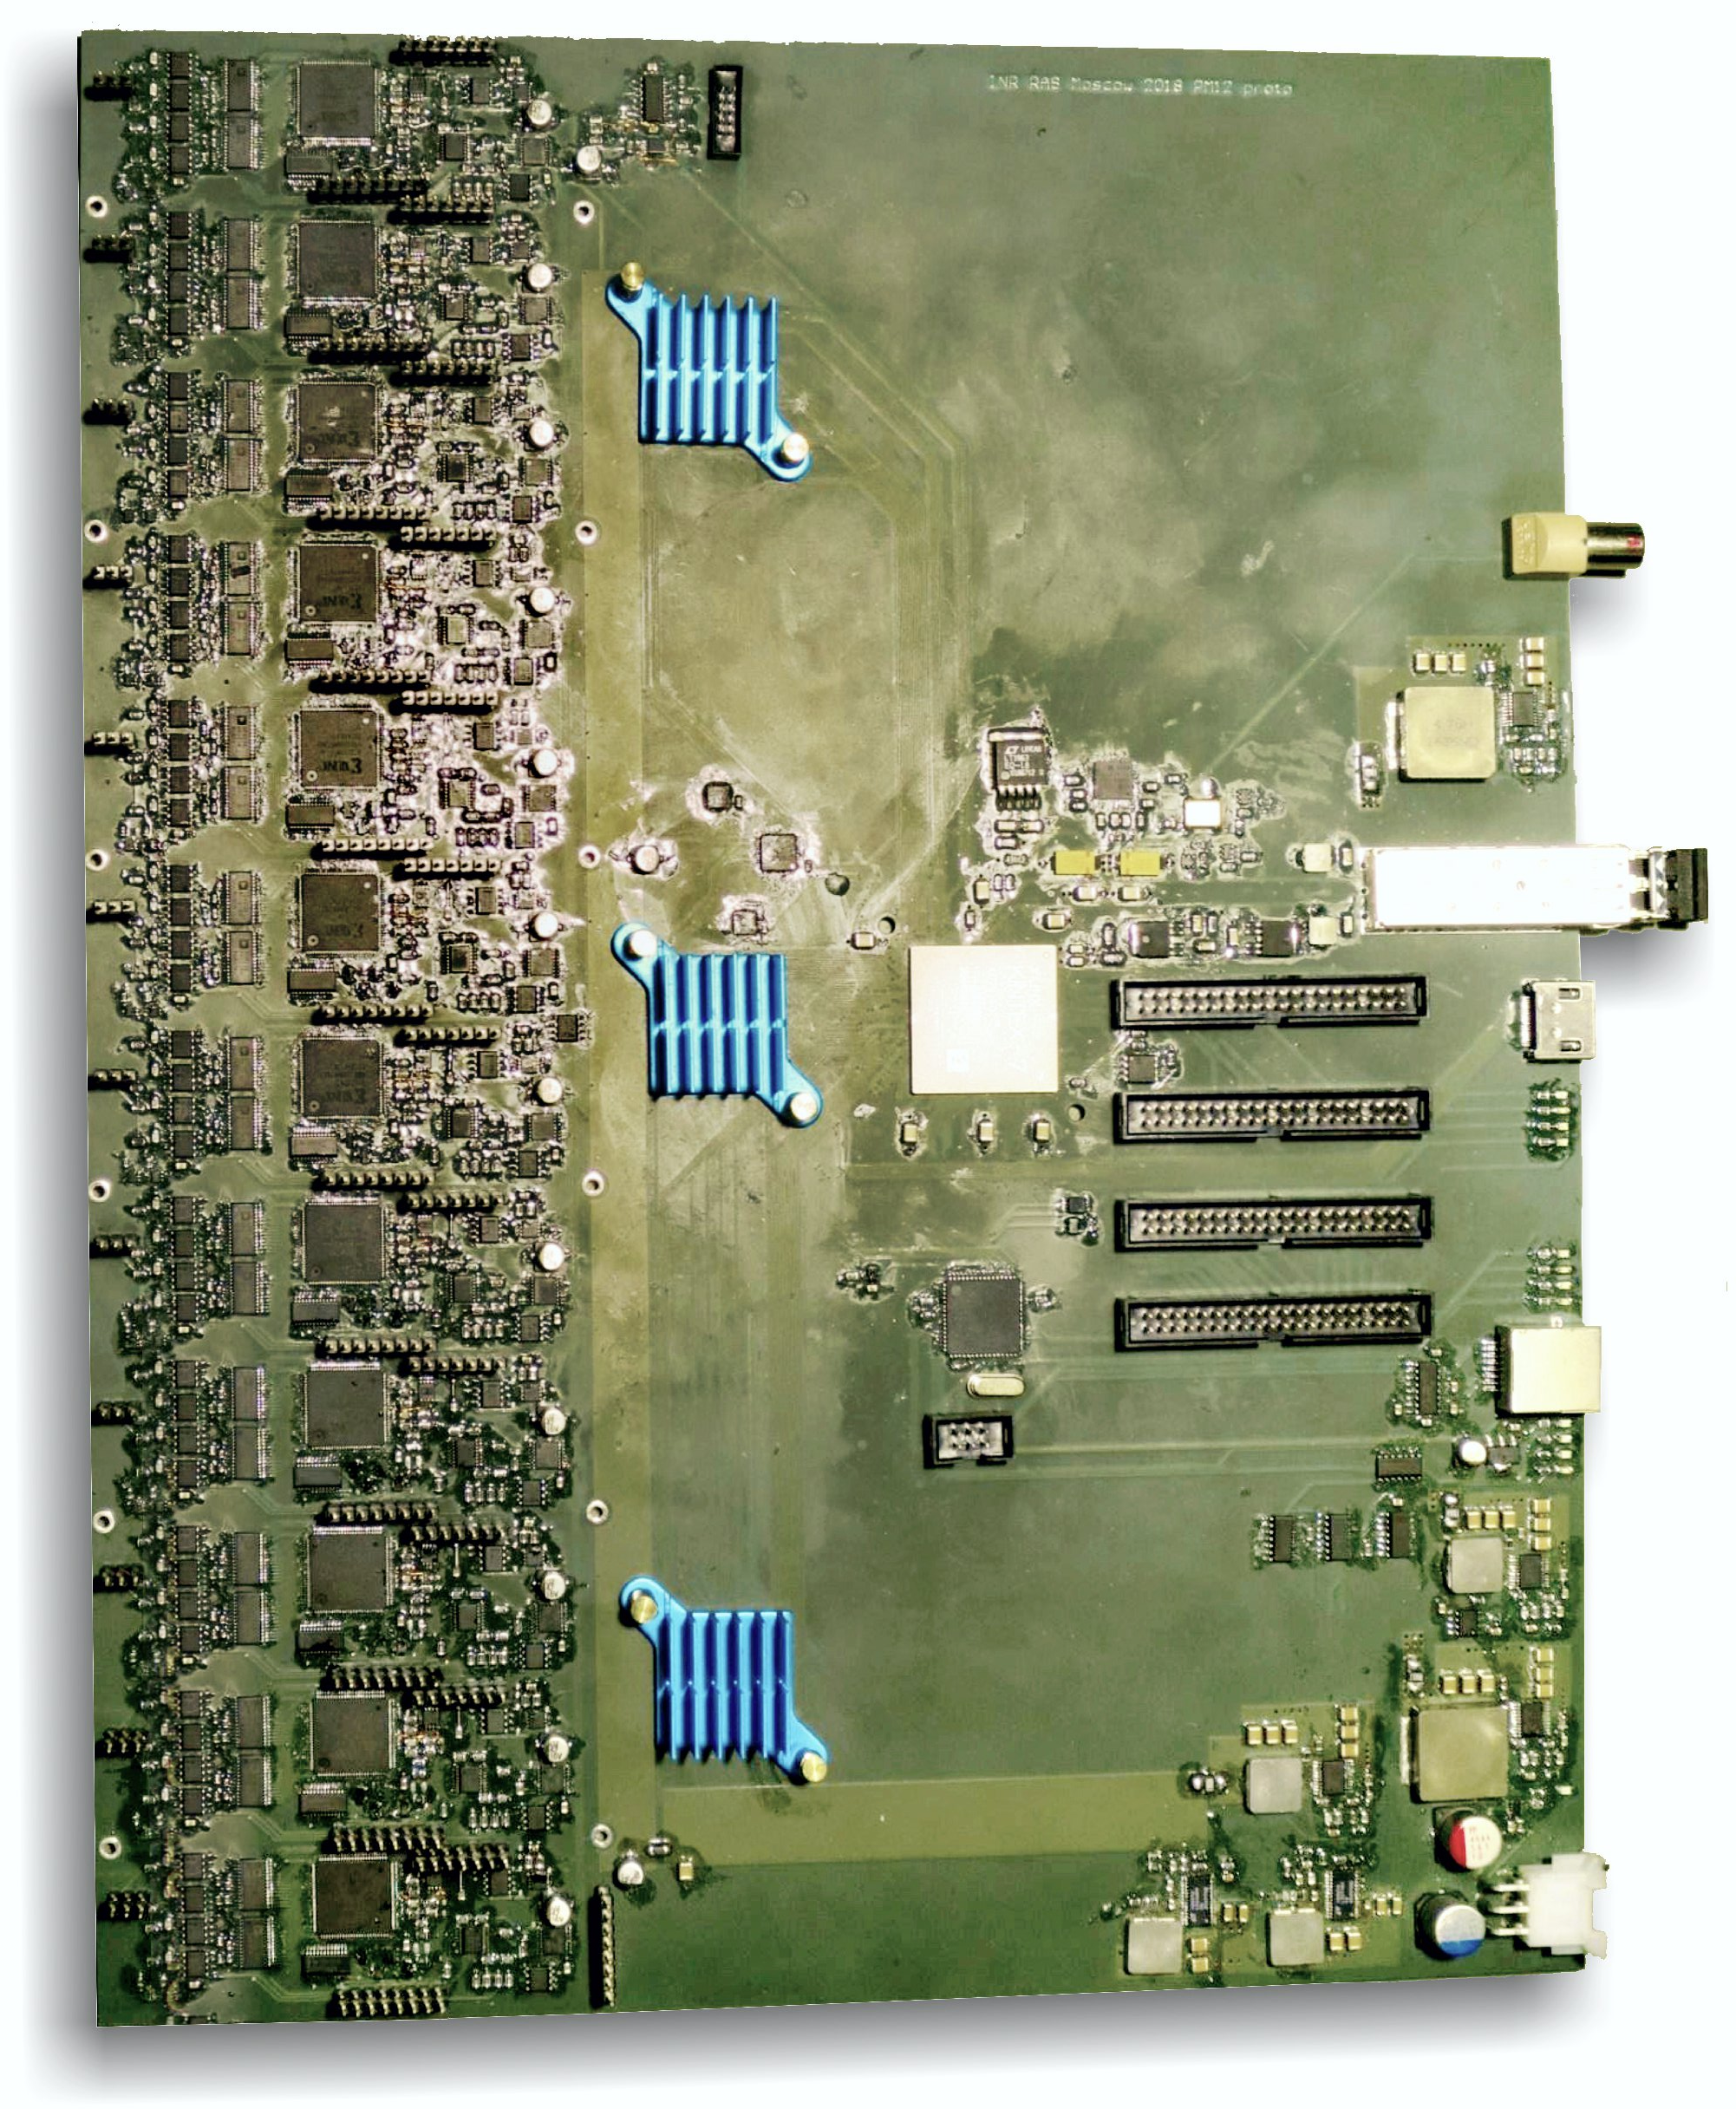
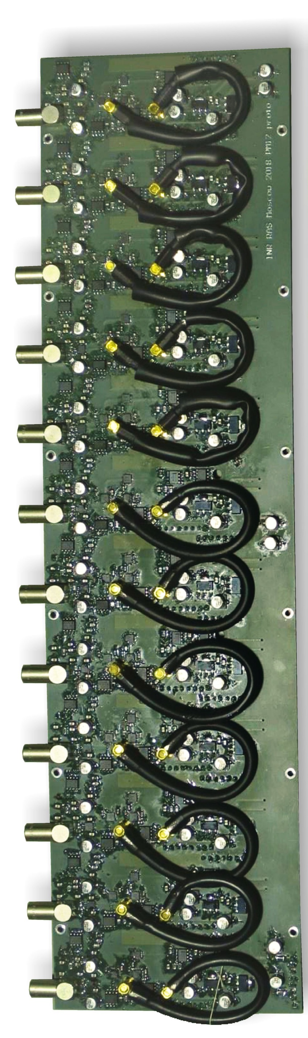
The Fast Interaction Trigger of ALICE
FIT PM
FIT Processing Module – custom readout solution common for all three subsystems
Few hardware fixes so far:
  Replaced mezzanines in FV0 and FDD PMs to better match the bandwidth
  and accommodate a wider dynamic range;
  Some cabling rework to minimize electrical reflections.
FV0 amp vs time spectra:
Default mezzanine
New mezzanine
Mezzanine
+
=
PM main board
Modulation caused by mismatch between the voltage comparator bandwidth with FM-PMT timing

Slide 14
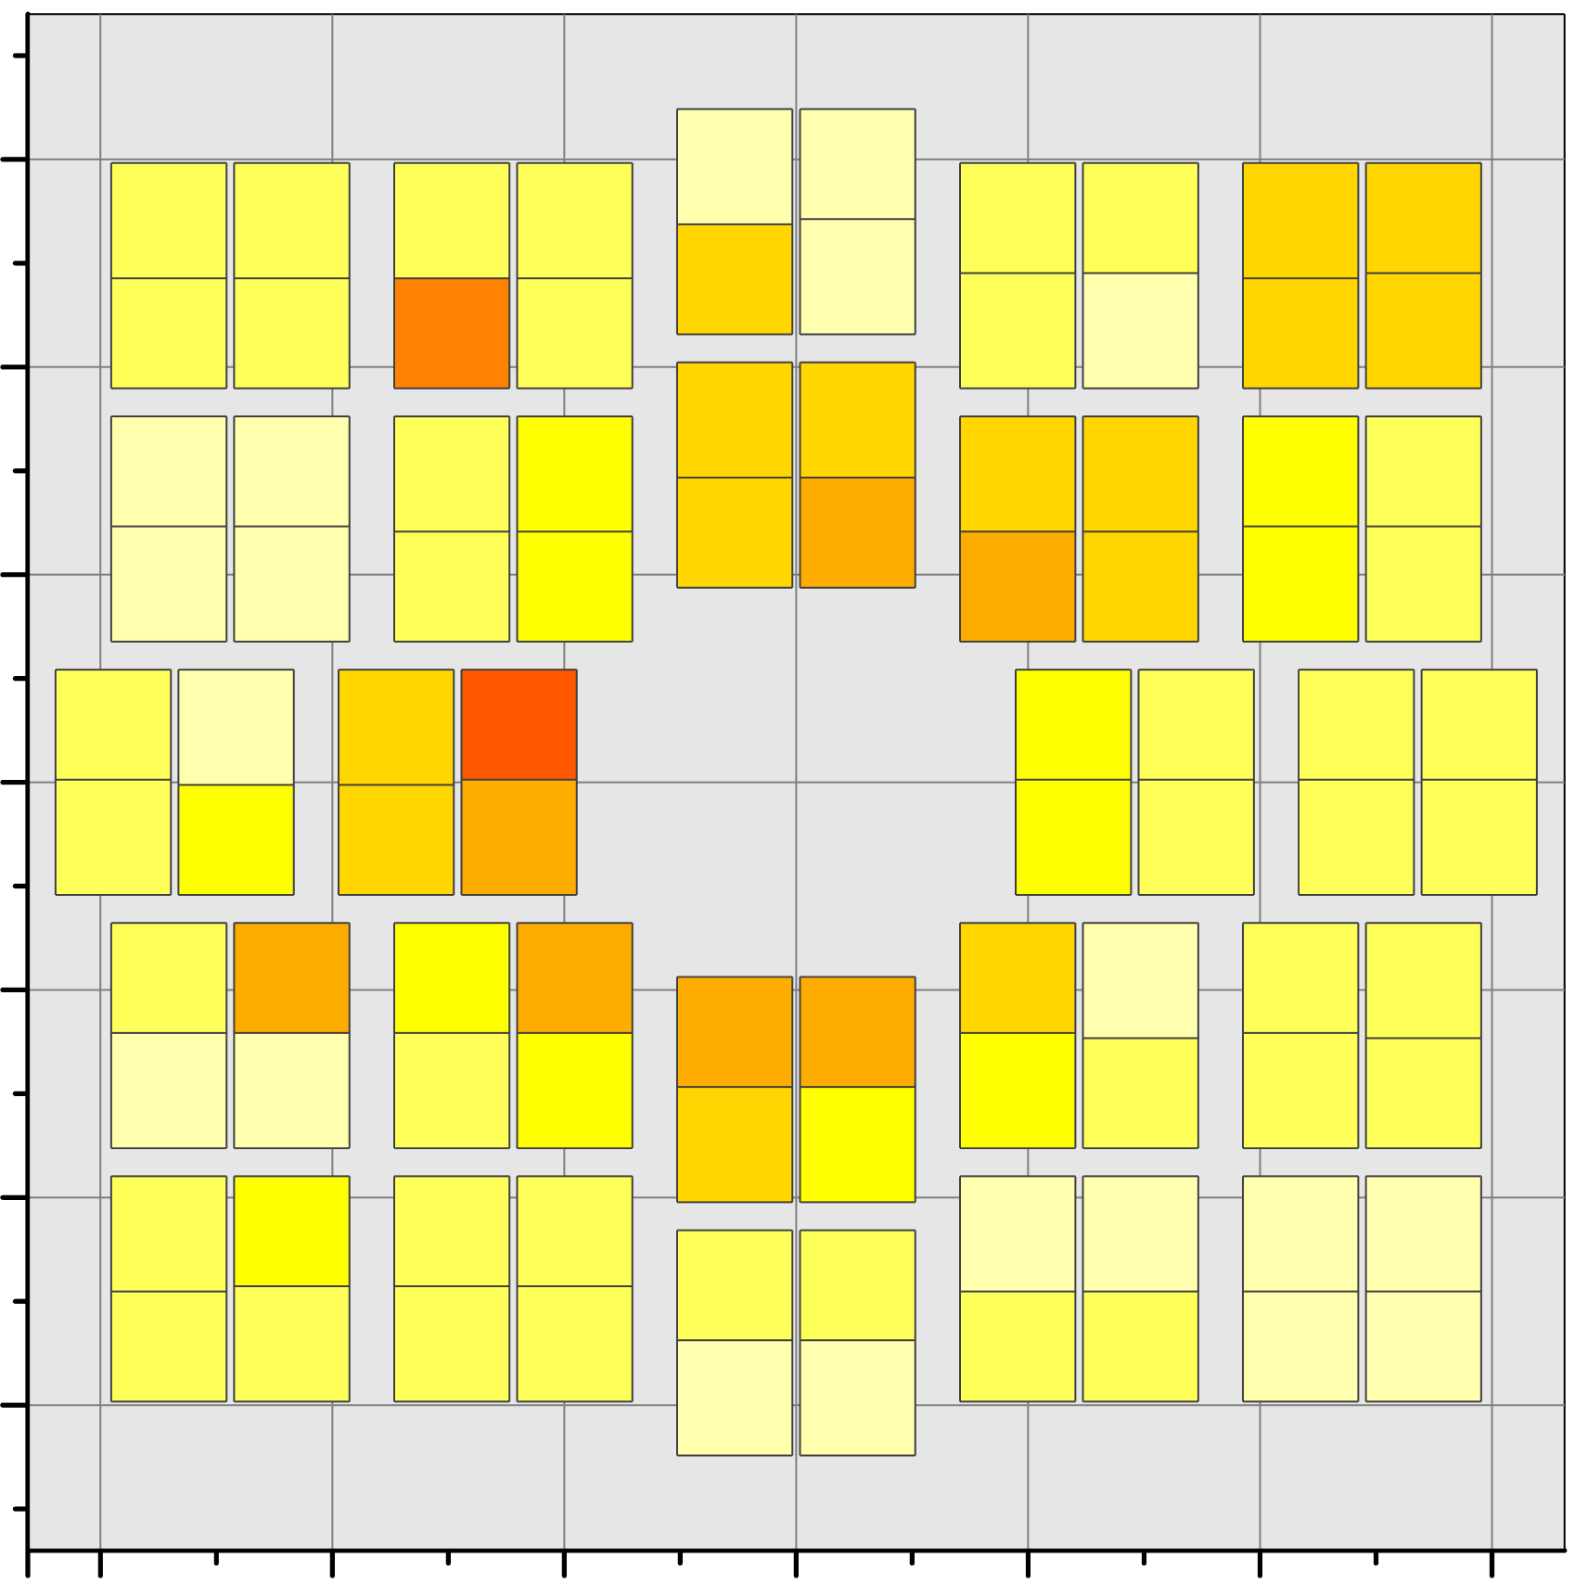
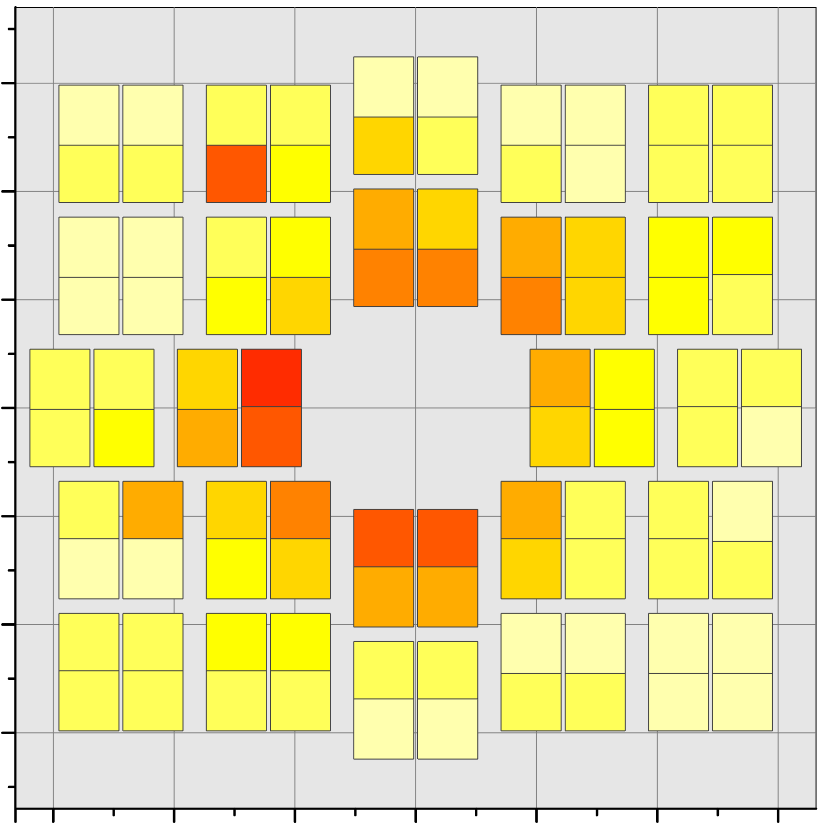
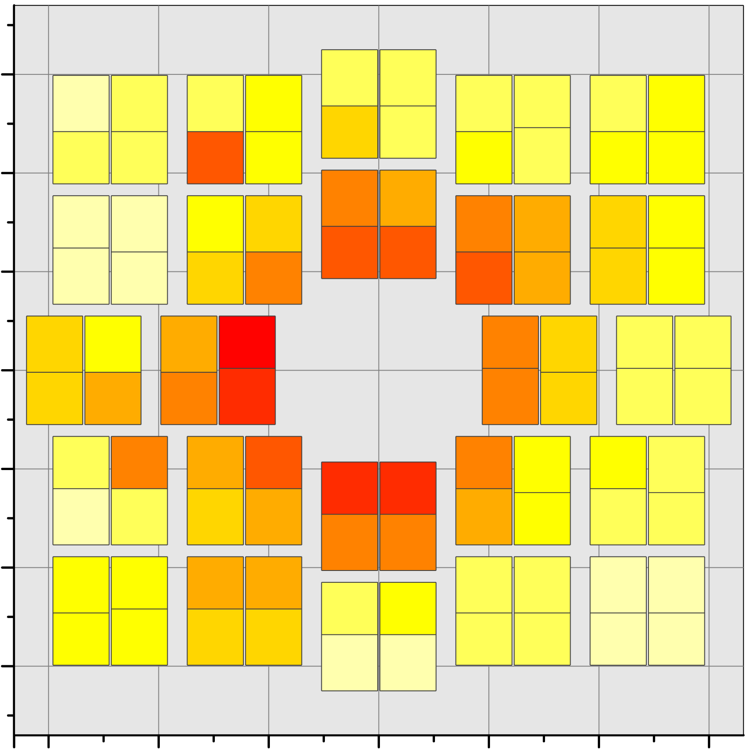
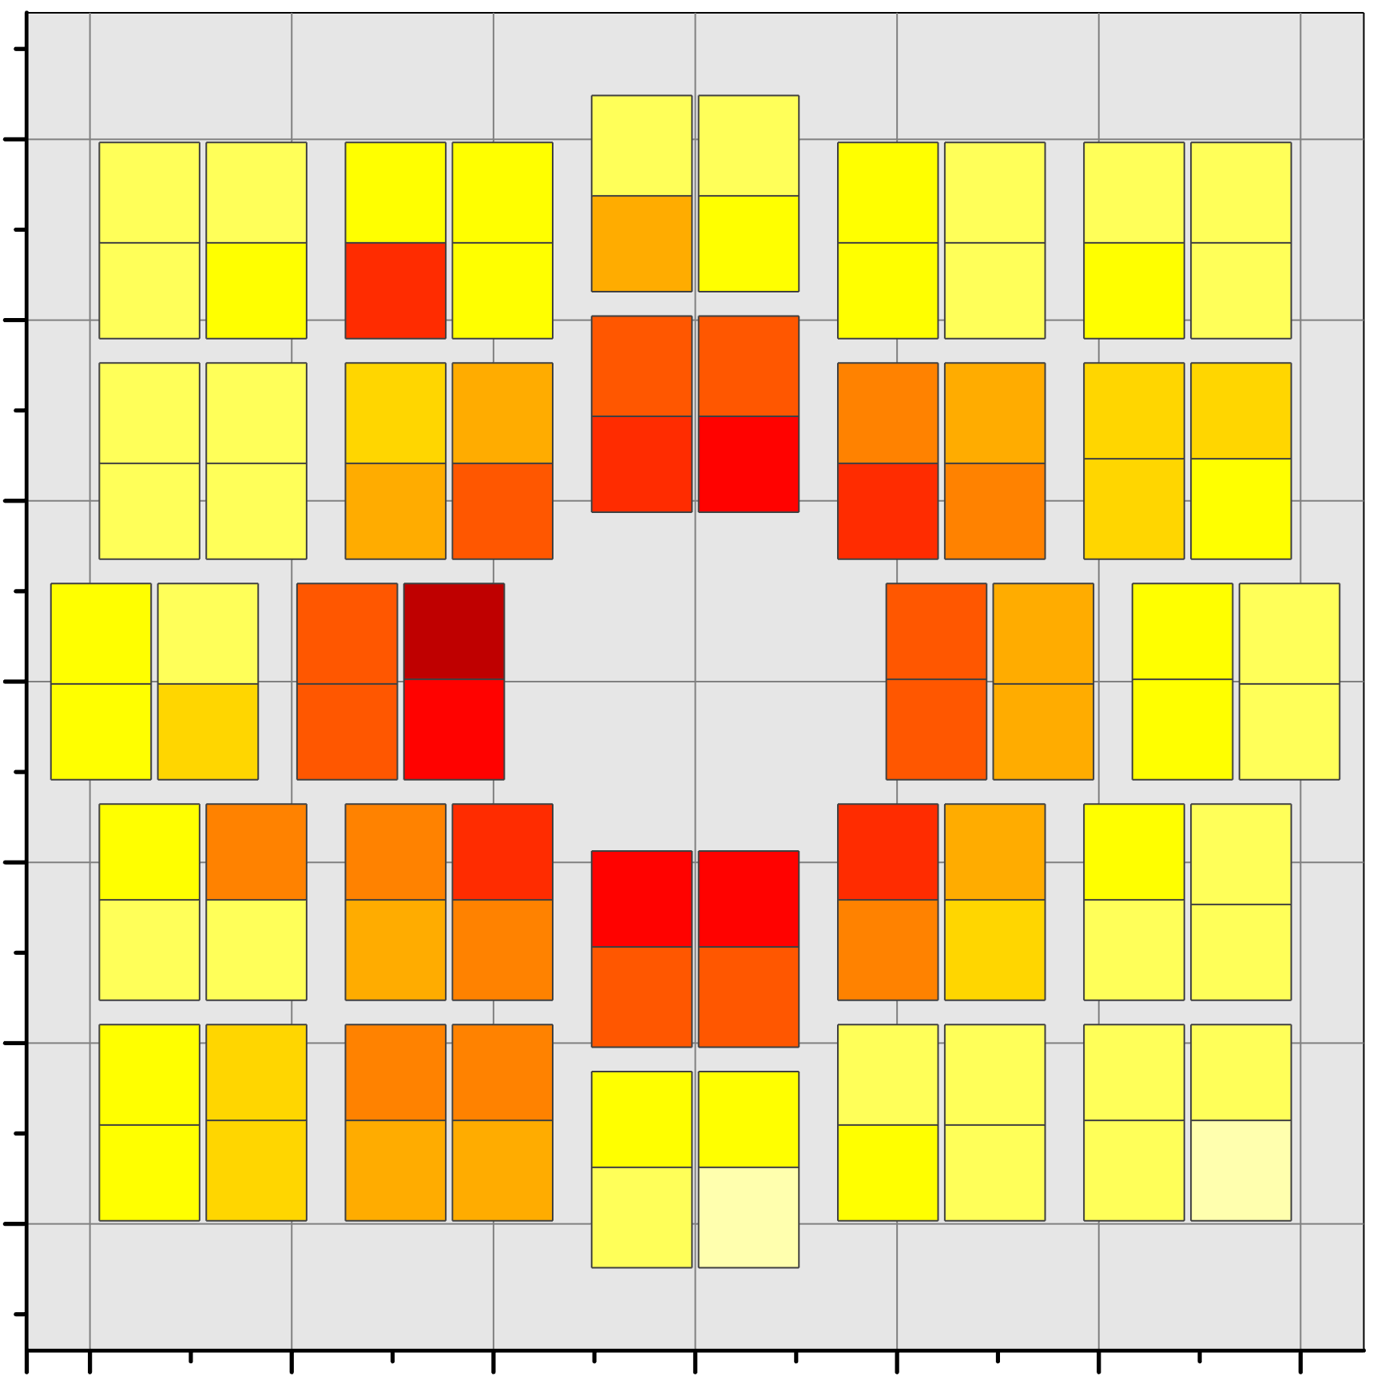
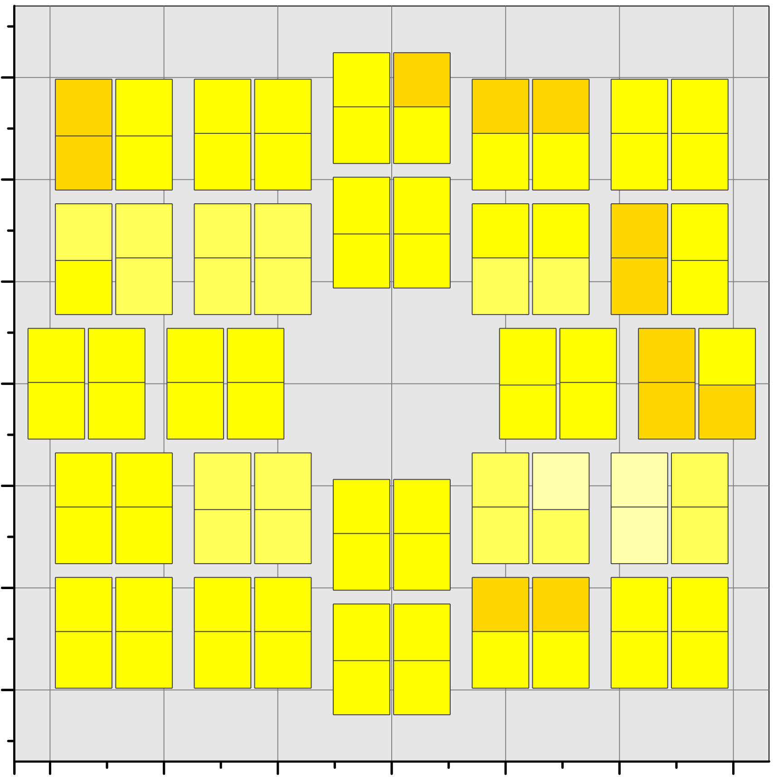
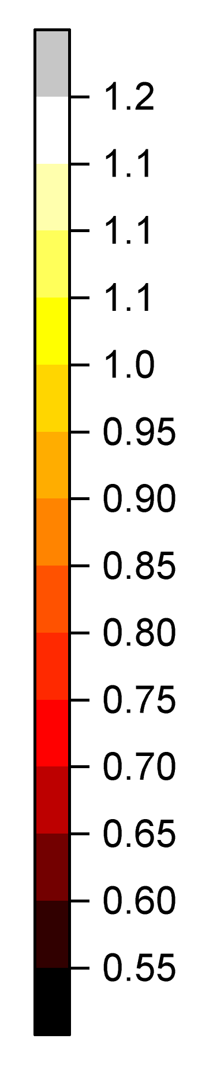
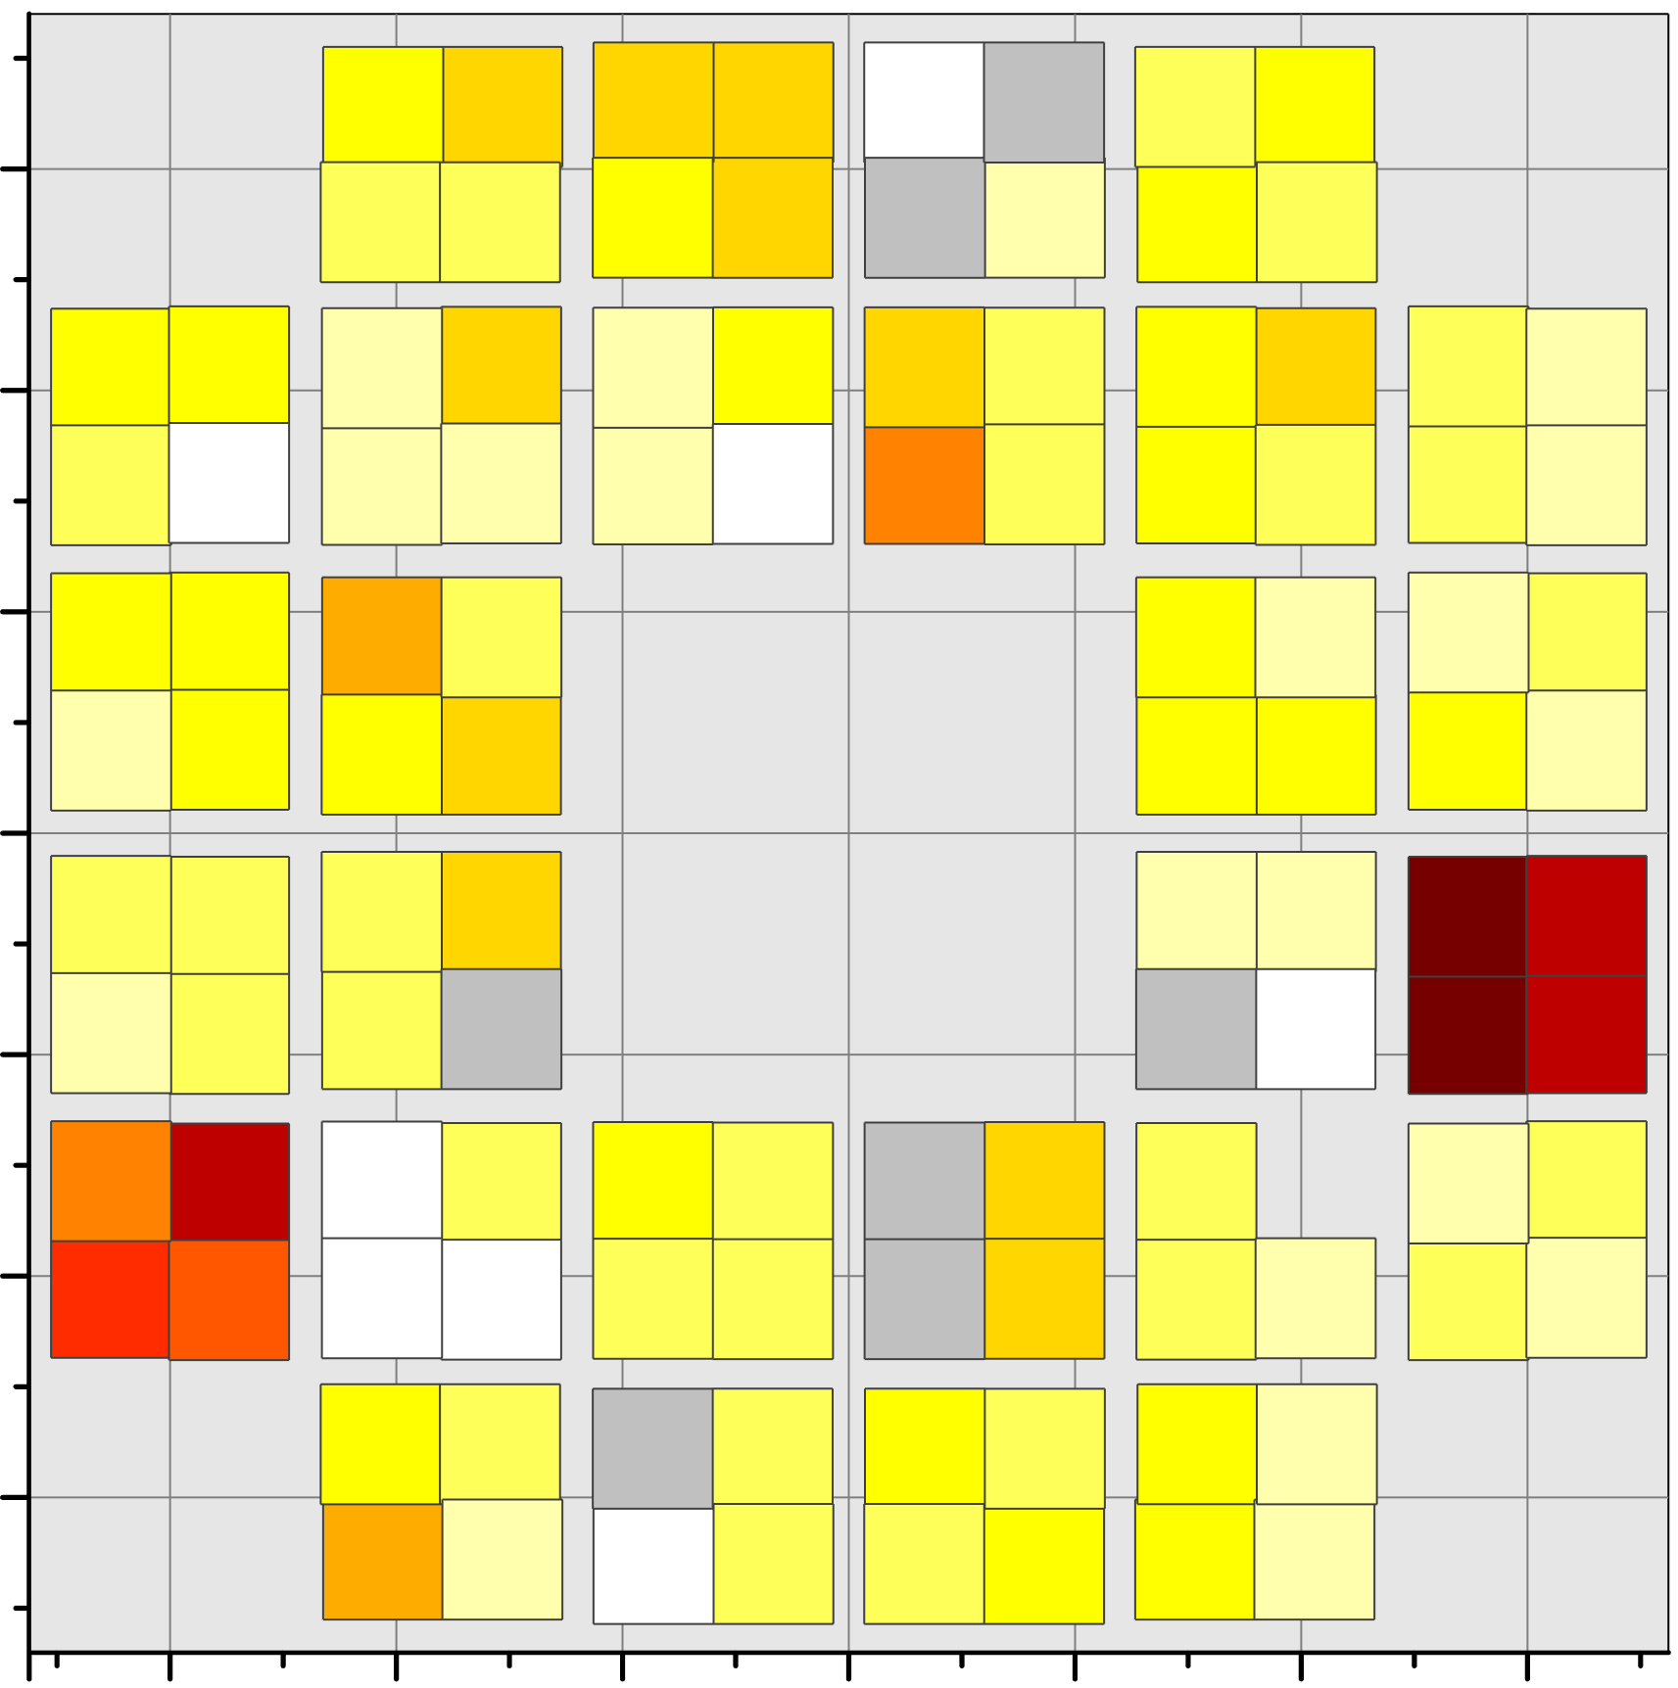
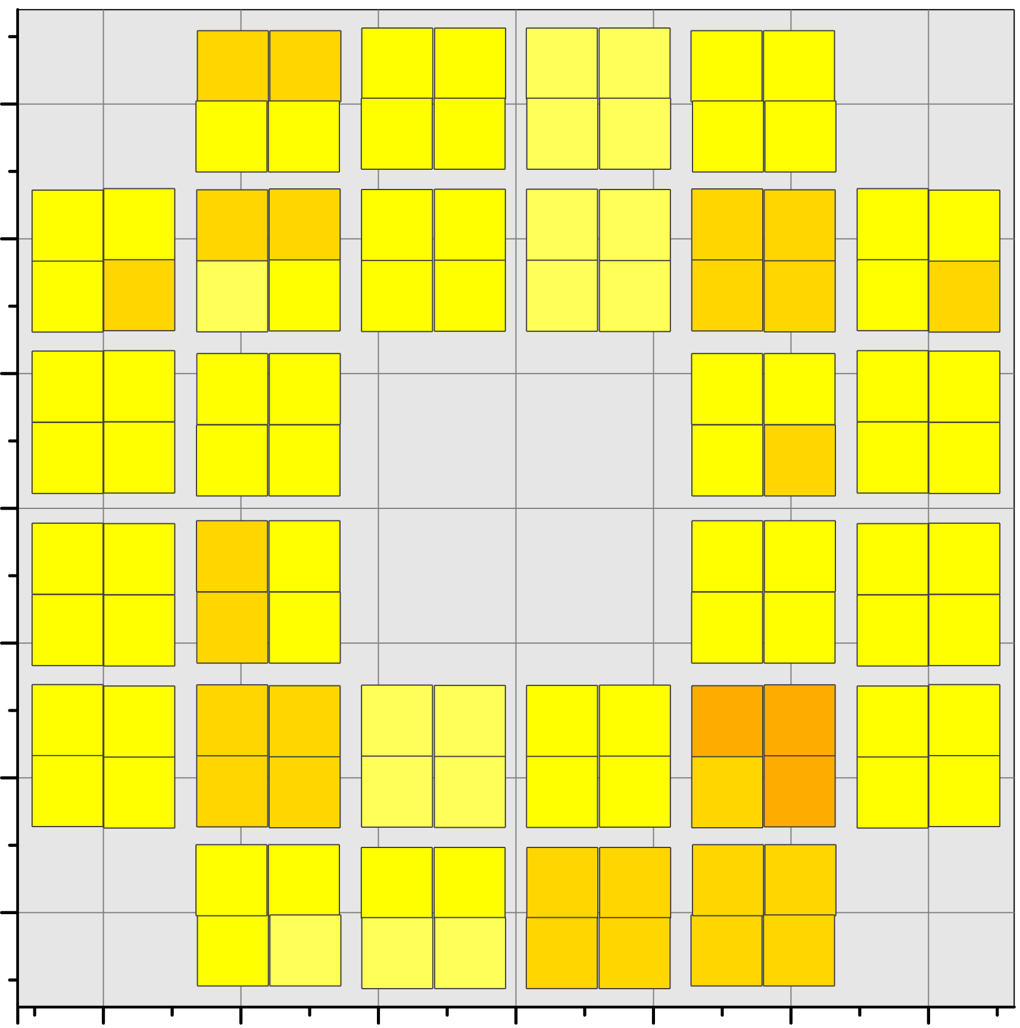
The Fast Interaction Trigger of ALICE
ALICE operation at increased luminosity w.r.t. the planned one → accelerated ageing of FT0 photosensors:
  Ageing correction techniques developed (tuning of 52 groups of 14 interdependent parameters);
  First correction already performed;
  Innermost photosensors to be replaced by spare units in few years from now.
Ageing
correction
here
0 pb⁻¹
Integrated luminosity delivered to ALICE
30 pb⁻¹
30 pb⁻¹
A
A
A
A
A
Change in the MCP-PMT response function
C
C

Slide 15
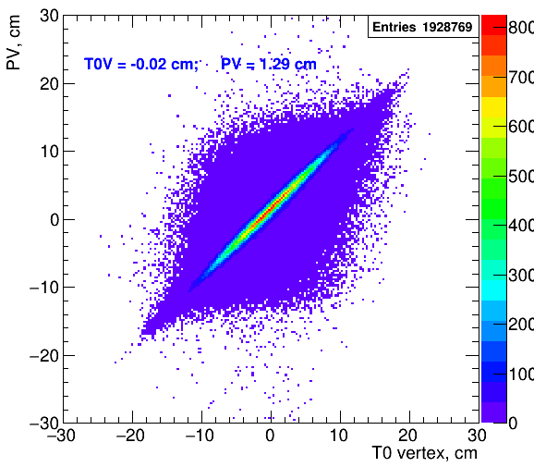
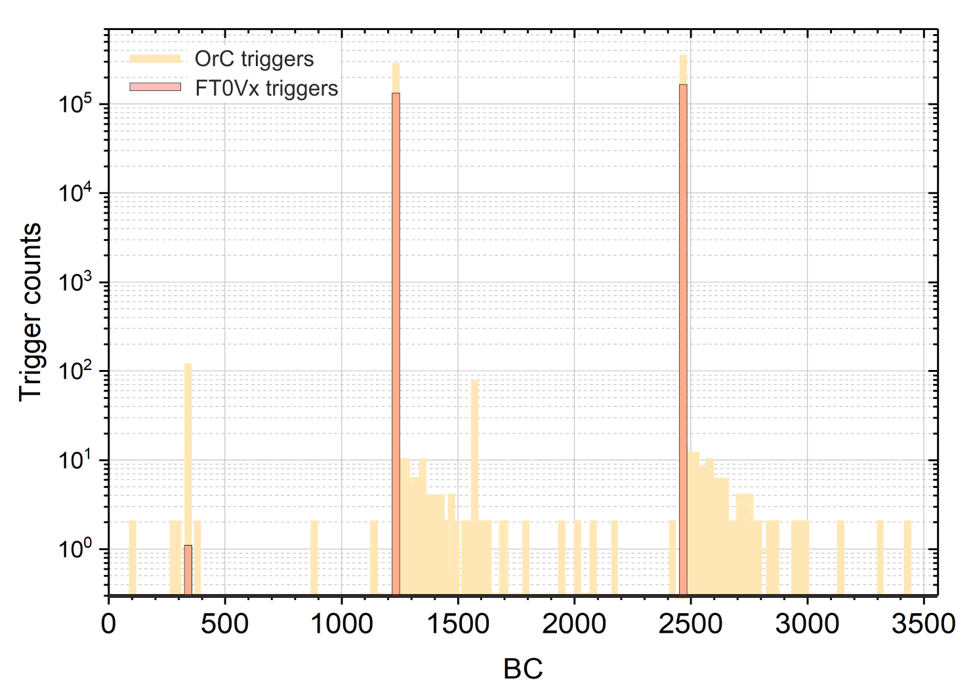
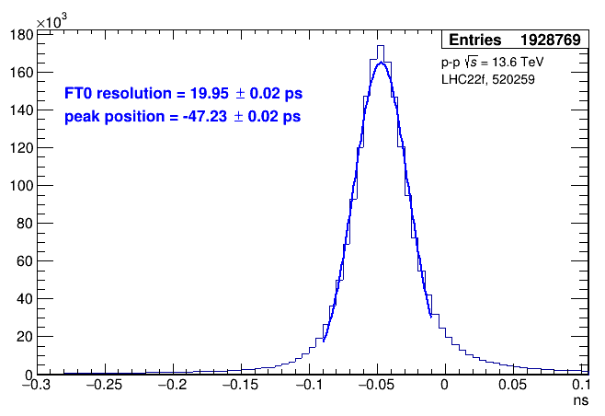
The Fast Interaction Trigger of ALICE
Few values on FT0 performance:
FT0Vx signal-to-noise ratio - better than 1:10⁵;
Time-zero resolution σ = 20 ps in pp, σ = 8 ps in Pb-Pb;
Unambiguous correlation with the post-processed vertex position served by ITS.

Slide 16
ALICE status and plans
Target ∫ L_{14 TeV p-p} for 2022 achieved: 16.5 pb⁻¹ collected in spite of serious problems in LHC beam availability;
  More pp data collected by ALICE in 2022 than in RUN1+2;
First VdM scan of RUN3 successfully performed early in November;
Inefficient LHC operation in August-September & December power savings → Pb-Pb run cancelled for 2022;
  Instead, Pb-Pb test beam was held last week;
  Target ∫ L_{14 TeV Pb-Pb} = 13 nb⁻¹ still unchanged – longer Pb-Pb running time allocated in 2023, 2024 and 2025;
  No change in plans for oxygen collisions in RUN3 (p-O & O-O);
YETS starts in four days from now, first beam of 2023 – April 27th. Stay tuned!

Slide 17
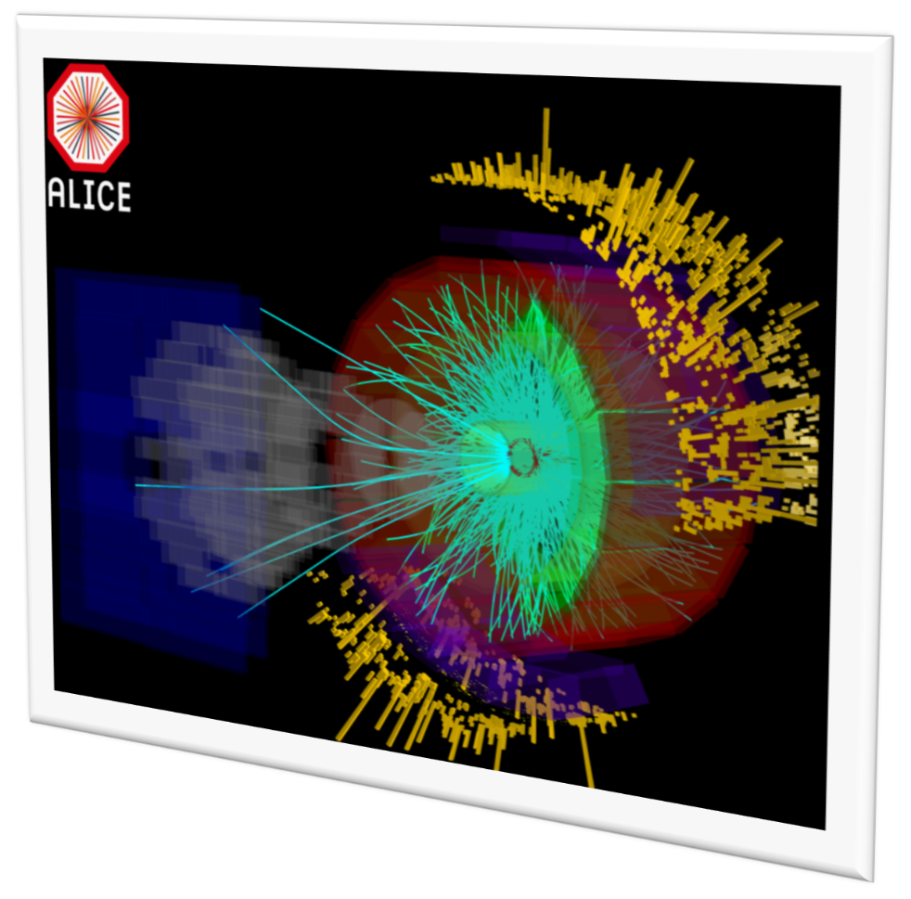
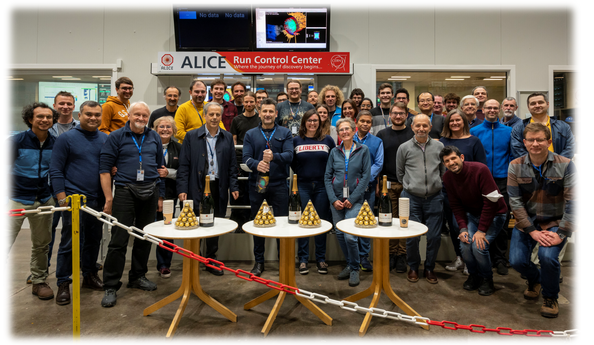
First Pb-Pb collisions since 2018
2 fills-long test beam for the detector commissioning in real conditions;
all 15 ALICE detectors taking data (ZDC commissioning finished just in time);
~50 Hz collision rate only (x1000 lower than the target Pb-Pb collision rate);
~12h of stable beams, ~2 million collisions delivered;

Slide 18
Conclusions
A remarkable year of ALICE operation came to its end:
  Hardware/firmware/software optimization and debugging throughout the entire year;
  Still, pp data sample of a record size was successfully collected;
  No Pb-Pb data this year, but a good occasion for Pb-Pb commissioning was provided.
A number of expectation vs reality discrepancies observed in the detectors performance (average load, radiation damage, ageing, data size etc.), but no show-stoppers so far;
  Looking forward to see some expectation vs reality discrepancies in data!
FIT was the last ALICE detector deployed in 2021. Still, successfully commissioned in time – serving the entire ALICE from the very first beams;
  Highest running efficiency from the very beginning;
  Few successful hardware fixes to improve performance;
  Plans for the detector activities in the next years being cleared up with the ageing observed.

Slide 19
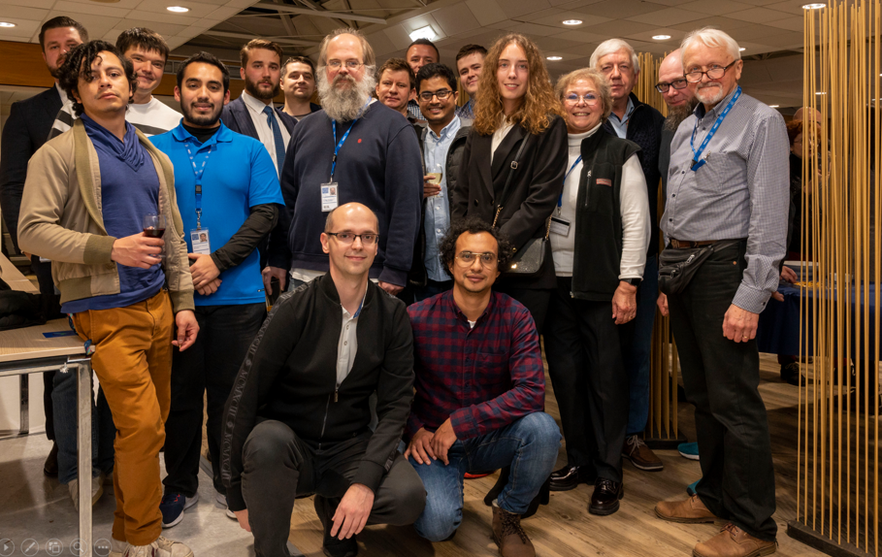
Thank you for your attention!
Part of FIT team at the latest ALICE week

Slide 20
Back-up slides

Slide 21
