Slide 1
The CMS/TOTEM Upgrades
F. García
On behalf of the CMS and TOTEM Collaborations

Slide 2
OUTLINE
TOTEM:
  Introduction and Experimental Apparatus
  Detector Upgrade for the nT2 telescope
  Installation, commissioning and running scenarios
The Precision Proton Spectrometer of CMS:
  Introduction and experimental apparatus
  Operation in Run 2 and Upgrade for Run 3
R&D for the HL-LHC Roman Pot Upgrades for Run4 and on:
  The Phase-2 inner tracker project and TimeSpot Collaboration
  The MIP Timing Detector (MTD) with LGADs
2

Slide 3
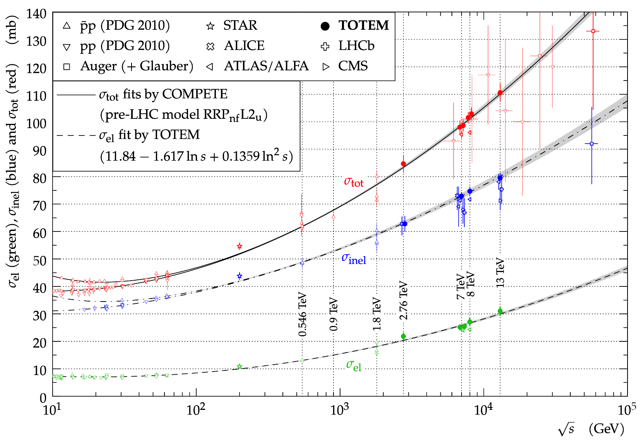
σ_{tot}, σ_{inel} and σ_{el} as a Function of √s
TOTEM FORWARD PHYSICS EXPERIMENT FOCUSES ON THE MEASUREMENTS OF:
The total proton proton (pp) cross section,
The ρ parameter,
The elastic differential pp cross section in a wide range of |t|,
Diffractive physics with CMS
The total, elastic and inelastic cross-sections as measured at various LHC energies and below.
3

Slide 4
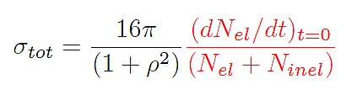
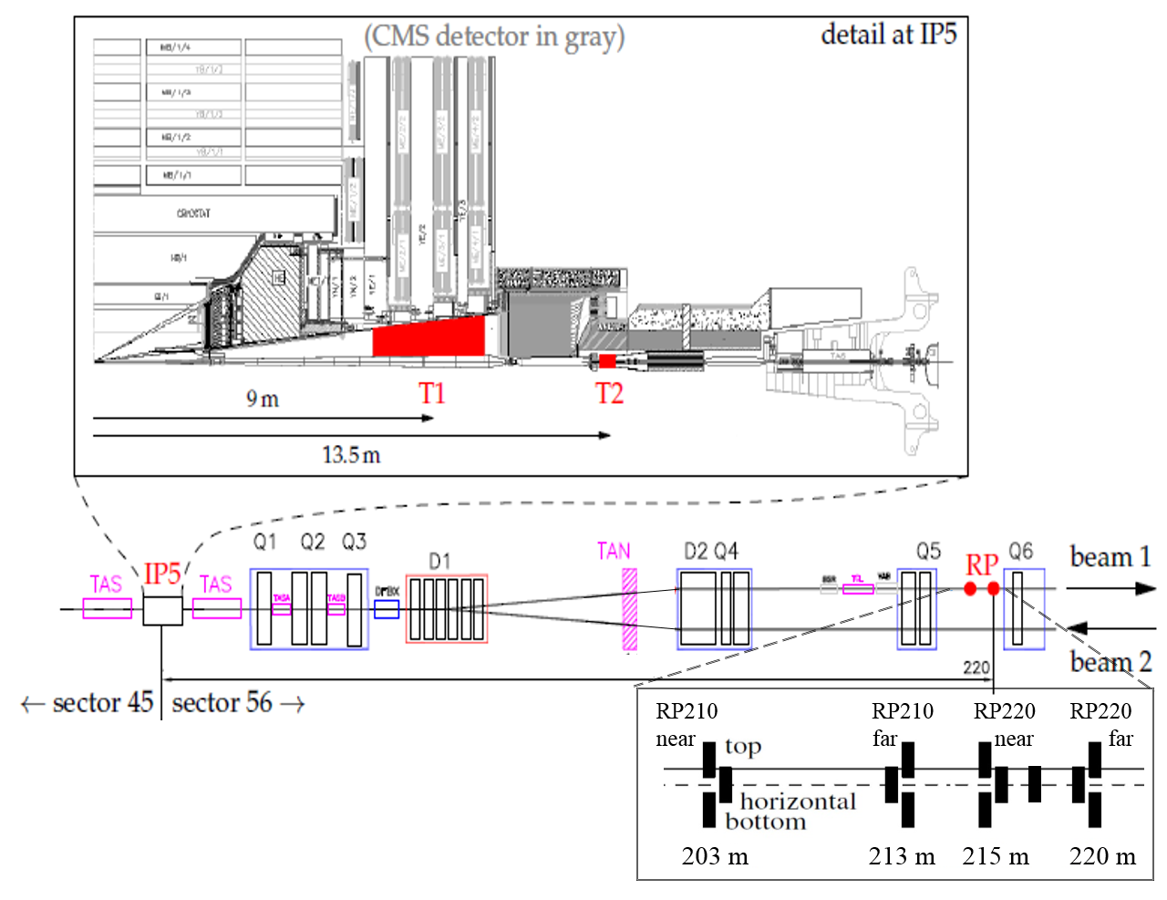
σ_{tot} Measurement at √s = 13.6 TeV
Luminosity independent method:
Dedicated special
β* = 90 m run in 2023
n
Old T2 not compatible with the LHC vacuum pipe installed in LS2 (for CMS HGCAL)
4

Slide 5

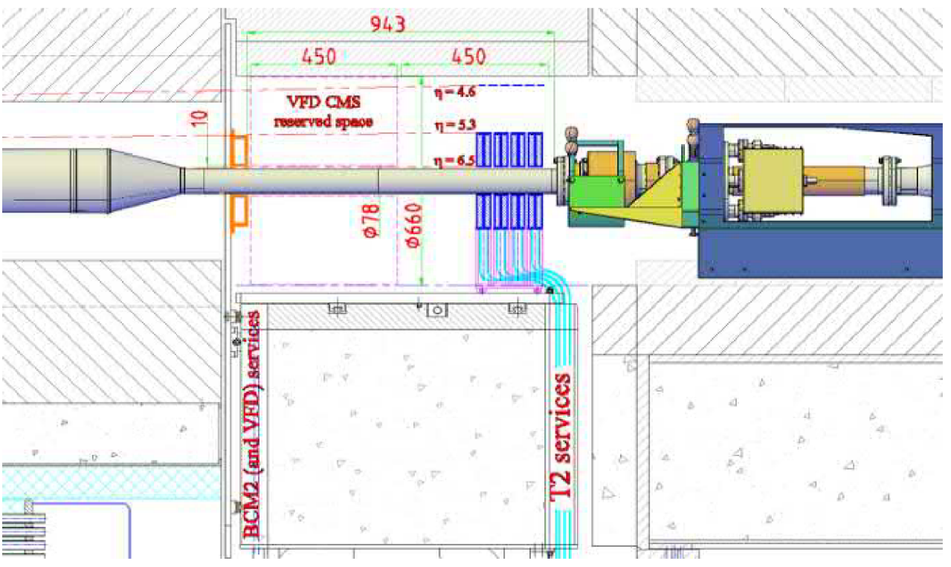
nT2 Telescope for Run 3
A new plastic scintillitaion based detector for the TOTEM experiment is designed to measure the rate of inelastic proton-proton events in low luminosity special runs dedicated to the measurement of the total cross section at the highest LHC energy.
With a pseudorapidity coverage of 5.3 < |η| < 6.5, the new T2 will detect more than 90 % of the inelastic events at a center-of-mass energy of 13.6 TeV and thus allow a precise inelastic rate and total cross section measurement.
5

Slide 6
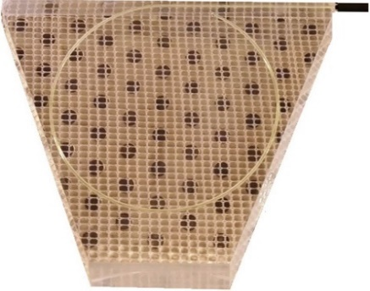
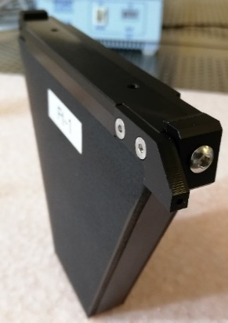
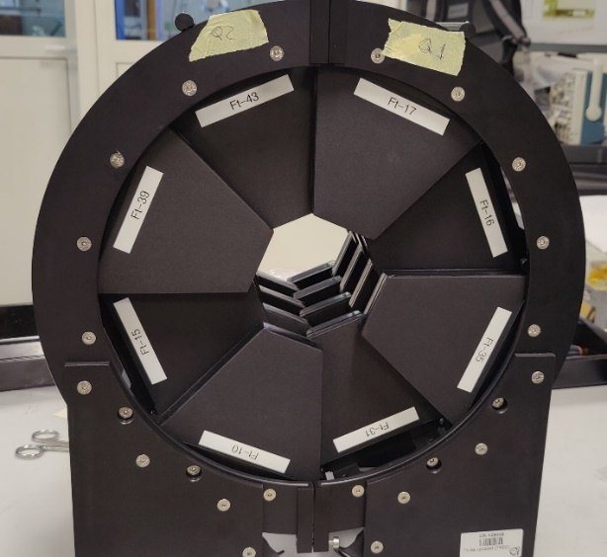
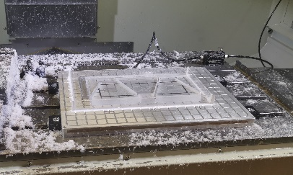
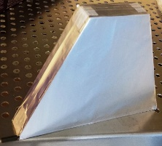
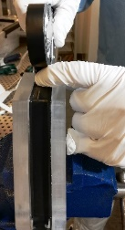
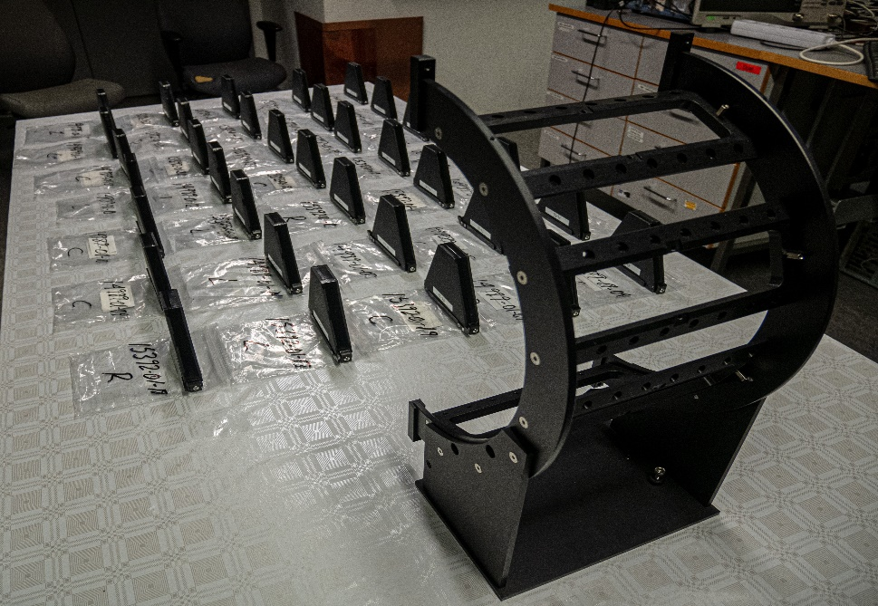
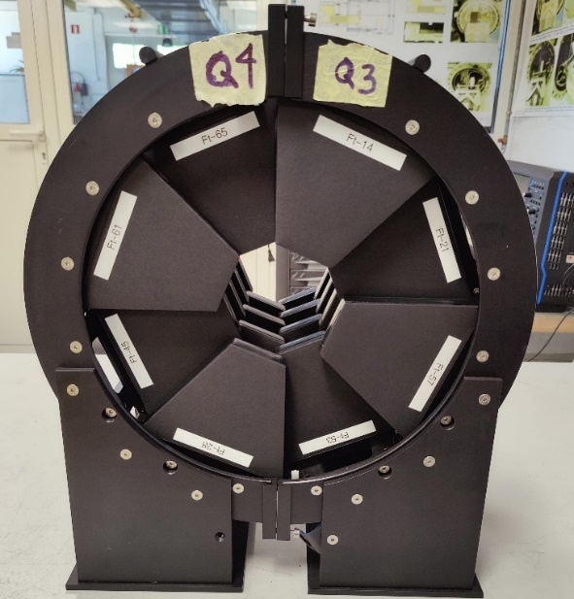
nT2 Installation, Commissioning and Running Scenarios
Process developed at HIP: mechanical workshop & clean rooms
nT2 telescope goes to the CMS - side
Final Tile structure and assembling
nT2 telescope goes to the CMS + side
The Finnish Contribution to TOTEM experiment is very wide from the coordination of the physics program to the R&D of the different types of detectors currently in use, as for instance the production and operation of the T2 telescope and now with its upgrade.
The production of 80 tiles is finished at the Helsinki Institute of Physics. They are used to equip four quarters, which forms two telescopes.
Set of tiles for all four quarters
6

Slide 7
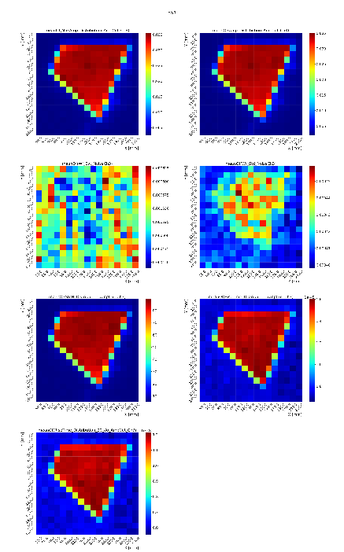
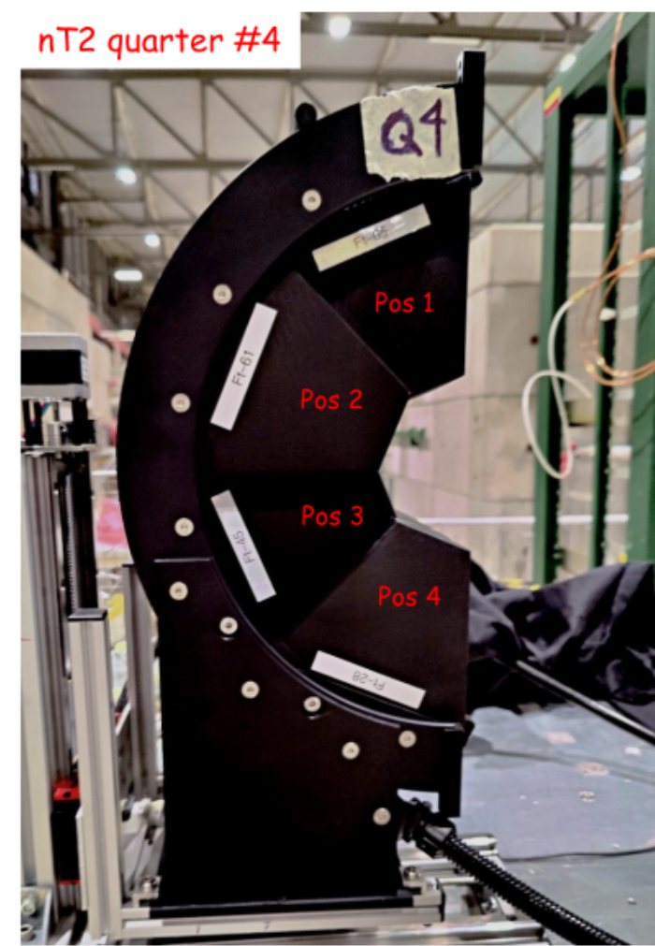
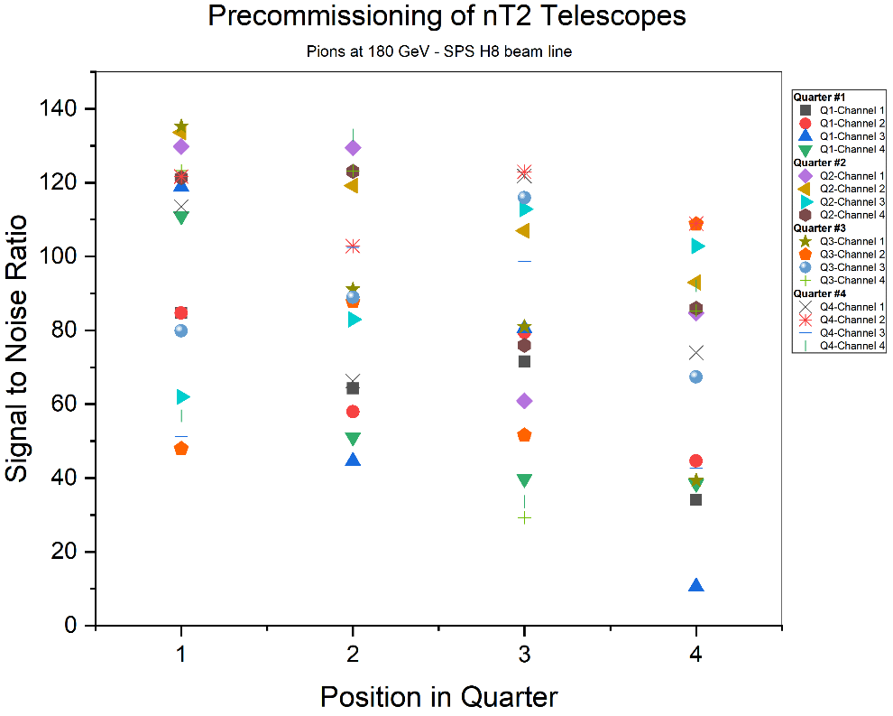
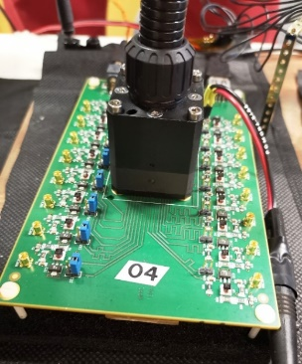
Tomography scans of Amplitude, Noise, Signal to Noise ratio and Rise time
nT2 Tiles Test Beam at the SPS in 2022
The tomography scans of the Mean Amplitude, Noise, Signal to Noise ratio and Rise Time for pions showed good uniformity for all four quarters.
2022 → Commissioning 1st quarter in May at SPS
2022 → Commissioning 2nd, 3rd and 4th quarters
2023 → New date for the special run?
Test setup at the SPS – H8 line
The photosensor used for the measurements was a Hamamatsu MPPC matrix array of 4 x 4 pixels. Operating at temperature around 30C and with a bias voltage of 54V
Acceptance limit
Test bench card for the photosensor
7

Slide 8
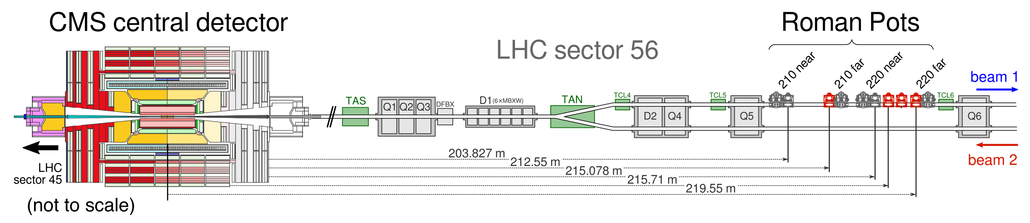
The Precision Proton Spectrometer of CMS
timing RPs
[*] F. Garcia for The Tenth Annual Large Hadron Collider Physics - LHCP2022
CT-PPS was a joint CMS-TOTEM project to study Central Exclusive Processes → Since 2018 is a CMS subdetector
Detects intact protons surviving from the IP and driven by magnets within the beam pipe → Detector approach the beam at few millimetres
With the Tracking Roman Pots stations used for measuring the proton kinematics using the LHC as spectrometer
And with the Timing Roman Pots stations used to measure the proton time-of-flight to reduce the pile-up background by correlating the vertex with the one of the central system
during Run 3 (2023-25) / Run 2 (2016-18)+2022 two tracking stations and two/one timing station
Designed to operate continuously at standard LHC running conditions (for Run2 PPS collected data
up to an integrated luminosity of 100 fb⁻¹)
8

Slide 9
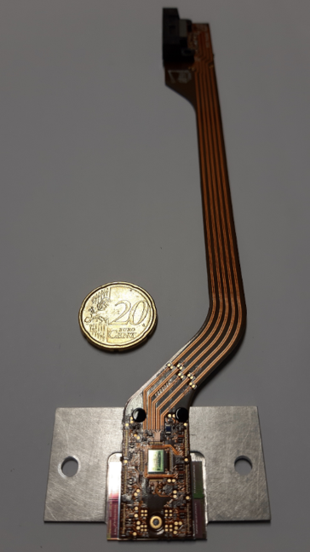
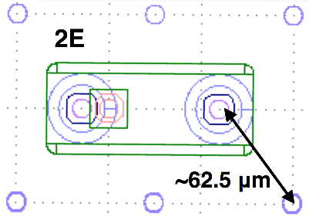
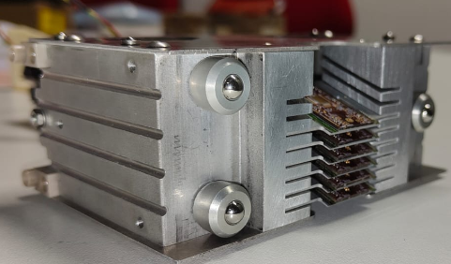
PPS - Roman Pots Upgraded for Tracking
New 3D Silicon Pixel detectors produced by FBK:
  Single side technology
  2 x 2 sensor geometry
  150 μm thick
  2E electrode configuration
ROC: PROC600 (same as for layer-1 of CMS pixel detector)
Pixel electrode configuration
Flex cable with detector and electronics
New flex circuit design (different look but similar to the one used in Run 2)
New detector package with internal moving system (12 positions spaced by 500 μm withstanding 50 fb⁻¹ with minimal efficiency losses)
One pixel package equipped with six detector planes
[*] A. Solano for the Precision Proton Spectrometer of CMS: performance and upgrade – ICHEP2020
9

Slide 10
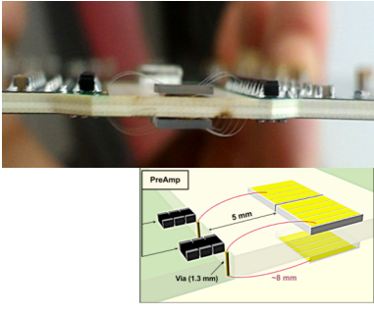
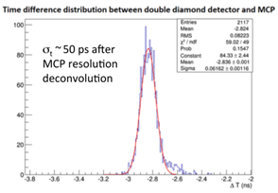
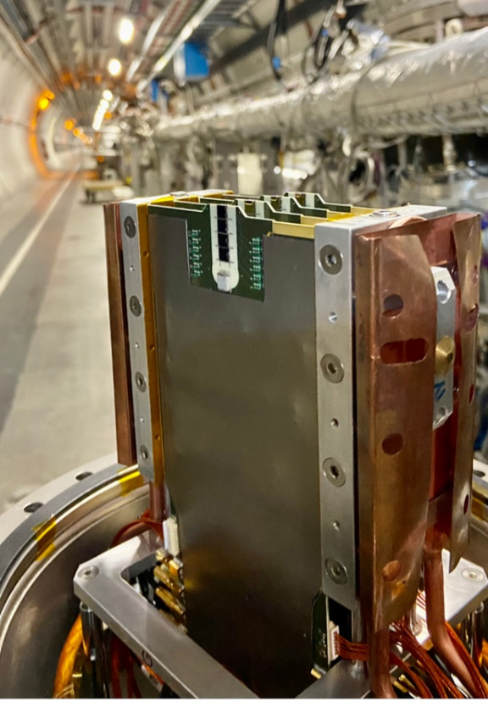
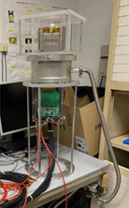
PPS - Roman Pots Upgraded for Timing
DD plane configuration (right)
ScCVD diamond detectors:
  Four Double Diamond (DD) detectors per plane (4.5 mm x 4.5 mm) of
  500 μm thick (detector configurations of 2 and 4 strips)
  Intrinsic radiation hardness withstanding an integrated radiation
  flux 5⋅10¹⁵ p/cm²
Time resolution for a DD plane (left)
  Time resolution 50 ps per plane
  Amplification with TOTEM hybrids (remote control for low voltages)
  Readout by TOTEM boards (remote control of thresholds) for NINO chips plus HPTDC (calibration)
RP in sector 56 at the LHC tunnel (right)
Lab test of High voltage stability under vacuum (bottom)
[*] M. Beretti et al., JINST 12 (2017) P03026
For Run 3:
Two Roman pot already equipped with double diamond planes and installed at the LHC tunnel in sectors 45 and 56
Two more additional stations to be installed during the
EYETS 2022
Ultimate resolution goal (< 30 ps) with the 7 – 8 planes on each sector
10

Slide 11
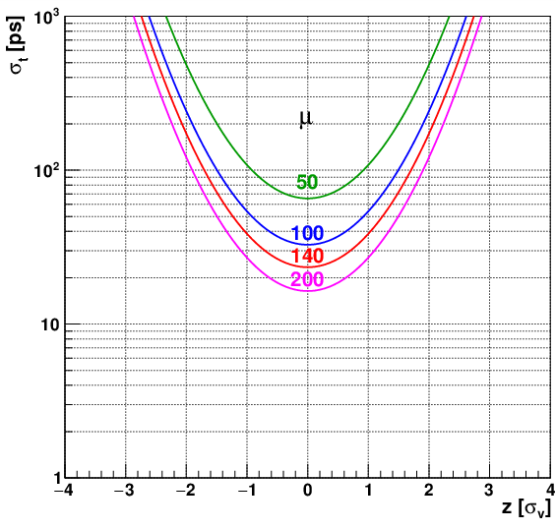
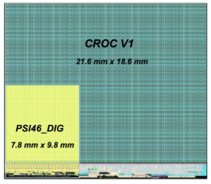
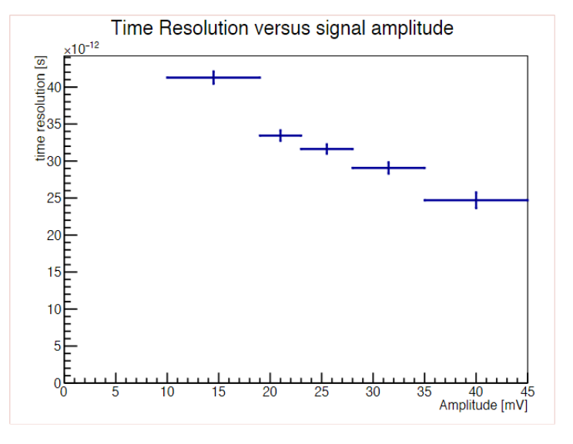
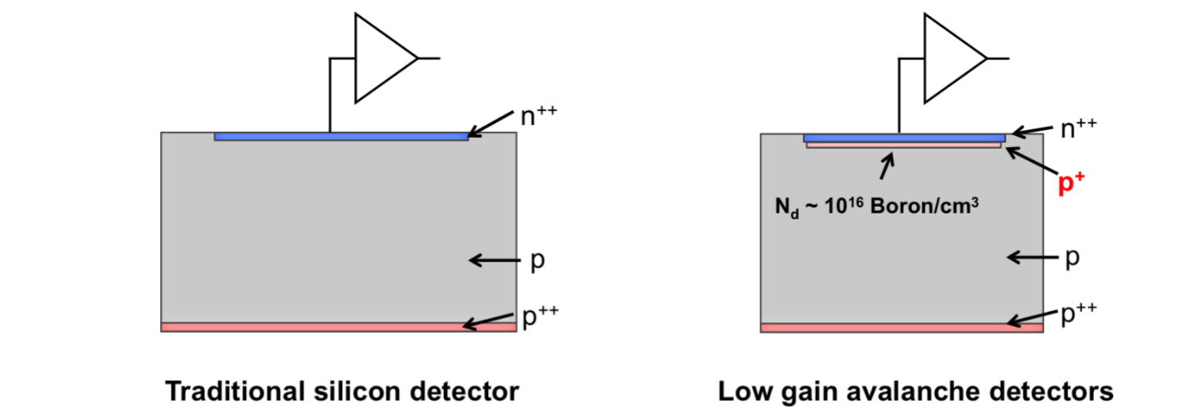
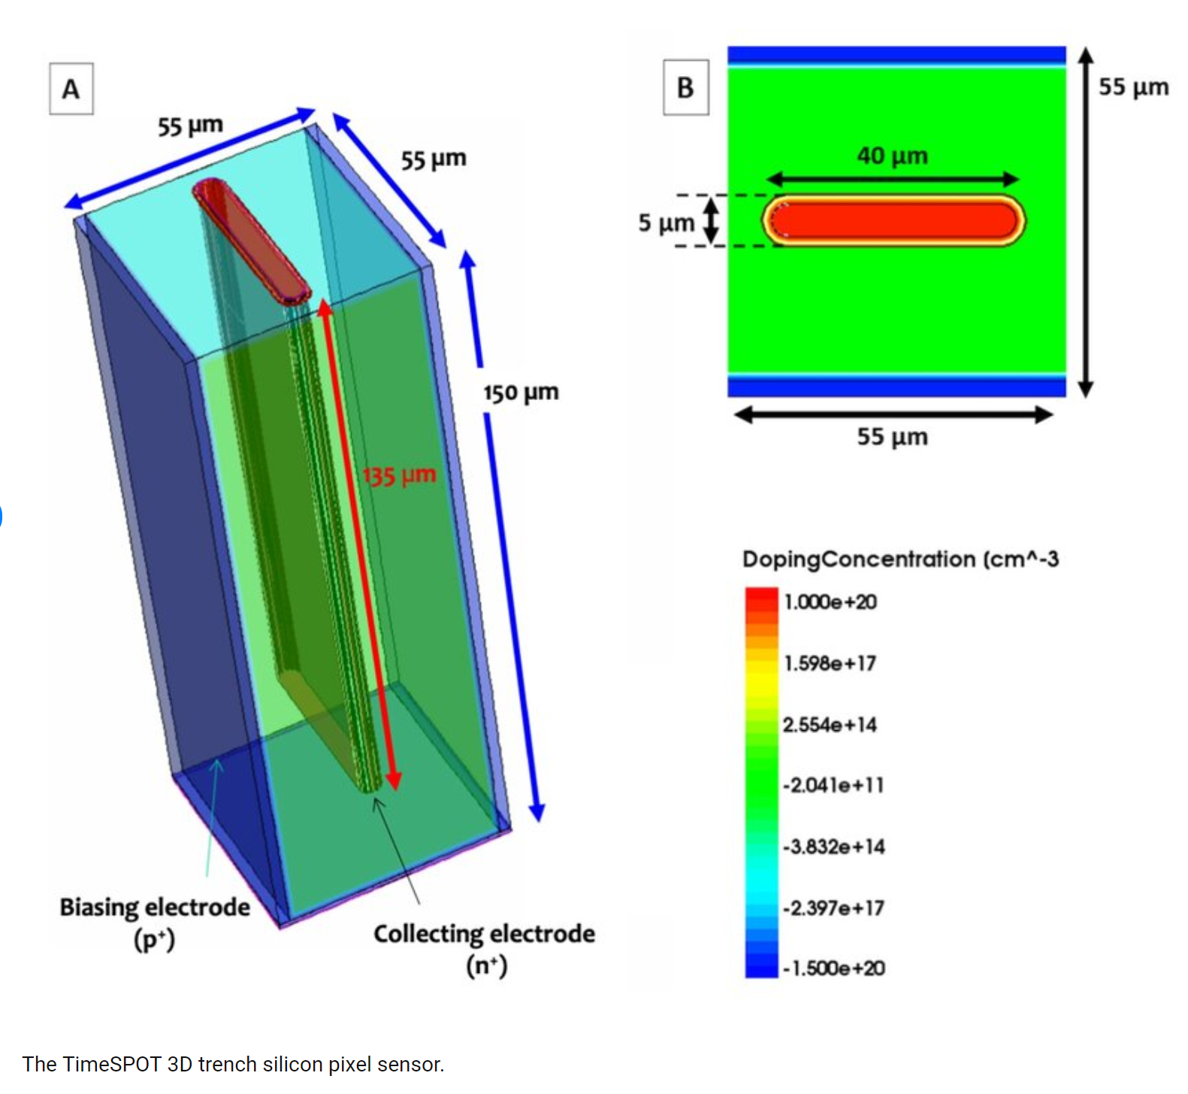
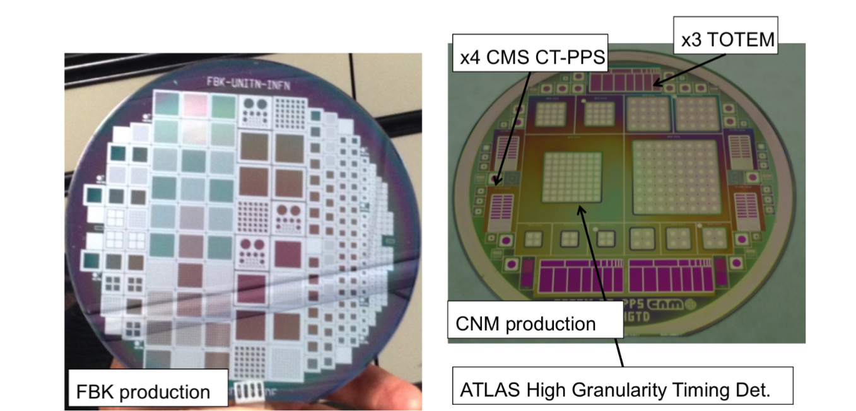
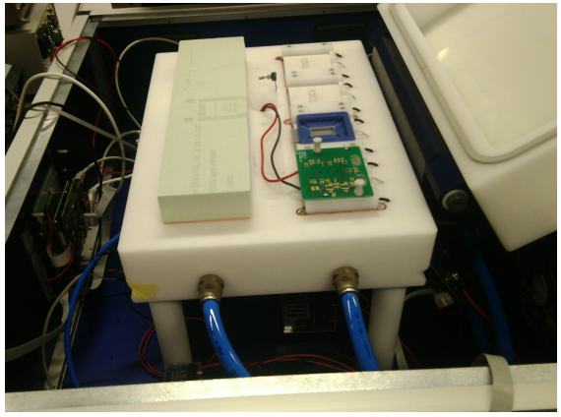
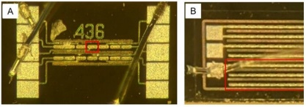
R&D for HL-LHC Roman Pot Upgrade for Run4 and on
Challenges:
Increased of the pile-up multiplicity at the interaction point in the HL-LHC
(L ≈ 7.5 x 10³⁴ cm⁻² s⁻¹) . A factor of 3 - 4 higher than in Run2 and Run 3
Timing requirements for combined PPS – MTD of about 15 ps
Synergies:
For the tracking possible scenario a solution with the TimeSpot collaboration
For the Timing possible combine collaborations:
  The TimeSpot collaboration (some colleagues are working in PPS)
  The Phase-2 Inner Tracker and the MIP Timing Detector (MTD) (lead by Prof. Panja Lukka)
The CMS collaboration. The CMS Precision Proton Spectrometer at the HL-LHC -- Expression of Interest. arXiv:2103.02752.
Phase-2 Inner Tracker
TimeSpot Detector
Low Gain Avalanche Detector
Hybrid pixel modules using new CROC ASIC.
Smaller pixels for less occupancy.
Planar n-in-p Si sensors baseline, rad hard 3D Si sensors for innermost layer.
S. Orfanelli et al., JINST 17 C08003,2022
Finnish contribution:
Building, testing and calibrating 250 TEPX modules
Produced successfully our first full digital module with CROCs
Currently: setting up of TEPX readout electronics in Helsinki lab to develop QC software; constructing of cold box for QC of pixel modules.
R. Mulargia et al., 15th Topical Seminar on Innovative Particle and Radiation Detector
CERN-LHCC-2017-027 ; LHCC-P-009. Technical proposal for a MIP timing detector in the CMS experiment Phase 2 upgrade
Courtesy of: E. Brucken
11

Slide 12
SUMMARY
The scintillator based nT2 telescope of TOTEM will be installed for the total cross section measurements at 13.6 TeV during special run (~ 2023)
The CMS Precision Proton Spectrometer has been upgraded for tracking and timing in continuous data taken during Run 3
Looking for synergies in the R&D of suitable technologies to be used for the HL-LHC upgrade of the Roman Pots
12

