Slide 1
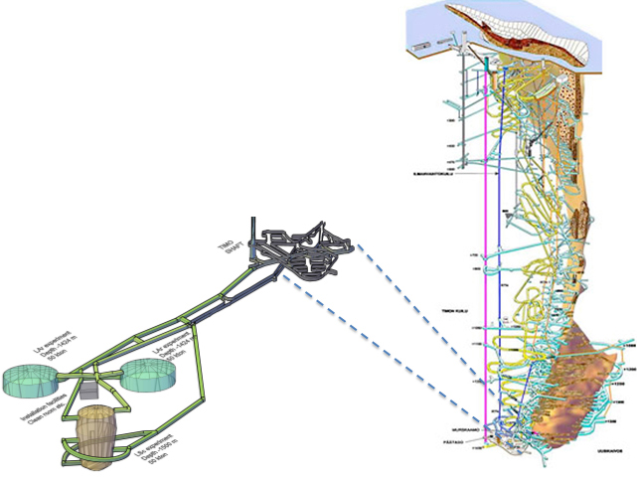
LAGUNA
The status of Pyhäsalmi Mine
Jari Joutsenvaara,
Particle Physics Days 7/11/2019

Slide 2
Life
after
X
LAGUNA
The status of Pyhäsalmi Mine

Slide 3
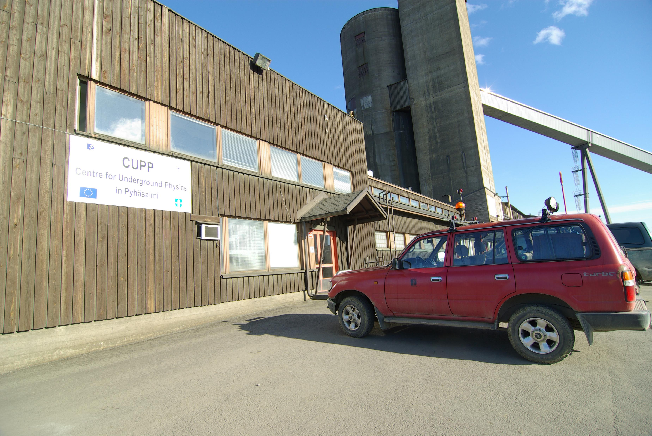


From single science to multidisciplinary

Slide 4
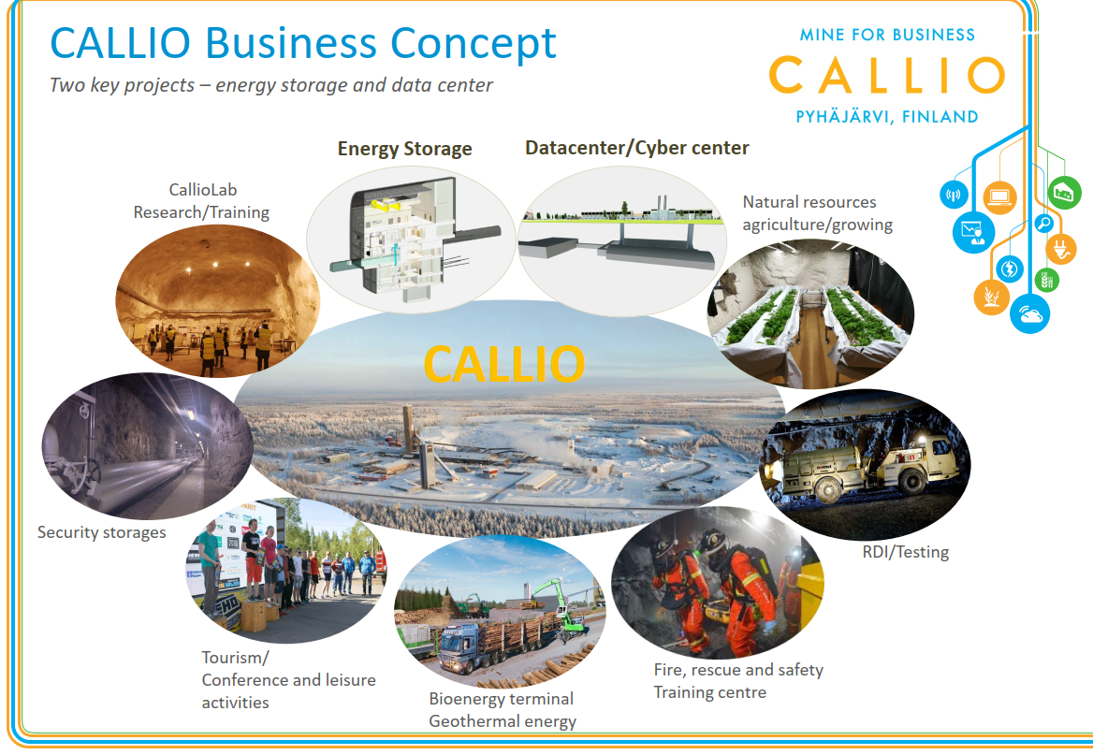



Callio Lab is a unique underground research environment in Pyhäsalmi, Finland.
It is one of the corner stones of CALLIO – mine for business. The aim of CALLIO Business Concept is to be economically feasible environment for all activities.
Some facts about Callio Lab (former CUPP)
Callio Lab is steered by the University of Oulu
Good understanding of overall geological structures & characteristics of measuring halls
Growing network
New research initiatives
On-going
Feasibility study
Design study

Slide 5
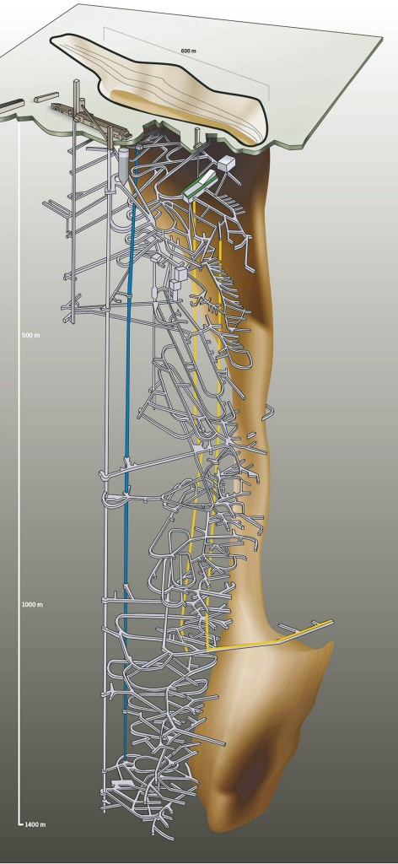

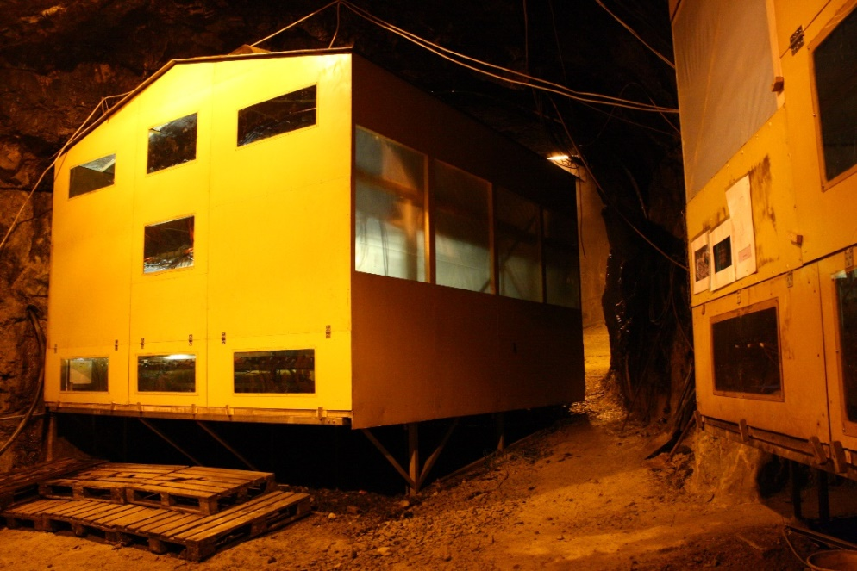
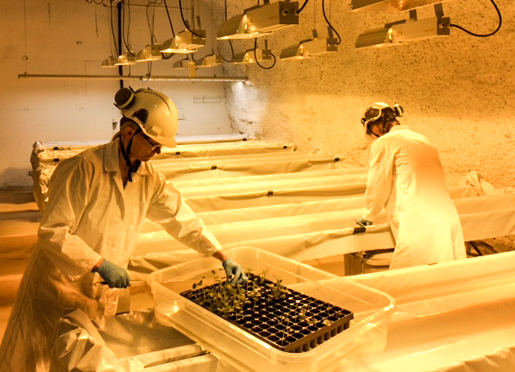
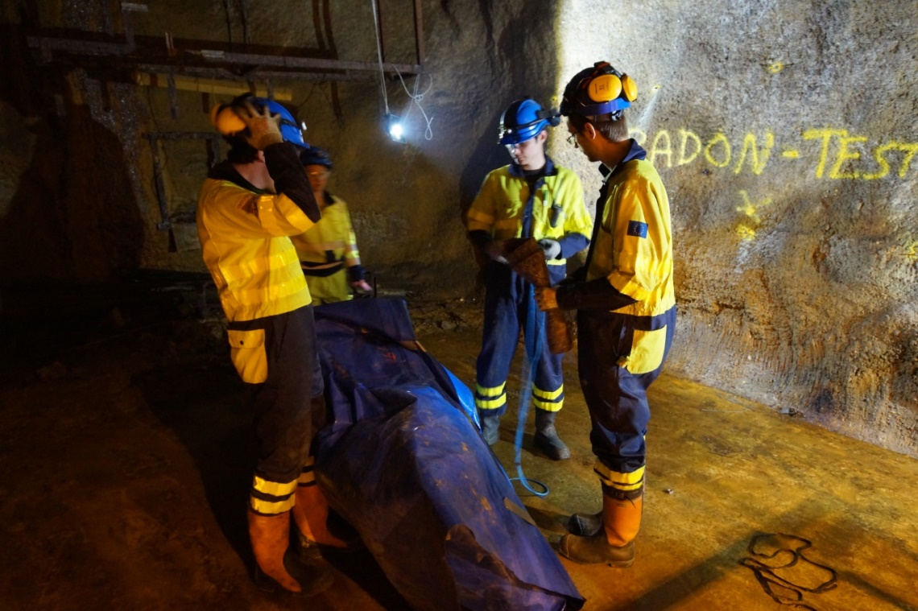
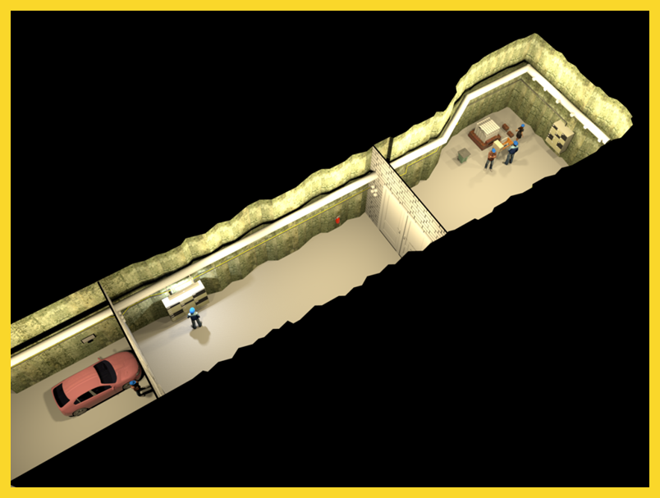
LAB 1
Existing underground multidisciplinary research environments
  Physics: LAB 1, Main level
  Biology and food production: LAB 2, LAB 4
  Underground information modelling: LAB 3
  Occupational health (iLighting): Main Level
  Geology and hydrogeology studies: LAB 2
  MINETRAIN: all over the mine
  Microseismic network: all over the mine
LAB 4
Main level
LAB 3
LAB 2

Slide 6
Vision for 2025
Callio Lab 2025 =
Organisation dedicated to underground science and facilitating research, which requires underground conditions
Multidisciplinary knowledge center for conducting research in underground facilities
Callio in the Pyhäsalmi mine is the unique research tool in Finland for underground science
Callio Lab is included in Finnish research infrastructure roadmaps
Callio Lab participates in several networks of research infrastructure and is in the European roadmaps
  DULIA
  EPOS
  BSUIN → EUL
  EUROL

Slide 7
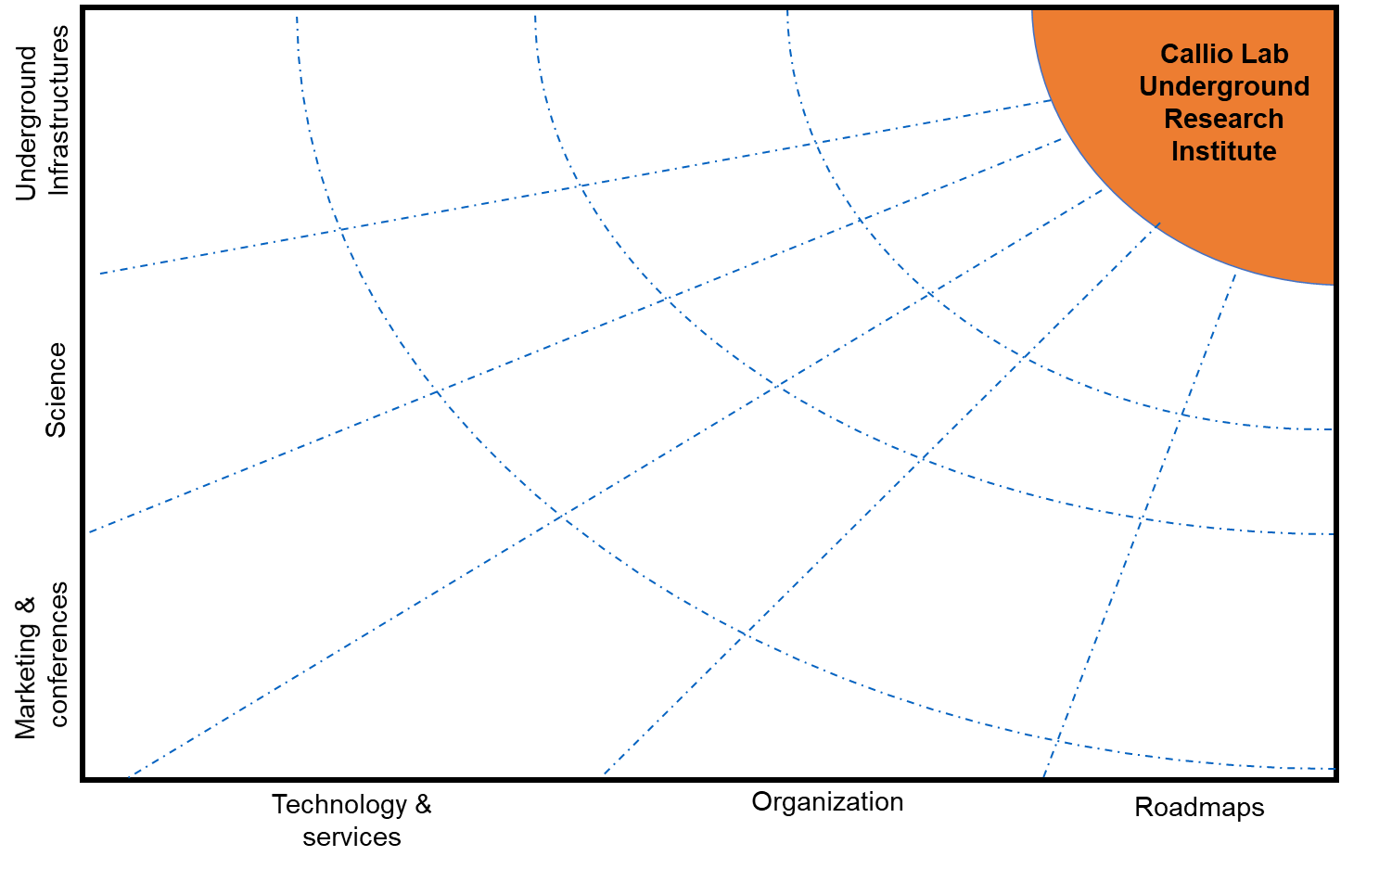
2018
2020
2022
2024
2025
CALLIO
2018
Post-mining
elevator and technical
services
Infrastructure
Readiness for
Large scale
Event production
Area design: Campus,
underground “city plan”
Functional service infrastructure
for underground tourism and industrial users
BSUIN
End of underground
mining
Improved low
Background lab
LUKE
Greenhouse
facilities
Muography lab
Marketing operations
w/ international stakeholders
Callio
SpaceLab
Mining education
MINETRAIN
Deep mining,
geophysics
Thematic Underground Science conferences
ISO/TS 16949 or
corresponding
QM system
for operations
Long term Vision
development
Tunneling
R&D
EUROL
EU Underground lab
network
Callio, and its
partner laboratories included in ERIC/ESFRI
Intelligent
lighting pilot
infrastructure for
facilitating large
International science
experiments
C14-experiment
Online multi-channel marketing
Geothermal
Energy production
Callio Lab
Co-ordinator
EMMA
BSUIN
Marketing activities,
Road show
Science
Exhibition, visitor center
Callio Lab
in FIRI
www.calliolab.com
update
Callio Lab’s
Steering group organized
ISO45001 for
EHS
EPOS
EUL
Network organization
Callio Lab
Reseach community
launch 2018
Agreement with Callio and the Mine until 2025 (2030)
Callio Lab
included in
the participating organizations
strategy

Slide 8
2018
2020
2022
2024
2025
End of underground mining 6/2021
End of re-mining 2025-26
CALLIO
2018
Post-mining
elevator and technical
services
Infrastructure
Readiness for
Large scale
Event production
Area design: Campus,
underground “city plan”
Functional service infrastructure
for underground tourism and industrial users
BSUIN
End of underground
mining
Improved low
Background lab
LUKE
Greenhouse
facilities
Muography lab
Marketing operations
w/ international stakeholders
Callio
SpaceLab
Long-term vision
Geosciences research and education
Physics research
Occupational health
Circular-economy
Deep mining,
geophysics
Mining education
MINETRAIN
Thematic Underground Science conferences
ISO/TS 16949 or
corresponding
QM system
for operations
Long term Vision
development
Tunneling
R&D
EUROL
EU Underground lab
network
Callio, and its
partner laboratories included in ERIC/ESFRI
Intelligent
lighting pilot
infrastructure for
facilitating large
International science
experiments
C14-experiment
Online multi-channel marketing
Geothermal
Energy production
Callio Lab
Co-ordinator
EMMA
BSUIN
Marketing activities,
Road show
Science
Exhibition, visitor center
Callio Lab
in FIRI
Callio Lab community
  MoU in progress
Callio – Mine agreement until 2025 (2030)
Callio Lab’s
Steering group organized
www.calliolab.com
update
ISO45001 for
EHS
Within Univ. Oulu strategy
In EPOS
EPOS
EUL
Network organization
Callio Lab
Reseach community
launch 2018
Agreement with Callio and the Mine until 2025 (2030)
Callio Lab
included in
the participating organizations
strategy

Slide 9
Conclusions
Underground research is one of the corner stones of Callio
Callio Lab underground research community getting bigger
Callio agreement ensures the projects at least until 2025 (2030)
Activities of Callio in transition from project-based to more permanent → more security also for research
Researcher can benefit from the existing mine sensor networks and data
Underground science has a future at Pyhäsalmi Mine!

Slide 10
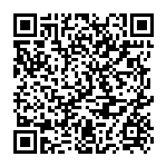
Thank you for listening!

Slide 11

ADVERTISIMENT
SPACE
Initiative

