Slide 1


Overview of left-right symmetric extensions of the SM
Particle Physics Day / Katri Huitu, 7.11.2019

Slide 2
OUTLINE
Motivation
Left-right extensions of the Standard Model
Simple left-right model
  Gauge bosons
  Fermions
  Higgs sector
  Tests of left-right model
Supersymmetrizing left-right model
  Dark Matter
Conclusions

Slide 3
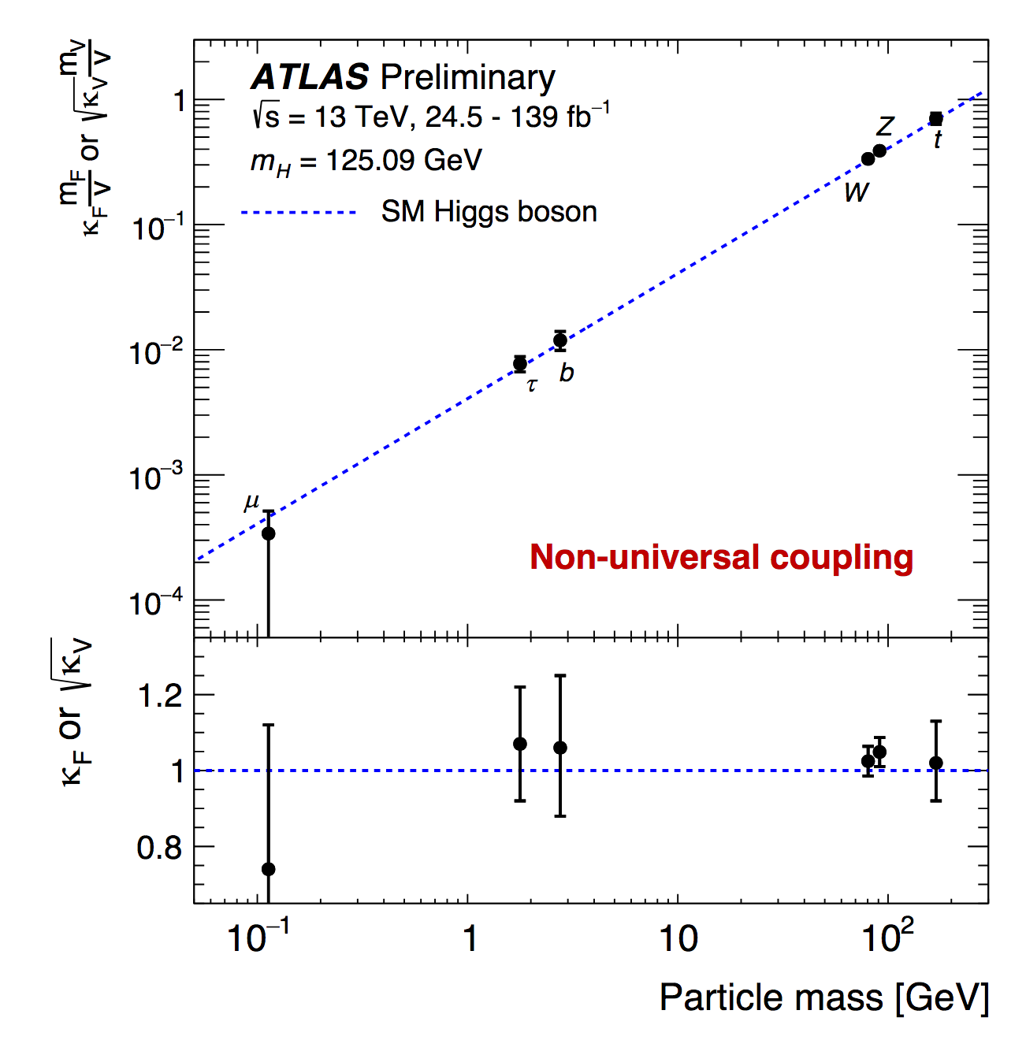
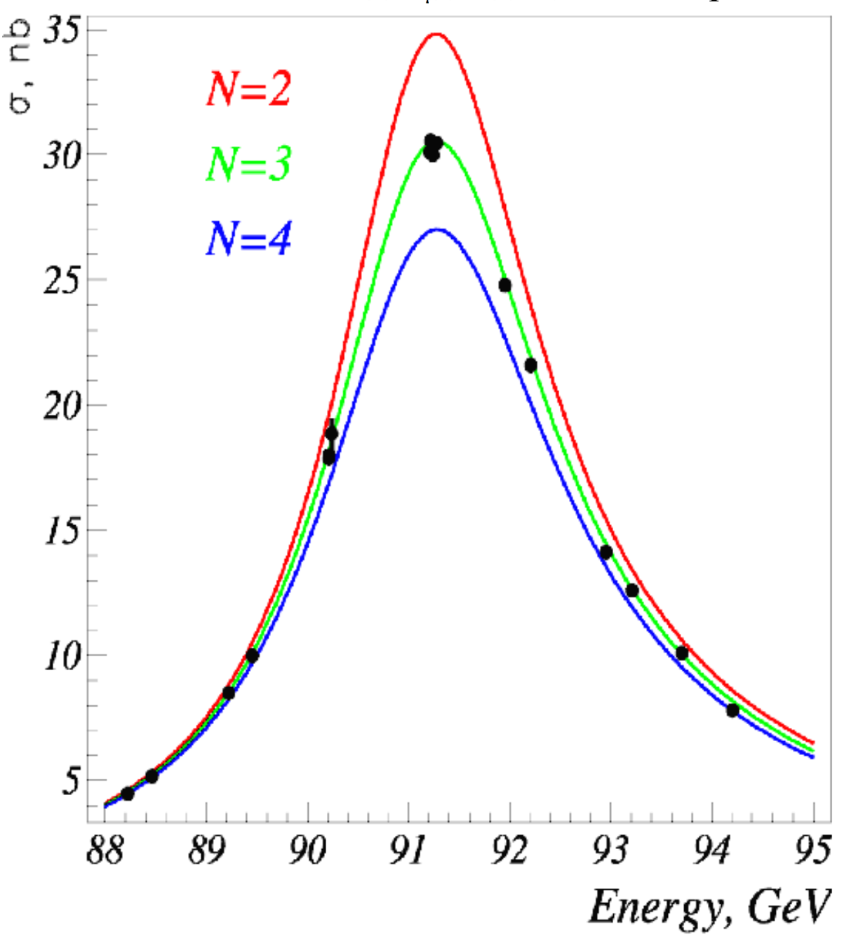
MOTIVATION
Problems in the Standard Model:
Neutrino mass
Dark matter
Higgs mass
Strong CP violation
Weak CP violation
No quantum gravity
…
Some mundane questions:
Why three generations?
Why large mass differences?
Why left- and right-handed fermions are fundamentally different?
...
LEP Legacy, hep-ex/0503050

Slide 4
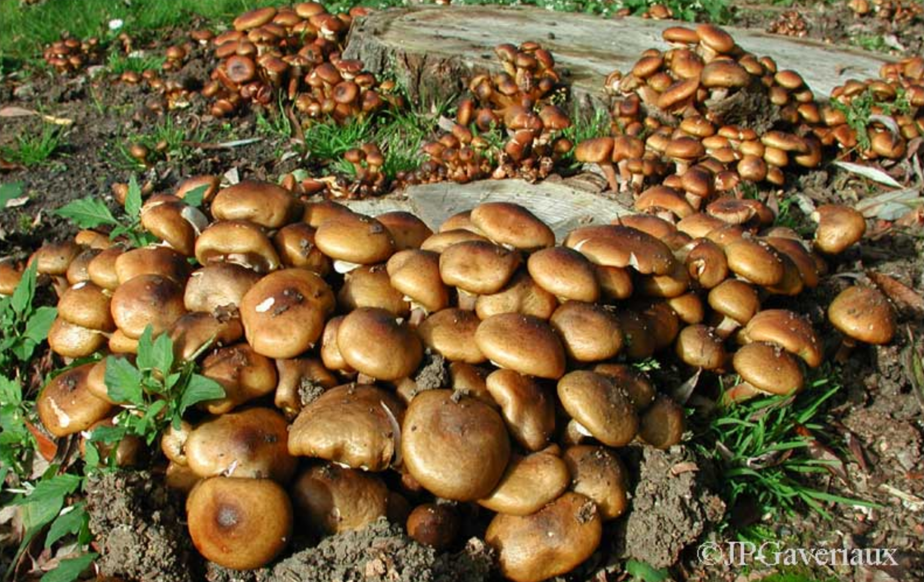
In recent years a multitude of BSM directions have appeared, both utilizing the ”old” BSM models with susy, extra dimensions, compositeness, and otherwise

Slide 5
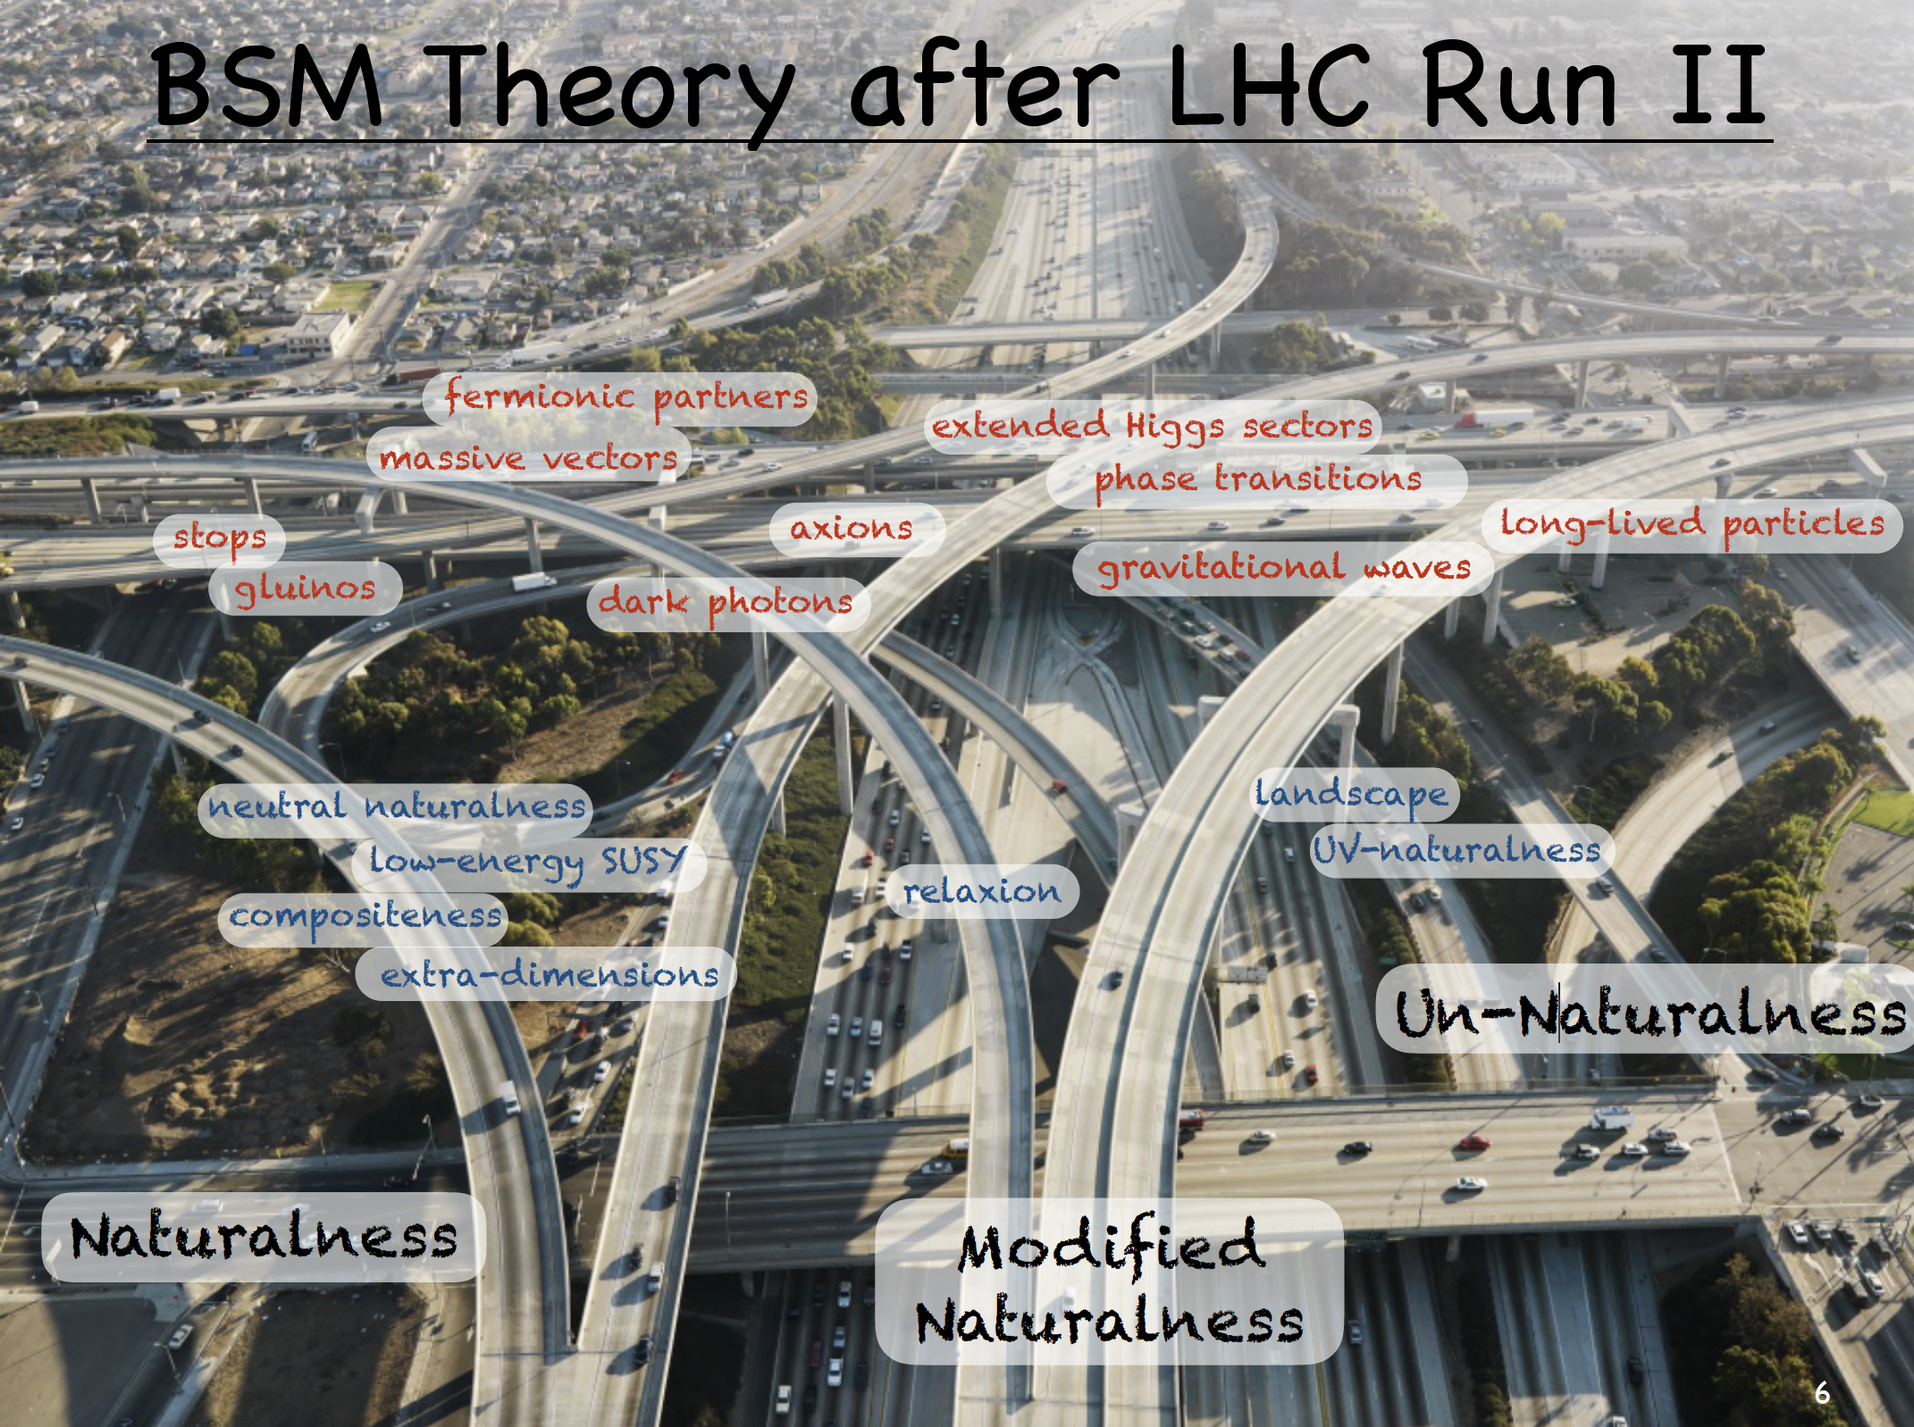
Panico in
EPS-HEP conference, 2019

Slide 6
A large number of models, including all kinds of combinations of earlier attempts.
Working close to experiments:
  Choose a model (personal preference is some well motivated model)
  Check the experimentally allowed parameter space (note: not a trivial task)
  Find testable predictions
  Discard the model/parameter region, if not viable

Slide 7
Left-right symmetric extensions of the Standard Model
Electromagnetic, strong and gravitational interactions conserve parity.
Maybe conserved at high energies also by weak interactions and dynamically broken
Pati, Salam (1974); Mohapatra, Pati (1975); Senjanovic, Mohapatra (1975)
If weak interactions were parity conserving at a high scale, every left-handed particle would need a right-handed counterpart
right-handed neutrinos needed
After neutrinos were deemed massive, neutrino mass has also become a motivation.
Smallest gauge group where left-right symmetry can be implemented is
SU(3)_{c} x SU(2)_{L} x SU(2)_{R} x U(1)_{B-L} Davidson (1979), Mohapatra, Marshak (1980)
Gauge symmetry could originate from SO(10) or E₆ unified model

Slide 8

Simple Left-Right Model with SU(2)_{L} x SU(2)_{R} x U(1)_{B-L}
Fermions:
${\left(Q_{L}\right)}^{i}=\left(\begin{matrix}u_{L}^{i} \\ d_{L}^{i}\end{matrix}\right)$=$\left(3,2,1,\frac{1}{3}\right)$, ${\left(Q_{R}\right)}^{i}=\left(\begin{matrix}u_{R}^{i} \\ d_{R}^{i}\end{matrix}\right)$=$\left(3,1,2,\frac{1}{3}\right)$,
${\left(L_{L}\right)}^{i}=\left(\begin{matrix}ν_{L}^{i} \\ ℓ_{L}^{i}\end{matrix}\right)$=$\left(1,2,1,−1 \right)$, ${\left(L_{R}\right)}^{i}=\left(\begin{matrix}ν_{R}^{i} \\ ℓ_{R}^{i}\end{matrix}\right)$=$\left(1,1,2,−1 \right)$
with L,R the left- and right-chiral components, $P_{L,R}=\left(1±γ_{5}\right)$

Slide 9

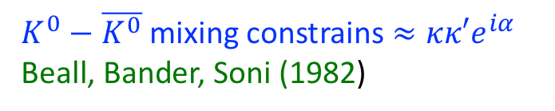
Higgs sector: need to break SU(2)_{L} x SU(2)_{R} x U(1)_{B-L} → SU(2)_{L} x U(1)_{Y}
Break SU(2)_{R} x U(1)_{B-L} → U(1)_{Y} by a triplet:
$∆_{R}=\left(\begin{matrix}∆_{R}^{+}/\sqrt{2} & ∆_{R}^{++} \\ ∆_{R}^{0} & {−∆}_{R}^{+}/\sqrt{2}\end{matrix}\right)=\left(1,1,3,2\right)$; $\left\langle ∆_{R}^{0}\right\rangle = v_{R}$
For simplicity, assume that $∆_{L}$ is decoupled Chang, Mohapatra, Parida, PRL (1984)
SU(2)_{L} x U(1)_{Y} → U(1)_{em} by a bidoublet:
$Φ=$ $\left(\begin{matrix}φ_{1}^{0} & φ_{2}^{+} \\ φ_{1}^{−} & φ_{2}^{0}\end{matrix}\right)$ = $\left(1,2,2,0\right)$; $\left\langle Φ\right\rangle$ = $\left(\begin{matrix}κ & 0 \\ 0 & κ^{′}e^{iα}\end{matrix}\right)$
$v_{R}≫κ≫κ$’; $κ^{2}+κ^{′2 }$=$v_{SM}^{2}$
$K^{0}−\overline{K^{0}}$ mixing constrains $≈κκ′e^{iα}$
Beall, Bander, Soni (1982)

Slide 10


Masses can be found from:
$ℒ_{Y}=h_{q,ij}^{a}{\overline{Q}}_{L,i}Φ_{a}Q_{R,j}+$ ${\tilde{h}}_{q,ij}^{a}{\tilde{Q}}_{L,i}{\tilde{Φ}}_{a}Q_{R,j}+h_{ℓ,ij}^{a}{\overline{L}}_{L,i}Φ_{a}L_{R,j}+$ ${\tilde{h}}_{ℓ,ij}^{a}{\overline{L}}_{L,i}{\tilde{Φ}}_{a}L_{R,j}$
$$+f_{ij}L_{R,i}^{T}Ciτ_{2}∆_{R}L_{R,j}+h.c.$$
With
Quark masses:
$M_{u}=h_{u}κ+$ ${\tilde{h}}_{u}^{}e^{−iα}κ$’; $M_{d}=h_{d}e^{iα}κ′+$ ${\tilde{h}}_{d}^{}κ$
Charged lepton masses $M_{ℓ}=h_{ℓ}e^{iα}κ′+$ ${\tilde{h}}_{ℓ}^{}κ$
$\tilde{Φ}=iσ_{2}Φ^{∗}$ $σ_{2}$

Slide 11
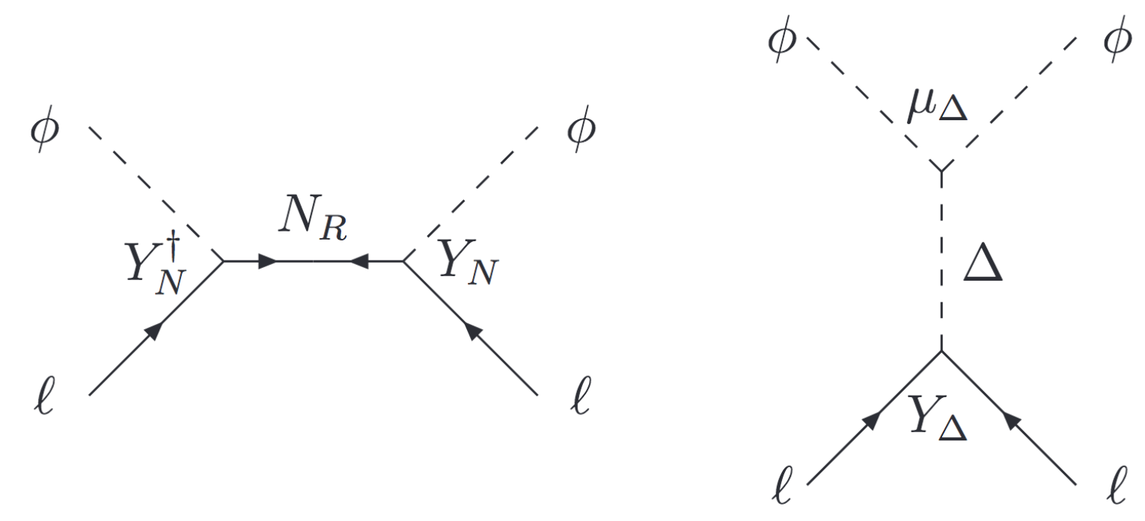
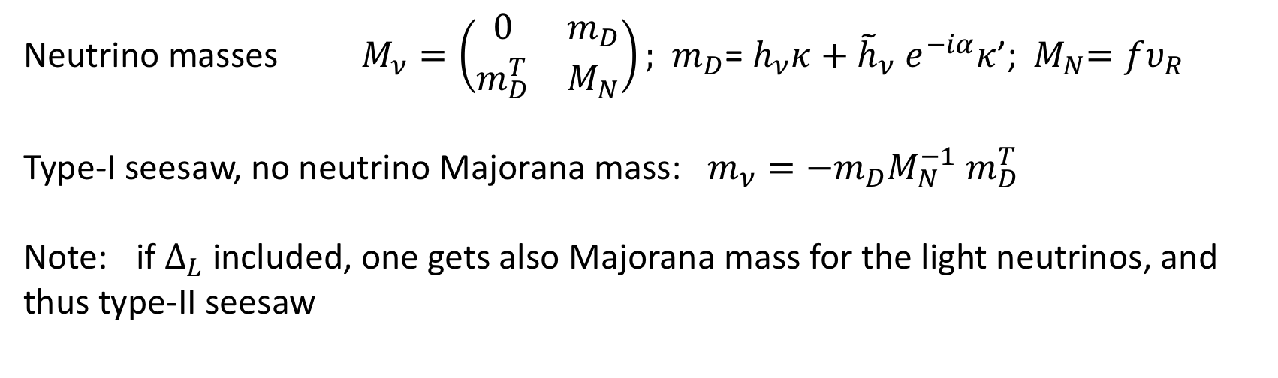
Neutrino masses $M_{ν}=\left(\begin{matrix}0 & m_{D} \\ m_{D}^{T} & M_{N}\end{matrix}\right);$ ${ m}_{D}$= $h_{ν}κ+$ ${\tilde{h}}_{ν}^{}e^{−iα}κ$’; ${ M}_{N}=fυ_{R}$
Type-I seesaw, no neutrino Majorana mass: $m_{ν}=−m_{D}M_{N}^{−1}$ $m_{D}^{T}$
Note: if $∆_{L}$ included, one gets also Majorana mass for the light neutrinos, and thus type-II seesaw
Gell-Mann, Ramond, Slansky (1979); Yanagida (1979); Mohapatra, Senjanovic (1980)
Type - I
Type - II

Slide 12

Gauge bosons, SU(2)_{L} x SU(2)_{R} x U(1)_{B-L}
New gauge bosons connected to enlarged gauge group $W_{R}, W, Z_{R}, Z$, γ
$m_{W}^{2}=\frac{g_{L}^{2}}{2}\left(κ^{2}+κ^{′2}\right)$; $m_{W_{R}}^{2}$ $=$ $g_{R}^{2}υ_{R}^{2}$
$m_{Z}^{2}=\frac{g_{L}^{2}}{2 cos2{θ_{W}}}\left(κ^{2}+κ^{′2}\right)$; $m_{Z_{R}}^{2}$ $=$ ${2(g}_{R}^{2}+g_{BL}^{2})υ_{R}^{2}$
Theoretically $\frac{g_{R}}{g_{L}}≳0.55$ ; the smaller the ratio is, the heavier $Z_{R}$ is
Mixings $≈\frac{g_{R}}{g_{L}}$ $\frac{m_{V}}{m_{V_{R}}}, V=W, Z_{}$

Slide 13
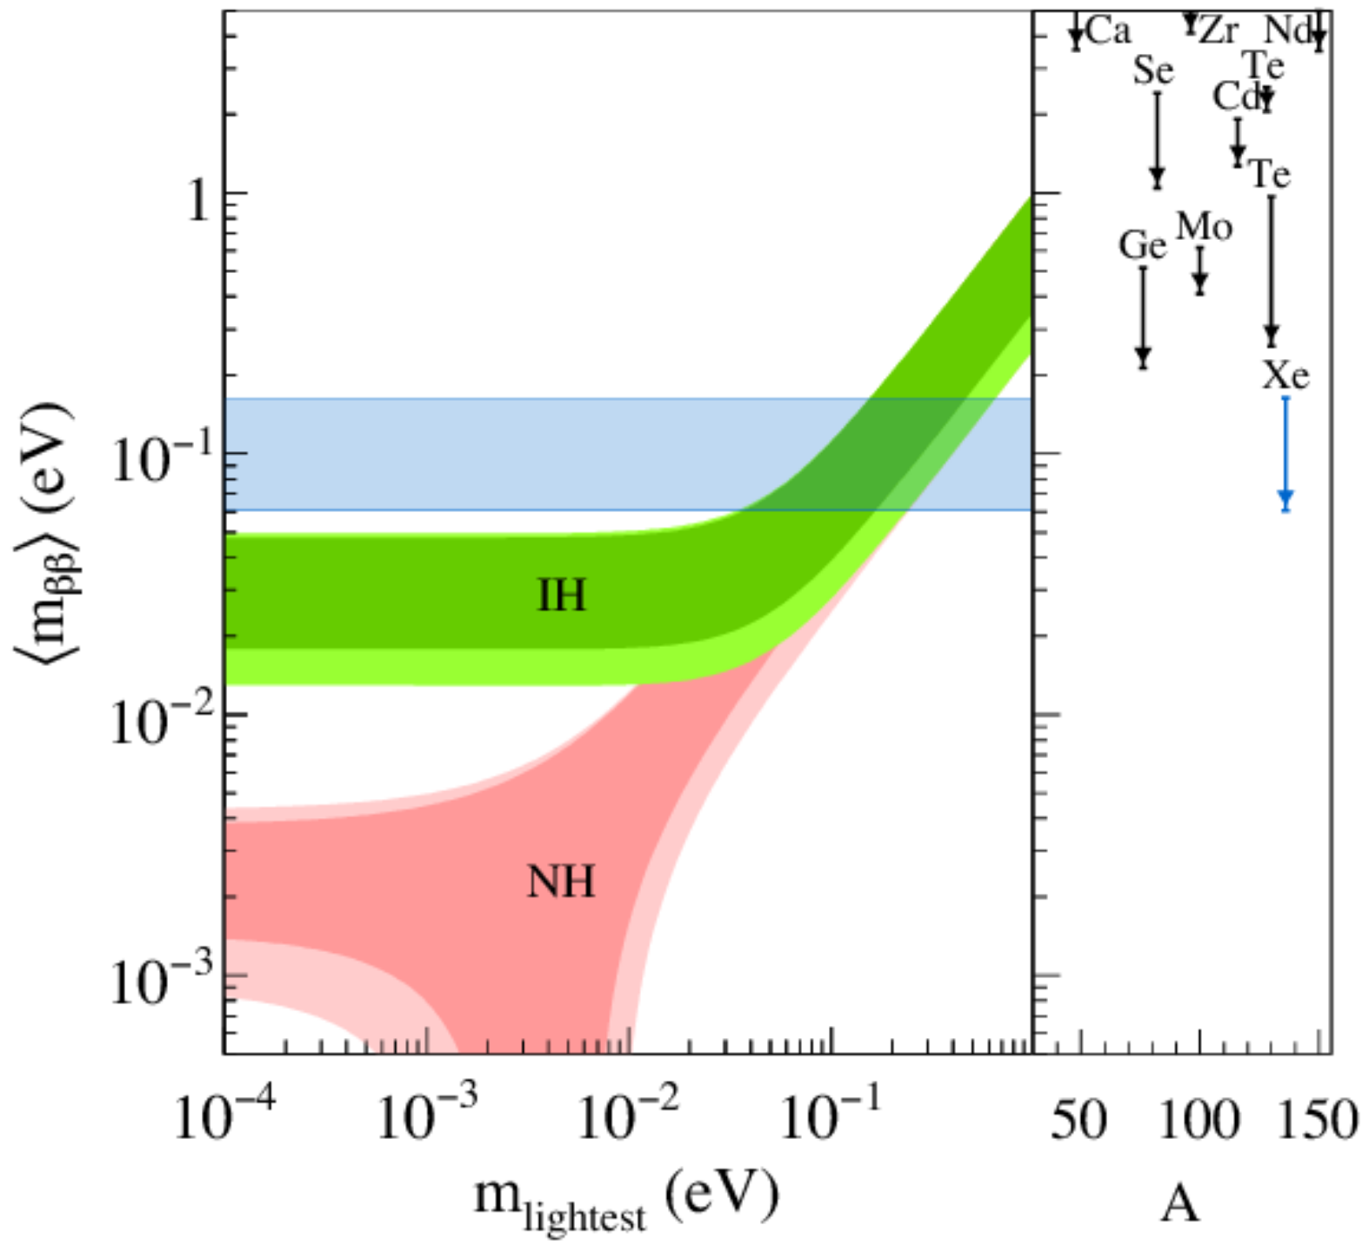
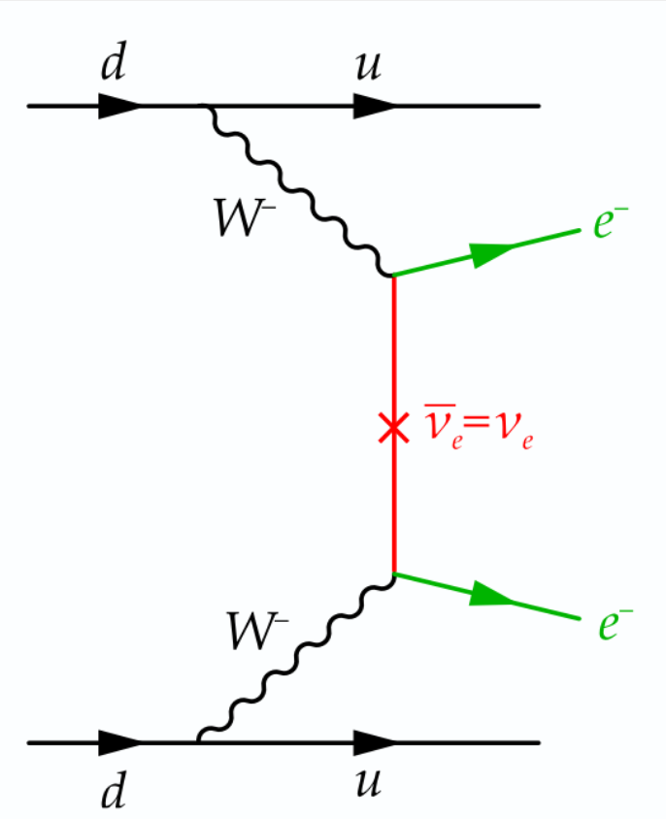

Tests of left-right model
Lepton number violating processes:
Neutrinoless double beta decay, 0$νββ$
Lepton number violation in
Meson decays, $τ→μ,eγ, μ→eγ, μ↔e$ –conversion,…
J. Engel et al, Rept.Prog.Phys (2017)

Slide 14
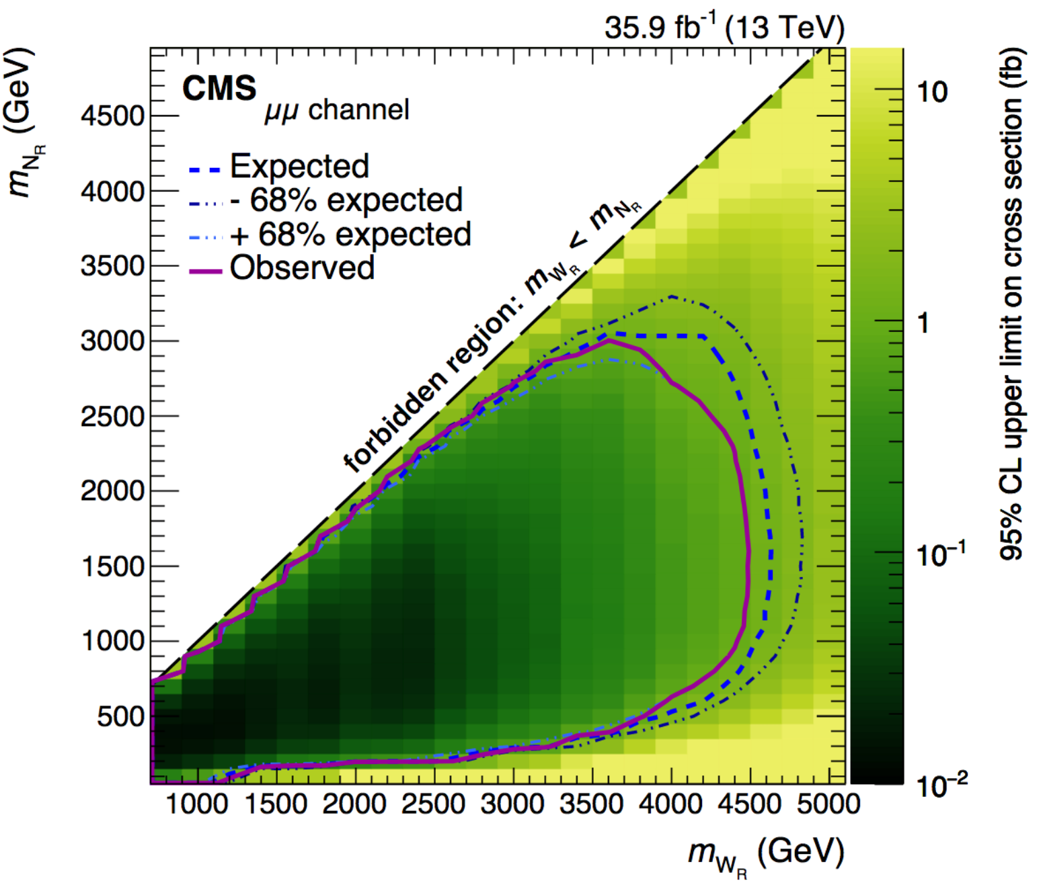
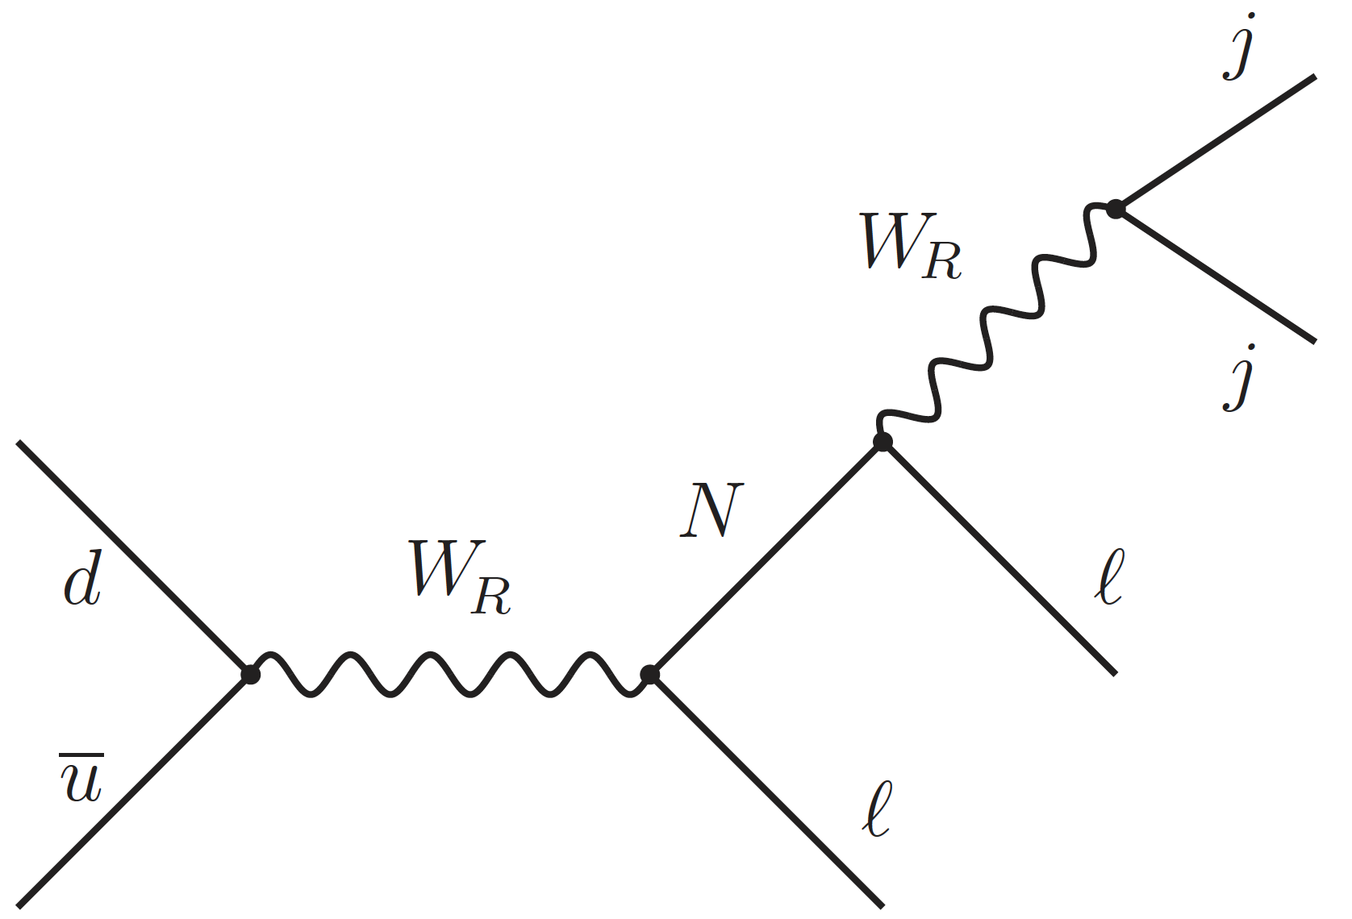
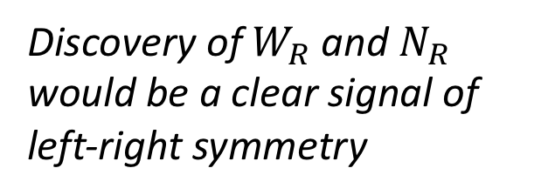
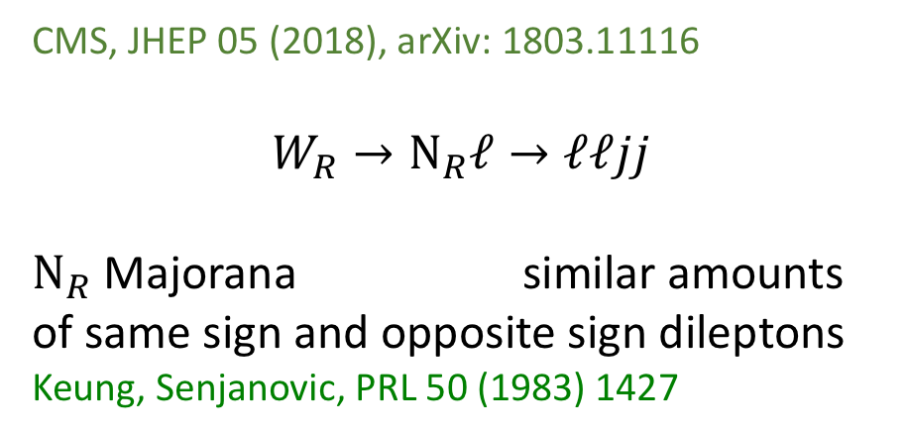
CMS, JHEP 05 (2018), arXiv: 1803.11116
$$W_{R}→N_{R}ℓ→ℓℓjj$$
$N_{R}$Majorana similar amounts of same sign and opposite sign dileptons
Keung, Senjanovic, PRL 50 (1983) 1427
Discovery of $W_{R}$ and $N_{R}$ would be a clear signal of left-right symmetry

Slide 15

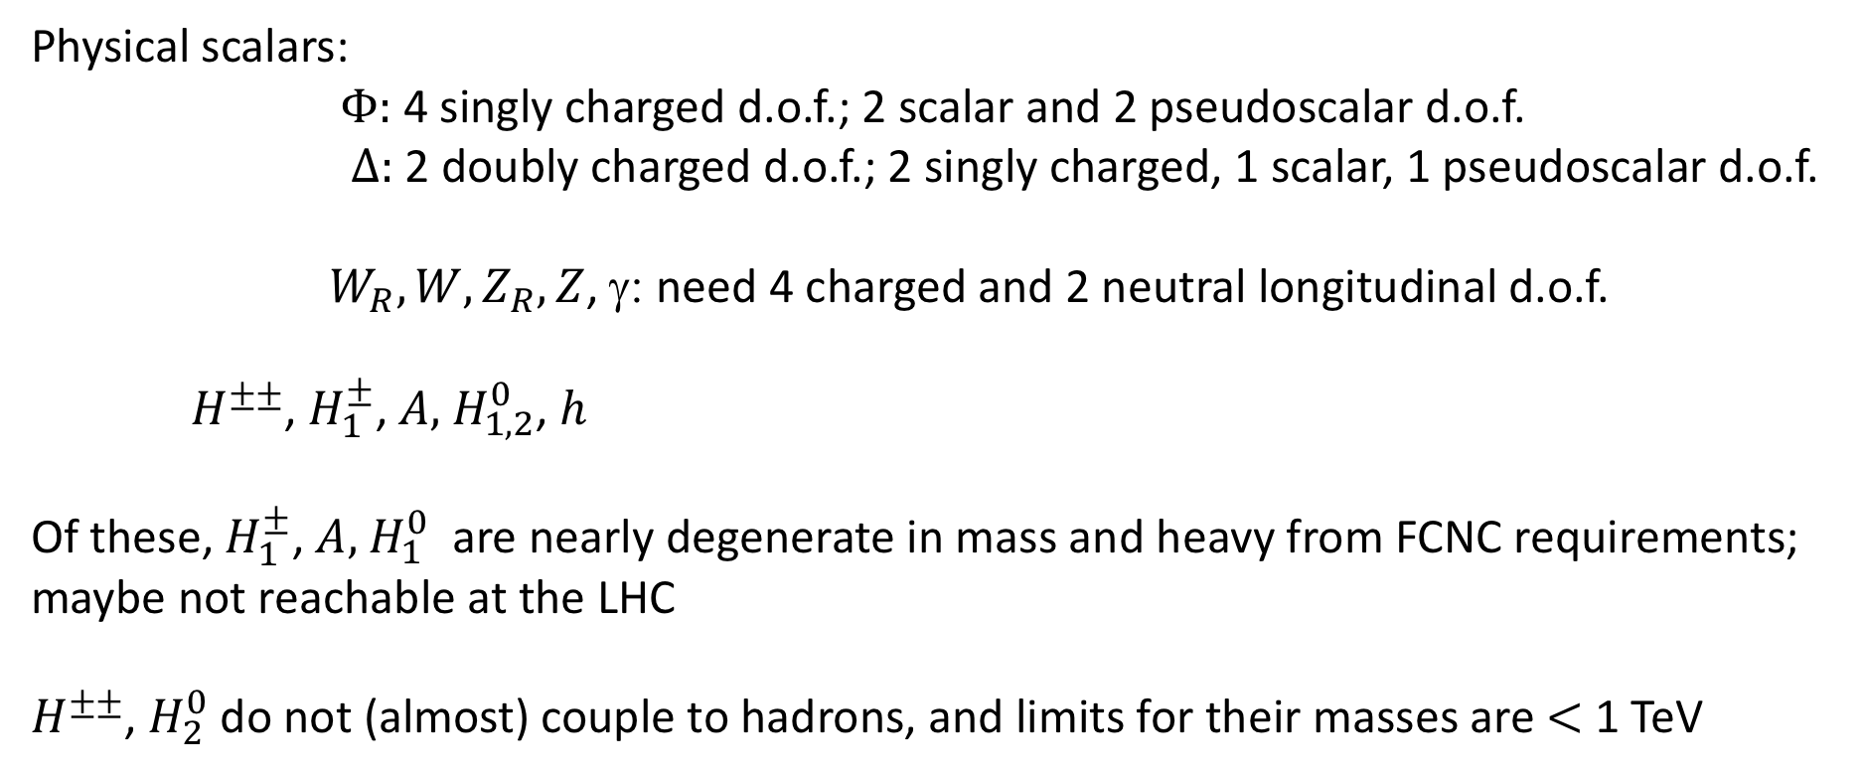
$Φ=$ $\left(\begin{matrix}φ_{1}^{0} & φ_{2}^{+} \\ φ_{1}^{−} & φ_{2}^{0}\end{matrix}\right)$, $∆_{R}=\left(\begin{matrix}∆_{R}^{+}/\sqrt{2} & ∆_{R}^{++} \\ ∆_{R}^{0} & {−∆}_{R}^{+}/\sqrt{2}\end{matrix}\right)$
Physical scalars:
$Φ:$ 4 singly charged d.o.f.; 2 scalar and 2 pseudoscalar d.o.f.
$∆:$ 2 doubly charged d.o.f.; 2 singly charged, 1 scalar, 1 pseudoscalar d.o.f.
$W_{R}, W, Z_{R}, Z$, γ: need 4 charged and 2 neutral longitudinal d.o.f.
$H^{±±}$, $H_{1}^{±}$, $A,$ $H_{1,2}^{0}$, $h$
Of these, $H_{1}^{±}$, $A,$ $H_{1}^{0}$ are nearly degenerate in mass and heavy from FCNC requirements;
maybe not reachable at the LHC
$H^{±±}$, $H_{2}^{0}$ do not (almost) couple to hadrons, and limits for their masses are $<$1 TeV

Slide 16

Supersymmetric left-right model (SUSYLR)
R_{parity}=(-1)^{3(B-L)+2s} is an exact symmetry as B-L is a gauge symmetry;
if SU(2)_{R}xU(1)_{B-L} is broken by L=$±2$ triplet, remains unbroken also after symmetry breaking LSP a dark matter candidate
Mohapatra, PRD (1986); Font, Ibanez, Quevedo, PLB (1989); Martin PRD (1992)
proton remains stable
There is no SUSY CP problem because of parity invariance
Kuchimanchi, PRL (1996), Mohapatra, Rasin, PRL (1996)
Also strong CP problem may be solved
Beg, Tsao (1978); Mohapatra, Rasin, (1996); Babu, Dutta, Mohapatra (2002)

Slide 17
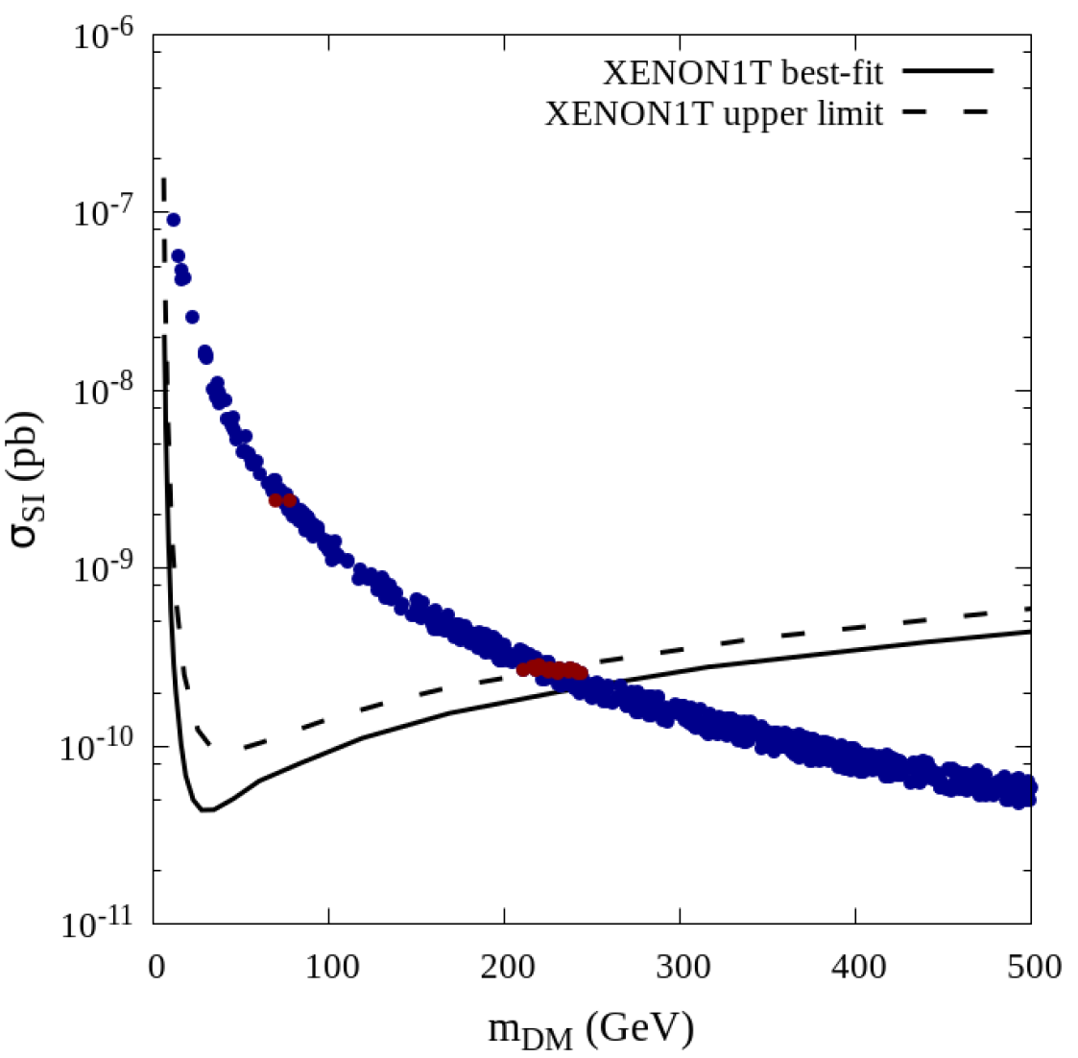
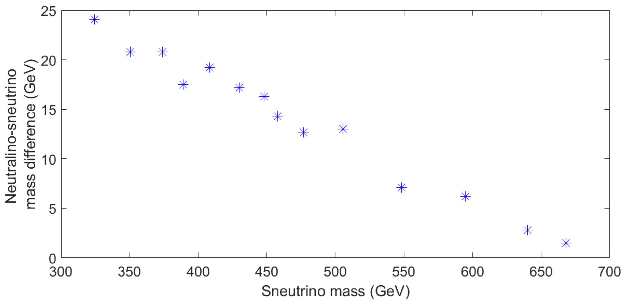
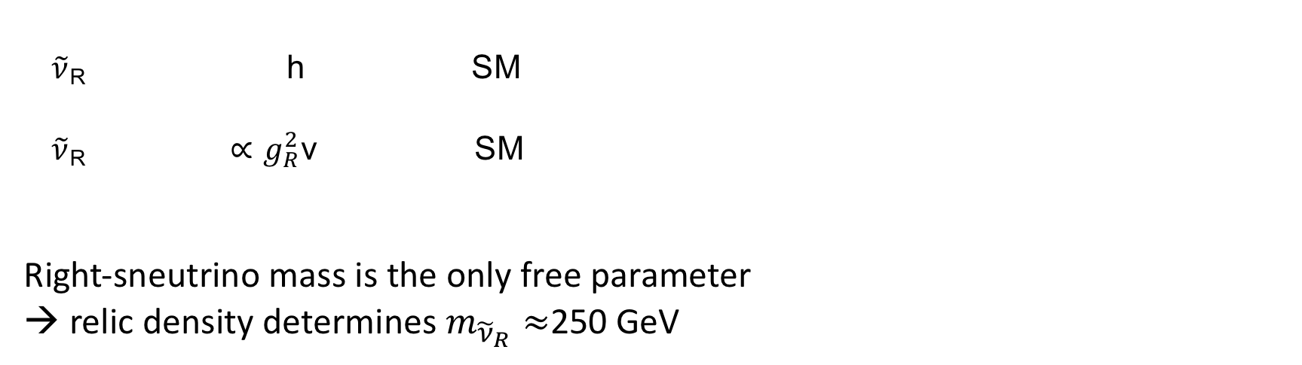

Dark matter in SUSYLR Frank, Fuks, KH, Rai, Waltari (2017);
Chatterjee, Frank, Fuks, KH, Mondal, Rai, Waltari (2019)
1) partners of right-handed neutrinos can produce DM
Right sneutrino LSP with coannihilations with
another sneutrino or neutralinos: $m_{{\tilde{ν}}_{R}}≈$700 GeV
$\tilde{ν}$_{R} h SM
$\tilde{ν}$_{R} $∝g_{R}^{2}$v SM
Right-sneutrino mass is the only free parameter
→ relic density determines $m_{{\tilde{ν}}_{R}}≈$250 GeV

Slide 18
2) SUSY partners of gauge bosons or Higgses can be the dark matter
Bidoublet higgsinos form a nearly degenerate set of four neutralinos and two charginos
Coannihilations cannot be avoided, when the lightest higgsino is the LSP
The Planck-value for relic density is achieved with 750 GeV LSP higgsino (could be silghtly decreased with further coannihilations, with e.g. sneutrino)
Note that in this case the spectrum is rather heavy and compressed
difficult to detect.
3) Right-handed neutrinos can contribute to dark matter
Bhattacharya, Ma, Wegman (2014)
Chatterjee, Frank, Fuks, KH, Mondal, Rai, Waltari (2019)

Slide 19

In the minimal form need to take into account the one-loop corrections to scalar potential to stabilize the model and $υ_{R}≲10$TeV
In addition to $h$, $A_{1 },H_{1 }, H_{1}^{±}$could be within LHC reach:
almost degenerate with mass $≳$ 700 GeV
One $H^{±±}$light, not much heavier than 1 TeV possibility to exclude the model
$H^{±±}→ℓ^{±}$ $ℓ^{′±}$; $m_{H^{±±}}≳$ 700 GeV, if decays to electrons or muons
…KH, Maalampi, PLB (1995), KH, Maalampi, Raidal, (1994); KH, Maalampi, Pietilä, Raidal (1997); Barenboim, KH, Maalampi, Raidal (1997); Dutta, Mohapatra (1998); Chacko, Mohapatra (1998); KH, Pandita, Puolamäki (1998); Babu, Mohapatra (2008); Frank, Korutlu (2011); Chun, Sharma, PLB (2013); Basso, Fuks, Krauss, Porod (2015); Babu, Patra (2016); Frank, Ghosh, KH, Rai, Saha, Waltari (2014); Frank, Fuks, KH, Rai, Waltari, (2017); Chatterjee, Frank, Fuks, KH, Mondal, Rai, Waltari, (2019)…

Slide 20
Conclusions
Need some experimental guidance
Meanwhile:
consider relevant possibilities
check all possible implications
indirect experiments can provide the scale
Experiments need to know the new type of signals to analyze
and
theorists need to apply experimental results to their favourite theory
For the field it is essential to fully use the LHC potential

