Slide 1
Advanced Mechanics and Materials for
Detectors and Accelerators (AMMDA)
M. Aicheler & A. Onnela & K. Österberg
25th January 2019

Slide 2
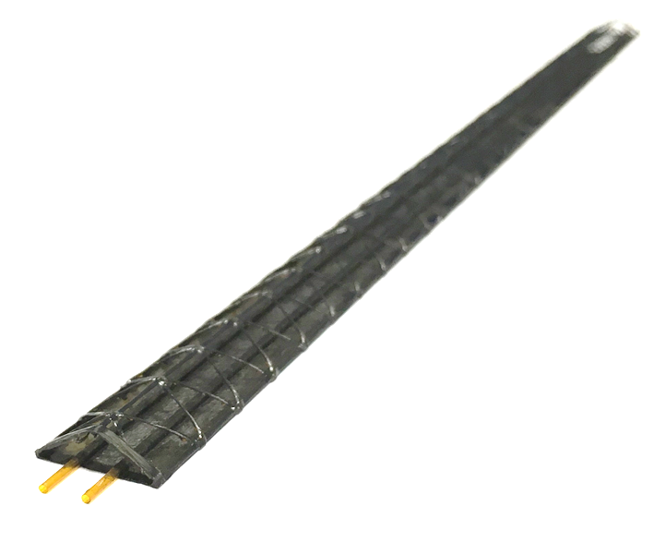
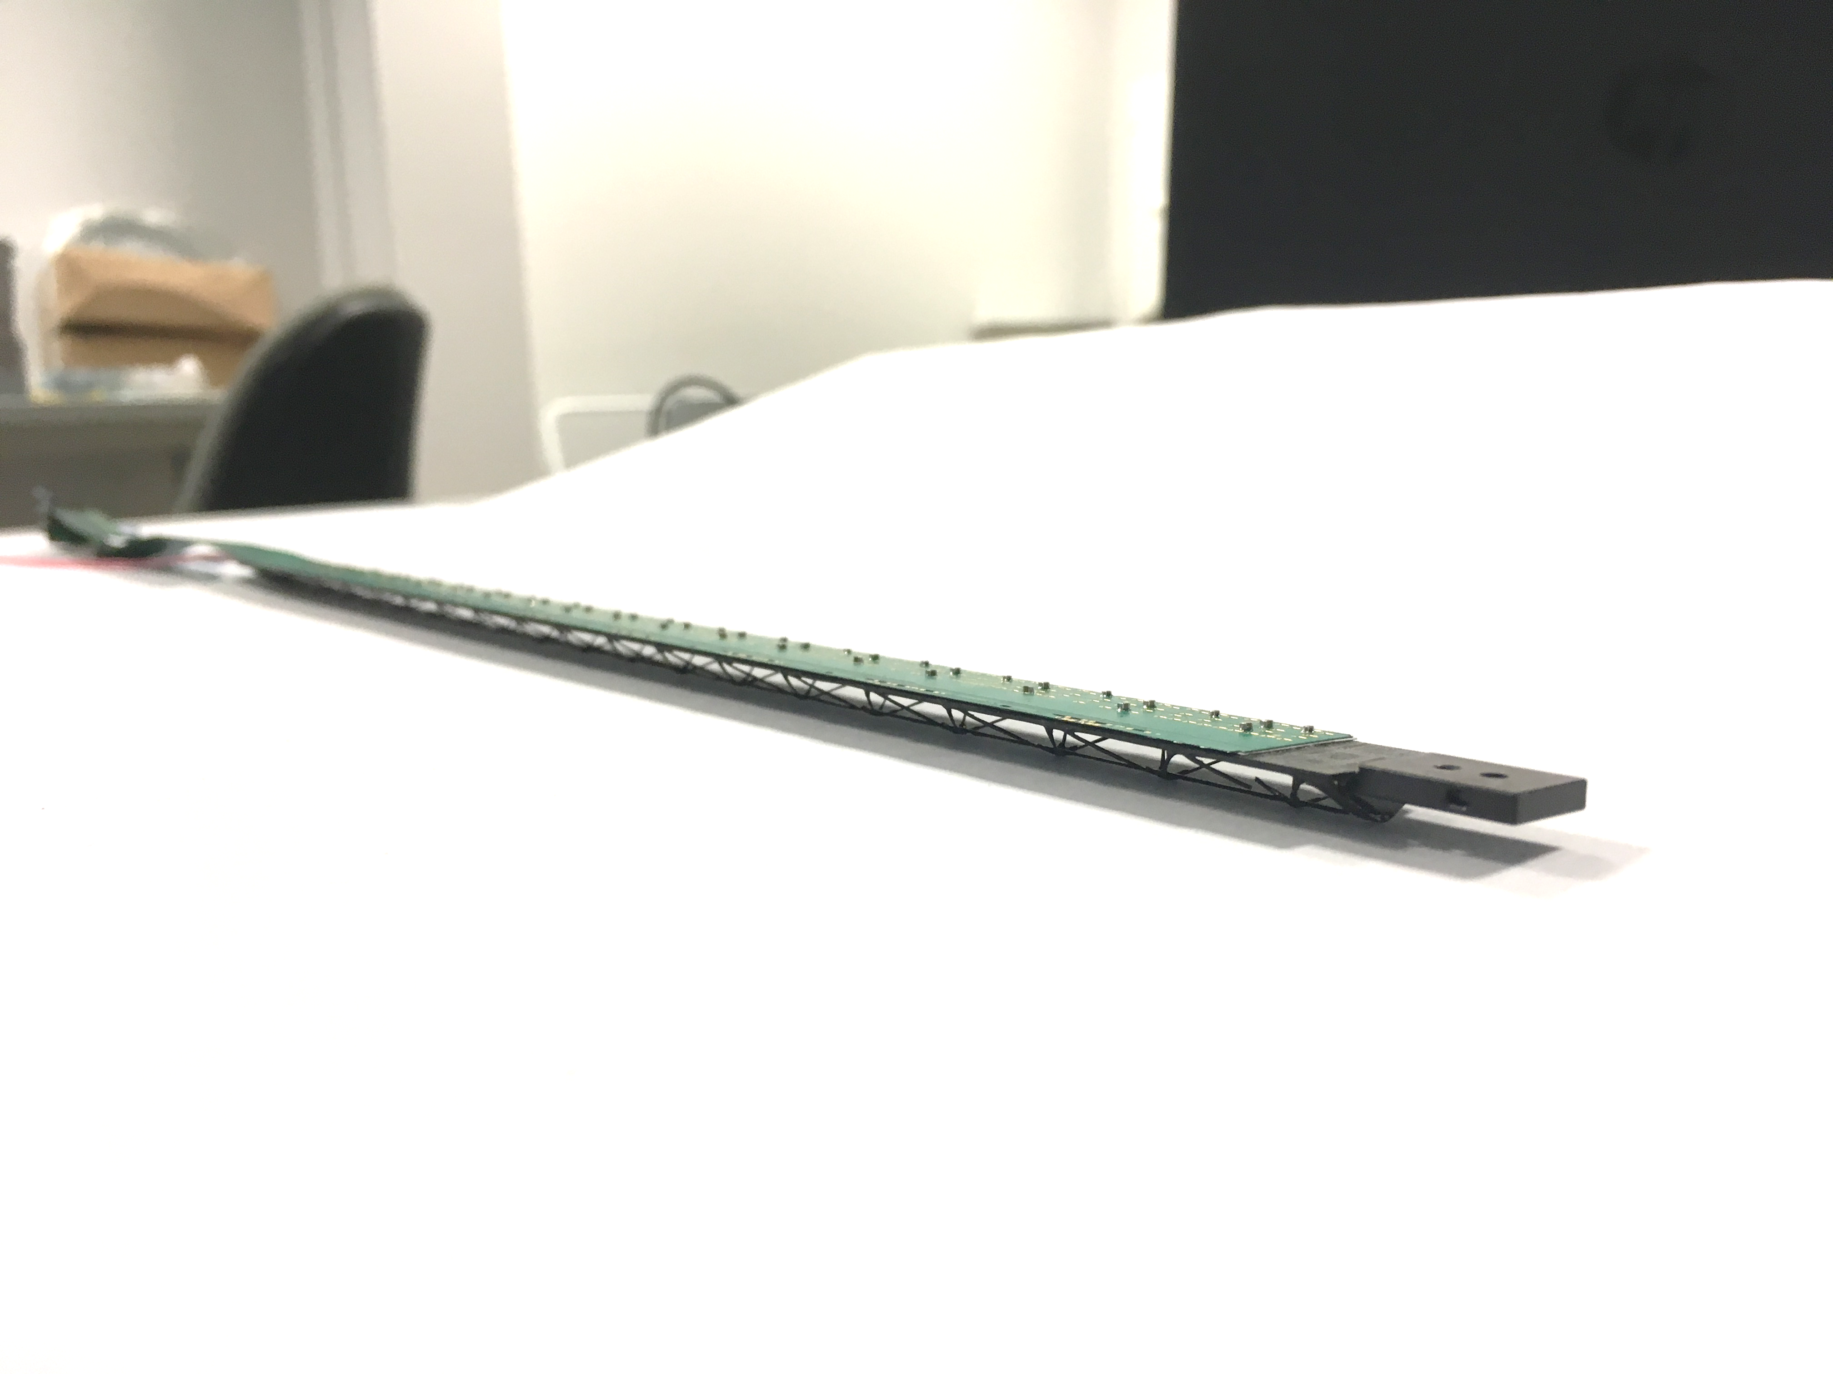
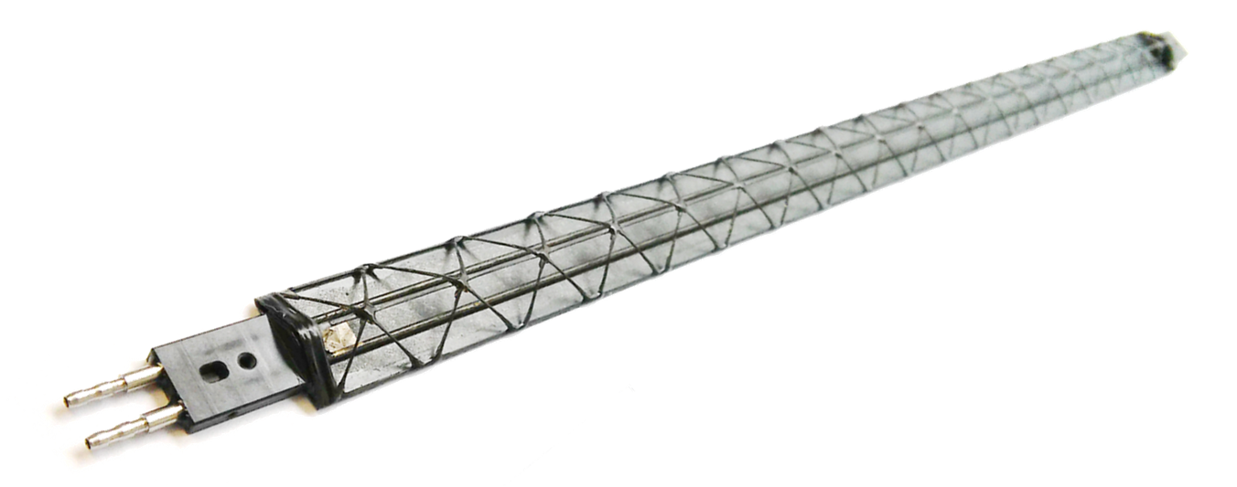
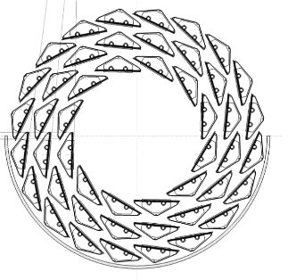
Background Detectors
Detectors for High Energy Physics face constantly technological challenges on their track to meet unprecedented precision requirements at ever-growing measurement event rates.
For the mechanics, this translates into competing requirements on minimum space use, complex geometries, low mass, precise operating temperature, high precision and high stability
CERN seeks to stay at the forefront of key technologies enabling new detector projects by launching dedicated R&D studies and fostering external collaboration.
CERN is also seeking for collaborations for its next major R&D programs on experimental technologies for particle detectors (https://ep-dep.web.cern.ch/rd-experimental-technologies).

Slide 3
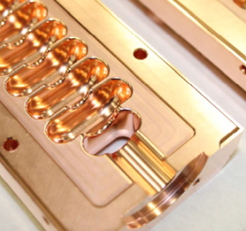
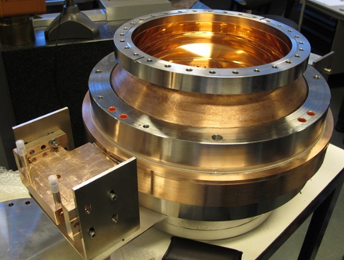
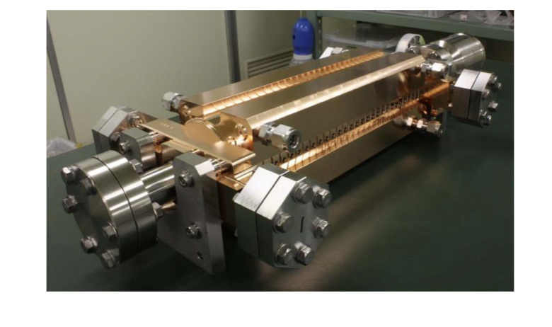
Background Accelerators
The Compact LInear Collider (CLIC) is in a phase of industrializing their main components, such as the accelerating structures and related RF components
Focus of the pure R&D aspect of the project is shifting more and more towards building up industrial collaborations and probing for manufacturing capabilities within industry
CLIC represents a clear need for R&D in the area of Ultra-high precision manufacturing for particle accelerator technology. This implies novel machining technologies, assembly and joining technologies as well as related material technology
http://clic-study.web.cern.ch/

Slide 4
Goals of AMMDA
Clear synergy between some of the needs for the future detector mechanics and the future colliders such as CLIC.
  low mass mechanics
  ultra-high precision machining and assembly
  as well as novel materials and their related manufacturing technologies
These needs require academia work together with industry in order to develop and validate materials and/or manufacturing methods.
We aim for an active short-term manufacturing technology R&D period (up to 2021) to match with CERN’s on-going LHC LS3 upgrades and a longer lasting technology R&D period (up to 2025) for developments aiming for later LHC upgrades and other future accelerator (CLIC) and detector projects.
AMMDA will seek for identifying technology fields interesting for AMMDA and where expertise is already available/can be build up in academia and industry in Finland.
Our goal is to make AMMDA the first element of a series of projects aiming at different time scales: Business Finland Co-Innovation project detailing of and starting the development on concrete projects for CERN’s LS3, and ultimately leading to an EU funded project for CERN’s LS4/5 period.

Slide 5
Key persons in AMMDA
Markus Aicheler (German) is currently working at HIP/CERN. He is the project leader of the Accelerator Technology project of the Helsinki Institute of Physics. He submitted multiple national and European project proposals and was executing the technical coordination of an Industry Academia partnerships and Pathways (IAPP).
  Markus represents direct access to academia R&D, and is well enrolled in the CLIC project at CERN. He will act as project leader of AMMDA
Kenneth Osterberg (Finnish) is a full professor at the Helsinki University and will act as a link person to the Academia world. He was the PI for an IAPP project and had multiple Academia of Finland projects funded. He has extensive knowledge of the university landscape of Finland.
  Kenneth will act as academia and administration link for AMMDA
Antti Onnela (Finnish) is a senior mechanical engineer and CERN staff member. He has 25 years’ experience in design, construction and operation of high-energy physics experiments, like CMS and CLOUD.
  Antti will act for AMMDA as the link person to CERN’s LHC detector upgrade projects and to CERN EP’s R&D programme on detector mechanics

Slide 6
Implementation (1/2)
AMMDA establishes motivated and stimulating community consisting of:
  research institutions: Aalto University, Helsinki University, Tampere University and potentially others
  CERN detector R&D
  the CLIC study
  Finnish industry (e.g. EXEL, Hollmen, Toolman, Welas Laser Technology, …)
we would like to perform a systematic market potential evaluation of common technological fields important to AMMDA and Finnish companies/academia.
Once these fields have been identified, a dedicated survey of key players has to be executed harvesting information from all possible sources:
  Business Finland
  various academic teams
  key experts
  industrial newsletters
  expert consultants.

Slide 7
Implementation (2/2)
Once the potential academic and industrial partners have been identified (20-30), we invite them to an introduction event presenting the various technological fields identified by AMMDA and their challenges for CERN
After the meeting, the AMMDA team will work out several concrete research plans based on the feedback of the introduction gathering.
In a second meeting (potentially small group face-to-face meetings) the research plans detailing roles of each participant will be presented and discussed and, finally, the further funding seeking strategy will be laid out.
AMMDA will hire a master student in the field of mechanical engineering/business development who will closely work together with the core team of AMMDA. He will coordinate with the external consultants and services and conduct the various surveys and summaries. He will be supported directly by the AMMDA team and their expertise and networks at CERN.

Slide 8
Thank you!
;-)

Slide 9
BF proposal: Advanced Mechanics and Materials for
Detectors and Accelerators (AMMDA)
Markus Aicheler, Helsinki University
Clear synergy between needs for the future detector mechanics and the future colliders such as CLIC.
AMMDA establishes motivated and stimulating community consisting of
- research institutions: Aalto University, Helsinki University, Tampere University and potentially others
- CERN detector R&D
- the CLIC study
- and Finnish industry (e.g. EXEL, Hollmen, Toolman, Welas Laser Technology, …)
Potential field of interests:
- low mass mechanics
- ultra-high precision machining and assembly
- as well as novel materials and their related manufacturing technologies

