Slide 1
Business Finland – CERN collaboration
Robotics & AI
Roel Pieters (Asst Prof., Automation Technology and Mechanical Engineering)
Esa Rahtu (Asst Prof., Information Technology and Communication)
25.1.2019

Slide 2
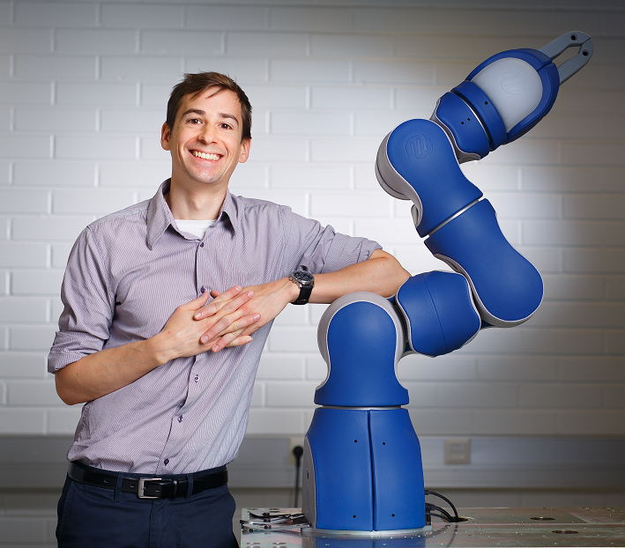

Background
Roel Pieters (Assistant Professor), roel.pieters@tuni.fi
+358 50 447 8347, @pieters_roel
Automation Technology and Mechanical Engineering
Cognitive Robotics Group
Tampere University
https://research.tuni.fi/cogrob/
Esa Rahtu (Assistant Professor), esa.rahtu@tuni.fi
+358 40 7628898
Artificial Intelligence and Vision Group
Information Technology and Communication
Tampere University
http://esa.rahtu.fi

Slide 3
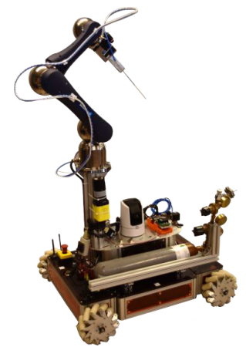
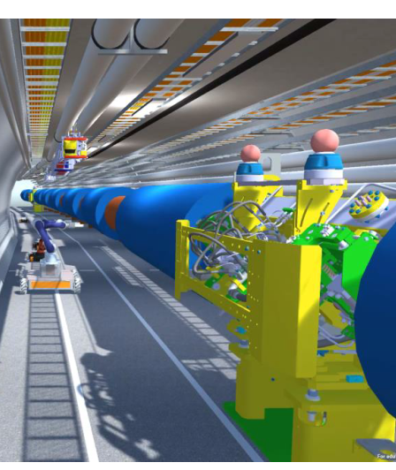
CERN: Current and future problems
My perspective, based on discussion, current R&D and state-of-the-art
Video link Presentation link
Current LHC:
Remote intervention: maintenance, inspection, handling
Robot tele-operation: object manipulation, localization/mapping
Perception: tele-presence, detection/recognition, AR/VR,
Future:
LHC/FCC: maintenance, inspection of future infrastructures
Conclusion:
CERN can serve as test-bed, facilitator, knowledge resource
Long-term commitment is key
CERN-bot
Virtual LHC tunnel + robot

Slide 4
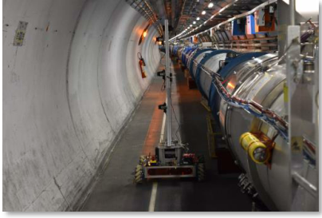
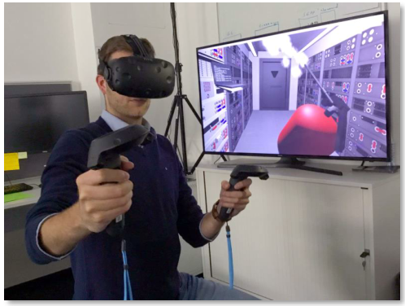
Targeted topics/needs: Remote, enhanced tele-operation
Robotics: mobile base + arm
AI: virtual/augmented reality interaction
Augmented Man: human assistance and training
  Towards inspection and maintenance of
  infrastructure/objects
CERN tunnel environment
Virtual Reality interaction

Slide 5
Current TAU-CERN activities
Research with CERN robotics group (Engineering Department (EN))
1 researcher + 2 in future
Intent to participate in CERN EP R&D 5 year plan
ATTRACT proposal
Co-Creation → Co-Innovation

Slide 6
BF Co-Innovation: Current state and potential
Discussion with multiple companies:
Clear interest in:
  Robotic tele-operation + Augmented/Virtual Reality
  Remote object handling
  Object/infrastructure inspection, personnel training
Core competence of companies does not necessarily relate to CERN,
but their problems and needs do!
Companies cannot do R&D without BIC!
Common interests are these problems, and CERN as potential business facilitator/motivator

Slide 7
BF Co-Innovation: Next steps
Get company commitment
Refine and narrow down on topics
Ensure that CERN benefits as well
Coordinate among other BIC collaboration projects/proposals

Slide 8
Thank You!

