Slide 1


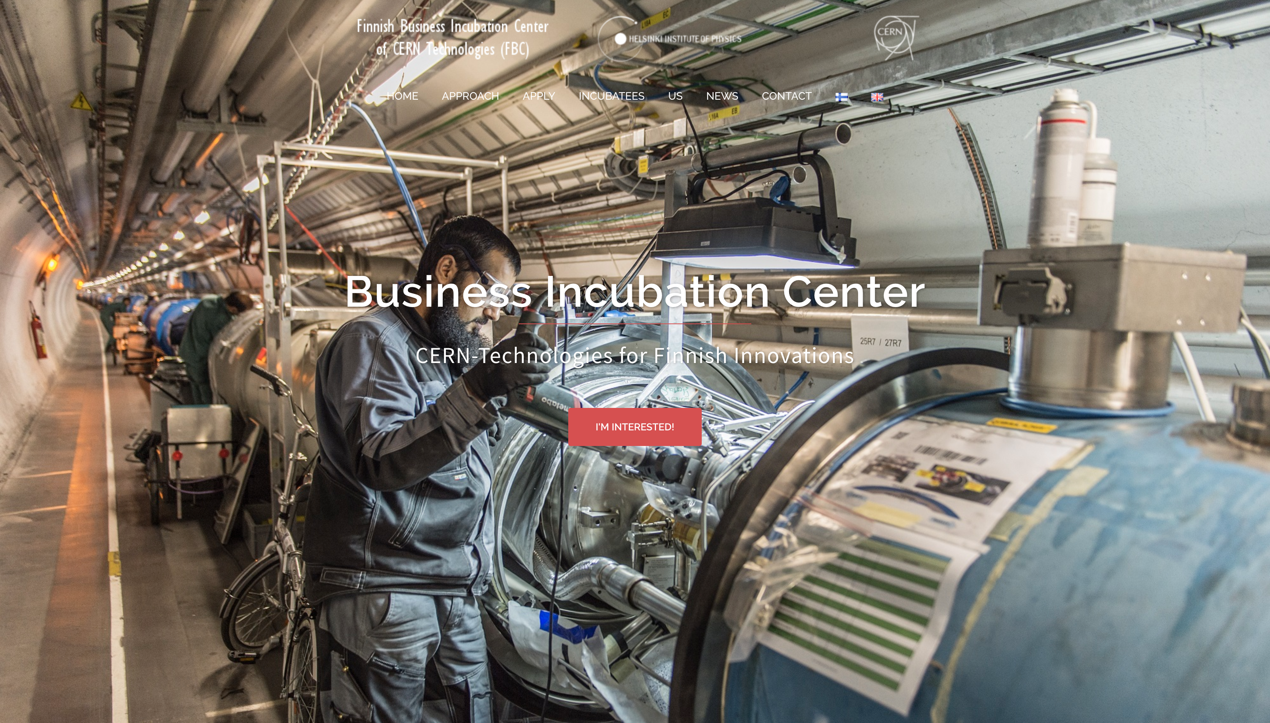

Slide 2

BIC project @ Technology Programme of HIP
Business Finland supported R&D&I collaborations’ preparation & info exchange
Saku Mäkinen, Pietari Kauttu, Harri Toivonen

Slide 3
BIC project aims at
Developing new Research, Development & Innovation (R&D&I) cases by
  Taking part, hands-on, into R&D&I cases’ and FBC incubatees ramp up and development activities with extensive global expert network of serial entrepreneurs, business accelerators’ managers, VCs, attorneys and innovation mgmt scholars
  Providing support in finding funding partners (public R&D&I funding agencies, such as Business Finland & the European Commission and private equity with an emphasis on VCs/Business Angels/Family Offices supporting very early stage high-tech cases).
Taking part into European R&D&I policy by
  Continuing, and extending our involvement in innovation management Expert roles for a) Public R&D&I funding agencies, such as Business Finland & the European Commission and b) research institutions like CERN & ESA research communities
Contributing into academic discussions of innovation management field
  Strategic technology and innovation management
  Societal impact of scientific research infrastructures
  Technology foresight and forecasting
Supporting young talent in their innovation management study and career paths (main focus areas: academic & high-tech startup careers)

Slide 4
Focus Areas of the BIC Project
Innovation management studies &students
Business-research partnerships
R&D&I projects
High-tech startup and spin off companies

Slide 5
Topical Areas withing HIP Research Having Potential for Industrial R&D Collaboration Initiatives (non-exhaustive, in random order)
Radiation hard semi-conductor components
Detector Mechanics
High gradient accelerators and manufacturing technologies
Augmented man/Robotics/AI/radiation hard equipment/smart machines/environment monitoring
Magnets/superconductivity/quench protection
Signal processing
Data center technologies
CLOUD
Instrumentation for Nuclear Safety, Security and Safeguards
Quantum programming, RAMS software etc.

Slide 6
Today’s Meeting Agenda
Co-Innovation as a funding instrument, tricks of the trade
Synergies between projects
  Important to communicate towards CERN in a coherent manner
  Collaboration in some work packages?
  Ramp up of larger combined (e.g. EU projects)?
  Common outreach & industry activation efforts?

Slide 7
Today’s Goals
Get all PIs on same page about ongoing ramp up efforts & co-innovation as a funding instrument
Define synergies: projects, outreach, contacts etc.
Agree about next steps

Slide 8
Examples of Past Industry Activation Events & Outreach

Slide 9
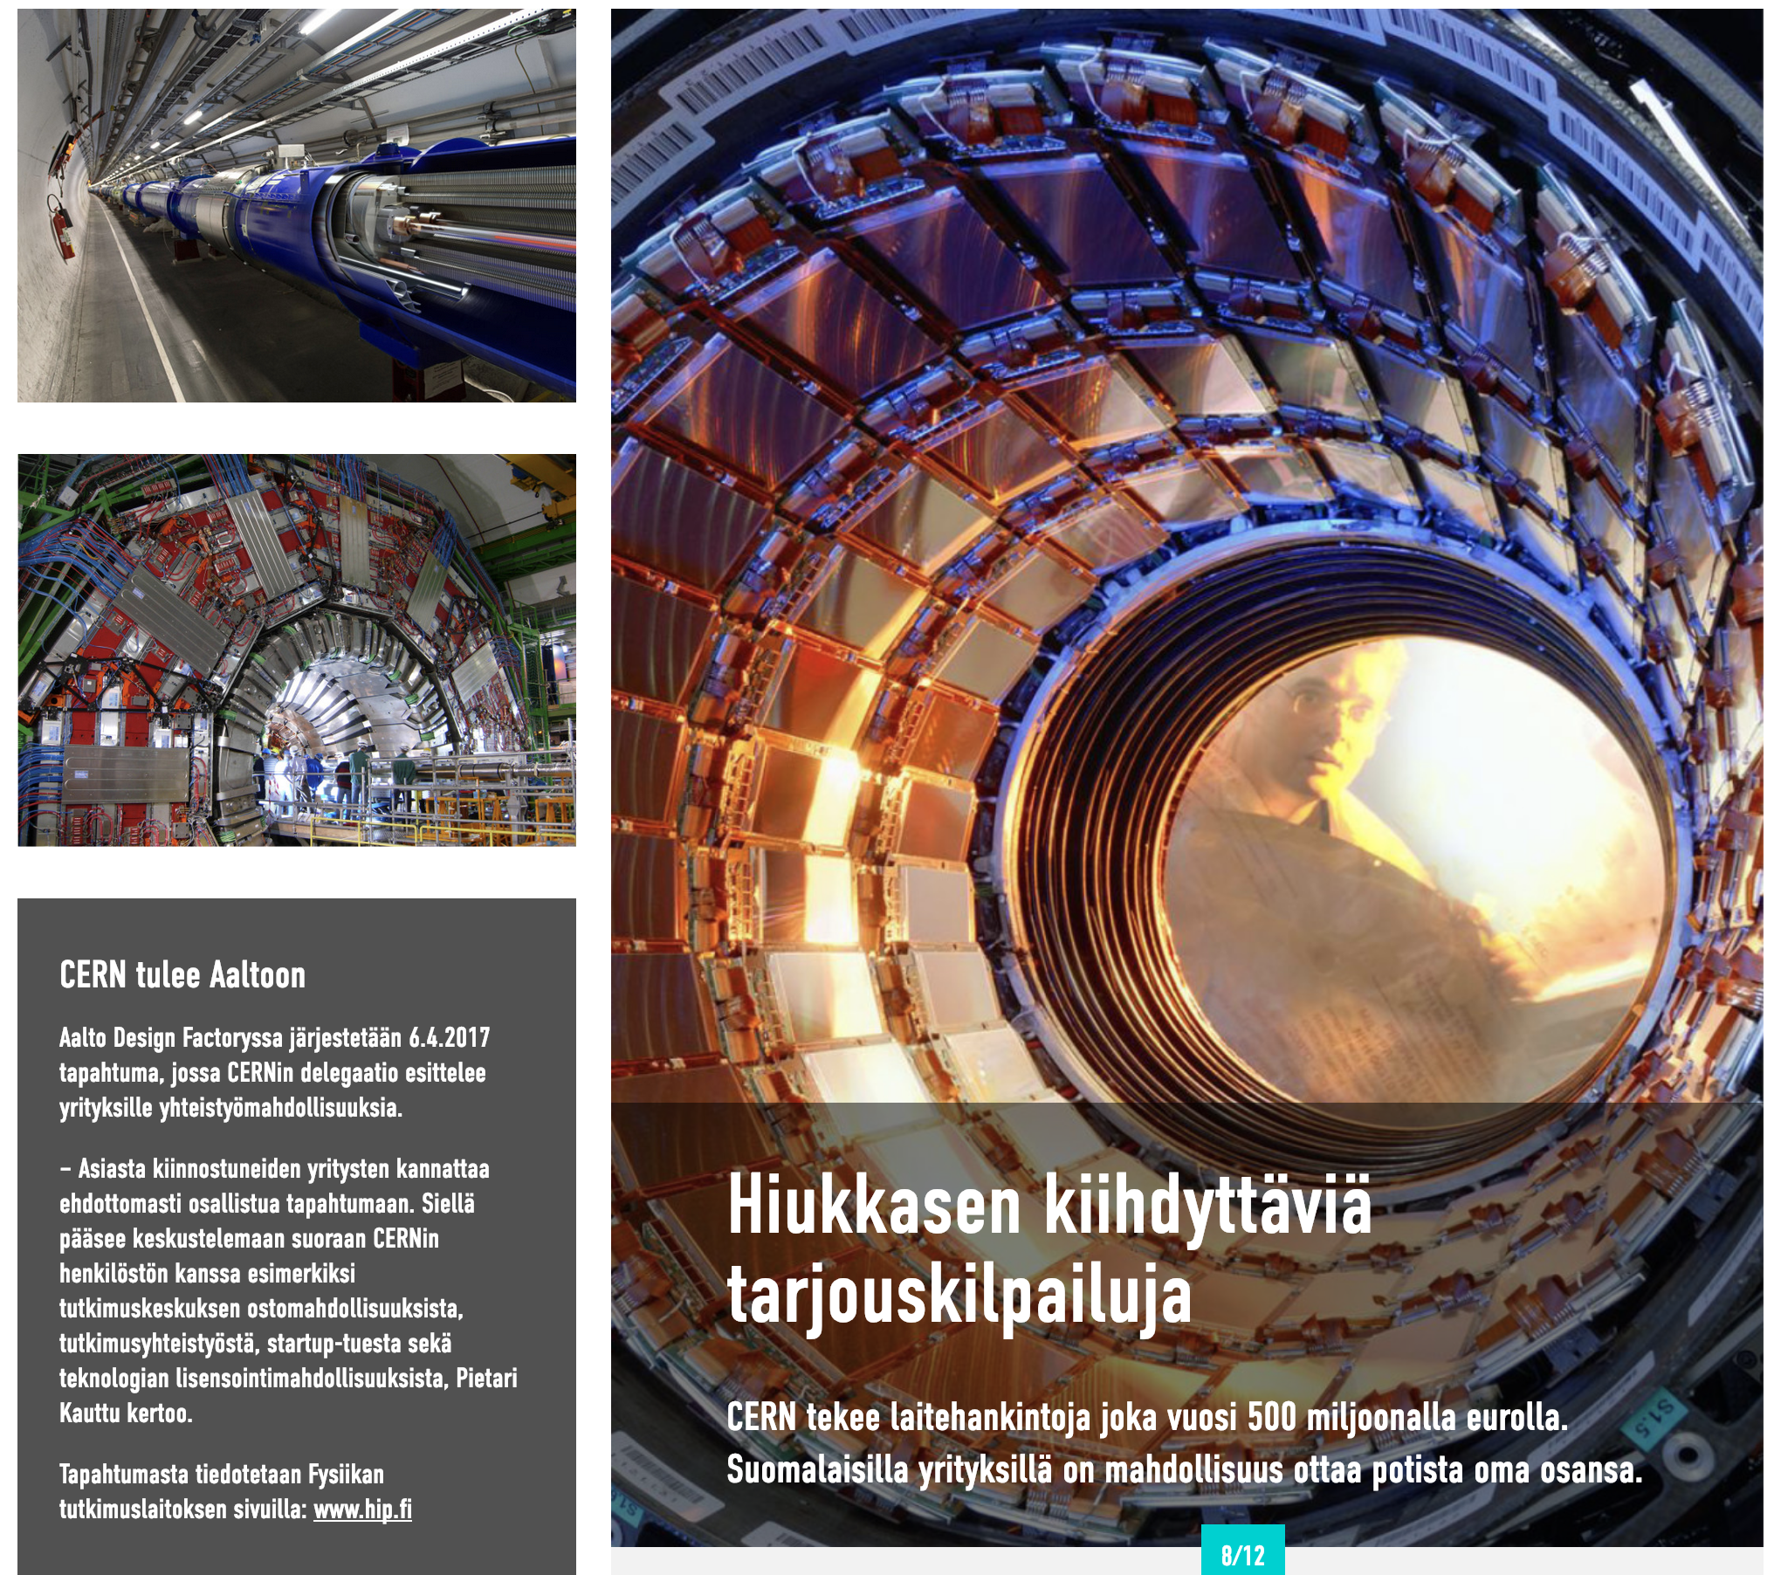
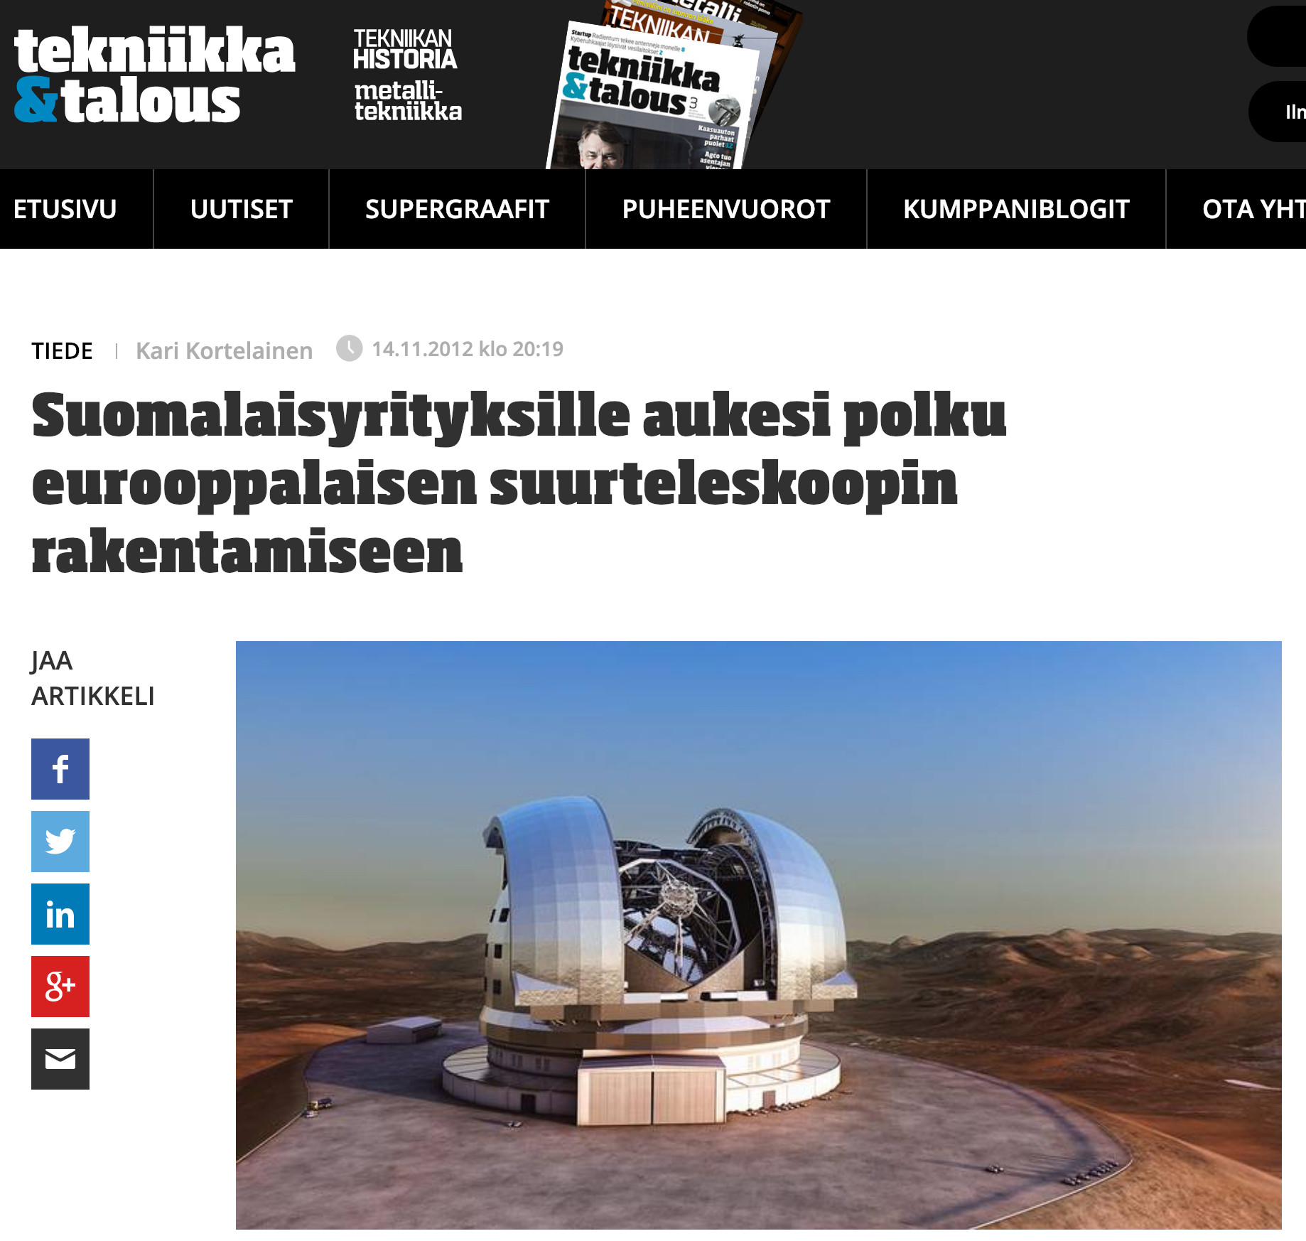
Copyright: Teknologiateollisuus

Slide 10
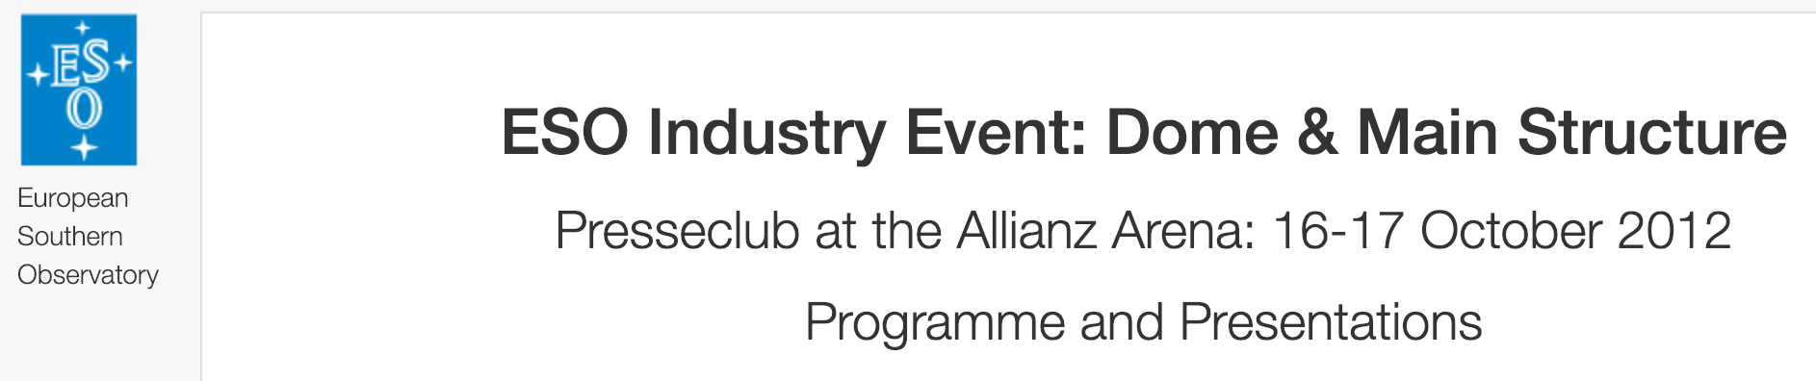
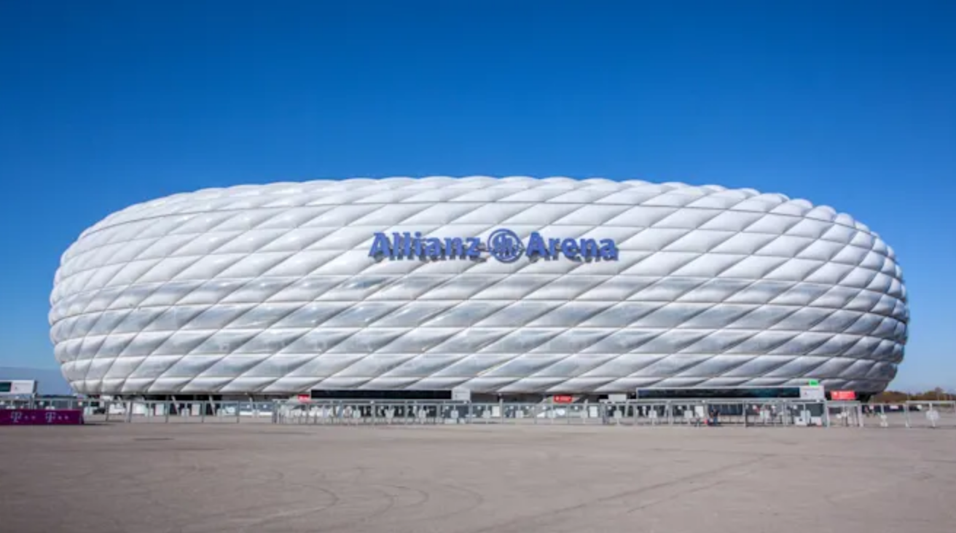

Slide 12
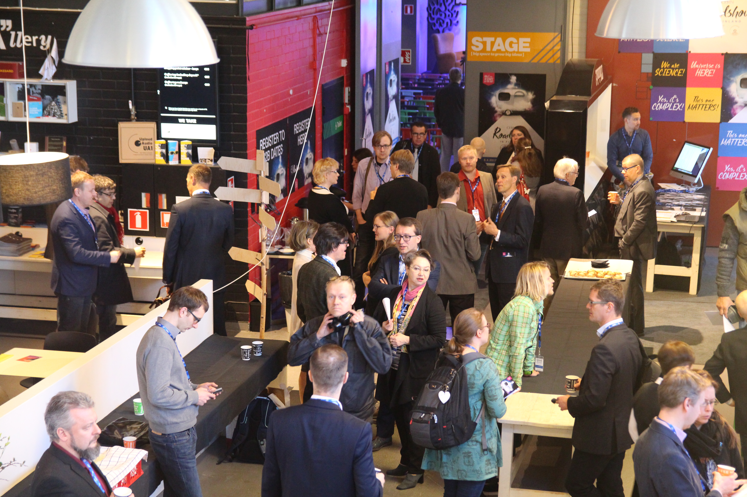

CERN Roadshow in Finland
144 persons attended
  (150 limit at venue due to safety rules)
  176 registered
  44 preregistered B2Bs took place
51 business executives
42 companies
23 different institutions
8 identified interests for follow ups with companies 8 identified companies worth of further DD
  (about 40 % rate for company follow ups in some form, and procurement’s data still n/a!)
6 identified leads with institutions
Some students still in contact with HR
50 networking session participants from DFGN

Slide 13

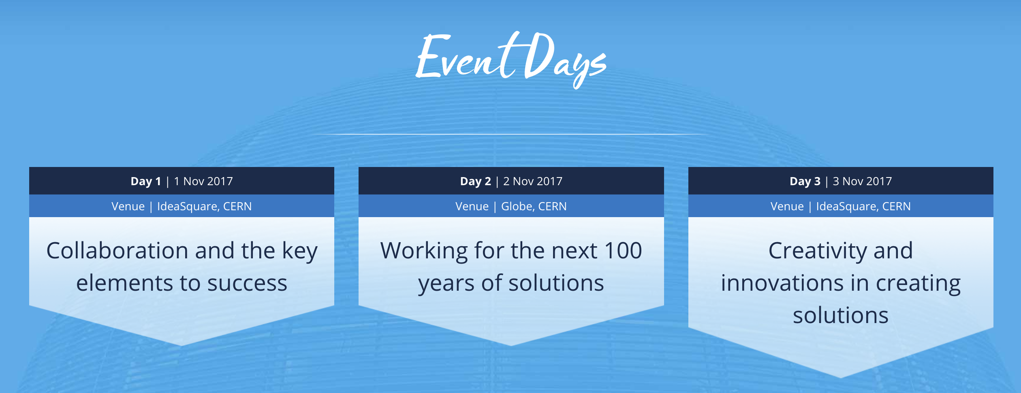

Slide 14
Why would companies be interested?

Slide 15
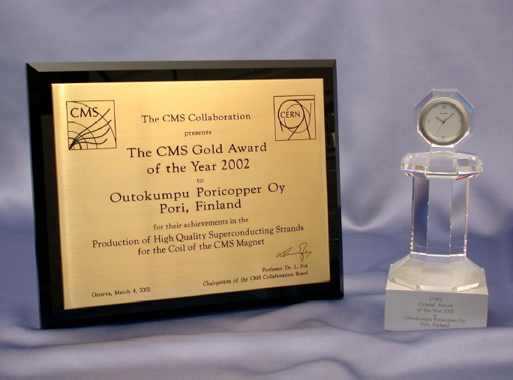
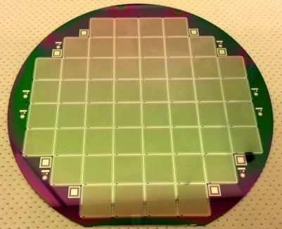
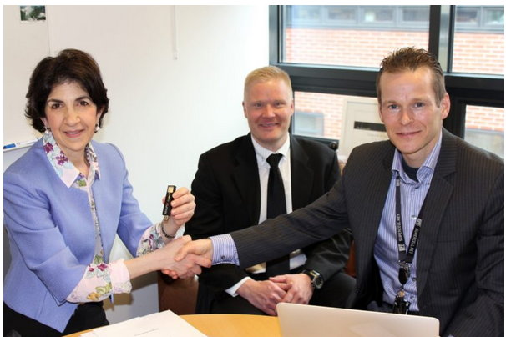
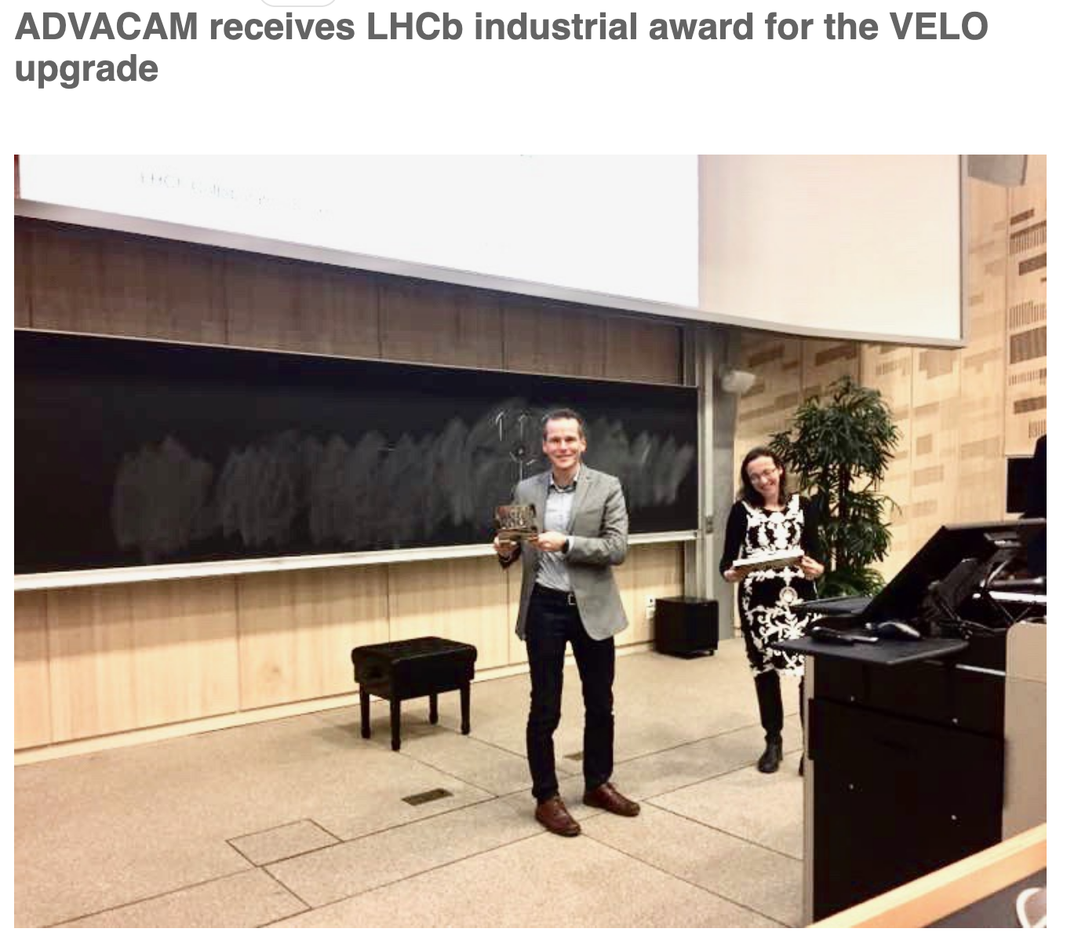
References
© Luvata
© Okmetic
© Advacam
© VTT

Slide 16
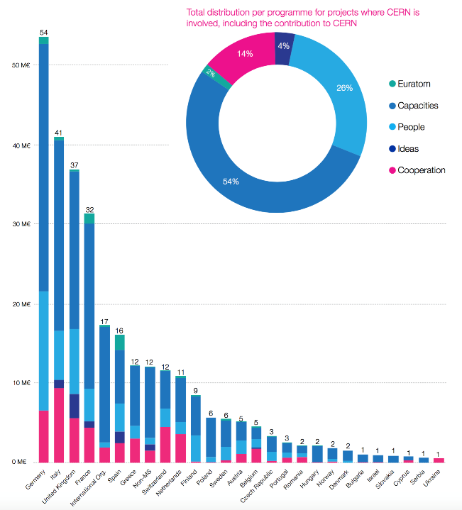
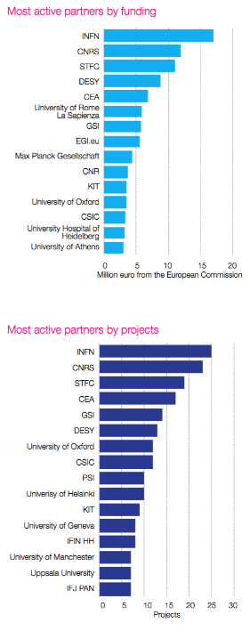
EU Funding opportunities

Slide 17
Overview of the participation of CERN in H2020 (2014-2017)
Pillar | H2020 programme | Number of submitted proposals* | Number of funded projects* | EC funding for CERN
Excellent Science | European Research Council | 29 (26) | 8 (8) | ~ 8.9 M€
 | Research infrastructures | 23 (5) | 14 (5) | ~ 12 M€
 | E-Infrastructures | 22 (1) | 12 (0) | ~ 5 M€
 | Future and Emerging Technologies | 22 (9) | 2 (0) | ~ 0.4 M€
 | Marie Skłodowska-Curie actions | 47 (26) | 16 (8)** | ~ 11.8 M€***
Industrial Leadership | Information & Communication Technologies | 12 (2) | 3 (2) | ~ 2.6 M€
 | Other | 5 (0) | 0 (0) | 0 M€
Other | Health | 3 (0) | 0 (0) | 0 M€
 | Science in Society | 6 (0) | 1 (0) | ~ 0.2 M€
 | Spreading excellence and widening participation | 5 (0) | 1 (0) | ~ 0.1 M€
 | EURATOM | 1 (0) | 1 (0) | ~ 0.1 M€
 | COST | 8 (3) | 4 (1) | ~ 0.1 M€
 | Other programmes (EURAMET, Eurostars, ERA-NET) | 3 (0) | 2 (0) | ~ 0.1 M€
TOTAL |  | 186 (72) | 64 (24) | ~ 41.3 M€
H2020 success rate for CERN: 34%
Average success rate in H2020 for all participants and programmes is ~12%
* the numbers in brackets indicate the projects coordinated by CERN
** In addition, CERN hosts 9 Marie-Curie Individual Fellowships
*** In addition, CERN receives 1.6 M€ for the 9 Marie-Curie Individual Fellowships

Slide 18
Students and fellows - Finland
Notes:
Graphic shows the total of Finnish summer students (19), technical and doctoral students (26), administrative students (5), and fellows (33) at CERN between 2011-2015

Slide 19


CERN long term expenditure
HL-LHC, supply purchasing volumes rising over next years
Supply expenditure, most relevant for FI companies
19
Courtesy of A. Unnervik, CERN

Slide 20
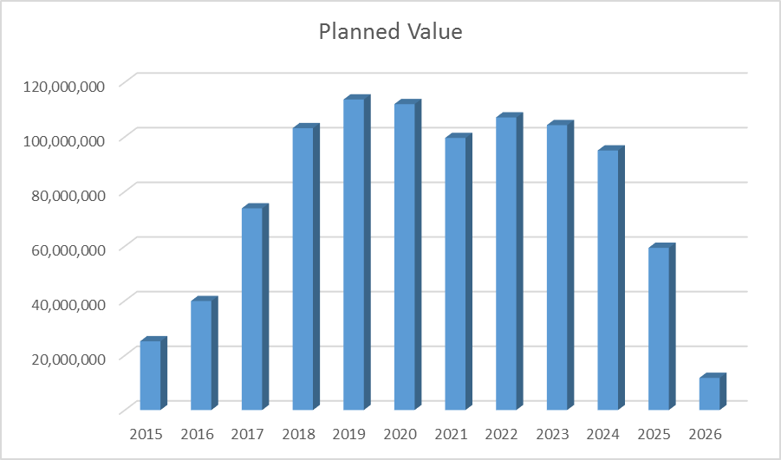

HILumi Ramp up foreseen expenditure
Courtesy of I. Bejar Alonso, CERN

Slide 21
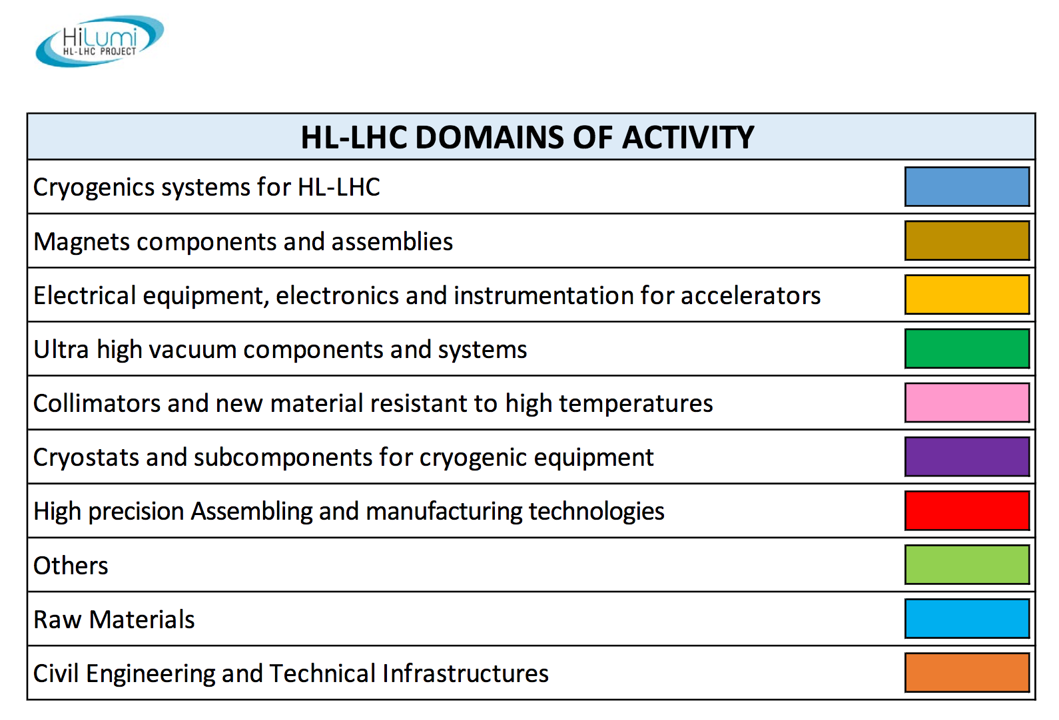

Slide 22
How Can BIC Team Help?
High tech dating service
  CERN end
  Companies
Workshop facilitations in order to
    Refine & document the scope of projects
    Define roles & IP strategy
    Advance projects through hackathon style sprints
Event organization & outreach efforts
  Seminars, media etc.

Slide 23


Thank You.

