Slide 1
STAFF MEETING OF HELSINKI INSTITUTE OF PHYSICS
________________________
Time: Friday, December 15, 2017 at 14.30
Place: 13-2-005, CERN, Geneva
Agenda
1. Opening of the meeting
2. Status report of the Institute
3. The project structure of the Institute in 2018 (appendix)
4. The action plan of the Institute for 2018 (appendix, in Finnish)
5. Other issues brought up by the staff

Slide 2
2. Status report of HIP
National mandate to carry out and facilitate:
  research in basic and applied physics,
  research and technology development at international accelerator laboratories
CERN from 1996, FAIR from 2010
Currently 5 universities
  University of Helsinki (host)
  University of Jyväskylä
  Aalto University, Lappeenranta University of Technology, Tampere University of Technology

Slide 3
HIP 2016 – 2017 progress and highlights ₁
2016: record year of publications, 340
LHC Run 2, FI involvement in CMS, ALICE and TOTEM experiments.
CMS: 700 publications produced
FI: CMS pixel Phase-1 upgrade and (minor) Phase-2 forward muon on-detector electronics completed, in operation 2017. Some issues with innermost layer readout, specially towards end of the run.
P. Luukka CMS Tracker Institute Board chair and CMS career committee co-chair
TOTEM: joint TOTEM-CMS CT-PPS paper exclusive high-mass pp → p μ⁺μ- p(*) production at 13 TeV
Total, inelastic and elastic cross-section at 13 TeV. Highlighted by Keith Ellis on Council Open session: “the Council members pay for all these collisions”.

Slide 4
HIP 2016 – 2017 progress and highlights ₂
ALICE: close to 200 papers produced
Investigation of quark matter with identified particles, resonances, hyperons, deuterons, hypertritons, flows,…
GEM-TPC (Finland large involvement) upgrade ongoing
FIT detector responsibility (new subdetector)
ISOLDE: completion of HIE-ISOLDE Phase 1, operation and extensive physics campaign with ¹¹⁰Sn- beams.
CLOUD: CLOUD11 8-week measurement campaign autumn 2016
  FAIR: FI+SE consortium (HIP+VR). Ground-breaking July 2017, start of civil construction.
  FI: Super-FRS, NuSTAR.
  First in-kind accelerator contract.

Slide 5
Refereed journal articles 2016
All time record in 2016: 340 journal articles
TOTAL | 340
Theory programme | 83
CMS programme | 109
Nuclear matter programme | 69
Technology programme | 13
Planck project | 50
Cloud project | 16

Slide 6
Number of degrees, school visits, trainees in 2016
2016 | N
PhD/PhD(tech) | 7
MSc/MSc(tech) | 14
Summer students, CERN | 16
Summer students, ESRF | 1
High school groups, CERN | 18
Teacher groups, CERN | 1

Slide 7
School visits
2016: 18 school groups, 369 pupils+56 teachers

Slide 8

CERN Roadshow 6 April 2017 at Aalto Design Factory
CERN procurement, knowledge transfer and HR experts meeting Finnish companies, career service experts and public stakeholders (and media)
144 persons attended
  (150 limit at venue due to safety rules)
  176 registered
  44 preregistered B2Bs took place
51 business executives
42 companies
23 different institutions
8 identified interests for follow ups with companies
6 identified leads with institutions
Some students still in contact with HR
50 networking session participants from DFGN
Themes: CERN – an important part of the Finnish Innovation Ecosystem
  Business opportunities
  Job, Trainee and Study opportunities
  Knowledge transfer

Slide 9
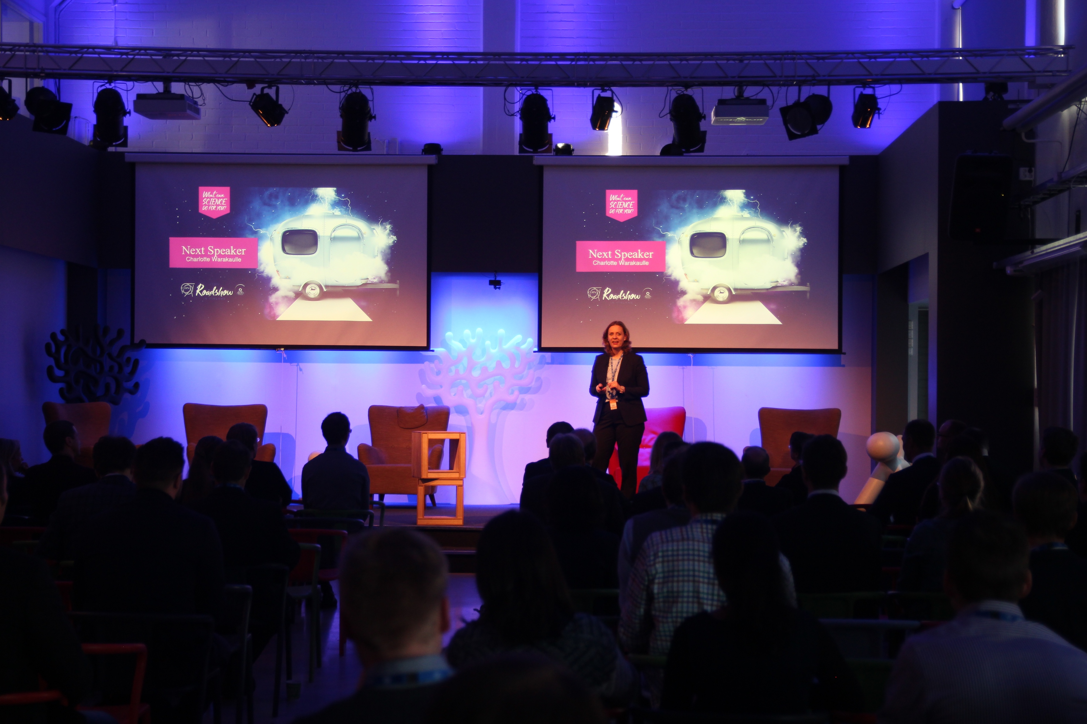
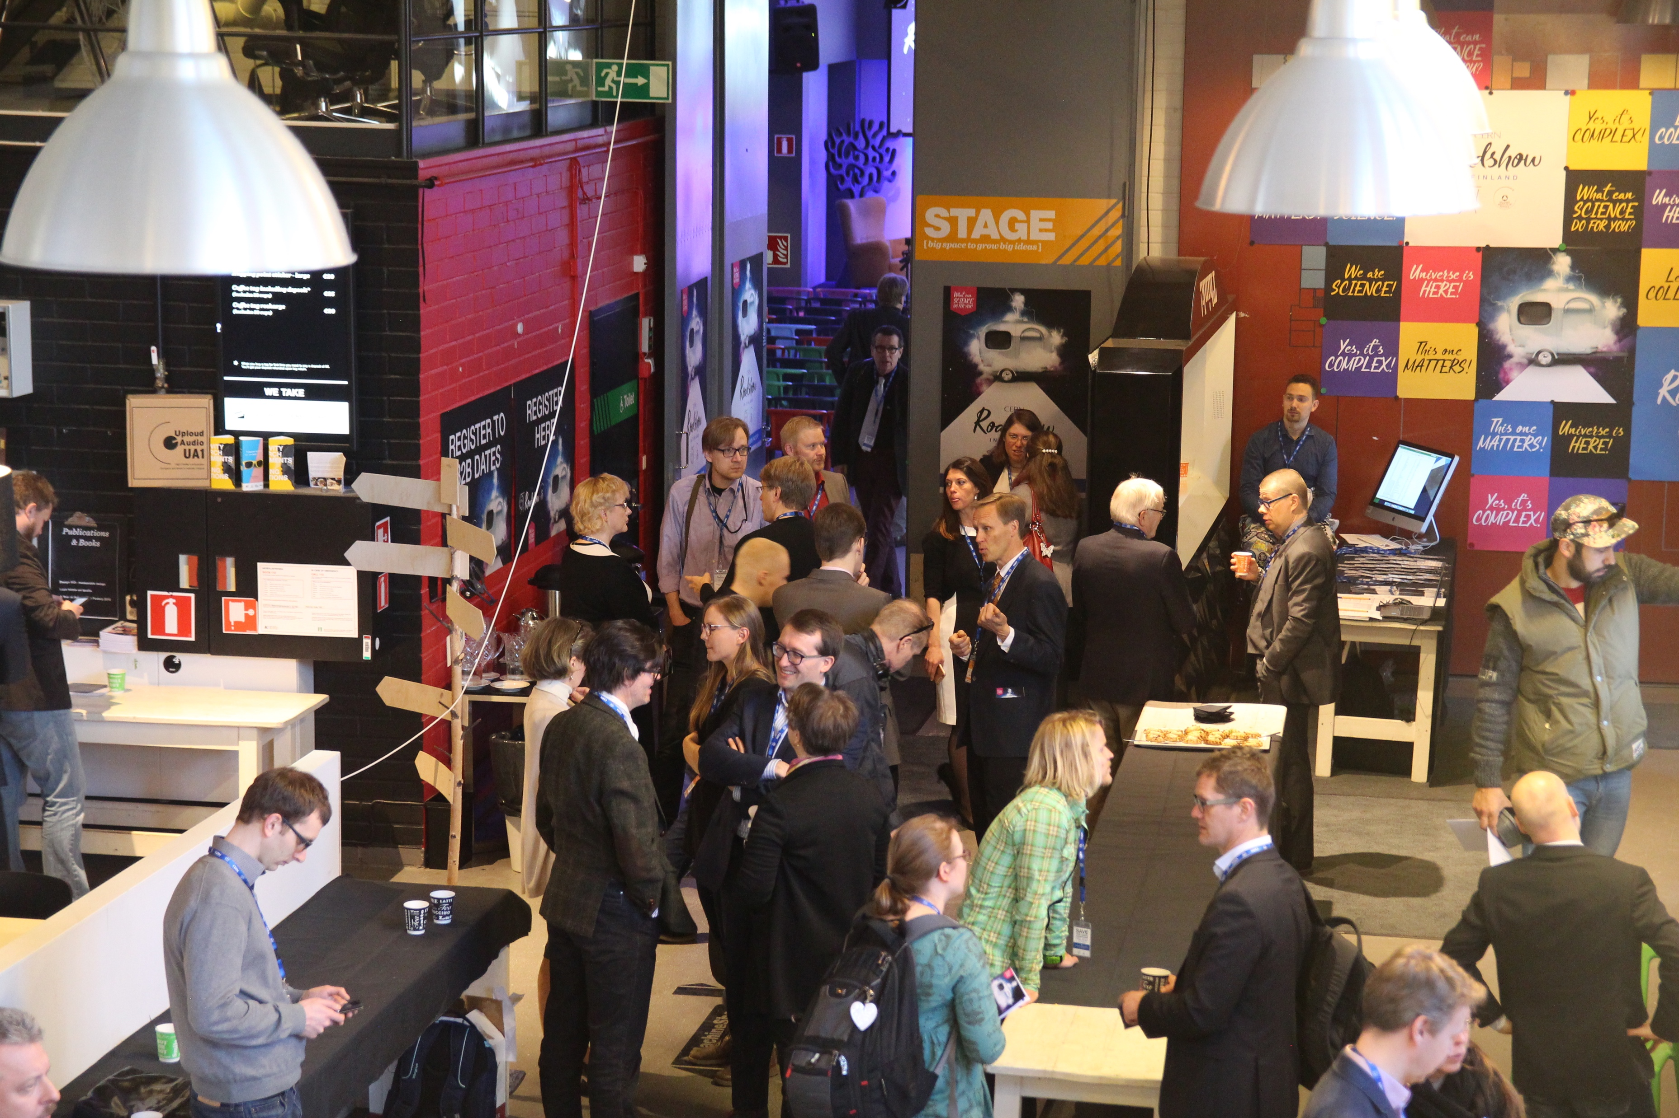
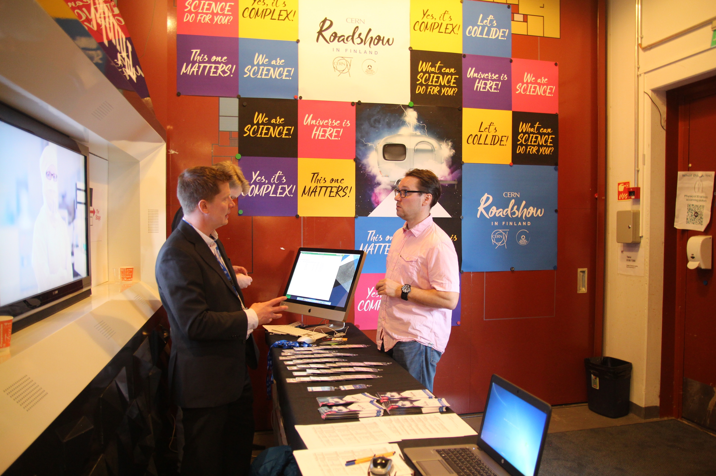
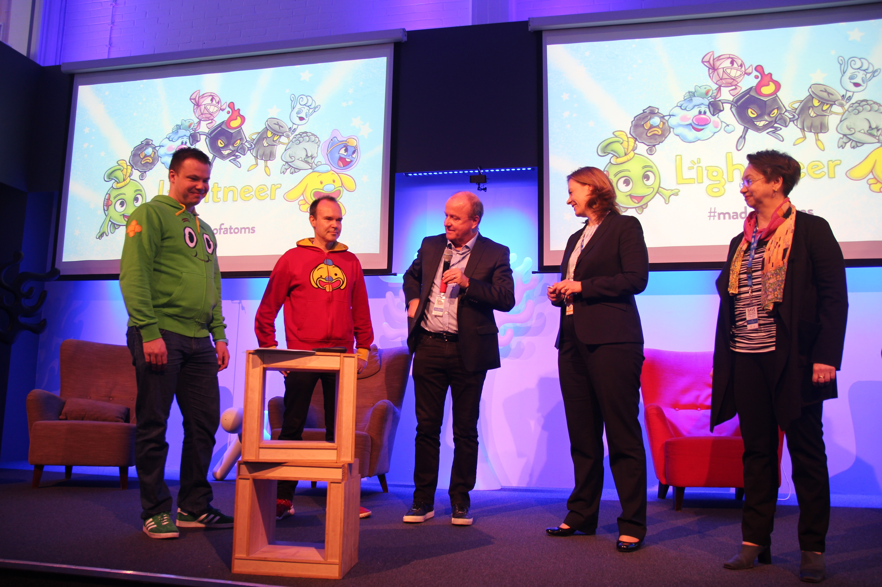
https://events.hip.fi/cernroadshowinfinland/

Slide 10

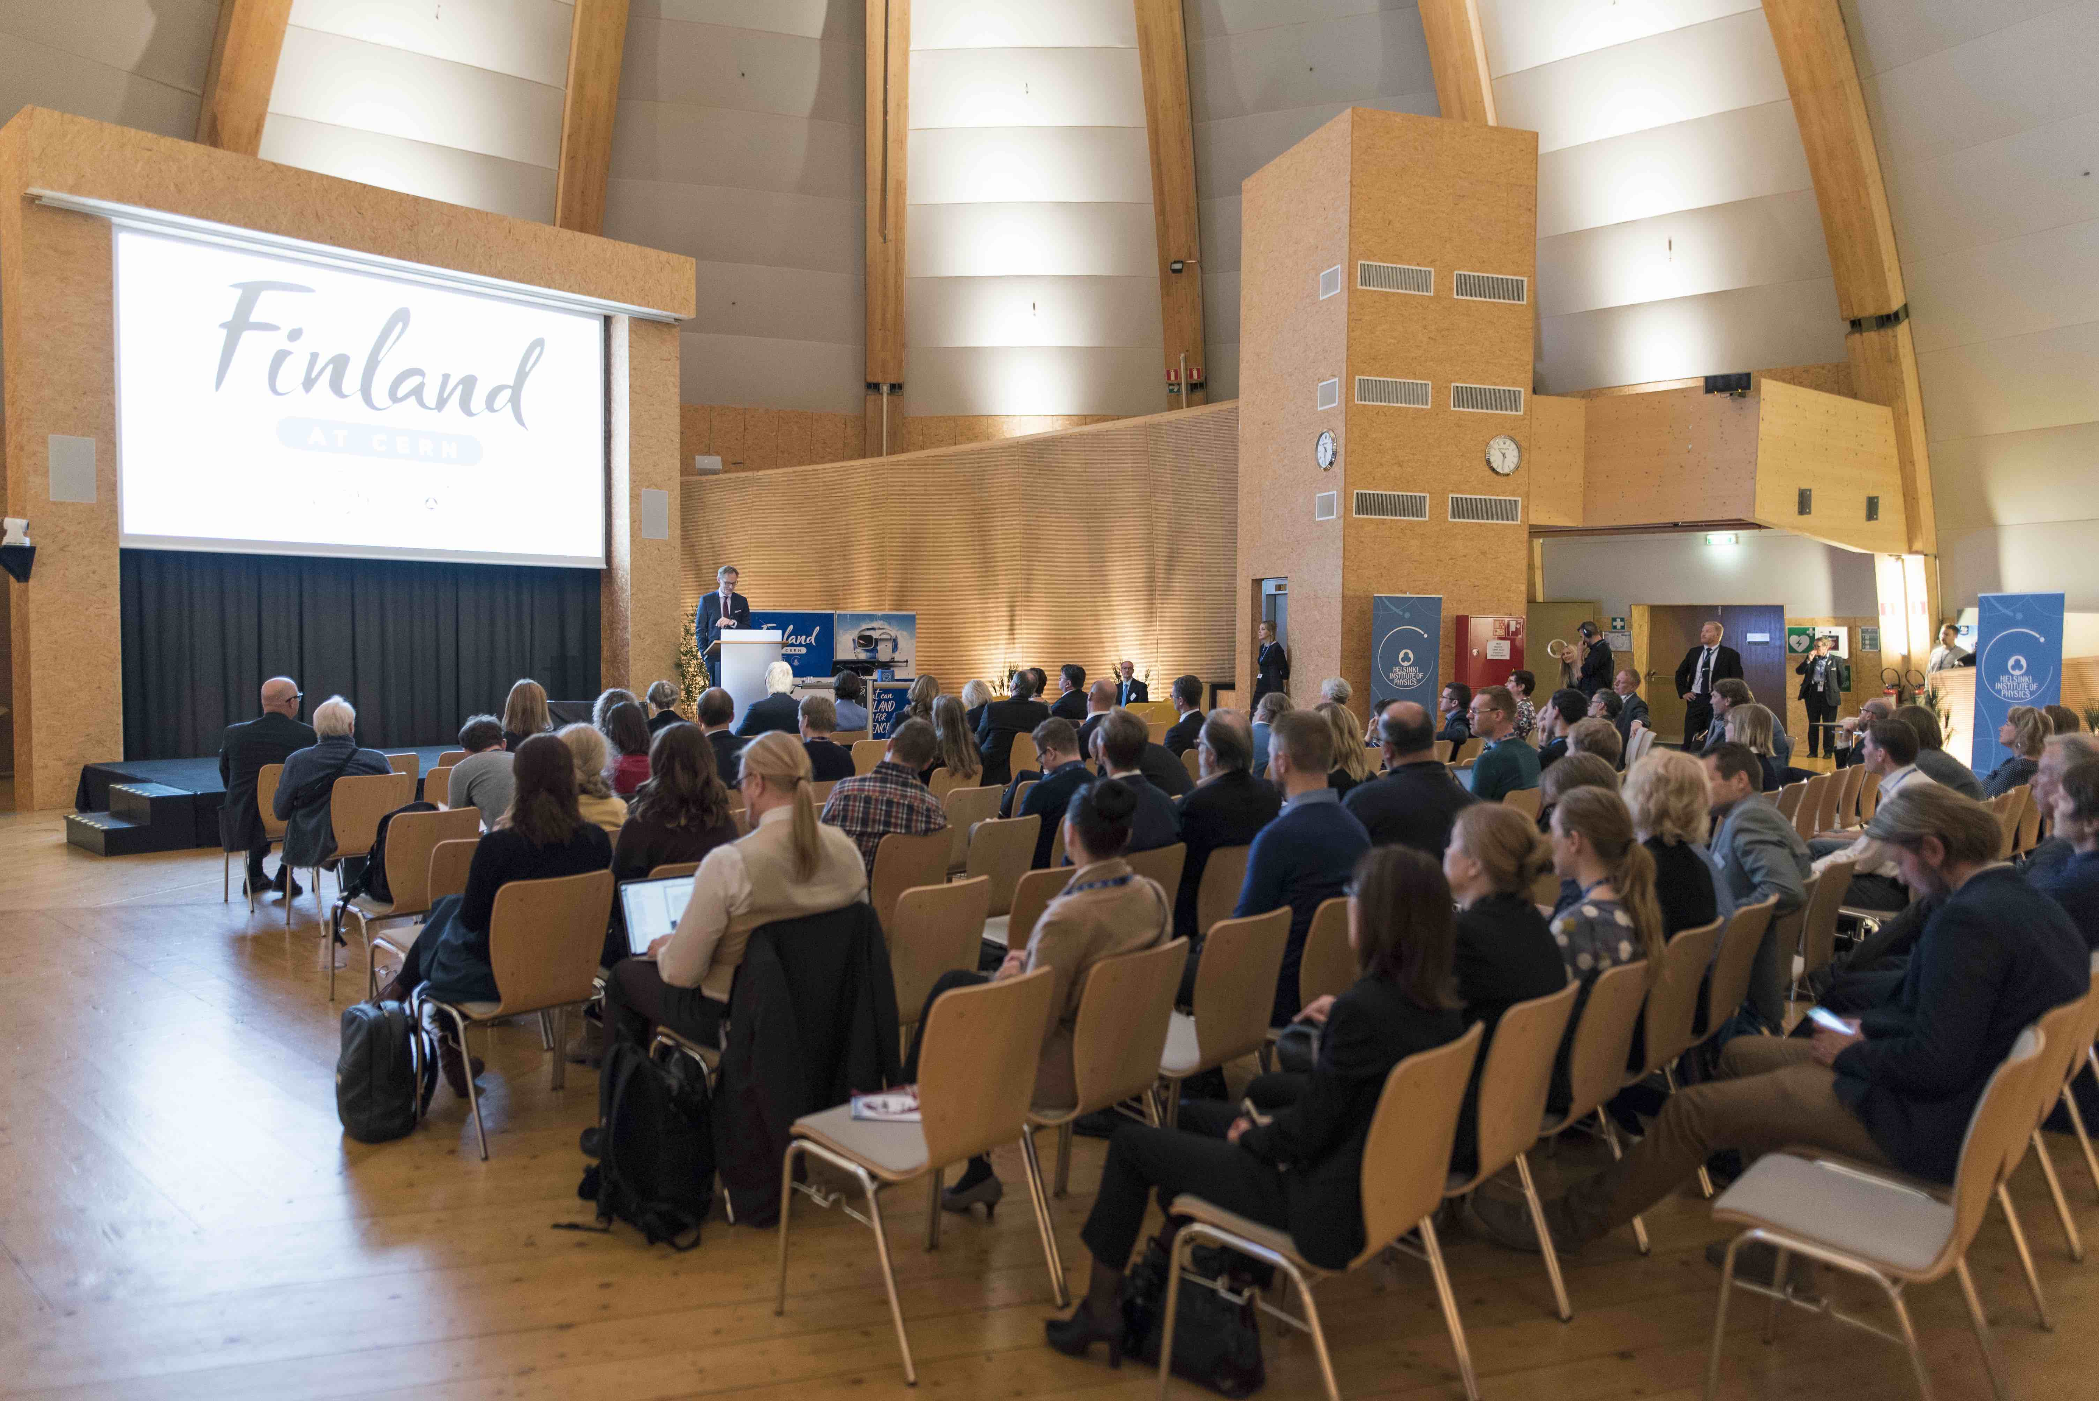
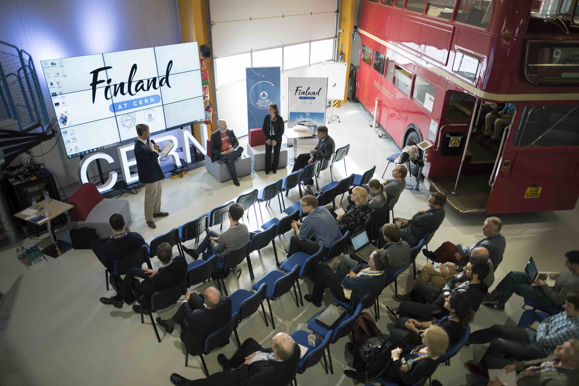
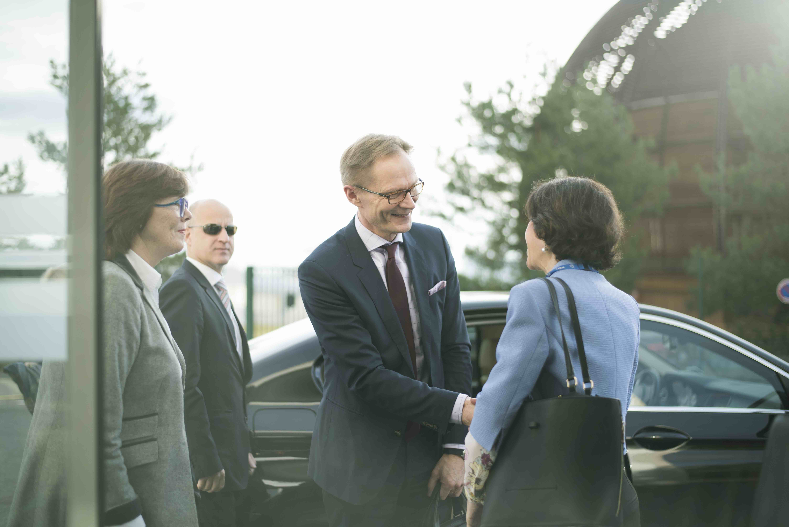
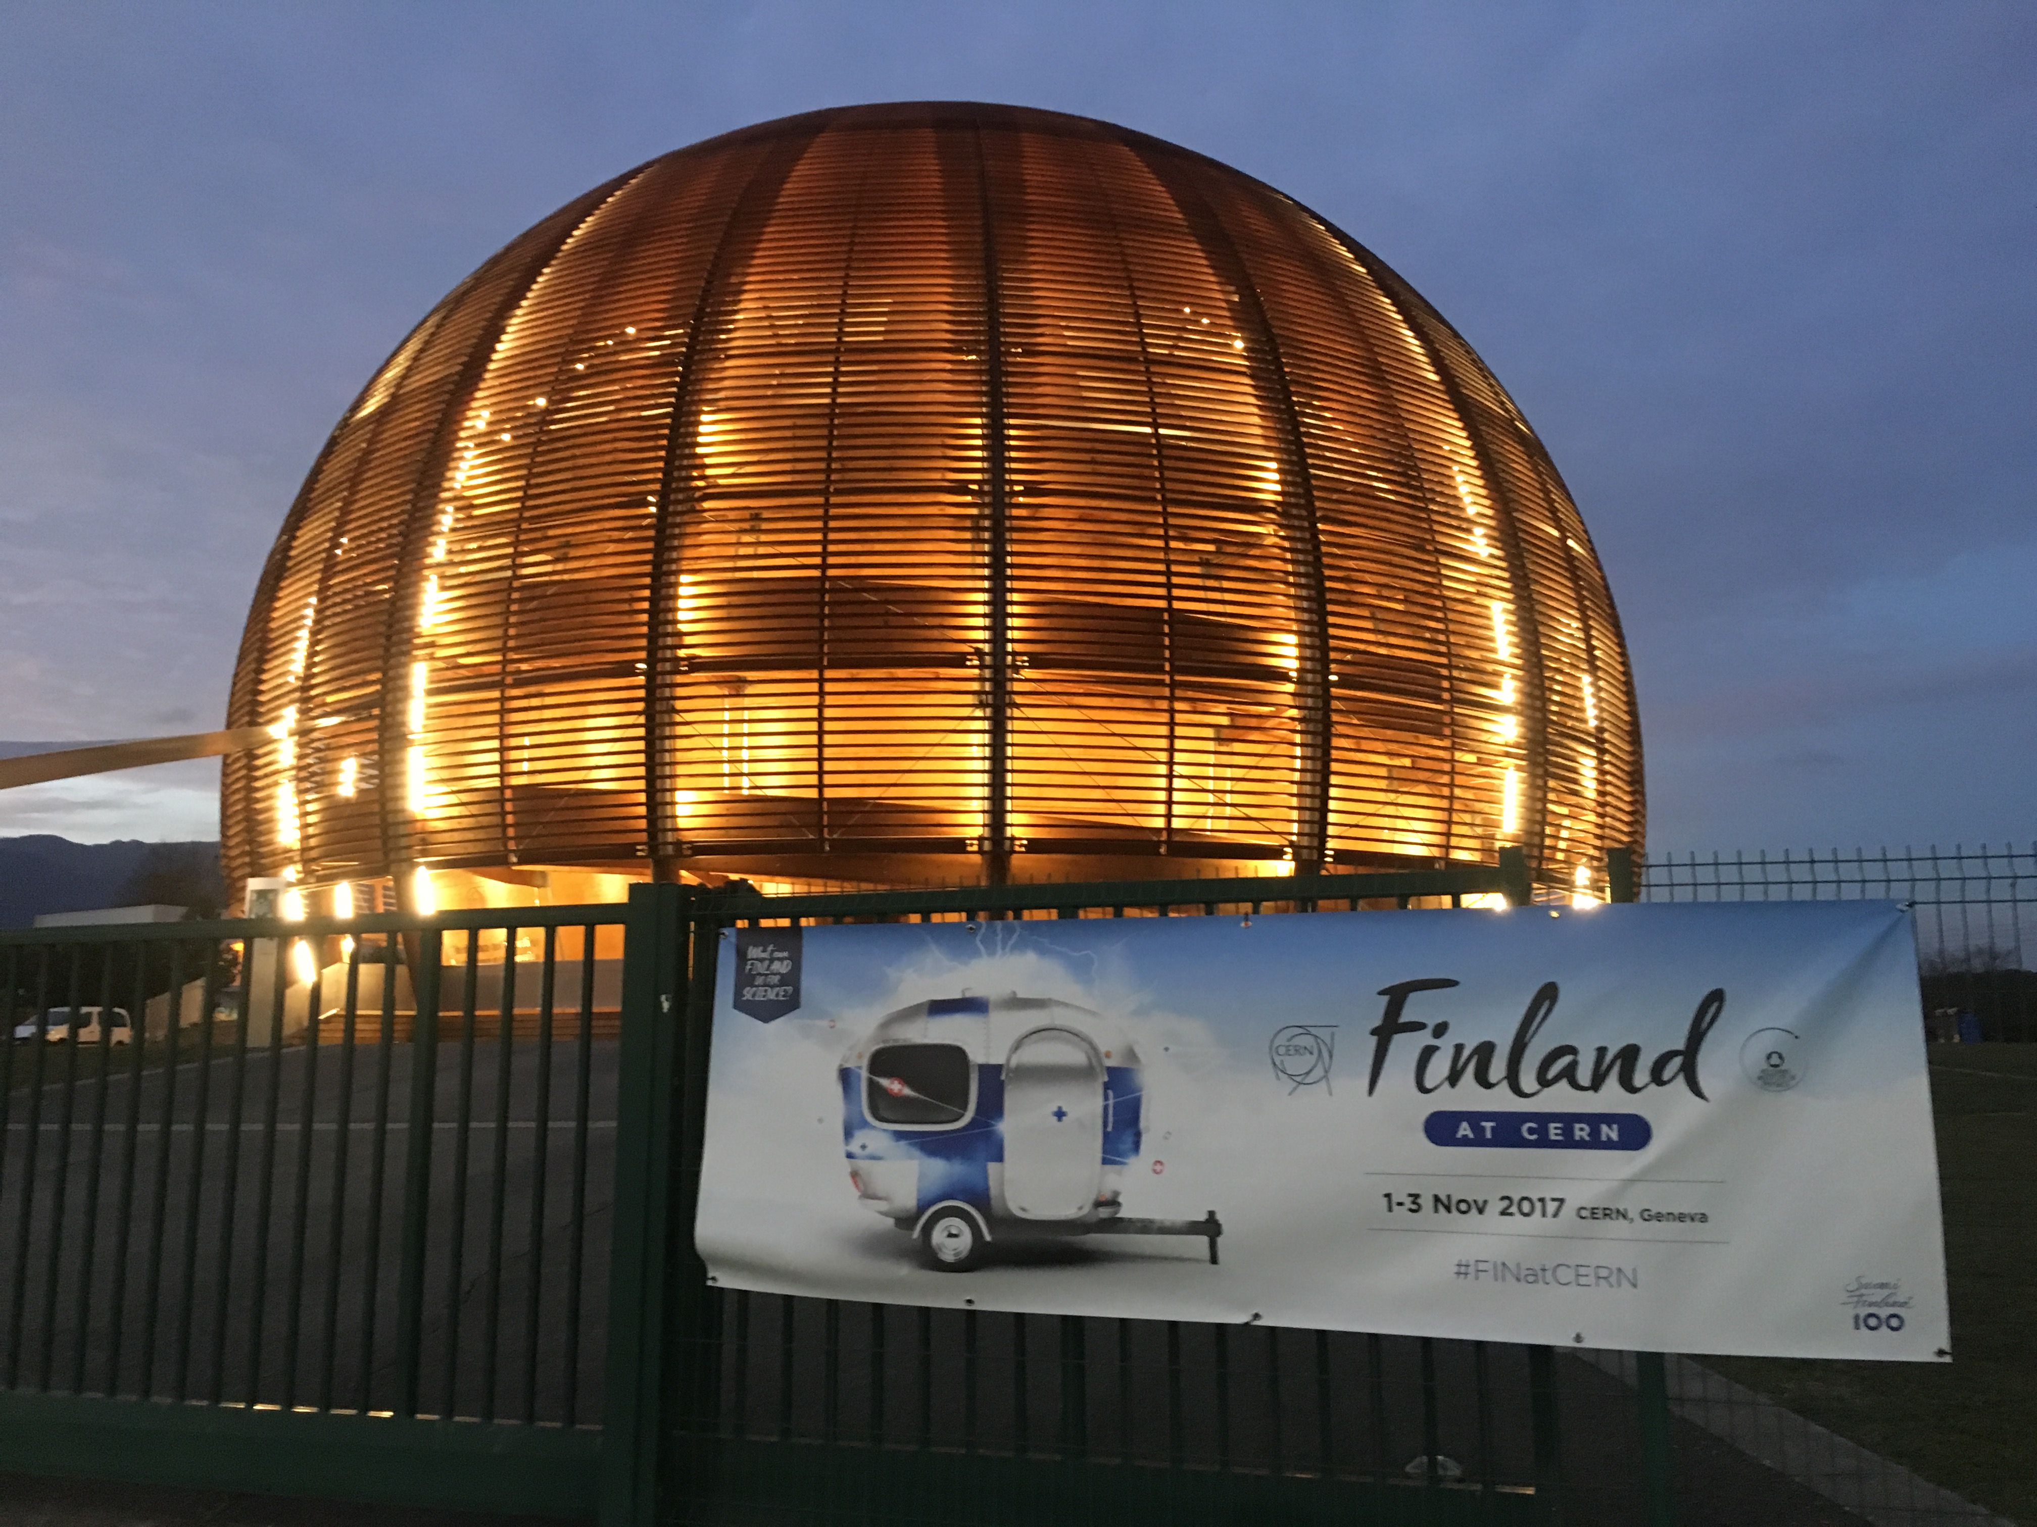
Finland at CERN 1-3.11.2017
Finland@Globe 2.11: ~90 attendants, with
under-secretary of state Petri Peltonen, ambassador Terhi Hakala, CERN DG, CERN Council chair
Workshop 1.11. ~40 attendants
Workshop 3.11 ~30 attendants

Slide 11
HIP organization, personnel
2016: HIP’s legal host is Faculty of Science, University of Helsinki.
HIP administration to University Services, including the Finnish Office at CERN, finances, HR, general administration.
Starting 2018: Faculty sub-units no more budgeting units except HIP: HIP will retain its’ own finances.
HIP personnel: in 2017 about 80 FTE including scholarships. About 50 FTE basic funding, 30 FTE external funding.
People:
  M. Kulmala, HIP CLOUD project leader, nominated to Academician of Science (appointed by President, max 16 at a time)
  K. Österberg, HIP CMS programme leader, promoted to professor in experimental particle physics in UH
  A. Vuorinen, HIP theory project leader, nominated as tenure-track professor in UH

Slide 12
HIP management 2018
Starting 2018: HIP Director Paula Eerola becomes the Dean of the Science Faculty, UH.
PE continues as the CERN and FAIR Council Delegate, and probably becomes the chair of the HIP Board.
New Director recruitment is in progress. Short-listed and interviewed candidates:
  Mikko Alava Aalto
  Richard Brenner Uppsala
  Katri Huitu Helsinki
  Kari Rummukainen Helsinki
  Decision by the HIP Board expected before Christmas
Starting 2018: new technology programme director prof. Filip Tuomisto, Aalto University

Slide 13
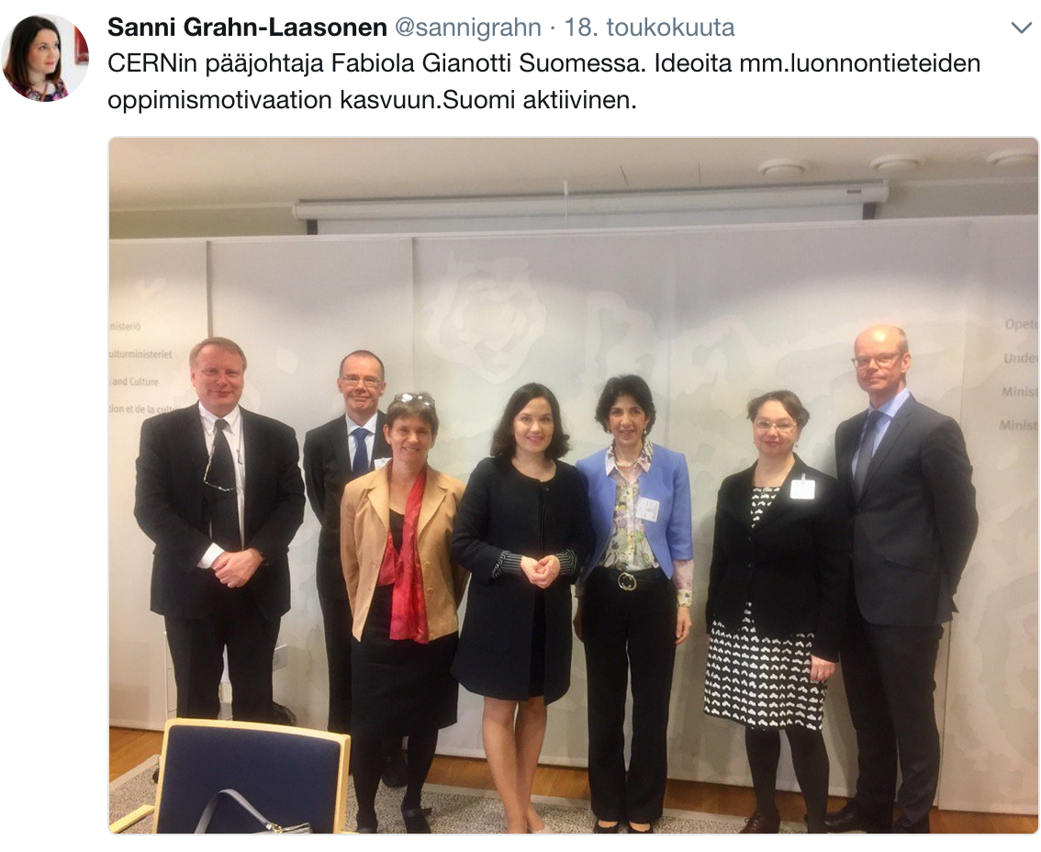
RECFA visit to Finland 19-20 May 2017
CERN DG F. Gianotti: meetings with Ministers and vice-rectors
RECFA positive remarks: HIP role, CMS+TOTEM cooperation, commitments to CMS and ALICE Phase-1 upgrades, theory activities, nuclear physics+JYFL-ACCLAB, instrumentation, schools
RECFA suggestions/hopes: CMS and ALICE Phase-2 upgrades, broaden scope to neutrinos or e⁺e⁻, theory+experiment joint activities, accelerator education, student cooperation across the HIP universities, contacts towards astroparticle/astronomy communities, intensified efforts with Industrial Liaison

Slide 14
  HIP Scientific Advisory Board 28-29 August 2017
Excellent scientific production of HIP in 2016.
Main concern: the budgetary situation.
Very positive that Detector Laboratory becomes a permanent facility.
Very impressed by the new project Education and Open Data.
Theory, good results for all projects.
CMS, TOTEM: number of postdocs should be increased, specially in CMS upgrade group. Also ALICE tense personnel situation.
SAB supports strongly participation in ISOLDE.
Technology projects: SAB supports broadening of the Accelerator technology projects. NINS3 (Tekes-Fidipro) and Radiation metrology: projects are a promising avenue for applying detector technologies to fields with important societal impact.
SAB stresses the need for a well supported Industrial Liaison Officer. SAB asks HIP to develop the BIC project.

Slide 15
HIP funding
HIP funding is for operations: M&O costs, salaries of HIP researchers and students, travels, computing.
Investments (like upgrades): we apply for external, competitive research infrastructure funding from Academy of Finland.
k€ | 2018 | 2017 | 2016 | 2015 | 2014 | 2013
Ministry | 3 200 | 3 200 | 3 505 | 3 644 | 3 590 | 3 500
UH: host, doctoral school, overhead (investments) | 566* | 579* | 825 (27) | 913 (156) | 912 (172) | 908
Other univ | 335 | 335 | 335 | 335 | 335 | 335
SUM | 4 101* | 4 114* | 4 665 | 4 892 | 4 837 | 4 743
External | 1 400 (estimate) | 1 540 | 1 405 | 1 325 | 840 | 974
* administration moved outside of HIP budget to University
services, estimated value 241k€

Slide 16
HIP budget 2018
Ministry of Education: 3.2 M€/year 2017-2020
Basic funding 2018: 4.1 M€
Expected balance 31.12.2017 0 €
2018 budget is planned to be negative 235 k€ (using existing surplus)
External funding about 1.4 M€

Slide 17
HIP sources of funding

Slide 18
3. The project structure of HIP in 2018

Slide 19
Project leaders
Technology programme 1.1.2018-31.12.2020
  Accelerator technology MSM, Markus Aicheler (HIP)
  Gamma-ray spectroscopy GAMMA, Rene Bes (Aalto)
  Accelerator technology MAT, Flyura Djurabekova (UH)
  Materials for big science BIGS, Ilja Makkonen (Aalto)
  Business Incubation Centre BIC, Saku Mäkinen (TUT)
Nuclear matter programme, 1.1.2018-31.12.2020
  Isolde, Janne Pakarinen (UJ)
Nuclear matter programme, 1.1.-31.12.2018
  ALICE-forward, Risto Orava (UH)

Slide 20
4. The action plan of HIP in 2018
HIP strategy 2017 – 2020
Vision for 2025
Global impact in interaction
A creative, international environment for learning and top-level research
-High-level and high-impact research
-High-level research infrastructure
-International partnerships
A focus on the student
-Interaction and learning in the scientific community
Resources for reform
-Versatile funding

Slide 21
HIP profile and focus areas
National CERN strategy:
Visible participation in international research collaborations in front-line particle and nuclear physics research
Applied research for accelerators, radiation detection and information technology
Doctoral education in physics and new technologies in challenging project-based international research environments
Promotion of CERN (and FAIR) –related R&D and business opportunities in Finnish companies
Using CERN for education and outreach in natural sciences
University Strategies:
- University of Helsinki: ”Matter and Materials”
University of Jyväskylä: accelerator-based research
Aalto, Tampere, Lappeenranta: instrumentation, technology applications, material sciences, ICT
International:
European Particle Physics Strategy,
CERN Medium Term Plan,
FAIR Green Paper and related planning documents.

Slide 22
HIP strategy actions 2018
  National responsibility – CERN ja FAIR
  Full utilization of experiments at CERN – CMS, TOTEM, ALICE, ISOLDE, CLOUD
  Detector construction and upgrades at CERN and FAIR
    Finish ALICE phase-1 upgrade 2018
    Concretize CMS- ja ALICE phase-2 upgrades, apply funding from Academy of Finland infrastructure call 2018.
    Construction and/or delivery of detector and accelerator components to FAIR, together with Finnish industry when possible.
    FAIR-project will expand when the FAIR Phase-0 experimental programme will start in 2018.

Slide 23
  Improve industrial cooperation and CERN/FAIR purchases
    Develop BIC towards broader scope
    Follow-up of events in 2017, CERN Roadshow in Finland ja Finland at CERN
    Search for new partners for industrial activation (Business Finland, Ministries).
  Societal impact
    Develop cooperation with other large facilities such as ESRF, ITER ja XFEL.
    New partnerships STUK, IAEA, VTT.
  Students: interaction and learning in the international scientific community
    Cooperation with graduate schools; CERN accelerator school in Finland 2018; cooperation with ESIPAP.
  Healthy funding base and appropriate indicators.
  Education and open data

Slide 24
4+. News from the Council in brief ₁
Science: LHC breaking new records, wealth of new results. CMS some operational issues during last weeks.
European Particle Physics Strategy Update process starting. Goal: update ready May 2020. Chair H. Abramowicz.
Earned-Value Management reports on the LHC Injector upgrade and high-luminosity LHC projects (now 120 MCHF out of 1 404 MCHF). First Nb₃Sn magnets for HL-LHC (CERN, BNL, KEK). Nb₃Sn: US company only provider at the moment.
CERN enlargement discussed. Renewed interest in the Baltic states. Russia officially withdrew application for Associate Membership, but committed to CERN cooperation.
CERN budget 2018: entering construction of HL-LHC, LIU and detector upgrades, rise of expenses 50-60 MCHF/year from 2016 to 2018. Anticipated cumulative budget deficit projected for the end 2018 reduced from -334 MCHF to -298 MCHF.

Slide 25
4+. News from the Council in brief ₂
Many societal impact projects and initiatives.
Science Gateway (50-70 MCHF), external donations.
High-school internships. Grant from STFC (UK).
SE-Eur. Internat. Institute for Sustainable Technologies (Albania, Bosnia-H, Bulgaria, Croatia, Cyprus, Greece, Kosovo, FYROM, Montenegro, Serbia, Slovenia). Synchrotron light, hadron therapy.
Elections: Council chair and vice-chair re-elected, FC chair and vice-chair re-elected, 2 SPC members re-appointed, Pension Fund governing board members re-appointed.
New: Bob Cousins, Marie-Helene Schune SPC, Kerstin Jon-And Audit Committee.
September Council: Paula Eerola appointed member to the Council fundraising group.

Slide 26
5. Other issues brought up by the staff

