Slide 1
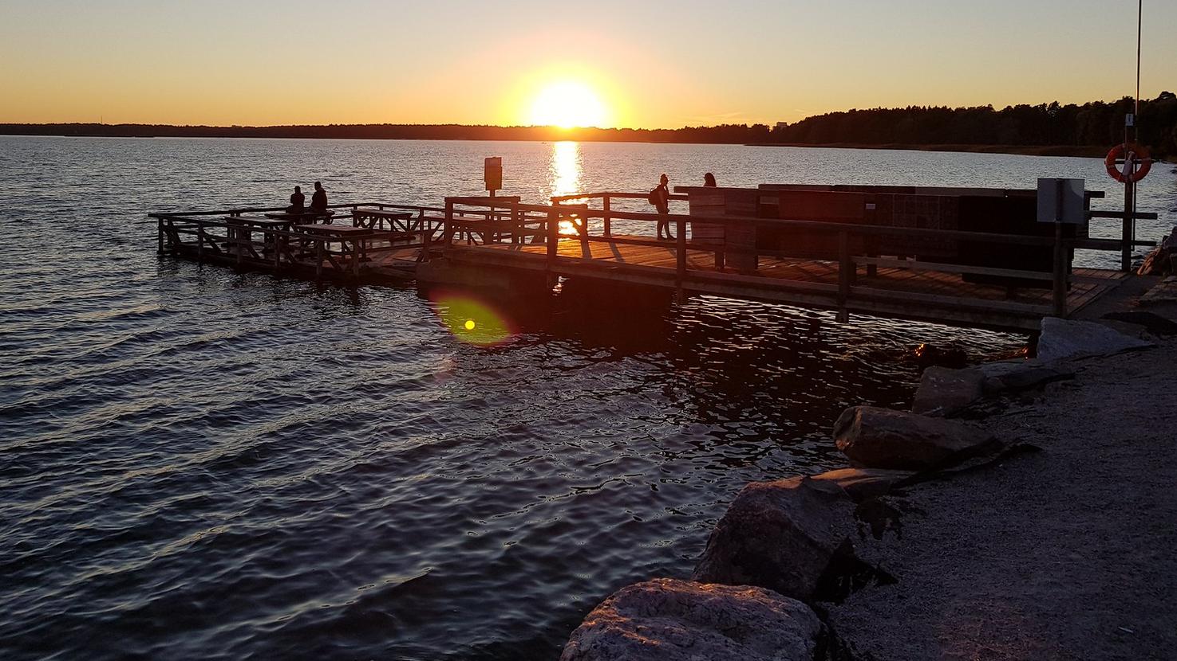


7th NON MINIMAL HIGGS –WORKSHOP
H2020 EU MSCA RISE NETWORK
1 – Warsaw (pegged to Scalars 2015)
2 – Uppsala (pegged to Charged 2016)
3 – Toyama (pegged to Higgs as a Probe of New Physics 2017)
4 – Warsaw (pegged to Scalars 2017)
5 – Lisboa (pegged to Multi-Higgs workshop 2018)
6 – Osaka (pegged to Higgs as a Probe of New Physics 2019)
Secondments to/from non-European nodes:
(Southampton- Lisboa-Uppsala-Helsinki-Orsay-Santa Cruz-Tangiers-Ottawa-Toyama/Osaka-Zewail City)

Slide 2
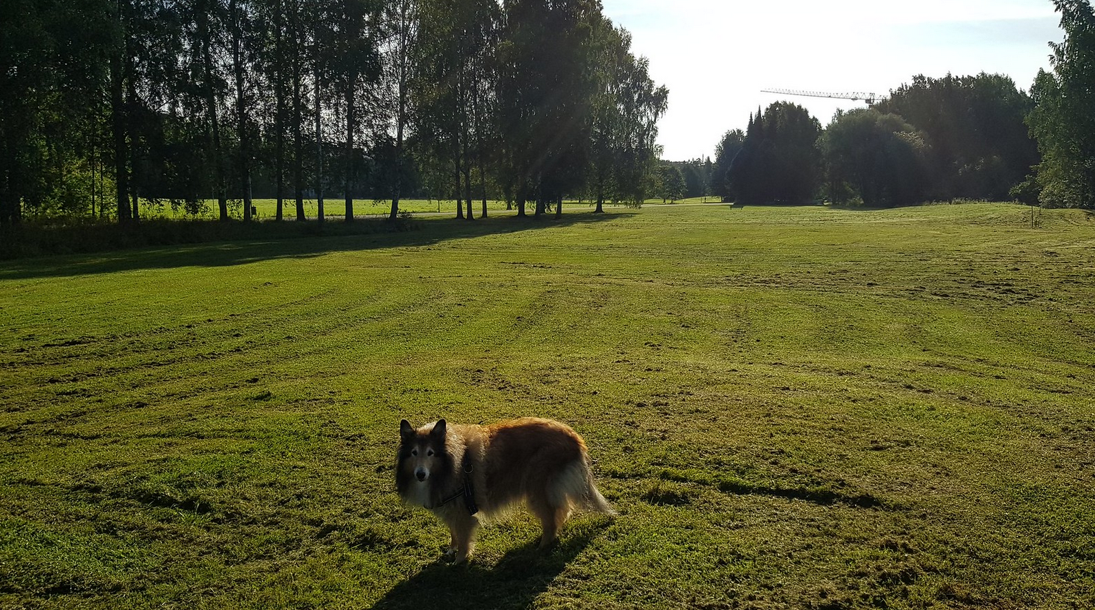
Non Minimal Higgs activities in Helsinki:
Helsinki Institute of Physics
-partners Universities of Helsinki, Jyväskylä, Tampere, Aalto University, LUT University
-responsible for Finnish research collaboration with CERN and contribution to FAIR
Div. of Particle and Astrophysics of Dept. of Physics in Helsinki Univ
We participate in LHC experiments ALICE, CMS, TOTEM, CLIC, ISOLDE, CLOUD;
ESA missions PLANCK, EUCLID
Recent addition:
gravitational waves, LISA

Slide 3
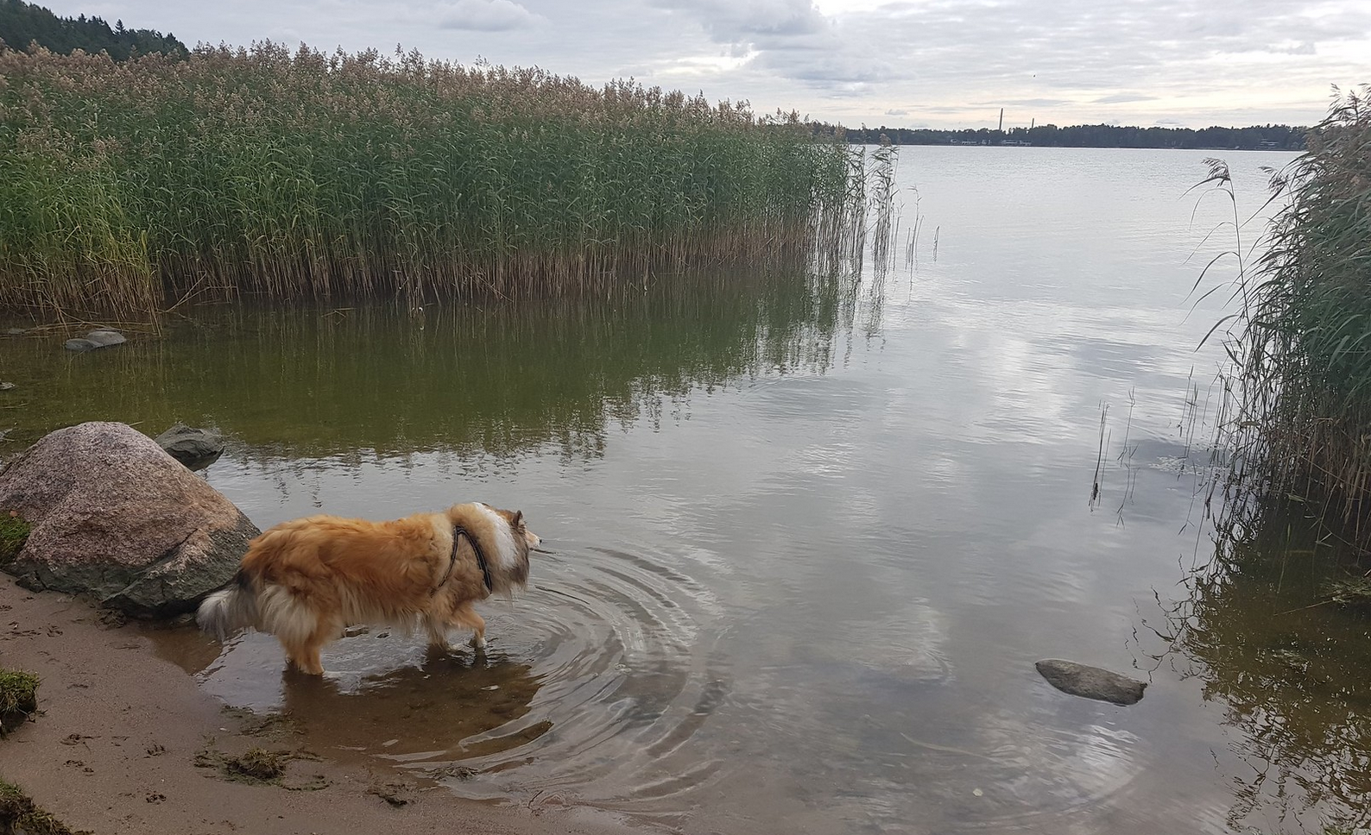
In Helsinki research connected to Non Minimal Higgs
theory includes collider phenomenology, dark matter, CP violation,
flavour models, inflation, cosmology, phase transition,…
In the workshop all this
and MORE!
Enjoy the workshop!
Welcome!

