Slide 1
The gravity track of Higgs inflation
(work with Vera-Maria Enckell, Kari Enqvist,
Eemeli Tomberg and Lumi-Pyry Wahlman)
Syksy Räsänen
University of Helsinki
Department of Physics and Helsinki Institute of Physics
Notes:
20 minutes
Using the Standard Model Higgs as the inflation is attractively economical. However, there are complications both on the side of quantum corrections and gravity. I will discuss possibilities and problems due to such complications. In particular I will cover how Higgs inflation can be used to distinguish between different gravitational degrees of freedom to find what spacetime is made of.

Slide 2
Also starring
Eemeli Tomberg today here at 16.45: Primordial black holes from Higgs inflation?
Lumi-Pyry Wahlman on Wednesday in A315 at 14.15: Can we Probe Gravitational Degrees of Freedom through Inflation?

Slide 3
Using what you have
Non-minimal coupling 𝜉h²R is the only new dimension 4 operator for the combined Einstein-Hilbert + SM action.
The coupling 𝜉 is generated by renormalisation, even if it is classically zero.
Non-minimal coupling enables Higgs inflation, which uses the only known scalar field that may be elementary. (Bezrukov and Shaposhnikov: 0710.3755)

Slide 4
The many faces of Einstein gravity
Usually the gravitational degrees of freedom are taken to be the metric and its derivatives.
In the Palatini formulation, the metric and the connection are independent degrees of freedom.
In the Einstein-Hilbert case, the metric and the Palatini formulation are equivalent.
With a non-minimally coupled scalar field, they are different physical theories. (Bauer and Demir: 0803.2664)

Slide 5
To the Einstein frame
The Einstein frame is reached with the conformal transformation
In the Palatini case, the conformal transformation does not affect the Ricci tensor.
To recover canonical kinetic term, define new field 𝜒:
  metric:
  Palatini:
Polynomial potential is transformed into exponential potential.

Slide 6
Higgs potential in
Metric vs Palatini
We get a different Einstein frame potential depending on the gravitational degrees of freedom:
  metric:
  Palatini:
The potential is exponentially flat.

Slide 7
Predictions of Higgs inflation on the plateau
On the exponentially flat plateau, we get:
  metric:
  Palatini:
  Reheating is fixed: N≈50. (Figueroa et al: 1504.04600, Rubio and Tomberg: 1902.10148)

Slide 8
The data likes Higgs inflation
Higgs inflation
Planck: arXiv:1807.06211

Slide 9
Metric vs Palatini: R² term
Loop corrections generate an R² term in the action.
Its effect is completely different in the metric and in the Palatini formulation.

Slide 10
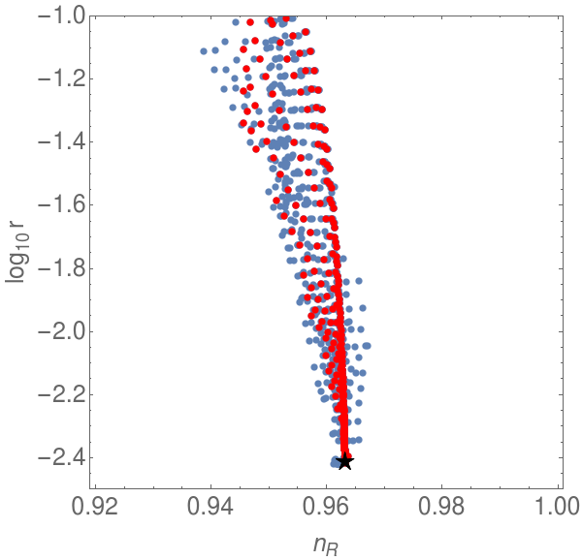
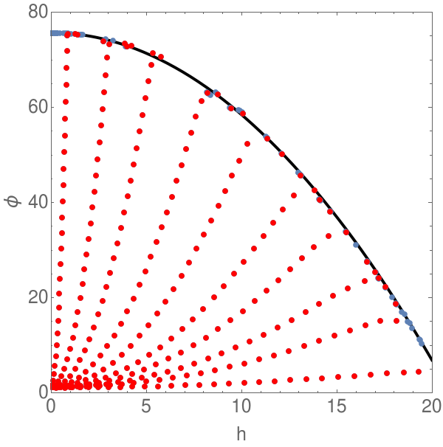
R² à la metric: two-field model
In the metric case, the R² term adds a scalar degree of freedom, so we get a two-field model. (Wang and Wang: 1701.06636, Ema: 1701.07665, Zhang, Huang and Sasaki: 1712.09896, He, Starobinsky and Yokoyama: 1804.00409, Gundhi and Steinwachs: 1810.10546, Enckell, Enqvist, SR, Wahlman: 1812.08754)
The R² term destabilises Higgs inflation. (Enckell, Enqvist, SR, Wahlman: 1812.08754)
Trajectories in field space.
Results for observables.

Slide 11
R² à la Palatini: saving your favourite model
In the Palatini case, the new scalar field does not get a kinetic term and can be integrated out. (Enckell, Enqvist, SR, Wahlman: 1810.05536)
The action reduces to
The only effect is to change the tensor power spectrum, giving
This can be used to rescue any scalar field model where r was excluded by the data.

Slide 12
Features unique to Palatini
In the metric case, the metric and the Riemann tensor are the only geometrical tensors.
In the Palatini case, we also have the non-metricity tensor .
Now there are many more scalars, with no correspondence in the metric case.

Slide 13
Kinetic terms for the metric
We have new kinetic terms, such as
Mixing of Higgs and metric kinetic terms sources non-metricity (SR: 1811.09514).
Going to the Einstein frame and canonical field now has more possibilities:
By tuning the constants, we can generate an inflection point, 𝛼-attractor or the potentials

Slide 14
Higgs as a window to gravity
Higgs inflation is a conservative possibility using only known degrees of freedom.
Different formulations of general relativity become inequivalent theories when the matter couples to the connection.
Higgs opens a window to gravitational degrees of freedom.
In the Palatini case, r is suppressed.
In the metric case, R² term leads to a complicated two-field model. In the Palatini case, it is harmless.
In the Palatini case, new gravitational terms can completely change the effective potential. (More to come: teleparallel, Ashtekar, ...)

Slide 16
R² à la metric: two-field model details
In the metric case, the R² term adds a scalar degree of freedom, so we get a two-field model. (Wang and Wang: 1701.06636, Ema: 1701.07665, Zhang, Huang and Sasaki: 1712.09896, He, Starobinsky and Yokoyama: 1804.00409, Gundhi and Steinwachs: 1810.10546, Enckell, Enqvist, SR, Wahlman: 1812.08754)
The action becomes

Slide 17
Kinetic terms for the metric
Considering terms with only up to 2 derivatives (and demanding the equations of motion can be derived without adding boundary terms), the action is (SR: 1811.09514)
Non-minimal coupling and kinetic mixing source non-metricity and torsion.

Slide 18
Coordinates in field space
The action can be simplified by choosing suitable coordinates in field space.
All effects of the non-minimal connection are mapped onto the potential:
The field transformation is , where K(h) is a complicated function.

Slide 19
The Higgs case
Let us consider the Higgs case with only dimension 4 operators.
Here f, k, a_{i}, b_{i0} and b_{i1} are constants. We get
By tuning the constants, we can generate an inflection point, 𝛼-attractor or .

