Slide 1


Gravitational Waves from colliding bubbles in cold hidden sectors
Malcolm Fairbairn in collaboration with:
Edward Hardy (Liverpool), Ali Wickens (KCL)
arviX:1901.11038

Slide 2
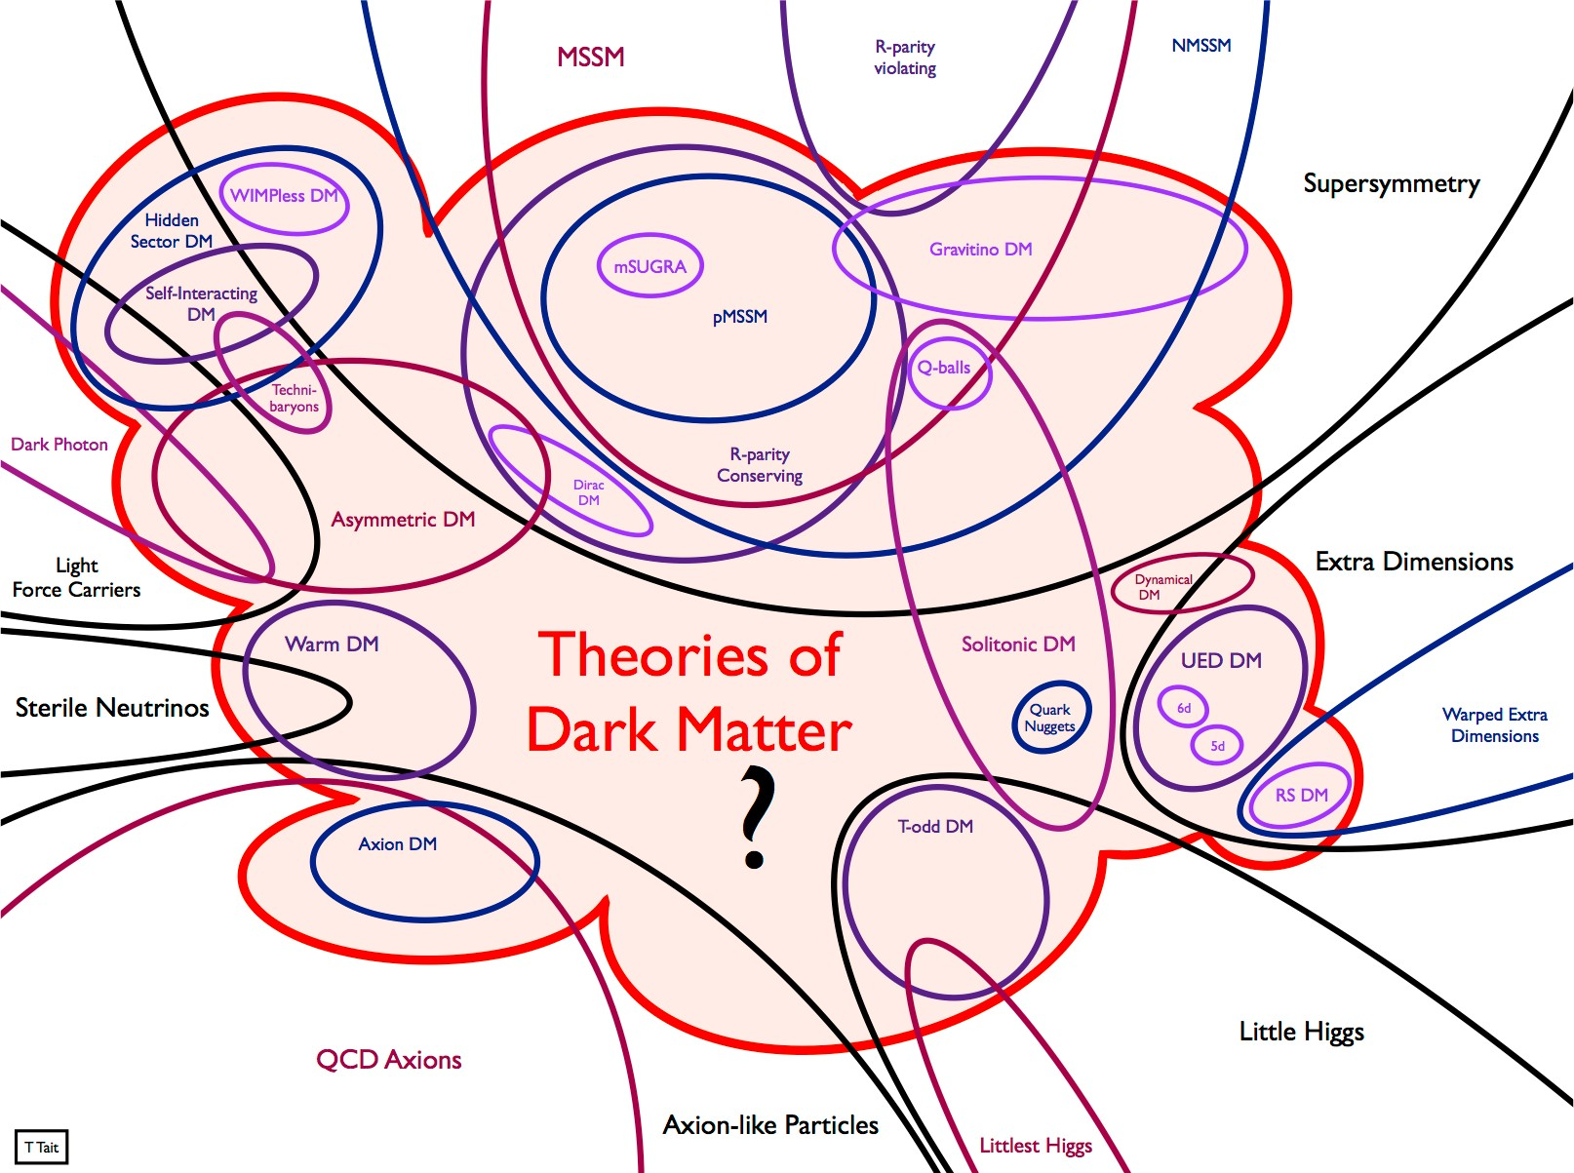
From Tim Tait

Slide 3
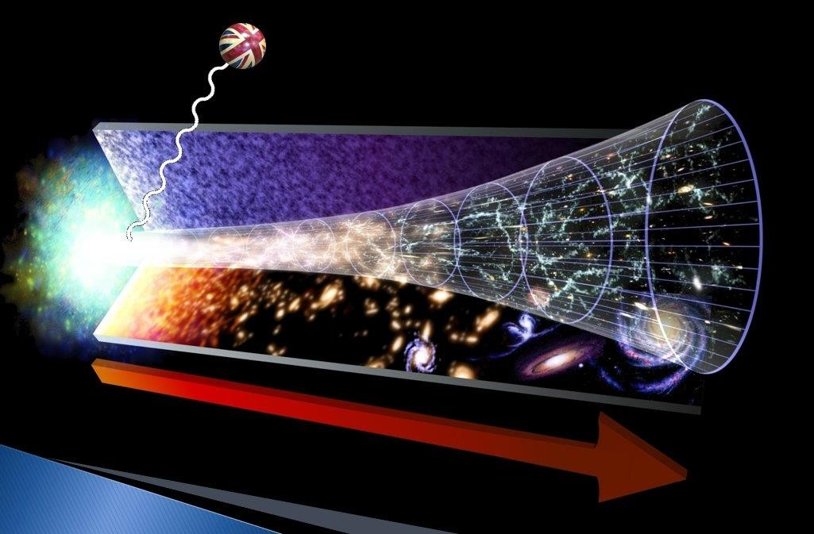
The Brexiton (Enqvist 2017, Rajantie 2017)
Goes out of thermal equilibrium then acts as a decoupled spectator field while it decays

Slide 4
Everything couples to Gravity!
If we observe phase transitions using gravitational waves, how will we know whether they come from our sector or some dark sector?
Like most things in Physics, it’s a bit messy and complicated but today I will try to explain our investigations.
PLAN OF TALK
Toy model
Phase transitions
Gravitational waves

Slide 5
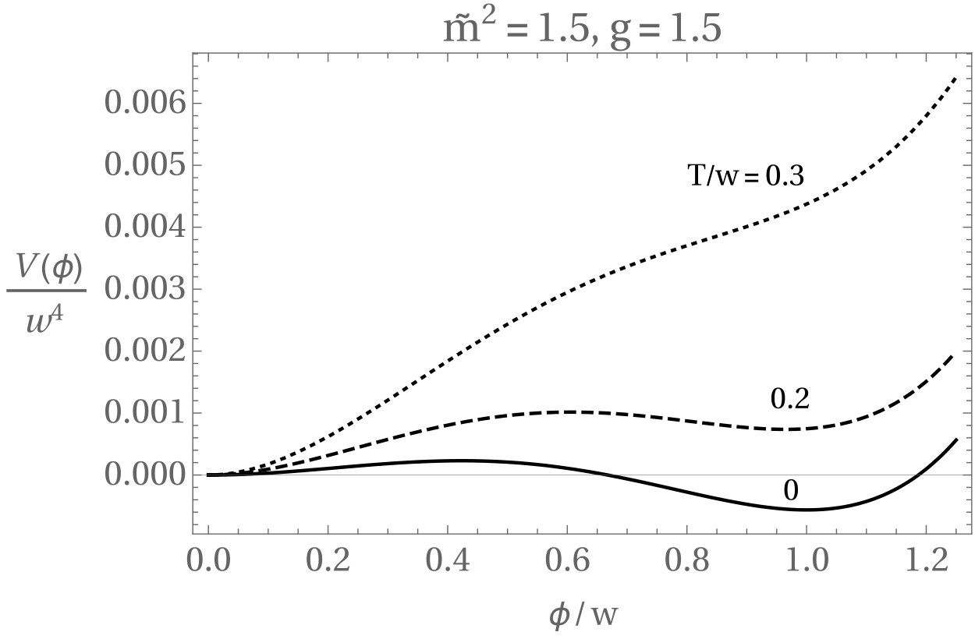
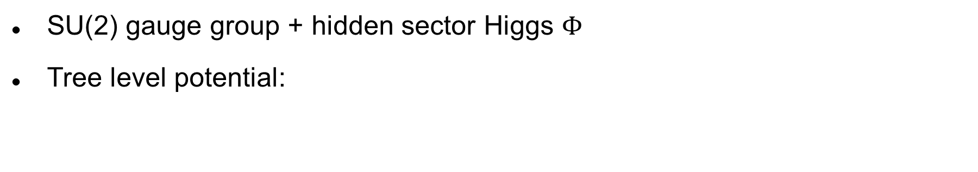
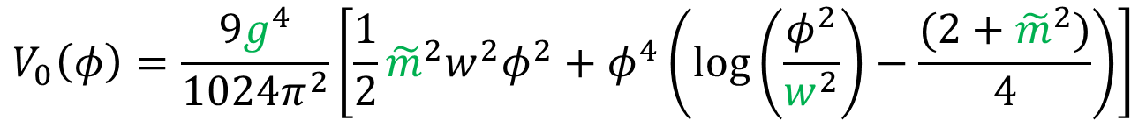

Our toy cold hidden sector
An example hidden sector
SU(2) gauge group + hidden sector Higgs $Φ$
Tree level potential:
$$V\left(φ\right)=−m^{2}{\left|Φ\right|}^{2}+λ{\left|Φ\right|}^{4}$$
With 1 -loop corrections:
$$V_{0}\left(φ\right)=\frac{9g^{4}}{1024π^{2}}\left[\frac{1}{2}{\tilde{m}}^{2}w^{2}φ^{2}+φ^{4}\left(\log\left(\frac{φ^{2}}{w^{2}}\right)−\frac{(2+{\tilde{m}}^{2})}{4}\right)\right]$$
Full thermal potential:
We consider parts of the parameter space where there is a barrier at zero temperature!
$$V\left(φ,T_{hidden}\right)=V_{0}\left(φ\right)+V_{T_{hidden}}(φ,T_{hidden})$$
5
Notes:
Graph shows particular point in parameter space i.e. specific g, m-tilde

Slide 6
Hidden sector vacuum energy relative to visible sector energy is given by parameter
Decay of φ into hidden sector fermions is required if α is large or the hidden sector higgs or gauge bosons may create too much dark matter
If there are too many hidden sector fermions, they will act as dark radiation which will create problems for BBN or CMB
These constraints can all be applied in any given situation

Slide 7
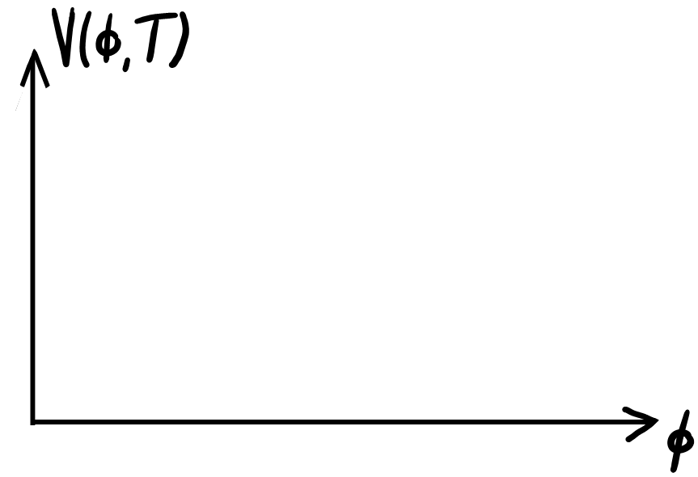

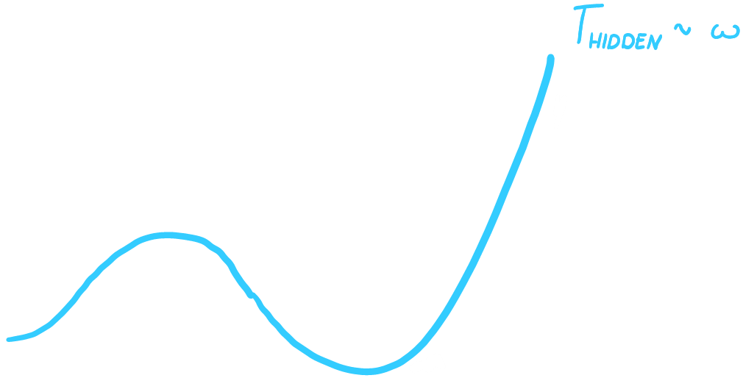
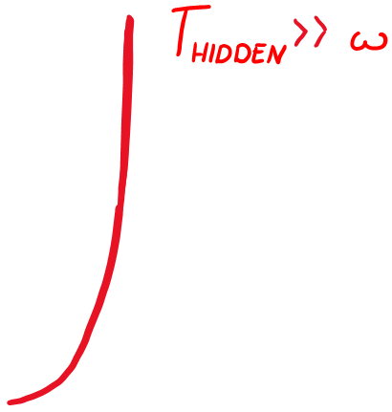
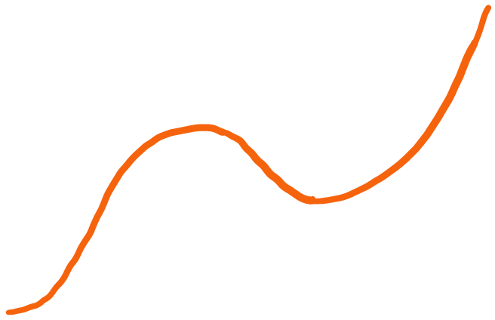
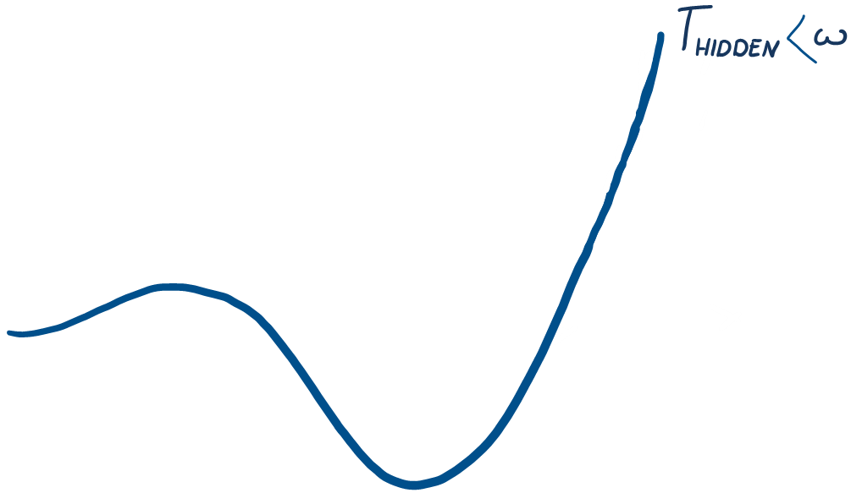
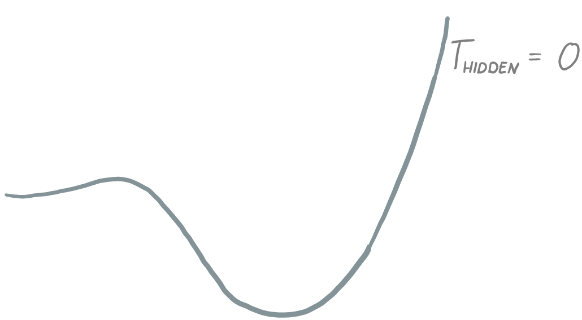

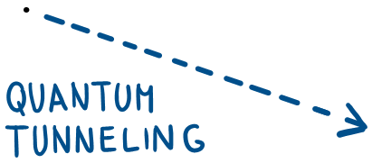


Cold hidden sectors
The two types of transition
Thermal Transition
Happens when $Γ_{thermal}{\left(t\right)}^{\frac{1}{4}}>H(t)$
Tunnelling transition
Happens when $Γ_{tunnel}{\left(t\right)}^{\frac{1}{4}}>H(t)$
7
Notes:
When the temperature of the hidden sector is still high enough such that there is sufficient thermal energy then a transition can happen via thermal fluctuations over the barrier and one can can calculate a nucleation rate of thermal bubbles that varies with temperature.
As we drop the hidden temperature further and it gets closer to its zero temperature form the barrier height will not be varying very much whilst the thermal energy in the hidden plasma is rapidly dropping and so transition via thermal fluctuations become more difficult and the nucleation rate rate drops off.
Now quantum tunnelling nucleation rate only does not have explicit temperature dependence only dependence on barrier height. Thus transition via quantum tunnelling becomes easier and easier as barrier height drops until you reach a roughly constant nucleation rate where the barrier height is not changing much with the hidden sector temperature

Slide 8
Cold hidden sectors
The two types of transition
Thermal phase transition
Tunneling Phase transition
Both temperature dependent
Notes:
When the temperature of the hidden sector is still high enough such that there is sufficient thermal energy then a transition can happen via thermal fluctuations over the barrier and one can can calculate a nucleation rate of thermal bubbles that varies with temperature.
As we drop the hidden temperature further and it gets closer to its zero temperature form the barrier height will not be varying very much whilst the thermal energy in the hidden plasma is rapidly dropping and so transition via thermal fluctuations become more difficult and the nucleation rate rate drops off.
Now quantum tunnelling nucleation rate only does not have explicit temperature dependence only dependence on barrier height. Thus transition via quantum tunnelling becomes easier and easier as barrier height drops until you reach a roughly constant nucleation rate where the barrier height is not changing much with the hidden sector temperature

Slide 9
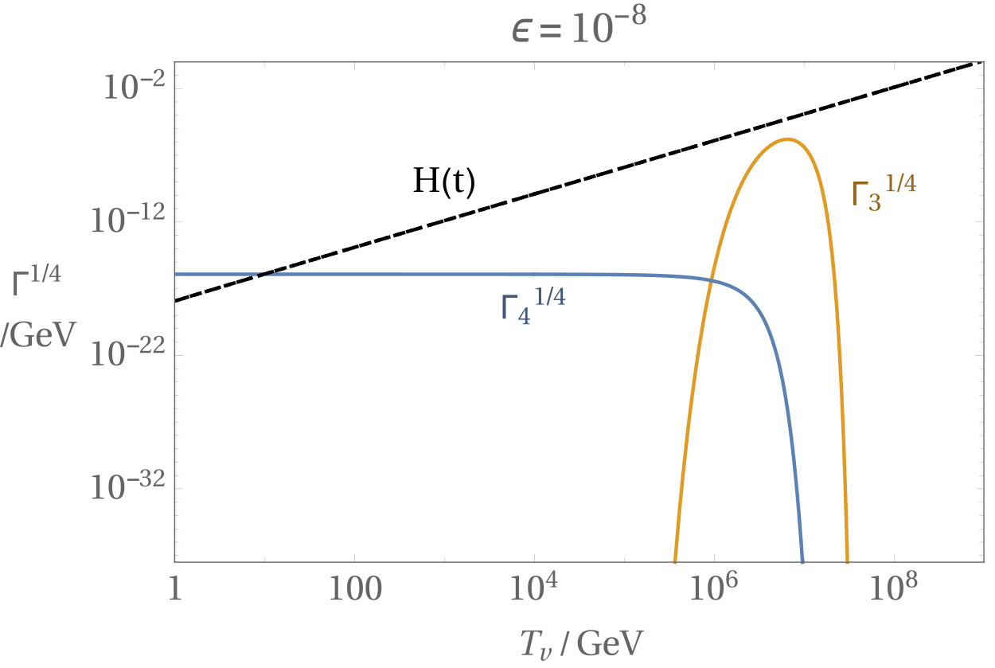
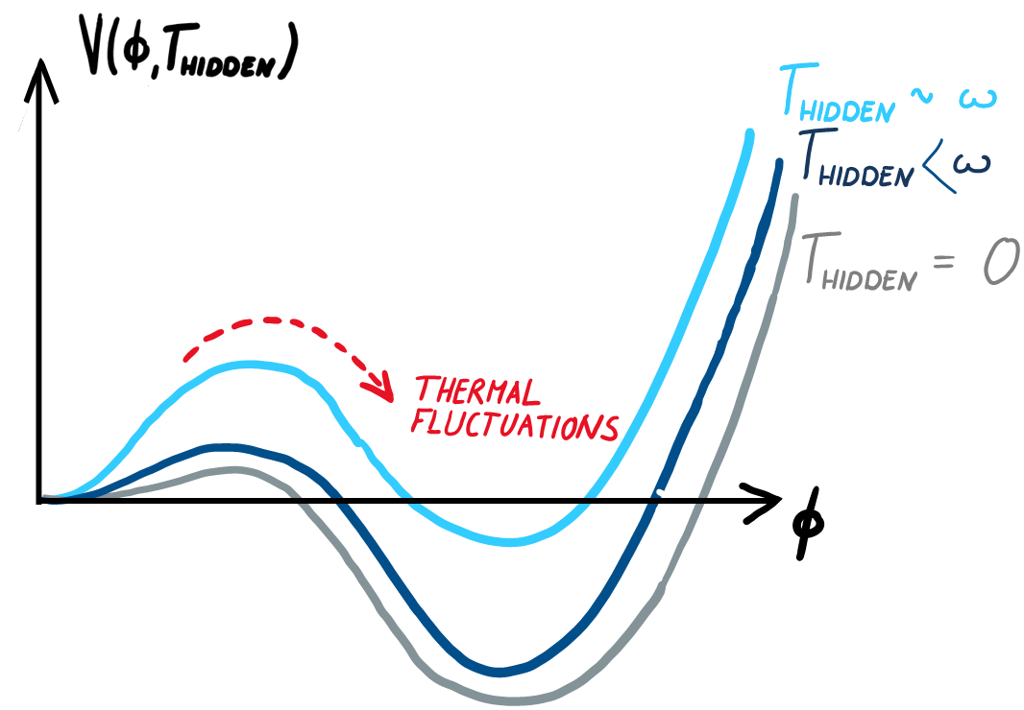










Thermal phase transition
The two types of transition: concrete example
Optimal point for thermal transition
Thermal fluctuations are very small
$$Γ_{thermal}^{\frac{1}{4}}$$
Nucleation rate $[Γ^{\frac{1}{4}}]$
Barrier is very high
$${10}^{−8}$$
$${10}^{−6}$$
$${10}^{−4}$$
$${10}^{−2}$$
$${10}^{0}$$
$T_{hidden}$ /GeV
Notes:
Talk about size of thermal fluctuations relative to height of barrier.

Slide 10
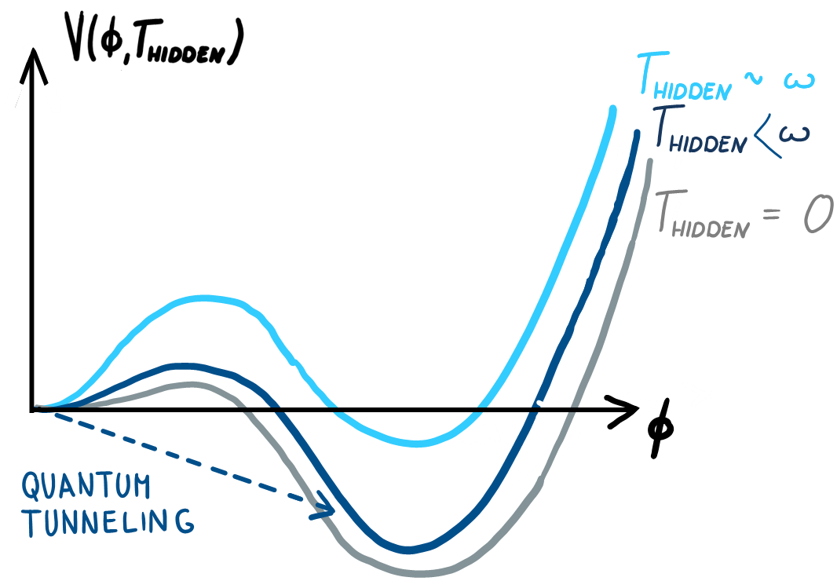




Tunnelling phase transition
Case 1: $ε=\frac{T_{hidden}}{T_{visible}}≈1$
The two types of transition: concrete example
Tunnelling nucleation rate stays constant
$$Γ_{thermal}^{\frac{1}{4}}$$
Barrier close to $T_{hidden}=0$ form
Nucleation rate $[Γ^{\frac{1}{4}}]$
$$Γ_{tunnelling}^{\frac{1}{4}}$$
Barrier height very high
$${10}^{−8}$$
$${10}^{−6}$$
$${10}^{−4}$$
$${10}^{−2}$$
$${10}^{0}$$
$T_{hidden}$ /GeV
Notes:
Now we want to work out the hubble expansion rate to see if either the thermal or tunnelling nucleation rate beats hubble rate. Choosing the case where T_vis = T_hiden first we can use this to work out the hubble expansion at each hidden sector temperature….see next slide

Slide 11
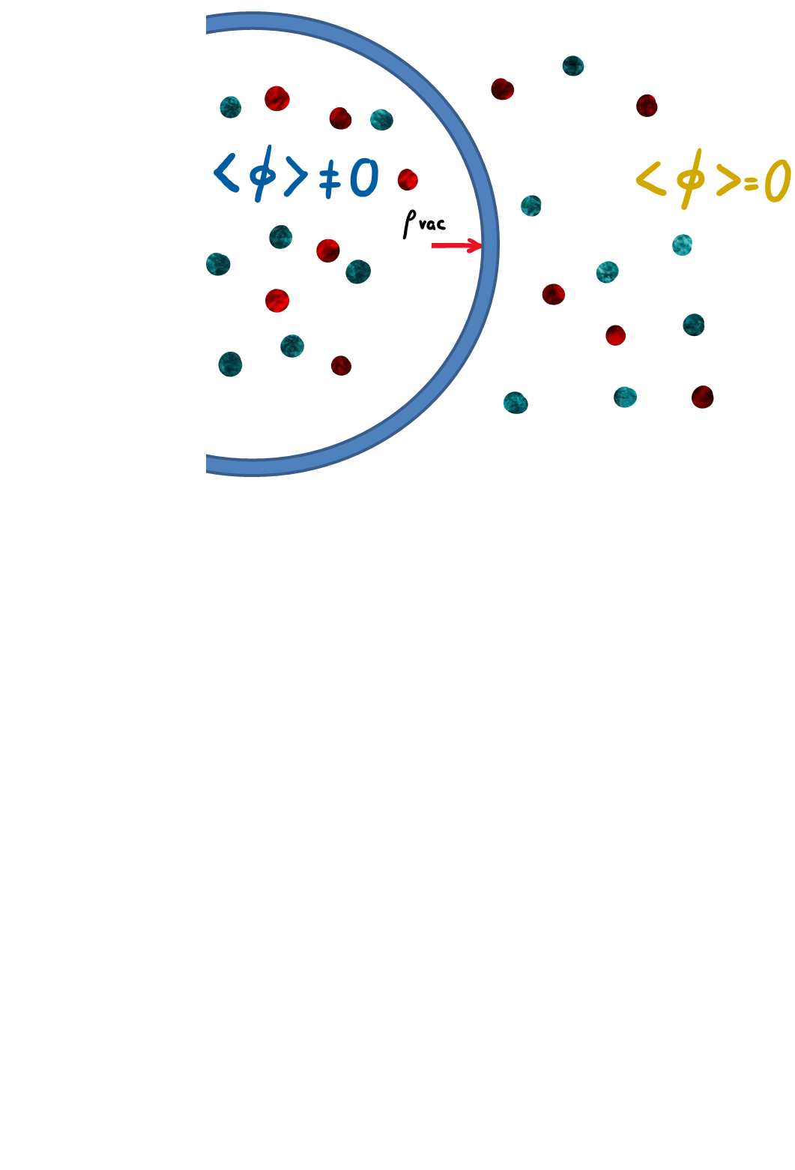
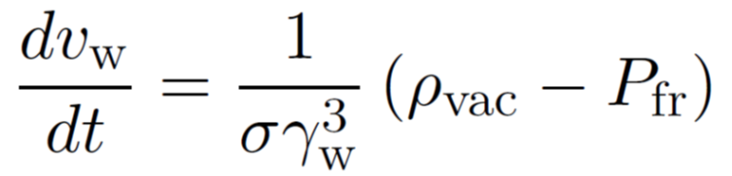


Bubble wall dynamics
The wall velocity
Friction set by $T_{hidden}$
Wall Velocity
Friction determines wall velocity at collision
Controls shape of GW spectrum (fraction in sound waves vs shock waves)
11
Notes:
Radial profile of bubble depends on the form of the potential which depends on the hidden sector temperature. So bubble wall only interacts with hidden plasma!

Slide 12
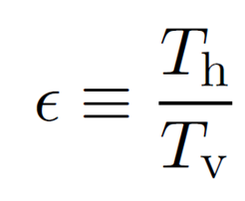
Ratio of temperatures between dark and visible sector
dark sector might have different temperature for a few reasons:-
Large number of BSM degrees of freedom in visible sector
Different reheating after inflation into visible and hidden sector
String theory moduli decay preferentially into one sector rather than other
Notes:
When the temperature of the hidden sector is still high enough such that there is sufficient thermal energy then a transition can happen via thermal fluctuations over the barrier and one can can calculate a nucleation rate of thermal bubbles that varies with temperature.
As we drop the hidden temperature further and it gets closer to its zero temperature form the barrier height will not be varying very much whilst the thermal energy in the hidden plasma is rapidly dropping and so transition via thermal fluctuations become more difficult and the nucleation rate rate drops off.
Now quantum tunnelling nucleation rate only does not have explicit temperature dependence only dependence on barrier height. Thus transition via quantum tunnelling becomes easier and easier as barrier height drops until you reach a roughly constant nucleation rate where the barrier height is not changing much with the hidden sector temperature

Slide 13


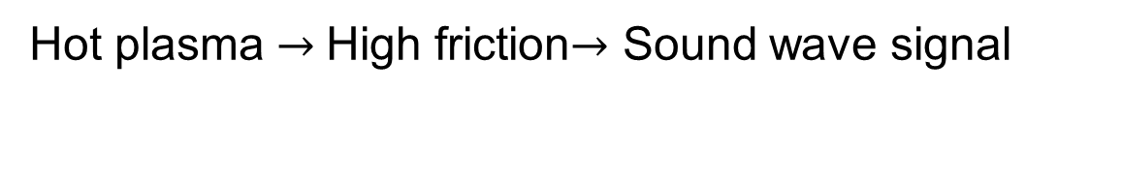



Phase transitions
Case 1: $ε=\frac{T_{hidden}}{T_{visible}}≈1$
$$Γ_{thermal}^{\frac{1}{4}}$$
Nucleation rate $[Γ^{\frac{1}{4}}]$
$$Γ_{tunnelling}^{\frac{1}{4}}$$
Thermal transition takes place when hidden plasma is hot
$$H\left(t\right)$$
$${10}^{−8}$$
$${10}^{−6}$$
$${10}^{−4}$$
$${10}^{−2}$$
$${10}^{0}$$
$T_{hidden}$ /GeV
Hot plasma $→$High friction$→$ Sound wave signal

Slide 14








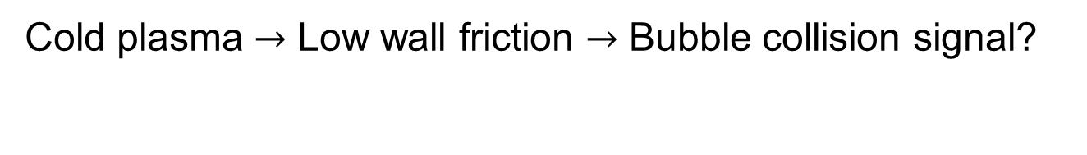


Phase transitions
Case 2: $ε=\frac{T_{hidden}}{T_{visible}}≪1$
Thermal transition window missed
$$H\left(t\right)$$
$$Γ_{thermal}^{\frac{1}{4}}$$
Nucleation rate $[Γ^{\frac{1}{4}}]$
$$Γ_{tunnelling}^{\frac{1}{4}}$$
Tunnelling transition happens later when hidden plasma is cold
$${10}^{−8}$$
$${10}^{−6}$$
$${10}^{−4}$$
$${10}^{−2}$$
$${10}^{0}$$
$T_{hidden}$ /GeV
Cold plasma $→$ Low wall friction $→$ Bubble collision signal?
Notes:
Visible sector dominates energy density and drives expansion.
Talk about visible sector being hot/cold relative to hidden sector.

Slide 15
very different hidden sector temperatures, but visible sector temperature
of phase transition can be the same (or bigger, or smaller)

Slide 16
Incomplete Phase transitions
H(t)
If vacuum energy density dominates expansion
before phase transition, we are essentially stuck in old inflation scenario.
Phase transition never completes….
$$Γ_{thermal}^{\frac{1}{4}}$$
Nucleation rate $[Γ^{\frac{1}{4}}]$
$$Γ_{tunnelling}^{\frac{1}{4}}$$
$${10}^{−8}$$
$${10}^{−6}$$
$${10}^{−4}$$
$${10}^{−2}$$
$${10}^{0}$$
$T_{hidden}$ /GeV
Notes:
Now we want to work out the hubble expansion rate to see if either the thermal or tunnelling nucleation rate beats hubble rate. Choosing the case where T_vis = T_hiden first we can use this to work out the hubble expansion at each hidden sector temperature….see next slide

Slide 17
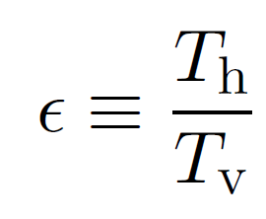
These phase transitions correspond to w=1 GeV

Slide 18
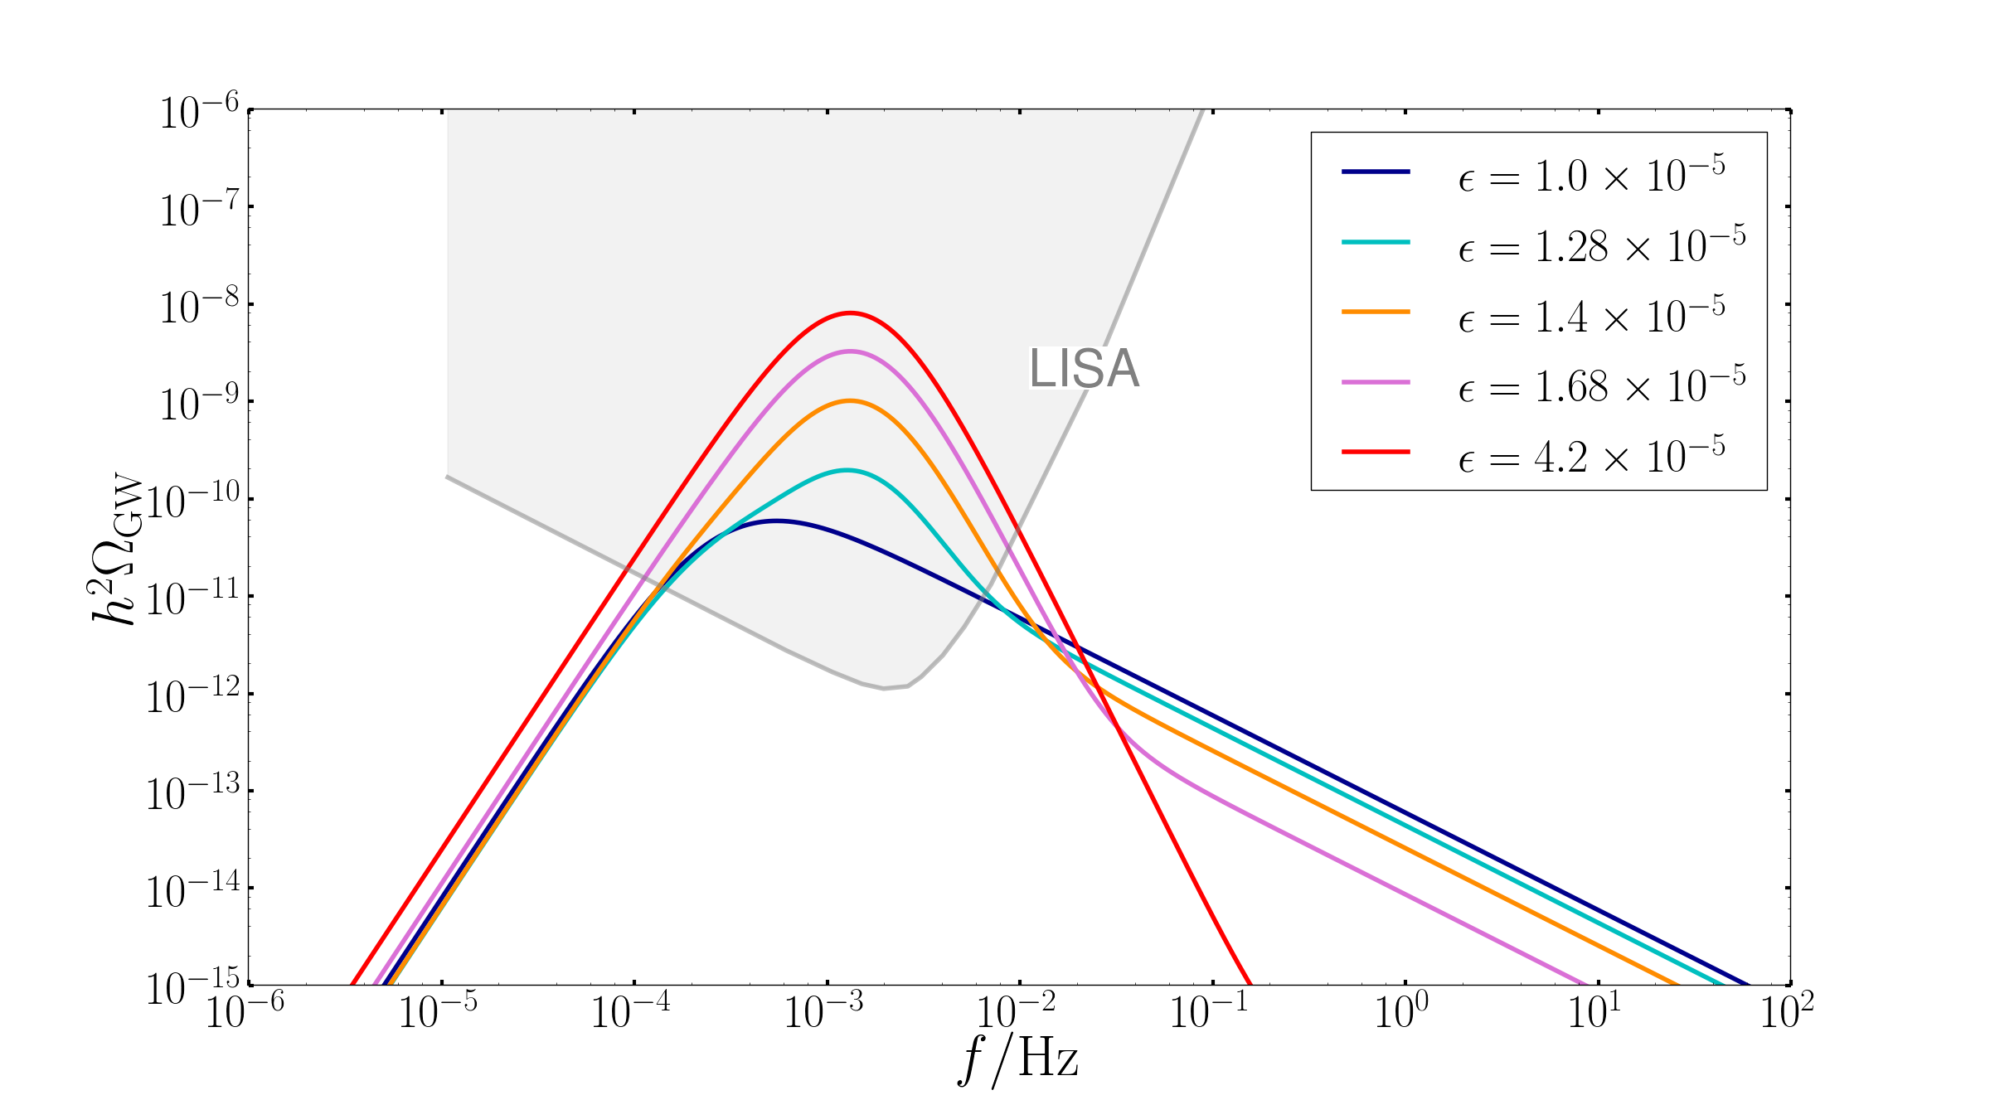
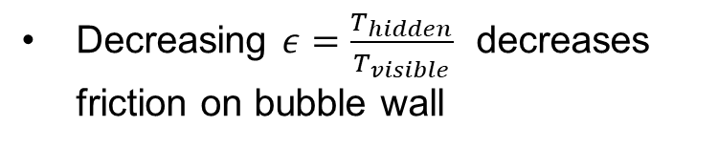
Gravitational Waves : example 1
here visible temperature at transition is around TeV
Hidden sector temperature different
Decreasing $ε=\frac{T_{hidden}}{T_{visible}}$ decreases friction on bubble wall
Sound wave → bubble collision
Changes the shape of the gravitational wave signal
A tunnelling transition where a sound wave is expected could be a signal of a hidden cold sector

Slide 19
Gravitational Waves : example 2
A phase transition with a frequency below 10⁻⁹ Hz would be strong evidence of a cold dark sector

Slide 20


Summary
We investigated how to distinguish between hidden and visible sector phase transitions
Cold hidden sector could give rise to the same peak frequency as hot visible sector but with different spectrum
Strong phase transition at low frequency would be difficult to understand because of BBN

