Slide 1

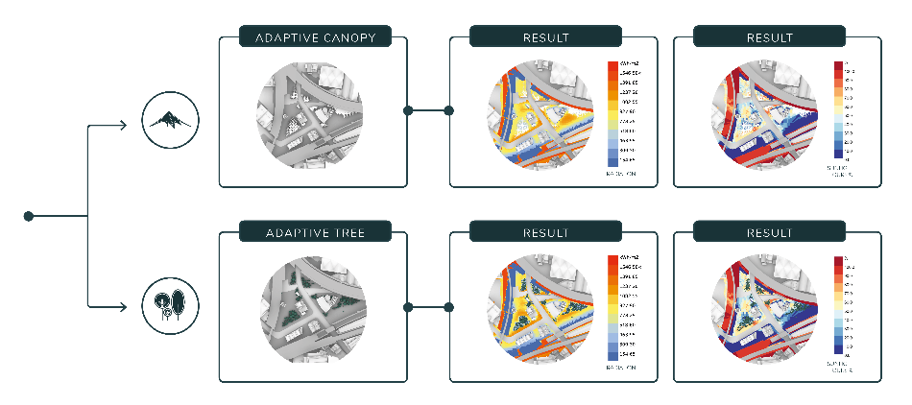
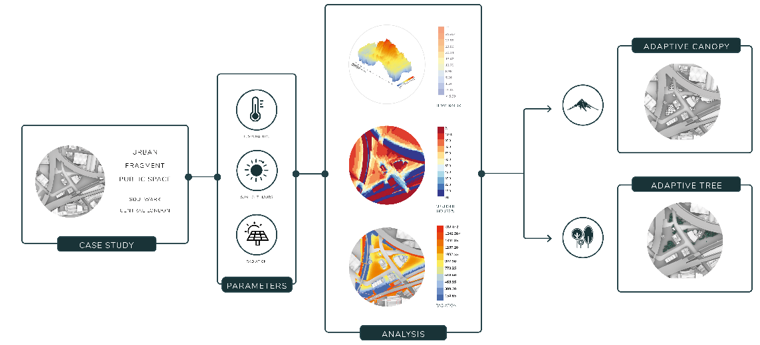

Climate-Responsive parametric Urban Interventions for Public Realm Spaces
  Nora Fankhauser
  Urban Computational Designer at Gensler, London
Keywords: Urban Heat Island, Climate-Responsive Design, Sustainable Urbanism, Adaptation Measures, Outdoor Comfort Level,
1 Introduction
4 Results and Discussion
Dense urban spaces are strongly affected by the consequences of urban heat island effect (UHI) which can lead to compromised human health and comfort (Taylor, 2015). Previous research has shown the pressing need for climate-informed urban design to improve outdoor thermal comfort (Klein-Rosenthal 2017; Nouri 2018; Kikegawa 2007). This leads my paper to investigates the following query: To what extent can micro-climate analysis drive a data-informed urban design approach to mitigate the effect of urban heat islands in metropolitan areas using sunlight analysis? The presented research directly correlates the outcome of the climate analysis with the structural scaling and density of urban interventions in public spaces.
The objective is to control the shading elements within a given space in such a manner that shields individuals from unfavourable aspects of the climate while allowing them to experience favourable ones. Once the 3d elements are computationally generated, the climate analysis can be run again to test the output.
The outcome of the analysis implies that the adaptive canopy and the additional landscape element contributes to a cooling effect up to 5°C and significantly less radiation (-200kwh/m2) at the pedestrian-level which contributes to an improvement in terms of heat stress.
However, the analysis considers only one factor of the outdoor thermal comfort index and the whole set of data, such as wind speed, wind direction and relative humidity would need to be incorporate into the analysis for a comprehensive understanding of the outdoor comfort level.
2 Method
The current work demonstrates the use of climate-responsive methodologies using the example of an urban fragment of public realm in central London.
1. The urban context is modelled in the Rhinoceros 3D computer-aided design (CAD) application and the local climate conditions are computationally simulated within Grasshopper (a visual programming language) with the help of corresponding EnergyPlus weather files (.epw).
2. The digitally simulated representation is programmed to measure factors like sunlight hours, illuminance, pavement temperature and radiation in kwh/m2.
3. The quantified outcome of the computational simulation, projected onto the modelled surface is visualised in a gradient heat map in order to determine the most exposed areas to heat due to radiation and other parameters.
4. The dataset of this analysis then used for the location and scaling factor of the generated shading elements, such as trees or canopies.
The aim is to correlate the quantity of sunlight that penetrates a particular surface area (climate analysis data output) with the scaling and sizes of the shading elements, such as canopies or trees.
5 Conclusion
The research highlights the value of computational simulation of micro-climate factors affecting outdoor spaces in urban environments. These climate related design drivers can have a significant impact on human comfort level and the experience of public realm.
The methodology presented in the study, such as correlating the generation of shading elements with the output of the climate analysis can be scaled and applied to other urban environments considering local climate conditions.
These climate-responsive design strategies can help to mitigate the effects of urban heat islands in other cities in order to promote the creation of resilient and liveable outdoor spaces globally.
References
1. Quantifying the influence of land-use and surface characteristics on spatial variability in the urban heat island, Hart & Sailor, 2009
2. Some Effects of the Urban Structure on Heat Mortality, Clarke, 1972
3. Embedding Climate Change in Urban Planning and Urban Design, Mills et al., 2010; Watts et al., 2016
4. Sustainable urban systems: Co-design and framing for transformation, Webb et al., 2018
5. Observed and simulated effects of urban canopy on air temperatures in summer tokyo, Ohashi et al., 2007
6. Designing Open Spaces in the Urban Environment: A Bioclimatic Approach, Nikolopoulou, 2004\

