Slide 1
FCC Physics
Emphasis here on FCC-ee:
A great `Higgs Factory’ and MUCH MORE!
Many thanks to the FCC collaboration members
for the great efforts and ideas
joining Theory, Experiment and Accelerator Physics
And congratulations/thanks to
Florencia Canelli, Anna Sfyrla, ahmin Ilg and all organizers of this second FCC-CHIPP physics meeting

Slide 2
Particle physics after the discovery of the Higgs boson
Two facets:
The Higgs boson is very special
It generates (couples to) mass. Alone?
-- W,Z masses ⇔ Higgs coupling to WW, ZZ?
-- (all) fermion masses ⇔ Higgs couplings?
-- loop decays (γγ, gg, Zγ) ⇔ SM particle content?
-- are all elementary particles given mass this way?
even electrons? and even the neutrinos?
Yukawa (→ ν_{R} , sterile)
+ Majorana (ν ↔‾ν) → HNL?
It couples to itself!
-- Spontaneous Symmetry Breaking
-- What is the value of the self coupling?
-- impact on σ_{HZ} near threshold
-- HH production
FCC-hh, high energy lepton colliders
The SM is « complete »
-- Higgs and top masses predicted from EWPOs assuming no new SM coupled particles exist
-- SM extrapolates to the Plank scale
assuming no new SM coupled particles exist
-- SM works wonderfully... So why continue?
-- But SM does not explain everything
Baryon Asymmetry of the Universe
Dark Matter
and more.... ➔ require new particles!
mass scale is unknown
Are there any further SM-coupled particles?
-- no guarantee or solid indication that there are
-- but many BSM solutions include them...
-- DARK SECTOR → possibly light, sterile particles
FCC-ee
FCC-ee
FCC-hh(+ee)
FCC-ee(?)
FCC-ee
FCC-ee:
EWPO
Flavour
FCC-ee
FCC-hh
FCC-hh
FCC-ee:
LLP
EWPO
Flavour

Slide 3
After the discovery of the Higgs boson we enter a new era of exploration
We absolutely need a next accelerator but the next facility must be versatile (and feasible!)
with as broad and powerful reach as possible, as there is no precise target
➔ more Sensitivity, more Precision, more Energy
FCC, thanks to synergies and complementarities, offers
the most versatile and adapted response to today’s physics landscape

Slide 4
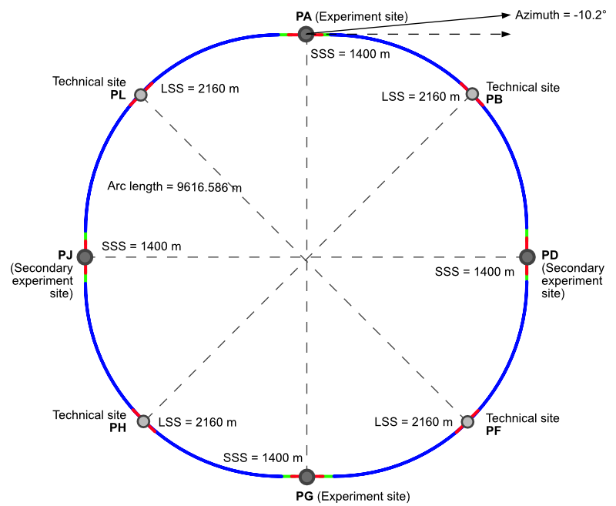
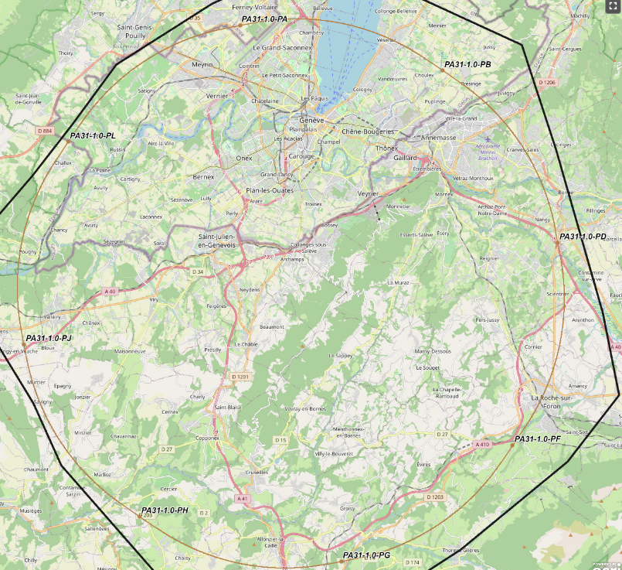
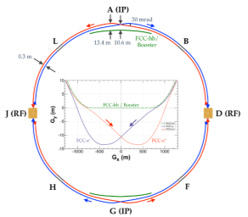
Synergy: The FCC integrated program at CERN
Comprehensive cost-effective program inspired by successful LEP – LHC success story
Stage 1: FCC-ee (Z, W, H, tt) as first generation Higgs EW and top factory at highest luminosities.
Stage 2: FCC-hh (~100 TeV) as natural continuation at energy frontier, with ion and eh options.
Maximizes physics output with strong complementarity
Integrating an ambitious high-field magnet R&D program
Common civil engineering and technical infrastructures, building on and reusing CERN’s existing infrastructure.
Start construction early 2030’s, start data taking shortly after HL-LHC completion
FCC-INT project plan is fully integrated with HL-LHC exploitation ➔ seamless continuation of HEP
Feasibility study approved and funded at CERN (100MCHF/5yrs) + magnet R&D (120 MCHF/6yrs) *** GLOBAL COLLABORATION ***
FCC-ee
FCC-hh
FCC-ee is the most pragmatic, safest, and most effective way toward FCC-hh
new layout
consistent with 4 IP
siting in progress on the ground.
It.is.happening!

Slide 5
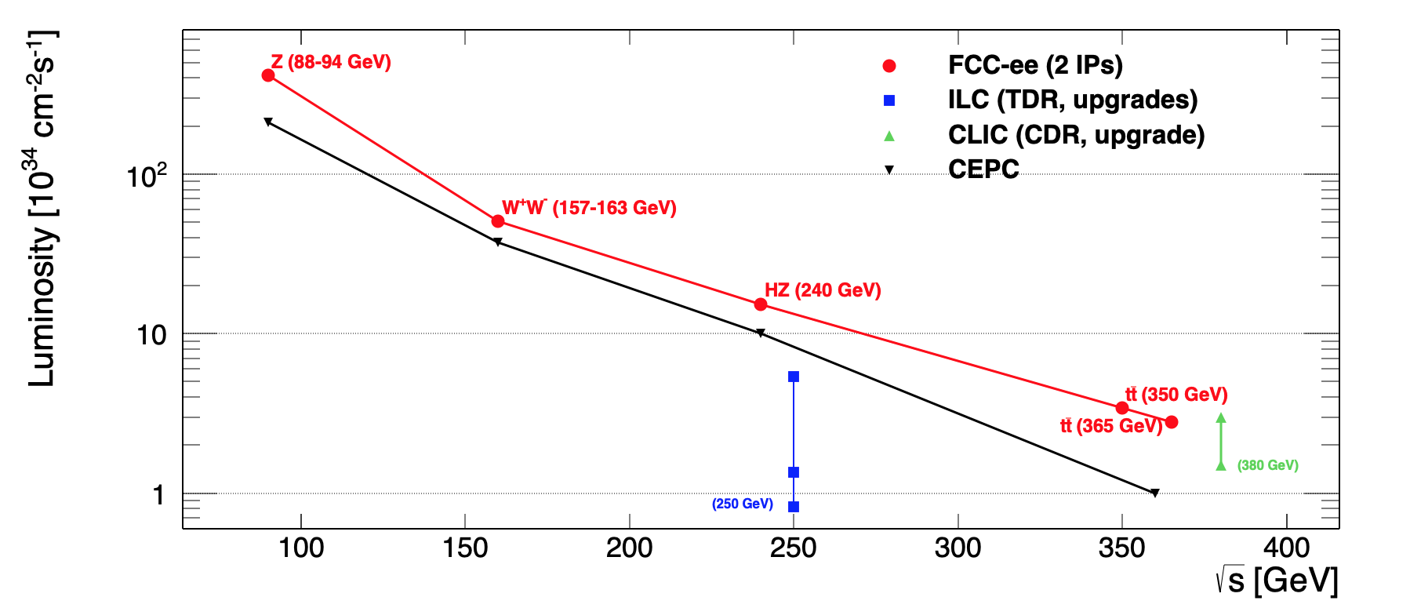
FCC-ee
Great energy range for the
heavy particles of the Standard Model
notes:
-- 4IP increases Total Lumi by 1.7
-- 2IP assumed in all numbers below
-- order and duration of Z/WW/ZH
can be decided at a later stage
-- ee→ H must be after both Z and ZH
and before tt
Z factory:
LEP x 210⁵
ILC x 10³
Total
see back-ups for facility comparisons
Event statistics (2IP) for typical run plan:
E_{CM} errors:
Z peak E_{cm} : 91 GeV 4yrs 5 10¹² e+e- → Z
WW threshold E_{cm} ≥ 161 GeV 2yrs >10⁸ e+e- → WW
ZH maximum E_{cm} : 240 GeV 3yrs > 10⁶ e+e- → ZH
s-channel H E_{cm} : m_{H} (3yrs?) O(5000) e+e- → H
‾tt E_{cm} : ≥ 340 GeV 5yrs 10⁶ e+e- →‾tt
LEP x 2.10⁵
LEP x 2.10³
Never done
Never done
Never done
<100 keV
<300 keV
1 MeV
<< 1 MeV
2 MeV

Slide 6
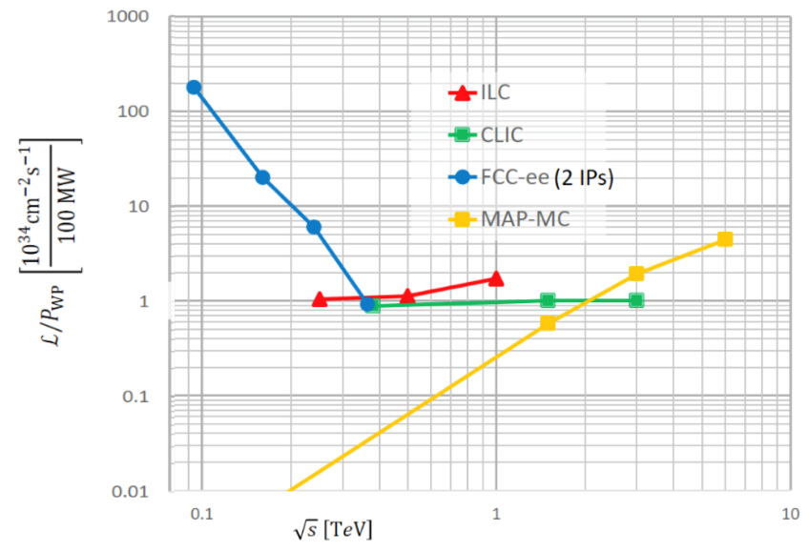
plot fromESPP Briefing Book
The Greenest
Luminosity/Power → Energy efficiency
Compounding the higher energy efficiency at the ZH point (and below!) the FCC benefits from clean energy
as France and Switzerland rely largely on low carbon footprint energy sources: nuclear, hydro, solar and wind
MWh/ ZH evt
ton of CO₂eq
/ZH evt
The carbon footprint of a Higgs boson is much much smaller for FCC-ee @CERN
Janot, AB 2208.10466

Slide 7







e⁻
H
FCC-ee Physics Programme
Z*
2
e⁺
Z
mZ, ΓZ, N𝜈
Rl, AFB
mW, ΓW
αS(mZ) with per-mil accuracy
Quark and gluon fragmentation
Clean non-perturbative QCD studies
Higgs
mHiggs, ΓHiggs
Higgs couplings
self-coupling
EW & QCD
detector hermeticity
tracking, calorimetry
time-of-flight
precise acceptances
High efficiency
energy resol.
particle ID
particle flow
1
direct searches
of light new physics
"intensity
frontier”
FCC-ee
𝜈
Axion-like particles, dark photons,
Heavy Neutral Leptons
long lifetimes - LLPs
flavour factory
(10¹² bb/cc; 1.7x10¹¹ 𝜏𝜏)
3
Top
𝜏 physics
B physics
mtop, Γtop
EW top couplings
Momentum resol.
tracker
Ecal granularity
𝜏-based EWPOs
lept. univ. violation tests
Flavour EWPOs (R_{b}, A_{FB}^{b,c})
CKM matrix,
CP violation in neutral B mesons
Flavour anomalies in, e.g., b ➝ s𝜏𝜏
vertexing, tagging
energy resolution
hadron identification
new detector req.

Slide 8
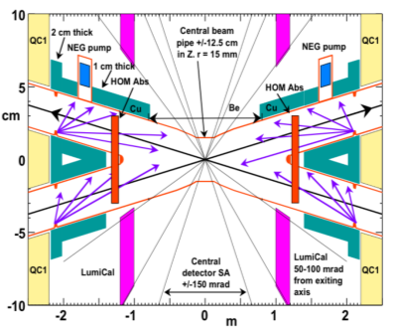
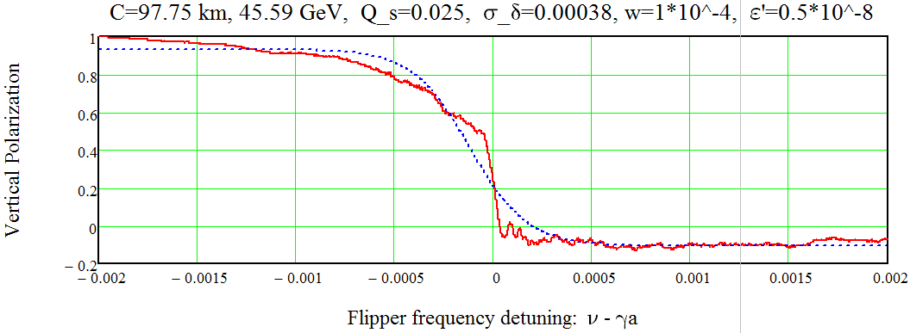
FCC-ee experimental conditions
By design of the accelerator, low background
conditions in the experiments, ~1cm radius beam pipe
2. High luminosity → high DAQ rate, 100kHz @Z
Low pile-up : O(0.001)
No trigger necessary (important for LLP searches)
3. High precision E_{CM} calibration O(100 keV)
--@ Z (+WW unlike LEP) resonant depolarization:
-- at higher energies relies on ee→ Zγ , WW
4. Moderate beamstrahlung
→measurable, ~Gaussian energy spread
5. New design compatible with 4 IP for FCC-ee → improve total Luminosity (and physics/MW)
to match the multiple detector requirements
FCC-ee simulation of
resonant depolarization
instantaneous << 50keV

Slide 9
ee-hh complementarity: Higgs Physics at FCC
e⁻
H
  FCC-ee → g_{HZZ} to <±0.2% from σ_{ZH}
  (model-independent )
  and Γ_{H}, g_{Hbb} , g_{Hcc} , g_{Hττ} , g_{HWW}
  →normalizes all HL-LHC / FCC-hh couplings
  also measure m_{H} with 2-3 MeV precision
  FCC-hh produces over 10¹⁰ Higgs bosons
  use g_{HZZ} from FCC_{ee} will give g_{Hμμ} , g_{Hγγ} , g_{HZγ} , Br_{inv}
  FCC-ee also measures top EW couplings (e⁺e⁻ ➝ tt)
  FCC-hh produces 10⁸ ttH and 2. 10⁷ HH pairs
    ➝ g_{Htt} and g_{HHH}, model-independent & precise!
HL-LHC/FCC-ee/FCC-hh complementarity !
Z*
e⁺
Z
}
ee
}
hh
ee
hh
hh
ee
30-50
Comparison with other e+e- colliders in spare slides
ee only
LHC+ee
FCC-ee+hh+ep
ep → WW mostly

Slide 10
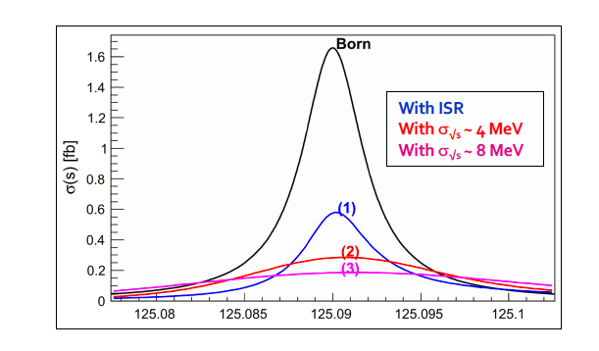
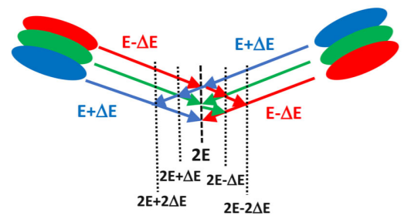
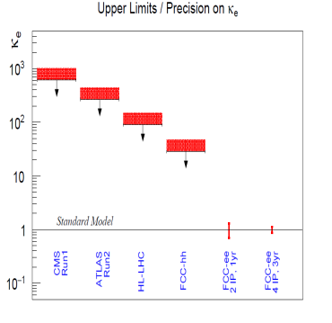
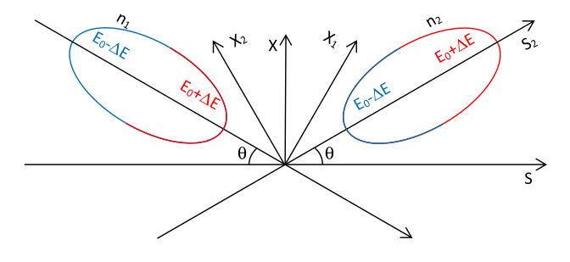
Unique: electron Yukawa @FCC-ee
Measure e+e- → H @ 125.xxx GeV
requires
-- Higgs mass to be known to <<5 MeV (OK, 3 MeV)
-- Huge luminosity (several years)
-- monochromatization to reduce σ_{ECM}
-- continuous adjustment of E_{CM} (transv. Polar.)
-- an extremely sensitive event selection
HUGE CHALLENGE
Monochromatization: UNDER STUDY
taking advantage of the separate e+ and e- rings, one can distribute
in opposite way high and low energies in the beam (in x, z time)
combine?
so far,
SM level
opposite sign horizontal dispersion
opposite difference in arrival time within 30 ps

Slide 11
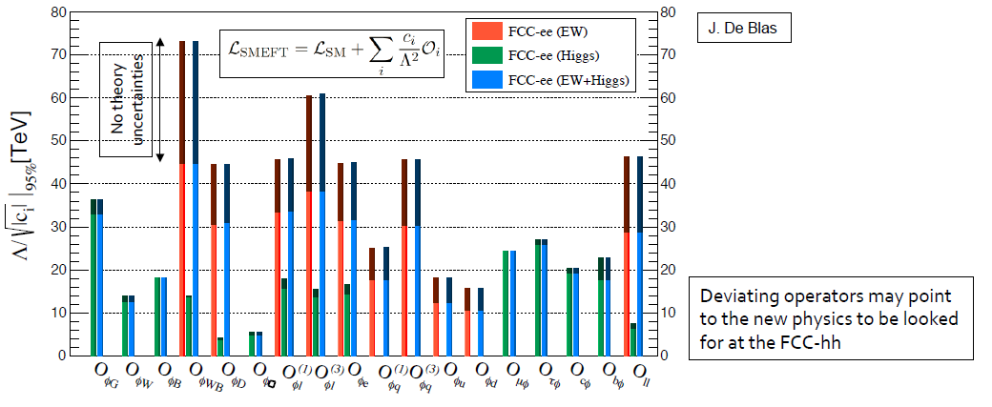
Precision EW measurements: is the SM complete?
NP Sensitivity by oblique/vertex loops or mixing
Higgs + EWPO (+ flavours) are complementary
top quark mass and couplings essential!
(the 91km circumference is optimal for this)
preliminary systematics!
aim at reducing to the level of statistics
many observables still to be added (flavours)
complemented by high energy FCC-hh
Theory work is critical and initiated 1809.01830
see also recent physics workshop session.

Slide 12
Precision Natural SUSY at CEPC, FCC-ee, and ILC, JJ Fan, M. Rees and Liantao Wang
arXiv:1412.3107v2 figure 5 (top row)
«Higgs and EWPOs are complementary»
“ also, b→ sγ could be useful”

Slide 13
Electroweak Physics
Z factory + WW + top The realm of FCC-ee
Highest luminosities at 91, 160 and 350 GeV
Transverse pol. at 91 and 160 GeV→Ecm calibration
m_{Z} (100 keV) Γ_{Z} (25 keV), m_{W} (<500 keV), α_{QED}(m_{Z}) (3.10⁻⁵)
and sin²θ_{w} at 310⁻⁶
Complete set of EW observables can be measured
Precision unique to FCC-ee + new physics sensitivity
a lot more potential to exploit with good detector design
than present treatment suggests
The reach for new physics depends on which new physics:
-- 1/Λ² new physics → 30-70 TeV
-- Heavy Neutrino → 500-1000 TeV
-- new non-degenerate doublet should not have
mass splitting greater than ~5 GeV

Slide 14
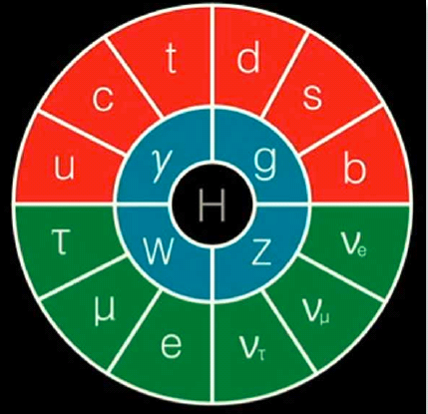
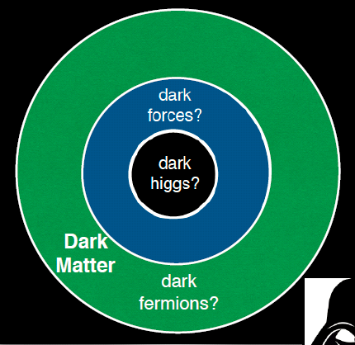
Dark Sector at Z factory
With the Higgs discovery SM works perfectly, yet we need new physics to explain the baryon
asymmetry of the Universe, the dark matter etc… without interfering with SM rad. corr.
mediator
or
mixing
S. Gori
Dark photons, axion like particles, sterile neutrinos, all feebly coupled to SM particles

Slide 15
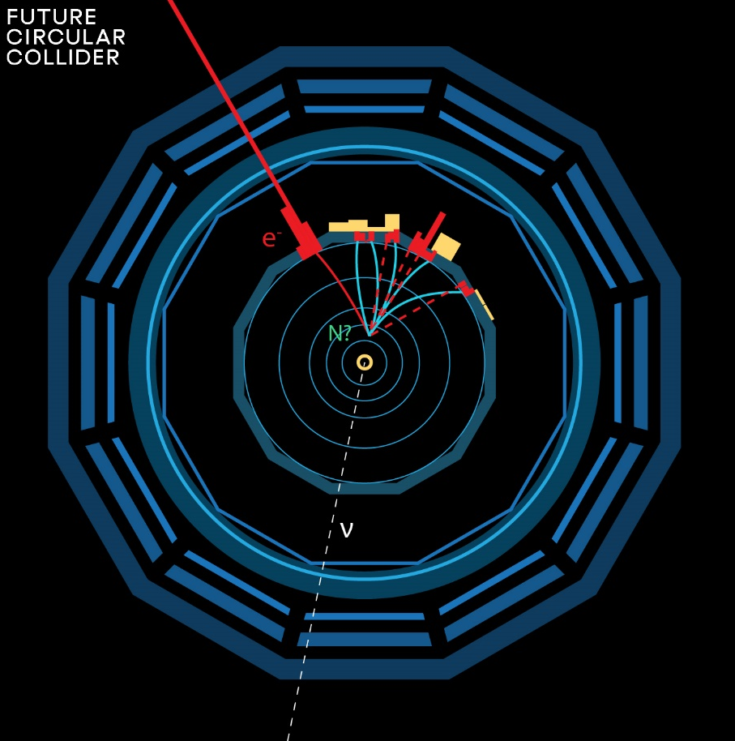
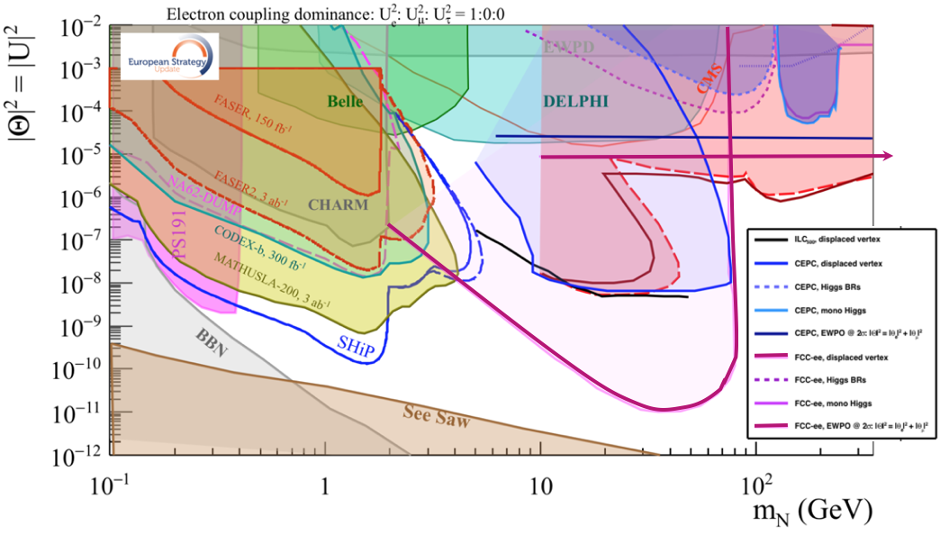
Heavy Right-Handed ‘sterile’ neutrinos (see-saw type I)
Straighforward SM extension for massive neutrinos with Dirac *and* Majorana mass terms
FCC-ee (Z) compared to the other machines shows the power of the TeraZ running.
Both «direct» and «indirect» observation. How close can we get to the ‘see-saw limit’?
Higgs couplings to neutrinos!
-- the purple line shows the 95% CL limit if no HNL is observed. (here for 10¹² Z)
-- the horizontal line represents the sensitivity to mixing of neutrinos to the dark sector,
using EWPOs (G_{F} vs sin²θ_{W}^{eff} and m_{Z}, m_{W} + tau decays) which extends sensitivity
to 10⁻⁵ mixing all the way to very high energies (500-1000 TeV at least). arxiv:2011.04725

Slide 16
Neutrino masses occur via processes which are intimately related to the Higgs boson
This aspect is quite relevant for a « Higgs factory »!
Adding masses to the Standard model neutrino 'simply' by adding a Dirac mass term
m_{D} is the Yukawa coupling (like everybody else). Then the right handed neutrinos are perfectly sterile.
Things become more interesting when a Majorana mass term arises. So-called Weinberg Operator (only Dim5 operator in EFT) and involves the Higgs boson and the neutrino Yukawa coupling
Pilar Hernandez,
Granada 2019-05
Majorana mass term is extremely interesting as this is the
particle-to-antiparticle transition
that we want in order to explain
the Baryon asymmetry of the Universe
(+ CP violation in neutrinos)
This implies a decay H→ vN that would be worthwhile investigating -- can we see such a thing with 10¹⁰ Higgs decays @FCC-hh?
“Direct” observation of Yukaya coupling of neutrinos at FCC-hh

Slide 17
A little bit on timing studies
In an event like this, there is considerable amount of
information for reconstruction.
-- primary vertex and secondary vertex give 3D direction
of HNL and decay length
-- the final state reconstruction has therefore
many constraints for a kinematic fit
--ECM and PCM
-- v_{N} and energy at secondary
B However if precision timing is available,
mass and velocity can be reconstructed for any visible decay
on the basis only of
-- time-of-flight
-- and decay length
time of flight = E/M . τ
Decay length = P/M . cτ
knowning the two and applying the 2-body constraint at production P² = (m²_{Z} - m²_{N})/2m_{Z ,} E² = (m²_{Z} + m²_{N})/2m_{Z}
will give the required information. This means that long lived particle mass can be reconstructed by timing

Slide 18
More on TeraZ
The Flavour Factory
Progress in flavour physics wrt SuperKEKb/BELLEII requires > 10¹¹ b pair events,
FCC-ee(Z): will provide ~10¹² bb pairs. “Want at least 5 10¹² Z…”
-- precision of CKM matrix elements
-- Push forward searches for FCNC, CP violation and mixing
-- Study rare penguin EW transitions such as b ➝s 𝜏+ 𝜏− , σπεχτροσχοπψ (προδυχε β−βαρψονσ, Β_{σ} …)
-- Test lepton universality with 10¹¹ 𝜏 decays (with 𝜏 lifetime, mass, BRs) at 10⁻⁵ level, LFV to 10⁻¹⁰
-- all very important to constrain / (provide hints of) new BSM physics.
need special detectors (PID, lifetime); a story to be written!
The 3.5 × 10¹² hadronic Z decay also provide precious input for QCD studies
High-precision measurement of αs(mZ) with Rℓ in Z and W decay, jet rates, 𝜏 decays, etc. : 10 ⁻⁻ ³ ➝10 ⁻⁻ ⁴
huge √s lever-arm between 30 GeV and 365 GeV, fragmentation, baryon production ….
Testing running of αs to excellent precision with hadron production from low energy (γ*/Z* +γ )
to 365 GeV
And... H→gg is a pure gluon factory (100’000 events)

Slide 19
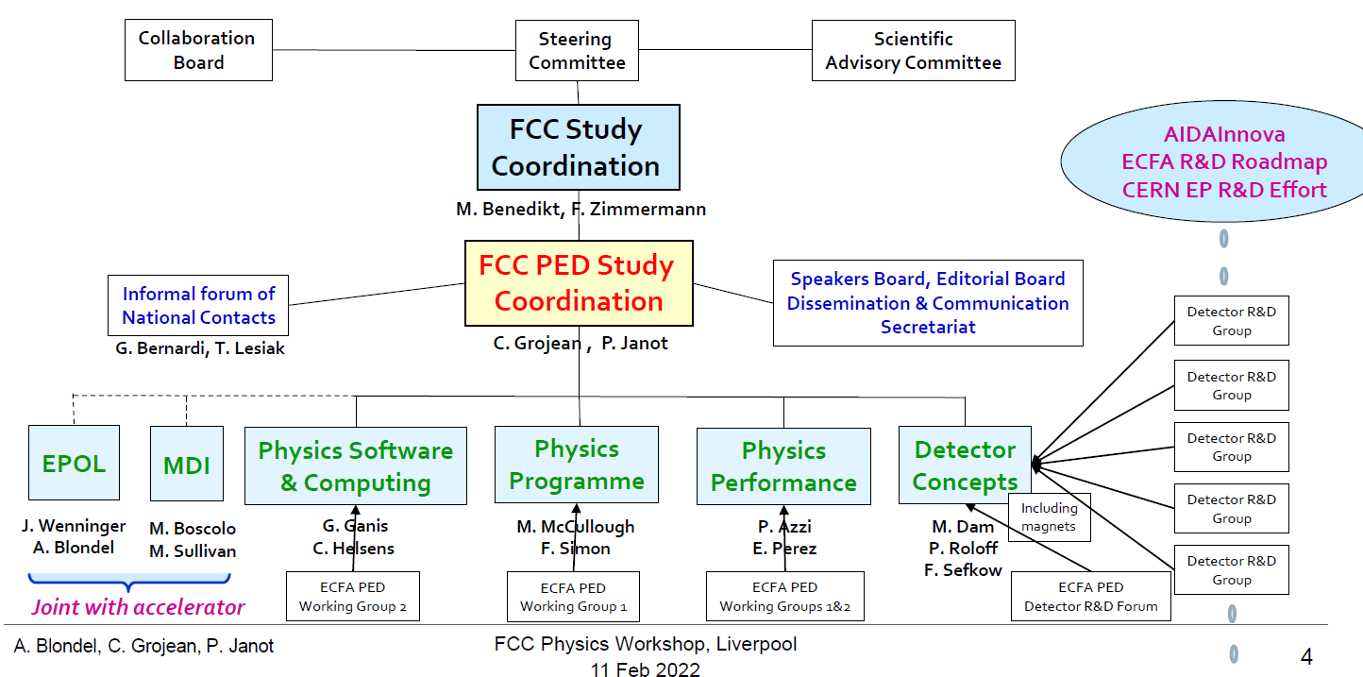
Organigram of the PED pillar of the FCC feasibility study

Slide 20
C. Paus
G. Wilson
Physics groups define benchmark measurements
to be picked up by case studies ...
leading to performance evaluation and detector requirements

Slide 21
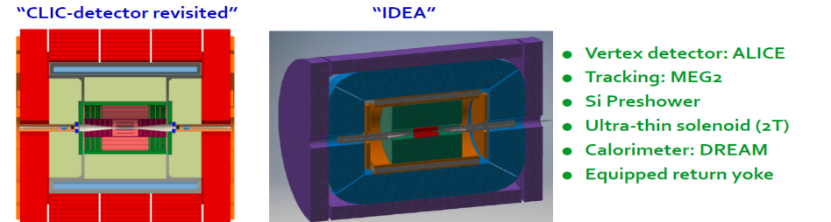
FCC-ee Detectors
Detectors can be done and work for the FCC-ee, but physics optimization remains to be done.
Two integration, performance and cost estimates:
-- Linear Collider Detector group at CERN has undertaken the adaption of
CLIC-SID detector for FCC-ee
-- IDEA, detector specifically designed for FCC-ee (and CEPC)
MAPS
SiD at ILC, CLD at FCC-ee IDEA at FCC-ee & CEPC
Many challenges to come, mainly because of the Z run.

Slide 22
New at the FCC ‘Liverpool’ physics workshop
implementation of Noble Liquid Calorimeter in FCCSW
→ intention to develop an entire detector concept around this key element.

Slide 24
USA | 78
Italy | 66
UK | 60
CERN | 59
France | 46
Germany | 40
Russia | 31
India | 29
China | 22
Turkey | 22
Poland | 19
Spain | 18
Switzerland | 18
Brazil | 13
Portugal | 9
Japan | 8
Pakistan | 7
Scandinavia | 7
Korea | 5
Greece | 5
Canada | 4
Iran | 4
Marocco | 4
Austria | 3
Belgium | 3
Netherlands | 2
others America | 4
others Asia&Africa | 28
others Europe | 11
unidentified | 17
sum | 625
grand total 642 | 642
other Europe:
Ireland 1
Israel 1
Slovenia 1
Czech 2
Estonia 1
Croatia 1
Serbia 1
Bulgaria 1
Belarus 1
Romania 1

Slide 25
Conclusions and what to do
The FCC-integrated programme, FCC-ee then hh with ep and heavy ion options, thanks to synergies and complementarities,
offers the most versatile and adapted response to today’s physics landscape.
FCC-ee is the best low energy Higgs Factory, and MUCH more. It offers a unique physics programme and discovery potential
(Precision EW and Flavour, high sensitivity LLP searches, QCD) thanks to an outstanding high luminosity and E_{cm} calibration.
FCC-ee presents numerous novel challenges in detector design and experimentation!
FCC-ee matches well the European strategy vision and recommandations, and is well supported by CERN council!
The FCC is a global project and the participation of the CERN international partners is both essential and welcome
PED goal is to deliver input for the FCC FS CDR+ in 2025, assemble community, promote detector concepts towards next ESPP
It is a great project, where there is much to learn
The FCC PED effort will strive from the contributions of its members
we rejoy to see enthusiasm from the Swiss particle community!

Slide 26
SPARES

Slide 27
Particle physics after the discovery of the Higgs boson
Two facets:
The Higgs boson is very special
It generates (couples to) mass. Alone?
-- W,Z masses ⇔ Higgs coupling to WW, ZZ?
-- (all) fermion masses ⇔ Higgs couplings?
-- loop decays (γγ, gg, Zγ) ⇔ SM particle content?
-- are all elementary particles given mass this way?
even electrons? and even the neutrinos?
Yukawa (→ ν_{R} , sterile)
+ Majorana (ν ↔‾ν) → HNL?
It couples to itself!
-- Spontaneous Symmetry Breaking
-- What is the value of the self coupling?
-- impact on σ_{HZ} near threshold
-- HH production
FCC-hh, high energy lepton colliders
The SM is « complete »
-- Higgs and top masses predicted from EWPOs assuming no new SM coupled particles exist
-- SM extrapolates to the Plank scale
assuming no new SM coupled particles exist
-- SM works wonderfully... So why continue?
-- But SM does not explain everything
Baryon Asymmetry of the Universe
Dark Matter
and more.... ➔ require new particles!
mass scale is unknown
Are there any further SM-coupled particles?
-- no guarantee or solid indication that there are
-- but many BSM solutions include them...
-- DARK SECTOR → possibly light, sterile particles
FCC-ee
FCC-ee
FCC-hh(+ee)
FCC-ee(?)
FCC-ee
FCC-ee:
EWPO
Flavour
FCC-ee
FCC-hh
FCC-hh
FCC-ee:
LLP
EWPO
Flavour

Slide 28
After the discovery of the Higgs boson we enter a new era of exploration
We absolutely need a next accelerator but the next facility must be versatile (and feasible!)
with as broad and powerful reach as possible, as there is no precise target
➔ more Sensitivity, more Precision, more Energy
FCC, thanks to synergies and complementarities, offers
the most versatile and adapted response to today’s physics landscape

Slide 29
Synergy: The FCC integrated program at CERN
Comprehensive cost-effective program inspired by successful LEP – LHC success story
Stage 1: FCC-ee (Z, W, H, tt) as first generation Higgs EW and top factory at highest luminosities.
Stage 2: FCC-hh (~100 TeV) as natural continuation at energy frontier, with ion and eh options.
Maximizes physics output with strong complementarity
Integrating an ambitious high-field magnet R&D program
Common civil engineering and technical infrastructures, building on and reusing CERN’s existing infrastructure.
Start construction early 2030’s, start data taking shortly after HL-LHC completion
FCC-INT project plan is fully integrated with HL-LHC exploitation ➔ seamless continuation of HEP
Feasibility study approved and funded at CERN (100MCHF/5yrs) + magnet R&D (120 MCHF/6yrs) *** GLOBAL COLLABORATION ***
FCC-ee
FCC-hh
FCC-ee is the most pragmatic, safest, and most effective way toward FCC-hh
new layout
consistent with 4 IP

Slide 30
FCC-ee
Great energy range for the
heavy particles of the Standard Model
notes:
-- 4IP increases Total Lumi by 1.7
-- 2IP assumed in all numbers below
-- order and duration of Z/WW/ZH
can be decided at a later stage
-- ee→ H must be after both Z and ZH
and before tt
Z factory:
LEP x 10⁵
ILC x 10³
Total
see back-ups for facility comparisons
Event statistics (2IP)
E_{CM} errors:
Z peak E_{cm} : 91 GeV 4yrs 5 10¹² e+e- → Z
WW threshold E_{cm} ≥ 161 GeV 2yrs >10⁸ e+e- → WW
ZH maximum E_{cm} : 240 GeV 3yrs > 10⁶ e+e- → ZH
s-channel H E_{cm} : m_{H} (3yrs?) O(5000) e+e- → H
‾tt E_{cm} : ≥ 350 GeV 5yrs 10⁶ e+e- →‾tt
LEP x 10⁵
LEP x 2.10³
Never done
Never done
Never done
<100 keV
<300 keV
1 MeV
<< 1 MeV
2 MeV

Slide 31
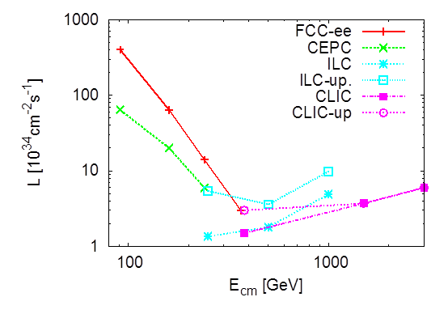
«Higgs Factories»
plots from Briefing Book
Luminosity
Luminosity/Power → Energy efficiency
Luminosity vs Energy circular below 350 GeV linear above 250 GeV
Efficiency : 9 (5) GJ/Higgs at FCC-ee with 2(4)IP vs 50GJ/Higgs for ILC250 (first 15 years)
Beam polarization: circular: transverse → ppm beam energy calibration
linear: longitudinal : e- ±80% easy, (e+ ±30% difficult → additional d.o.f
Long term energy upgrade circular: pp collider linear: High energy lepton collisions
Interaction points circular: 2-4 linear: 1
Run limited in time by arrival of hadron collider Run is open ended

Slide 32
plot fromESPP Briefing Book
The Greenest
Luminosity/Power → Energy efficiency
Compounding the higher energy efficiency at the ZH point (and below!) the FCC benefits from clean energy
as France and Switzerland rely largly on low carbon footprint energies: nuclear, hydro, solar and wind energies
MWh/ ZH evt
ton of CO₂eq
/ZH evt
The carbon footprint of a Higgs boson is much much smaller for FCC-ee @CERN
Janot, AB 2208.10466

Slide 33
Physics at FCC-ee
HIGGS FACTORY
Higgs provides a very good reason why we need e+e- (or μμ) collider
2. ELECTROWEAK PRECISION ( 10⁻³ today → 10⁻⁵)
Z + WW + top required!
Test of the completeness of the SM
3. Z FACTORY
(5 10¹² Z i.e. 1.5 10¹¹ ee, μμ, ττ ; ~0.7 10¹² uu,dd,ss,cc,bb ; 10¹² νν)
High statistics for Heavy Flavours, QCD
Search for Feebly Coupled Particles
The place for ‘direct discovery’
+ comments on the synergy and complementarity of FCC-ee hh and eh

Slide 34
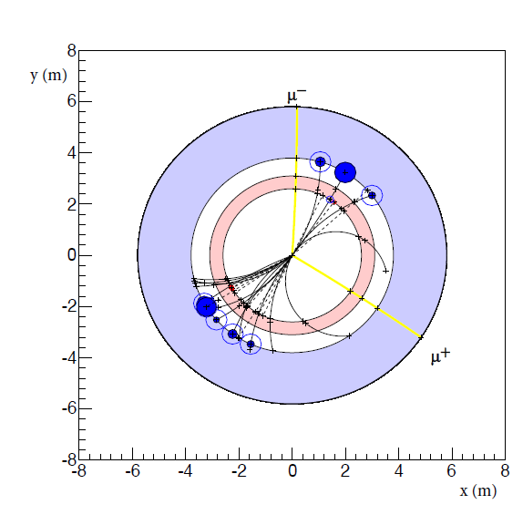
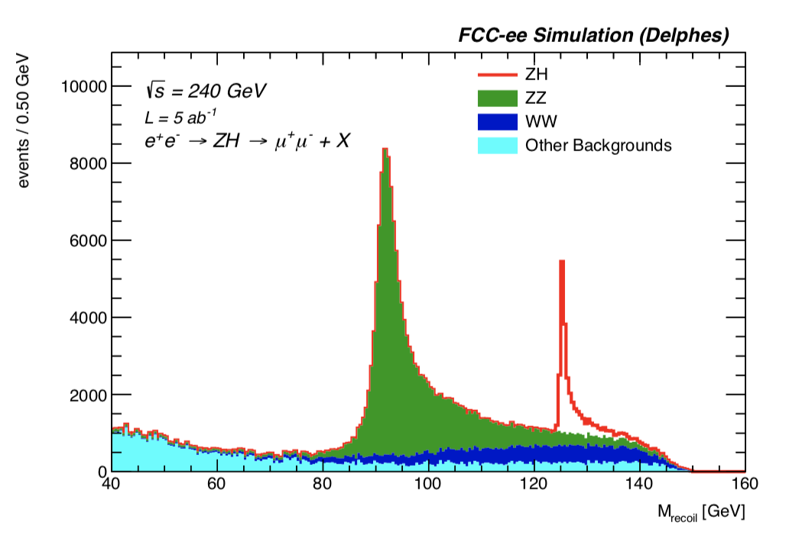
Higgs Physics
e+e- : Z – tagging by missing mass
→ must do physics with ratios
THE LHC is a Higgs Factory…BUT
total rate ∝ g_{HZZ}²
ZZZ final state ∝ g_{HZZ}⁴/ Γ_{H}
measure total width Γ_{H}
g_{HZZ} to ±0.2%
empty recoil = invisible width
‘funny recoil’ = exotic Higgs decay
e⁻
H
σ_{i→f} ^{observed} ∝ σ_{prod} (g_{Hi} )²(g_{Hf})²
Γ_{H}
Z*
?
e⁺
Z

Slide 35
Complementarity: Higgs Physics at FCC
  FCC-ee → g_{HZZ} to <±0.2% from σ_{ZH}
  (model-independent standard candle)
  and Γ_{H}, g_{Hbb} , g_{Hcc} , g_{Hττ} , g_{HWW}
  →fixes all HL-LHC / FCC-hh couplings
  FCC-hh produces over 10¹⁰ Higgs bosons
  use g_{HZZ} from FCC_{ee} will give g_{Hμμ} , g_{Hγγ} , g_{HZγ} , Br_{inv}
  FCC-ee also measures top EW couplings (e⁺e⁻ ➝ tt)
  FCC-hh produces 10⁸ ttH and 2. 10⁷ HH pairs
    ➝ g_{Htt} and g_{HHH}, model-independent & precise!
HL-LHC/FCC-ee/FCC-hh complementarity
outstanding
}
ee
}
hh
30-50
ee
hh
ee
Comparison with other e+e- colliders in spares
ee only
LHC+ee
FCC-ee+hh+ep
ep → WW mostly

Slide 36
Unique: electron Yukawa coupling
Measure e+e- → H @ 125.xxx GeV
requires
-- Higgs mass to be known to <<5 MeV (OK, 3 MeV)
-- Huge luminosity (several years)
-- monochromatization to reduce σ_{ECM}
-- continuous adjustment of E_{CM} (transv. Polar.)
-- an extremely sensitive event selection
HUGE CHALLENGE
under study
Monochromatization: UNDER STUDY
taking advantage of the separate e+ and e- rings, one can distribute
in opposite way high and low energies in the beam (in x, z time)
combine?
so far,
SM level
opposite sign horizontal dispersion
opposite difference in time within 30ps luminosity

Slide 37
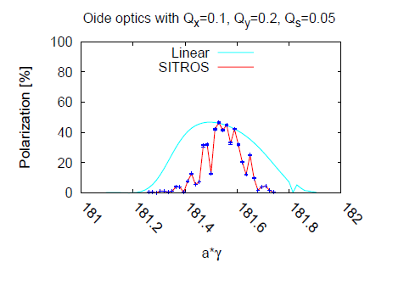
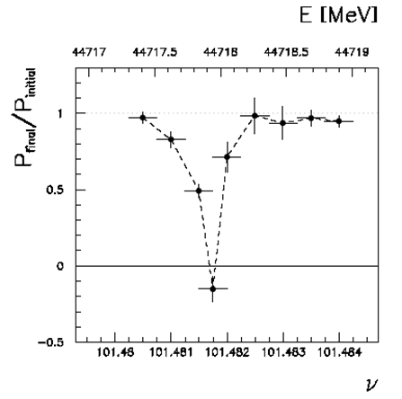
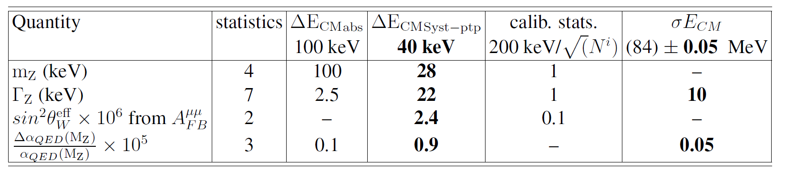
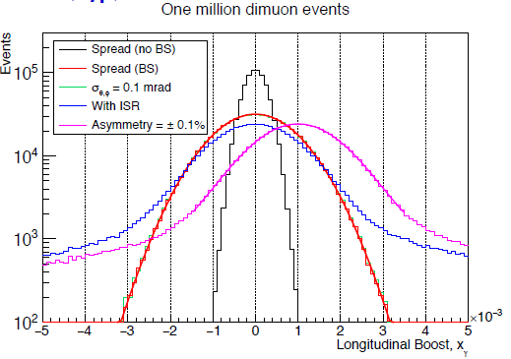
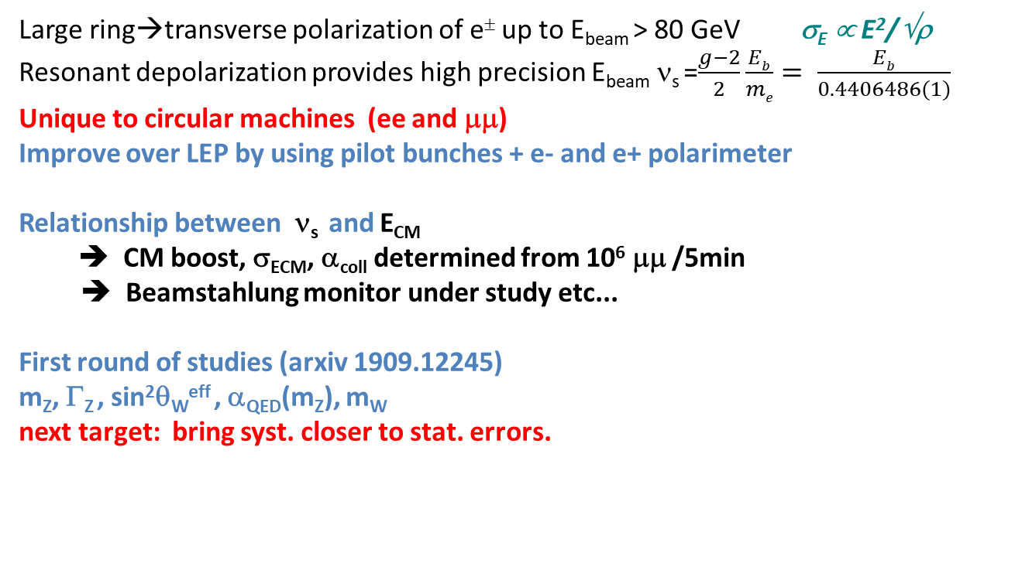
Centre of mass Energy Calibration: the cornerstone of the precision programme
Large ring→transverse polarization of e± up to E_{beam} > 80 GeV σ_{E} ∝ E²/√ρ
Resonant depolarization provides high precision E_{beam} ν_{s} =$\frac{g−2}{2}\frac{Eb}{me}= \frac{Eb}{0.4406486(1)}$
Unique to circular machines (ee and μμ)
Improve over LEP by using pilot bunches + e- and e+ polarimeter
Relationship between ν_{s} and E_{CM}
➔ CM boost, σ_{ECM}, α_{coll} determined from 10⁶ μμ /5min
➔ Beamstahlung monitor under study etc...
First round of studies (arxiv 1909.12245)
m_{Z}, Γ_{Z} , sin²θ_{W}^{eff} , α_{QED}(m_{Z}), m_{W}
next target: bring syst. closer to stat. errors.
E. Gianfelice
LEP
FCC-ee simulation of
resonant depolarization
Alain Blondel Physics at the FCCs
37
At our luminosity level, longitudinal polarization brings
nothing that cannot be done otherwise.

Slide 38
Precision EW measurements: is the SM complete?
Higgs and EWPOs are complementary
top quark mass and couplings essential!
(the 100km circumference is optimal for this)
preliminary systematics!
aim at reducing to the level of systematics
many observables still to be added (flavours)
complemented by high energy FCC-hh
Theory work is critical and initiated 1809.01830

Slide 39
Electroweak Physics
Z factory + WW + top The realm of FCC-ee
Highest luminosities at 91, 160 and 350 GeV
Transverse pol. at 91 and 160 GeV→Ecm calibration
m_{Z} (100 keV) Γ_{Z} (25 keV), m_{W} (<500 keV), α_{QED}(m_{Z}) (3.10⁻⁵)
and sin²θ_{w} at 310⁻⁶
Complete set of EW observables can be measured
Precision unique to FCC-ee + new physics sensitivity
a lot more potential to exploit with good detector design
than present treatment suggests
The reach for new physics depends on which new physics:
-- 1/Λ² new physics → 30-70 TeV
-- Heavy Neutrino → 500-1000 TeV
-- new non-degenerate doublet should not have
mass splitting greater than ~5 GeV

Slide 40
More on TeraZ
The Flavour Factory
Progress in flavour physics wrt SuperKEKb/BELLEII requires > 10¹¹ b pair events,
FCC-ee(Z): will provide ~10¹² bb pairs. “Want at least 5 10¹² Z…”
-- precision of CKM matrix elements
-- Push forward searches for FCNC, CP violation and mixing
-- Study rare penguin EW transitions such as b ➝s 𝜏+ 𝜏− , σπεχτροσχοπψ (προδυχε β−βαρψονσ, Β_{σ} …)
-- Test lepton universality with 10¹¹ 𝜏 decays (with 𝜏 lifetime, mass, BRs) at 10⁻⁵ level, LFV to 10⁻¹⁰
-- all very important to constrain / (provide hints of) new BSM physics.
need special detectors (PID); a story to be written!
The 3.5 × 10¹² hadronic Z decay also provide precious input for QCD studies
High-precision measurement of αs(mZ) with Rℓ in Z and W decay, jet rates, 𝜏 decays, etc. : 10 ⁻⁻ ³ ➝10 ⁻⁻ ⁴
huge √s lever-arm between 30 GeV and 365 GeV, fragmentation, baryon production ….
Testing running of αs to excellent precision with hadron production from low energy (γ*/Z* +γ )
to 365 GeV
And... H→gg is a pure gluon factory (100’000 events)

Slide 41
This picture is relevant to Neutrino, Dark sectors and High Energy Frontiers.
FCC-ee (Z) compared to the other machines for right-handed (sterile) neutrinos
How close can we get to the ‘see-saw limit’?
-- the purple line shows the 95% CL limit if no HNL is observed. (here for 10¹² Z),
-- the horizontal line represents the sensitivity to mixing of neutrinos to the dark sector,
using EWPOs (G_{F} vs sin²θ_{W}^{eff} and m_{Z}, m_{W}, tau decays) which extends sensitivity
to 10⁻⁵ mixing all the way to very high energies (500-1000 TeV at least). arxiv:2011.04725

Slide 42
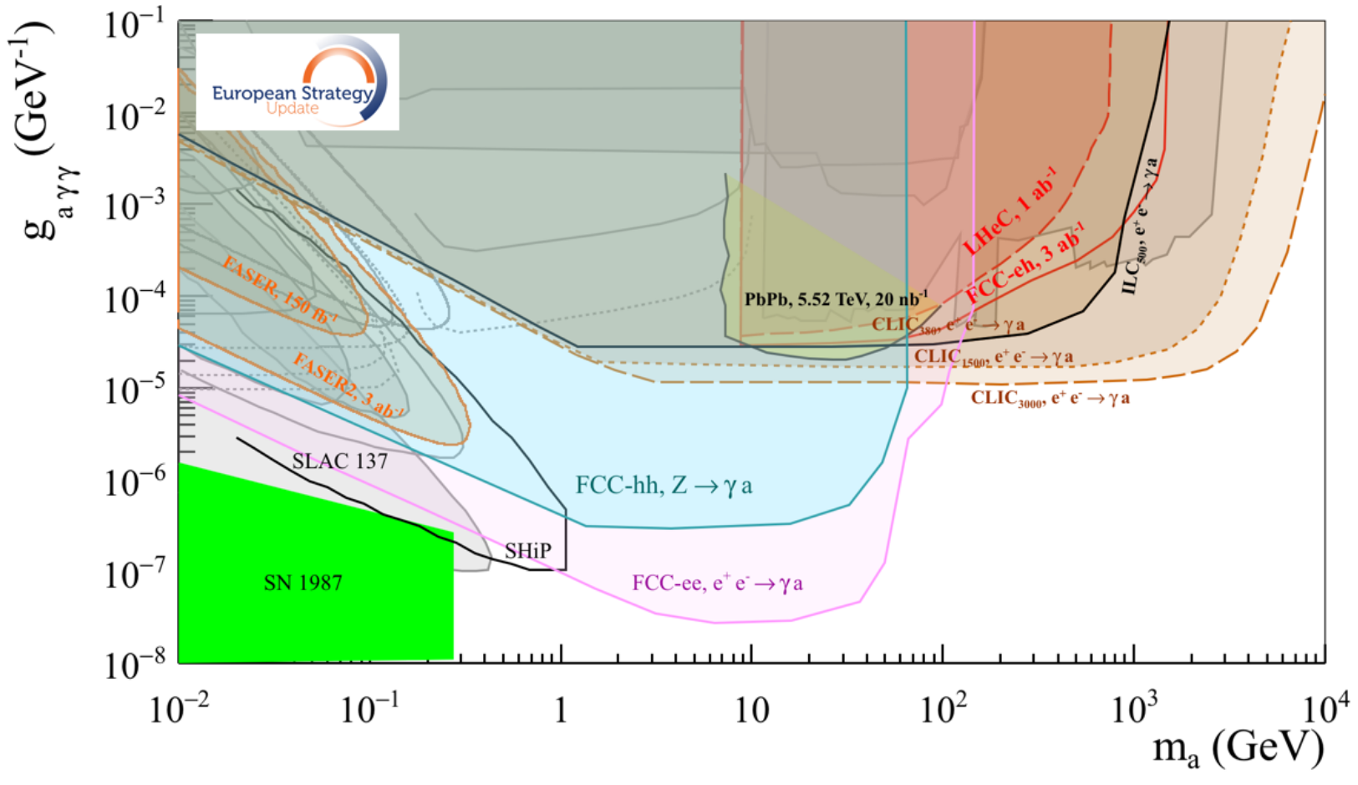
Similar situation for Axion-like-particles; Luminosity is key to the game
Complementarity with High energy lepton collider,
Much more left to explore at FCC-ee-Z and FCC-hh!

Slide 43
Conclusions
The FCC-integrated programme, FCC-ee then hh with ep and heavy ion options, thanks to synergies and complementarities,
offers the most versatile and adapted response to today’s physics landscape.
FCC-ee is the best low energy Higgs Factory, and MUCH more. It offers a unique physics programme and discovery potential
(Precision EW and Flavour, high sensitivity LLP searches, QCD) thanks to an outstanding high luminosity and E_{cm} calibration.
FCC-ee presents numerous novel challenges in detector design and experimentation!
FCC-ee matches well the European strategy vision and recommandations, and is well supported by CERN council!
The FCC financial and technical feasibility study has now started (with focus on the tunnel and FCC-ee implementation).
Significant funding (100MCHF/5years) at CERN together with the High Field Magnet R&D (120MCHF/6years).
Start of construction target: soon after completion of the HL-LHC construction and commissionning (2030).
The FCC is a global project and the participation of the CERN international partners is both essential and welcome
It is a great project, where there is much to learn, join us!
5th Physics workshop 7-11 Feb 2022 Registration: https://cern.ch/FCCPhysics2022

Slide 44
FCC-Conceptual Design Reports and other resources
  Vol 1 – Physics
  Vol 2 – FCC-ee,
  Vol 3 – FCC-hh,
  Vol 4 – HE-LHC
  1338 authors
  Preprints since 15 January 2019 on http://fcc-cdr.web.cern.ch/ and INSPIRE
  CDRs published in European Physical Journal C (Vol 1) and ST (Vol 2 – 4)
  ESPP summaries: FCC-integral, FCC-ee, FCC-hh, HE-LHC http://fcc-cdr.web.cern.ch/
  FCC-ee «Your questions answered» https://arxiv.org/abs/1906.02693v1
  “Circular vs linear, another story of complementarity” arXiv:1912.11871v2
  FCC-ee Energy Calibration paper https://arxiv.org/abs/1909.12245
  LOIs to Snowmass, challenges: https://indico.cern.ch/event/951830/
EPJ+ special issue “A future Higgs and EW Factory: Challenges towards discovery”
CDR + Documentation
A public presentation of the CDR was given on 4-5 March 2019
at CERN https://indico.cern.ch/event/789349/
FCC Phys workshop Nov 9-13 2020 https://indico.cern.ch/event/932973/
FCC week 28/06-02/07/2021 https://indico.cern.ch/event/995850/
ECFA plenary 20/11/2021 https://indico.cern.ch/event/1085137/
FCC Physics Workshop Feb 7-11 2022 https://cern.ch/FCCPhysics2022

Slide 45
Contacts
patrick.janot@cern.ch Christophe.Grojean@desy.de (PED coordination)
manuela.boscolo@cern.ch (MDI) alain.blondel@cern.ch (E-POL)
Gerardo.ganis@cern.ch clement.helsens@cern.ch (software)
matthew.mccullough@cern.ch frank.simon@cern.ch (Physics Programme)
Patrizia.Azzi@cern.ch emmanuel.perez@cern.ch (Physics Performance)
Mogens.Dam@nbi.dk philipp.roloff@cern.ch felix.sefkow@cern.ch (Detector Concepts)
1. register to the study (both)
https://simba3.web.cern.ch/simba3/SelfSubscription.aspx?groupName=fcc-experiments-lepton
https://simba3.web.cern.ch/simba3/SelfSubscription.aspx?groupName=fcc-experiments-hadron
2. Prepare MOU with Addendum that can evolve with increased participation

Slide 46
A future Higgs and Electroweak Factory; Challenges towards discovery EPJ+ spec. issue

Slide 47
A future Higgs and Electroweak Factory; Challenges towards discovery EPJ+ spec. issue

Slide 48
Physics at FCC-ee
HIGGS FACTORY
Higgs provides a very good reason why we need e+e- (or μμ) collider
2. ELECTROWEAK PRECISION ( 10⁻³ today → 10⁻⁵)
Z + WW + top required!
Test of the completeness of the SM
3. Z FACTORY
(5 10¹² Z i.e. 1.5 10¹¹ ee, μμ, ττ ; ~0.7 10¹² uu,dd,ss,cc,bb ; 10¹² νν)
High statistics for Heavy Flavours, QCD
Search for Feebly Coupled Particles
The place for ‘direct discovery’
+ comments on the synergy and complementarity of FCC-ee hh and eh

Slide 49
Higgs Physics
e+e- : Z – tagging by missing mass
→ must do physics with ratios
THE LHC is a Higgs Factory…BUT
total rate ∝ g_{HZZ}²
ZZZ final state ∝ g_{HZZ}⁴/ Γ_{H}
measure total width Γ_{H}
g_{HZZ} to ±0.2%
empty recoil = invisible width
‘funny recoil’ = exotic Higgs decay
e⁻
H
σ_{i→f} ^{observed} ∝ σ_{prod} (g_{Hi} )²(g_{Hf})²
Γ_{H}
Z*
?
e⁺
Z

Slide 50
Complementarity: Higgs Physics at FCC
  FCC-ee → g_{HZZ} to <±0.2% from σ_{ZH}
  (model-independent standard candle)
  and Γ_{H}, g_{Hbb} , g_{Hcc} , g_{Hττ} , g_{HWW}
  →fixes all HL-LHC / FCC-hh couplings
  FCC-hh produces over 10¹⁰ Higgs bosons
  use g_{HZZ} from FCC_{ee} will give g_{Hμμ} , g_{Hγγ} , g_{HZγ} , Br_{inv}
  FCC-ee also measures top EW couplings (e⁺e⁻ ➝ tt)
  FCC-hh produces 10⁸ ttH and 2. 10⁷ HH pairs
    ➝ g_{Htt} and g_{HHH}, model-independent & precise!
HL-LHC/FCC-ee/FCC-hh complementarity
outstanding
}
ee
}
hh
30-50
ee
hh
ee
Comparison with other e+e- colliders in spares
ee only
LHC+ee
FCC-ee+hh+ep
ep → WW mostly

Slide 51
Unique: electron Yukawa coupling
Measure e+e- → H @ 125.xxx GeV
requires
-- Higgs mass to be known to <<5 MeV (OK, 3 MeV)
-- Huge luminosity (several years)
-- monochromatization to reduce σ_{ECM}
-- continuous adjustment of E_{CM} (transv. Polar.)
-- an extremely sensitive event selection
HUGE CHALLENGE
under study
Monochromatization: UNDER STUDY
taking advantage of the separate e+ and e- rings, one can distribute
in opposite way high and low energies in the beam (in x, z time)
combine?
so far,
SM level
opposite sign horizontal dispersion
opposite difference in time within 30ps luminosity

Slide 52
Centre of mass Energy Calibration: the cornerstone of the precision programme
Large ring→transverse polarization of e± up to E_{beam} > 80 GeV σ_{E} ∝ E²/√ρ
Resonant depolarization provides high precision E_{beam} ν_{s} =$\frac{g−2}{2}\frac{Eb}{me}= \frac{Eb}{0.4406486(1)}$
Unique to circular machines (ee and μμ)
Improve over LEP by using pilot bunches + e- and e+ polarimeter
Relationship between ν_{s} and E_{CM}
➔ CM boost, σ_{ECM}, α_{coll} determined from 10⁶ μμ /5min
➔ Beamstahlung monitor under study etc...
First round of studies (arxiv 1909.12245)
m_{Z}, Γ_{Z} , sin²θ_{W}^{eff} , α_{QED}(m_{Z}), m_{W}
next target: bring syst. closer to stat. errors.
E. Gianfelice
LEP
FCC-ee simulation of
resonant depolarization
Alain Blondel Physics at the FCCs
52
At our luminosity level, longitudinal polarization brings
nothing that cannot be done otherwise.

Slide 53
Precision EW measurements: is the SM complete?
Higgs and EWPOs are complementary
top quark mass and couplings essential!
(the 100km circumference is optimal for this)
preliminary systematics!
aim at reducing to the level of systematics
many observables still to be added (flavours)
complemented by high energy FCC-hh
Theory work is critical and initiated 1809.01830

Slide 54
Electroweak Physics
Z factory + WW + top The realm of FCC-ee
Highest luminosities at 91, 160 and 350 GeV
Transverse pol. at 91 and 160 GeV→Ecm calibration
m_{Z} (100 keV) Γ_{Z} (25 keV), m_{W} (<500 keV), α_{QED}(m_{Z}) (3.10⁻⁵)
and sin²θ_{w} at 310⁻⁶
Complete set of EW observables can be measured
Precision unique to FCC-ee + new physics sensitivity
a lot more potential to exploit with good detector design
than present treatment suggests
The reach for new physics depends on which new physics:
-- 1/Λ² new physics → 30-70 TeV
-- Heavy Neutrino → 500-1000 TeV
-- new non-degenerate doublet should not have
mass splitting greater than ~5 GeV

Slide 55
More on TeraZ
The Flavour Factory
Progress in flavour physics wrt SuperKEKb/BELLEII requires > 10¹¹ b pair events,
FCC-ee(Z): will provide ~10¹² bb pairs. “Want at least 5 10¹² Z…”
-- precision of CKM matrix elements
-- Push forward searches for FCNC, CP violation and mixing
-- Study rare penguin EW transitions such as b ➝s 𝜏+ 𝜏− , σπεχτροσχοπψ (προδυχε β−βαρψονσ, Β_{σ} …)
-- Test lepton universality with 10¹¹ 𝜏 decays (with 𝜏 lifetime, mass, BRs) at 10⁻⁵ level, LFV to 10⁻¹⁰
-- all very important to constrain / (provide hints of) new BSM physics.
need special detectors (PID); a story to be written!
The 3.5 × 10¹² hadronic Z decay also provide precious input for QCD studies
High-precision measurement of αs(mZ) with Rℓ in Z and W decay, jet rates, 𝜏 decays, etc. : 10 ⁻⁻ ³ ➝10 ⁻⁻ ⁴
huge √s lever-arm between 30 GeV and 365 GeV, fragmentation, baryon production ….
Testing running of αs to excellent precision with hadron production from low energy (γ*/Z* +γ )
to 365 GeV
And... H→gg is a pure gluon factory (100’000 events)

Slide 56
This picture is relevant to Neutrino, Dark sectors and High Energy Frontiers.
FCC-ee (Z) compared to the other machines for right-handed (sterile) neutrinos
How close can we get to the ‘see-saw limit’?
-- the purple line shows the 95% CL limit if no HNL is observed. (here for 10¹² Z),
-- the horizontal line represents the sensitivity to mixing of neutrinos to the dark sector,
using EWPOs (G_{F} vs sin²θ_{W}^{eff} and m_{Z}, m_{W}, tau decays) which extends sensitivity
to 10⁻⁵ mixing all the way to very high energies (500-1000 TeV at least). arxiv:2011.04725

Slide 57
Similar situation for Axion-like-particles; Luminosity is key to the game
Complementarity with High energy lepton collider,
Much more left to explore at FCC-ee-Z and FCC-hh!

Slide 58
Conclusions
The FCC-integrated programme, FCC-ee then hh with ep and heavy ion options, thanks to synergies and complementarities,
offers the most versatile and adapted response to today’s physics landscape.
FCC-ee is the best low energy Higgs Factory, and MUCH more. It offers a unique physics programme and discovery potential
(Precision EW and Flavour, high sensitivity LLP searches, QCD) thanks to an outstanding high luminosity and E_{cm} calibration.
FCC-ee presents numerous novel challenges in detector design and experimentation!
FCC-ee matches well the European strategy vision and recommandations, and is well supported by CERN council!
The FCC financial and technical feasibility study has now started (with focus on the tunnel and FCC-ee implementation).
Significant funding (100MCHF/5years) at CERN together with the High Field Magnet R&D (120MCHF/6years).
Start of construction target: soon after completion of the HL-LHC construction and commissionning (2030).
The FCC is a global project and the participation of the CERN international partners is both essential and welcome
It is a great project, where there is much to learn, join us!
5th Physics workshop 7-11 Feb 2022 Registration: https://cern.ch/FCCPhysics2022

Slide 59
Our marching orders from ESPP 2020:
“Europe, together with its international partners, should investigate the technical and financial feasibility of a future hadron collider at CERN with a centre-of-mass energy of at least 100 TeV, and with an electron-positron Higgs and electroweak factory as a possible first stage. Such a feasibility study of the colliders and related infrastructure should be established as a global endeavour and be completed on the timescale of the next Strategy update.”
Feasibility of the colliders (ee and hh) and related infrastructure.
→ FCC is the highest priority after HL-LHC for Europe and its international partners (Plan A)

Slide 60
Physics at FCC-ee
HIGGS FACTORY
Higgs provides a very good reason why we need e+e- collider
2. ELECTROWEAK PRECISION ( 10⁻³ today → 10⁻⁵)
Z + WW + top required!
Test of the completeness of the SM
Are there further particles with SM couplings?
3. Z FACTORY
(5 10¹² Z i.e. 1.5 10¹¹ ee, μμ, ττ ; ~0.7 10¹² uu,dd,ss,cc,bb ; 10¹² νν)
High statistics for Heavy Flavours, QCD
Search for Feebly Coupled Particles
The place for ‘direct discovery’
+ comments on the synergy and complementarity of FCC-ee hh and eh

Slide 61
Status of FCC
-- June 2021 The FCC Feasibility Study (2021-2025) organization was proposed to CERN council, approved unanimously
-- Council documents :
-- Financial study: “ The focus will be on the tunnel and the first-stage collider (FCC-ee)”
-- Design of FCC-ee and FCC-hh, and their injectors, key technologies, technical infrastructure
-- MDI and Ecm calibration for FCC-ee
-- The physics case and detector concepts will be consolidated for both colliders (FCC-ee and FCC-hh).
-- intermediate review mid 2023, delivery of Feasibility Study Report (FSR) end 2025, (first collisions >2040)
-- Stress the importance of communication towards
scientific community, governments and funding agencies, industries and general public
-- work has started on placement in Geneva area (France and Switzerland)
→ reduce number of surface points to 8
→ layout consistent with later choice of 2 or 4IP for the e+e- collider
-- in parallel, high field magnet R&D for FCC-hh will be carried out with high priority
These events bring both FCC-ee and FCC-hh one step closer to reality
MTP: 100MCHF/5yrs
- Organisational structure of the FCC feasibility study
http://cds.cern.ch/record/2774006/files/English.pdf
- Main deliverables and timeline of the FCC feasibility study
http://cds.cern.ch/record/2774007/files/English.pdf
+120MCHF/6yrs

Slide 62
More on TeraZ
The Flavour Factory
Progress in flavour physics wrt SuperKEKb/BELLEII requires > 10¹¹ b pair events,
FCC-ee(Z): will provide ~10¹² b pairs. “Want at least 5 10¹² Z…”
-- precision of CKM matrix elements
-- Push forward searches for FCNC, CP violation and mixing
-- Study rare penguin EW transitions such as b ➝s 𝜏+ 𝜏− , σπεχτροσχοπψ (προδυχε β−βαρψονσ, Β_{σ} …)
-- Test lepton universality with 10¹¹ 𝜏 decays (with 𝜏 lifetime, mass, BRs) at 10⁻⁵ level, LFV to 10⁻¹⁰
-- all very important to constrain / (provide hints of) new BSM physics.
need special detectors (PID); a story to be written!
The 3.5 × 10¹² hadronic Z decay also provide precious input for QCD studies
High-precision measurement of αs(mZ) with Rℓ in Z and W decay, jet rates, 𝜏 decays, etc. : 10 ⁻⁻ ³ ➝10 ⁻⁻ ⁴
huge √s lever-arm between 30 GeV and 365 GeV, fragmentation, baryon production ….
Testing running of αs to excellent precision with hadron production from low energy (γ*/Z* +γ )
to 365 GeV
And... H→gg is a pure gluon factory (100’000 events)

Slide 63
Centre of mass Energy Calibration: the cornerstone of the precision programme
Large ring→transverse polarization of e± up to E_{beam} > 80 GeV σ_{E} ∝ E²/√ρ
Resonant depolarization provides high precision E_{beam} ν_{s} =$\frac{g−2}{2}\frac{Eb}{me}= \frac{Eb}{0.4406486(1)}$
Unique to circular machines (ee and μμ)
Improve over LEP by using pilot bunches + e- and e+ polarimeter
Relationship between ν_{s} and E_{CM}
➔ CM boost, σ_{ECM}, α_{coll} determined from 10⁶ μμ /5min
➔ Beamstahlung monitor under study etc...
First round of studies (arxiv 1909.12245)
m_{Z}, Γ_{Z} , sin²θ_{W}^{eff} , α_{QED}(m_{Z}), m_{W}
next target: bring syst. closer to stat. errors.
E. Gianfelice
LEP
FCC-ee simulation of
resonant depolarization
Alain Blondel Physics at the FCCs
63
At our luminosity level, longitudinal polarization brings
nothing that cannot be done otherwise.

Slide 64
Higgs Physics
e+e- : Z – tagging by missing mass
→ must do physics with ratios
THE LHC is a Higgs Factory…BUT
e⁻
H
total rate ∝ g_{HZZ}²
ZZZ final state ∝ g_{HZZ}⁴/ Γ_{H}
measure total width Γ_{H}
g_{HZZ} to ±0.2%
empty recoil = invisible width
‘funny recoil’ = exotic Higgs decay
σ_{i→f} ^{observed} ∝ σ_{prod} (g_{Hi} )²(g_{Hf})²
Γ_{H}
Z*
?
e⁺
Z

Slide 65
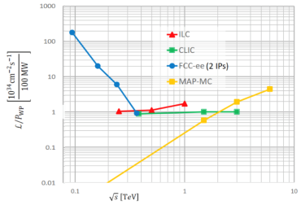
Circular vs linear complementarity
plots from Briefing Book
Luminosity
Luminosity/Power → Energy efficiency
cross-over ~350 GeV
Luminosity vs Energy circular below 365GeV linear above 365 GeV
Efficiency : 9 (5) GJ/Higgs at FCC-ee with 2(4)IP 50GJ/Higgs for ILC250 (first 15 years)
Beam polarization: circular: transverse → ppm beam energy calibration
linear: longitudinal : e- ±80% easy, (e+ ±30% difficult) → additional d.o.f
Monochromatization for e+e- → H (125 GeV)
Long term energy upgrade circular: pp, AA, e-h linear: High energy lepton collisions
Interaction points circular: 2-4 linear: 1 IP (at a time)
Run limited in time by arrival of hadron collider Run is open ended

Slide 66
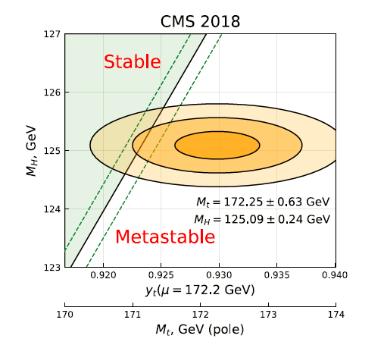
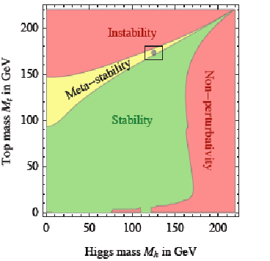
The Standard Model is a very consistent and complete theory.
It explains all known collider phenomena and almost all particle physics (except ν’s)
– this was beautifully verified at LEP, SLC, Tevatron and the LHC.
-- the EWPO radiative corrections predicted top and Higgs masses
assuming SM and nothing else
we can even extrapolate the Standard Model all the way to the the Plank scale :
FCC 2048

Slide 67
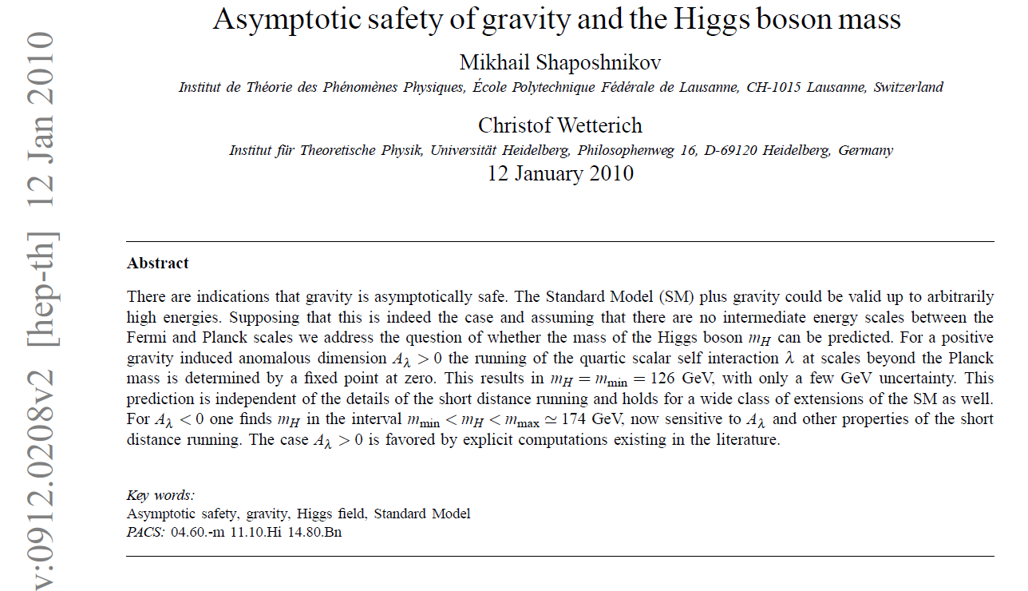
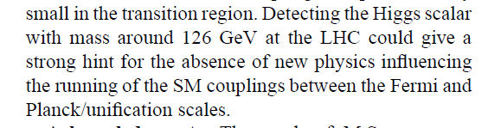
Is it the end?
Is it the end?

Slide 68
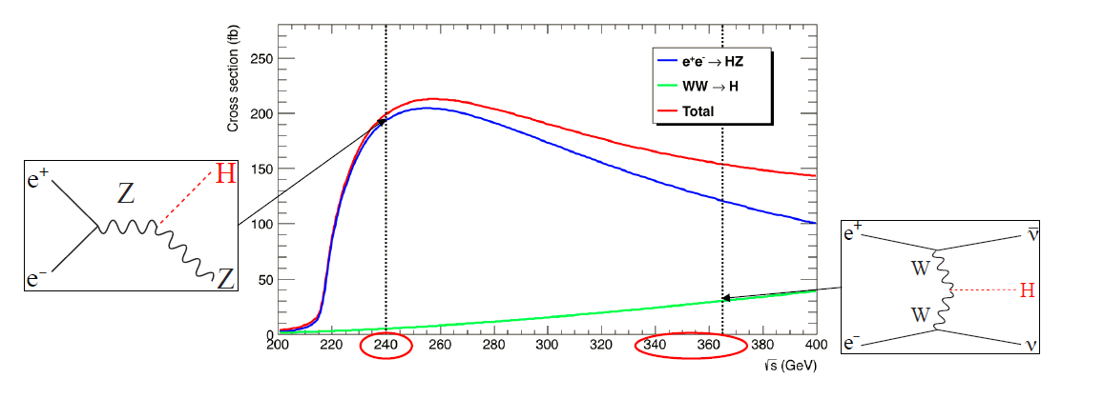
Higgs Production
LEP
10⁶ e+e- → ZH events with 5 ab-1
● Target : few per-mil precision, statistics-limited.
● Complemented with 200k events at √s = 350 – 365 GeV
Of which 30% in the WW fusion channel (useful for the Γ_{H} precision)

Slide 69
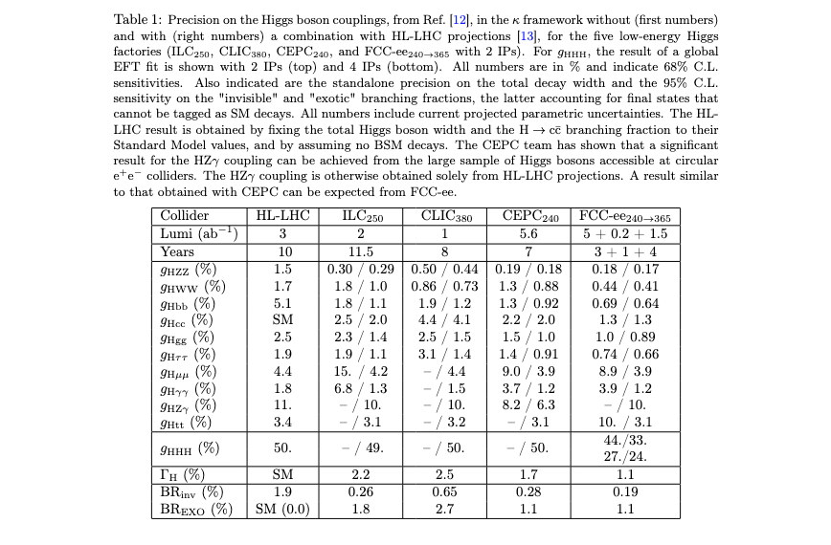
table from ESPP briefing book

Slide 70
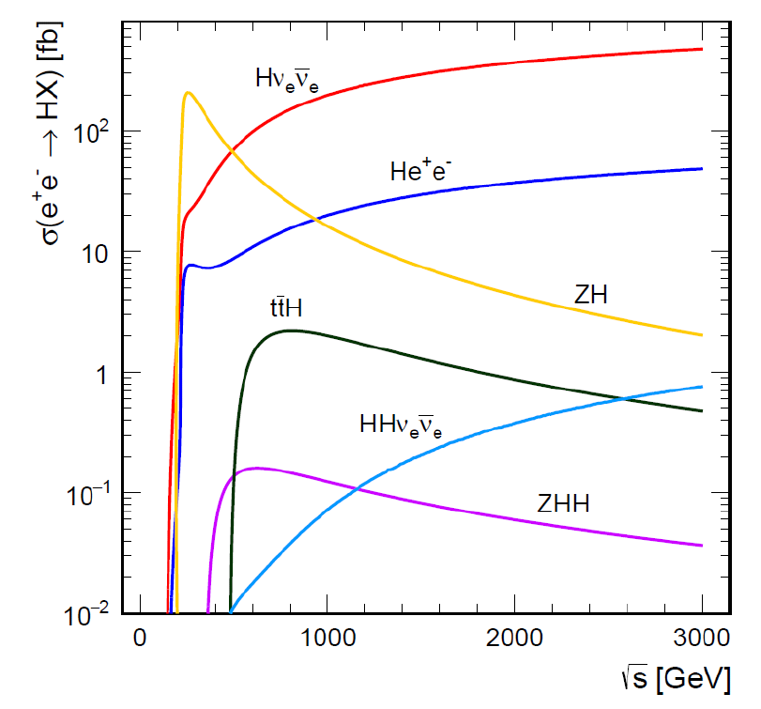
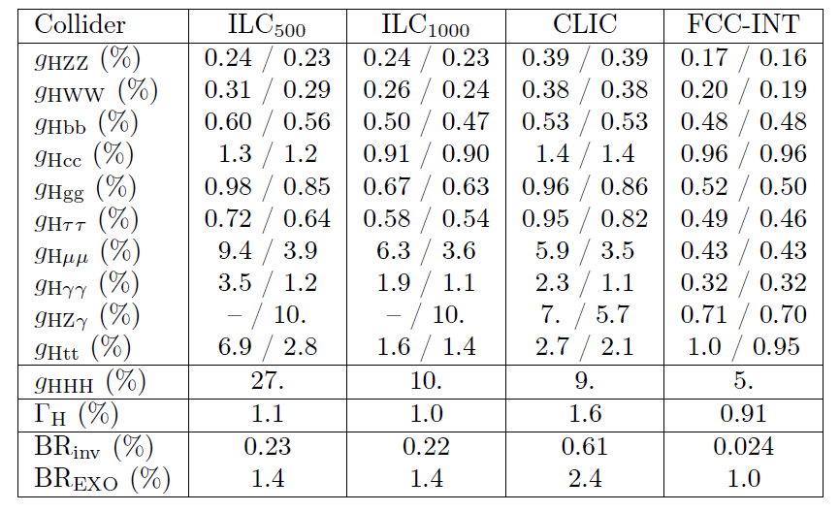
High energy Higgs factories: ILC500, CLIC3000, FCC-hh.
FCC-ee + FCC-hh is very competitive
}
ee
}
hh
±3(stat)±~1.4(syst)
ee
hh
ee
FCC-hh > 10¹⁰ H produced, +
FCC-ee measurement of g_{HZZ}
g_{HHH} , g_{Hγγ} , g_{HZγ} , g_{Hμμ} , BR_{inv}
(*)see M. Selvaggi, 3d FCC physics workshop,
9% precision in 3 years of FCC-hh running, 2004.03505v1

Slide 71
FCC-ee at the intensity frontier
TeraZ offers four additional pillars to the FCC-ee physics programme
Flavour physics programme
Enormous statistics 10¹² bb, cc
Clean environment, favourable kinematics (boost)
Small beam pipe radius (vertexing)
Flavour EWPOs (R_{b}, A_{FB}^{b,c}) : large improvements wrt LEP
CKM matrix, CP violation in neutral B mesons
Flavour anomalies in, e.g., b ➝ sττ
QCD programme
Enormous statistics with Z ➝𝓁𝓁, qq(g)
Complemented by 100,000 H ➝ gg
α_{S}(m_{Z}) with per-mil accuracy
Quark and gluon fragmentation studies
Clean non-perturbative QCD studies
Often statistics-limited
5. 10¹² Z is a minimum
Tau physics programme
Enormous statistics: 1.7 10¹¹ ττ events
Clean environment, boost, vertexing
Much improved measurement of mass, lifetime, BR’s
τ-based EWPOs (R_{τ}, A_{FB}^{pol}, P_{τ})
Lepton universality violation tests
PMNS matrix unitarity
Light-heavy neutrino mixing
Rare/BSM processes, e.g. Feebly Coupled Particles
Intensity frontier offers the opportunity to directly
observe new feebly interacting particles below m_{Z}
Signature: long lifetimes (LLP’s)
Other ultra-rare Z (and W) decays
Axion-like particles
Dark photons
Heavy Neutral Leptons

Slide 72
FCC-ee at the intensity frontier
… which in turn provide specific detector requirements
Flavour physics programme
Formidable vertexing ability; b, c, s tagging
Superb electromagnetic energy resolution
Hadron identification covering the momentum
range expected at the Z resonance
QCD + EW programme
Particle-Flow reconstruction
Lepton and jet angular and energy resolution ; Lepton ID
More case studies will lead to
more detector requirements
Tau physics programme
Momentum resolution
  Mass measurement, LFV search
Precise knowledge of vertex detector dimensions
  Lifetime measurement
Tracker and ECAL granularity and e/μ/π separation
  BR measurements, EWPOs, spectral functions
Rare/BSM processes, e.g. Feebly Coupled Particles
Sensitivity to far-detached vertices (mm ➝ m)
  Tracking: more layers, continuous tracking
  Calorimetry: granularity, tracking capability
Larger decay lengths ⇒ extended detector volume
Full acceptance ⇒ Detector hermeticity
If all these constraints are met, Higgs and top programme probably OK (tbc)

Slide 73
Precision Natural SUSY at CEPC, FCC-ee, and ILC, JJ Fan, M. Rees and Liantao Wang
arXiv:1412.3107v2 figure 5 (top row)
«Higgs and EWPOs are complementary»
“ also, b→ sγ could be useful”

