Slide 1






CHART
Lenny Rivkin, Mike Seidel
www.chart.ch

Slide 2

Swiss Accelerator Research and Technology CHART Collaboration
development of future accelerator technologies
Emphasis: high field magnets
development of accelerator concepts beyond the existing technology for synchrotron light sources, medical and industrial applications
Commitments from SERI, ETHs, PSI, UniGE and CERN for a total sum of 40 MCHF to fund these activities for five years (until 2024)
ETHZ
EPFL
UniGE
Securing the future of CERN beyond LHC

Slide 3

FCC integrated project technical schedule
1
2
3
4
5
6
7
8
9
10
11
………………..
19
20
~ 15 years operation
7 – 10 years
~ 25 years operation
70
Feasibility Study
EPPSU
Project preparation &
administrative processes
Permis-sions
Update
Permissions
Funding strategy
Funding and
in-kind contribution agreements
Funding and
in-kind contribution agreements
Geological investigations, infrastructure detailed design and tendering preparation
Tunnel, site and technical infrastructure construction
FCC-ee dismantling, CE & infrastructure adaptations FCC-hh
engineering design, energy efficiency, maintainability
conductors & high-field magnet technology
FCC-ee accelerator R&D and technical design
FCC-ee accelerator construction, installation, commissioning
FCC-hh accelerator R&D and technical design
FCC-hh accelerator construction, installation, commissioning
Set up of international experiment collaborations, detector R&D and concept development
FCC-ee detector technical design
FCC-ee detector
construction, installation, commissioning
FCC-hh detector R&D,
technical design
FCC-hh detector
construction, installation, commissioning
Superconducting wire and magnet R&D, short models
Long model magnets, prototypes, preseries
High-field magnet
industrialization and
series production
Notes:
FCC-all schedule. Time scale comparable to the LEP/LHC programme

Slide 4



Feasibility study timeline
2021 |  |  |  | 2022 |  |  |  | 2023 |  |  |  | 2024 |  |  |  | 2025
Q1 | Q2 | Q3 | Q4 | Q1 | Q2 | Q3 | Q4 | Q1 | Q2 | Q3 | Q4 | Q1 | Q2 | Q3 | Q4 | Q1 | Q2 | Q3 | Q4
fundamental design & adaptations for
implementation scenario
Status reports &
study planning ,
Workshop & Review : focus on preferred implementation scenario
high-risk areas site investigations, environmental evaluation & impact study with host states
Workshop & mid-term review:
general coherency, CDR cost update
until next strategy update:
investigate the technical and financial feasibility of a future hadron collider at CERN with a centre-of-mass energy of at least 100 TeV and with an electron-positron Higgs and electroweak factory as a possible first stage
detailed design phase
Workshop & Review: key technology R&D programs
FS Report
Release FSR
Project cost update

Slide 5


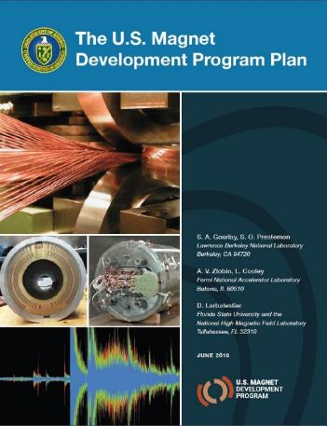
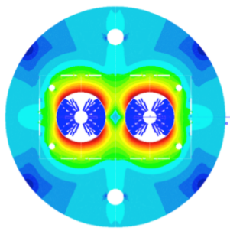
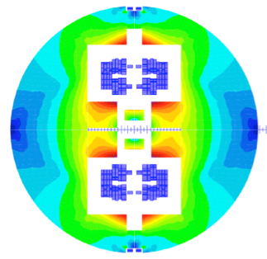

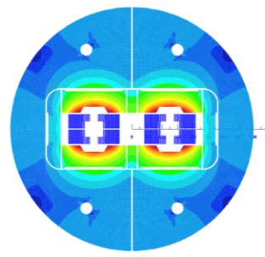
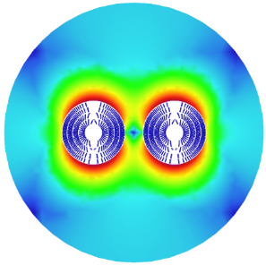
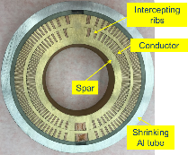
High field magnets R&D
H2020
Swiss contribution
Cos-theta
Common coils
Canted
Cos-theta
Blocks
INFN
CIEMAT
LBNL
CEA
PSI
FNAL
Short model magnets (1.5 m lengths) will be built from 2018 – 2022
Russian 16 T magnet program coordinated by BINP.
B. Auchmann

Slide 6


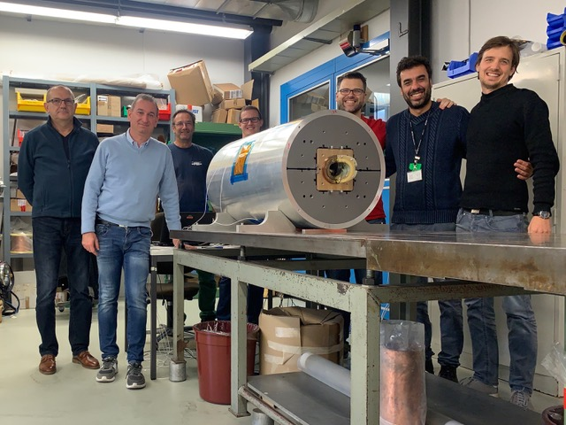
2019: FNAL demonstrator dipole exceeded 14 T at 4.5 K
2019: PSI CCT demonstrator dipole

Slide 7

CHART Low Temperature Superconductor HFM Roadmap
2020
2021
2022
2023
2024
2025
2026
2027
ESPP Update
ESPP Update
1
2
3
CHART1
CHART2
CHART3
Infrastructure
MagDev Lab
LHe Testing Facility
Wire Development
Wire Lab Extension
Wire performance and robustness
100 m UL R&D wire
Enabling Technologies
Coil composite and interfaces
Manufacturing processes
Advanced Design Techniques
LTS Magnet R&D
Instrumentation and multi-messenger signal analysis
CD1
BOX Program
Subscale Program
Concept Study
Processes
Test
Coil
Fast-turnaround Demo Program 12+ T
14+ T Demo
Caveat: CHART3 is not today an approved program. The funding envelop will determine the possible
level of engagement, and a selection of activities may have to be made according to priorities.
Notes:
B. Auchmann can comment on the strategy details

Slide 8

CHART High Temperature Superconductor HFM Roadmap
2020
2021
2022
2023
2024
2025
2026
2027
ESPP Update
ESPP Update
1
2
3
CHART1
CHART2
CHART3
Infrastructure
High-field HTS coil test facility
HTS Tape R&D
Pinning engineering to reduce anisotropy
Enabling Technologies
Insulation materials
Quench protection
HTS Magnet R&D
SuperBend Technology Demo
Cable and Insulation Technology
FCC-ee injector test, SC solenoid
HTS HFM Concept Study
5-T HTS Demo1
HTS HFM program
Accelerator Design
FQ in HTS accelerators
Caveat: CHART3 is not today an approved program. The funding envelop will determine the possible
level of engagement, and a selection of activities may have to be made according to priorities.
Notes:
B. Auchmann can comment on the strategy details

Slide 9
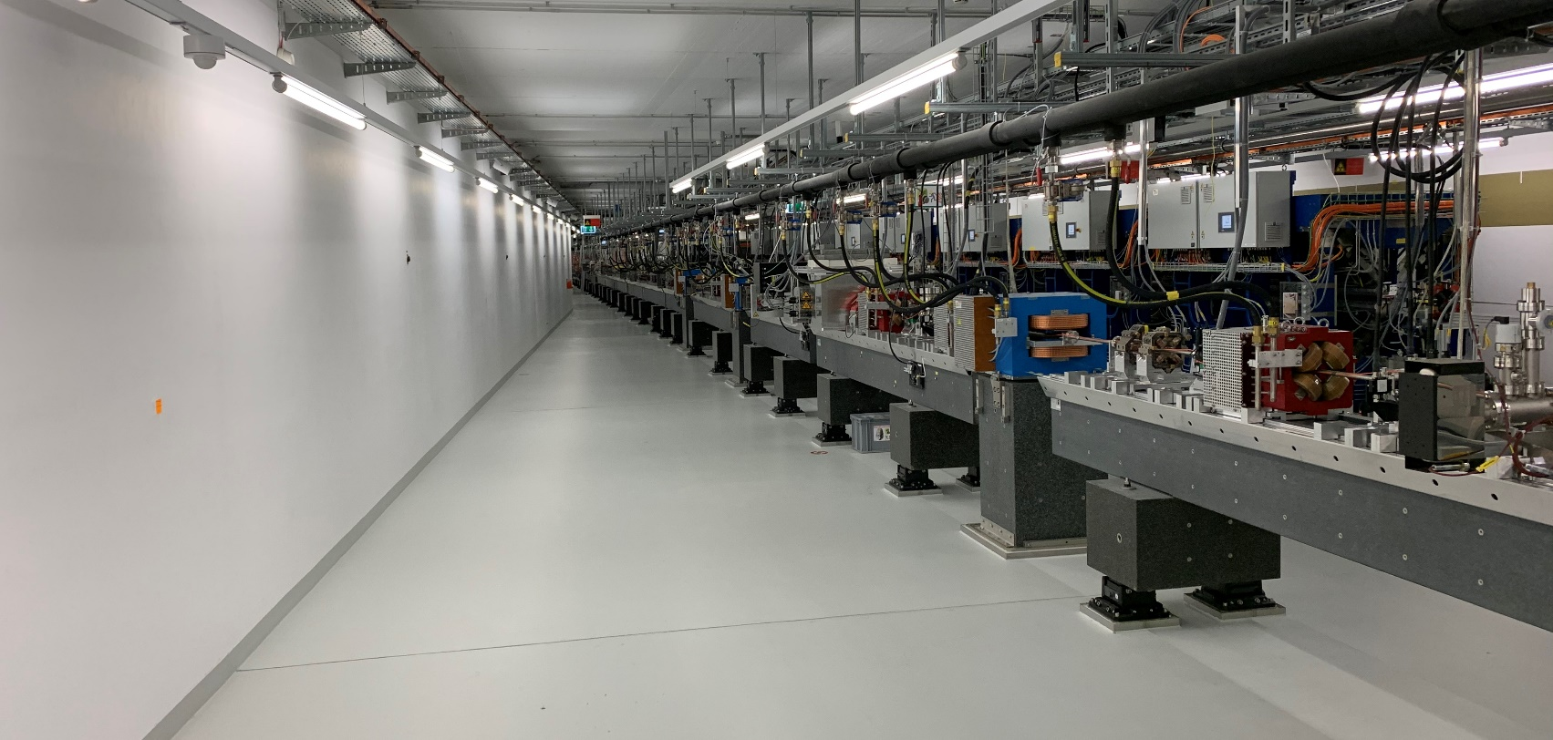
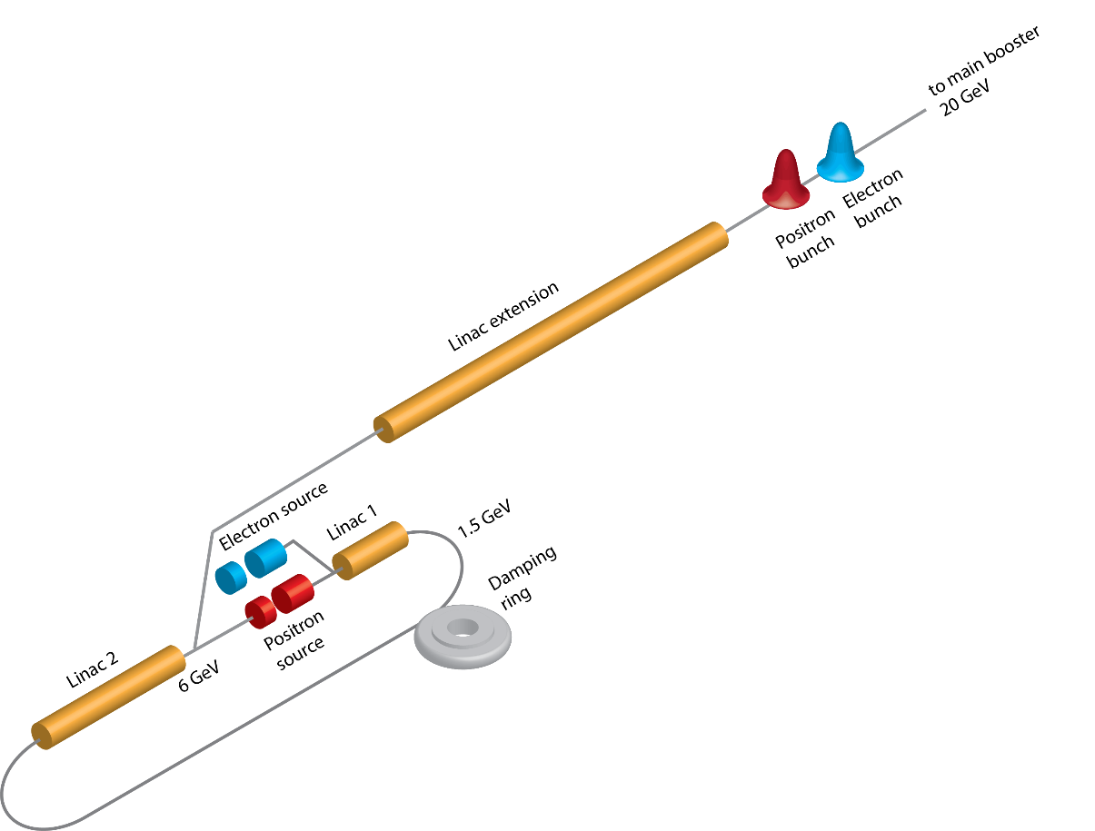
FCC-ee Positron Source Project
6 GeV SwissFEL Linac
Key point: Positron production and capture efficiency reduces the cost and complexity of the driver linac, the heat and radiation load of the converter system, and increases the operational margin
Any progress with R&D on the target and capture systems will have a direct benefit for the injector chain
Test bench at PSI/SwissFEL for the conventional and hybrid schemes using a SC solenoid, mainly for the positron yield (and maybe for the positron beam quality as well)

Slide 10
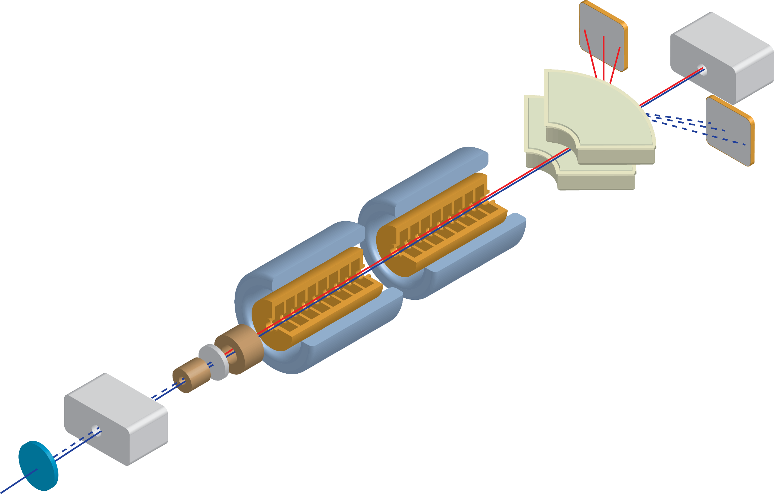
Experiment layout
beam dump or beam stopper
Goal: have a comparative study between conventional and hybrid schemes and to test the SC solenoid
Spectrometer
positron beam
electron beam
Radiation from the crystal
SC solenoid with embedded target
RF cavities and NC solenoids
Diagnostic not defined yet (charge measurement)
Both e- and e+ have huge energy spread, beam dump design and shielding problems.
Option: operate with extremely low beam charge <<200 pC, <<100 Hz
Crystal in/out
Beam stopper
and permanent magnet
SwissFEL 6 GeV electron beam
electron beam
Courtesy of R. Zennaro

Slide 11



Development of simulation framework for FCC-ee (F.Carlier et al)
Why? Some critical simulations for FCC-ee are not within the capabilities of current simulation codes
Beam-beam instability studies with full lattice descriptions
Efficient on- and off-momentum dynamic aperture simulations
Self-consistent optics with beam-beam
Spin dynamics simulations with complete FCC-ee model
Team:
Félix Carlier (Postdoc EPFL)
Peter Kicsiny (Ph.D. EPFL/CERN)
Guillaume Simon (Ph.D. CERN)
Yi Wu (MSc. EPFL)
Staff and supervisors:
Tatiana Pieloni (EPFL)
Xavier Buffat (CERN)
Daniel Schulte (CERN)
Riccardo De Maria (CERN)
Frank Schmidt (CERN)
What? Establish a modern and maintainable simulation framework to address key limitations for the FCC-ee
Integrate and merge functionalities of established simulation tools
Develop new simulation modules to replace outdated legacy codes
Perform key simulation campaigns with developed tools: beam-beam, spin dynamics, collimation…
How? Current efforts focus on:
Updating codes to accept FCC-ee model including tapering and solenoid modelling
Developing common interface and APIs to move towards multi-code simulations
Efficient multiparticle tracking modules with synchrotron radiation and beam-beam
Developing 6D beam-beam model with various levels of approximations
Collaboration between EPFL & CERN in synergy with current LHC based efforts at CERN, and with broader interests towards lightsource and muon collider communities

Slide 12

CHART
CERN is key for Swiss science landscape
Swiss contribution to next generation collider at CERN
focused on critical technologies and accelerator physics aspects of FCC
networking between CH institutions & CERN
involving and educating the next generation accelerator experts
    → developing and maintaining competences during the preparation period for FCC
CHART welcomes your contribution!

Slide 13
Spare Slides

Slide 14
High Field Magnets: Low Temperature Superconductors Driving Questions
How to increase the overall robustness and performance of Nb₃Sn technology in terms of
  increased field,
  increased yield of conforming coils,
  reduced magnet training to ultimate field, and
  resilience to operational and thermal cycles?
To which level can the magnetic field be pushed in an economical way?
How to reduce the manufacturing complexity and material cost?
Ultimate performance
Robustness
Cost

Slide 15
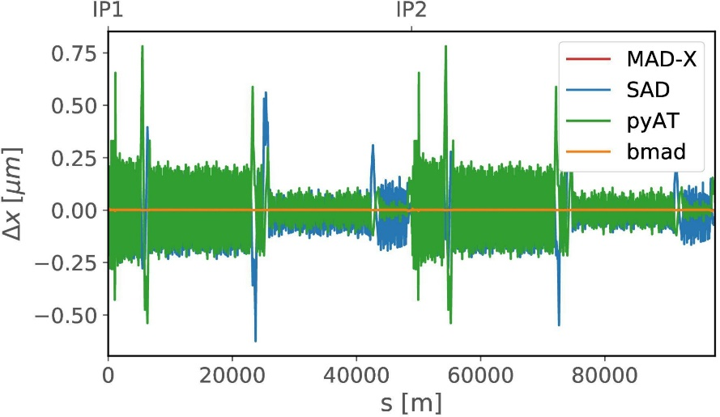
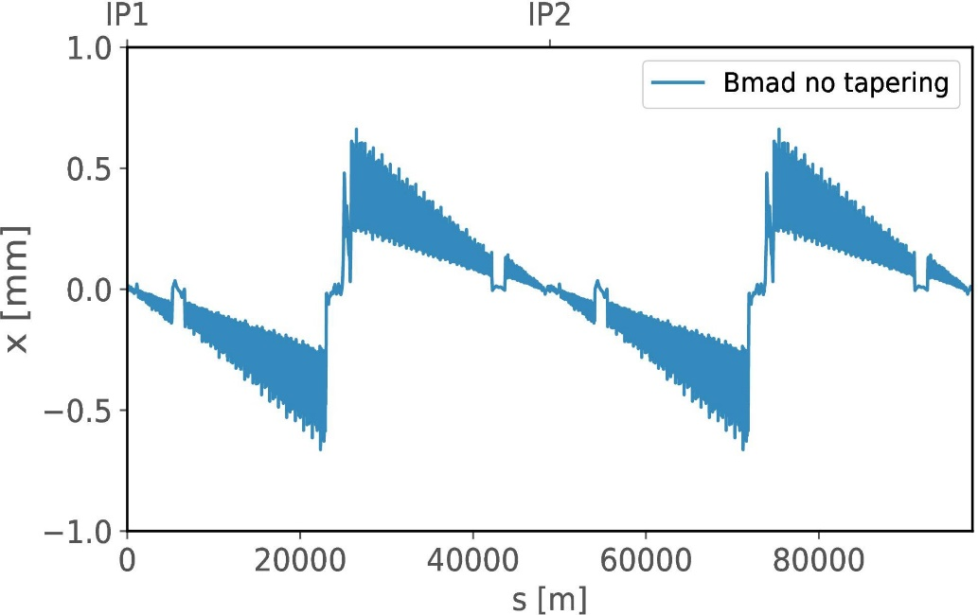
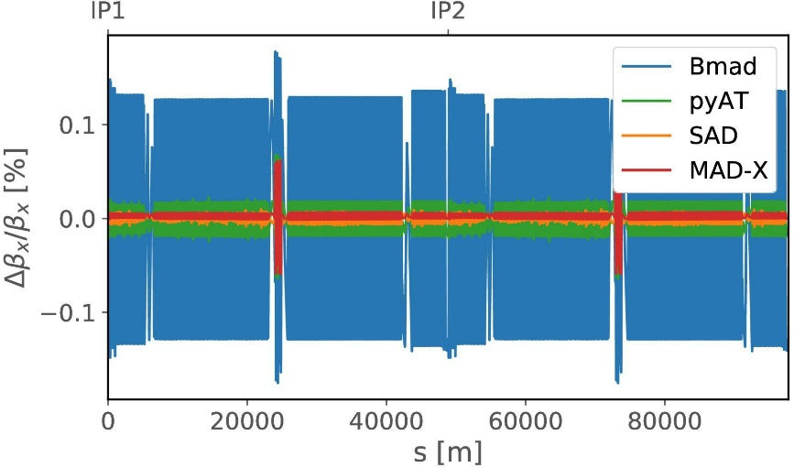
Simulation Framework: Example Tapering to Compensate SR Losses
now implemented for several codes
untapered (code Bmad)
Tapering
also optics functions well controlled

