Slide 1

4D tracking at FCC-ee
An overview of the present activities aimed at developing trackers with excellent spatial and temporal resolutions
(this short summary covers sensors with internal gain, other possibilities in other talks)
UFSD group
INFN – Torino-Genova, Univ. of Turin, Univ. of Piemonte Orient,
FBK-Trento, Univ. of Trento, Univ. of California at Santa Cruz.
Extensive collaborations with other groups and within the RD50 CERN collaboration
PRIN
4DInSiDe
AIDA
Innova

Slide 2
Setting the stage
The first step is to define the phase space of the required performances
(table from the ECFA document presentlyin preparation)
 | Vertex | Tracker | ToT
Position precision (um) | < 3 | ~ 6
material X/Xo | 0.05 | 1
Power (mW/cm²) | 20 | <100
Rates (GHz/cm²) | 0.05
Timing precision (ns) | 25 | < 0.1 | ~ 0.01

Slide 3
Silicon time-tagging detector
(a simplified view)
Time is set when the signal crosses the comparator threshold
The timing capabilities are determined by the characteristics of the signal at the output of the pre-Amplifier and by the TDC binning.
Strong interplay between sensor and electronics

Slide 4

Temporal resolution: electronics and sensors
$$σ_{t}^{2}={\left(\frac{Noise}{dV/dt}\right)}^{2}+{\left(∆ionization\right)}^{2}$$
Minimized by electronics
Minimized by good sensor design
Amplitude variation:
variation in the total charge
Shape distortion:
non homogeneous energy deposition
Usual “Jitter” term
Here enters everything that is “Noise” and the steepness of the signal
Need large dV/dt
➔ Need internal gain

Slide 5
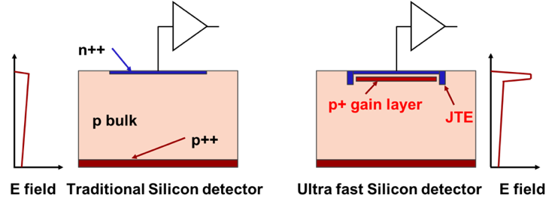
First design innovation: low gain avalanche diode (LGAD)
zoom
Drift area with gain
0.5 – 2 μm long
The gain layer:
a parallel plate capacitor with high field
The LGAD sensors, as proposed and first manufactured by CNM
(National Center for Micro-electronics, Barcelona):
High field obtained by adding an extra doping layer
E ~ 300 kV/cm, closed to breakdown voltage
The low-gain mechanism, obtained with a moderately doped p-implant, is the defining feature of the design.
The low gain allows segmenting and keeping the shot noise below the electronic noise, since the leakage current is low.
Low gain is the key ingredient to good temporal resolution

Slide 6
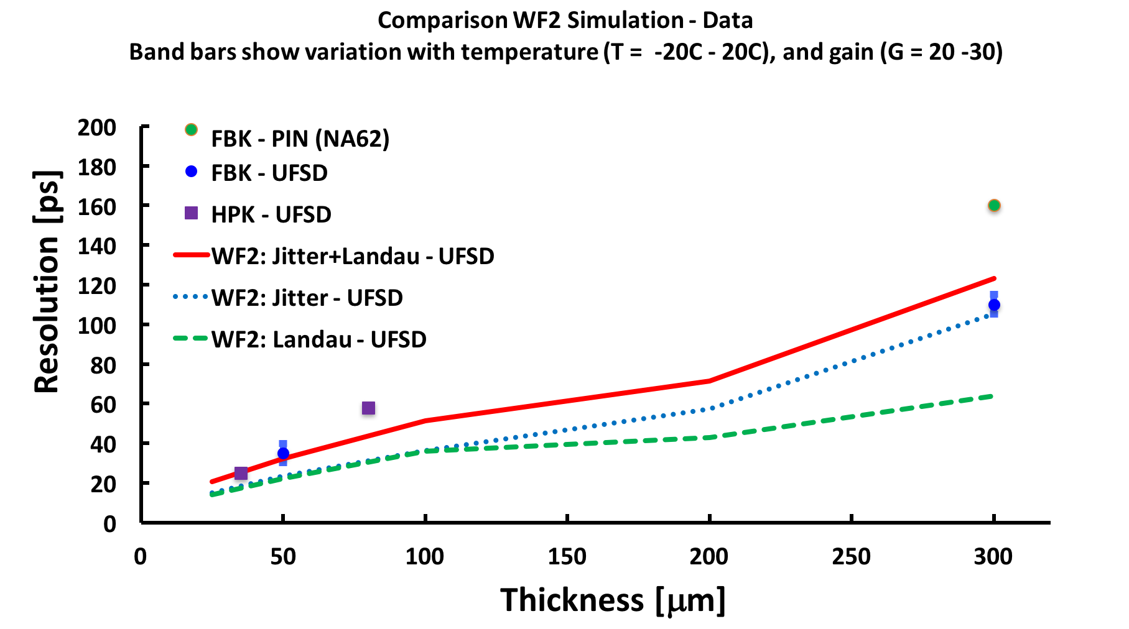
Summary of UFSD temporal resolution
Resolution without gain
(n-in-p) = 115 ps at 250V
Resolution without gain
There are now hundreds of measurements on 45-55 μm-thick UFSDs
➔ Current sensor choice for the ATLAS and CMS timing layers

Slide 7
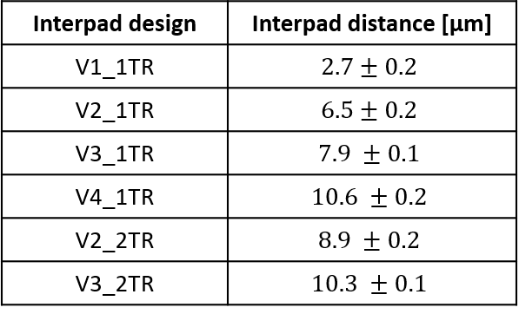
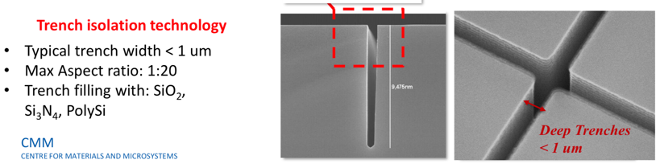
Towards 100% fill factor: Trench Isolated LGAD
No gain
50-80 μm
No-gain region ~ 50-80 μm
➔ cannot use UFSDs for small pixels
oxide
Gain layer
p-stop
Solution: use trenches for pad isolation
➔ No-gain region ~ 5 – 10 μm
JTE
JTE
p bulk
RD50-TI production
V_{Bias}
No gain
5-10 μm
oxide
Gain layer
trench
trench
JTE
p bulk
V_{Bias}
The R&D to achieve small pixels is clear (AIDAInnova is part of this)

Slide 8


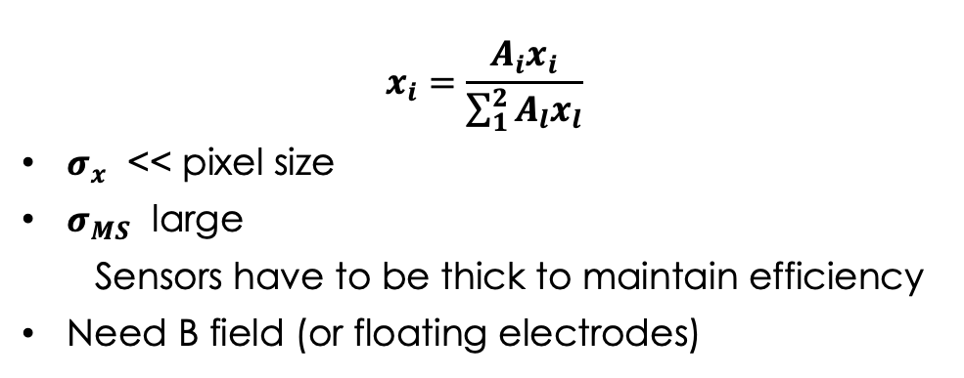
Position precision $σ_{x},$ readout, and material budget
Binary readout
where the only information is hit/miss (0,1)
Analog readout
where the amplitude of the signal is recorded
Pixel size
thin sensor
Summary:
Very good position precision can be obtained with:
(1) Digital readout && very small pixels && thin sensors
(2) Analog readout && large pixels && thick sensors
---
++++
---
--
++
+++
++++
Thick sensor
-
-
-
Lorentz angle
$$θ$$
$$x_{i}=\frac{A_{i}x_{i}}{\sum_{1}^{2}{A_{l}x_{l}}}$$
$σ_{x}$ << pixel size
$σ_{MS}$ large
  Sensors have to be thick to maintain efficiency
Need B field (or floating electrodes)
$σ_{x}=k \frac{pitch}{\sqrt{12}}$, k ~ 0.5 - 1
$σ_{x}$ depend on the pixel size
pixel = 100$μm$ ➔ $σ_{x}=20 μm$
$σ_{MS}$ small : sensors might be thin
Can we have the best of both options?
Very good precision with
Large pixels && low material budget?

Slide 9
Second design innovation: resistive read-out
The signal is formed on the n+ electrode ==> no signal on the AC pads
The AC pads offer the smallest impedance to ground for the fast signal
The signal discharges to ground
short RC
short RC
Fast signal
Fast signal
long RC
long RC
-+
-+
-+
-+
-+
-+
In resistive readout the signal is naturally shared among pads (4-6) without the need of B field or floating pads
Thanks to the internal gain, full efficiency even with sharing
Results presented here are from the FBK RSD1 production

Slide 10
RSD main formula in motion

Slide 11
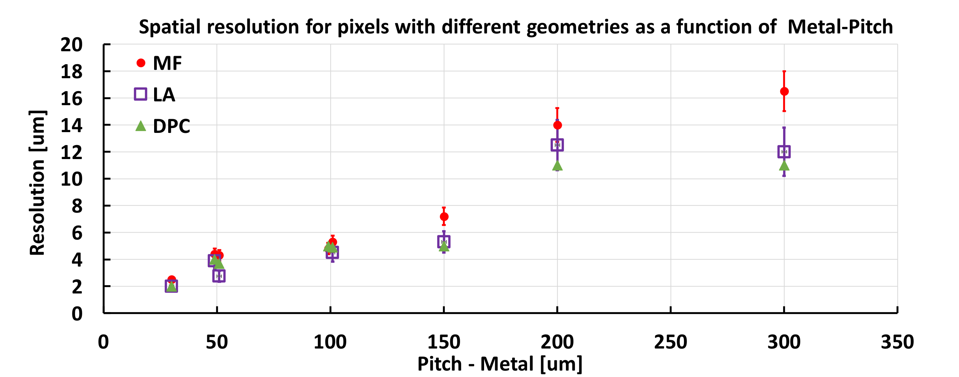
Laser study: position resolution as a function of pixel geometry
3 different position reconstruction methods
150 - 300
50 -100
150 - 200
100 - 200
300 - 500
200 - 500
70-100
RSDs reach a spatial resolution that is about 5% of the inter-pad distance
➔ ~ 5 μm resolution with 150 μm pitch
RSDs have the “usual” UFSD temporal resolution of 30-40 ps

Slide 12
ASIC for RSD
Very important point: in hybrid technology (sensor bump-bonded to the ASIC), the area available for each read-out channel is identical to the pixel area
Assuming a goal of ~ 5 mm spatial resolution,
the RSD pitch can be 150-200 μm
At least a factor of 10-20 more space than using binary readout
Can concentrate the power available for that area into a single channel
The needed circuits for timing might actually fit
ASIC
Sensor
ASIC channel area
150 x 150 um²
Example:
TDC evolution
?
130 nm:
70 x 150 micron
65 nm:
40 x 60 micron
28 nm:
~20 x 30 micron

Slide 13
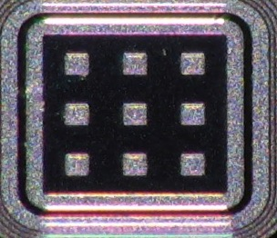
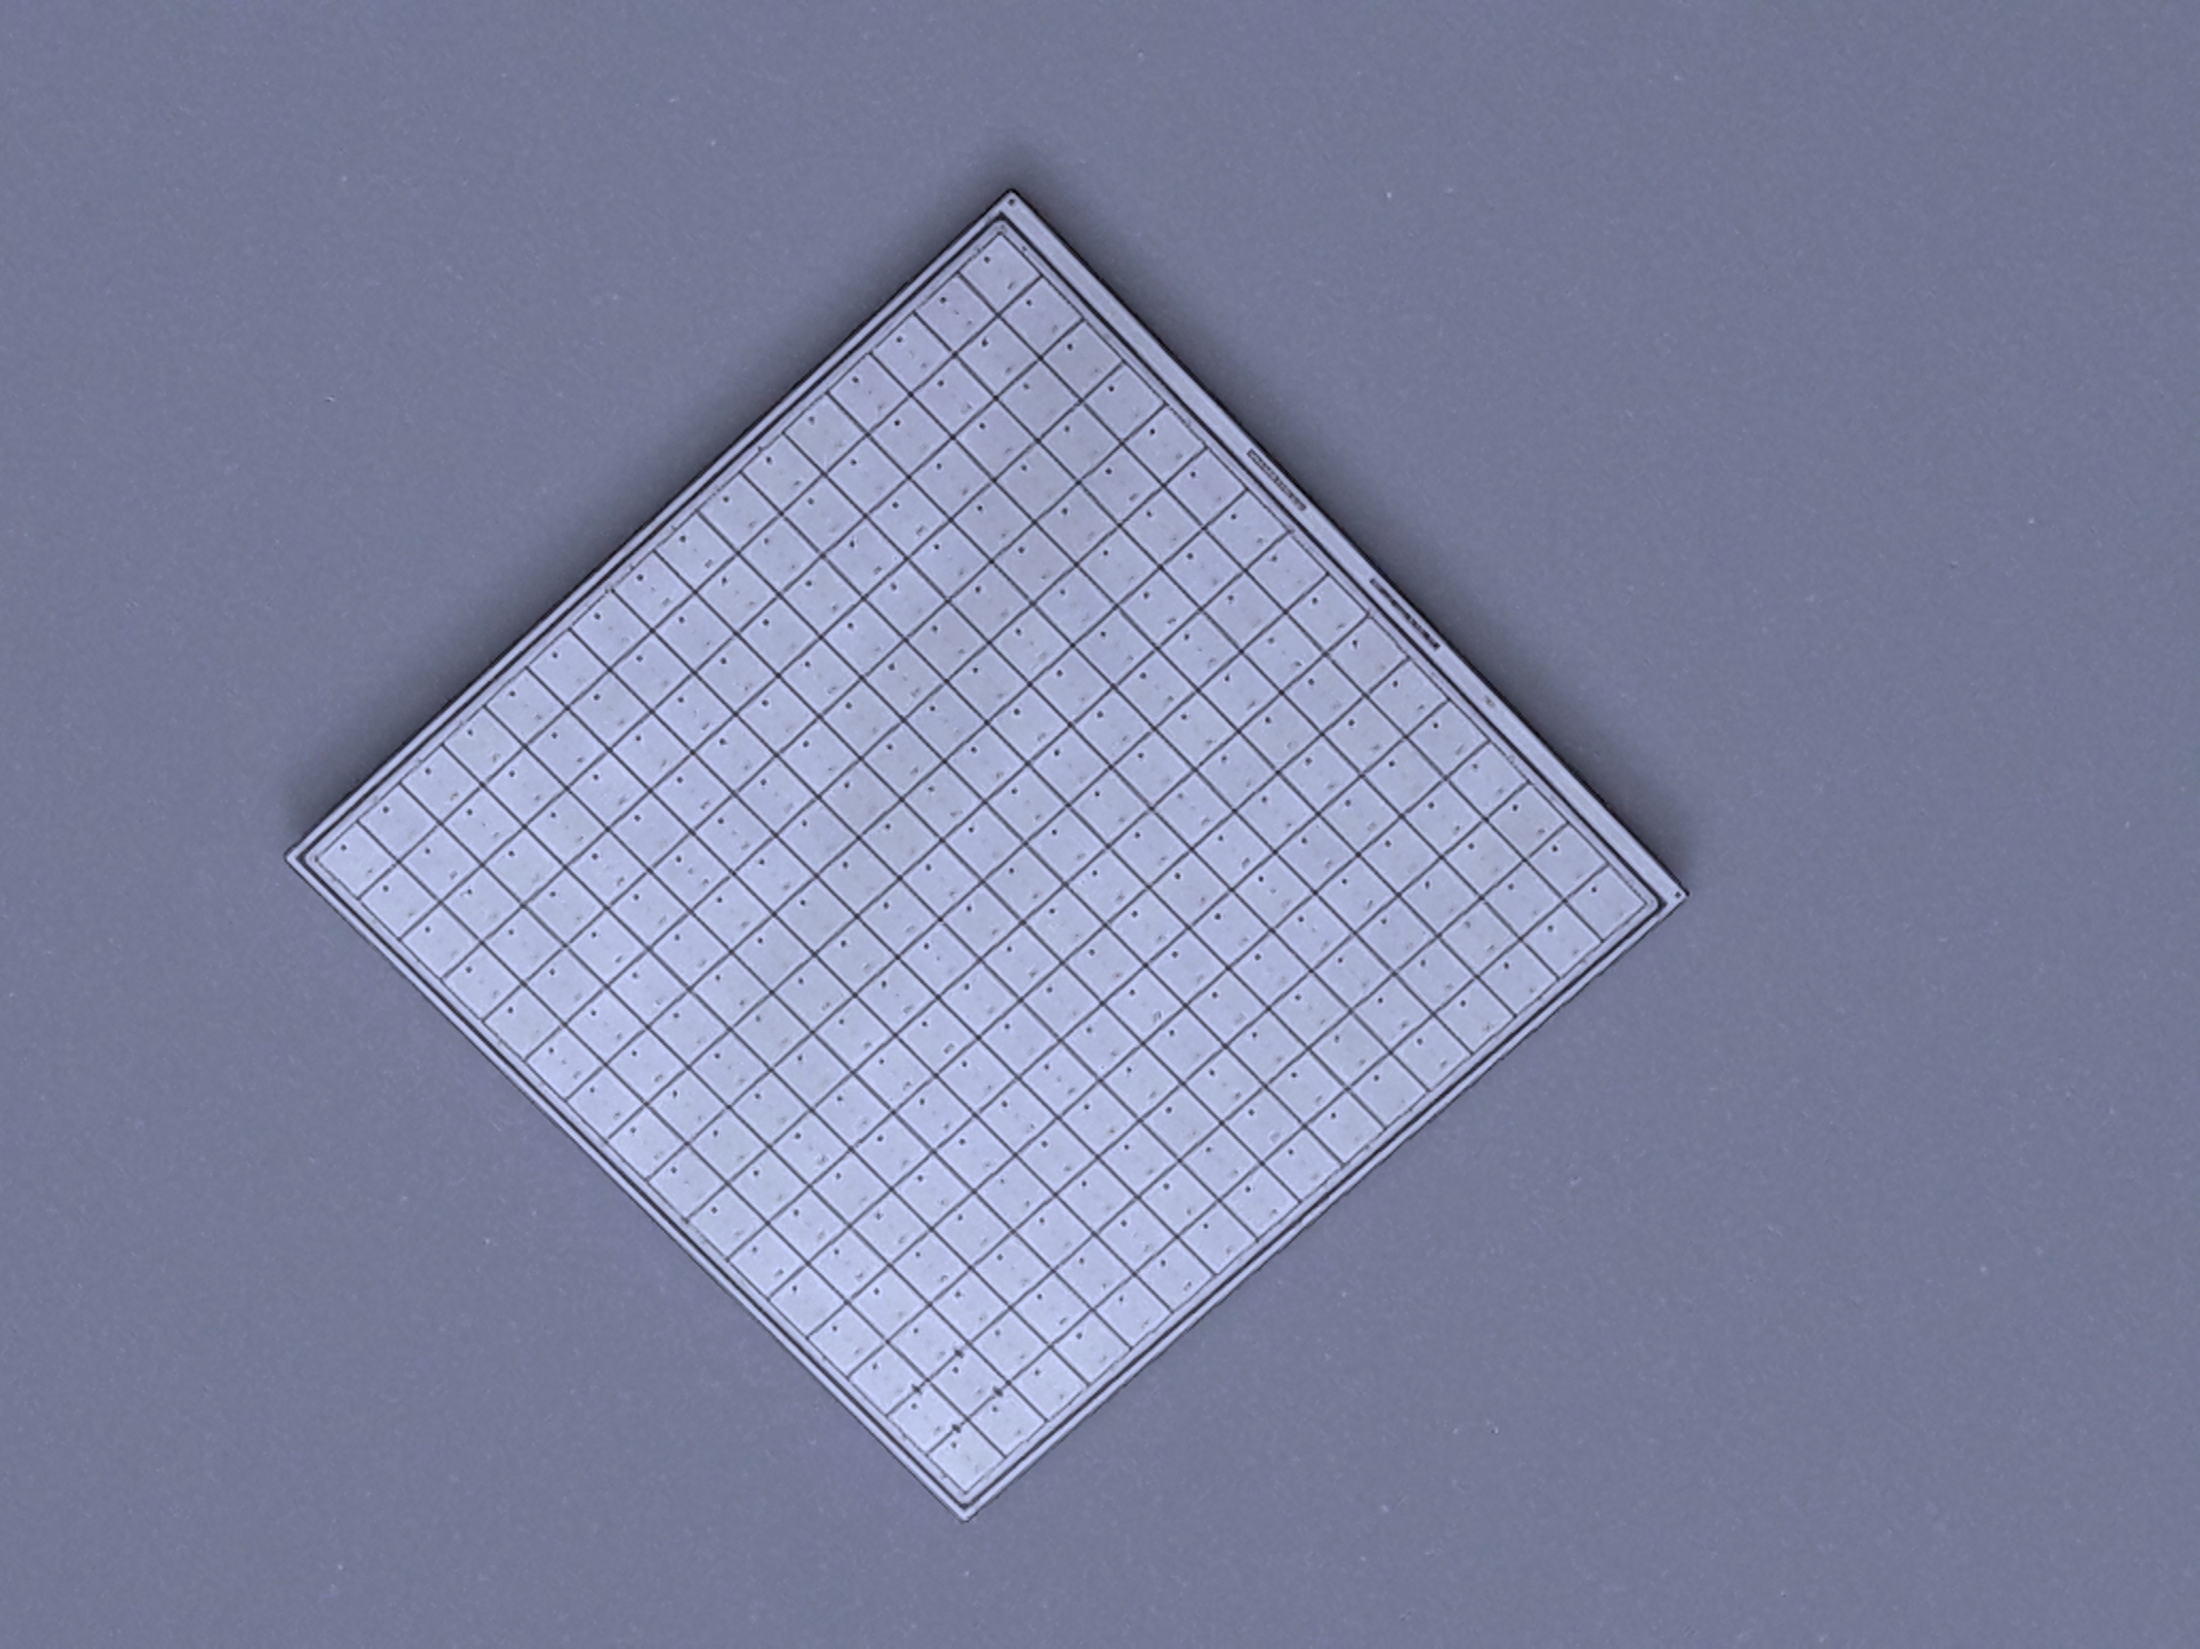
UFSD Summary: more gaining and more sharing
Physicist
No gain area ~ 50 um
No gain area ~ 5 um
JTE + p-stop design Trench-isolated design RSD -- AC-LGAD
JTE/p-stop UFSD
CMS && ATLAS choice
Signal in a single pixel
Not 100% fill factor
Very well tested
High Occupancy OK
Rate ~ 50-100 MHz
Rad hardness ~ 2-3E15 n/cm2
UFSD evolution: use trenches
Signal in a single pixel
Almost 100% fill factor
Temporal resolution (50 μm) : 35-40 ps
High Occupancy OK
Rate ~ 50-100 MHz
Rad hardness: to be studied
RSD evolution: resistive readout
Signal in many pixels
100% fill factor
Excellent position resolution:
  ~ 5 μm with large pixels
Temporal resolution (50 μm) : 35-40 ps
Rate ~ 10-50 MHz
Rad hardness: to be studied
2.1 cm
HPK2
16x16 array

Slide 14
Outlook
Silicon detectors, thanks to internal gain and resistive readout, are offering unprecendented combinations of
temporal resolution && spatial resolution && low mass && large pixels
Personal point of view: in this moment, sensors are ahead of readout.
The design of the ASICs to read-out the sensors is complex (~ 5 years)
The R&D path is very open, a strong project can define the future evolution of silicon detectors.
The R&D offers a unique combination of sensors’ development and ASIC designs in the very new 4D tracking field (not yet charted).

Slide 15
It takes a village
Very special thanks to the UFSD group, for enduring endless weeks of measurements in the lab and many many meetings
R. Arcidiacono^{ab} , G-F Dalla Betta^{ae}, G. Borghi^{fa}, M. Boscardin^{fa}, M. Costa^{ac}, F. Fausti^{ac}, F. Ficorella^{fa}, M. Ferrero^{ab}, M. Mandurrinoª, J. Olaveª, L. Pancheri^{ae}, F. Sivieroª, V. Solaª, M. Tornago^{ac,} ,G. Paternoster^{f}, H. Sadrozinski^{d}, A. Seiden^{d,} M. Centis Vignali^{fa}
ª INFN, ^{b} Università del Piemonte Orientale, ^{c} Università di Torino,
^{d} University of California, Santa Cruz , ^{e} Università di Trento, ^{f} FBK
Fermilab beam test team: A. Apreysan, R. Heller, K. Di Petrillo, S. Los.

Slide 16
Bibliography
[1] N. Cartiglia, Tredi 2015,”Topics in LGAD Design” https://indico.cern.ch/event/351695/contributions/828366/attachments/695875/955507/TREDI_Cartiglia.pdf
[2] M. Mandurrino et al., "Demonstration of 200-, 100-, and 50- micron Pitch Resistive AC-Coupled Silicon Detectors (RSD) With 100% Fill-Factor for 4D Particle Tracking," in IEEE Electron Device Letters, vol. 40, no. 11, pp. 1780-1783, Nov. 2019.
[3] M. Mandurrino et al. ”Analysis and numerical design of Resistive AC-Coupled Silicon Detectors (RSD) for 4D particle tracking” https://doi.org/10.1016/j.nima.2020.163479
[4] H. Sadrozinski, HSTD11, “Time resolution of Ultra-Fast Silicon Detectors”, https://indico.cern.ch/event/577879/contributions/2740418/attachments/1575077/2487327/HSTD1--HFWS1.pdf
[5] G. Giacomini, W. Chen, G. D’Amen, A. Tricoli, Fabrication and performance of AC-coupled LGADs, JINST 14 (09) (2019)
[6] M. Tornago et al, “First combined laser and beam test analysis of Resistive AC-coupled LGAD”, paper in preparation
[7] F. Siviero et al, “Application of machine learning algorithms to the position reconstruction of Resistive Silicon Detectors”, paper in preparation
[8] A. Apresyan, “Measurements of an AC-LGAD strip sensor with a 120 GeV proton beam”, https://arxiv.org/abs/2006.01999

