Slide 1
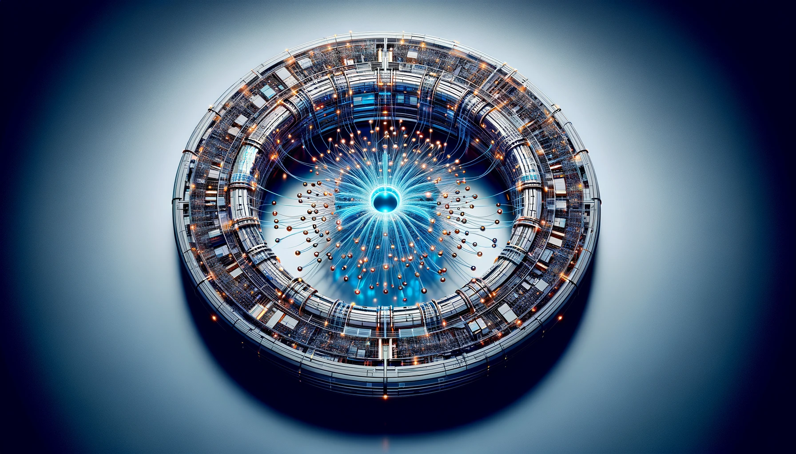






Active deep learning for single-particle beam dynamics studies
D. Di Croce², M. GiOVANNOZZI¹, G. IaDAROLA¹, E. Krymova⁴, T. Pieloni², S. Radaelli¹, M. SEIDEL^{2,4}, F. F. Van der Veken¹
¹CERN, ²EPFL, ³PSI, ⁴SDSC
9th Low Emittance Rings Workshop – 19th June 2024, UNIGE - Geneva
CHIPP 2024 ANNUAL MEETING
This work was carried out under the auspices and with the support of the Swiss Accelerator Research and Technology programme (CHART) and the Swiss Data Science Centre (SDSC)

Slide 2
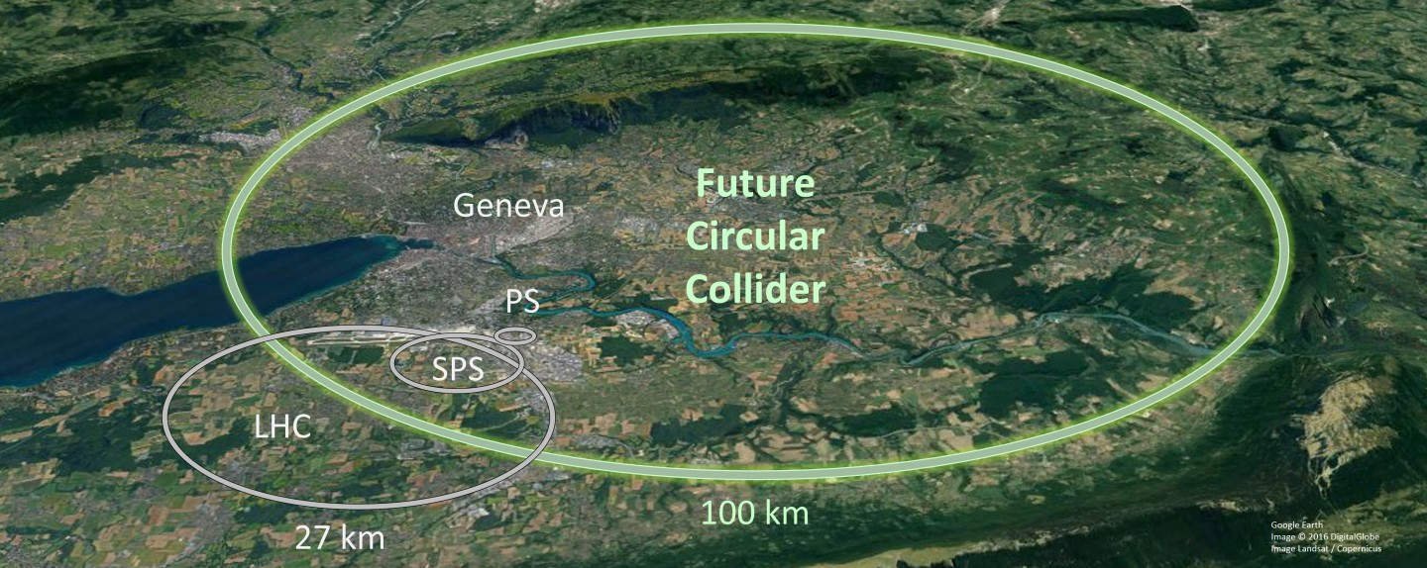
Machine LEARNING 4 FUTURE CIRCULAR COLLIDER
The ML4FCC project is a collaboration between EPFL, CERN, and The Swiss Data Center (SDSC):
https://www.epfl.ch/labs/lpap/machine-learning-applied-to-accelerators/
Our focus is on applying Machine Learning techniques to improve the understanding of Beam Dynamics in various accelerator setups.
Currently, developing tools and benchmarking models on an existing accelerator (LHC) to demonstrate the ML effectiveness before moving to the design of a future, large accelerator (FCC).
For the case of lepton accelerators, additional effects (e.g. synchrotron radiation) should be included.

Slide 3
Machine LEARNING 4 FUTURE CIRCULAR COLLIDER
Extracting Physics-Relevant Features with ML: Identify key features for predicting beam loss from accelerator variables: betatron tunes, chromaticities, octupole strength, realization of magnet errors, phase advance, crossing angles and separation, beam energy, emittance, bunch intensity, anharmonicities and more.
Ultra-Fast Simulations: ML enables rapid and efficient simulations, significantly accelerating the exploration of machine configurations for the optimization of current machines and the design of future accelerators as FCC.
Knowledge Preservation: models capture and store physics knowledge, reducing the need for numerical simulations to acquire the same physics insights.

Slide 4
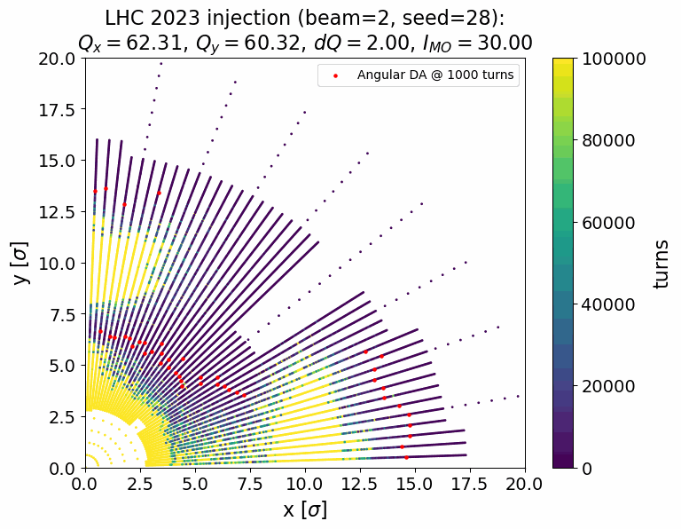
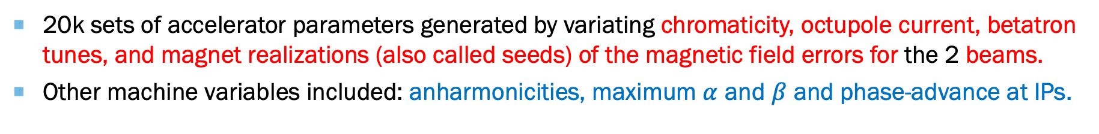

Deep Learning FOR Dynamic Aperture
The Dynamic Aperture (DA) is defined as the extent of the connected phase-space region within which the dynamics of a single particle remains bounded in circular accelerators
DA is important to assess linear and non-linear optics, lattice imperfections, beam-beam, e-cloud, and incoherent effects!
The dataset is based on simulation (MADX) and tracking (Xsuite) on LHC.
Tracked the particles distributed in polar coordinates (44 angles and 0.06 $σ$ radial steps) for every machine configuration.
Goal is to regress the evolution of the stable region (angular DA) in 12 different number of turns (up to ${10}^{5}$ turns) [Red points].
20k sets of accelerator parameters generated by variating chromaticity, octupole current, betatron tunes, and magnet realizations (also called seeds) of the magnetic field errors for the 2 beams.
Other machine variables included: anharmonicities, maximum $α$ and $β$ and phase-advance at IPs.

Slide 5
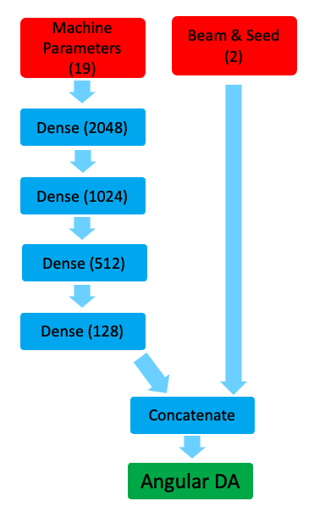
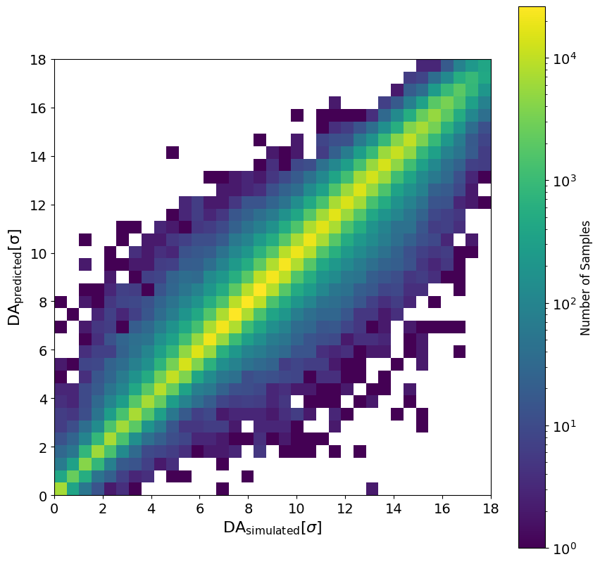

Deep Learning FOR Dynamic Aperture
Multilayer Perceptron with 4 hidden layers with ReLU and 5% dropout.
Trained with Reduce on Plateau for learning rate scheduler, NADAM optimizer and Mean Absolute Error (MAE) as Loss Function.
Test MAE = 0.34 beam $σ$ and MAPE = 11.91 %.
Inference of a single machine in 0.5 ms (~1 $μ$s/angular DA prediction)
Dense (128)

Slide 6
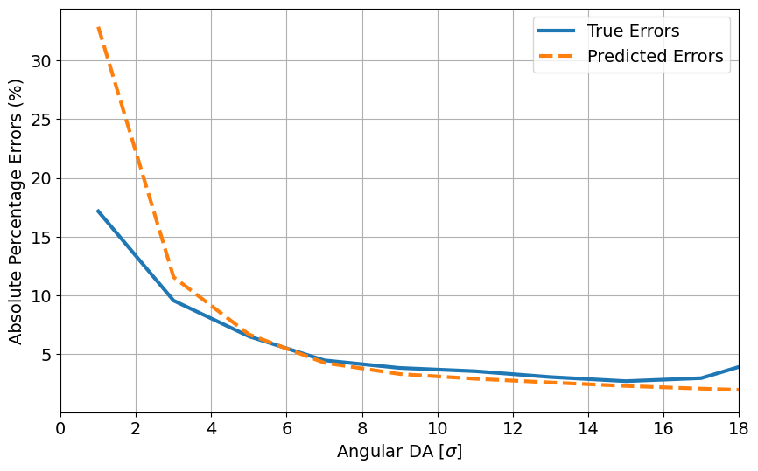
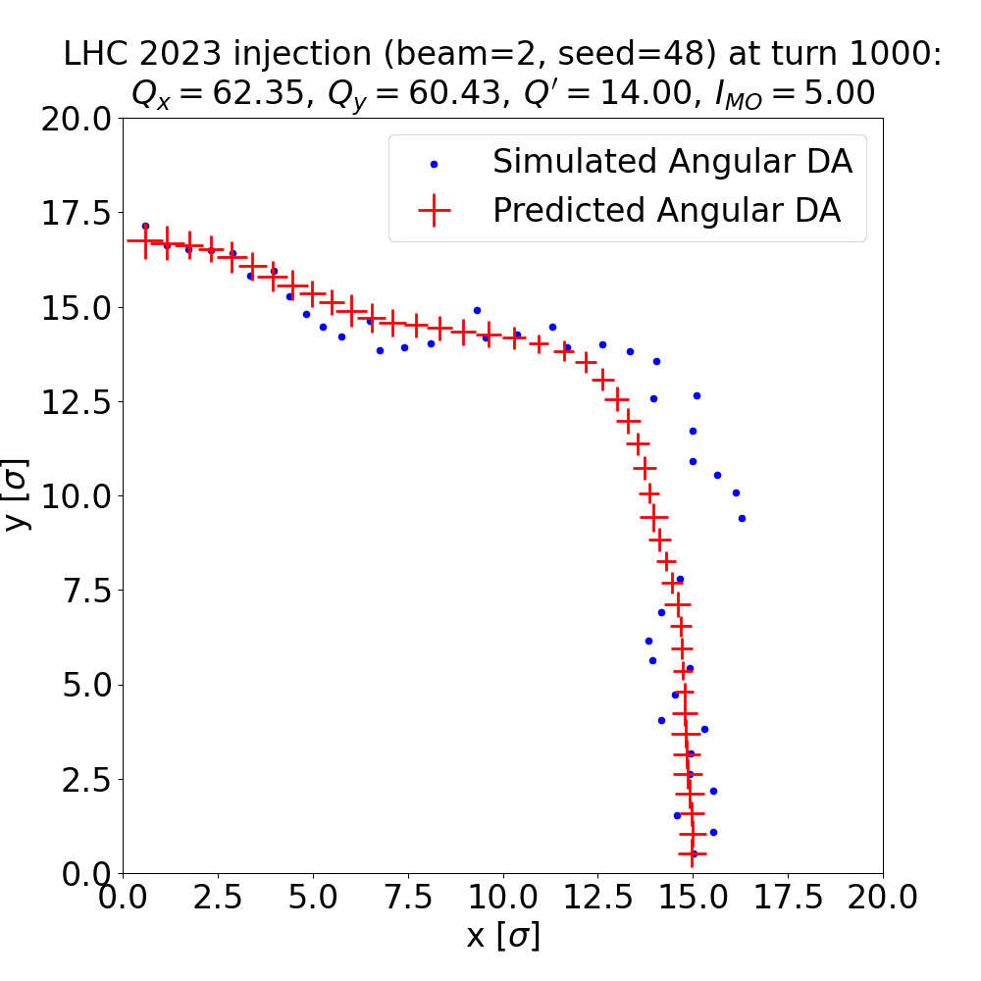
Estimating the prediction ERROR
By leveraging dropout at inference time, we introduce diversity among the predictions (different angular DAs every time). This technique is known as Monte Carlo (MC) dropout.
The variation in these predictions are utilized to estimate uncertainty: dropout at 1% between the first hidden layers and 1 std of 128 variations as error.
DA and error prediction (129 inferences) in
0.75 s/machine configuration.
Tracking on Xsuite takes 147s/machine configurations (using HT-Condor). Our model, once trained, is approximately 200 times faster!
Simulation | 10k configs | 15k configs
MADX + Xsuite * | 425 h | 612 h
DA Regressor ** | 126h (3.4x faster) | 136h (4.5x faster)
*MADX and Xsuite simulations with HT-Condor (1000 simultaneous jobs)
**Including the simulation time of an initial dataset of 5k and training time

Slide 7
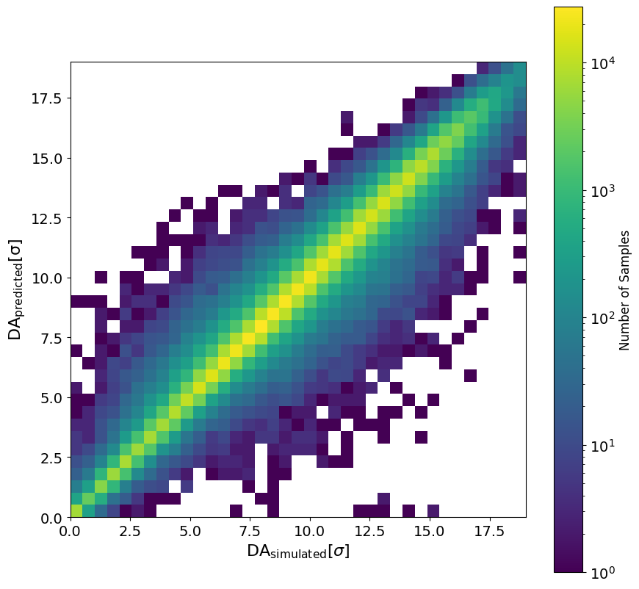
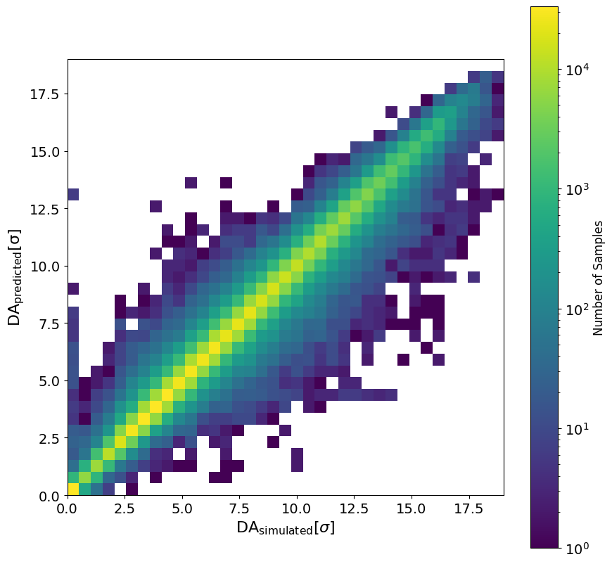


adaptability to different optics configurations
We want to ensure that the model can adapt to different optics configurations, which is a key advantage, especially in scenarios where the optics are unknown to the model like in designing a new accelerator.
We included merely 1k configurations from 2016 optics (which can be simulated in 5 days) in conjunction with the 20k from 2023, enabling the model to become predictive for 2016 as well.
Learning solely from physics variables reduces the need for extensive retraining and provides adaptability to new optics.
2023: Test MAE=0.33 $σ$
2016: Test MAE=0.26 $σ$

Slide 8
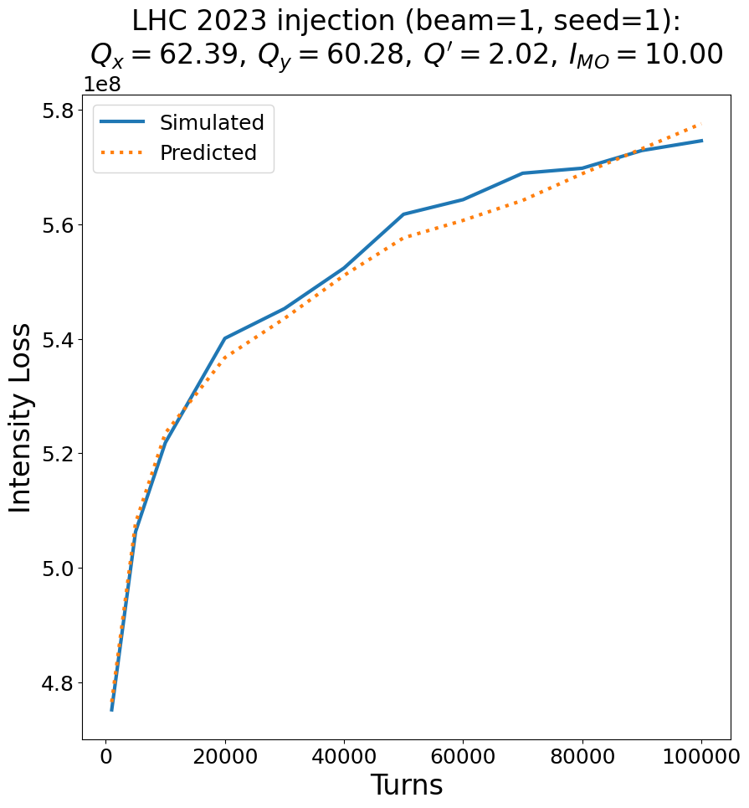
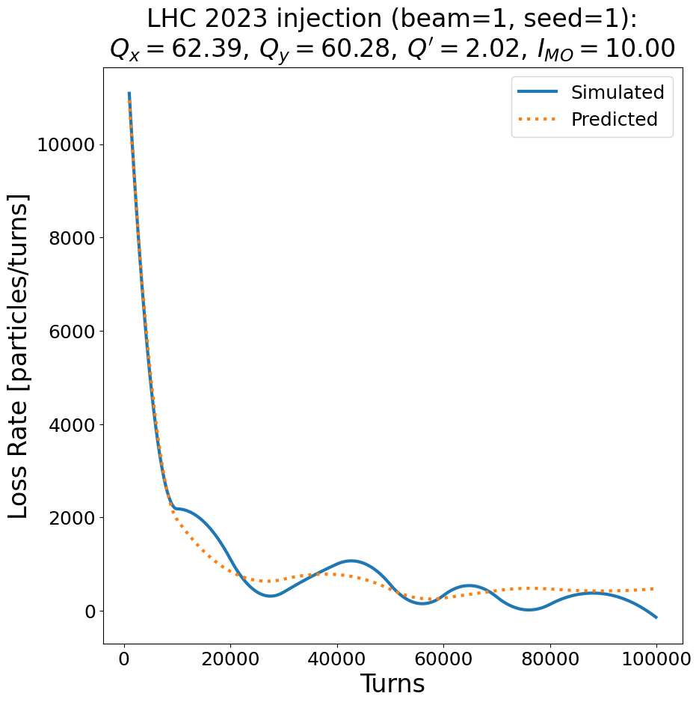

Prediction of real observables
Another crucial aspect is the capability to link simulations with real observables, such as loss rates, to enhance the practicality and reliability of our models.
We combined theoretical calculations of beam intensity into our ML models. The theoretical Intensity loss for a gaussian distribution considering their angles:
  $$ℒ=N_{P}\left(1−4\int_{0}^{\frac{π}{2}}{\int_{0}^{DA_{θ}}{r^{3}e^{−r^{2}}\sin{θ}\cos{θ}dr dθ}} \right)$$
Loss rates estimated by computing the derivate of the intensity loss.
This month we performed an 8h MD to measure LHC intensity loss for several machine configurations to compare with the predicted ones.

Slide 9
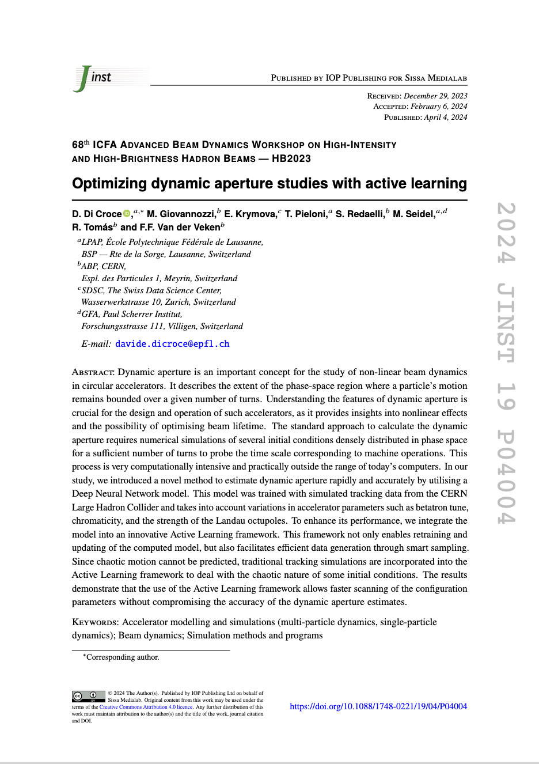
ACTIVE LEARNING FRAMEWORK
We integrated the DNN model alongside its error estimator into an innovative Active Learning (AL) framework.
AL framework also enables smart sampling of simulations: by prioritising predictions with higher errors, it efficiently determines the sequence in which to simulate new machine configurations.
MAD-X
Lattices
XSuite
DA data
DA training
Configurations
Lattices
NEW configurations
DA + error
Estimation
MODEL
ML variabbles
Synthetic
DOI 10.1088/1748-0221/19/04/P04004
Interface with tracking tools is crucial for assessing chaotic dynamics whenever the estimate errors are significant

Slide 10
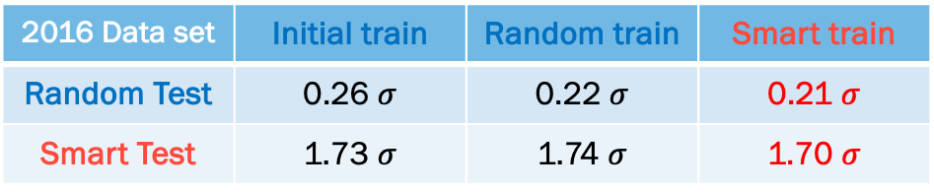
ACTIVE LEARNING FRAMEWORK
To test the effectiveness of smart sampling, we compared the performance of the model when trained with two different data sets: random search of machine configuration input and with the AL framework.
MAD-X
Lattices
XSuite
DA data
DA training
Configurations
2016 Data set | Initial train | Random train | Smart train
Random Test | 0.26 $σ$ | 0.22 $σ$ | 0.21 $σ$
Smart Test | 1.73 $σ$ | 1.74 $σ$ | 1.70 $σ$
Lattices
NEW configurations
DA + error
Estimation
MODEL
ML variabbles
Improvement in setups with challenging predictions
Synthetic
The AL framework allows to explore machine configurations more efficiently where the model has not yet learnt the features of the underlying physics.
By adding 1000 synthetic machine configurations (predicted errors < 0.1 beam 𝜎), MAE improved to 0.20 beam 𝜎
MAD-X
Lattices
XSuite
DA data
DA training
Configurations
Ability to refine the model’s prediction while waiting for the acquisition of new simulated data.
Lattices
NEW configurations
DA + error
Estimation
MODEL
ML variabbles
Synthetic

Slide 11
Conclusion
Improving beam dynamics simulations with ML for optimization and design of accelerators:
  Faster simulations and good predictions within uncertainty.
  Models based on physics variables offer adaptability across various optics setups, a crucial advantage when dealing with unknown optics, such as in accelerator design.
  Incorporating accelerator tools like MAD-X and Xsuite empowers models to learn physics and enhances the tools themselves.
  Active Learning to efficiently generate datasets containing relevant physics.
  Preserving accelerator knowledge, eliminating the need for redundant simulations.

Slide 12
MERCI !
Thank you !

