Slide 1
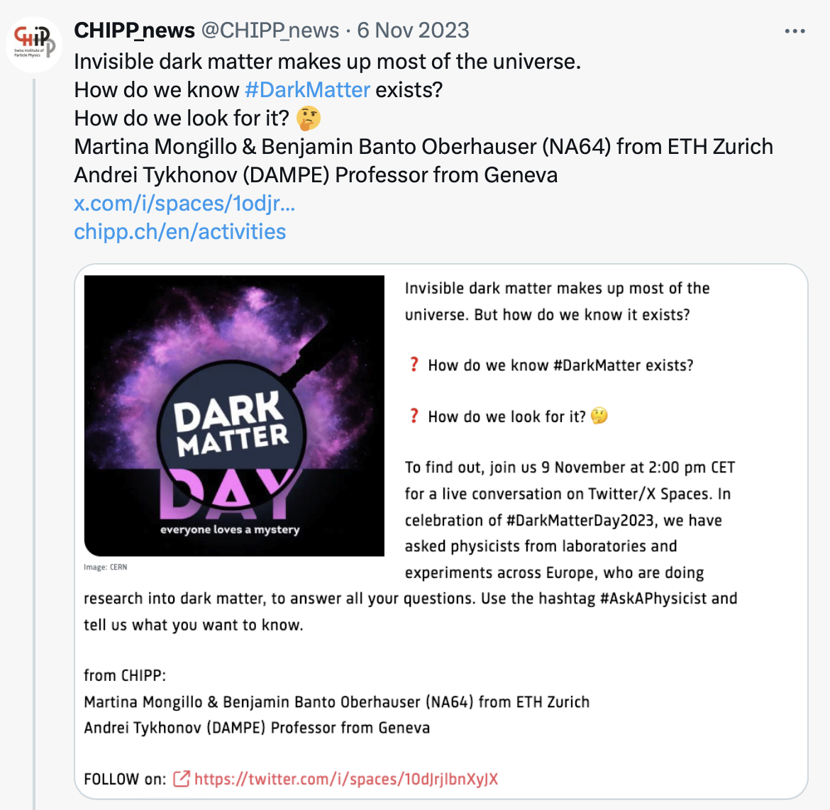
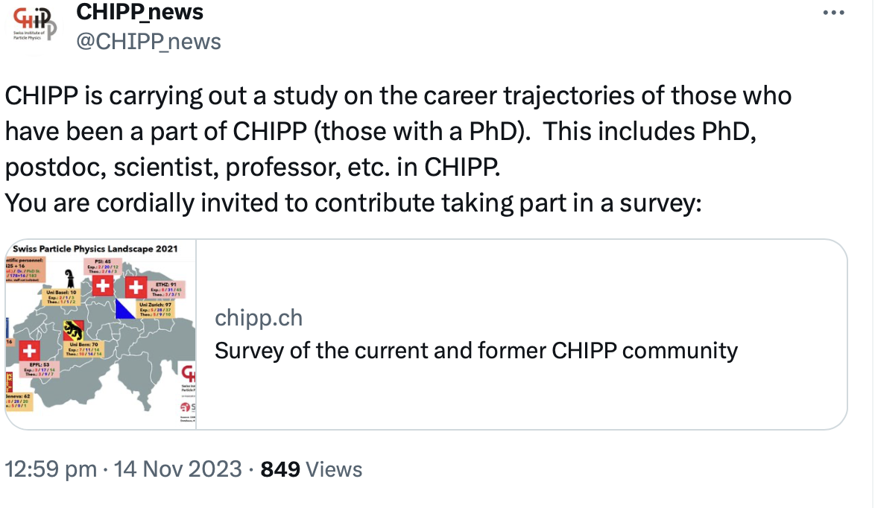
EPPCN updates
Dark Matter Day 31 October -> very successful campaign with CERN and the network
more than 100K visualisation on Twitter/X
Now:
2025/26 European Strategy for Particle Physics Update
FCC project – outreach campaign

Slide 2
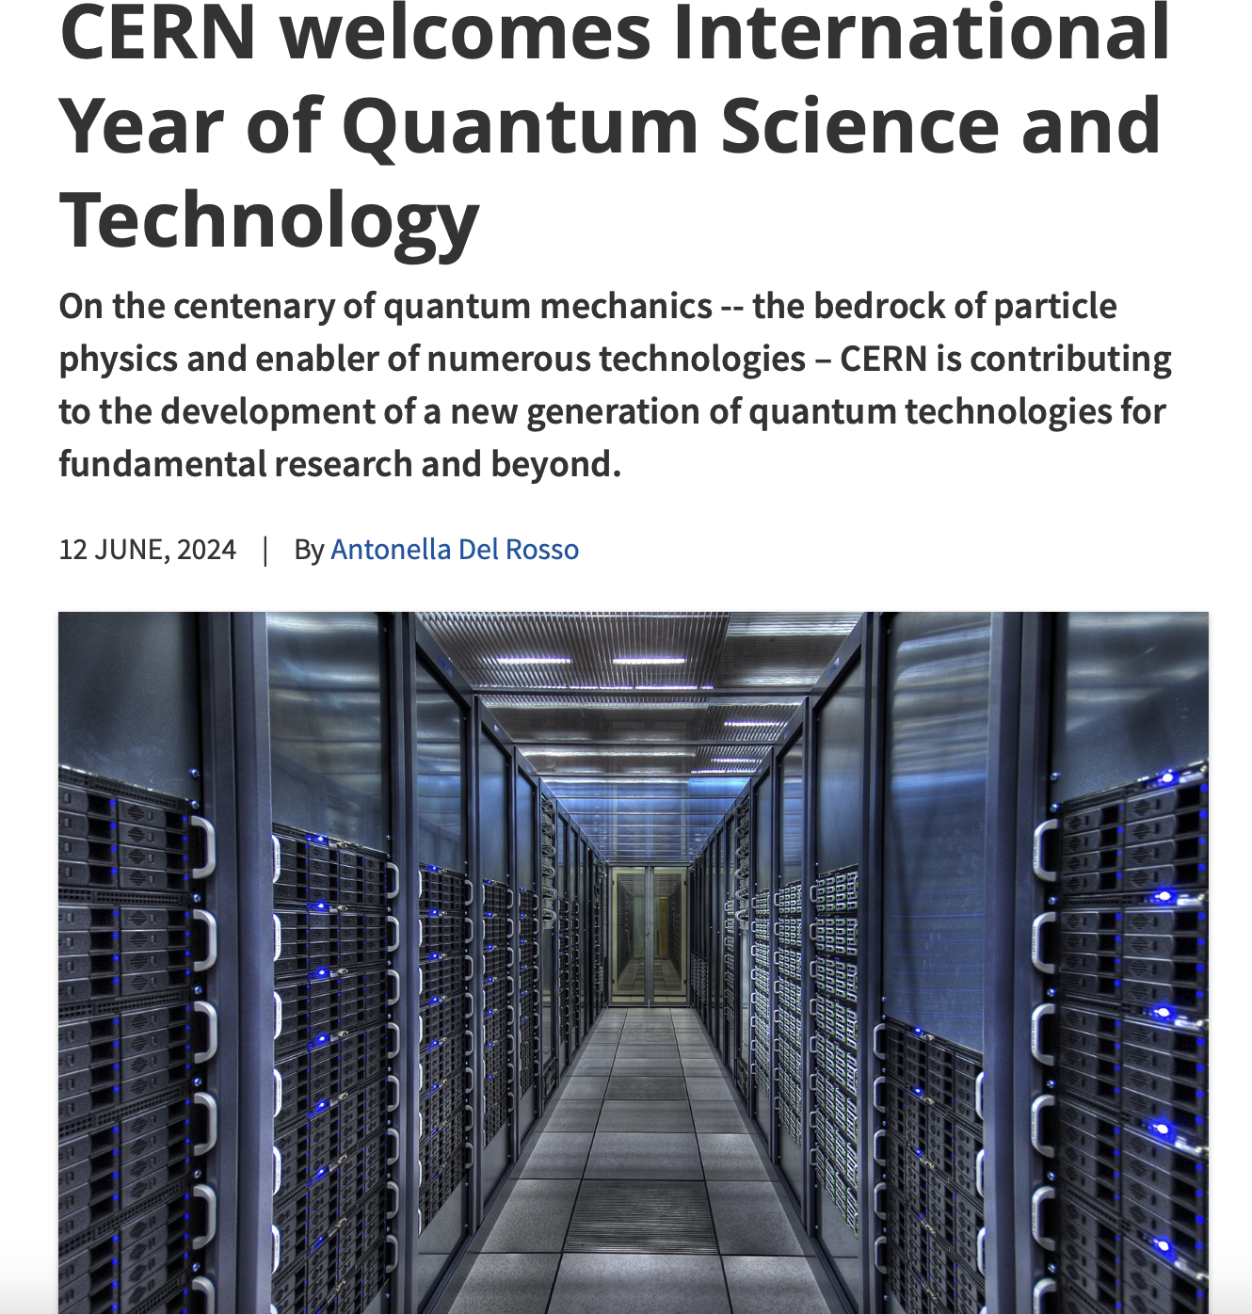
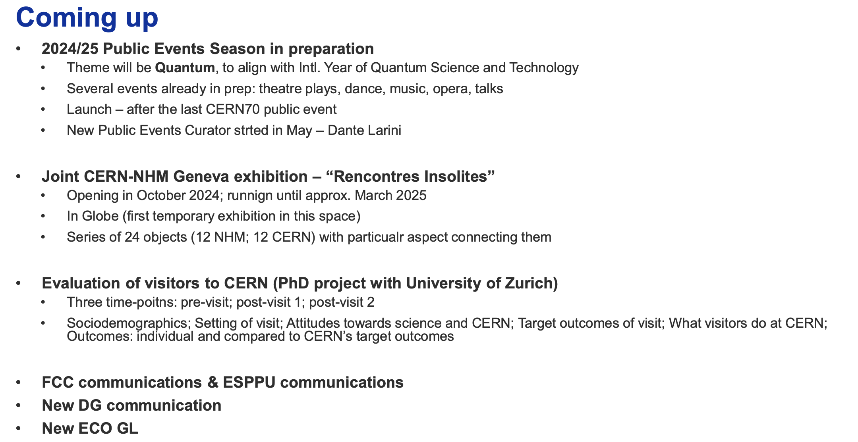
Future plans & campaigns
Naturhistorisches Museum (NHM) Vienna

