Slide 1

Computing report
Mauro Donegà
20 June 2024
meeting name date

Slide 2
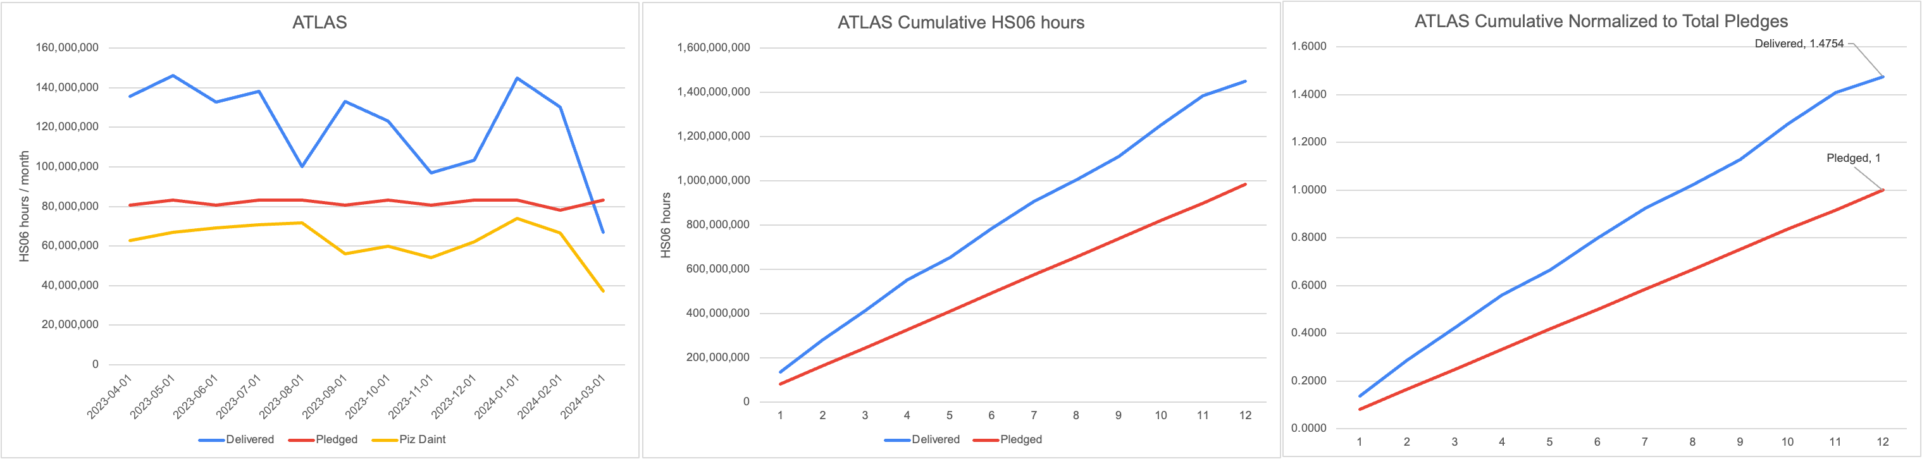
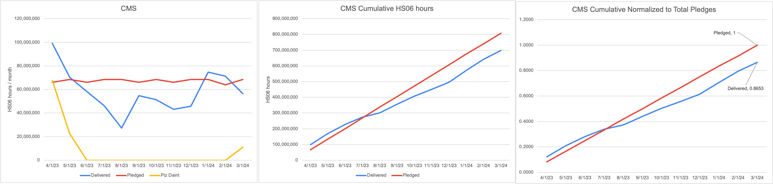
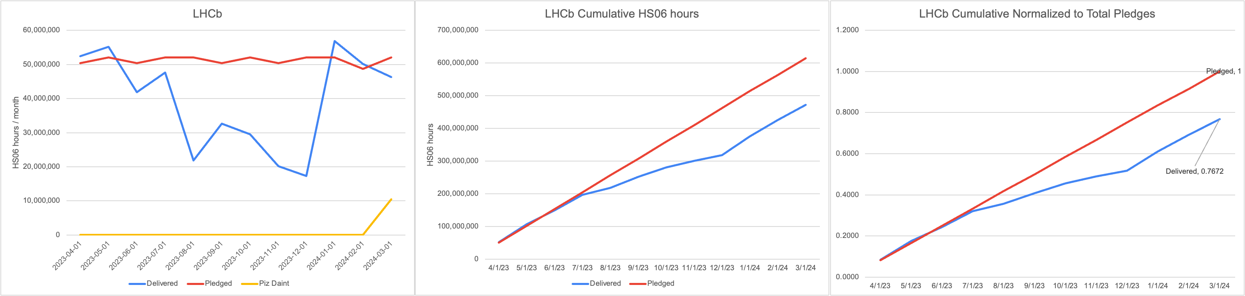
April 2023 - March 2024
Notes:
ASCR = advanced Scientific Computing Research

Slide 3
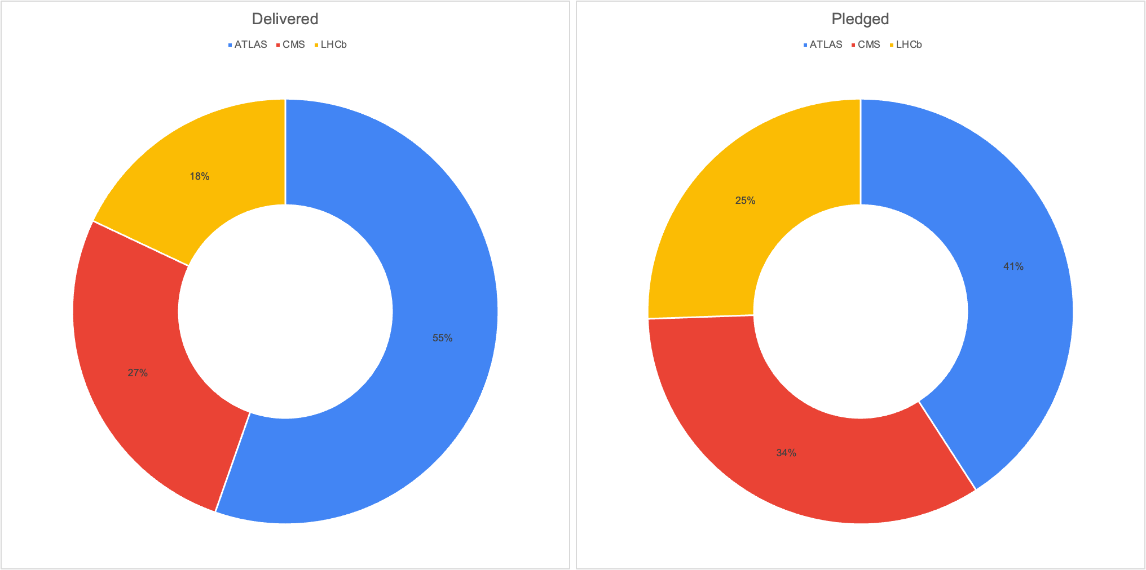
April 2023 - March 2024
Notes:
ASCR = advanced Scientific Computing Research

Slide 4
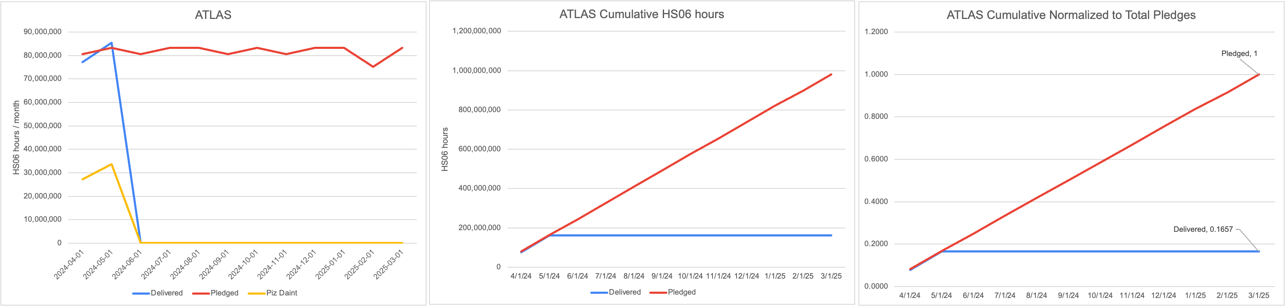
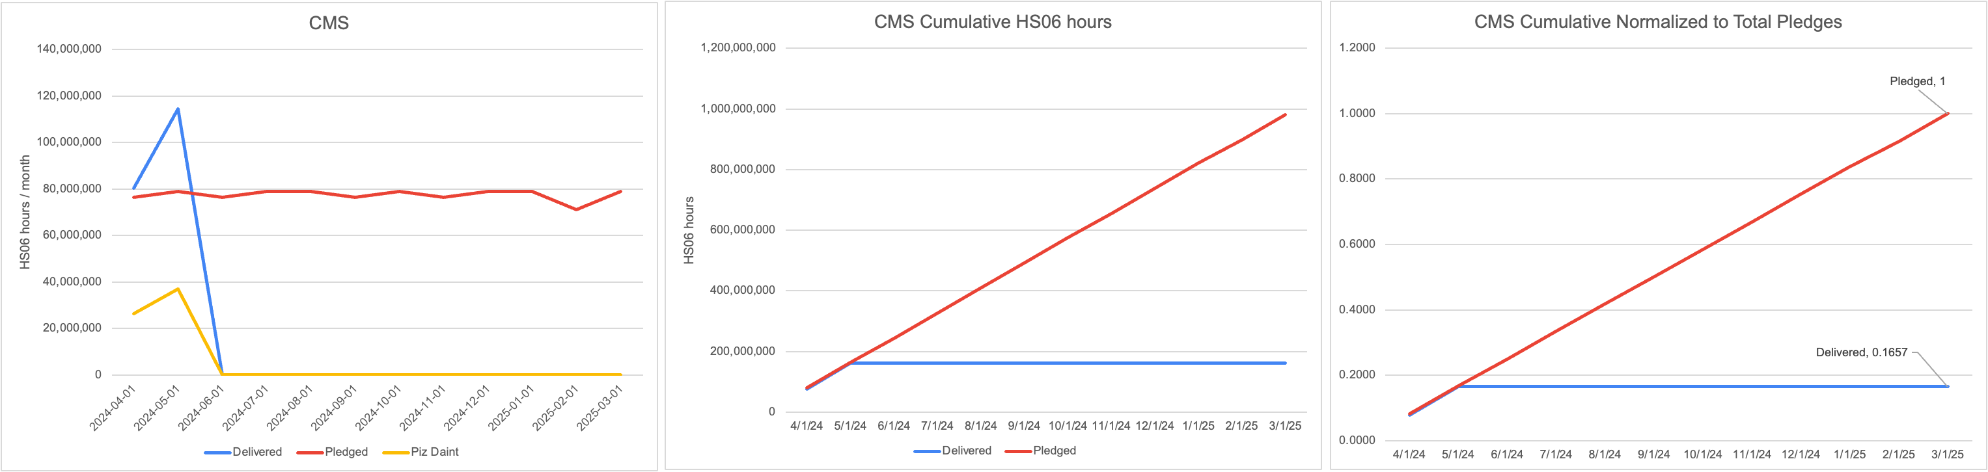
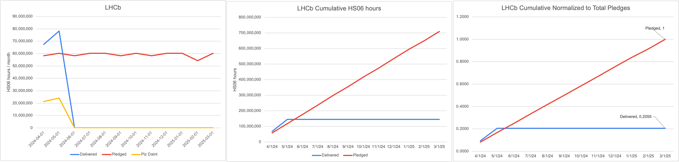
April 2024 - May 2025
Notes:
ASCR = advanced Scientific Computing Research

Slide 5
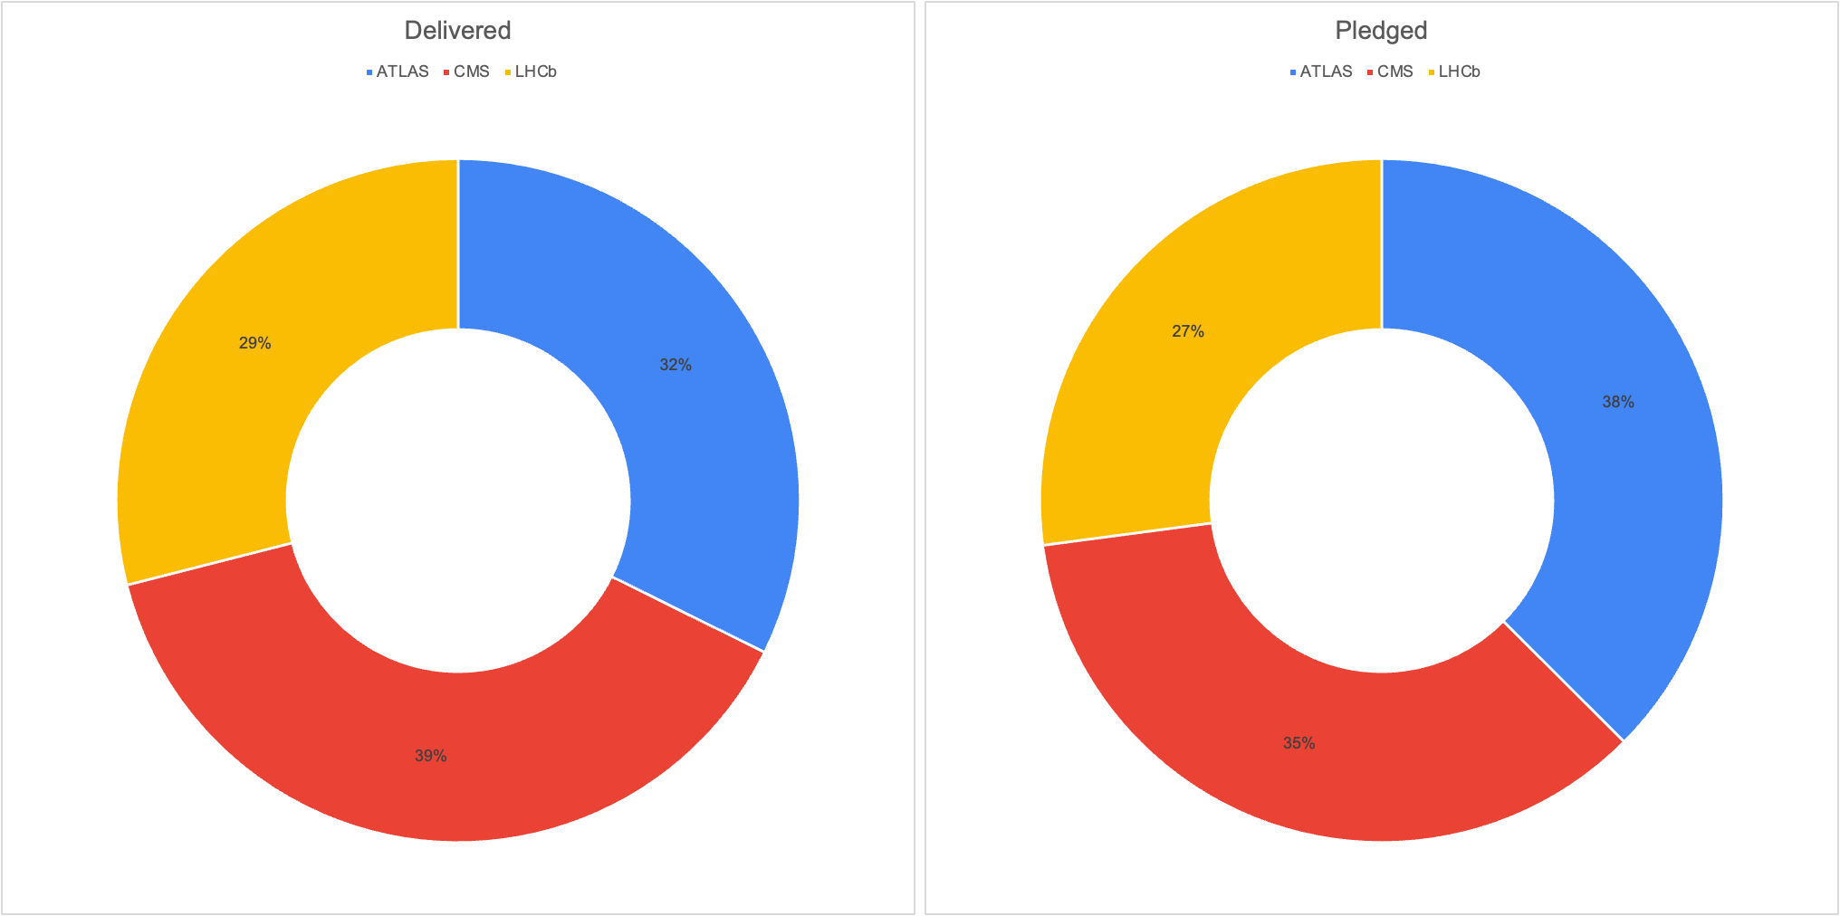
April 2024 - May 2025
Notes:
ASCR = advanced Scientific Computing Research

