Slide 1
Overarching Science Recommandations
- A document with findings on main outcomes of dark matter - multi-messenger astrophysics and scientific overarching recommendations :
The last decade revolutionized astrophysics with multi-messenger probes. A new picture of the galaxy to the highest energies, of magnetic fields in the extragalactic space and regulating powerful accelerators, of the dark matter possible nature, of gravitation in extreme conditions, and of most extreme high-energy relativity laboratories is emerging. Gamma-ray astrophysics offers serendipitous views of acceleration processes, unravels sources not seen in other bands, and will reach the precision era within this decade. Two new messengers, neutrinos and gravitational waves, offer complementary deeper observations of the universe. Serendipitous processes bring together researchers in different observational domains and a variety of data requiring a common platform of analysis, early alert distribution, high-reduction factors, and efficient processing in a sustainable data centre in Switzerland.
2) The search for dark matter is one of the major quests of cosmology and particle physics. Direct detection (DD), together with experiments at colliders, probes de nature of dark matter. DD dark matter detectors have explored a substantial fraction of the weakly interacting DM parameter space and started the exploration of feebly interacting particles and sub-GeV dark matter particles. DM direct detection also has the potential to enter the multi-messenger domain with neutrino detection probing unexplored regions of astrophysical neutrino spectra in the keV domain. Indirect detection with cosmic rays intercepted by space-based facilities, and gamma-ray and neutrino ground-based large observatories. These seek coupling to standard particle signatures and potentially locate dark matter in its sites of the cosmos. Gravitational waves probe further gravitational effects together with astronomical observations and large-scale surveys and have the potential to probe cosmological signatures also related to inflation.

Slide 2
Pillar 3 Update: Findings
  The Swiss community has achieved a mature whitepaper on the scientific interest in CTAO.
  New will be:
  The Swiss community recognises the scientific potential of a ground-based and space-based gravitational wave program overarching the CHIPP theory, experimental and astronomical teams in CHAPS. GWs have revealed an unprecedented scientific potential concerning the exploration of matter in extreme conditions, from the equation of state of neutron stars revealing the quark hadron transition, and the origin of heavy elements on the Earth. The existence of new populations of black holes and the role of primordial black holes for dark matter is a needed exploration that only the gravitational channels can offer. With ET redshifts of more than can be reached making GWs probes of cosmology. Participation in the discoveries of the most violent processes in the universe with multi-messenger will reveal how they work.
  This potential has relevant synergies with new space and established programs (EUCLID, Gaia, large-scale surveys, CTAO and SKAO), overarching CHIPP and CHAPS, and other communities (theory, engineering, computing,...)

Slide 3
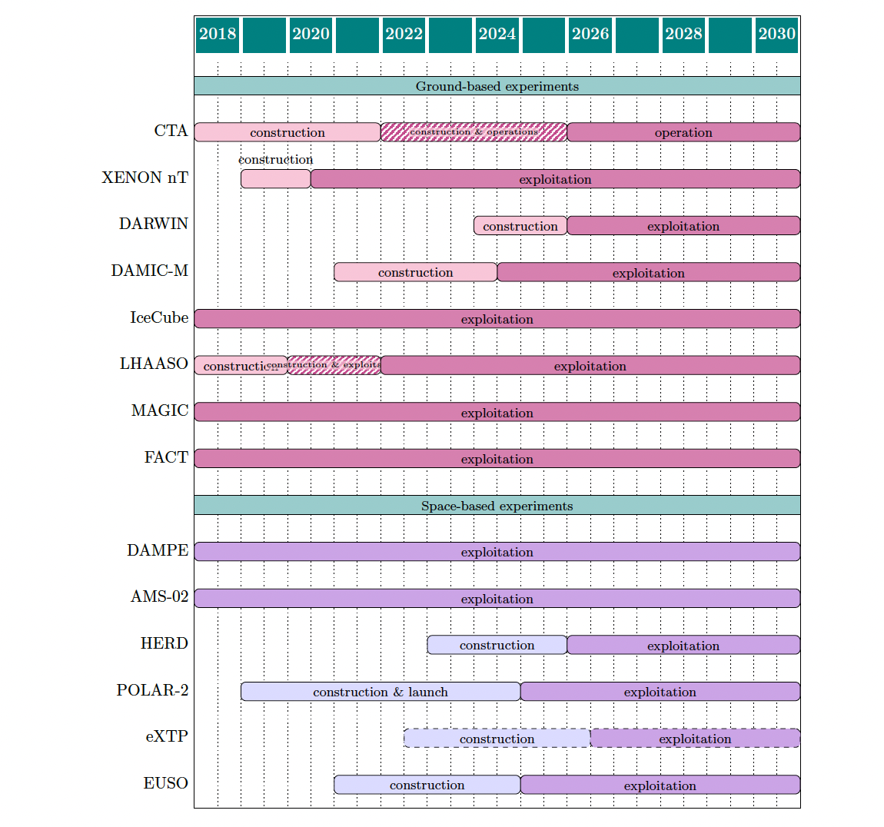
Updated schedule
Operation
Construction
CTAO : ERIC in 2025, construction to 2028-29
XENON/LZ exploitation to 2026-28DARWIN, Space experiments
ET : site selection in 2026, operation in 2035 with LISA
AMS runs with upgrades to 2030, HERD launch 2028
Then a global schedule?
R&D
Construction
OBSCURA?
Upgrade
ET

Slide 4

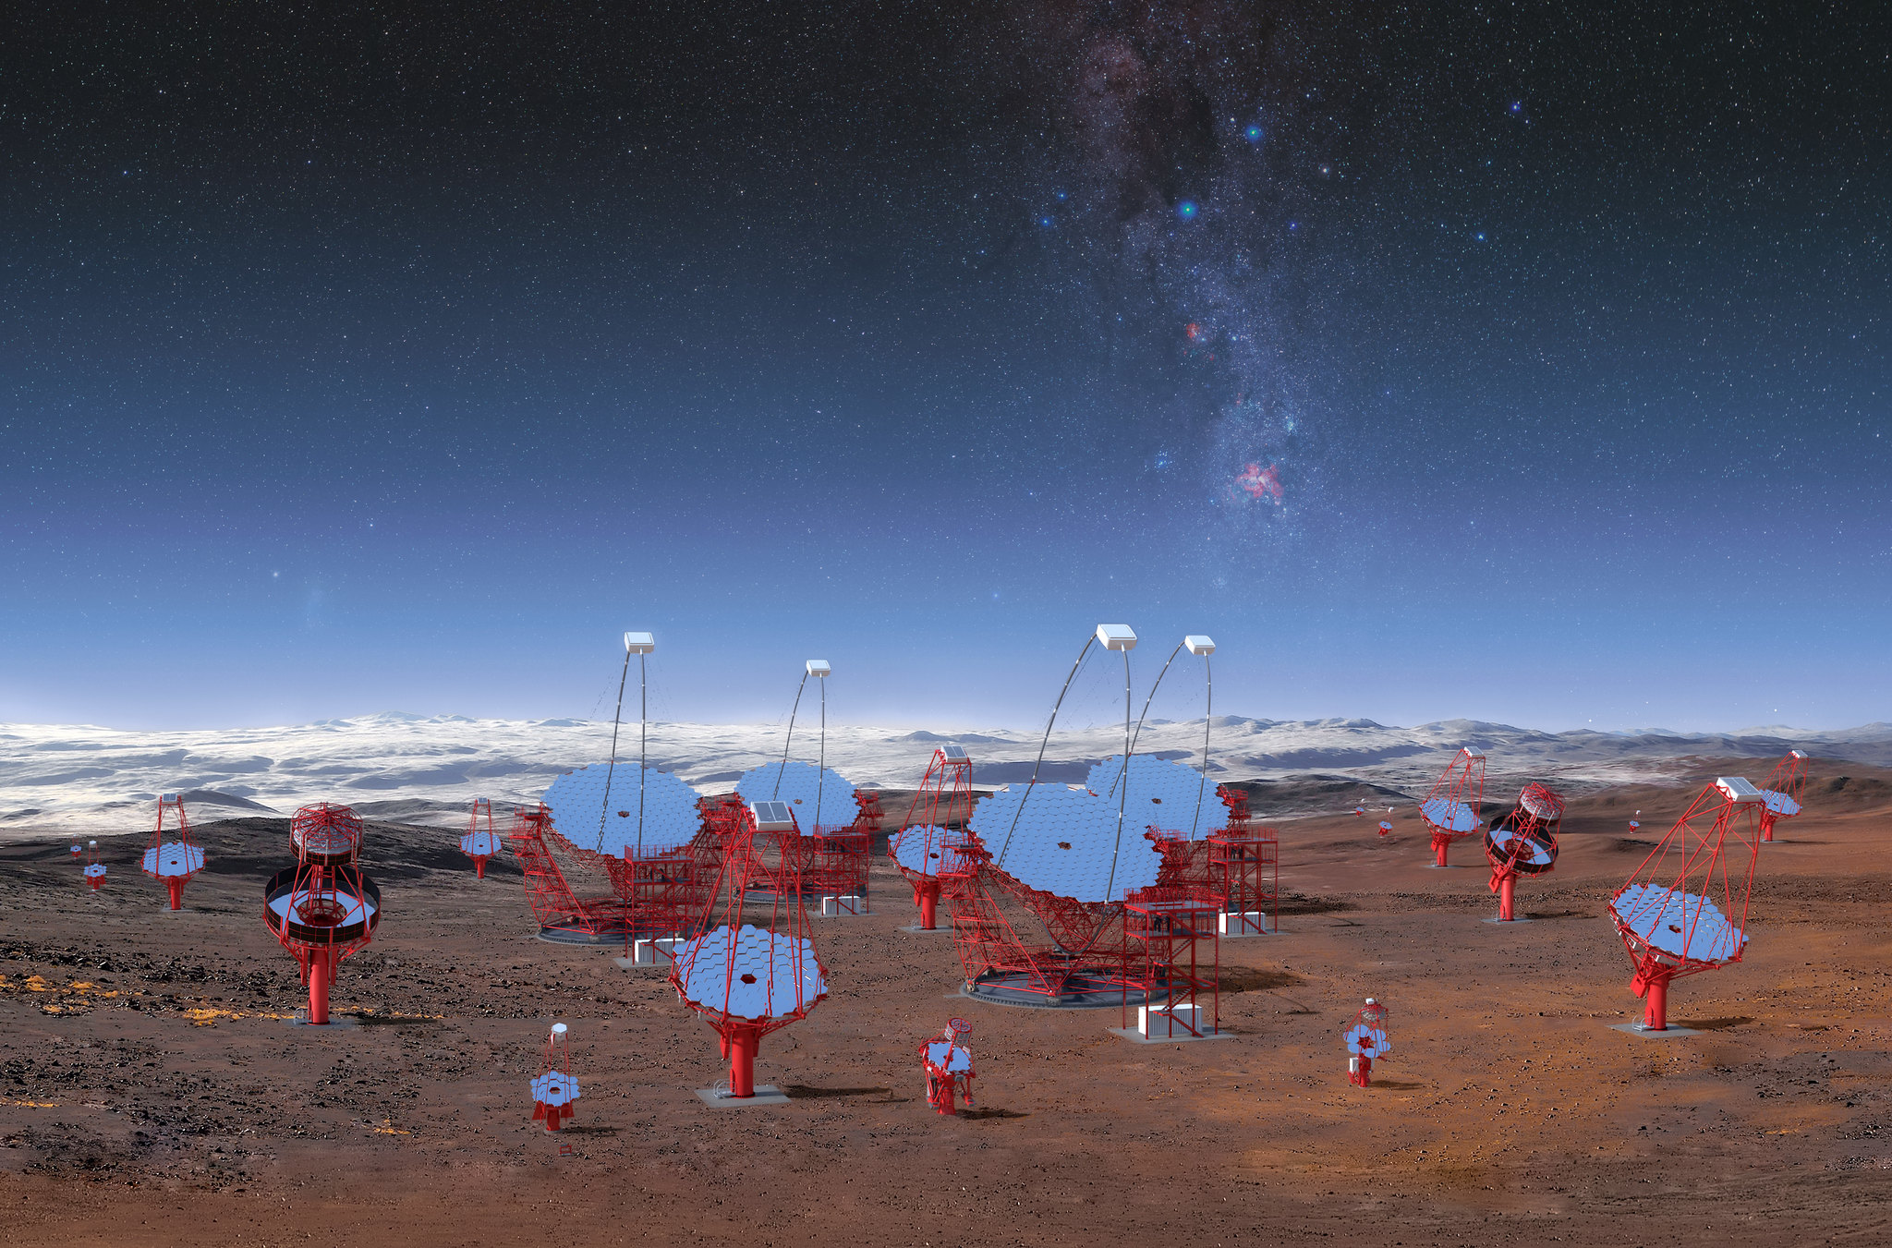


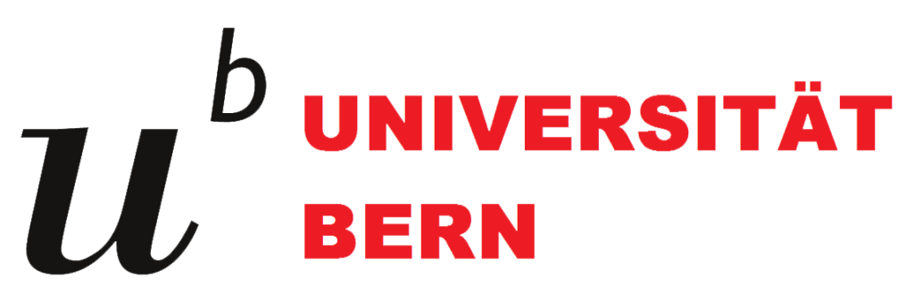
The Cherenkov Telescope Array Observatory (CTAO)
www.cta-observatory.org/
• 5-10 times better sensitivity w.r.t. current generation
• 4 decades of energy coverage: 20 GeV to 300 TeV
• Improved angular and energy resolution
• Two arrays (North/South)
Low-energy range:
23 m ø
Parabolic reflector
4.3° FoV
Sensitivity in 20 GeV-1 TeV
Mid energy-range:
11.5 m ø modified Davies-Cotton
9.7 m ø Schwarzschild-Couder reflector
7.5° - 7.7° FoV
Sensitivity in 150 GeV – 5 TeV
High-energy range:
4.3 m ø Schwarzschild-Couder reflector
10.5° FoV
Several km² area at
multi-TeV energies
CTAO-CH Collaboration is regulated by a collaboration agreement
CH-CTAO Whitepaper
Science with CTA, arXiv:1709.07997

Slide 5
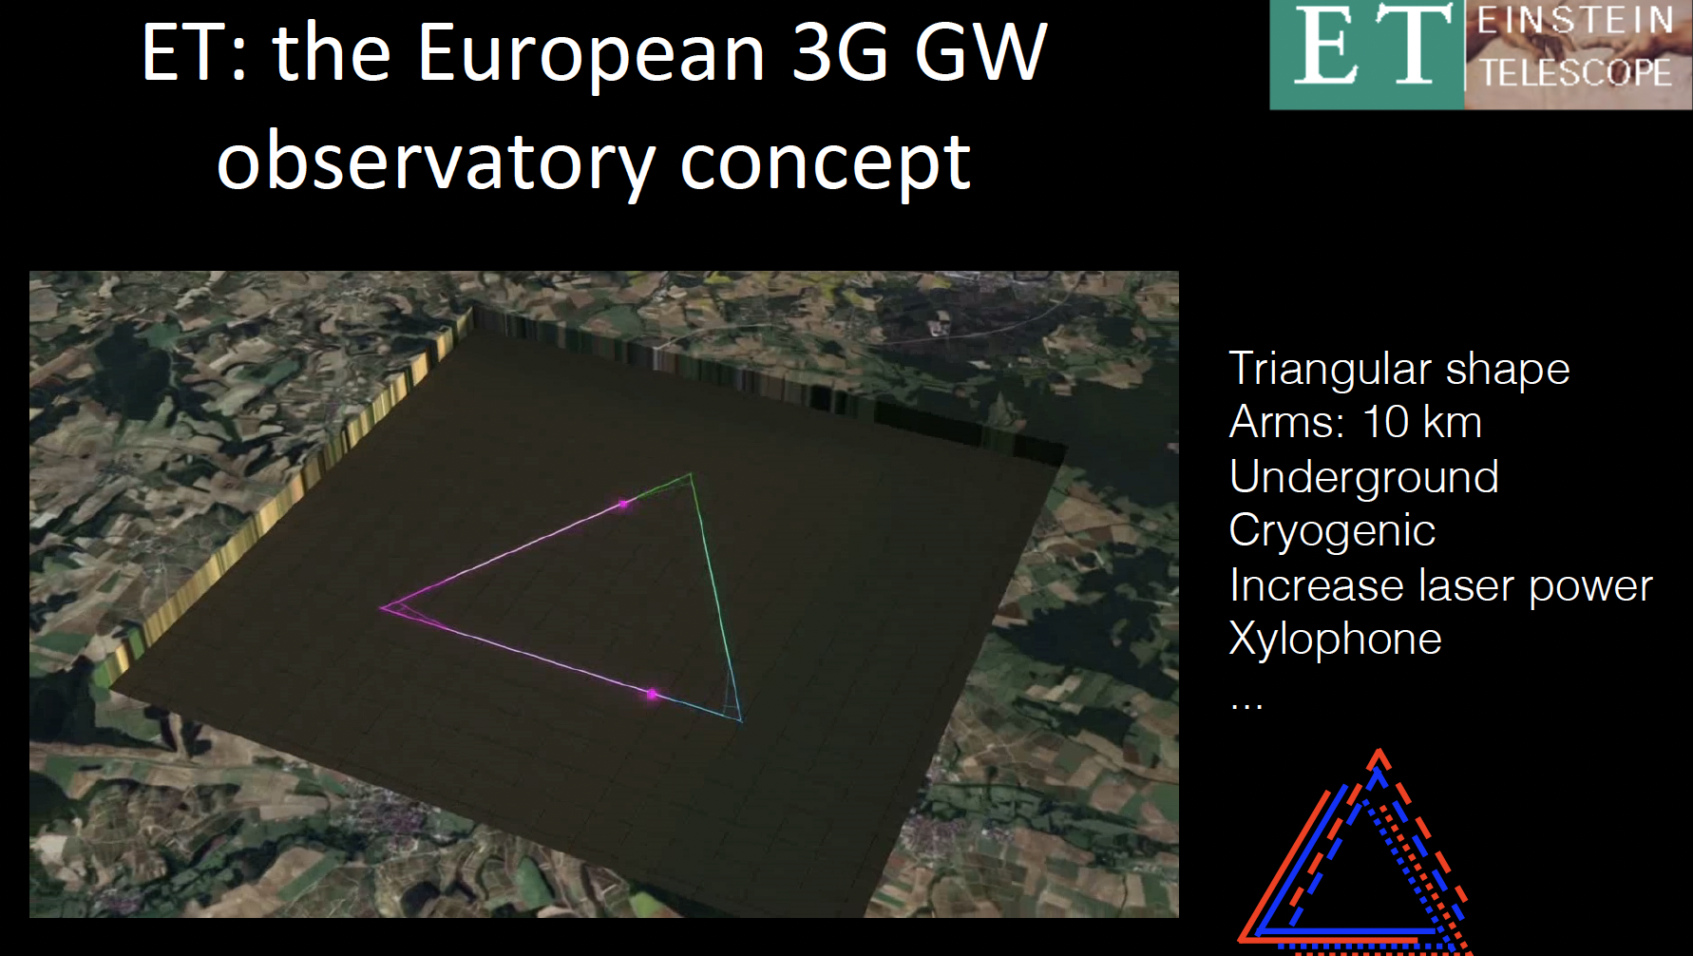
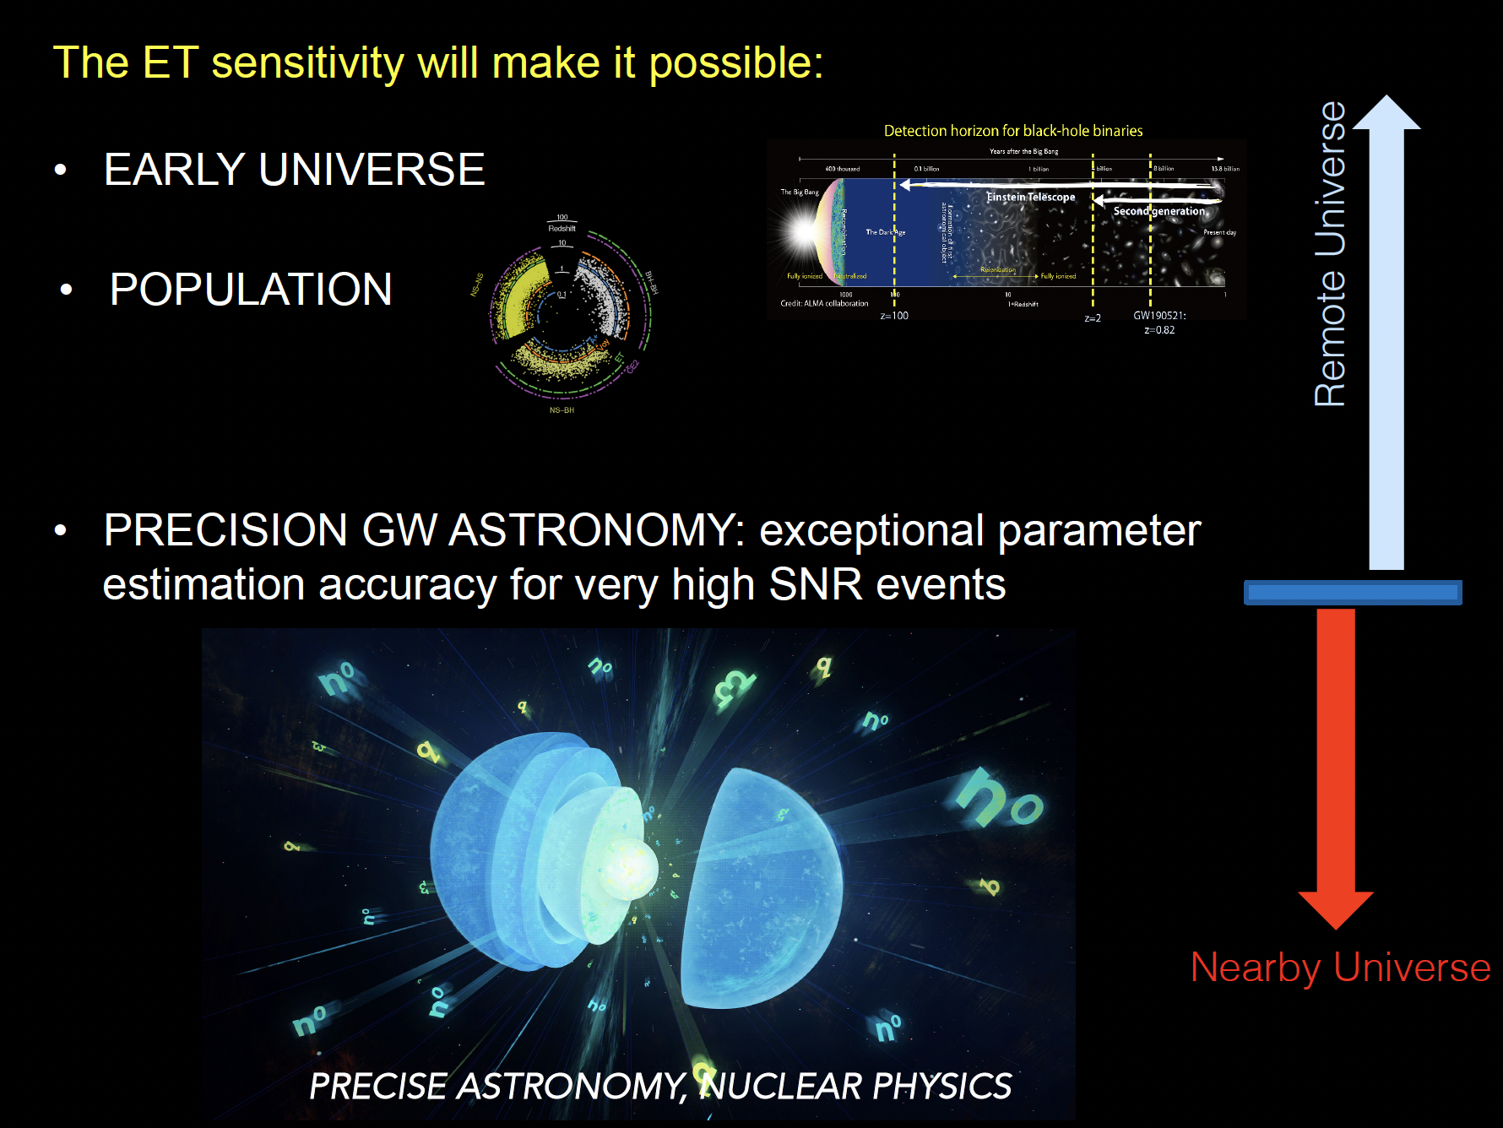
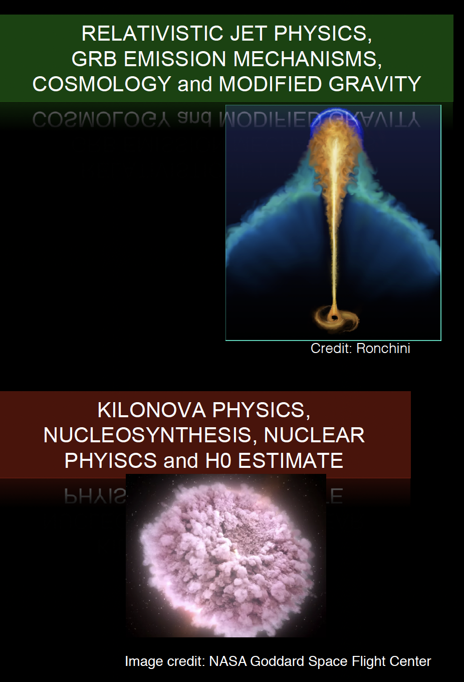
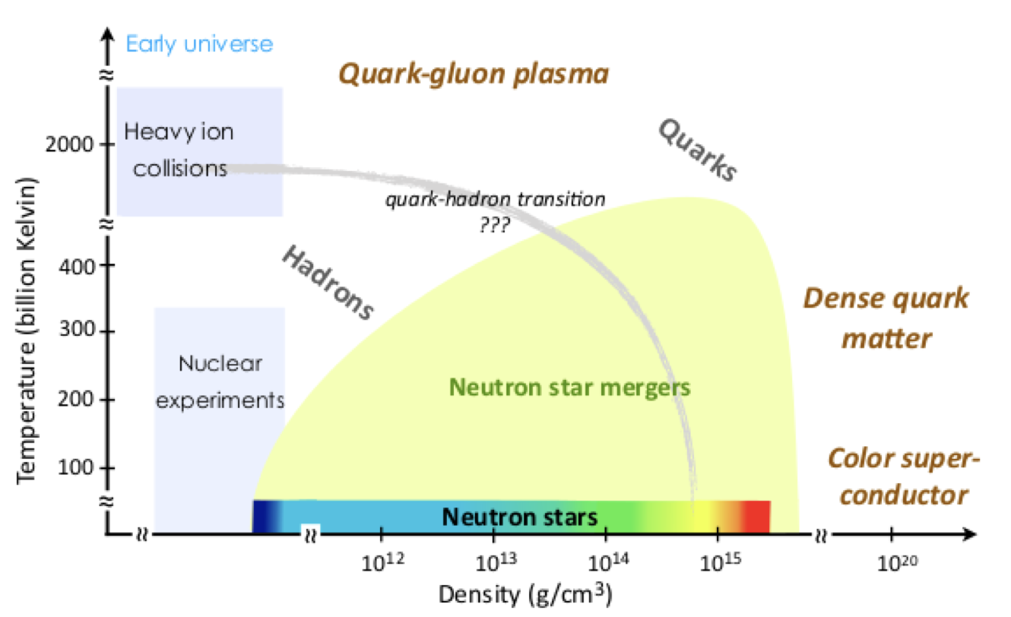
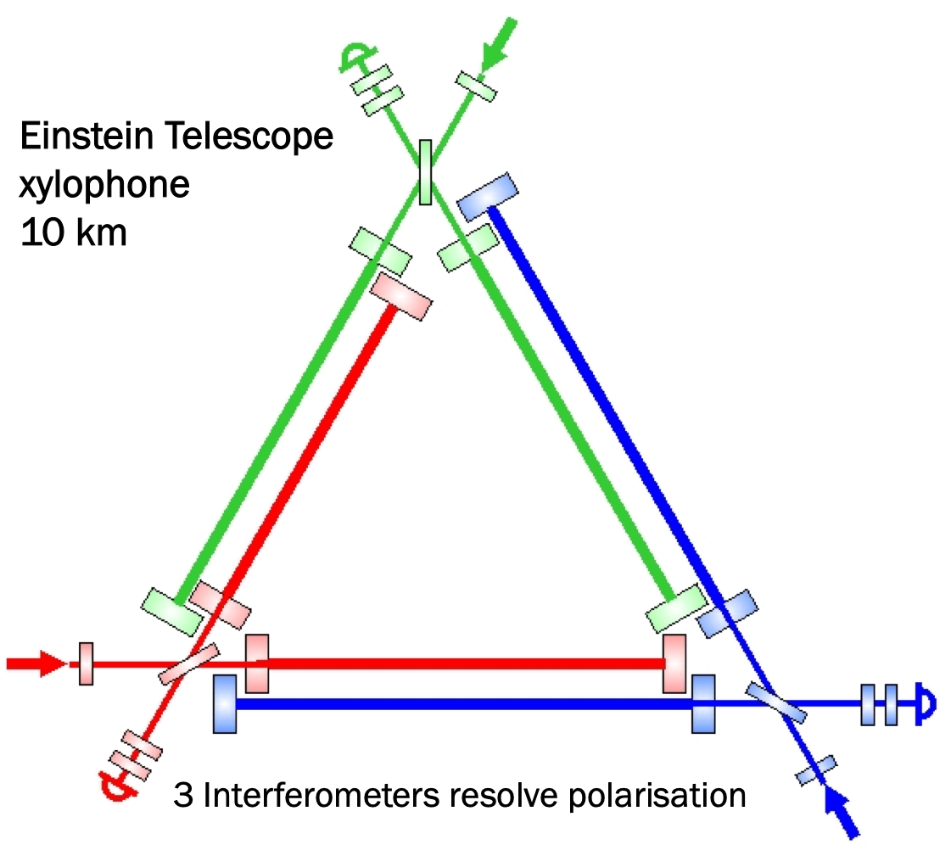
100-200 m underground
2 sites is a probable scenario with appropriate orientation for polarisation
Notes:
GW address exciting science: tests of gravity in regions of greatesr space-time curvature, graviton mass constraints, Hubble constant measurement, black holes and their horizon and their connection to dark matter, matter in extreme environment, origin of heavy elements, equation of state of ultra-dense matter elements, exotic objects
(B.S. Sathyaprakash’s talk, Input #64)

Slide 6
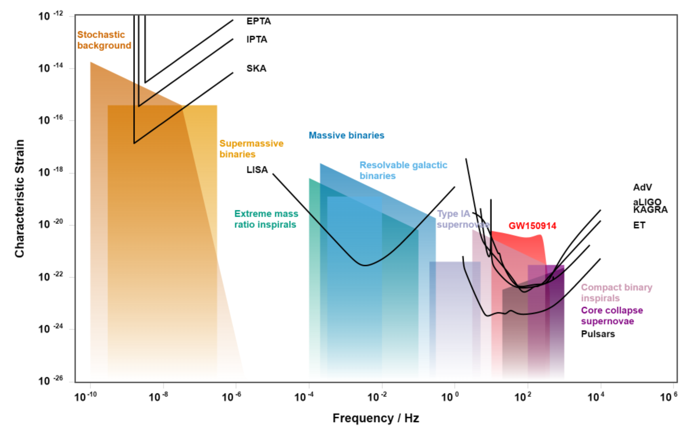
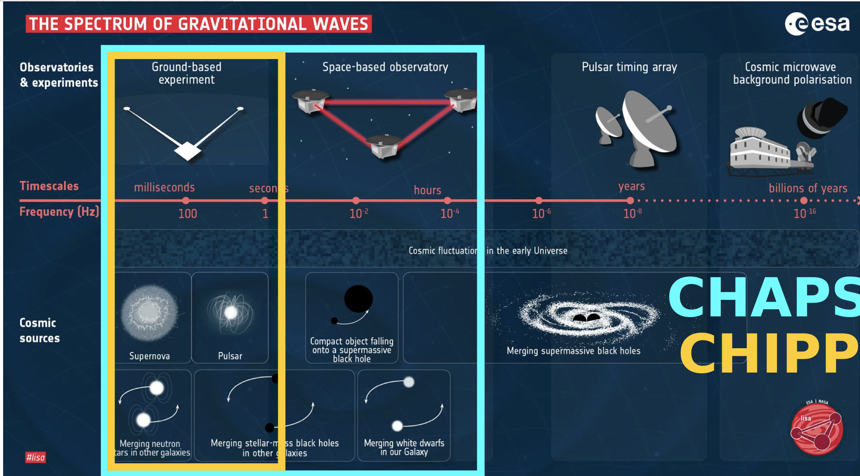
Gravitational wave searches
Plot from http://gwplotter.com/

Slide 7
Specific recommendations (CTAO/ET)
CHIPP and CHAPS should recognise the shared interest in large research infrastructures as CTAO and ET and cooperate in seeking solutions for securing access of Switzerland to their final legal entities, acknowledging their schedules and their common scientific interest in multi-messenger astrophysics.
The operation of CTAO is foreseen to last an order of ~30 yrs from its completion to be achieved by the end of the decade. ET plans the start of construction in 2030 for ~50 yrs. Such long-term observatories require a comparable investment to construction, for long-term computing and centralized project office operation, and the strong and diffuse interest of large consortia distributed in major Swiss universities.
The Data Centre in Astrophysics/Astroparticle at CSCS is one of the 4 off-site data centres of CTAO and Regional Data Centre of SKAO, and requires the necessary synergy with LHC to steer the infrastructure investments for the needs of the RI and their Swiss scientists.

Slide 8
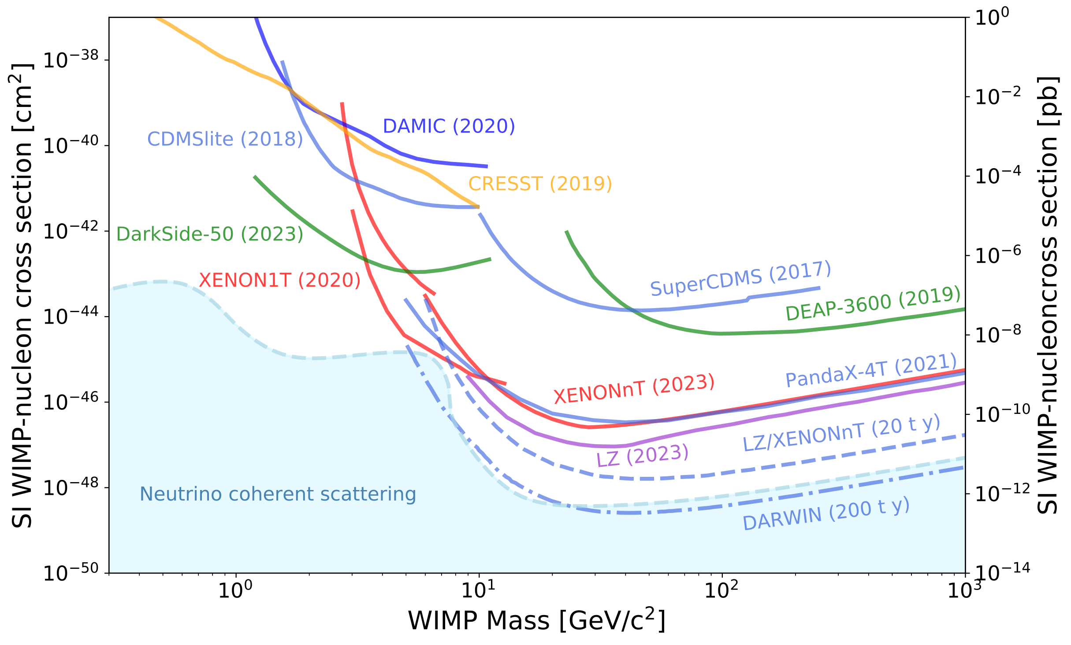

Towards Generation 3 going beyond the neutrino floor and low mass dark matter
Findings : a long history of successes with Swiss leadership
HV
time
gas
S2
$$\overset{⃗}{E}$$
drift time
(depth)
e–
e–
e–
HV
S1
liquid

Slide 9
Specific recommendations
XENON and LZ have set the most stringent limits to date on the WIMP parameter space and will exploit results at 20 t x y to the end of this decade. The convergence of the Swiss Community towards a G3 LXe TPC is clear. G3 will probe conclusively the WIMP parameter space. Alternate solutions uniquely exploring the light-dark matter parameter space with smaller experimental efforts should be sustained.

