Slide 1






Accelerator R&D for Future Colliders
T. Pieloni
With material from: L. Bottura, L. Rivkin, B. Auchmann, M. Seidel, M. Calvi, M. Koratzinos, A. Ballarino, C. Senatore
www.chart.ch

Slide 2
Outlook
Landscape
Magnets R&D:
  Low Temperature Superconductors LTM
    Limits of Nb3SN
    Global effort, Cross-cutting activities
    Epoxy Example
  High Temperature Superconductors HTS
    HTS developments for HFM
    Material studies
    Ondulators
    Hybrid Magnets program 17 T
Beam dynamics: importance of modelling and design
  SuperKEKB → modelling and understanding
  Power efficiency during design and smart choices for operational scenarious
Summary
2

Slide 3
Outlook
Landscape
Magnets R&D:
  Low Temperature Superconductors LTM
    Limits of Nb3SN
    Global effort, Cross-cutting activities
    Epoxy Example
  High Temperature Superconductors HTS
    HTS developments for HFM
    Material studies
    Ondulators
    Hybrid Magnets program 17 T
Beam dynamics: importance of modelling and design
  SuperKEKB → modelling and understanding
  Power efficiency during design and smart choices for operational scenarious
Summary
3

Slide 4
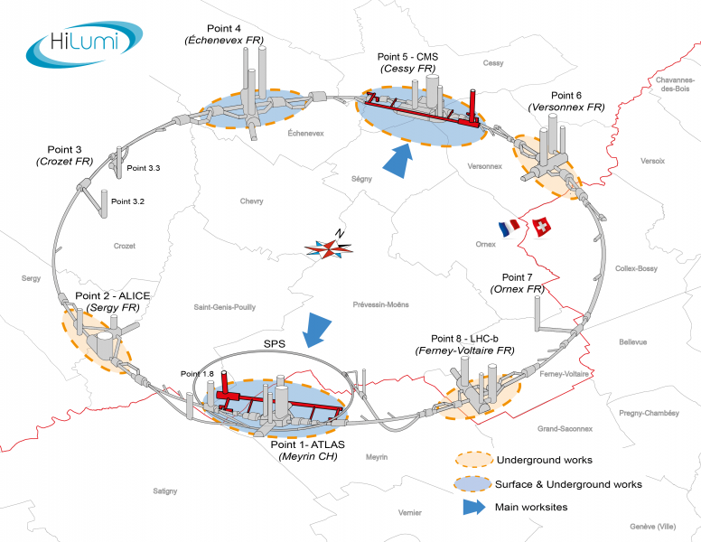
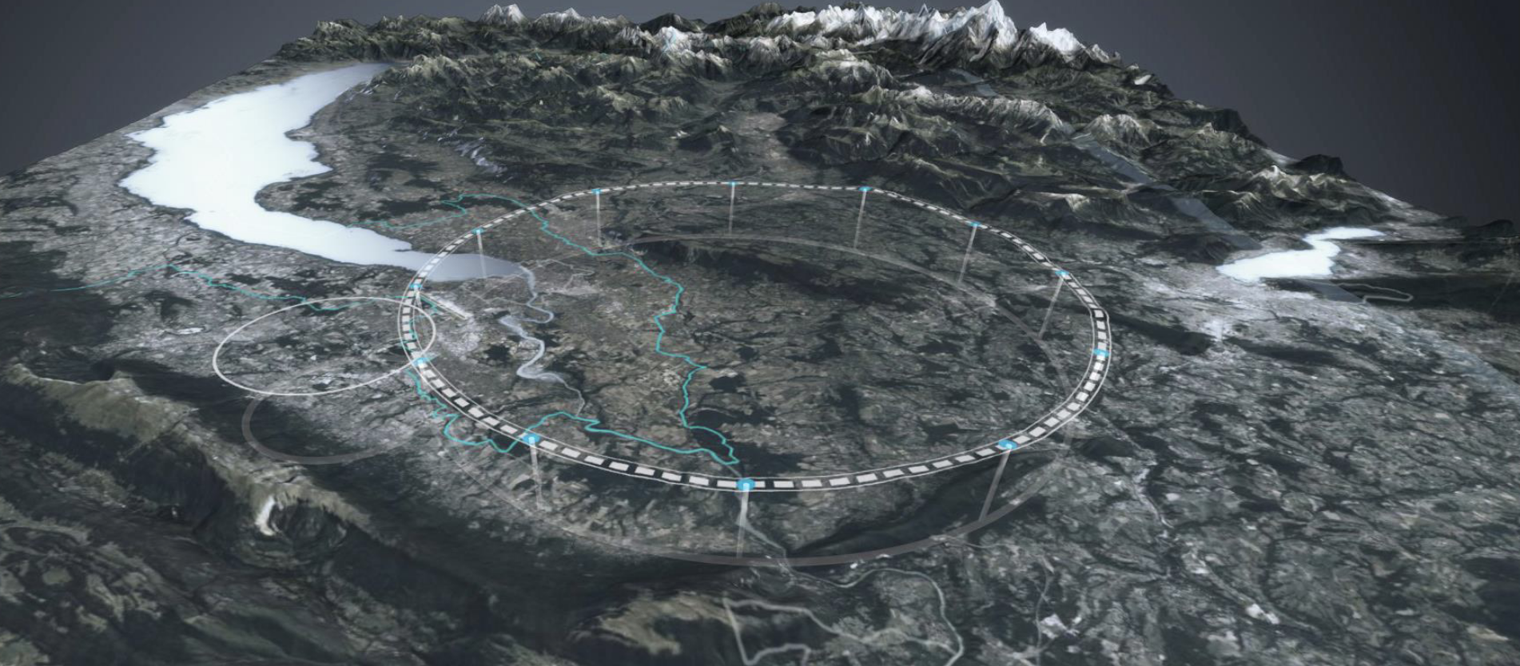
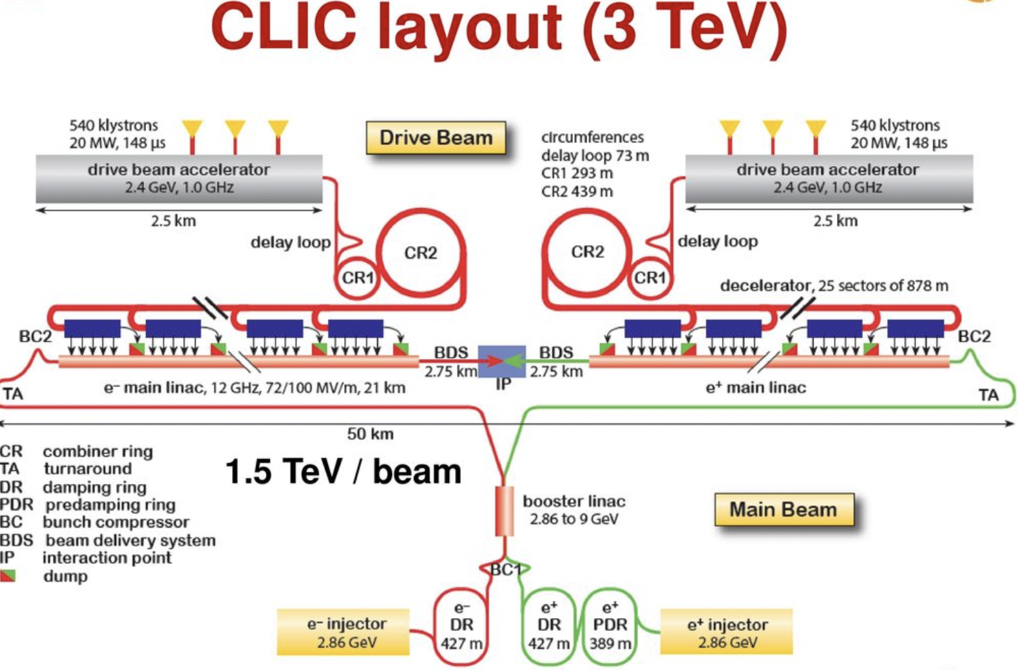
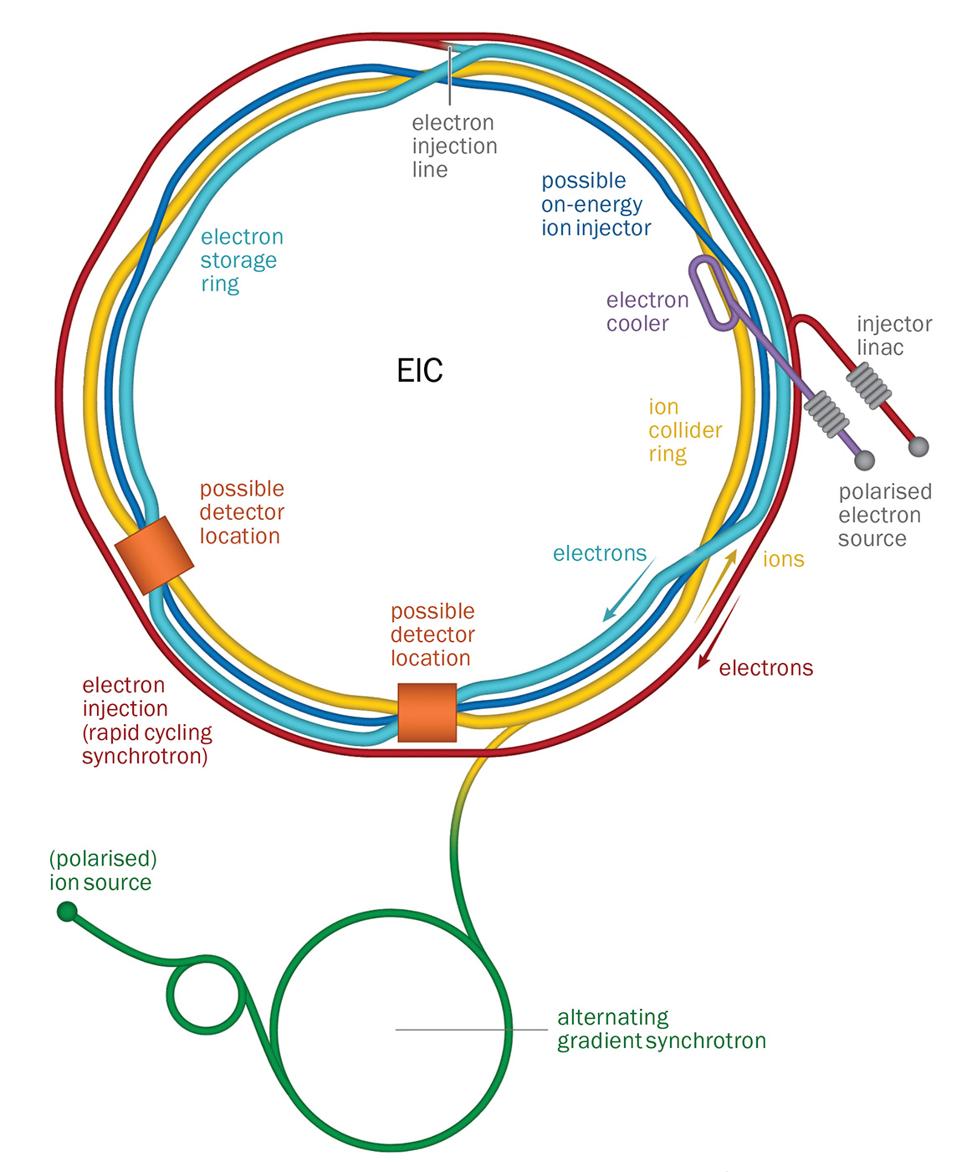
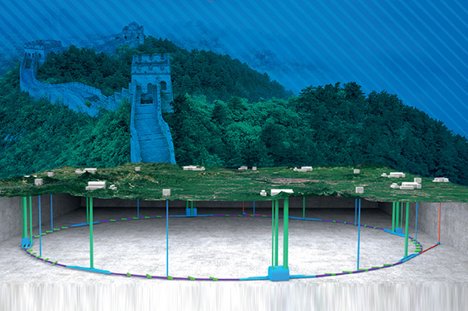
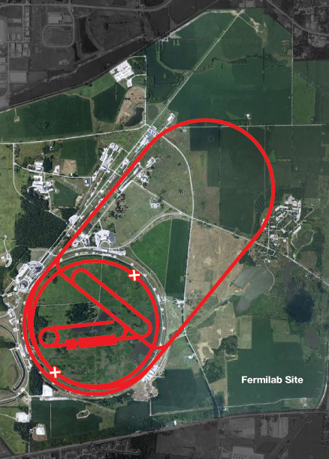
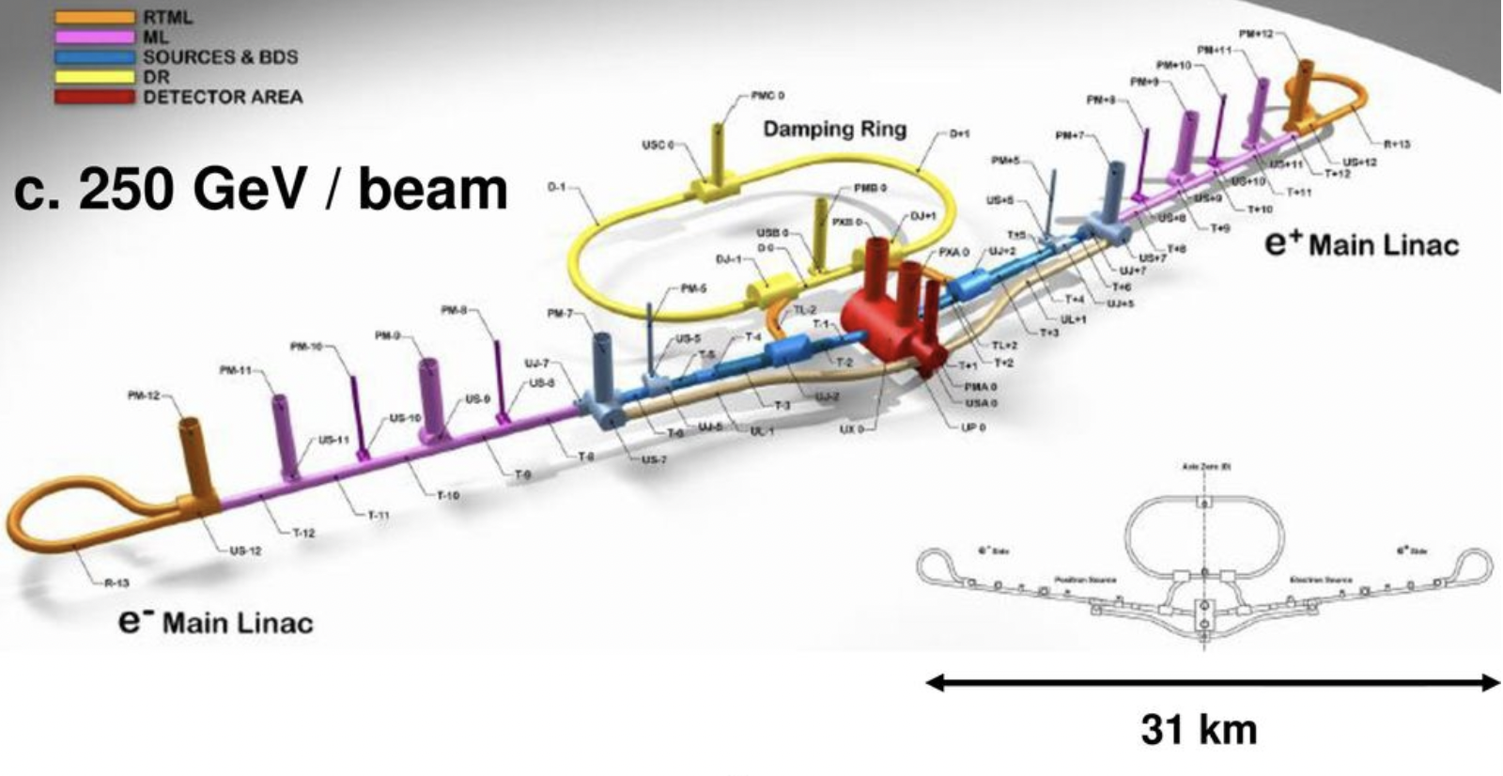
HEP Landscape - Colliders
HL-LHC (CERN)
Installation 2026
Commissioning 2029
FCC-ee , hh , eh (CERN)
2040-2090
SppC (IHEP)
> 2040
μ Collider
> 2040
ILC
EIC (BNL)
In construction
CD4 June 2030
Notes:
Maybe linear colliders…
The two large HEP projects in construction are the High Luminosity upgrade of the LHC (HL-LHC), at CERN, and the Electron-Ion Collider at BNL A number of options have been identified for future colliders. Among the circular collider options, those that are most advanced and conceptually developed at the Future Circular Collider (FCC) for lepton (FCC-ee) and hadron (hh) collision, at CERN, the Chinese Electron-Positron Collider (CEPC) to be followed by the Super Proton-Proton Collider (SPPC) in China, and the Muon Collider, last studied as part of the US Muon Accelerator Program (MAP) and now the objective of the International Muon Collider Collaboration hosted by CERN.

Slide 5

2020 Update of the European Strategy for Particle Physics
  “Europe, together with its international partners, should investigate the technical and financial feasibility of a future hadron collider at CERN with a centre-of-mass energy of at least 100 TeV and with an electron-positron Higgs and electroweak factory as a possible first stage. “
  “The technologies under consideration include high-field magnets, high-temperature superconductors, plasma wakefield acceleration and other high-gradient accelerating structures, bright muon beams, energy recovery linacs.
  The European particle physics community must intensify accelerator R&D and sustain it with adequate resources.
http://cds.cern.ch/record/2721370

Slide 6

2020 Update of the European Strategy for Particle Physics
  “Europe, together with its international partners, should investigate the technical and financial feasibility of a future hadron collider at CERN with a centre-of-mass energy of at least 100 TeV and with an electron-positron Higgs and electroweak factory as a possible first stage. “
  “The technologies under consideration include high-field magnets, high-temperature superconductors, plasma wakefield acceleration and other high-gradient accelerating structures, bright muon beams, energy recovery linacs.
  The European particle physics community must intensify accelerator R&D and sustain it with adequate resources.
  A roadmap should prioritise the technology, taking into account synergies with international partners and other communities such as photon and neutron sources, fusion energy and industry.
  Deliverables for this decade should be defined in a timely fashion and coordinated among CERN and national laboratories and institutes.“
https://arxiv.org/abs/2201.07895

Slide 7

2020 Update of the European Strategy for Particle Physics
  “Europe, together with its international partners, should investigate the technical and financial feasibility of a future hadron collider at CERN with a centre-of-mass energy of at least 100 TeV and with an electron-positron Higgs and electroweak factory as a possible first stage. “
  “The technologies under consideration include high-field magnets, high-temperature superconductors, plasma wakefield acceleration and other high-gradient accelerating structures, bright muon beams, energy recovery linacs.
  The European particle physics community must intensify accelerator R&D and sustain it with adequate resources.
  A roadmap should prioritise the technology, taking into account synergies with international partners and other communities such as photon and neutron sources, fusion energy and industry.
  Deliverables for this decade should be defined in a timely fashion and coordinated among CERN and national laboratories and institutes.“
https://chart.ch/wp-content/uploads/2022/09/220207_CHART-Roadmap.pdf

Slide 8
Outlook
Landscape
Magnets R&D:
  Low Temperature Superconductors LTM
    Limits of Nb3SN
    Global effort, Cross-cutting activities
    Epoxy Example
  High Temperature Superconductors HTS
    HTS developments for HFM
    Material studies
    Ondulators
    Hybrid Magnets program 17 T
Beam dynamics: importance of modelling and design
  SuperKEKB → modelling and understanding
  Power efficiency during design and smart choices for operational scenarious
Summary
8

Slide 9
The physics landscape
 | Dipoles | Quadrupoles | Undulators/Wigglers | Detectors | Field (T)
FCC-ee |  | IR Quad |  | × | < 3 T
CEPC |  | IR Quad |  | × | < 5 T
ILC | × | × | × | × | < 2 T
CLIC |  |  | × | × | < 2.5 T
FCC-pp | × | × |  |  | 16 T -20 T
SppC | × | × |  |  | 12 T- 24 T
Muon Colliders | × | × |  |  | Solenoids > 10 T-20 T
Higgs Factories
Energy Frontier
Magnets represent ~70% of a collider cost
9

Slide 10
The physics landscape
 | Dipoles | Quadrupoles | Undulators/Wigglers | Detectors | Field (T)
FCC-ee |  | IR Quad |  | × | < 3 T
CEPC |  | IR Quad |  | × | < 5 T
ILC | × | × | × | × | < 2 T
CLIC |  |  | × | × | < 2.5 T
FCC-pp | × | × |  |  | 16 T -20 T
SppC | × | × |  |  | 12 T- 24 T
Muon Colliders | × | × |  |  | Solenoids > 10 T-20 T
Higgs Factories
High Field Magnet Technology: Low Temp and High Temp Superconductors
Energy Frontier
10
Cortesy of A. BallarinoBallarino – HTS Developments

Slide 11
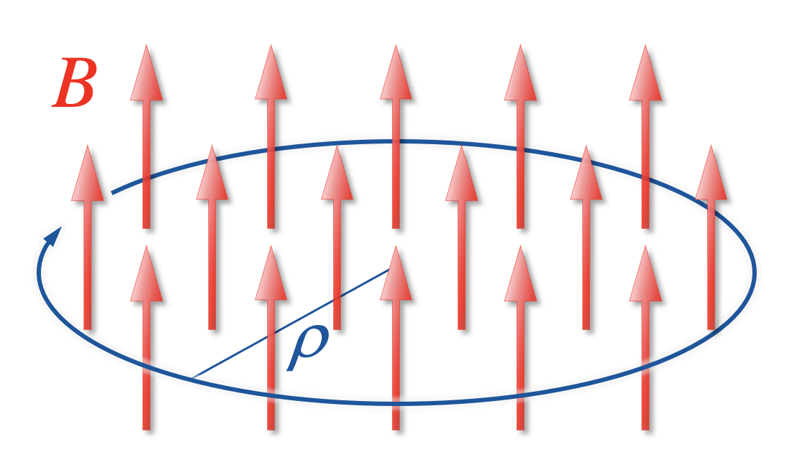
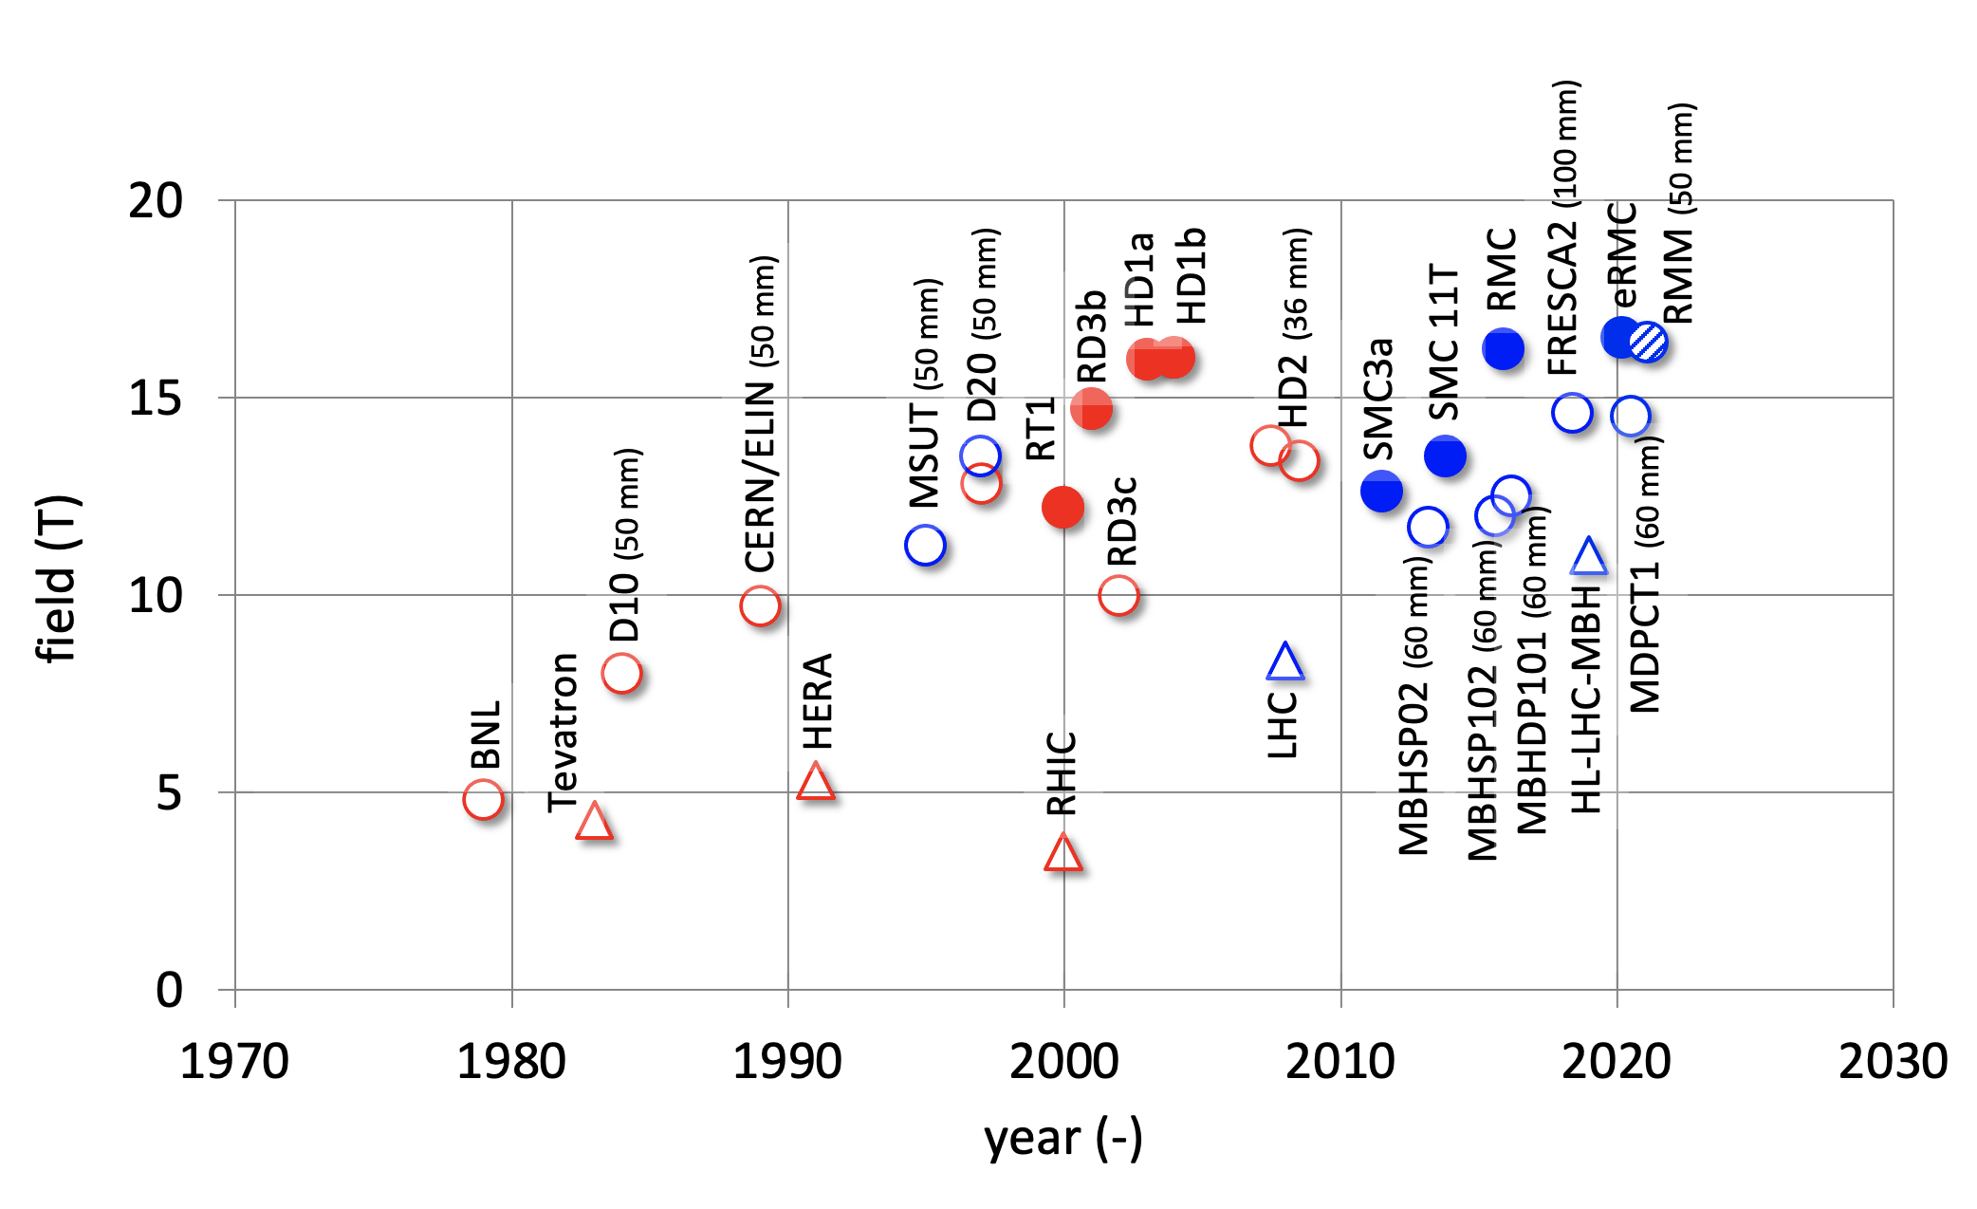
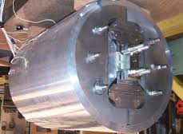
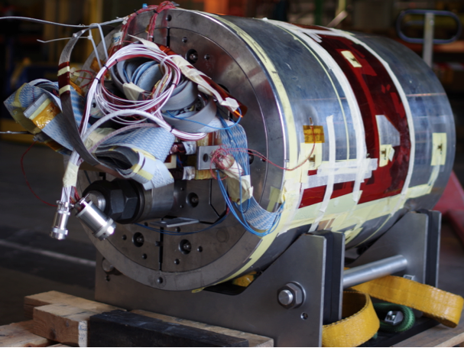
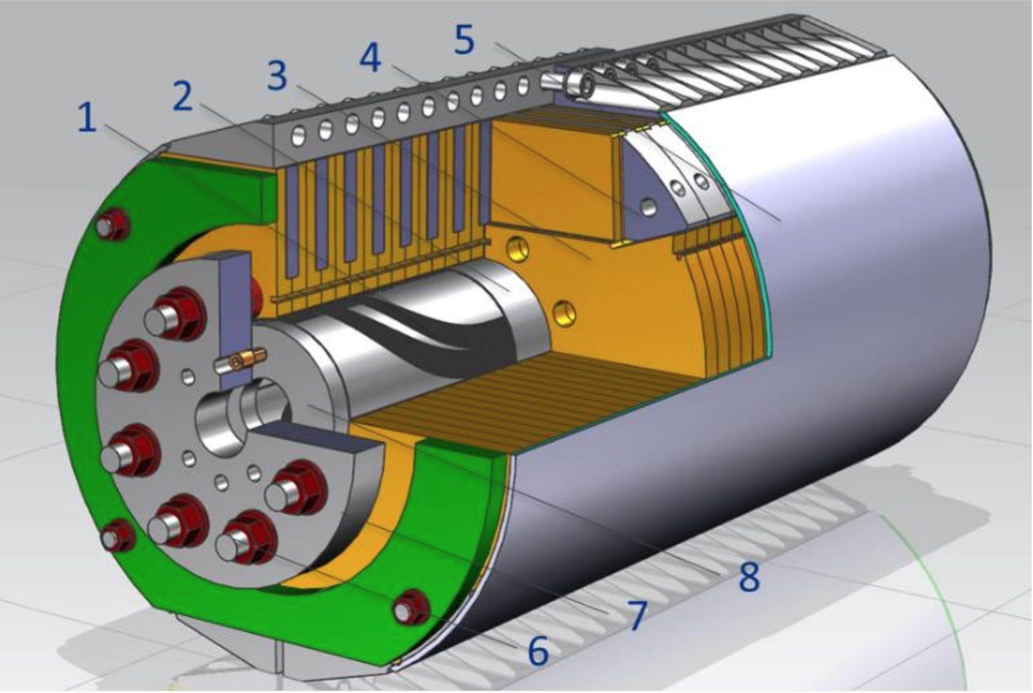
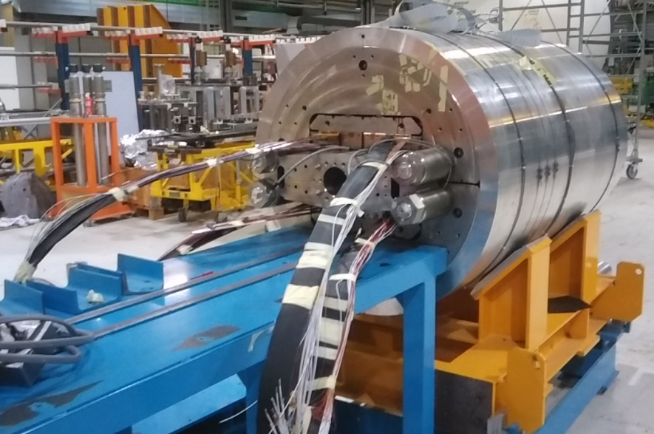
High field magnets: dipoles
Beam energy
Bending radius
Dipole field
This is the reason for the steady call for higher fields in accelerator magnets
Upper limit of LTS (Nb₃Sn)
Notes:
High field motivation for HTS – 1. A common challenge of future hadron (and muon) colliders is the need for high field dipoles, required to keep the circomference of the collider small. This is the main pull for the development of the past 40 years in accelerator magnets, whose main results are shown schematically in the figure. In fact, it is clear that having surpassed the capability of Nb-Ti (range of 8-10 T), and having now demonstrated that Nb3Sn can reach the range of 14-16 T, we have reached the liomit of performance of LTS for this application. The only way to outperform these magnets and demonstrators is to switch to HTS materials.

Slide 12

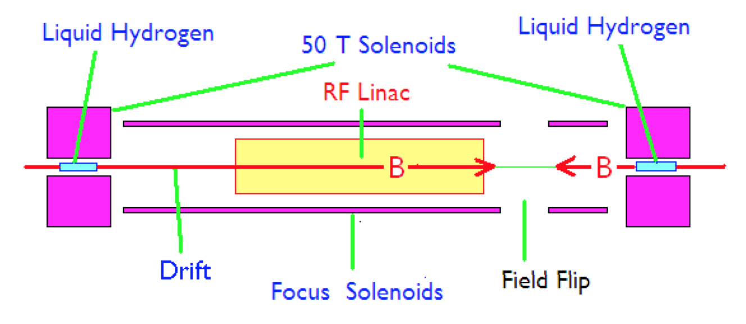
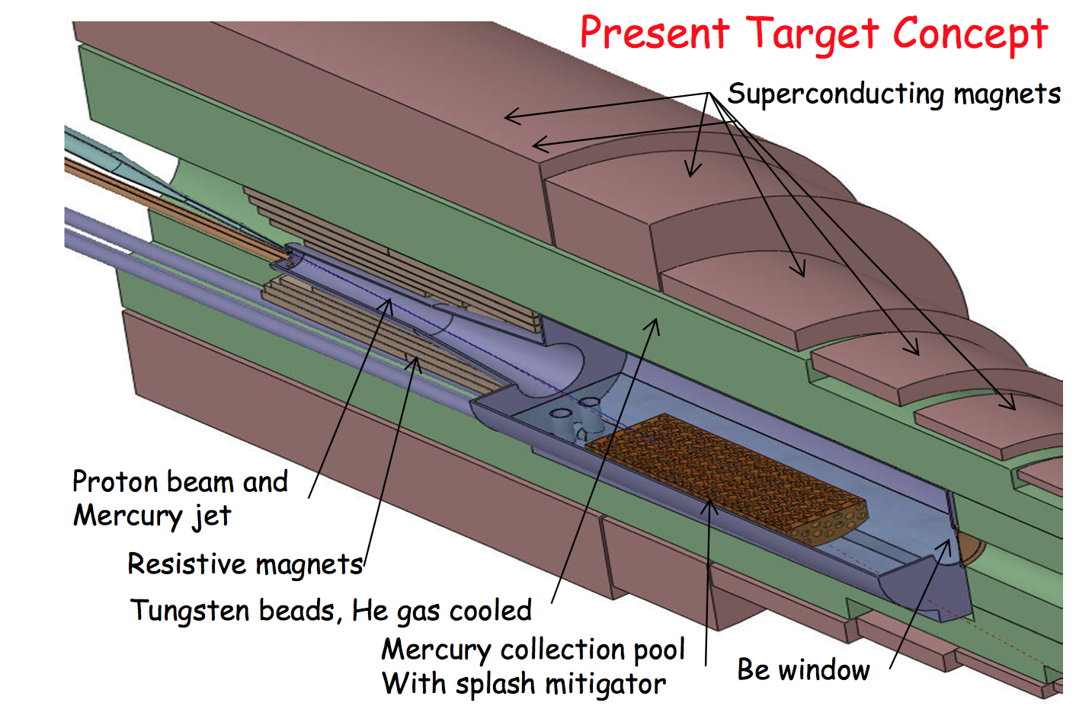
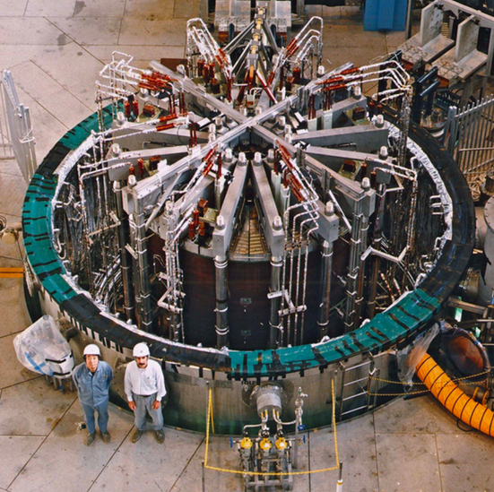
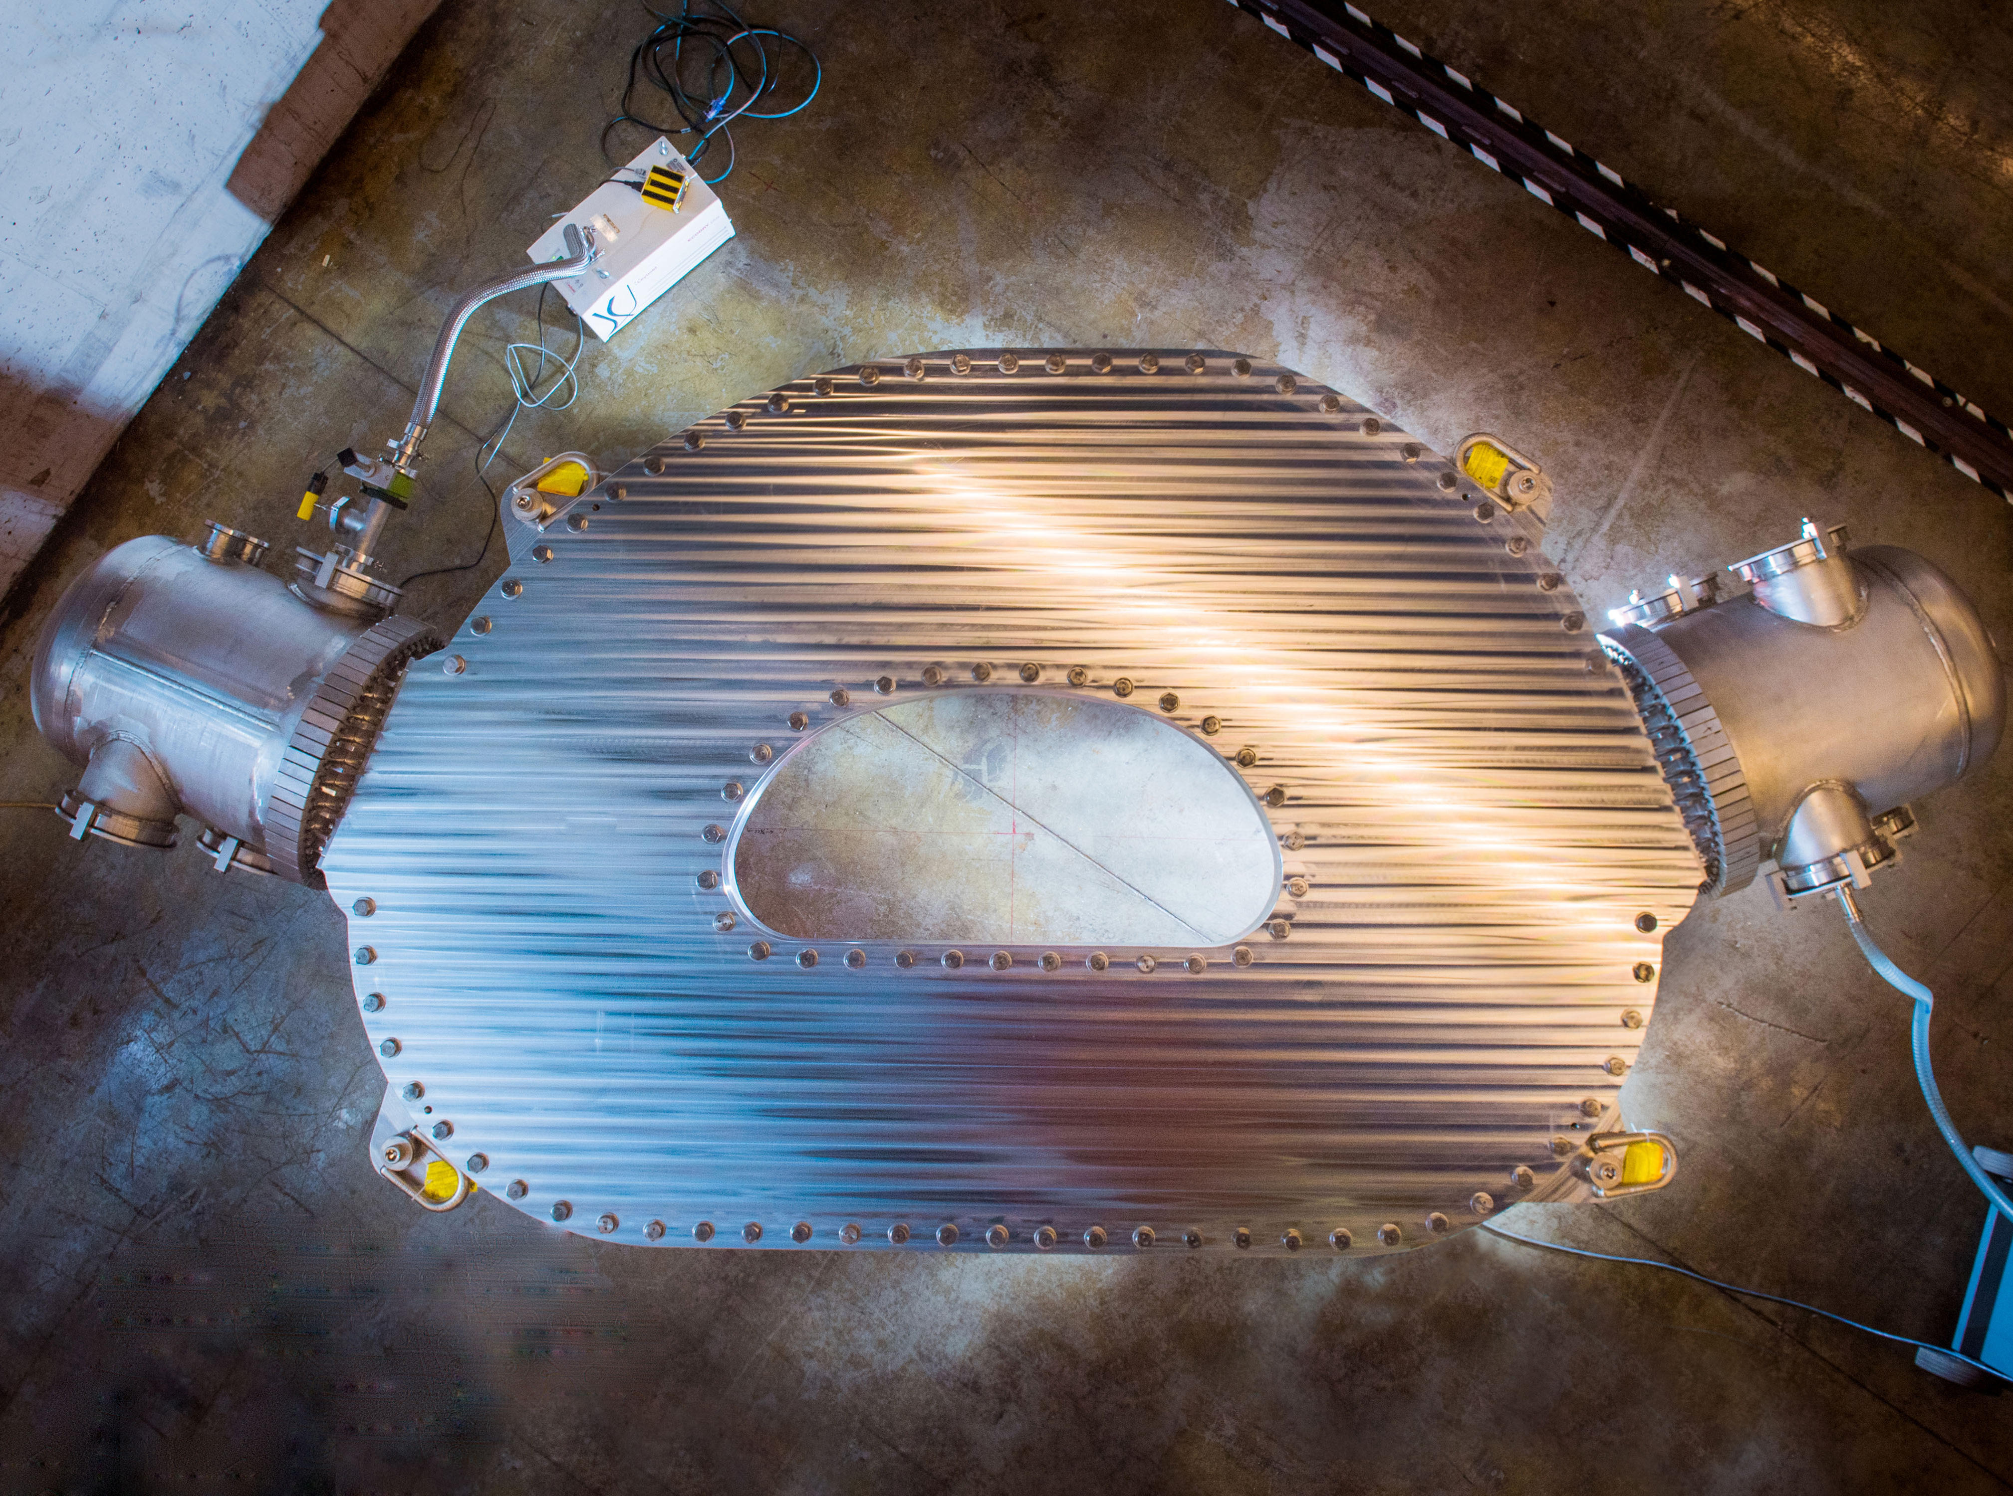
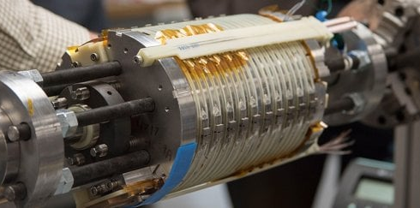
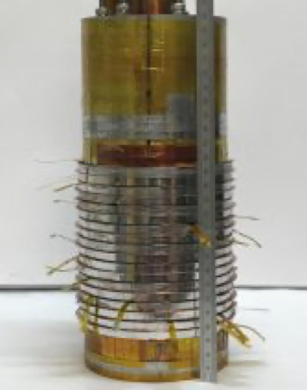
High field magnets: solenoids (Muon Collider)
30…50 T, 50 mm
20 T, 150 mm, 100 kW
Notes:
High field motivation for HTS – 2. The muon collider study has also provided a need for solenoids with fields higher than can be reached with LTS. These fields are required to c apture and cool chared beams of muons, elusive leptons that need to be manipulasted into very small emittance beams. The field levels required are at the upper limit (20 T at the target), or well beyond (40 to 60 T at the final cooling stage) the capability of LTS. These solenoids can only be envisaged with HTS

Slide 13
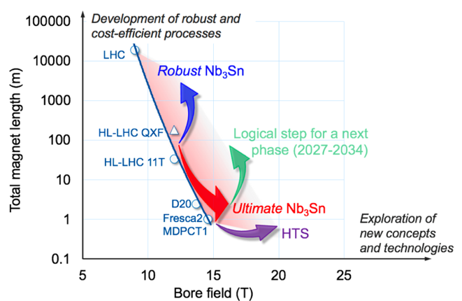
Goals of Magnets developments
Demonstrate Nb3Sn magnet technology for large scale deployment, pushing it to its limits in terms of maximum field and production scale.
  The effort to quantify and demonstrate Nb3Sn ultimate field comprises the development of conductor and magnet technology towards the ultimate Nb3Sn performance.
  Develop Nb3Sn magnet technology for collider-scale production, through robust design, industrial manufacturing and cost reduction.
Demonstrate the suitability of HTS for accelerator magnets, providing a proof-of-principle of HTS magnet technology beyond the reach of Nb3Sn.
Notes:
Can Nb3Sn produce the required fields16 T?
Can we produce Km of magnets? AT which cost?
What is the infrusctructure around these magnets needed? Cryogenics,…..
Can HTS produce higher fields? 20-30 T? More?
At which cost and can the technology be scaled for large fasility?
The goal is not only a demonstrator but also a robust design and low cost for applications to large machines.

Slide 14
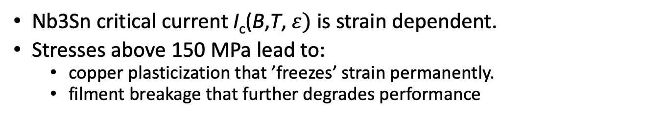
Nb₃Sn Conductor Challenge
Nb3Sn critical current I_{c}(B,T,$ε)$ is strain dependent.
Stresses above 150 MPa lead to:
  copper plasticization that ’freezes’ strain permanently.
  filment breakage that further degrades performance
σ_{irr} = 145–175 MPa
I_{c}/I_{c0} @ 150 MPa
→ 16 % - 28 %

Slide 15
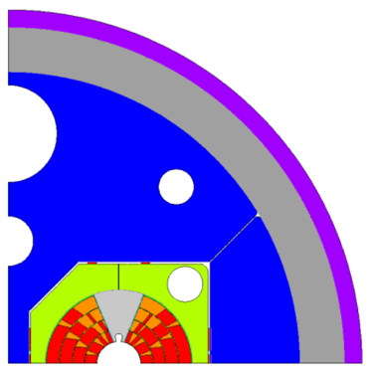
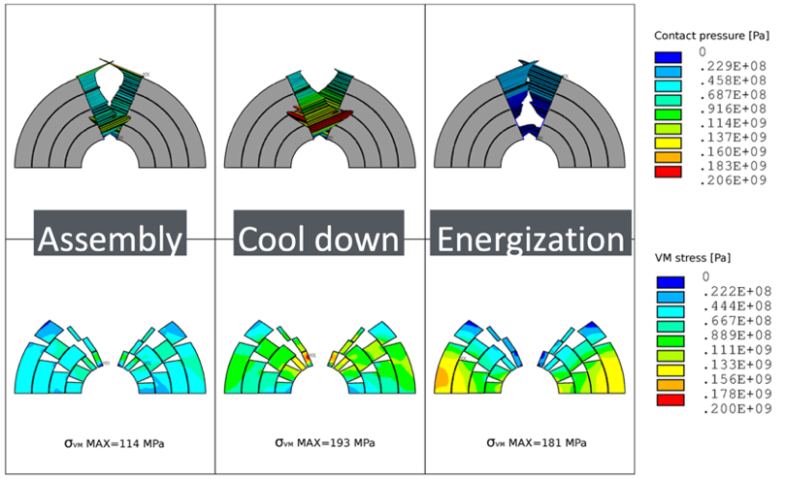
Nb₃Sn High Field Magnet Mechanics Challenge
Full pre-stress: a lesson learned from the Nb-Ti era:
Keep coils under compression at all stages of operation
→ avoid stick-slip motion.
  Forces scale quadratically with field. For 16 T dipole,
  forces equivalent of 1.5 kt/m pull coil-halves apart.
  10 µm abrupt movement is enough to cause quench.
Need to limit stress on Nb₃Sn!
[S. Farinon et al., in M. Benedikt et al., FCC Conceptual Design Report, 2019.]

Slide 16
Focus Area Nb₃Sn Conductors and Magnets
Reaching ultimate Nb₃Sn performance (towards 16 T) is aided by innovation and new approaches in:
Conductor
Technology
Magnet
Technology
Nb₃Sn Conductor
R&D
New Nb₃Sn wire structures with enhanced mechanical strength
Higher J_{c} (increased margins)
Industrialization of improved superconductors.
Novel
Design Concepts
Reinforced coils; Stress-management eliminates pre-stress.
Low-prestress designs, allowing for some moderated movement.
Coil designs and structures with minimal stress in high-field regions.

Slide 17


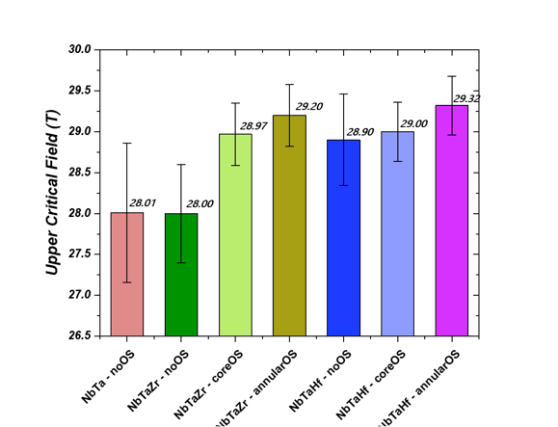
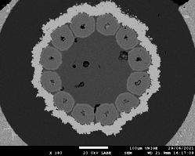
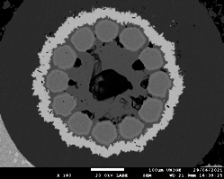
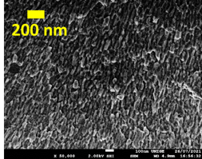
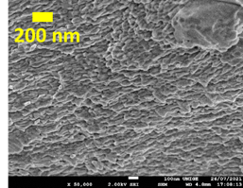
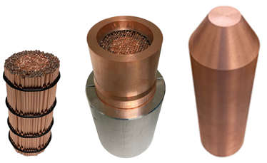
Ongoing projects:
Nb₃Sn Conductor
Internal Oxidation in prototype multifilamentary wires
3
1
2
Reference
Average grain size
∼ 47 nm
Average grain size
∼ 45 nm
Pushing Nb₃Sn towards its ultimate performance
1
Refinement of the grain size: 100 nm → 50 nm
2
Large increase of the layer J_{c} → exceeding the FCC target
Larger billets under development
3
Enhancement of B_{c2} by > 1 T → improved in-field performance
Courtesy of C. Senatore

Slide 18




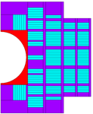
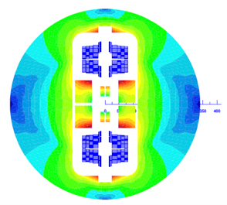
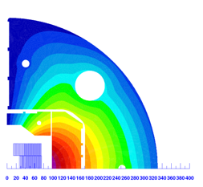
Nb₃Sn Magnet Projects Ramping Up
Development of technological steps towards 16-T block coil Nb₃Sn magnets with stress management: conceptual design has started.
Collaboration agreement for the development of technological steps towards 16-T Nb₃Sn magnets with low-prestress common coil structure: preparation of workshops for the implementation phase.
Collaboration agreement for the development of technological steps towards 16 T common coil Nb₃Sn magnets with stress management: collaboration agreement is finalized. First test 14.5-15 T in 2025/26.

Slide 19
Cross-Cutting Activities
Numerical models, materials, protection techniques, cryogenics, diagnostics, magnetic measurements, etc. are all challenging applications of their respective engineering sciences.
Involving more labs as well as academic and industrial partners promises enhanced efforts, competency and cross-pollination.
Only a steady technical exchange can ensure that a magnet engineer’s challenges motivate research into possible solutions, and that new developments inspire magnet designs.
Open R&D Line Fora have started – HFM a dynamic research network!
HFM R&D has suffered from slow turnaround and late feedback on technological choices.
Magnet R&D developed as a [succession funnel] of meaningful fast-turnaround demonstrations, ranging from non-powered material […] samples […] towards ultimate specifications. In this way, new technologies can be tested under realistic conditions at the earliest possible stage, the smallest relevant scale and cost, and the fastest pace.“

Slide 20
Cross-Cutting Activities
Numerical models, materials, protection techniques, cryogenics, diagnostics, magnetic measurements, etc. are all challenging applications of their respective engineering sciences.
Involving more labs as well as academic and industrial partners promises enhanced efforts, competency and cross-pollination.
Only a steady technical exchange can ensure that a magnet engineer’s challenges motivate research into possible solutions, and that new developments inspire magnet designs.
Open R&D Line Fora have started – HFM a dynamic research network!
HFM R&D has suffered from slow turnaround and late feedback on technological choices.
Magnet R&D developed as a [succession funnel] of meaningful fast-turnaround demonstrations, ranging from non-powered material […] samples […] towards ultimate specifications. In this way, new technologies can be tested under realistic conditions at the earliest possible stage, the smallest relevant scale and cost, and the fastest pace.“

Slide 21


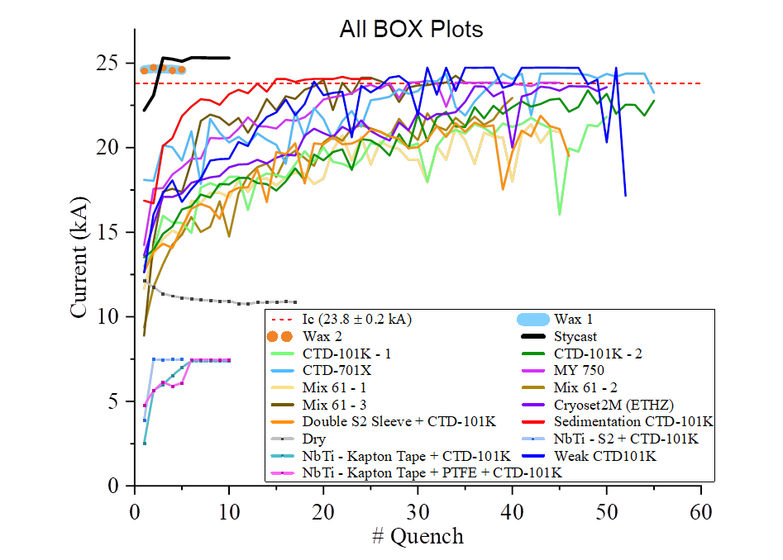
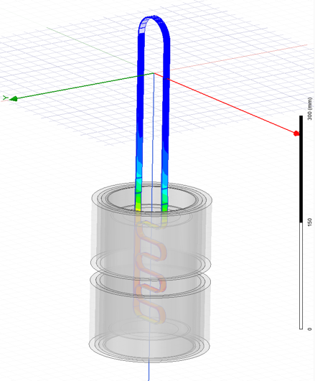

BOX Program example
Traditional superconducting magnet design ensures magnet can survive quenches (transition between normal and the superconducting state)
Pictures by M. Daly, S. Sidorov, S. Otten
BOX (BOnding eXperiment) program with university of Twente has shown a wide variety of results, from complete conductor degradation (no impregnation) to substantial training (epoxy) to no-training (wax, Stycast), with 18 BOX samples successfully manufactured and tested in 2 years.
Clear evidence of different training quench behaviours depending on impregnants (epoxy used to guarantee helium flow in cables). Multi disciplinary effort (material, magnet design, cryogenics and engineering)
Notes:
LBNL is preparing a wax impregnated subscale CCT magnet

Slide 22
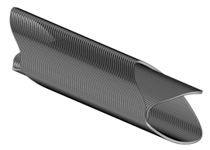
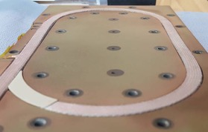
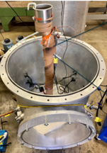
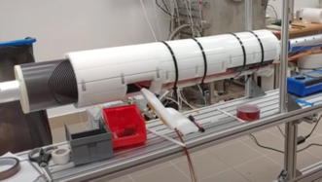
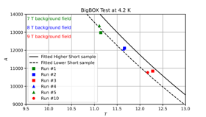
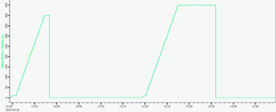

Feedback to Magnet Programs
PSI’s BigBOX: a 13-turn stress-managed racetrack.
No training with 12.3 T coil field, 150 MPa coil stress at BNL’s DCC17 facility.
LBNL’s wax impregnated
sub-scale (5 T) CCT.
First Nb₃Sn CCT without training.
Follow-up magnet
and test planned.
Wigner Inst. / CERN collaboration on SuShi septum for FCC-hh
Wax impregnated CCT required no training to nominal current.
[Courtesy D. Araujo et al]
[Courtesy D. Barna et al.,
Wigner Institute]
[Courtesy J.L. Rudeiros
Fernandez, LBNL]
Notes:
Active network and team beyond Europe. The BOX observations in 2022 had a very fast turn around and magents designer and constructors have prepared first new prototypes

Slide 23

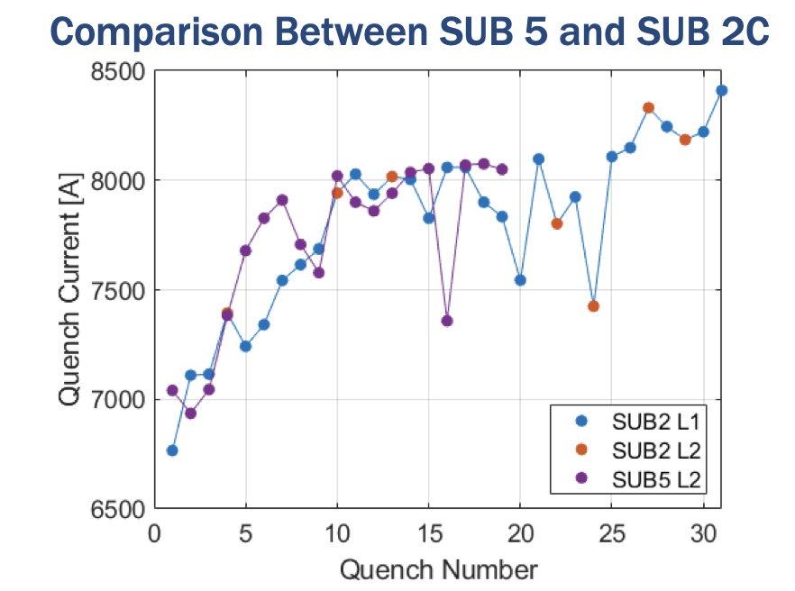
US Magnet development
1st Nb₃Sn CCT coil impregnated with wax
no quench of inner wax coil!
All quenches were in outer coil
Curtesy of Soren Prestemon
US Magnet Development Program LBNL FCC week Presentation
Motivated by “Box” results: Daly et al 2022
SUST 35 055014
23

Slide 24
Outlook
Landscape
Magnets R&D:
  Low Temperature Superconductors LTM
    Limits of Nb3SN
    Global effort, Cross-cutting activities
    Epoxy Example
  High Temperature Superconductors HTS
    HTS developments for HFM
    Material studies
    Ondulators
    Hybrid Magnets program 17 T
Beam dynamics: importance of modelling and design
  SuperKEKB → modelling and understanding
  Power efficiency during design and smart choices for operational scenarious
Summary
24

Slide 25
The physics landscape
 | Dipoles | Quadrupoles | Undulators/Wigglers | Detectors | Field (T)
FCC-ee |  | IR Quad |  | × | < 3 T
CEPC |  | IR Quad |  | × | < 5 T
ILC | × | × | × | × | < 2 T
CLIC |  |  | × | × | < 2.5 T
FCC-pp | × | × |  | × | 16 T -20 T
SppC | × | × |  | × | 12 T- 24 T
Muon Colliders | × | × |  | × | Solenoids > 10 T-20 T
Higgs Factories
LTS and HTS Enabling Technology
Energy Frontier
High field beyond Nb3Sn
25

Slide 26
The physics landscape
 | Dipoles | Quadrupoles | Undulators/Wigglers | Detectors | Field (T)
FCC-ee |  | IR Quad |  | × | < 3 T
CEPC |  | IR Quad |  | × | < 5 T
ILC | × | × | × | × | < 2 T
CLIC |  |  | × | × | < 2.5 T
FCC-pp | × | × |  | × | 16 T -20 T
SppC | × | × |  | × | 12 T- 24 T
Muon Colliders | × | × |  | × | Solenoids > 10 T-20 T
HTS Beneficial Technology
Higgs Factories
LTS and HTS Enabling Technology
Energy Frontier
Exploration at lower fields: possible reduction of cryo power, lighter magnets, more efficient optics design…?
26

Slide 27
Advantages of HTS
Very high in-field current density at low temperature
  Enabling technology for magnets with fields > 16 T
  No magneto thermal-thermal instability, e.g. no flux jump (an issue to be treated for future high-field Nb₃Sn accelerator magnets);
  Higher temperature margin, e.g. capability of tolerating a rise of temperature due, for instance, to decay particles
  Operation at higher temperature
    Low(er) field magnets operated at temperatures higher than liquid helium (dry-cooling, He gas cooling, LH₂, LN₂): operational energy saving
    High specific heat, i.e. high thermal stability (MQE) – the issue comes once the quench has generated (detection and protection)
    Higher temperature margin to the benefit of an easier cryogenic control
27

Slide 28
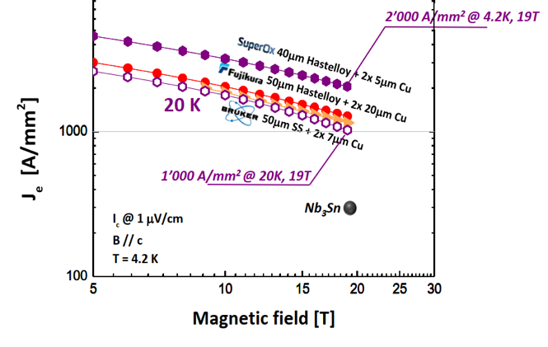
Focus Area HTS Conductors and HFMs
In Europe, we focus mainly on ReBCO tape, due to its availability from multiple suppliers and excellent performance.
Drawbacks are related to
  limited shear-strength,
  large magnetization effects that impact ramp losses and field quality,
  large anisotropy,
  unit lengths, uniformity, bending radius, etc.
Other HTS-related challenges pertain to magnet protection (slow-rising voltage signal, large temperature margins).
Engineering current density (J_{e}) in magnetic field perpendicular to substrate for selected conductors (C. Senatore, UNIGE)

Slide 29
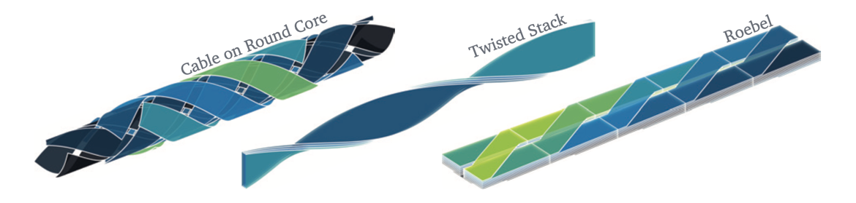
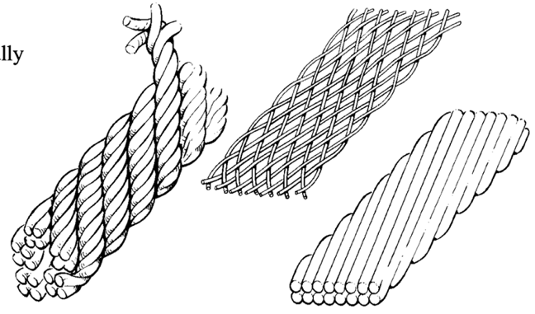
Back to the Future …
ReBCO magnet technology is at the stage of LTS in the 1970ies.
[J. v. Nugteren, High Temperature Superconductor Accelerator Magnets. UTwente, 2016.]
[M. Wilson, Pulsed Superconducting Magnets' CERN Academic Training May 2006]

Slide 30
Focus Area HTS Conductor and HFMs
“Consideration of only engineering current density would suggest that magnetic fields in the range of 25 T could be generated by HTS“
“… performance of HTS in the range 10 to 20K has reached values of Jc well in excess of 500 to 800A/mm2, i.e., the level that is required for compact accelerator coils. […] it would open a pathway towards a reduction of cryogenic power, [and] a reduction of helium inventory (e.g., dry magnets)” [LDG Roadmap on High-Field Magnets, p. 33]
We are building a new body of knowledge; today we do not know whether we can keep all of the above promises.
Cryogenics, magnetics, mechanics, protection will be ever more tightly integrated – collaboration and communication, i.e., systems thinking and systems engineering will be mandatory.
HTS Conductors
Improvement of ReBCO for low magnetisation, mechanical robustness, and reduced anisotropy
Development of alternative HTS superconductors such as IBS
Development of practical HTS cables
HTS Magnets
Development of stand-alone HTS demonstrator magnets
Subscale tests in background field and development of hybrid LTS/HTS magnets

Slide 31
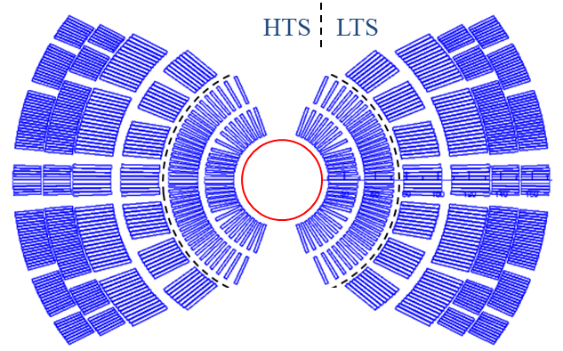
Hybrid Magnets: HTS + LTS superconductors & magnets
HTS materials outperform LTS at higher field, but under-perform at low field
=> hybrid magnets are most efficient
Magnet Development Program seeks to address questions such as:
What is the nature of accelerator magnet training? Can we reduce or eliminate it?
What are the drivers and required operation margin for Nb₃Sn and HTS accelerator magnets?
What are the mechanical limits and possible stress management approaches for Nb₃Sn and 20 T LTS/HTS magnets?

Slide 32
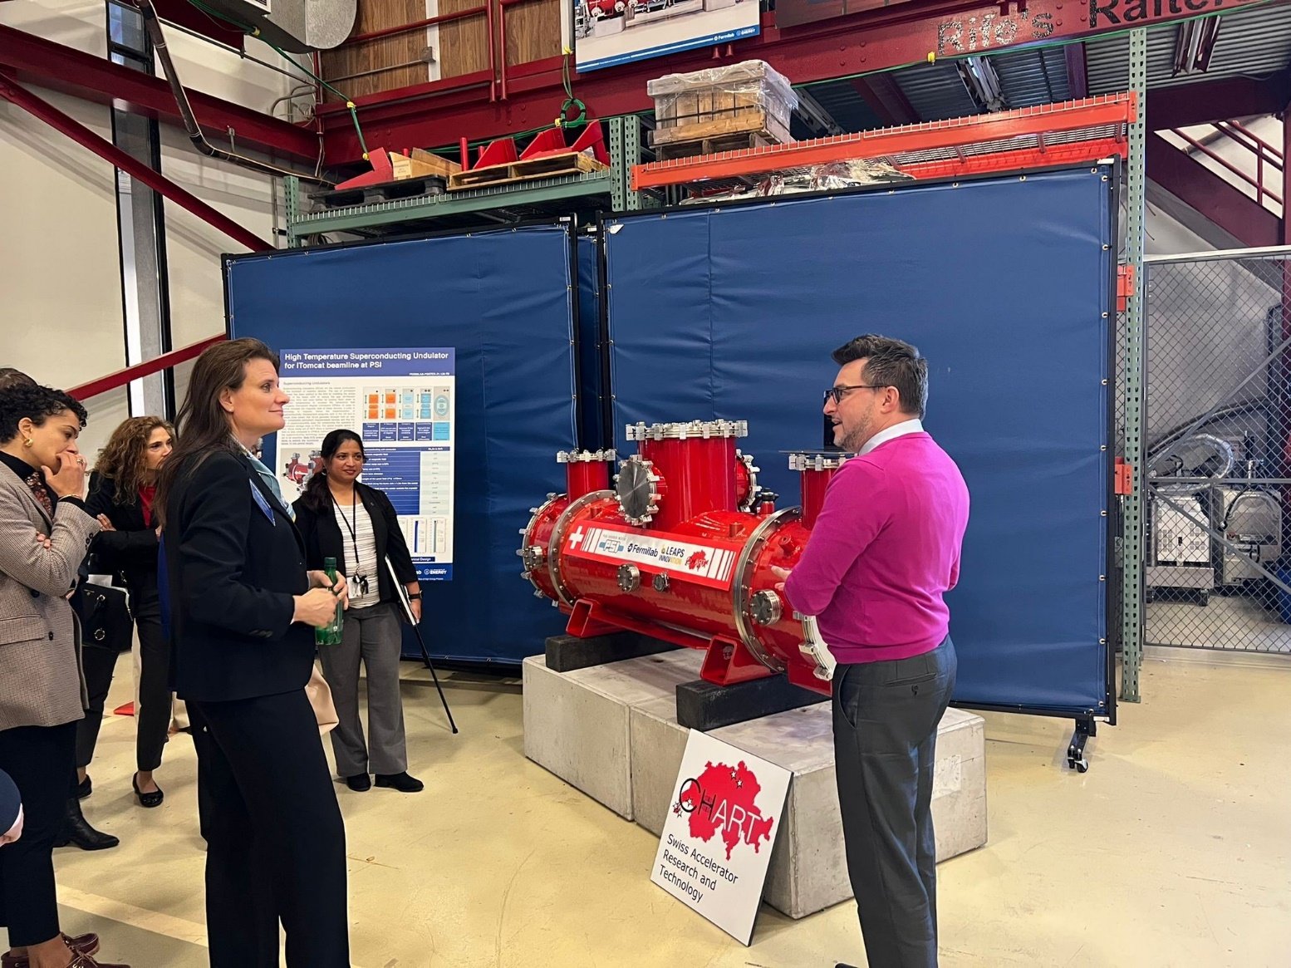

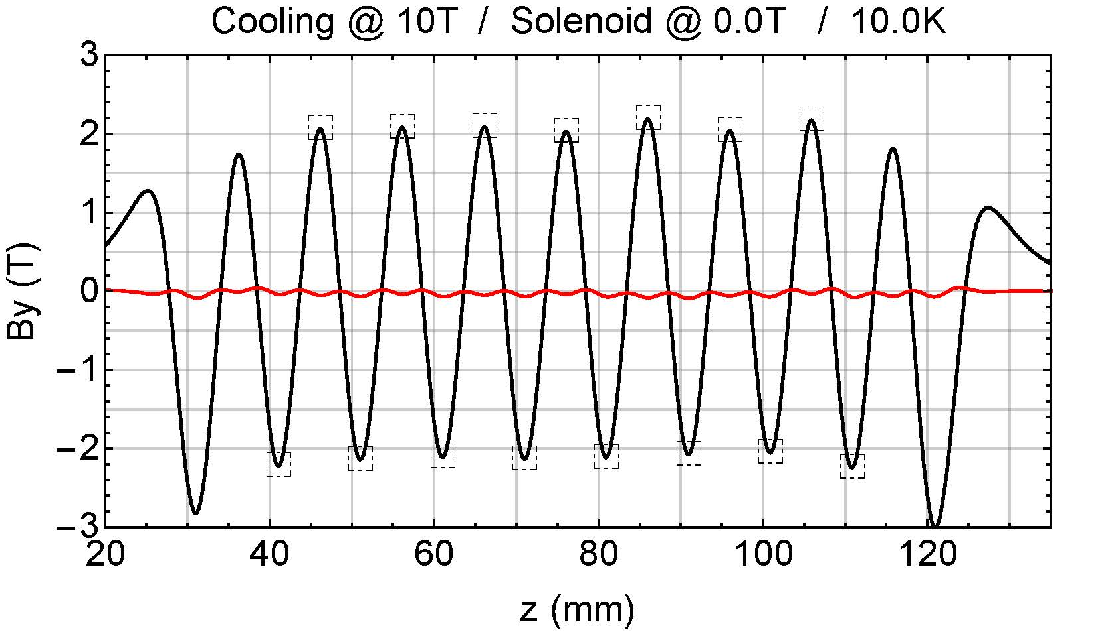
HTS superconducting magnet technology undulators synergy
Using bulk HTS material: has reached 2 Tesla for very short period magnets
Put the structure into a solenoid magnet, cool it and trap the field
Use of HTS material in different sectors increases our knowmledge
32
Curtesy of M. Calvi PSI

Slide 33
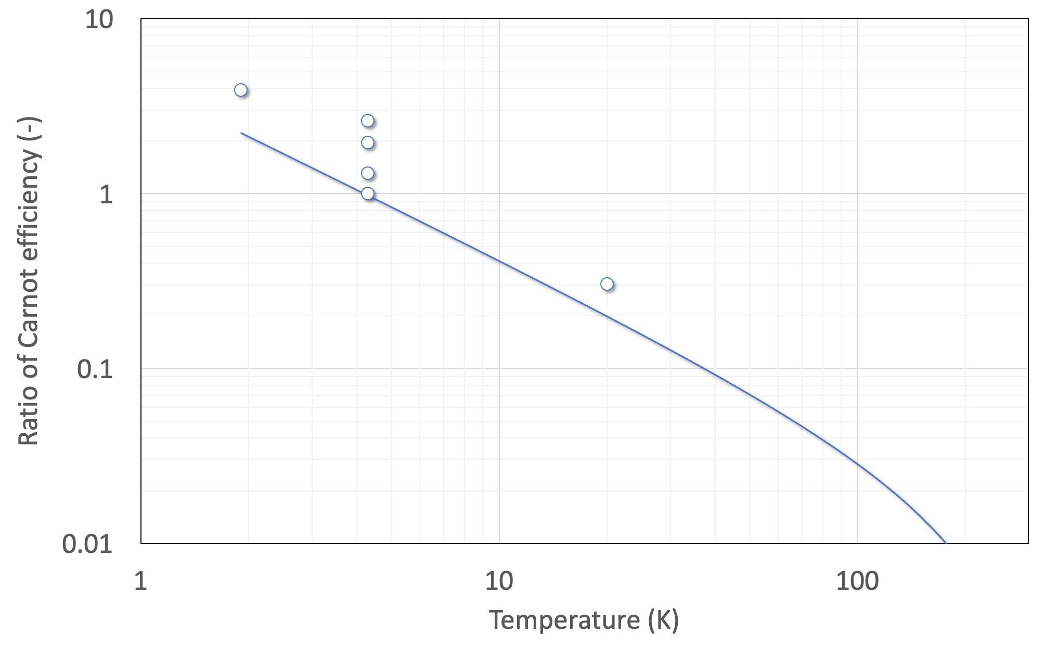
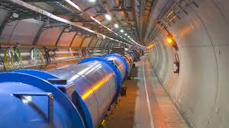
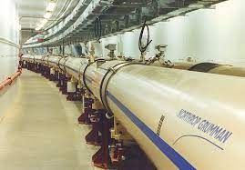



Energy efficient cryogenics
Credits to P. De Sousa and R. Van Weelderen, CERN
LHC
(FCC)
Need efficient cryo-plant and heat removal scheme in the range of 10…20 K (see work at ESS)
RHIC
Tevatron
HERA
LHC
Nb-Ti
8T
5T
ESS
The 60…80 K range would be a dream…
Nb₃Sn
16T
12…14T
This could be the best range of operating temperature of a future HEP collider
HTS
40…60T
20…40T
a few T
1.9
4.2
77
HTS may be the only path towards a future collider
33
Notes:
Energy efficiency motivation for HTS – 2. One of the means to achieve higher efficiency in superconducting magnets is to move towards operation at gemperature higher than liquid helium. Examples of existing refrigerator show that operation at 10…20 K can be more than an order of magnitude more efficient than liquid or superfluid helium. To be noted that the whole refrigeration and cooling process needs to be taken into account, and not only the cryoplant efficiency, which will likely imply modifications in the design of future magnets. HTS has the potential required for this paradigm shift.

Slide 34




Conductor cost
Grateful thanks to fusion !
Based on CERN orders and requests for quotations 2010-2022
Normalised costs are not aligned to currency, nor corrected for inflation
Mangnets represents ~70% of collider cost
Impressive cost reduction in HTS !
34
Notes:
Cost motivation for HTS – 4. A final and striking observation is that in the past 10 years HTS unit cost, as well as cost per unit current, has dropped steadily. Most recently, efforts towards magnetically confined thermonuclear fusion have induced a wave of upscaling in production capacity, which has produced a significant reduction in unit cost. Comparing scaled costs per unit length and current (12 T and 4.2 K) of best LTS and HTS materials, we are presently at a factor two in favor of LTS (NOTE: the same comparison at 16 T, 4.2 K yields comparable scaled costs). It is likely that we will witness a cross-over in the coming years, as HTS production continues to feed fusion needs.

Slide 35
Outlook
Landscape
Magnets R&D:
  Low Temperature Superconductors LTM
    Limits of Nb3SN
    Global effort, Cross-cutting activities
    Epoxy Example
  High Temperature Superconductors HTS
    HTS developments for HFM
    Material studies
    Ondulators
    Hybrid Magnets program 17 T
Beam dynamics: importance of modelling and design
  SuperKEKB → modelling and understanding
  Power efficiency during design and smart choices for operational scenarious
Summary
35

Slide 36


Smarter Design and new paths
SuperKEKB*
Accelerator design defines the requirements, tollerances and possibly can give important input to the design of future magnets
Improve models to increase beam dynamics understandings reproducing observations from existing machines (i.e. input models of material degradation SEY after huge beam losses)
Critical to understand (not necessarily fix) Super KEKB luminosity versus current and ‘fast beam loss’ challenges!

Slide 37

Smarter Design and new paths
HTS combined function magnets lattice FCC-ee
Accelerator design defines the requirements, tollerances and possibly can give important input to the design of future magnets
Improve models to increase beam dynamics understandings reproducing observations from existing machines (i.e. input models of material degradation SEY after huge beam losses)
Study alternative options (i.e. HTS combined function magnets for colliders by C. Garcia talk yesterday)
Cortesy Cristobal Garcia

Slide 38






Smarter Design and new paths
Accelerator design defines the requirements, tollerances and possibly can give important input to the design of future magnets
Improve models to increase beam dynamics understandings reproducing observations from existing machines (i.e. input models of material degradation SEY after huge beam losses)
Study alternative options (i.e. HTS combined function magnets for colliders by C. Garcia talk yesterday)
Study different operational scenarious (i.e. electron cloud induced heat load reduction)
Design to reach the goals but with a close contact to technology developments!
Electron Cloud heat-load studies
25 ns (2760b)
72b
25 ns slot
8b+4e (1972b)
Successfully tested in the LHC in 2015 and used in operation in 2017
25 ns
(2017)
8b+4e
(2017)
Cortesy of G. Iadarola, L. Mether

Slide 39
Summary
The HEP landscape is very reach and now a clear goal is defined → High Field Magnets
LTS→ fast and positive advancements 16 Tesla magnets seems more and more in reach!
    Re-thinking from material Nb3Sn, design, models, fast-turnaround of developments
    Demonstrators testing in coming years
    Scalability to large scale and robustness still needs to be proved
HTS → New technology advancing very fast but still with many un-knowns
    Material experience still very little
    Magnets design has to be redefined
    Very useful also for lower fields → more energy efficient
    Cost and prove of principle still far
Collider design:
  We need to understand the present before moving to the future→ SuperKEKB
  Close work with magnet people to define together the future magnet design and operational scenarious
  A major re-thinking of the optics design and mode of operation is required

Slide 40
Summary
The HEP landscape is very reach and now a clear goal is defined → High Field Magnets
LTS→ fast and positive advancements 16 Tesla magnets seems more and more in reach!
    Re-thinking from material Nb3Sn, design, models, fast-turnaround of developments make technology ad
    Demonstrators testing in coming years
    Scalability to large scale still needs to be proved
HTS → New technology advancing very fast but still with many un-knowns
    Material experience still very little
    Magnets design has to be redefined
    Very useful also for lower fields → more energy efficient
    Cost and prove of principle still far
Collider design:
  We need to understand the present before moving to the future→ SuperKEKB
  Close work with magnet people to define together the future magnet design and operational scenarious
  A major re-thinking of the optics design and mode of operation is required
Fundamental ingredients: Interdisciplinary research, techinical exchange and coordinated network for fast turnaround of knowledge

Slide 41
Material from FCC week
Andrzej Siemko and Bernard Auchmann High Field Magnets
Soren Preston The US Magnet Development Program
Amalia Ballarino HTS Developments
Luca Bottura HTS for Accelerators Status, Needs and Perspective at the Applied Superconductivity Conference
Marco Calvi

Slide 42

BOX Program example
1975 review paper of 1968-71 results
recommends wax or oil impregnation
Modern take on wax: combination with
stress-management extends the
validitity of the approach.
Pictures by M. Daly, S. Sidorov, S. Otten
Notes:
An effect already observed in the 1975 and not followed up. Now re-thiking and cross fields collaboration is allowing for a larger scale coordinated research plan. Pushing the technology faster.

Slide 43



The need for energy
CERN uses today 1.3 TWh per year of operation, with peak power consumption of 200 MW (running accelerators and experiments), dropping to 80 MW in winter (technical stop period)
Electric power is drawn directly from the French 400 kV distribution, and presently supplied under agreed conditions and cost
Supply cost, chain and risk are obvious concerns for the present and future of the laboratory
Notes:
Energy efficiency motivation for HTS – 1. The typical consumption of a laboratory at the scale of CERN is large. Future costs and acvailability of power are inducing reflections on the way energy is procured and used. Future projects will have to strive to minimize electricity consumption, maximise efficiency.

Slide 44











FCC-ee R&D Examples
efficient RF power sources
(400 & 800 MHz)
efficient high-Q SC cavities
Slotted Waveguide Elliptical cavity (SWELL) for high beam current & for high gradient, seamless by nature – links to past work at ANL (Liu & Nassiri, PRAB 13, 012001)
I. Syratchev
400 MHz 1- & 2-cell Nb/Cu, 4.5 K
high efficiency klystrons
& scalable solid-state amplifiers
FPC & HOM coupler, cryomodule,
thin-film coatings
I. Syratchev
under study: CCT HTS quad’s & sext’s for arcs
reduce energy consumption by O(50 MW)
energy efficient twin aperture arc dipoles
M. Koratzinos,
B. Auchmann
A. Milanese

