Slide 1

Brief News
CHIPP Road Map Meeting
27 August 2020

Slide 2
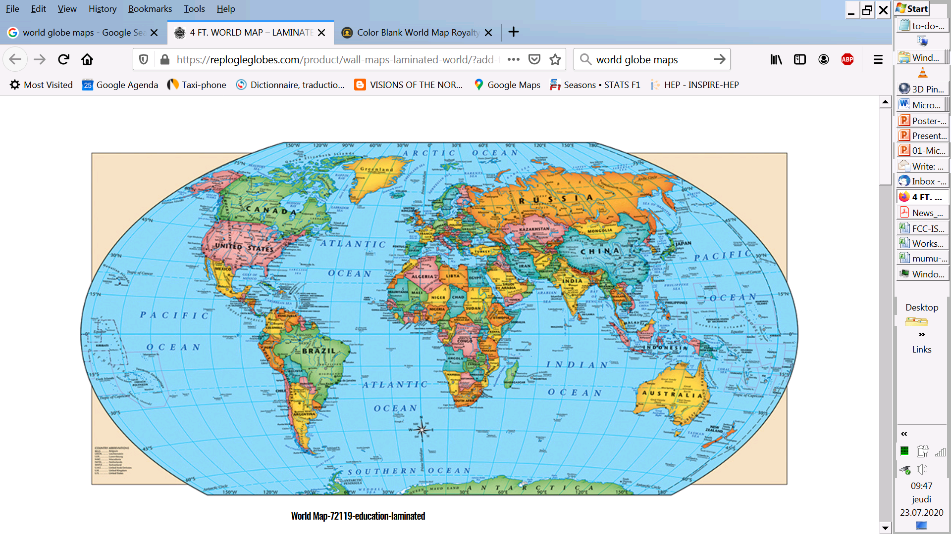

Our marching orders from ESPP 2020:
“Europe, together with its international partners, should investigate the technical and financial feasibility of a future hadron collider at CERN with a centre-of-mass energy of at least 100 TeV, and with an electron-positron Higgs and electroweak factory as a possible first stage. Such a feasibility study of the colliders and related infrastructure should be established as a global endeavour and be completed on the timescale of the next Strategy update.”
Every word and character counts: feasibility of the colliders (ee and hh) and related infrastructure.
-- confirmed in meeting with DG on 14 July ➔ studies continue with 2013 mandate for now
-- FCC is the highest priority for Europe and its international partners

Slide 3
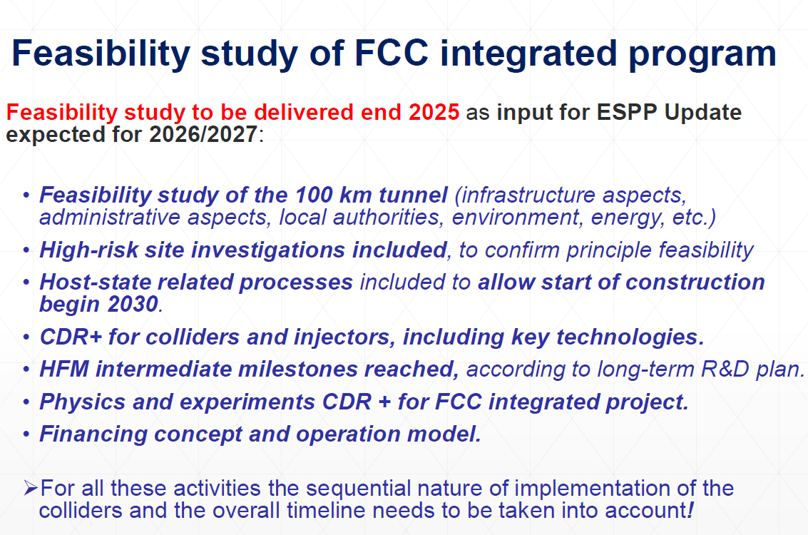
FCC (ee, then hh)
M. Benedikt

Slide 4
Will include CERN-PH FCC group

Slide 6
Compare with LEP/LHC
76
81 <- construction ->
89
2000
2010
2038
12 years operation
8+2 years installation
28 years operation
64
20
2038
15 years operation
1
2
3
4
5
6
7
8
9
10
11
12
13
14
15
16
17
18
15 years operation
34
35
36
37
38
39
40
41
42
43
~ 25 years operation
70
Project preparation &
administrative processes
Permis-sions
Update
Permissions
Funding strategy
Funding and
in-kind contribution agreements
Funding and
in-kind contribution agreements
Geological investigations, infrastructure detailed design and tendering preparation
Tunnel, site and technical infrastructure construction
FCC-ee dismantling, CE & infrastructure adaptations FCC-hh
FCC-ee accelerator R&D and technical design
FCC-ee accelerator construction, installation, commissioning
FCC-hh accelerator R&D and technical design
FCC-hh accelerator construction, installation, commissioning
Set up of international experiment collaborations, detector R&D and concept development
FCC-ee detector technical design
FCC-ee detector
construction, installation, commissioning
FCC-hh detector R&D,
technical design
FCC-hh detector
construction, installation, commissioning
Superconducting wire and magnet R&D
SC wire and 16 T magnet R&D, model magnets, prototypes, preseries
16 T dipole magnet
series production

Slide 7
Swiss Accelerator Research and Technology
CHART Collaboration
Commitments from SERI, ETHs, PSI, UniGE and CERN for a total sum of 40 MCHF to fund these activities for the next 5 years
Main activities:
-High field magnets (Nb3Sn and HTS)
-FCC-ee injector study, including a positron target exp’t at Swiss FEL PSI
-3D geology model of the Geneva basin (Geology department of UNIGE)
-Geodesy and Survey concepts for FCC (ETHZ, Swisstopo, HEIG Vaud)
-Beam dynamics for FCC-ee and FCC-hh
ETHZ
EPFL
UniGE
Securing the future of CERN beyond LHC
L. Rivkin, M. Seidel

Slide 8
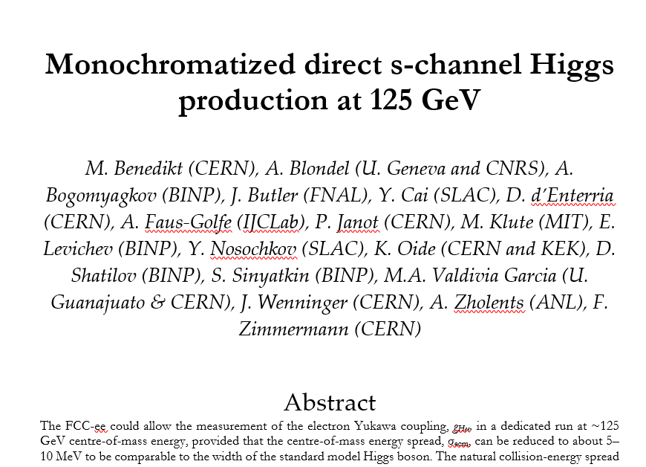
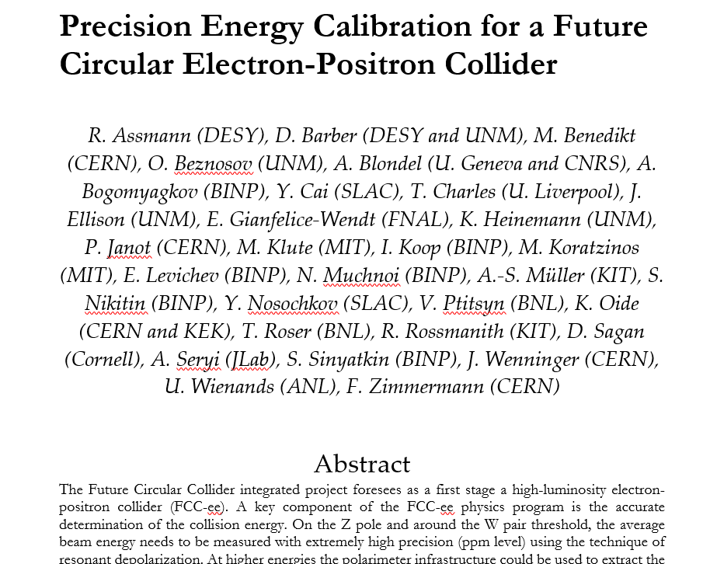
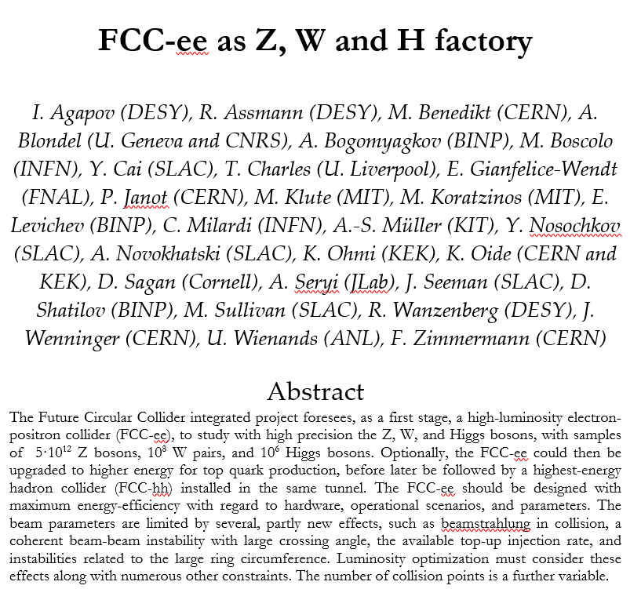
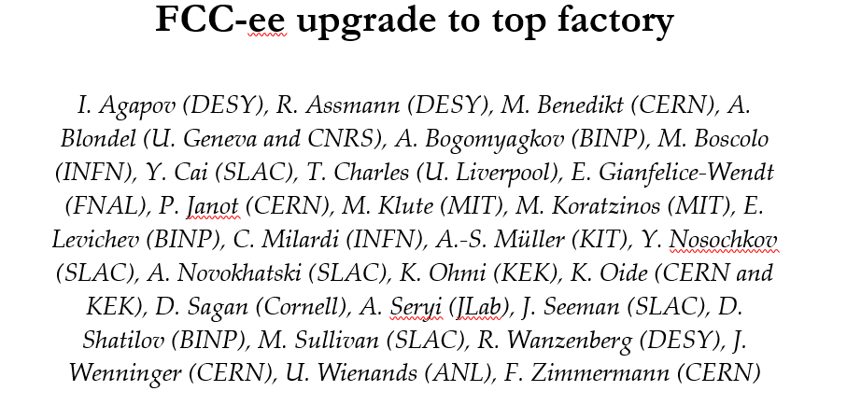
Presently setting up collaborations via the LOIs for SNOWMASS

Slide 9
FCC Physics and Experiments
In 2012-2019 the physics landscape and detector feasibility for FCC (ee&hh) was
established, by a relatively small group of people.
Best/unique for a very broad program (a Higgs factory and much more) well matched to the present physics landscape. (see spares)
Higgs (ee and hh) /Electroweak Precision (10⁻⁵)/flavours/QCD/BSM feeble (ee) High Mass (hh)
The greatest remaining challenge is the creation of a world-wide consortium of scientific contributors who reliably commit resources to the development and preparation of the FCC-ee science project from 2020 onwards. (from the FCC submission to the ESPP2020)
We thus concentrate now on detector design and collaboration forming for FCC-ee in view of protocollaborations by 2023 (→ LOIs for the next strategy)
Detectors for FCC-ee are similar to the ILC or CLIC concepts but the requirements are much broader and more demanding on systematic precision

Slide 11
Physics Performance group & conveners
The FCC-ee PE&D SG approved a proposal for a Physics Performance group.
Patrizia Azzi and Emmanuel Perez have agreed to serve as coordinators
operation (see next slide)
1. Physics working groups (conveners) → establish list of BENCHMARK MEASUREMENTS
-- each can correspond to several case studies
-- group case studies from different measurements for efficiency/consistency
-- will start with the Z (as in the run plan)
2. Case study teams establish DETECTOR REQUIREMENTS for optimizing measurement,
and in particular matching exp. systematics with the expected statistical precision.
-- one team already started: c vs b/g jets in Higgs (and Z) decays
3. This requires simulations of detector setup (fast sim or full sim as appropriate)
with help/guidance from detector experts

Slide 12
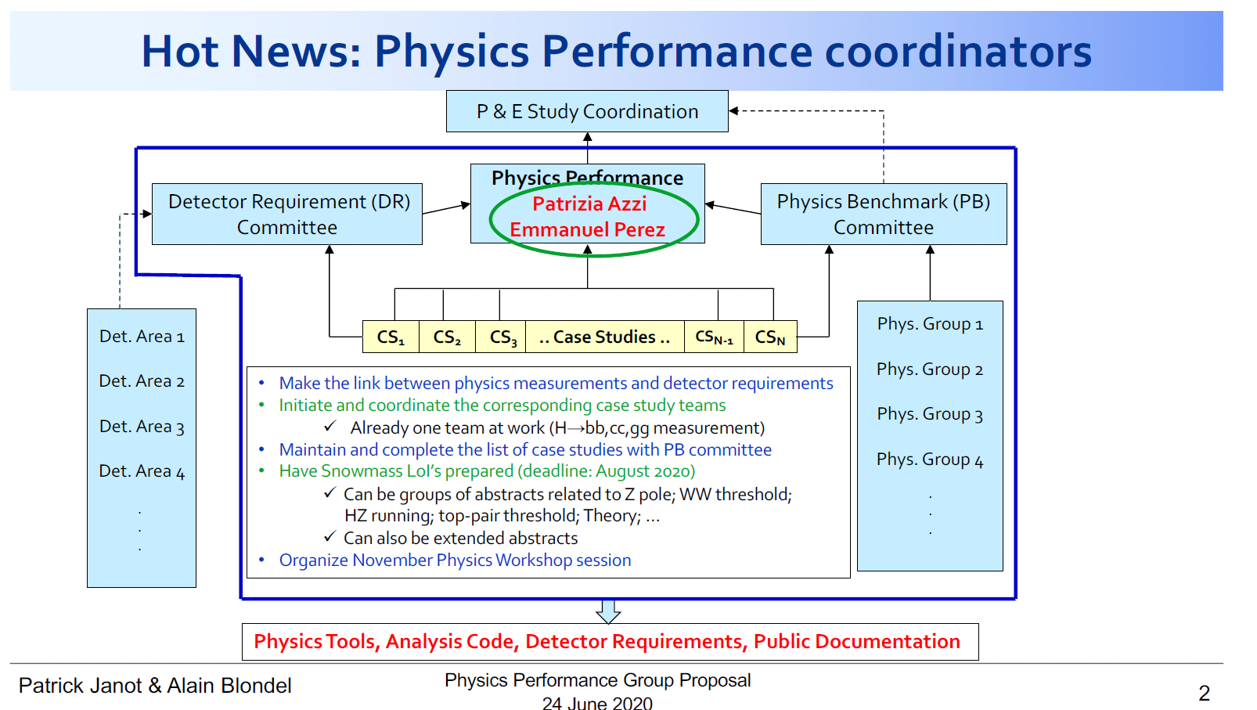

Slide 13
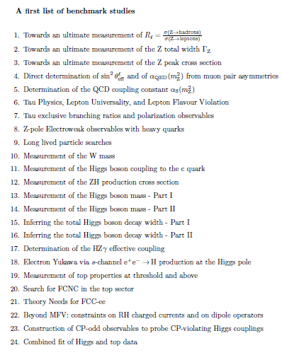
A first selection of Benchmark studies
(mostly experimental, some theory)
has already been prepared.
A list of abstracts is here:
https://www.overleaf.com/read/dyjpdszrqxhz
it will be regularly updated
This was also submitted to the SNOWMASS
process. https://snowmass21.org/ as LOI
If you are interested in contributing this is a
great way to start.
Now writing these up as LOIs by 31 August
Tera Z
τ, b,c
WW
H fact
ee→H
top
theory

Slide 14
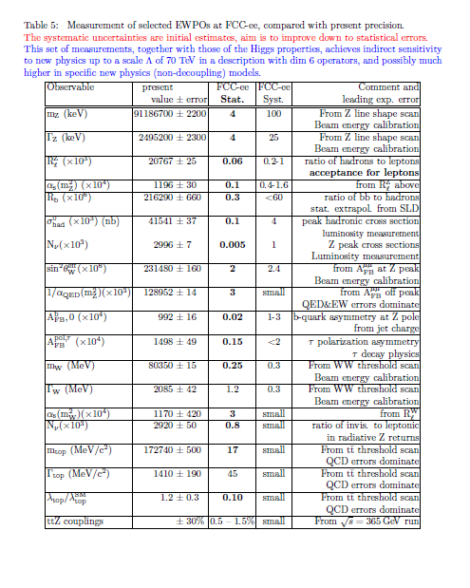
This table presents the statistical errors
for EWPOs, as given by the run plan.
It represents the real potential of FCC-ee
Systematics are ‘just a start’
and next challenge will be to
-- design detectors and analysis
and
--improve calculations/simulations
so that systematics ≈≤ statistics
One common mistake in all the
previous studies was to underestimate ….
the ability of a real group of collaborators
to exploit real data to reduce systematics

Slide 15
FCC-IS kick-off meeting and 4th Physics workshop
9-13 November https://indico.cern.ch/event/932973/
You can register already and let us know if you wish to present something
Rainer Wallny is member of the international program advisory committee

Slide 16
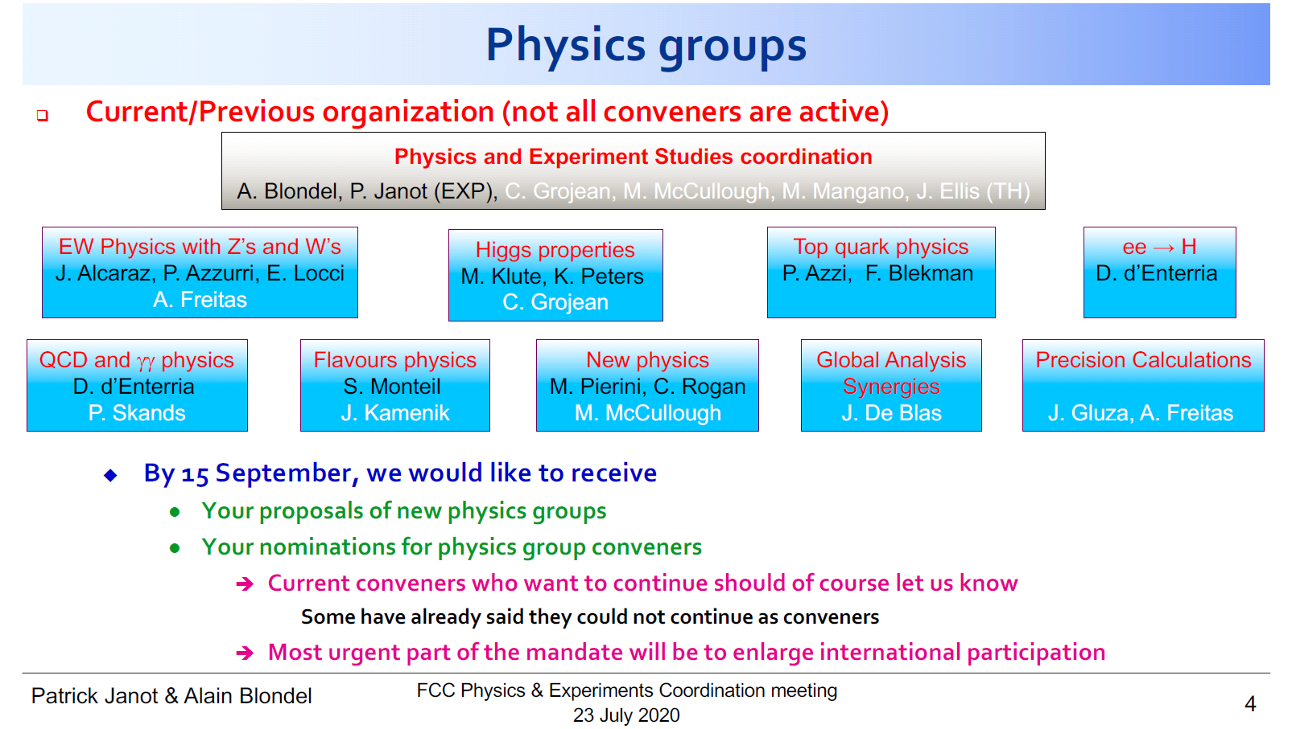
Freitas, J. Gluza
S. Heinemeyer
ex: tau physics, Long Lived Particles, (+FCC-hh)
self-nominations as group member
or convener are most welcome.

Slide 17
National FCC-groups for physics, experiments and detectors
Progress ongoing
-- FCC-FRANCE and ITALY: are well established already.
Contacts (G. Bernardi, R. Aleksan) (F. Bedeschi)
-- UK: lots of progress. Contacts in all HEP groups and at the two STFC lab sites (RAL and DL).
First meeting 11 September. (Christos Leonidopoulos, Guy Wilkinson)
-- Poland: (Tadeusz Lesiak) planning FCC information day at Epiphany conference in January 2021
-- Spain: starting within a national ‘future colliders’ structure (Juan Alcaraz)
-- CH well in the road map, CHART for accelerator (esp. ee injector complex, hh magnet R&D)
discussions on towards effort FCC funding. CH unambiguously supported FCC-INT project.
Rainer Wallny has agreed to serve as contact for the next workshop organization.
-- Begium and Netherlands (just starting, contact Freya Blekman)
-- Contacts with Germany (Heinemann, Simon), USA, Austria, Estonia etc..
have been initiated – to be followed.

Slide 18
SUMMARY
With all its careful writing the strategy gives CERN and its international partners
an unambiguous mandate:
Financial and technical feasibility study of the FCC colliders and infrastructure.
National groups are steadily being formed and seeking their own visibility/resources.
Organizing FCC-CH should be discussed for a scientific contribution matching/supporting
the already large infrastructure/accelerator contribution.
Mark the 4th Physics workshop in your calendars and join.
Time to go into high gear!

Slide 19
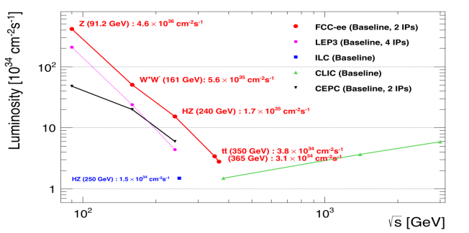
Z WW HZ tt
FCC-ee
LEPx10⁵!
Event
statistics :
E_{CM} errors:
Z peak E_{cm} : 91 GeV 5 10¹² e+e- → Z
WW threshold E_{cm} : 161 GeV 10⁸ e+e- → WW
ZH threshold E_{cm} : 240 GeV 10⁶ e+e- → ZH
‾tt threshold E_{cm} : 350 GeV 10⁶ e+e- →‾tt
LEP x 10⁵
LEP x 2.10³
Never done
Never done
<100 keV
<300 keV
2 MeV
5 MeV
Great energy range for the heavy particles of the Standard Model.

Slide 20
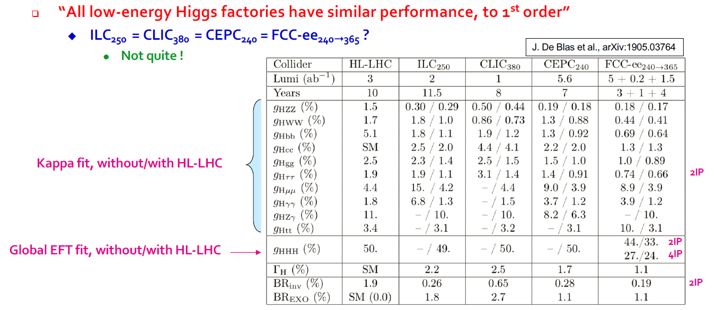
First stage ‘Higgs Factory’ (E_{CM} ≤365 GeV)
HL-LHC: alone requires
total width assumptions,
with e+e- → model indept
{
LHC-dominated
Higher luminosity of circular collider --> more statistics, in less time
- TeraZ program helps (arXiv:1907.04311)
- longitudinal polarization helps little if HL-LHC or Giga-Z are added

Slide 21
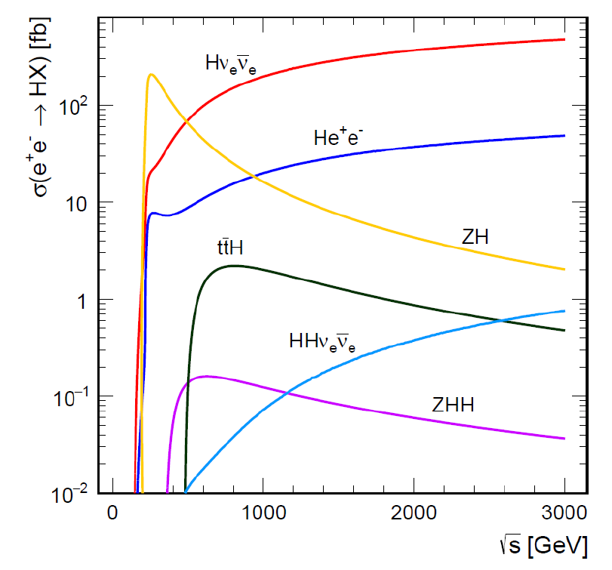
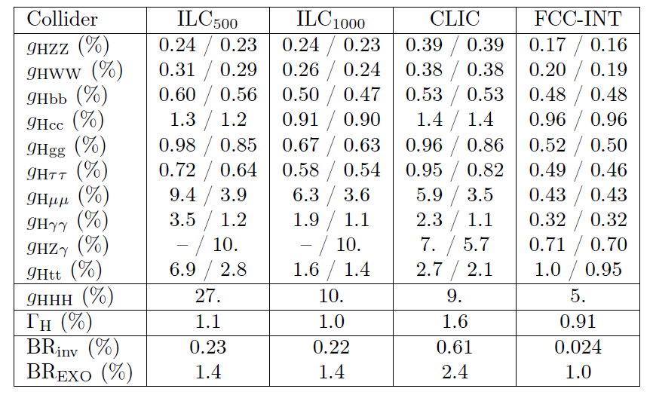
Higgs factories: FCC-ee + FCC-hh is unbeatable
}
ee
}
hh
±2(stat)±~3(syst)
FCC-hh (> 10¹⁰ H produced)
+FCC-ee measurement of g_{HZZ}
g_{HHH} , g_{Hγγ} , g_{HZγ} , g_{Hμμ} , BR_{inv}
(*)see M. Selvaggi, 3d FCC physics workshop,
9% precision in 3 years of FCC-hh running, 2004.03505v1

Slide 22
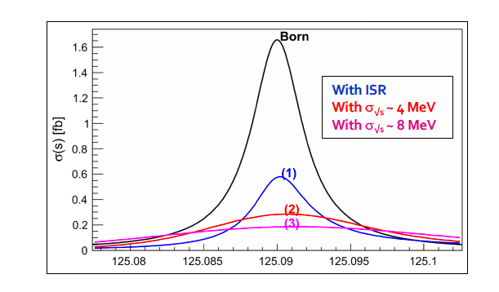
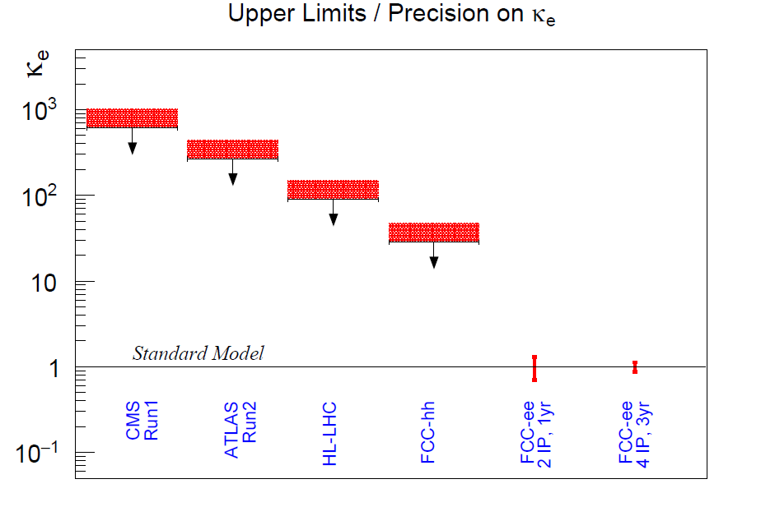
Something unique for FCC-ee: electron Yukawa coupling
Jadach & Kycia arXiv:1509.02406
e+e- → H @ 125.xxx GeV requires
-- Higgs mass to be known to <5 MeV from 240 GeV run (FCC: under study, CEPC group did it)
-- Huge luminosity (special single cell 400 MHz RF is foreseen for low energy runs)
-- monochromatization (opposite sign dispersion using magnetic lattice) to reduce σ_{ECM}
-- continuous monitoring and adjustment of E_{CM} to MeV precision (transv. Polar.)
-- an extremely sensitive event selection against backgrounds
-- typically 3 years doing this (also neutrino counting+ rare Z decay search with γtagged Ζγ evts)

Slide 23
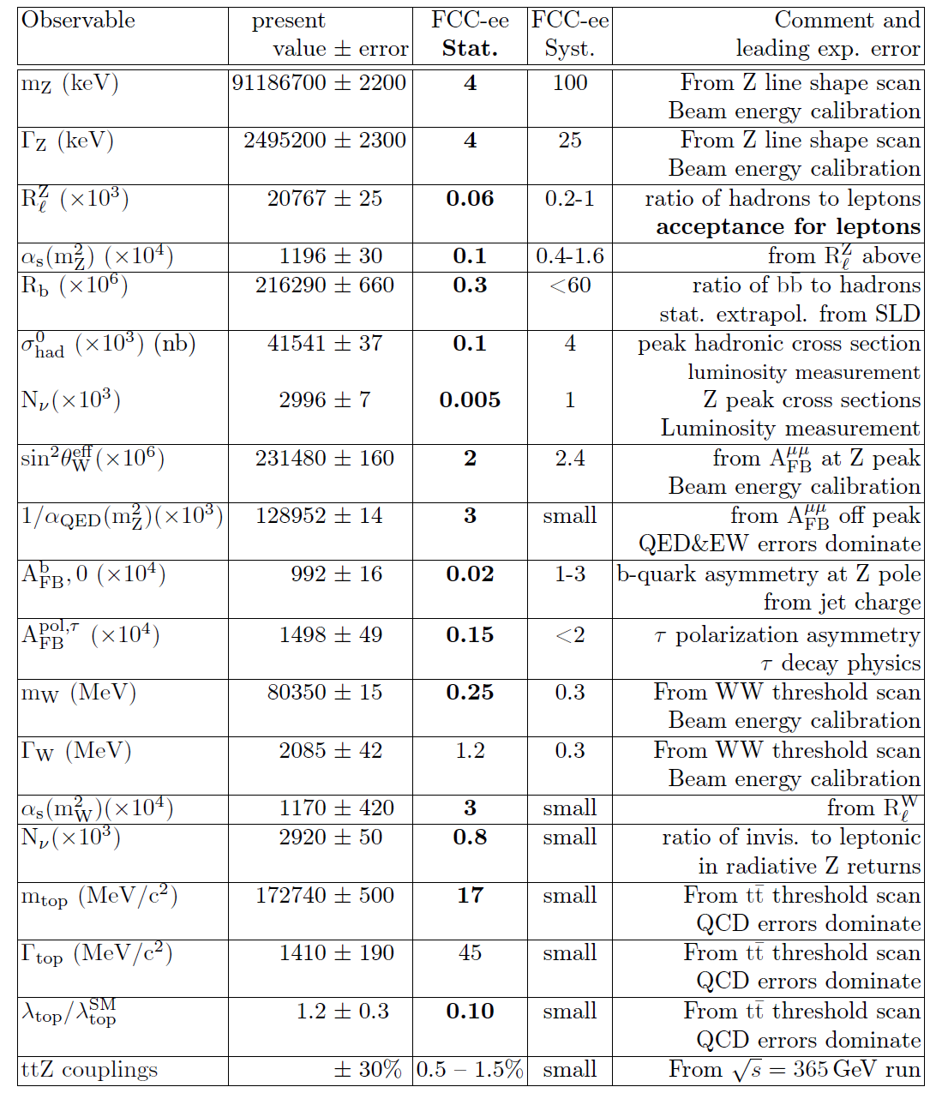
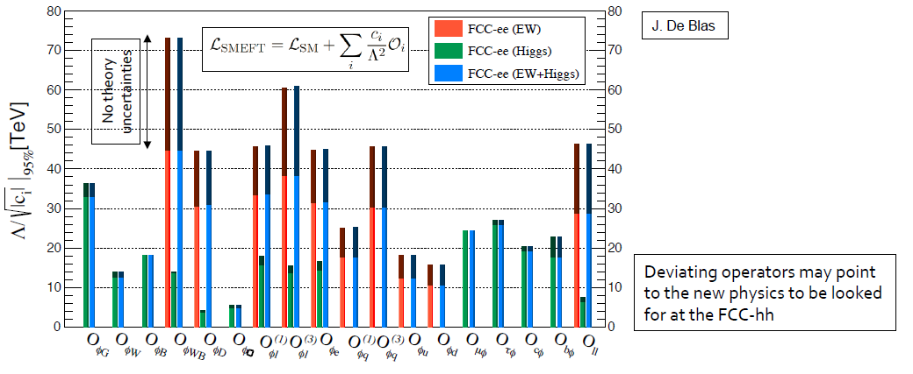
Precision EW measurements:
is the SM complete?
-^- EFT D6 operators (some assumptions)
-^- Higgs and EWPOs are complementary
-^- top quark mass and couplings essential!
(the 100km circumference is optimal for this)
<-- systematics are preliminary
(aim at reducing to systematics)
<-- tau, b, and c observables still to be added
<-- complemented by high energy FCC-hh
Theory work is critical and initiated 1809.01830

Slide 24
Electroweak Physics
Low Energy: the realm of FCC-ee
Highest luminosities at 91, 160 and 350 GeV
Transverse pol. at 91 and 160 GeV→Ecm calibration
m_{Z} (100 keV) Γ_{Z} (25 keV), m_{W} (<500 keV), α_{QED}(m_{Z}) (3.10⁻⁵)
and sin²θ_{w} at 310⁻⁶
Complete set of EW observables can be measured
Precision unique to FCC-ee + new physics sensitivity
a lot more potential to exploit
with good detector design than present treatment suggests

Slide 25
More on TeraZ
The Flavour Factory
Progress in flavour physics wrt SuperKEKb/BELLEII requires > 10¹¹ b pair events,
FCC-ee(Z): will provide ~10¹² b pairs. “Want at least 5 10¹² Z…”
-- precision of CKM matrix elements
-- Push forward searches for FCNC, CP violation and mixing
-- Study rare penguin EW transitions such as b ➝s 𝜏+ 𝜏− , σπεχτροσχοπψ (προδυχε β−βαρψονσ, Β_{σ} …)
-- Test lepton universality with 10¹¹ 𝜏 decays (with 𝜏 lifetime, mass, BRs) at 10⁻⁵ level, LFV to 10⁻¹⁰
-- all very important to constrain / (provide hints of) new BSM physics.
need special detectors (PID); a story to be written!
The 3.5 × 10¹² hadronic Z decay also provide precious input for QCD studies
High-precision measurement of αs(mZ) with Rℓ in Z and W decay, jet rates, 𝜏 decays, etc. : 10 ⁻⁻ ³ ➝10 ⁻⁻ ⁴
huge √s lever-arm between 30 GeV and 1 TeV (FCC vs ILC), fragmentation, baryon production ….
Testing running of αs to excellent precision

Slide 26
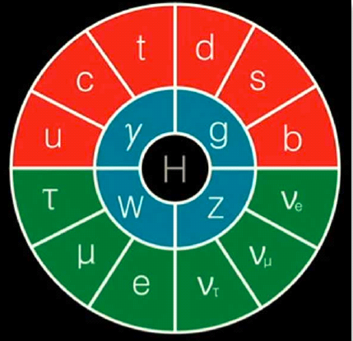
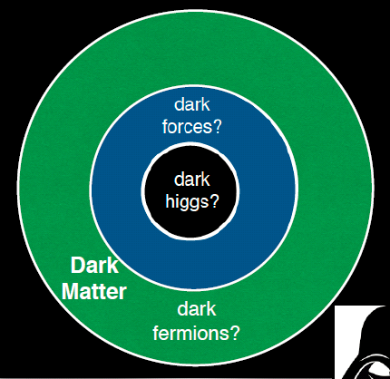
Dark Sector at Z factory
With the Higgs discovery SM works perfectly, yet we need new physics to explain the baryon
asymmetry of the Universe, the dark matter etc… without interfering with SM rad. corr.
mediator
or
mixing
S. Gori
Dark photons, axion like particles, sterile neutrinos, all feebly coupled to SM particles

Slide 27
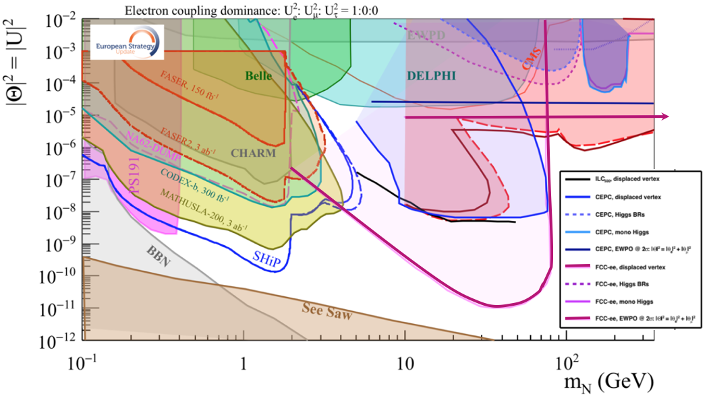
This picture is relevant to Neutrino, Dark sectors and High Energy Frontiers.
FCC-ee (Z) compared to the other machines for right-handed (sterile) neutrinos
How close can we get to the ‘see-saw limit’?
-- the purple line shows the reach for observing heavy neutrino decays (here for 10¹² Z),
-- the horizontal line represents the sensitivity to mixing of neutrinos to the dark sector,
using EWPOs (G_{F} vs sin²θ_{W}^{eff} and m_{Z}, m_{W}, tau decays) which extends sensitivity
to 10⁻⁵ mixing all the way to very high energies (60 TeV at least).

Slide 28
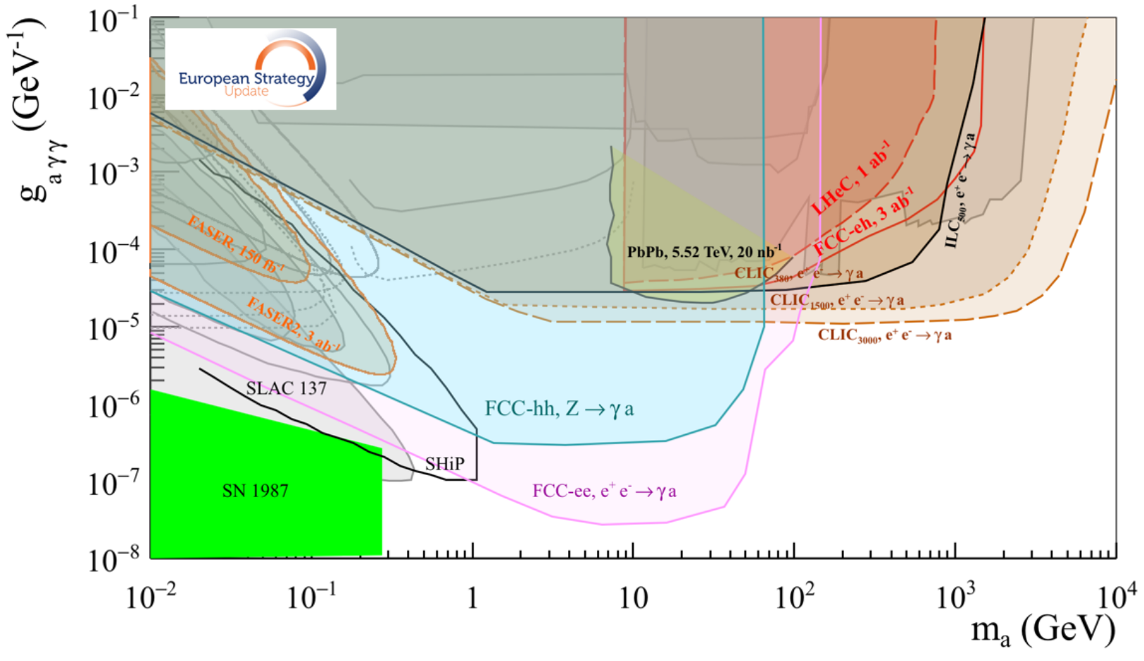
Similar situation for Axion-like-particles; Luminosity is key to the game
Complementarity with High energy lepton collider,
Much more left to explore at FCC-ee-Z and FCC-hh!

