Slide 1

Central Limit Theorems, Large Deviations and the Renormalization Group
Adam Rançon
Laboratoire PhLAM – Université de Lille
ERG 2024
23/09/2024
with Ivan Balog, Bertrand Delamotte, Félix Rose and Sankarshan Sahu
I. Balog, AR, B. Delamotte, PRL 129, 210602 (2022)
I. Balog, B. Delamotte, AR, arXiv:2409.01250 , arXiv:????.????
S. Sahu, B. Delamotte, AR, arXiv:2407.12603
F. Rose, I. Balog, AR, arXiv????.????

Slide 2
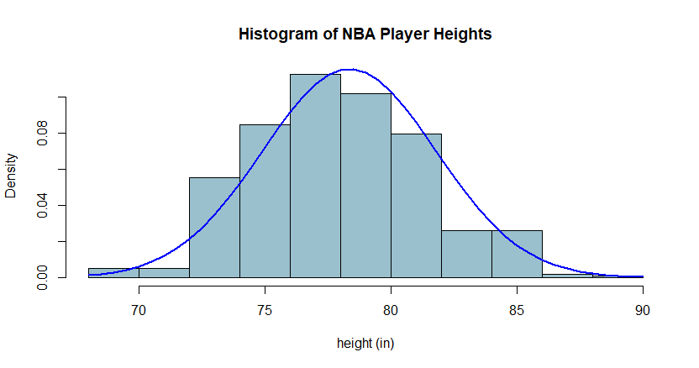
Introduction
Statistics/probability needed for complex systems (many degrees of freedom, correlations, etc.)
Ex: biology, demographics, engineering, finance, statistical physics, …
When d.o.f independent or weak correlations: Central Limit Theorem (CLT) and generalization (Levy distribution)
Normal distribution
Sum of independent random events

Slide 3
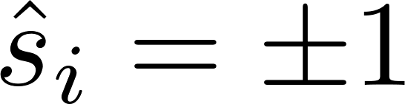
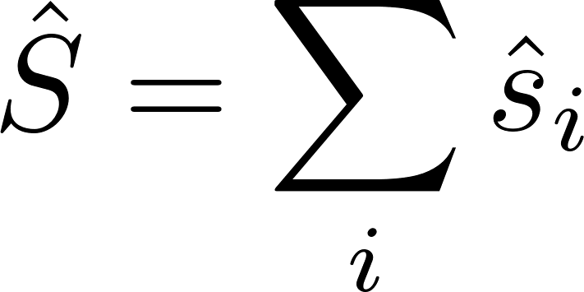
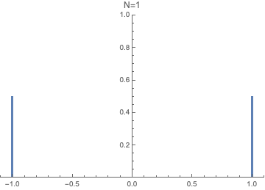
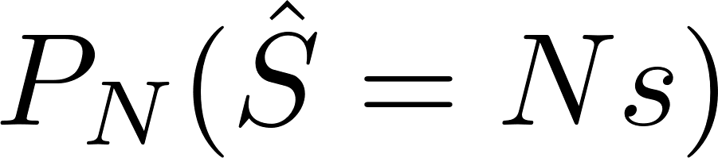
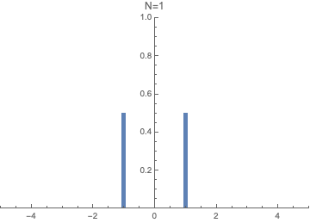
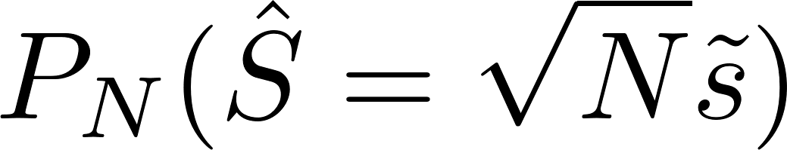


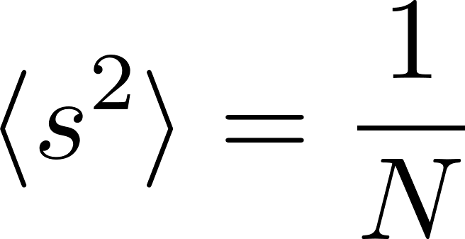
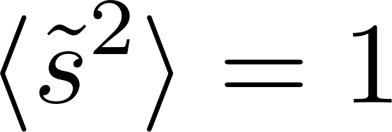
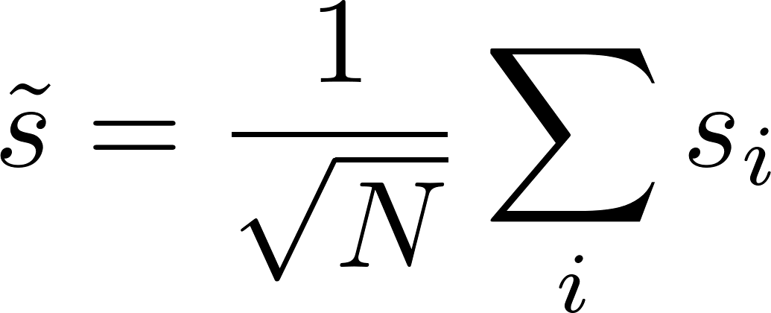
Central Limit Theorem
Take N random i.i.d variables (coin flips, spins, Brownian motion, Ising at T=∞)
Distribution of the sum for large N,
Law of large number
Central Limit Theorem (CLT)

Slide 4
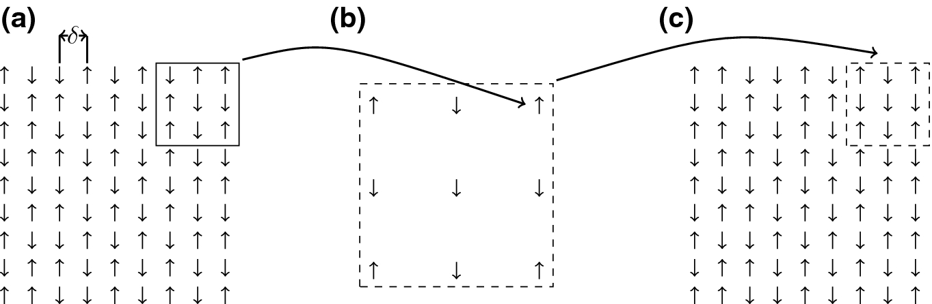
CLT from RG (block spins)
For independent variables
rescaling of the spins and lattice

Slide 5
CLT from RG (block spins)
For independent variables
rescaling of the spins and lattice

Slide 6
Example: CLT from blocking
For independent variables
rescaling of the spins and lattice
After many iterations: reaches fixed point

Slide 7
RG and CLT
Koralov & Sinai, “Theory of Probability and Random Processes”
- Gaussian distribution is the fixed point of a “coarse-graining” transformation
- Gaussian FP has: 2 relevant perturbations (normalisation and mean)
1 marignal perturbation (variance aka normalisation of variable)
∞-many irrelevant perturbations
- Eigenperturbations are hermite functions
- Very large bassin of attraction (all finite variance probabilities)
What about rare events ?

Slide 8
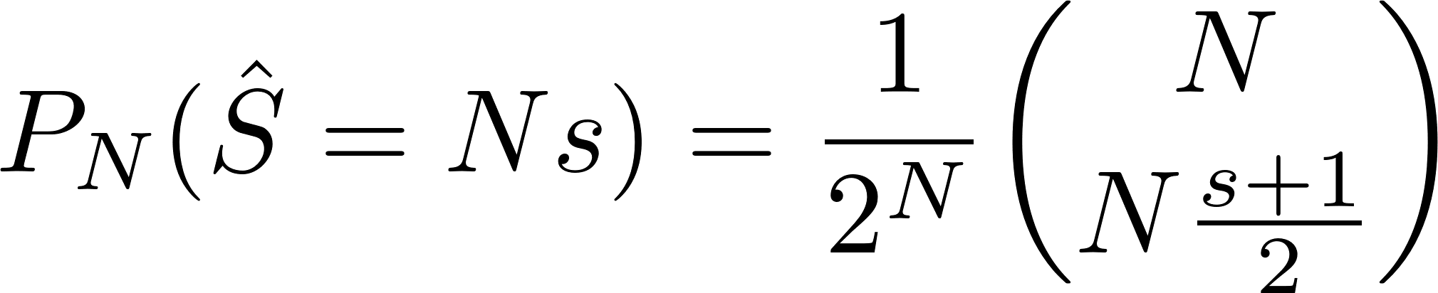

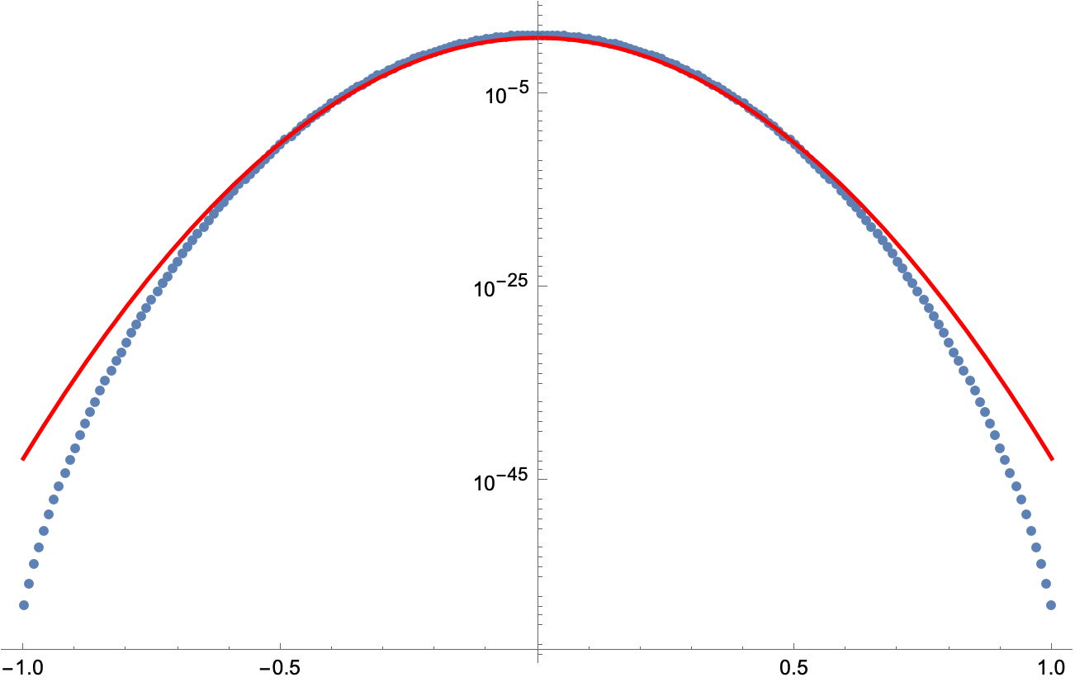
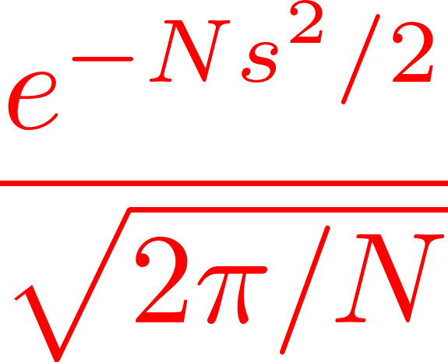
Large Deviation Principle
Large deviations = rare events beyond the CLT

Slide 9
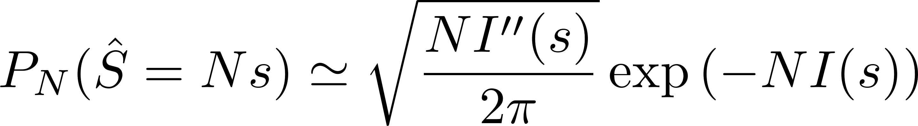
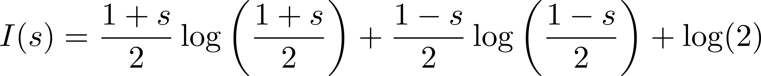
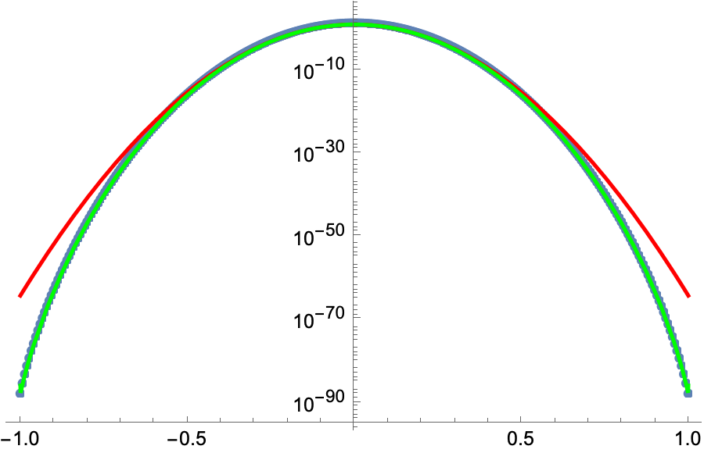
Rate function
Large Deviation Principle (LDP)
Rate function

Slide 10
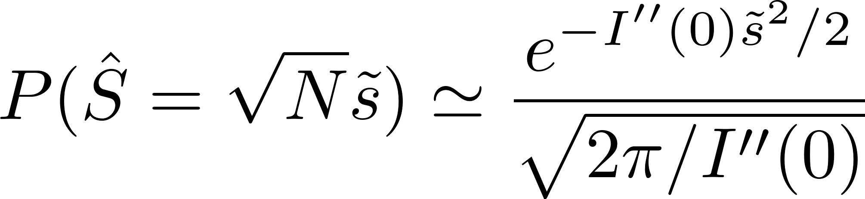
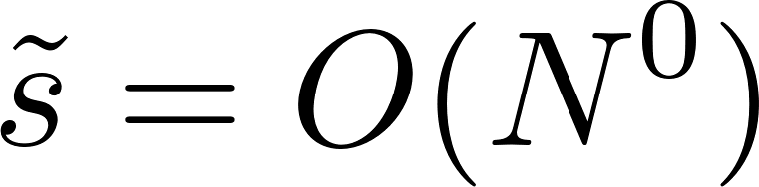
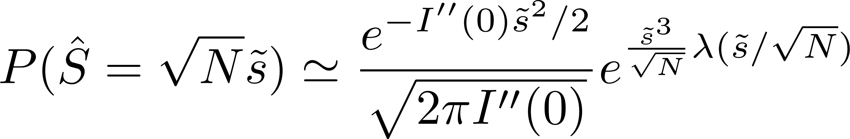
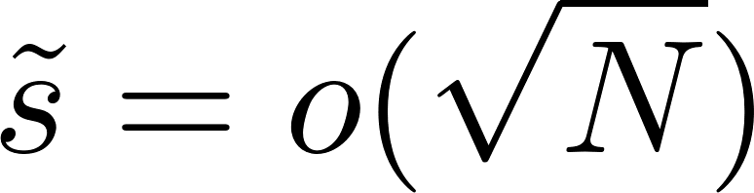
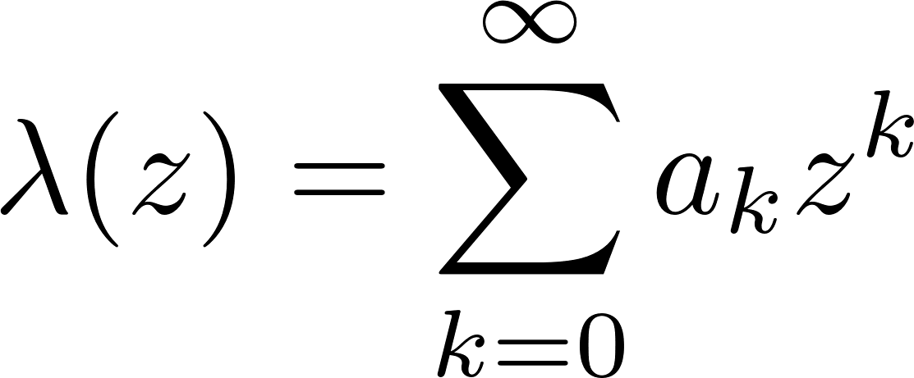
LDP to CLT (Cramer’s series)
Recovering the CLT from the LDP for
Universal (gaussian) law with one non-universal amplitude
“Finite size corrections”
Carmer’s series
Universal power of system size
non-universal amplitude

Slide 11
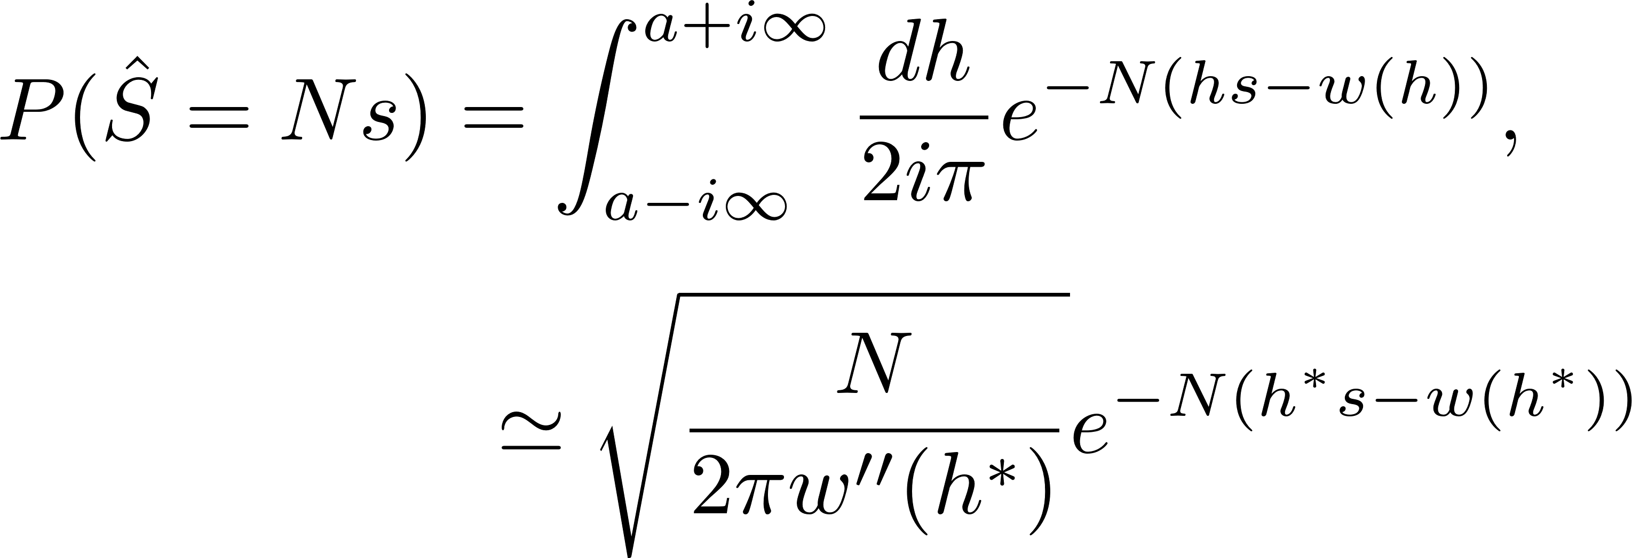
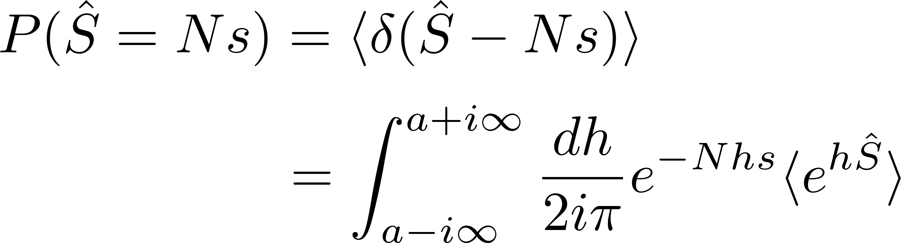
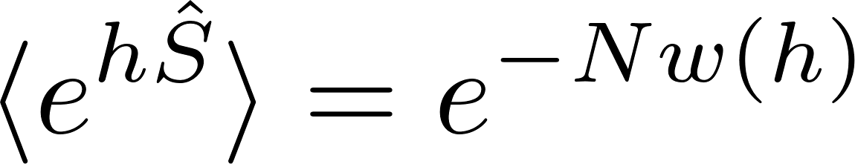
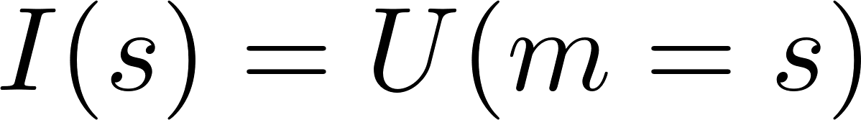
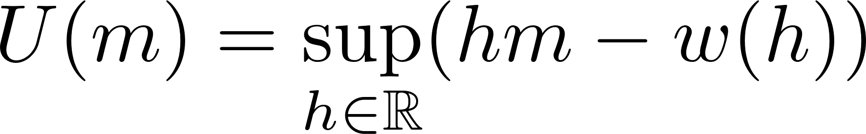
Rate function and Legendre transform (Cramer’s theorem)
saddle-point
Effective potential
Always convex
Valid in regions where rate function convex !

Slide 12
Strongly correlated variables ?
Generalization of CLT, LDP and Cramer’s series
from
(Functional) Renormalization Group
NB: connection between RG and CLT undertood already in the 70’s (Jona-Lasino)

Slide 13
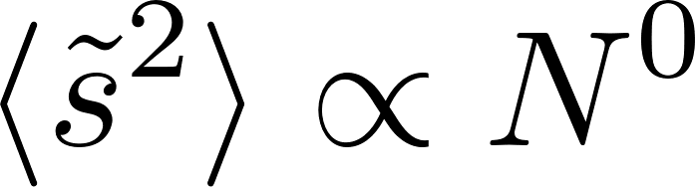
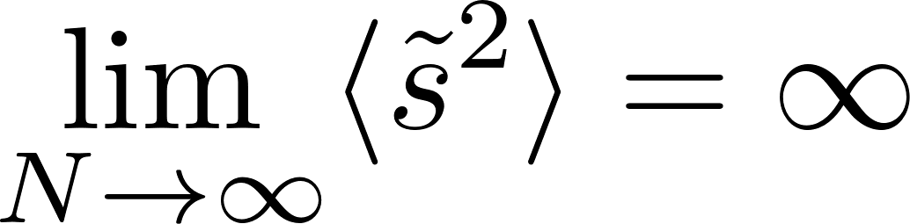
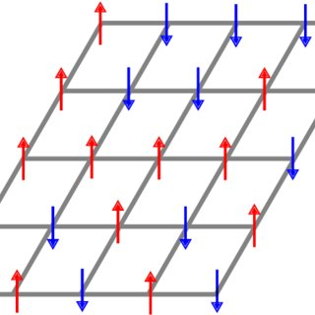
Generalized CLT for strongly correlated variables
Correlations:
Weak correlations:
Similar to i.i.d.’s: standard CLT
Strong correlations:
Example: Second order phase transitions
Standard model of statistical physics: Ising model
Energy of configuration:
Number of spins:

Slide 14
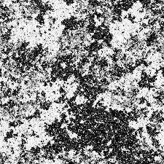
Basics of the Ising model
Phase transition from paramagnet at high T ( ) to a ferromagnet at low T ( )
High temperature (T>>T_{c}): finite correlation length
Close to T_{c}, many emergent phenomena:
- scale invariance at T_{c}
- scaling
- universality (e.g. liquid-gas critical point, many ferromagnets)
- conformal invariance, fractal dimension of domains,…
L

Slide 15
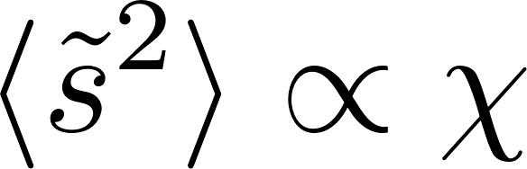
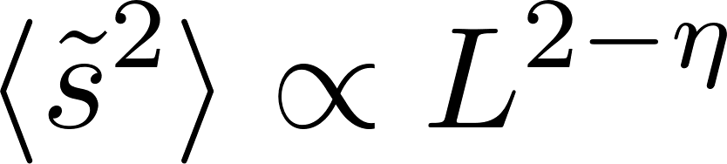
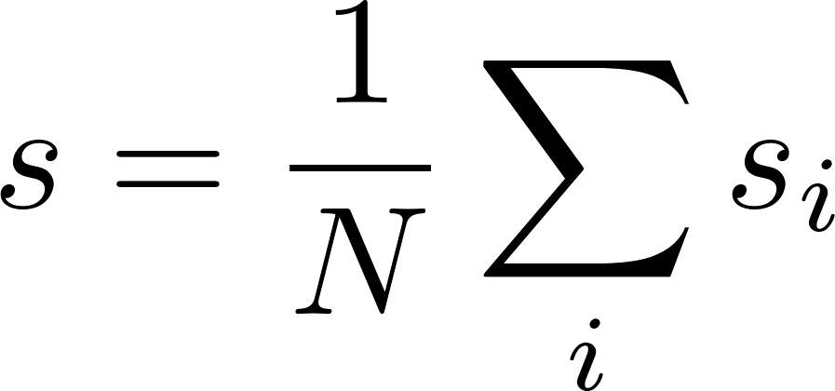
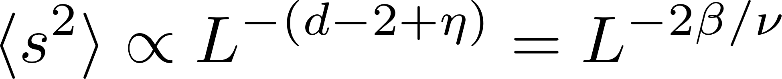
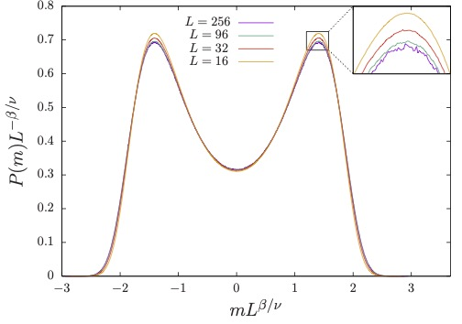
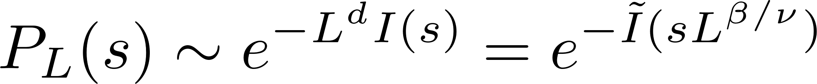
Distribution of the magnetization
High temperature phase: many independent blocks
Weak correlations and gaussian distribution
Exactly at T_{c} :
Strong correlations and non-Gaussian distribution
3D Ising model at T=T_{c}
Stable law
for strongly correlated variables
Xu and Landau ‘20
standard CLT

Slide 16
Understanding the scaling of typical magnetization fluctuations
Number of “truly correlated” spins with a spin at position i:
Assume that these correlated spins behave as a block-spin
Number of block spins
Total magnetization
is thus expected to have fluctuations of order
Bouchaud & Georges ‘90

Slide 17
Understanding the scaling of typical magnetization fluctuations
Block-spins are not independent, or we would recover the standard CLT
≠
We can’t glue systems of size L/2 to get a system of size L because of long-range correlations
Boundary conditions matter (Binder ‘81)
Can we still compute the stable law?

Slide 18
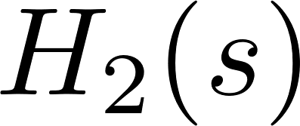
Renormalization group and CLT (bis)
Blocking procedure, again
At criticality, fixed point Hamiltonian for block-spin variables
Remark: explicit rigorous calculations of non-trivial critical PDF for hierarchical model (Sinai, Bleher, etc ’70s and ‘80s)

Slide 19
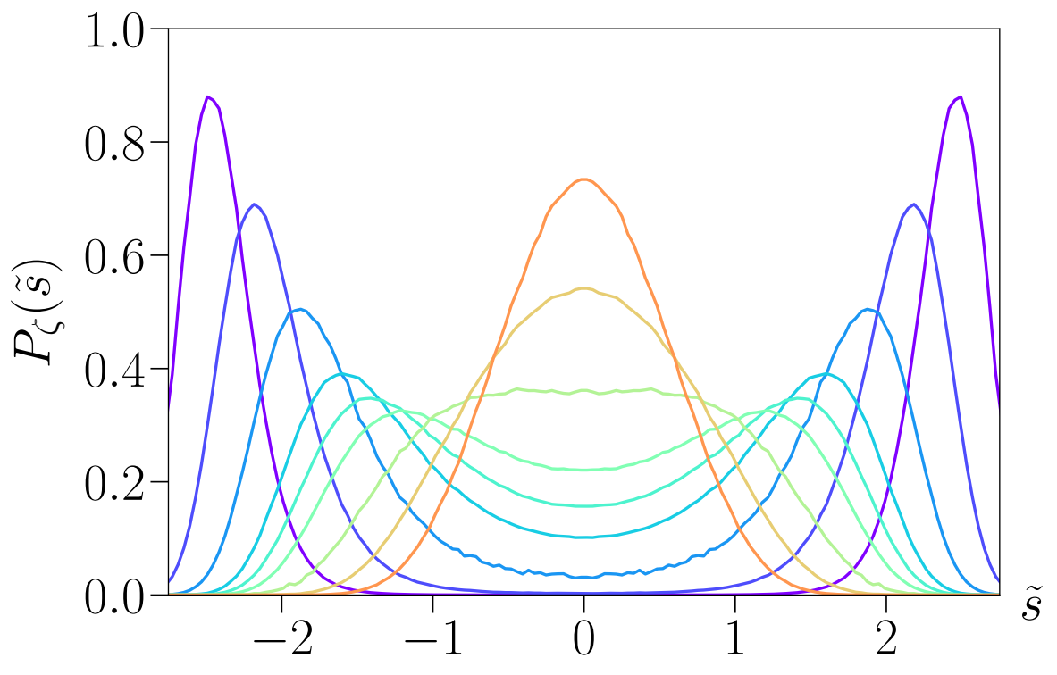
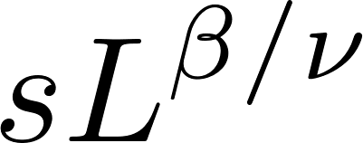
Generalized CLT from blocking?
Expectation
computed at 1-loop Bruce ‘81, Domb and Chen ‘96, Rudnik et al. ’98, Sahu et al. ‘24
Problems: - depends on blocking procedure (RG scheme)
- family of probability depending on ,
3D Ising

Slide 20
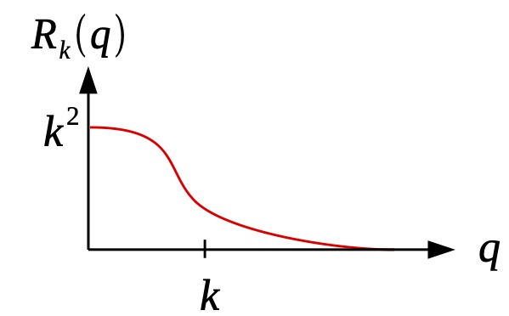
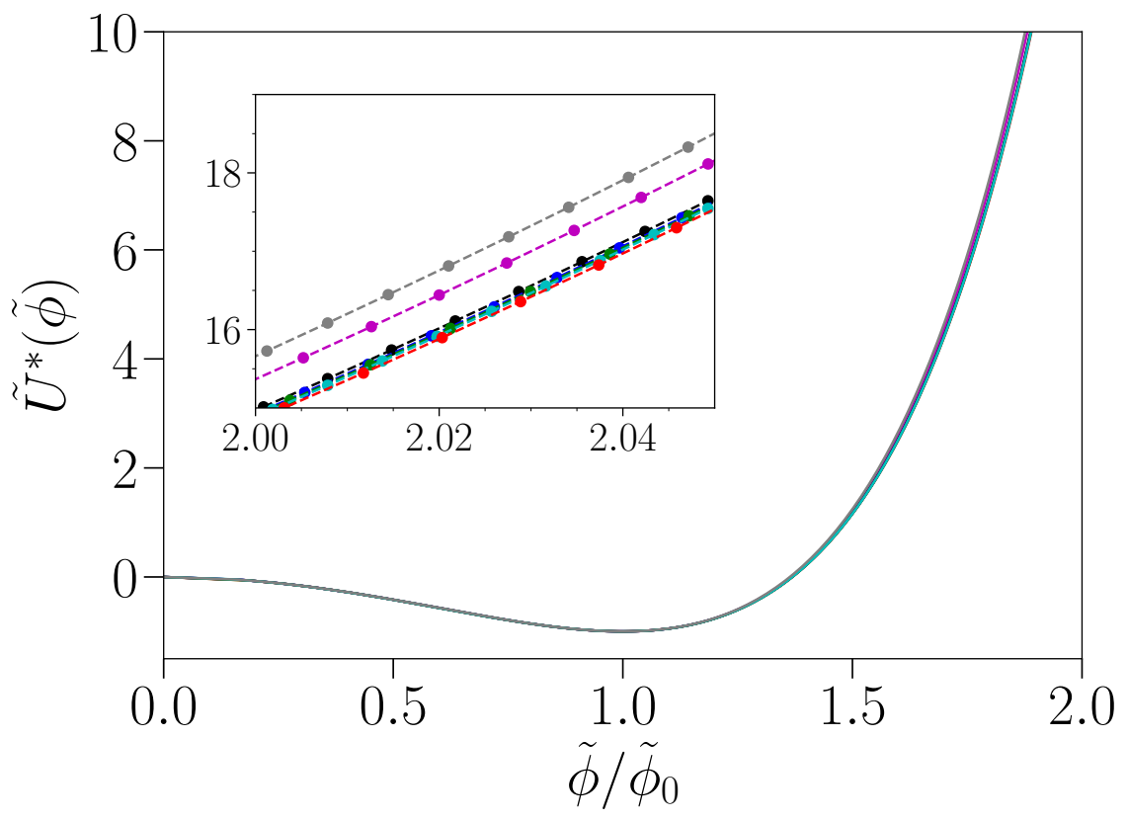
Functional RG
Scale-dependent Gibbs energy
(Wetterich ‘93)
Generalizes trivially to finite size (periodic BC)
see also Fister & Pawlowski ‘15
Fixed point (non convex)
return to convexity

Slide 21
Functional for the rate function
Define a “flowing” probability distribution and rate function
Problem: flow of the rate function is not closed
Define a (scale-dependent) “constraint effective action”
with
Flow equation of closed and
see Felix Rose’s talk at 3:30, Parallel session B
Balog et al ‘22

Slide 22
Flow equation for the rate function
Simple approximation: “Local Potential Approximation”
q≠0
Fixed point (non convex)
flow stops (non convex)
Balog et al ‘22

Slide 23
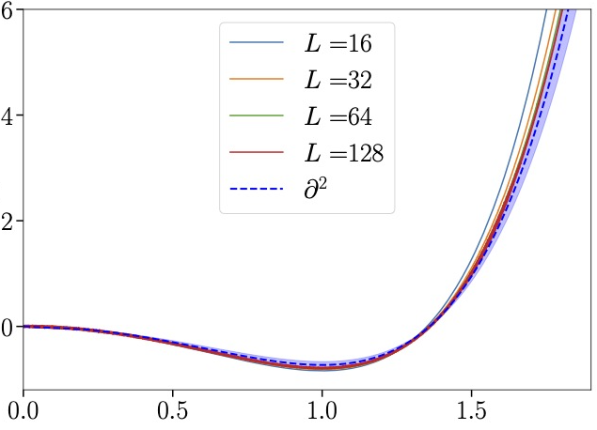
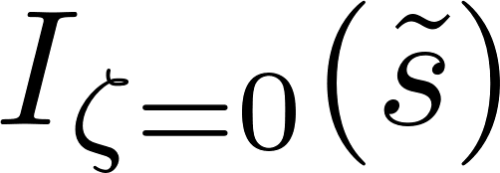
Convergence and comparison to Monte Carlo simulations
Possibility to do Derivative Expansion
(subtle, see F. Rose’s talk)
Comparison to MC (no fitting parameter)
Error bar estimated following Balog et al ‘19 & De Polsi et al ‘20
Rose et al ‘24

Slide 24
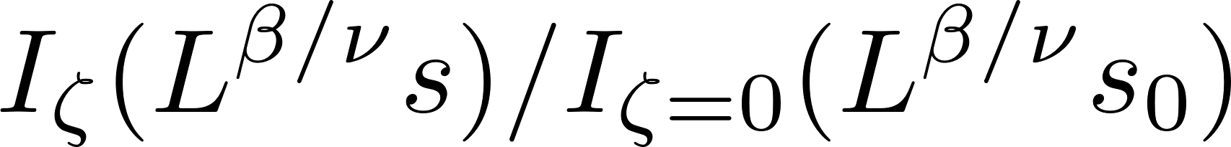
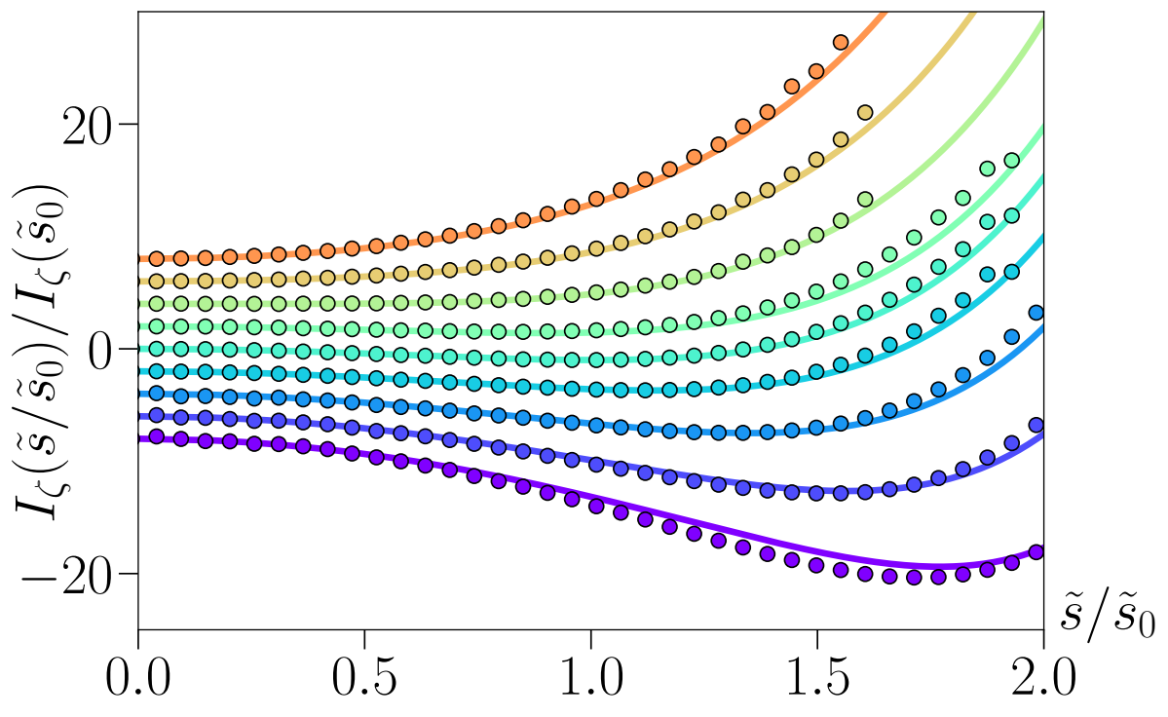
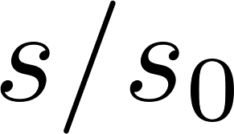
Family of rate functions
LPA
Shape of rate function at LPA correct for all 𝜻 up to global constant
(true also at 1-loop Sahu et al ‘24)
Balog et al ‘22

Slide 25
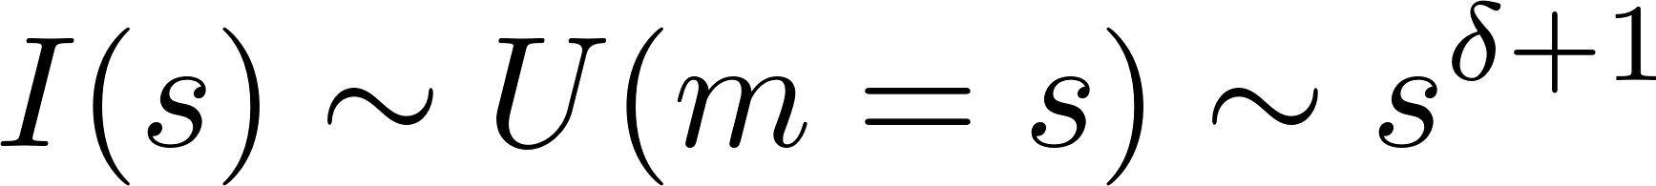
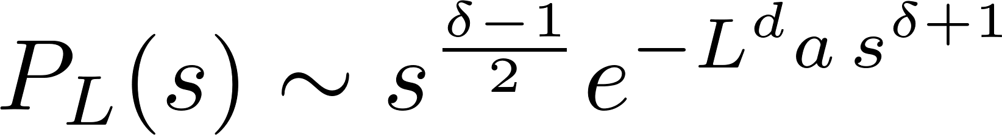
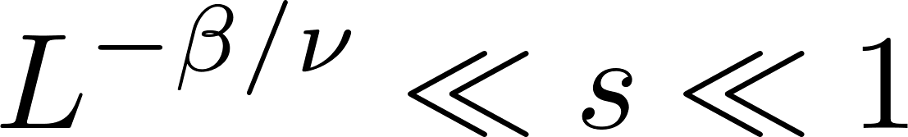



Critical rare event
Tail of distribution given by tail of rate function
Fisher ‘66, Tsypin ’94, Bruce ‘95
Universal Large Deviations in the regime
Can be generalized to model
Power law prefactor observed: MC Ising 3D, hierarchical model, large n, FRG LPA (n=1,2,3)
Balog et al ‘24

Slide 26


Non-universal large deviations and finite size correction
For , proba has to be non-universal: transition from universal to non-universal rare events?
Correction to scaling induced by finite size (established explicitely in large n)
universal
irrelevant perturbations
non-universal amplitudes
universal
critical exponents
(irrelevant)
Finite-size corrections-to-scaling generalizes Cramer’s series!

Slide 27




Conclusion
generalized
CLT
universal
large deviations
non-universal
generalized Cramer’s series
Perspectives: low-temperature phase, effects of domain walls, instantons, etc (cf Ivan Balog’s talk at 3:00, parallel session B)

Slide 29
Template

Slide 30
Return to convexity

Slide 31


Universality of critical PDF: rate function
Choose , such that is constant.

Slide 32
Probability distribution and RG fixed points
Direct connection between the probability distribution and RG fixed point quantities we compute?
Wilson’s RG
Fixed point coupling constants
Link between Wilson’s RG and probability distribution:
Bruce ‘81, Domb and Chen ‘96, Rudnik et al. ‘98,…
???
Based on perturbative RG, inclusion of finite size ad hoc…
and fixed point couplings are scheme dependent!?!

Slide 33

Comparison fixed point vs rate function

