Slide 1
Several Problems in Particle Physics and Cosmology Solved in One SMASH
Inflation, matter-anti-matter asymmetry, dark matter, neutrino oscillations, strong CP problem
Andreas Ringwald
FLASY 2018
Basel, 2-5 July 2018

Slide 2
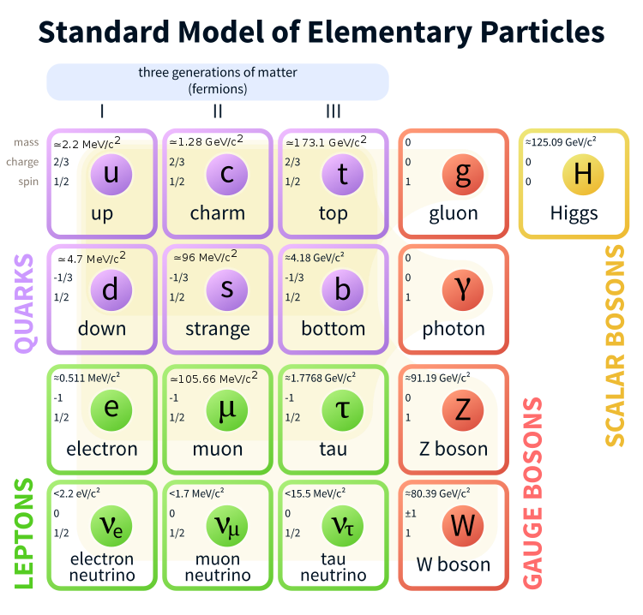
Introduction
Strong case for physics beyond the Standard Model
Standard Model (SM) describes interactions of all known particles with remarkable accuracy
[Wikipedia]
[twiki.cern.ch]

Slide 3
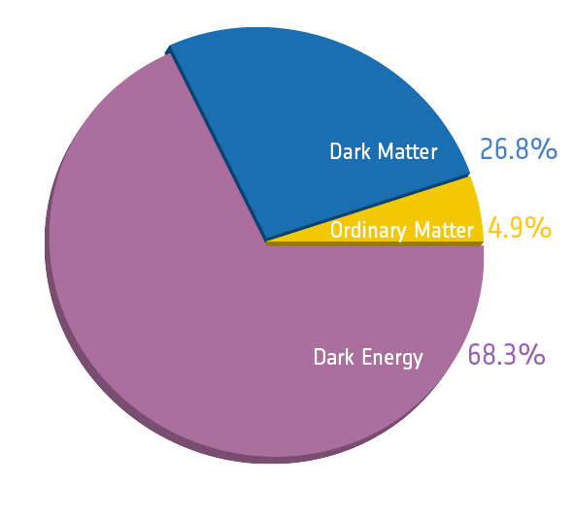
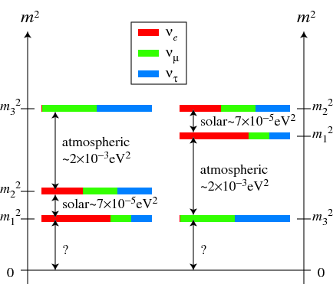
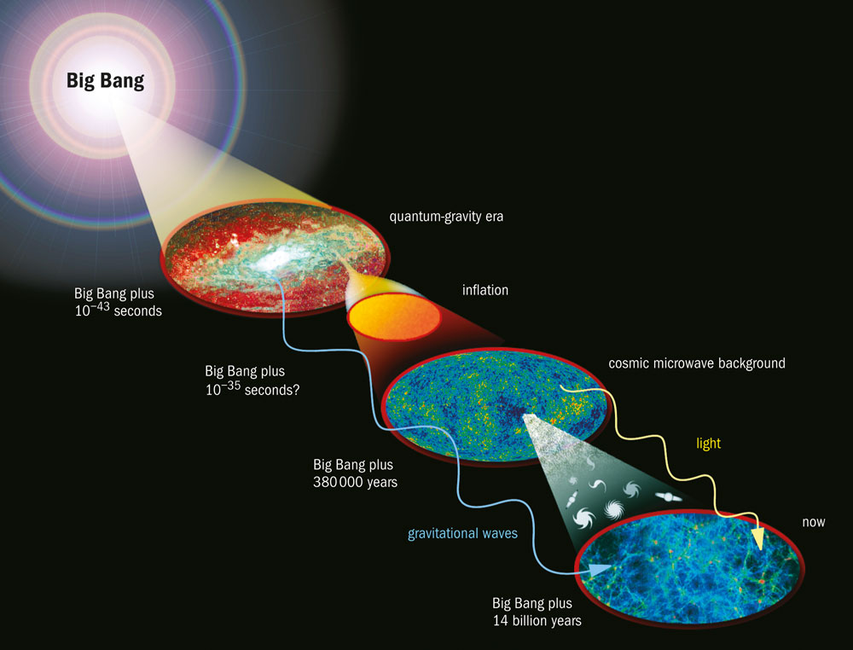
Introduction
Strong case for physics beyond the Standard Model
Observations in particle physics, astrophysics and cosmology strongly suggest physics beyond the SM
  Dark matter
  Neutrino masses and mixing
  Baryon asymmetry
  Inflation
  Strong CP problem
[PLANCK]
[King et al. 13]
[Rev. Part. Phys. 18]
[physicsworld.com]

Slide 4
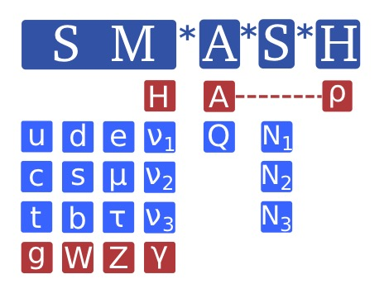
Introduction
Strong case for physics beyond the Standard Model
Observations in particle physics, astrophysics and cosmology strongly suggest physics beyond the SM
  Dark matter
  Neutrino masses and mixing
  Baryon asymmetry
  Inflation
  Strong CP problem
These problems may be intertwined in a minimal way, with a solution pointing to a new physics scale between
[Ballesteros,Redondo,AR,Tamarit, 1608.05414; 1610.01639]

Slide 5
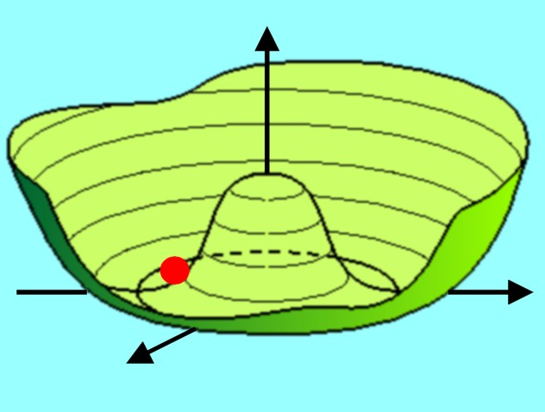
Peccei-Quinn Extension of Standard Model
UV completions yielding axion
A singlet complex scalar field , featuring a global symmetry, is added to SM
Symmetry is broken by vev
  Excitation of modulus:
  Excitation of phase: NGB
[Raffelt]

Slide 6
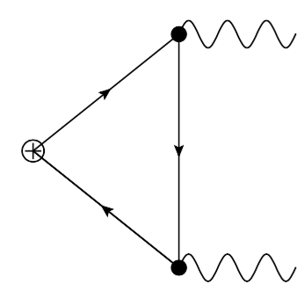
Peccei-Quinn Extension of Standard Model
UV completions yielding axion
A singlet complex scalar field , featuring a global symmetry, is added to SM
Symmetry is broken by vev
  Excitation of modulus:
  Excitation of phase: NGB
Colored fermions (SM or extra) carry PQ charges such that is broken due to gluonic triangle anomaly:

Slide 7

Peccei-Quinn Extension of Standard Model
UV completions yielding axion
A singlet complex scalar field , featuring a global symmetry, is added to SM
Symmetry is broken by vev
  Excitation of modulus:
  Excitation of phase: NGB
Colored fermions (SM or extra) carry PQ charges such that is broken due to gluonic triangle anomaly:
Low energy effective field theory at energies above but below :
[Peccei,Quinn 77; Weinberg 78; Wilczek 78]
[Kim 79;Shifman,Vainshtein,Zakharov 80;Zhitnitsky 80;Dine,Fischler,Srednicki 81;...]

Slide 8
Peccei-Quinn Extension of Standard Model
Axion couplings to SM at energies below QCD scale
Axion mass:
Couplings of axion to SM suppressed by powers of
rendering the axion „invisible“
Photon coupling:
Nucleon couplings:
Electron coupling very model-dependent
[Grilli di Cortona et al. `16 ;
Borsanyi et al. `16]
[Kim 79;Shifman,Vainshtein,Zakharov 80;Zhitnitsky 80;Dine,Fischler,Srednicki 81;...]
[Kaplan 85;Srednicki `85]
[Grilli di Cortona et al. `16]

Slide 9
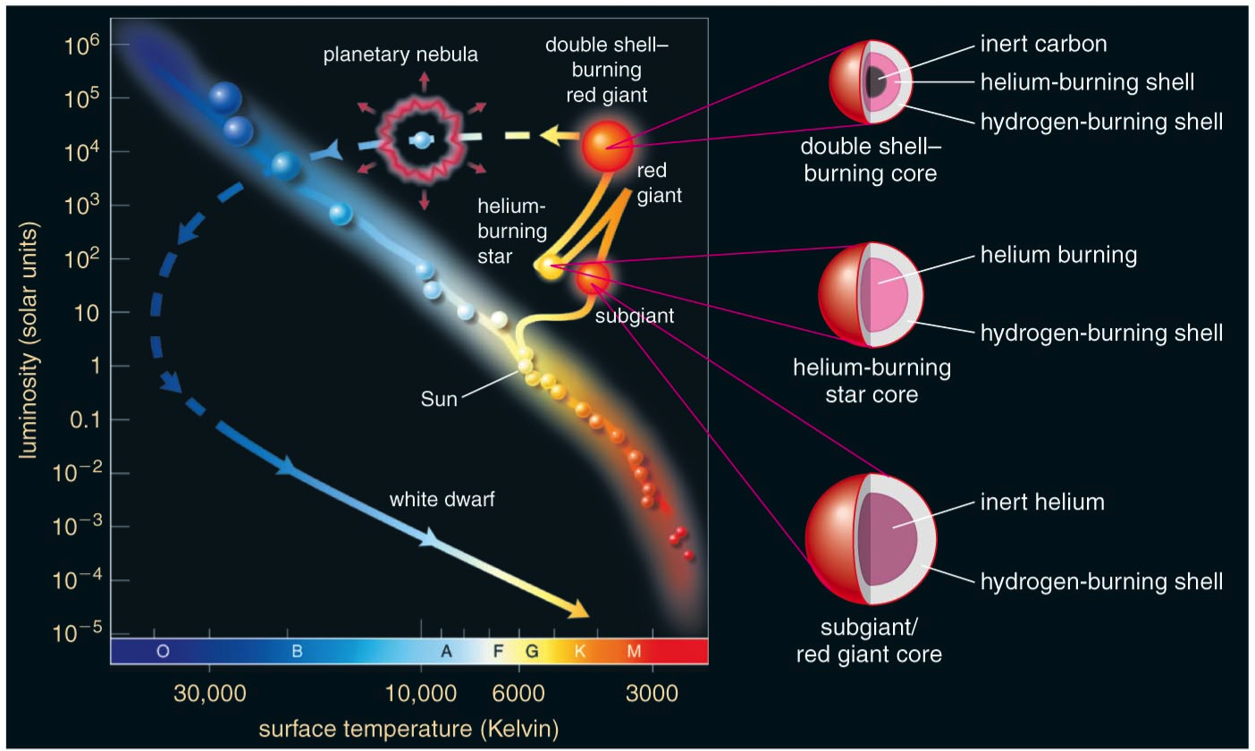
Astrophysical Hints for Axions/ALPs
Excessive stellar energy losses
Evolution of stars (Main Sequence – Red-Giant (RG) – Helium Burning (HB) – White Dwarf (WD)) sensitive to non-SM energy losses
[Copyright Addison Wesley]

Slide 10
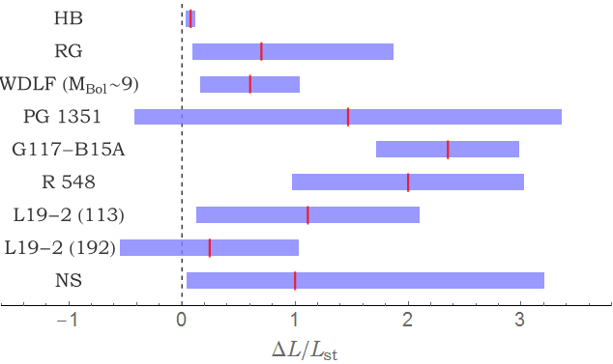
Astrophysical Hints for Axions/ALPs
Excessive stellar energy losses
Practically every stellar systems seems to be cooling faster than predicted by models:
Ayala et. al. (2014), Straniero (proc. of XI Patras Workshop)
Viaux et. al. (2013), Arceo-Daz et. al. (2015)
Bertolami (2014)
Corsico et. al., (2014, 2015), Battich et. al. (2016)
Kepler et. al., (1991) + many others
Corsico et. al., (2012)
Corsico et. al., (2016)
Corsico et. al., (2016)
Shternin et. al. (2011)
[Giannotti, Irastorza, Redondo, AR ‘15; Giannotti, Irastorza, Redondo, AR, Saikawa ‘17]

Slide 11


Astrophysical Hints for Axions/ALPs
Excessive stellar energy losses
Excessive energy losses of HBs, RG, WDs can be explained at one stroke by production of axion/ALP with coupling to photons and electrons:
a
γ
g_{aγ}
γ
Ze
Ze
a
e
g_{ae}
e
γ
Ze
Ze
[Giannotti,Irastorza,Redondo,AR,Saikawa 17]

Slide 12
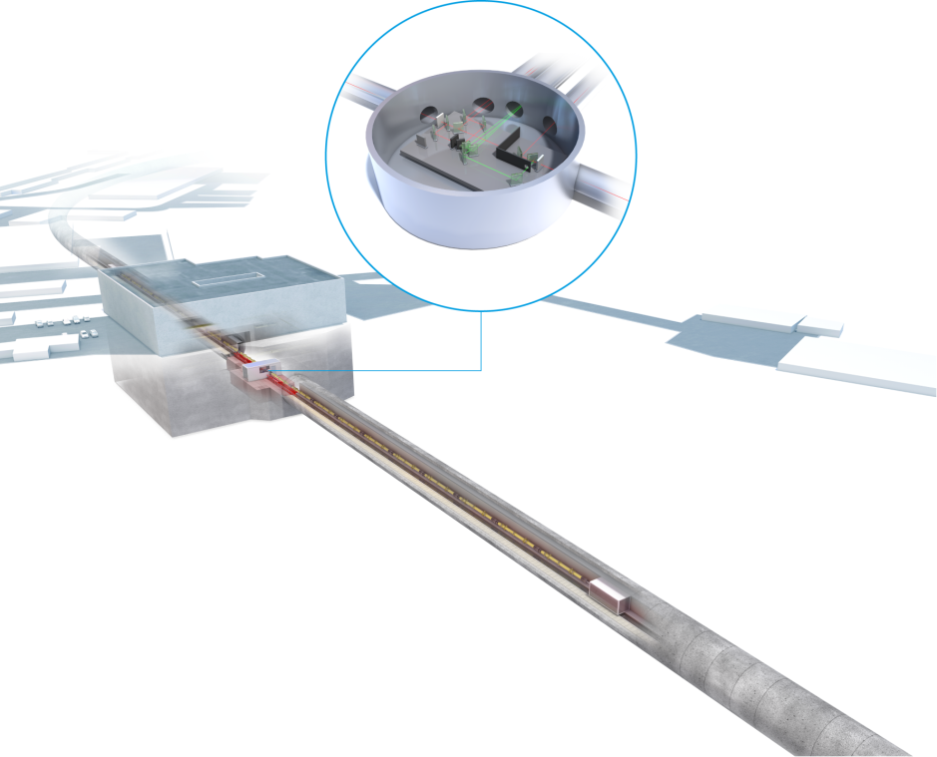
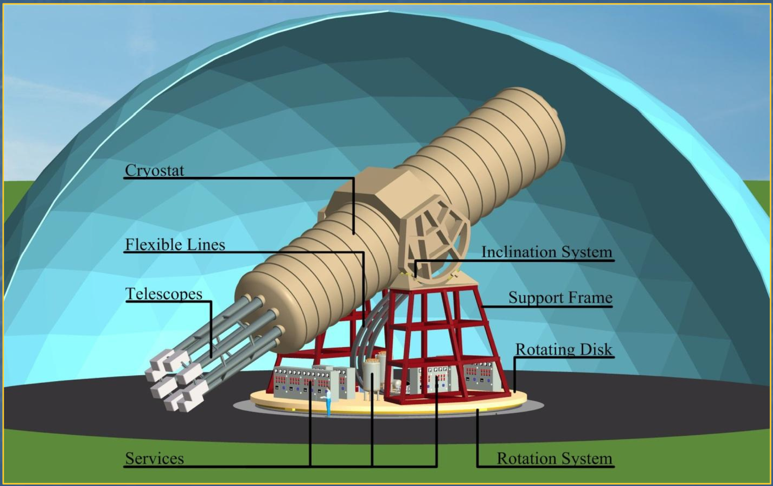
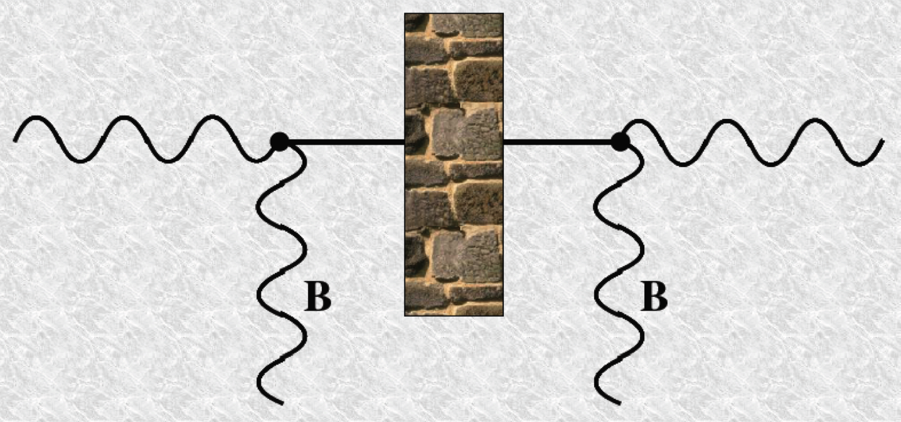
Astrophysical Hints for Axions/ALPs
Excessive stellar energy losses
Excessive energy losses of HBs, RG, WDs can be explained at one stroke by production of axion/ALP with coupling to photons and electrons and probed by next generation experiments:
IAXO
ALPS II

Slide 13
Astrophysical Hints for Axions/ALPs
Excessive stellar energy losses
Excessive energy losses of HBs, RG, WDs can be explained at one stroke by production of axion/ALP with coupling to photons and electrons, e.g. KSVZ axion/majoron model
[Shin `88]
[Giannotti,Irastorza,Redondo,AR,Saikawa 17]

Slide 14
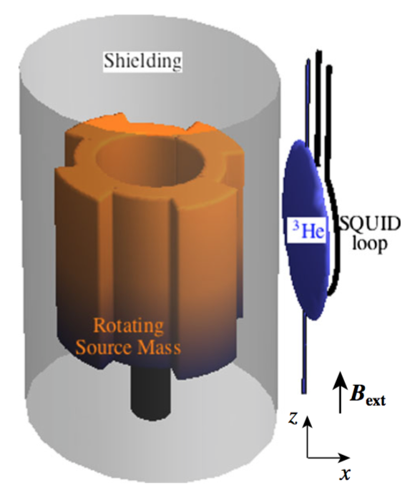
Astrophysical Hints for Axions/ALPs
Excessive stellar energy losses
Excessive energy losses of HBs, RG, WDs can be explained at one stroke by production of axion/ALP with coupling to photons and electrons, e.g. DFSZ model
[Zhitnitsky 80;Dine,Fischler,Srednicki 81]
ARIADNE
[Giannotti,Irastorza,Redondo,AR,Saikawa 17]

Slide 15
Saxion/Higgs Inflation
Exploiting modulus of PQ field or mixture of it with Higgs modulus to solve horizon and flatness puzzle
Take into account non-minimal coupling of Higgs and PQ field to gravity,
  Generated anyway radiatively even if set to zero at some scale
[Fairbairn,Hogan,Marsh `14]

Slide 16
Saxion/Higgs Inflation
Exploiting modulus of PQ field or mixture of it with Higgs modulus to solve horizon and flatness puzzle
Take into account non-minimal coupling of Higgs and PQ field to gravity,
  Generated anyway radiatively even if set to zero at some scale
Non-minimal couplings stretch scalar potential in Einstein frame: makes it convex and asymptotically flat at large field values
[Fairbairn,Hogan,Marsh `14]

Slide 17
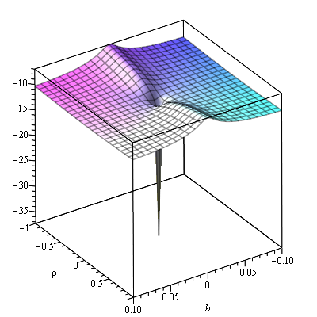
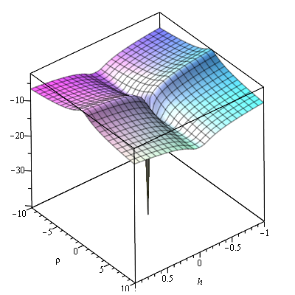
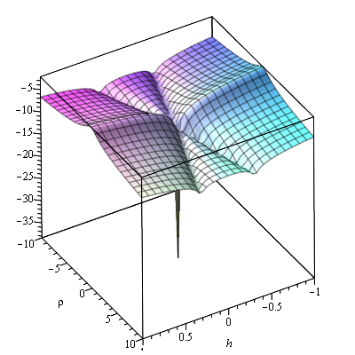
Saxion/Higgs Inflation
Exploiting modulus of PQ field or mixture of it with Higgs modulus to solve horizon and flatness puzzle
Take into account non-minimal coupling of Higgs and PQ field to gravity,
  Generated anyway radiatively even if set to zero at some scale
Non-minimal couplings stretch scalar potential in Einstein frame; makes it convex and asymptotically flat at large field values
Potential has valleys = attractors for Higgs Inflation (HI), Saxion Inflation (SI) or mixed Saxion/Higgs Inflation (SHI), depending on relative signs of
[Fairbairn,Hogan,Marsh `14]
[Ballesteros,Redondo, AR,Tamarit, 1610.01639]

Slide 18
Saxion/Higgs Inflation
Exploiting modulus of PQ field or mixture of it with Higgs modulus to solve horizon and flatness puzzle
Characteristics of primordial density fluctuations inferred from CMB fluctuations
fit by
where
  HI has unitarity problem
  SI and SHI have no unitarity problem if
[Ballesteros,Redondo, AR,Tamarit, 1610.01639]

Slide 19
Saxion/Higgs Inflation
Modulus of PQ field or mixture with Higgs modulus as inflaton
Stability up to Planck scale?
  SM-singlet scalar helps to stabilize scalar potential in Higgs direction through threshold effect associated with Higgs portal
    When integrated out, Higgs portal gives negative contribution to Higgs quartic,
    At energies above , true (and larger!) value of is revealed by integrating in
  Stability up to Planck scale ensured if exceeds a minimum value dependent on top mass
[Ballesteros,Redondo, AR,Tamarit, 1610.01639]

Slide 20
Saxion/Higgs Inflation
Modulus of PQ field or mixture with Higgs modulus as inflaton
Both in SI and SHI with , slow-roll infla-tion ends at a value of
Inflaton starts to undergo Hubble-damped oscil-lations in a quasi-quartic potential, with Universe expanding as in a radiation-dominated era
[Ballesteros,Redondo, AR,Tamarit, 1610.01639]

Slide 21
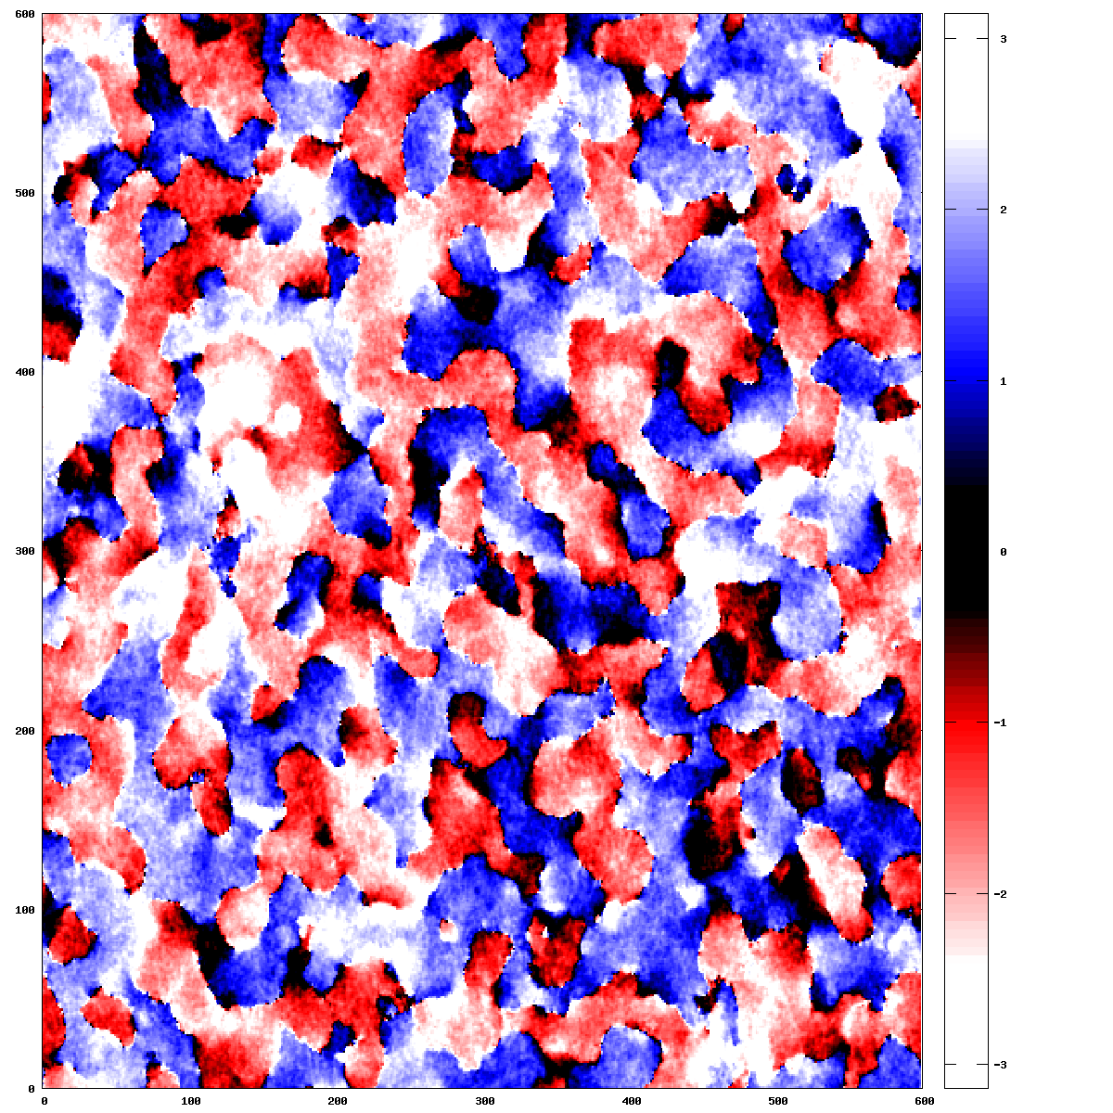
Saxion/Higgs Inflation
Modulus of PQ field or mixture with Higgs modulus as inflaton
Both in SI and SHI with , slow-roll infla-tion ends at a value of
Inflaton starts to undergo Hubble-damped oscil-lations in a quasi-quartic potential, with Universe expanding as in a radiation-dominated era
For , PQ symmetry restored after few oscillations and then broken again
[Ballesteros,Redondo, AR,Tamarit, 1610.01639]

Slide 22
Saxion/Higgs Inflation
Modulus of PQ field or mixture with Higgs modulus as inflaton
Both in SI and SHI with , slow-roll infla-tion ends at a value of
Inflaton starts to undergo Hubble-damped oscil-lations in a quasi-quartic potential, with Universe expanding as in a radiation-dominated era
For , PQ symmetry restored after few oscillations and then broken again
SI: Large induced particle masses quench infla-ton decays or annihilations into SM particles
SHI: Higgs component of inflaton allows for production of SM gauge bosons
[Ballesteros,Redondo, AR,Tamarit, 1610.01639]

Slide 23
Saxion/Higgs Inflation
Modulus of PQ field or mixture with Higgs modulus as inflaton
Expansion and thermal history of universe predicted
Number of e-folds from the time a given comoving scale leaves horizon until end of inflation predicted
[Ballesteros,Redondo, AR,Tamarit, 1610.01639]

Slide 24
Saxion/Higgs Inflation
Modulus of PQ field or mixture with Higgs modulus as inflaton
Sharp prediction of vs :
[Ballesteros,Redondo, AR,Tamarit, 1610.01639]

Slide 25
Saxion/Higgs Inflation
Modulus of PQ field or mixture with Higgs modulus as inflaton
Sharp prediction of vs can be probed by upcoming CMB experiments (e.g. CMB-S4):
[Ballesteros,Redondo, AR,Tamarit, 1610.01639]

Slide 26
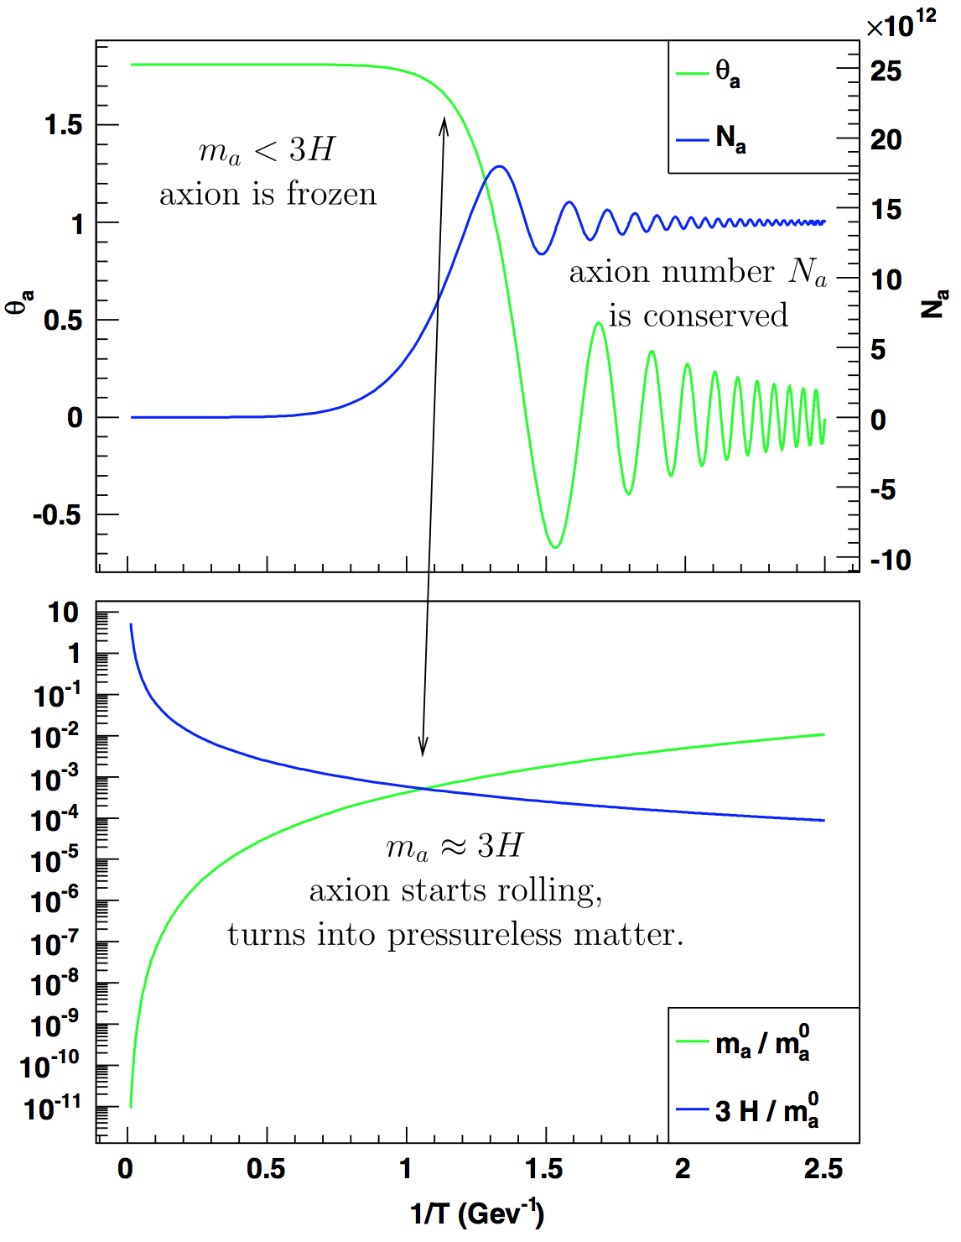
Axion Dark Matter
Predictions of post-inflationary PQ SB scenario
PQ phase transition takes place at
Axion takes random initial values in causally connected domains
Later when , axion field starts to oscillate around minimum of potential; be-haves like cold dark matter:
[Preskill,Wise,Wilczek 83; Abbott,Sikivie 83; Dine,Fischler 83,....]
[Wantz,Shellard `09]

Slide 27
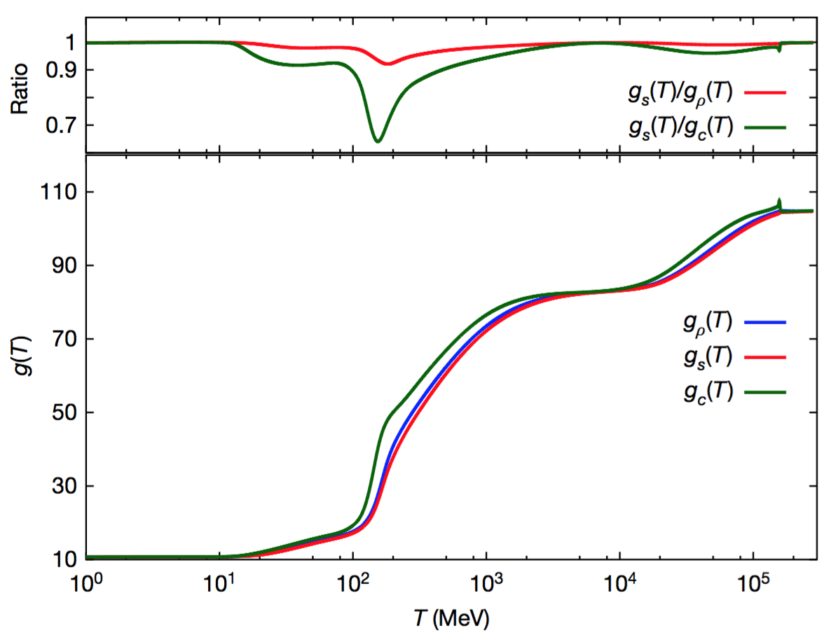
Axion Dark Matter
Predictions of post-inflationary PQ SB scenario
PQ phase transition takes place at
Axion takes random initial values in causally connected domains
Later when , axion field starts to oscillate around minimum of potential; be-haves like cold dark matter:
QCD input from lattice:
  Equation of state
[Borsanyi et al., Nature `16 [1606.0794]]
[Preskill,Wise,Wilczek 83; Abbott,Sikivie 83; Dine,Fischler 83,....]

Slide 28
Axion Dark Matter
Predictions of post-inflationary PQ SB scenario
PQ phase transition takes place at
Axion takes random initial values in causally connected domains
Later when , axion field starts to oscillate around minimum of potential; be-haves like cold dark matter:
QCD input from lattice:
  Equation of state
  Topological susceptibility
[Borsanyi et al., Nature `16 [1606.0794]]
[Preskill,Wise,Wilczek 83; Abbott,Sikivie 83; Dine,Fischler 83,....]

Slide 29
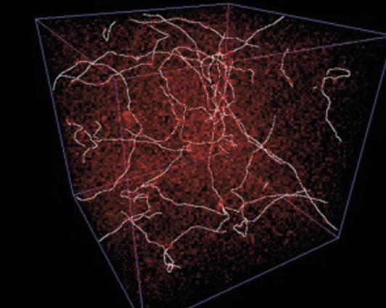
Axion Dark Matter
Predictions of post-inflationary PQ SB scenario
Averaging over random initial axion field values
Does not exceed observed CDM abundance for
Axions also produced by collapse of network of topological defects – strings and domain-walls –
  Need field theoretic simulations to determine their contribution to dark matter
[Hiramatsu et al. ]

Slide 30
Axion Dark Matter
Predictions of post-inflationary PQ SB scenario
For , exploiting results from field theoretic lattice simulations, updated to latest determination of topological susceptibility, find CDM explained for
  Still large unknown theoretical error because simulations can be done only at unrealistic values of the string tension
  Result from new simulation technique designed to work directly at high string tension:
[Hiramatsu et al. 11,12,13; Kawasaki,Saikawa,Segikuchi 15;
Borsanyi et al. 16;
Ballesteros et al. 16]
[Gorghetto,,Hardy,Villadoro.18]
[Klaer,Moore `17]

Slide 31
Axion Dark Matter
Predictions of post-inflationary PQ SB scenario
For , exploiting results from field theoretic lattice simulations, updated to latest determination of topological susceptibility, find CDM explained for
  Still large unknown theoretical error because simulations can be done only at unrealistic values of the string tension
  Result from new simulation technique designed to work directly at high string tension:
For , domain wall problem can be avoided if PQ symmetry explicitely broken, e.g. by Planck suppressed operators, , for ,
  May postulate discrete symmetry to forbid lower dimensional operators
  Axion n this mass range may explain excessive stellar energy losses
[Hiramatsu et al. 11,12,13; Kawasaki,Saikawa,Segikuchi 15;
Borsanyi et al. 16;
Ballesteros et al. 16]
[Gorghetto,,Hardy,Villadoro.18]
[Klaer,Moore `17]
[Kawasaki,Saikawa,Sekiguchi `15;
AR,Saikawa `16]
e.g. [Dias et al. `14]
[Giannotti,Irastorza,Redondo,AR,Saikawa`17]

Slide 32
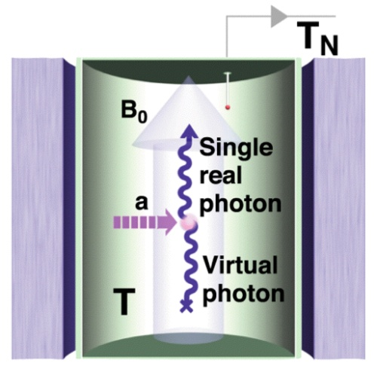
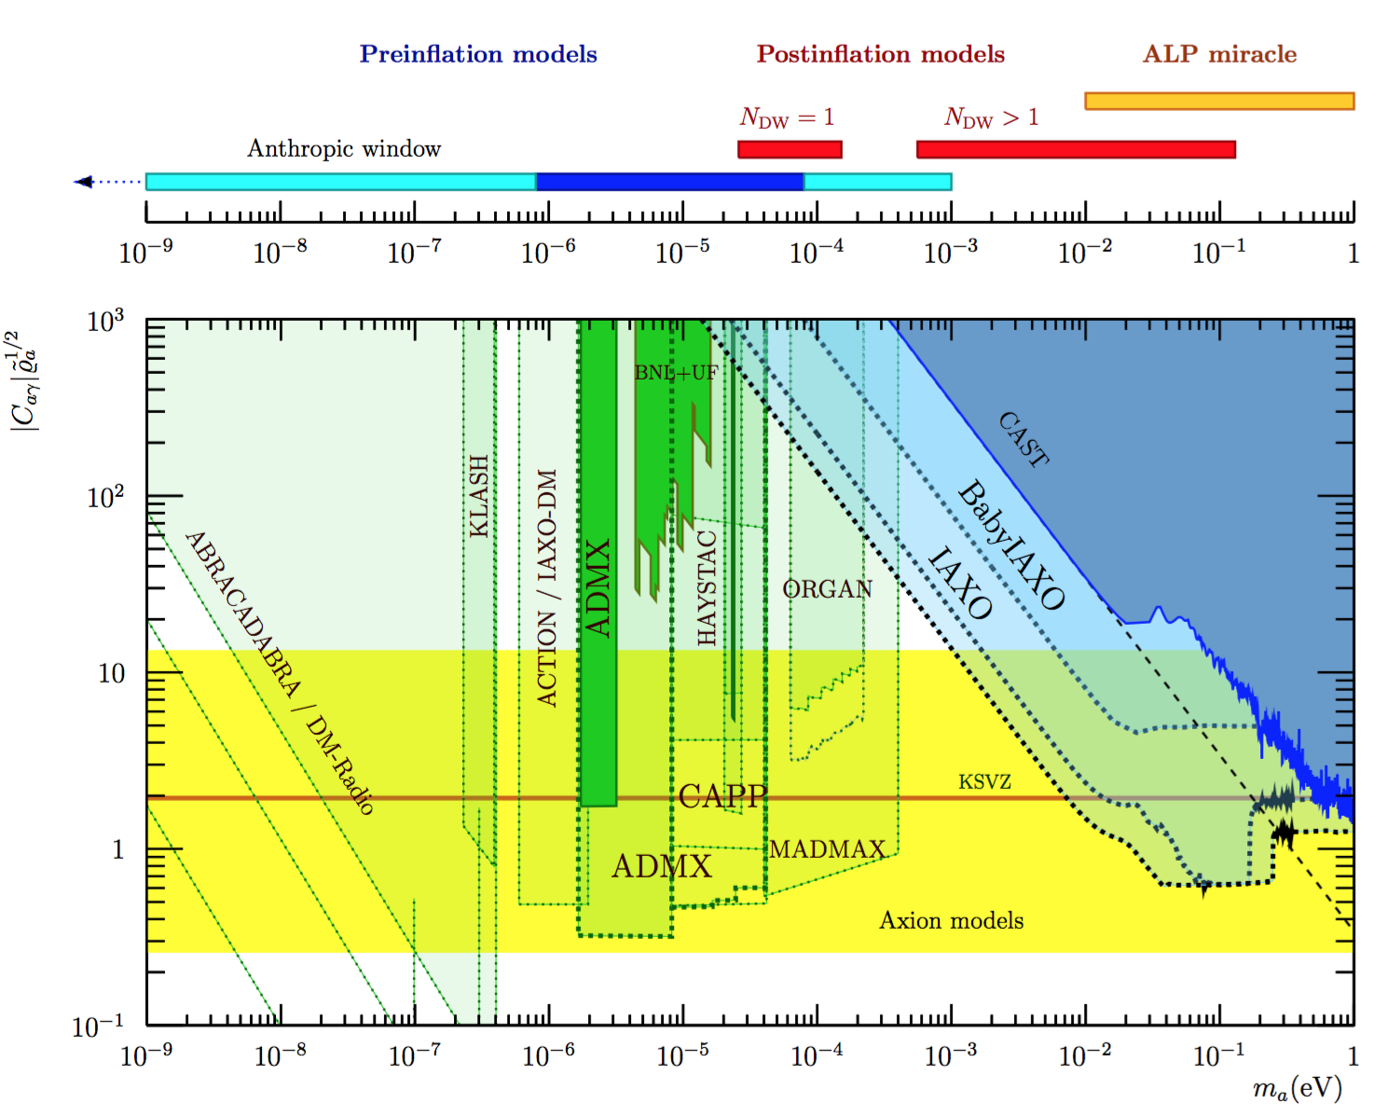
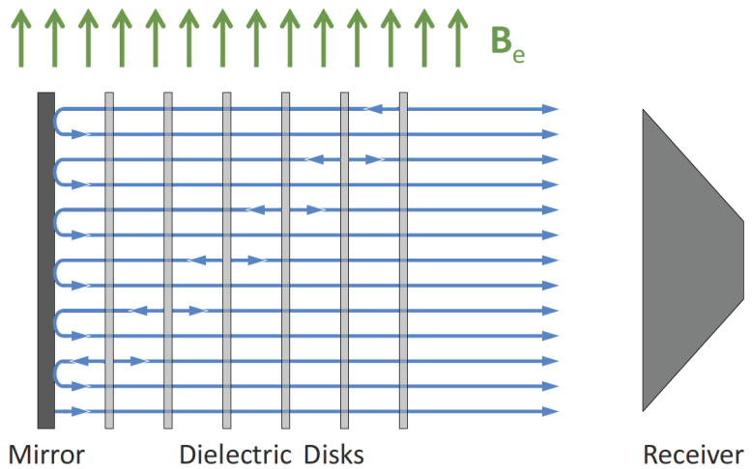
Axion Dark Matter
Predictions of post-inflationary PQ SB scenario
HAYSTAC
Mass range will be probed in near future:
CAPP
ORGAN
MADMAX
IAXO
[Irastorza,Redondo `18]

Slide 33
Unifying Inflation, Dark Matter, and Seesaw with PQ Field
One SM*A*S*H to rule them all ...
Extension of SM to PQSM plus three SM singlet neutrinos, getting their Majorana masses also through PQ vev
  no strong CP problem
  dark matter
  inflation
  neutrino masses and mixing
  baryogenesis via leptogenesis
SM*Axion*Seesaw*Higgs Portal Inflation
[Shin `88 ; Dias et al. `14; Ballesteros et al. `16]

Slide 34
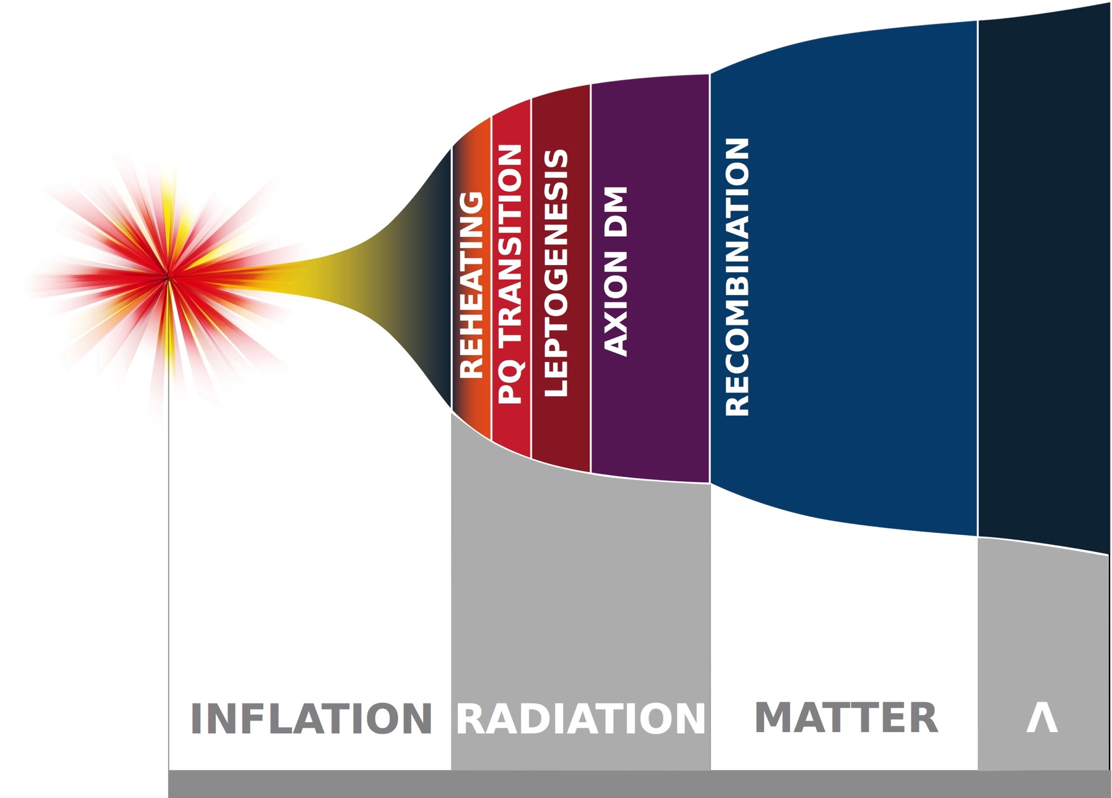
Unifying Inflation, Dark Matter, and Seesaw with PQ Field
One SM*A*S*H to rule them all ...
Extension of SM to PQSM plus three SM singlet neutrinos, getting their Majorana masses also through PQ vev
  no strong CP problem
  dark matter
  inflation
  neutrino masses and mixing
  baryogenesis via leptogenesis
Complete and consistent history of the universe from inflation to now
[Shin `88 ; Dias et al. `14; Ballesteros et al. `16]
[desy.de]

Slide 35
Summary
PQ extensions of SM very attractive:
  Axion solves strong CP puzzle
  Axion is dark matter candidate (for )
  Saxion/Higgs is inflaton candidate (for )
PQSM with saxion/Higgs inflation very predictive and thus experimentally testable in near future:
  CMB observatories:
  Axion dark matter experiments:
STAY TUNED!

Slide 36
Back-Up: Topological Susceptibility
Topological susceptibility notoriously difficult to calculate on lattice
  Large cutoff effects when exploiting action with non-chiral quarks to calculate topo-logical observables
  Tiny topological susceptibility needs extremely long simulation threads to observe enough changes of topological sectors
Solutions of these problems:
  Eigenvalue reweighting technique: Substitute topology related eigenvalues of non-chiral quark Dirac operator with its corresponding eigenvalues in continuum
  Fixed sector integral technique: Measure logarithmic differential of topological sus-ceptibility which is related to quantities to be measured in fixed topological sectors. Then integrate.
[Borsanyi et al. `16]

Slide 37
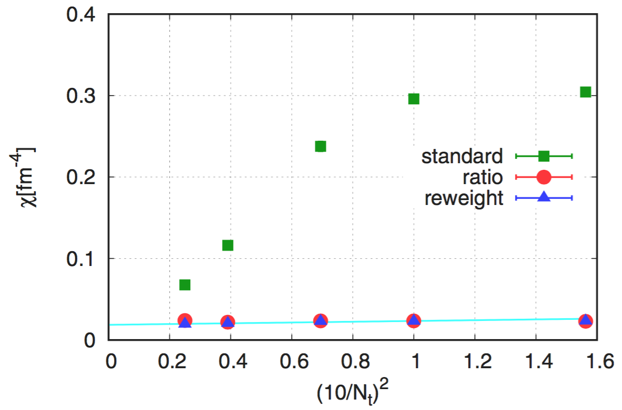
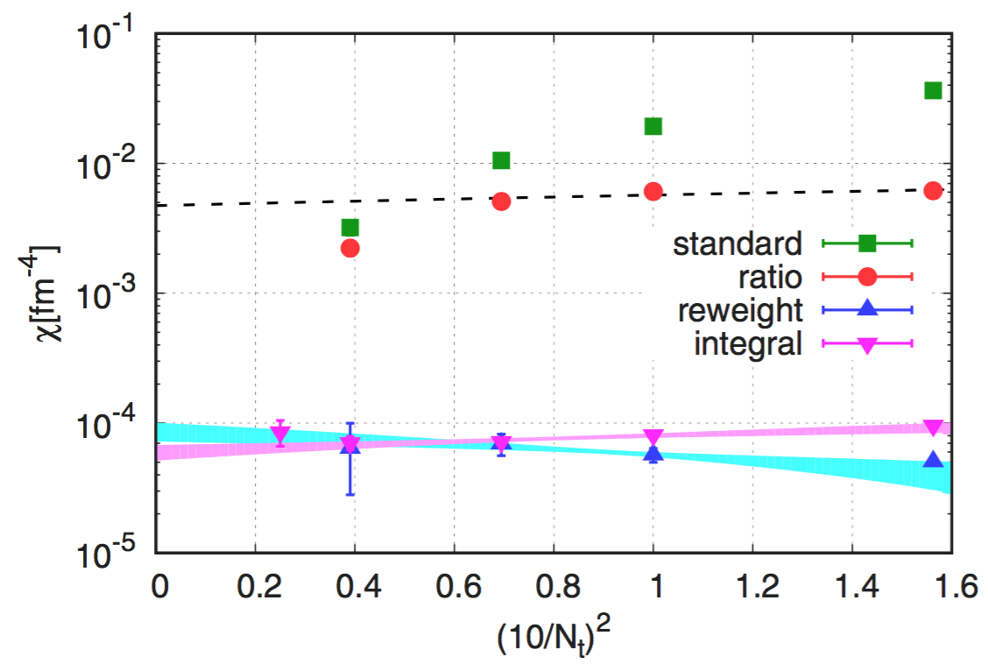
Back-Up: Topological Susceptibility
Comparison of lattice spacing dependence of topological susceptibility determined via different methods:
At high temperatures, brute force („standard“) method and ratio method suffer from strong cutoff effects
[Borsanyi et al. `16]

Slide 38
Back-Up: Topological Susceptibility
Result:
Temperature slope close to dilute instanton gas approximation (DIGA)
DIGA underestimates topological susceptibility by overall normalization „K factor“ of order ten (should be improved in two-loop DIGA)
[Borsanyi et al. `16]

Slide 39
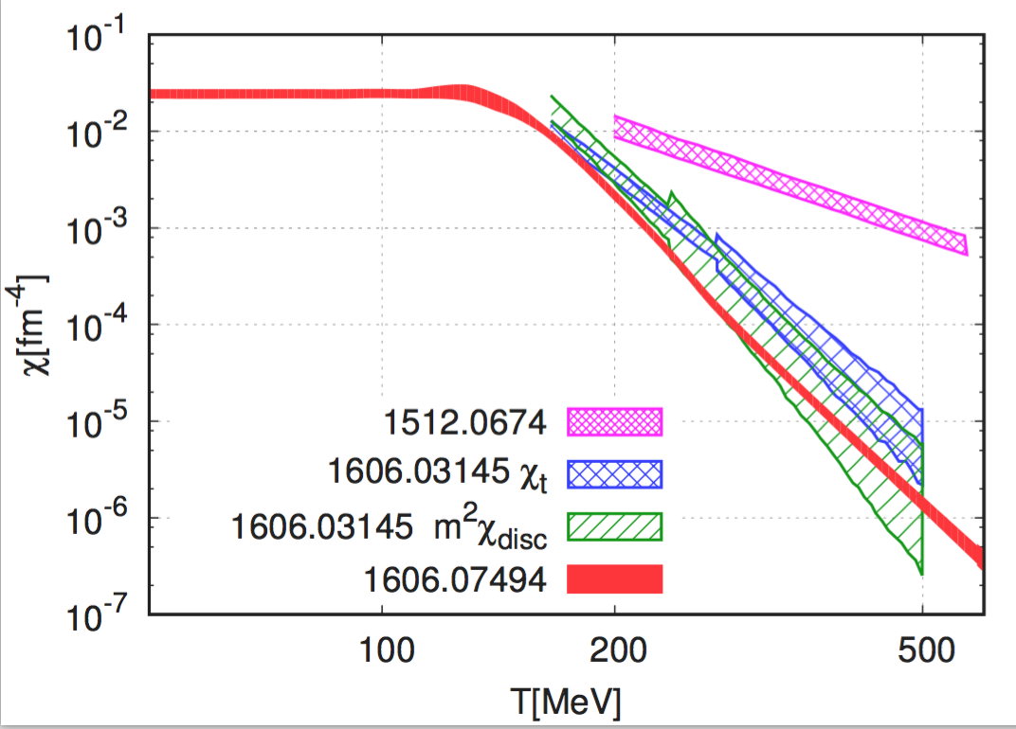
Back-Up: Topological Susceptibility
Lattice: Buchoff et al.
Lattice: Bonati et al.
ILM: Wantz, Shellard
Lattice: Borsanyi et al.
DIGA x 10
Bonati et al.
Petreczky et al.
Borsanyi et al.
[Borsanyi `16]
[Ballesteros,Redondo, AR,Tamarit `16]

Slide 40
Back-Up: DM Axion Mass in Post-Inflationary PQ SB Scenario
For , string‘s interactions with the long range PQ field ( ) become less important relative to string evolution under tension ( )
For , string behavior should approach that of infinitely thin, i.e. local Nambu-Goto strings
New method: exploit UV extension of PQ field theory, with additional comp-lex scalar and additional local U(1) symmetry,
[Klaer,Moore `17]

Slide 41
Back-Up: DM Axion Mass in Post-Inflationary PQ SB Scenario
Exploiting lattice results on topological susceptibility of :
Axion production efficiency smaller than angle-average of ``realignment'' mechanism
  Simple sum
  double counts
    Energy in domain walls is the energy of field misalignment, from values
[Borsanyi et al. `16]
[Klaer,Moore `17]
[Klaer,Moore `17]

Slide 42
Unifying Inflation, Dark Matter, and Seesaw with PQ Field
One SM*A*S*H to rule them all ...
Minimal models:
Extension of SM to PQSM plus three SM singlet neutrinos, getting their Majorana masses also through PQ vev
  no strong CP problem
  dark matter
  inflation
  neutrino masses and mixing
  baryogenesis via leptogenesis
GUT SMASH?
  Minimal scalar sector predicts GUT-scale decay constant
  Need to extend scalar sector in order to accommodate smaller decay constant
[Dias et al. `14; Ballesteros et al. `16]
[Ernst,AR,Tamarit `18 and in prep.]

