Slide 1
Updates on Electron Cloud Studies
Sabato Luca
FCC E-Cloud Meeting
7th May 2024

Slide 2
Outline
Introduction
E-Cloud Build-Up Studies
Heat Loads
Stability Studies
Conclusions and Outlooks

Slide 3
Outline
Introduction
E-Cloud Build-Up Studies
Heat Loads
Stability Studies
Conclusions and Outlooks

Slide 4
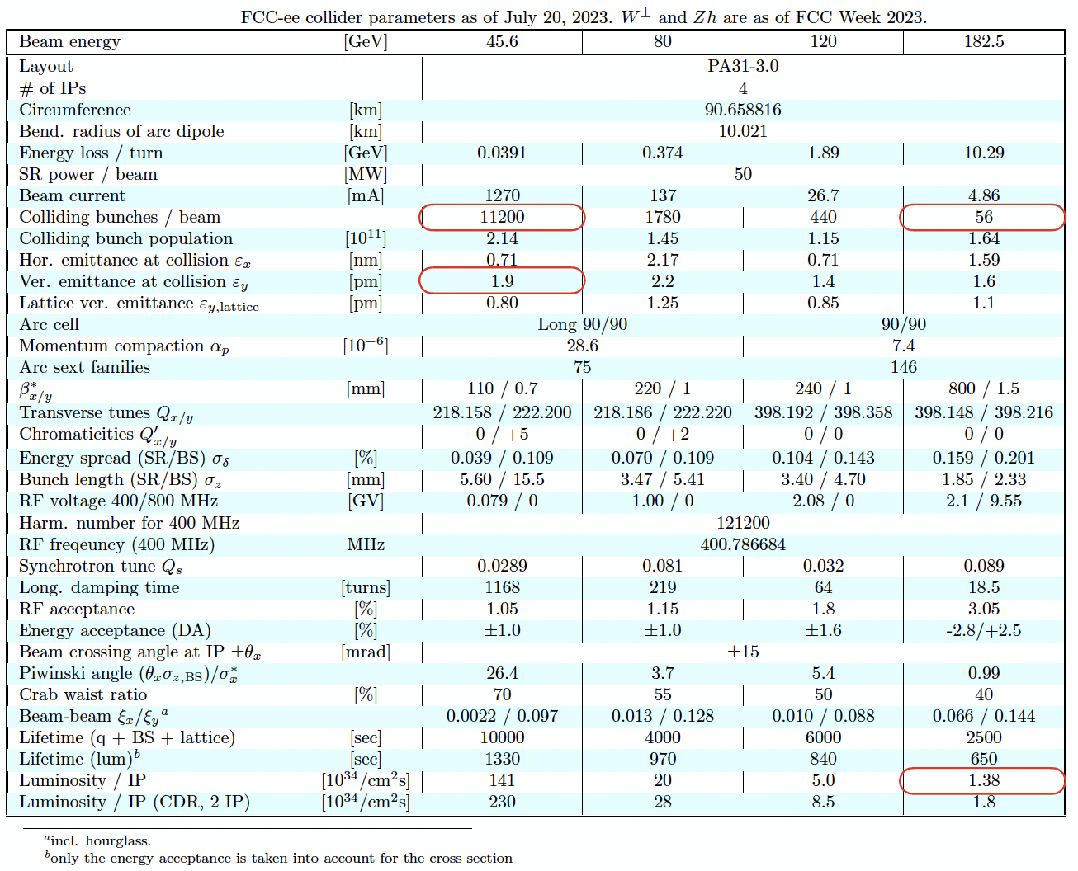
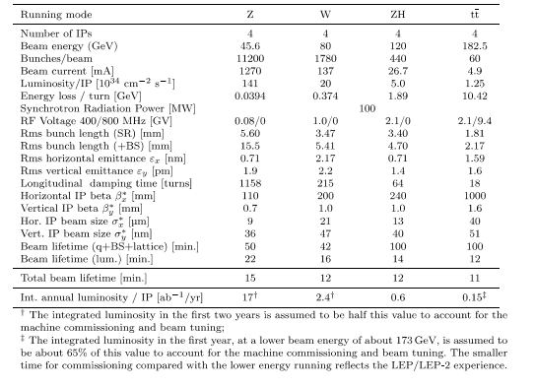
FCC-ee MidTerm Report Parameters
From FCC MidTerm Report
From K. Oide, ”Small updates on the baseline optics”
July 20, 2023 @ the 170th FCC-ee Optics Design Meeting & 41st FCCIS WP2.2 Meeting

Slide 5
Possible Filling Schemes
Filling schemes (with constant total number of particles per beam)
From Tor Raubenheimer
Filling Scheme Number | Bunch Intensity [x10¹¹ ppb] | Bunch Spacing [ns] | Number bunches / Train | Number Trains | Gap Length [ns] (gap/bunch spacing)
1 | 2.15 | 20 | 280 | 40 | 1980 (99)
2 | 2.15 | 25 | 560 | 20 | 1175 (47)
Important to understand the impact of lower bunch intensity (we will need to fill the ring)

Slide 6
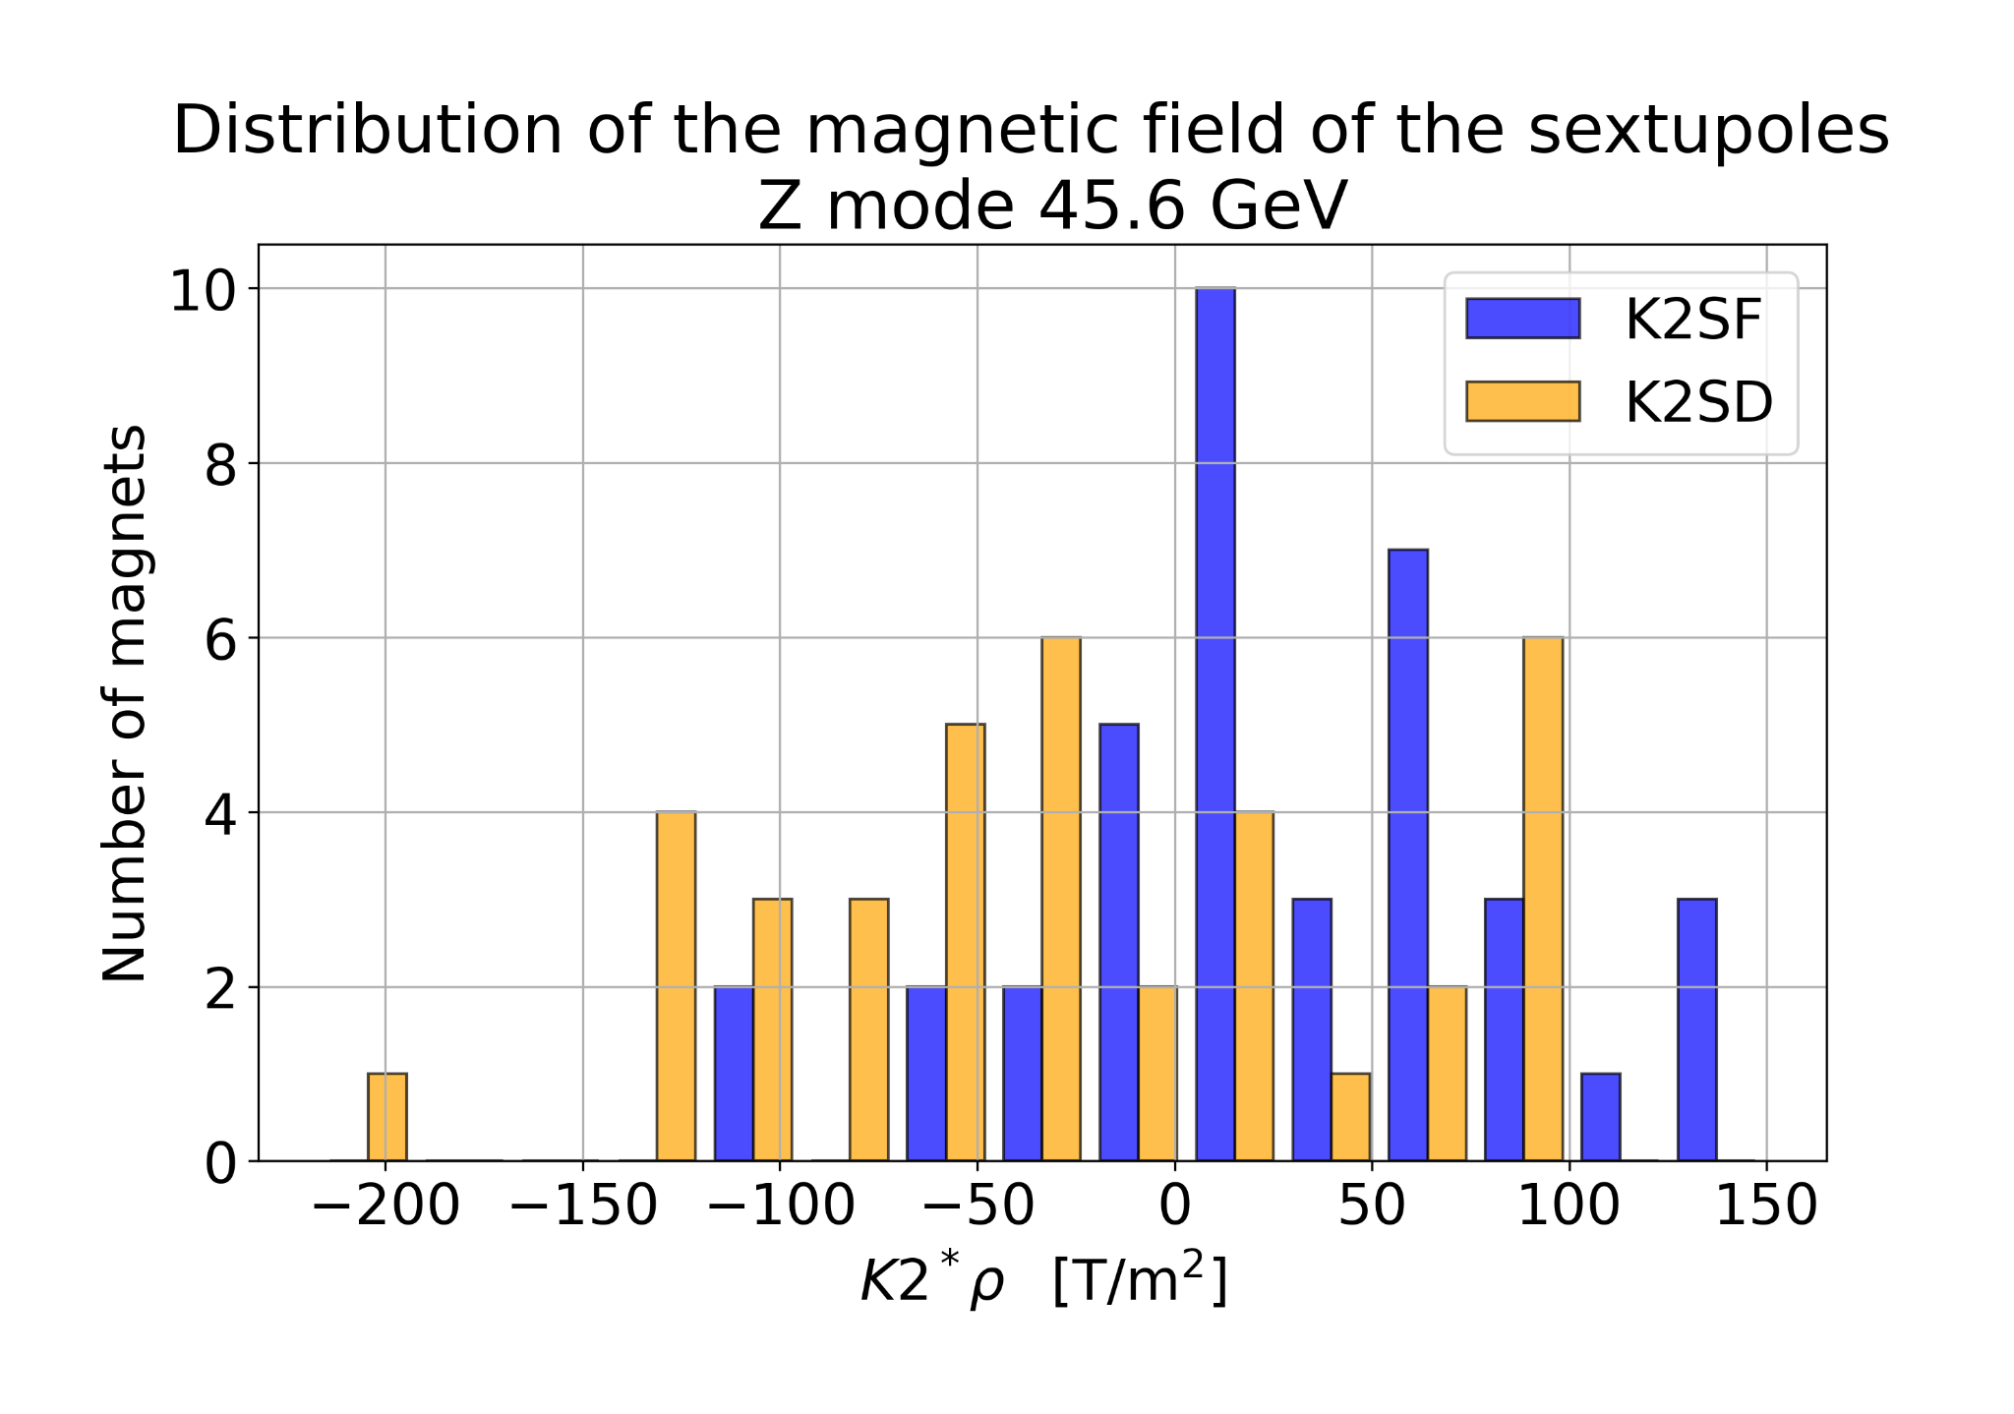
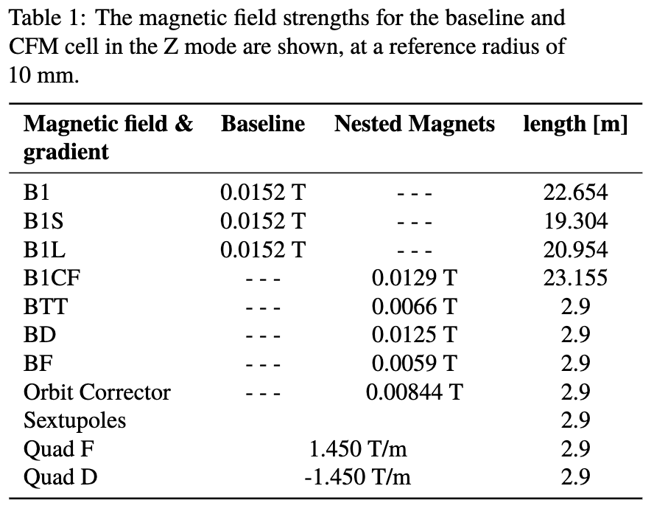
Magnetic Field Elements
Update values from FCC-ee optics team
Dipoles 15.2 mT (previous value used for e-cloud simulations 14.15 mT [1])
Quadrupoles 1.45 T/m (previous value used for e-cloud simulations 5.65 T/m [2])
Sextupoles 72.5 T/m² (previous value used for e-cloud simulations 200-800 T/m² [3])
Largest number:
149.503 T/m2
Average:
27.714 T/m2
Smallest number:
-216.550 T/m2
RMS for k2sf: 63.316 T/m2
RMS for k2sd: 81.560 T/m2
Courtesy of Cristobal Garcia and Leon Van Riesen-Haupt
[1] Fatih Yaman, “Electron Cloud Simulations for the FCC-ee”, June 30, 2021 @ FCC week
[2] Jaime Rocha, Humberto Maury, Karla Cantún, “ELECTRON CLOUD IN THE ARC QUADRUPOLES”, December 8,2021 @ FCCIS WP2 Workshop 2021
[3] Humberto Maury, Karla Cantún, “STUDIES ON THE ELECTRON CLOUD BUILD-UP FORTHE FCC-ee MAIN SEXTUPOLES UNDER DIFFERENT SCENARIOS”, November 2nd, 2023 @ 174th FCC-ee Optics Design Meeting & 45th FCCIS WP2.2 Meeting

Slide 7
Outline
Introduction
E-Cloud Build-Up Studies
Heat Loads
Stability Studies
Conclusions and Outlooks

Slide 8
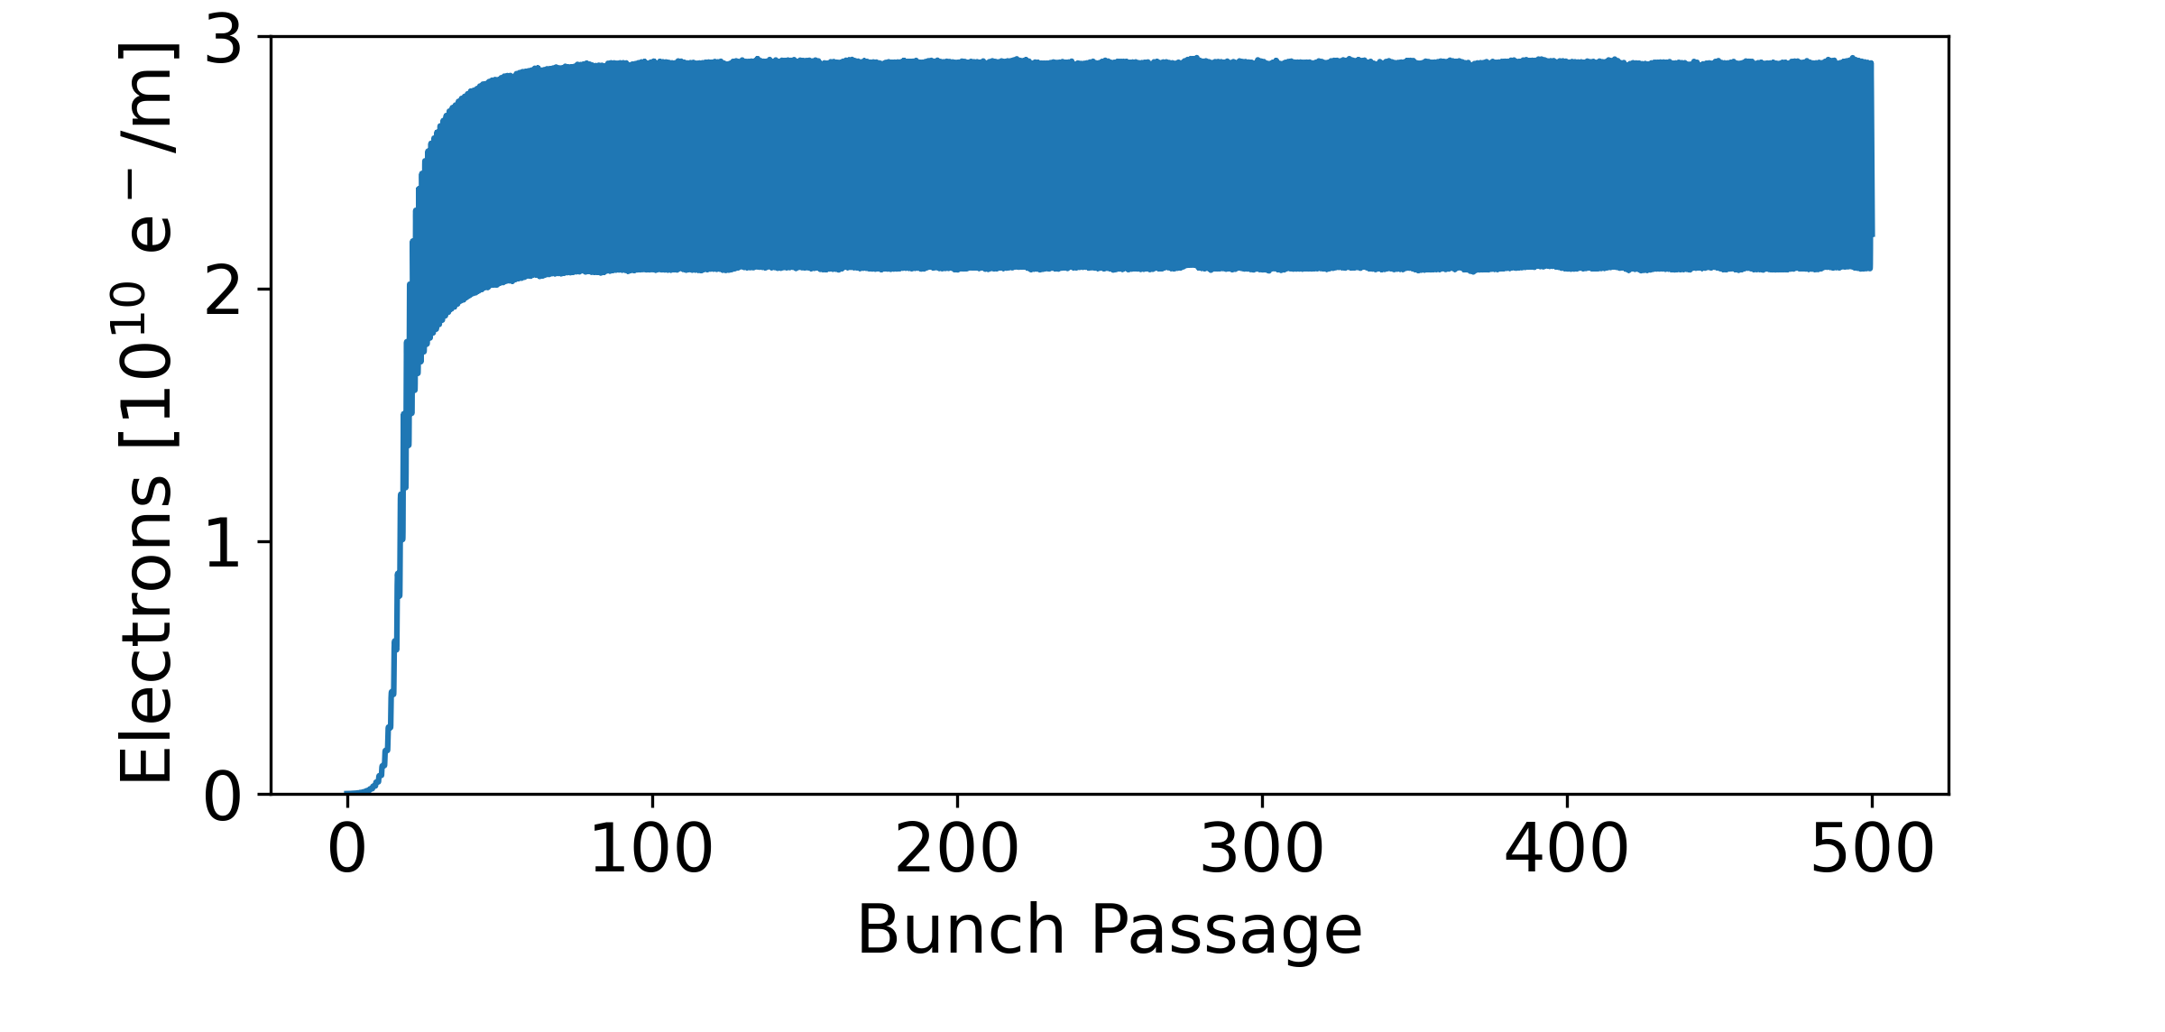
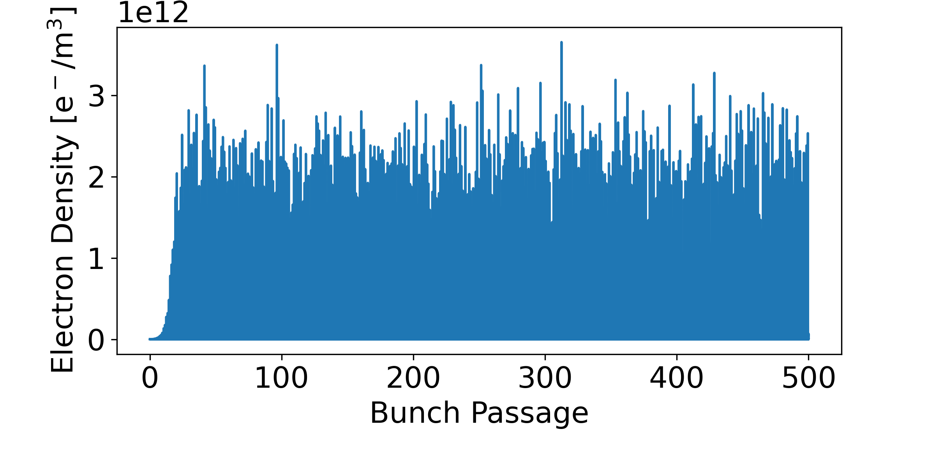
E-Cloud Build-Up Studies
Find the material propriety constraints to avoid e-cloud avalanche multiplication (multipacting)
To find the SEY multipacting threshold, we considered the e-cloud density in the full chamber (less noisy than the central e-cloud density)
The analysed parameter in the next plots is the average e-cloud density when the saturation value is reached
Total electrons in the chamber
Electrons close the chamber centre
parameter

Slide 9
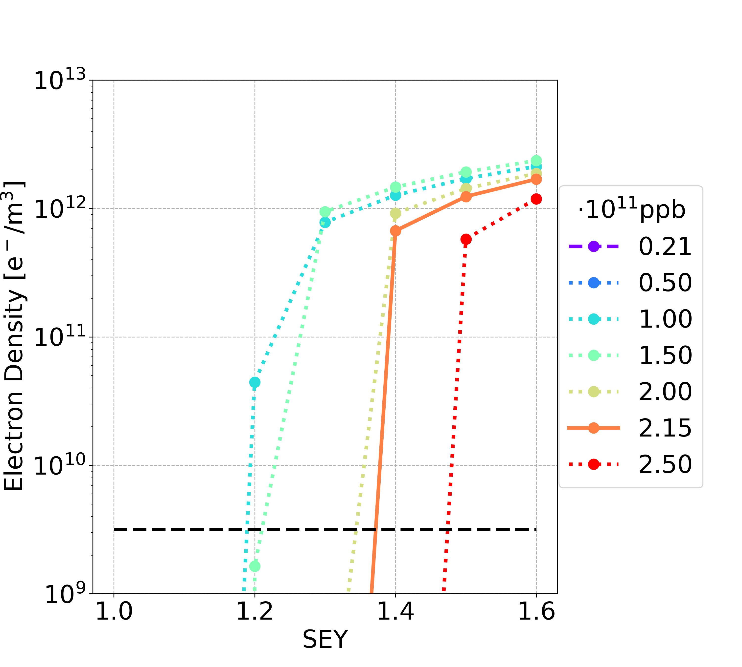
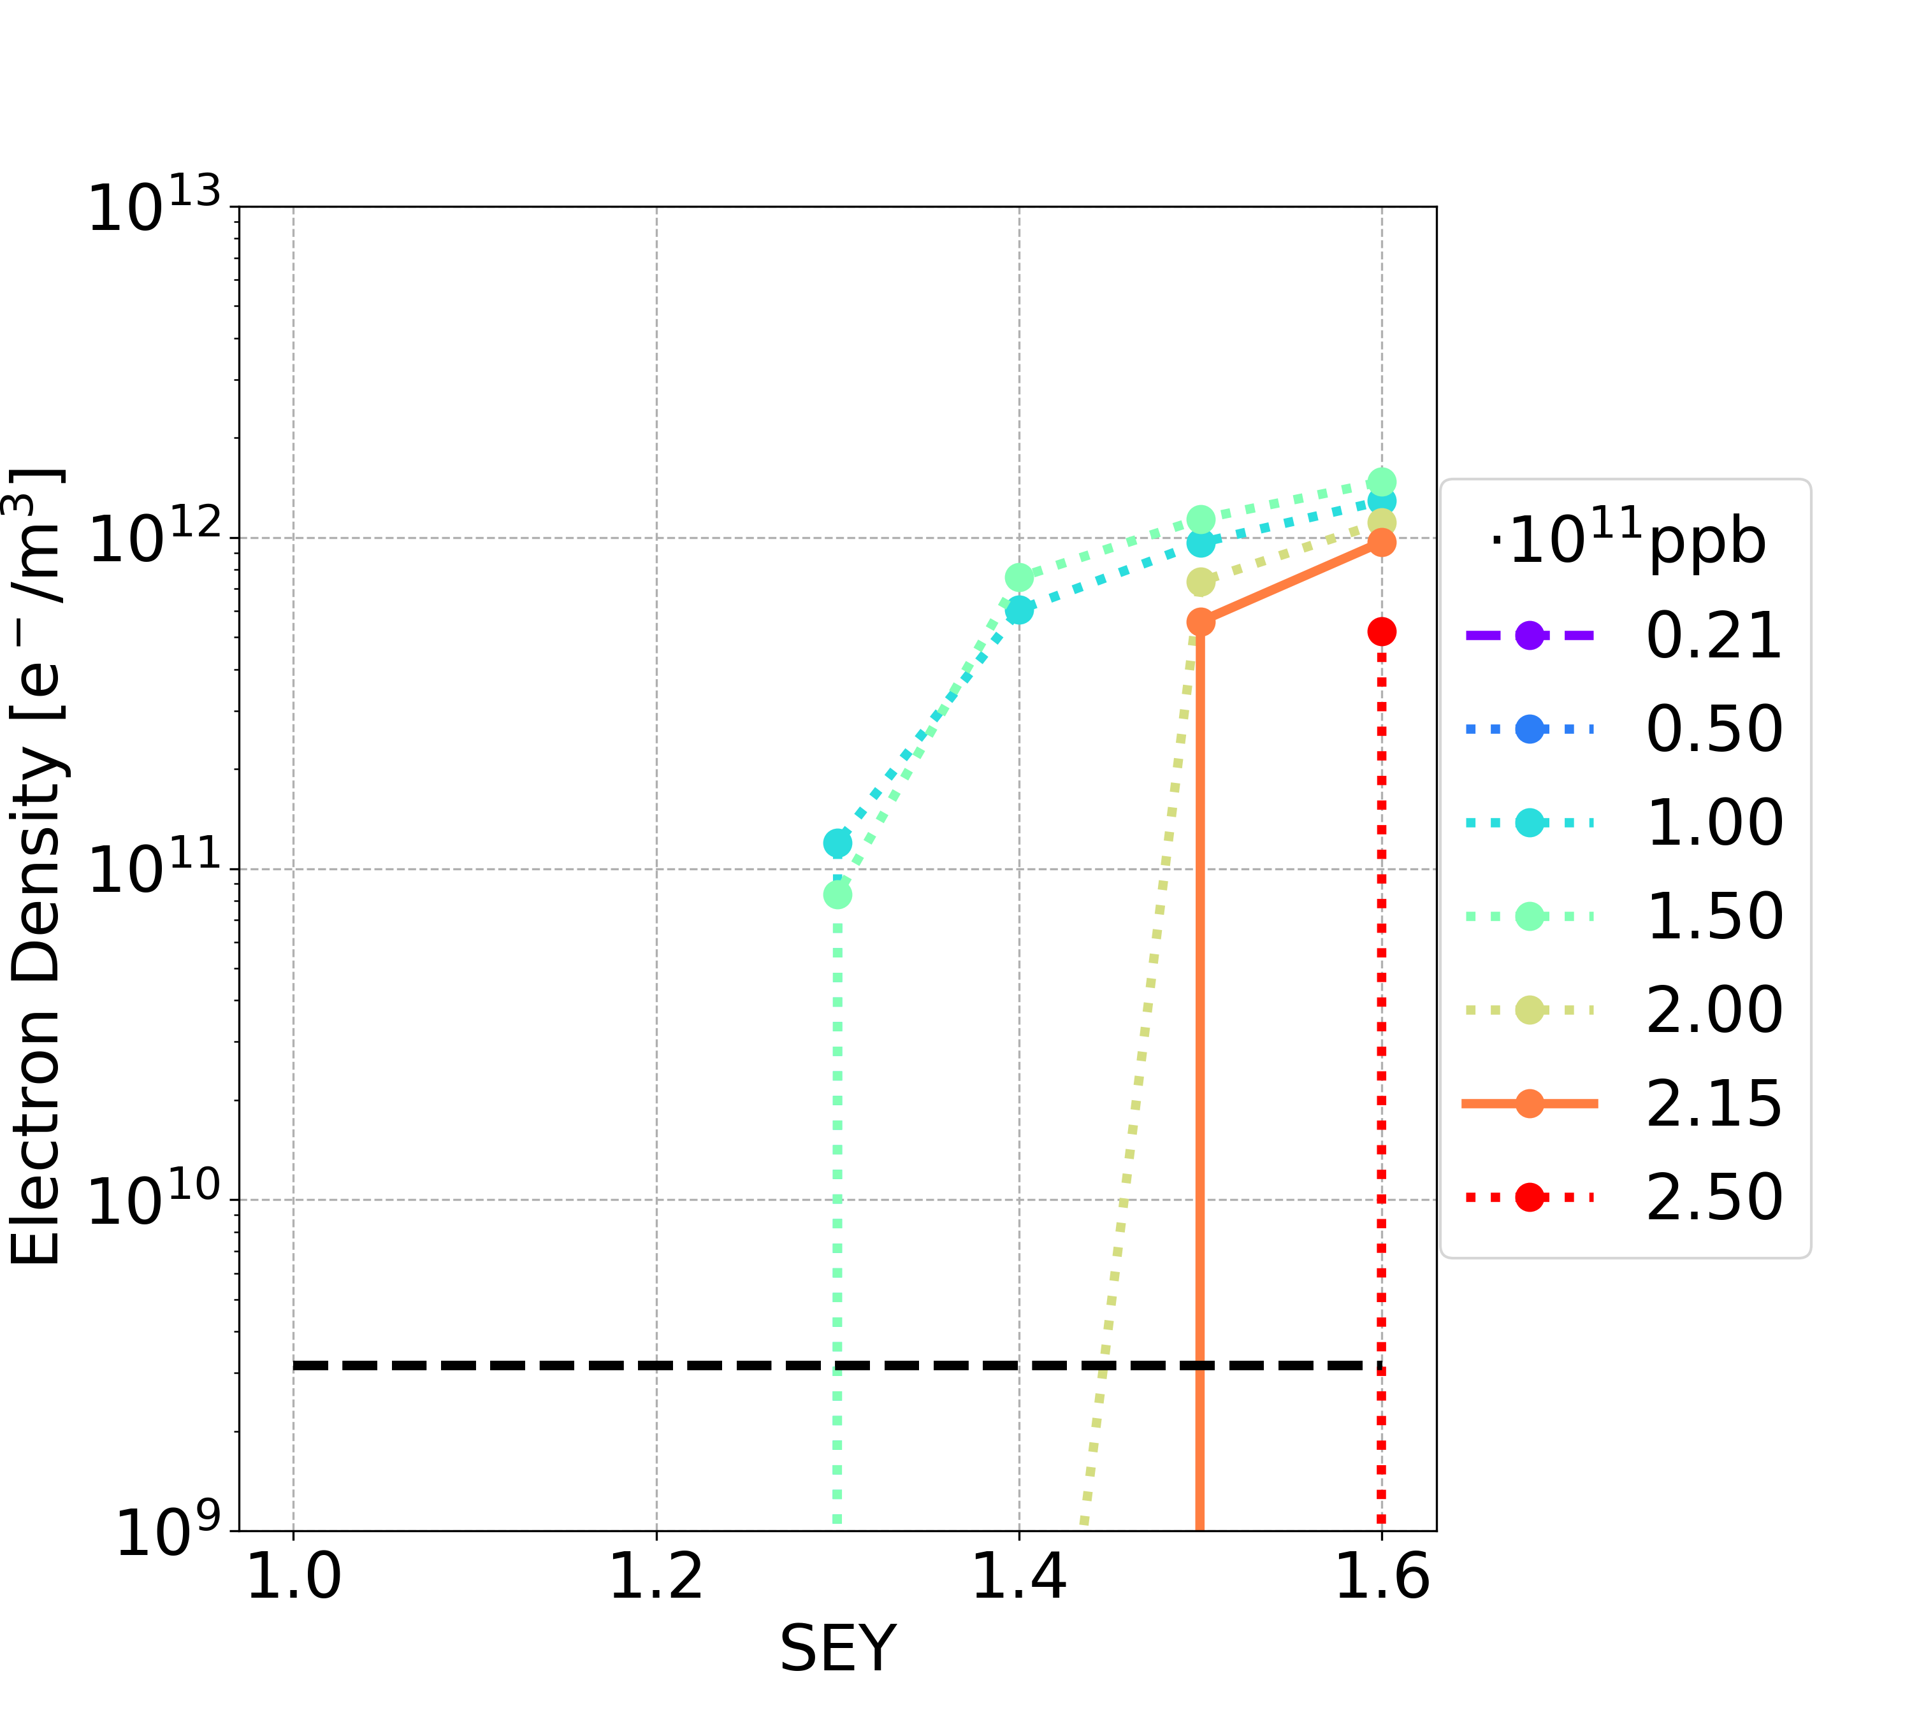
E-Cloud Build-Up Studies: Drift Space
Filling scheme 1
Filling scheme 2
Multipacting
regime
Multipacting
regime
The bunch intensities 1.00e11 and 1.50e11 ppb are the most critical cases
 | Filling Scheme 1 | Filling Scheme 2
SEY threshold (nominal intensity) | 1.3 | 1.4
SEY threshold (all intensity below nominal one) | 1.1 | 1.2

Slide 10
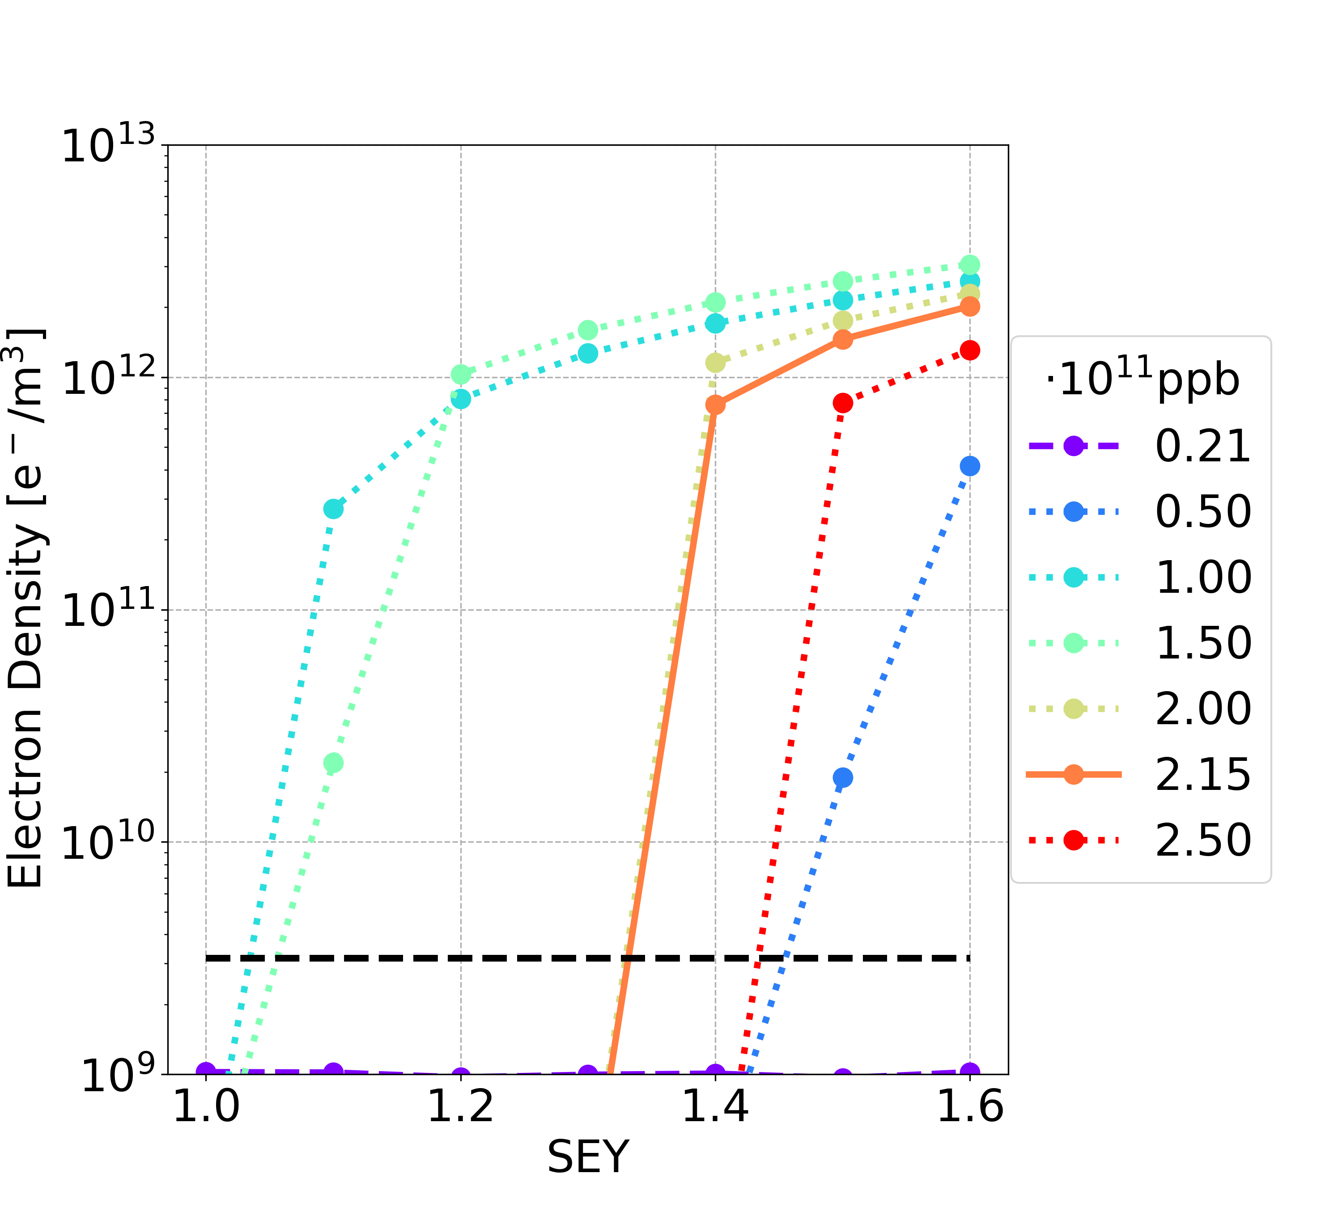
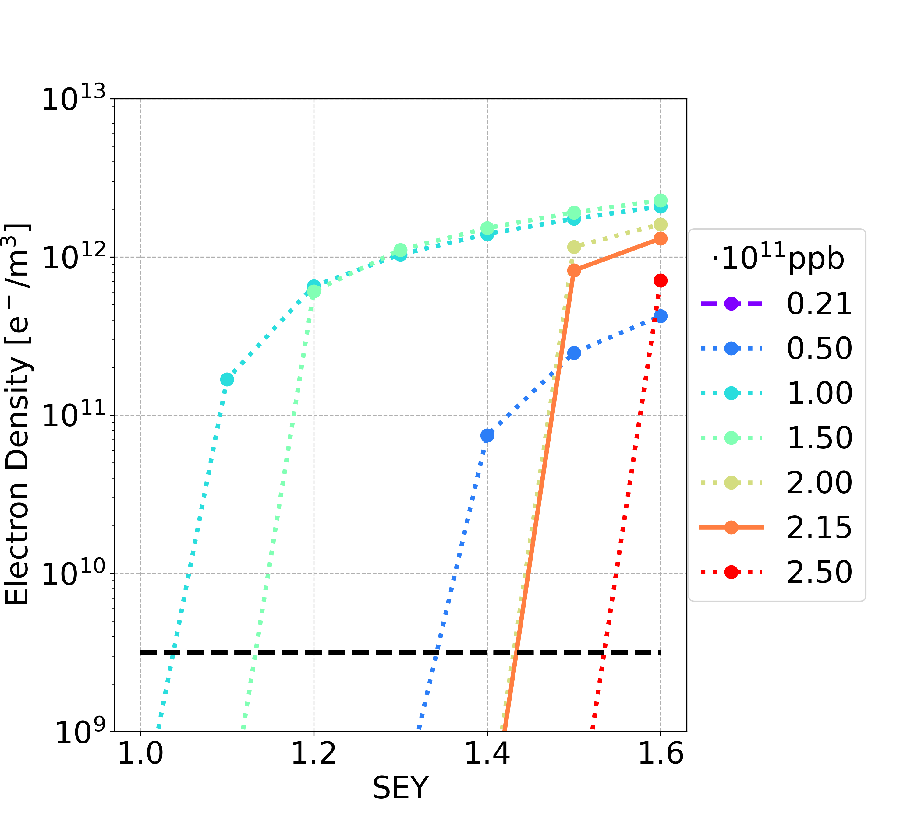
E-Cloud Build-Up Studies: Dipole
Filling scheme 1
Filling scheme 2
Multipacting
regime
Multipacting
regime
The bunch intensities 1.00e11 and 1.50e11 ppb are the most critical cases
 | Filling Scheme 1 | Filling Scheme 2
SEY threshold (nominal intensity) | 1.3 | 1.4
SEY threshold (all intensity below nominal one) | 1.0 | 1.0

Slide 11
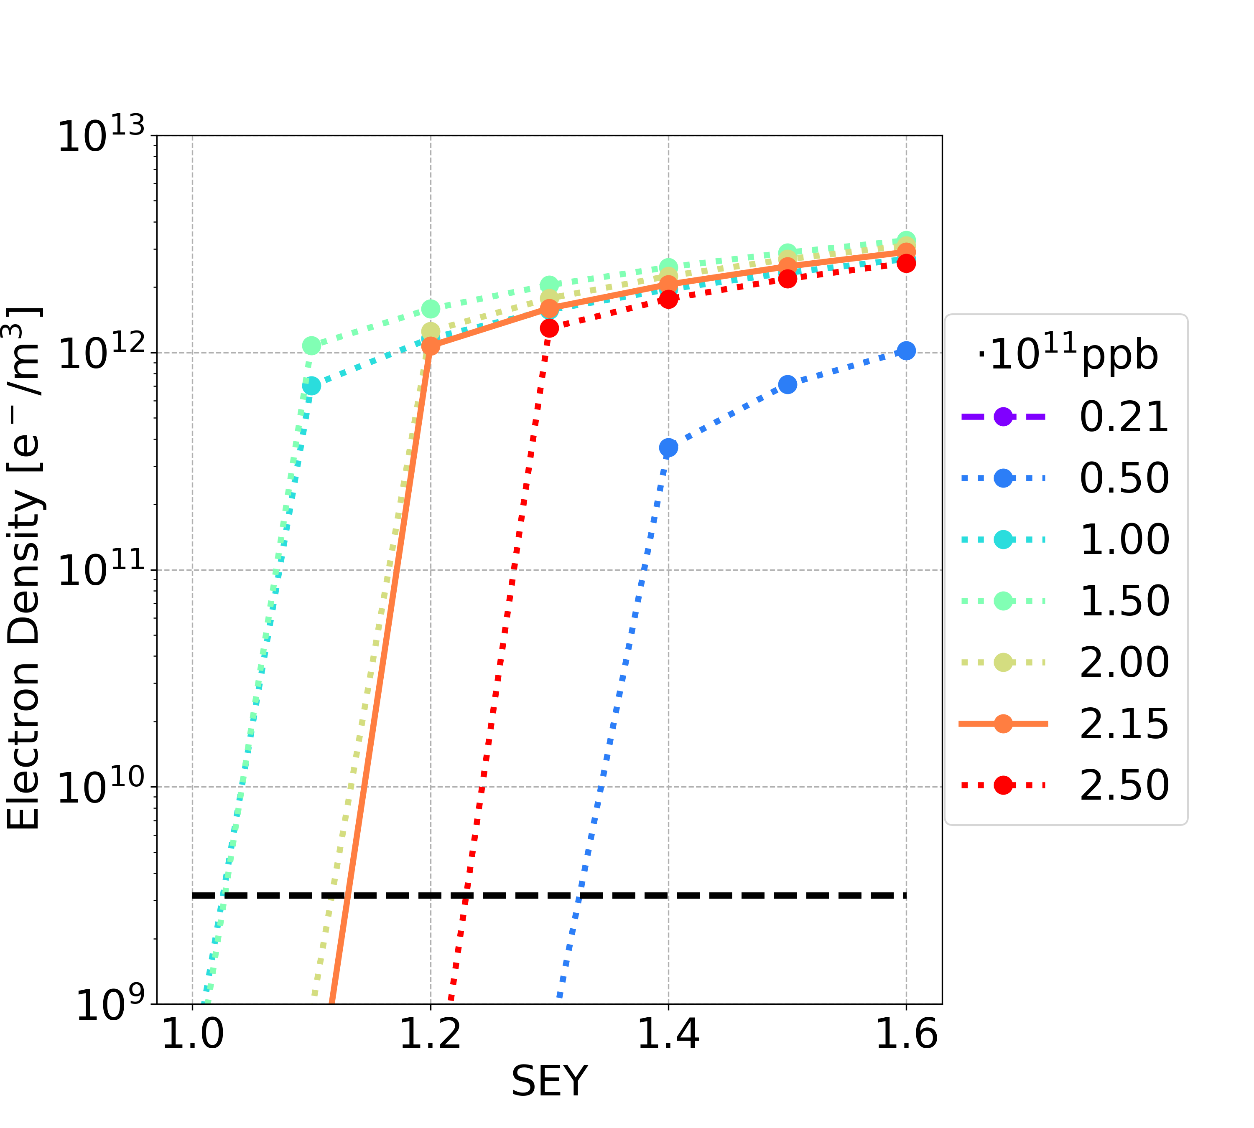
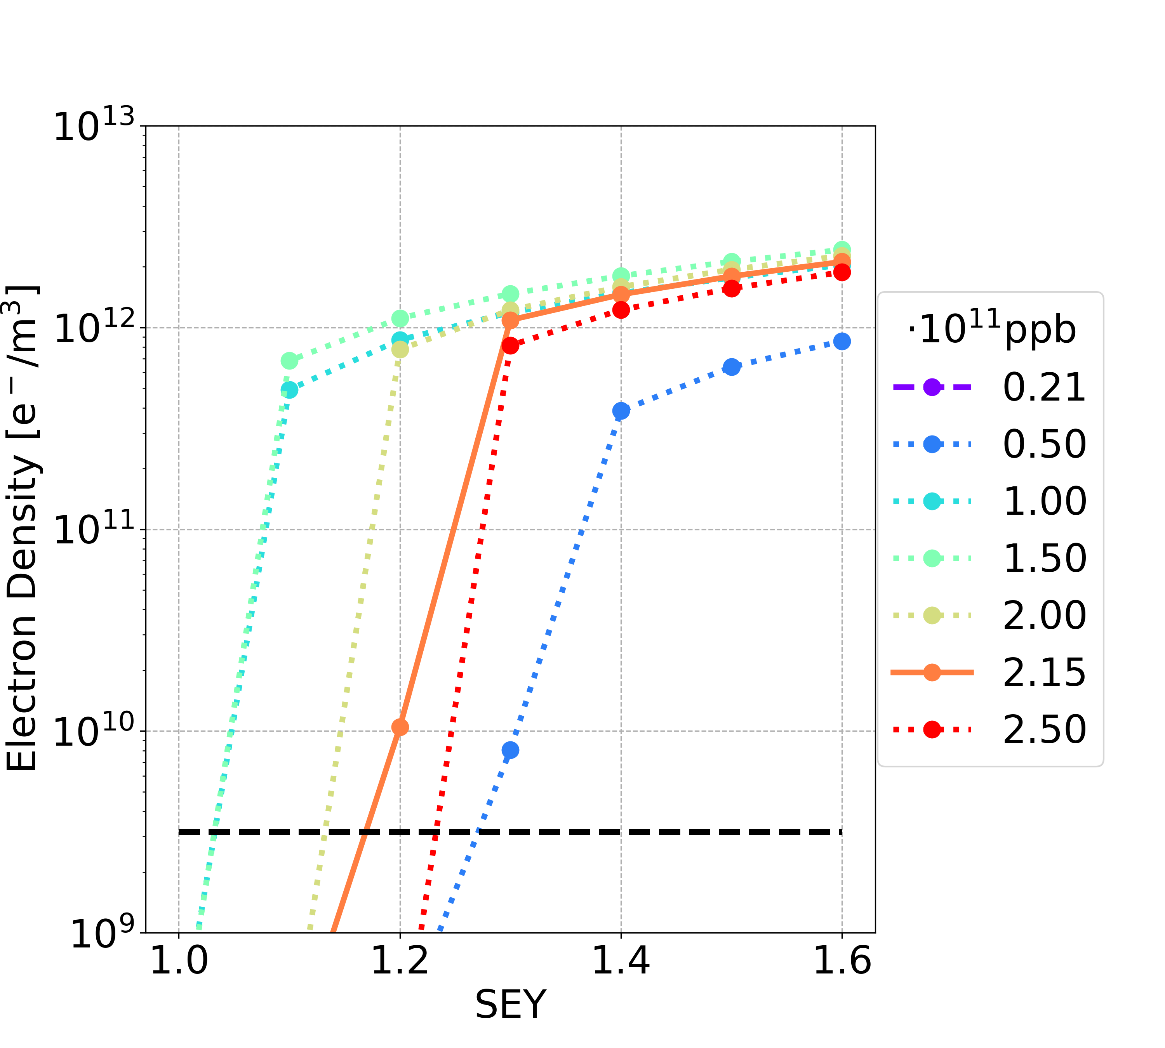
E-Cloud Build-Up Studies: Quadrupole
Filling scheme 1
Filling scheme 2
Multipacting regime
Multipacting
regime
The bunch intensities 1.00e11 and 1.50e11 ppb are the most critical cases
 | Filling Scheme 1 | Filling Scheme 2
SEY threshold (nominal intensity) | 1.1 | 1.2
SEY threshold (all intensity below nominal one) | 1.0 | 1.0

Slide 12
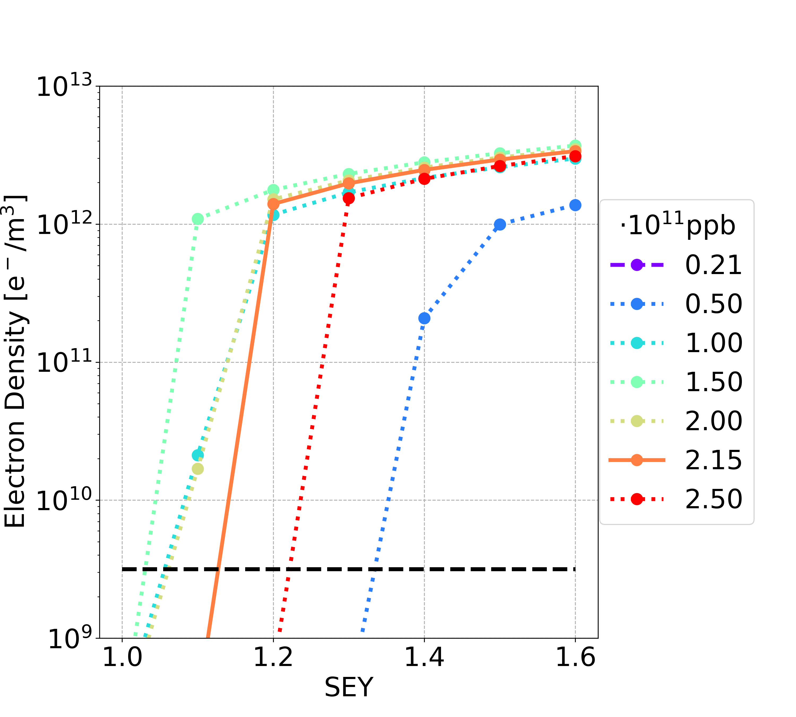
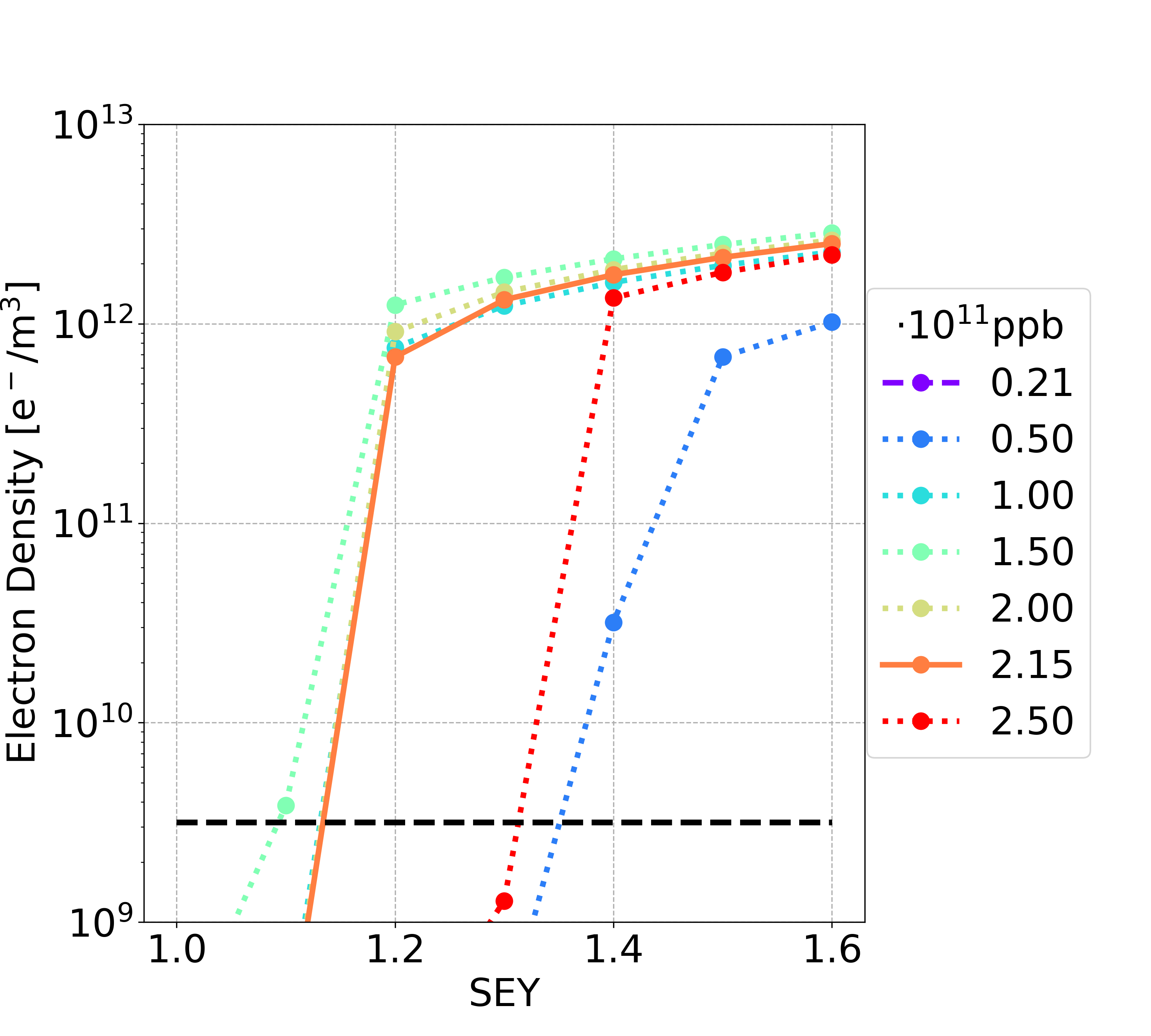
E-Cloud Build-Up Studies: Sextupole
Filling scheme 1
Filling scheme 2
Multipacting regime
Multipacting
regime
The bunch intensities 1.00e11 and 1.50e11 ppb, 2.00e11 and 2.15e11 ppb are the most critical cases
 | Filling Scheme 1 | Filling Scheme 2
SEY threshold (nominal intensity) | 1.1 | 1.1
SEY threshold (all intensity below nominal one) | 1.0 | 1.0

Slide 13
Simulation Results: Summary
Quadrupoles and sextupoles are the most critical elements from the e-cloud point of view
Larger SEY multipacting thresholds considering the filling scheme 2 (25 ns bunch spacing)
Bunch intensities 1.00e11 and 1.50e11 ppb are the most critical cases
Element | SEY Threshold | Filling Scheme 1 | Filling Scheme 2
Drift Space | nominal intensity | 1.3 | 1.4
 | all intensity below nominal one | 1.1 | 1.2
Dipole | nominal intensity | 1.3 | 1.4
 | all intensity below nominal one | 1.0 | 1.0
Quadrupole | nominal intensity | 1.1 | 1.2
 | all intensity below nominal one | 1.0 | 1.0
Sextupole | nominal intensity | 1.1 | 1.1
 | all intensity below nominal one | 1.0 | 1.0

Slide 14
Outline
Introduction
E-Cloud Build-Up Studies
Heat Loads
Stability Studies
Conclusions and Outlooks

Slide 15
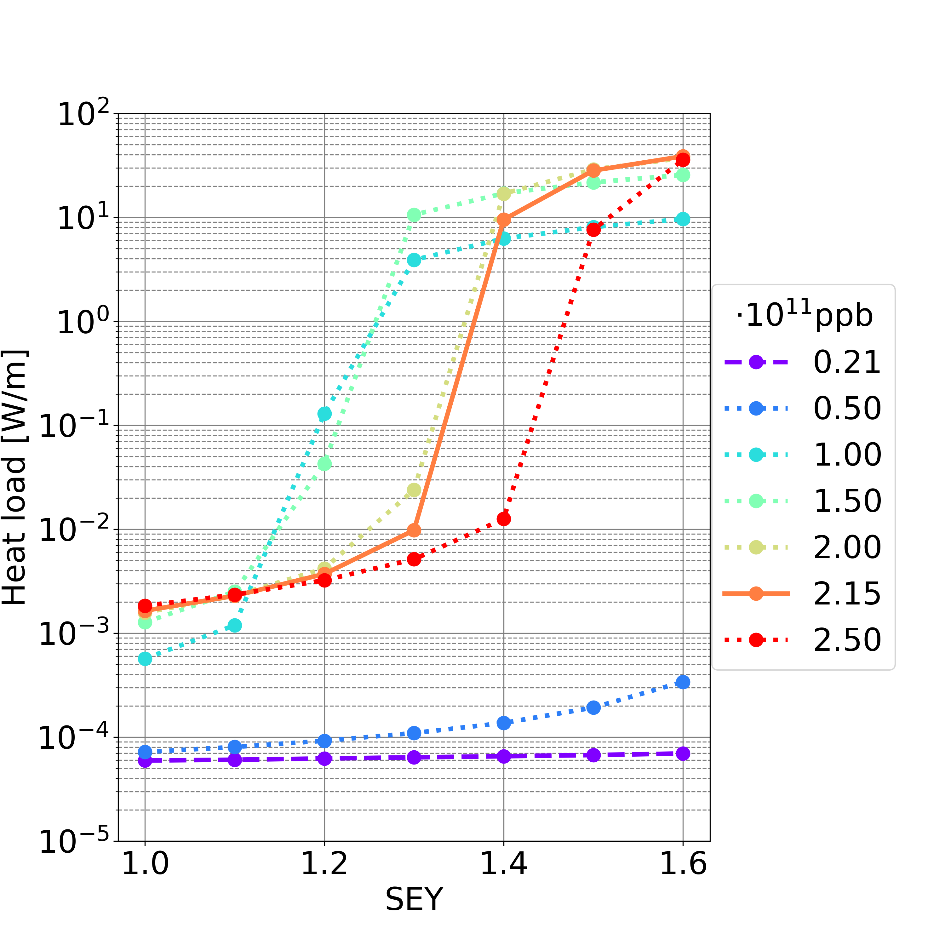
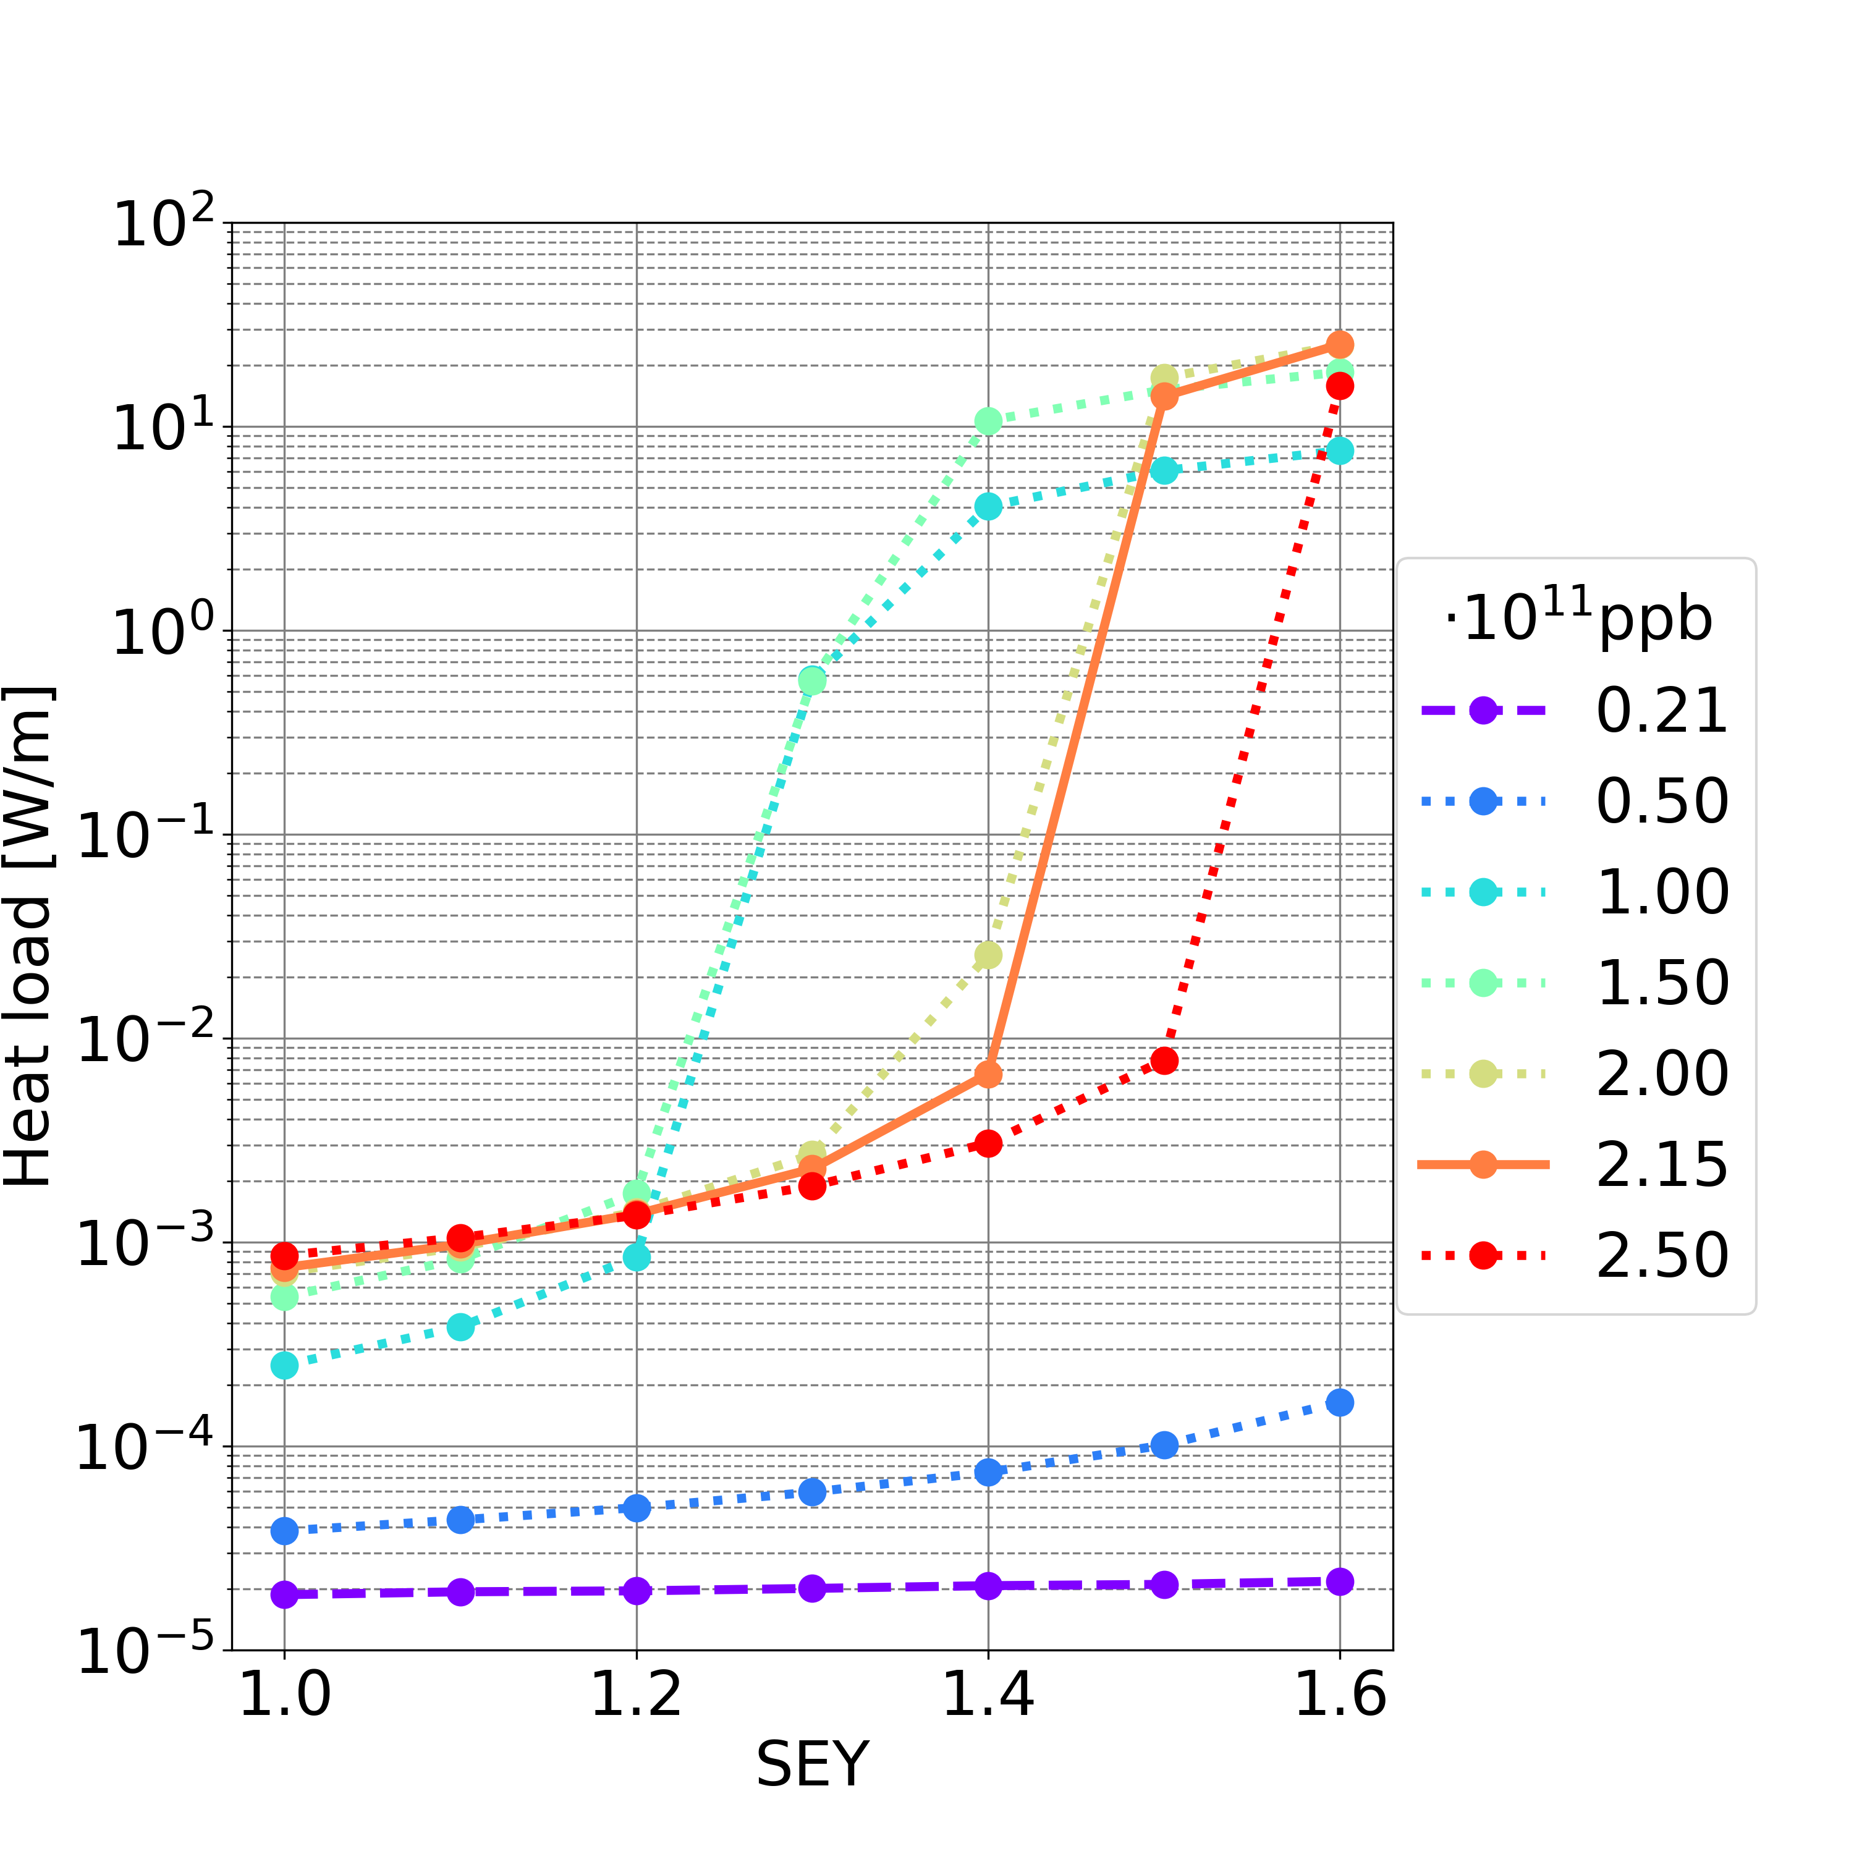
Heat Loads: Drift Space
 | Filling Scheme 1 | Filling Scheme 2
SEY threshold (nominal intensity) | 1.3 | 1.4
SEY threshold (all intensity below nominal one) | 1.1 | 1.2
Filling scheme 1
Filling scheme 2
  L_{drift} = 17.4 km (L_{drift} /L = 19.18%)
Synchrotron radiation power: ∼50 MW per beam
If multipacting (considering nominal bunch intensity and maximum simulated SEY=1.6):
  Filling scheme 1: ∼38.7 W/m -> full circumference ∼673 kW ∼1.35% of synchrotron radiation power
  Filling scheme 2: ∼25.3 W/m -> full circumference ∼439 kW ∼0.88% of synchrotron radiation power
If no multipacting (considering SEY smaller the SEY multipacting threshold, all simulated bunch intensities):
  Filling scheme 1 (SEY<=1.1) & 2 (SEY<=1.2): smaller than 0.01 W/m -> full circumference smaller than 200 W ∼0.0004% of synchrotron radiation power

Slide 16
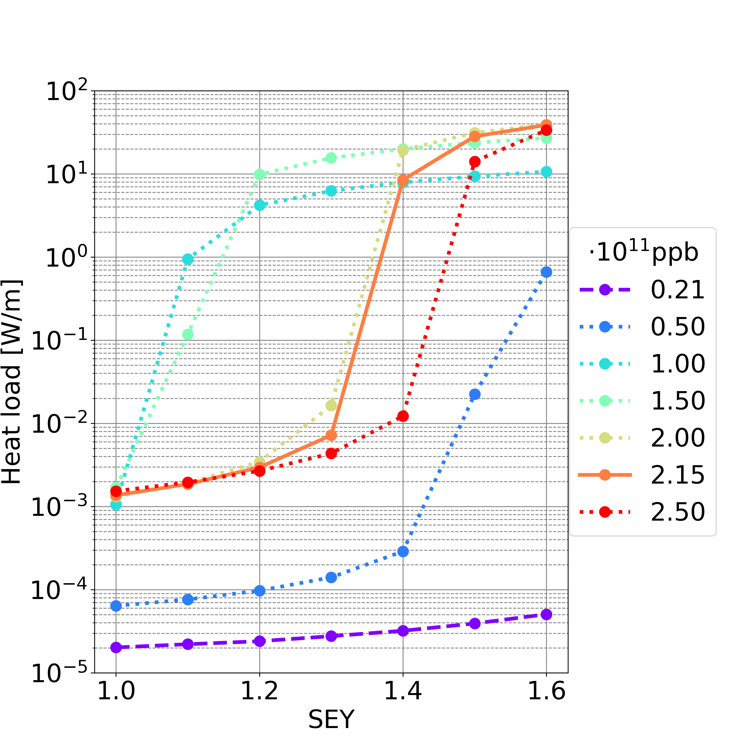
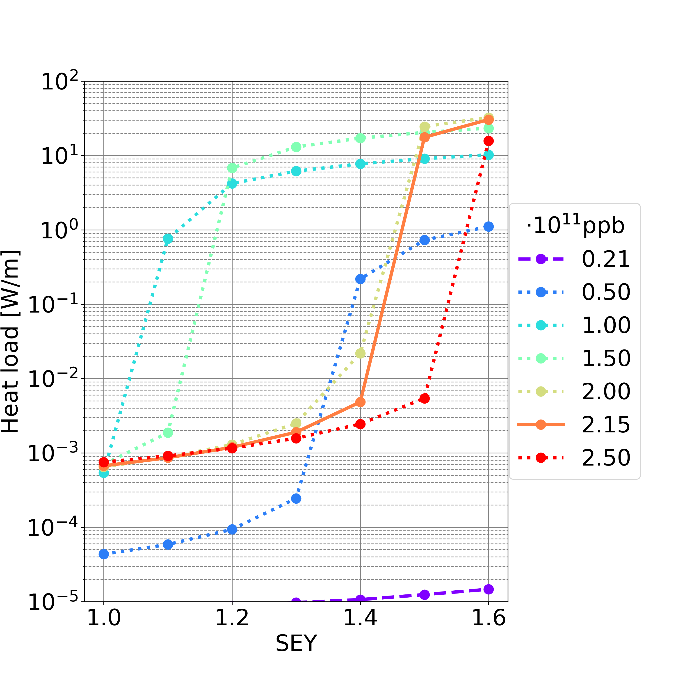
Heat Loads: Dipole
 | Filling Scheme 1 | Filling Scheme 2
SEY threshold (nominal intensity) | 1.3 | 1.4
SEY threshold (all intensity below nominal one) | 1.0 | 1.0
Filling scheme 1
Filling scheme 2
  L_{dipole} = 62.8 km (L_{dipole} /L = 69.24%)
Synchrotron radiation power: ∼50 MW per beam
If multipacting (considering nominal bunch intensity and maximum simulated SEY=1.6):
  Filling scheme 1: ∼38.7 W/m -> full circumference ∼2.43 MW ∼4.87% of synchrotron radiation power
  Filling scheme 2: ∼30.4 W/m -> full circumference ∼1.91 MW ∼3.82% of synchrotron radiation power
If no multipacting (considering SEY smaller the SEY multipacting threshold, all simulated bunch intensities):
  Filling scheme 1 (SEY<=1.0) & 2 (SEY<=1.0): smaller than 0.01 W/m -> full circumference smaller than 700 W ∼0.002% of synchrotron radiation power

Slide 17
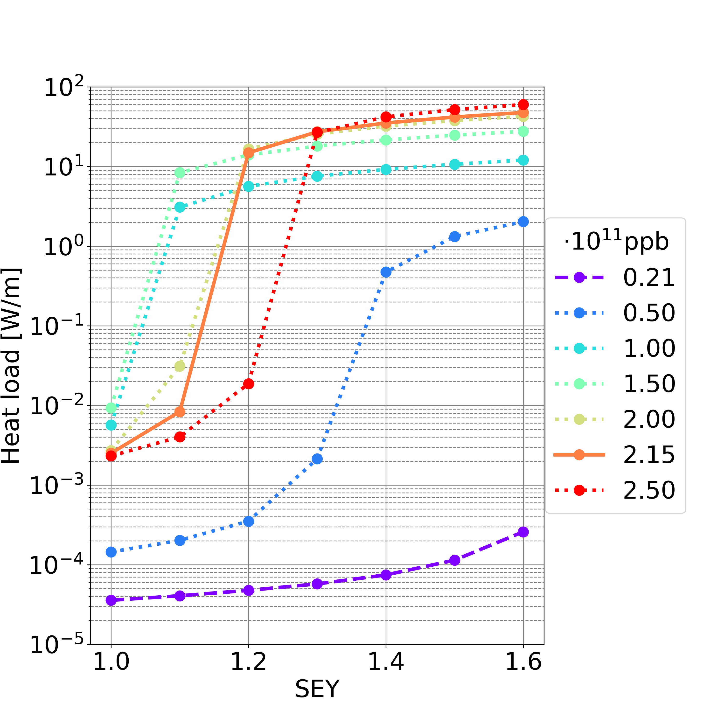
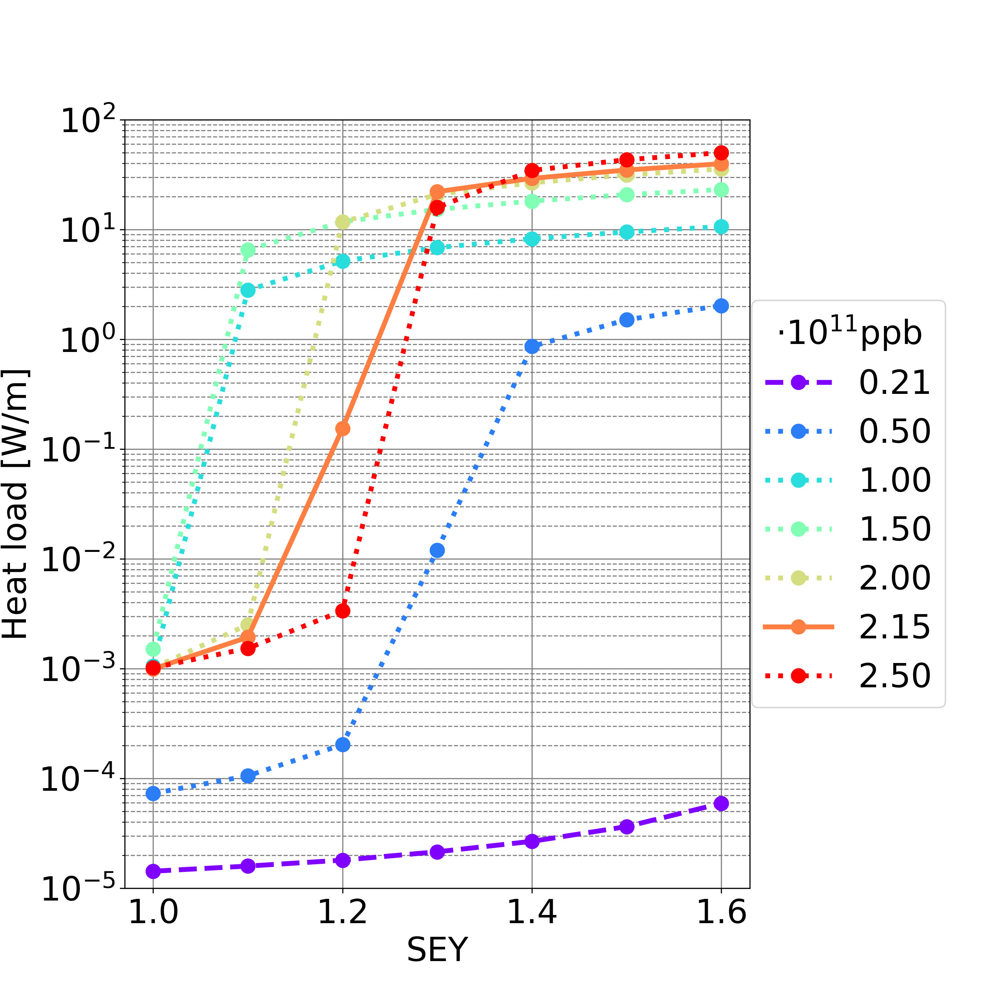
Heat Loads: Quadrupole
 | Filling Scheme 1 | Filling Scheme 2
SEY threshold (nominal intensity) | 1.1 | 1.2
SEY threshold (all intensity below nominal one) | 1.0 | 1.0
Filling scheme 1
Filling scheme 2
  L_{quad} = 4.77 km (L_{quad} /L = 5.26%)
Synchrotron radiation power: ∼50 MW per beam
If multipacting (considering nominal bunch intensity and maximum simulated SEY=1.6):
  Filling scheme 1: ∼47.7 W/m -> full circumference ∼227 kW ∼0.45% of synchrotron radiation power
  Filling scheme 2: ∼39.8 W/m -> full circumference ∼190 kW ∼0.38% of synchrotron radiation power
If no multipacting (considering SEY smaller the SEY multipacting threshold, all simulated bunch intensities):
  Filling scheme 1 (SEY<=1.0) & 2 (SEY<=1.0): smaller than 0.01 W/m -> full circumference smaller than 50 W ∼0.0001% of synchrotron radiation power

Slide 18
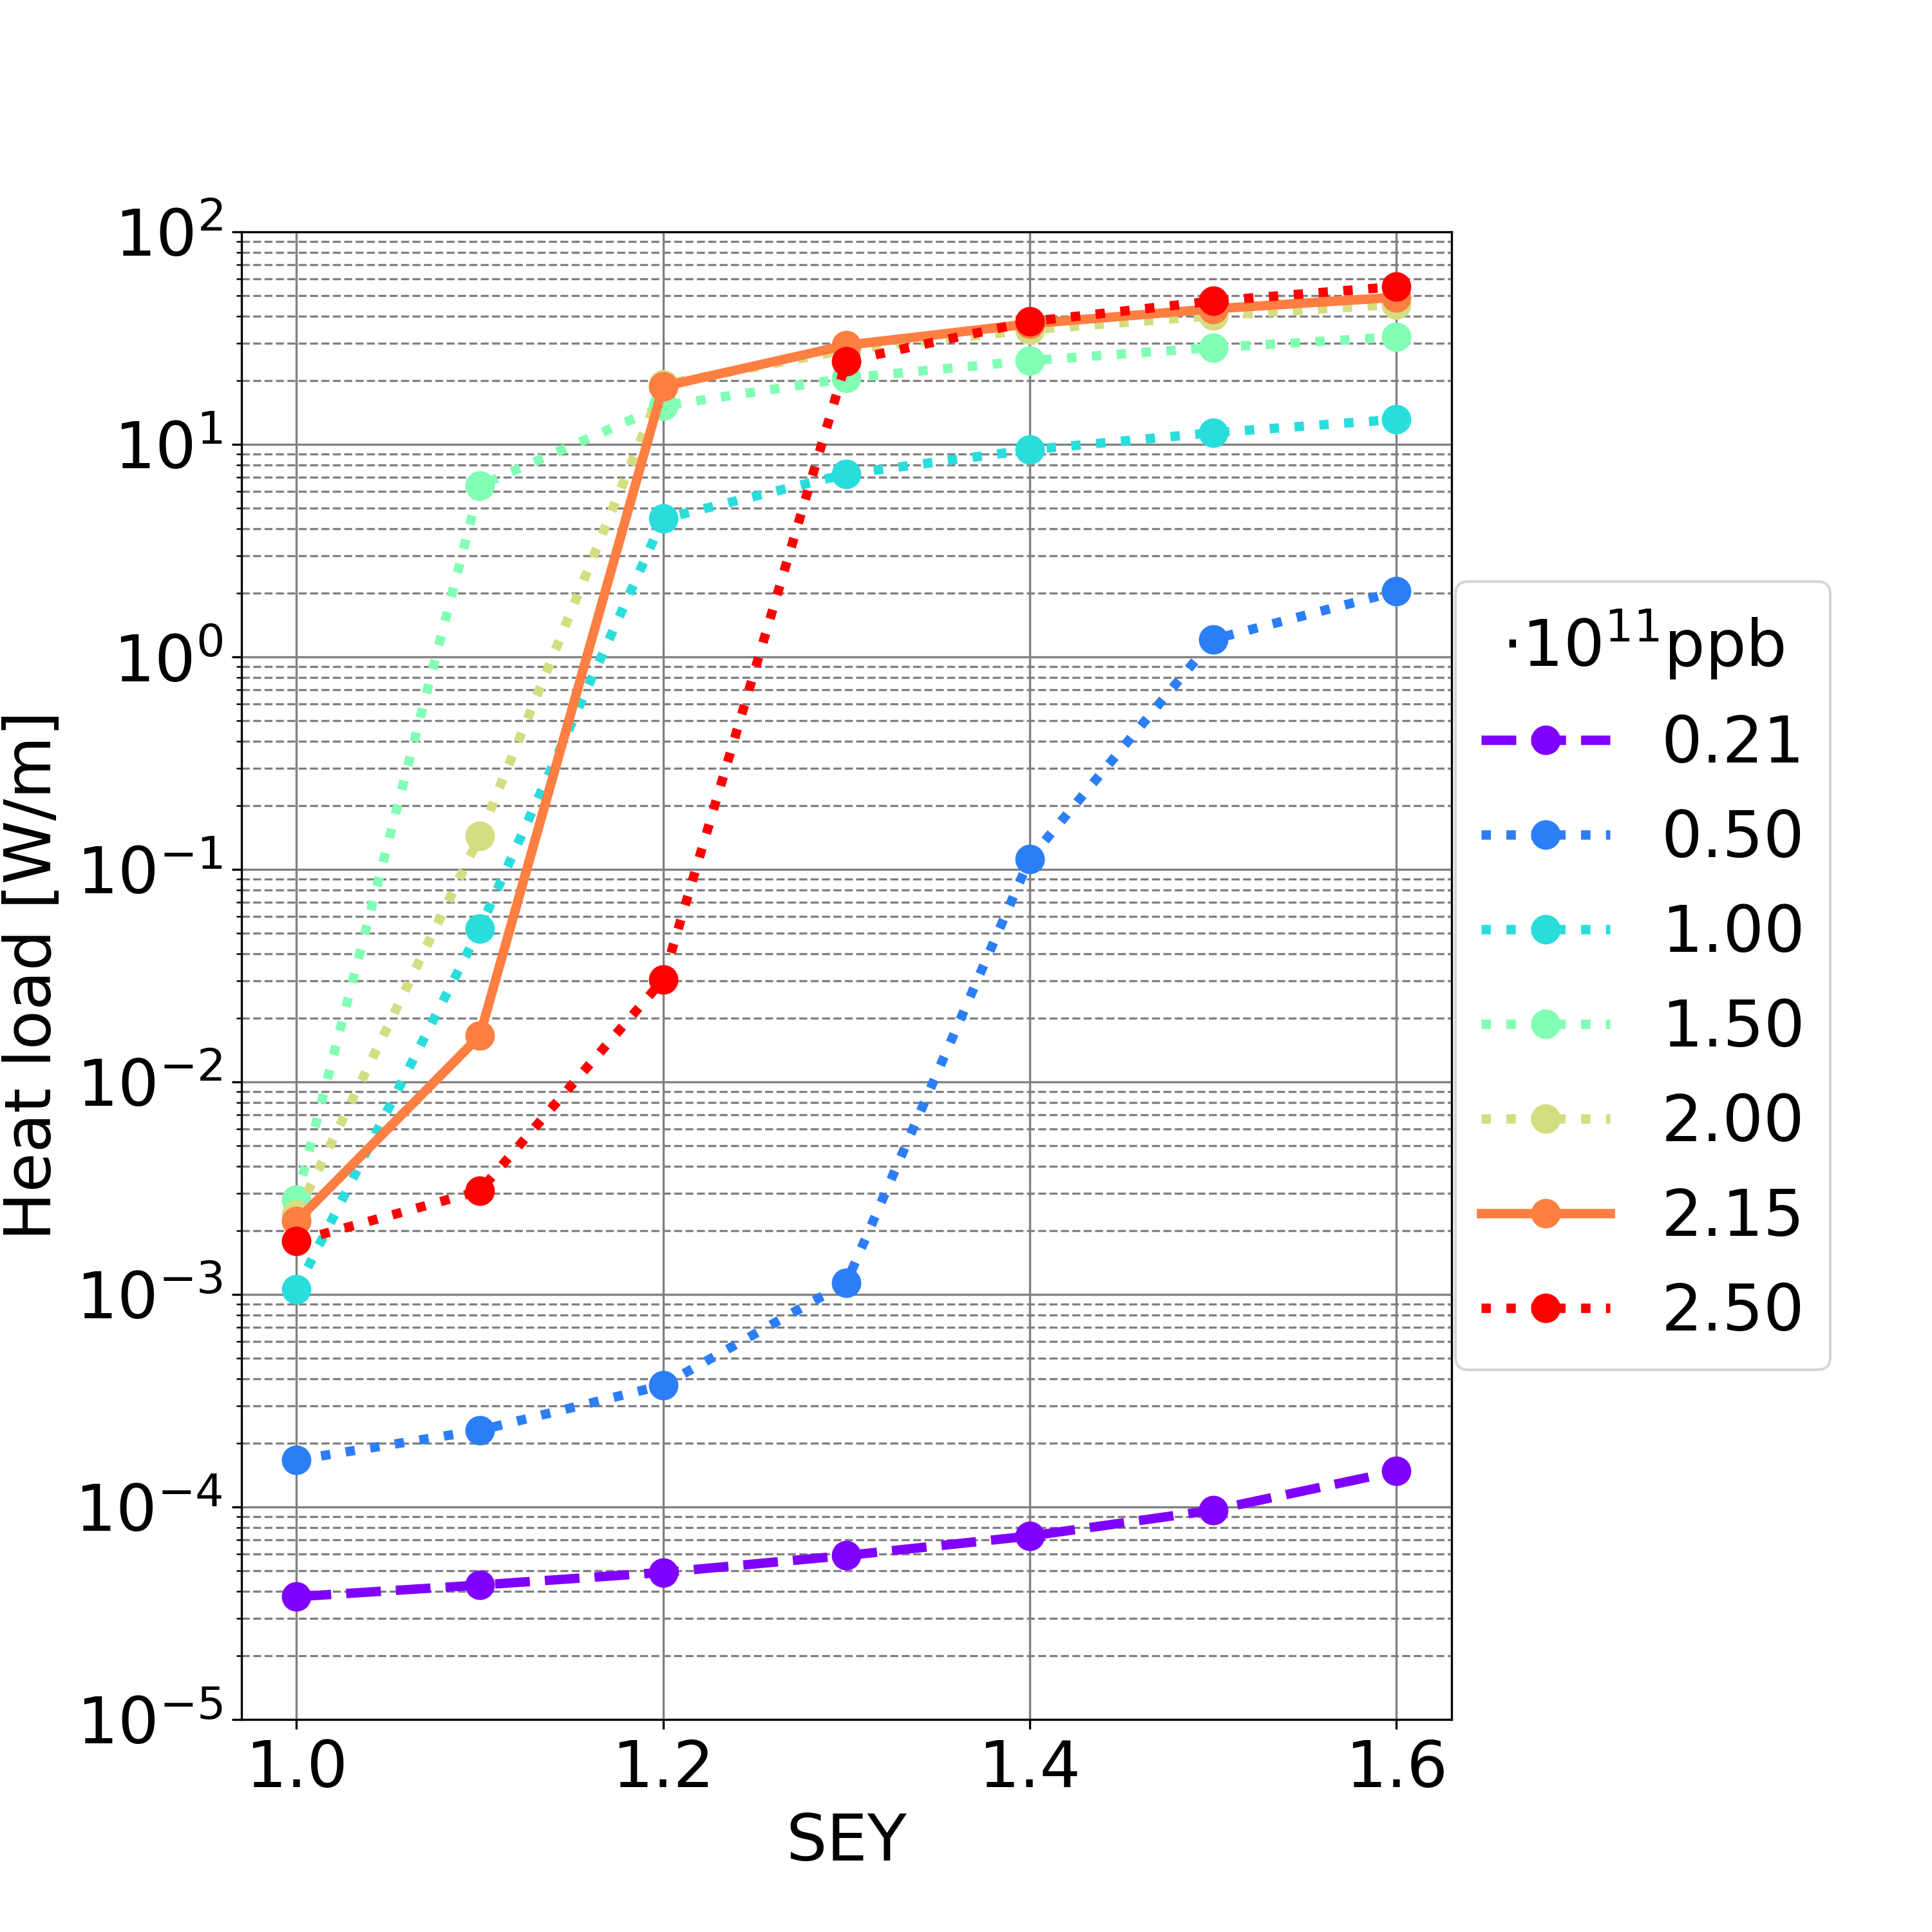
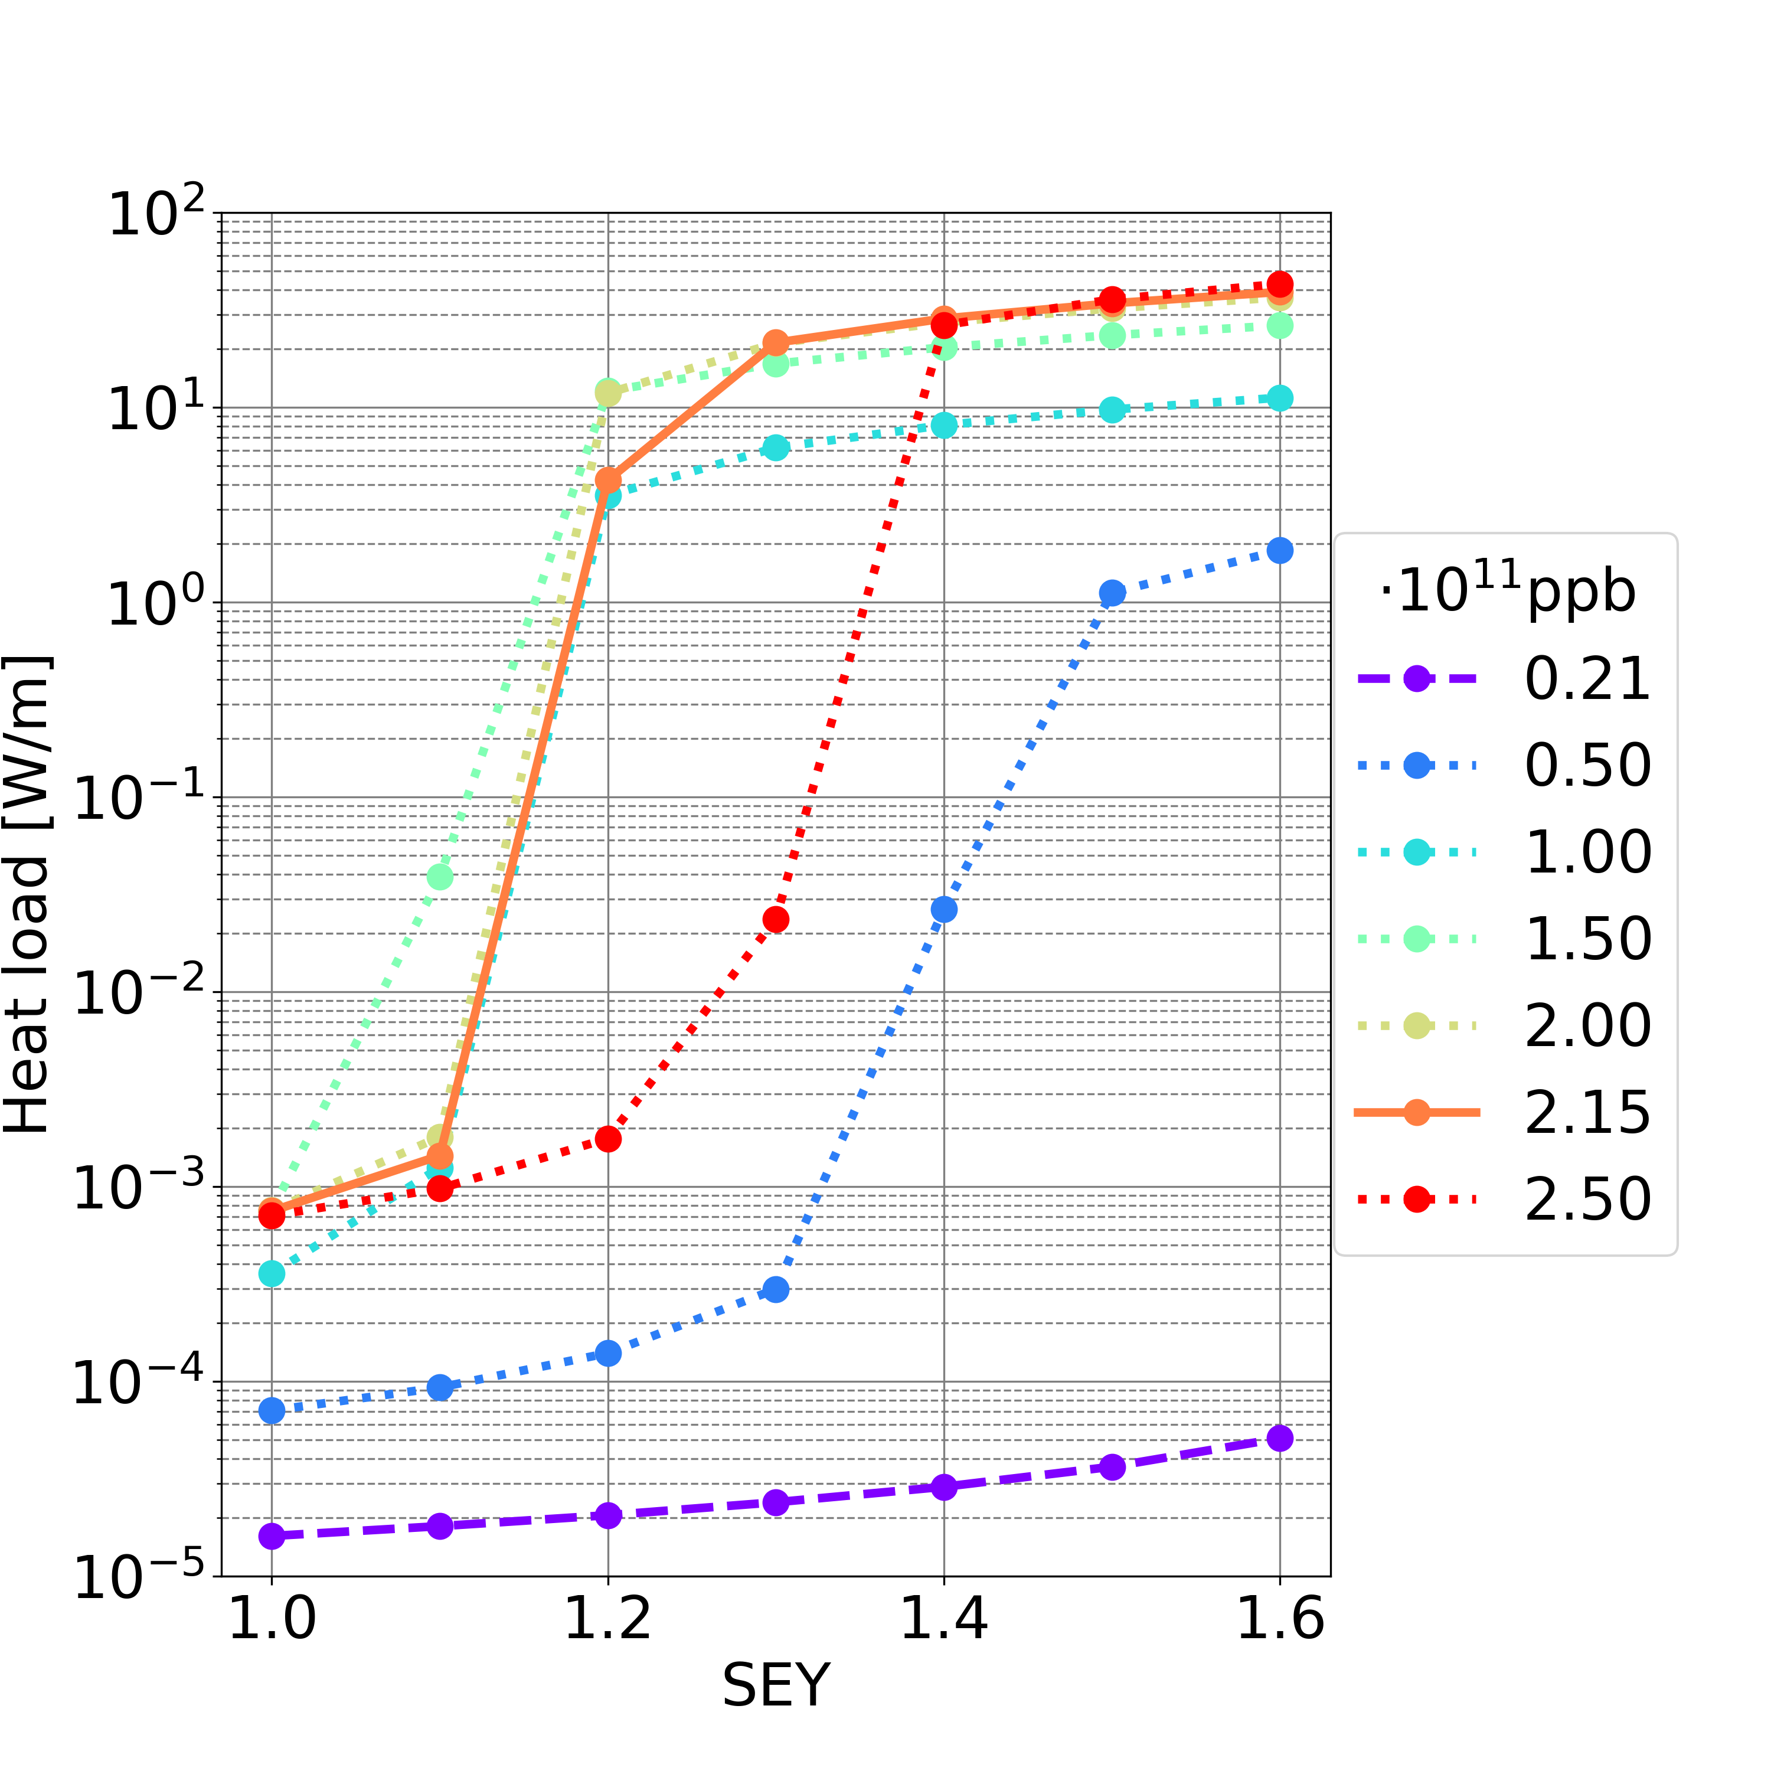
Heat Loads: Sextupole
 | Filling Scheme 1 | Filling Scheme 2
SEY threshold (nominal intensity) | 1.1 | 1.1
SEY threshold (all intensity below nominal one) | 1.0 | 1.0
Filling scheme 1
Filling scheme 2
  L_{sex} = 0.900 km (L_{sex} /L = 0.99%)
Synchrotron radiation power: ∼50 MW per beam
If multipacting (considering nominal bunch intensity and maximum simulated SEY=1.6):
  Filling scheme 1: 49.2 W/m -> full circumference 44.3 kW ∼0.09% of synchrotron radiation power
  Filling scheme 2: 39.1 W/M -> full circumference 35.2 kW ∼0.07% of synchrotron radiation power
If no multipacting (considering SEY smaller the SEY multipacting threshold, all simulated bunch intensities):
  Filling scheme 1 (SEY<=1.0) & 2 (SEY<=1.0): smaller than 0.01 W/m -> full circumference smaller than 10 W ∼0.00002% of synchrotron radiation power

Slide 19
Heat Loads: Summary
In case there is the multipacting, the total heat loads are in the order of:
  7% of synchrotron radiation power for the filling scheme 1
  5% of synchrotron radiation power for the filling scheme 2
Heat loads are smaller considering the filling scheme 2 (25 ns bunch spacing)
Dipoles are the main contributors to the total heat loads
If there is no multipacting, the total heat loads are negligible compared to the synchrotron radiation power

Slide 20
Outline
Introduction
E-Cloud Build-Up Studies
Heat Loads
Stability Studies
Conclusions and Outlooks

Slide 21


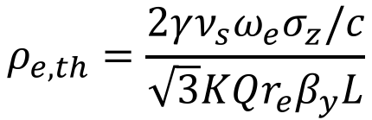

E-Cloud Stability Threshold
E-cloud could trigger instabilities, because the beams pass through the e-clouds and they receive transverse kicks
Which is the e-cloud density stability threshold?
  Theoretical equation:
  Simulations by means of PyECLOUD-PyHEADTAIL suite in order to track the beams through the e-clouds
$$ρ_{e,th}=\frac{2γν_{s}ω_{e}σ_{z}/c}{\sqrt{3}KQr_{e}β_{y}L}$$
$$ω_{e}=\sqrt{\frac{λ_{p}r_{e}c^{2}}{σ_{y}\left(σ_{x}+σ_{y}\right)}}$$
$$λ_{p}=\frac{i_{b}}{{\sqrt{2π}σ}_{z}}$$
$$\begin{matrix}K=ω_{e}σ_{z}/c \\ Q=min⁡\left(K,7\right)\end{matrix}$$
From K. Ohmi et al., “Study of Electron Cloud Instabilities in FCC-hh”, Proc. of IPAC2015

Slide 22
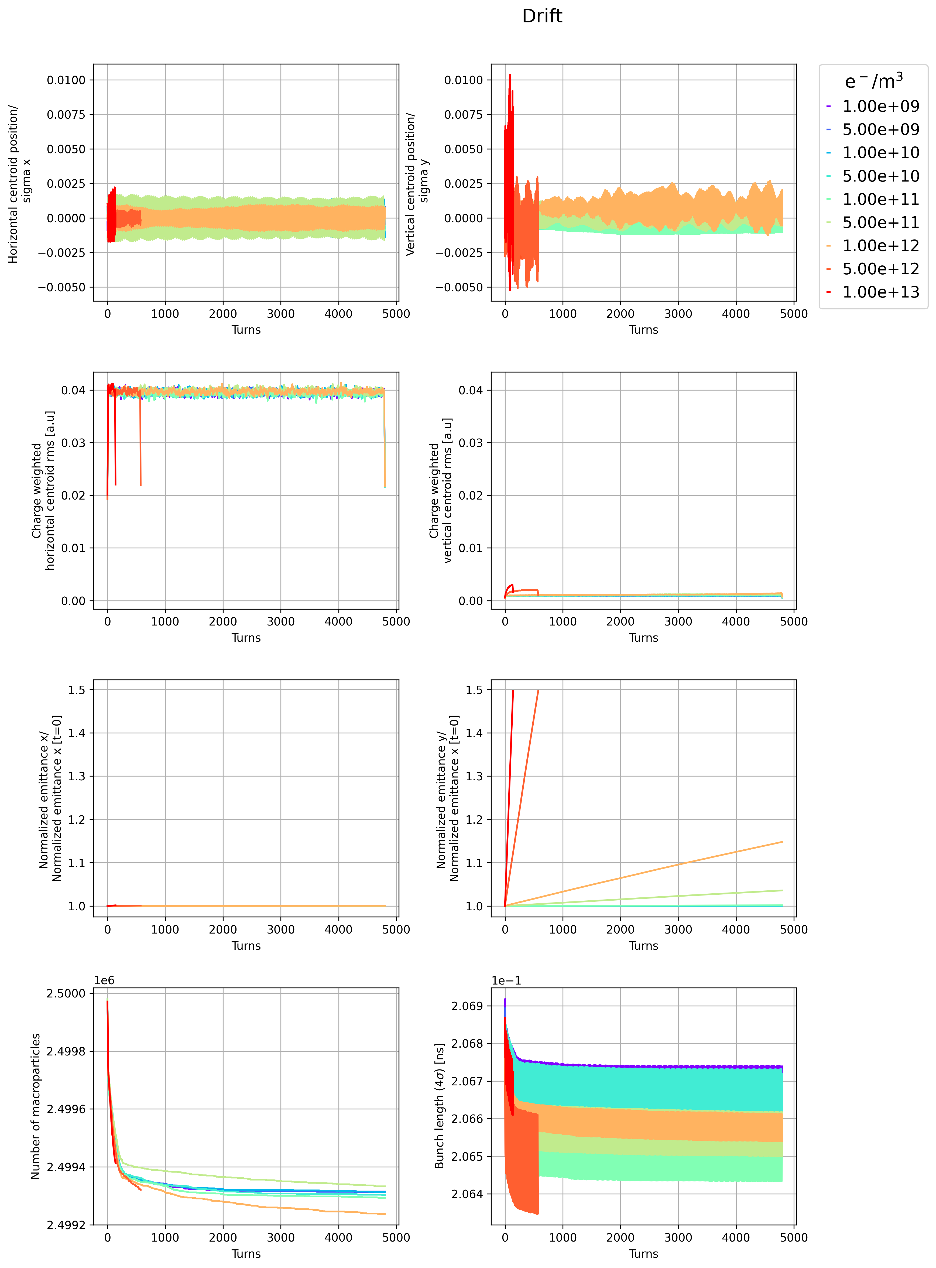
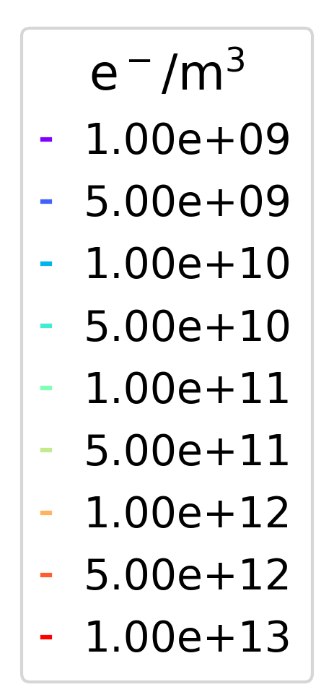
E-Cloud Stability Simulation Threshold: Drift Space
  ⍴_{e,th} = 9.53 ⋅10¹⁰ e⁻/m³ considering only the drift length L_{drift} = 17.4 km (L_{drift} /L = 19.18%)
Horizontal
Vertical
Centroid/
Sigma
Stable
Unstable
Very unstable
Normalised emittance/
Normalised emittance [t=0]
  Theoretical and numerical e-cloud density stability threshold have the same order of magnitude
  Vertical plane is unstable

Slide 23
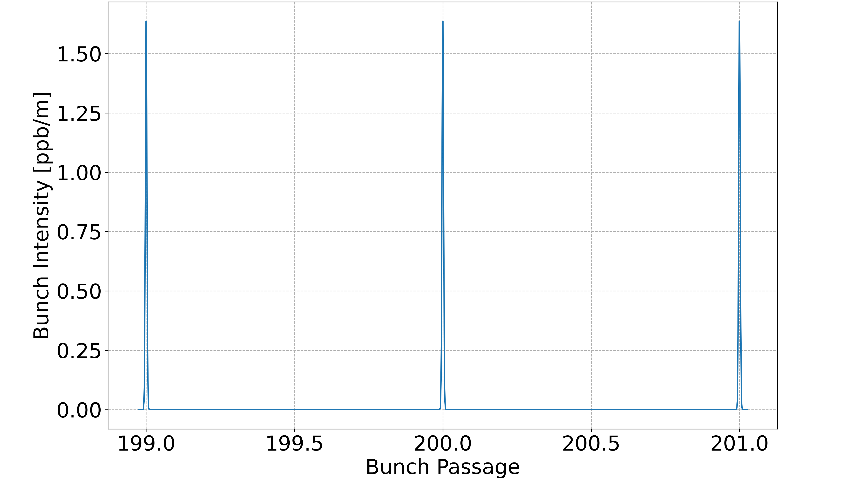
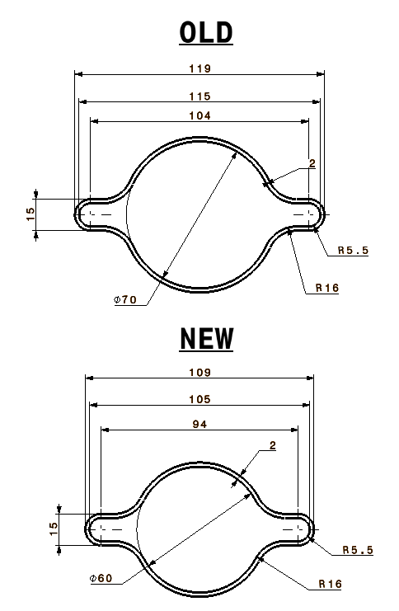
E-Cloud Central Density
E-cloud stability threshold has to be compared with the e-cloud density
  before the bunch passage
  close to the vacuum chamber centre
10σ_{z}
y
r_{centre} ≈ 10 σ_{x}
r_{centre}
r_{chambre} ≈ 600 σ_{x}
x

Slide 24
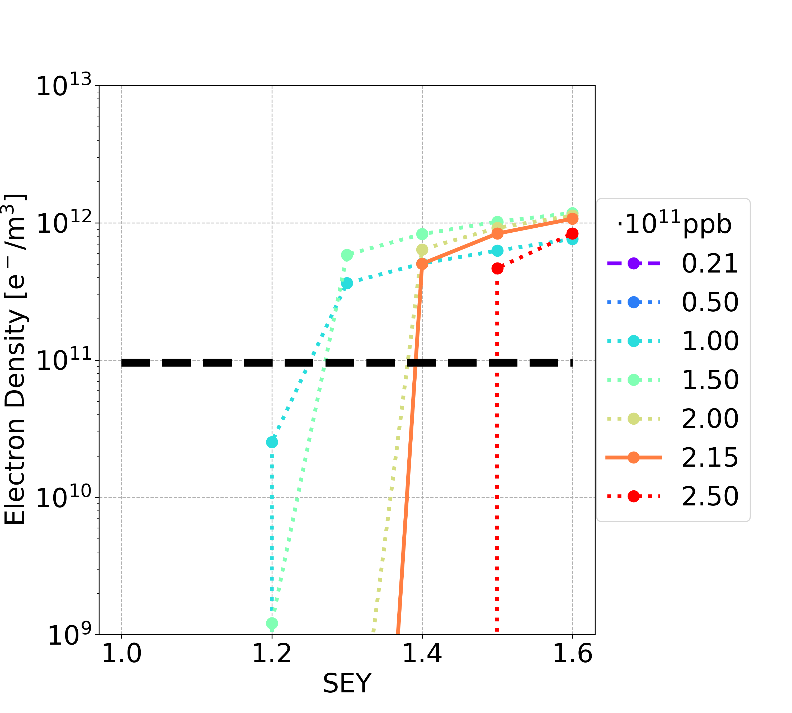
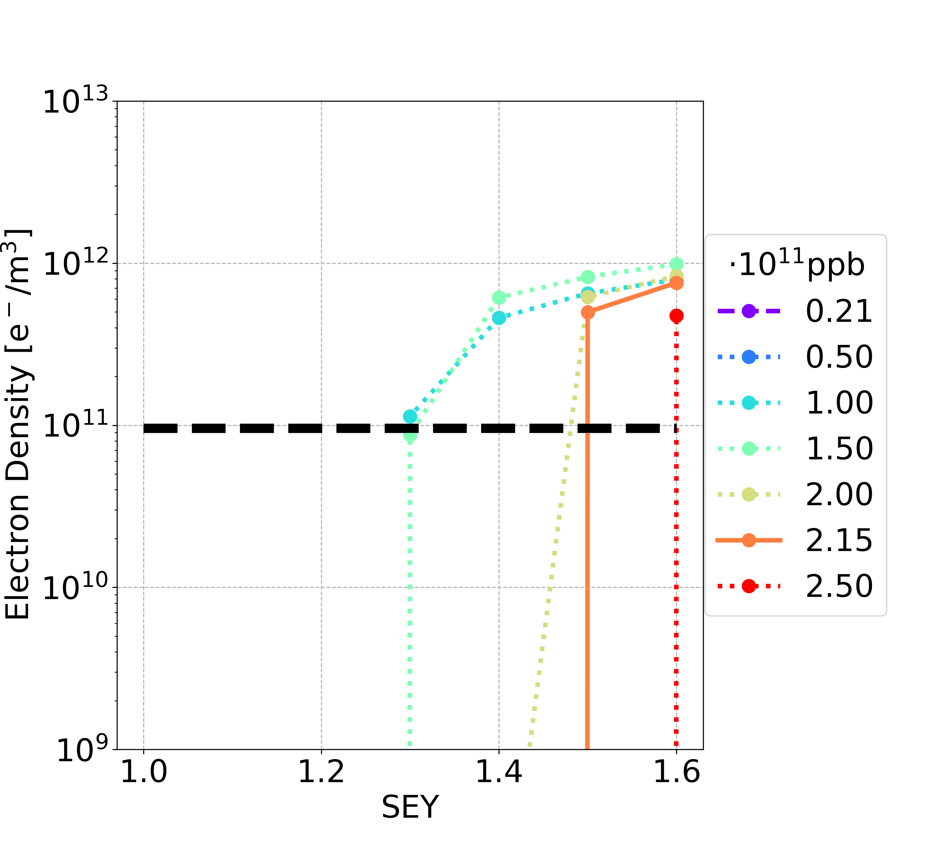
E-Cloud Stability: Drift Space
Filling scheme 1
Filling scheme 2
Above the multipacting threshold, the central e-cloud density before the bunch passage is larger than the e-cloud stability threshold

Slide 25
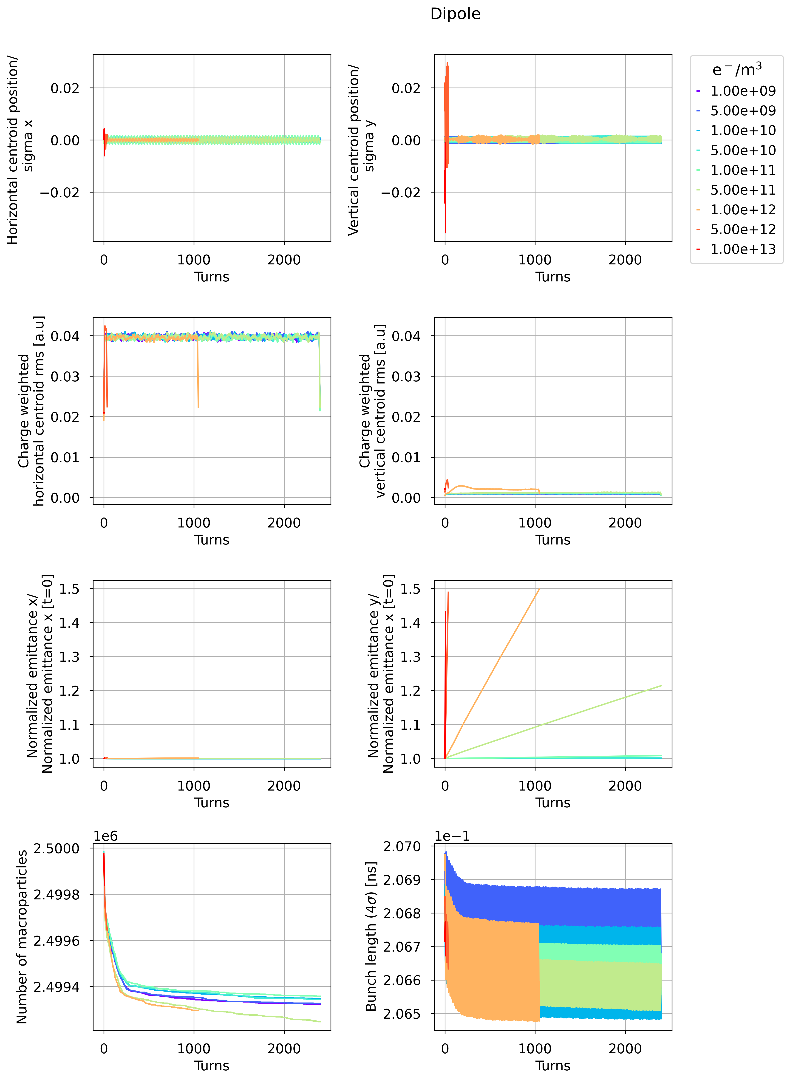
E-Cloud Stability Simulation Threshold: Dipole
  ⍴_{e,th} =2.42 ⋅10¹⁰ e⁻/m³ considering only the dipole length L_{dipole} = 62.8 km (L_{dipole} /L = 69.24%)
Horizontal
Vertical
B = 14.15 mT
Centroid/
Sigma
Stable
Unstable
Very unstable
Normalised emittance/
Normalised emittance [t=0]
  Theoretical and numerical e-cloud density stability threshold have the same order of magnitude
  Vertical plane is unstable

Slide 26
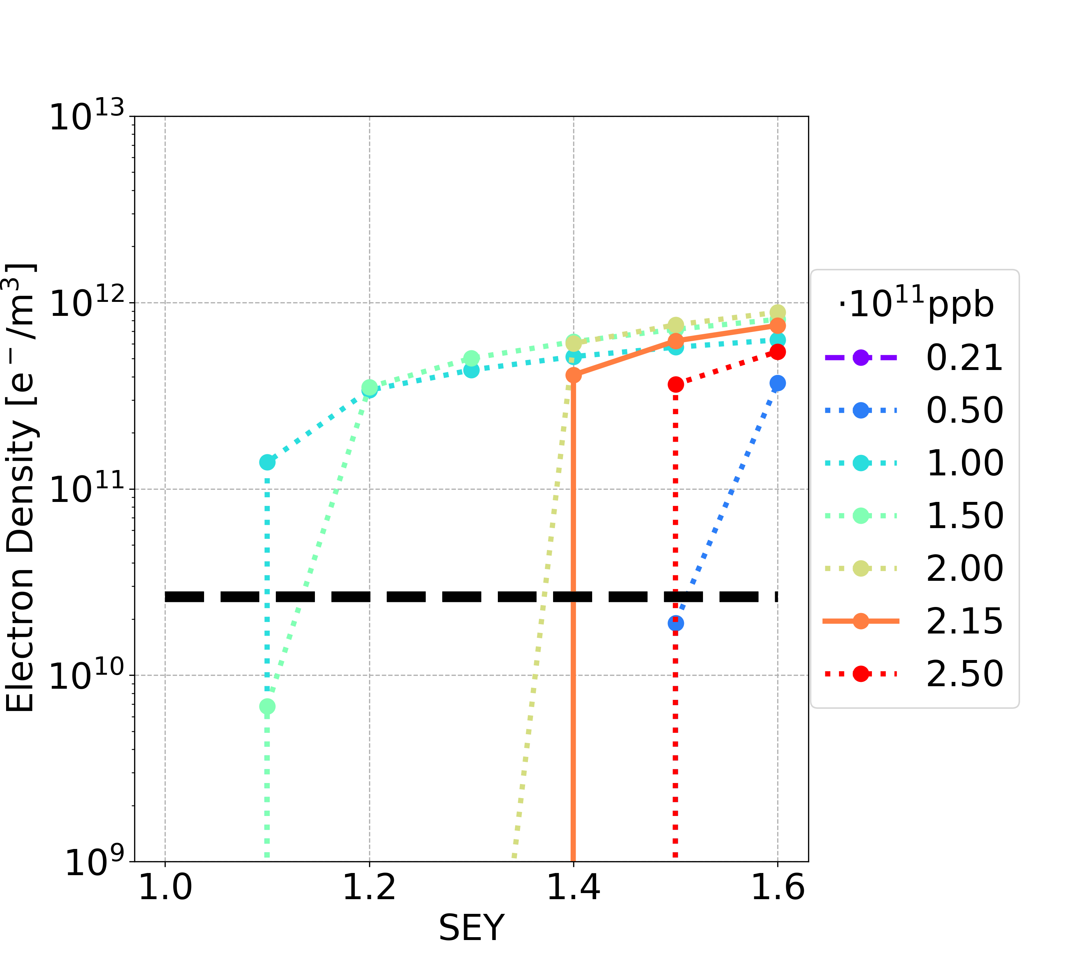
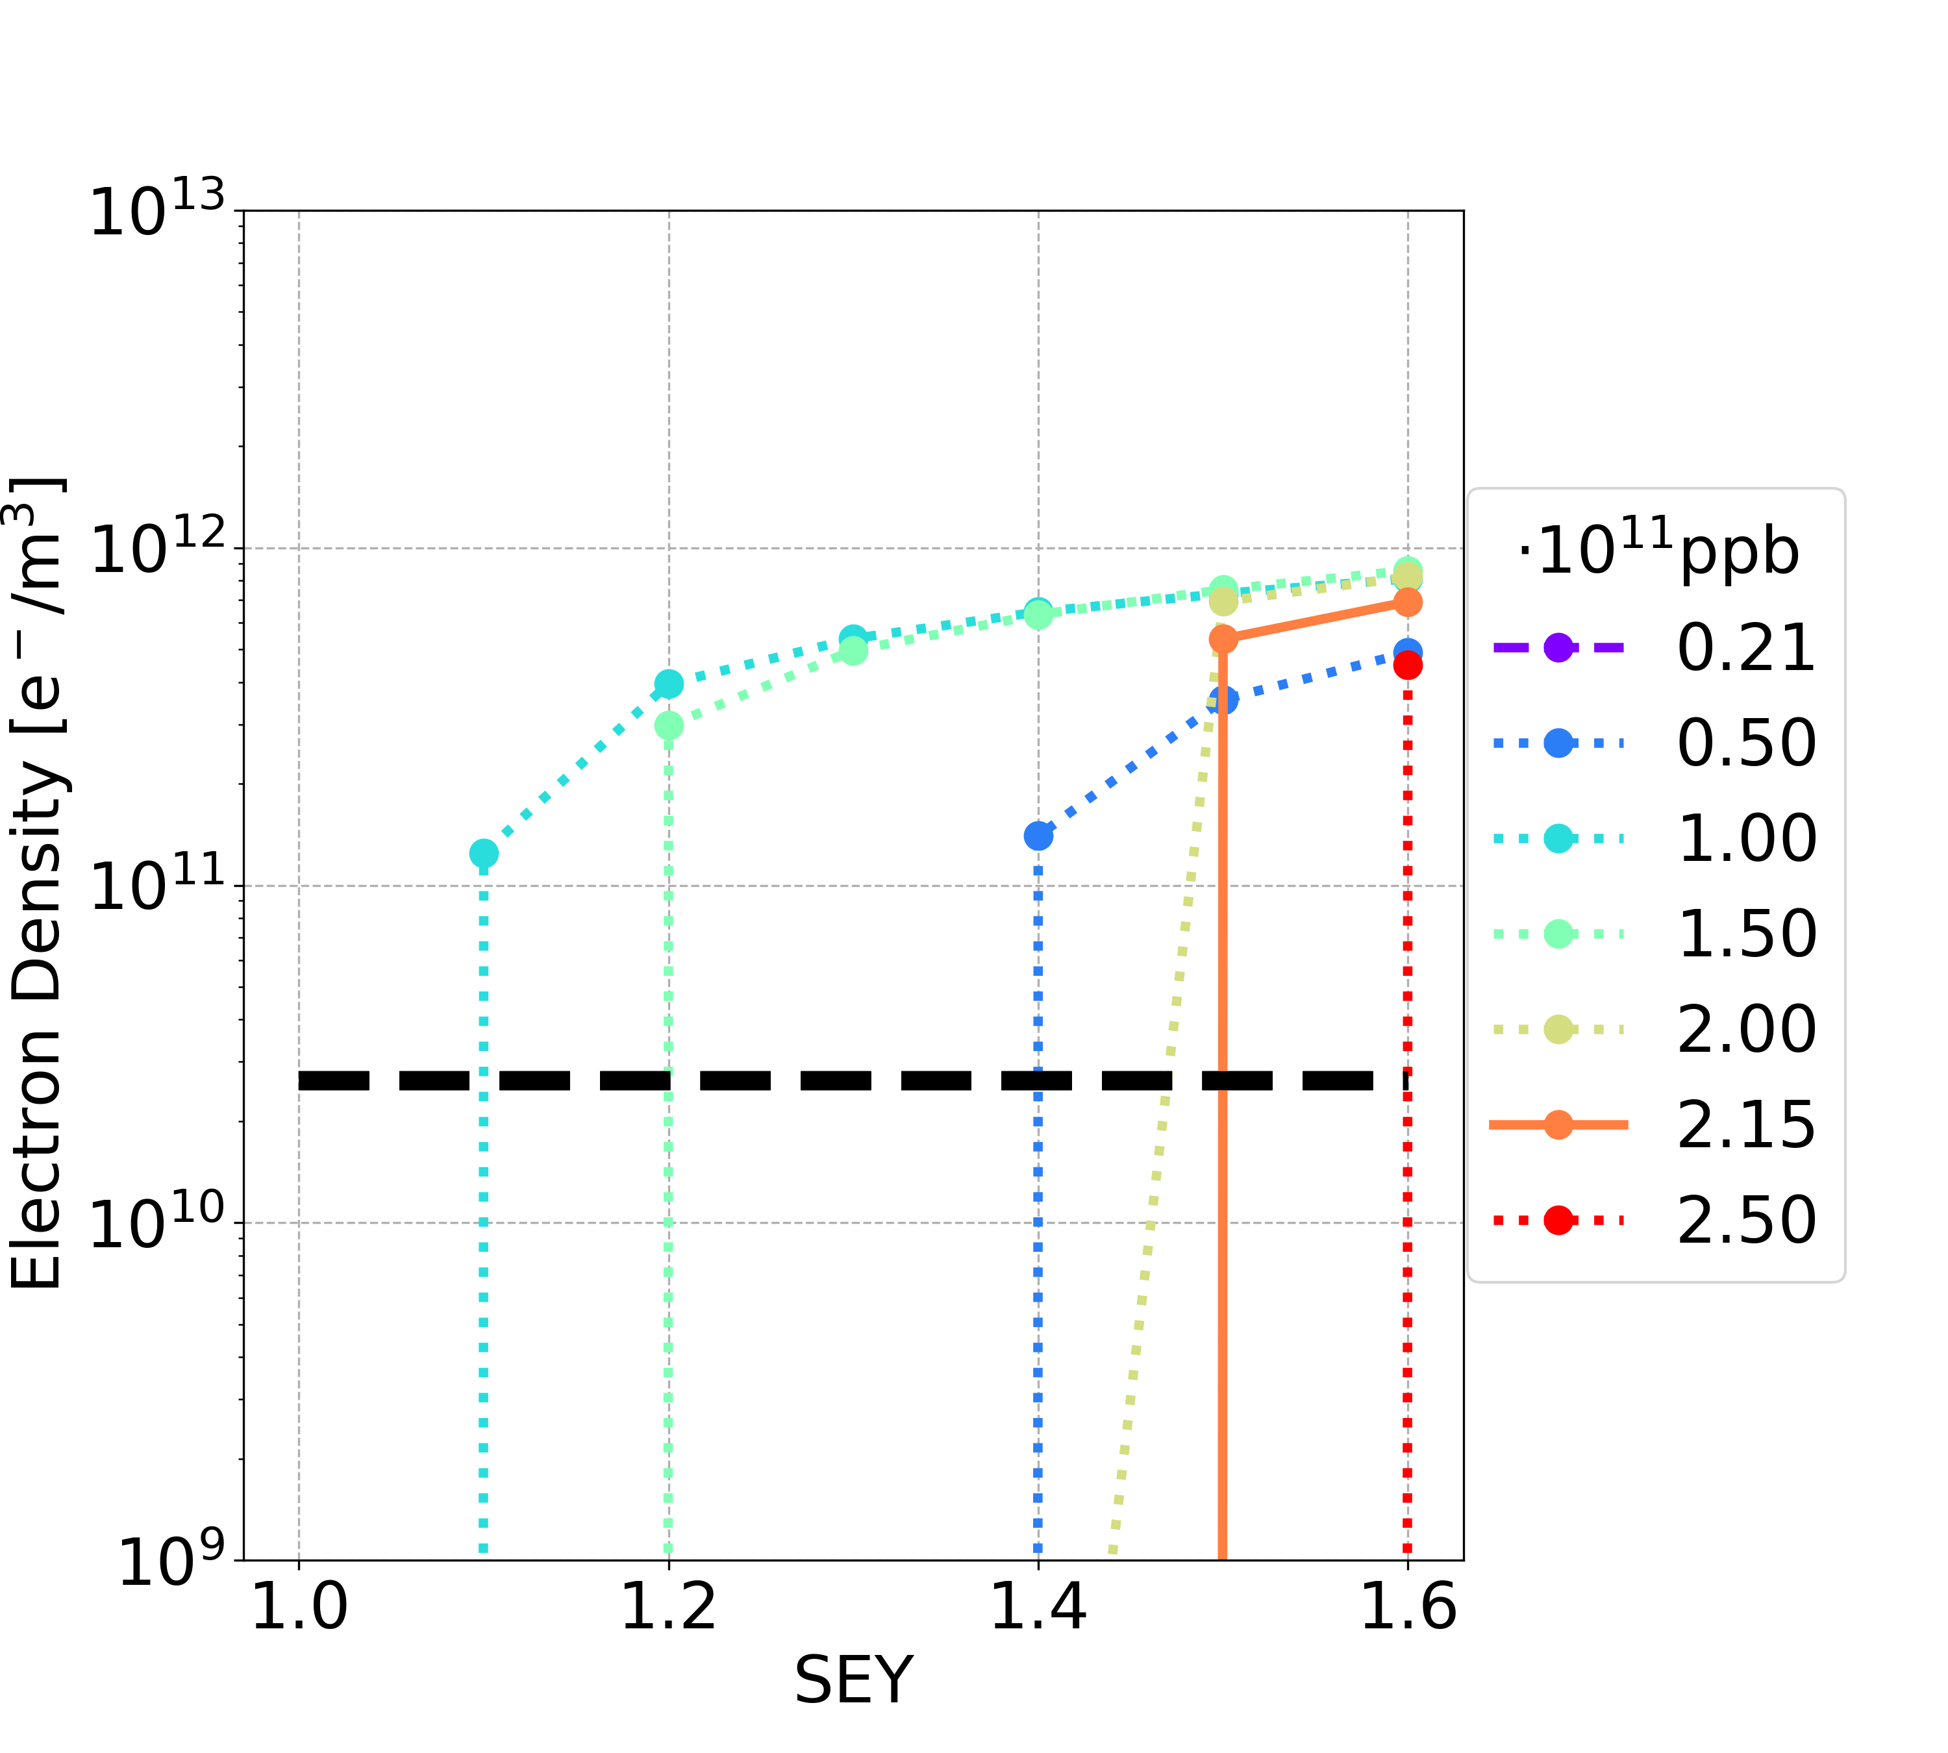
E-Cloud Stability: Dipole
Filling scheme 1
Filling scheme 2
Above the multipacting threshold, the central e-cloud density before the bunch passage is larger than the e-cloud stability threshold

Slide 27
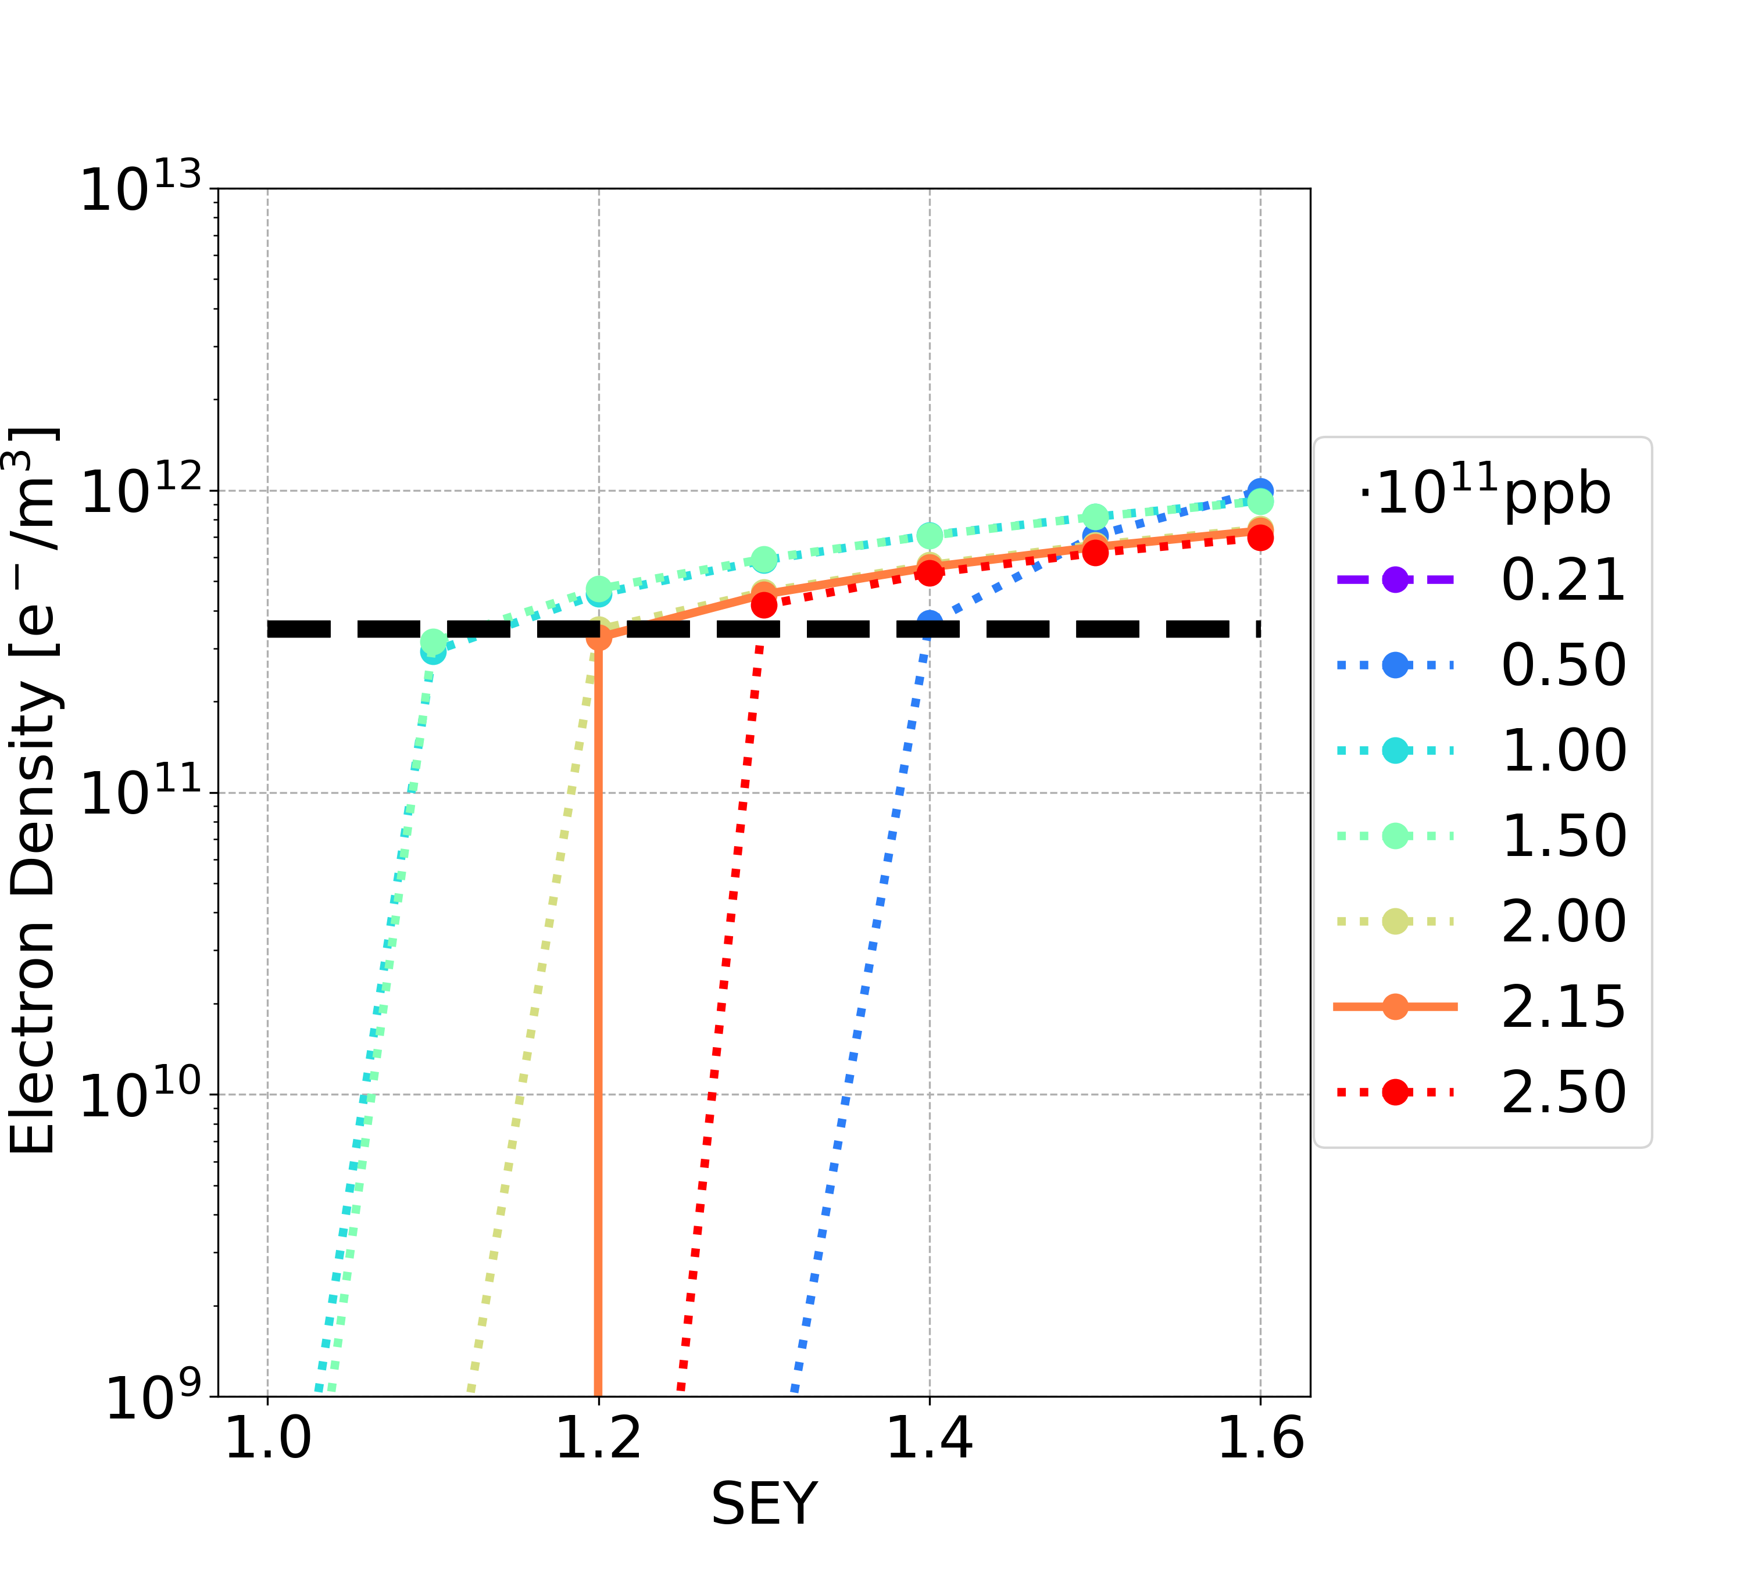
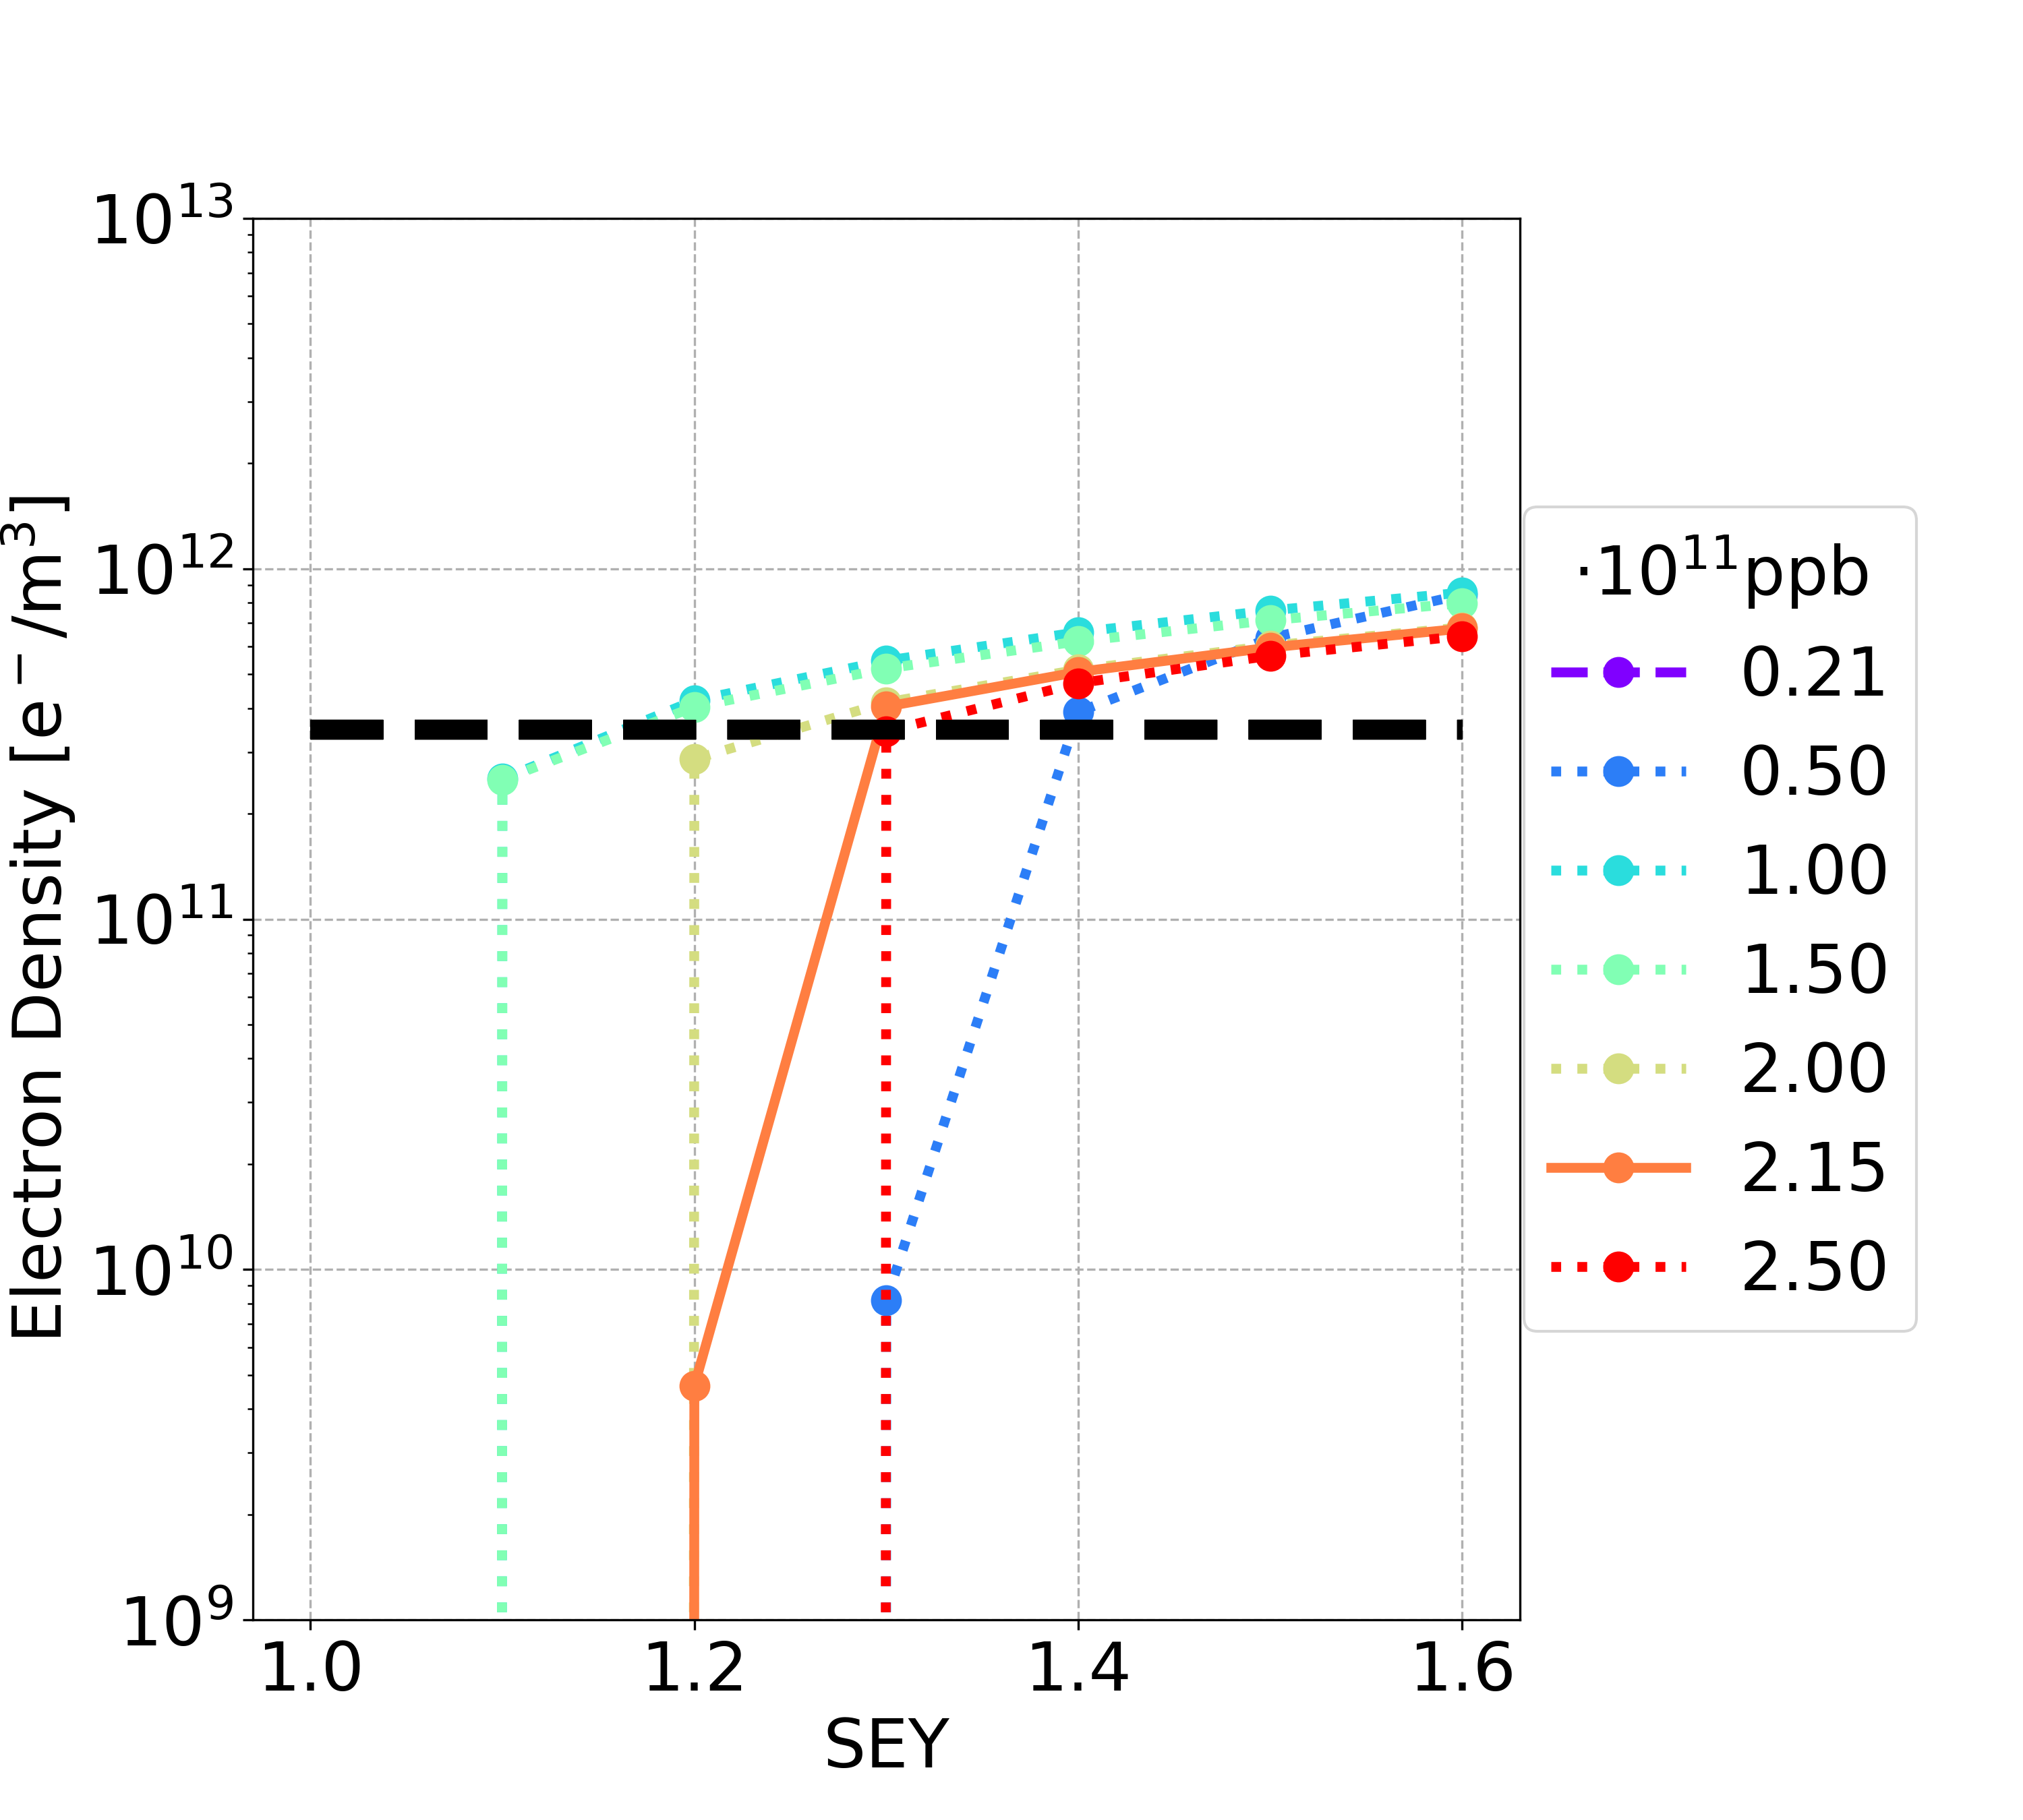
E-Cloud Stability: Quadrupole
Filling scheme 1
Filling scheme 2
Above the multipacting threshold, the central e-cloud density before the bunch passage is larger than the e-cloud stability threshold

Slide 28
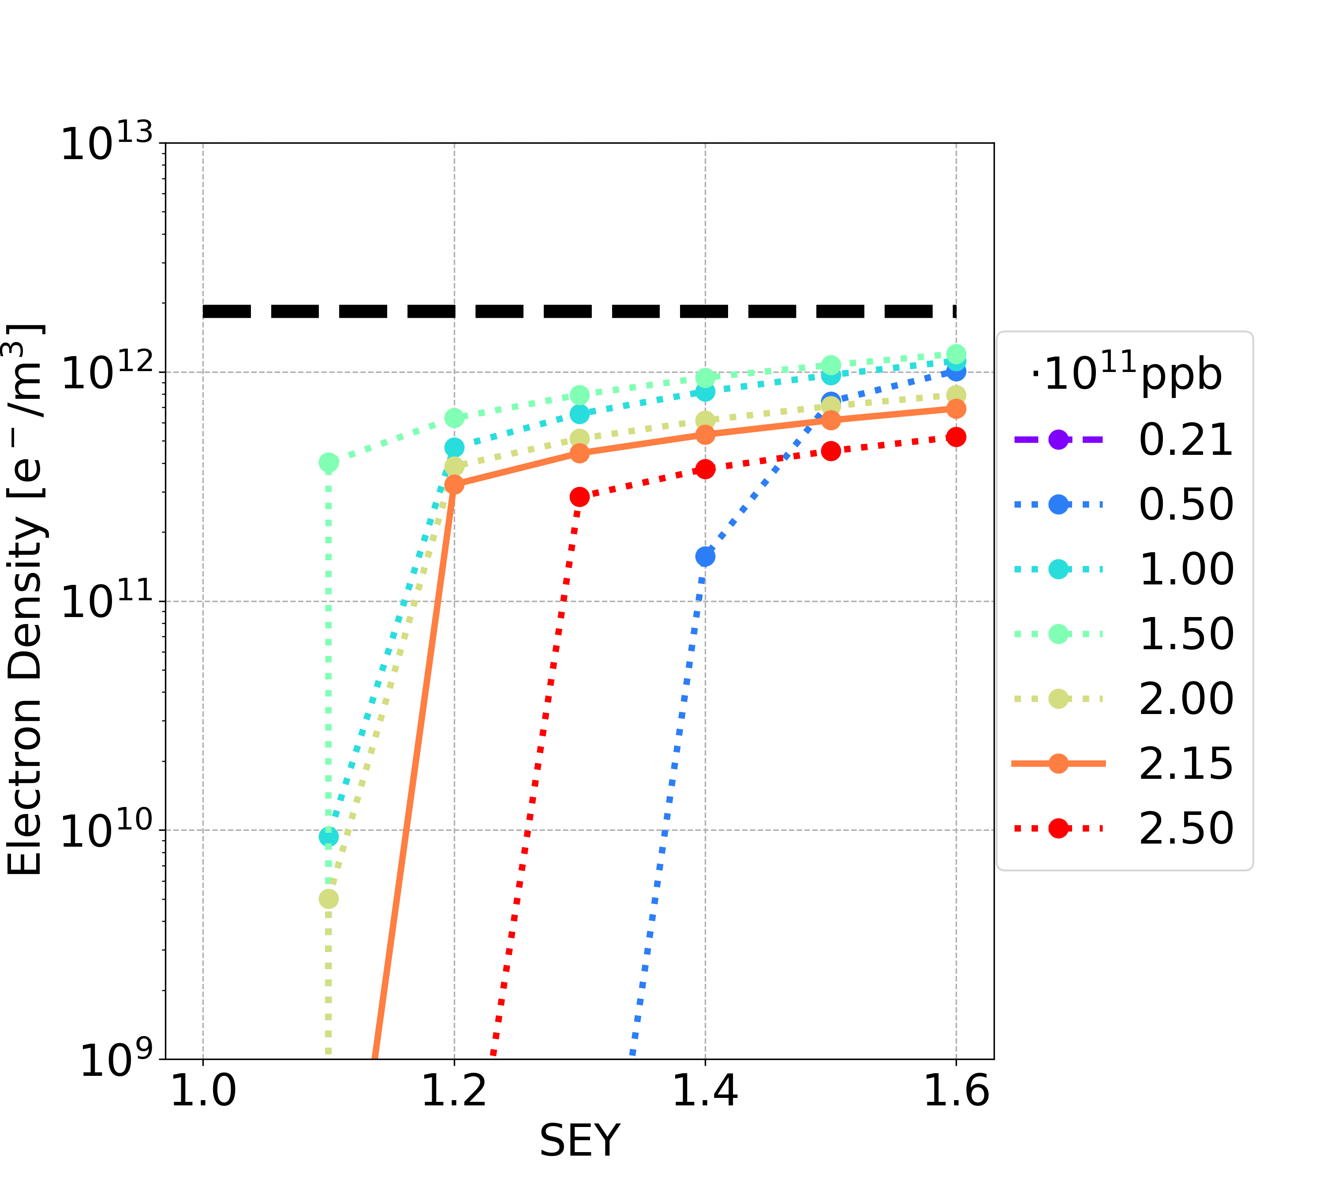
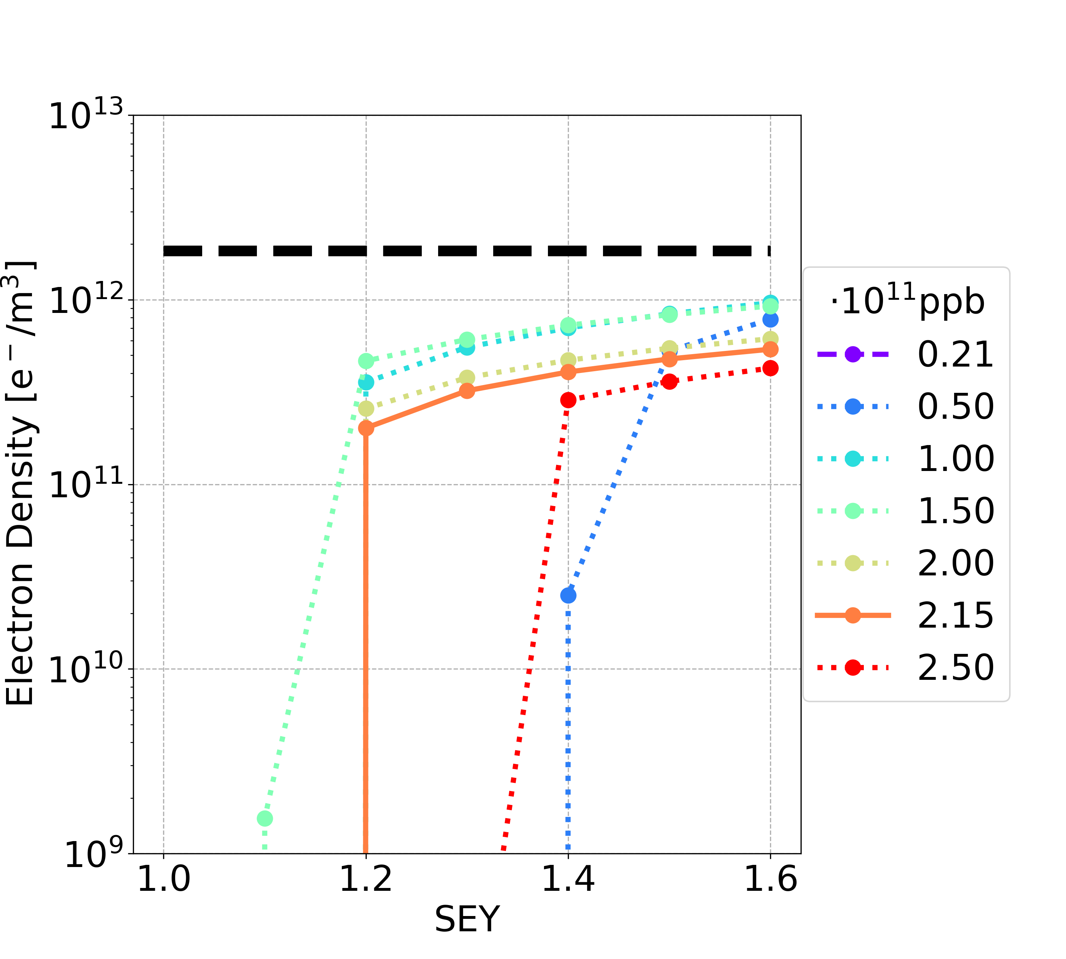
E-Cloud Stability: Sextupole
Filling scheme 1
Filling scheme 2
The central e-cloud density before the bunch passage is smaller than the e-cloud stability threshold

Slide 29
Outline
Introduction
E-Cloud Build-Up Studies
Heat Loads
Stability Studies
Conclusions and Outlooks

Slide 30
Conclusions
An extensive study related to the effects of the e-cloud for FCC-ee with the midterm report parameters has been presented
E-cloud build-up studies
  Table with material propriety constraints per magnetic element (drift spaces, dipoles, quadrupoles, sextupoles) to avoid e-cloud avalanche multiplication in terms of SEY multipacting thresholds
  Quadrupoles and sextupoles are the most critical elements
  SEY multipacting thresholds are better considering the filling scheme 2 (25 ns bunch spacing)
  Bunch intensities in the range of 1/10 of the nominal intensity to the nominal intensity are the most critical cases
Heat loads
  In case there is the multipacting, the total heat loads are in the order of some percent of synchrotron radiation power
  Heat loads are smaller in case of the filling scheme 2 (25 ns bunch spacing)
  Dipoles are the main contributors to the heat loads
  If there is no multipacting, the total heat loads are negligible compared to the synchrotron radiation power

Slide 31
Conclusions
Stability studies
  E-cloud single-bunch stability theoretical and numerical thresholds have the same order of magnitude (checked for drift spaces and dipoles)
  Simulations show that the vertical plane is unstable
  In all the studied elements (except sextupoles): above the SEY multipacting thresholds, the central e-cloud density before the bunch passage is larger than the e-cloud stability threshold: multipacting has to be avoided

Slide 32
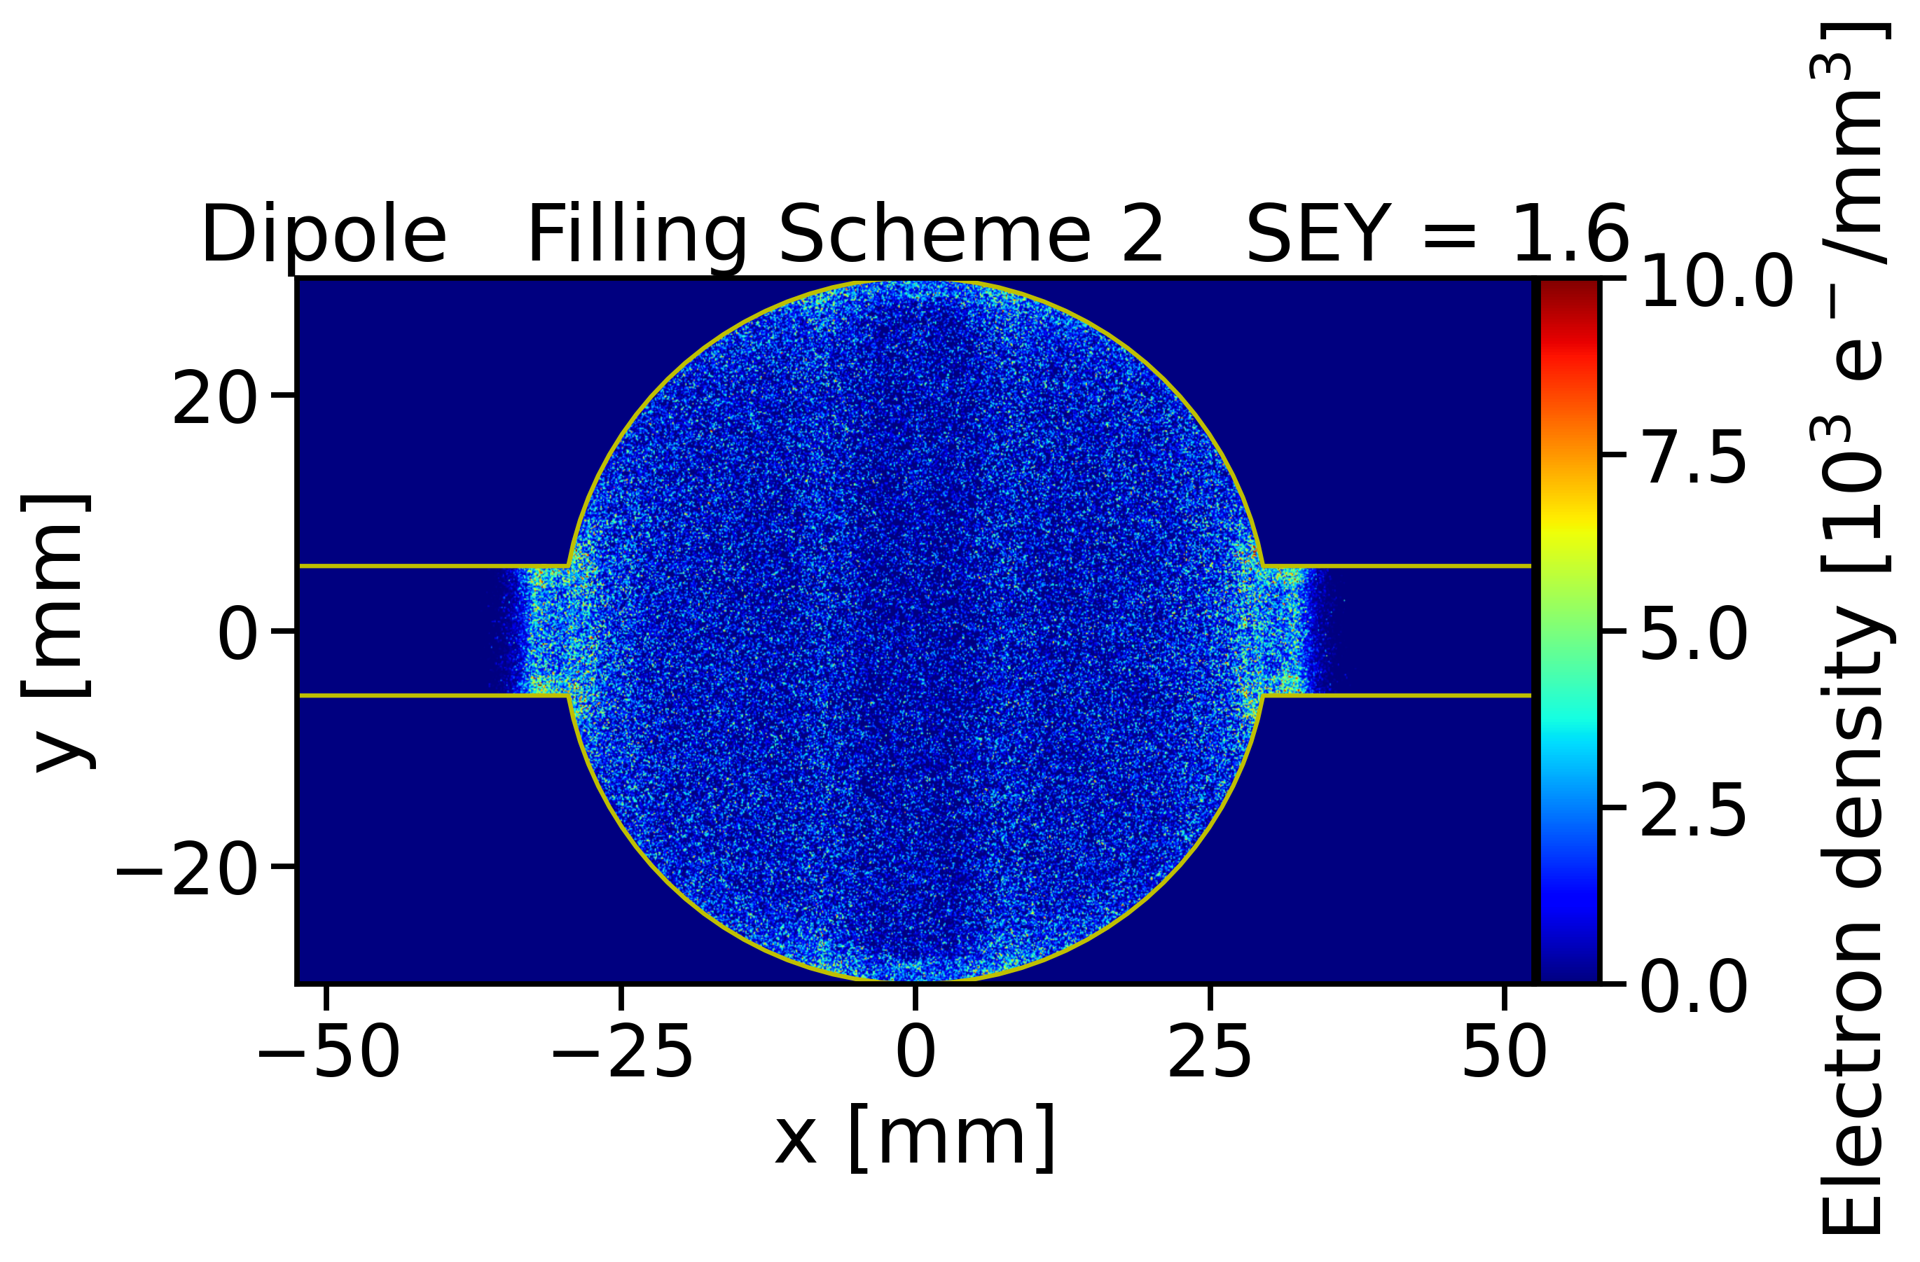
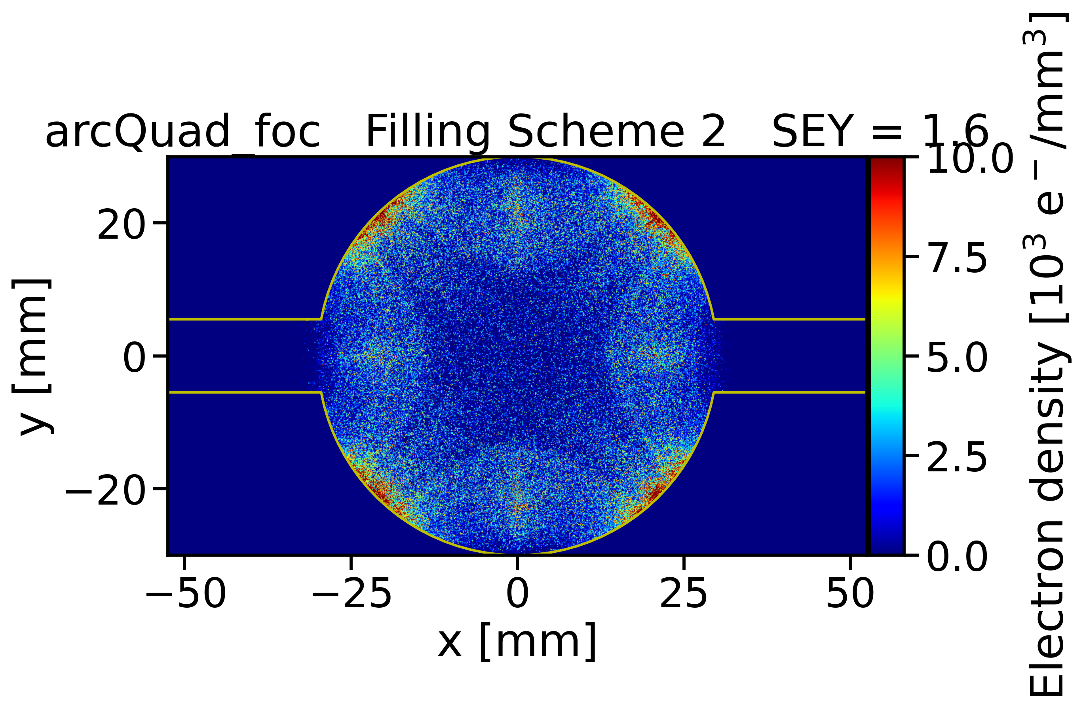
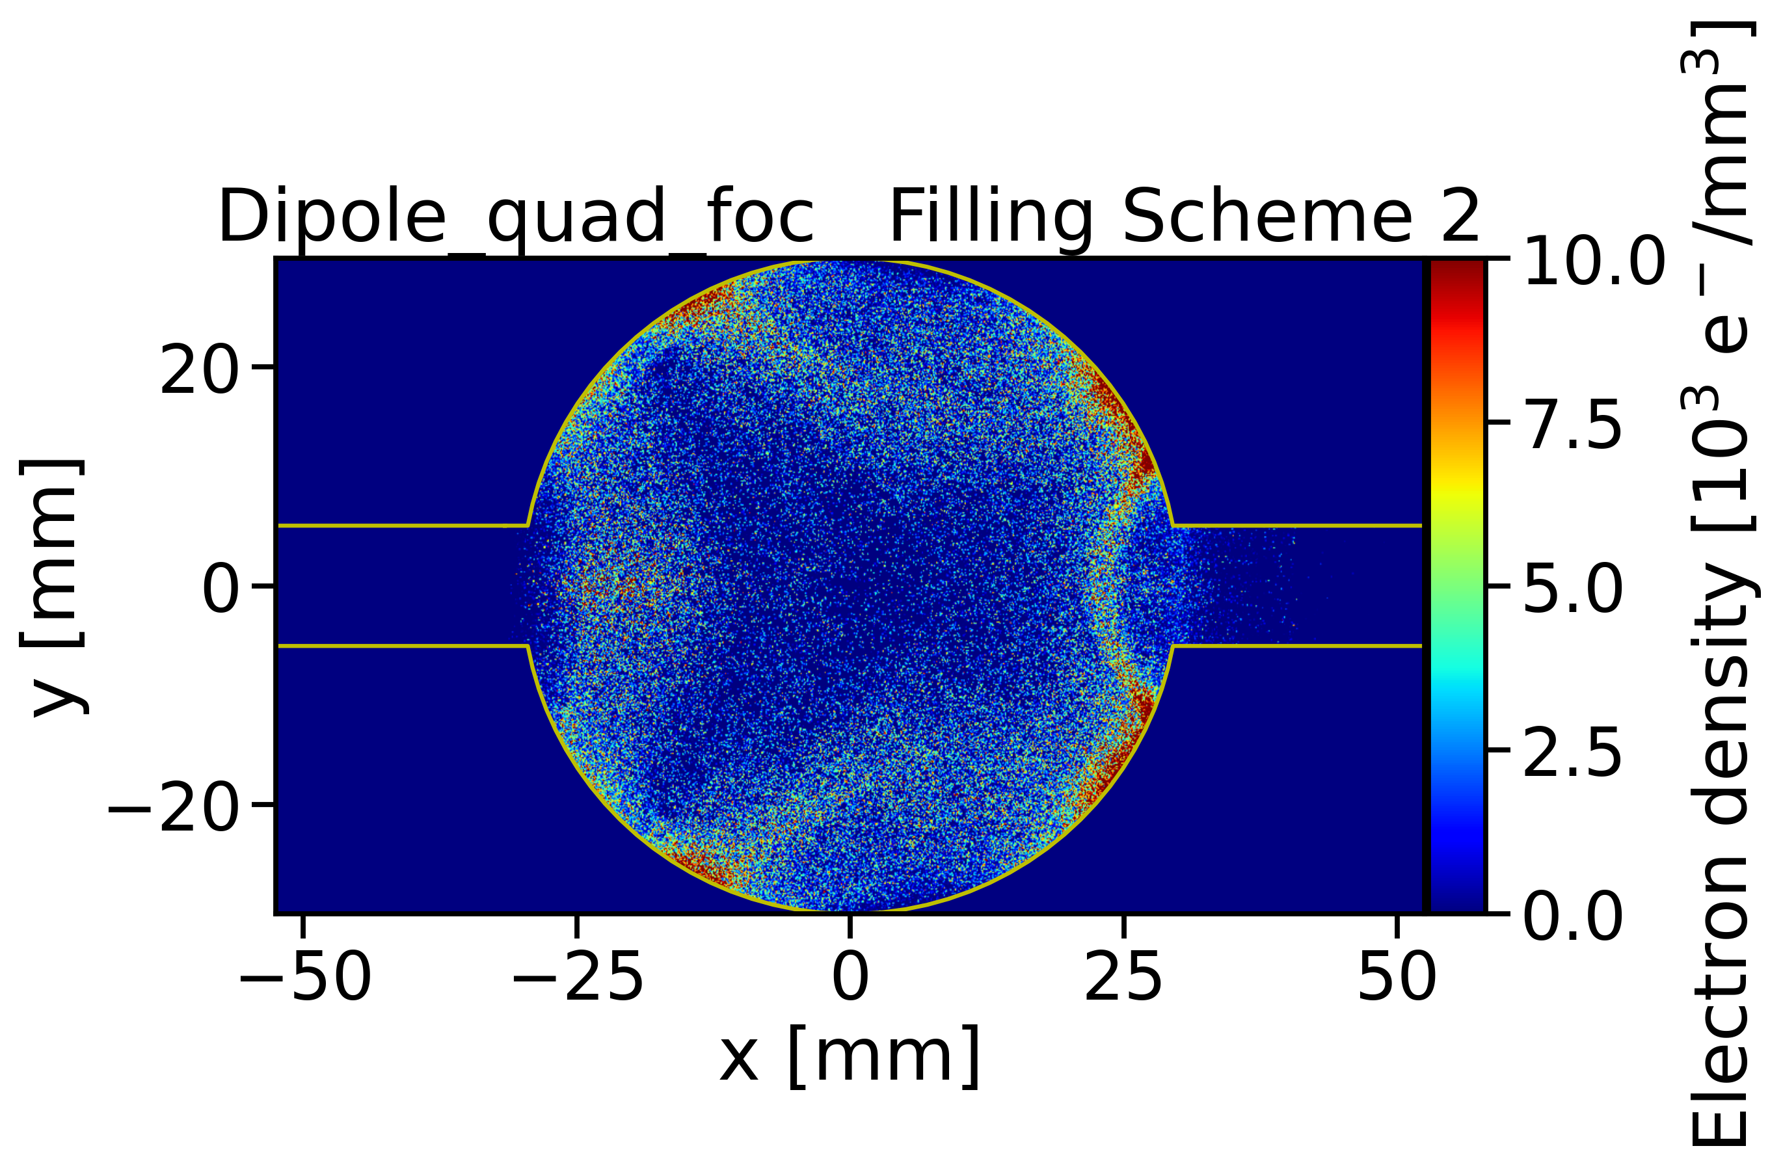
Outlooks: Nested Magnets
The configurations with nested magnets (dipoles + quadrupole + sextupoles) have to be studied from the e-cloud point of view
Dipole
Quadrupole
Dipole + Quadrupole
10

Slide 33
Outlooks: Photoemission
The results presented do not take into account the photoemission
From Lucas’ presentation -> the e-cloud density increases taking into account photoemission (especially for high values of the photoemission yield)
Lucas’s results are valid for the previous magnetic fields, therefore the effects of the photoemission have to be analysed for the updated magnetic fields
The simulations with photoemission use an approximation: uniform photon distribution per segment of the perimeter chamber
Simulations with realistic photon distribution
  Import in PyECLOUD a realistic photon distribution, obtained before using for example a raytracing code SYNRAD+
  Simulations with a PyCLOUD + SYNRAD+ code

Slide 34
Thanks for your attention

Slide 36
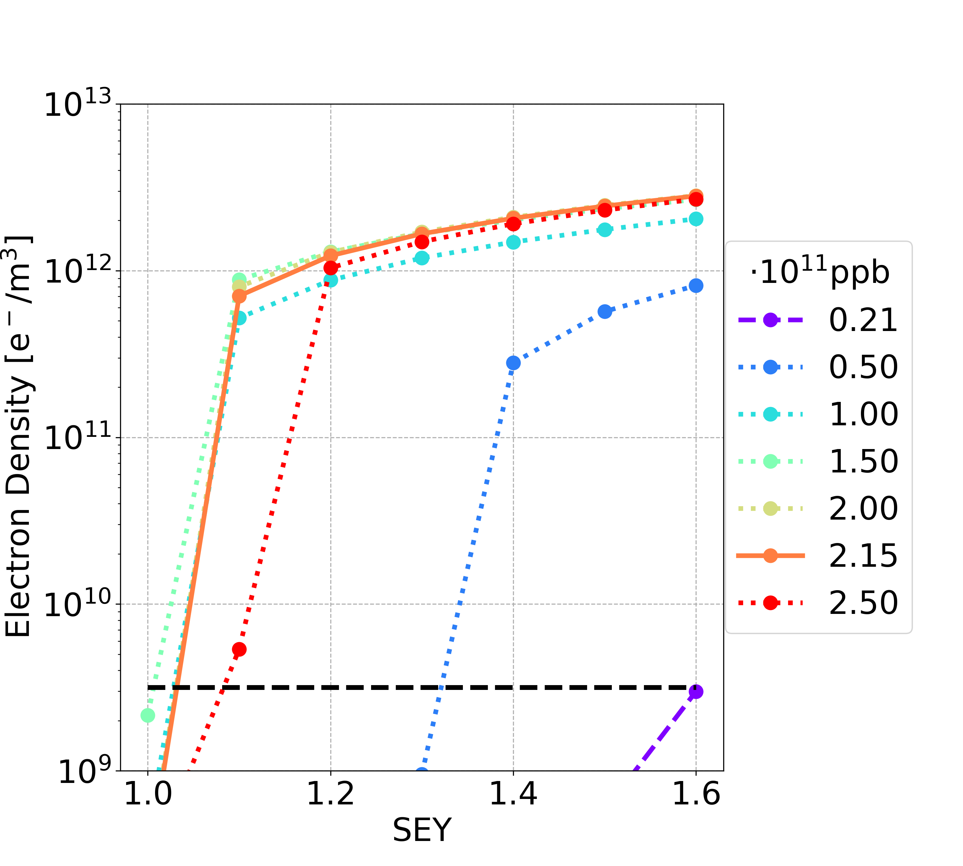
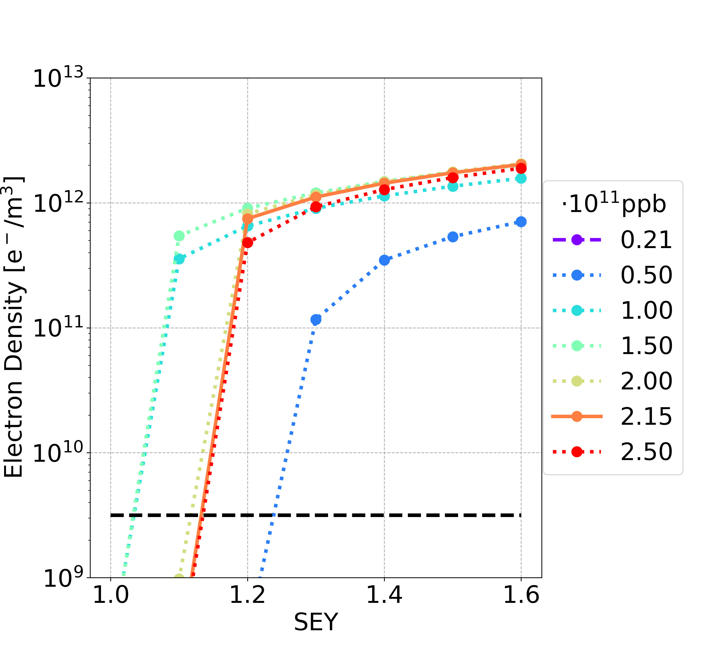
E-Cloud Build-Up Studies: Quadrupole
Filling scheme 1
Filling scheme 2
Multipacting regime
Multipacting
regime
1.45 T/m
5.65 T/m

Slide 37
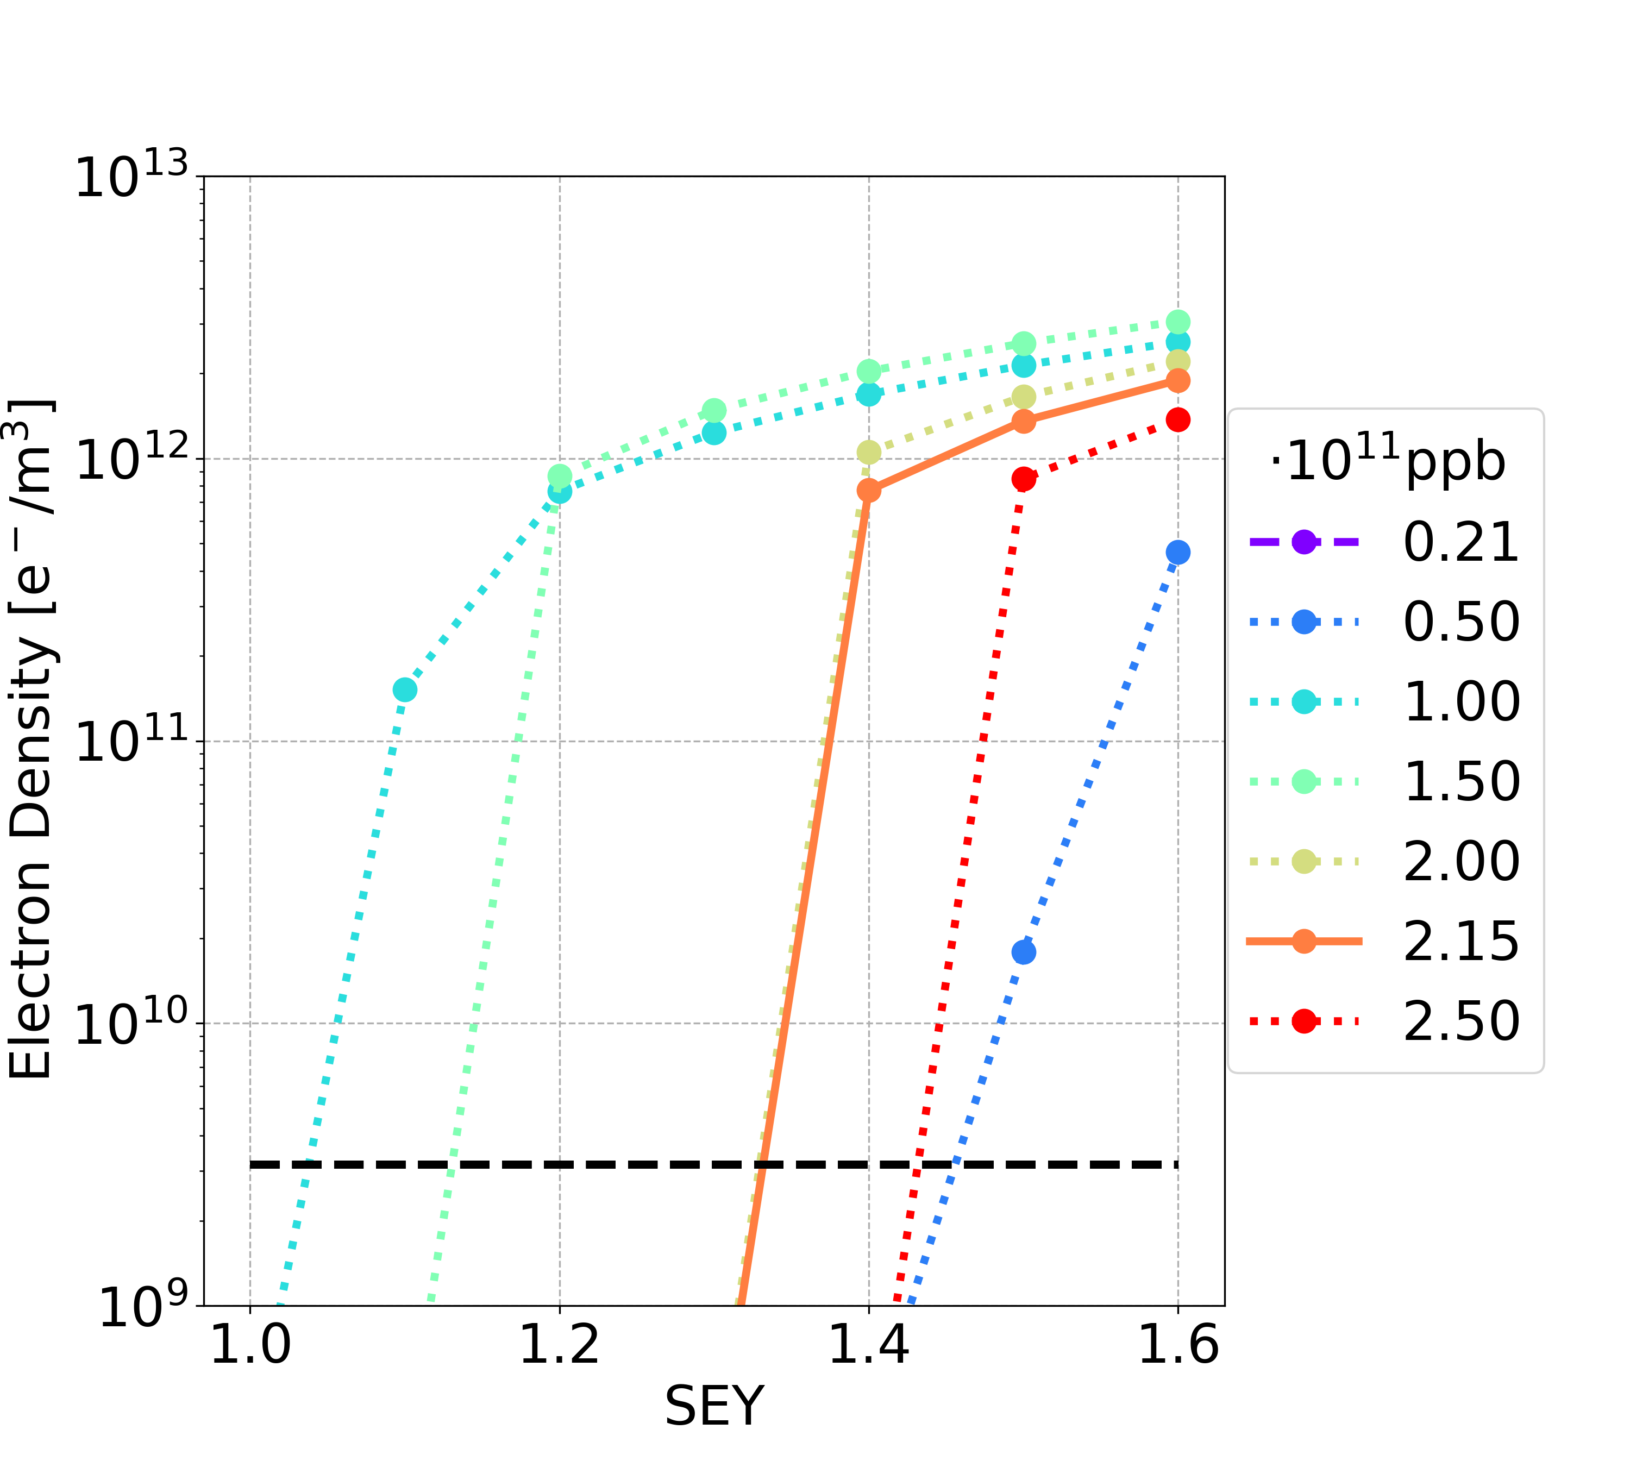
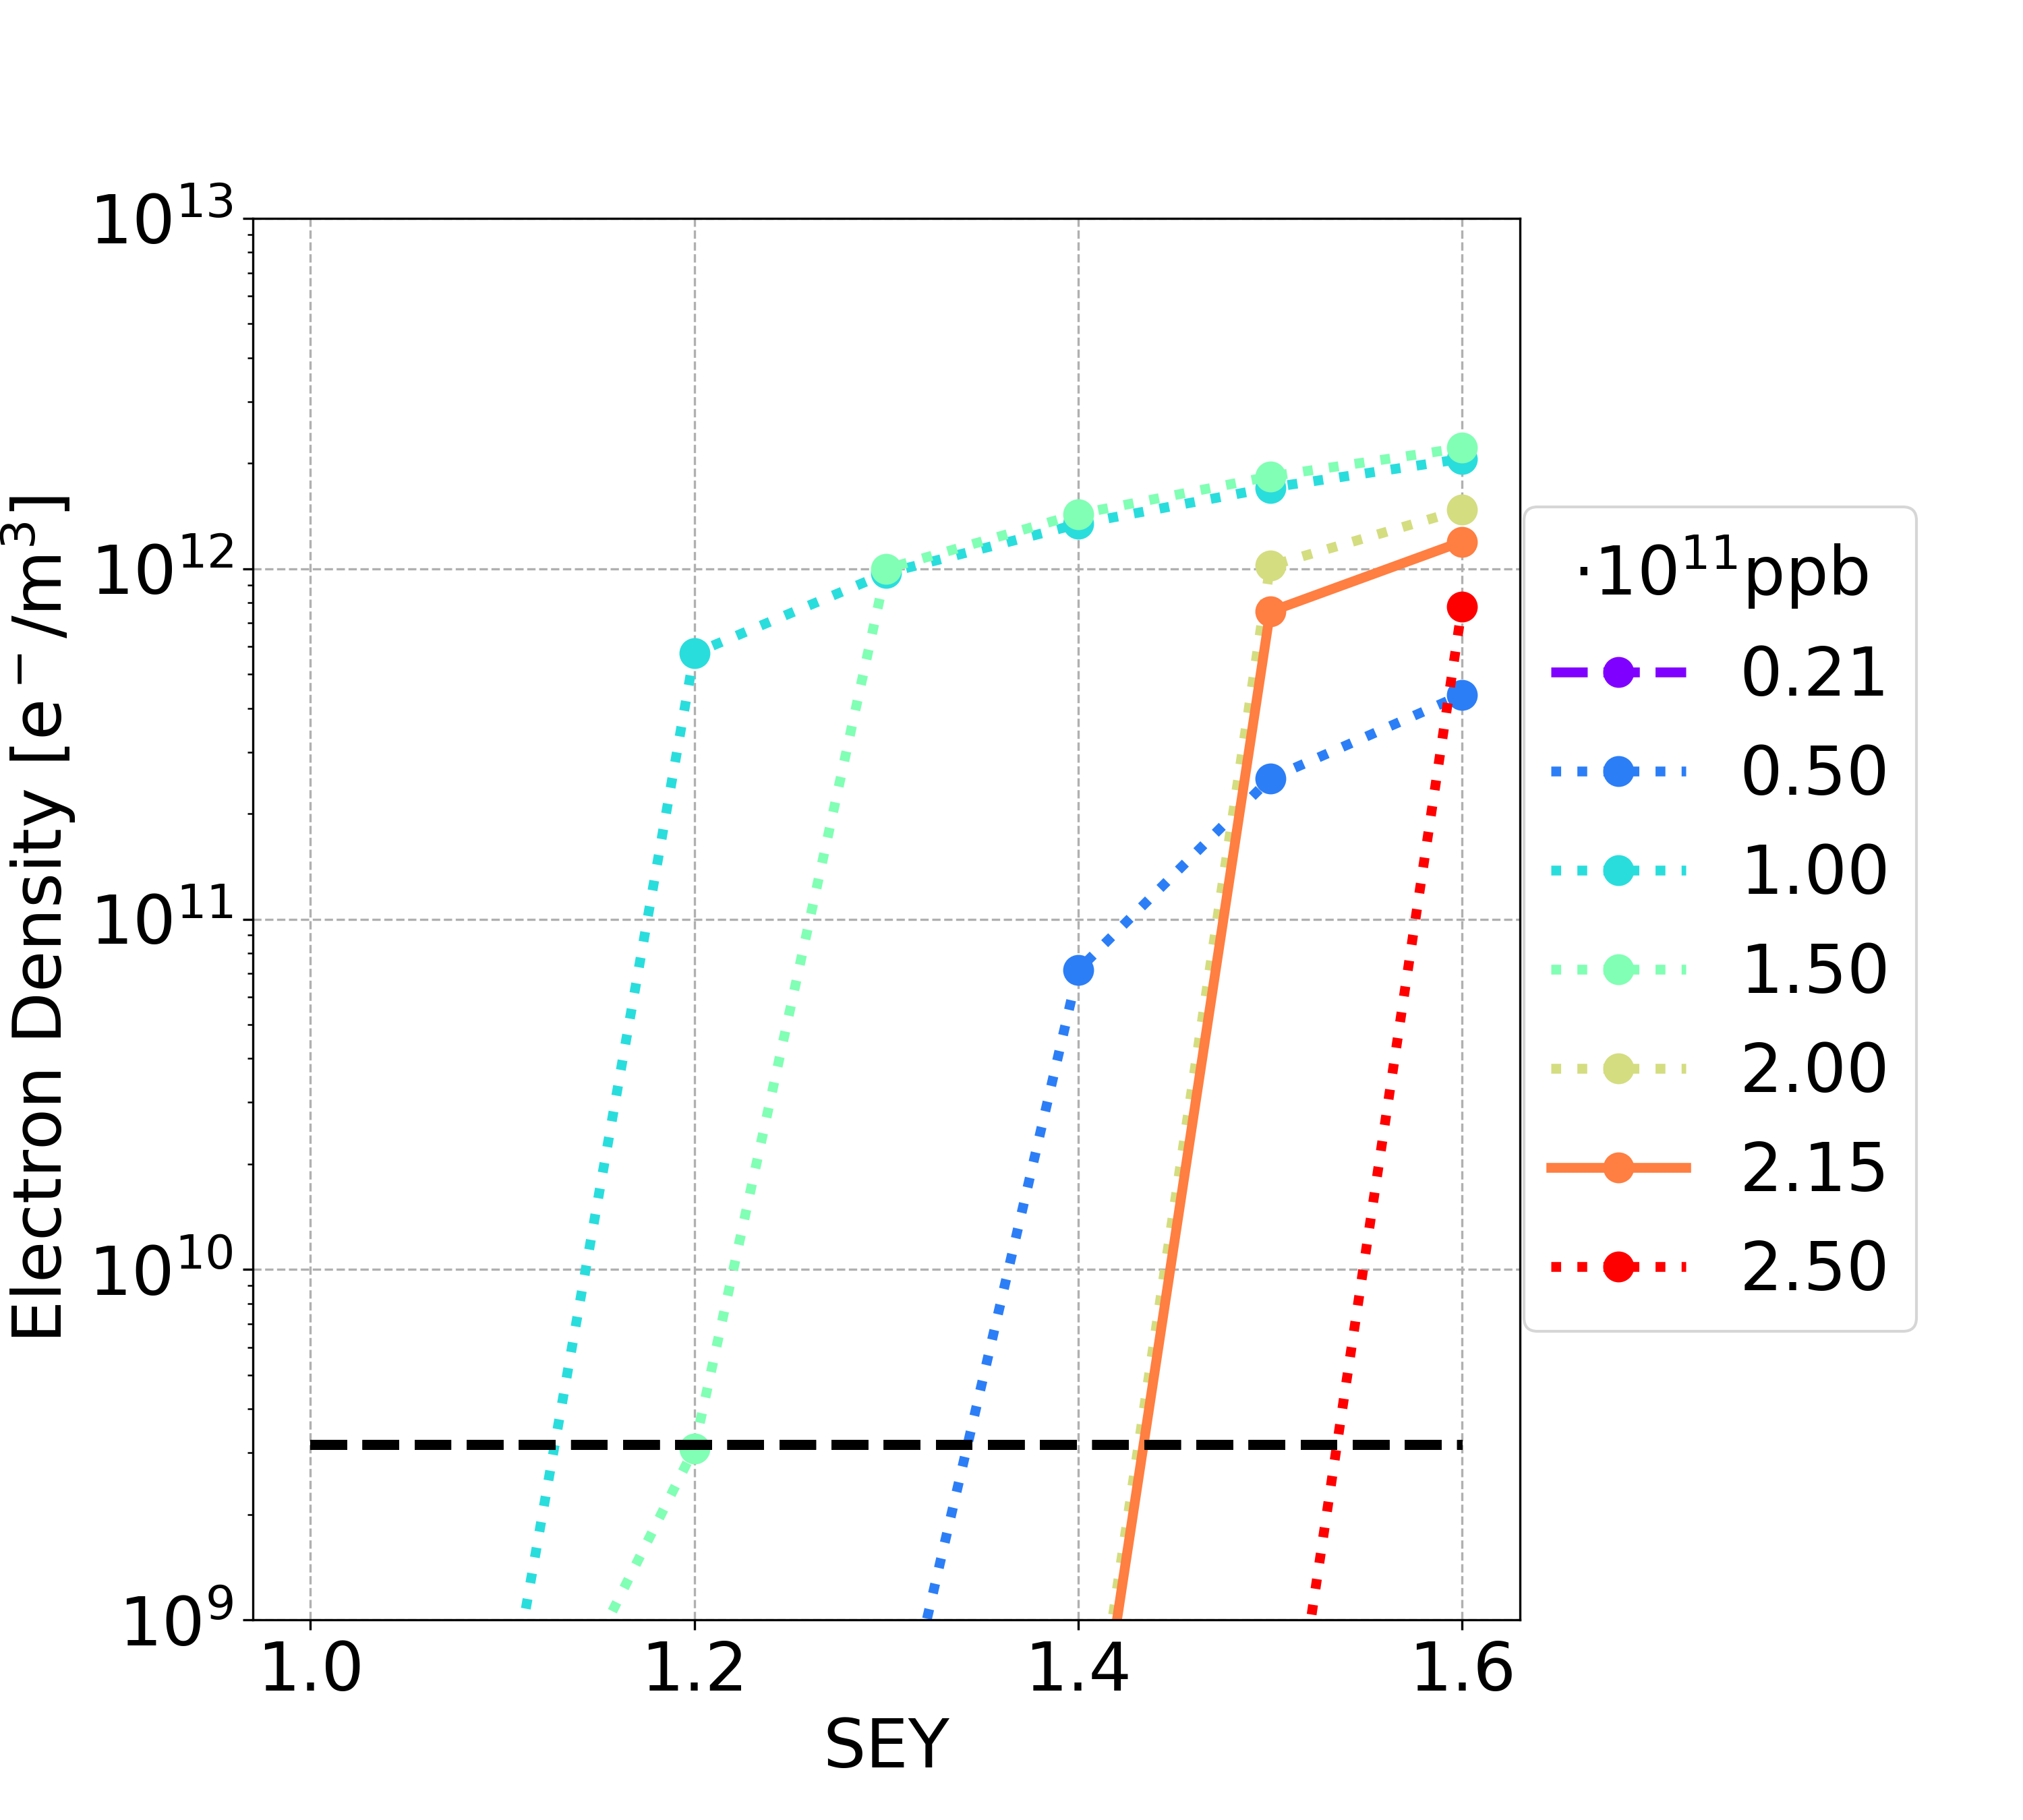
E-Cloud Build-Up Studies: Dipole
Filling scheme 1
Filling scheme 2
15.2 T
14.15 T

Slide 38


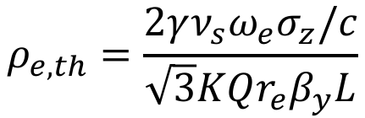

E-Cloud Stability Theoretical Threshold
$$ρ_{e,th}=\frac{2γν_{s}ω_{e}σ_{z}/c}{\sqrt{3}KQr_{e}β_{y}L}$$
$$ω_{e}=\sqrt{\frac{λ_{p}r_{e}c^{2}}{σ_{y}\left(σ_{x}+σ_{y}\right)}}$$
$$λ_{p}=\frac{i_{b}}{{\sqrt{2π}σ}_{z}}$$
$$\begin{matrix}K=ω_{e}σ_{z}/c \\ Q=min⁡\left(K,7\right)\end{matrix}$$
From K. Ohmi et al., “Study of Electron Cloud Instabilities in FCC-hh”, Proc. of IPAC2015
  ⍴_{e,th} = 1.89⋅10¹⁰ e⁻/m³ considering the full circumference L = 90.7 km
𝛾 = E/E₀ , where E is the beam energy, E₀ is the particle rest energy.
𝜈_{s} is the synchrotron tune.
σ_{z} is the bunch length.
c is the light velocity.
r_{e} is the classical electron radius.
σ_{x} and σ_{y} are the bunch horizontal and vertical dimension, respectively.
λ_{p} is the line density of the proton bunch.
ω_{e} is the electron angular oscillation frequency.
K characterizes how many electrons contribute to the instability.
Q is the quality factor of the wake field.
𝛽_{y} is the vertical beta function.
L is the circumference length.

Slide 39
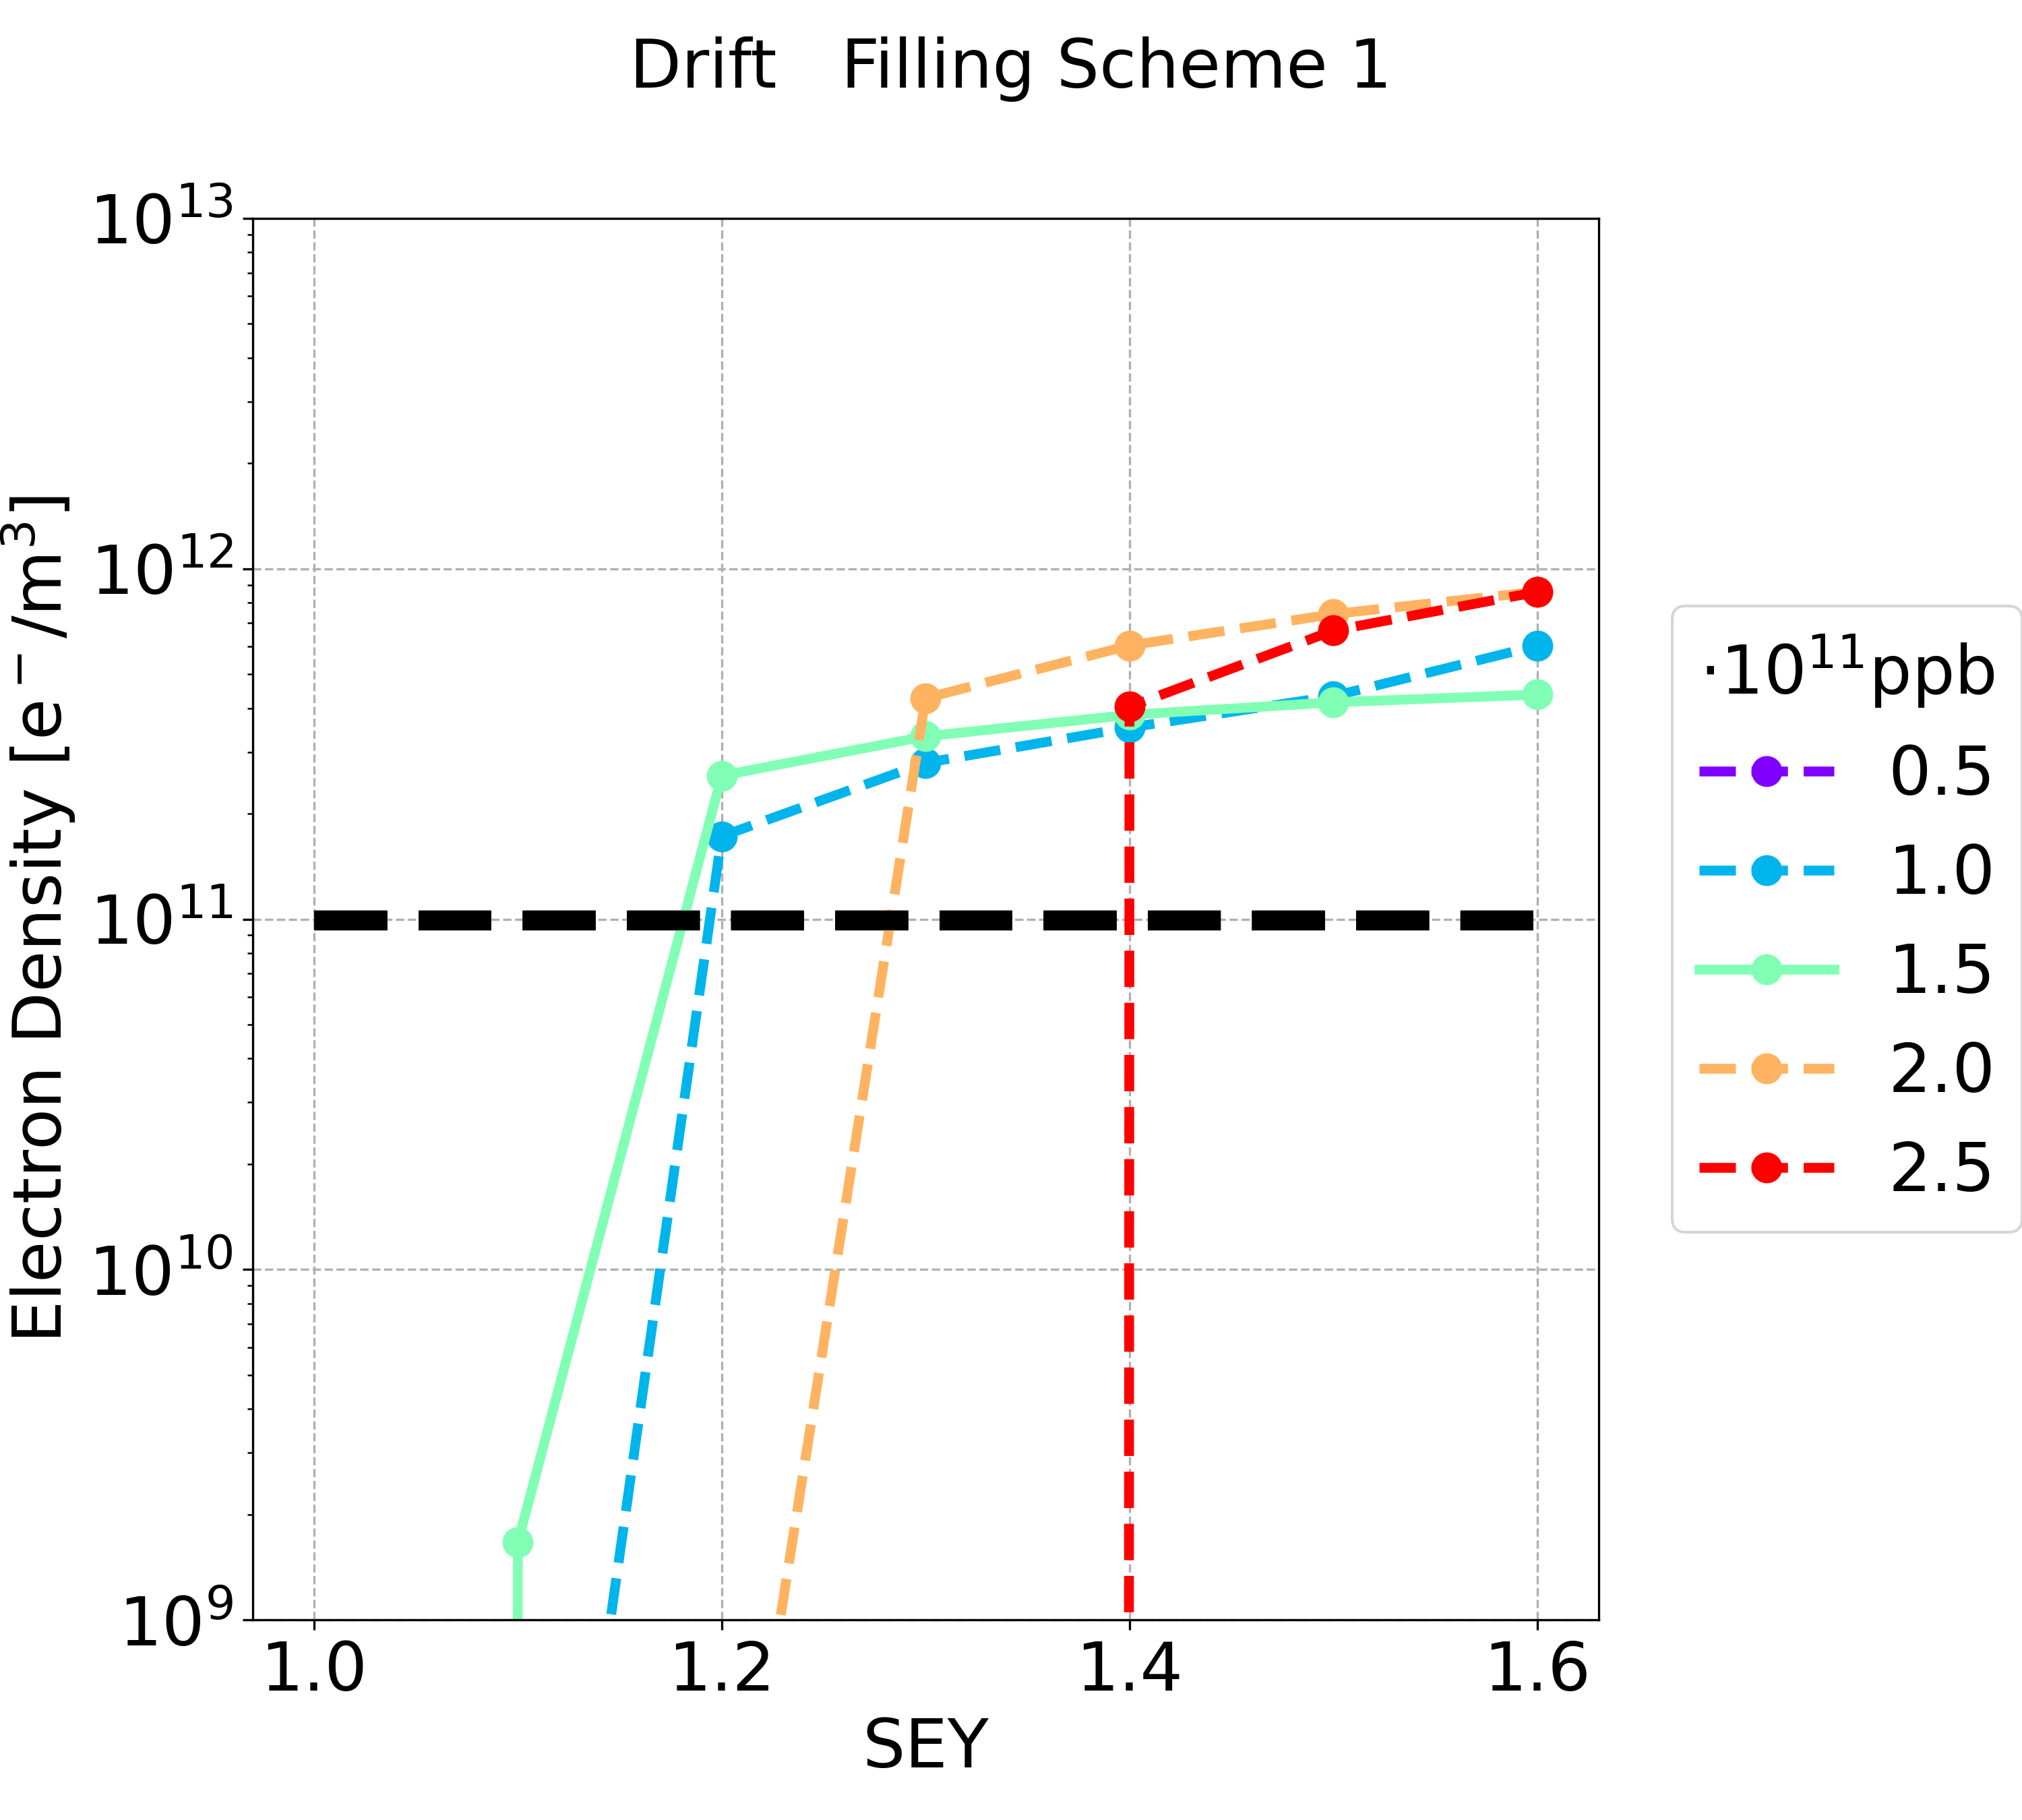
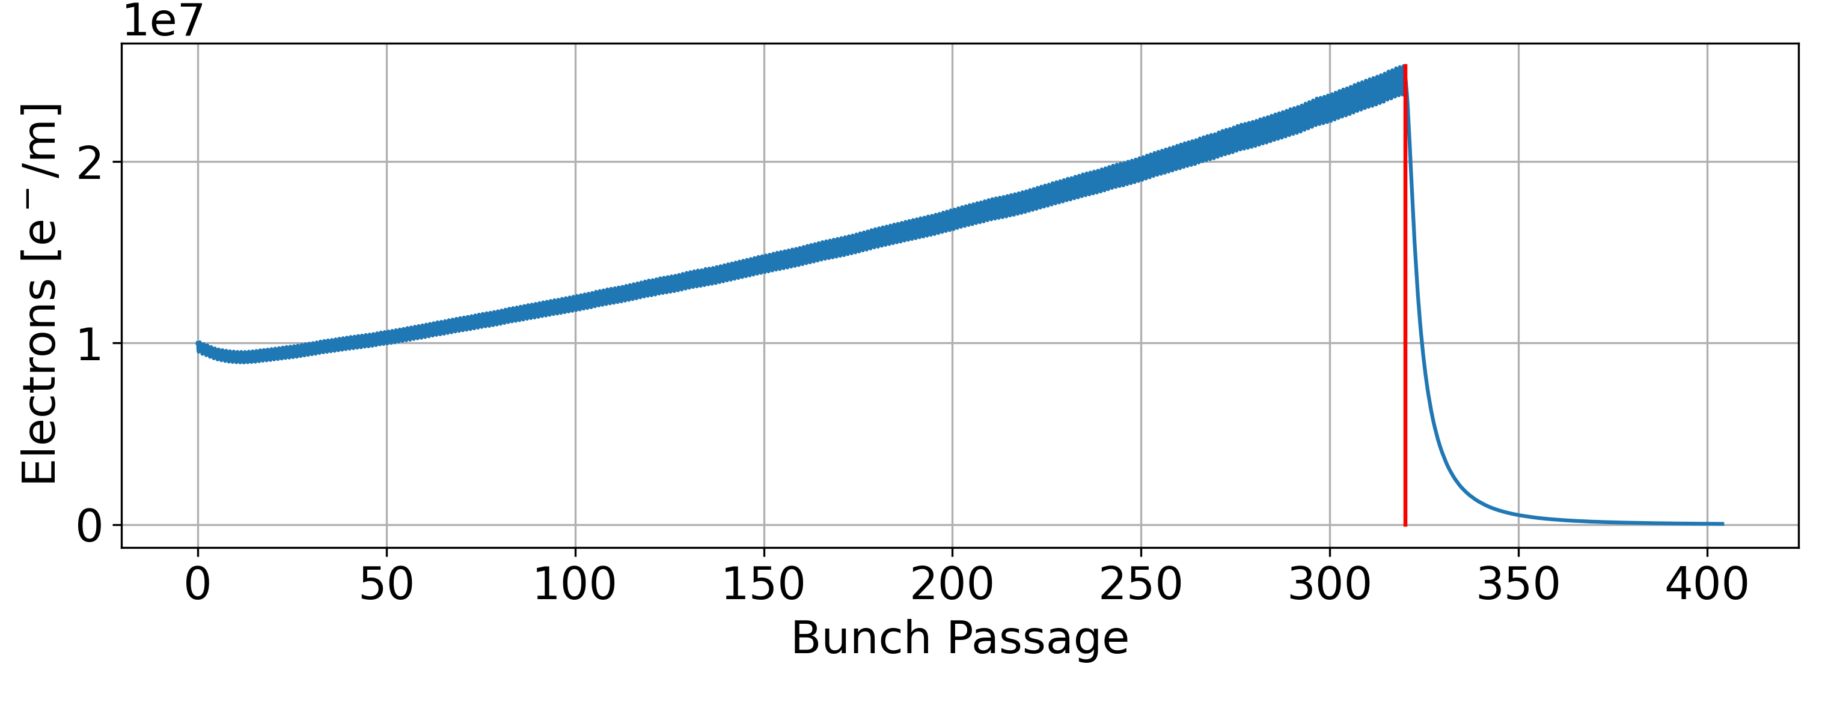
E-Cloud Stability
Drift Space
Some simulations do not reach the multipacting saturation value
With larger values of the photoemission generation rate, the saturation value can be reached within less bunch passages

Slide 40
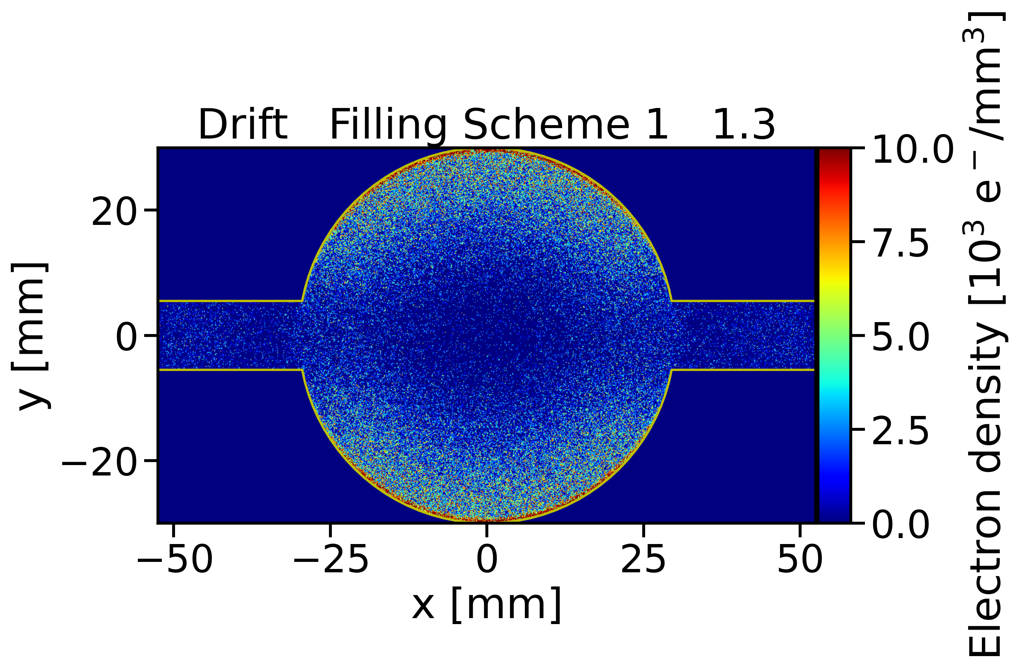
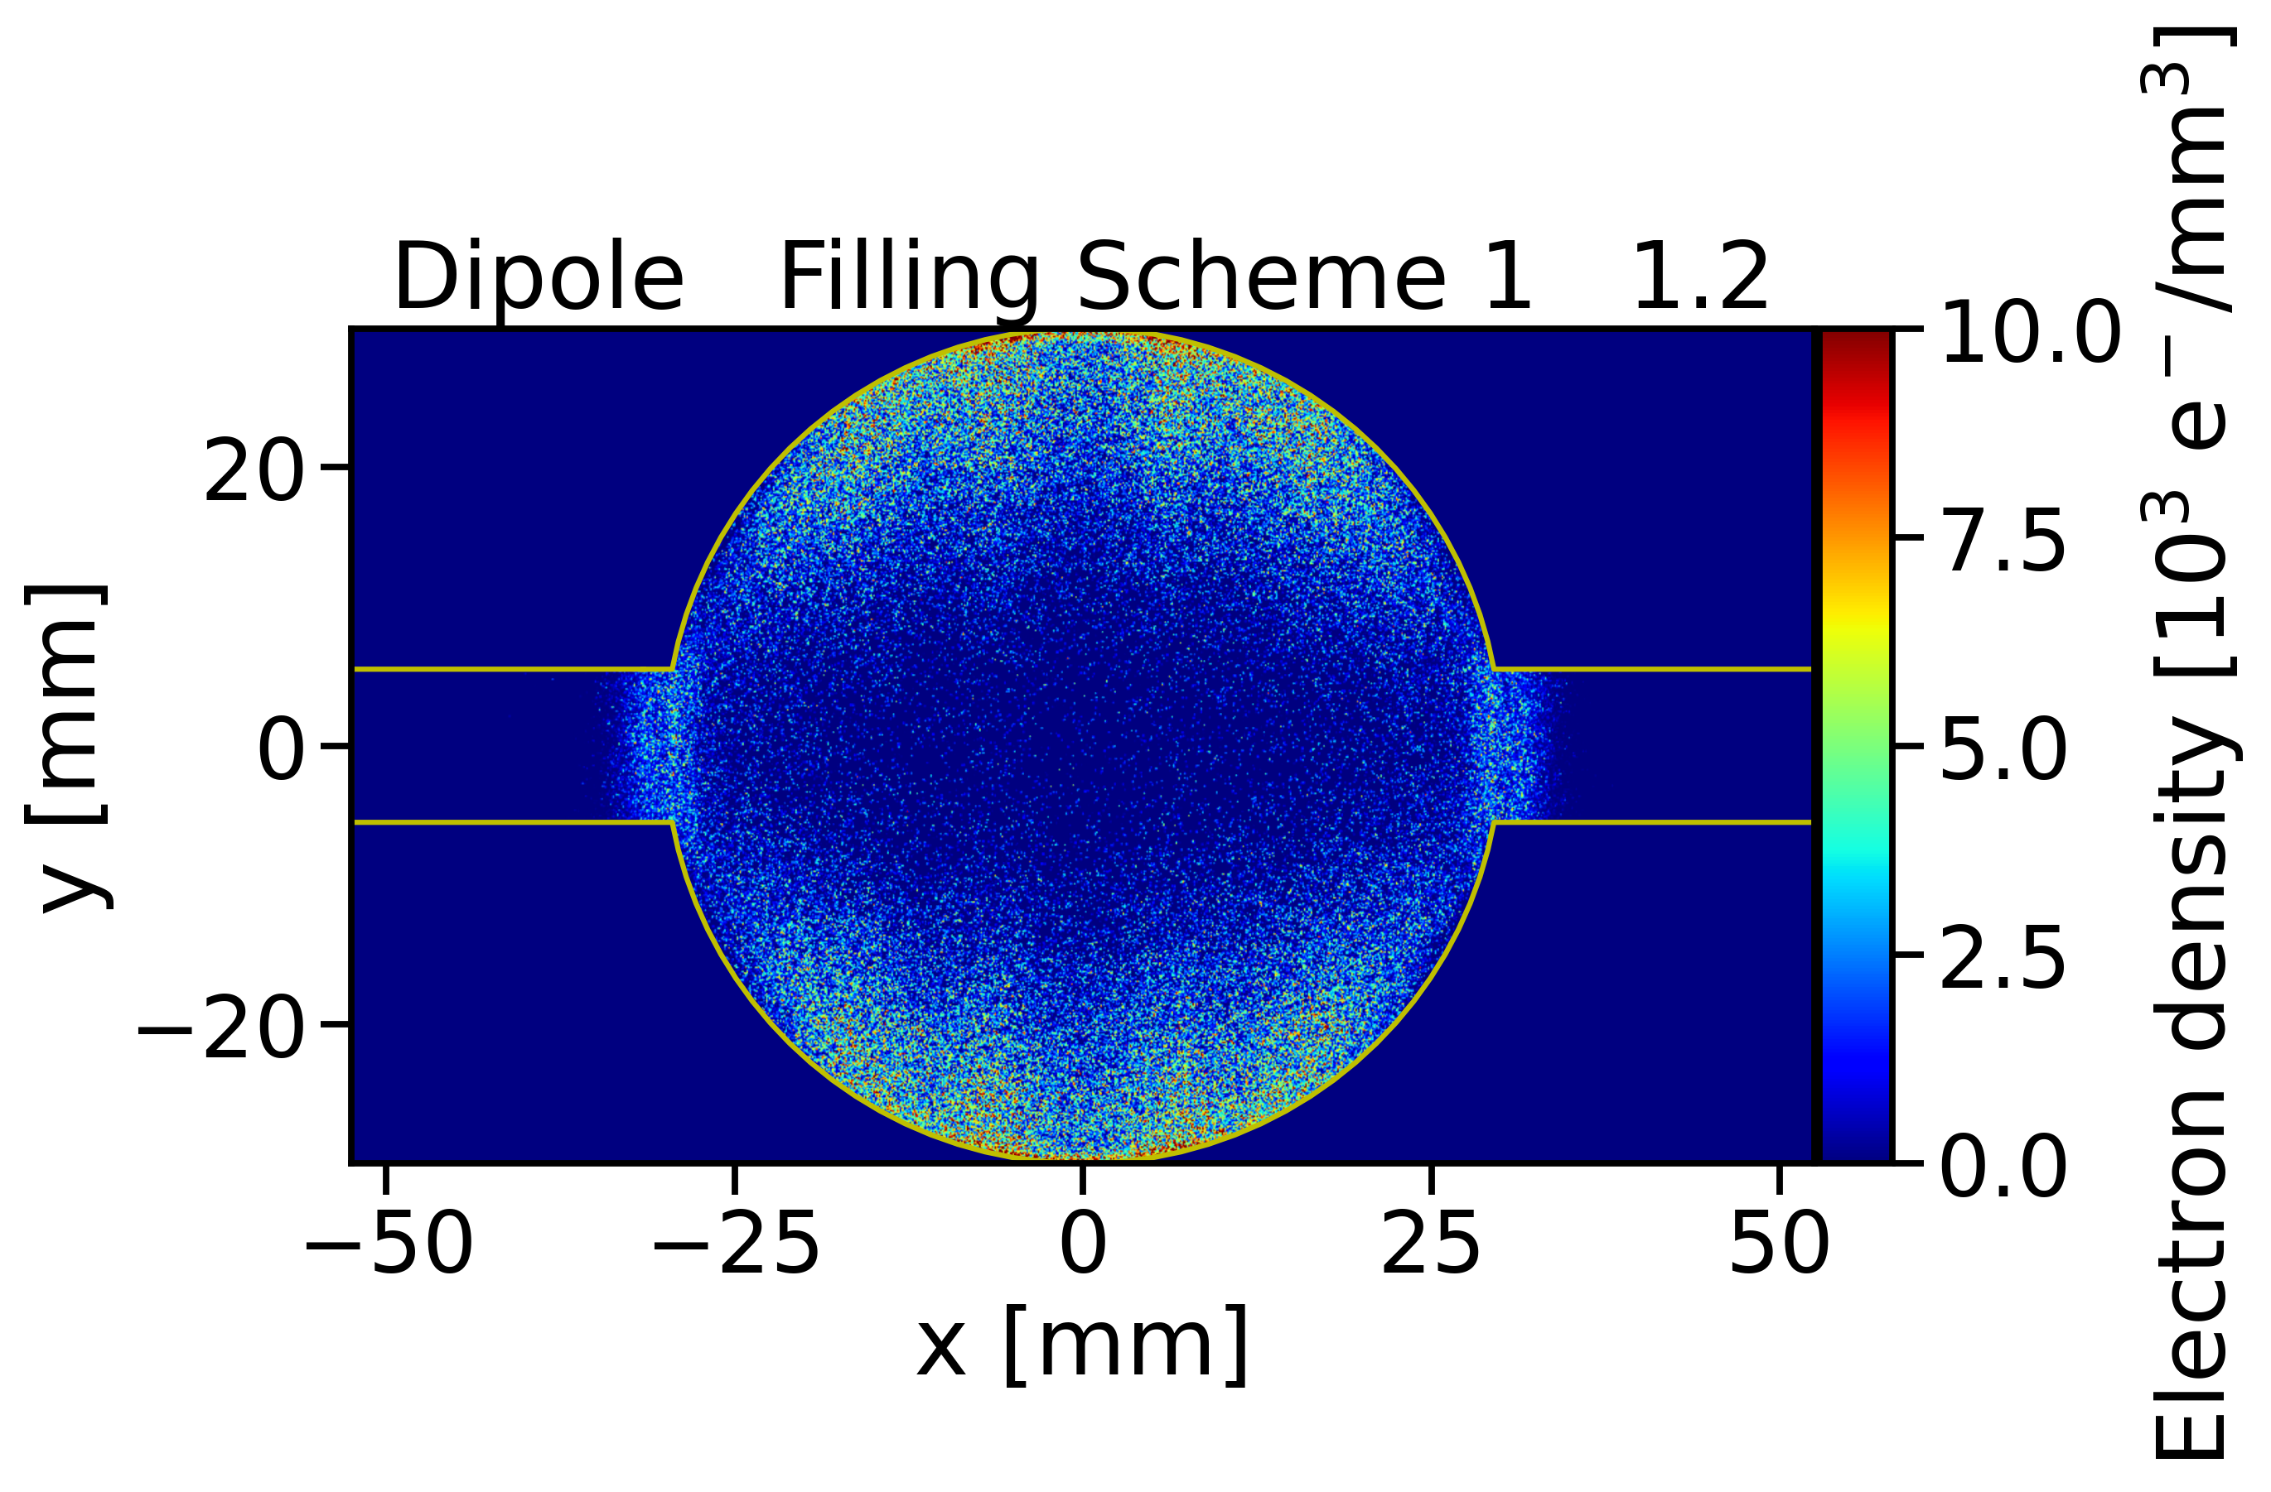
E-Cloud Transverse Distribution
Drift Space
Dipole

Slide 41
Stability Simulations
A complex problem involving two sets of particles mutually interacting
Vacuum chamber
Electron cloud effects
Courtesy of
G. Rumolo
Shape, PEC boundary conditions
e⁻ production mechanisms
(e.g. secondary emission)
Beam charge distribution
Maxwell’s equations
E.M.
forces
e⁻ equations of motion
Maxwell’s equations
E.M.
forces
External B field
Beam equations of motion
External forces from
Magnets & RF

Slide 42
Stability Simulations
Beam dynamics simulations → Model the interaction of the beam (typically a single bunch) with a given initial electron distribution
Vacuum chamber
Electron cloud effects
Courtesy of
G. Rumolo
Shape, PEC boundary conditions
Pre-calculated initial electron distribution
e⁻ production mechanisms
(e.g. secondary emission)
Beam charge distribution
Maxwell’s equations
E.M.
forces
e⁻ equations of motion
Maxwell’s equations
E.M.
forces
External B field
Beam equations of motion
External forces from
Magnets & RF

Slide 43
Stability Simulations
E-cloud build-up → Solely focuses on electron dynamics with an unperturbed beam distribution to determine how the e-cloud forms and where it saturates
Vacuum chamber
Electron cloud effects
Courtesy of
G. Rumolo
Shape, PEC boundary conditions
e⁻ production mechanisms
(e.g. secondary emission)
External EM fields
in RF cavity
Pre-calculated forces from unperturbed beam distribution
Beam charge distribution
Maxwell’s equations
E.M.
forces
e⁻ equations of motion
Maxwell’s equations
E.M.
forces
External B field
Beam equations of motion
External forces from
Magnets & RF

