Slide 1
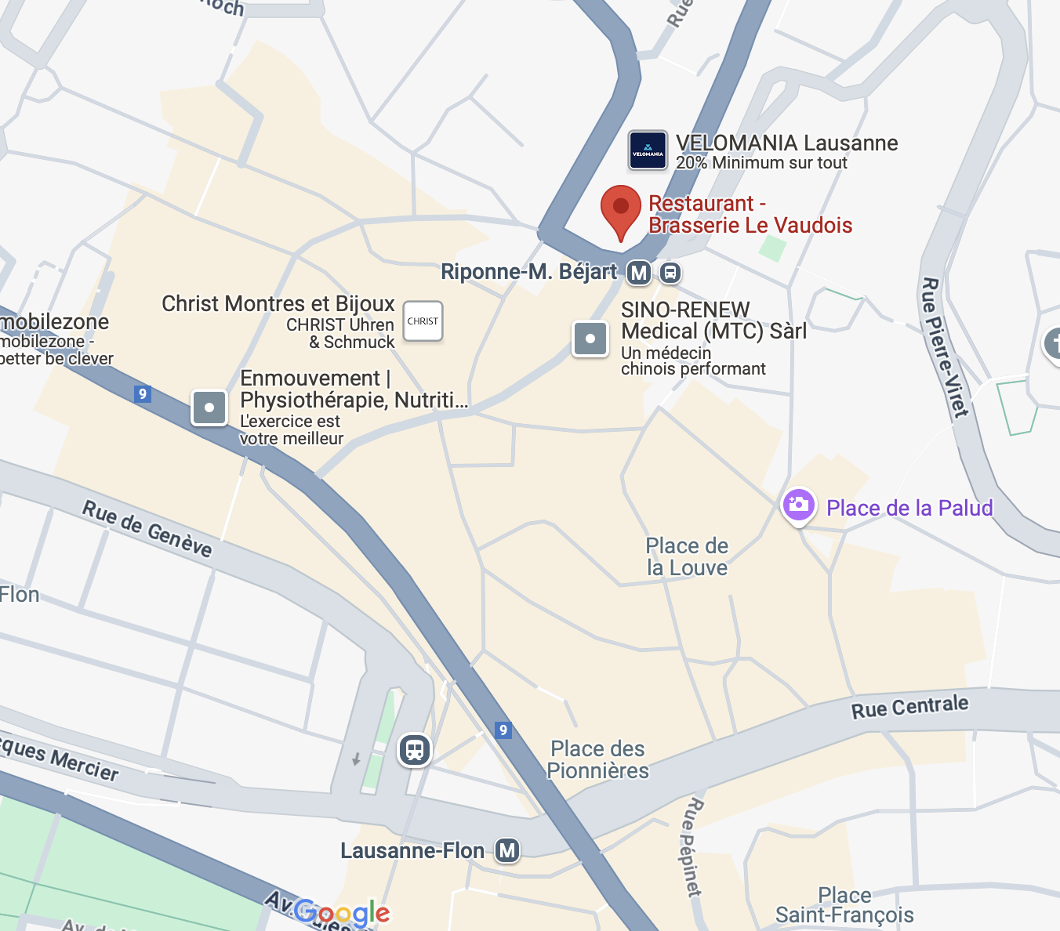
Le Vaudois Restaurant - Brasserie - Caveau
Place de la Riponne 1
1005 Lausanne
https://www.levaudois-sa.ch
Dinner starts at 19:30
From EPFL Campus the simplest is
1) Metro M1 Stop at FLON
2) then metro M2 towards "Epalinges, Croisettes" and drop at "Lausanne, Riponne-M. Béjart"
2bis) Walk up hill through the city center till the restaurant
Around at walking distance:
- the Cathedral
- city center

