Slide 1
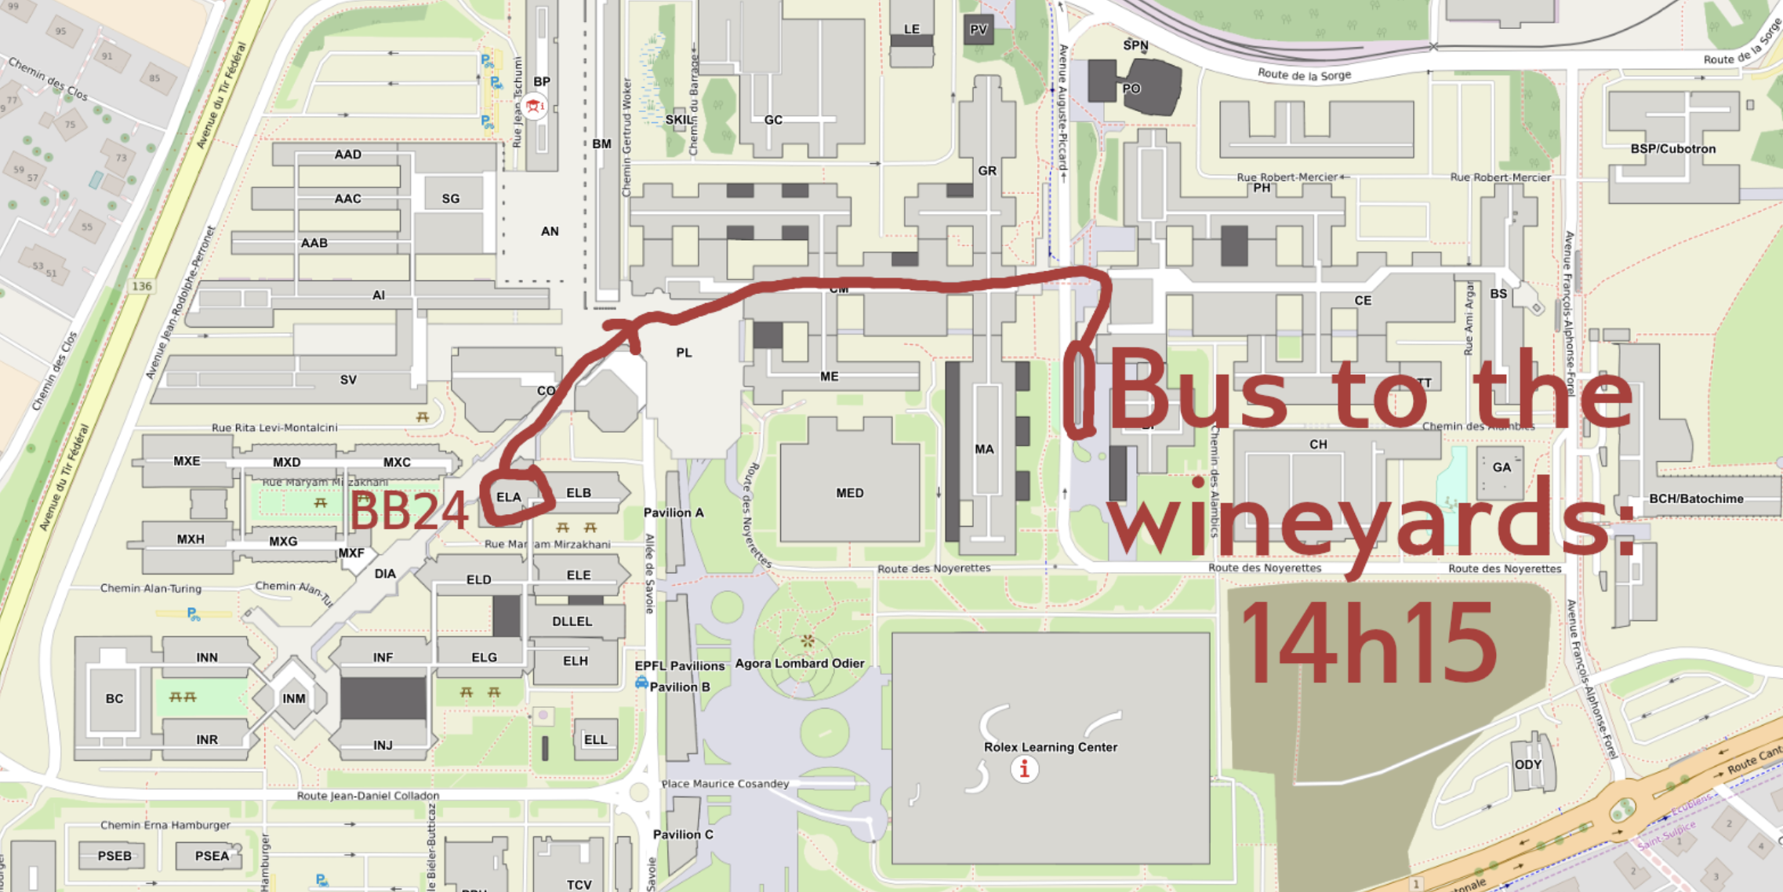
Afternoon outing at Lavaux
- walk in the vignards
- video about the wine productions of the area
-wine tasting
Meeting point
Departure from : Ecublens, EPFL, Av. Piccard, Arrêt bus
Itinerary :
14.15 Meeting
14.30 Bus leaves
15.10 Arrival to Rivaz, VINORAMA, route Cantonale 2
Visite: 3h experience
18h00-18:30 Departure
19h00 env., arrival to EPFL
Xavier:
Driver: SCHOPFER / 076.327.78.06

