Slide 1


Welcome to the ICFA mini workshop on Beam-Beam effects in Circular Colliders!
T. Pieloni (EPFL), L. Rivkin (CHART-PSI), X. Buffat(CERN)
International Organizing Committee IOC
Chair of the International Organising Committee:
D. Schulte, CERN, Switzerland
Members:
J. Qiang, LBNL, USA
D. Zhou, KEK, Japan
A. Valishev, Fermilab, USA
F. Willeke, BNL, USA
Y. Zhang, IHEP, China
F. Zimmermann, CERN, Switzerland
T. Pieloni, EPFL, Switzerland
M. Boscolo, INFN, Italy
Y. Jiancheng, Inst. Modern Phys, China
H. Bartosik, CERN, Switzerland
Local Organizing Committee IOC
C. Craman
E. Hoffmann
L. Van Riesen-Hapt
Welcome to EPFL!

Slide 2
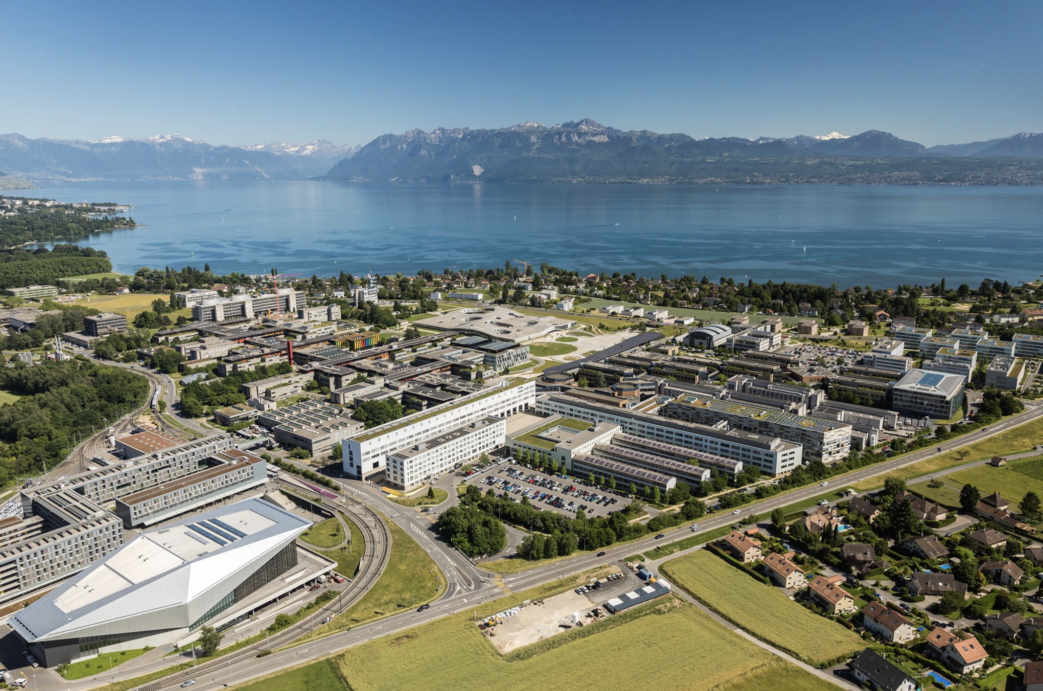
A bit about EPFL
Founded in 1969 with the mission to “train talented engineers in Switzerland”
A yearly increasing population of 18’000, including 13’400 students
More than 130 nationalities (57% of foreign students)
29 Masters’ and 22 PhD degrees available
428 laboratories and chairs
4’260 scientific publications in 2023

Slide 3

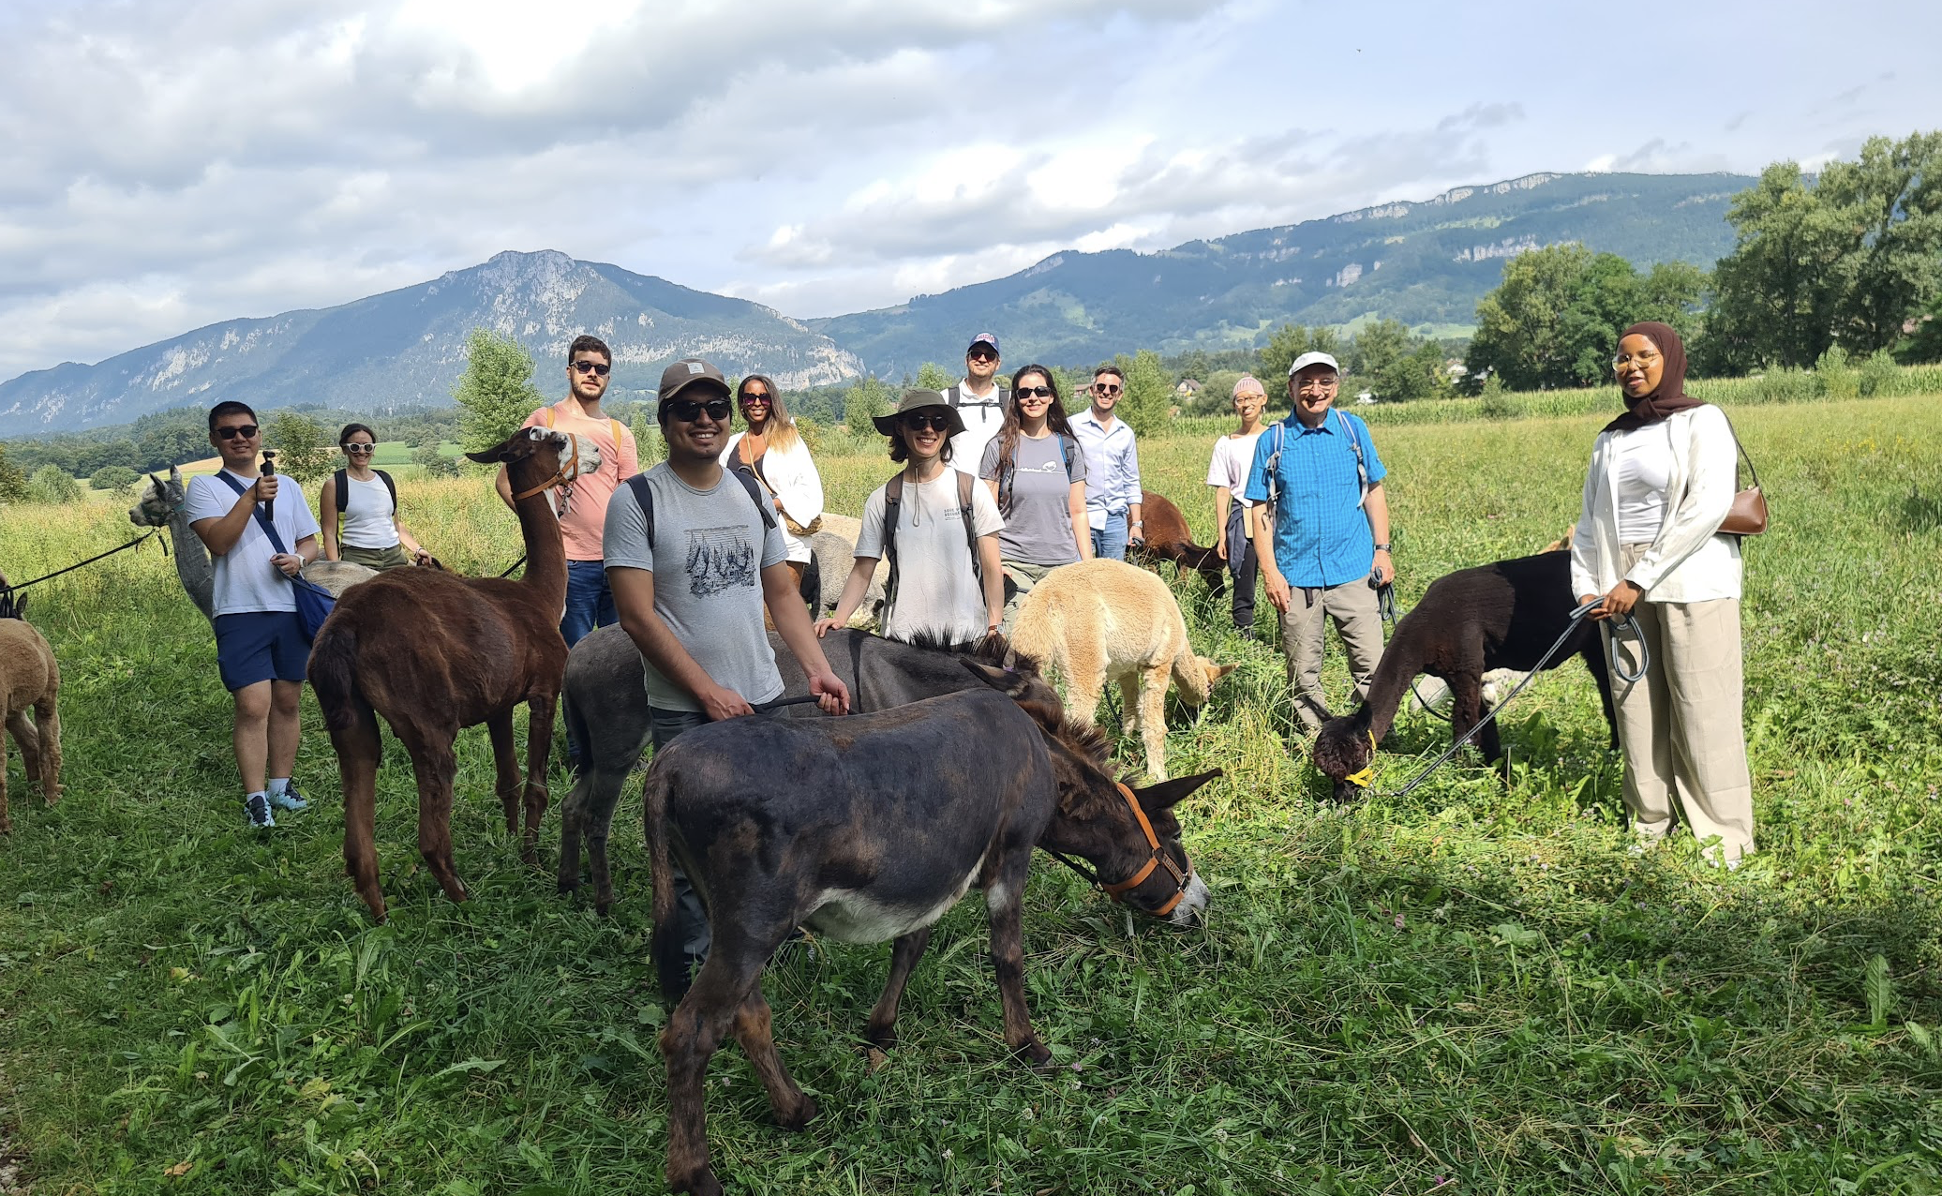
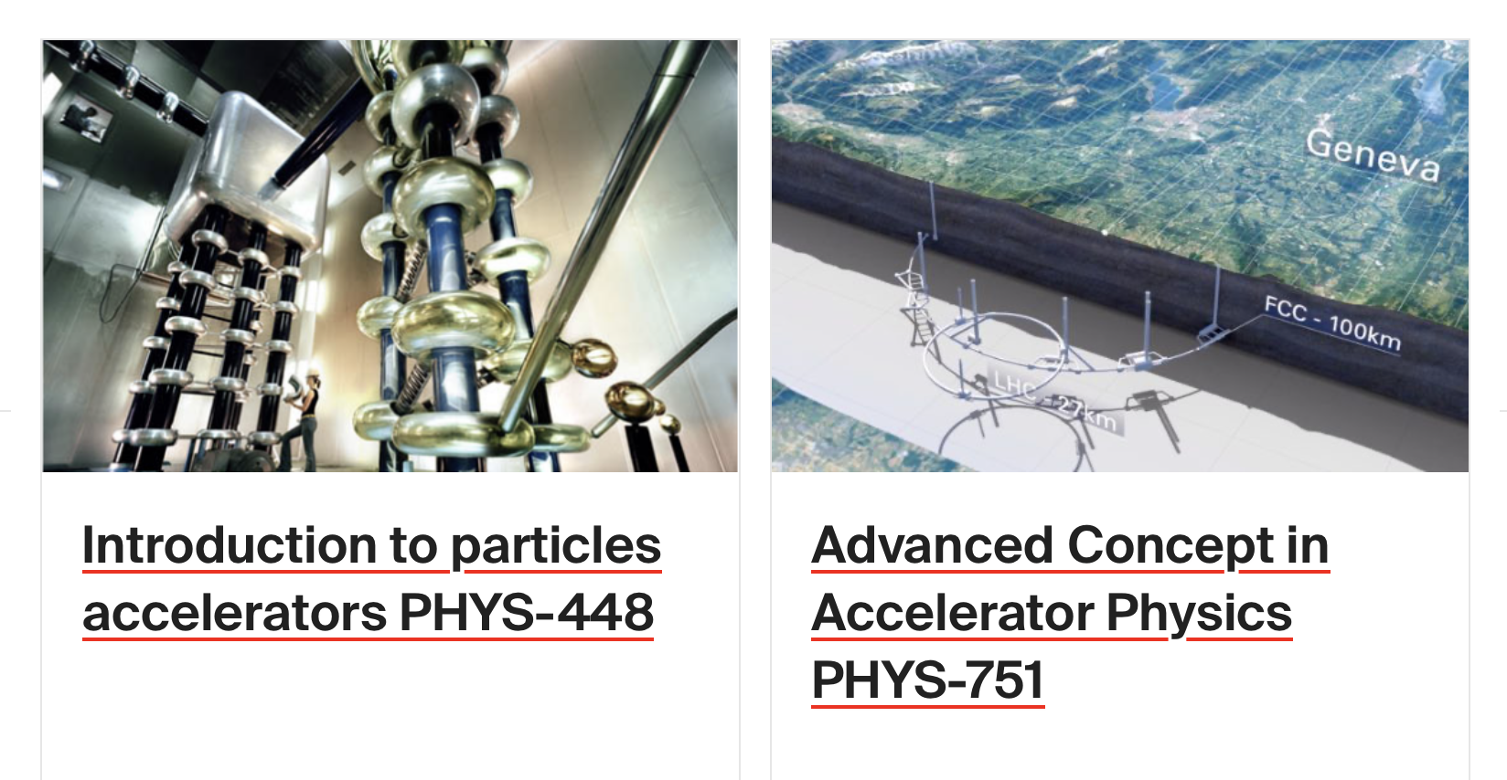
Laboratory of Particle Accelerator Physics
Summer 2024 Outing
Small team mainly involved in beam dynamics studies for the FCC: simulation models and experimental studies. But also LHC, HL-LHC, SLS2, Plasma Acceleration and much more.
New laboratory with 2MeV H⁻ RFQ + FODO cell under development to train students during lab work for High Energy and Accelerator Physics classes
2 Courses Introduction and Adavanced Accelerator Physics, Laboratory experiments and Master Thesis
1 Professor, 1 Senior Sientist, 3 post-docs, ~15 PhD Students and ~2-3/year Master Students, ~2-4/year laboratory students

Slide 4
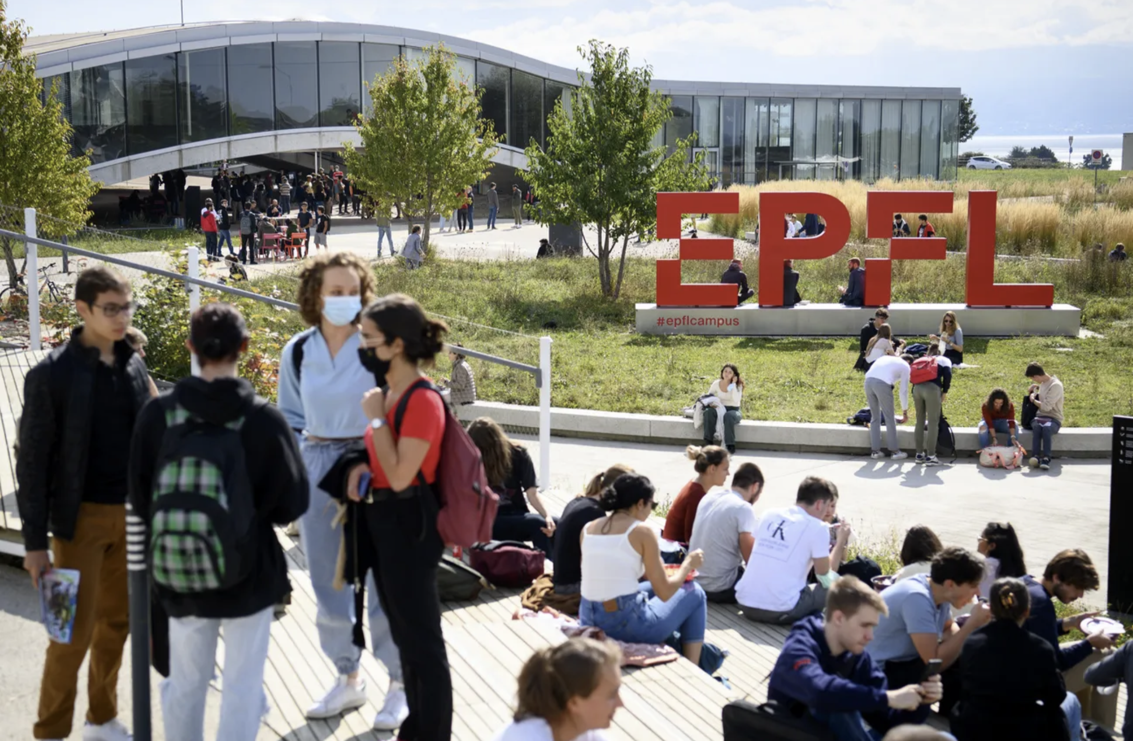
Campus life
125 buildings
34 catering points
EPFL Innovation Park : 152 companies present including 107 startups
Host of the biggest student festival in Europe: Balélec

Slide 5
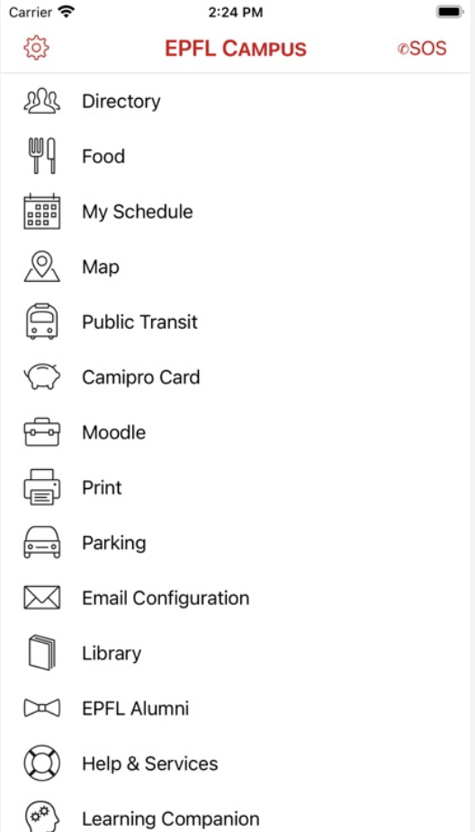

A guide to get around…
EPFL Campus app
  Find out about food options and access to the differents restaurants / food trucks on campus
  Use the map to find your way

Slide 6
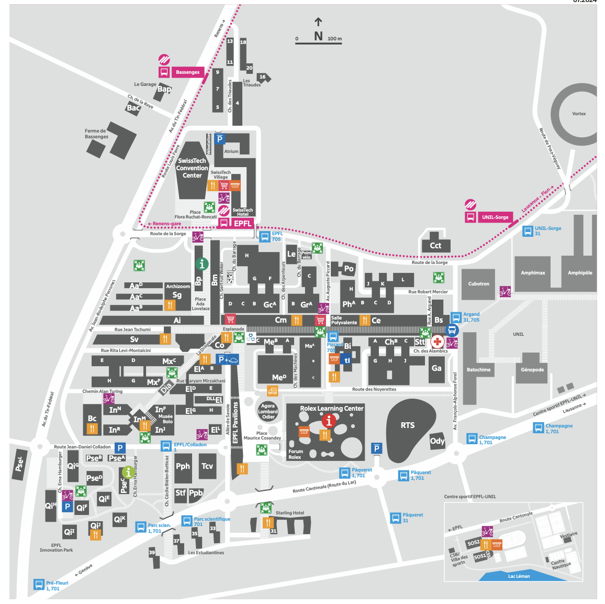
Things to do around EPFL
Swisstech hotel
EPFL metro stop
Go to Agora to have lunch with a view
Go for a walk and swim to the Lac Léman
  plage du Pélican
  plage de Vidy
Rolex Learning Center
Agora
ELA building
To the lake

Slide 7
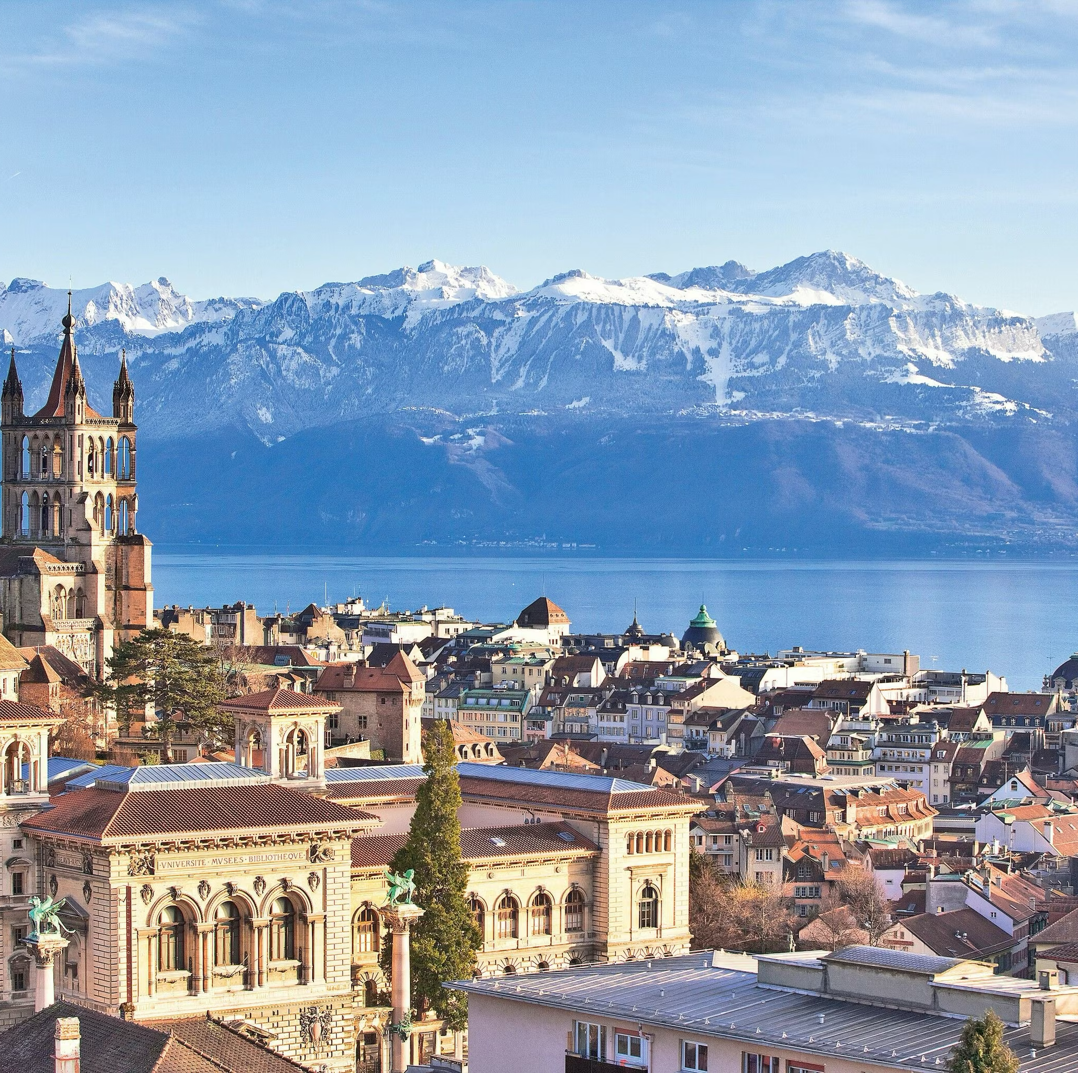
Visiting Lausanne
Take the metro from EPFL (15 minutes to Flon lively part of the city!)
Cathedral
Esplanade de Montbenon (parc with a view)
Olympic museum
Vidy-Ouchy lakeside walk
L’Art Brut when art is unfettered by cultural and/or societal conditioning

Slide 8


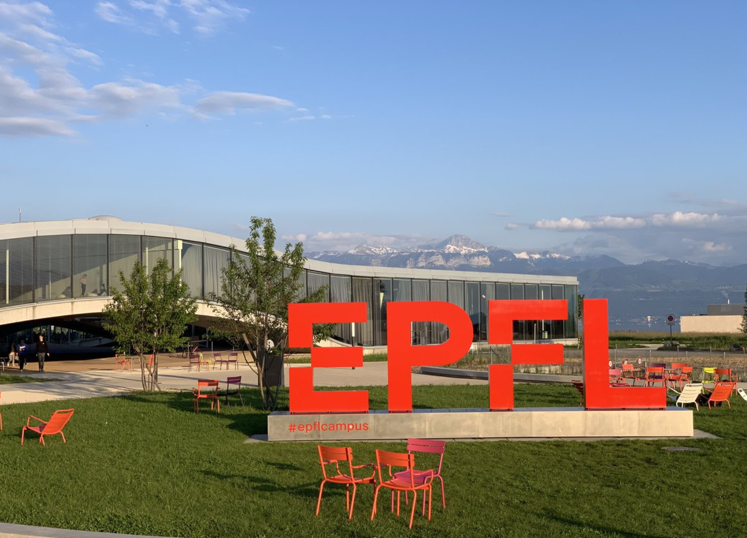
Workshop overview
Important moment to gather experts on colliders: in operation, under construction or under desing. Also in view of the very special moment of CERN and the European Strategy for High Energy Physics
Sponsors
Photo on Wednesday at 12:35 at the EPFL Agora’

Slide 9
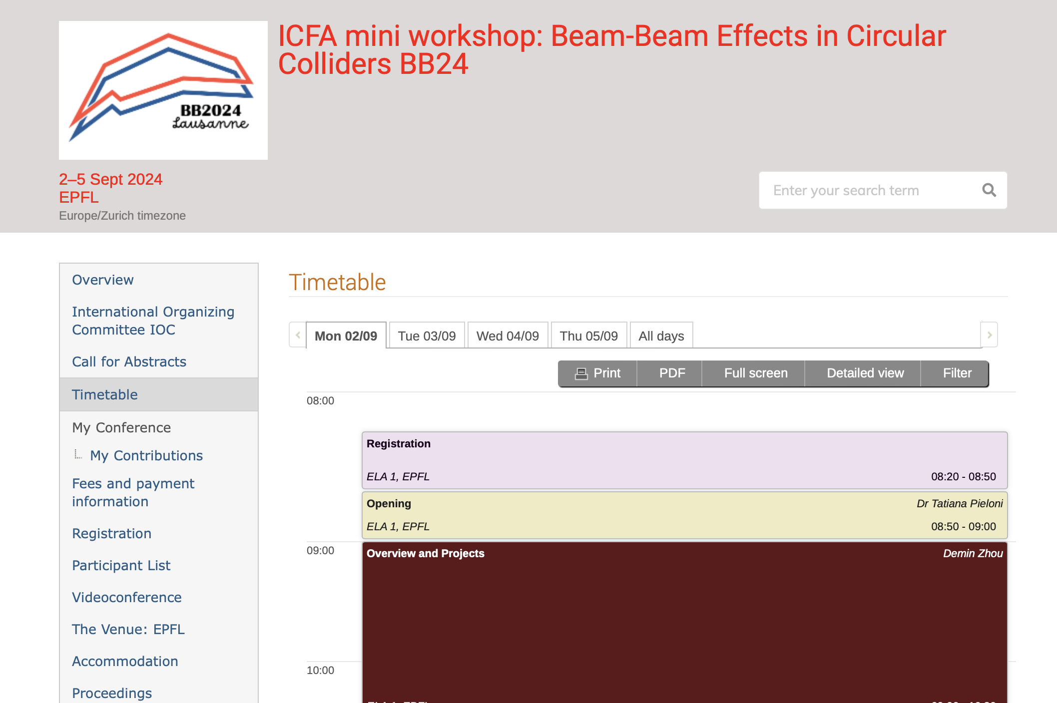
Workshop program
Timetable very dense organized in sessions with several discussion breaks:
  Overviews and Collider projects: operational, under design
  Single Particle Effects
  Coherent Effects
  Luminosity and beam distribution
  Codes
  Accelerator design
  General Summary and Outlook (ends Thursday at 16:30)
Closing session by K. Oide and J. Wenninger: highlight advances, open questions and inspire future developments
Please, draft version of talks should be uploaded ahead of time to organize discussions.
Proceedings details at the closing. Deadline 15th Nov 2024.

Slide 10
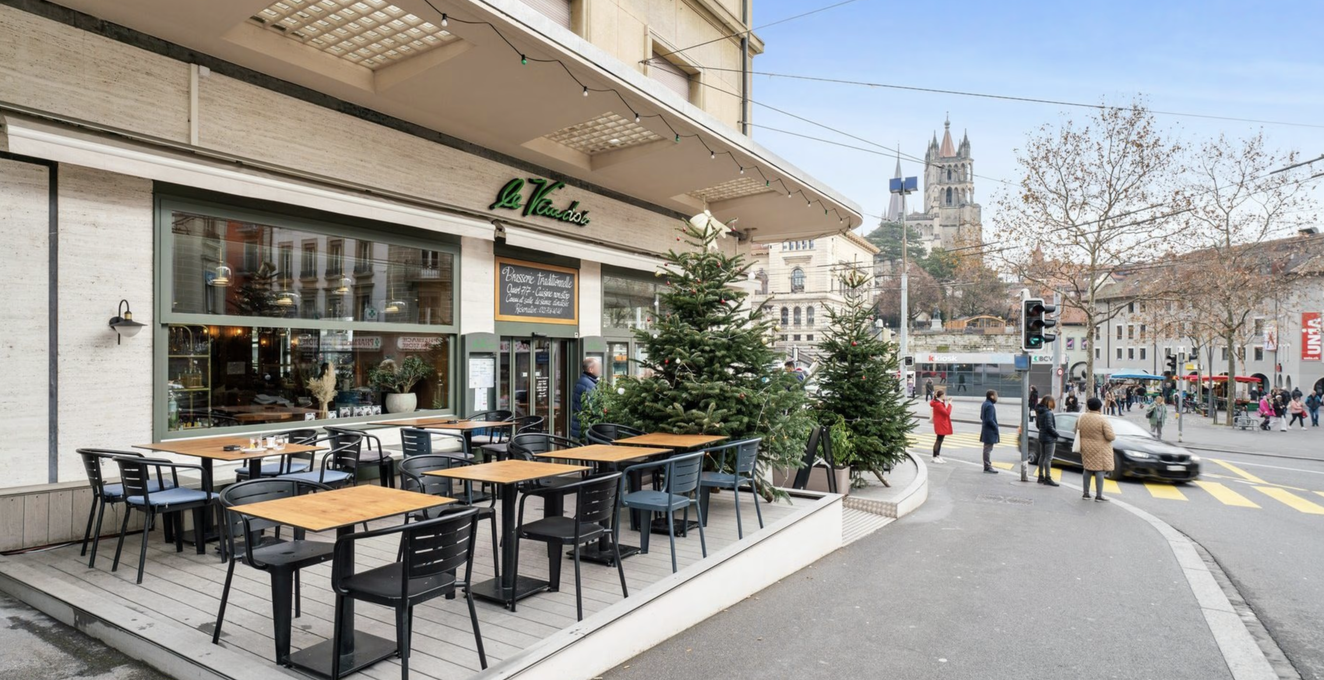
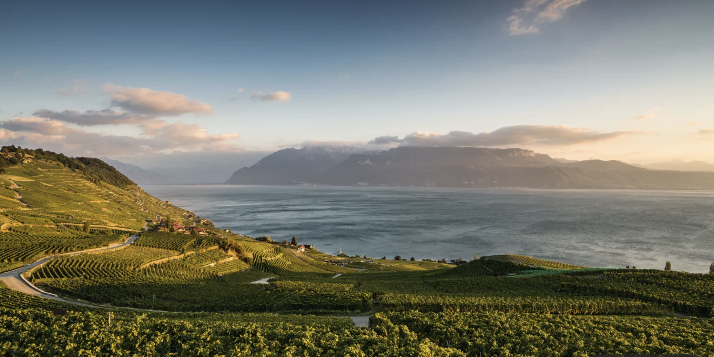
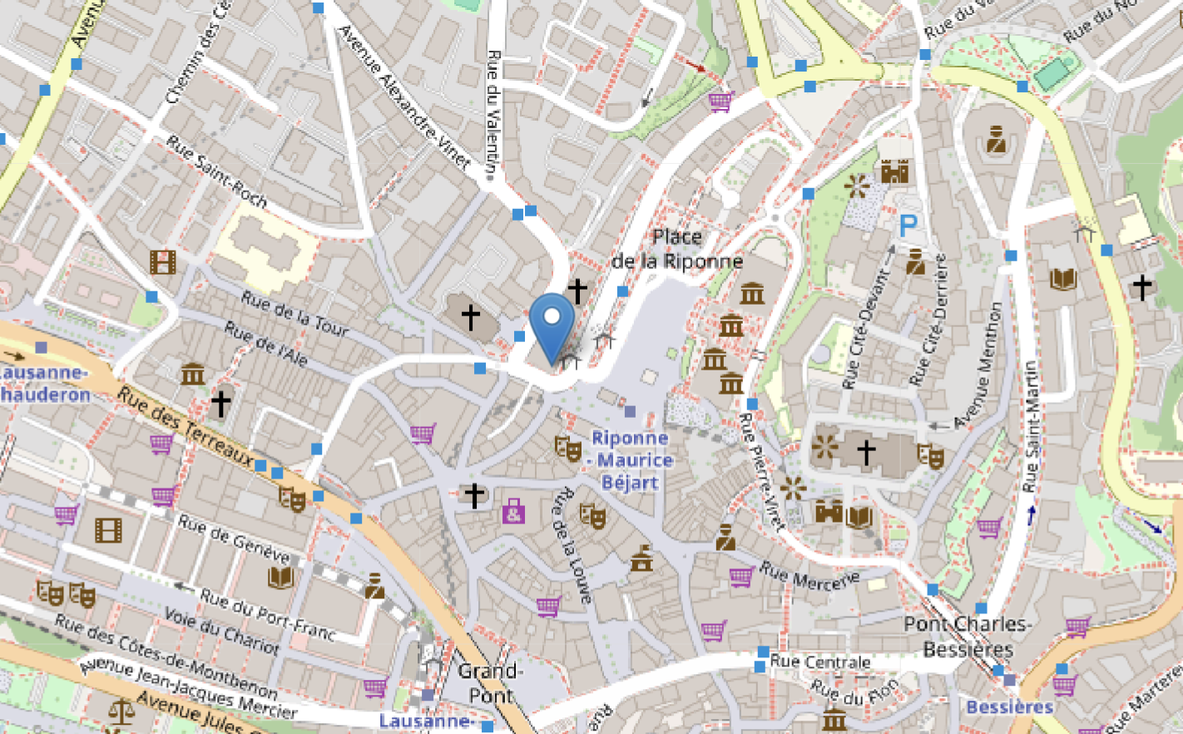
Workshop: social events
Le Vaudois Lausanne
Event Dinner at 19:00 directly at the location (city center)
Outing by Bus Wednesday afternoon 14:00 – 18:00
Walk in the wineyards + Wine experience and tasting
Lavaux Vineyards UNESCO heritage

Slide 11
Contact details
Xavier +41227663591 and Tatiana +41216934861 in case of problems.
Adm bb24@epfl.ch Esther Hofmann and Corinne Cramer

Slide 12
We wish you a productive workshop full of discussions and quality time at EPFL!

