Slide 1


Beam-beam from the control room
LEP1, LEP2, LHC – 3 beam-beam stories
J. Wenninger, (ex-LEP) LHC operation

Slide 2
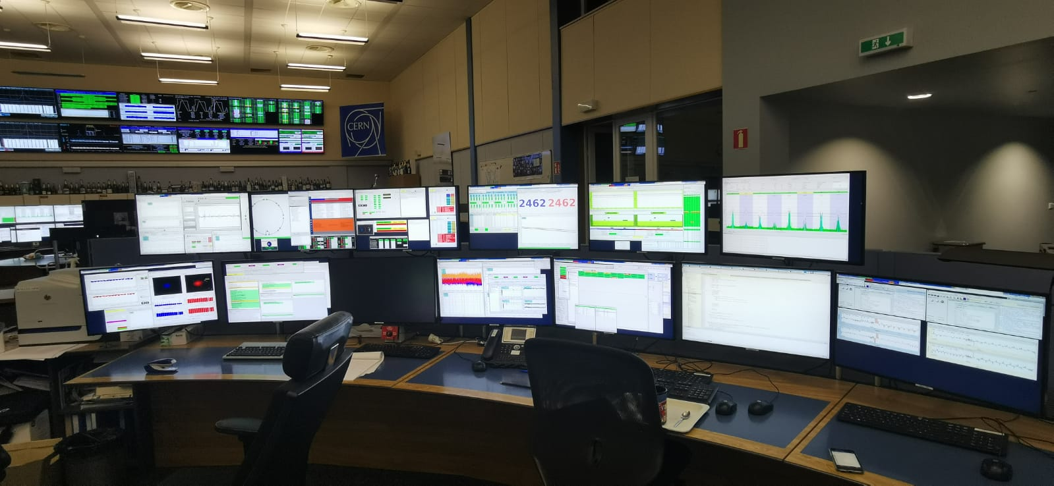
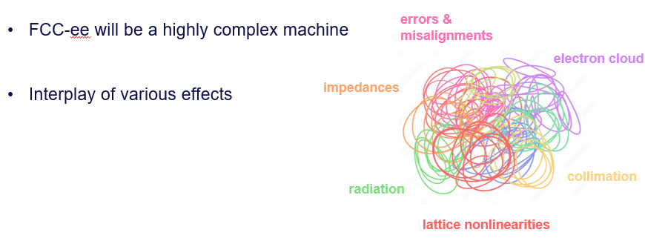
In CRs full interplay of effects
Beam-beam (BB) is an important aspect of collider physics and operation, but in a control room, BB is never alone – many factors conspire and couple to degrade machine performance.
  Importance of close contact between operation and modelling.
  “Tuning parameters” are not always orthogonal.
Linear optics (imperfections)
Collective effects
Tails
Beam-beam
P. Kicsiny
Electron clouds
Non-linear optics (imperfections)
What is our problem?

Slide 3
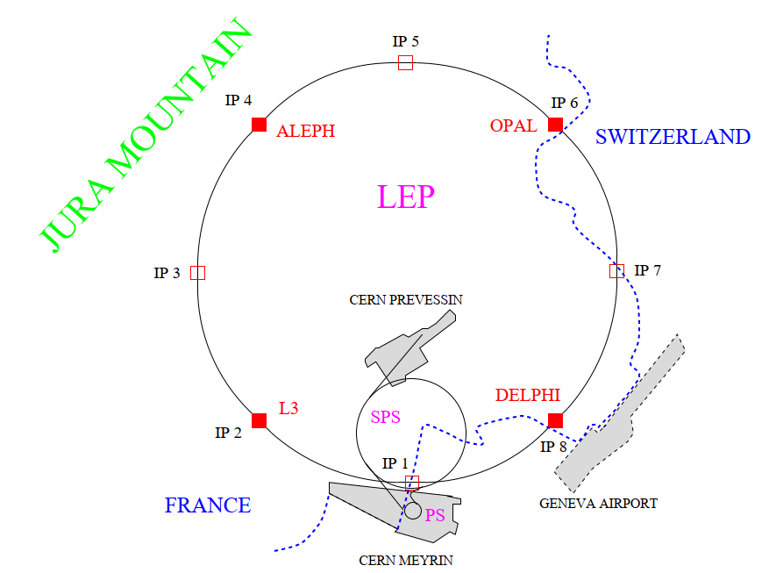
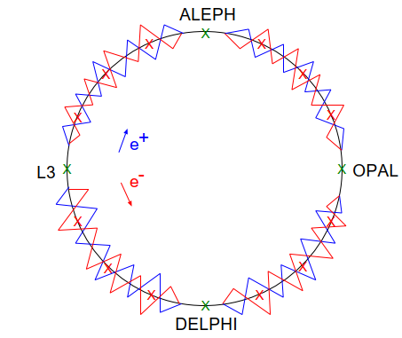
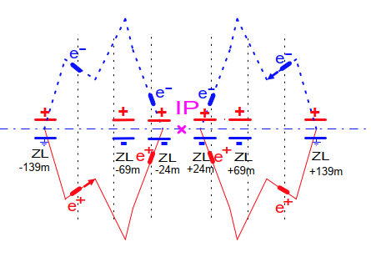
LEP
The 26.7 km LEP ring was designed before the emergence of the “factory” concept (PEPII, KEKB – second half of the 1990’s):
Single ring, 4-12 bunches, beams separated with electrostatic elements.
No crossing angle, no crab waist, no hour-glass.
Injection at 20 GeV, later 22 GeV, followed by ramp, squeeze, collisions at 43 – 104.5 GeV.
H. Shopper (former CERN DG): “final choice of circumference selected in view of LHC”.
Gentle competition between SLC* and LEP at 45 GeV.
LEP : statistics & energy calibration (Z mass and width)
SLC : longitudinal polarization
Bunch train @ LEP1
Pretzel scheme @ LEP1
(*) Stanford Linear Collider

Slide 4
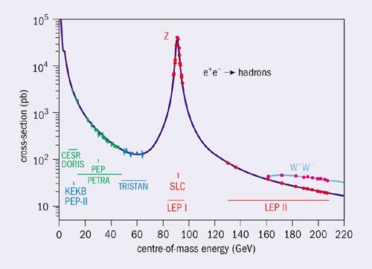
The Standard Model of particle physics in the 1990s
When LEP operation started, the Standard Model (SM) had holes – missing particles – and was not much constrained.
Many physicists hoped to discover top quark and Higgs at LEP.
By ~1993, the Z mass and width measurements at LEP pointed to a heavy top (~180 GeV), out of reach of LEP.
The top quark was discovered at the TEVATRON in 1995.
The SM constraints on the Higgs boson mass were weak, in the last two years, 1999-2000, LEP was in Higgs hunting mode, focus was on highest beam energy and no longer on highest luminosity.
Exiting times, discovery years !

Slide 5
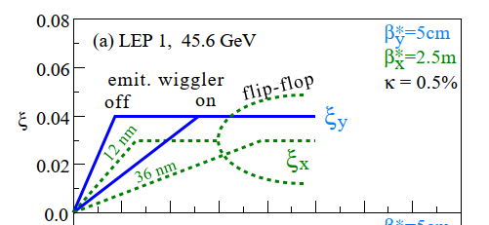

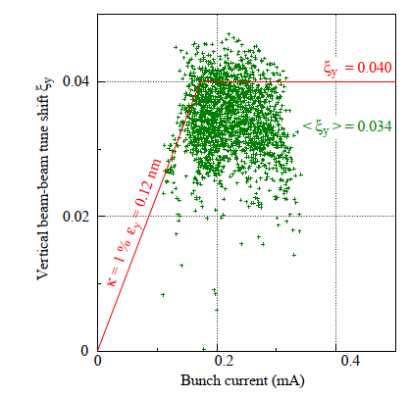
LEP 1 – E ~ 45 GeV
Beam-beam limited at ξ_{y} ~ 0.04.
Beam-beam controlled with emittance wigglers (in D^{x} != 0 areas). Performance optimization versus flip-flop…
Wigglers at full steam at start of collisions, lowered with intensity.
Peak performance depended on orbit and uncontrolled factors.
Favorite OP game was to re-seed the orbit (‘bare’ correction) and hope for an increase in luminosity…
Fighting experimental backgrounds – sometimes difficult, tense interactions with experiments → also for LEP2
Following the needs of the energy calibration program, begin systematic logging of beam observables (ORACLE DB).
Don’t save on instrumentation and data logging !

Slide 6
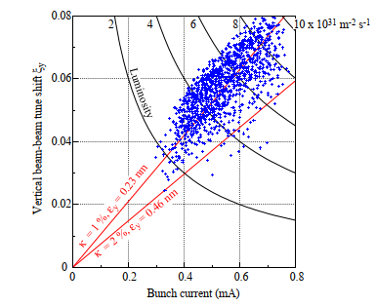
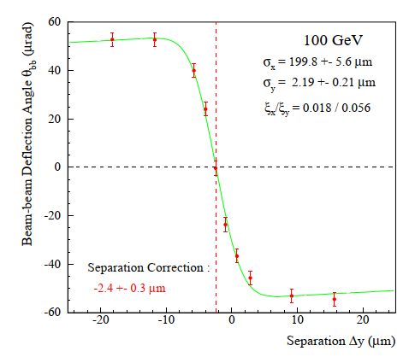
LEP 2 – E > 80 GeV
Beam-beam is no longer an “issue”, the strong radiation damping at LEP2 (E >= 80 GeV) lifts the beam-beam limit.
Concurrent change of the lattice (→ FCC-ee) to lower ε_{x}.
Fast coherent beam-beam deflection scans used every fill to optimize beam overlap (pioneered at SLC).
Orbit remained critical, more deterministic approach with combined vertical dispersion+orbit correction – lattice error corrections.
First optics measurements with beam excitation and turn-by-turn BPM acquisition. But no corrections yet.
Optimal tune WP was found by … accident.
From beam-beam limit surfers at LEP1, OP team becomes expert RF cavity tuners & fixers (“only“ 3 GV RF system).

Slide 7

The end of LEP – transition to LHC
LEP2 operation was stopped in November 2000.
Many physicists in the LEP community wanted to continue LEP, but CERN resources were needed to build on the LHC.
At the time, the lower limit on the mass was 114.4 GeV/c² (HZ production), CM energy ~209 GeV.
The Higgs boson was eventually discovered in 2012 at LHC with a mass of 125 GeV/c².
He is right to stop LEP
A difficult and heavily debated decision – emotional.
Fortunately, social networks did not exist...
Next transition: HL-LHC → FCC-ee

Slide 8
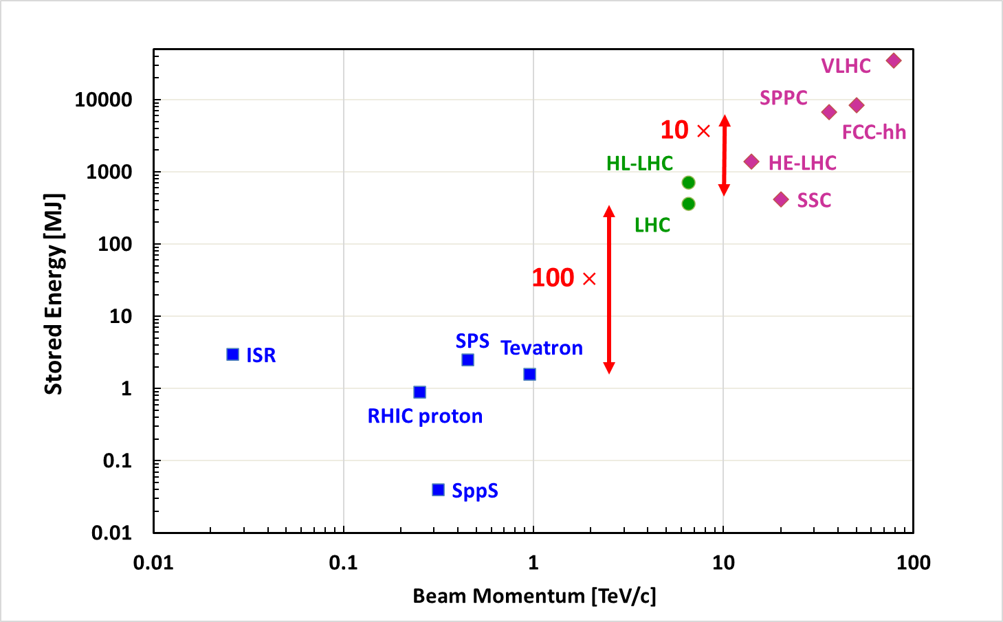
LHC – machine protection dominated regime
How to handle 100x more stored beam energy than at SPS and TEVATRON was from the key challenge of LHC operation.
Reached 420 MJ @ 6.8 TeV (per beam).
Operation at LHC is dominated by machine protection rather than beam-beam – even nowadays.
Machine setup with <0.1% of the nominal intensity.
Validation of protection (collimation, absorbers, loss points).
Intensity ramp up in ~6 steps with checkpoints.
Limited flexibility during high intensity operation (by procedure and/or interlocks) – some tuning done at SuperKEKB / proposed for FCC-ee is “beyond limits”.
Complicates diagnostics and cure of issues: beta* waist shifts, luminosity asymmetries etc to be studied at << lower intensity.
With 20 MJ stored beam energy,
FCCee @ Z may also be limited in “freedom of tuning” during operation

Slide 9
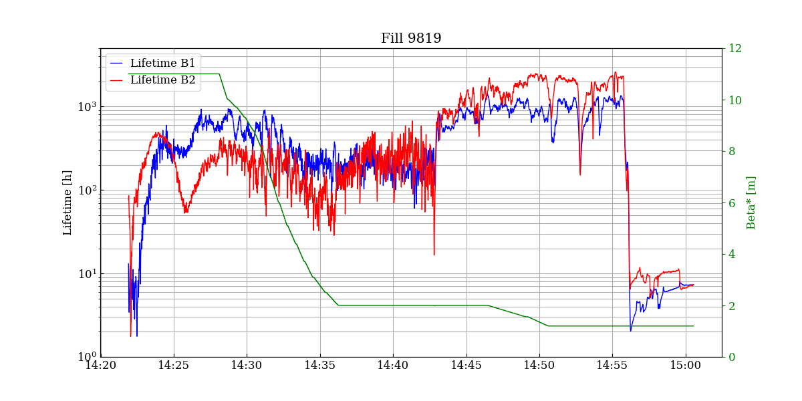
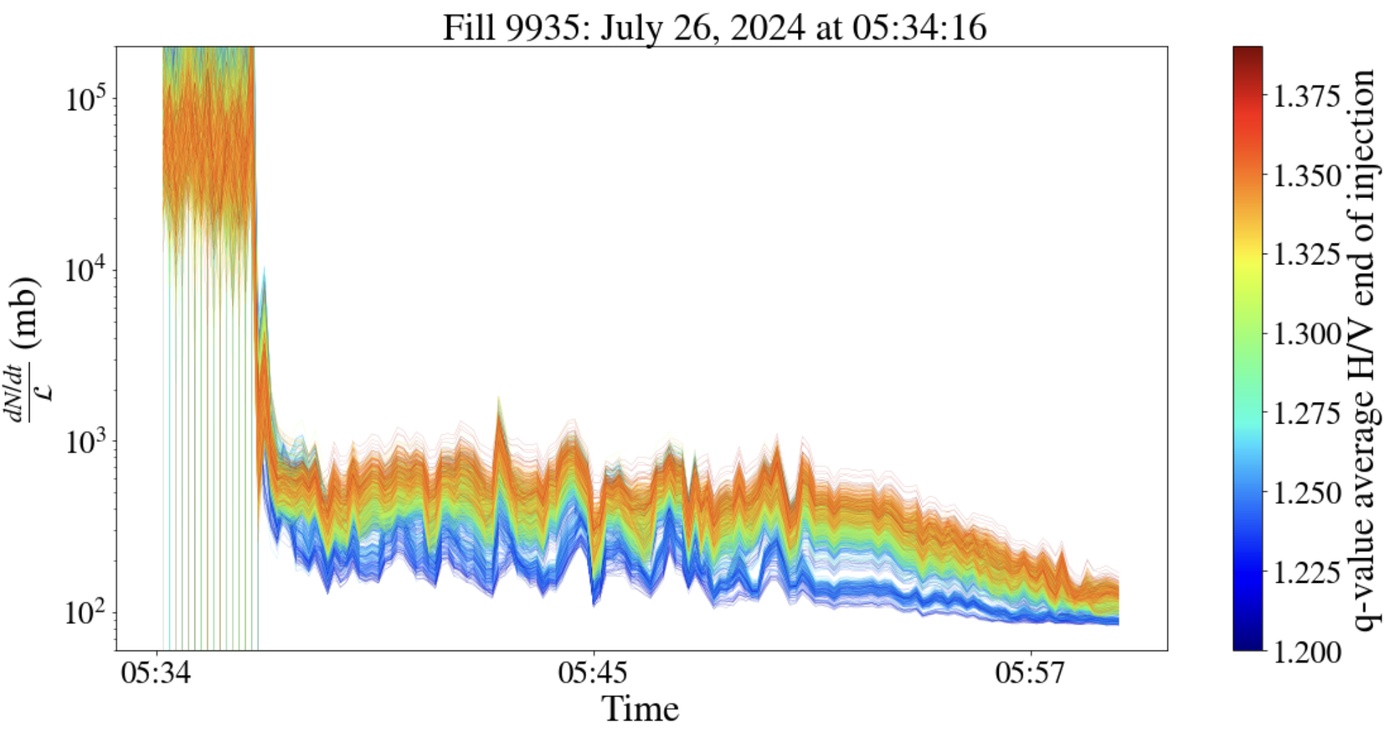
Beam-beam and tails
The most critical moment of the cycle: collapsing the beam separation for collisions → switch on HO beam-beam – has triggered beam dumps due to excessive losses for lifetime drops below ~1 hour.
Tails expelled; phase prone to trigger instabilities (most of them → emittance growth).
Loss of tails when HO beam-beam is switched on
Collisions
β*squeeze
S. Kostoglou
Combined ramp & β* squeeze

Slide 10
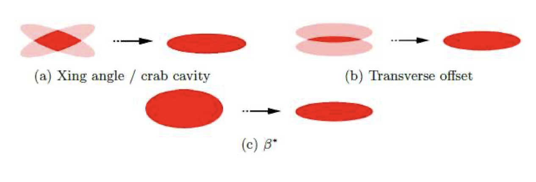
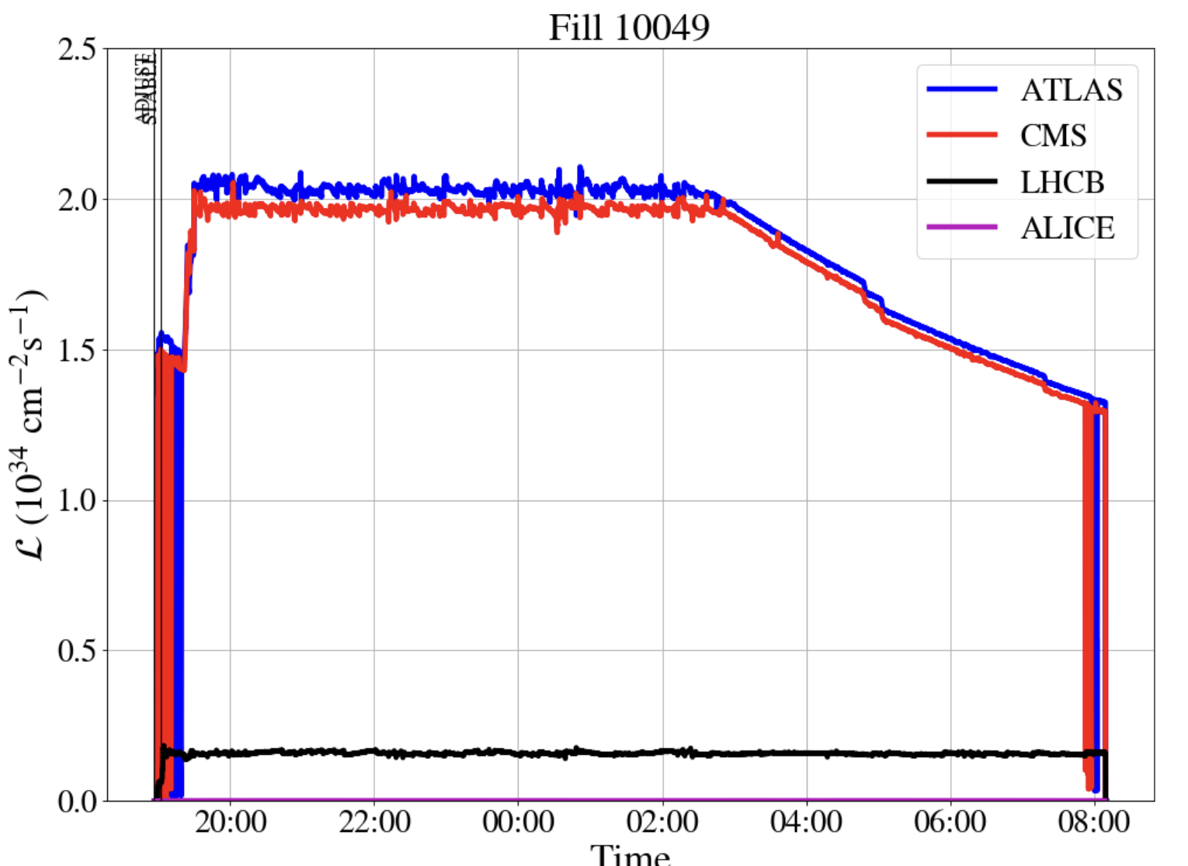
Luminosity levelling
T. Pieloni
From the start, different luminosity targets of the LHC experiments called for levelling of luminosity.
2011: levelling ALICE & LHCb by transverse offsets.
2017: levelling crossing angle down to enhance luminosity at end of fills and prepare experiments “psychologically” for more complex manipulations.
2018: first levelling by β*.
Since 2022: combined levelling of all experiments (β*, offset) – β* range: 120 cm to 30 cm.
Complex manipulations with 2 x 420 MJ !
Limited by pile-up (exp) and cryo heat load
β* levelling
Intensity decay
Offset levelling

Slide 11
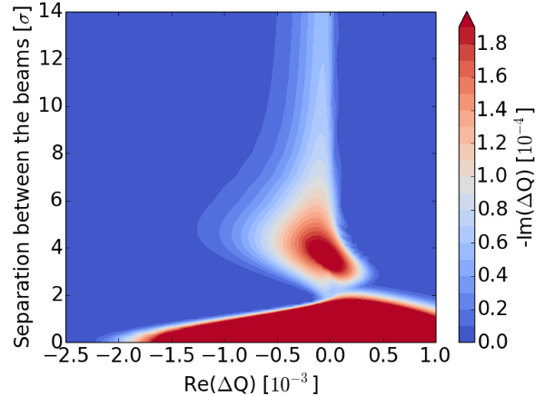
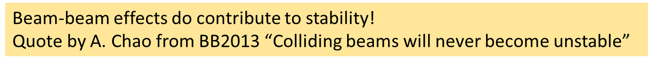
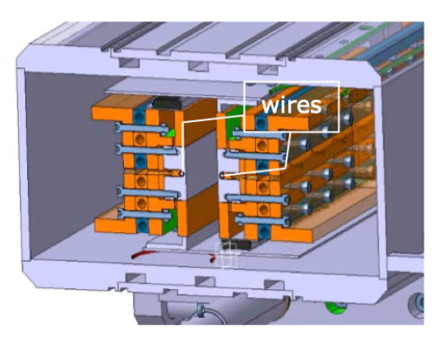
Beam-beam is not the limit
Beam-beam never stopped (progress of) operation. LHC was pushed progressively in number of bunches and bunch intensity.
Instabilities during collisions were encountered, lifetimes have been lower than desired… Overcome with octupoles, damper, chromaticity, change of procedures.
X. Buffat
LHC operation confirms:
Two performance jokers – you always gain:
Lower emittances : never HO BB issue, tune shift > 2x design ~0.007/IP.
Smaller β* always gave full benefits (limited by aperture margins).
  Coupled with improved optics corrections, linear and non-linear.
  Luminosity reduction from crossing angle, enhanced LRBB effects → BB wire tests.
But must collide ~ HO !
G. Sterbini, P. Belanger

Slide 12
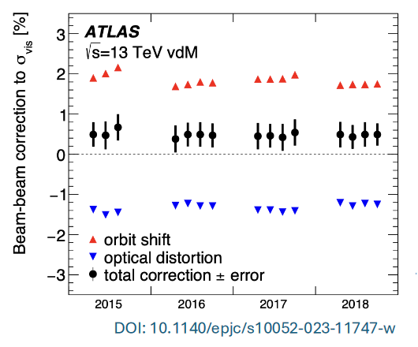
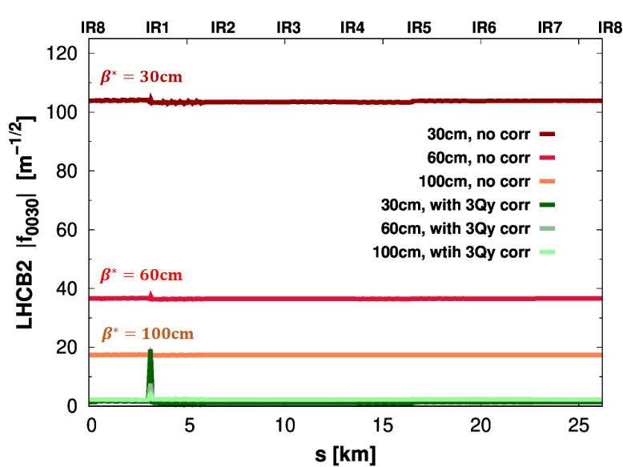
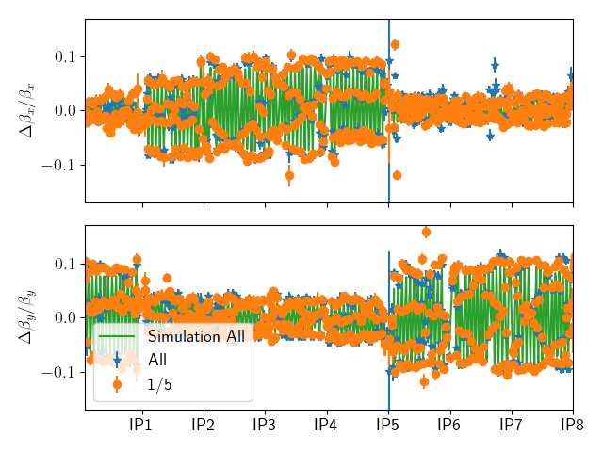
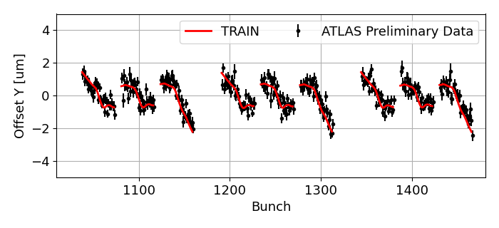
Beam-beam observables
J. Wanzcyk
Measurement of beam-beam impact on observables and associated simulation show (very) good agreement.
Beam-beam correction for precise luminosity normalization.
  Initial LHC estimate ~5%, now ~1% syst. error on luminosity.
LRBB induced orbit differences.
Beam-beam impact on beam optics.
Measurement and possibly correction of BB driven RDT.
E. Maclean
T. Persson
M. Hostettler

Slide 13
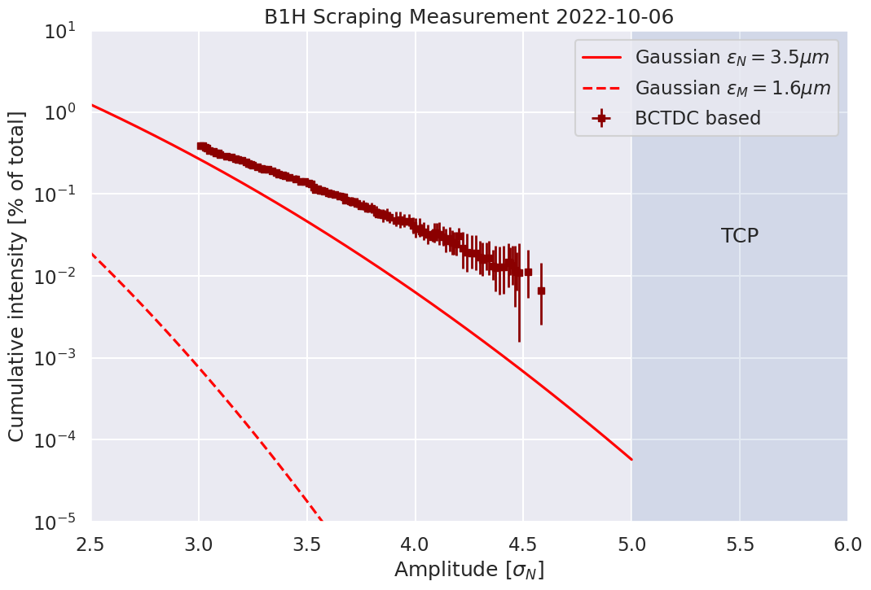
Beam-beam and machine protection
Beam-beam becomes relevant for machine protection at HL-LHC.
Sudden missing beam-beam kick during beam dump: kicks the opposing beam to 1 sigma amplitudes – a fast beam-beam kicker.
Fast crab-cavity failures can kick parts of a bunch at large amplitudes → HL-LHC.
C. Montanari
With a densely populated tail, 1-10 MJ can impact and potentially damage collimators during such fast failures.
Importance of beam tails beyond background to experiments and lifetimes.
Understanding tails from injectors and tail evolution is an important study item.
Interplay with non-linearities breaking collimation hierarchies.
F. Van Dee Veken

Slide 14
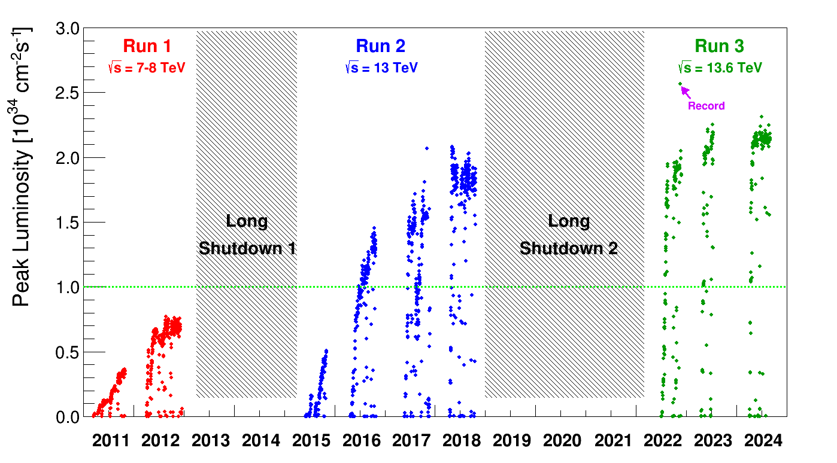
Over 10 years of LHC operation
Peak L pushed > 2 x design
Limited by experiments and cryo system!
Ingredients:
Higher bunch currents (HL upgrades)
Much smaller beam emittances (injectors).
Much smaller β* (use of aperture).
Complex optics manipulations with colliding beams – beam control.
But also thanks to excellent understanding of the machine with efficient exchange between operation and modelling.
Design

Slide 15


ss
Thank you for your attention !
LHC event on your 200 CHF banknote

