Slide 1
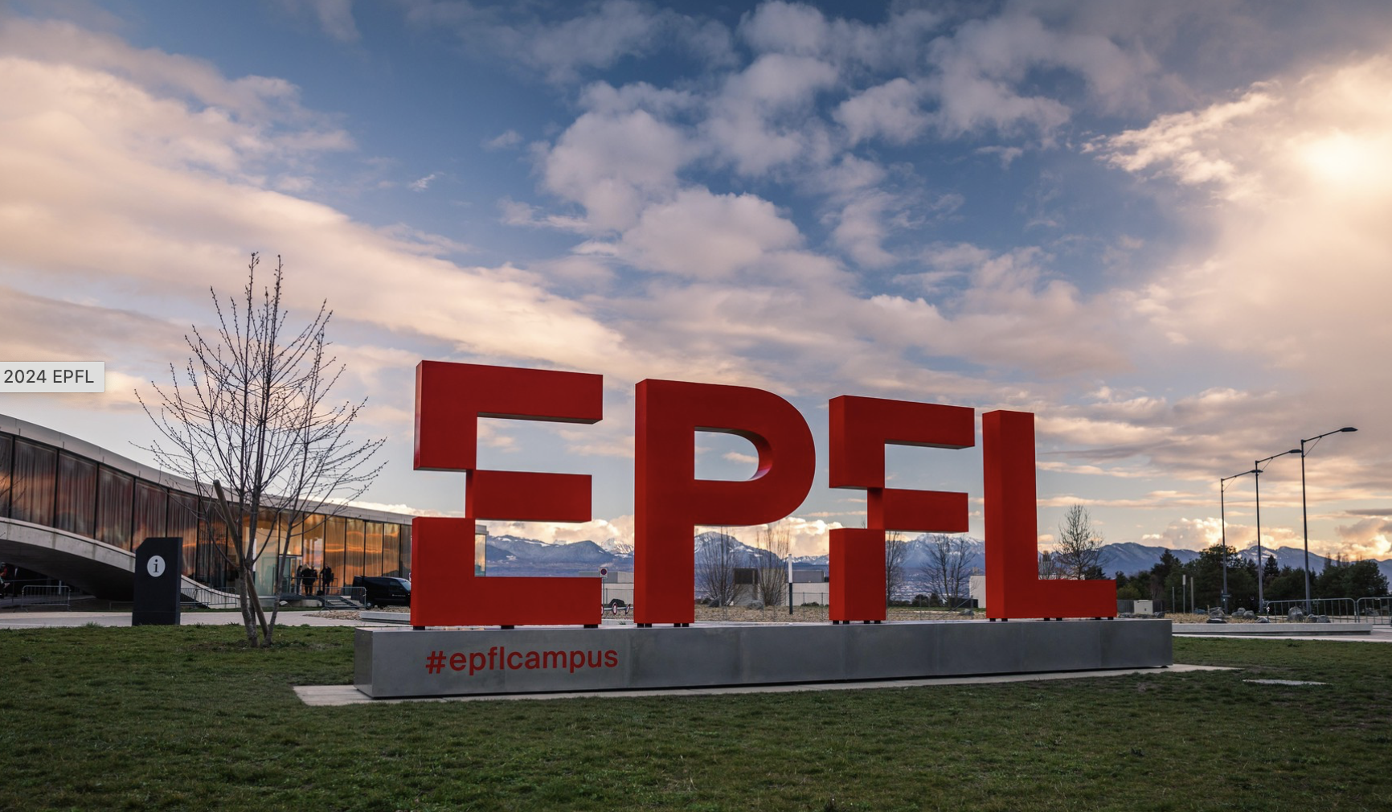
Group Photo
-when? Today at the end of morning session ~12:30
-where? Meeting point in front of the EPFL BIG logo

