Slide 1


Machine Learning applications to Improving RHIC luminosity
Xiaofeng Gu
Collaborators:
MSU: Yue Hao, Will Fung
LBNL: Ji Qiang, Sherry Li, Yi-Kai Kan, Yang Liu
BNL: Xiaofeng Gu, Robert-Demolaize, Takeshi Kanesue, Lucy Lin, Kevin Brown
Sep 2 – 5, 2024 EPFL
ICFA mini workshop: Beam-Beam Effects in Circular Colliders BB24

Slide 2
Outline:
Motivation and Methods
EBIS Beam Intensity Optimization
Luminosity Optimization
Plan & Summary

Slide 3
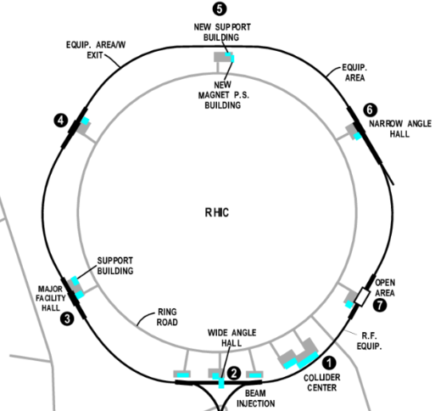
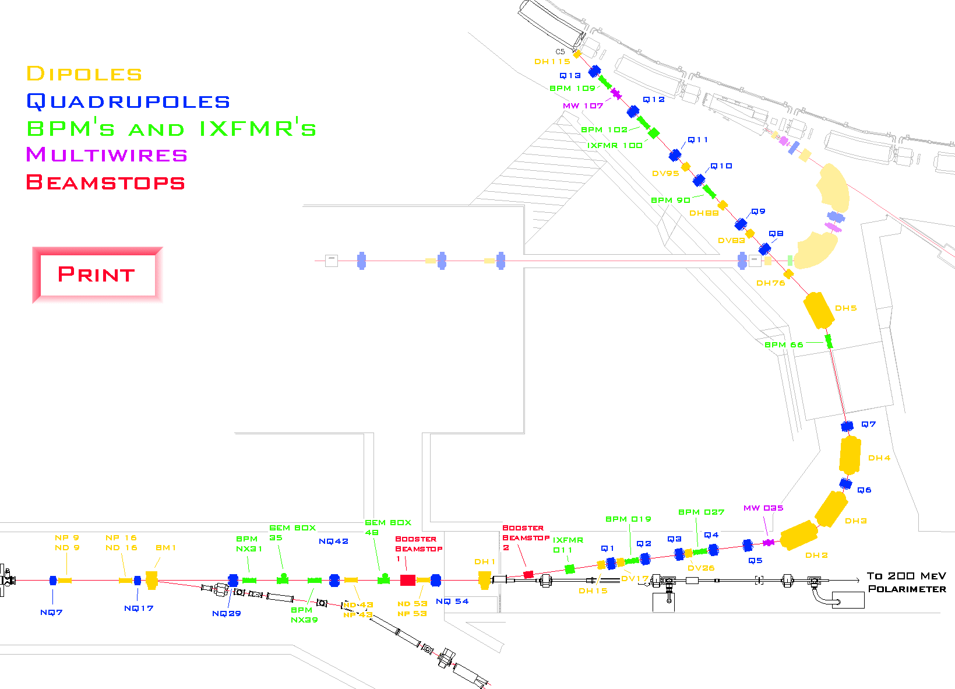
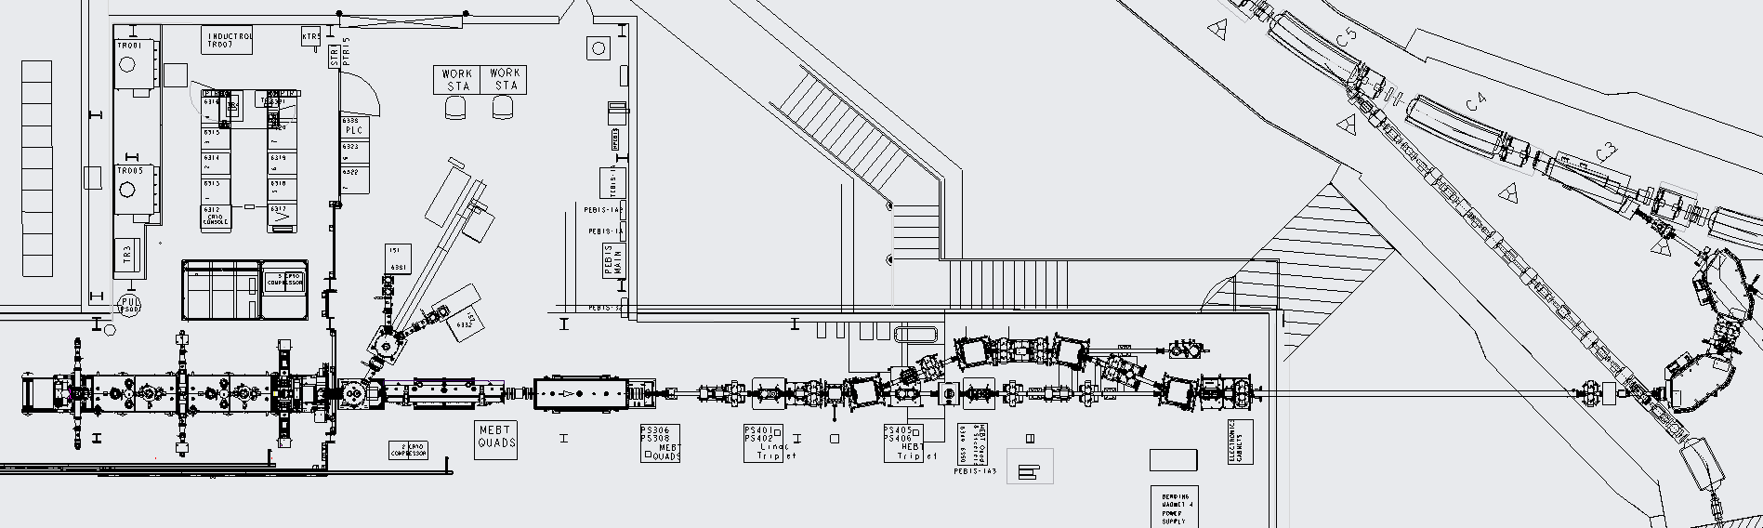
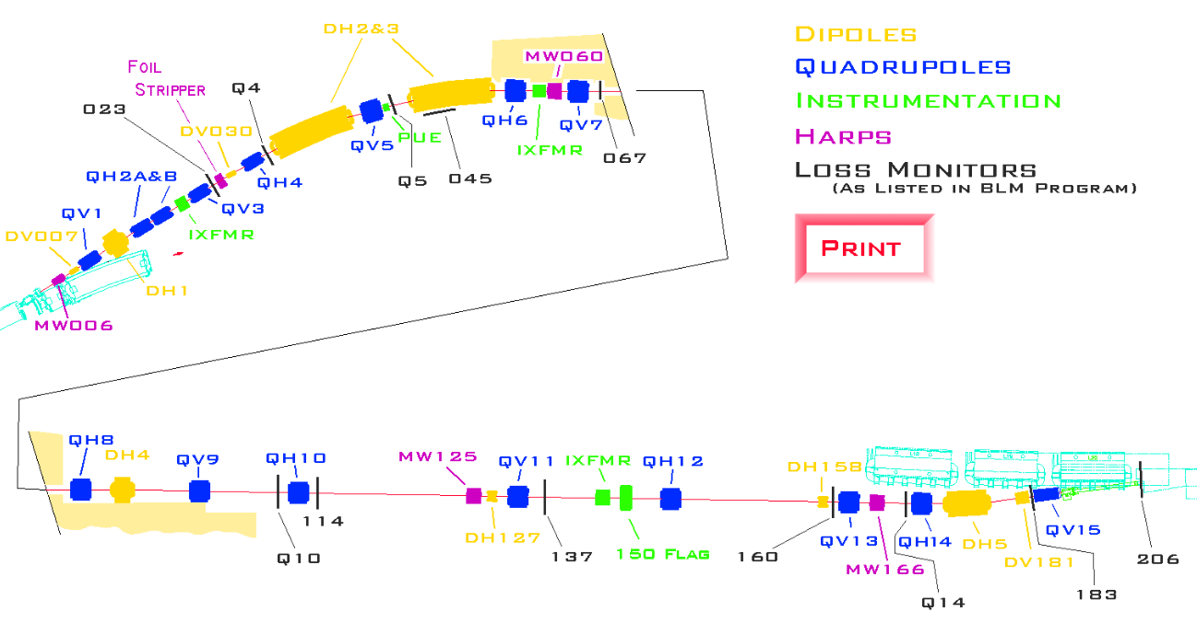
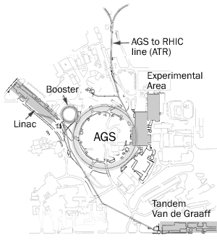
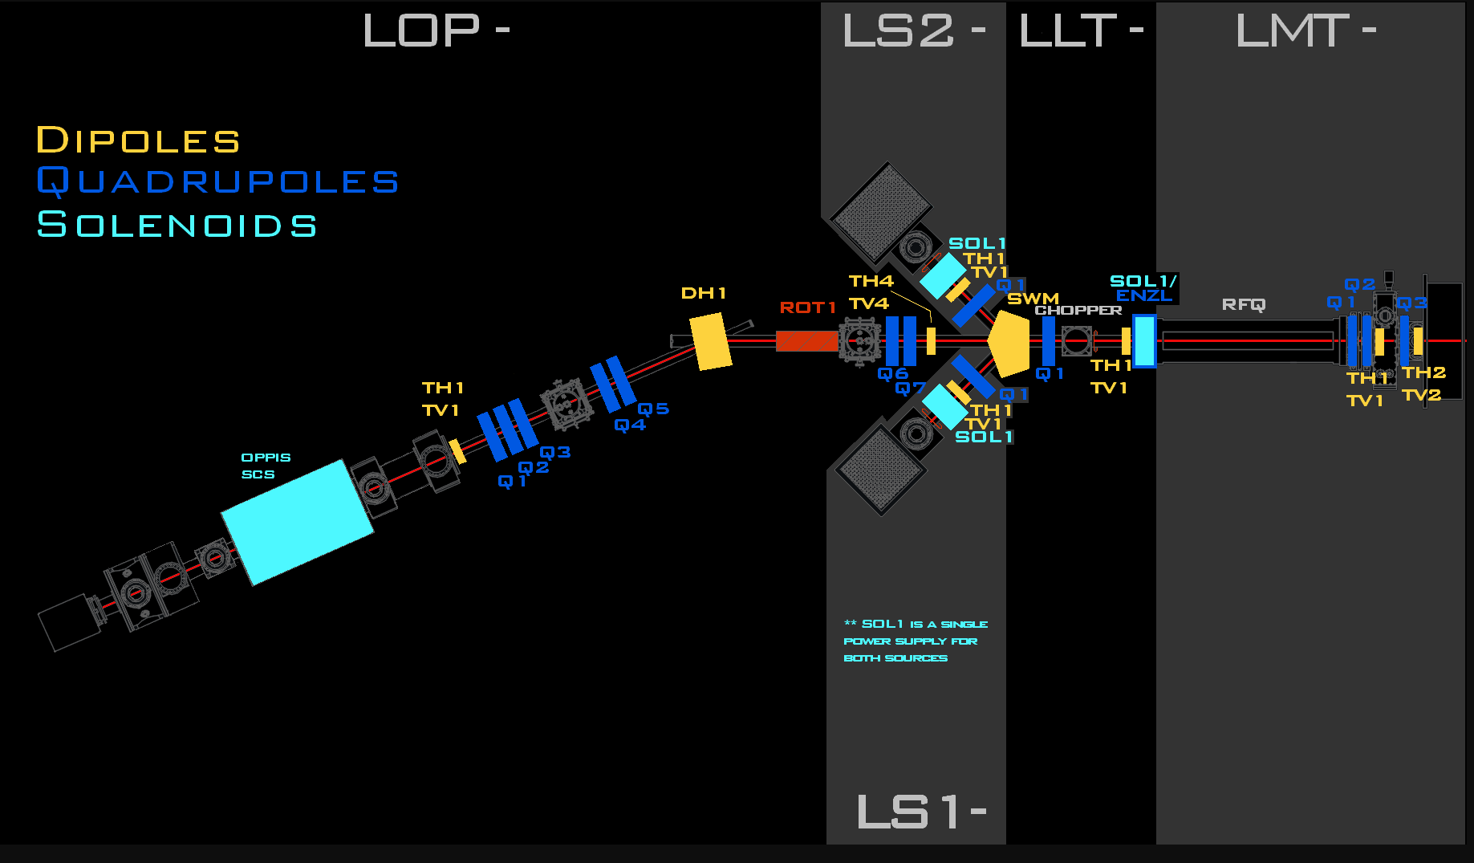
1) RHIC Complex Beam Optimization
Intensity, emittance and polarization
ltb
Ion Source: EBIS
bta
Proton Source: OPPIS

Slide 4
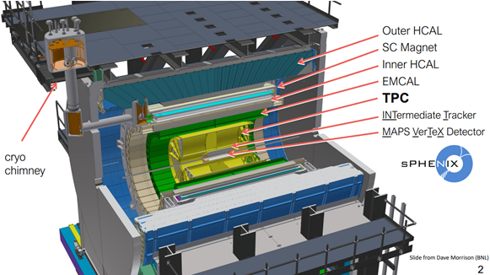
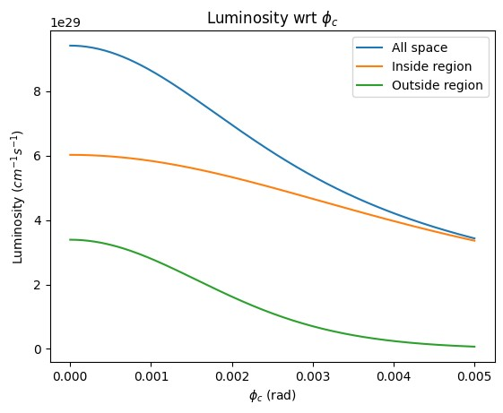
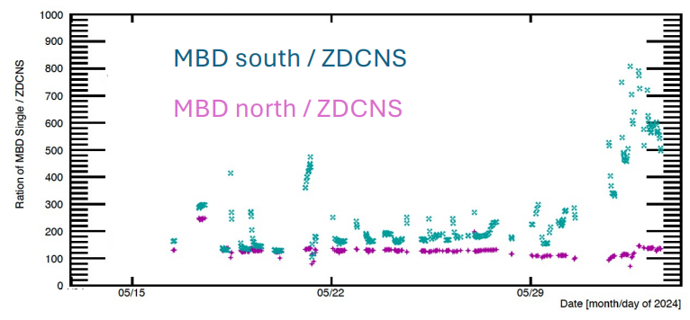
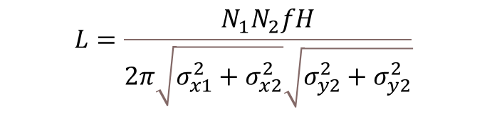
1) sPHENIX luminosity Optimization (RHIC)
$$L=\frac{N_{1}N_{2}fH}{2π\sqrt{σ_{x1}^{2}+σ_{x2}^{2}}\sqrt{σ_{y2}^{2}+σ_{y2}^{2}}}$$
sPHENIX:
max. MVTX (+/-10 cm)
min. unwanted signal
Crossing angle (2mrad)
Global Parameters:
Orbit (Dipole)
Tune (Quadrupole),
Chromaticity (Sextuple)
Octupole
Local (IR8) Parameters:
Beta* (beam size)
S* (longitudinal beam waist)
Transverse offset
Other Parameters:
RF Voltage
Collimator Position
Maximize
minimize
Jamie Nagle, 06/04
Many variables;
Maximize the useful signal within VTX while minimize the unwanted signal outside of VTX
Machine learning could be a good tool for a fast, multi-objects tunning.
GPTune will be used for ONLINE optimization, XGBoost for offline analysis.

Slide 5
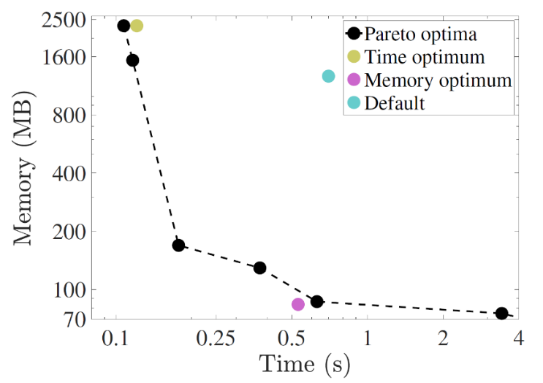
1) Bayesian optimization at LBNL GPTune
Several features of GPTune (BLNL) are very useful, including:
relies on dynamic process management for running applications with varying core counts and GPUs
can incorporate coarse performance models to improve the surrogate model
allows multi-objective tuning such as tuning a hybrid of computation, memory and communication.
allows multi-fidelity tuning to better utilize the limited resource budget
supports checkpoints and reuse of historical performance database.
Many variables;
Maximize the useful signal within VTX while minimize the unwanted signal outside of VTX.
https://github.com/gptune/

Slide 6
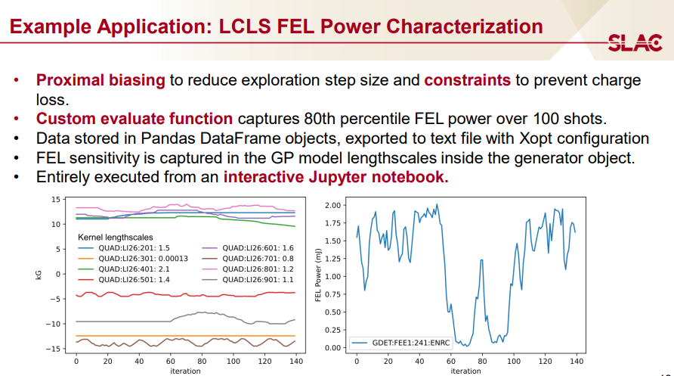
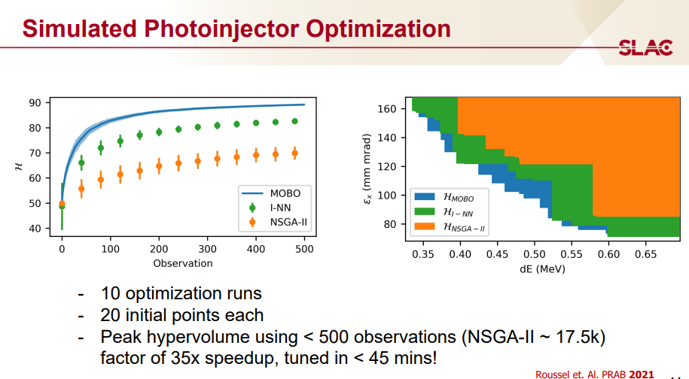
1) Bayesian optimization at SLAC
optimization algorithms:
  cnsga Continuous NSGA (nondominated sorting genetic algorithm)-II with constraints.
  bayesian_optimization Single objective Bayesian optimization (w/ or w/o constraints, serial or parallel).
  mobo Multi-objective Bayesian optimization (w/ or w/o constraints, serial or parallel).
  bayesian_exploration Bayesian exploration.
sampling algorithms:
  random sampler
Convenient YAML/JSON based input format.
Driver programs:
  xopt.mpi.run Parallel MPI execution using this input format.
https://github.com/ChristopherMayes/Xopt
https://christophermayes.github.io/Xopt/assets/xopt_overview.pdf
https://arxiv.org/pdf/2312.05667

Slide 7
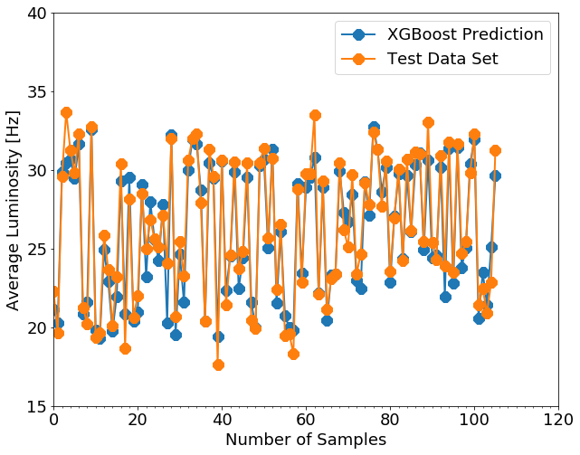
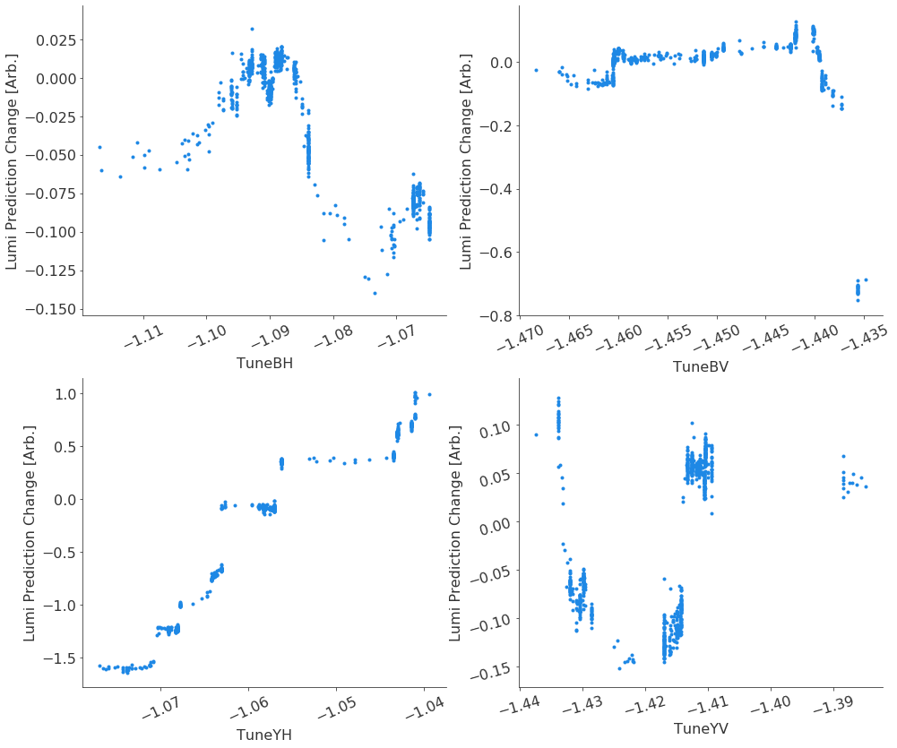
1) XGBoost for offline regression, SHAP for plotting
XGBoost python package:
Multi-dimensions nonlinear regression algorithm: good for f(x1,x2,x3, … , xn) with n>3 or 4. (Higgs Machine Learning Challenge)
The black-box model (LEReC data): 80% data for training, 20% data for test and comparison
Model R_2 score: 0.90, predicts the luminosity very well.
How to explanate the black-box model?
SHAP python package:
an approach to explain the output of any machine learning black-box model via calculating their Shapley values (marginal effect), which are their contributions to the total performance.
Taxi: A[$6] B[$16] C[$42]
Pay: $2 $5 $35
SHAP plot: Data visualization, and model explainability; Shapley values with offsets.

Slide 8
Outline:
Motivation and Methods
RHIC Complex Beam Optimization
Luminosity Optimization
Plan & Summary

Slide 9
2) GPTune Test: EBIS Intensity Optimization
LION
fc96
1
2
RFQ
LINAC
3
4
5
6
7
8
EBIS
Buncher1
xf14
Buncher2
Buncher3
LION
EBIS Injection Line (fc96)
EBIS
EBIS Extraction line (xf14)
RFQ
MEBT
Linac
HEBT
 |  | Injection [fc96] | Extraction [xf14]
1 | IonLens20-40kV | ✓ | ✓
2 | DeflPlatBias | ✓ | ✓
3 | 16PoleX | ✓ | ✓
4 | 16PoleY | ✓ | ✓
5 | Gridded_Lens | ✓ | ✓
6 | Horiz_Bend_Defl | ✓ | ✓
7 | Inter_Vert_Defl | ✓ | ✓
8 | Inter_Vert_Defl_Lower | ✓ | ✓
9 | Horiz_Sphere_Bend | ✓ | ×
10 | RFQ_Horiz_Bend | × | ✓
11 | LEBT_Solenoid | × | ✓
 | Total Variables | 9 | 10

Slide 10
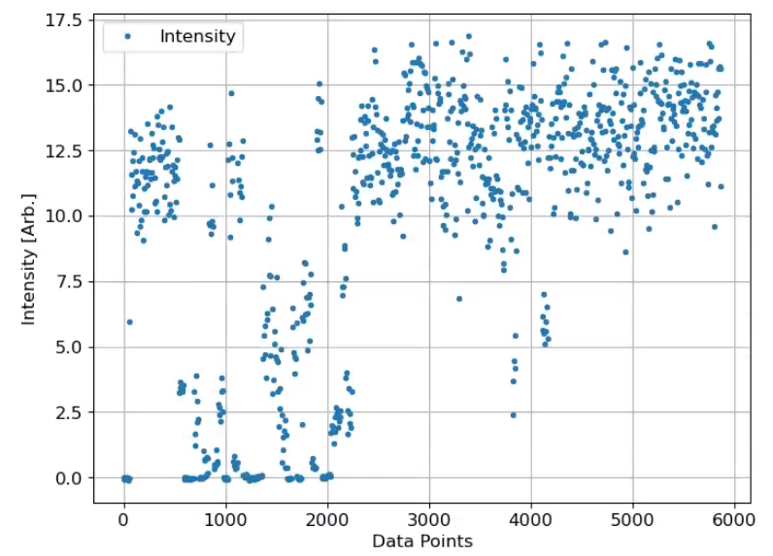
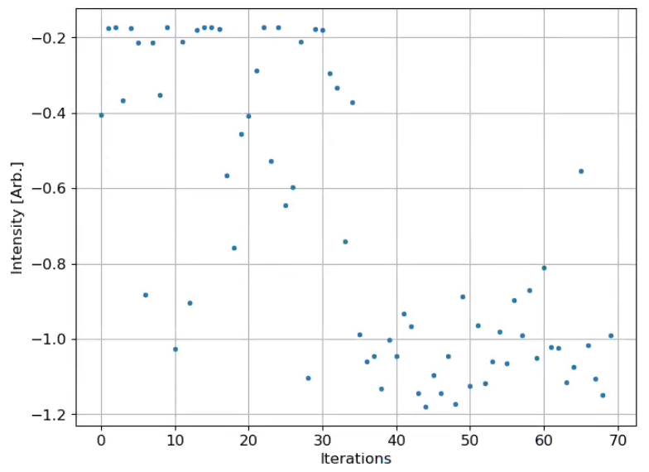
2) GPTune: EBIS Injection Line (9 parameters)
~14.0
11.5
fc96 Intensity
~22% improvement after optimization
  script was running from 12:33 to 13:36 (~63 min)
  1 beam / supercycle [6.6 s]; it takes 2 supercycles for the powers settle down;4 supercycles for measurement.
  fc96 measurement was used for injection optimization
  9 control parameters after 70 iterations

Slide 11
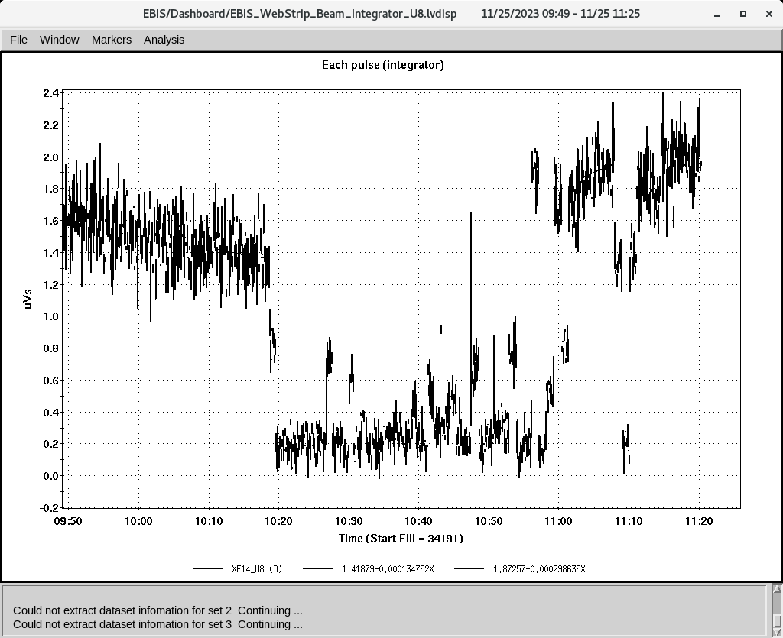
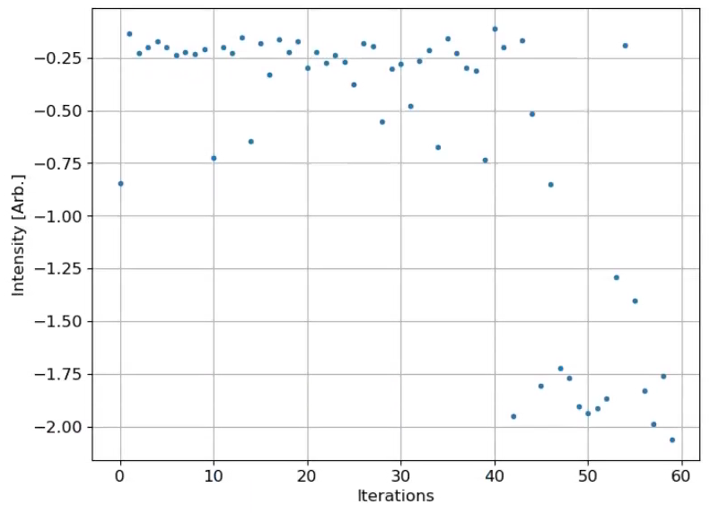
2) GPTune: EBIS Extraction Line (10 parameters)
~2.0
Xf14 Intensity
1.4
~43% improvement after optimization
  script was running from 10:18 to 11:15 (~57 min)
  2 beam / supercycle [6.6 s].
  xf14 measurement was used for extraction optimization.
  10 control parameters after 60 iterations

Slide 12
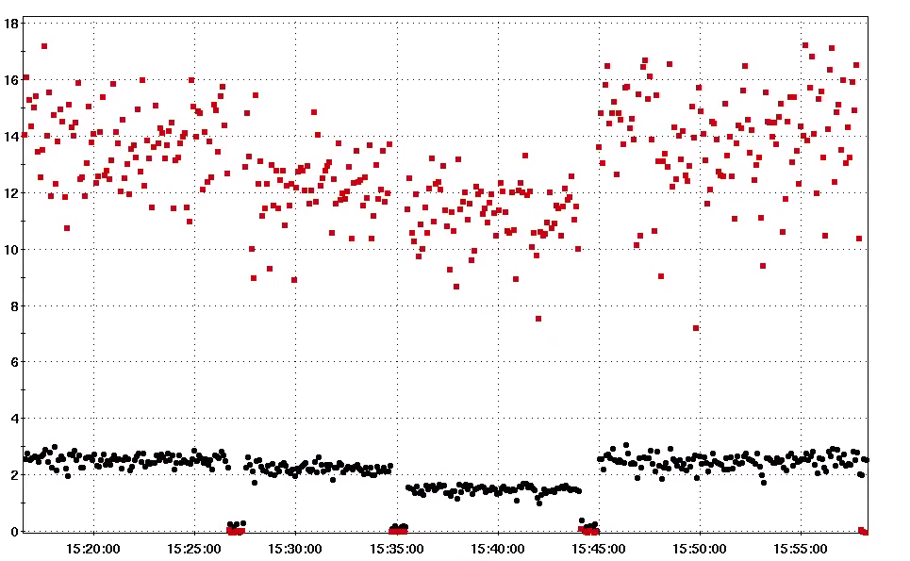
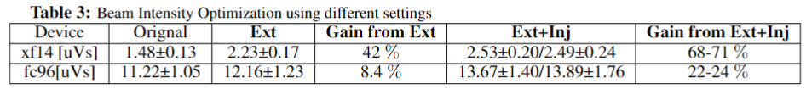
2) GPTune: EBIS Intensity Gain (11/25/2023)
13.67±1.40
13.89±1.76
12.16±1.23
11.22±1.05
Beam Intensity [uVs]
Original.
Inj+Ext.
Inj+Ext.
Ext.
Original, Ext., Inj. + Ext.: use the saved parameters for these beam lines.
GPTune works with std ±10% (pp ±15% ) noisy signals!
Possible more gain with fc96 instead of xf14 for the extraction line?
2.53±0.20
2.49±0.24
2.23±0.17
1.48±0.13
Time

Slide 13
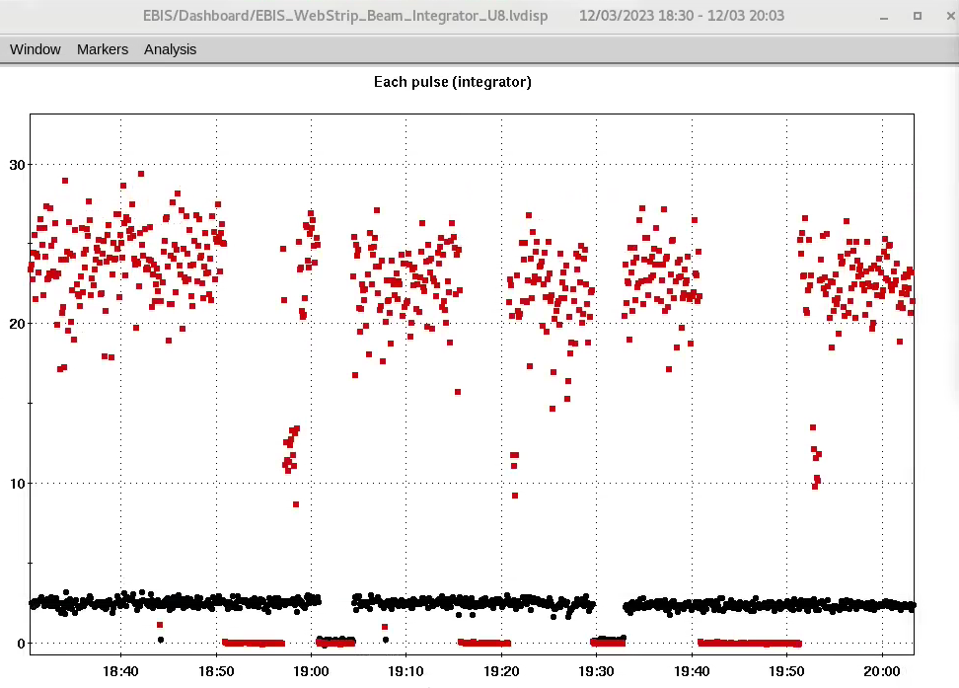
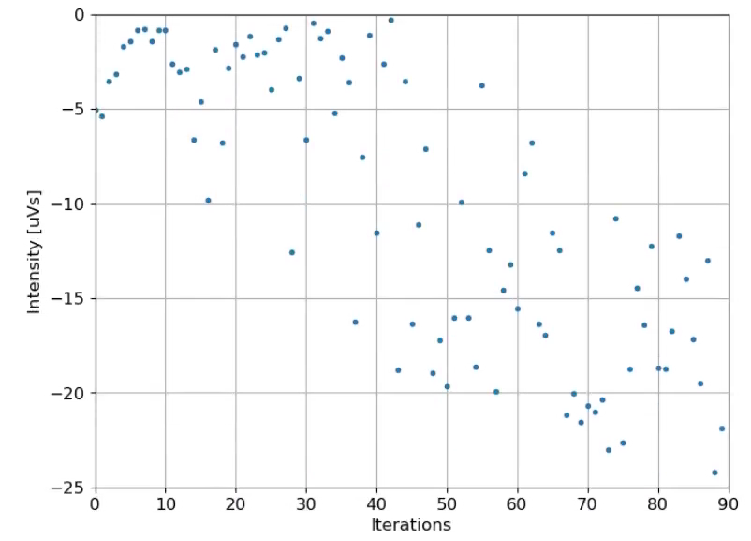
2) GPTune: EBIS Injection + Extraction (19 parameters)
Continue to optimize the total 19 parameters simultaneously AFTER optimizing the injection and extraction separately.
Fc96 was used. After optimization, the results were compared via reversing their corresponding settings.
Original setting: 22 [uVs]
80-iterations setting: 23 [uVs]
90-iterations setting: 23.56 [uVs] (7%)
1.07×1.22 ~ 1.30 ?
90 iterations
Original
80 iterations
Beam Intensity [uVs]
Time

Slide 14
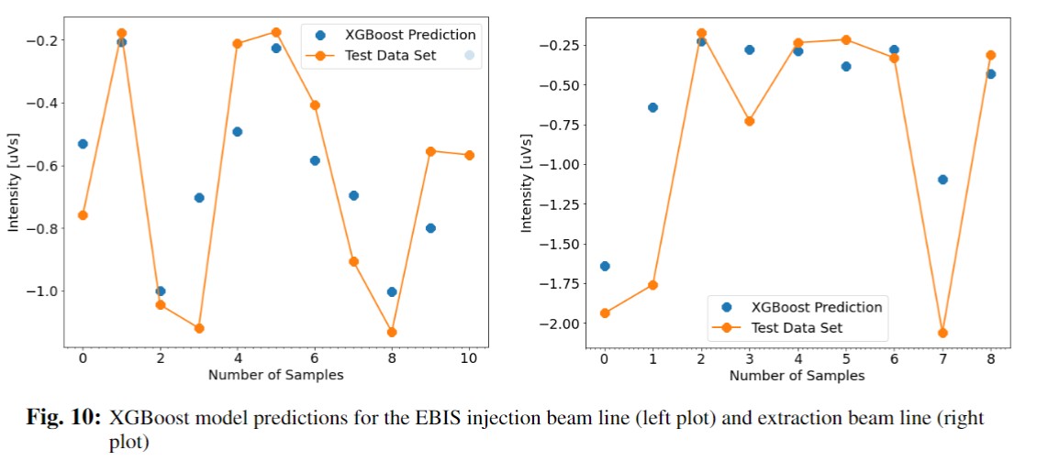
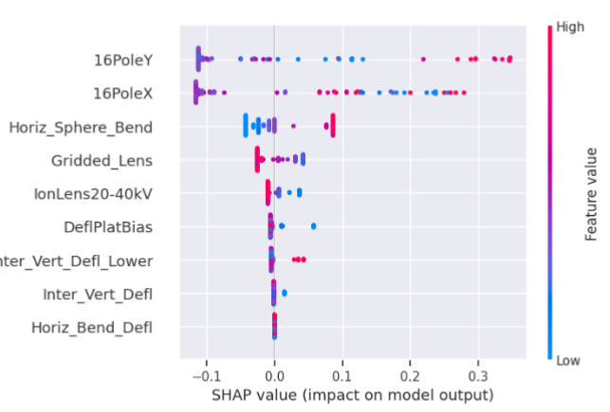
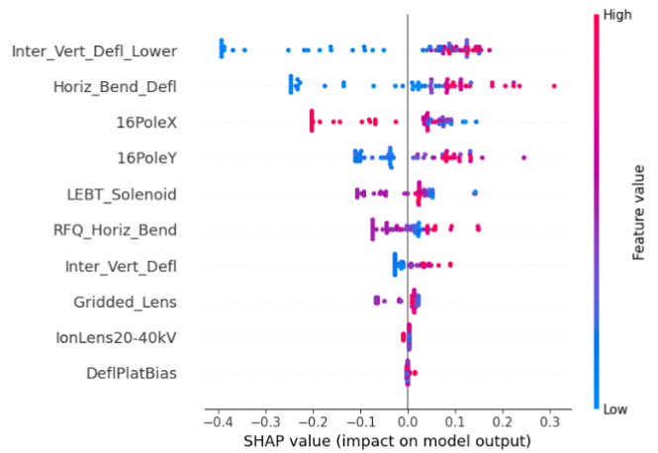
2) Offline XGBoost Model and Important Features
Motivations (guide operation):
Find some most important parameters
Find their operation range.
Explore different operation region.
XGBoost python package:
Multi-dimensions nonlinear regression algorithm: good for f(x1,x2,x3, … , xn) with n>3 or 4. (Higgs Machine Learning Challenge)
The black-box model: 80% data for training, 20% data for test and comparison
How to explanate the black-box model?
SHAP python package:
an approach to explain the output of any machine learning black-box model via calculating their Shapley values (marginal effect), which are their contributions to the total luminosity.
Separate the individual effect.
The models achieved scores of 79% and 80% for the injection and extraction beam lines.
Important Parameters

Slide 15
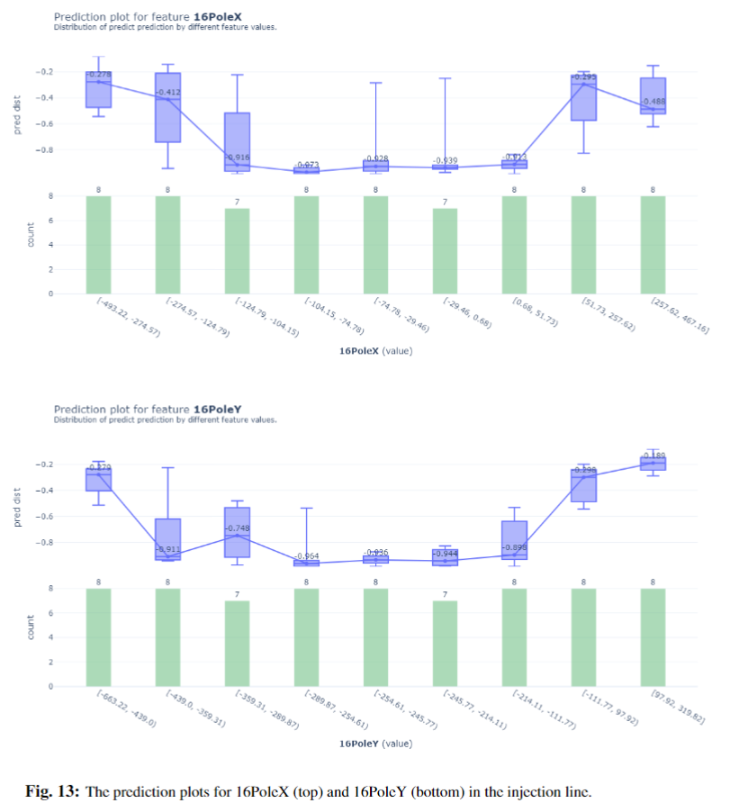
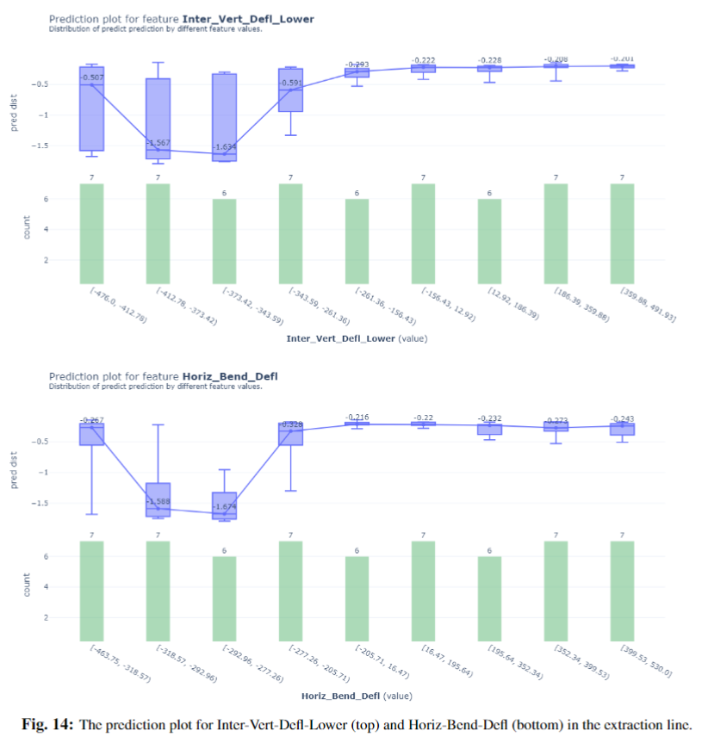
2) SHAP Plot: Prediction for Operation Range
Operation range
Explore range?!

Slide 16
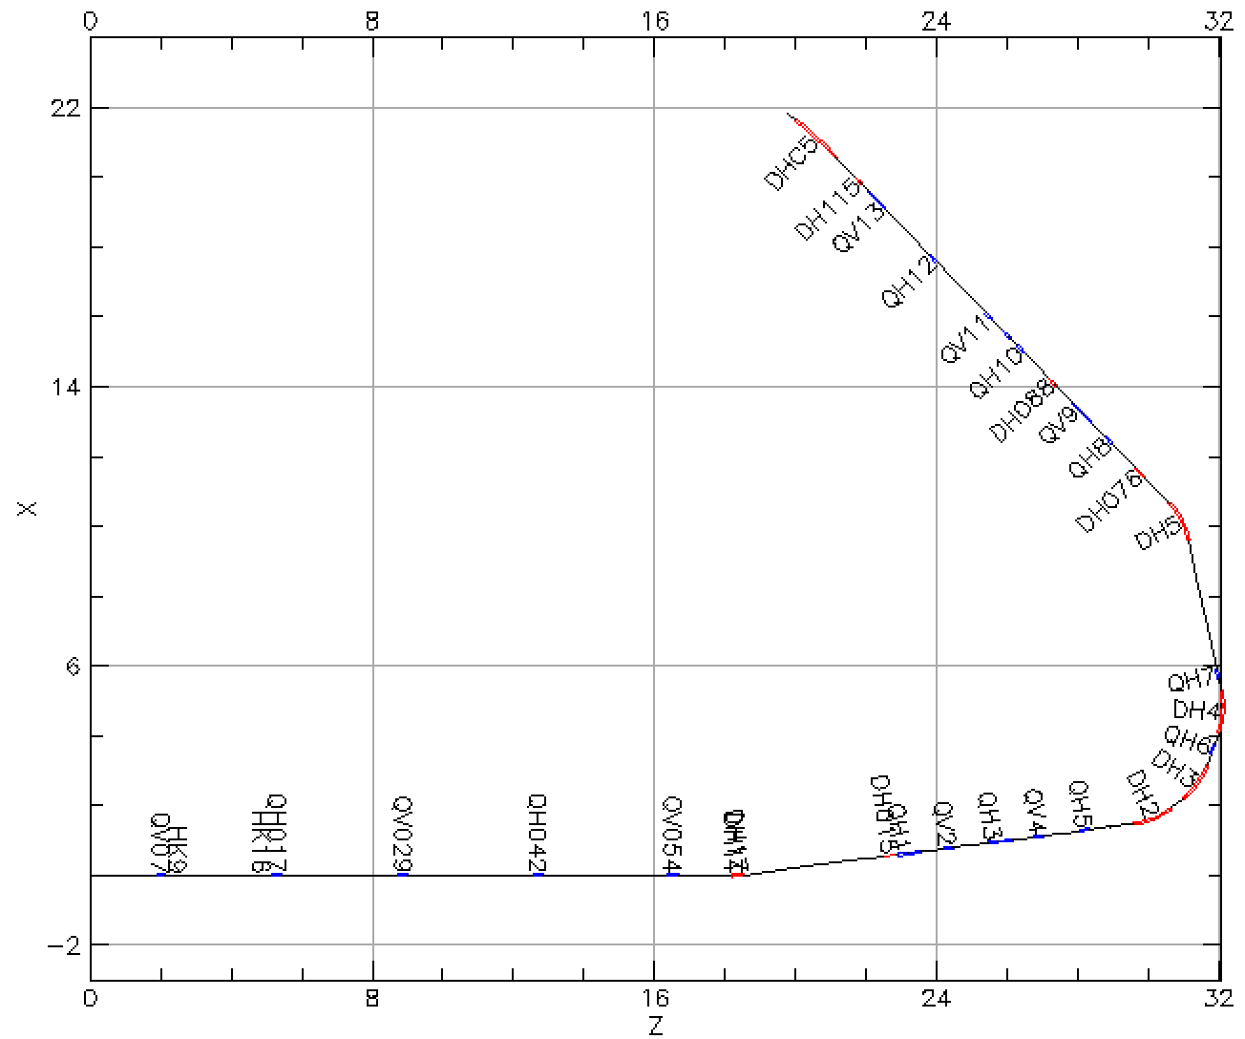
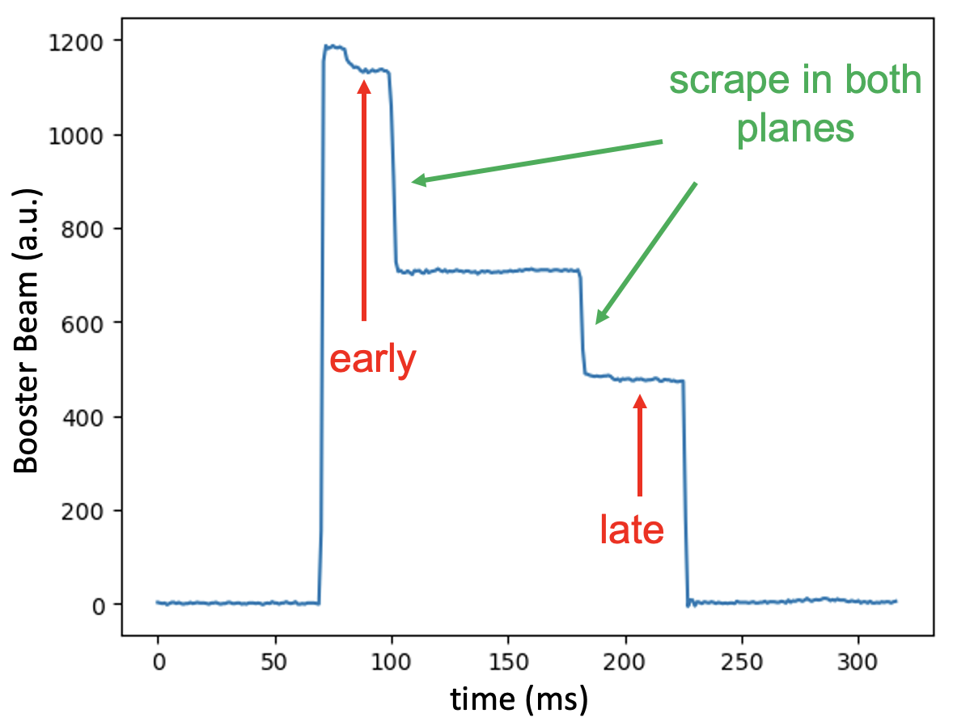
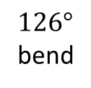
2) Xopt: Linac to Booster
To Booster
$126°$
bend
From Linac
Booster injection process sets maximum beam brightness for rest of acceleration through RHIC
Known emittance effect on polarization loss
Intentional horizontal and vertical scraping reduce emittance to RHIC requirements
Goal: minimize emittance / maximize beam intensity after scraping
Controls: Linac to Booster (LtB) transfer line optics
Method: Bayesian optimization (BO)
Lucy Lin

Slide 17
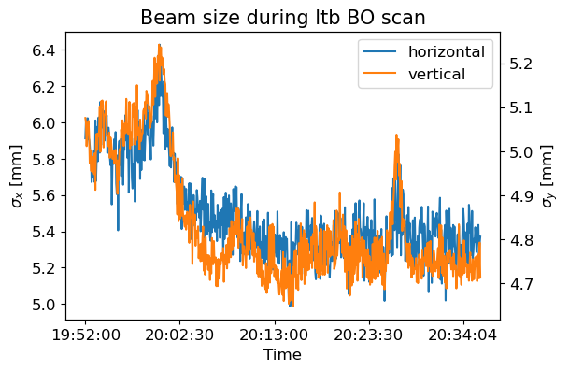
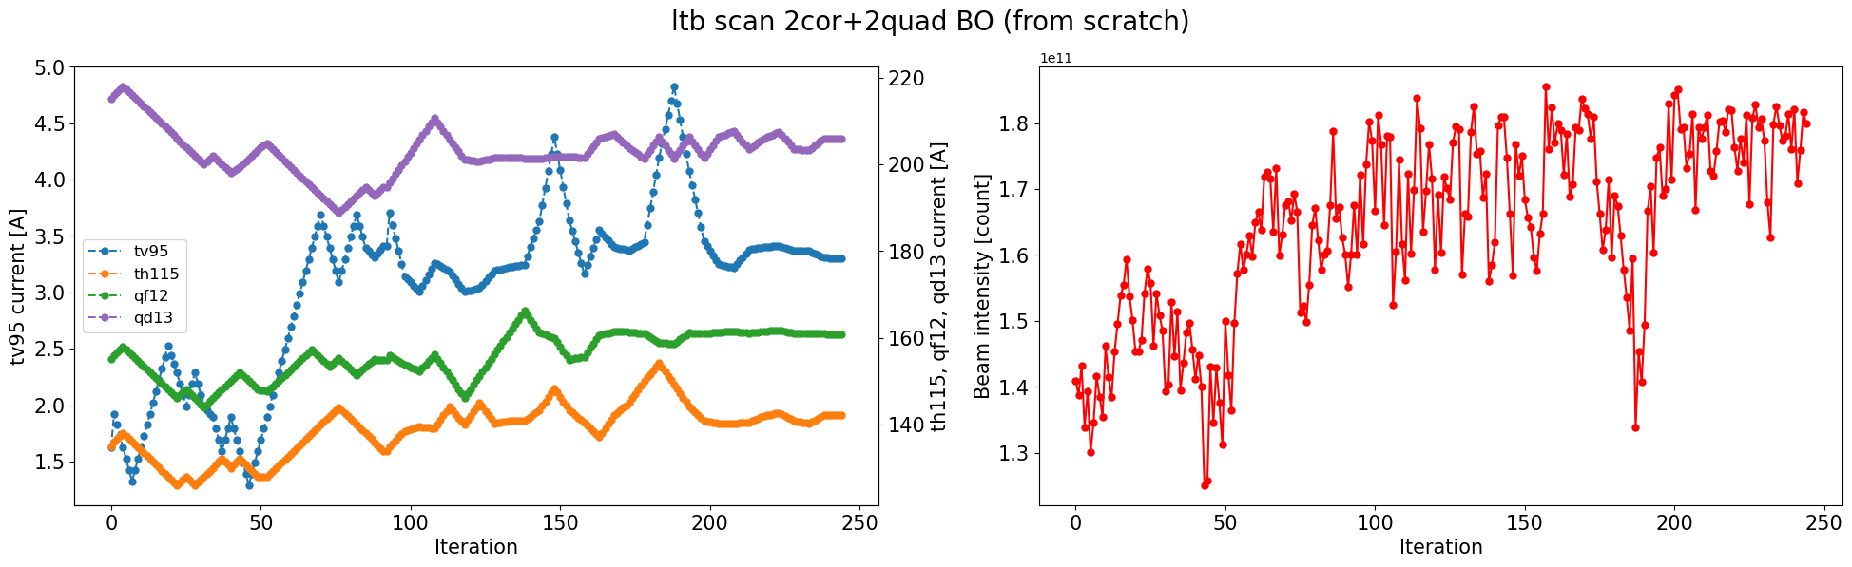
2) Xopt: Linac to Booster (03/04/2024)
Controls: Power supply currents of 2 correctors and 2 quadrupoles at the end of the LtB line
Beam size decrease in both planes in the BtA line in correspondence with intensity increase
Lucy Lin

Slide 18
Outline:
Motivation and Methods
  Motivation
  Methods
RHIC Complex Beam Optimization
  EBIS (GPTune)
  LTB (Xopt)
Luminosity Optimization
  LEReC (XGBoost)
  sPHINEX (GPTune)
Plan & Summary

Slide 19
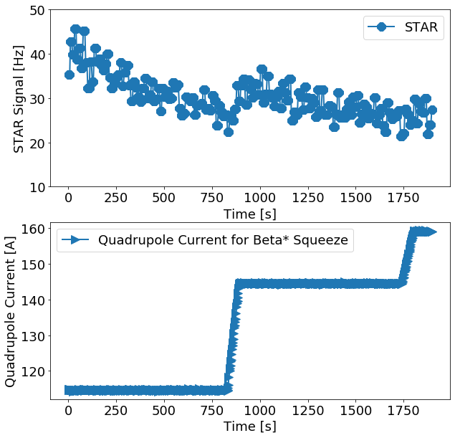
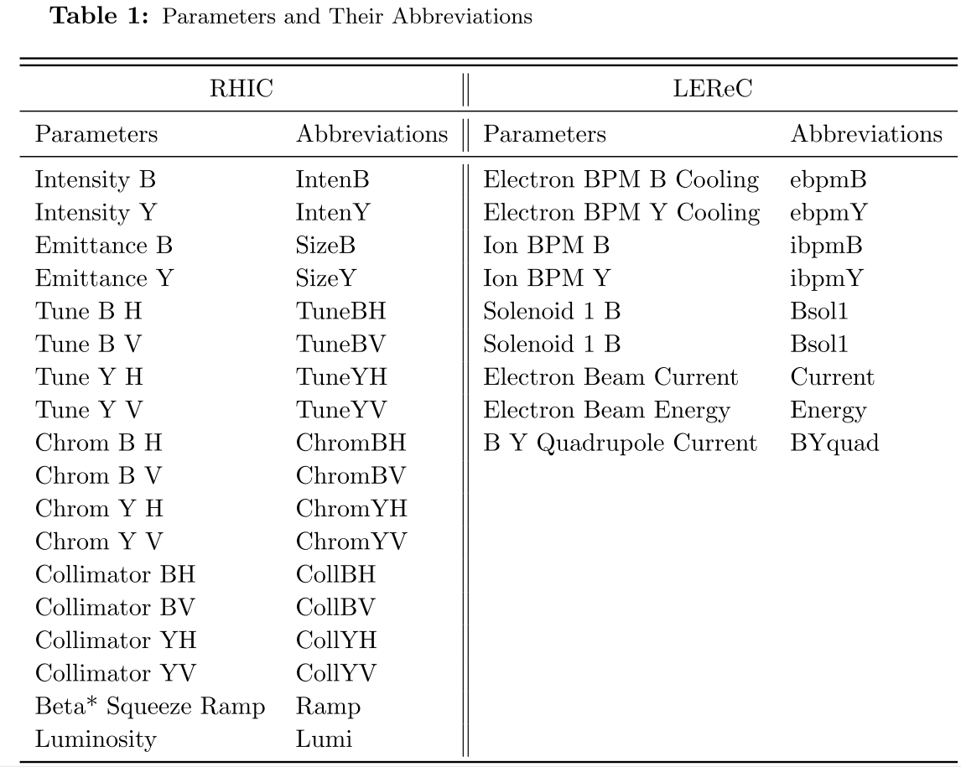
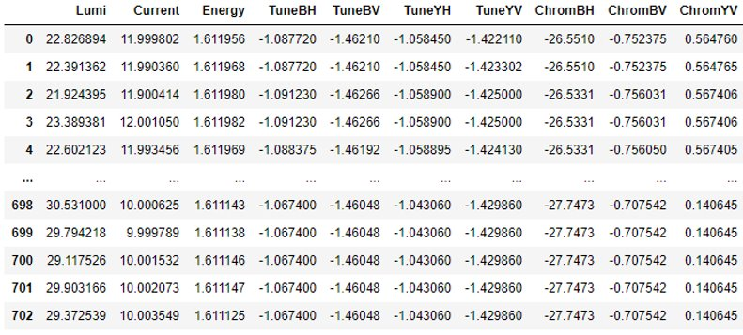
3) RHIC Parameters and LEReC Parameters
26 input parameters
1 output parameter
703 useful stores
Data Table
Trigger rate [Hz]

Slide 20
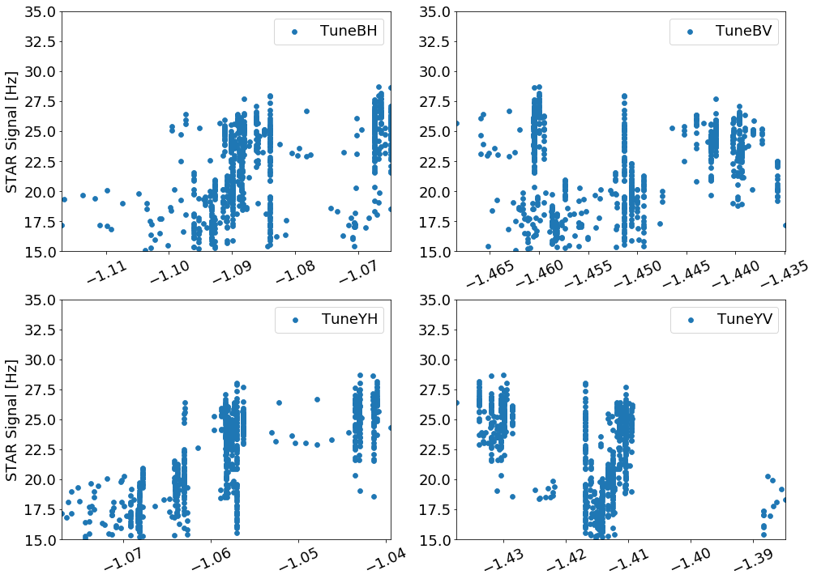
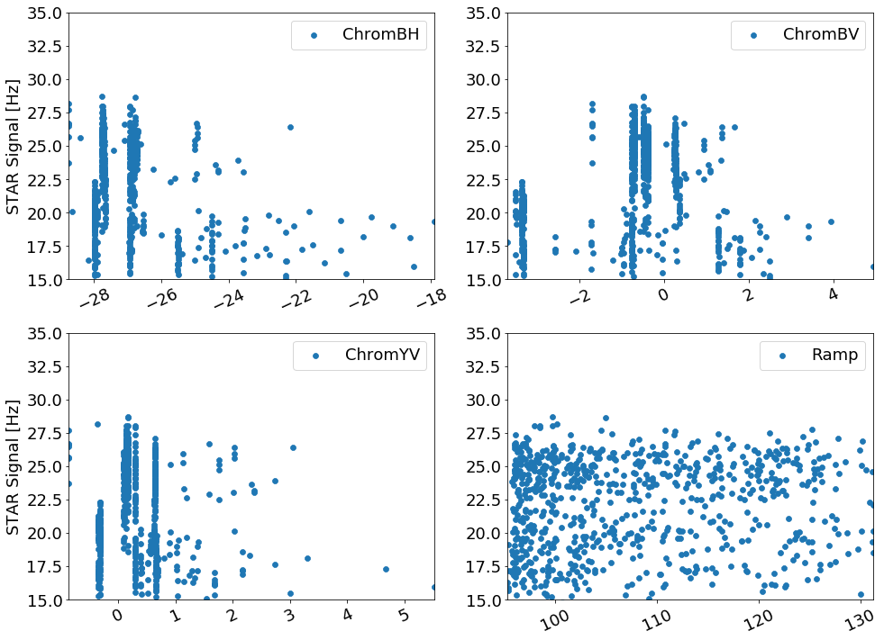
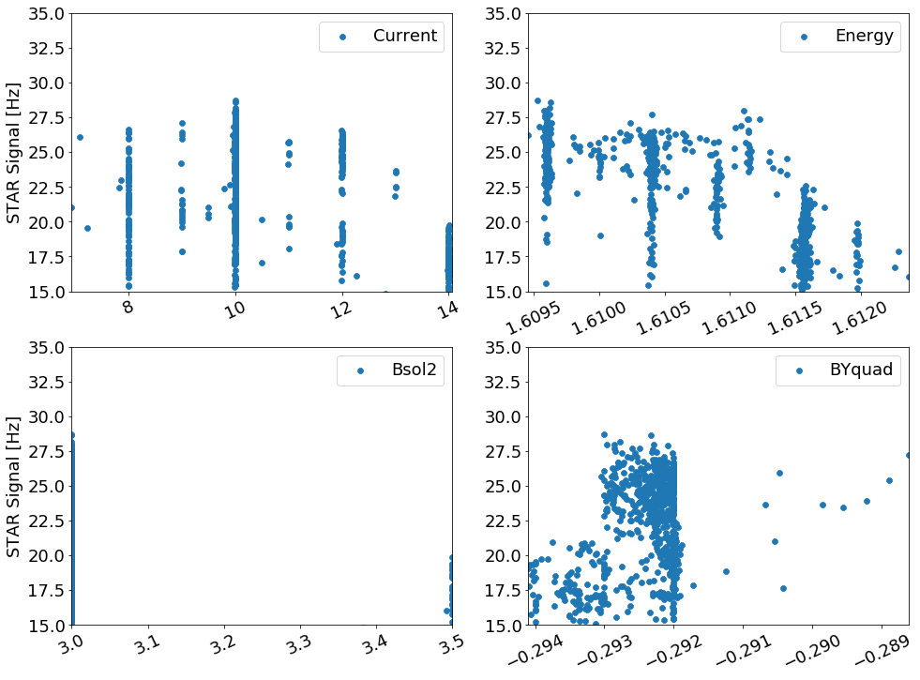
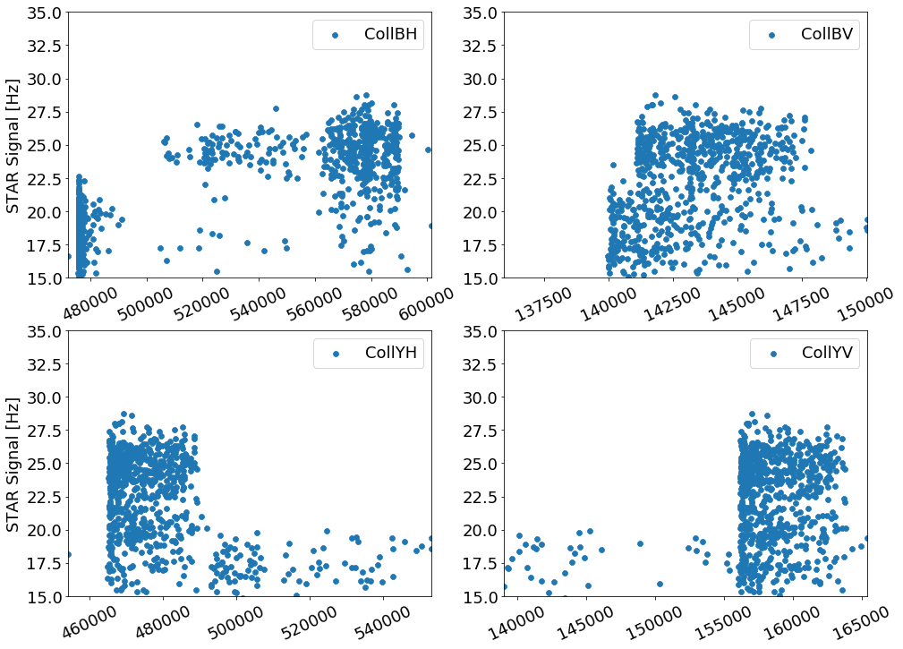
3) Luminosity as function of parameters
No clear message for most parameters. Their contributions the Lumi are mixed.
To decouple the correlation or separate the effects from each other.
Machine learning may help.
Tune
Chrom
LEReC
Collimators

Slide 21
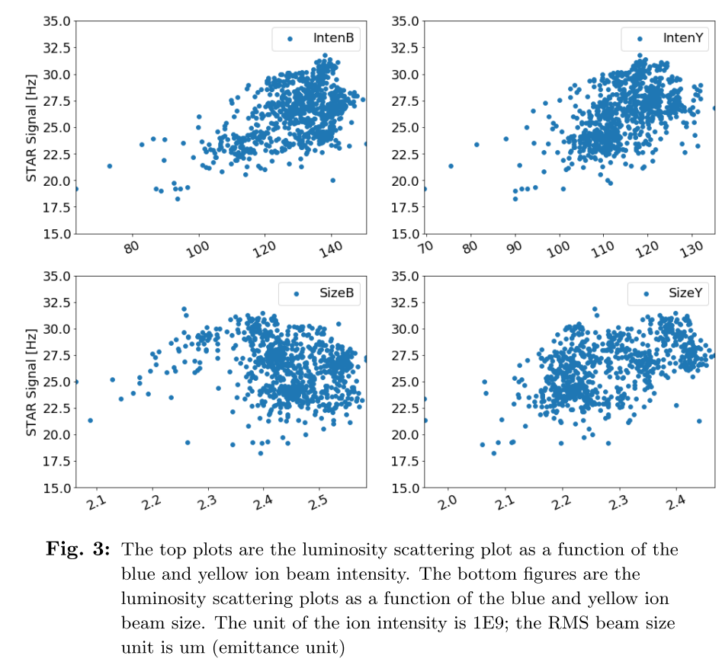
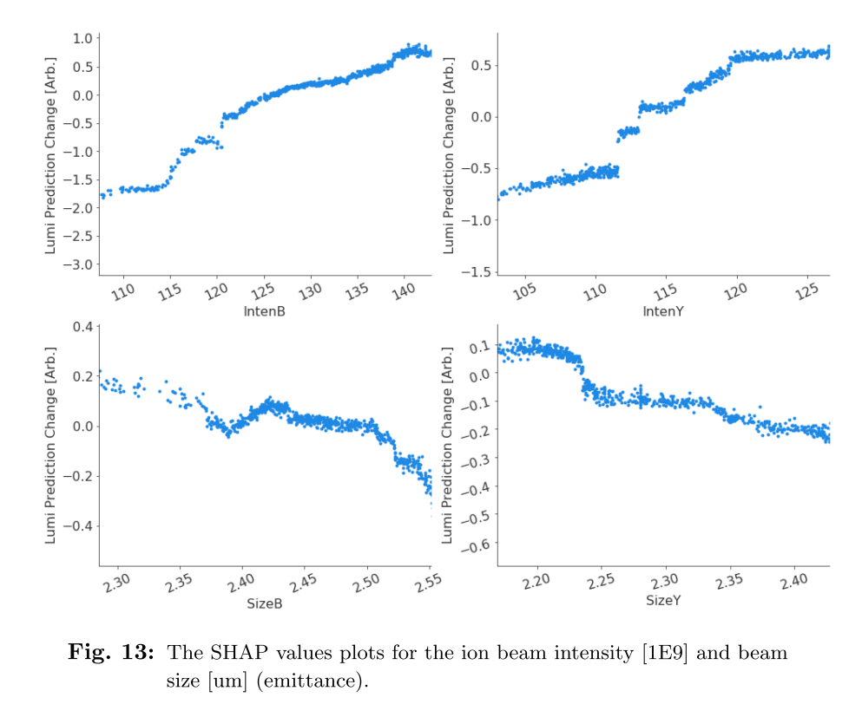
3) Validated XGBooster Model with 2020 Run data
Lumi (x1,x2,x3,….)
Lumi_SHAP (x1)
Not clear.
Doesn't agree with the theory​
Clear trend and they both agree with the theory.
It makes sense now (within the existing data range).

Slide 22
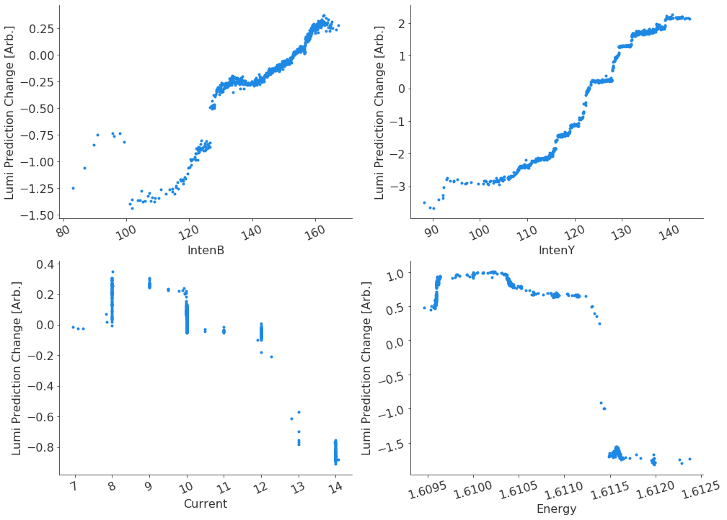
3) Offline Evaluate 2021 Operation data with XGBoost
Intensity: IntenY ~ 5 Hz, IntenB ~ 2 Hz; higher blue beam loss?
Current: 1 Hz, more data points (6A) to confirm the optimized value.
TuneYH and TuneBV
IntenB
IntenY
Tunes
LEReC Energy
LEReC Current

Slide 23
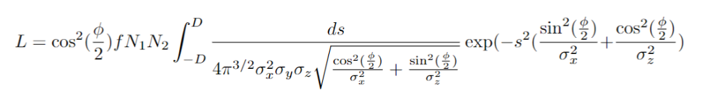
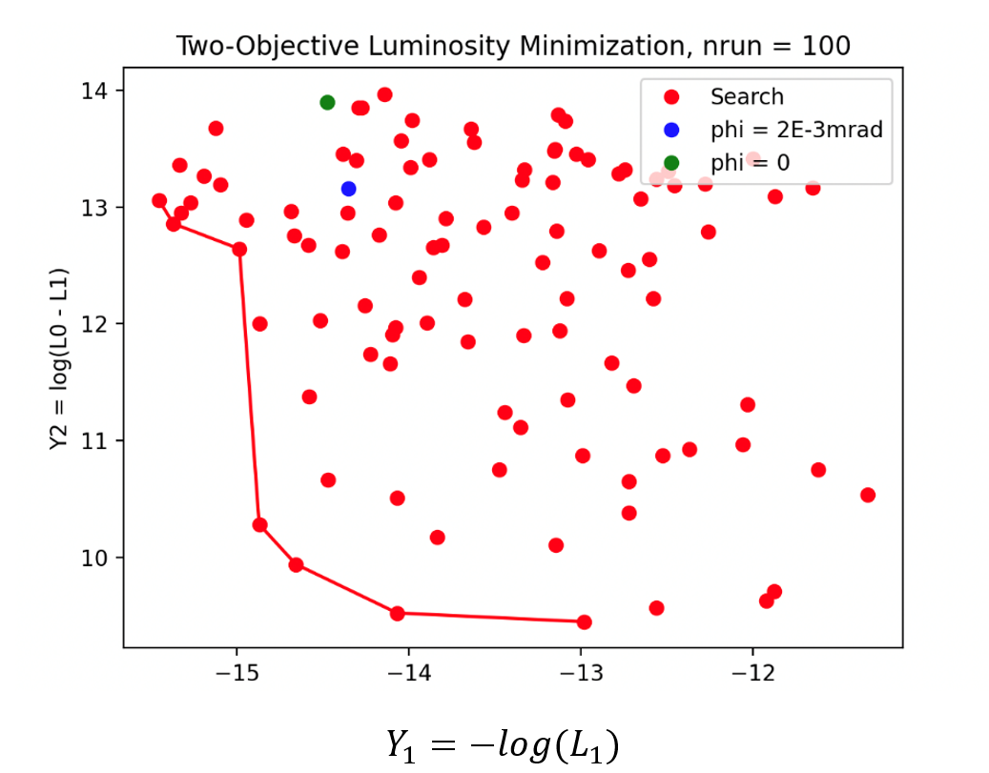
3) GPTune Luminosity Optimization-Analytical Model
Maximize
Unwanted Lumi
minimize
Unwanted
Vertex signal (±10cm)
The value of the objective function is minimized.

Slide 24
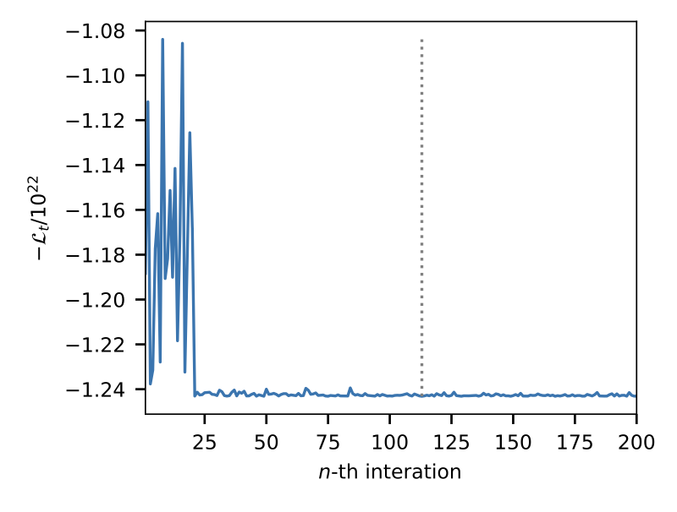
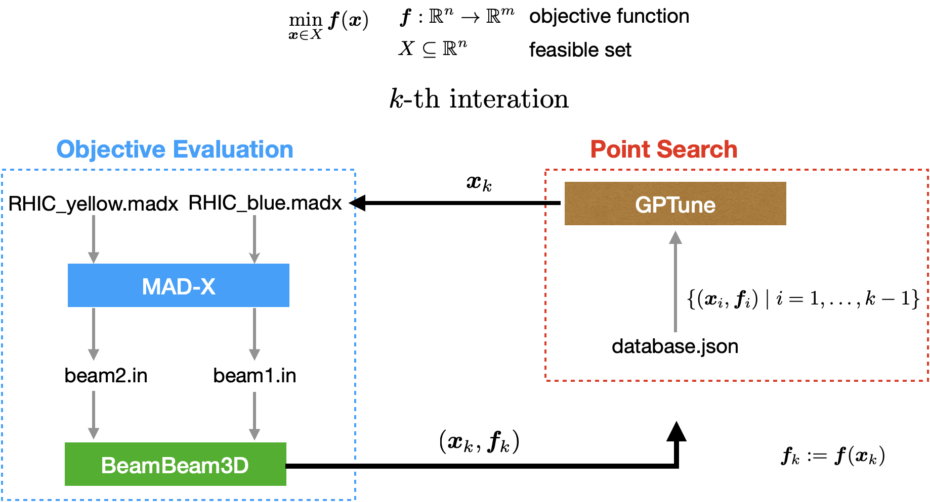
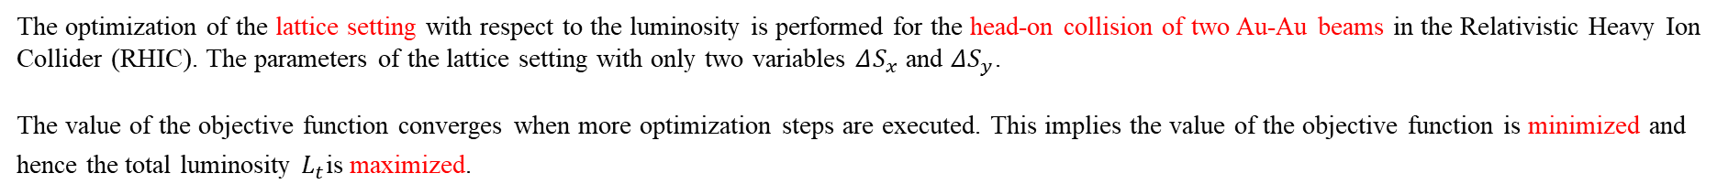
3) GPTune Luminosity Optimization-Simulation
The value of the objective function is minimized
The optimization of the lattice setting with respect to the luminosity is performed for the head-on collision of two Au-Au beams in the Relativistic Heavy Ion Collider (RHIC). The parameters of the lattice setting with only two variables $ΔS_{x}$ and $ΔS_{y}$.
The value of the objective function converges when more optimization steps are executed. This implies the value of the objective function is minimized and hence the total luminosity $L_{t}$is maximized.

Slide 25
3) GPTune luminosity Optimization sPHENIX
Global Parameters:
Orbit (Dipole)
Tune (Quadrupole),
Chromaticity (Sextuple)
Octupole
Local (IR8) Parameters:
Beta* (beam size)
S* (longitudinal beam waist)
Transverse offset
Other Parameters:
RF Voltage
Collimator Position
Machine
parameters
Luminosity Measurement
Optimization method
MVTX
ZDC
GPTune
S*
S* and beta* changing scripts: 2023
change the target s*, beta* within ‘deltas.dat’ file;
run ‘madx job.madx’ command, will get ‘IP8knob.dat’ file;
run ‘CreateSend.IP8’ command, will get ‘SendTrim.IP8’ file;
run ‘SendTrim.IP8’ command.
GPTune: 2023
Installed and tested
Did some optimizations EBIS and got some good results.
sPHENIX (OFF):
max. MVTX (+/-10 cm)
min. unwanted signal
Crossing angle (2mrad)
ZDC rate
Optimization Loop: May, 2024

Slide 26
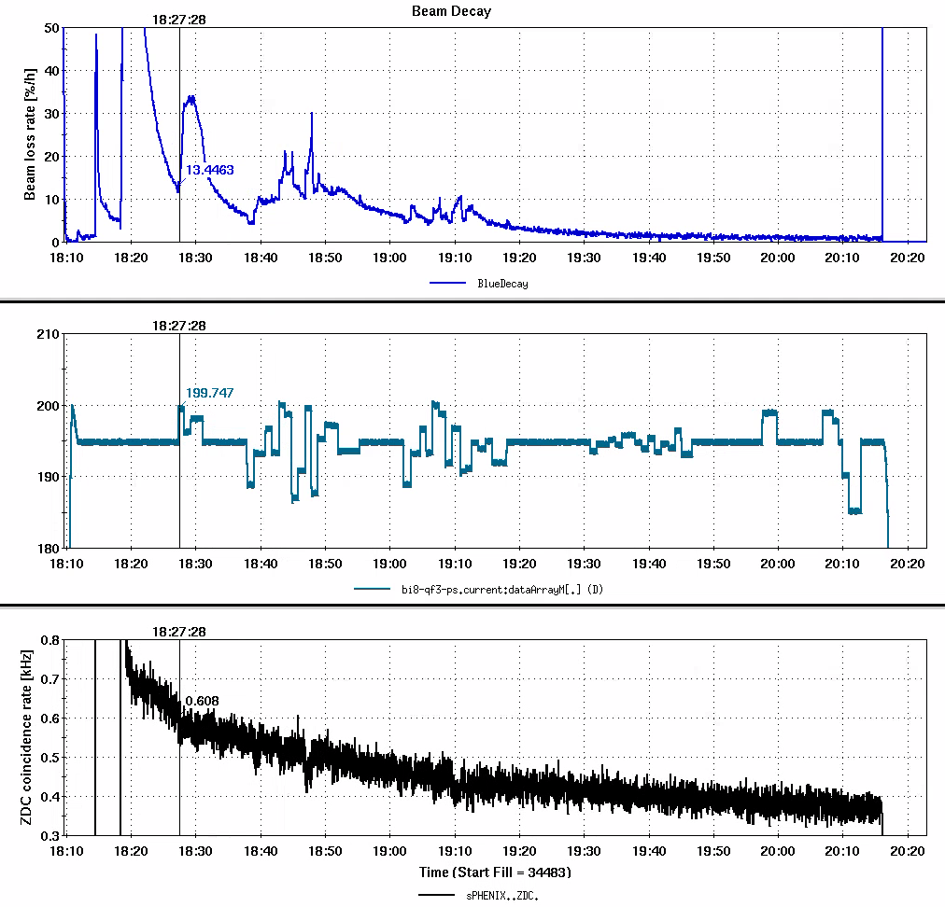
3) The First sPhenix ZDC GPTune Optimization 05/16/2024
S*: +/-0.5 m without decay compensation
S*: +/-0.5 m; +/-0.1 m.
S*(x plane): 0.74-0.76m; 0.8m->0.4m->0m->-0.4m->-0.8m.
S* > 0.8 m, MADX didn’t find solutions.
Blue Beam Loss
+/-0.5 m
+/-0.5 m
+/-0.1 m
0.74-0.76m
Beam loss is acceptable.
ZDC rate was changed. Didn’t see any visible improvement with ± 10% pp noise.
With +/- 0.8m, it is expected 17% change for ZDC rate.
GPTune works with std ±10% (pp) noisy signals ±15%!
GPTune Signal
0.8 to -0.8m
sPhenix ZDC rate

Slide 27
3) Reasons and Plan for Luminosity Optimization
S* control:
Base line: s*x = 1.19m, s*y = 0.67m
Move s*x -> -0.5 m: s*x = 1.14m, s*y = 0.01
Move s*x -> 0.5 m: s*x = 0.74m, s*y = 0.35
S* Measurement: lattice and real machine
Magnet hysteresis: Same current can have different field (up or down ramp)
Too large beam size: the emittance was 3~4 higher than nominal.
Optimal S* already: is very closed to its optimal and don’t need to do anything!
More than 20 times luminosity now.
S* measurement to confirm
Using Power supplies instead of S*
Control Power supplies only ramp to one direction
Improve Emittance: Done
Explore other control parameters?
Optimize Luminosity vs Reduce background?
sPHENIX detector or MVTX signal were OFF.
Orbit Tune feedback
Global Parameters:
Orbit (Dipole)
Tune (Quadrupole),
Chromaticity (Sextuple)
Octupole
Local (IR8) Parameters:
Beta* (beam size)
S* (longitudinal beam waist)
Transverse offset
Other Parameters:
RF Voltage
Collimator Position

Slide 28
Outline:
Motivation
EBIS Intensity Optimization
Luminosity Optimization
Plan & Summary

Slide 29
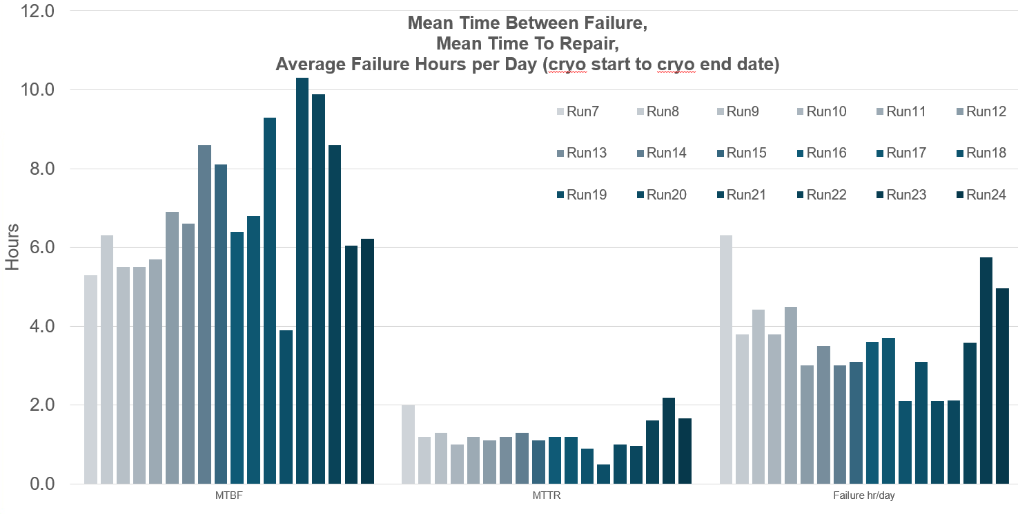
4) Plan
AGS injection
NSRL: target beam line
Proton Beam Source: OPPIS
Tandem beam line
RHIC coupling
Machine anomaly detection

Slide 30
4) Summary
GPTune was used for EBIS intensity optimization and got 22~30% intensity improvement at xf14 CT (70% with fc96 CT) , with ±10% std noisy signals and 19 variables.
Xopt has been used for LTB and can optimize beam size and intensity at the same time
The luminosity optimization with sPHENIX ZDC has been carried out for the first time. More APEX time is required to confirm the results or optimize the integral luminosity with more/different parameters.
GPTune/Xopt has been demonstrated as a powerful tool for optimization. It is planned to be used for other beam lines (intensity, emittance and polarization) optimization in RHIC complex.
XGBoost is a good tool for offline machine optimization.

Slide 31
Acknowledgement
R. Guillaume
T. Kanesue
M. Okamura
J. Morris
Greg

