Slide 1
Beam-beam effects in EIC electron coolers
S. Seletskiy (for C-AD cooling group)
Brookhaven National Laboratory
Presented at ICFA workshop: Beam-Beam Effects in Circular Colliders BB24
September 2-5, 2024

Slide 2
Beam-beam in Electron Ion Collider (EIC)
There is the beam-beam effect from the colliding beams
Also, EIC employs cooling of hadrons, both at the injection energy (pre-cooler) and at the top energy (high energy cooler).
In the coolers bunches of electrons co-travel with hadrons. The focusing effect from electrons on hadrons (and vice-versa for a proposed ring cooler) is non-negligible.
There is the beam-beam effect in the pre-cooler
There is the beam-beam effect in the high energy cooler
2

Slide 3
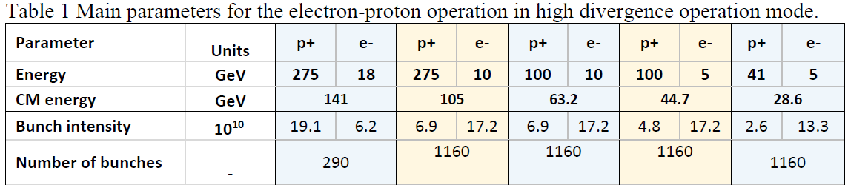
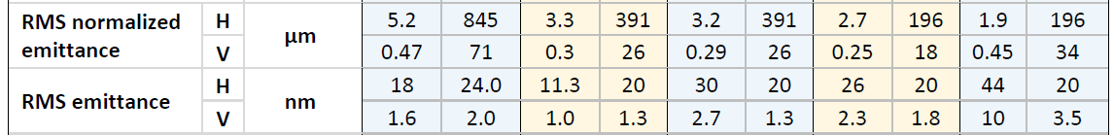
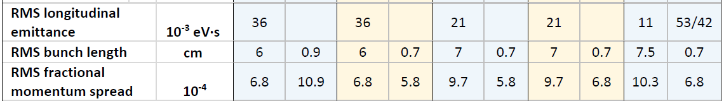
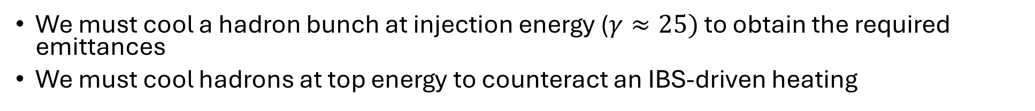
Why does Electron Ion Collider need coolers?
We need to achieve and maintain optimal hadron emittances at the collision energy
We must cool a hadron bunch at injection energy ($γ≈25)$ to obtain the required emittances
We must cool hadrons at top energy to counteract an IBS-driven heating
3

Slide 4
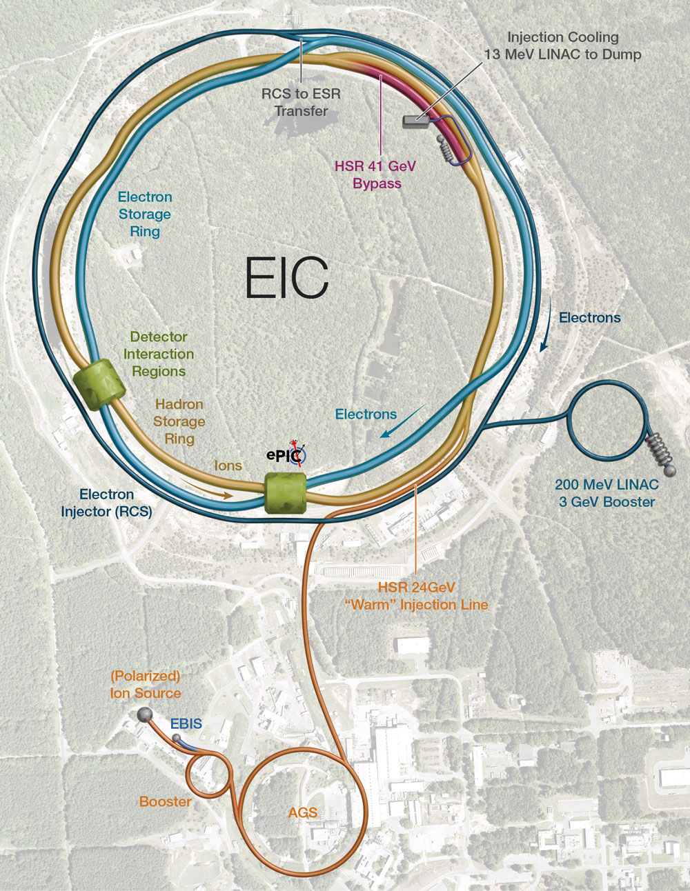
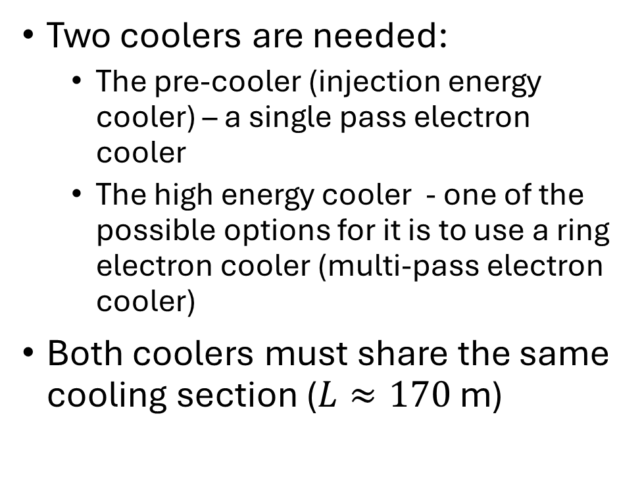
EIC layout
Two coolers are needed:
  The pre-cooler (injection energy cooler) – a single pass electron cooler
  The high energy cooler - one of the possible options for it is to use a ring electron cooler (multi-pass electron cooler)
Both coolers must share the same cooling section ($L≈170$ m)
4

Slide 5
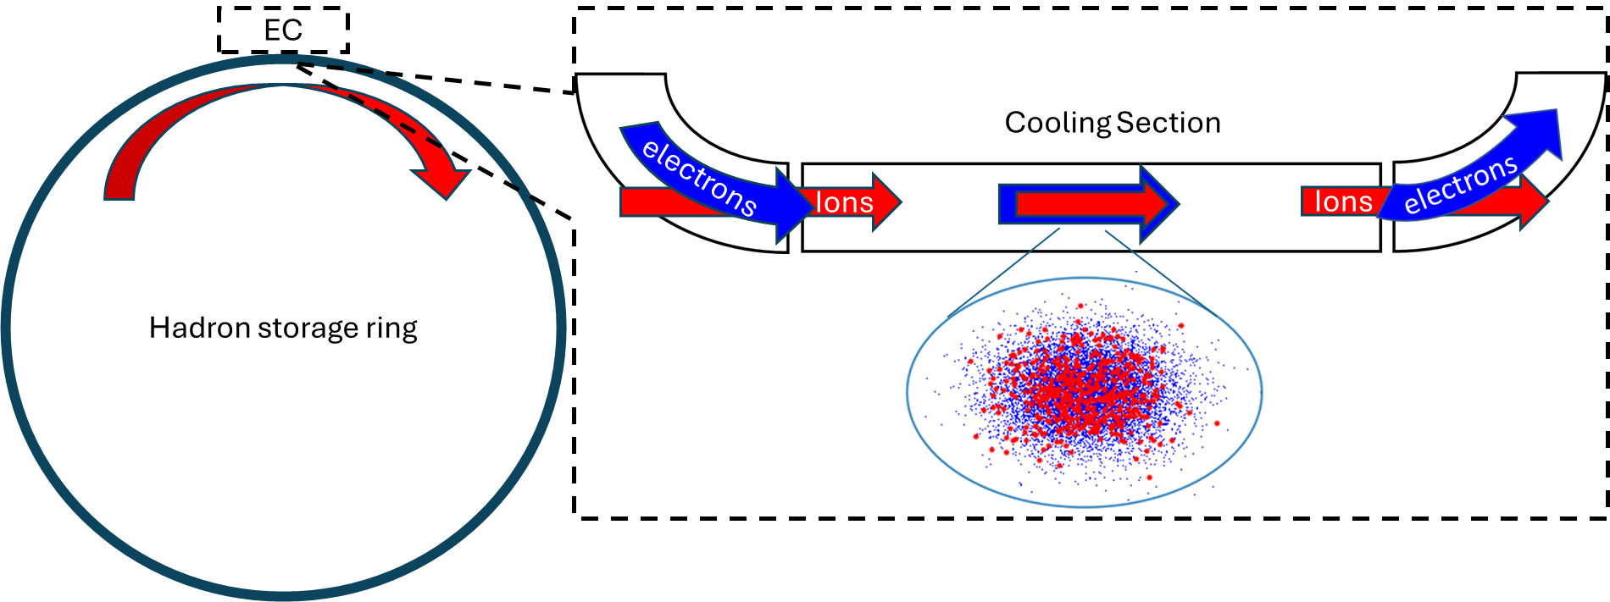
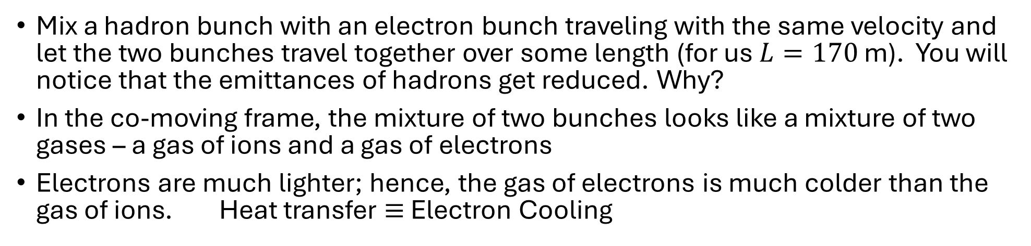
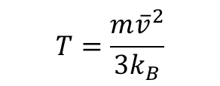
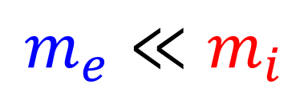
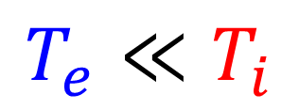
How electron cooling works
Mix a hadron bunch with an electron bunch traveling with the same velocity and let the two bunches travel together over some length (for us $L=170$ m). You will notice that the emittances of hadrons get reduced. Why?
In the co-moving frame, the mixture of two bunches looks like a mixture of two gases – a gas of ions and a gas of electrons
Electrons are much lighter; hence, the gas of electrons is much colder than the gas of ions. Heat transfer $≡$ Electron Cooling
$$m_{e}≪m_{i}$$
$$T=\frac{m{\overline{v}}^{2}}{3k_{B}}$$
$$T_{e}≪T_{i}$$
5

Slide 6
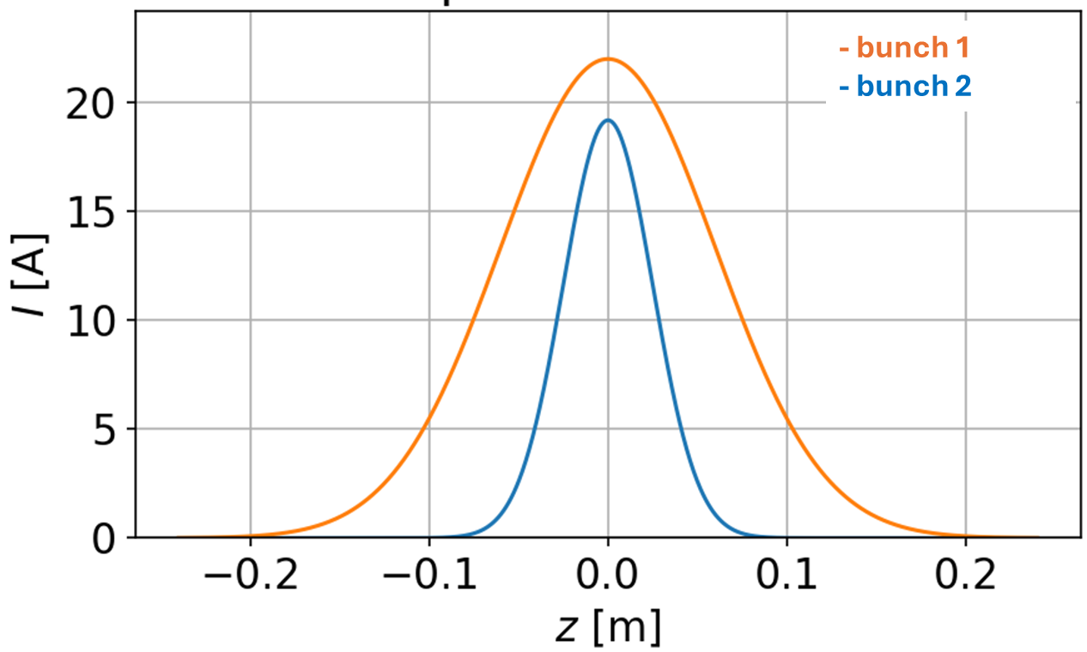

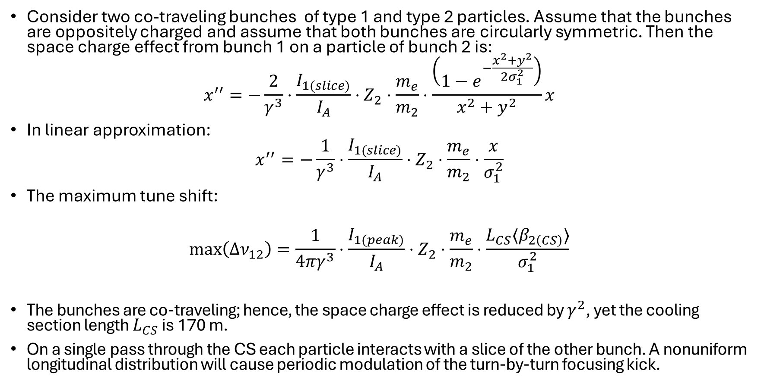


Beam-beam effect in electron coolers
$$y$$
Consider two co-traveling bunches of type 1 and type 2 particles. Assume that the bunches are oppositely charged and assume that both bunches are circularly symmetric. Then the space charge effect from bunch 1 on a particle of bunch 2 is:
$$x^{′′}=−\frac{2}{γ^{3}}⋅\frac{I_{1(slice)}}{I_{A}}⋅Z_{2}⋅\frac{m_{e}}{m_{2}}⋅\frac{\left(1−e^{−\frac{x^{2}+y^{2}}{2σ_{1}^{2}}}\right)}{x^{2}+y^{2}}x$$
In linear approximation:
$$x^{′′}=−\frac{1}{γ^{3}}⋅\frac{I_{1(slice)}}{I_{A}}⋅Z_{2}⋅\frac{m_{e}}{m_{2}}⋅\frac{x}{σ_{1}^{2}}$$
The maximum tune shift:
$$max\left(Δν_{12}\right)=\frac{1}{4πγ^{3}}⋅\frac{I_{1(peak)}}{I_{A}}⋅Z_{2}⋅\frac{m_{e}}{m_{2}}⋅\frac{L_{CS}⟨β_{2\left(CS\right)}⟩}{σ_{1}^{2}}$$
The bunches are co-traveling; hence, the space charge effect is reduced by $γ^{2}$, yet the cooling section length $L_{CS}$ is 170 m.
On a single pass through the CS each particle interacts with a slice of the other bunch. A nonuniform longitudinal distribution will cause periodic modulation of the turn-by-turn focusing kick.
$$x$$
$I_{1\left(slice\right)}$
6

Slide 7
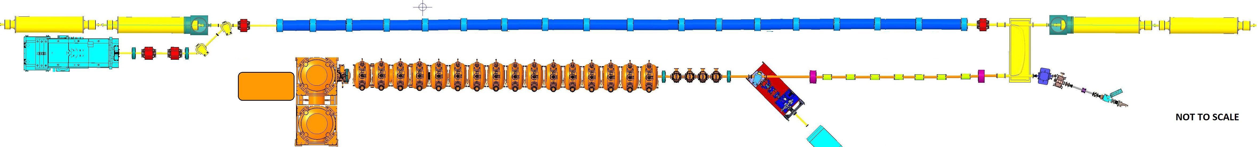
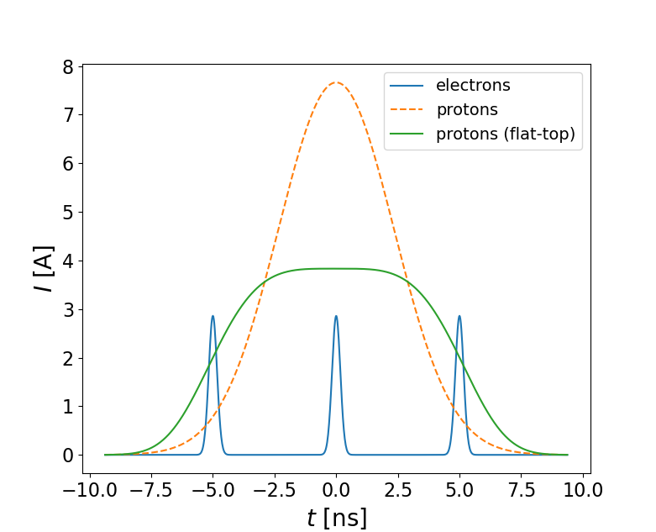
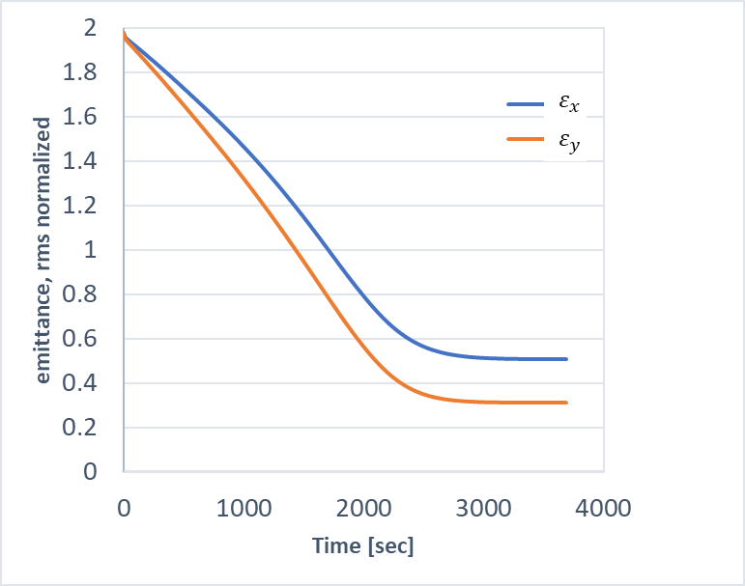


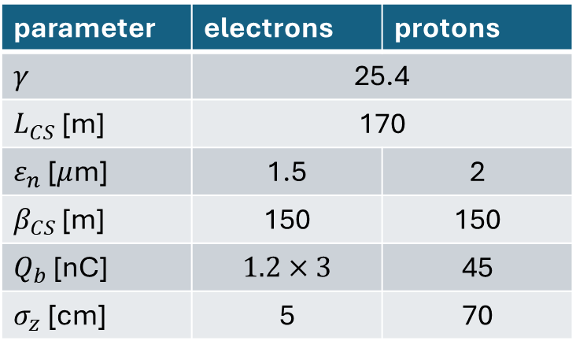




Beam-beam effect in EIC pre-cooler
HSR magnets
$$p$$
Cooling section
HSR magnets
$$e$$
$$p$$
e-beam dump
e-Gun
Linac
$$e$$
parameter | electrons | protons
$γ$ | 25.4
$L_{CS}$ [m] | 170
$ε_{n}$ [$μ$m] | 1.5 | 2
$β_{CS}$ [m] | 150 | 150
$Q_{b}$ [nC] | $$1.2×3$$ | 45
$σ_{z}$ [cm] | 5 | 70
$τ_{cool}≈30$ min
$$Δν_{ep}=1.3⋅{10}^{−3}$$
7

Slide 8
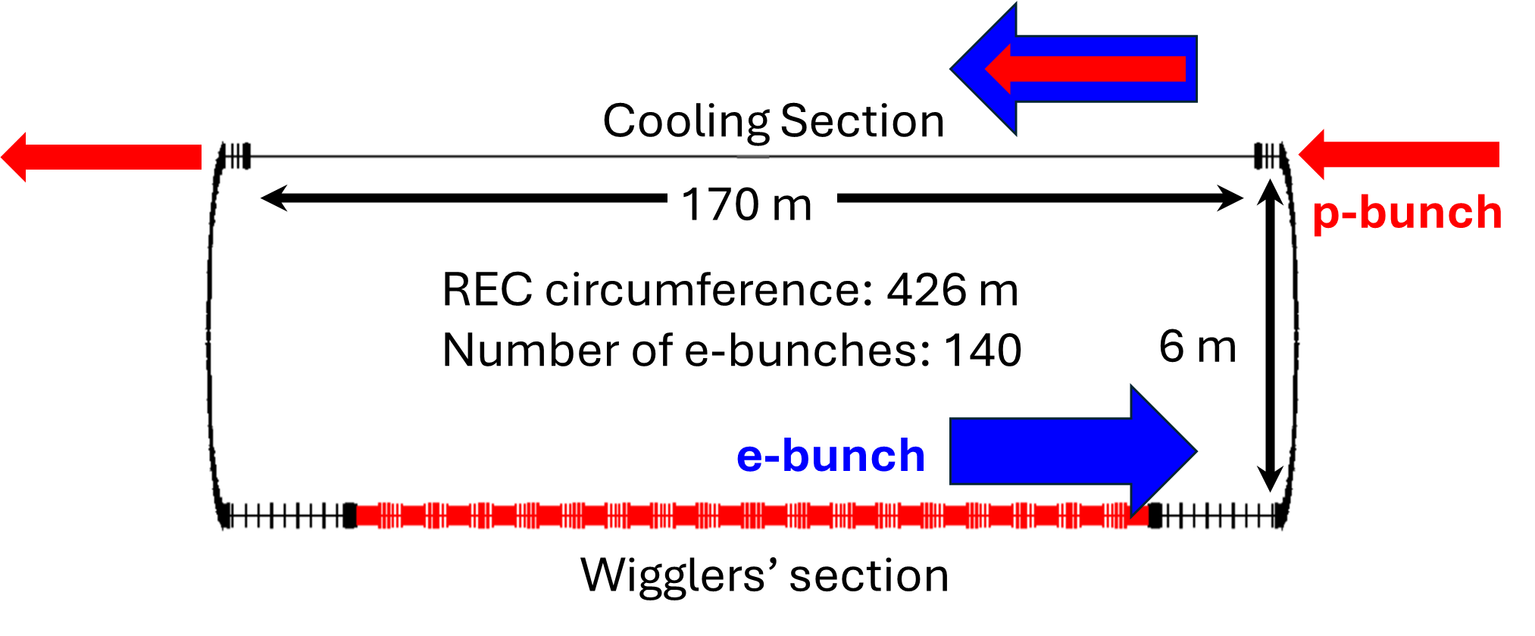
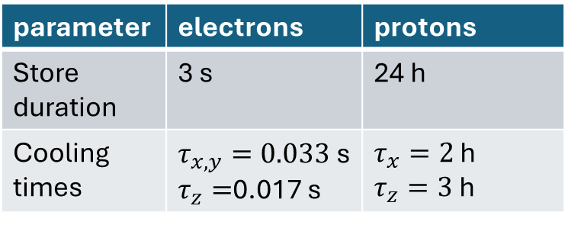
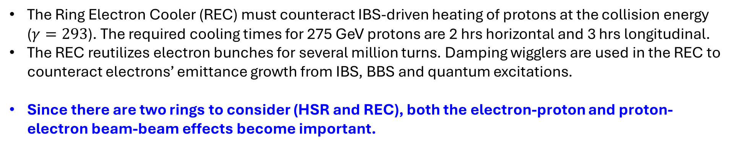
Ring Electron Cooler layout
parameter | electrons | protons
Store duration | 3 s | 24 h
Cooling times | $τ_{x,y}=0.033$ s $τ_{z}=$0.017 s | $τ_{x}=2$ h $τ_{z}=3$ h
The Ring Electron Cooler (REC) must counteract IBS-driven heating of protons at the collision energy ($γ=293$). The required cooling times for 275 GeV protons are 2 hrs horizontal and 3 hrs longitudinal.
The REC reutilizes electron bunches for several million turns. Damping wigglers are used in the REC to counteract electrons’ emittance growth from IBS, BBS and quantum excitations.
Since there are two rings to consider (HSR and REC), both the electron-proton and proton-electron beam-beam effects become important.
8

Slide 9
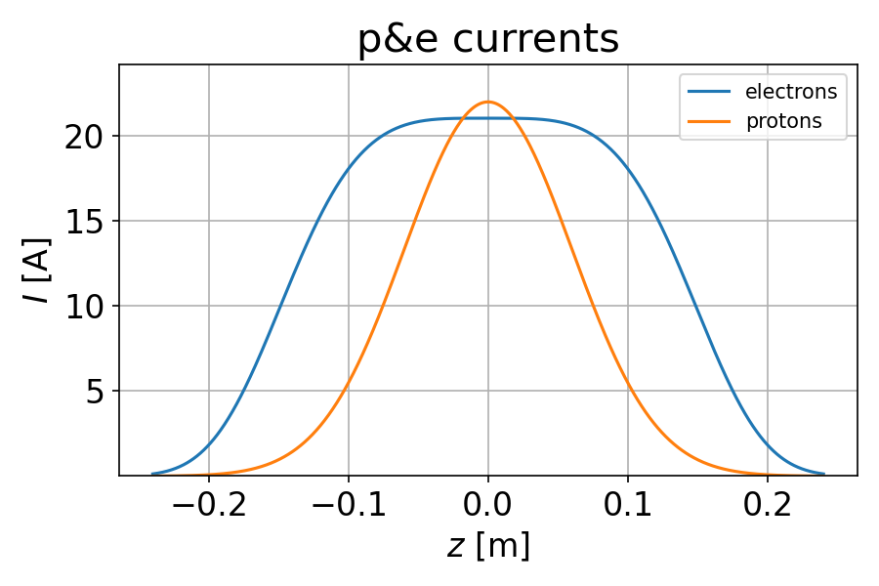
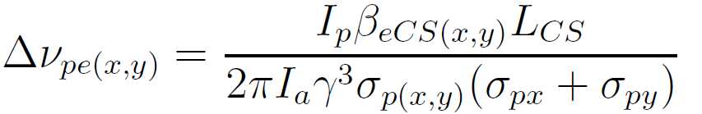

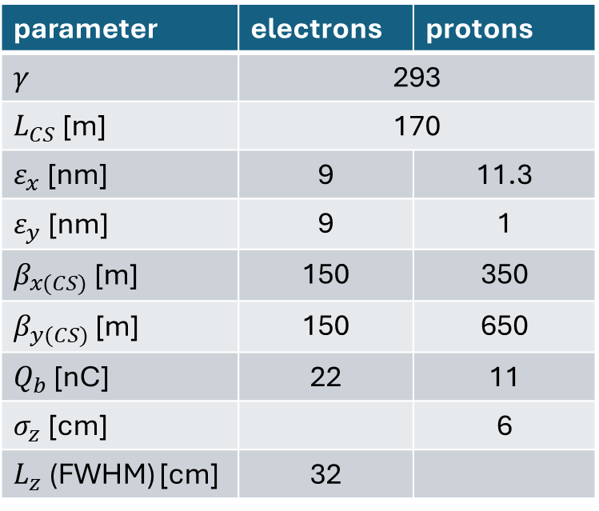



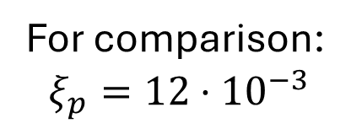
Beam-beam effects in REC
parameter | electrons | protons
$γ$ | 293
$L_{CS}$ [m] | 170
$ε_{x}$ [nm] | 9 | 11.3
$ε_{y}$ [nm] | 9 | 1
$β_{x(CS)}$ [m] | 150 | 350
$β_{y(CS)}$ [m] | 150 | 650
$Q_{b}$ [nC] | 22 | 11
$σ_{z}$ [cm] |  | 6
$L_{z}$ (FWHM) [cm] | 32
$$Δν_{ep(x)}=1⋅{10}^{−4}$$
For comparison:
$$ξ_{p}=12⋅{10}^{−3}$$
$$Δν_{ep(y)}=1.7⋅{10}^{−4}$$
$$Δν_{pe(x)}=0.04$$
$$Δν_{pe(y)}=0.1$$
9

Slide 10
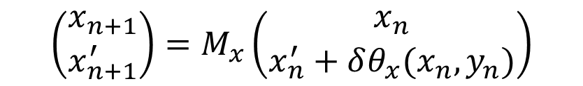
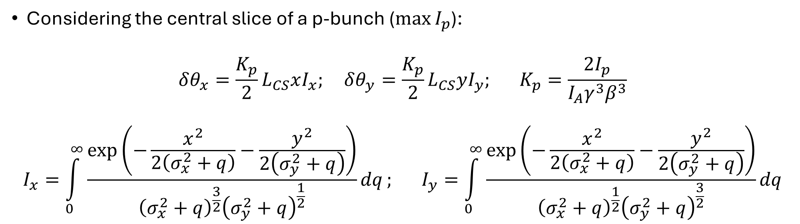
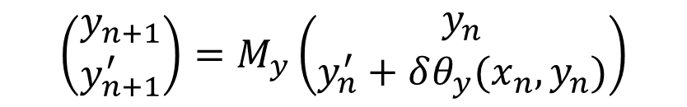
Tracking electrons in REC
Considering the central slice of a p-bunch ($\max{I_{p}}$):
$$δθ_{x}=\frac{K_{p}}{2}L_{CS}xI_{x}; δθ_{y}=\frac{K_{p}}{2}L_{CS}yI_{y}; K_{p}=\frac{2I_{p}}{I_{A}γ^{3}β^{3}}$$
$$I_{x}=\int_{0}^{∞}{\frac{\exp\left(−\frac{x^{2}}{2\left(σ_{x}^{2}+q\right)}−\frac{y^{2}}{2\left(σ_{y}^{2}+q\right)}\right)}{{\left(σ_{x}^{2}+q\right)}^{\frac{3}{2}}{\left(σ_{y}^{2}+q\right)}^{\frac{1}{2}}}dq}; I_{y}=\int_{0}^{∞}{\frac{\exp\left(−\frac{x^{2}}{2\left(σ_{x}^{2}+q\right)}−\frac{y^{2}}{2\left(σ_{y}^{2}+q\right)}\right)}{{\left(σ_{x}^{2}+q\right)}^{\frac{1}{2}}{\left(σ_{y}^{2}+q\right)}^{\frac{3}{2}}}dq}$$
(1)
$$\left(\begin{matrix}x_{n+1} \\ x_{n+1}^{′}\end{matrix}\right)=M_{x}\left(\begin{matrix}x_{n} \\ x_{n}^{′}+δθ_{x}(x_{n},y_{n})\end{matrix}\right)$$
$$\left(\begin{matrix}y_{n+1} \\ y_{n+1}^{′}\end{matrix}\right)=M_{y}\left(\begin{matrix}y_{n} \\ y_{n}^{′}+δθ_{y}(x_{n},y_{n})\end{matrix}\right)$$
10

Slide 11
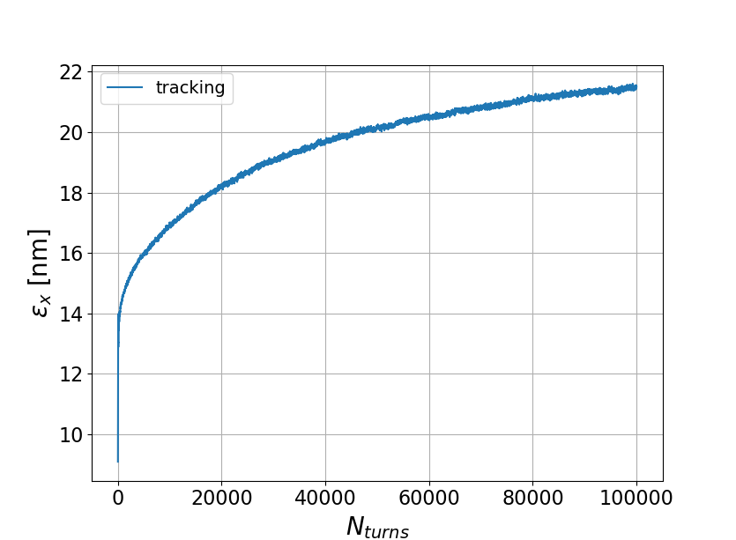
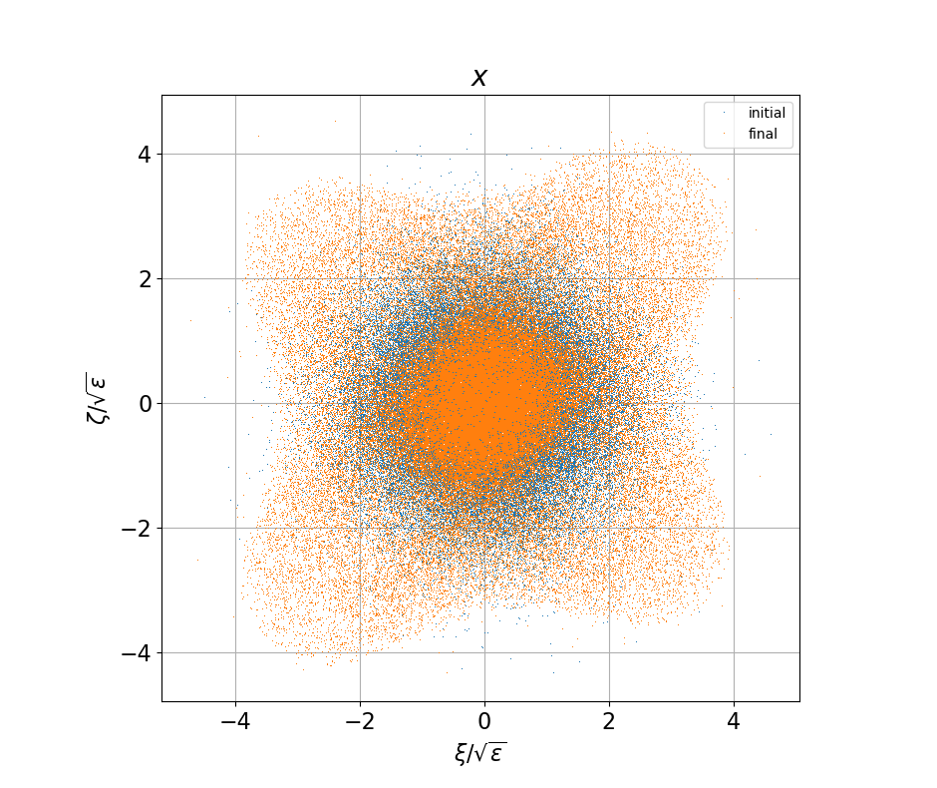
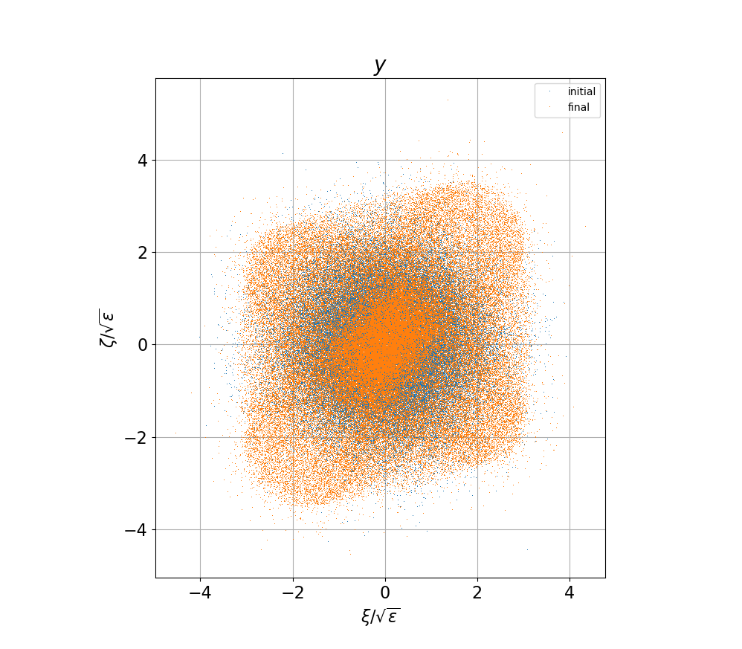
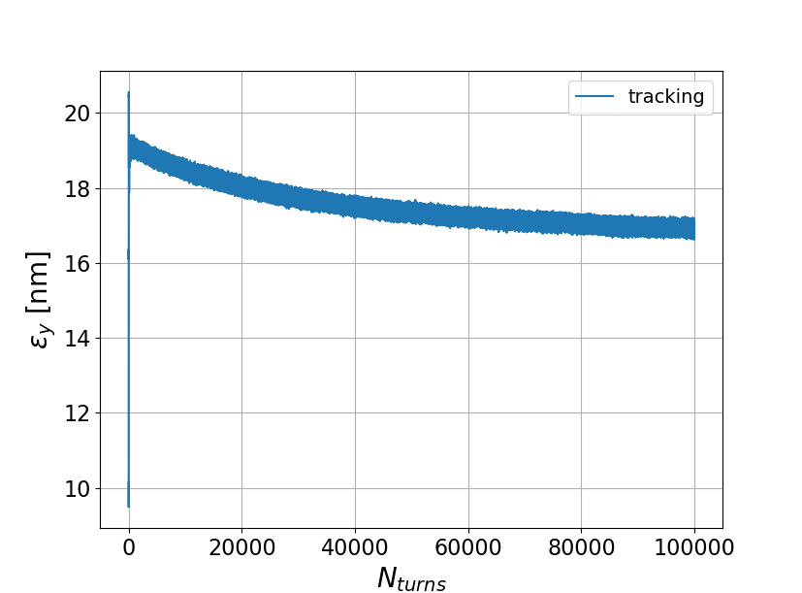
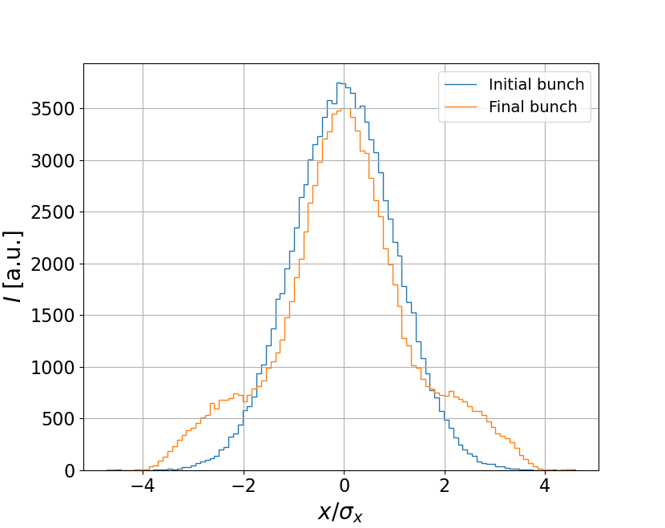
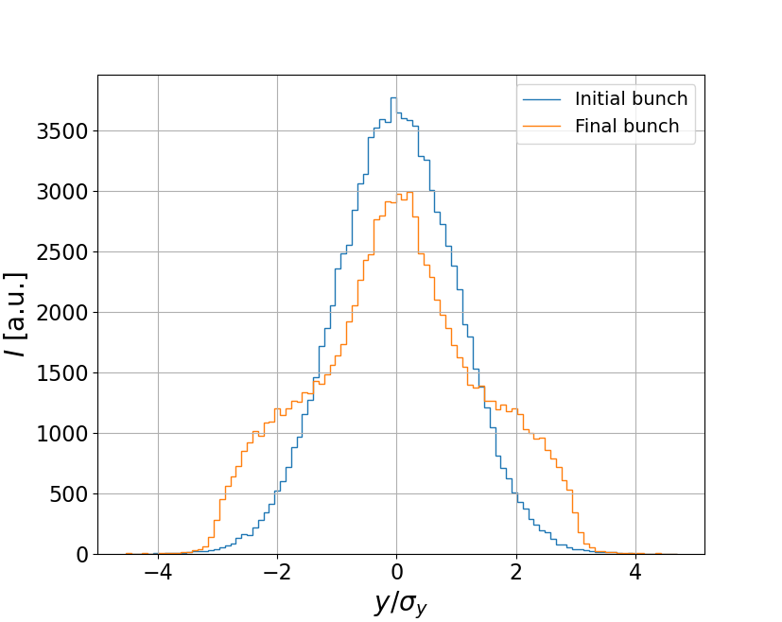

REC working point choice (I)
tracking 100k particles
We started with $ν_{x}=0.23, ν_{y}=0.21$
11

Slide 12
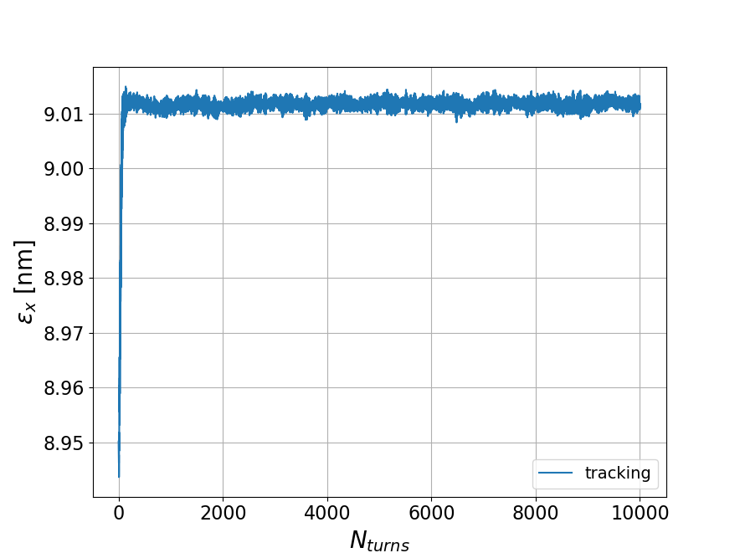
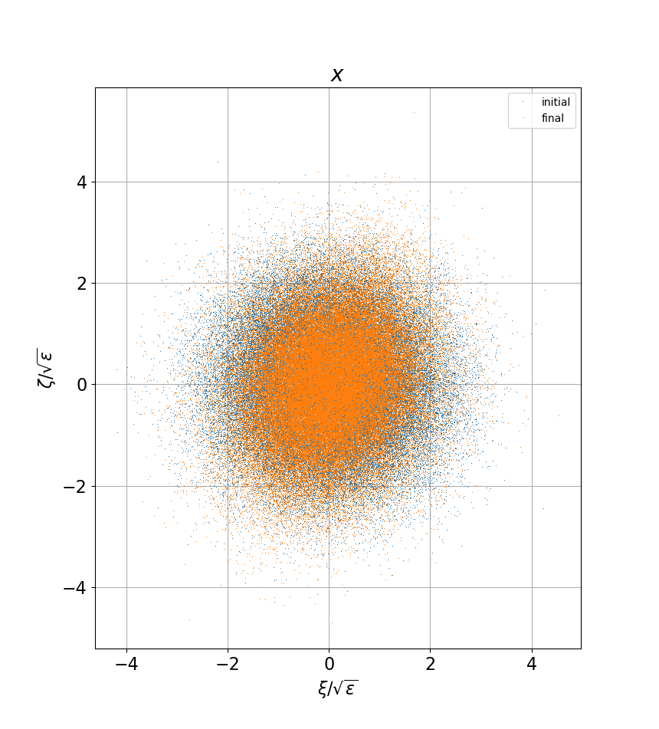
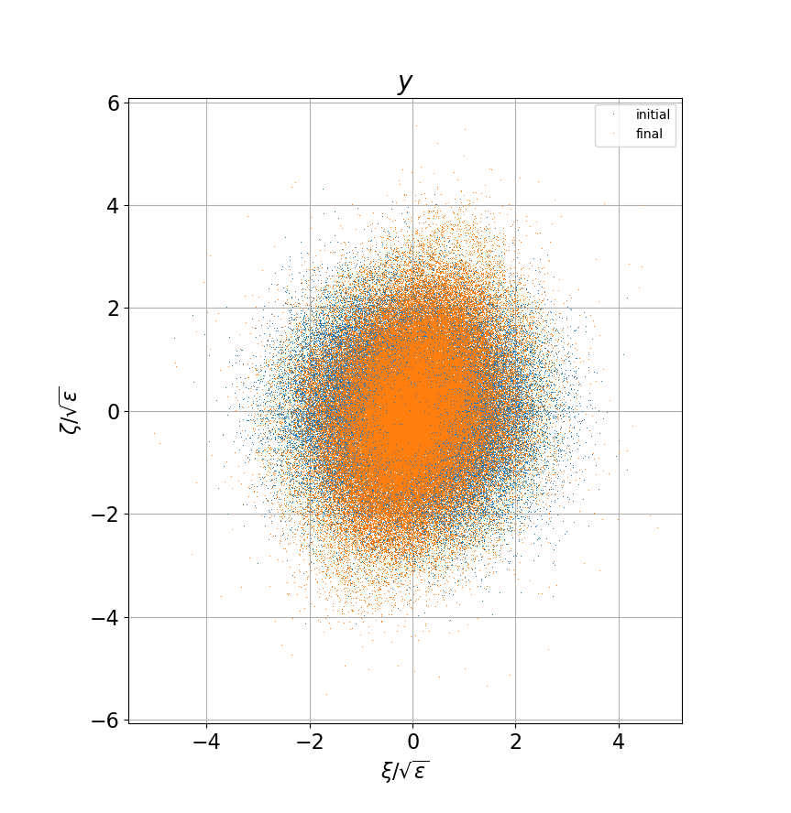
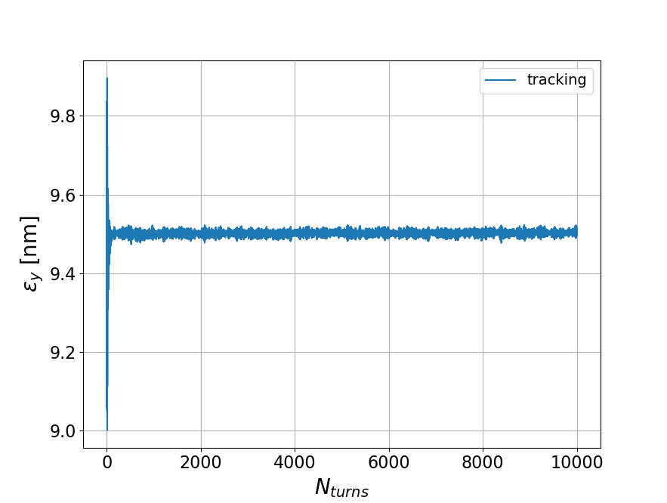
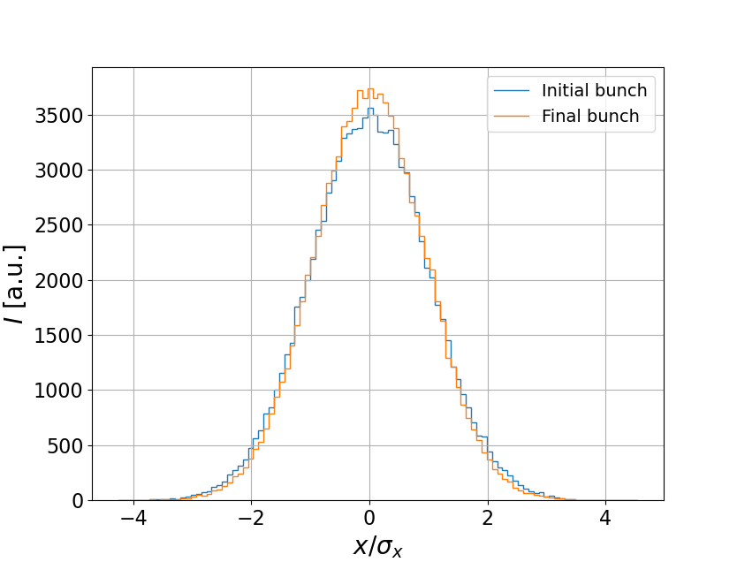
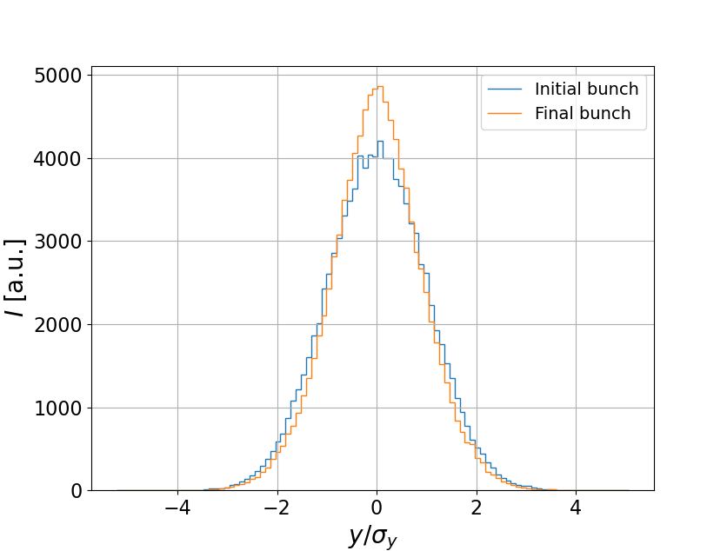
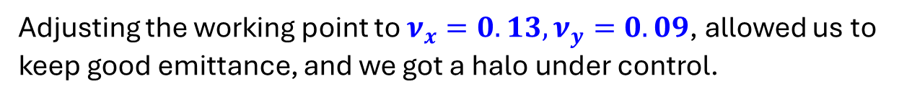
REC working point choice (II)
tracking 100k particles
Adjusting the working point to $ν_{x}=0.13, ν_{y}=0.09$, allowed us to keep good emittance, and we got a halo under control.
12

Slide 13
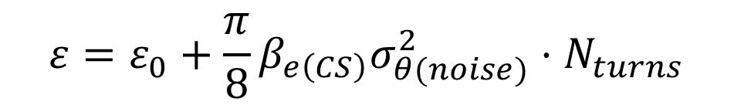
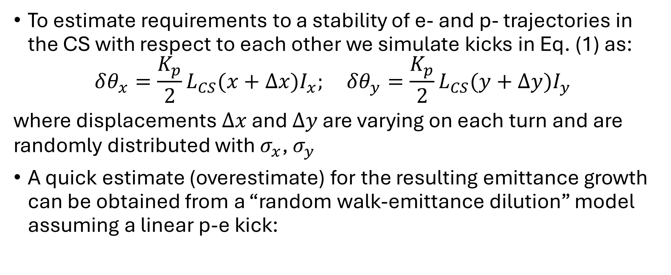
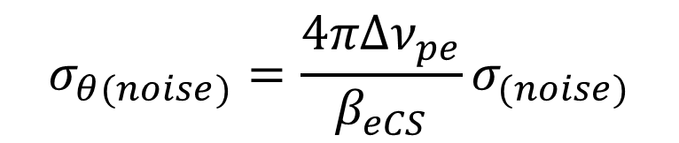
Relative trajectory stability (I)
To estimate requirements to a stability of e- and p- trajectories in the CS with respect to each other we simulate kicks in Eq. (1) as:
$$δθ_{x}=\frac{K_{p}}{2}L_{CS}(x+Δx)I_{x}; δθ_{y}=\frac{K_{p}}{2}L_{CS}(y+Δy)I_{y}$$
where displacements $Δx$ and $Δy$ are varying on each turn and are randomly distributed with $σ_{x}$, $σ_{y}$
A quick estimate (overestimate) for the resulting emittance growth can be obtained from a “random walk-emittance dilution” model assuming a linear p-e kick:
$$ε=ε_{0}+\frac{π}{8}β_{e\left(CS\right)}σ_{θ(noise)}^{2}⋅N_{turns}$$
$$σ_{θ(noise)}=\frac{4πΔν_{pe}}{β_{eCS}}σ_{(noise)}$$
13

Slide 14
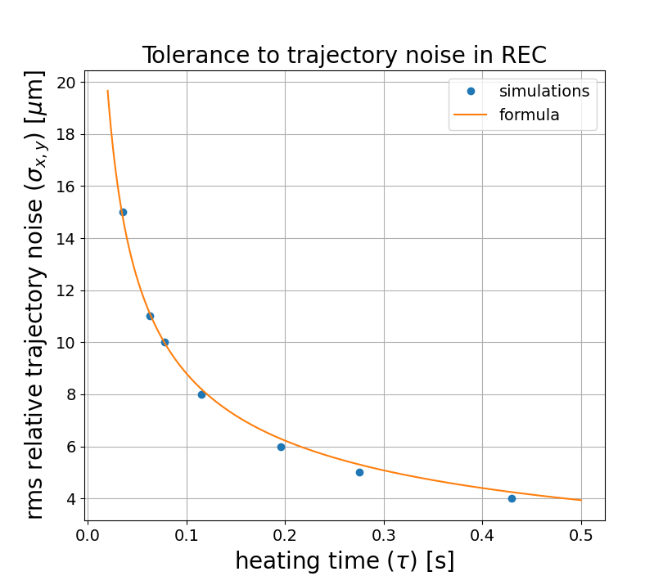
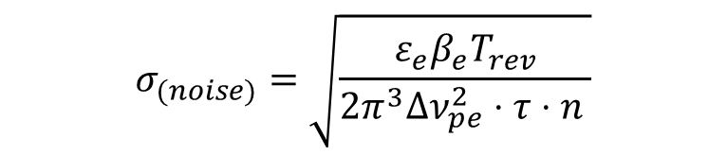
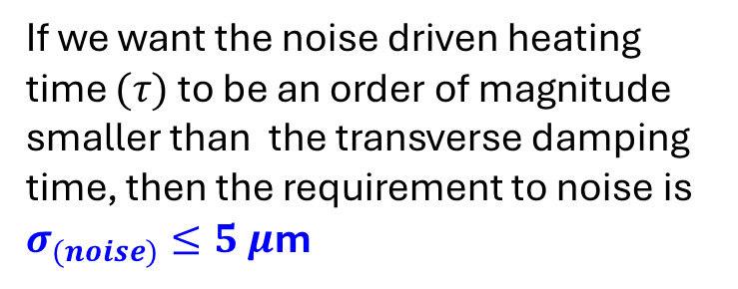
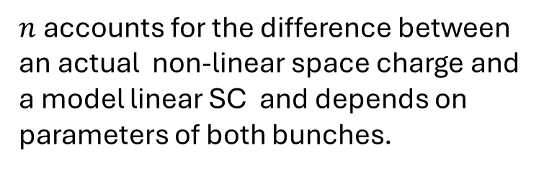
Relative trajectory stability (II)
An analytic formula (with a fudge-factor n=0.4) is a good match for heating times obtained from tracking
$$σ_{(noise)}=\sqrt{\frac{ε_{e}β_{e}T_{rev}}{2π^{3}Δν_{pe}^{2}⋅τ⋅n }}$$
$n$ accounts for the difference between an actual non-linear space charge and a model linear SC and depends on parameters of both bunches.
If we want the noise driven heating time $(τ)$ to be an order of magnitude smaller than the transverse damping time, then the requirement to noise is $σ_{(noise)}≤5 μ$m
14

Slide 15
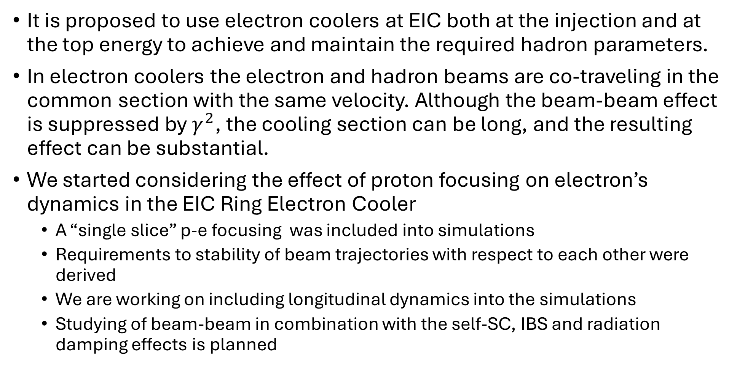
Conclusion
It is proposed to use electron coolers at EIC both at the injection and at the top energy to achieve and maintain the required hadron parameters.
In electron coolers the electron and hadron beams are co-traveling in the common section with the same velocity. Although the beam-beam effect is suppressed by $γ^{2}$, the cooling section can be long, and the resulting effect can be substantial.
We started considering the effect of proton focusing on electron’s dynamics in the EIC Ring Electron Cooler
  A “single slice” p-e focusing was included into simulations
  Requirements to stability of beam trajectories with respect to each other were derived
  We are working on including longitudinal dynamics into the simulations
  Studying of beam-beam in combination with the self-SC, IBS and radiation damping effects is planned
15

