Slide 1
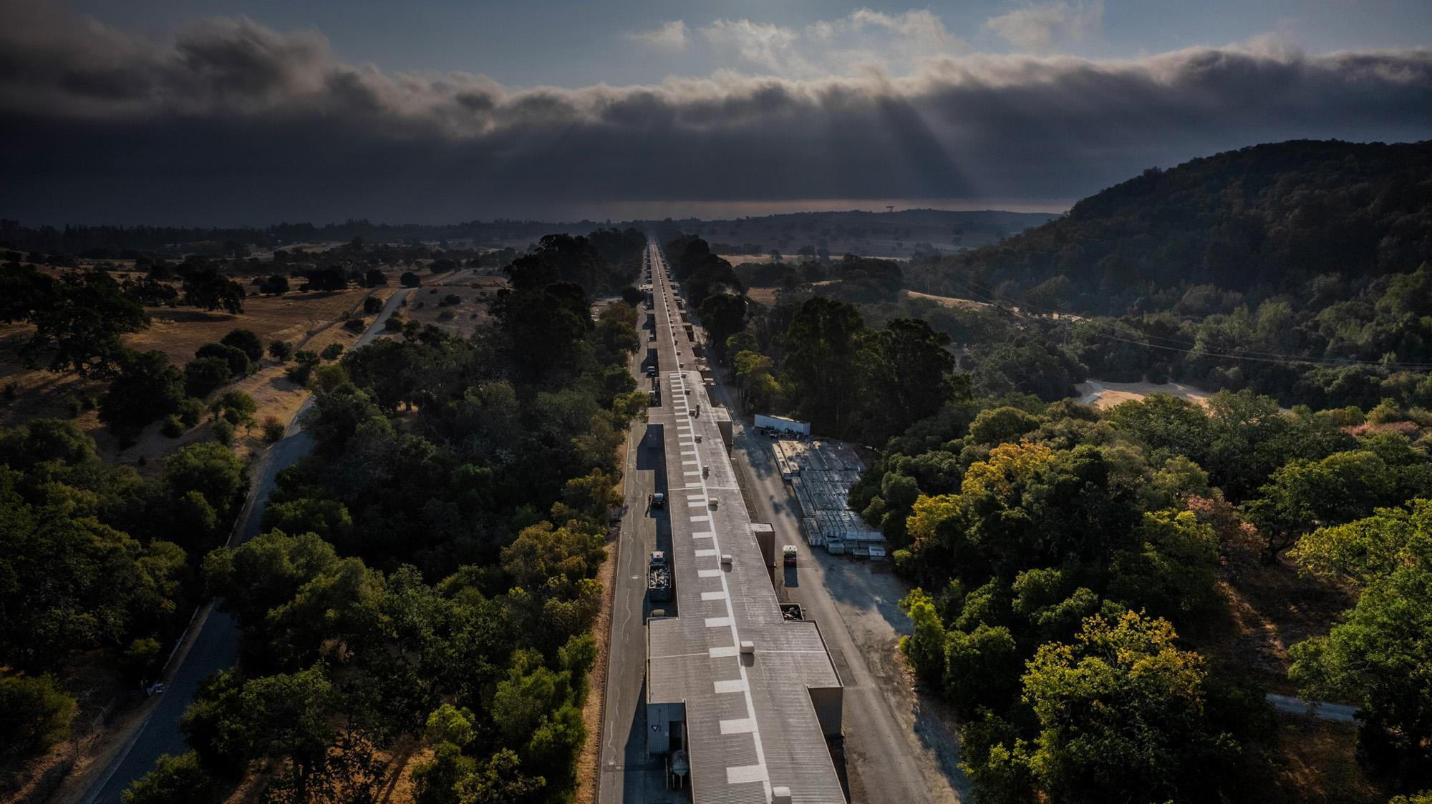
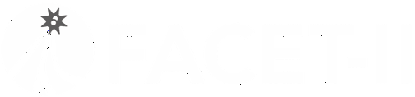


Facility for Advanced Accelerator Experimental Tests
Collider-Directed R&D at FACET-II
Mitigation of Beam-Beam Flip-Flop Instability
BB24 EPFL, Sep 2-5
Spencer Gessner
Asst. Professor (Starting Oct. 1)
SLAC and Stanford University
sgess@slac.stanford.edu

Slide 2
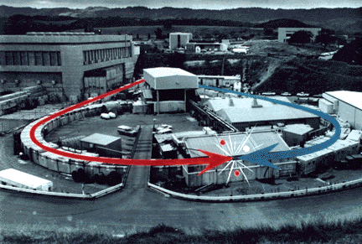
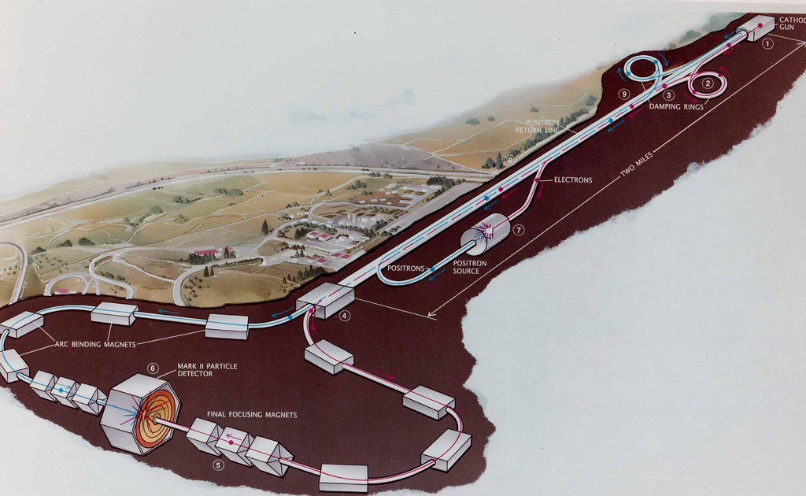
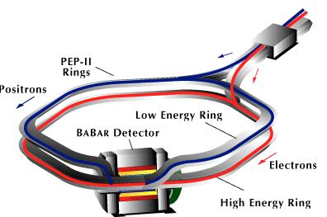
SLAC: Four Decades of Colliders
SLAC developed leadership in many areas of collider physics and continues to contribute expertise to the design and operation of colliders around the world.
SPEAR (1972-1990)
SLC (1988-1998)
PEP-II (1998-2008)

Slide 3

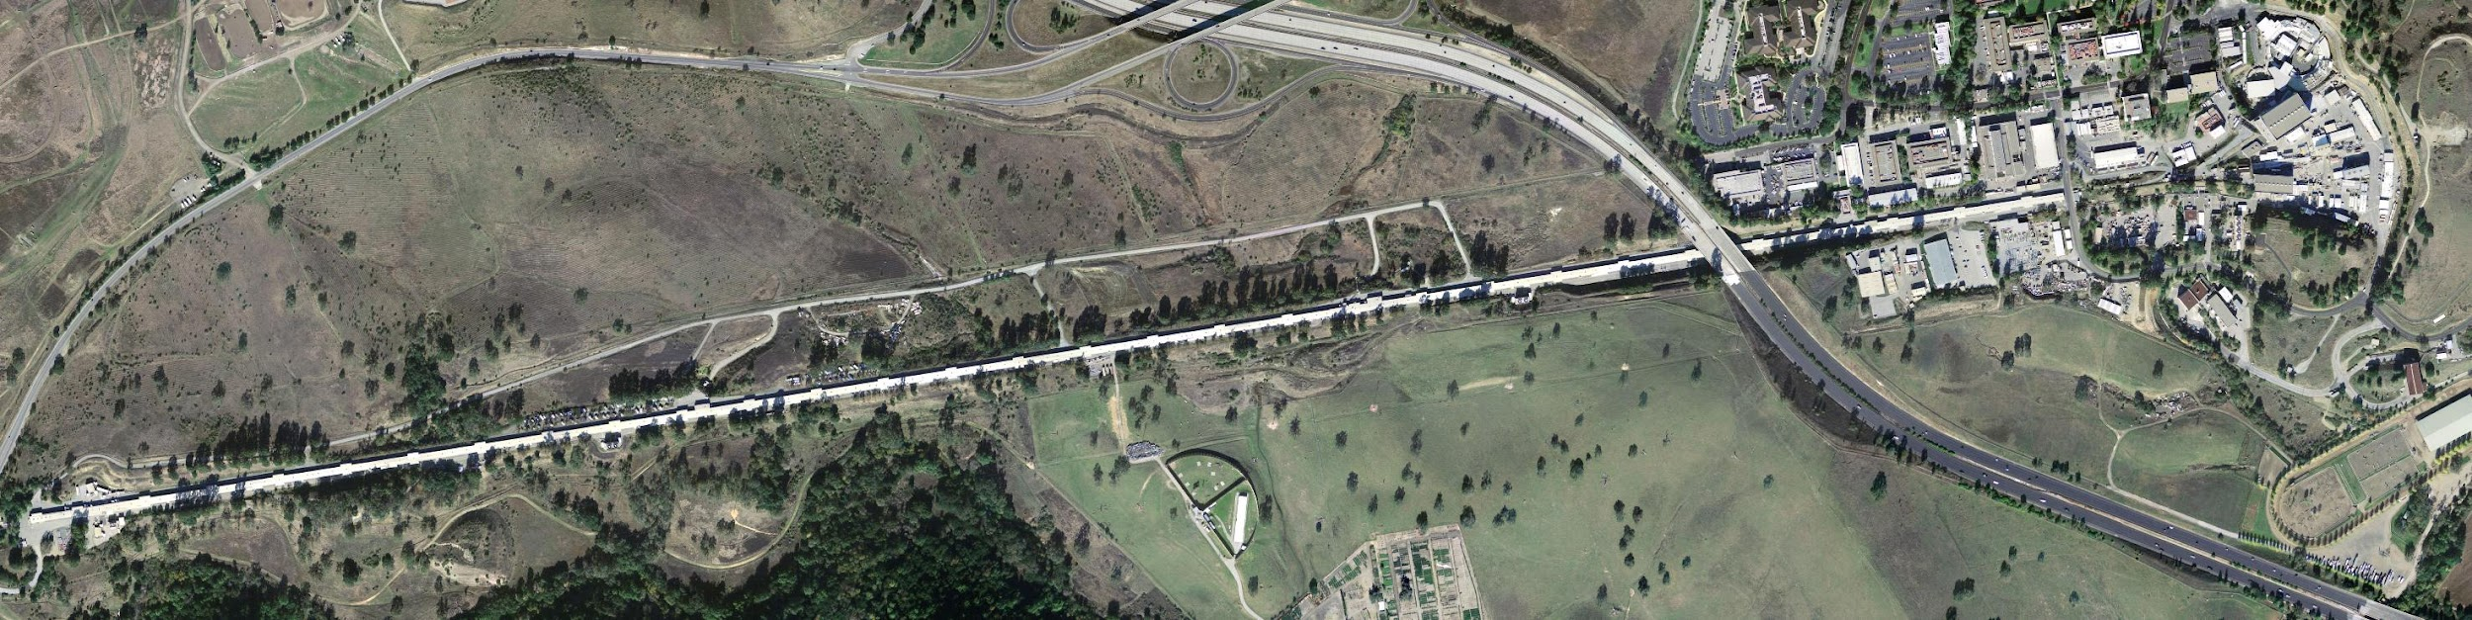


SLAC Today
FACET-II
Accelerator Beam Test Facility
LCLS-II
Highest Rate X-Ray FEL
First X-Ray FEL

Slide 4
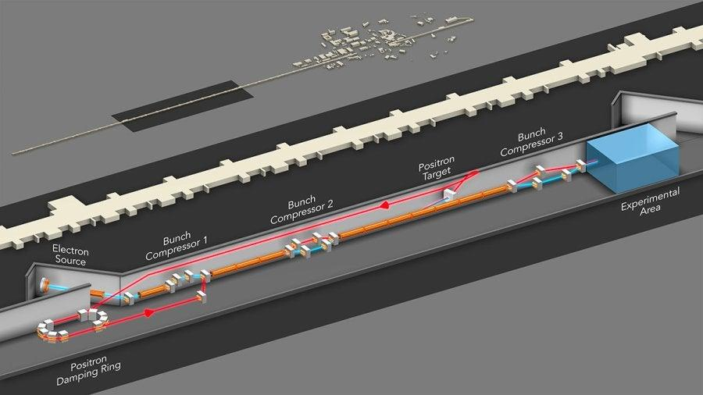
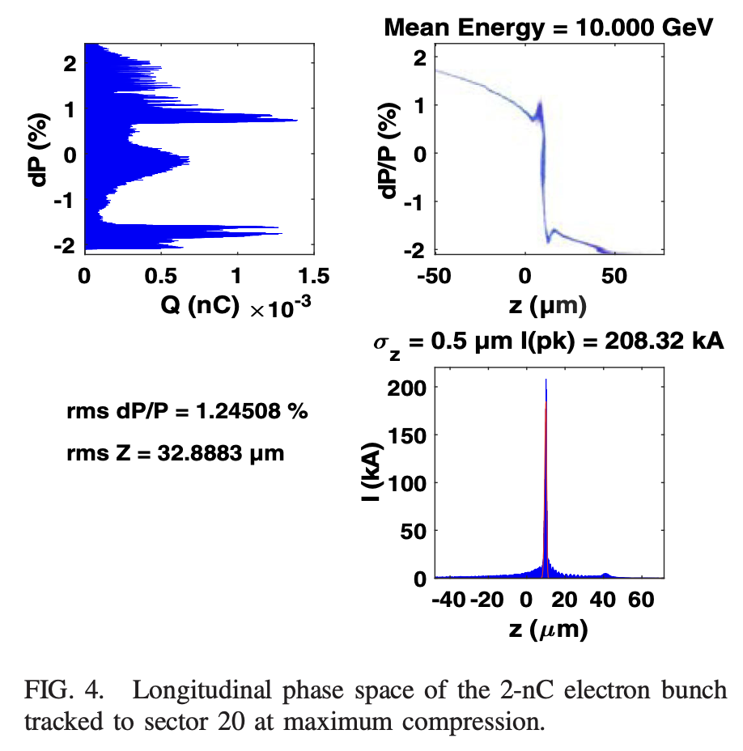
FACET-II provides unique beams
FACET-II facility layout
FACET-II delivers electron beams with nanocoulomb charge at 10 GeV energy.
FACET-II has three compressor chicanes to reduce the length of the bunch delivered to experiments.
The near term goal for FACET-II is to deliver beams with σ_{x} ≈ σ_{y} ≈ σ_{z} < 10 μm. The long term goal is 100 kA peak current beams.
The radial electric field of the electron bunch is about 100 GV/m in the lab frame!
https://doi.org/10.1103/PhysRevAccelBeams.22.101301

Slide 5
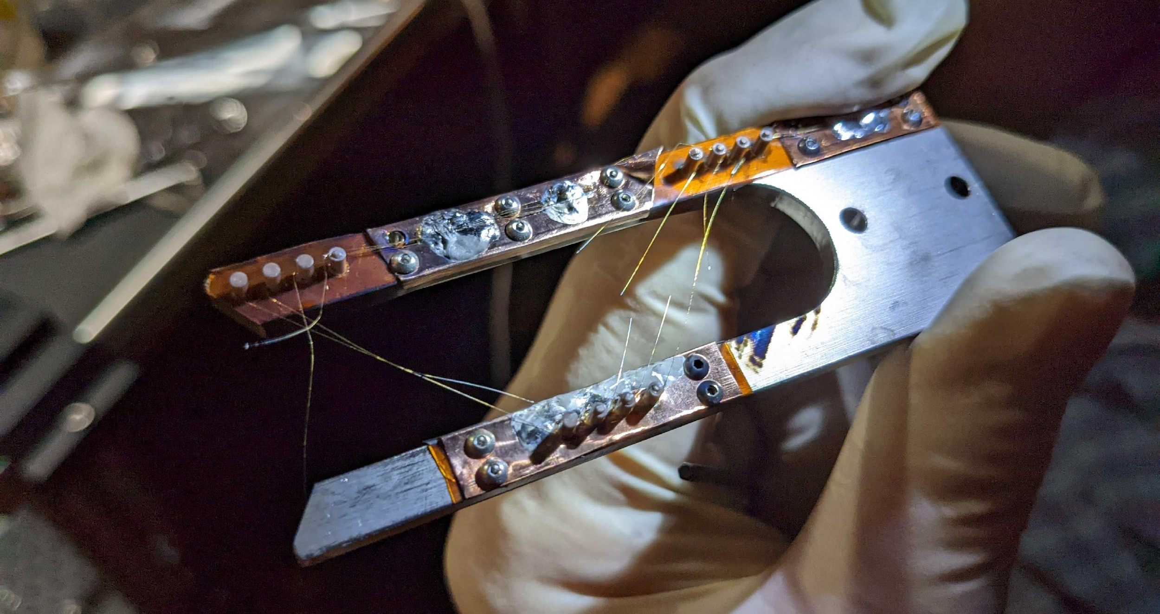
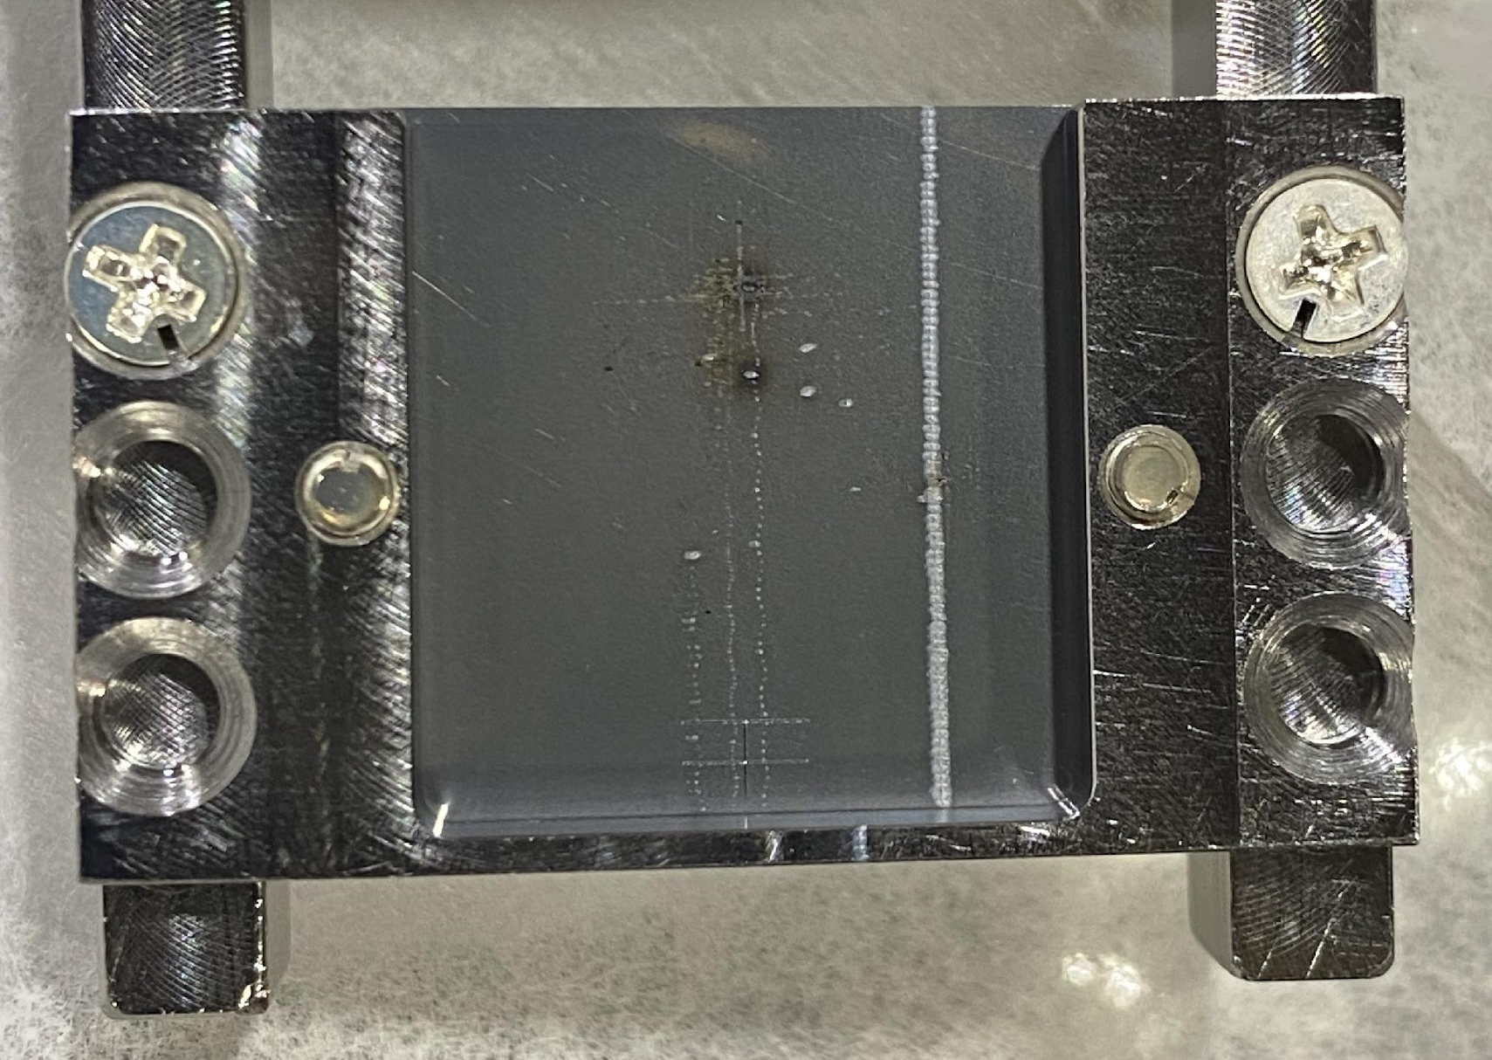
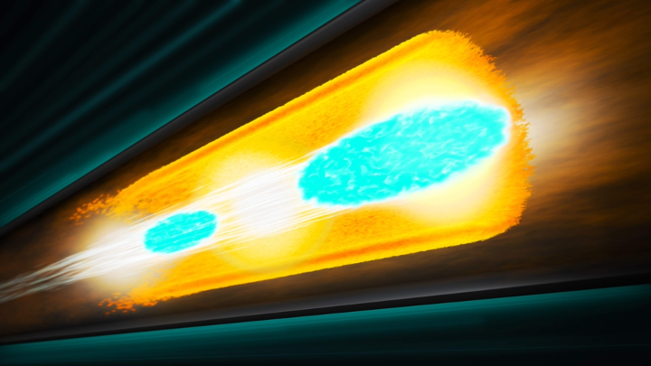
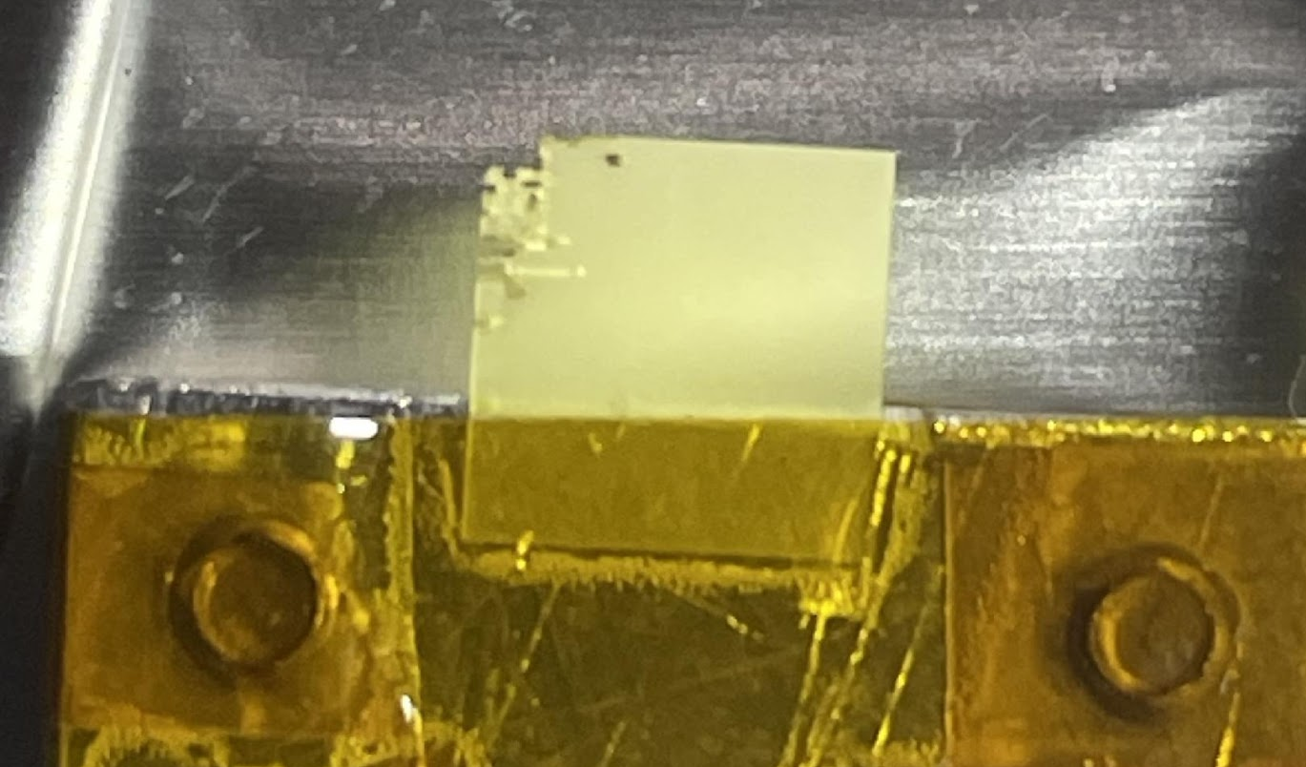
FACET-II: Extreme Beams
Ultra-high peak current bunches produce extreme fields!
The FACET beam eats intercepting diagnostics for breakfast.
Wire scanner. . . shredded
Beam-Driven Plasma Wakefield
OTR foil. . . drilled
Extreme beams are required for the plasma wakefield acceleration program at FACET-II.
YAG crystal. . . swiss-cheesed

Slide 6
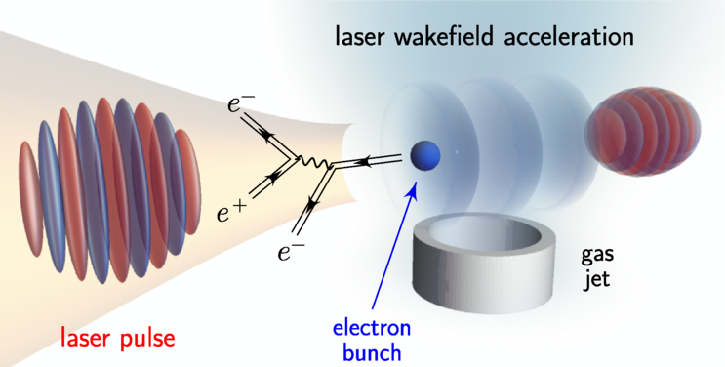
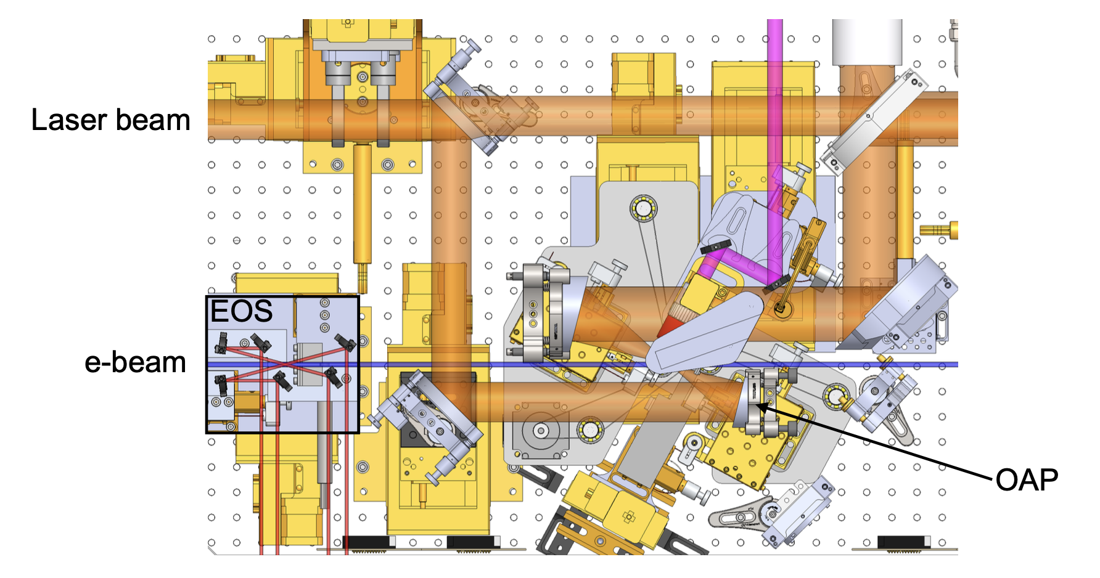
Strong Field QED at FACET-II
FACET-II has a 20 TW laser that can be used to collide with electron beam for inverse Compton scattering experiments.
The motivation for this research is to probe strong field QED effects:
Nonlinear Compton scattering
Coherent pair creation
Trident cascade
Violation of local constant field approximation
SLAC E320 Experiment

Slide 7
P5 Report and Accelerator R&D Priorities
Recommendation 2: Construct a portfolio of major projects that collectively study nearly all fundamental constituents of our universe and their interactions, as well as how those interactions determine both the cosmic past and future.
c. An off-shore Higgs factory, realized in collaboration with international partners, in order to reveal the secrets of the Higgs boson. The current designs of FCC-ee and ILC meet our scientific requirements. The US should actively engage in feasibility and design studies.
Recommendation 4: Support a comprehensive effort to develop the resources—theoretical, computational, and technological—essential to our 20-year vision for the field. This includes an aggressive R&D program that, while technologically challenging, could yield revolutionary accelerator designs that chart a realistic path to a 10 TeV pCM collider.
a. Support vigorous R&D toward a cost-effective 10 TeV pCM collider based on proton, muon, or possible wakefield technologies, including an evaluation of options for US siting of such a machine, with a goal of being ready to build major test facilities and demonstrator facilities within the next 10 years.
The FACET-II program will expand to include R&D for near-term colliders.

Slide 8
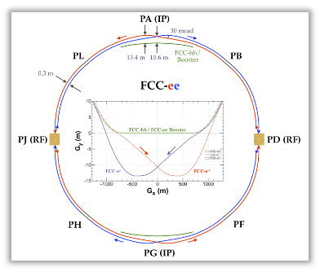
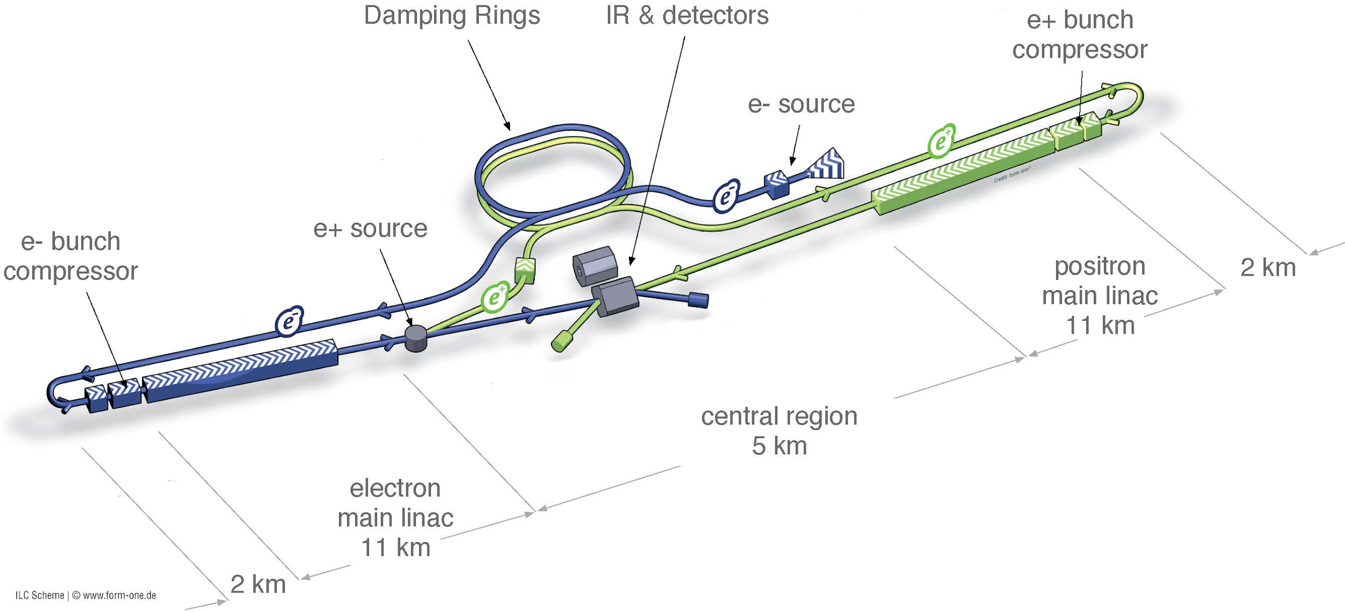
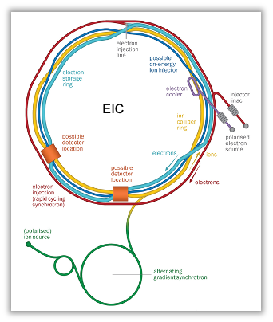
Collider-Directed R&D Opportunities at FACET-II
Laser control of electron bunch intensity for FCC-ee.
  For mitigating beam-beam flip-flop instability.
FCCee injector studies.
  Demonstrate fast charge variation from injector and wakefield verification.
Compton polarimetry studies for FCCee.
  Validate detector design and performance for ~10% polarization signal.
Laser collimation of electron beams for ILC.
  For “unbreakable” collimators.
Experimental verification of strong-field QED models.
  For high beamstrahlung regime collisions.
ILC source studies (US-Japan grant).
  Design and validation of very high power targets driven by electron beams.
Coherent Electron Cooling at EIC.
  Measure electron noise in the near-IR at the injector and test noise reduction.
See backup slides for more information.

Slide 9
The Beam-Beam Flip-Flop Instability
Symmetric scenario:
Equal bunch intensities and equal beamstrahlung.
N = N₀
n_{γBS} = n_{γBS0}
σ_{z} = σ_{z0}
ξ = ξ₀
N = N₀
n_{γBS} = n_{γBS0}
σ_{z} = σ_{z0}
ξ = ξ₀

Slide 10
The Beam-Beam Flip-Flop Instability
Asymmetric scenario:
“Weak” beam radiates more beamstrahlung photons than “Strong” beam.
N = N₀ - Δ
n_{γBS} ↓
σ_{z} = σ_{z0}
ξ = ξ₀
N = N₀ + Δ
n_{γBS} ↑
σ_{z} = σ_{z0}
ξ = ξ₀
Weak
Strong

Slide 11
The Beam-Beam Flip-Flop Instability
Asymmetric scenario:
More/less beamstrahlung radiation leads to longer/shorter bunch lengths.
N = N₀ - Δ
n_{γBS} ↓
σ_{z} ↑
ξ = ξ₀
N = N₀ + Δ
n_{γBS} ↑
σ_{z} ↓
ξ = ξ₀
Weak
Strong

Slide 12
The Beam-Beam Flip-Flop Instability
Asymmetric scenario:
Longer/shorter bunch lengths decrease/increase the beam-beam parameter.
N = N₀ - Δ
n_{γBS} ↓
σ_{z} ↑
ξ ↑
N = N₀ + Δ
n_{γBS} ↑
σ_{z} ↓
ξ ↓
Weak
Strong
ξ_{y} may become very large for the weak beam and it is lost.

Slide 13
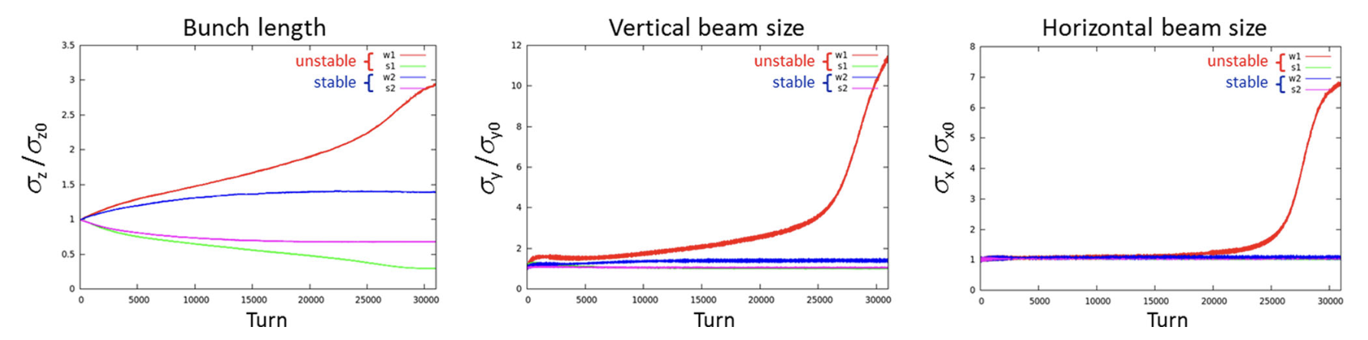
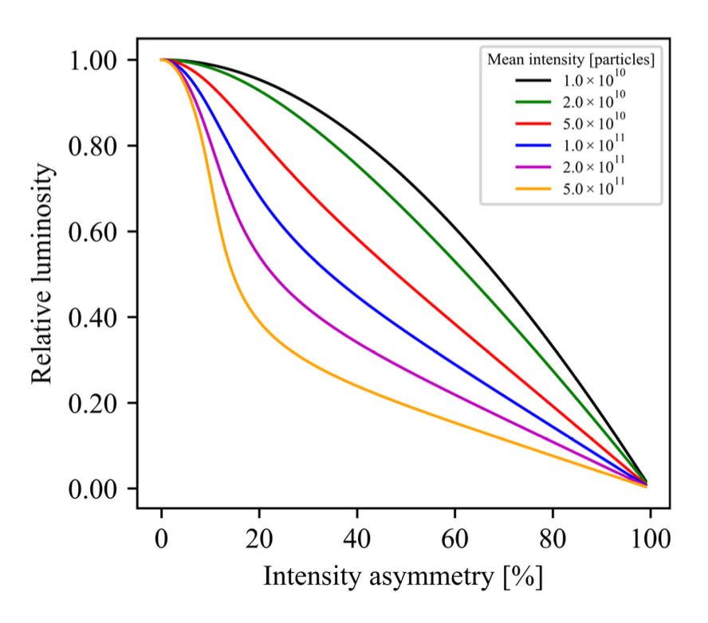
Growth Rate and Sensitivity to Asymmetries
Simulations by Shatilov indicate growth rate of the instability over ~10000 turns.
At the z-pole, a few percent intensity asymmetry is tolerable.
Asymmetries may be balanced through top-up injection.
The top-up rate is ever 15000-to-30000 turns.
D. Shatilov https://doi.org/10.1140/epjp/s13360-022-02346-x
Does the instability grow faster than the top-up rate?
K. Nguyen et al. https://arxiv.org/abs/2404.09012

Slide 14
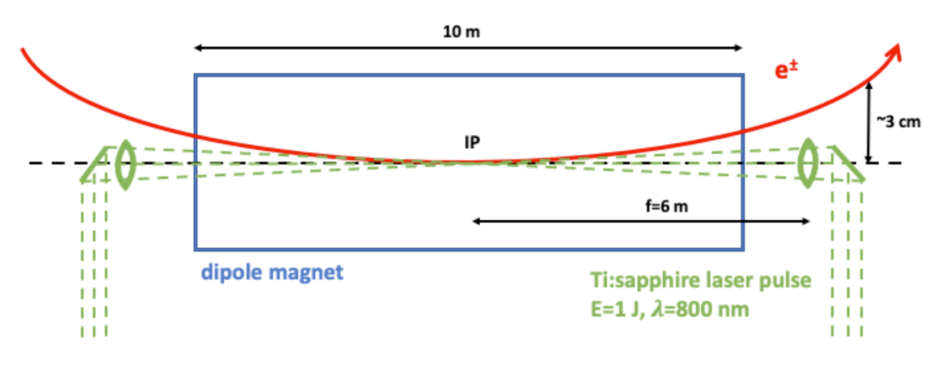
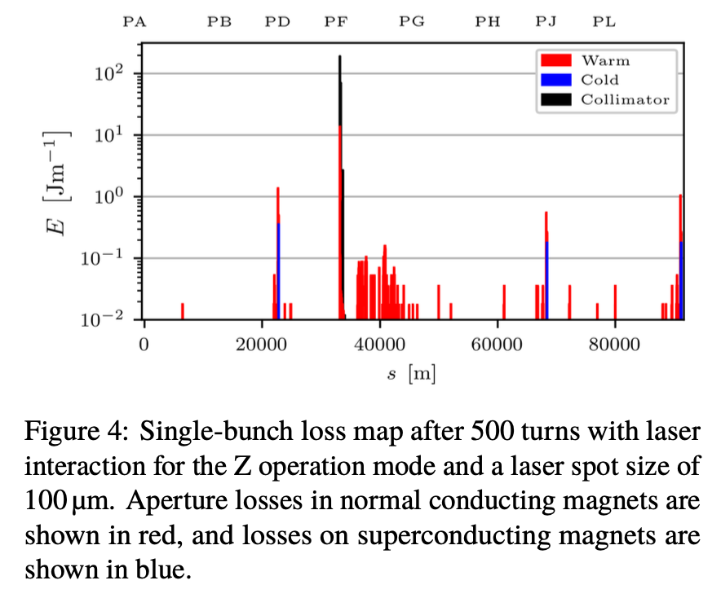
Fast-Feedback on Colliding Bunch Intensity
If the flip-flop instability develops faster than the top-up frequency, the FCC will require a fast feedback for bunch intensity control.
This can be achieved by Compton Back Scatter of individual bunches with high energy laser pulses.
The laser pulse energy is controlled on a bunch-by-bunch basis to compensate for intensity asymmetry between bunches.
F. Zimmermann, T. Raubenheimer IPAC 2022 https://accelconf.web.cern.ch/ipac2022/papers/wepost010.pdf
I. Drebot, et. al IPAC 2023 https://doi.org/10.18429/JACoW-IPAC2023-MOPA074

Slide 15
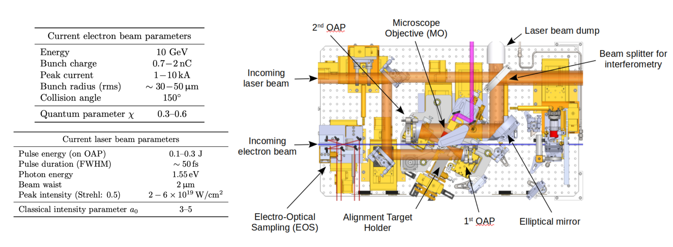
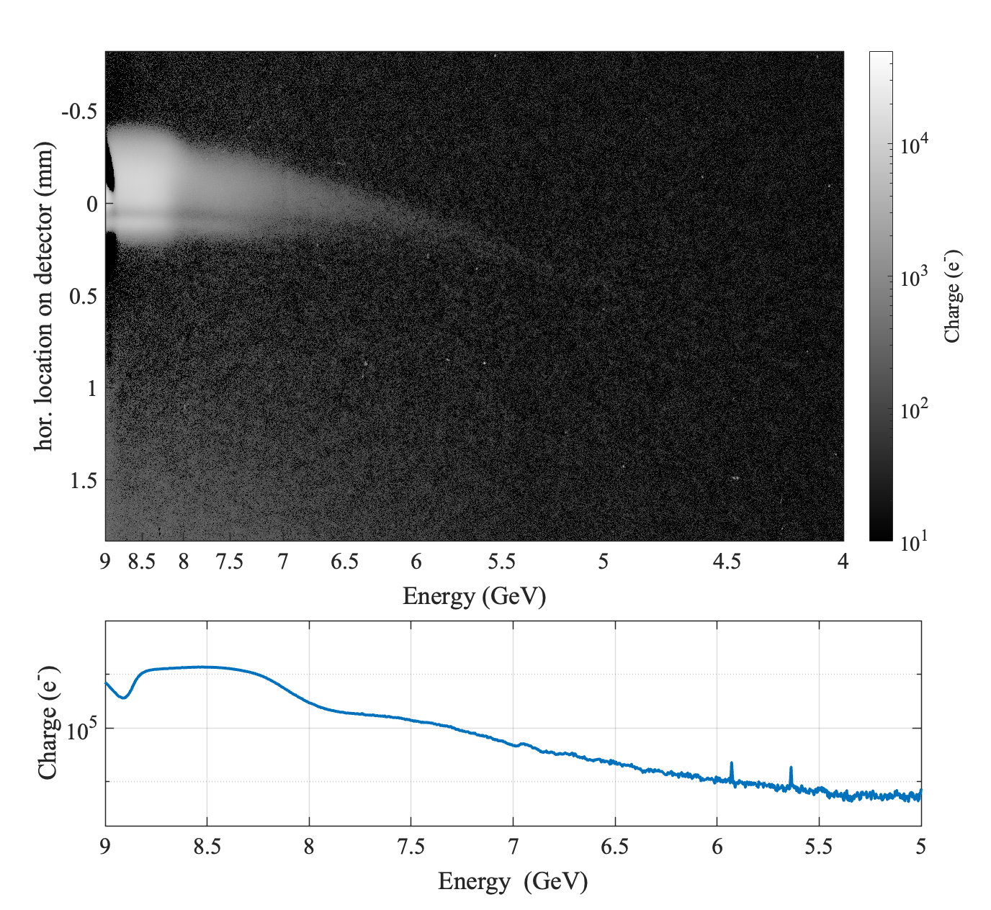
FACET-II Proposal
Proposal
With J. Keintzel and F. Zimmermann, CERN, I. Drebot, INFN, and E320 Team
Use the E320 infrastructure at FACET-II provides an R&D platform to demonstrate:
Bunch-to-bunch laser intensity control.
Performance and lifetime of laser optics in radiation environments
Explore optimal geometries for maximizing interaction and minimizing laser power.
Tatiana Smorodnikova, EPS 2024
E320 e-beam spectrum after laser interaction

Slide 16
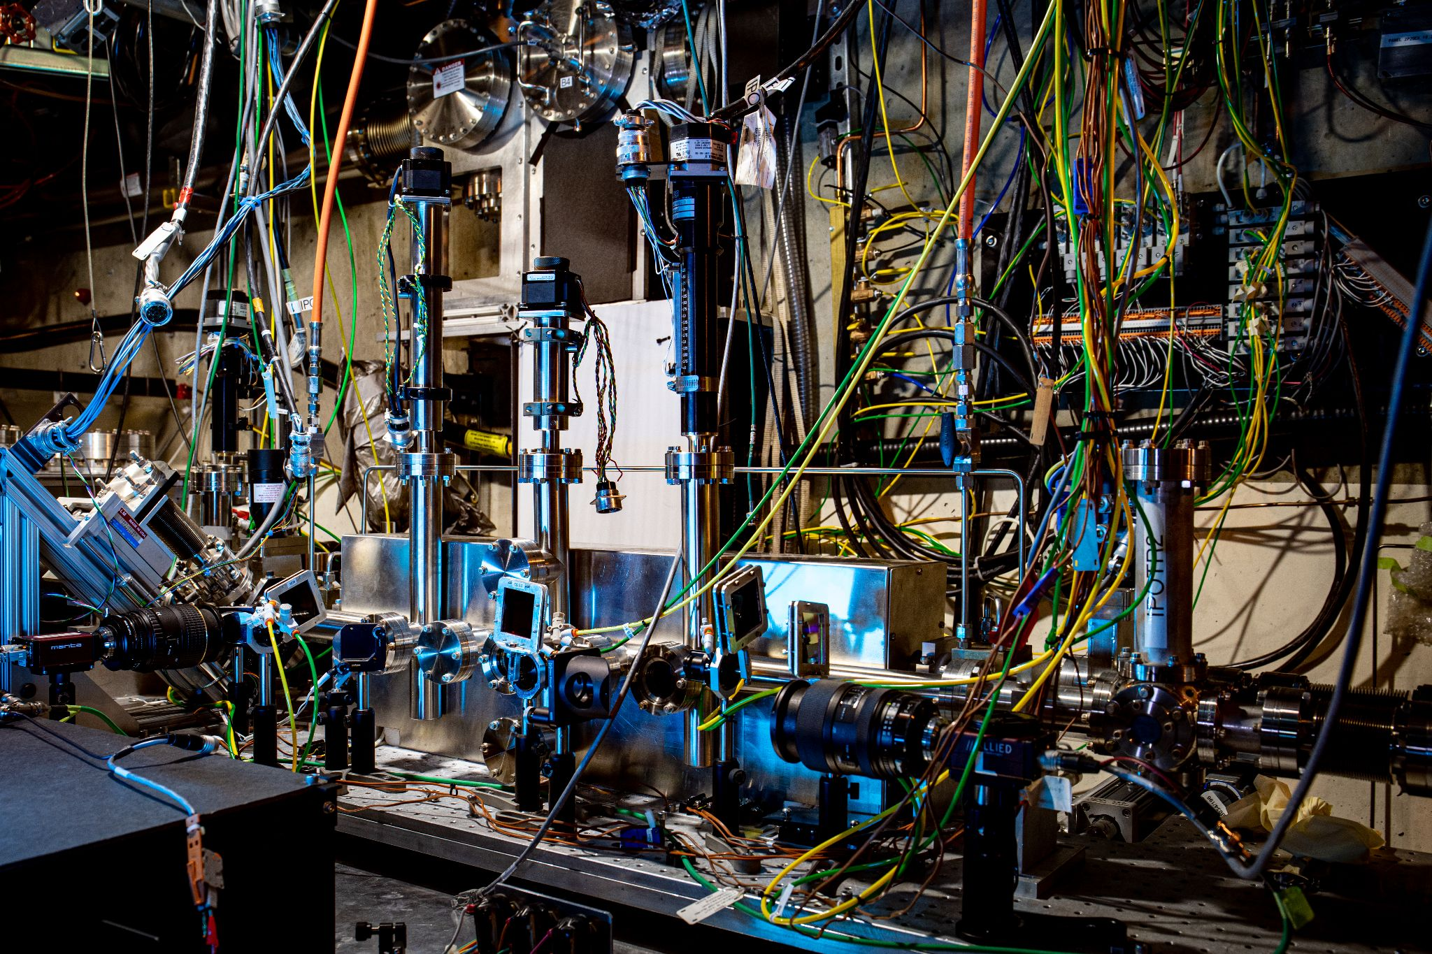
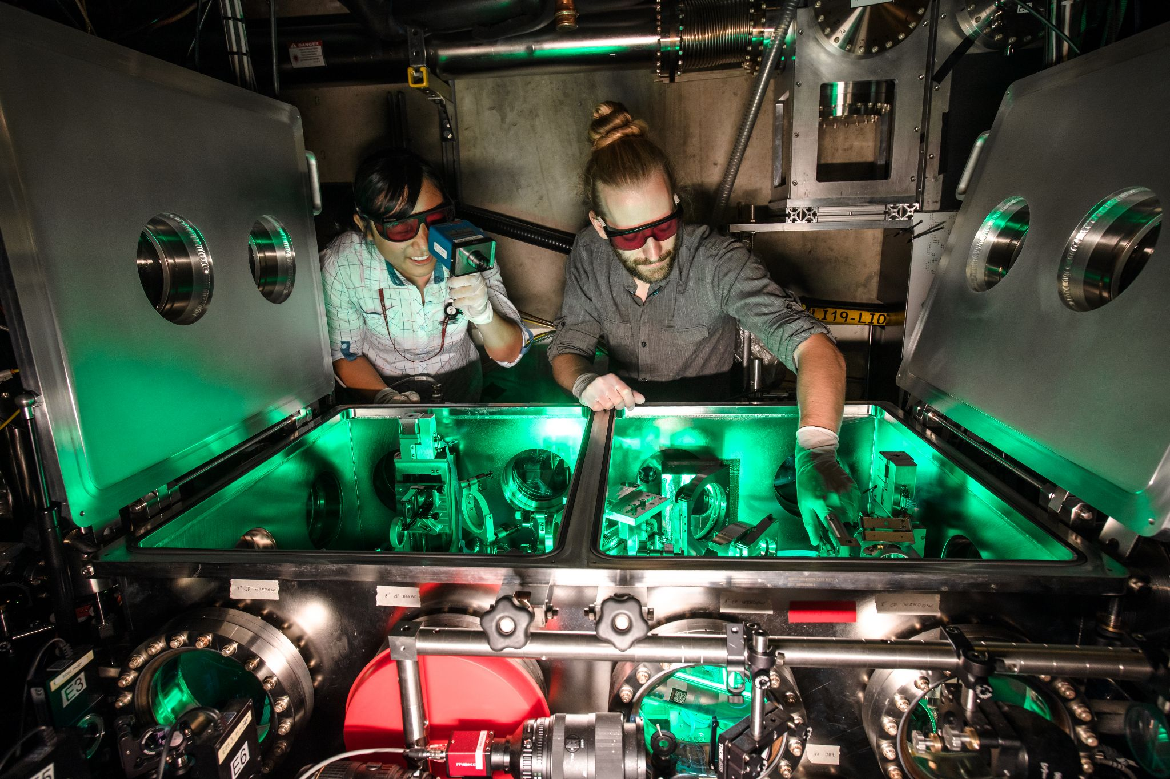
Advertisement #1: Experimental Proposals for FACET-II
We are currently accepting proposals for experiments at FACET-II, especially proposals for Collider R&D topics.
https://facet-ii.slac.stanford.edu/proposals
We want proposals to be successful!
Please contact myself or FACET managers before submitting your proposal:
Ivan Rajkovic, FACET User Manager
Mark Hogan, FACET Director

Slide 17
Advertisement #2: Postdoc Positions at SLAC
Research Associate in Beam-Beam Effects for Circular Colliders
SLAC is seeking qualified scientists to contribute to beam-beam studies for the FCC-ee and EIC colliders. These studies will utilize state-of-the-art simulation tools including XSuite, WarpX, BeamBeam3D, BMAD, and the Blast toolkit. Study topics include the beamstrahlung-induced 3D flip-flop instability at FCC-ee and polarization preservation with beam-beam interactions at the EIC.
Research Associate in the 10 TeV Wakefiled Collider Design Study
SLAC is seeking qualified scientists to contribute to the design of a very high energy future collider based on wakefield accelerator technology. Study topics include staging of plasma accelerators, advanced beam delivery systems, beam-beam interactions with extreme beamstrahlung, and overall system optimization. Participation in the FACET-II experimental program is encouraged.
Postdoc positions will be posted in October. I will forward them to BB24 organizers.

Slide 18
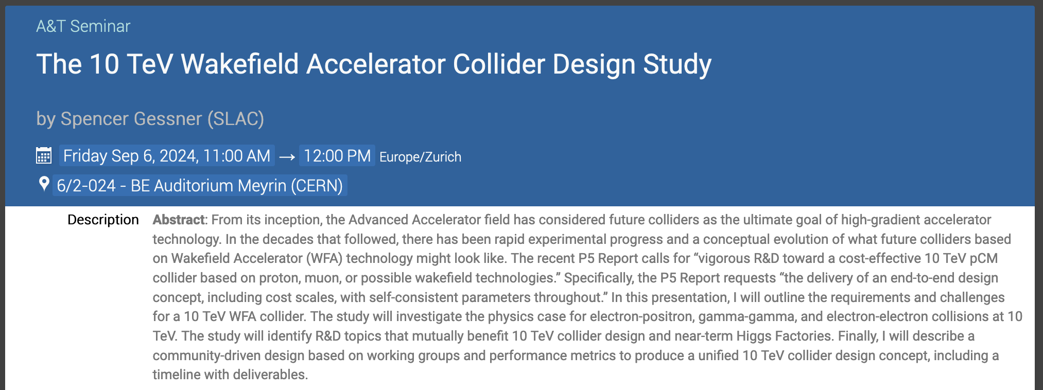
Advertisement #3: Seminar at CERN
For those at CERN on Friday, I am giving a seminar on the 10 TeV Wakefield Collider, including Beam-Beam effects (extreme beamstrahlung).

Slide 19
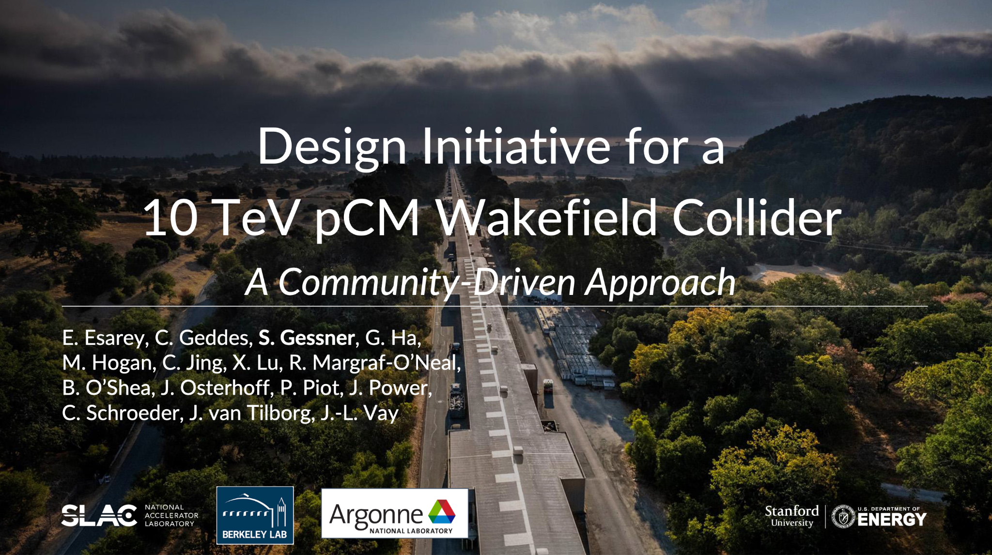
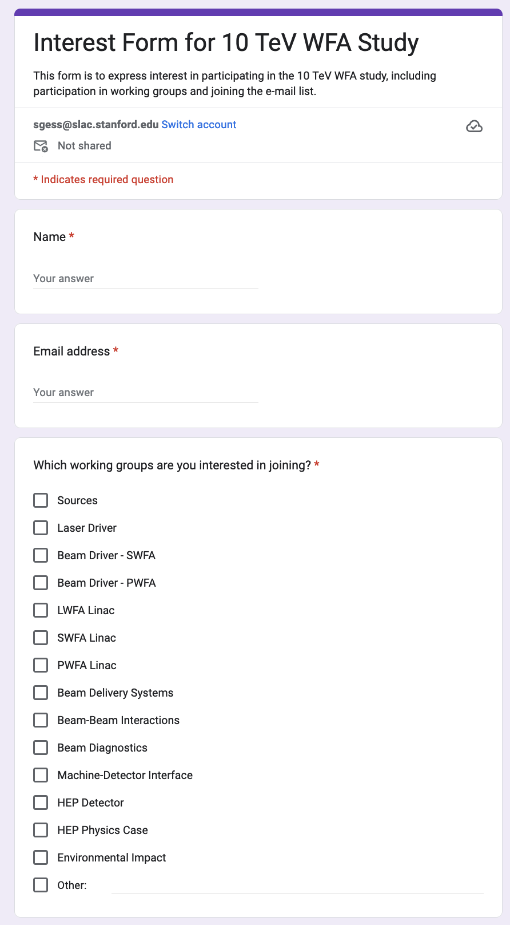
Advertisement #3: Seminar at CERN
https://indico.fnal.gov/event/59618/contributions/294346/attachments/179939/246829/The_10TeV_WFA_Study_v3.pdf
https://forms.gle/tLCYykFRdYus7CS86
For those at CERN on Friday, I am giving a seminar on the 10 TeV Wakefield Collider, including Beam-Beam effects (extreme beamstrahlung).

Slide 20
Thank you!

Slide 21
Backup

Slide 22
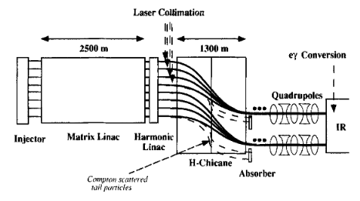
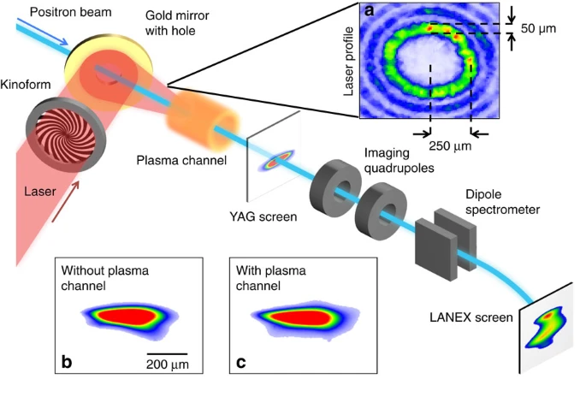
Collimation Challenge at Colliders
Collimation systems for linear and circular colliders have conservative designs: they must be able to withstand a complete mis-steering of the beam.
They can be destroyed in a single shot!
Proposal: use Compton scattering with shaped laser pulses for a robust, compact, and undamageable collimation system.
This programs leverages prior research by the E225 Experiment at FACET and E320 at FACET-II.
Zimmerman, F. New final focus concepts at 5 TeV and beyond. Eighth Advanced Accelerator Concepts Workshop. 1998.
Gessner, S. et al. Demonstration of a positron beam-driven hollow channel plasma wakefield accelerator. Nat. Comm. 2016.

Slide 23
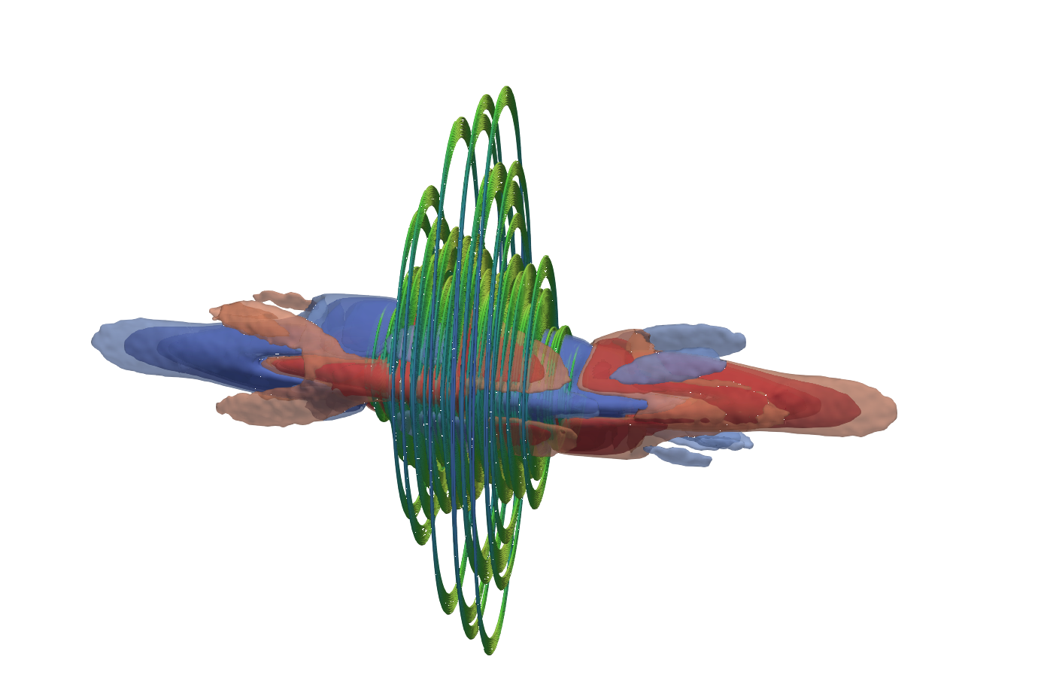
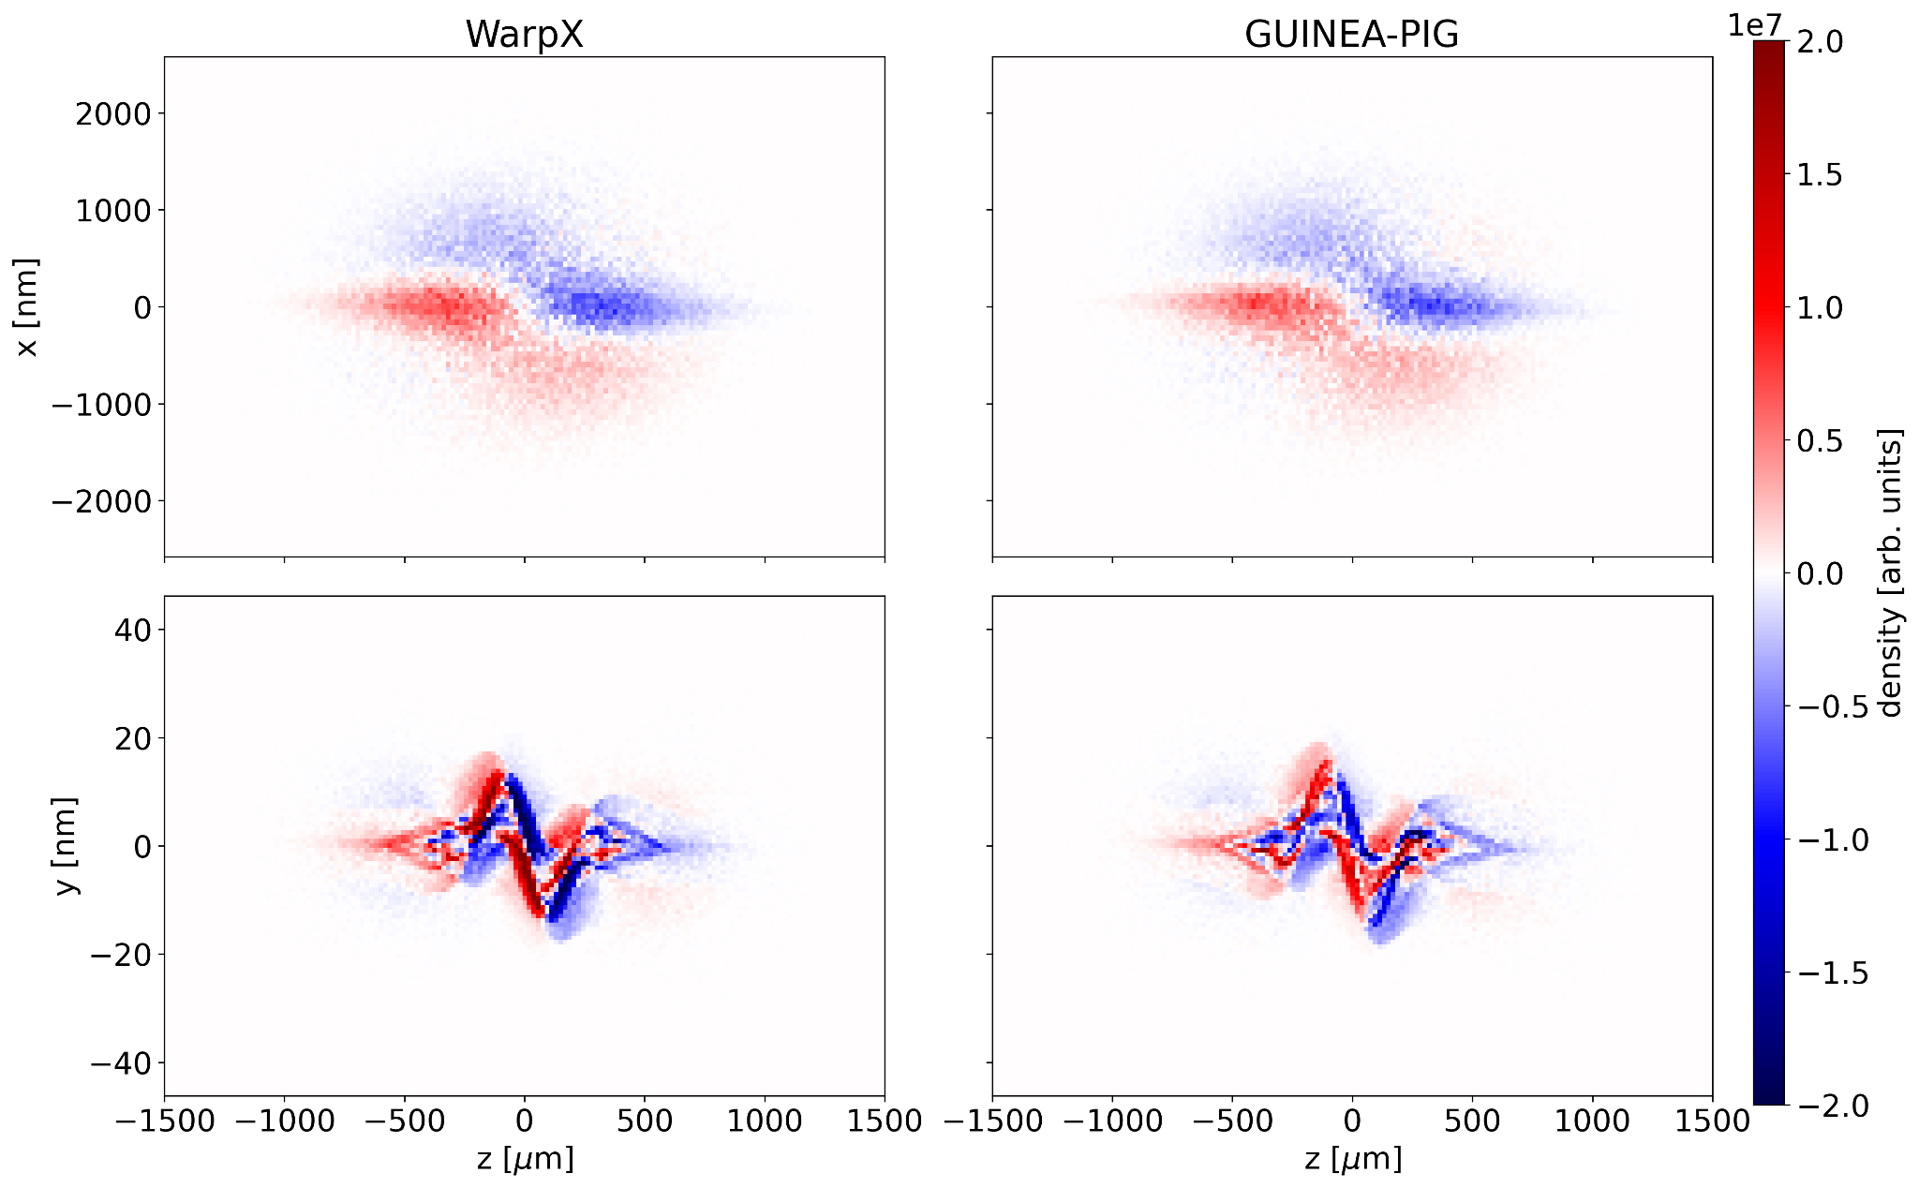
Verification of Beam-Beam Codes
For high-energy upgrades of linear colliders, the beamstrahlung parameter 𝛶 becomes very large.
With LBNL, we are developing the WarpX code as a high performance replacement of GUINEA-PIG and CAIN in the extreme beamstrahlung regime.
E320 provides a test bed to study the extreme beam physics relevant to large 𝛶 regime.
ILC bunch collision in WarpX
A. Formenti LBNL
We are targeting WarpX towards EIC and FCC-ee applications for high-speed, “strong-strong” simulations.

Slide 24
FCCee Injector Studies at FACET-II
Brendan O’Shea, SLAC
Paolo Craievich, PSI
Study 1: FCCee requires arbitrary 0 - 5 nC at +/-5% charge variation inside pulse train from injector to prevent flip-flop instability
  Prove design requirement of arbitrary bunch charge from injector, before engineering in 2029
Study 2: Test wakefield models used to design FCCee injector linac at bunch spacings from 25 to 100 ns
  Prove injector design before engineering in 2029
Study 3: Test FCCee high temperature superconducting magnet at FCCee design beam power
  Required to prove reliability required for FCCee
Exploring three possible studies at FACET-II for March 2025 review
Current studies at SwissFEL can show principles, but do not reach FCCee design parameters
All three studies well aligned to FACET-II machine capabilities
  FACET-II injector meets FCCee charge requirements
  FACET-II linac can accommodate FCCee beam power
  FACET-II has existing positron infrastructure and experience from FACET/FFTB/SLC
FACET-II capabilities are well-positioned to address FCCee injector R&D Topics

Slide 25
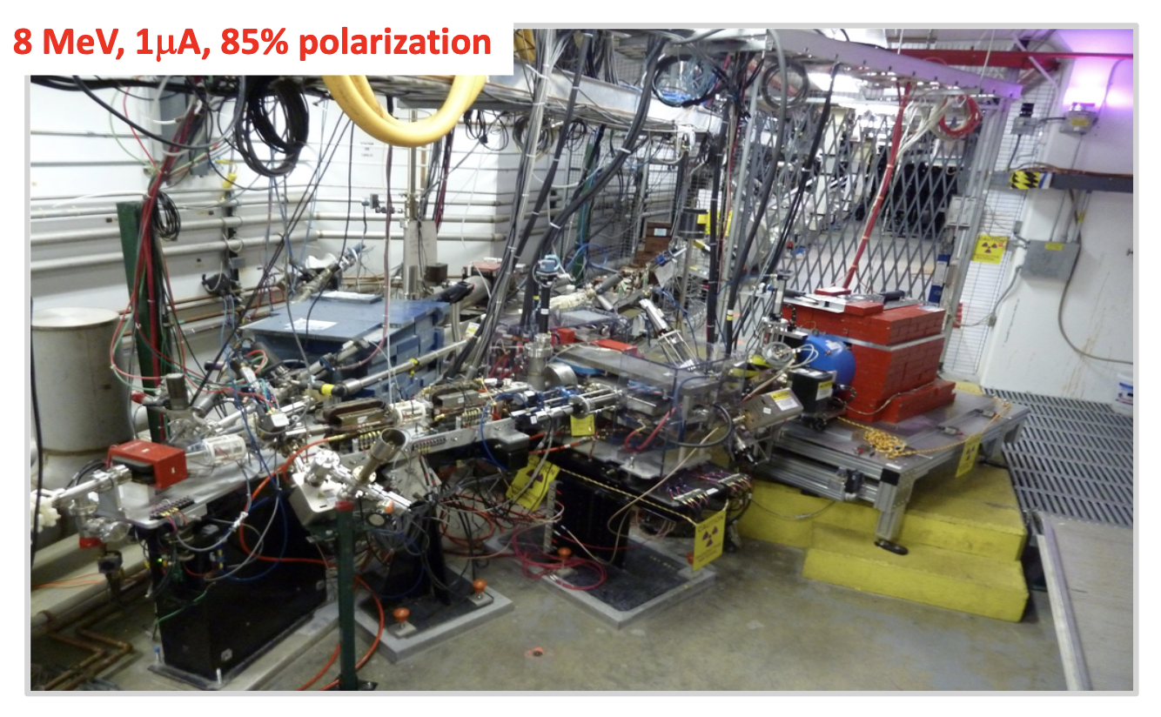
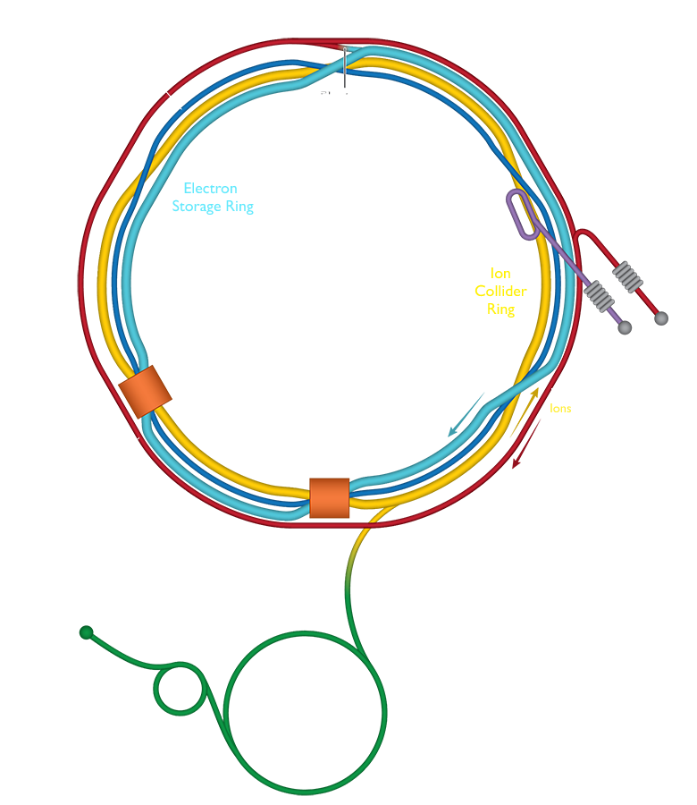
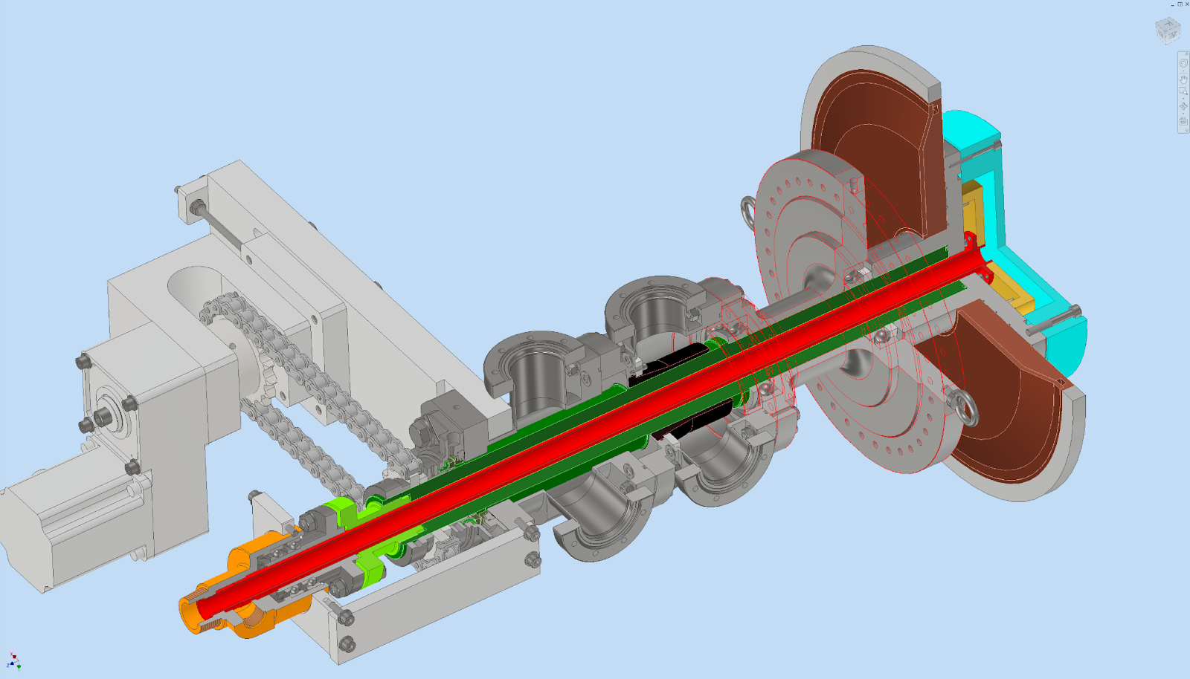
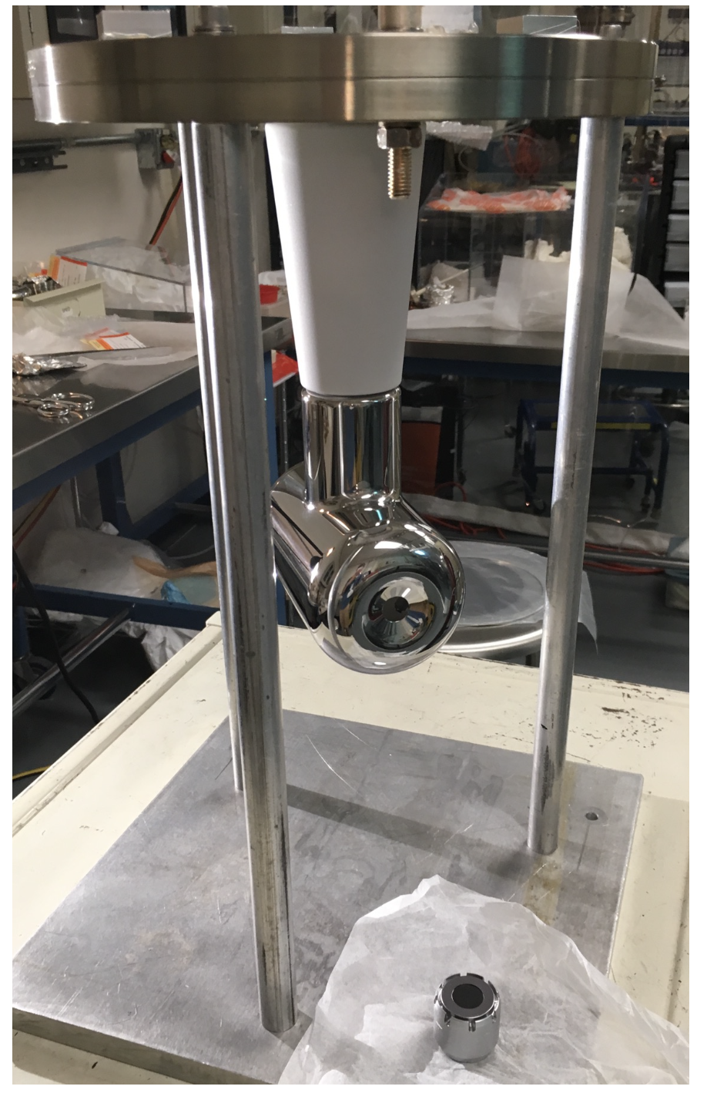
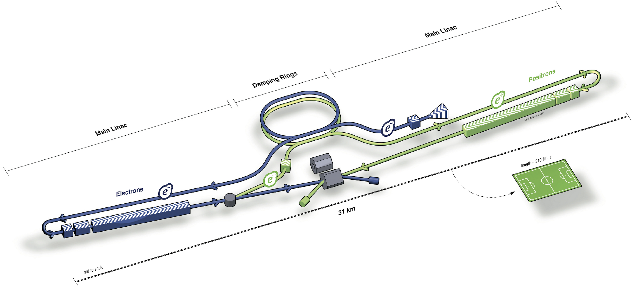
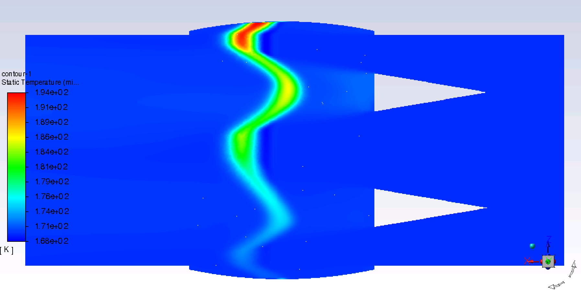



US-Japan Particle Sources Collaboration
The KEK, JLab, SLAC particle sources collaboration has been awarded two US-Japan grants.
FY24: Advanced Electron and Positron Source Concepts
FY25-26: Advanced Positron Source Concepts
The US-Japan Particle Sources Collaboration addresses particle source R&D topics relevant to the ILC, EIC, CEBAF facilities, as well as advanced R&D for future ultra-high-power sources.
Colliders and Facilities
R&D Topics
Design of e⁻-driven ILC e⁺ source
CEBAF e⁺ source
ILC
CFD modeling of LXe target
400V insulator design for e⁻ source

Slide 26
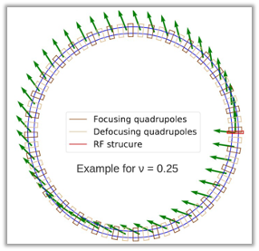
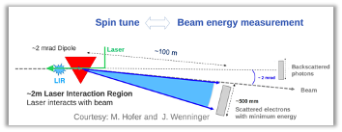
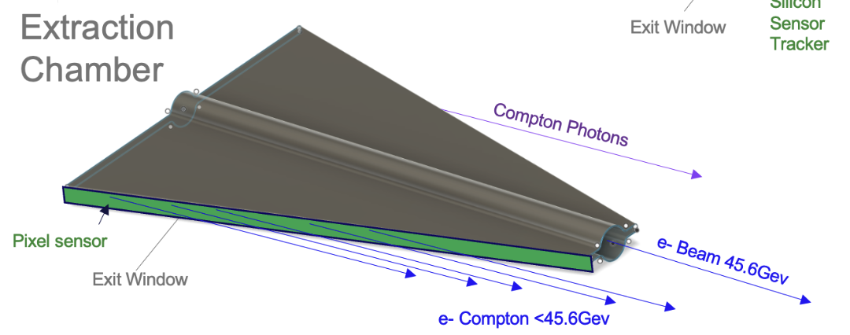
Compton Polarimetry Challenge at FCC-ee
The electron beam energy must be measured at the level of 10⁻⁶ at FCC-ee in order to measure the width of the Z boson.
This is only possible with spin tune measurements, but the FCC bunches are not polarized.
The FCC plans to produced weakly-polarized (10%) pilot bunches for this measurement.
Proposal: test measurement strategies and detectors for weak Compton signals using E320 setup.
R. Kiefer, FCC Week 2024
https://indico.cern.ch/event/1298458/contributions/5977825/attachments/2877527/5039902/2024_06_13_Polarimeter_FCCweek_p.pdf

Slide 27
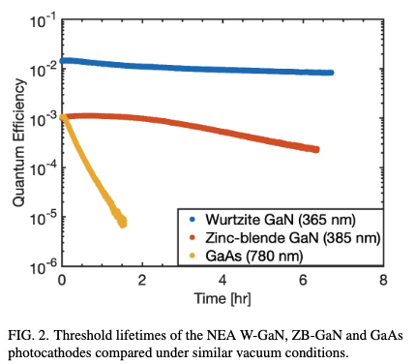
Compton Polarimetry at FACET-II?
FACET-II does not produce polarized electrons.
In general, it is not possible to use polarized cathode (GaAs) in RF guns because they do not survive the poor vacuum compared to DC guns.
But new ideas are currently in development! We are working with:
John Smedley, SLAC
Joe Grames, JLab
Jared Maxson, Cornell
to understand polarized source options for FACET-II.
Levenson, S. Measurement of Spin-Polarized Photoemission from Wurtzite and
Zinc-Blende Gallium Nitride Photocathodes. arXiv:2405.04481. 2024.

Slide 28
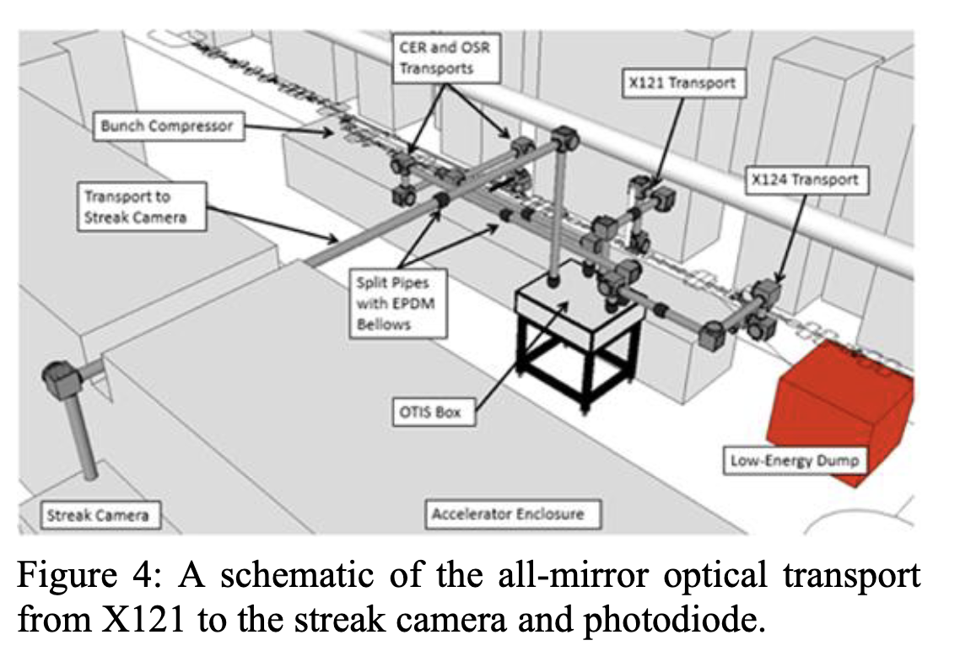
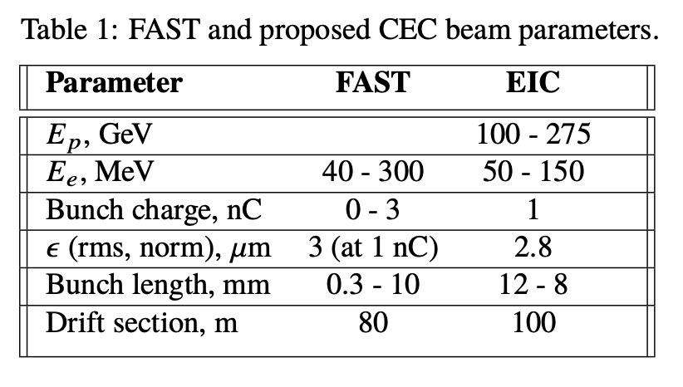
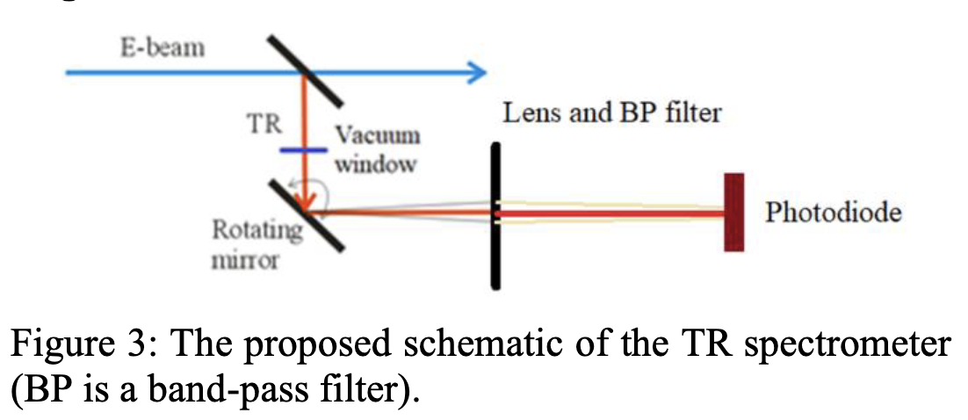
Electron bunch noise measurement for EIC
Electron bunch structure measurements were performed at FAST as part of EIC Coherent Electron Cooling R&D.
Near-IR Noise in Intense Electron Beams, Kladov, et al. IPAC24.
FACET-II can continue this research (similar injector parameters) and it also benefits FACET-II ABP program to better understand microbunching instability.

Slide 29
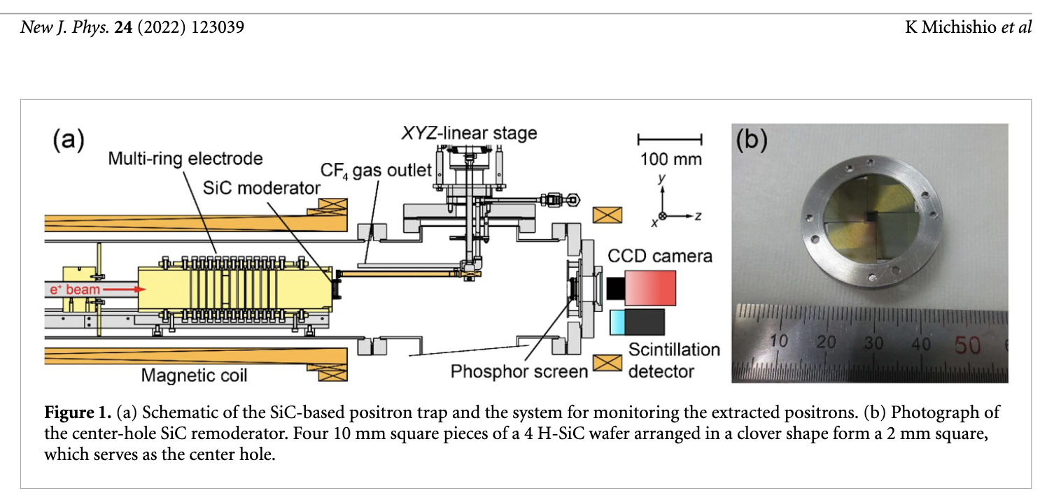
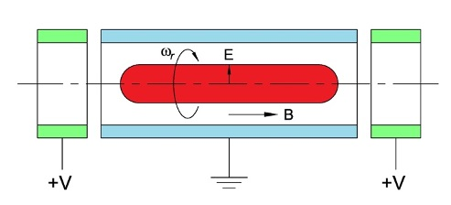
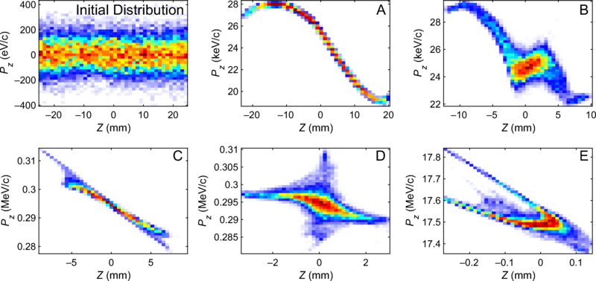
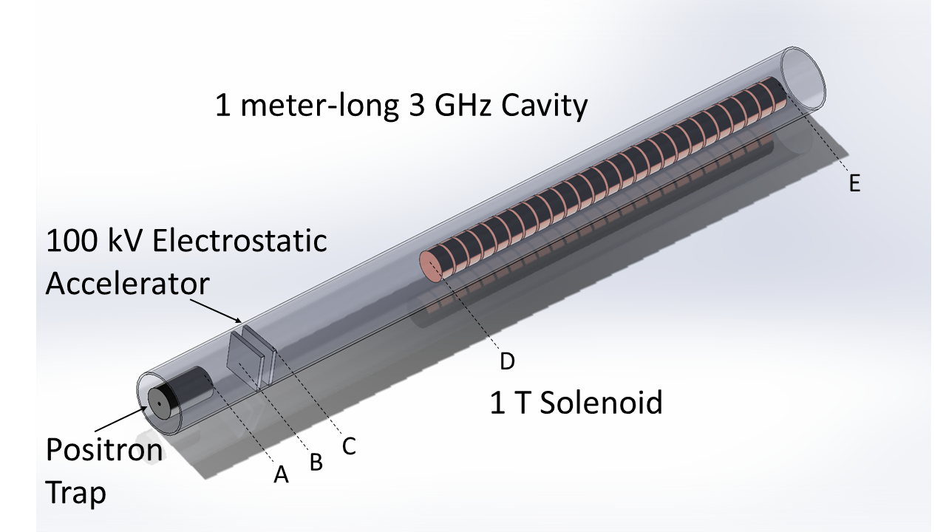
Compact Positron Source (SLAC LDRD)
SLAC is funding a 2-year LDRD on the design of a Compact Positron Source.
The Compact Positron Source is based on a Penning-Malmberg trap and produces 100 nm emittances without a damping ring.
Extraction and compression of the beam from the trap is a major beam physics challenge!
The Compact Positron Source is being explored as a low-cost option for bringing positrons back to FACET. It achieves cost savings by eliminating the following systems:
High-energy target
Positron return line
Positron damping ring
The design will start in FY25 and prototyping will start in FY26.
Penning-Malmberg Trap
AIST Trap for pulsed source
Compact Source of Positron Beams with Small Thermal Emittance, R. Hessami and S. Gessner. Phys. Rev. Accel. Beams 2023.

Slide 30
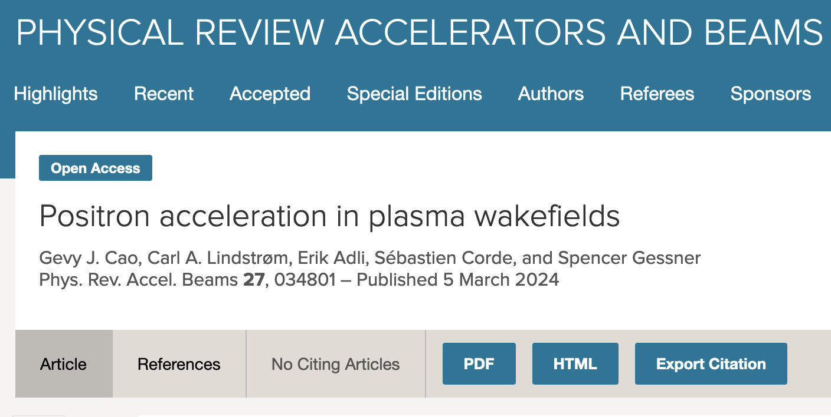





Positron PWFA Research at FACET-II
Review Article
Positrons are desired for very high energy e⁺e⁻ collisions, but there are challengers with accelerating positrons in plasma. We have a recent review article on this topic.
One concept stands out as the most promising for accelerating positrons: the finite-radius regime.
The E333 experiment at FACET-II is investigating the finite-radius regime while we wait for positron beams to become available. CU Boulder Ph.D. student is leading the experimental effort.
Stage 1: Demonstrate finite radius plasma with axicon and multi-optic ionization.
Stage 2: Demonstrate electron alignment to channel and guiding properties.
Stage 3: Wakefield measurements with electron driver and electron witness.
Stage 4 (when positrons are available): Demonstrate electron beam-driven acceleration of positrons.
S. Diederichs, et al, “High-quality positron acceleration in beam-driven plasma accelerators,” PRAB, 2020.
E333 Experiment at FACET-II, PI S. Gessner: Demonstration of finite-radius regime.

