Slide 1






Including beam-beam effects in
collimation studies for the FCC-ee
G. Broggi^{1,2,3}, A. Abramov², K. André², M. Boscolo³, R. Bruce², X. Buffat², M. Hofer², P. Kicsiny^{2,4}, S. Redaelli², T. Pieloni⁴
¹ Sapienza University of Rome, Italy
³ INFN-LNF, Frascati, Italy
² CERN, Meyrin, Switzerland
⁴ LPAP, EPFL, Lausanne, Switzerland
ICFA mini workshop on Beam-Beam Effects in Circular Colliders 2024 – Lausanne, Switzerland, 05/09/2024
Many thanks to:
A. Lechner, S. Marin, M. Migliorati, L. Nevay, G. Iadarola, A. Perillo-Marcone, L. van Riesen-Haupt, F. Zimmermann

Slide 2
Outline
Introduction
  Collimation for the FCC-ee
  FCC-ee collimation system
  Collimation and beam-beam effects
FCC-ee collimation simulations
FCC-ee Z mode spent beam losses
Addition of tertiary collimators for local protection
Summary and next steps
05/09/2024
G. Broggi | Including beam-beam effects in collimation studies for the FCC-ee

Slide 3
Outline
Introduction
  Collimation for the FCC-ee
  FCC-ee collimation system
  Collimation and beam-beam effects
FCC-ee collimation simulations
FCC-ee Z mode spent beam losses
Addition of tertiary collimators for local protection
Summary and next steps
05/09/2024
G. Broggi | Including beam-beam effects in collimation studies for the FCC-ee

Slide 4
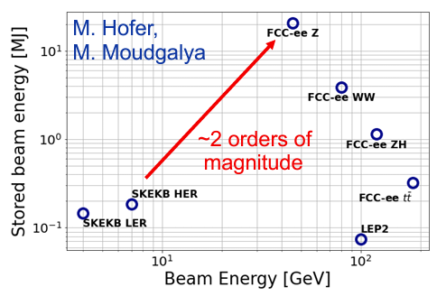
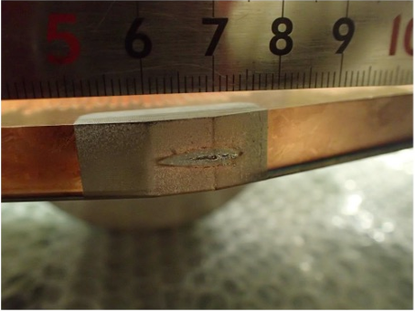
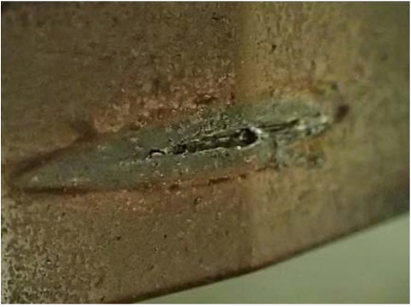
Collimation for the FCC-ee
Comparison of lepton colliders
FCC-ee is the FCC first stage e⁺e⁻ collider
  90.7 km circumference, tunnel compatible with FCC-hh
  4 beam operation modes, optimized for production of different particles:
  Z (45.6 GeV), W (80 GeV), H (120 GeV), ttbar (182.5 GeV)
FCC-ee presents unique challenges
  Unprecedented stored beam energy for a lepton collider: up to 17.5 MJ in the Z operation mode (45.6 GeV)
  Highly destructive beams: collimation system indispensable
  The main roles of the collimation system are:
    Reduce background in the experiments
    Protect the machine from unavoidable losses
  Two types of collimation currently foreseen for the FCC-ee:
    Beam halo (global) collimation
    Synchrotron Radiation (SR) collimation – around the IPs
    Secondary particle shower absorbers: under study (S. Marin, A. Lechner)
Damage to coated collimator jaw due to accidental beam loss in the SuperKEKB – T. Ishibashi (talk)
05/09/2024
G. Broggi | Including beam-beam effects in collimation studies for the FCC-ee

Slide 5
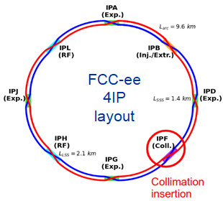
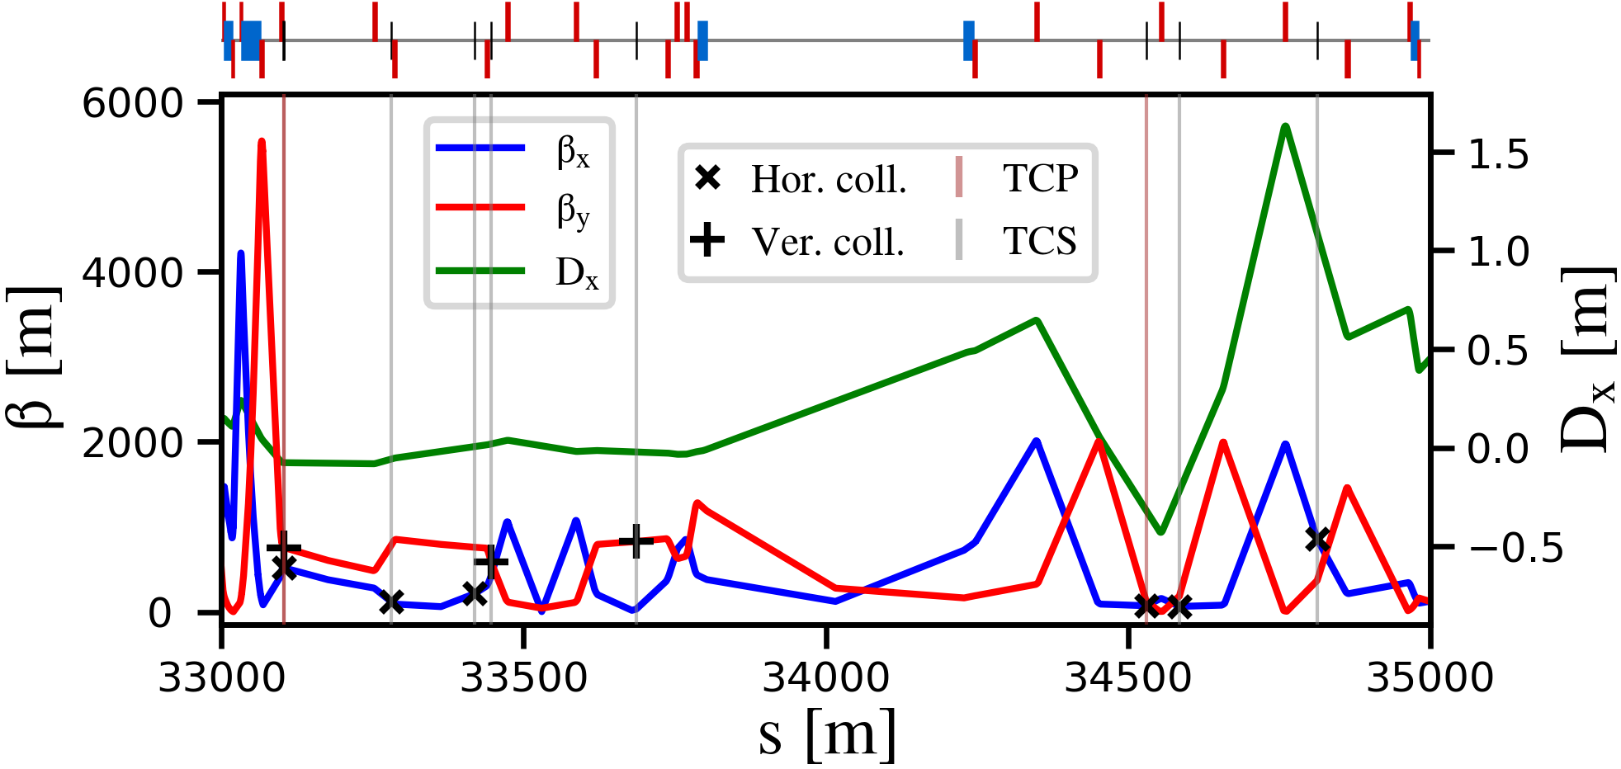
M. Hofer
FCC-ee halo collimation system
Dedicated halo collimation system in PF
  Dedicated collimation optics (M. Hofer)
  Two-stage betatron and off-momentum collimation system in one insertion
  Ensure protection of the aperture bottlenecks in different conditions
    Aperture bottleneck at Z: 14.6σ (H plane), 84.2σ (V plane)
  First collimator design for cleaning performance
    Ongoing studies for optimizing the collimator design (G. Broggi – IPAC’24 paper)
betatron
off-momentum
FCC-ee beam halo collimator parameters and settings
Name | Plane | Material | Length [cm] | Gap [σ] | Gap [mm] | δ_{cut} [%]
TCP.H.B1 | H | MoGr | 25 | 11 | 6.7 | 8.9
TCP.V.B1 | V | MoGr | 25 | 65 | 2.4 | -
TCS.H1.B1 | H | Mo | 30 | 13 | 3.8 | 6.7
TCS.V1.B1 | V | Mo | 30 | 75 | 2.5 | -
TCS.H2.B1 | H | Mo | 30 | 13 | 5.1 | 90.6
TCS.V2.B1 | V | Mo | 30 | 75 | 3.0 | -
TCP.HP.B1 | H | MoGr | 25 | 18.5 | 4.2 | 1.3
TCS.HP1.B1 | H | Mo | 30 | 21.5 | 4.6 | 2.1
TCS.HP2.B1 | H | Mo | 30 | 21.5 | 16.8 | 1.6
FCC-ee V23, tridodo_572 collimation optics
Further materials will be studied
05/09/2024
G. Broggi | Including beam-beam effects in collimation studies for the FCC-ee

Slide 6
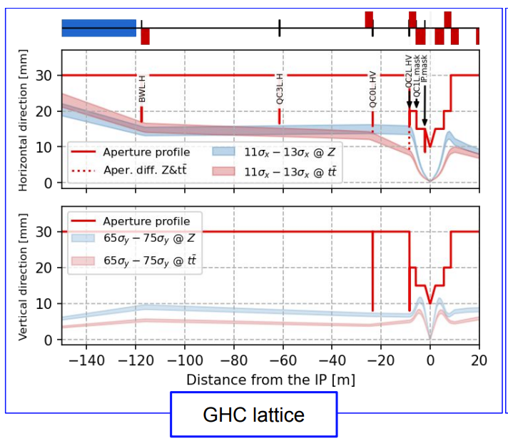
FCC-ee SR collimation system
Synchrotron radiation collimators around the IPs
  6 movable collimators and 2 fixed masks upstream of the IPs
  Designed to reduce detector backgrounds and power loads in the inner beampipe due to photon losses
FCC-ee SR collimators parameters and settings
Name | Plane | Material | Length [cm] | Gap [σ] | Gap [mm]
TCR.H.WL.B1 | H | W | 10 | 14.1 | 17.0
TCR.H.C3.B1 | V | W | 10 | 13.5 | 16.5
TCR.V.C0.B1 | V | W | 10 | 80.1 | 8.0
TCR.H.C0.B1 | H | W | 10 | 13.0 | 16.2
TCR.V.C2.B1 | V | W | 10 | 82.0 | 8.0
TCR.H.C2.B1 | H | W | 10 | 13.1 | 16.0
More details in K. André, FCC week 2024 talk
05/09/2024
G. Broggi | Including beam-beam effects in collimation studies for the FCC-ee

Slide 7


Collimation and beam-beam effects
Interactions at the IPs have a crucial role in FCC-ee beam dynamics
  Beamstrahlung, radiative Bhabha scattering, beam-beam kicks
  Main contribution to the beam lifetime in nominal operation
  Can produce distinct beam loss distributions around the ring
Large effort to model these effects in Xsuite (P. Kicsiny, X. Buffat, T. Pieloni)
  See talk by P. Kicsiny (FCCIS 23 talk)
  EPFL-led effort, part of a CHART-funded FCC software collaboration project
  Benchmarks show good agreement with established tools
  The models are modular and can be combined with other studies
Goal: integrate beam-beam effects in collimation tracking studies
  Multi-turn beam dynamics and beam losses of spent beam particles
  Effect of beam-beam interaction on collimation losses and distributions during collimation tracking
05/09/2024
G. Broggi | Including beam-beam effects in collimation studies for the FCC-ee

Slide 8
Outline
Introduction
  Collimation for the FCC-ee
  FCC-ee collimation system
  Collimation and beam-beam effects
FCC-ee collimation simulations
FCC-ee Z mode spent beam losses
Addition of tertiary collimators for local protection
Summary and next steps
05/09/2024
G. Broggi | Including beam-beam effects in collimation studies for the FCC-ee

Slide 9
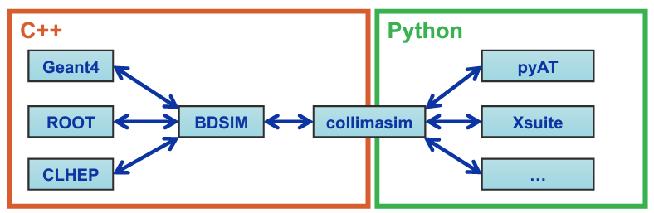
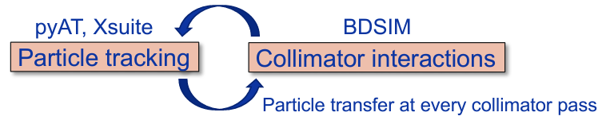
FCC-ee collimation simulations
FCC-ee presents unique challenges for collimation simulations
  Synchrotron radiation and magnet strength adjustment (tapering) to compensate it
  Complex beam dynamics – strong sextupoles in the lattice, strong beam-beam effects
  Detailed aperture and collimator geometry modelling
  Electron/positron beam particle-matter interactions
  Large accelerator system – 90+ km beamline
Ongoing effort for benchmarking Xsuite-BDSIM with data from lepton machines (SuperKEKB, DAΦNE)
Xsuite + BDSIM (Geant4) coupling
  Developed for FCC collimation simulations (A. Abramov, IPAC’22 paper, JINST paper)
  Benchmarked against
  Xsuite-FLUKA coupling being set up (F. Van der Veken, HB’23 paper, K. Skoufaris, FLUKA team)
other simulation codes: MAD-X, pyAT, Sixtrack-FLUKA (A. Abramov)
measured data from proton machines: SPS (T. Pugnat), LHC (G. Broggi)

Slide 10
Outline
Introduction
  Collimation for the FCC-ee
  FCC-ee collimation system
  Collimation and beam-beam effects
FCC-ee collimation simulations
FCC-ee Z mode spent beam losses
Addition of tertiary collimators for local protection
Summary and next steps
05/09/2024
G. Broggi | Including beam-beam effects in collimation studies for the FCC-ee

Slide 11
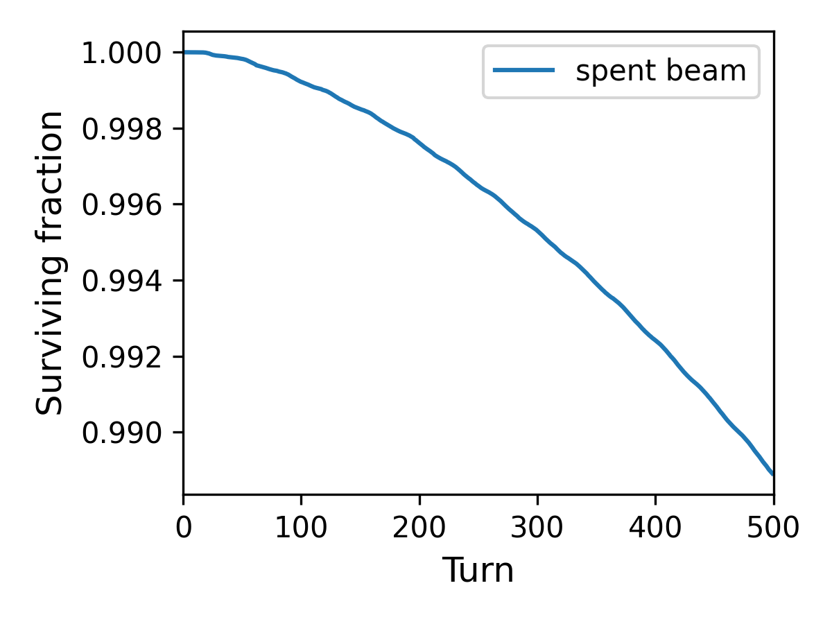
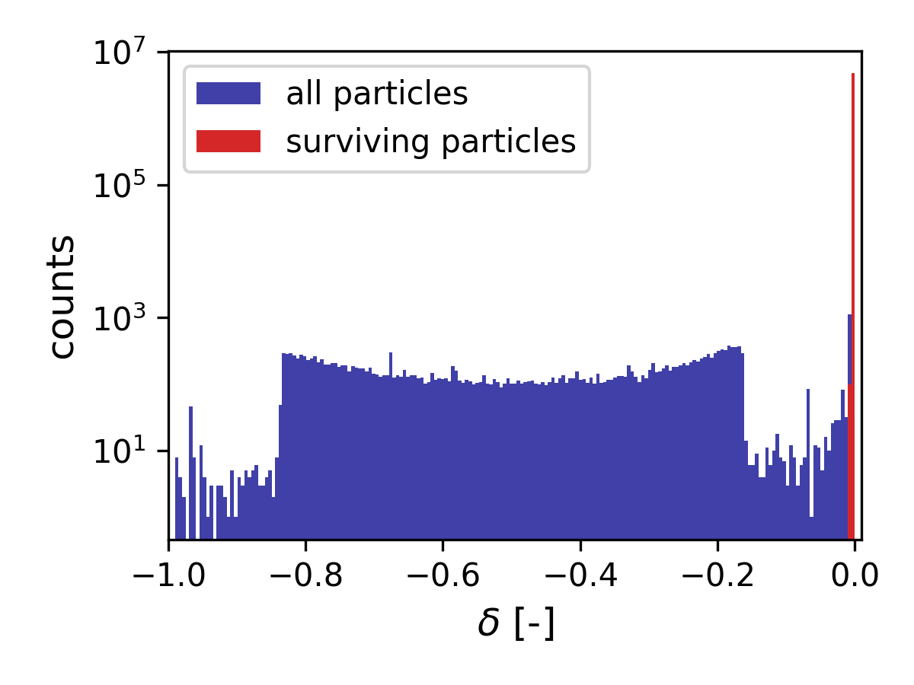
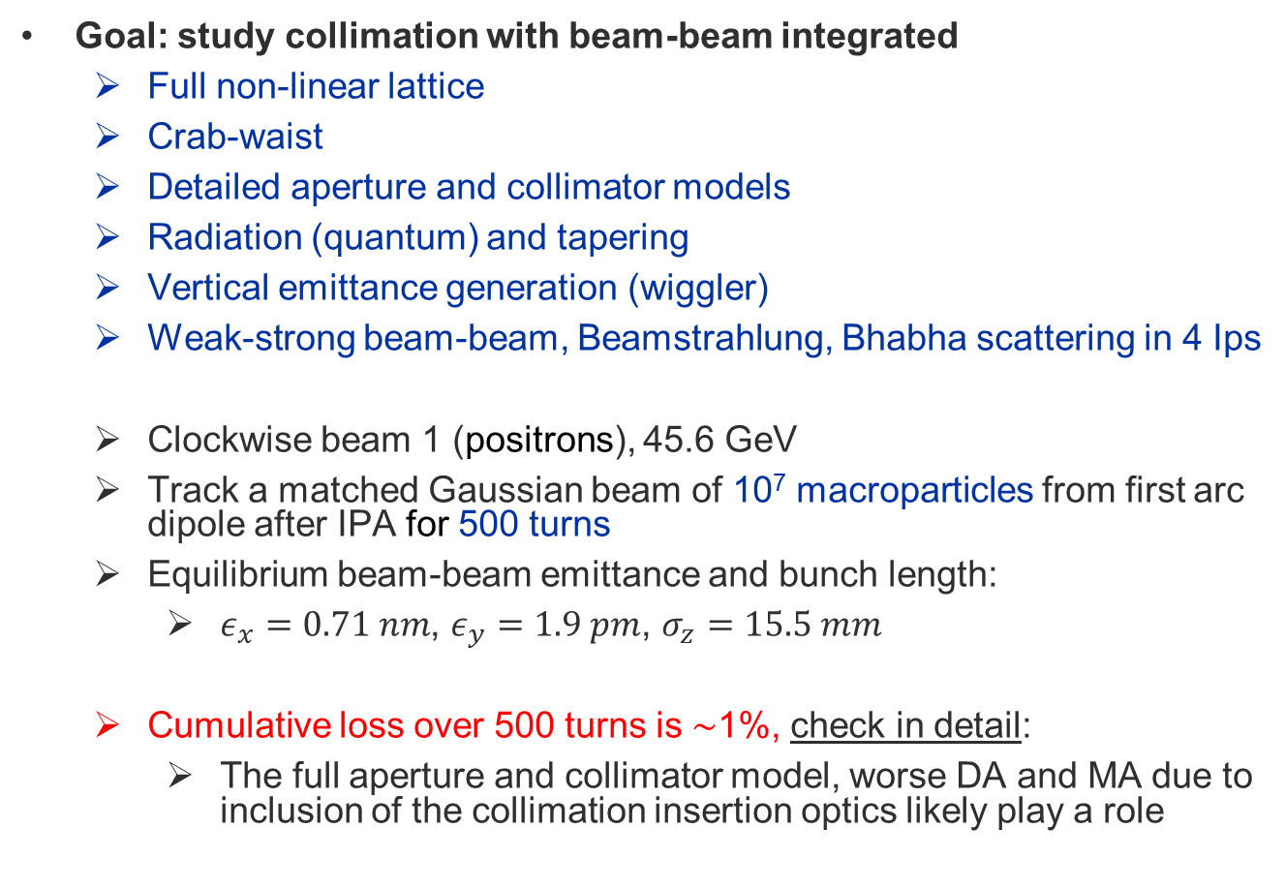
FCC-ee Z-mode spent beam losses
Goal: study collimation with beam-beam integrated
  Full non-linear lattice
  Crab-waist
  Detailed aperture and collimator models
  Radiation (quantum) and tapering
  Vertical emittance generation (wiggler)
  Weak-strong beam-beam, Beamstrahlung, Bhabha scattering in 4 Ips
  Clockwise beam 1 (positrons), 45.6 GeV
  Track a matched Gaussian beam of 10⁷ macroparticles from first arc dipole after IPA for 500 turns
  Equilibrium beam-beam emittance and bunch length:
    $ε_{x}=0.71 nm$, $ε_{y}=1.9 pm$, $σ_{z}=15.5 mm$
  Cumulative loss over 500 turns is ∼1%, check in detail:
    The full aperture and collimator model, worse DA and MA due to inclusion of the collimation insertion optics likely play a role
Needs to be understood and corrected in the future
05/09/2024
G. Broggi | Including beam-beam effects in collimation studies for the FCC-ee

Slide 12
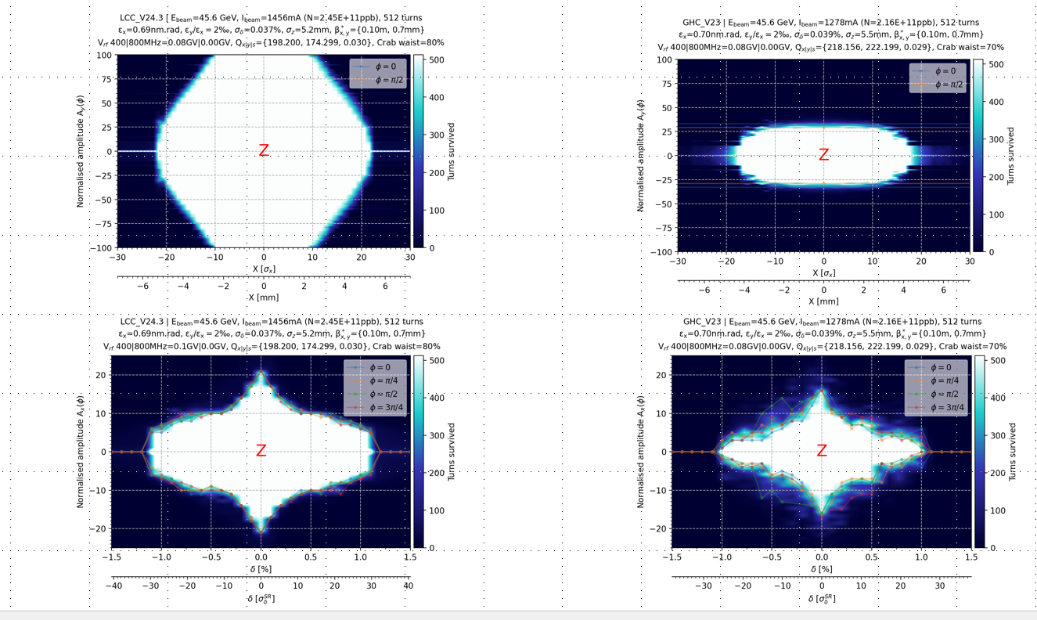
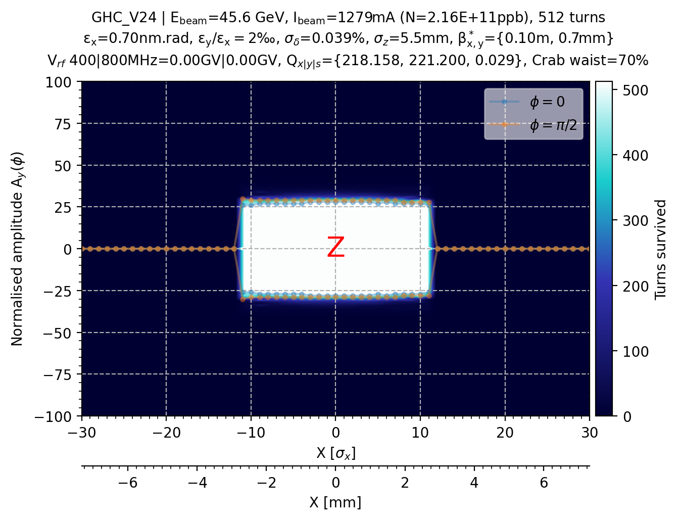
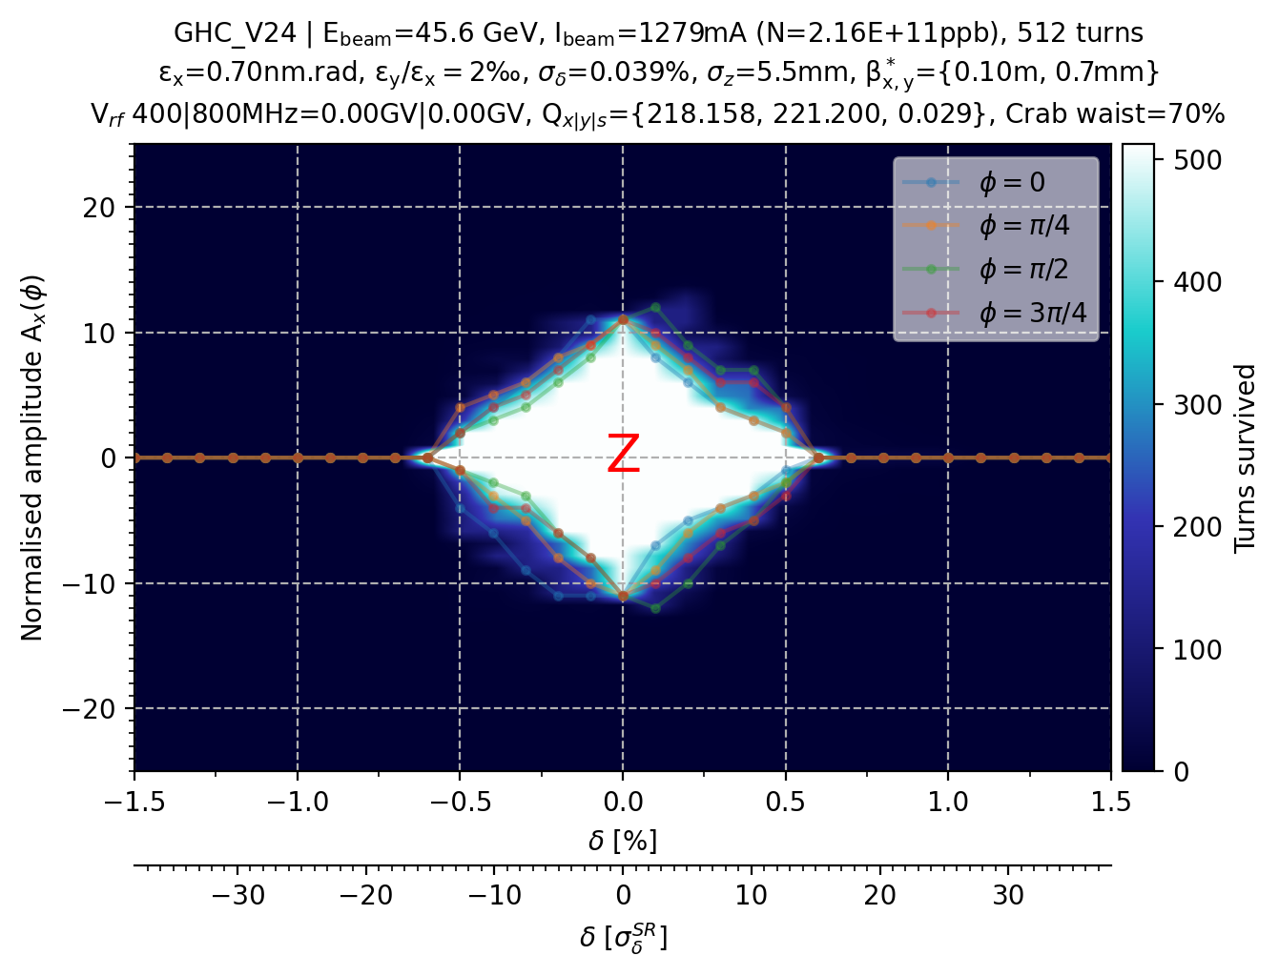
DA and MA with collimation insertion optics
Collimation insertion optics not included
Courtesy K. Andre
Including collimation insertion optics and full aperture and collimator model
Collimation insertion optics included
Courtesy K. Andre
    Only the loss distribution along the ring is considered, the lifetime from the simulation is not used: we cannot estimate the lifetime from this simulation
05/09/2024
G. Broggi | Including beam-beam effects in collimation studies for the FCC-ee

Slide 13
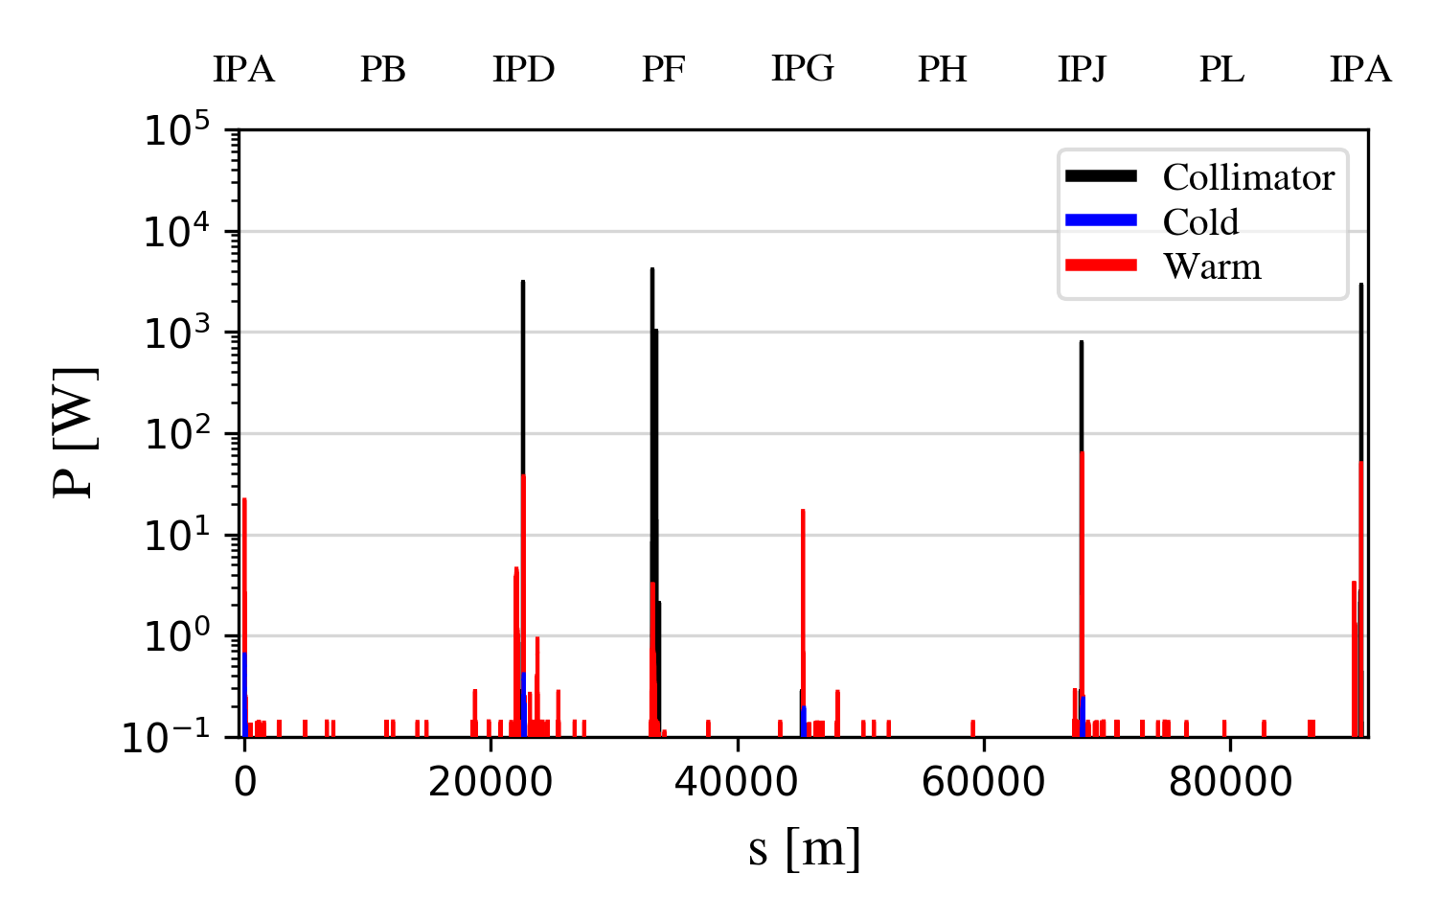
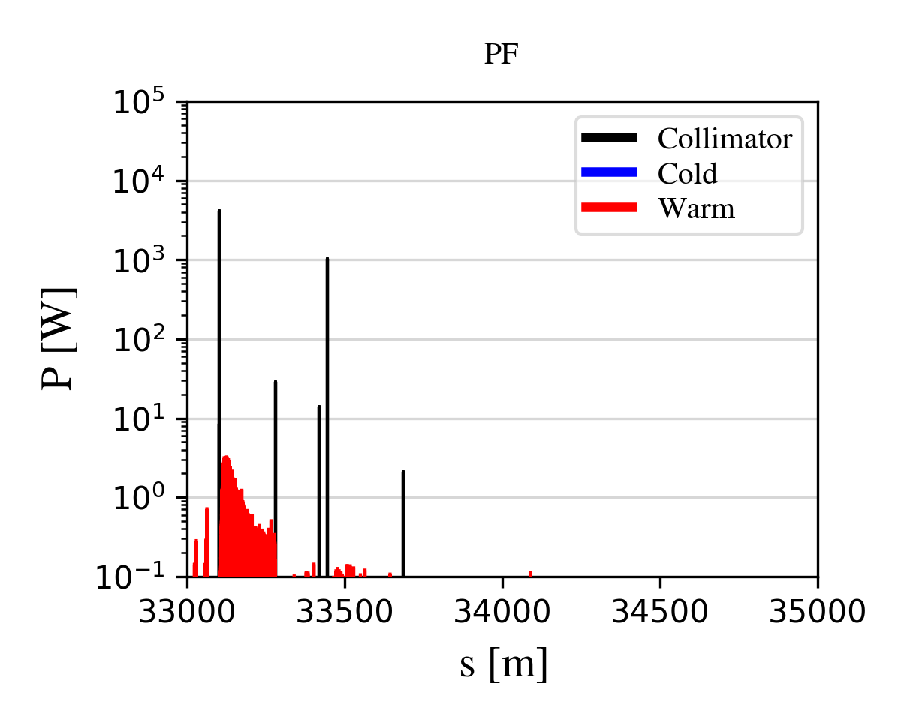
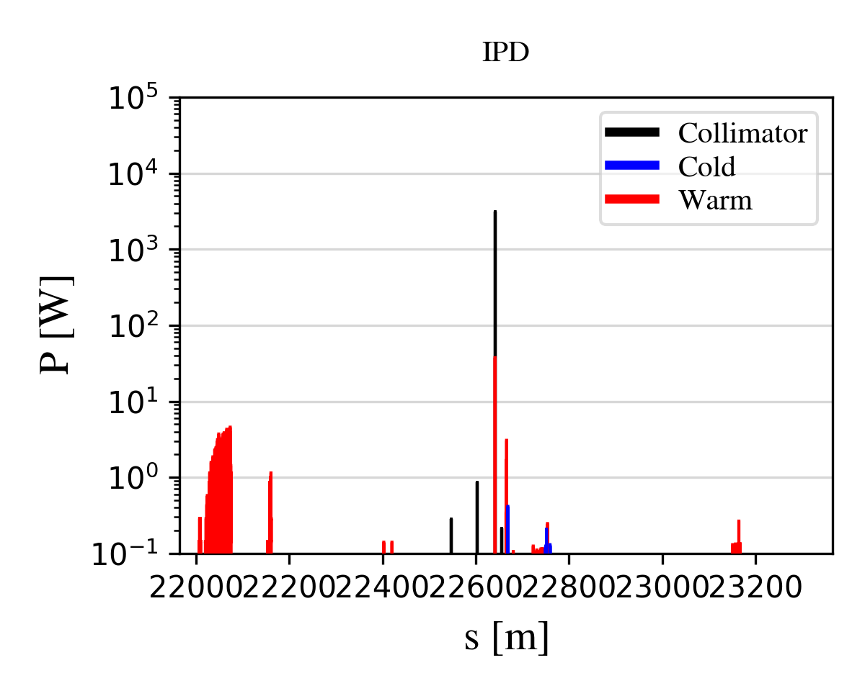
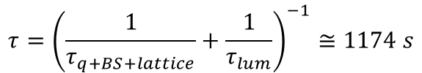
FCC-ee Z-mode spent beam losses
Lifetime for the Z mode, K. Oide talk
Lost particles accumulated to obtain loss maps
The loss maps are scaled to the combined nominal beam lifetime from lattice, SR, beamstrahlung and luminosity
Losses intercepted by betatron collimators in PF (43%)
Large losses on the TCR.V.C0 collimators in IPD, IPA and IPJ with no losses in IPG
  Up to 3.1 kW on a vertical SR collimator (TCR.V.C0)
  Likely single-pass losses that cannot be intercepted by the halo collimation system in PF
$$τ={\left(\frac{1}{τ_{q+BS+lattice}}+\frac{1}{τ_{lum}}\right)}^{−1}≅1174 s$$
Total loss power: 15 kW
TCR.V.C0
collimation insertion
Exp. interaction region
NO losses on off-momentum collimators
05/09/2024
G. Broggi | Including beam-beam effects in collimation studies for the FCC-ee

Slide 14
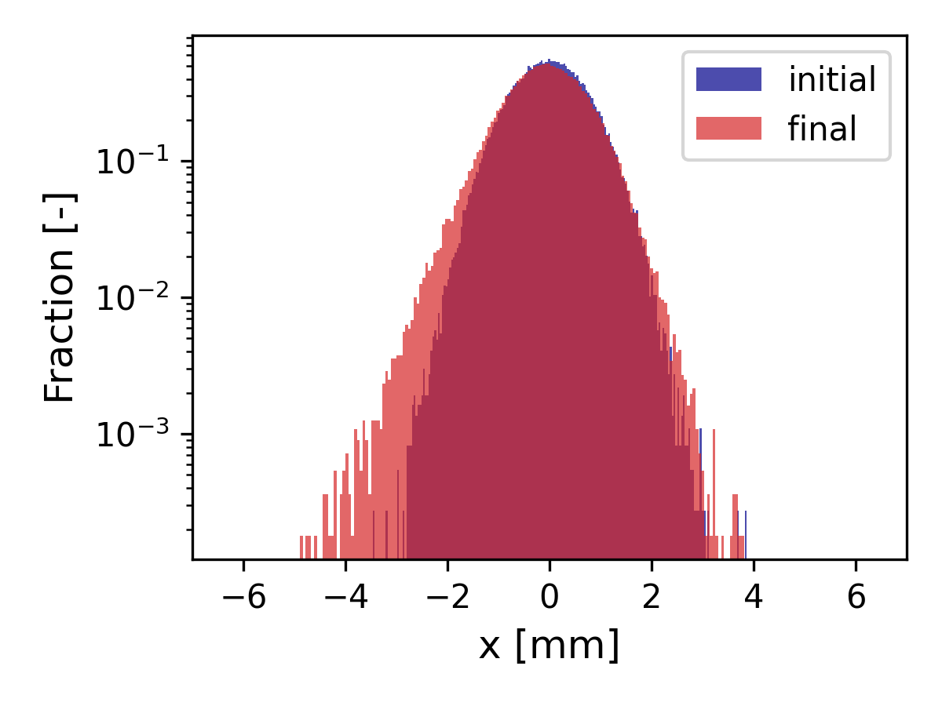
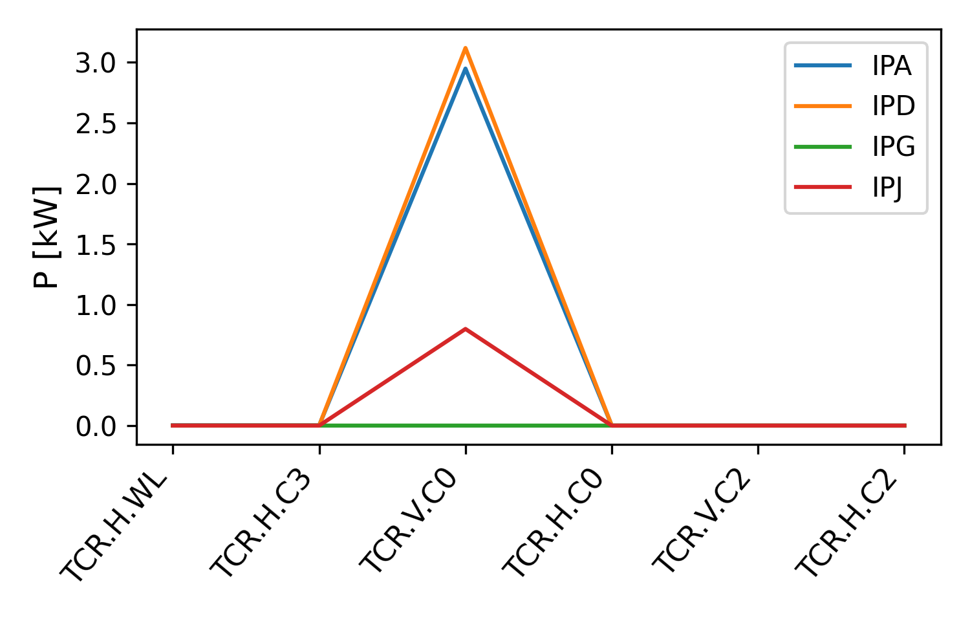
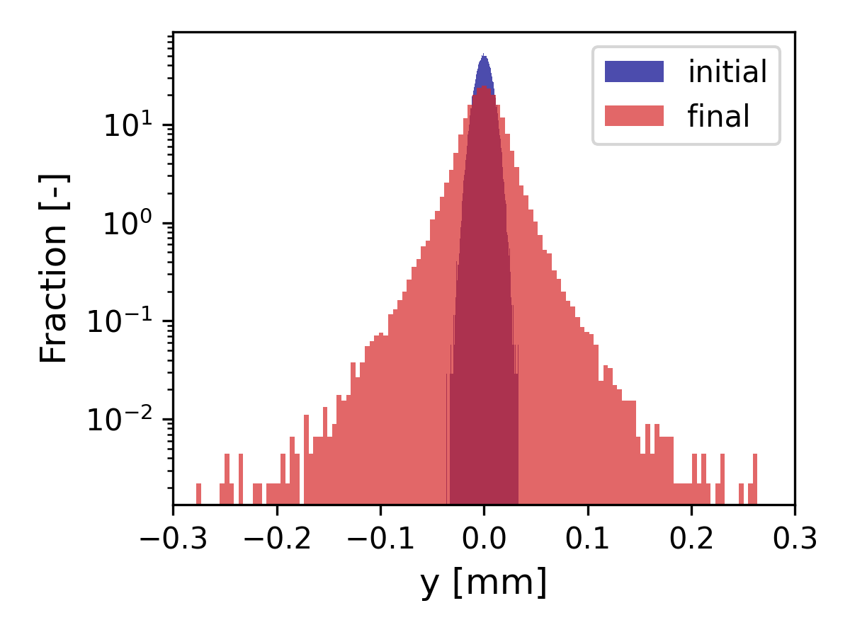
Transverse distribution after 500 turns
FCC-ee Z-mode spent beam losses
The high losses on SR collimators are in the vertical plane
The losses are driven by a strong blow-up in the V plane
SR collimators are not primarily designed for intercepting beam losses
  They might be damaged
  Being close to the IPs, they might induce backgrounds
Tertiary collimators (TCTs) for local protection ?
05/09/2024
G. Broggi | Including beam-beam effects in collimation studies for the FCC-ee

Slide 15
Outline
Introduction
  Collimation for the FCC-ee
  FCC-ee collimation system
  Collimation and beam-beam effects
FCC-ee collimation simulations
FCC-ee Z mode spent beam losses
Addition of tertiary collimators for local protection
Summary and next steps
05/09/2024
G. Broggi | Including beam-beam effects in collimation studies for the FCC-ee

Slide 16
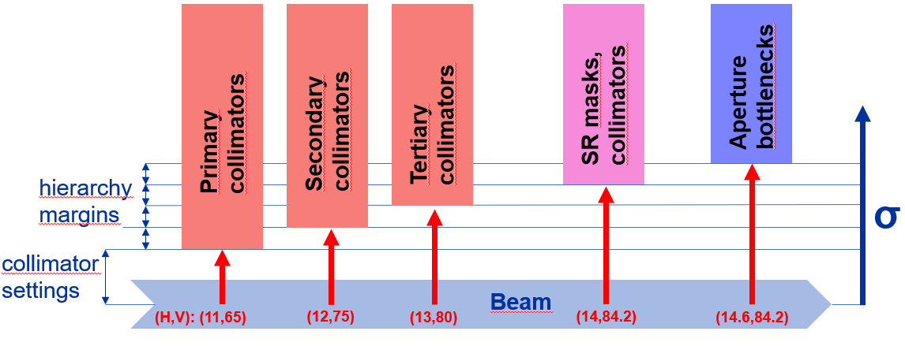
Tertiary collimators for local protection
Spent-beam losses shows the highest beam losses on SR collimators upstream of the IPs
Addition of two (H+V) tertiary collimators (TCTs) for local protection
  Placed ~690 m (H) ~420 m (V) upstream of each IP
  s-location optimized to have optimal phase-advance (multiple of π) between TCTs and
Collimator settings adjusted to fit the TCTs in the collimation hierarchy:
SR collimators
aperture bottlenecks
Name | Plane | Material | Length [cm] | Gap [σ] | Gap [mm]
TCT.H.B1 | H | MoGr | 25 | 13 | 3.4
TCT.V.B1 | V | MoGr | 25 | 80 | 6.1
FCC-ee tertiary beam halo collimator parameters and settings
05/09/2024
G. Broggi | Including beam-beam effects in collimation studies for the FCC-ee

Slide 17
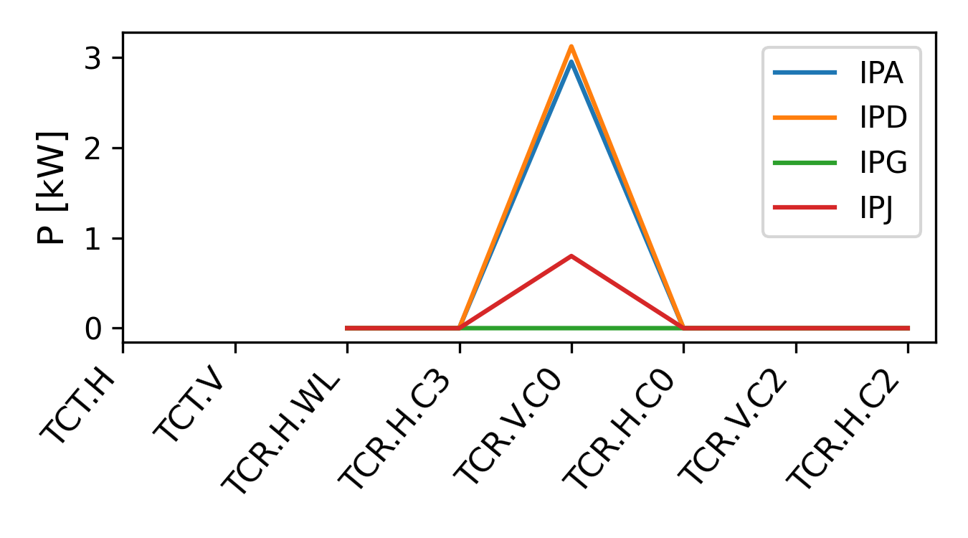
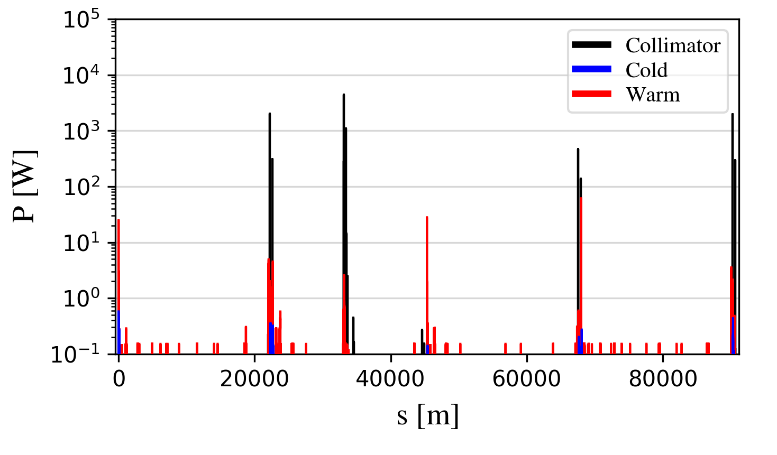
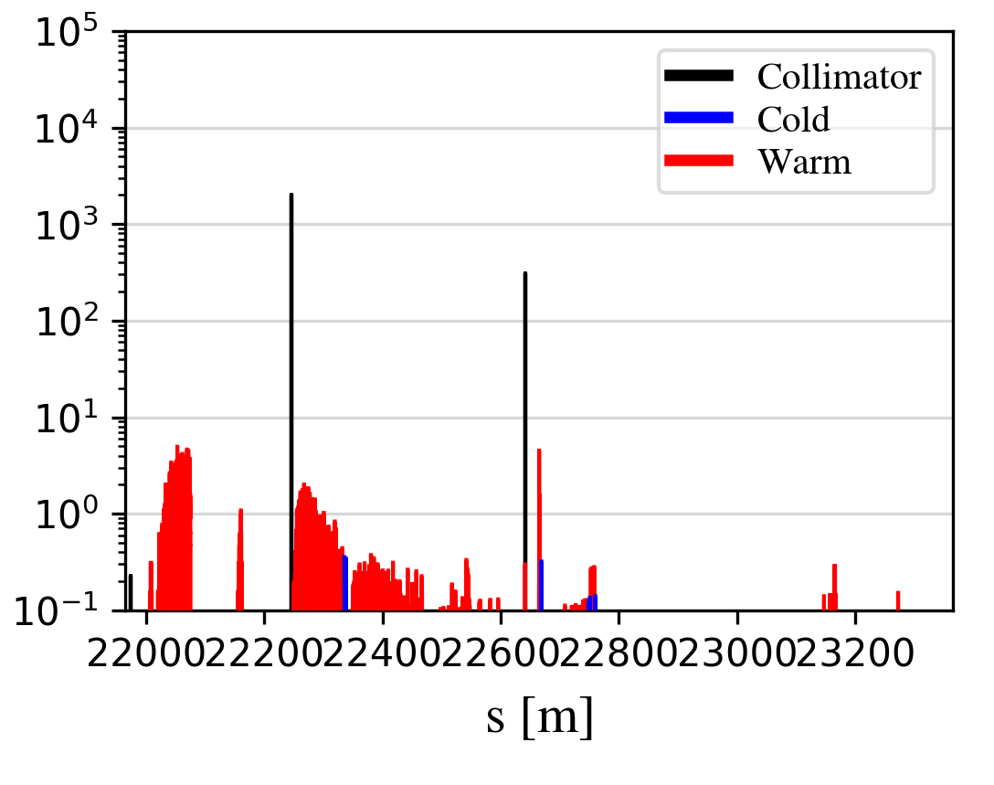
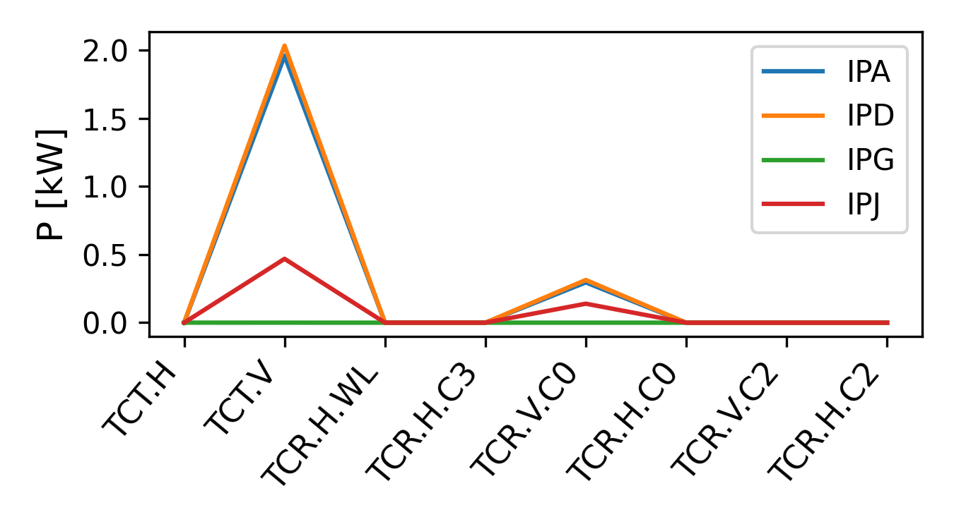
Collimation performance with beam-beam and TCTs
TCR.V.C0
Exp. interaction region
TCT.V
TCR.V.C0
Exp. interaction region
Adding TCTs
Addition of TCTs suppresses by one order of magnitude the power loads on the SR collimators
05/09/2024
G. Broggi | Including beam-beam effects in collimation studies for the FCC-ee
Notes:
The leakage to the SR collimators could potentially be reduced further in the future by optimizing the length and material of the TCTs, and maybe adding additional absorbers/masks after them.

Slide 18
Outline
Introduction
  Collimation for the FCC-ee
  FCC-ee collimation system
  Collimation and beam-beam effects
FCC-ee collimation simulations
FCC-ee Z mode spent beam losses
Addition of tertiary collimators for local protection
Summary and next steps
05/09/2024
G. Broggi | Including beam-beam effects in collimation studies for the FCC-ee

Slide 19
Summary
First integrated beam-beam and collimation studies performed
  Spent beam losses for the FCC-ee Z-mode
  Demonstrate the feasibility of combining collimation and beam-beam studies in the same model
  Important input for the optimization of the FCC-ee collimation system design
Spent beam losses show the highest power loads on the SR collimators upstream of the IPs
  Tertiary beam halo collimators (TCTs) for local protection included in the FCC-ee collimation system
  Integrated beam-beam and collimation simulations show their effectiveness in suppressing the power loads on the SR collimators: suppression of up to one order of magnitude
Next steps
Lifetime from integrated beam-beam and collimation simulations cannot be estimated yet
  Need to optimize DA and MA with collimation insertion optics and full aperture and collimator model
The need for shower absorbers downstream of the TCTs needs to be assessed
Investigate further particle distr. after beam-beam interactions - physics debris collimators like in the LHC ?
Iterate the collimation system design with other studies (SR backgrounds, impedance, energy deposition, radiation studies, mechanical design, …)
05/09/2024
G. Broggi | Including beam-beam effects in collimation studies for the FCC-ee

Slide 20
Thank you!
05/09/2024
G. Broggi | Including beam-beam effects in collimation studies for the FCC-ee

Slide 21
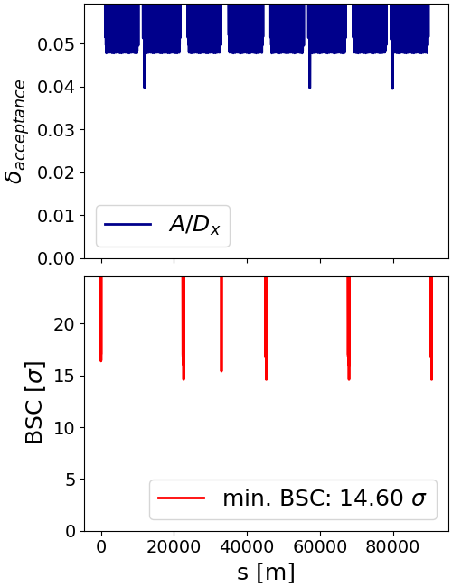
FCC-ee aperture
Aperture bottleneck for Z operation mode
Closed orbit tolerance: 250 μm
Maximum beta-beating: 10%
The momentum acceptance is the δ=A/D_{x}, where A is the mechanical aperture and D_{x} is the dispersion
M. Hofer
The Beam-Stay-Clear (BSC) is the beam-to-aperture distance in units of beam size
05/09/2024
G. Broggi | Including beam-beam effects in collimation studies for the FCC-ee

Slide 22
SR masks, collimators
Aperture
bottlenecks
Primary collimators
Secondary collimators
Tertiary collimators
hierarchy margins
σ
collimator settings
Beam
(H,V): (11,65)
(12,75)
(13,80)
(14,84.2)
(14.6,84.2)

