Slide 1
pyTRAIN a modern TRAIN implementation
Michi Hostettler, Xavier Buffat, Tobias Persson,
Tatiana Pieloni, Jorg Wenninger

Slide 2
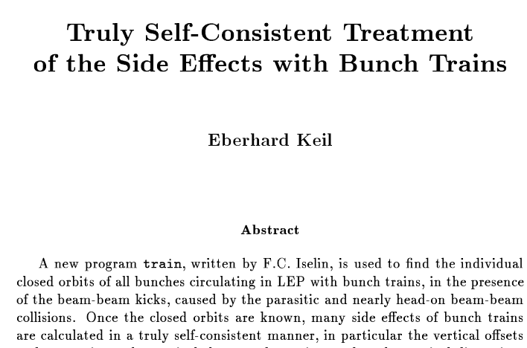
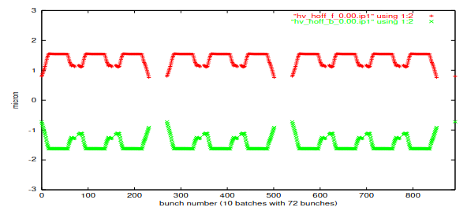
a brief history TRAIN
iteratively find self-consistent closed orbits
  under the presence of beam-beam effects
  in the many-bunch case ("trains")
  using second-order sectormaps from MAD-X
  “soft-Gaussian” approach
pioneered by E. Keil, F.C. Iselin for LEP
applied to LHC design by W. Herr, H. Grote
  showed clear advantage of V-H alternating crossing scheme over H-H crossing
  showed "PACMAN" effects (bunches missing long-range encounters due to kicker gaps)
  later further extended by T. Pieloni,
  A. Gorzawski, M. Hostettler, X. Buffat, A. Ribes
W. Herr, "Features and implications of different LHC crossing schemes", LHC project report 628, 2003.

Slide 3
TRAIN in a nutshell
input (from MAD-X)
main iteration loop
survey
(design separation)
insert beam-beam kick maps for all bunches
(based on current closed orbits)
post-processing
twiss output
with beam-beam markers
analyze final second-order maps: tunes, chromaticities
second-order maps K_{i}, R_{ij}, T_{ijk}
between beam-beam markers
find new closed orbits
for all bunches
write output
preparation
establish collision schedule
(which bunches encounter where?)
convergence?
(|co_{N-1} - co_{N}| < ε
for all bunches)
YES
find initial closed orbit
(no beam-beam)
NO

Slide 4
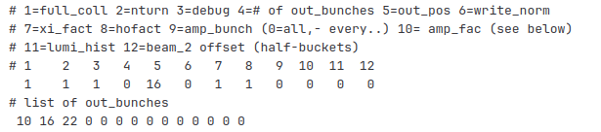
historic TRAIN limitations
ltrain.f, one flat file, 12145 lines of FORTAN-77
  local implementation of all numeric primitives (linear algebra, …)
    partially copied from historic MAD-8 or MAD-X code
    not always numerically stable or the most efficient
  no version control, no changelog (ktrain, ltrain, mtrain, …)
historic input formats
  flat files of records/numbers
  read(..., *) in
  MAD-X maps: historic scripts
limited extensibility & scriptability
  today most analysis is done in python / Jupyter
  first version of pyTRAIN: TRAIN python interface
    limited to running TRAIN in full, no control over the process, output only for BB points

Slide 5

the FORTRAN TRAIN code served us well for many years
now it is time to move on

Slide 6

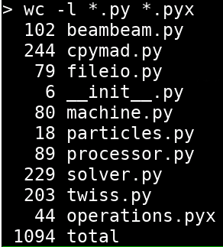
pyTRAIN: a modern re-implementation
complete re-implementation in python
using numpy and scipy primitives
  linear algebra, Faddeeva function, …
interface to MAD-X via cpymad
  reading MAD-X output from files also possible
total 1050 lines of python code
  44 lines of Cython: concatenation of second-order maps
performance similar to FORTAN-77 code
  slightly slower - not the first priority
  few minutes to solve full LHC with ~2400 bunches
https://gitlab.cern.ch/mihostet/pytrain/-/tree/pure-python

Slide 7
pyTRAIN - basic usage
from pytrain.fileio import read_train_files
from pytrain.machine import FillingScheme
from pytrain.solver import solve_train
# read survey, twiss & sector map input files (alternatively use included cpymad utils)
machine, twiss_b1, twiss_b2, maps_b1, maps_b2 = read_train_files('train-output')
# construct a "filling scheme": bunch intensities & normalized emittances
filling_scheme = FillingScheme(int_b1, int_b2, emit_b1x, emit_b1y, emit_b2x, emit_b2y)
# solve self-consistent orbits with BBLR interactions
result = solve_train(machine, filling_scheme, twiss_b1, maps_b1, twiss_b2, maps_b2)
# bunch-by-bunch closed orbit at any element
co_b1_x, co_b1_y = result.bunch_positions_b1('MKIP5')
co_b2_x, co_b2_y = result.bunch_positions_b2('MKIP5')
https://gitlab.cern.ch/mihostet/pytrain/-/tree/pure-python

Slide 8
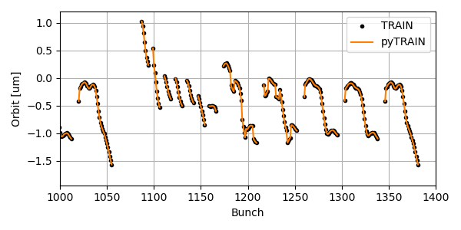
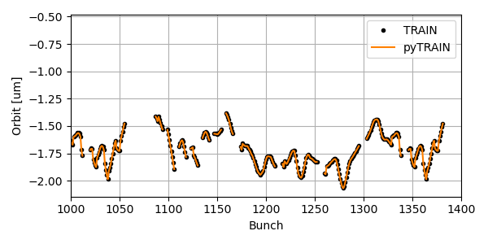
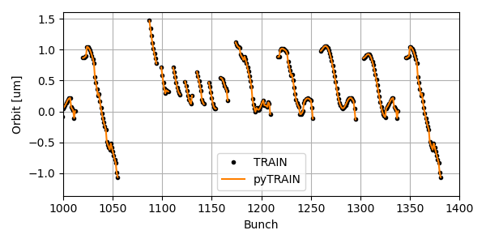
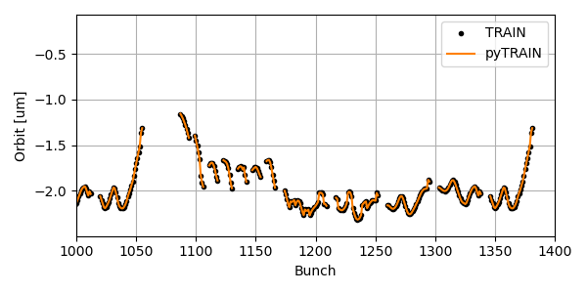
benchmarking: TRAIN vs pyTRAIN
Beam 1 H
Beam 1 V
Beam 2 H
Beam 2 V

Slide 9
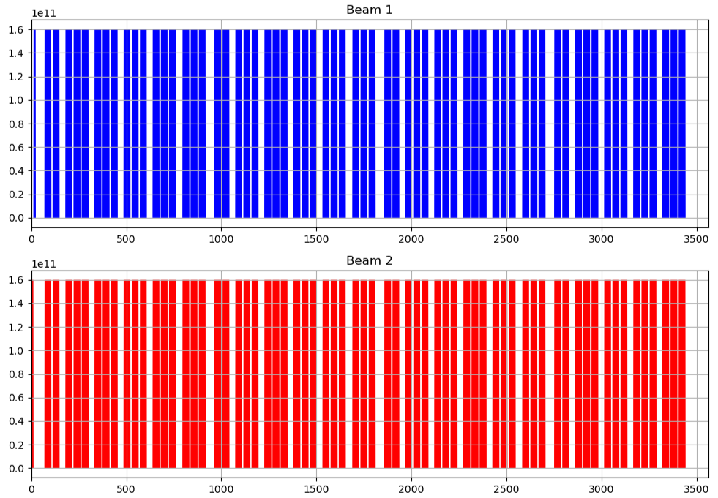
beam-beam long-range effects in LHC
~2400 bunches spaced by 25ns
  longer gaps for kicker rise times
4 interaction regions with common vacuum chamber
  long-range beam-beam encounters
  "pacman" effects due to kicker gaps (missing LR encounters)
  "super-pacman" effects as IRs not symmetric (missing head-on colls.)
luminosity levelling by beta* and separation: changing optics
bunch intensity [protons per bunch]
25ns bunch slot
more details in talk of T. Pieloni

Slide 10
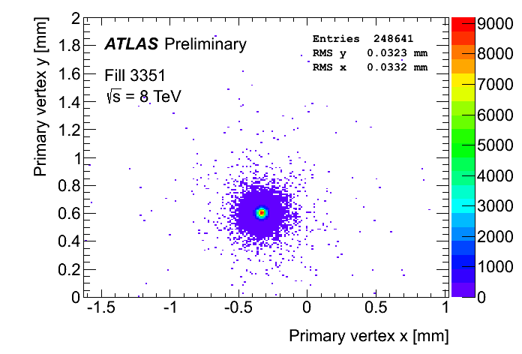
luminous centroid position at experiments
experiments measure the primary vertex positions ("beam spot")
  offline reconstructed from tracker data
  "luminous region" size
  "luminous centroid" position
  high-statistics data collected
  during calibration sessions
    interferes with physics data taking
"luminous centroid":
center of the overlap region
  average position of the two beams
  measured bunch-by-bunch

Slide 11
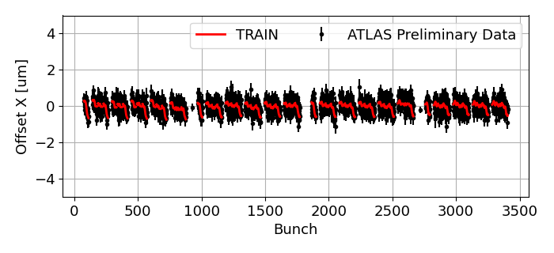
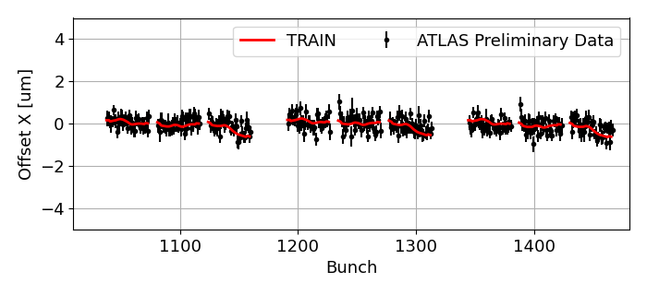
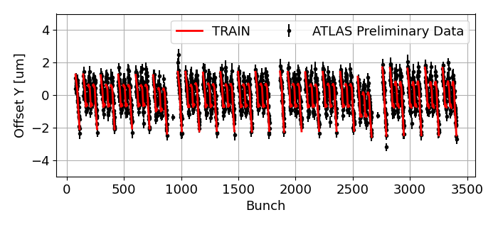
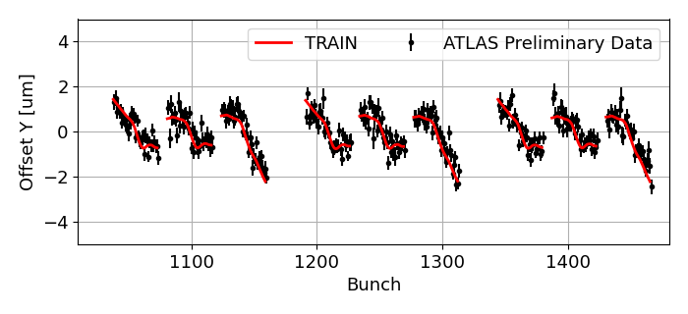
ATLAS luminous centroid position
Preliminary BeamSpot data courtesy of the ATLAS collaboration. LHC fill 9653 / ATLAS run 476033, 2024-05-28

Slide 12
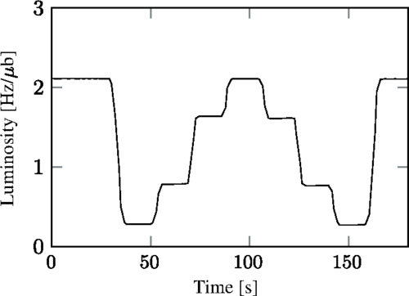
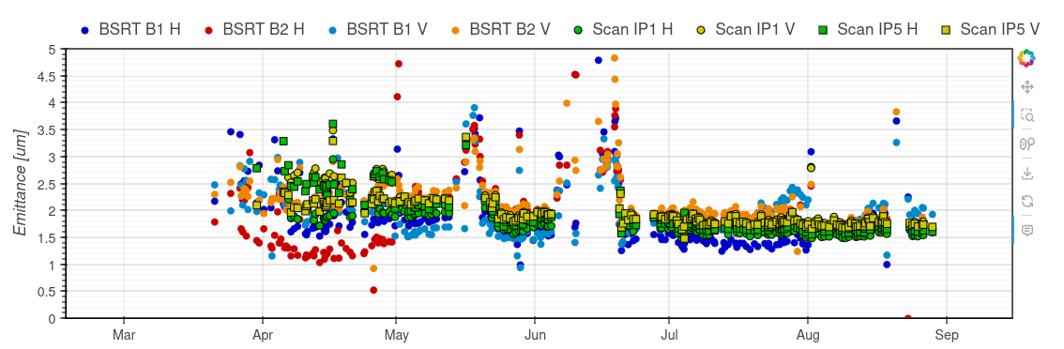
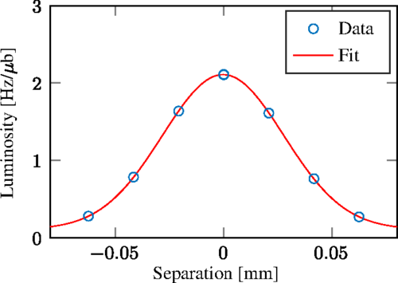
emittance scans - beam separations
beam separation scans ("mini-VdM")
  luminosity vs. separation fitted with Gaussian
  bunch-by-bunch
  done regularly in LHC for emittances and tracking of luminosity monitor degradation
fit centre gives bunch-by-bunch beam separation
details in: M. Hostettler et al., "Luminosity scans for beam diagnostics", PRAB 21, 2018

Slide 13
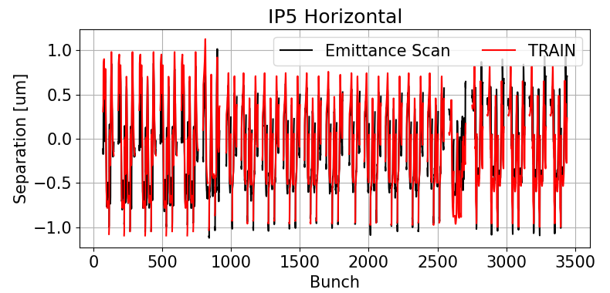
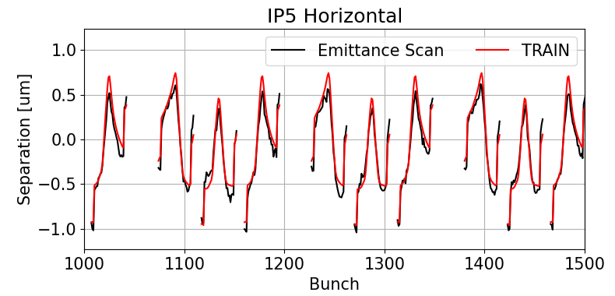
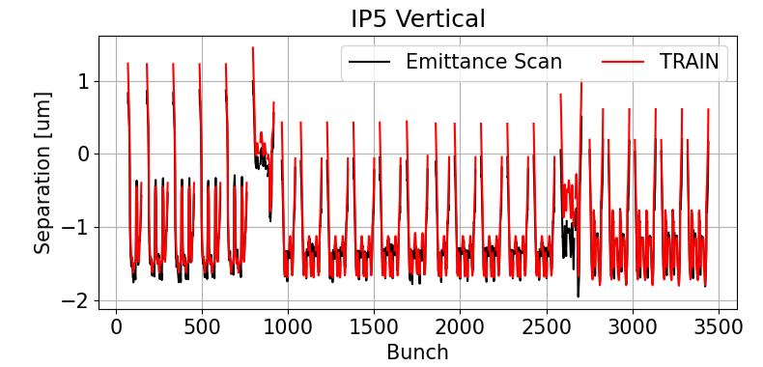
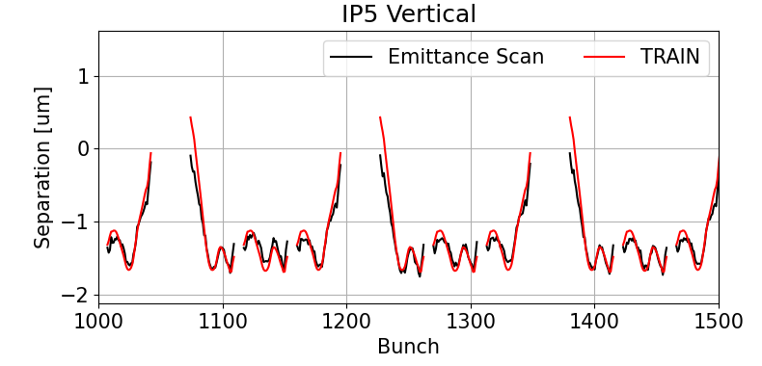
emittance scans - beam separations
emittance scans in CMS, at beta*=1.2m. Luminosity data courtesy of the CMS collaboration. LHC fill 10066, 2024-08-28

Slide 14
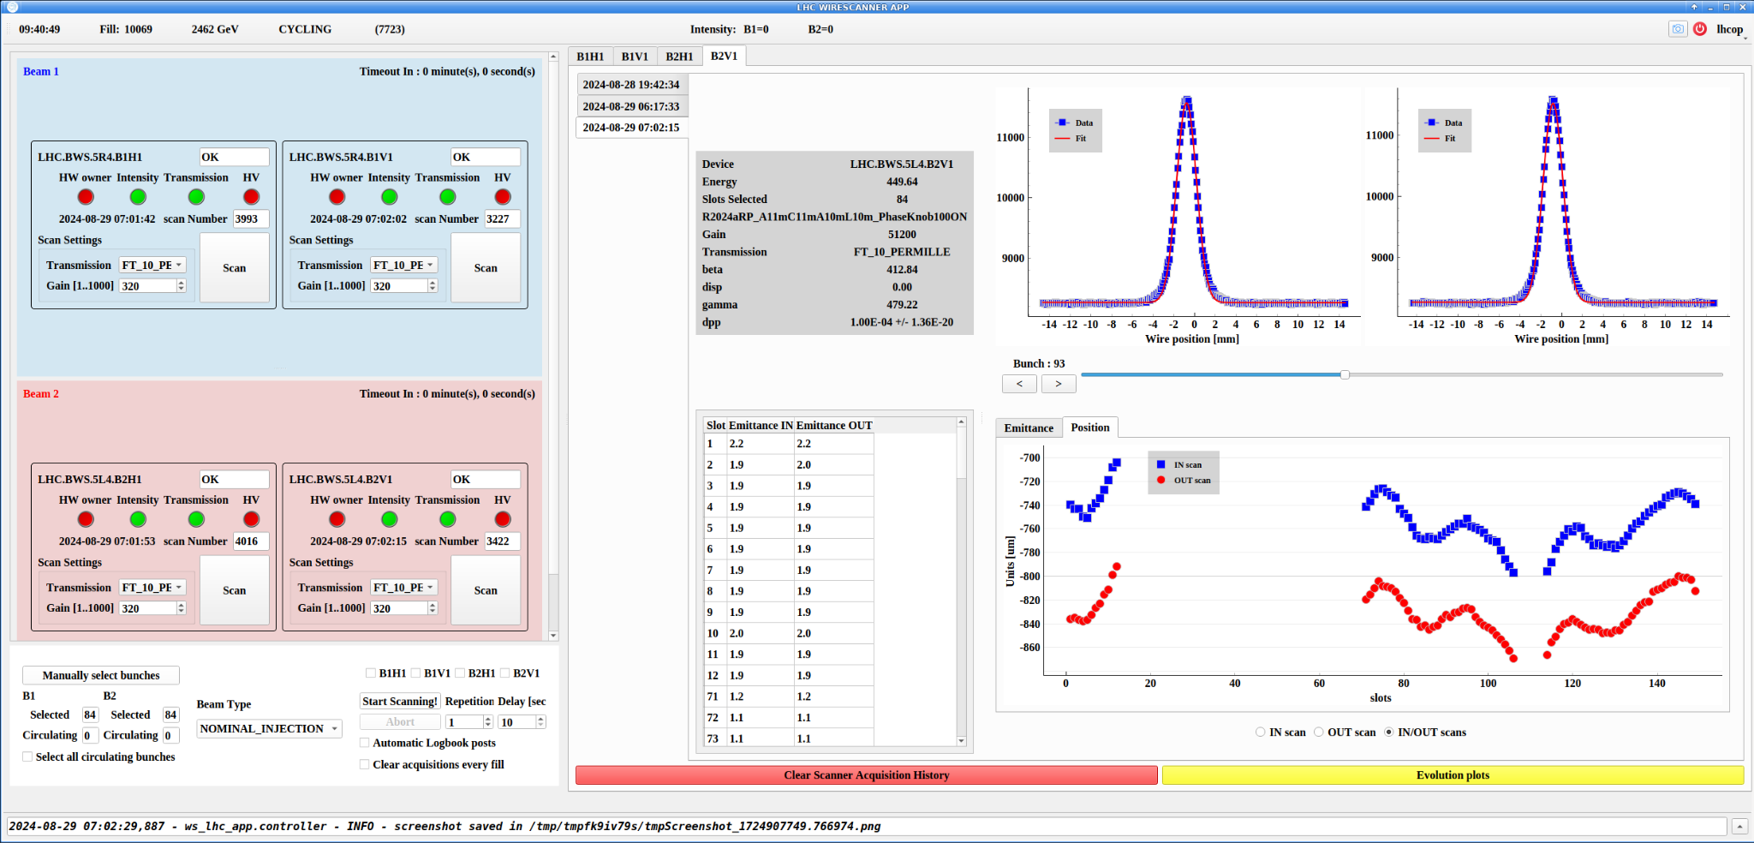
beam positions at wire scanners
wire scans regularly taken during LHC injection
  first 108 bunches only (scanner intensity limit)
  bunch positions from centre of Gaussian fit
  per-beam, per-plane, per-bunch data
no head-on collisions, but long-range encounters present!

Slide 15
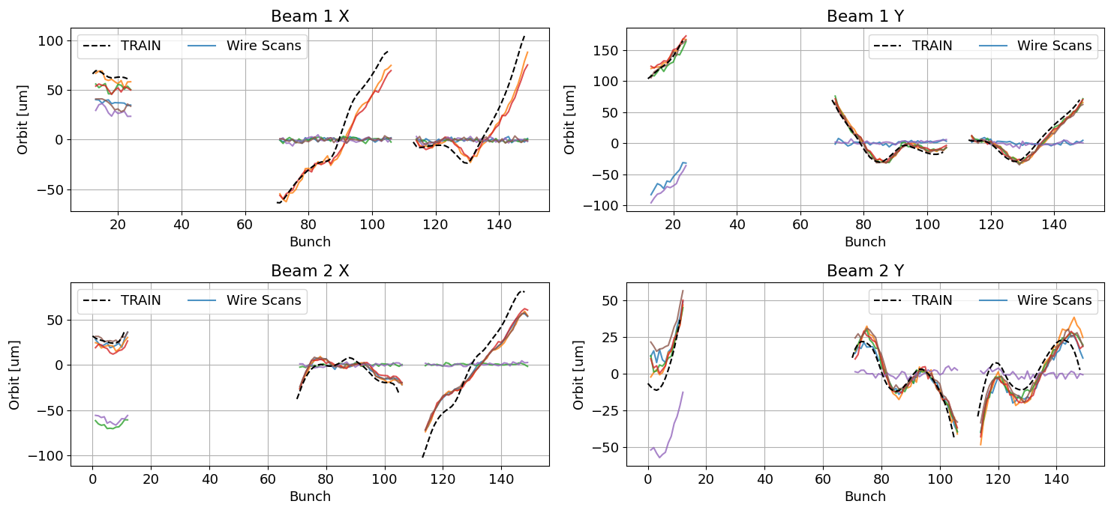
beam positions at wire scanners

Slide 16
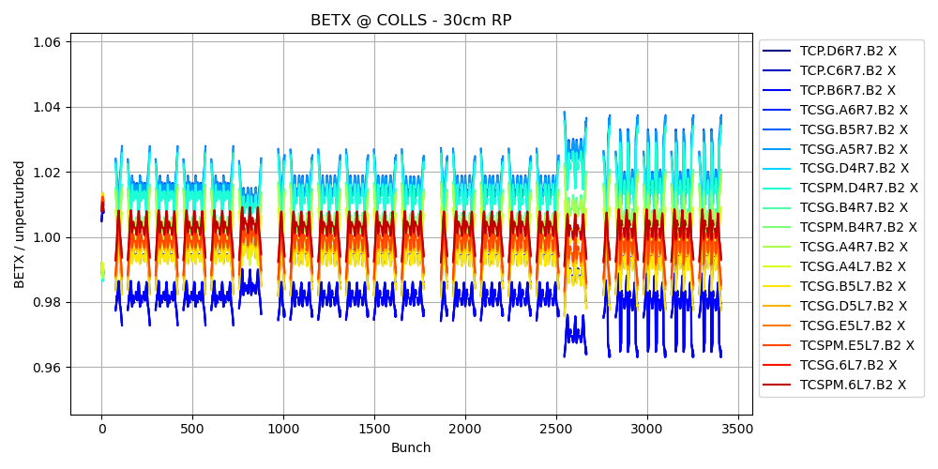
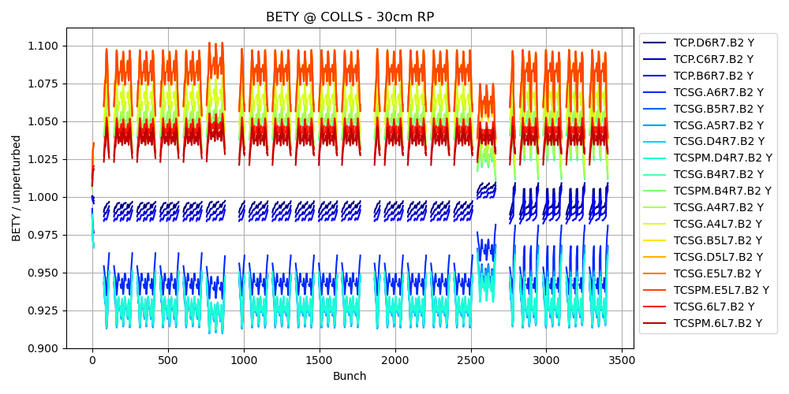
from orbits to optics parameters
classic TRAIN output: orbits, tunes, chromaticities per bunch
internal calculation based on second-order maps (per bunch)
  the maps contain all optics information up to second order!
  calculate twiss parameters & dispersion - for any bunch, at any location
    based on MAD-X code translated to python
    coupling not yet treated - future improvement

Slide 17
iteration processors
beam-beam effects can interplay with other machine systems
  e.g. feedback corrections
  self-consistent treatment
  needs to hook into TRAIN
  iteration loop
main iteration loop
insert beam-beam kick maps for all bunches
(based on current closed orbits)
iteration processor
Callable[BunchMaps]
iteration processors
  callback per iteration after new beam-beam maps are established
  can insert / mutate bunch maps
find new closed orbits
for all bunches
convergence?
(|co_{N-1} - co_{N}| < ε
for all bunches)
pre-defined: mean orbit correction (SVD)
  simulates the effect of a bunch-average feedback
YES
NO

Slide 18
conclusions
pyTRAIN: a reimplementation of TRAIN in modern python
  using numpy / scipy primitives where possible
  interface to MAD-X via cpymad
  scriptable from python
results look promising
  reproduces well the BBLR patterns observed in LHC
allows for novel features
  orbit anywhere in the ring (not just BB interaction points)
  twiss parameters anywhere in the ring
  iteration processors
  extensible in the future!

Slide 19
future improvements
physics improvements
  finite bunch length effect on the effective beam size due to beam angles
    A. Babaev, https://arxiv.org/abs/2104.02595
  fully self-consistent beam sizes, iterating on perturbed twiss parameters
  treatment of beam-beam introduced coupling
validation & application to other machines
  currently only tested on LHC - any collaborators welcome!
integration with Xsuite
  at least for input map generation
  install beam-beam elements at final separation for tracking?
performance
  nice to have: clean and readable code has higher priority
  possible synergy with Xsuite integration (fast primitives and data structures)

