Slide 1



Integrated beam beam modeling with Xsuite
G. Iadarola, R. De Maria, S. Łopaciuk,
A. Abramov, X. Buffat, D. Demetriadou, L. Deniau, P. Hermes, P. Kicsiny, P. Kruyt, A. Latina,
L. Mether, K. Paraschou, J. Salvesen, G. Sterbini, F. Van Der Veken, CERN, Geneva, Switzerland
P. Belanger, TRIUMF, Vancouver, Canada
D. Di Croce, T. Pieloni, L. Van Riesen-Haupt, M. Seidel, EPFL, Lausanne, Switzerland
P. Niedermayer, GSI, Darmstadt, Germany
Work supported by:
https://xsuite.web.cern.ch

Slide 2
Outline
Introduction
Architecture and main capabilities
  Lattice modeling
  Single-particle tracking
  Twiss module
  Optimized
  Particle-matter interaction
  Synchrotron radiation
  Collective effects (wakefields, spacecharge, IBS)
Beam-beam capabilities
  Weak-strong
  Strong-strong (soft-Gaussian)
  Beamstrahlung and Bhabha effect
  Strong-strong (Particle In Cell)
Summary and final remarks

Slide 3
Xsuite
Xsuite project was launched in 2021
Main goal: bring into a modern Python toolkit the know-how built at CERN in developing MAD, Sixtrack, COMBI, PyHEADTAIL
  Cover with one toolkit applications ranging from low-energy hadron rings to high-energy lepton colliders
Designed for seamless integration of components and for extendibility
Support different computing platforms, including multicore CPUs and GPUs from different vendors
Design constraints:
Need to grow the code in a “sustainable” way, being managed and maintained by a small core team integrating (in a clean way!) contributions by a wide developer community
Need user and developer learning curve to be short as possible
  Field specific features developed directly by field experts
3

Slide 4
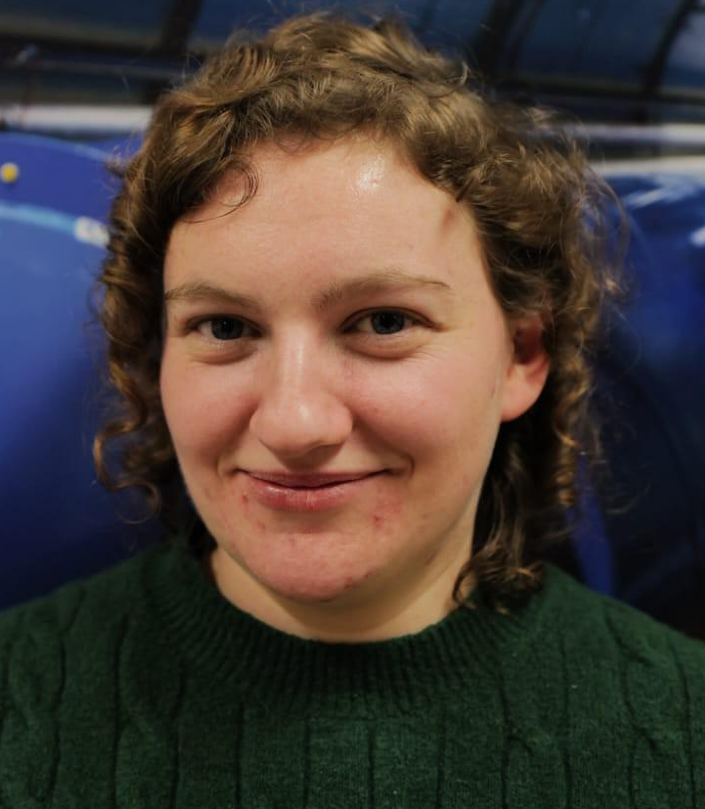



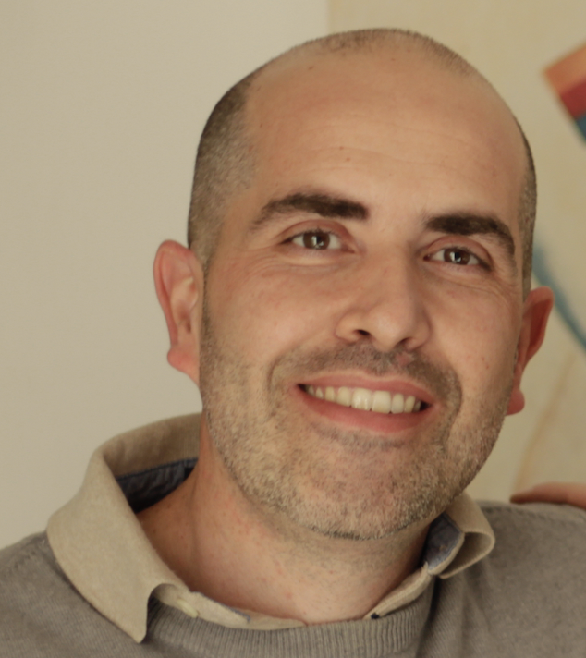
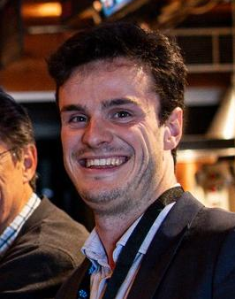

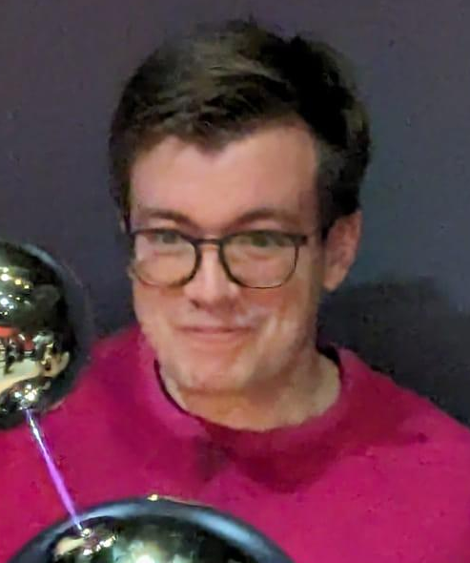
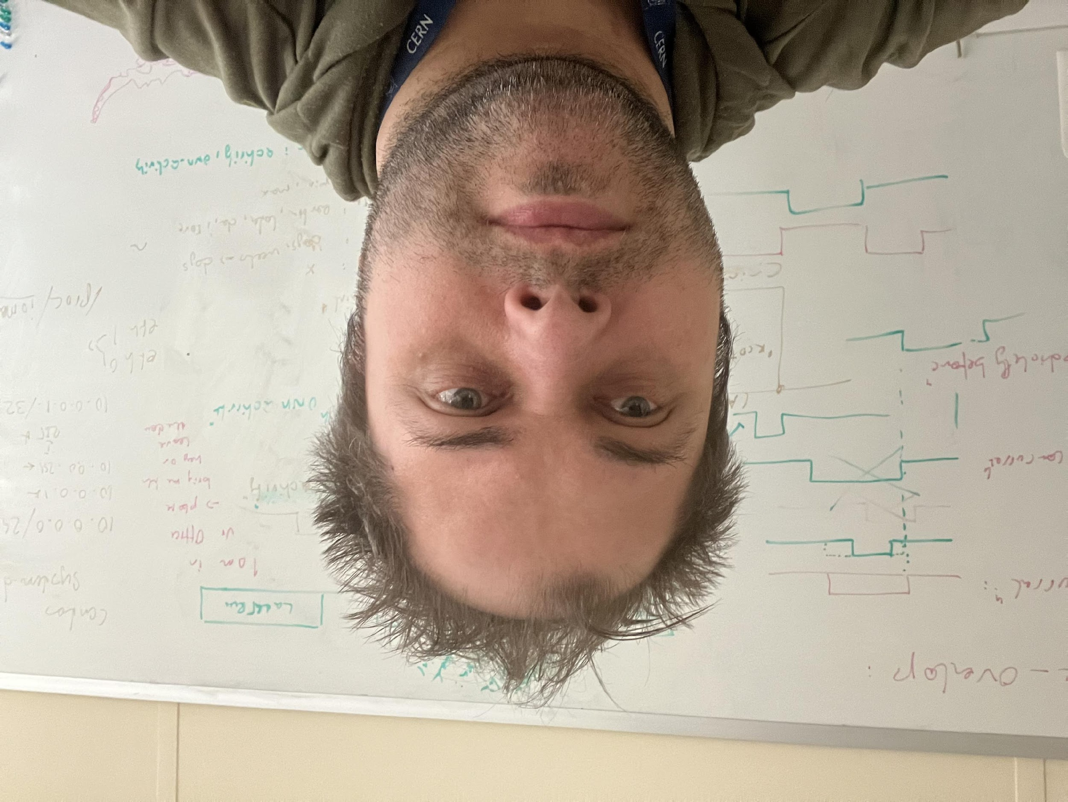
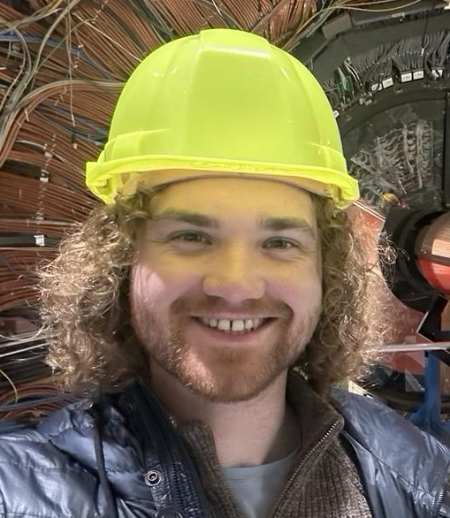

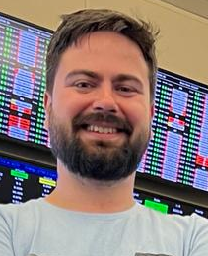
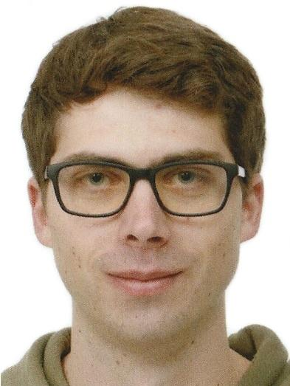
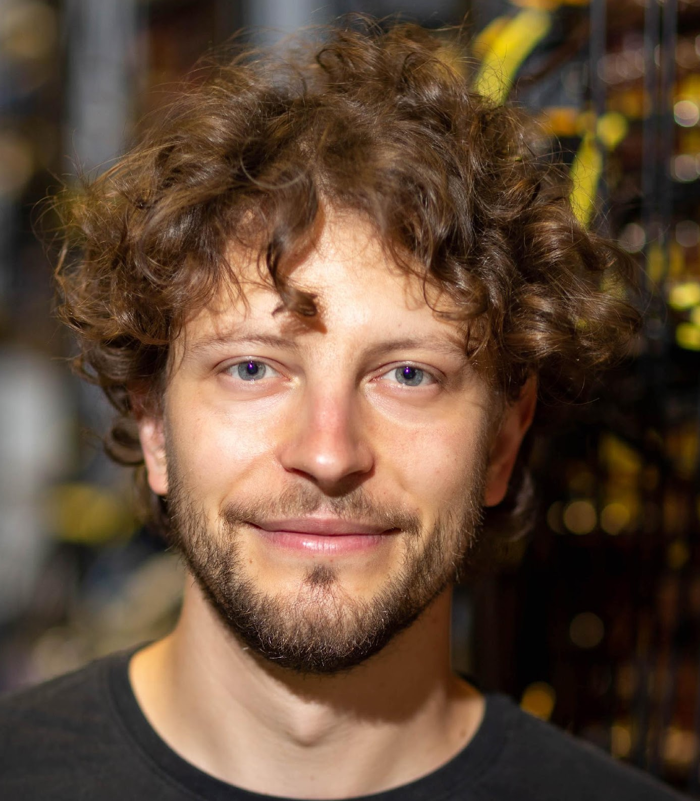


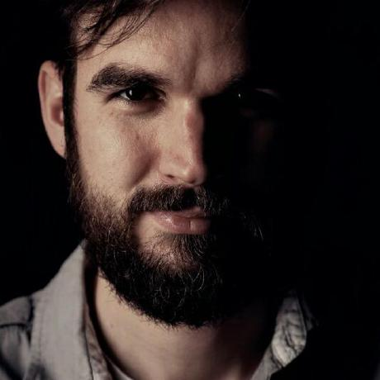
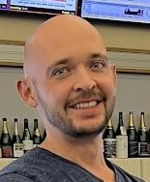
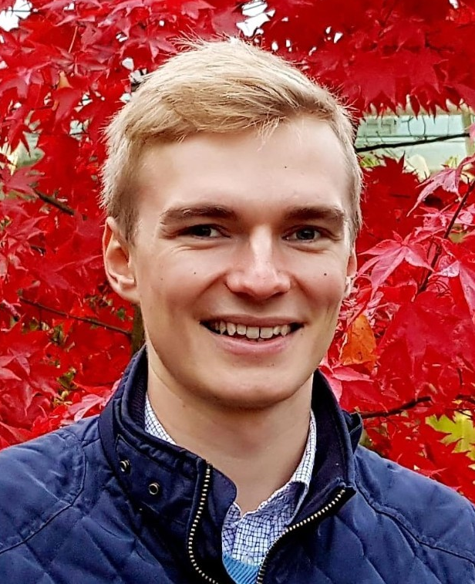
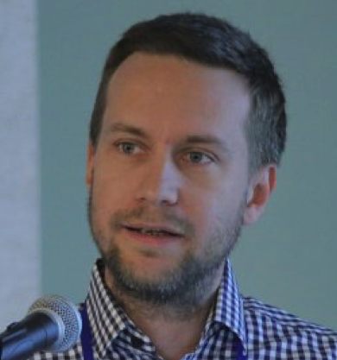

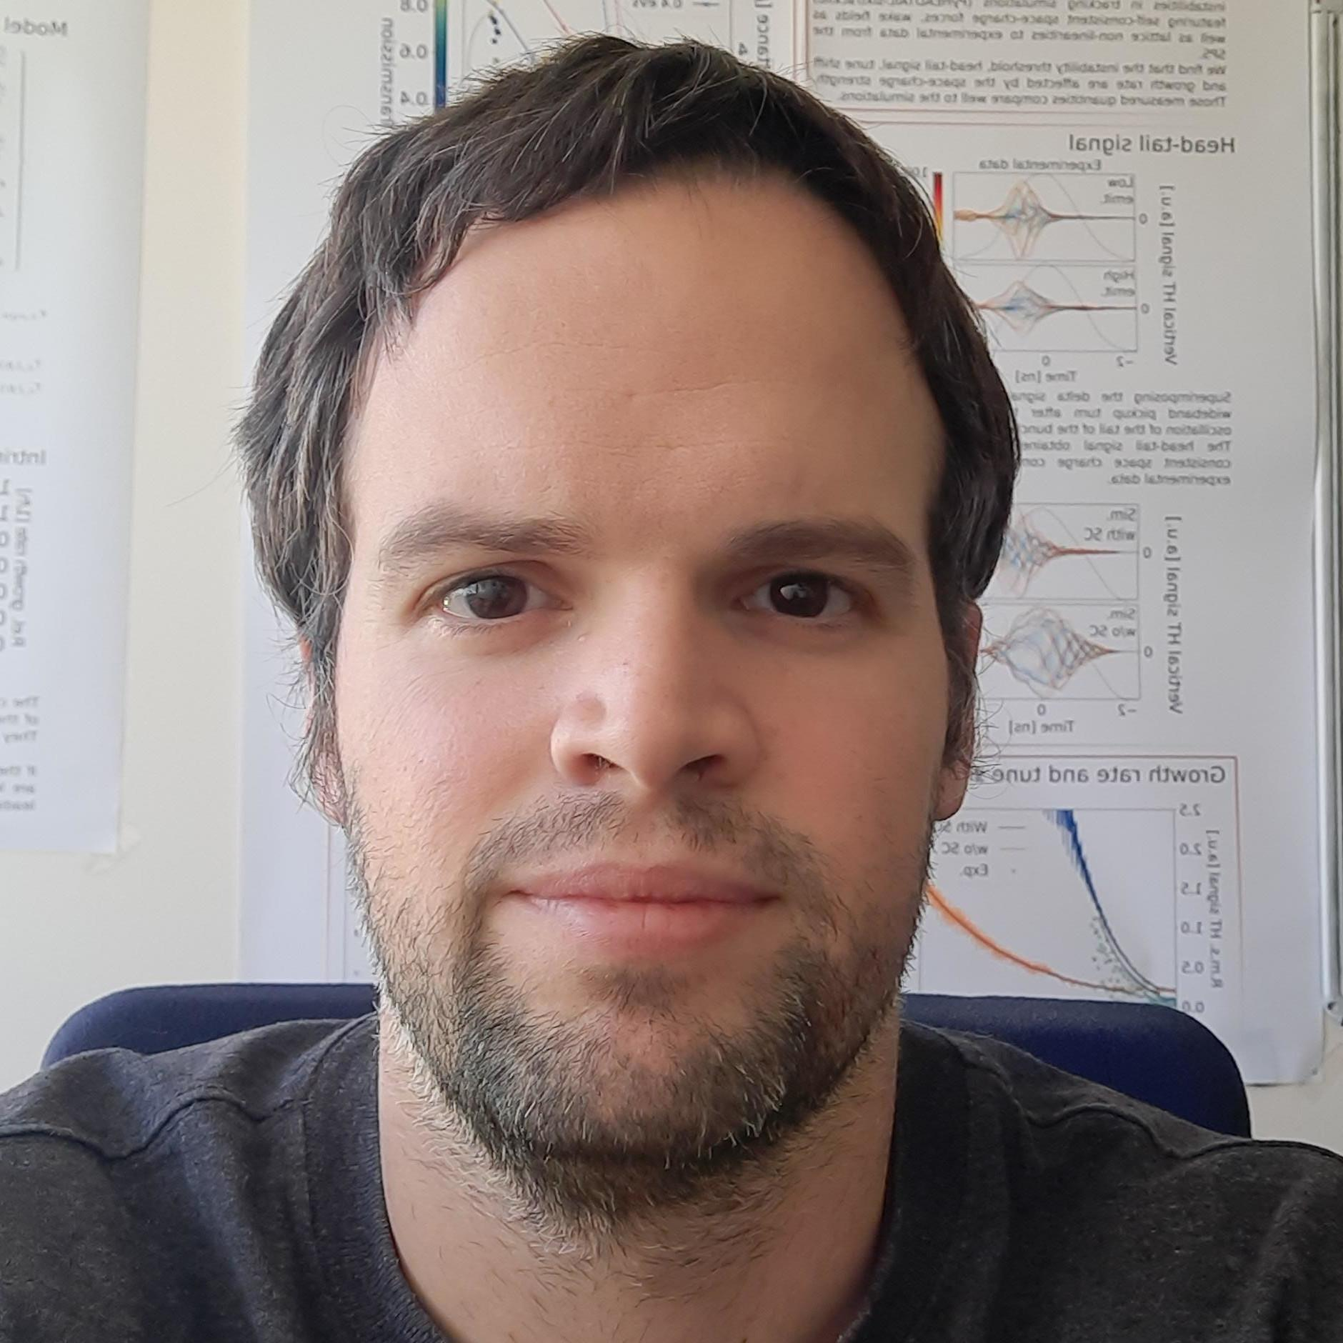









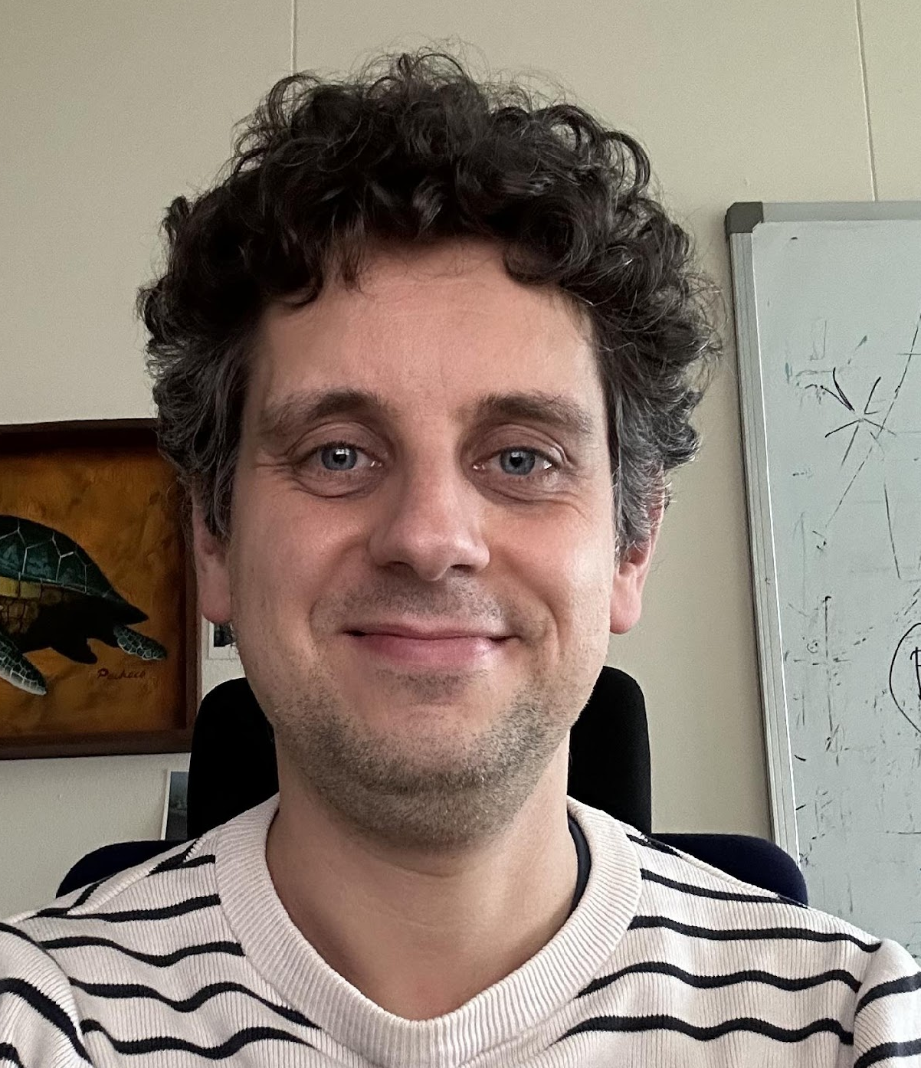




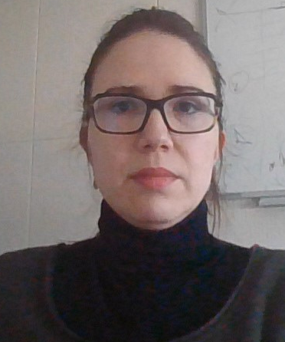
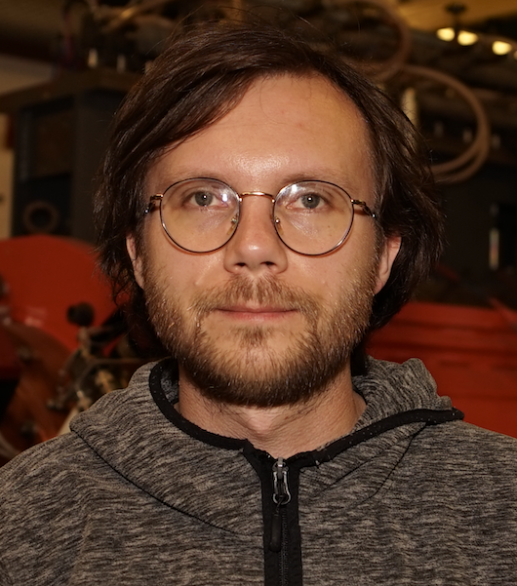

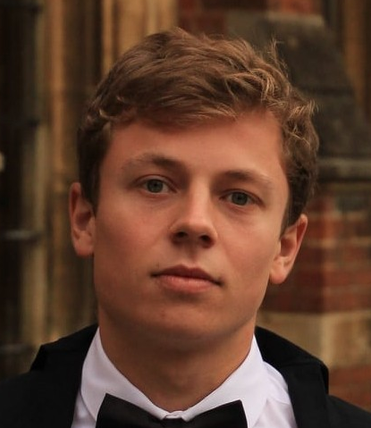
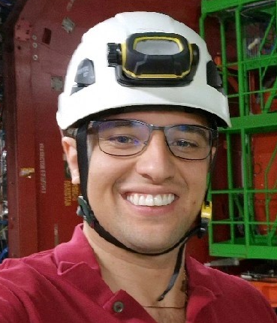
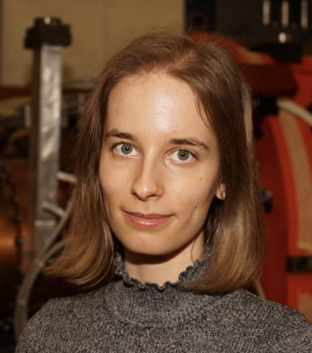
The Xsuite community
After three years the software has grown very rapidly, thanks to many people contributing code and expertise…
…
and more…

Slide 5
The Xsuite community
After three years the software has grown very rapidly, thanks to many people contributing code and expertise…
Response went well beyond our expectation:
>30 colleagues from CERN and other labs contributed by developing new features and debugging issues
          Leveraging their python skills and the short tool-specific learning curve
Xsuite was adopted by a large and diverse user community (>100 users!!!)
  Very lively community providing mutual support, advice, lots of feedback to developers (very precious!)
  For first time at CERN we are using the same software tool for optics, dynamic aperture studies, collimation, beam-beam, space-charge, instabilities, lepton machines, extraction and beam transfer studies and more…
    Already profited from lots of synergies
…
and more…

Slide 6
The Xsuite community
Xsuite simulations have been already used for studies covering a variety of rings:
CERN
ELENA
LEIR
PSB
PS
SPS, TI2, TI8
LHC
FCC-ee, FCC-hh
Muon collider
LEP
GSI
SIS-18
SIS-100
Medical facilities
HIT (Heidelberg)
MEDAUSTRON
PIMMS
NIMMS
BNL
RHIC
Booster
EIC
Fermilab
Main injector
Recycler
Booster
IOTA
Light sources and damping rings:
PETRA
DESY injector ring
ELETTRA
BESSY III
CLIC-DR
… and more
Each of these tought us something and contributed to extend and improve the software!

Slide 7
Outline
Introduction
Architecture and main capabilities
  Lattice modeling
  Single-particle tracking
  Twiss module
  Optimized
  Particle-matter interaction
  Synchrotron radiation
  Collective effects (wakefields, spacecharge, IBS)
Beam-beam capabilities
  Weak-strong
  Strong-strong (soft-Gaussian)
  Beamstrahlung and Bhabha effect
  Strong-strong (Particle In Cell)
Summary and final remarks

Slide 8






Xsuite – architecture
Xpart
generation of particles distributions
Xtrack
single particle
tracking engine
Xfields
computation of EM fields from particle ensembles
Xdeps
Dependency manager,
deferred expressions
Physics modules
Xcoll
Particle-matter interaction and collimation
Xobjects
interface to different computing plaforms
(CPUs and GPUs of different vendors)
Lower level libraries
(external, open source)
Hardware

Slide 9
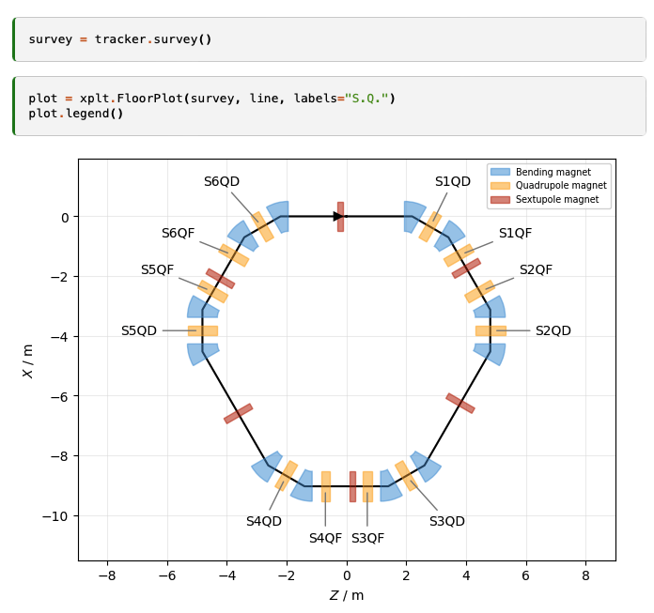
Lattice modelling
Xsuite model of a ring
(represented with the Xplt package)
The beam line is represented as a sequence of Python objects, each corresponding to an accelerator element or to other physical processes (e.g. magnets, cavities, aperture restrictions, etc.).
  Can be defined manually or imported from MAD-X
  Including tilts, misalignments and multipolar errors
We provide:
“Thin” lattice integration, largely based on the Sixtrack and Sixtracklib experience
“Thick” maps for bending and quadrupole magnets
Dipole edge effects including fringe fields can be modeled either in their linearized form or as full non-linear maps (same fringe model as in MAD-NG and PTC).
9

Slide 10
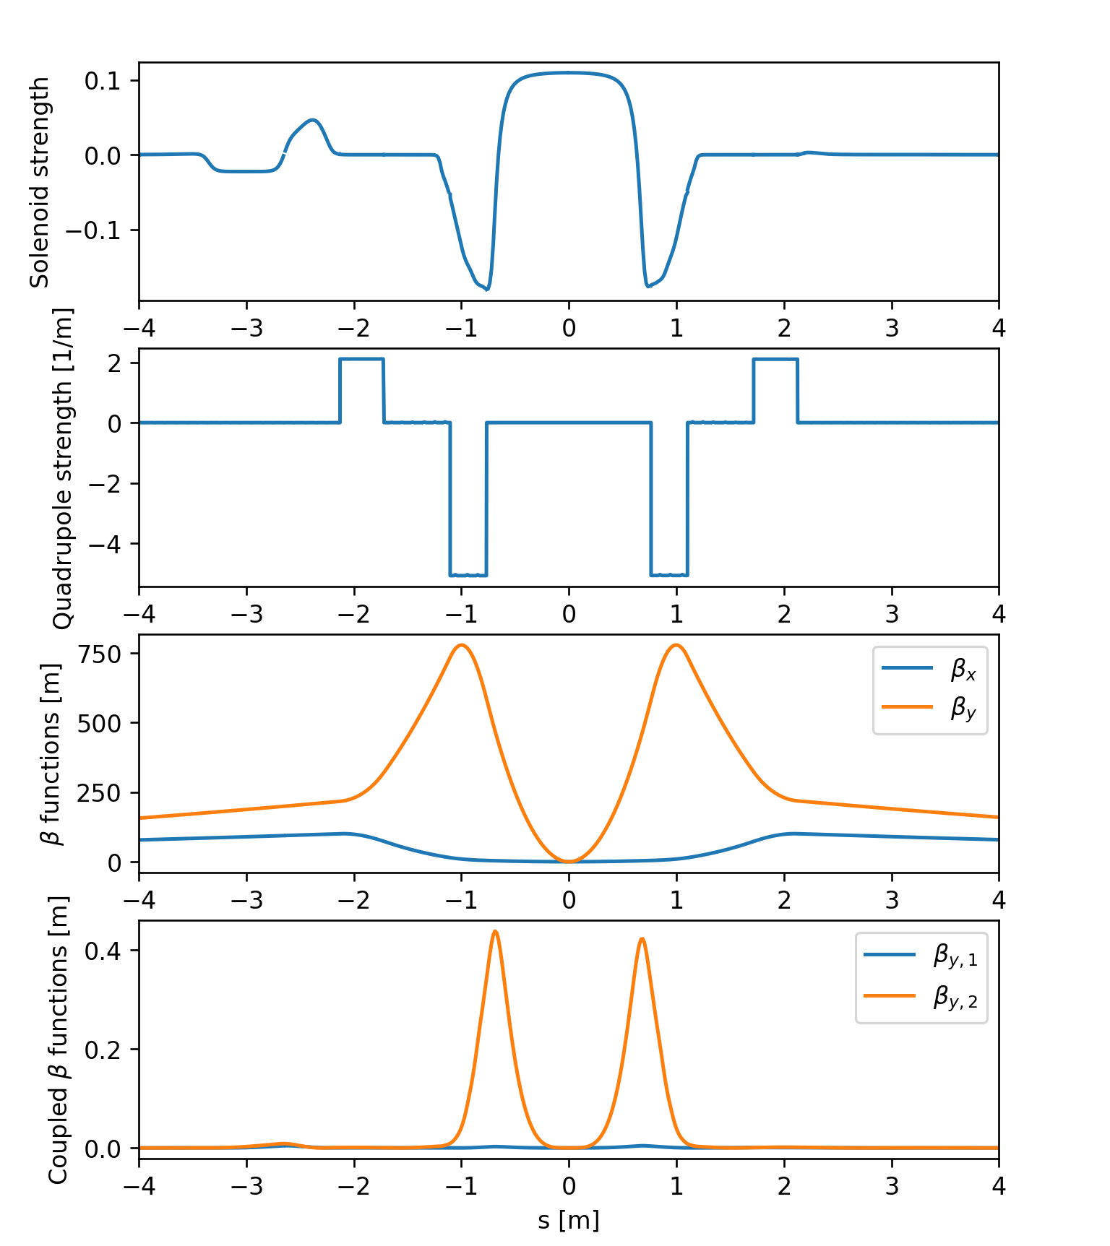
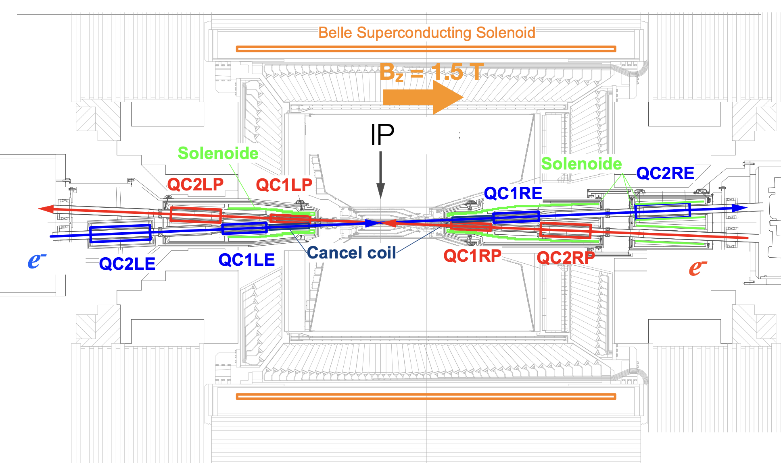
Solenoids and overlapping elements
SuperKEKb interaction region
Recent developments allow modelling of experimental solenoids of lepton colliders also in the presence of overlapping multipole fields
Tested on FCC-ee and SuperKEKb models
10
Many thanks to G. Broggi, J. P. Salvesen, KEK experts

Slide 11
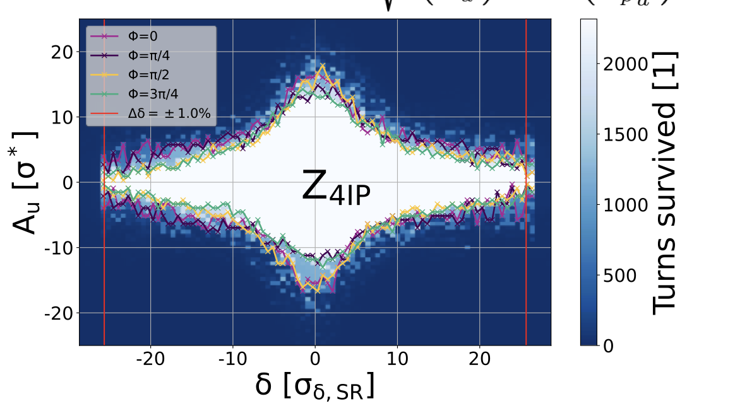
Single particle tracking
Multiturn element-by-element tracking speed is critical for several application
To speed up tracking simulations, Xsuite assembles and compiles a C kernel (callable from Python) optimized for the given beamline and specialized for the chosen platform (CPU or GPU)
  The tra cking speed is found to be similar to Sixtrack for single-core CPU and about two orders of magnitudes faster than that on high-end GPUs
FCC-ee DA studies (with bb)
Tracking time for a typical LHC simulation
Platform | Computing time
CPU (single core) | 190 (μs/part./turn)
GPU (NVIDIA V100, cupy) | 0.80 (μs/part./turn)
GPU (NVIDIA V100 pyopencl) | 0.85 (μs/part./turn)
P. Kicsiny et al.
11

Slide 12
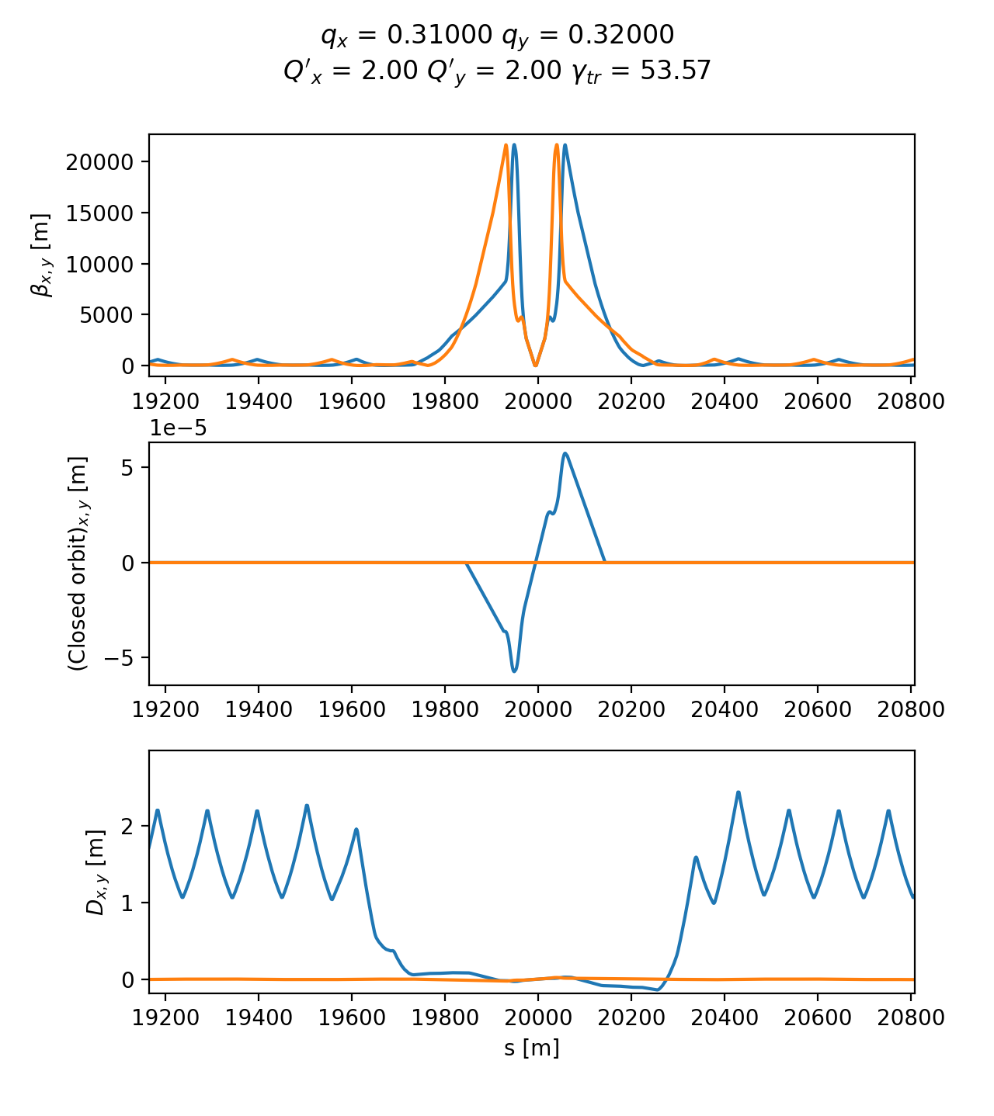
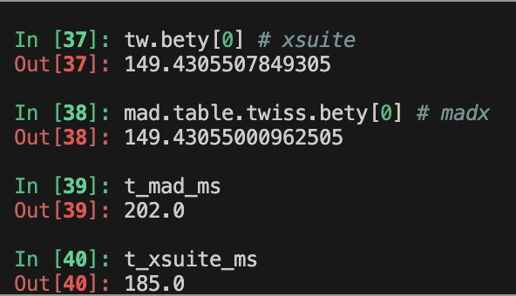
Twiss module
The Xsuite Twiss module can be used to extract lattice functions of a ring or a beamline
The calculation probes the lattice simply by tracking particles:
  Closed orbit obtained by applying a Python root finder on the tracking
  The Jacobian matrix obtained by tracking (central differences)
  Compute “Linear Normal Form” of the Jacobian matrix (diagonalization)
  Propagate eigenvectors by tracking
  Obtain from the eigenvectors Twiss parameters (𝛼, 𝛽, 𝛾) , dispersion functions, phase advances, coupling coefficients
Computation can be done with assigned beam momentum to get off-momentum beta-beating, non-linear chromaticity, non-linear dispersion, etc.
HL-LHC optics
Accuracy compared to MAD-X: Δβ / β << 10⁻⁴
Computation time is very similar
12
Example
12

Slide 13
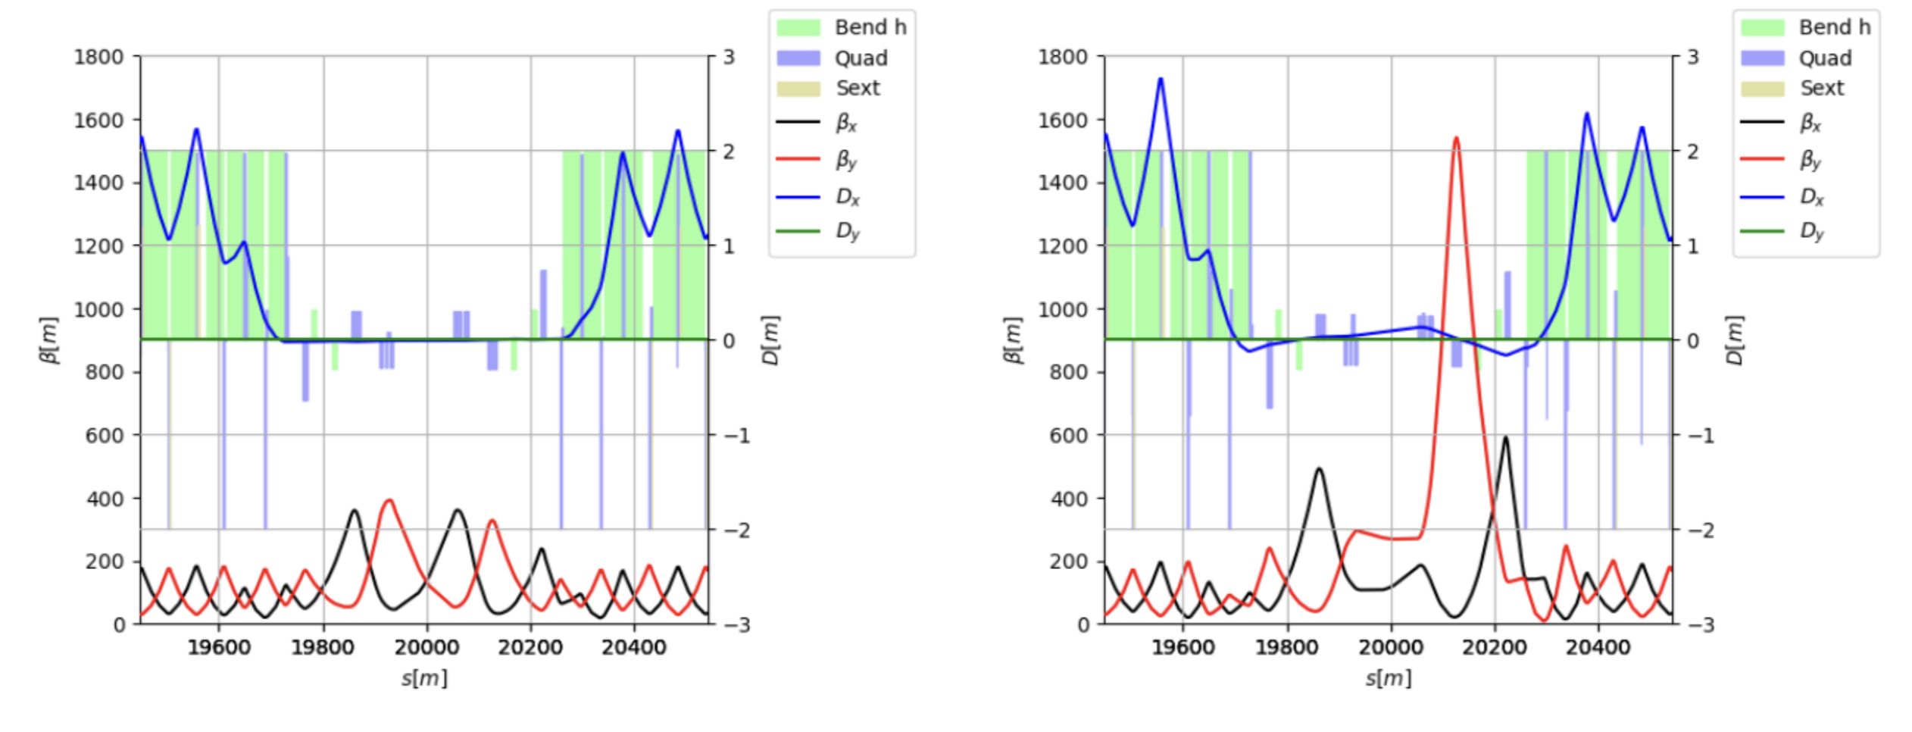
Optimizer
Xsuite provides a multi-objective optimizer to "match" model parameters to assigned constraints (e.g. control tunes, chromaticity, build orbit bumps, design the optics)
Based on the extensive experience of MAD-X → Uses the same optimization algorithm (Jacobian, proven robustness)
Interface designed for usage flexibility. User can intervene in the optimization by:
  Enabling/disabling targets or knobs, rolling back optimization steps, changing knob limits, target values, convergence tolerances
Used for optics matching of the LHC and of FCC-ee colliders
IR7 (450 GeV)
IR7 (7 TeV)
First full cycle designed with Xsuite tested at the LHC in 2024
(including combined ramp&squeeze for all insertions)
Courtesy R. De Maria and B. Lindstrom
13

Slide 14
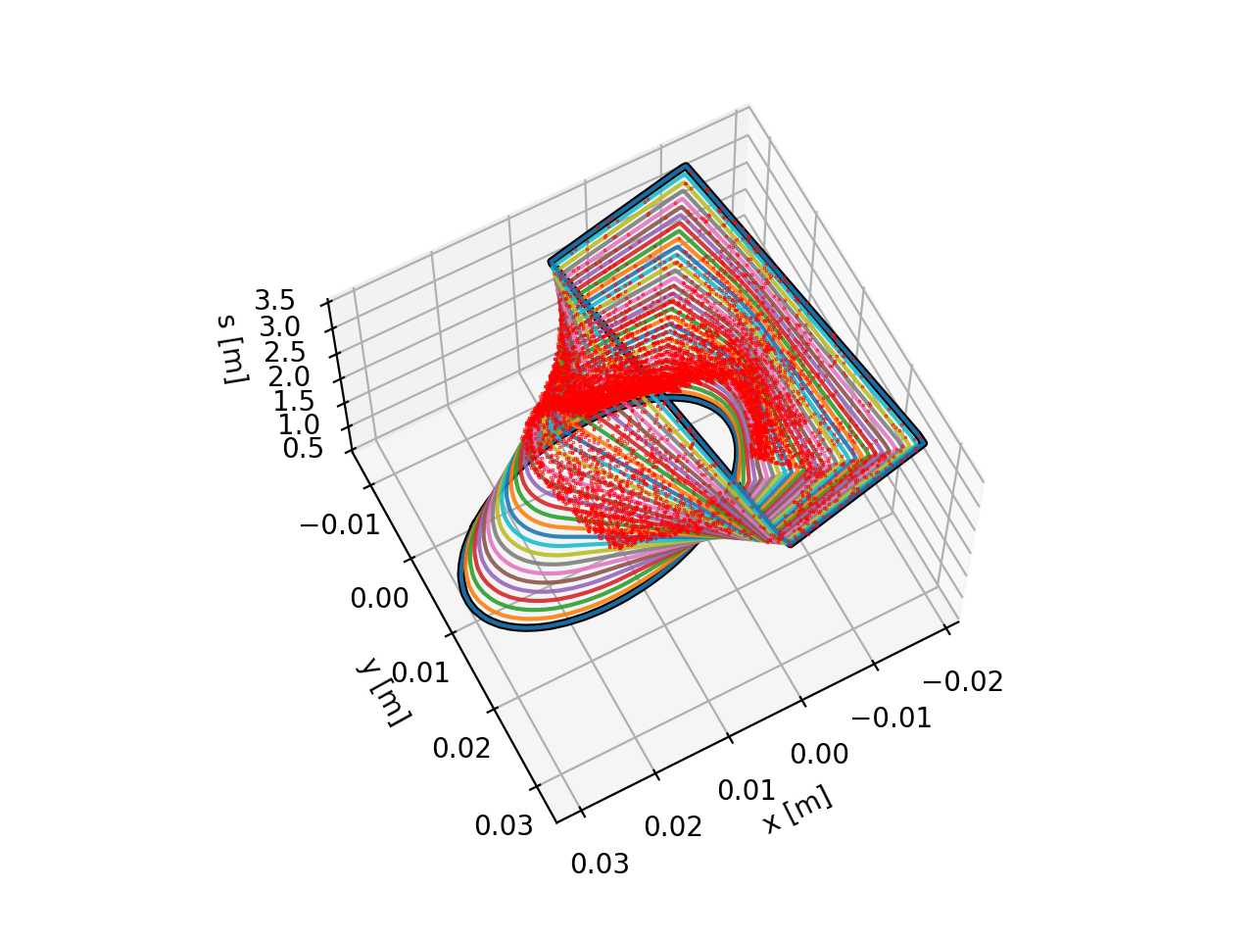
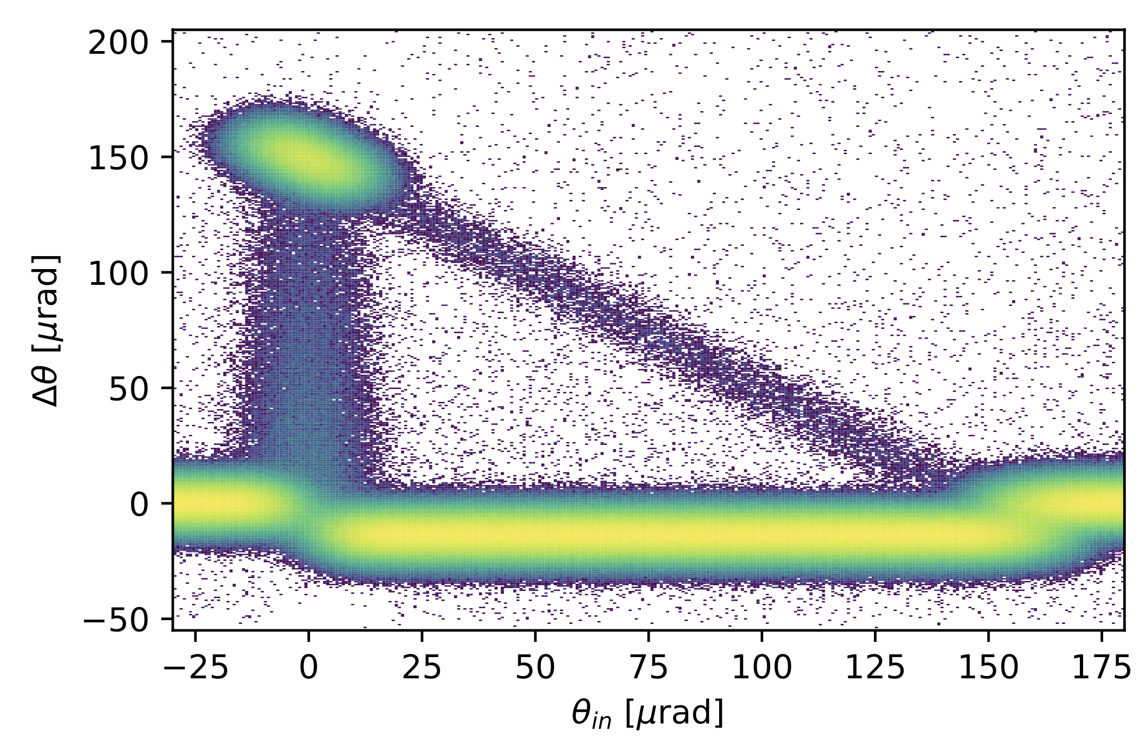
Particle-matter interaction
For collimation studies, the Xcoll module provides three particle-matter sim. engines:
The “Everest” engine embedded in Xcoll (evolution of K2 module from Sixtrack)
The “Geant 4” engine, based on an interface with BDSIM-Geant4
  Used for FCC-ee collimation studies (see presentation by G. Broggi)
The “FLUKA” engine, based on an interface with the FLUKA Monte Carlo code
To support collimation studies, Xsuite provides:
Tools to automatically install and configure collimators in the simulation model
Support for complex aperture modelling and accurate localization of the lost particles along the beam line (typically within 1-10 cm)
Particle deflection from a bent crystal (Everest engine)
Localization of lost particles along a beam pipe with changing cross section
14

Slide 15
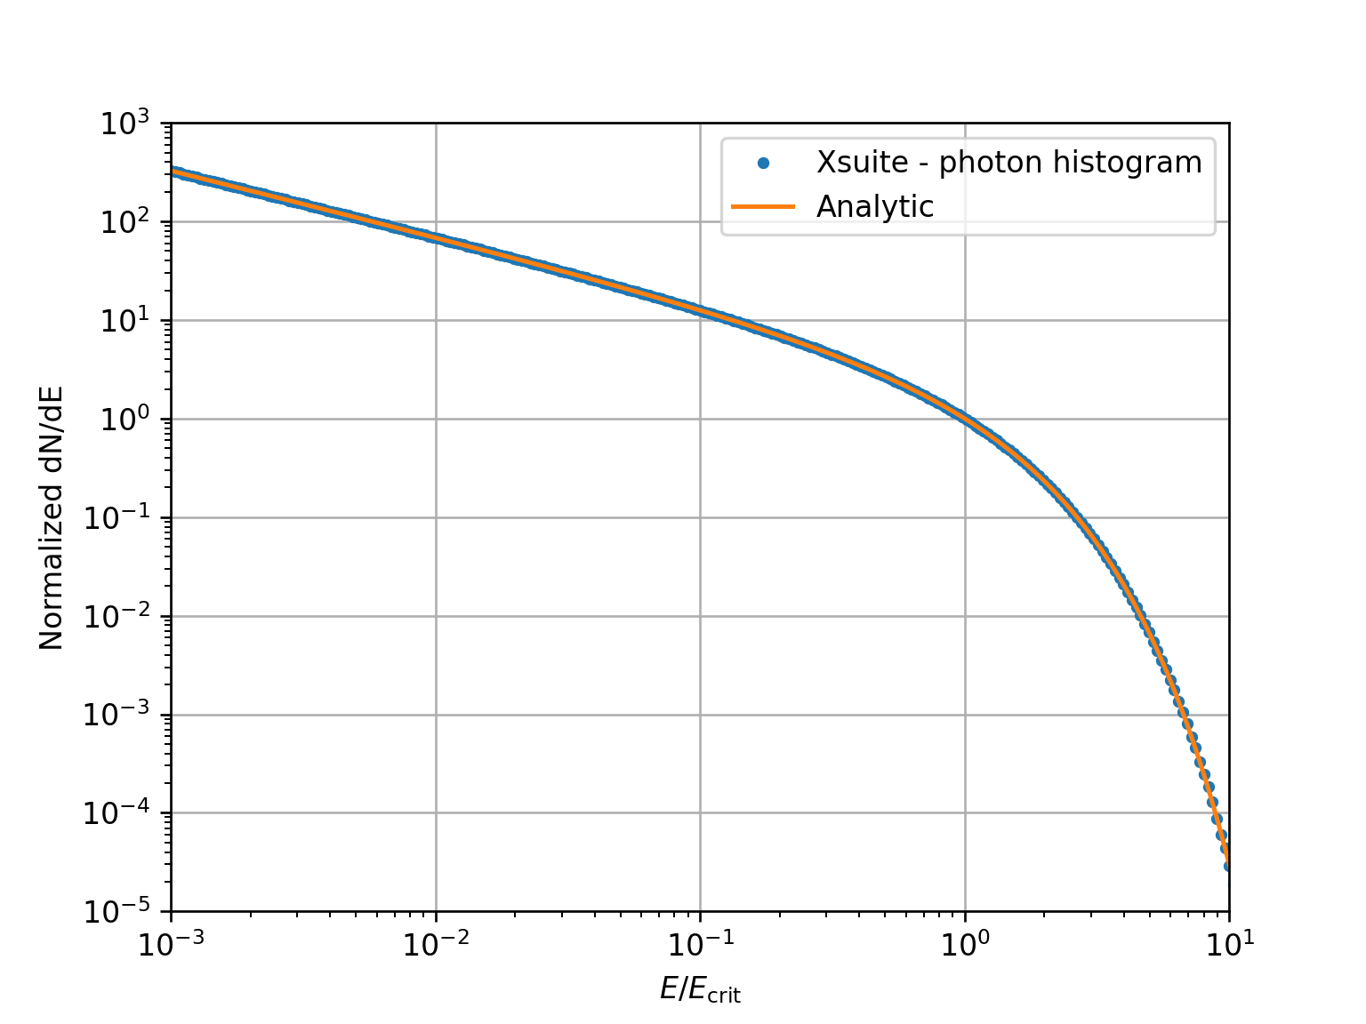
Synchrotron radiation
Supported by:
Validation against analytical photon spectrum
The effect of synchrotron radiation can be included in Xsuite tracking simulations. Two models available:
The “mean” model, for which the energy loss from the radiation is applied particle by particle without accounting for quantum fluctuations;
The “quantum” model for which the actual photon emission is simulated⁽¹⁾.
⁽¹⁾ Based on H. Burkhardt, “Monte Carlo generator for synchrotron radiation”, 1990. Implementation ported from PLACET (A. Latina)
⁽²⁾ E. Forest, From tracking code to analysis: generalised Courant-Snyder theory for any accelerator model. Springer, 2016
15

Slide 16
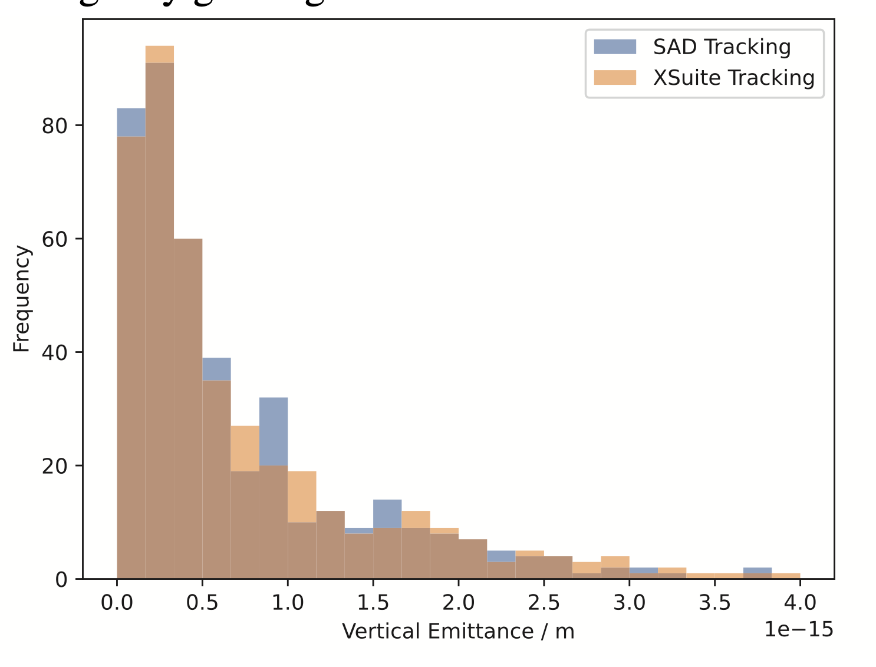
Synchrotron radiation
Supported by:
Benchmark of equilibrium emittaces from tracking (with lattice errors)
The effect of synchrotron radiation can be included in Xsuite tracking simulations. Two models available:
The “mean” model, for which the energy loss from the radiation is applied particle by particle without accounting for quantum fluctuations;
The “quantum” model for which the actual photon emission is simulated⁽¹⁾.
The Xsuite Twiss also includes:
Dedicated algorithm for non-symplectic one-turn map⁽²⁾
Computation of radiation energy loss, damping times and equilibrium emittances
An automatic tool is provided for phasing the RF cavities and adjusting magnet strengths to compensate the radiation energy loss (“tapering”)
L. Van van Riesen-Haupt , T. Pieloni, et al., EPFL
⁽¹⁾ Based on H. Burkhardt, “Monte Carlo generator for synchrotron radiation”, 1990. Implementation ported from PLACET (A. Latina)
⁽²⁾ E. Forest, From tracking code to analysis: generalised Courant-Snyder theory for any accelerator model. Springer, 2016
16

Slide 17
Collective effects
Supported by:
Space charge
Xsuite is designed to include collective effects in the simulations
Handling of collective elements is fully automatic → The Xtrack module identifies the collective elements and splits the sequence:
  The non-collective parts are handled asynchronously to gain speed
  The simulation of the collective effects is performed synchronously
Space-charge, beam-beam, IBS, e-cloud (weak-strong) are handled natively
Impedances and feedback systems are handled through an interface with PyHEADTAIL
  Native implementation coming soon
Lattice
Lattice
Space charge
Space charge
Lattice
Lattice
Impedance
Damper
Collective (synchronous)
Single-particle (asynchronuos)
17

Slide 18
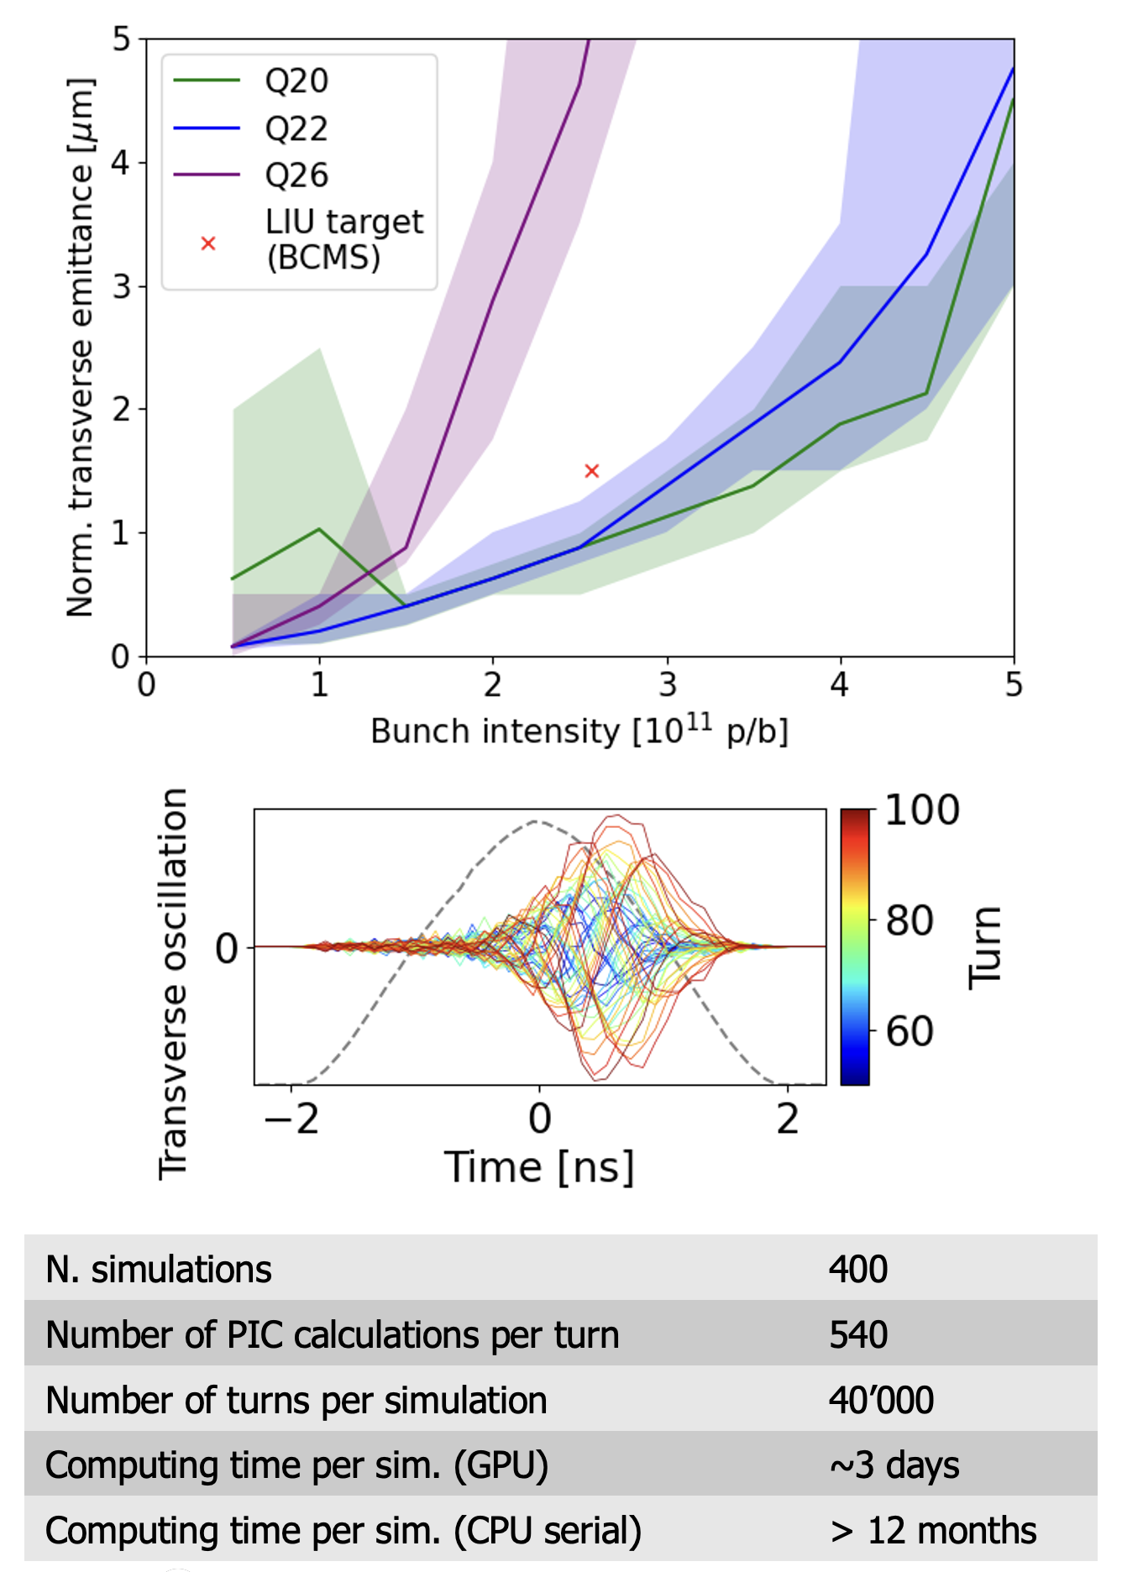
Space charge
Simulation campaign for the CERN SPS
including full non-linear lattice, space charge and wakefields
Different space-charge models are implemented:
The “frozen” model, in which particles interact with fixed charge distributions
The “quasi frozen” model that is a variant of the frozen model in which the beam intensity and beam sizes are recomputed at each interaction
The “Particle In Cell (PIC)” model:
  Charge of tracked particles distributed on a rectangular grid
  Fast Poisson solver based on FFT method with Integrated Green Functions
Space charge simulations strongly profiting from GPU acceleration
Courtesy X. Buffat
18

Slide 19
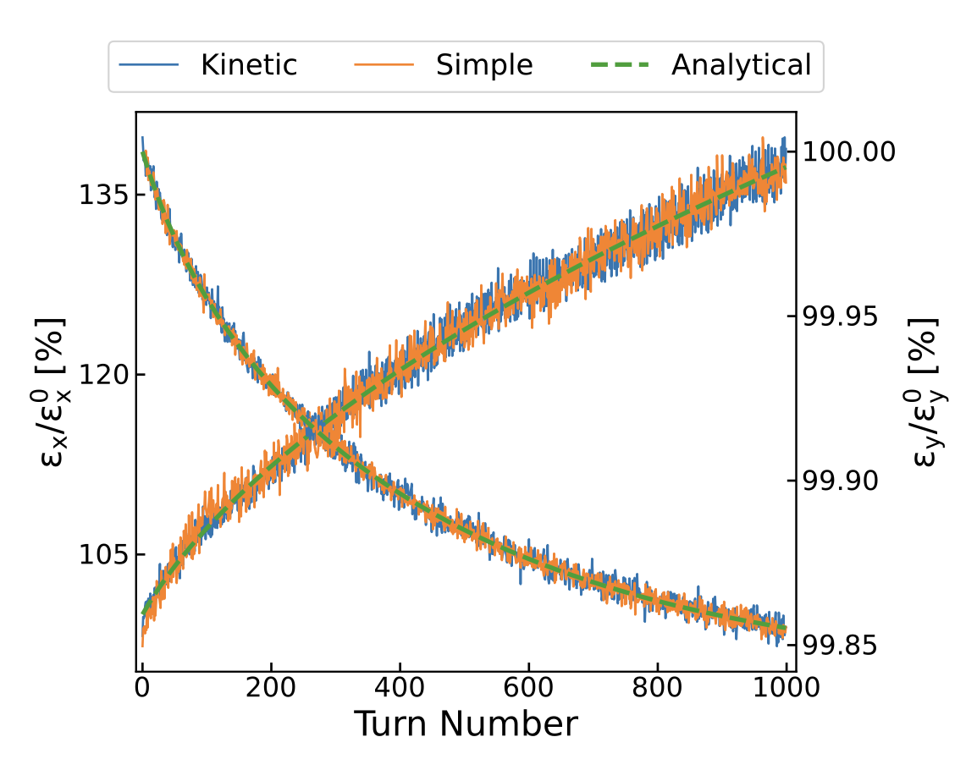
Intra Beam Scattering
Intra Beam Scattering (IBS) simulation capabilities have been recently introduced:
IBS growth rates computation from beam parameters and optics. Two methods available:
  Nagaitsev (very fast, vertical dispersion neglected)
  Bjorken-Mtingwa (slower, D_{y} correctly accounted)
Effect of IBS can be included in multiparticle simulations in combination with all other effects available in Xsuite. Two methods available:
  Effective kick
  Kinetic formalism
Benchmark case for the SPS ring (Pb ions)
Horizontal
Vertical
For more info: F. Soubelet et al., “Development of numerical tools for intra-beam scattering modelling”, IPAC24

Slide 20
Outline
Introduction
Architecture and main capabilities
  Lattice modeling
  Single-particle tracking
  Twiss module
  Optimized
  Particle-matter interaction
  Synchrotron radiation
  Collective effects (wakefields, spacecharge, IBS)
Beam-beam capabilities
  Weak-strong
  Strong-strong (soft-Gaussian)
  Beamstrahlung and Bhabha effect
  Strong-strong (Particle In Cell)
Summary and final remarks

Slide 21
Beam-beam capabilities in Xsuite
Xsuite offers different capabilities for the simulation of beam-beam effects in colliders that have become the workhorse for for LHC and FCC studies
Weak-strong model assuming Gaussian Transverse Beam Profile
  4D interaction (lumped transverse-only kick)
  6D interaction (Hirata approach, energy change)
Strong-strong modelling
  4D or 6D “soft Gaussian” approach
  Self-consistent Particle In Cell
GPU acceleration available for all models

Slide 22
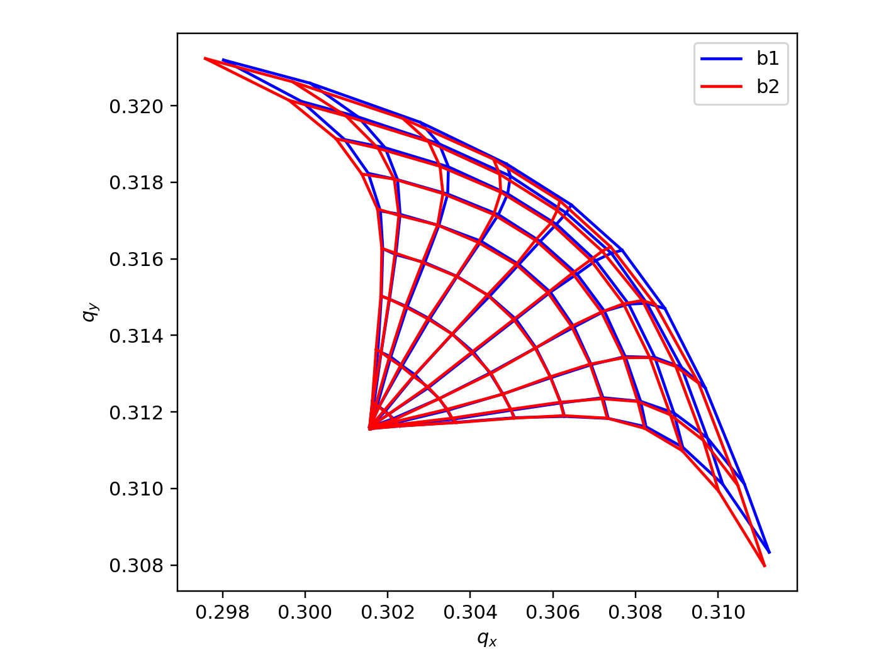
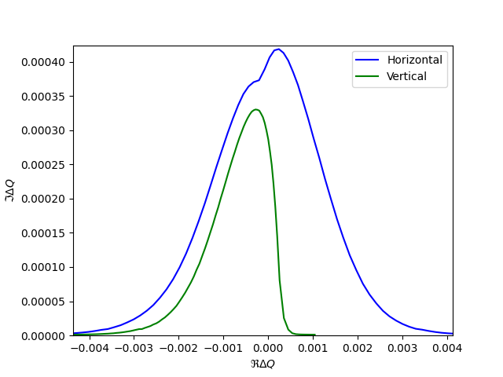
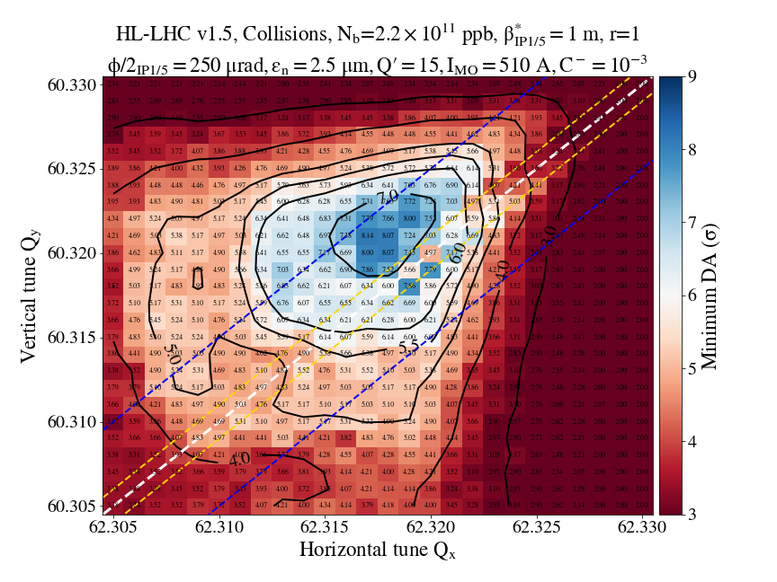
Beam-beam capabilities in Xsuite
Weak-strong approach used extensively to study effect of beam-beam non linearities on single-particle dynamics:
Amplitude detuning
  → effect on beam stability, (stability diagram computation)
Impact of beam-beam on Dynamic Aperture (DA)
Direct simulation on beam lifetime and emittance growth
Coherent stability region
S. Kostoglou

Slide 23
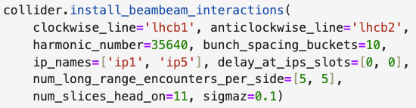

Beam-beam capabilities in Xsuite
The simulation can be easily configured from from the bare Xsuite collider model.
Required beam-beam interactions are installed and configured using survey, orbit and optics information computed by the Xsuite optics engine.
Effect of crab cavities is taken into account
… arbitrary machine config (optics, crossing angles, etc.) …
S. Kostoglou

Slide 24
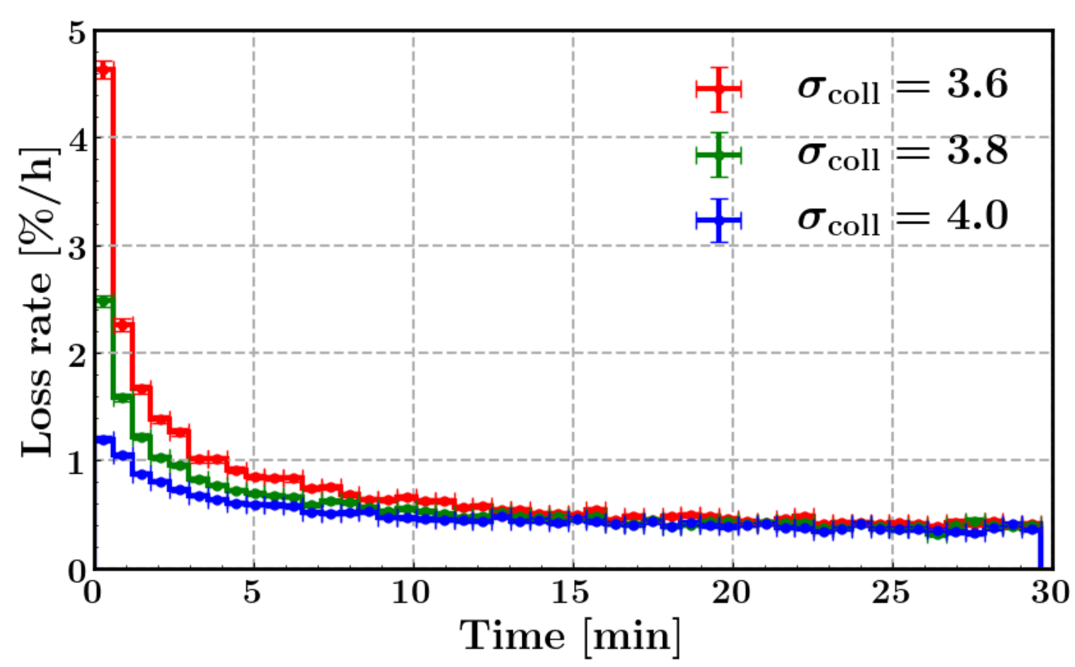
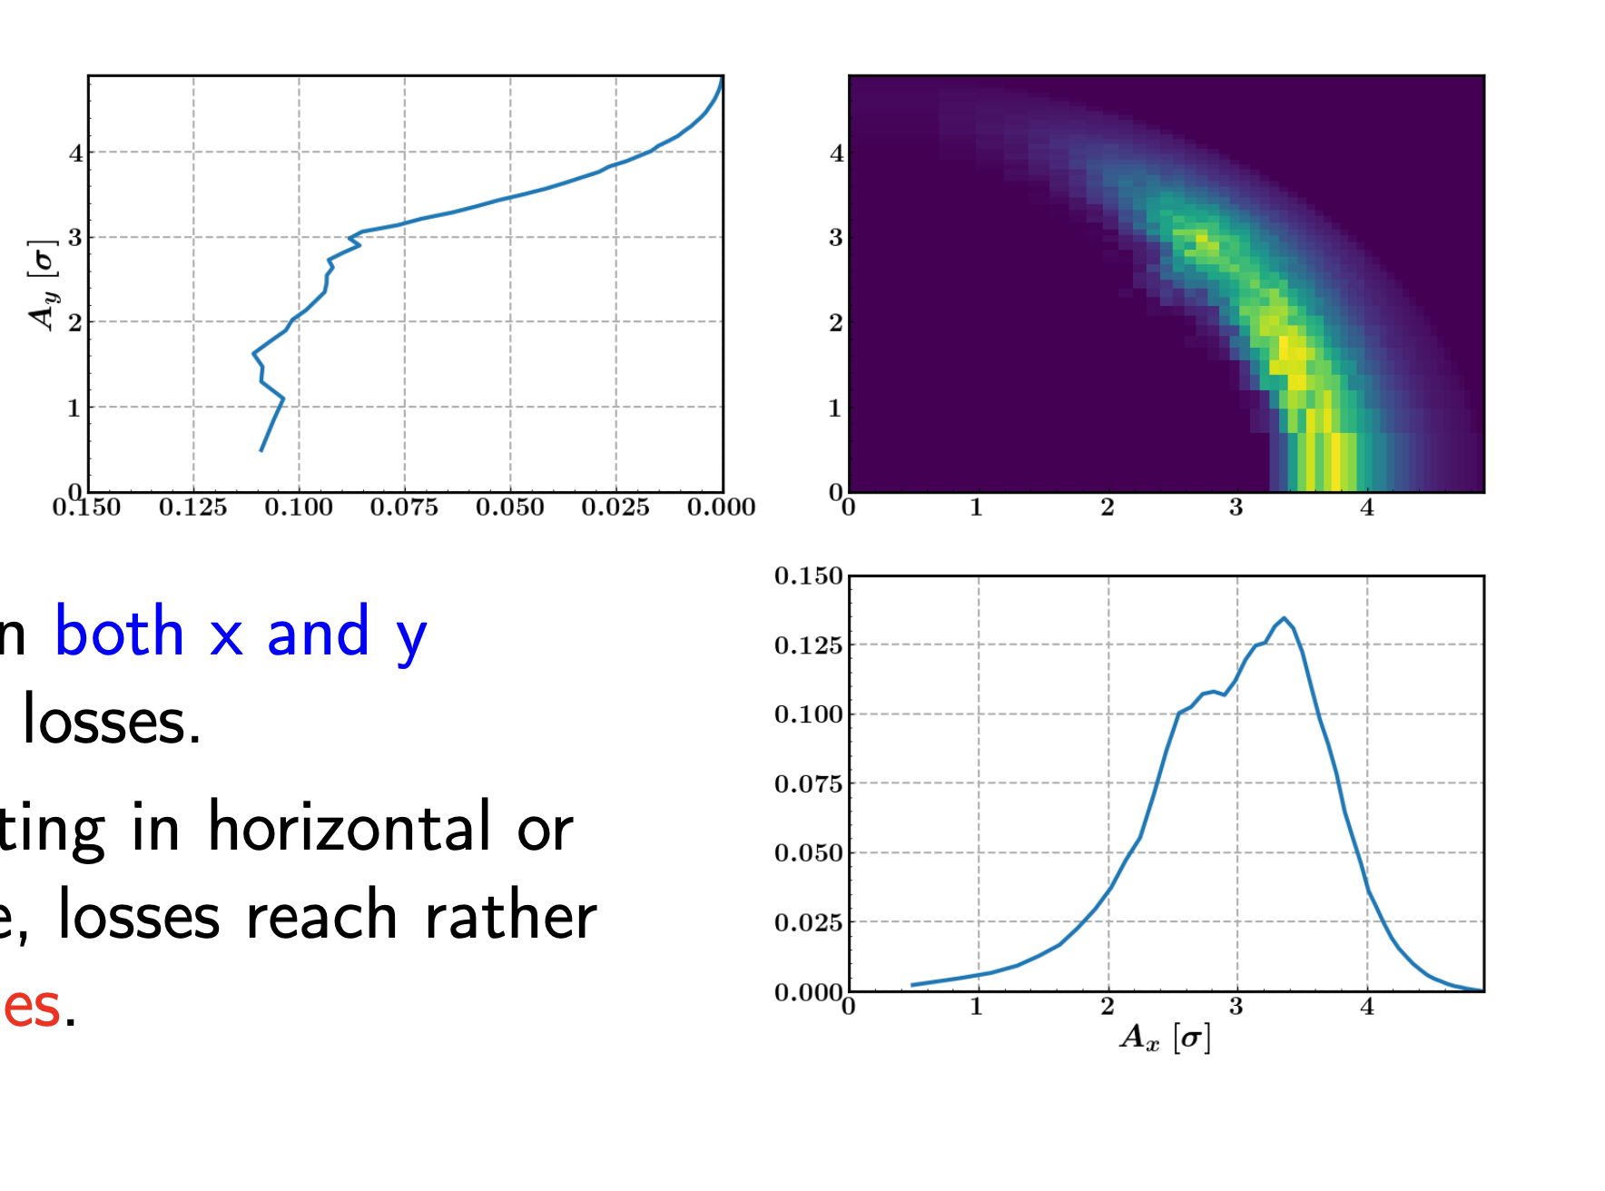
Beam-beam capabilities in Xsuite
GPU acceleration allows simulation of very long time scales, of interest for the LHC.
Example for LHC:
Direct element-by-element simulation of the first 30 minutes after bringing beams in collision (20 M turns!) to study lifetime, and tail depopulation
Simulation of 20 000 particles
  On CPU (single process) would take > 2 years simulation time
  On GPU (NVIDIA V100) was done in < 3 days simulation time
Density of lost particles in phase space
20 M turns
K. Padarchou
Notes:
CPU Time 162.37 us/part/turn
GPU Time 0.65 us/part/turn

Slide 25
Outline
Introduction
Architecture and main capabilities
  Lattice modeling
  Single-particle tracking
  Twiss module
  Optimized
  Particle-matter interaction
  Synchrotron radiation
  Collective effects (wakefields, spacecharge, IBS)
Beam-beam capabilities
  Weak-strong
  Strong-strong (soft-Gaussian)
  Beamstrahlung and Bhabha effect
  Strong-strong (Particle In Cell)
Summary and final remarks

Slide 26
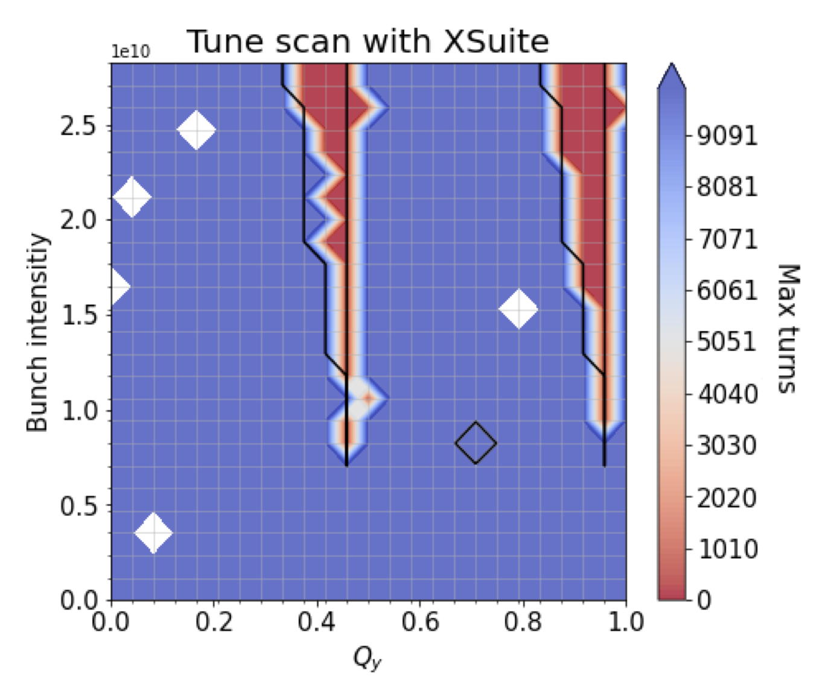
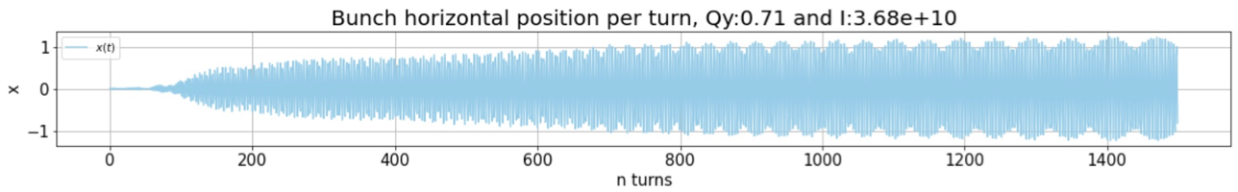
Strong-strong simulations – Soft-Gaussian approach
Supported by:
With some simple additions, the weak-strong simulation engine is extended to simulate coherent effects using the ”Soft-Gaussuan approach”:
The transverse distribution is assumed to be Gaussian
Both beams are tracked concurrently (optionally on different CPU processes - MPI)
At each beam-beam interaction, the moments of each bunch are updated and used to compute forces on other bunch
  If the 6d method (Hirata) is selected such update is done slice by slice
R. Soos

Slide 27
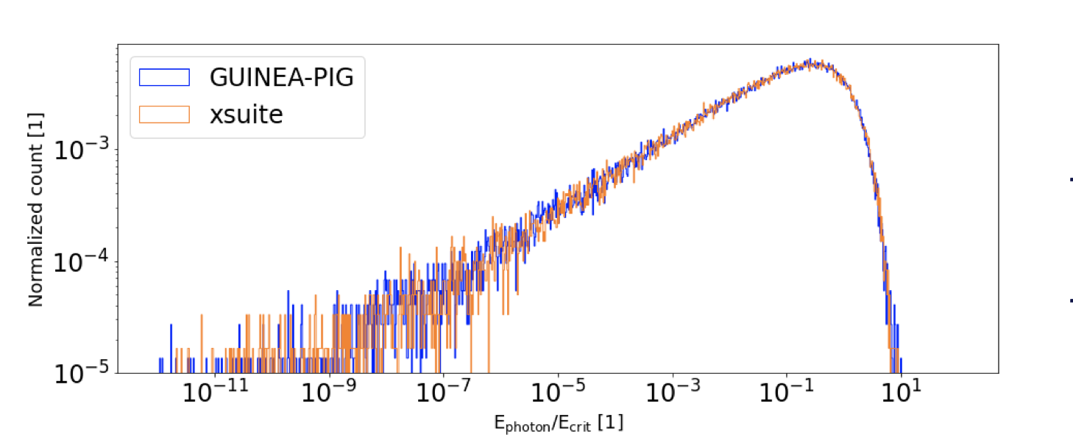
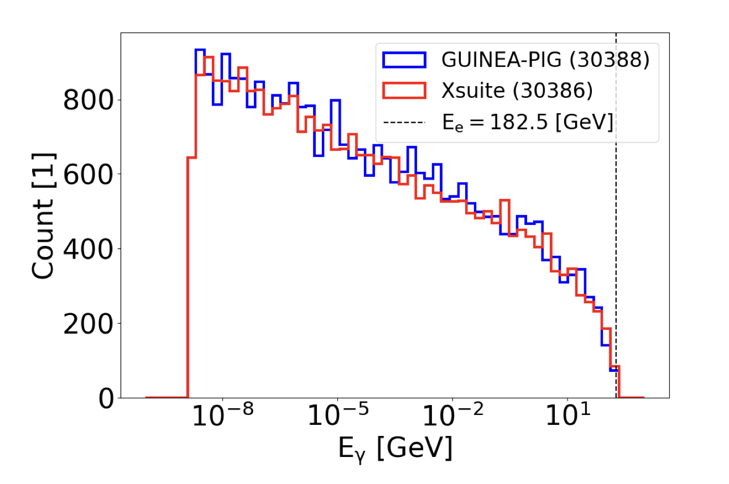
Beamstrahlung and Bhabha
Supported by:
Beamstrahlung and Bhabha effects are also modelled by the beam beam elements
For more info see
P. Kicsiny et al. https://indico.cern.ch/event/1160125/ and https://cds.cern.ch/record/2886033/

Slide 28
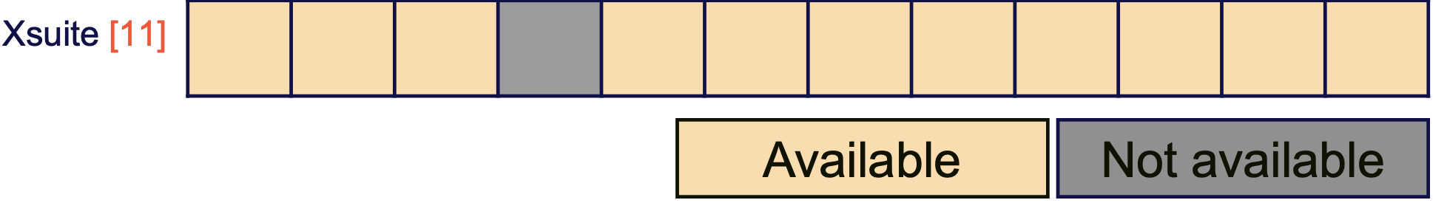
Outline
Introduction
Architecture and main capabilities
  Lattice modeling
  Single-particle tracking
  Twiss module
  Optimized
  Particle-matter interaction
  Synchrotron radiation
  Collective effects (wakefields, spacecharge, IBS)
Beam-beam capabilities
  Weak-strong
  Strong-strong (soft-Gaussian)
  Beamstrahlung and Bhabha effect
  Strong-strong (Particle In Cell)
Summary and final remarks
Last missing item on Peter’s wishlist developed last summer ☺

Slide 29
Strong-strong simulations – Particle In Cell
Lab frame
Interaction is computed in a Lorentz-boosted reference frame in which the two bunches are moving along the same direction
Crossing plane
Beam 2
Beam 1
IP
S
S*
Boosted
reference frame

Slide 30

Strong-strong simulations – Particle In Cell
Interaction is computed in a Lorentz-boosted reference frame in which the two bunches are moving along the same direction
Crossing plane
Beam 1
Beam 2
IP
S*
Boosted
reference frame

Slide 31
Strong-strong simulations – Particle In Cell
The beam-beam forces are computed on a cartesian 3D Grid using a discrete time step. At each step:
The particles charge is deposited on the grid cells
The scalar potential φ is computed by solving for each slice a 2D Poisson equations (FFT method, Integrated Green Function⁽¹⁾)
Force on individual particles is computed by interpolation (both transverse kicks and energy change are applied)
Particles are propagated for a single time step
x
s
⁽¹⁾ From J. Qiang et al., “A parallel particle-in-cell model for beam–beam interaction in high energy ring colliders”, Journal of Computational Physics 198 (2004) 278–294

Slide 32
Strong-strong simulations – Particle In Cell
The beam-beam forces are computed on a cartesian 3D Grid using a discrete time step. At each step:
The particles charge is deposited on the grid cells
The scalar potential φ is computed by solving for each slice a 2D Poisson equations (FFT method, Integrated Green Function⁽¹⁾)
Force on individual particles is computed by interpolation (both transverse kicks and energy change are applied)
Particles are propagated for a single time step
x
s
⁽¹⁾ From J. Qiang et al., “A parallel particle-in-cell model for beam–beam interaction in high energy ring colliders”, Journal of Computational Physics 198 (2004) 278–294

Slide 33
Strong-strong simulations – Particle In Cell
The beam-beam forces are computed on a cartesian 3D Grid using a discrete time step. At each step:
The particles charge is deposited on the grid cells
The scalar potential φ is computed by solving for each slice a 2D Poisson equations (FFT method, Integrated Green Function⁽¹⁾)
Force on individual particles is computed by interpolation (both transverse kicks and energy change are applied)
Particles are propagated for a single time step
x
s
⁽¹⁾ From J. Qiang et al., “A parallel particle-in-cell model for beam–beam interaction in high energy ring colliders”, Journal of Computational Physics 198 (2004) 278–294

Slide 34
Strong-strong simulations – Particle In Cell
The beam-beam forces are computed on a cartesian 3D Grid using a discrete time step. At each step:
The particles charge is deposited on the grid cells
The scalar potential φ is computed by solving for each slice a 2D Poisson equations (FFT method, Integrated Green Function⁽¹⁾)
Force on individual particles is computed by interpolation (both transverse kicks and energy change are applied)
Particles are propagated for a single time step
x
s
⁽¹⁾ From J. Qiang et al., “A parallel particle-in-cell model for beam–beam interaction in high energy ring colliders”, Journal of Computational Physics 198 (2004) 278–294

Slide 35
Strong-strong simulations – Particle In Cell
The beam-beam forces are computed on a cartesian 3D Grid using a discrete time step. At each step:
The particles charge is deposited on the grid cells
The scalar potential φ is computed by solving for each slice a 2D Poisson equations (FFT method, Integrated Green Function⁽¹⁾)
Force on individual particles is computed by interpolation (both transverse kicks and energy change are applied)
Particles are propagated for a single time step
x
s
⁽¹⁾ From J. Qiang et al., “A parallel particle-in-cell model for beam–beam interaction in high energy ring colliders”, Journal of Computational Physics 198 (2004) 278–294

Slide 36
Strong-strong simulations – Particle In Cell
The beam-beam forces are computed on a cartesian 3D Grid using a discrete time step. At each step:
The particles charge is deposited on the grid cells
The scalar potential φ is computed by solving for each slice a 2D Poisson equations (FFT method, Integrated Green Function⁽¹⁾)
Force on individual particles is computed by interpolation (both transverse kicks and energy change are applied)
Particles are propagated for a single time step
x
s
⁽¹⁾ From J. Qiang et al., “A parallel particle-in-cell model for beam–beam interaction in high energy ring colliders”, Journal of Computational Physics 198 (2004) 278–294

Slide 37
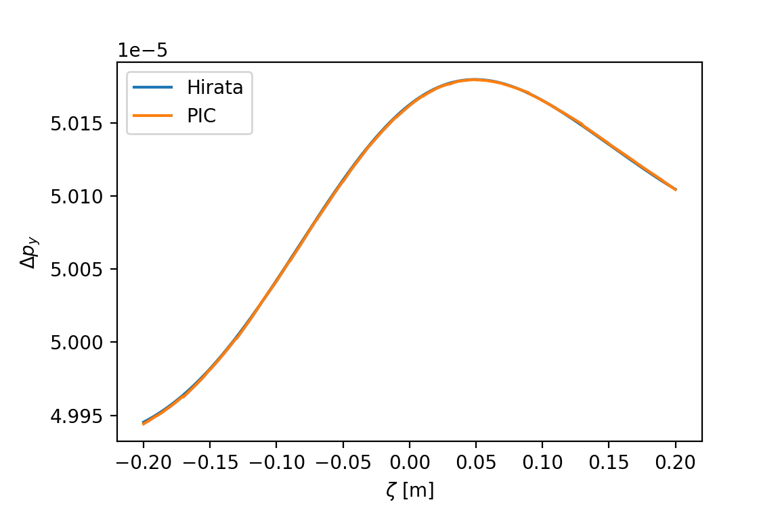
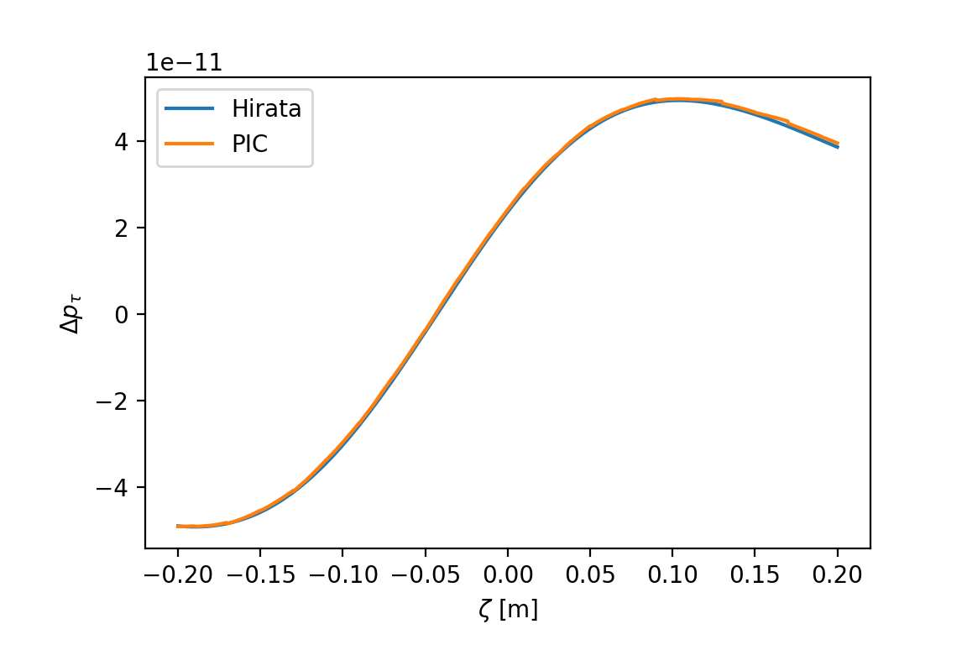
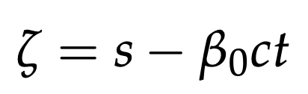
Strong-strong simulations – Particle In Cell
Result from PIC computations checked against Hirata method for Gaussian distribution
GPU acceleration available also for PIC calculation:
Observed speed-up of about x30 compared to single CPU process
Check on kick received by particles with a large angle as a function of the arrival time
Transverse kick
Energy change

Slide 38
Outline
Introduction
Architecture and main capabilities
  Lattice modeling
  Single-particle tracking
  Twiss module
  Optimized
  Particle-matter interaction
  Synchrotron radiation
  Collective effects (wakefields, spacecharge, IBS)
Beam-beam capabilities
  Weak-strong
  Strong-strong (soft-Gaussian)
  Beamstrahlung and Bhabha effect
  Strong-strong (Particle In Cell)
Summary and final remarks

Slide 39
Summary and final remarks
Xsuite offers a rather complete set of beam beam capabilities ranging from 4D and 6D weak strong modelling to self-consistent strong-strong interaction with both the “Soft-Gaussian” and the Particle In Cell method
These capabilities can be combined with several other features which often need to be studied in combination with beam beam, notably:
Symplectic element-by-element tracking
Optics calculations and matching
Dynamic effects (functions, ripples, noise)
Particle-matter interaction (collimation)
Synchrotron radiation, beamstrahlung and Bhabha effects
Collective effects (IBS, Wakefields, Space charge)
The code is publicly available on GitHub and can be installed through pip
You are very welcome to give it a try
Installation instructions and many examples available in the doc pages
Feedback is very welcome (please contact us for issues, questions, suggestions)
The code is open-source and is open to developments from the community:
Get in touch if you are interested in contributing to the development

Slide 40
Thanks for your attention!
40

Slide 41
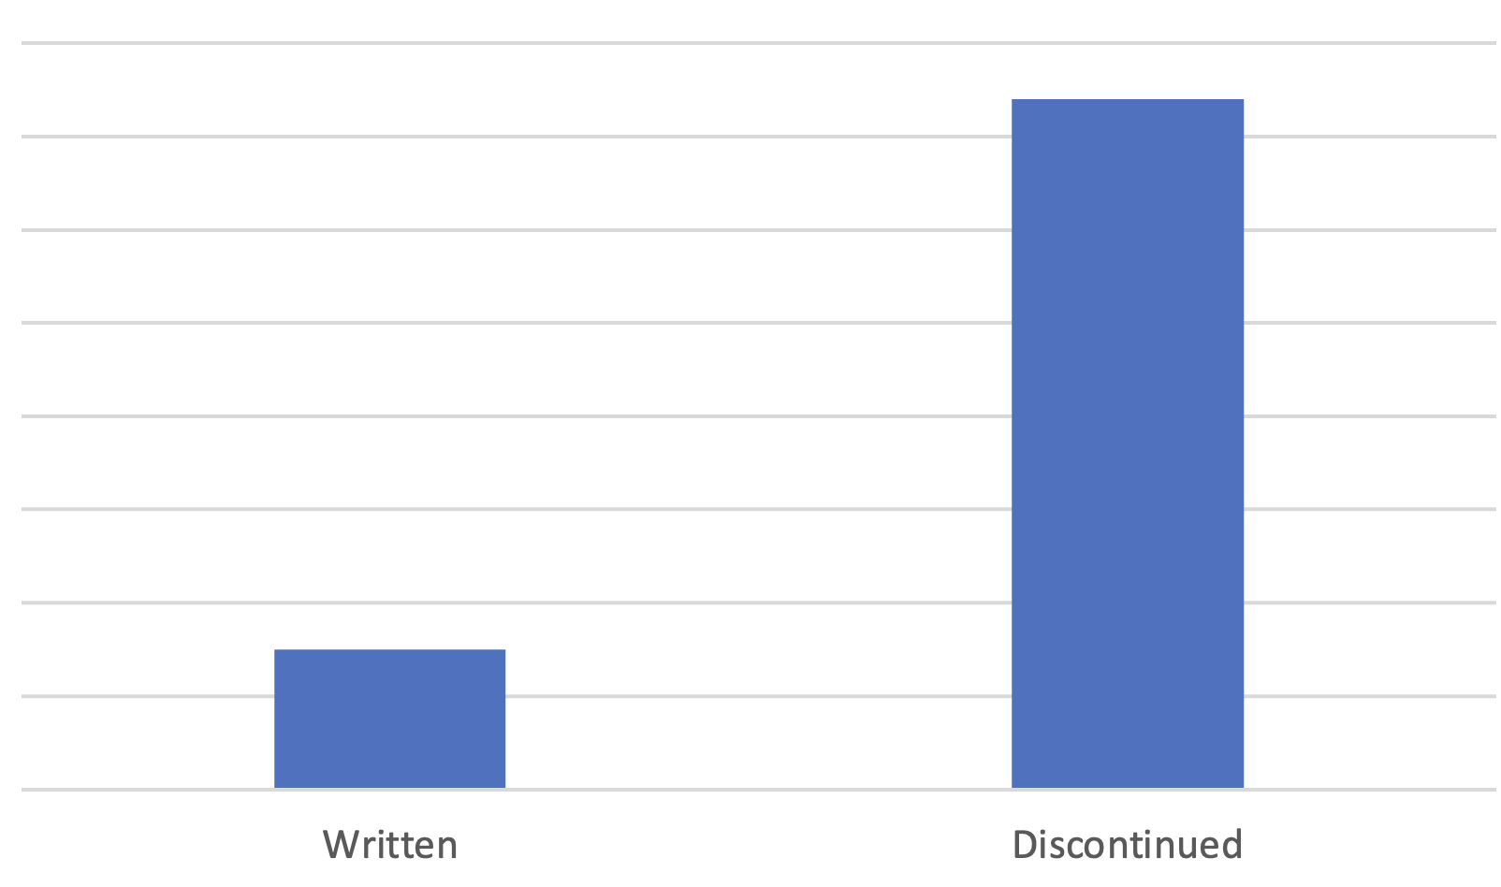
Discontinuation of legacy tools
In 2022-23 we have essentially discontinued the development and, to a very large extent, the usage of the following tools:
  Sixtrack
  Sixdesk
  Sixtracklib
  COMBI
  PySSD
  DistLib
This led to a massive simplification of our code base.
Lines of code
370k
75k
Written
(Xsuite)
Discontinued
(Legacy tools)

Slide 42
Space charge
Simulation campaign for the CERN SPS
including full non-linear lattice, space charge and wakefields
The implementation is largely based on PyHEADTAIL-PyPIC
Different space-charge models are implemented:
The “frozen” model, in which particles interact with fixed charge distributions
The “quasi frozen” model, in which the beam intensity and beam sizes are recomputed at each interaction
The “Particle In Cell (PIC)” model:
  Charge of tracked particles distributed on a rectangular grid
  Fast Poisson solver based on FFT method with Integrated Green Functions
Space charge simulations strongly profiting from GPU acceleration
Courtesy X. Buffat
42

Slide 43
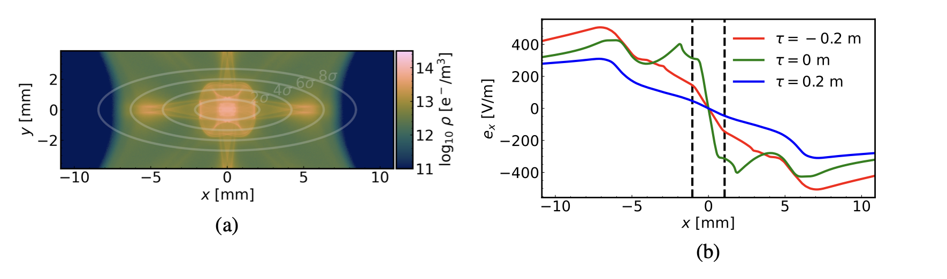
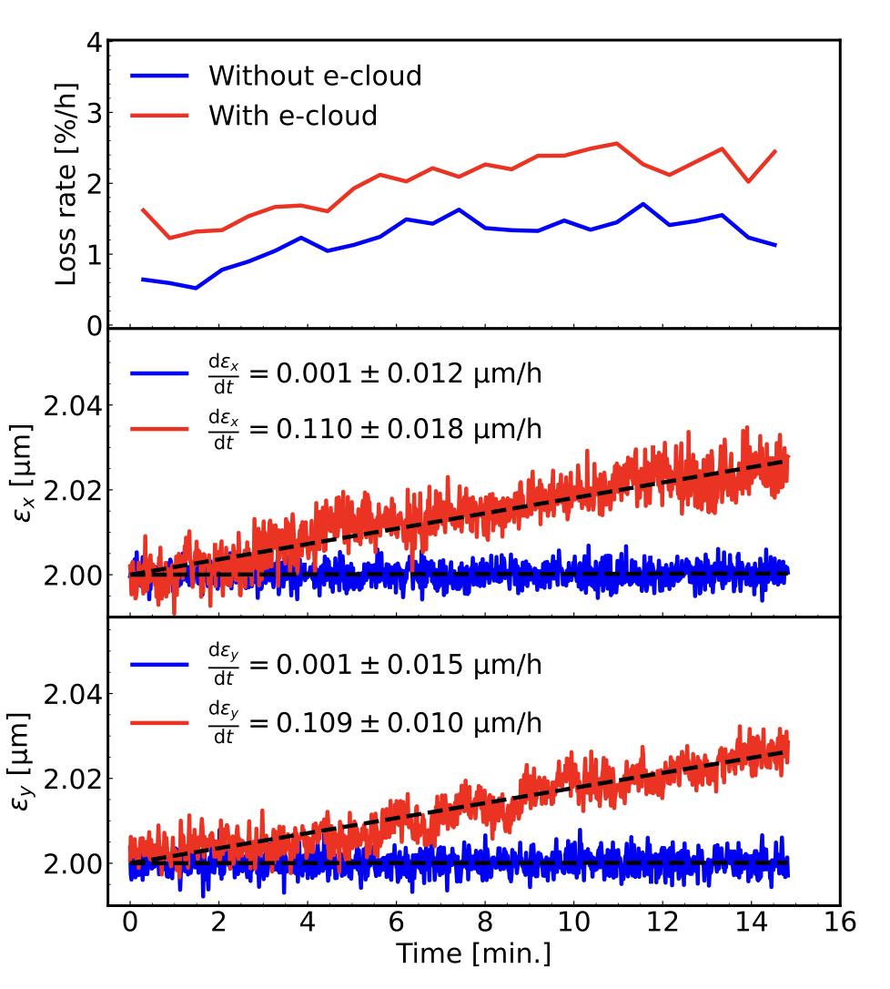
Electron cloud modeling
Xsuite has been exploited to study the effect of electron cloud on slow beam degradation (emittance growth, lifetime degradation).
Done by applying a high-order interpolation scheme to the e-cloud potential imported from a dedicated multipacting simulator.
  Scheme designed to preserve the symplecticity of the resulting map by ensuring the global continuity of the potential and required derivatives.
Use of GPUs is mandatory to simulate the required long time scales (>10⁶ turns).
See also: K. Paraschou, THBP16
43

Slide 44
Twiss module
Computation of Twiss parameters based on the tracking has two main advantages:
Any physical model included in the tracking is automatically usable in Twiss
  Without additional development effort
Twiss becomes a powerful diagnostics tool on the built tracking model
  Allows measuring directly on the tracking model tunes, chromaticities, closed orbit, beta functions, etc.
  Can be done effortlessly and without exporting or manipulating the model.
  Used daily to for validating simulation models, catching mistakes, investigating issues
HL-LHC optics
Accuracy compared to MAD-X: Δβ / β << 10⁻⁴
Computation time is very similar
44
Example
44

Slide 45

Beam beam effects
Xsuite implementation based on experience from Sixtrack and COMBI
Two models are provided:
  The “4D” model, which applies only transverse forces independent on the longitudinal motion
  The “6D” model, which applies longitudinal and transverse forces accounting for the synchrotron motion (method by Hirata et al.)
Both models can be used either in “weak-strong“ mode (fixed assigned distribution for the other beam) or in “strong-strong” mode (self-consistent two-beam simulation, “soft Gaussian”)
For the simulation of lepton colliders, the code can also simulate for beamstrahlung and Bhabha scattering (developed in collaboration with EPFL)
Strong-strong simulations are accelerated by parallel computing on HPC clusters (based on MPI)
  “Pipeline” algorithm⁽¹⁾ used to optimize workload distribution across the nodes
FCC-ee DA studies (with bb)
P. Kicsiny et al.
Wakefield + beam-beam simulations for HL-LHC (strong-strong modelling)
S. Furuseth and X. Buffat, Comput. Phys. Commun. 244 (2019)
For more details, see presentation by P. Kicsiny
45

Slide 46

Dynamic control of beam line parameters
Simulation of a fast orbit bump used for the H⁻ injection into the CERN PS Booster
In accelerators often a single high-level parameter can be used to control groups of components with complex dependency relations. (e.g. circuits with multiple magnets, groups of RF cavities, etc.)
The Xdeps module provides the capability to include such dependencies in the simulation model (as done by MAD-X deferred expressions)
Example, LHC crossing angle knob:
  At any time, the user can set:
lhc.vars[’on_x1’] = 160 # murad
  which automatically changes the strength of 40 dipole correctors to get the required crossing angle
User can also use “Time functions”, i.e. time dependent knobs that are updated automatically during the simulation
46

Slide 47

Synchrotron radiation
Supported by:
Equilibrium emittance (twiss vs track)
The effect of synchrotron radiation can be included in Xsuite tracking simulations. Two models available:
The “mean” model, for which the energy loss from the radiation is applied particle by particle without accounting for quantum fluctuations;
The “quantum” model for which the actual photon emission is simulated⁽¹⁾.
The Xsuite Twiss also includes:
Dedicated algorithm for non-symplectic one-turn map⁽²⁾
Computation of radiation energy loss, damping times and equilibrium emittances
An automatic tool is provided for phasing the RF cavities and adjusting magnet strengths to compensate the radiation energy loss (“tapering”)
Twiss (fast)
Twiss (full)
Tracking (300 particles)
⁽¹⁾ Based on H. Burkhardt, “Monte Carlo generator for synchrotron radiation”, 1990. Implementation ported from PLACET (A. Latina)
⁽²⁾ E. Forest, From tracking code to analysis: generalised Courant-Snyder theory for any accelerator model. Springer, 2016
47

