Slide 1


Strong-Strong Beam-Beam Simulations with Lattices of Circular e+e- Colliders
Zhiyuan Li
IHEP, CHINA
Contributors: Yuan Zhang(IHEP), Kazuhito Ohmi(KEK), Demin Zhou(KEK),
Yiwei Wang(IHEP), Gang XU(IHEP)
Many Thanks to K. Oide(KEK)，Y. Ohnishi (KEK)
ICFA mini workshop: Beam-Beam Effects in Circular Colliders BB24
EPFL, Lausanne, Sep. 5, 2024

Slide 2
Outline
Background
Introduction of APES-T
Benchmark
Simulation on CEPC
Summary
OUTLINE

Slide 3
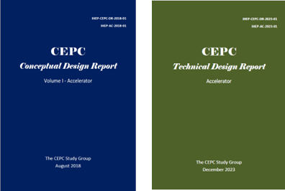
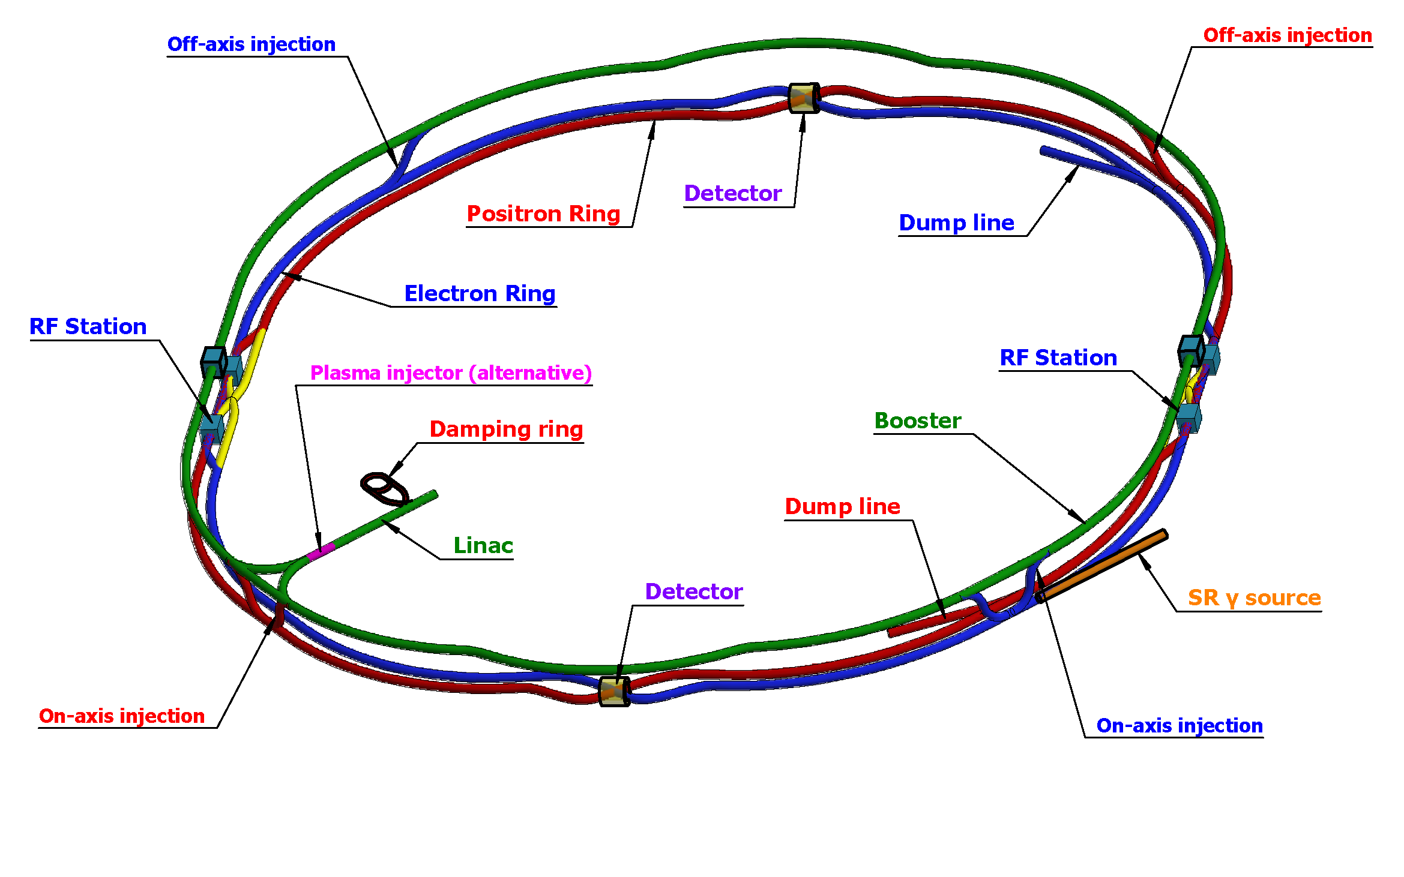
Brief Introduction to CEPC
2012 Higgs, CEPC was initiated
2018 CDR was published
2023 TDR was published
The CEPC aims to start operation in 2030’s, as a Higgs (Z / W) factory in China.
100km circumference, e+e- double ring collider
Possible pp collider (SppC) of 50–100 TeV in the far future
CEPC Study Group, et al., CEPC Conceptual Design Report, 2018, arXiv:1809.00285.
CEPC Study Group, et al., CEPC Technical Design Report, 2023, arXiv:2312.14363.

Slide 4
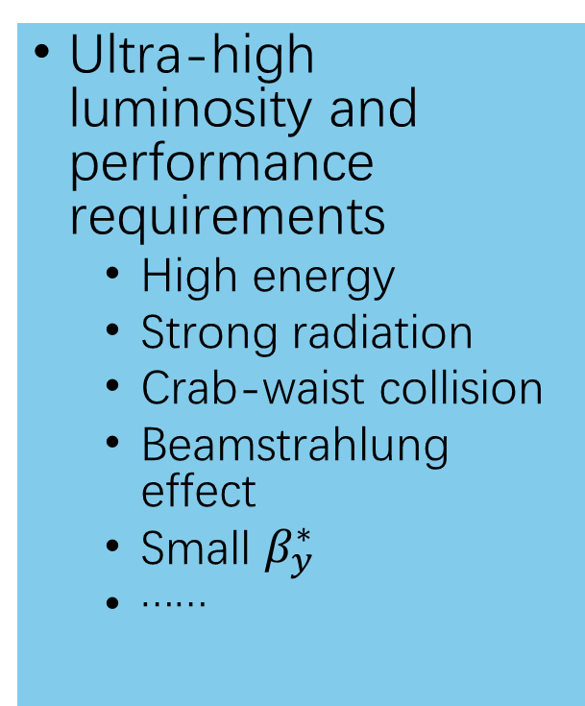
Challenges and Demand
In order to achieve the high luminosity and performance requirements of CEPC, many extreme conditions and parameters are used, and there are many new challenges, simulations should integrate more comprehensive models for the lattice.
Ultra-high luminosity and performance requirements
  High energy
  Strong radiation
  Crab-waist collision
  Beamstrahlung effect
  Small $β_{y}^{∗}$
  ……
Facing challenges
  Sawtooth effect
  Rad-COD
  Rad-Tapering
  Strong lattice non-linearity
  Bunch lengthen and energy spread increasing
  Small dynamic aperture
  X-Z instability
  Accurate simulation of collision process
  ……
Developing a program with more accurate modeling and simulation is essential for CEPC-like accelerators.

Slide 5
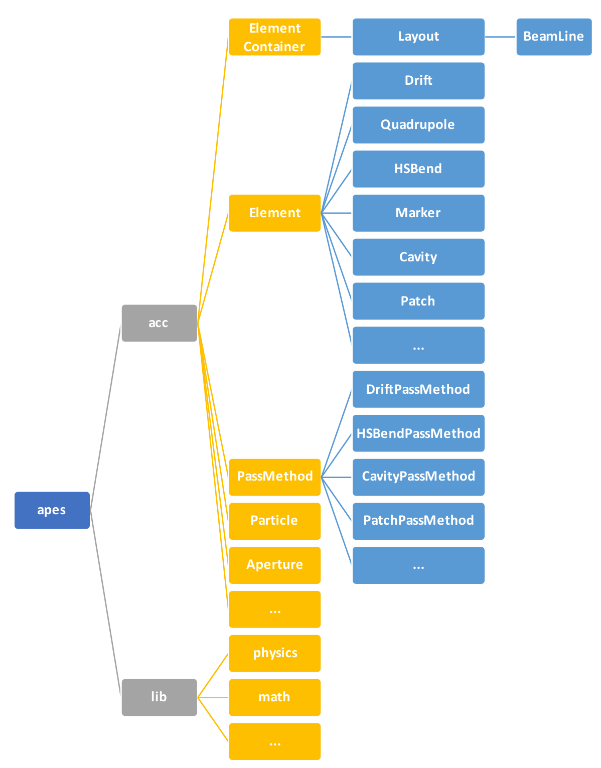
What is APES
So there is a need for a powerful software solution that can effectively handle these complex tasks while also offering flexibility for use and customization as needed.
Accelerator Physics Emulation System was proposed in 2021 and received support from the IHEP Innovative Fund in 2022 .
At present, the core architecture of APES has been completed and it now possesses basic accelerator design and calculation capabilities.
Under active development...
Liu W et al. Development status of beam dynamics software APES for CEPC. Proc SAP 2023.

Slide 6
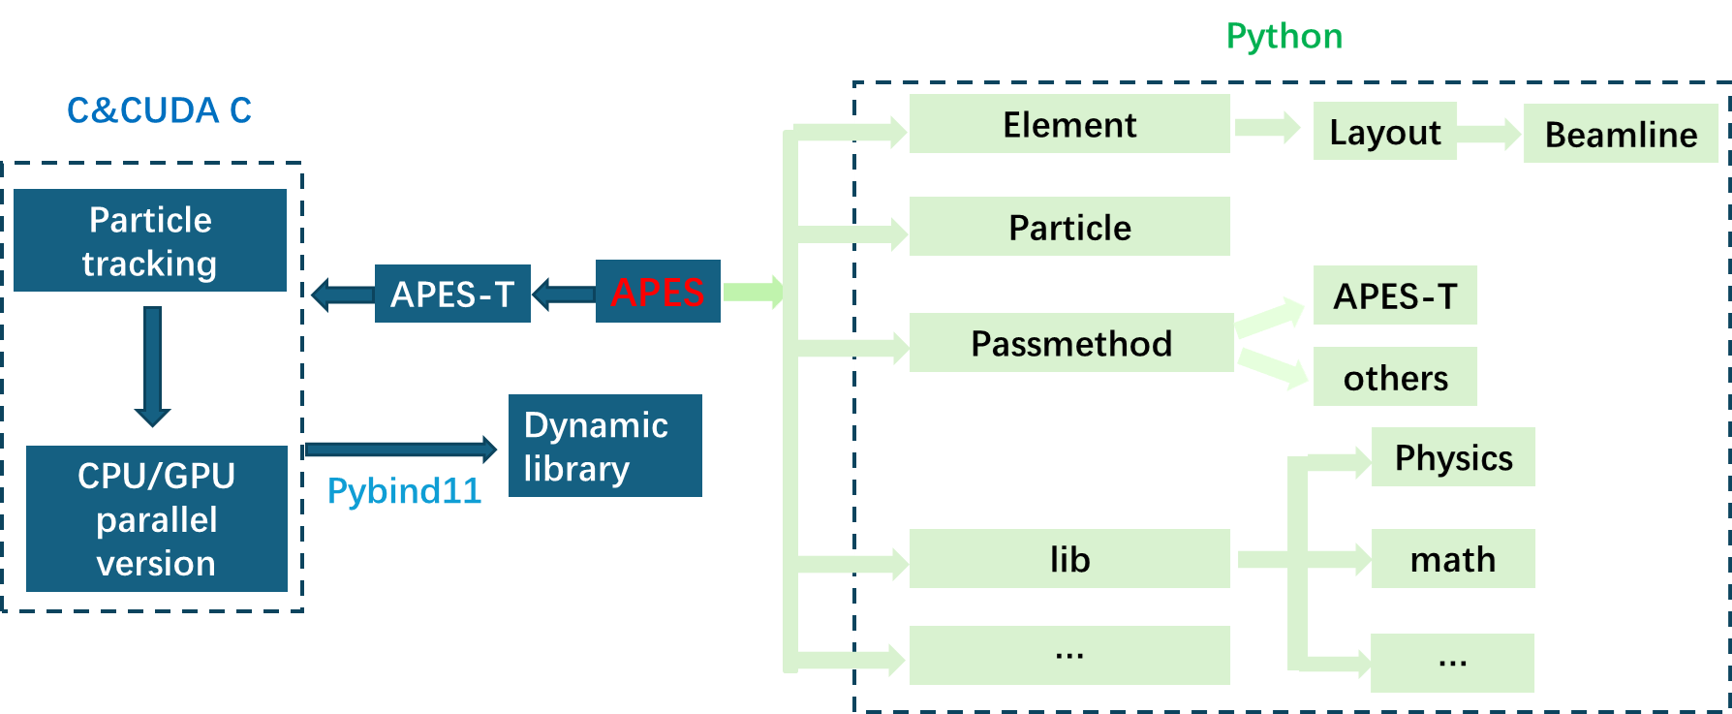
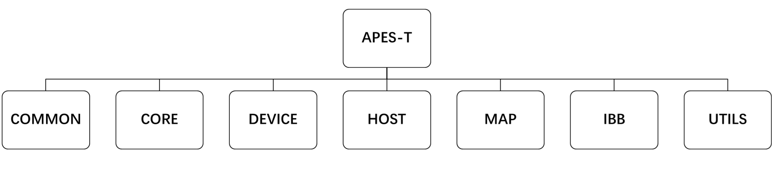
What is APES-T
In the APES project, there is a simulation program called APES-T that focuses on efficient particle tracking.
Developed using CUDA and C/C++. Can run independently
Can achieve strong–strong beam–beam simulation with element-by-element nonlinear tracking.
SAD lattice is fully supported.
Element map inheriting the features of the SAD*, including nonlinear fringe fields of magnets and magnetic fields overlapped with solenoids in the interaction regions .
IBB is seamlessly integrated as a part of APES-T to handle beam-beam interactions and other complex effects.
APES-T supports both CPU and GPU platforms ， hybrid parallel acceleration with CUDA and MPI.
*Thanks to K. Oide for discussions and for sharing his knowledge of the SAD code.

Slide 7
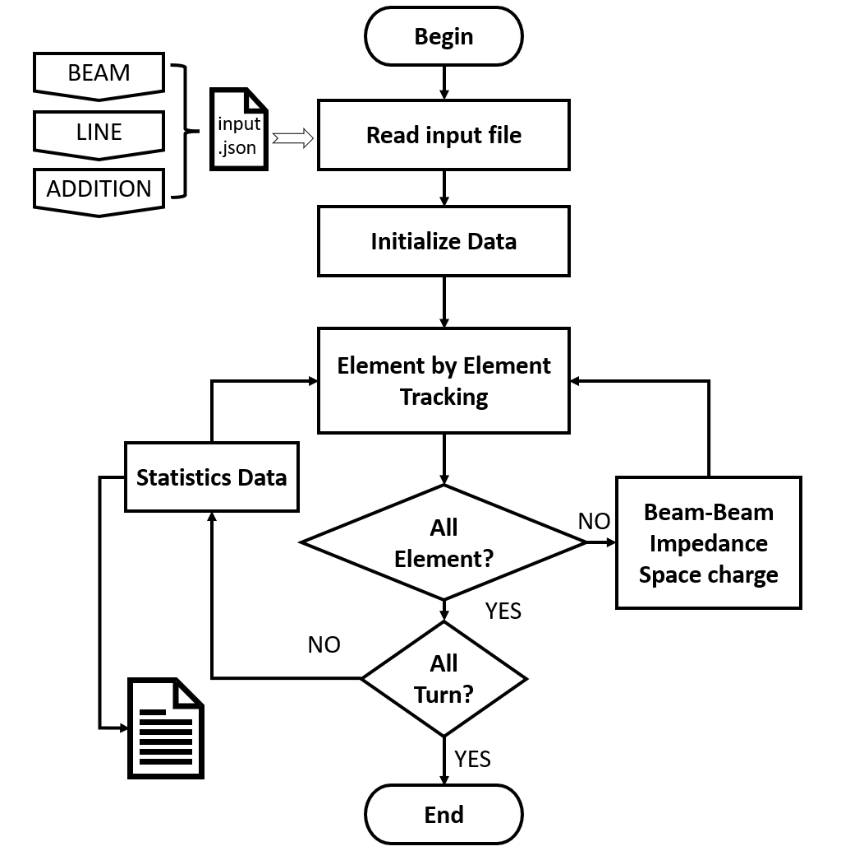
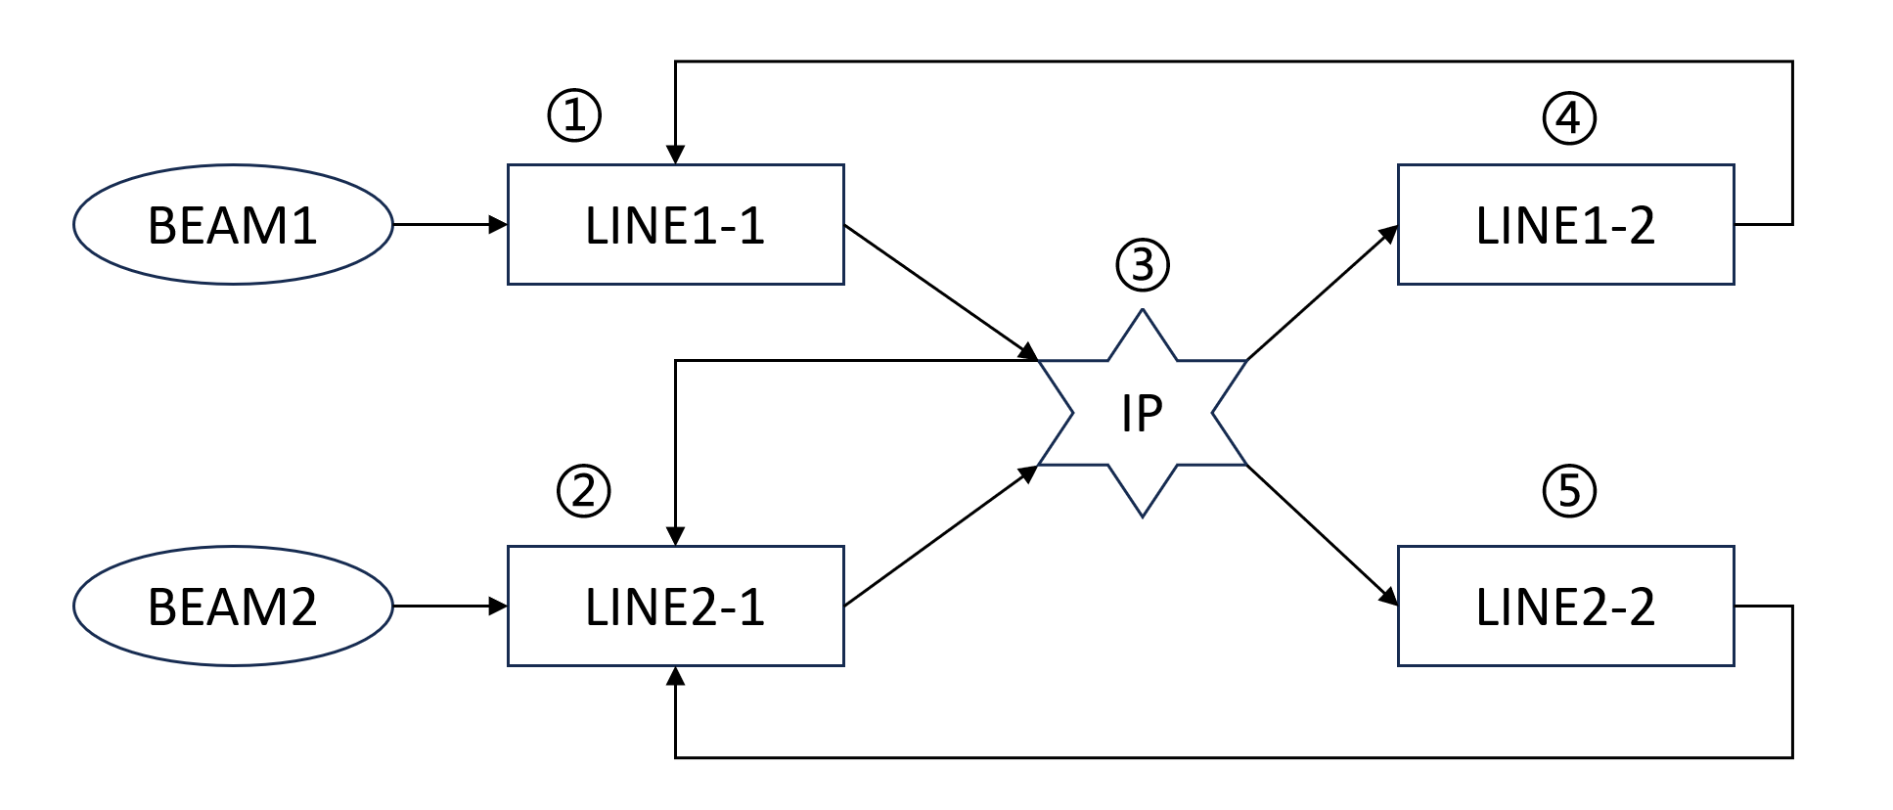
APES-T: Running Process
In this program, a JSON file serves as the input for obtaining command parameters. Contains three components
BEAM： Contains bunch information
LINE： Contains lattice information
ADDITION：is used to define special processes such as Beam-Beam, impedance, space charge and so on, allows calculations at any position in the lattice as needed.
LINE is divided into sections according to ADDITION’s positions.
The collision process is shown in the following figure.

Slide 8
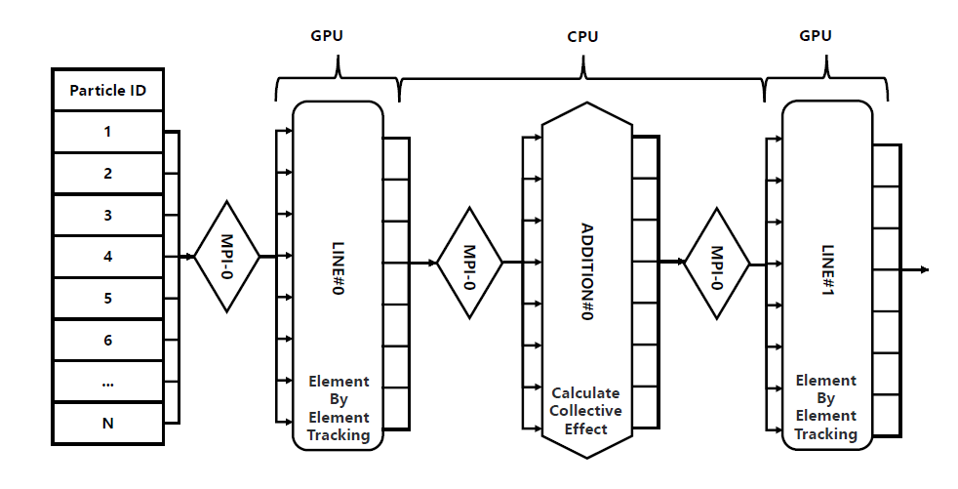
APES-T: Parallel Strategy
A high-efficiency hybrid parallelization approach employing both MPI and GPU is adopte.
GPU is responsible for efficiently tracking particles within the lattice. Particle level parallelism
So far, collective effects, such as beam–beam effects, have been only supported through MPI parallelization.
MPI manages collective effect calculations by partitioning particles into independent tasks and distributing them across various CPU threads.

Slide 9
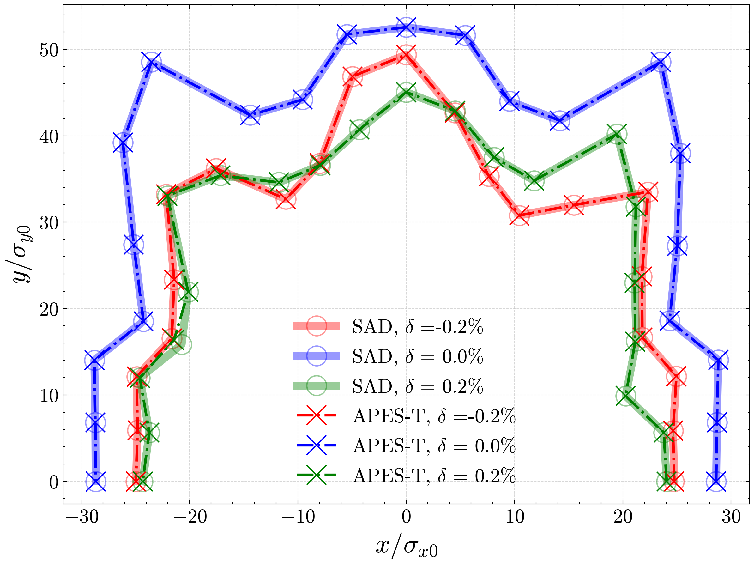
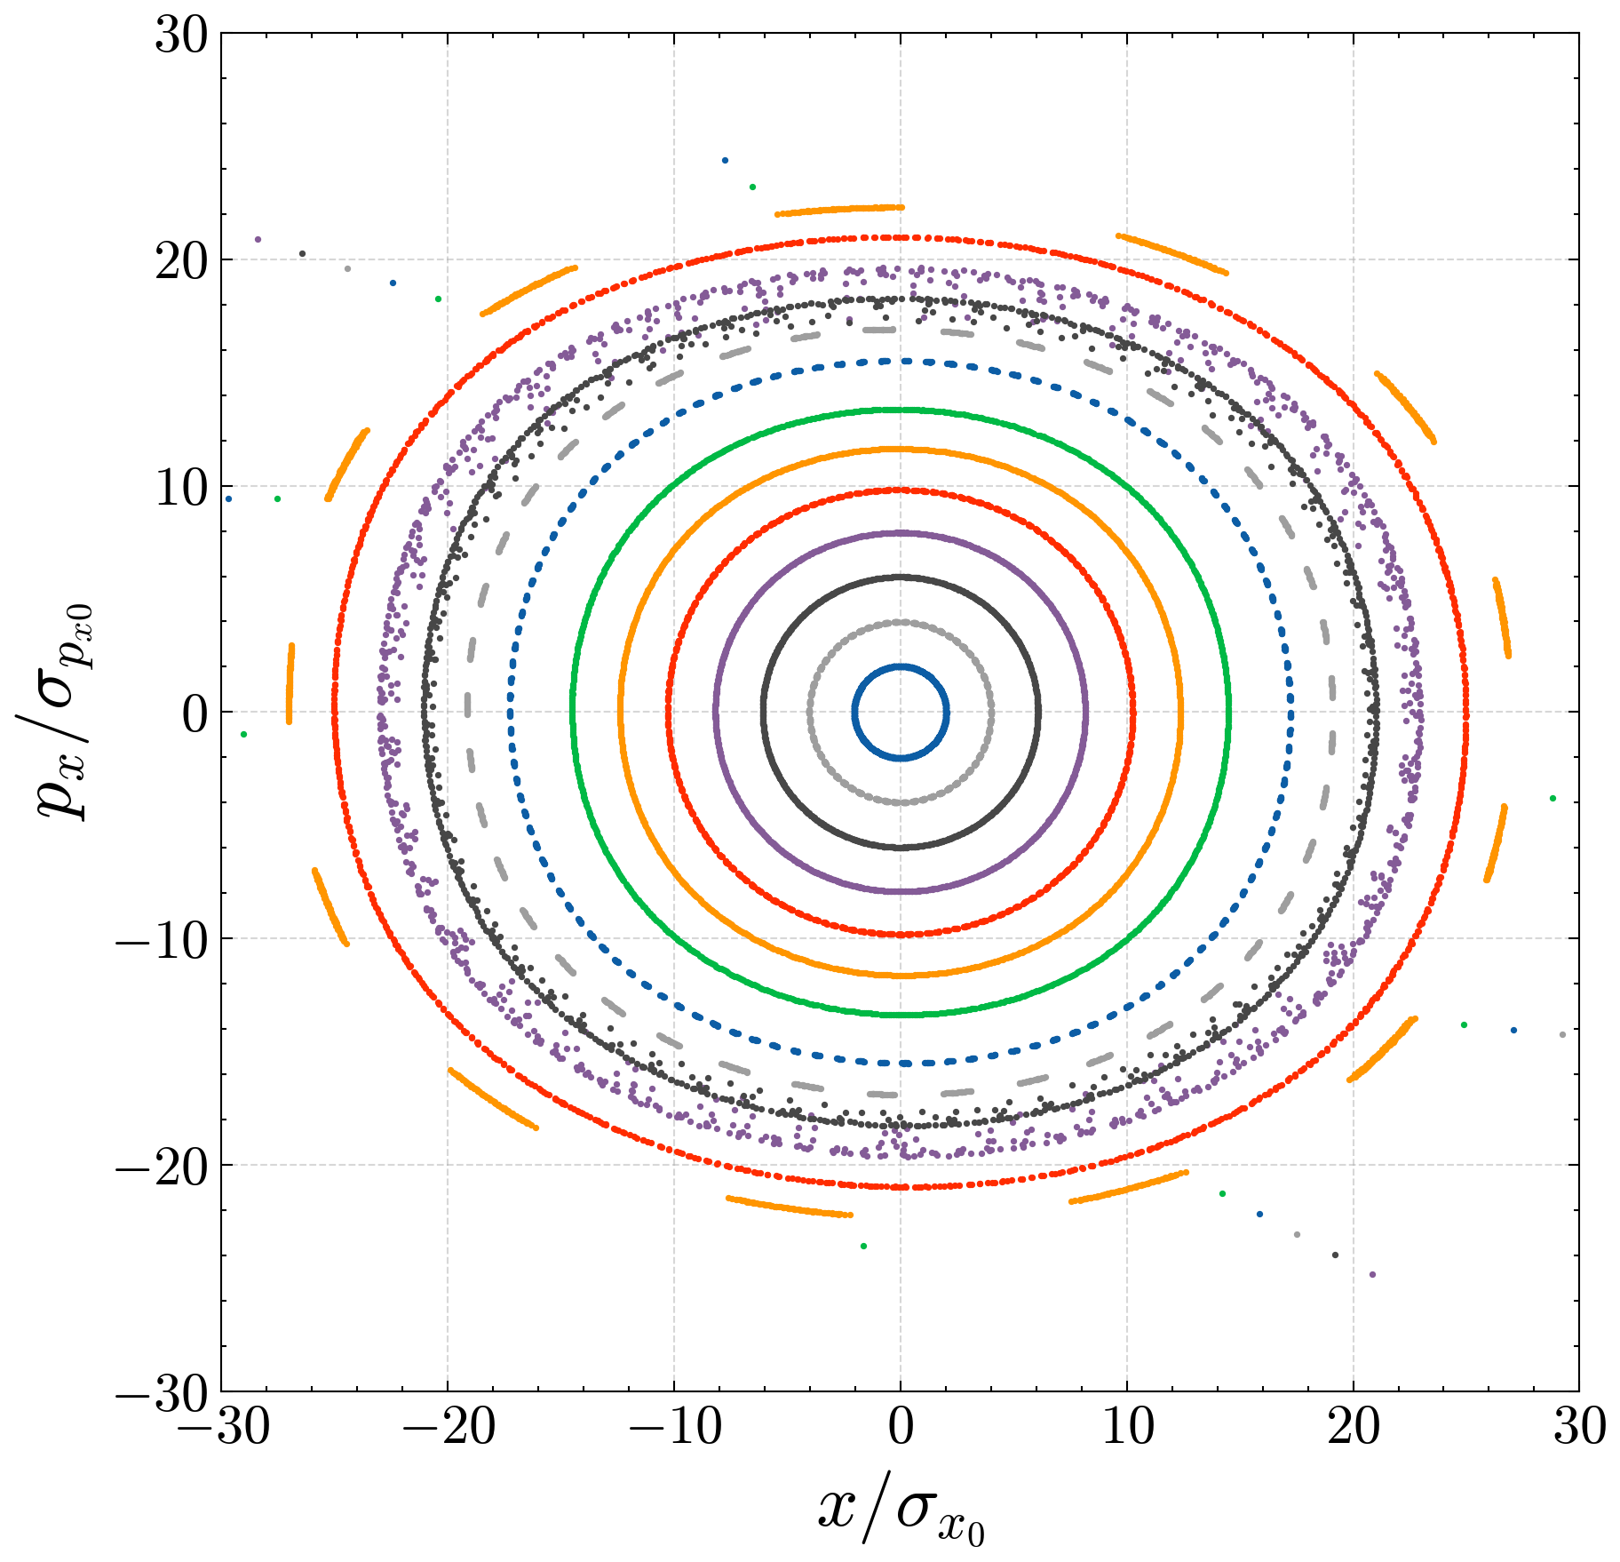
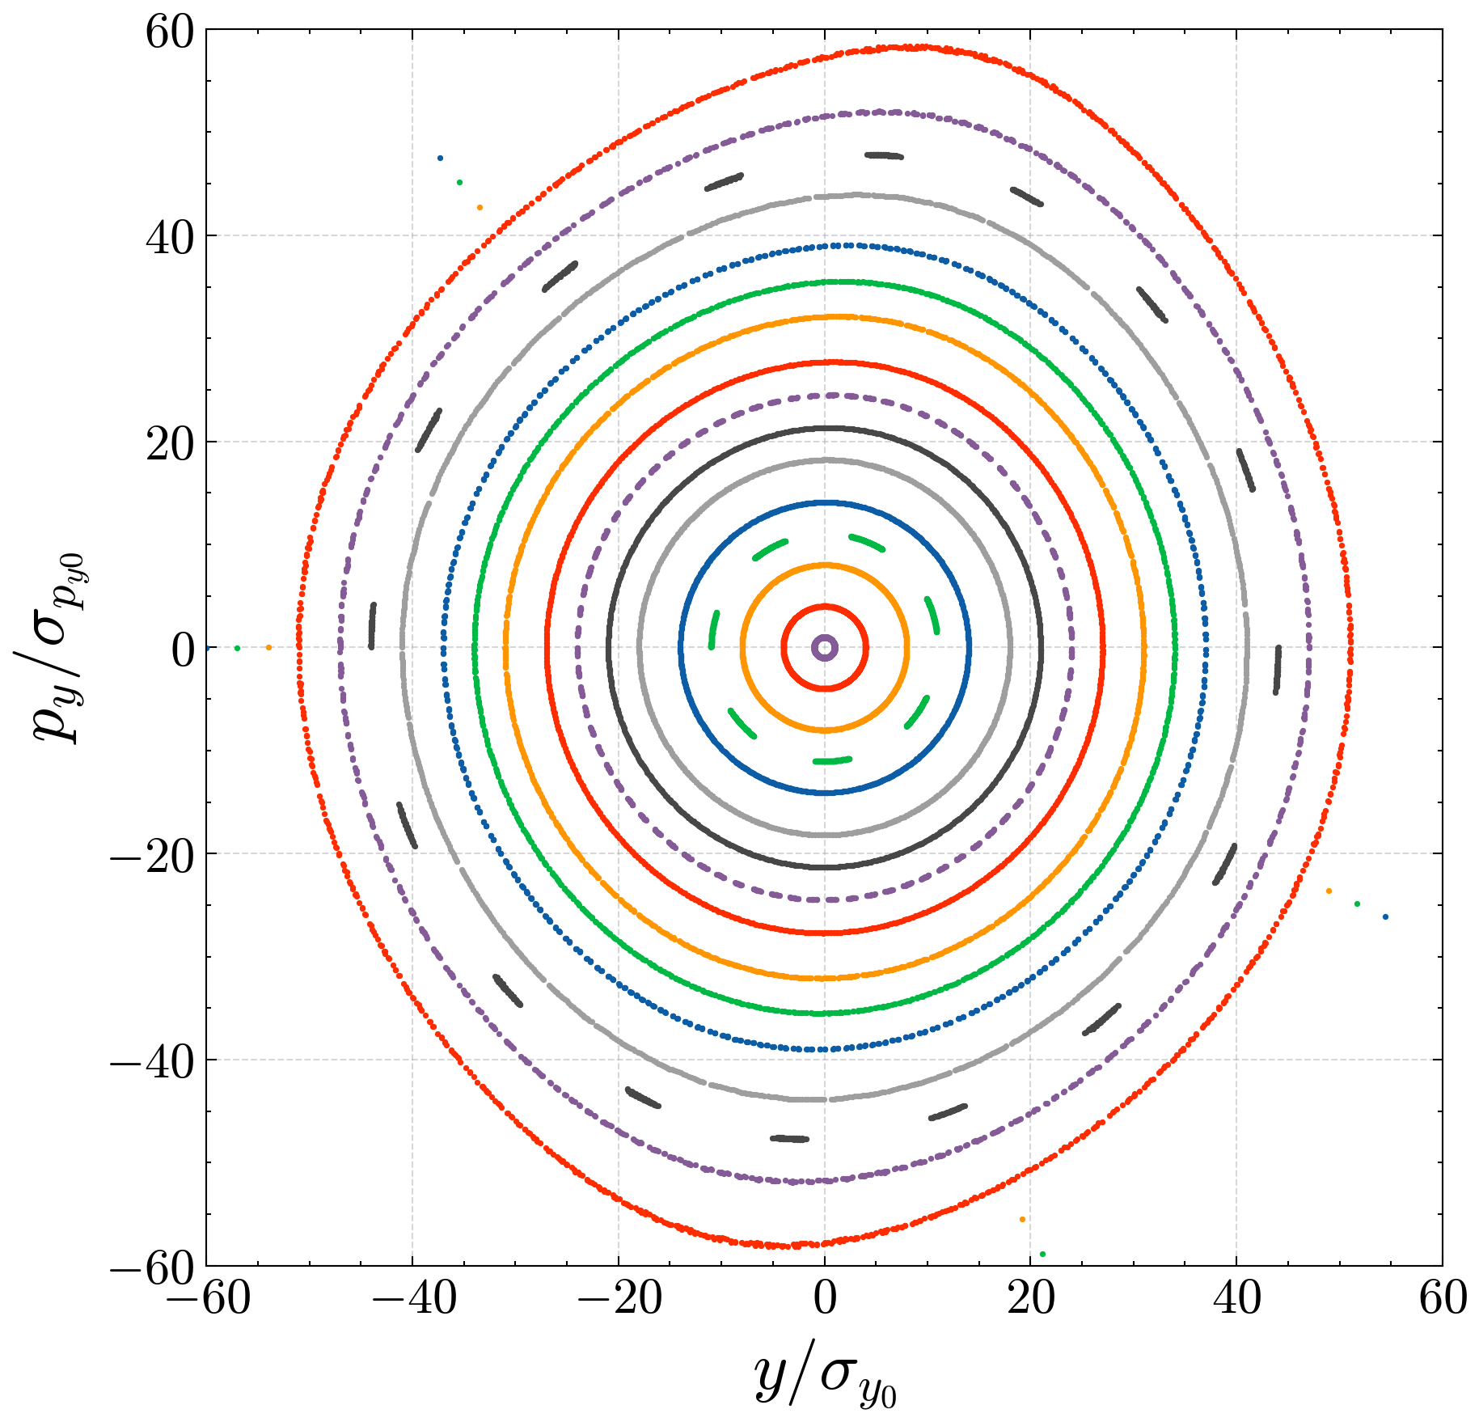

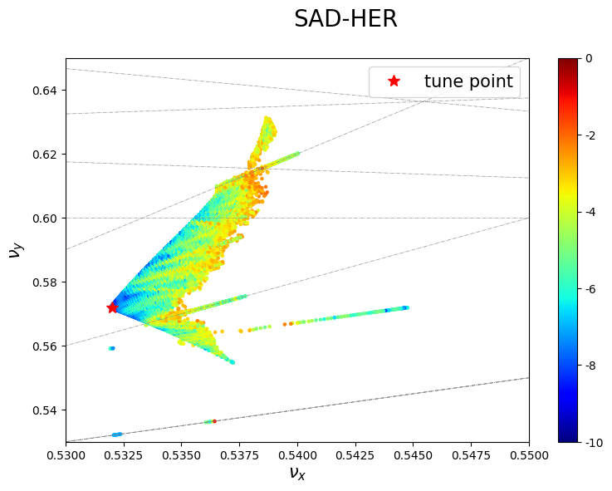
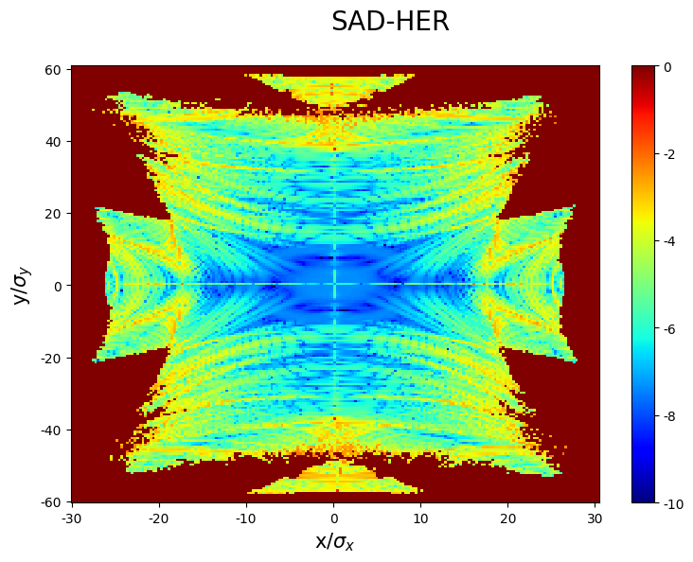
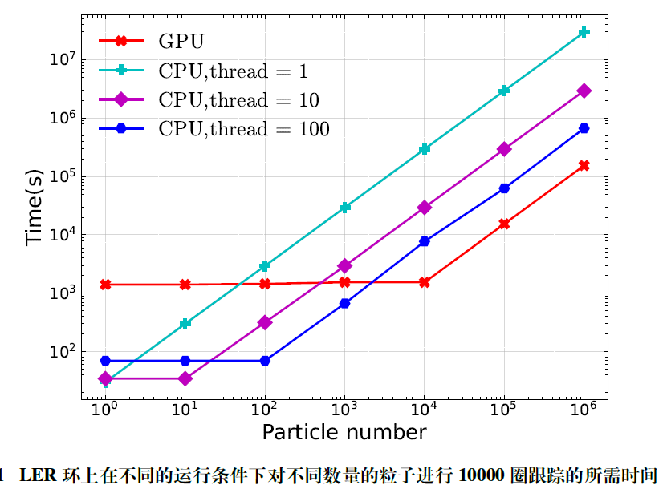
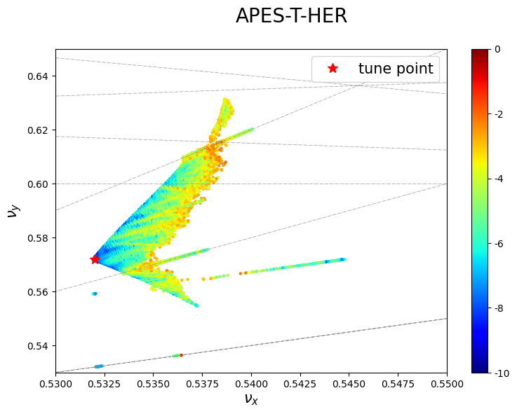
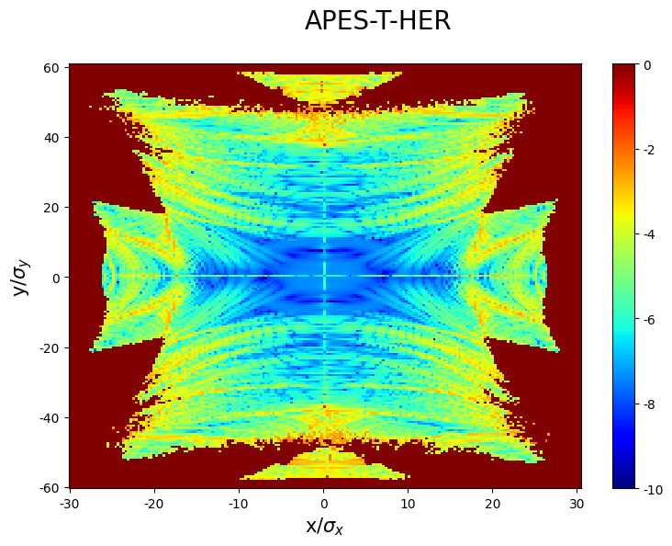
APES-T: Benchmark
DA
Poincare Map
To verify APES-T’s single-particle tracking module, a benchmark with SAD was carried out using the SuperKEKB HER lattice.
By comparing the results of DA,Poincare map and FMA, the results show that the program retains the nonlinear dynamics of SAD accurately
Reliable tracking results.
FMA
Efficiency
  Time spent for element-by-element tracking of 10,000 turns using a SuperKEKB‘s lattice with different numbers of macro-particles.
  The results show that when the computational workload is sufficiently large, a single GPU is approximately 4 to 5 times faster compared to 100 CPU threads.
  Considerable acceleration ratio
GPU: NVIDIA A100 GPU
CPU:2 × Intel(R) Xeon(R) Gold 6348

Slide 10
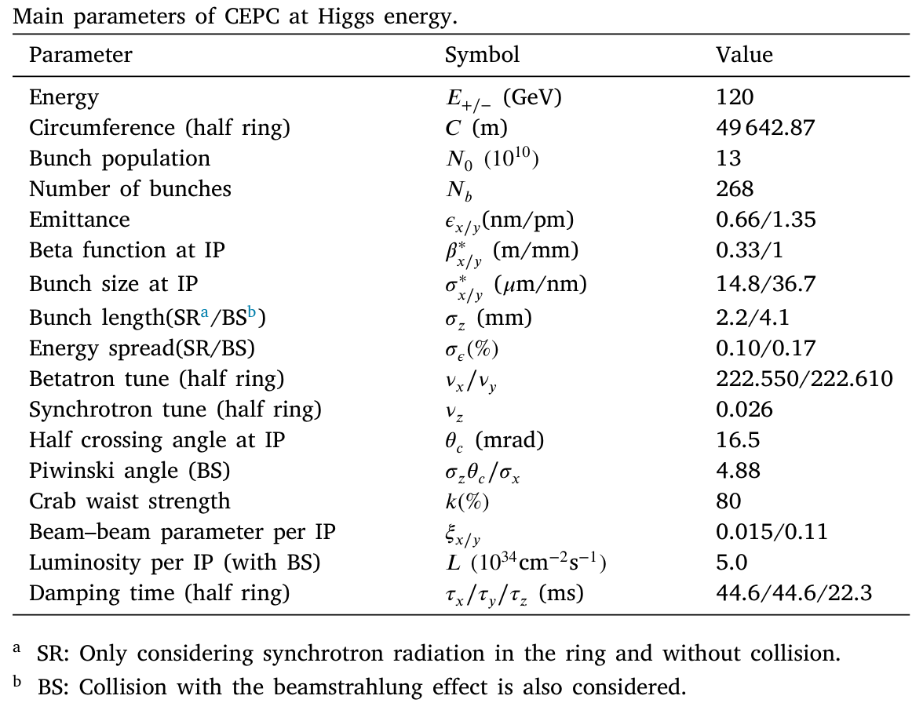
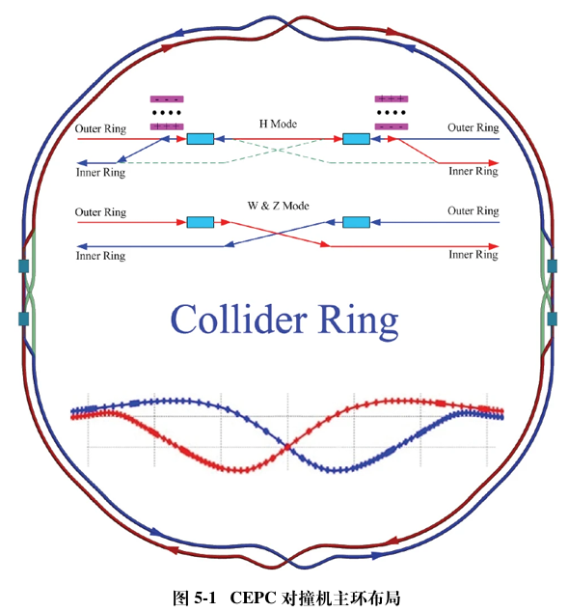
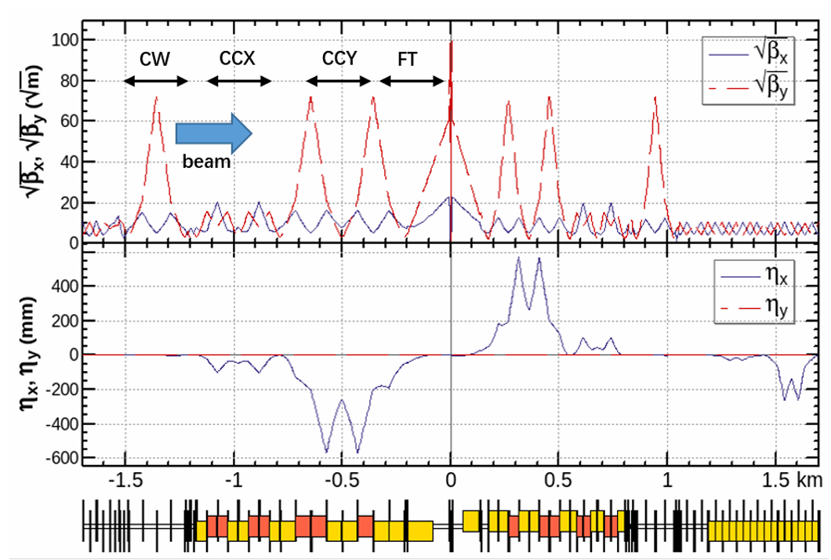
Preliminary Simulation Application
Use CDR‘s main parameter, Higgs Mode
100 km, 2 IP, symmetric design, The lattice for each half-ring comprises a total of 9135 element, including 4296 drifts, 1563 bends, 2637 quadrupoles, 538 sextupoles, 12 multipoles, 64 RF cavities, and 25 markers.
The IR chromatic sextupoles, crab waist sextupoles and arc chromatic sextupoles are all included in the lattice. Both the kinematic nonlinearity and nonlinear fringe field are included in the tracking with lattice.
Not include machine errors and physical apertures. SR use simplified model.
The soft-Gaussian approximation is used in strong–strong beam–beam simulations with inclusion of beamstrahlung. and set up 201 beam slices to account for the finite bunch length effect.
The number of macro-particles is set to be one million, which is a typical number required by strong–strong beam–beam simulations to suppress numerical noises.
100 CPU threads for the beam–beam effect simulation and an A100 GPU for element-by-element lattice tracking.
200 Turn/hour
Lattice：70% + Beam-Beam：25% + Other： 5%
beta and dispersion function of CEPC IR

Slide 11
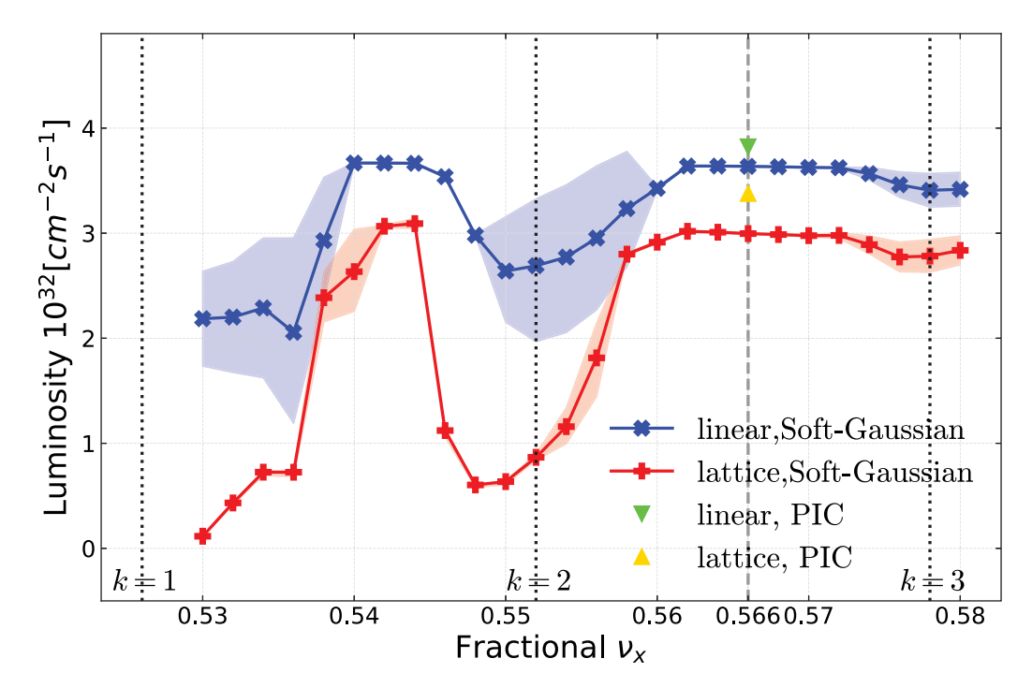
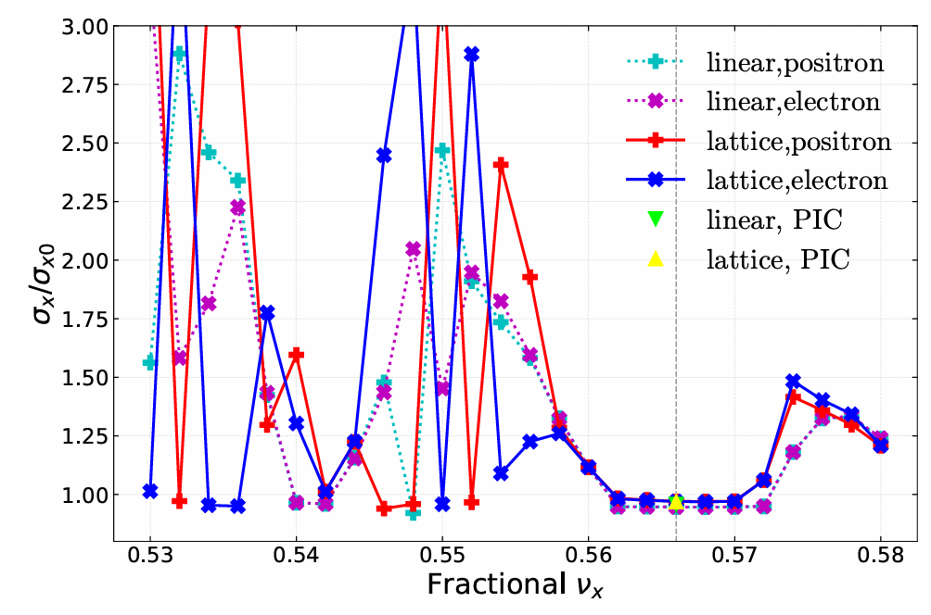
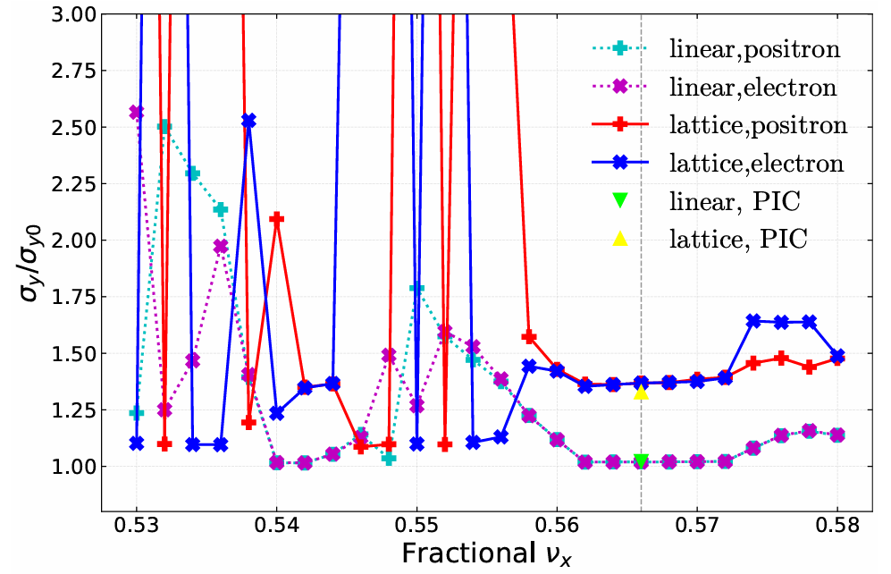
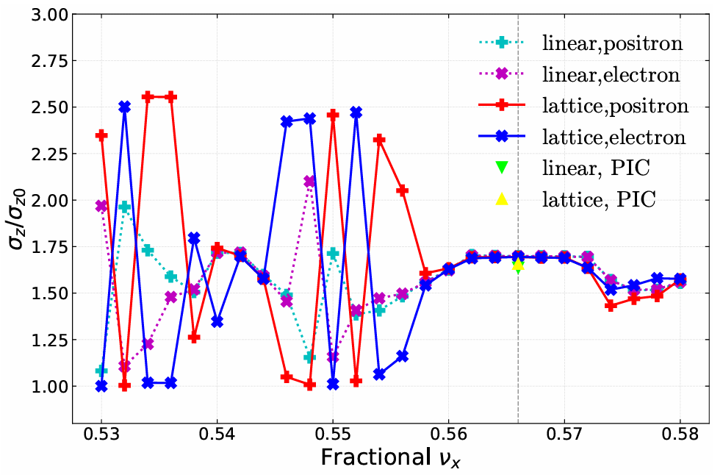
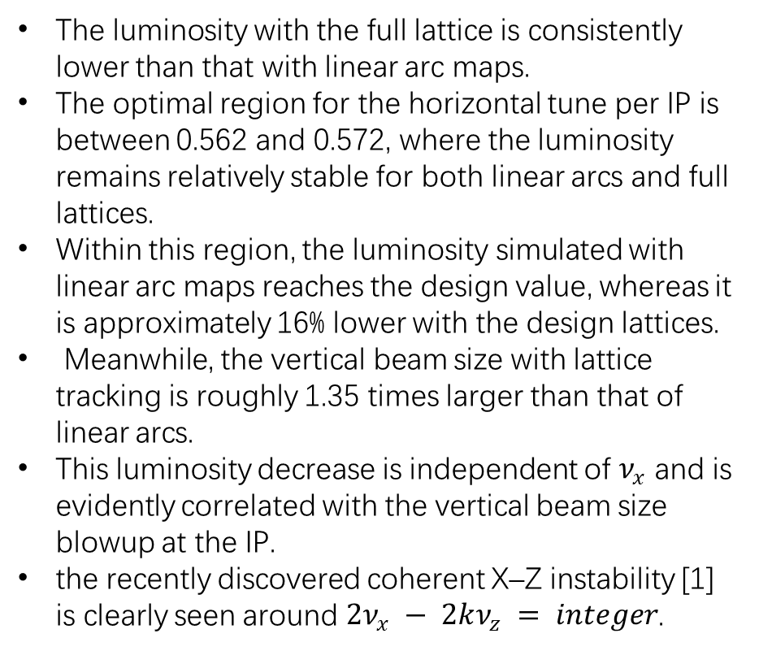

Symmetric Collision: Scan $ν_{x}$
With the symmetric lattices of the e- e+ rings, the two colliding beams also have symmetric parameters.
$$ν_{y} = 0.610$$
The luminosity with the full lattice is consistently lower than that with linear arc maps.
The optimal region for the horizontal tune per IP is between 0.562 and 0.572, where the luminosity remains relatively stable for both linear arcs and full lattices.
Within this region, the luminosity simulated with linear arc maps reaches the design value, whereas it is approximately 16% lower with the design lattices.
Meanwhile, the vertical beam size with lattice tracking is roughly 1.35 times larger than that of linear arcs.
This luminosity decrease is independent of $ν_{x}$ and is evidently correlated with the vertical beam size blowup at the IP.
the recently discovered coherent X–Z instability [1] is clearly seen around $2ν_{x} − 2kν_{z} = integer$.
The results of PIC simulation were also added to the key simulation points for comparison
WangN,ZhangY,LiuY,etal. Mitigationofcoherentbeaminstabilities in CEPC [C]//CERN Yellow Reports: Conference Proceedings: volume 9. 2020: 286-286.

Slide 12
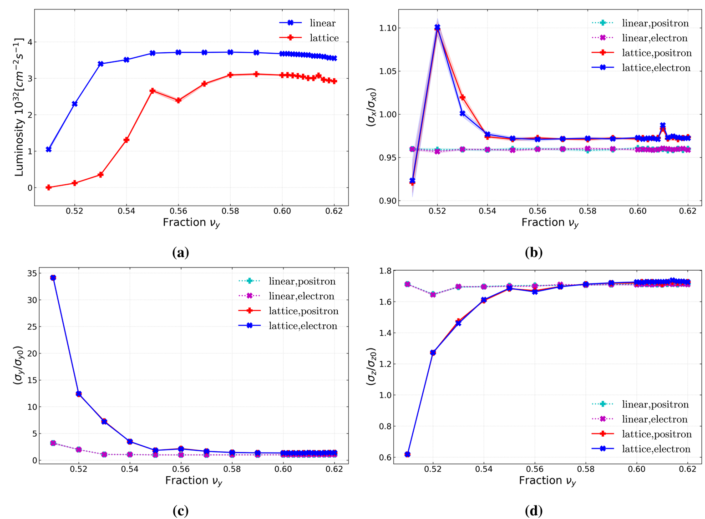
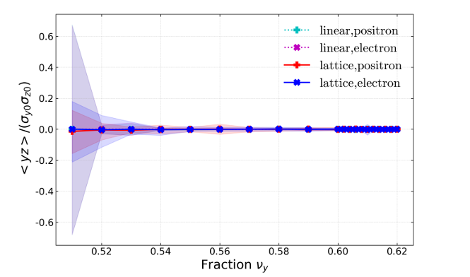
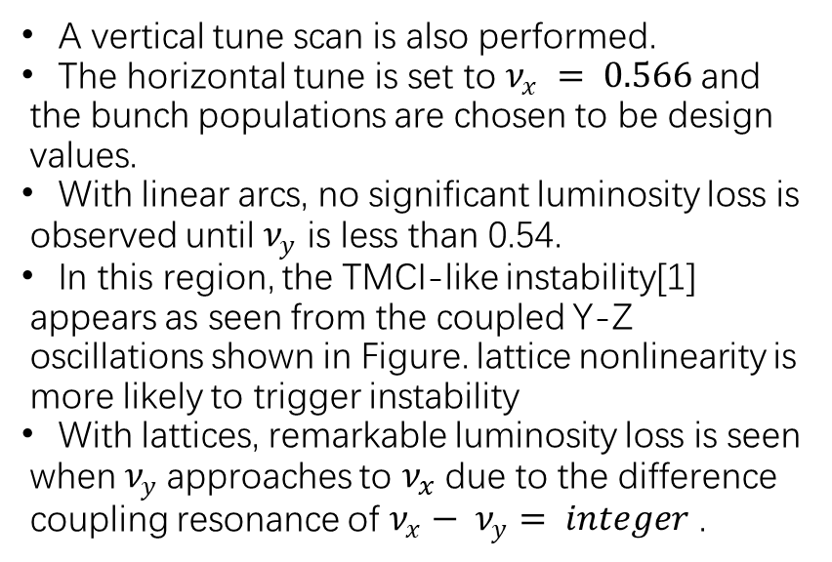
Symmetric Collision: Scan $ν_{y}$
A vertical tune scan is also performed.
The horizontal tune is set to $ν_{x} = 0.566$and the bunch populations are chosen to be design values.
With linear arcs, no significant luminosity loss is observed until $ν_{y}$ is less than 0.54.
In this region, the TMCI-like instability[1] appears as seen from the coupled Y-Z oscillations shown in Figure. lattice nonlinearity is more likely to trigger instability
With lattices, remarkable luminosity loss is seen when $ν_{y}$approaches to $ν_{x}$due to the difference coupling resonance of $ν_{x}− ν_{y}= integer$ .
Ohmi K, Zhang Y, Lin C. Beam-beam mode coupling in collision with a crossing angle [J]. PRAB, 2023, 26(11): 111001.

Slide 13
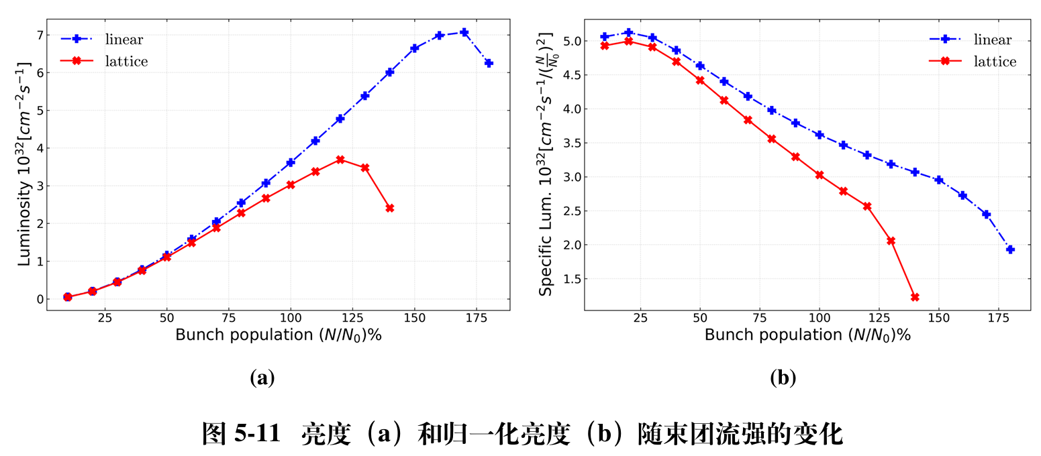
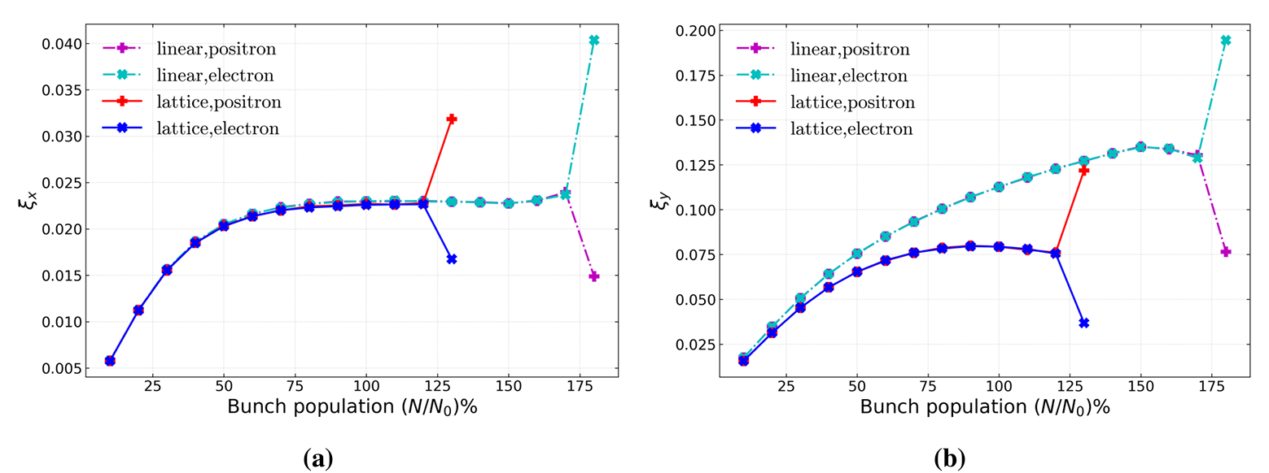
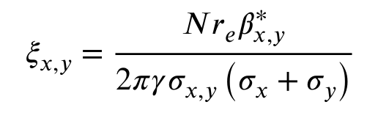
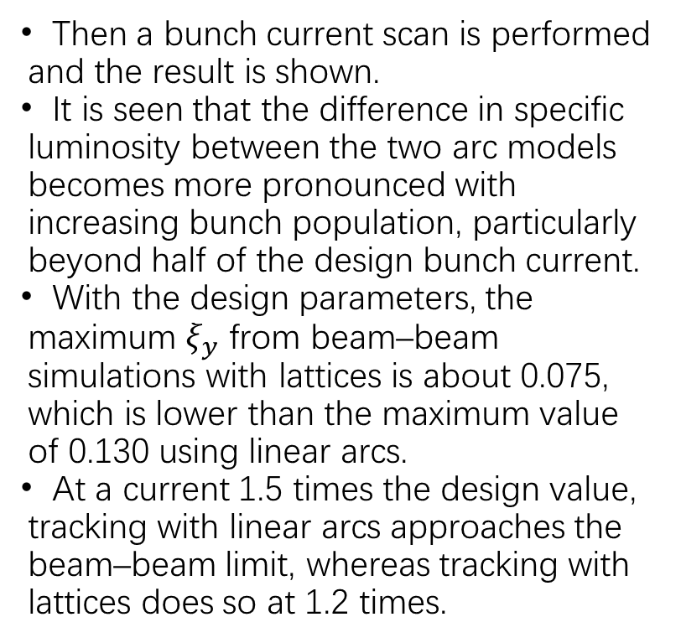

Symmetric Collision：Scan Bunch Current
$$\left(ν_{x},ν_{y}\right)=\left(0.566,0.610\right)$$
Then a bunch current scan is performed and the result is shown.
It is seen that the difference in specific luminosity between the two arc models becomes more pronounced with increasing bunch population, particularly beyond half of the design bunch current.
With the design parameters, the maximum $ξ_{y}$ from beam–beam simulations with lattices is about 0.075, which is lower than the maximum value of 0.130 using linear arcs.
At a current 1.5 times the design value, tracking with linear arcs approaches the beam–beam limit, whereas tracking with lattices does so at 1.2 times.

Slide 14
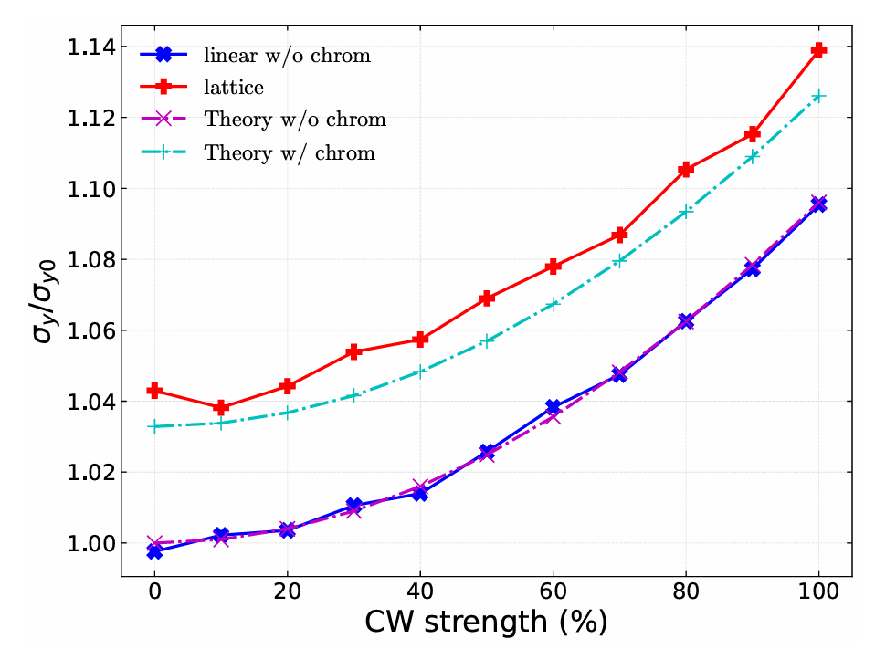

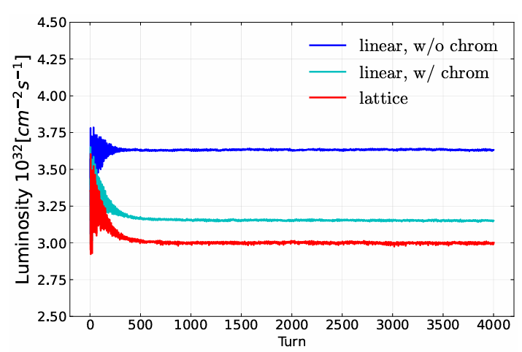
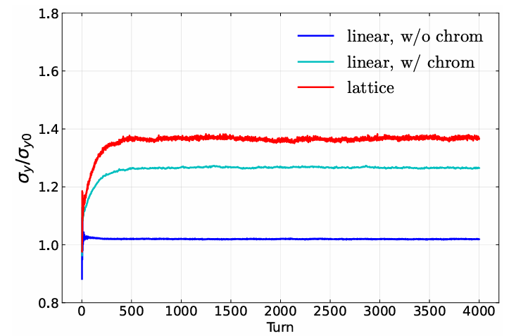
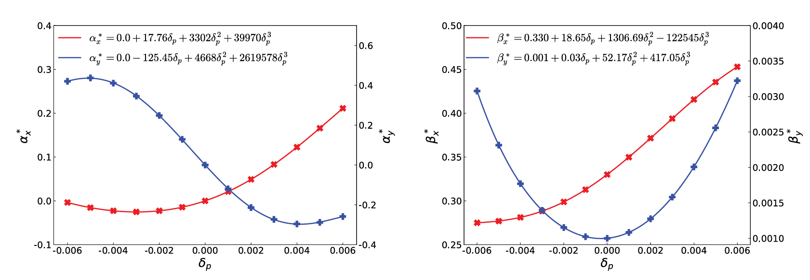
Symmetric Collision: Further Analysis
The cause of luminosity loss induced by the lattice.
Test: Linear tracking+BB+Chromaticity
CW 80%, linear tracking
w/o chromaticity：1.06×
w/ chromaticity：1.10×
There is a decrease in luminosity
The vertical beam size increases
The results are similar to those of the lattice model
There is a good agreement between theoretical prediction and simulation results
The vertical size blowup of beam is the result of CW transformation and chromaticity
Conclusion:
lattice caused luminosity loss due to CW transformation and chromaticity.
It is proved that there is room for further optimization of the current lattice.

Slide 15
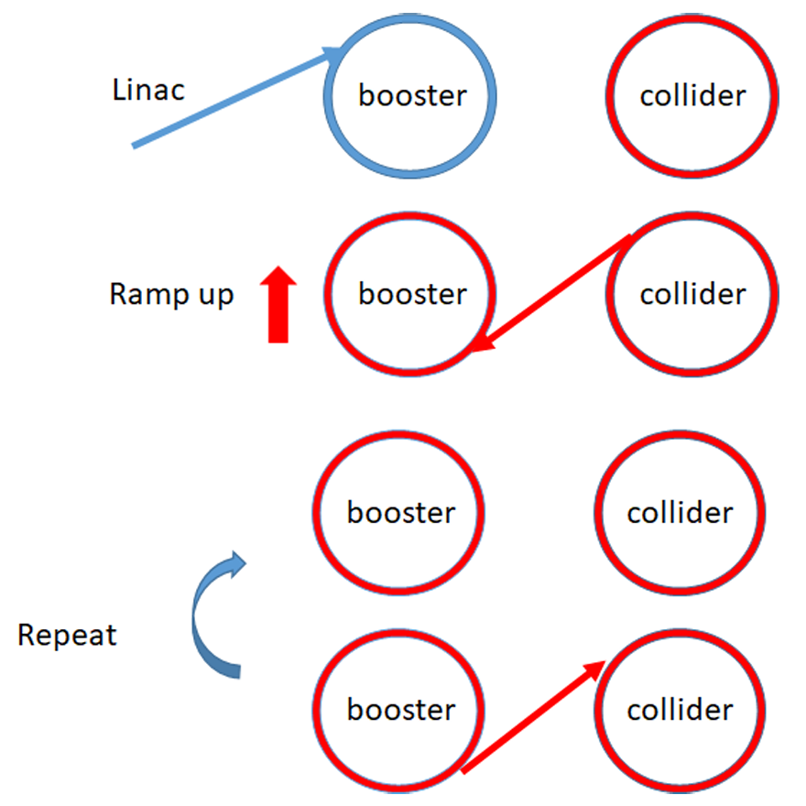
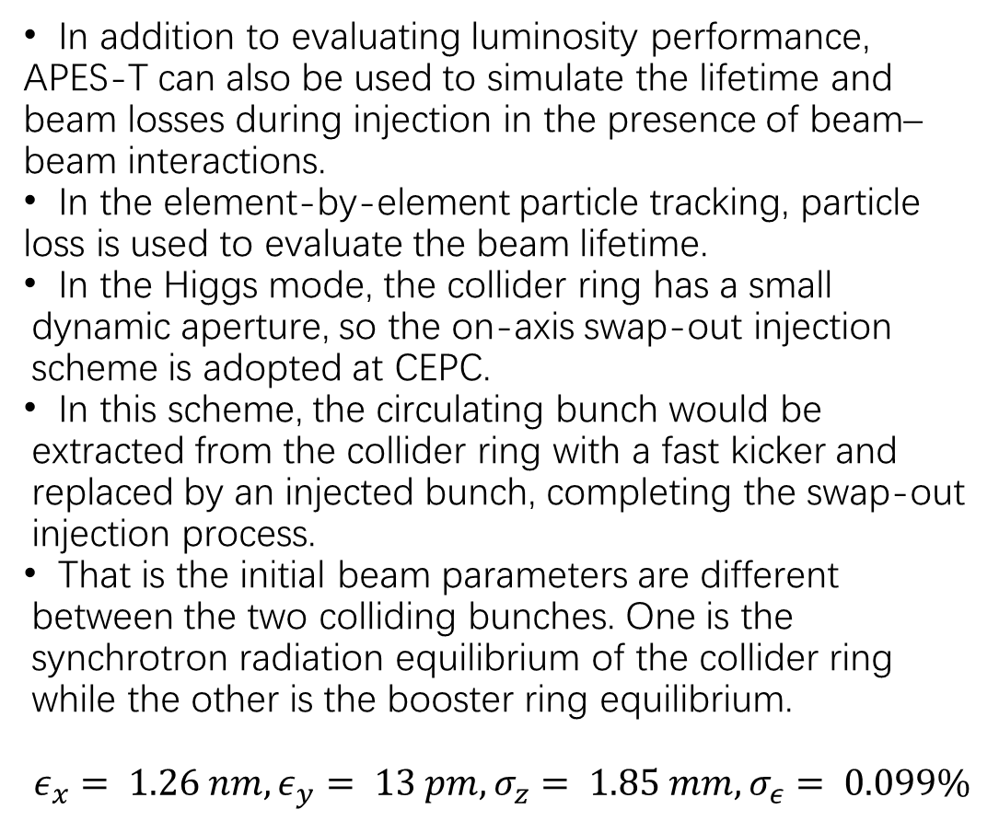
Asymmetric Collision: Swap-Out Injection
In addition to evaluating luminosity performance, APES-T can also be used to simulate the lifetime and beam losses during injection in the presence of beam–beam interactions.
In the element-by-element particle tracking, particle loss is used to evaluate the beam lifetime.
In the Higgs mode, the collider ring has a small dynamic aperture, so the on-axis swap-out injection scheme is adopted at CEPC.
In this scheme, the circulating bunch would be extracted from the collider ring with a fast kicker and replaced by an injected bunch, completing the swap-out injection process.
That is the initial beam parameters are different between the two colliding bunches. One is the synchrotron radiation equilibrium of the collider ring while the other is the booster ring equilibrium.
$$ε_{x}= 1.26 nm, ε_{y}= 13 pm, σ_{z}= 1.85 mm, σ_{ε}= 0.099\%$$

Slide 16
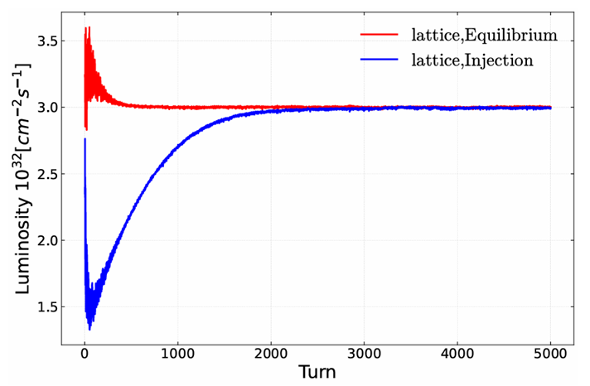
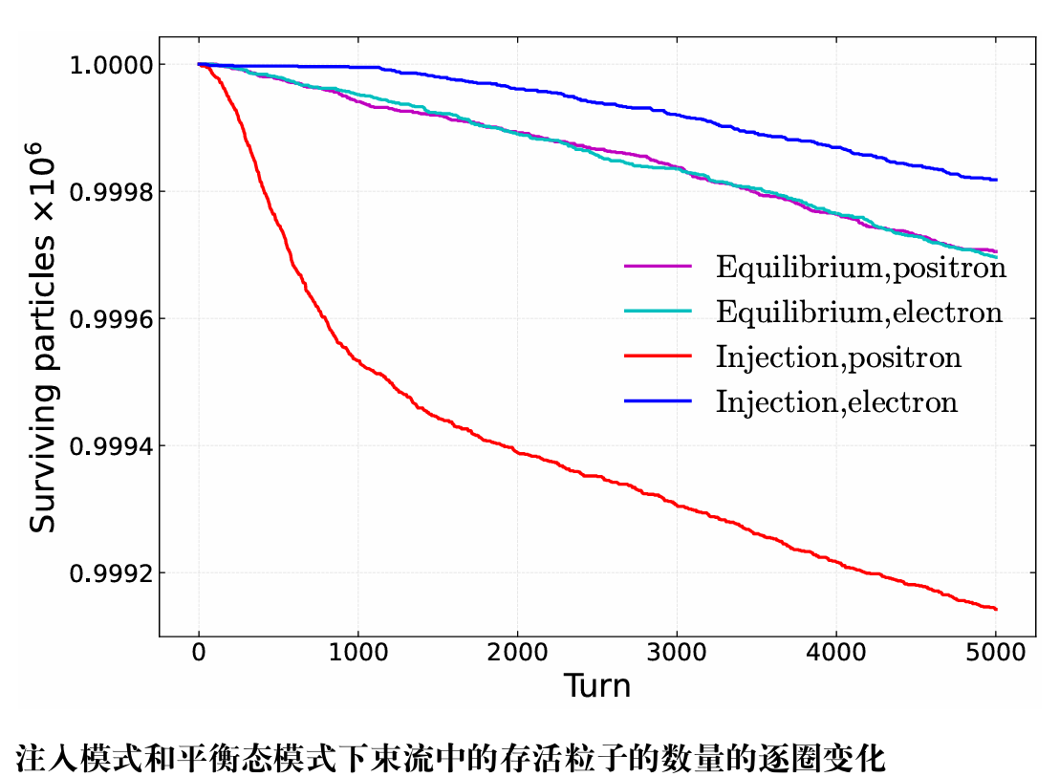
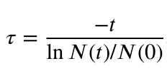
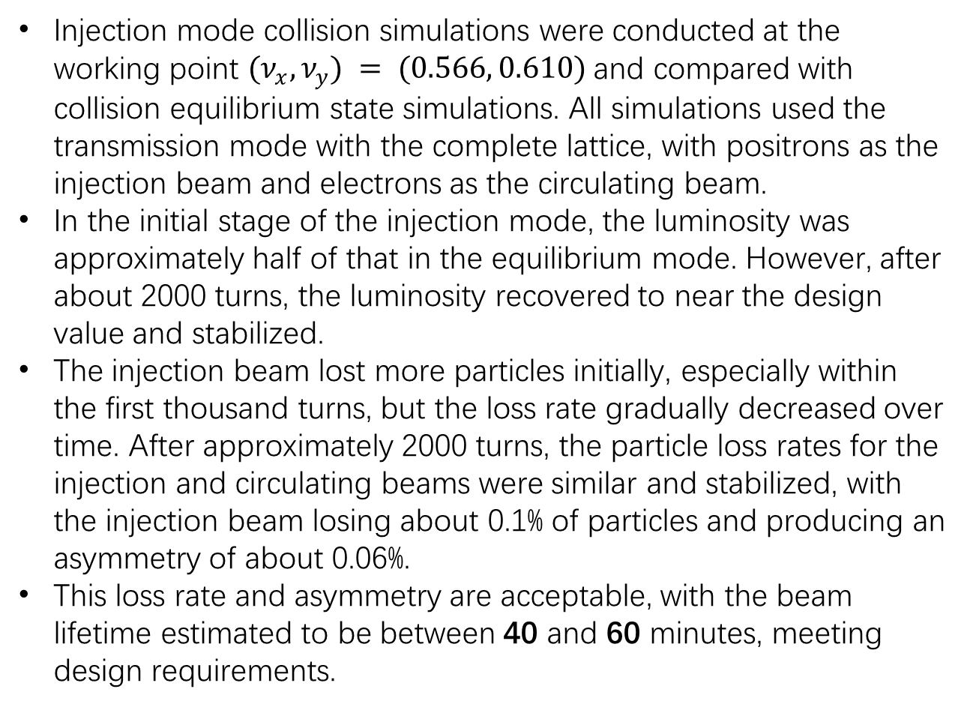
Asymmetric Collision
Injection mode collision simulations were conducted at the working point $(ν_{x},ν_{y}) = (0.566, 0.610)$and compared with collision equilibrium state simulations. All simulations used the transmission mode with the complete lattice, with positrons as the injection beam and electrons as the circulating beam.
In the initial stage of the injection mode, the luminosity was approximately half of that in the equilibrium mode. However, after about 2000 turns, the luminosity recovered to near the design value and stabilized.
The injection beam lost more particles initially, especially within the first thousand turns, but the loss rate gradually decreased over time. After approximately 2000 turns, the particle loss rates for the injection and circulating beams were similar and stabilized, with the injection beam losing about 0.1% of particles and producing an asymmetry of about 0.06%.
This loss rate and asymmetry are acceptable, with the beam lifetime estimated to be between 40 and 60 minutes, meeting design requirements.

Slide 17
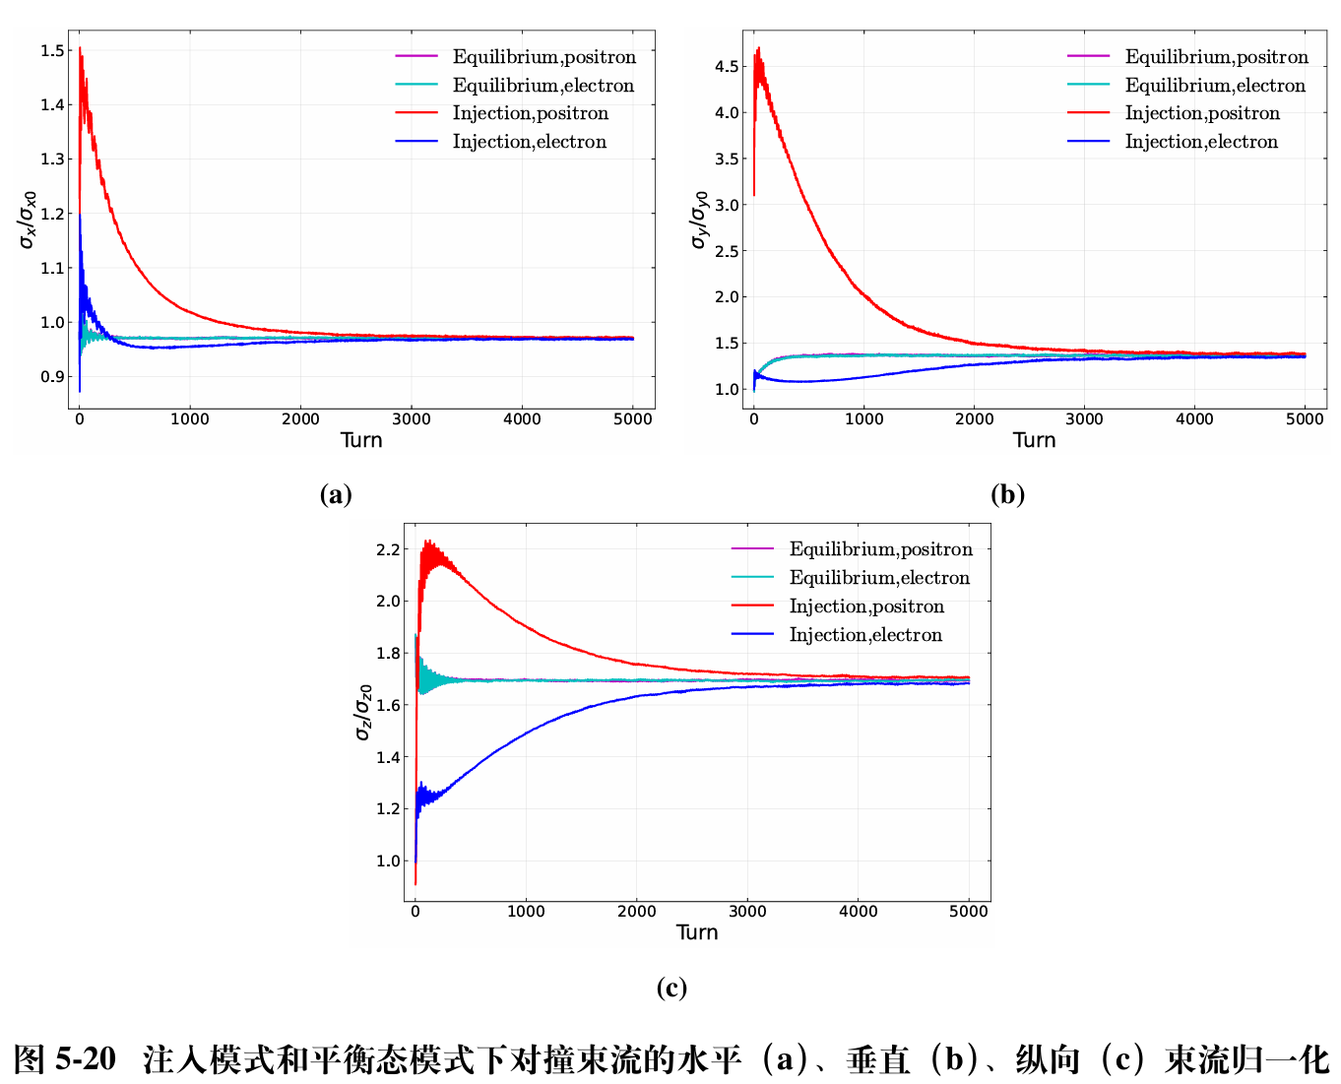
Asymmetric Collision
In the initial stage, the beam action of injection beam is weaker than that of circulation beam
After a certain period of cycle and collision, the parameters can be gradually adjusted, and finally a symmetric equilibrium state similar to that of the cyclic beam can be reached.

Slide 18
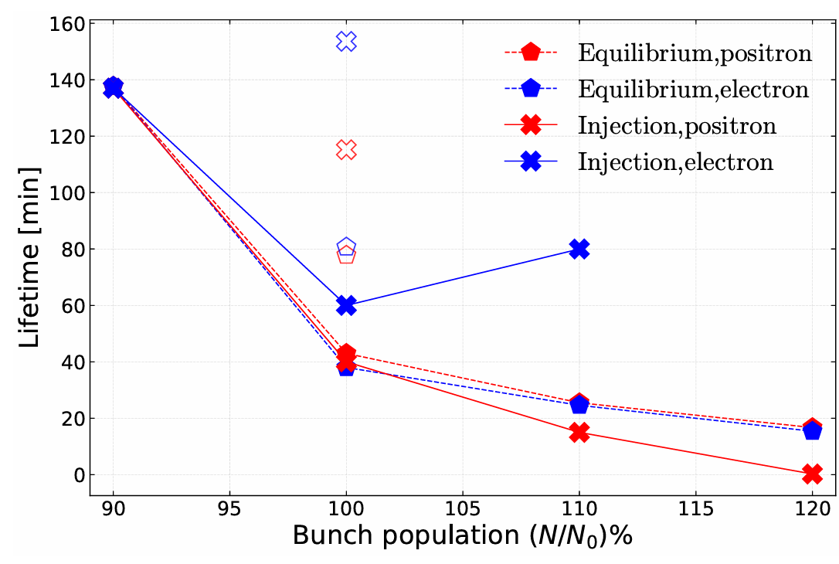
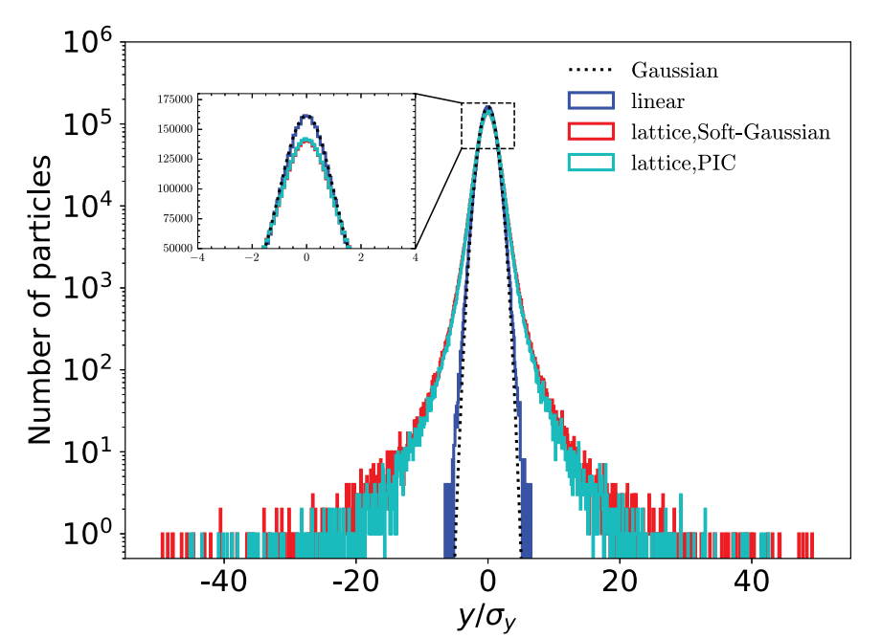
Asymmetric Collision
The beam lifetime versus the bunch population is shown.
when the bunch current is 1.2 times the design value, the collision would be unstable with the swap-out injection scheme, inducing severe beam losses and hence a very short lifetime.
On the other hand, for the symmetric collision, the limit of the bunch current is 1.2 times higher than the design value, beyond which the beams will be unstable and the lifetime will be extremely short.
The PIC simulation results at design bunch population are also shown the lifetime would be about 2 times longer than that of soft-Gaussian approximation in both the symmetric collision and asymmetric collision of swap-out injection.
This is consistent with the halo distribution.

Slide 19
Summary
An efficient simulation program, APES-T, has been developed to achieve element-by-element tracking of large-scale particles and the integration of strong-strong beam-beam interactions in complex lattices.
By utilizing MPI and GPU acceleration technologies, the capability for handling large-scale particle tracking tasks has been significantly enhanced, and benchmarking has been completed. This provides good tool support for the design optimization of future colliders.
APES-T has been effectively applied in the CEPC project. During CEPC simulations, it was found that the introduction of chromatic aberrations in the complete lattice led to a loss of luminosity.
Additionally, the injection scheme for CEPC has been simulated and verified.
Plan:
Element-by-element synchrotron radiation needs to be added.
Beam-beam and other collective effect need be GPU parallelization accelerated.
Machine errors and physical apertures should be considered in the next simulation.

Slide 20
Thank you for your attention!

Slide 21
Backup

