Slide 1
Beam-Beam Effects & Luminosity in LHC Run 3
P. Arrutia, F. Asvesta, H. Bartosik, P.Bélanger, M. Bozatzis, D. Butti, X. Buffat, A. Calia,
I. Efthymiopoulos, A. Fornara, P. Hermes, M. Hostettler, G. Iadarola, S. Kostoglou, E. Lamb,
I. Mases, D. Mirarchi, CE. Montanari, T. Persson, S. Radaelli, A. Radoslavova,
F. Roncarolo, G. Sterbini, G. Trad, D. Valuch, J. Wenninger
Beam-Beam Effects in Circular Colliders 2024

Slide 2
Introduction
Goal is to optimize the LHC performance and maximize the integrated luminosity:
  High brightness beams from the injectors
  Emittance preservation throughout the cycle
  Minimize losses during the cycle
  Fine tune key beam & machine parameters such as working point, chromaticity, octupole current, crossing angle, β*, turnaround time, fill duration
Luminosity model that can accurately predict the evolution of beam/machine parameters and luminosity throughout the fill:
  At injection: emittance blowup of unknown origin in both beams and planes, especially in V, that cannot be explained only by IBS.
  During collisions:
    Emittance blowup of unknown origin in both beams and planes, especially in V.
    Important losses beyond burn-off at the start of collisions.

Slide 3
Introduction
Beam-beam effects are a critical factor affecting the LHC performance:
  High bunch intensity & small emittance to push performance → Large head-on tune spread at the beginning of collisions
  Long-range dominated at the end of leveling: orchestration of beta*, crossing angle and bunch intensity to stay above the beam-beam limit and preserve a good beam lifetime.
  Use Dynamic Aperture computed from single particle tracking simulations including beam-beam effects as a guiding tool to define operational scenario for LHC (but also future upgrades such as the HL-LHC).
Transverse bunch profiles injected in the LHC are non-Gaussian: In 2024, systematic studies focused on tail evolution during the LHC cycle and its impact on performance.

Slide 4
Emittance evolution during the LHC cycle

Slide 5
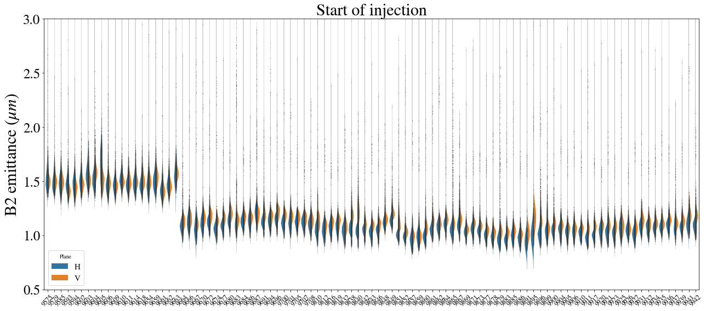
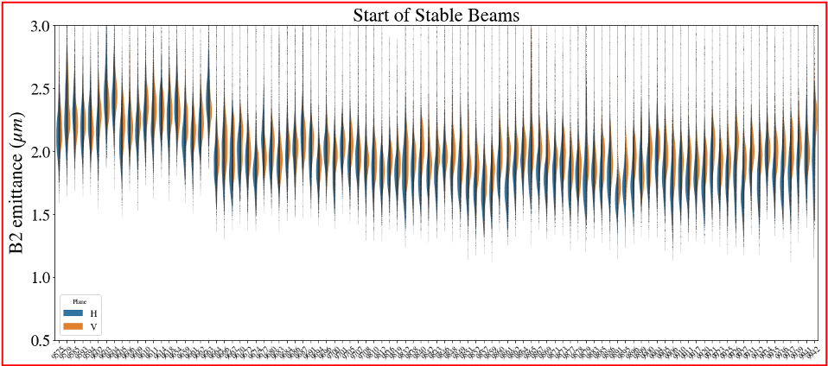
Emittance at injection
Different beam types from the injectors tested in 2024: ~20% emittance reduction at the start of injection, ~10% at start of collisions (1.8 μm)
BCMS
BCMS
Standard
BCMS
Low-tail BCMS
Low-tail BCMS
Standard
BCMS
Low-tail BCMS
Low-tail BCMS
Emittance (μm) | B1H | B1V | B2H | B2V
Standard | 1.56 | 1.58 | 1.5 | 1.5
BCMS | 1.19 | 1.27 | 1.13 | 1.17
% | -23.8 | -19.84 | -24.96 | -22.33
Emittance (μm) | B1H | B1V | B2H | B2V
Standard | 1.84 | 1.67 | 2.25 | 2.3
BCMS | 1.57 | 1.54 | 1.97 | 2.02
% | -14.74 | -7.38 | -12.48 | -12.06

Slide 6
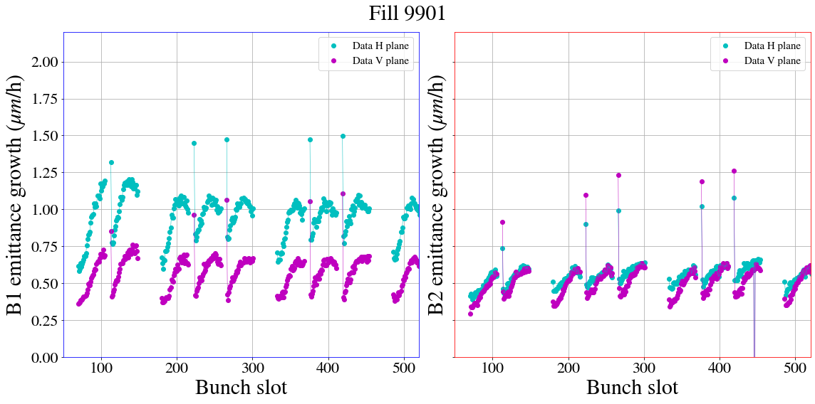
Emittance growth at injection
Emittance growth mechanism at injection not fully understood:
  Systematically larger in B1H: ~0.6 μm/h for B1H in addition to e-cloud.
  ~0.35 μm/h in B2H/V & B1V in addition to e-cloud.

Slide 7
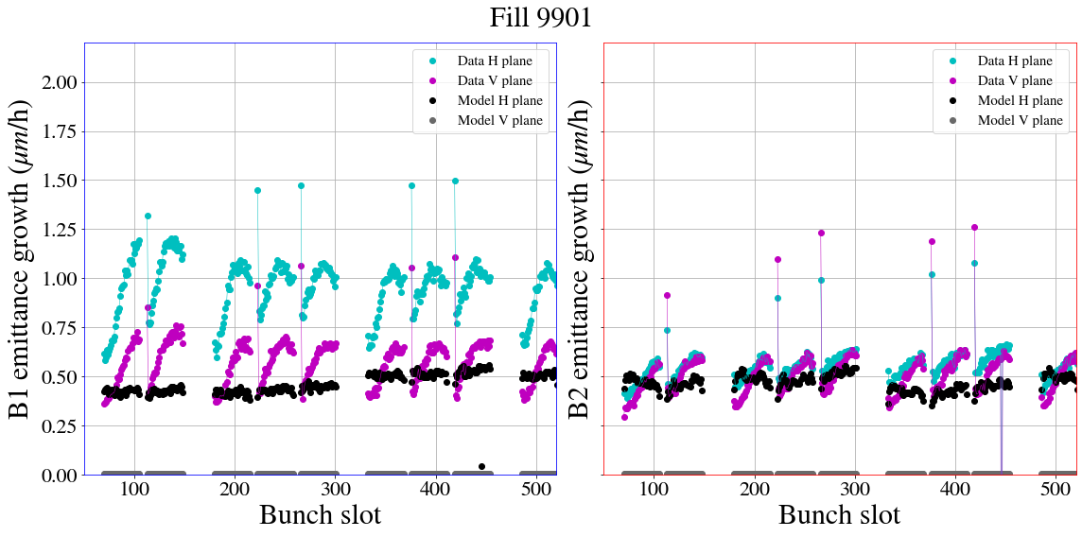
Emittance growth at injection
Emittance growth mechanism at injection not fully understood:
  Not consistent with IBS alone, especially for V plane, varies between fills.
  Linear increase of emittance in time.

Slide 8
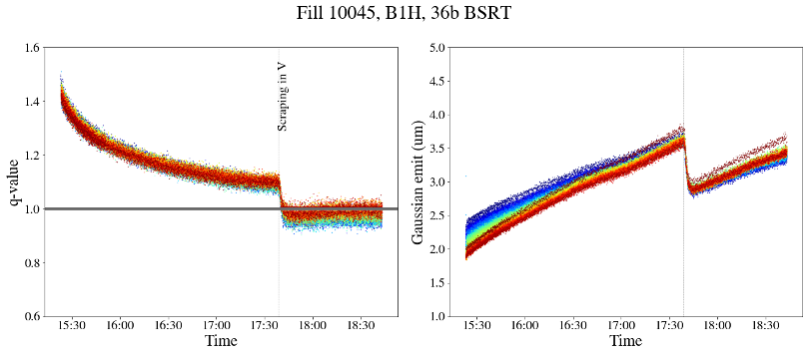
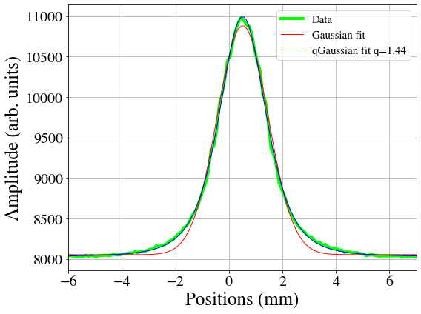
Emittance growth at injection
Emittance growth mechanism at injection not fully understood:
  Not consistent with IBS alone, especially for V plane, varies between fills.
  Linear increase of emittance in time.
Scraping in V plane
q-Gaussian fits:
q=1 Gaussian
q>1 heavy tails

Slide 9
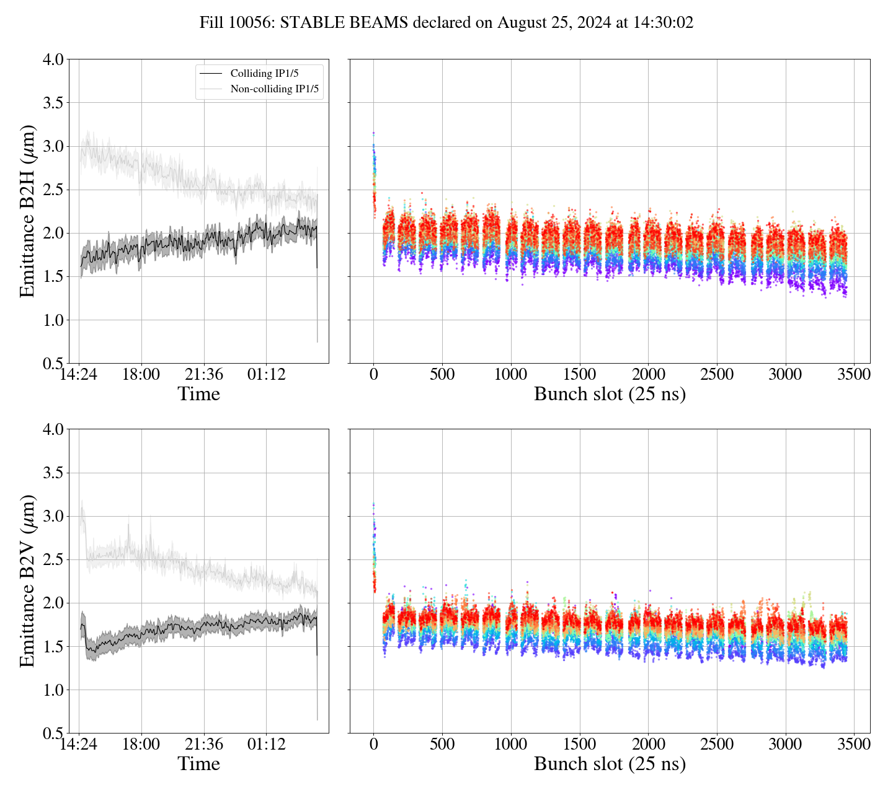
Emittance growth at collisions
Emittance growth of unknown origin also during collisions:
  Cannot be fully explained by IBS models.
  Vertical emittance expected to be shrinking due to SR.

Slide 10
Losses at the start of collisions

Slide 11
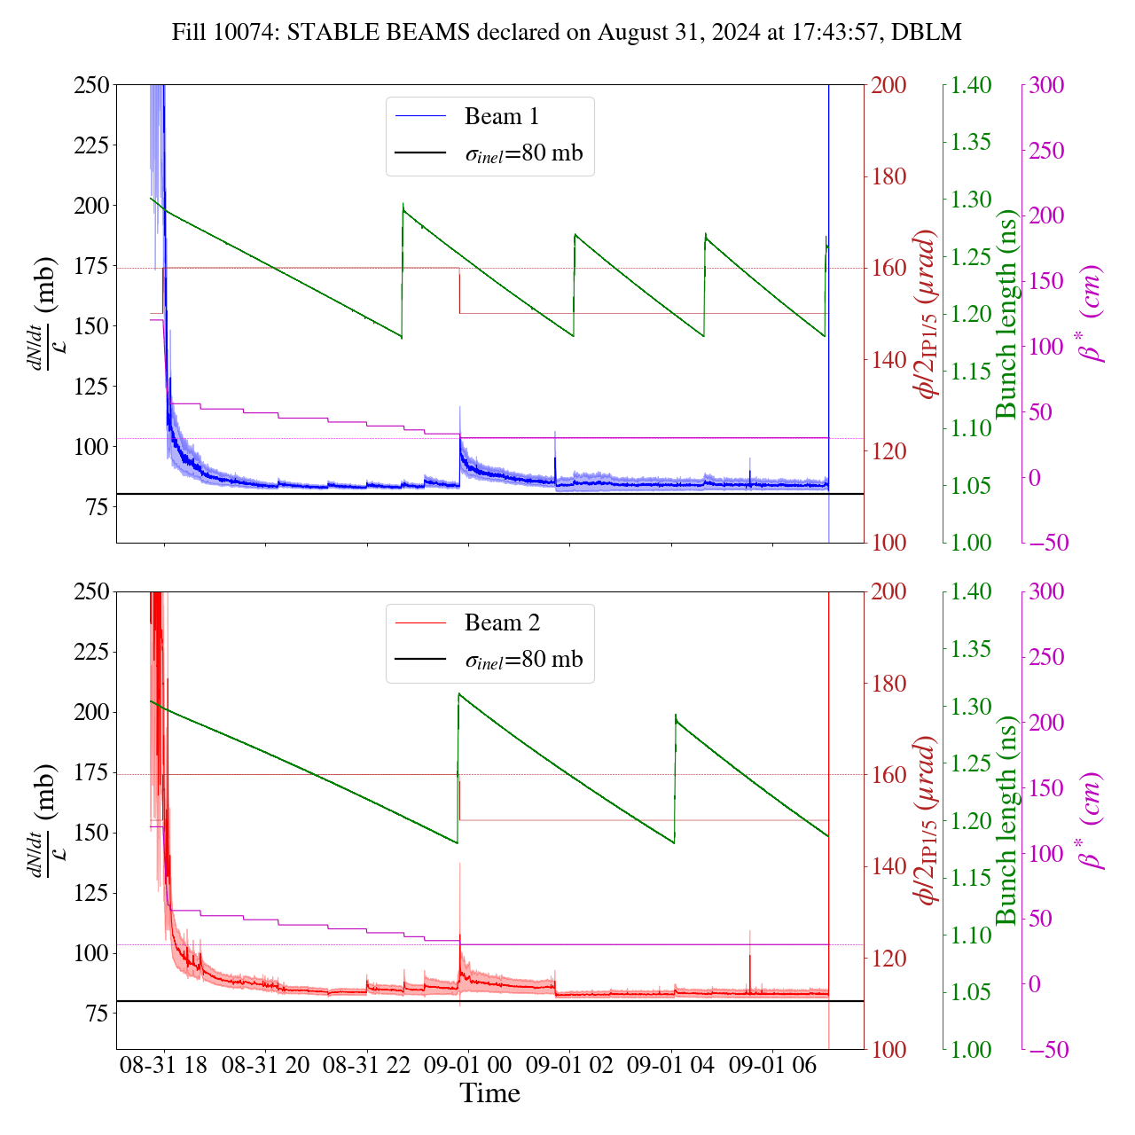
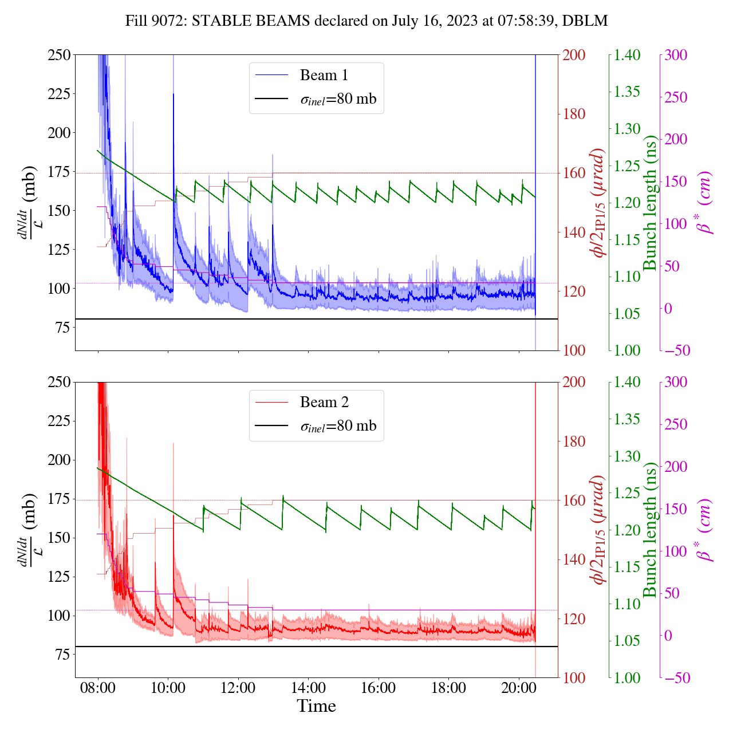
Losses at collisions
Effective cross section: loss rate normalized by luminosity.
Inelastic cross section 81 mb, larger values indicate losses beyond burn-off
2024
2023
Variation of the crossing angle during leveling in 2023: Much closer to the beam-beam limit

Slide 12
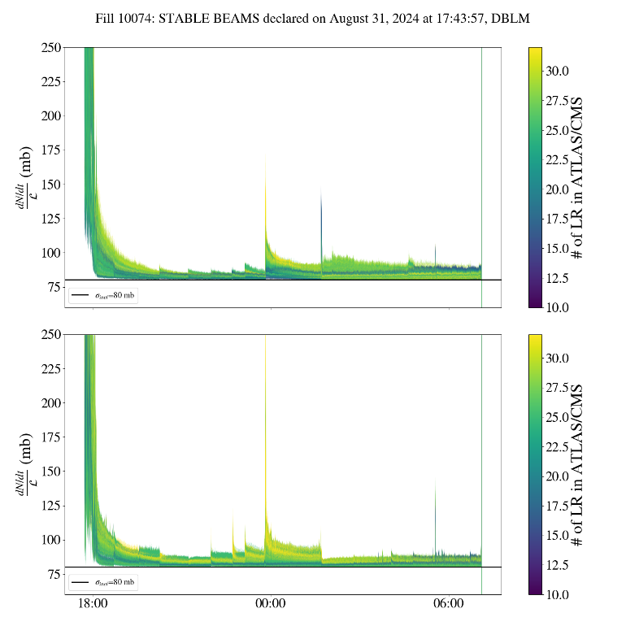
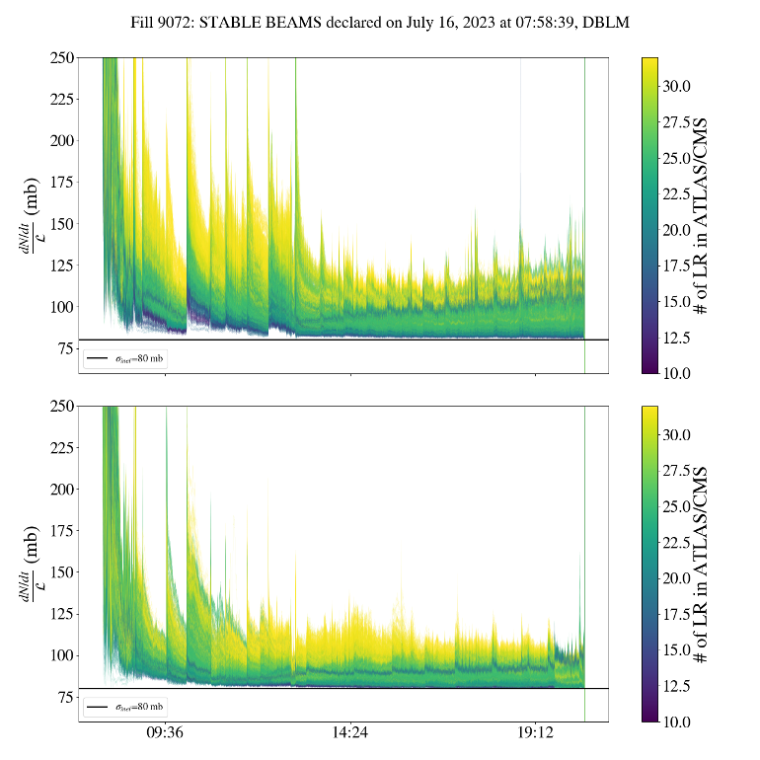
Losses at collisions
Effective cross section: loss rate normalized by luminosity.
Inelastic cross section 81 mb, larger values indicate losses beyond burn-off
2024
2023
Variation of the crossing angle during leveling in 2023: Much closer to the beam-beam limit

Slide 13
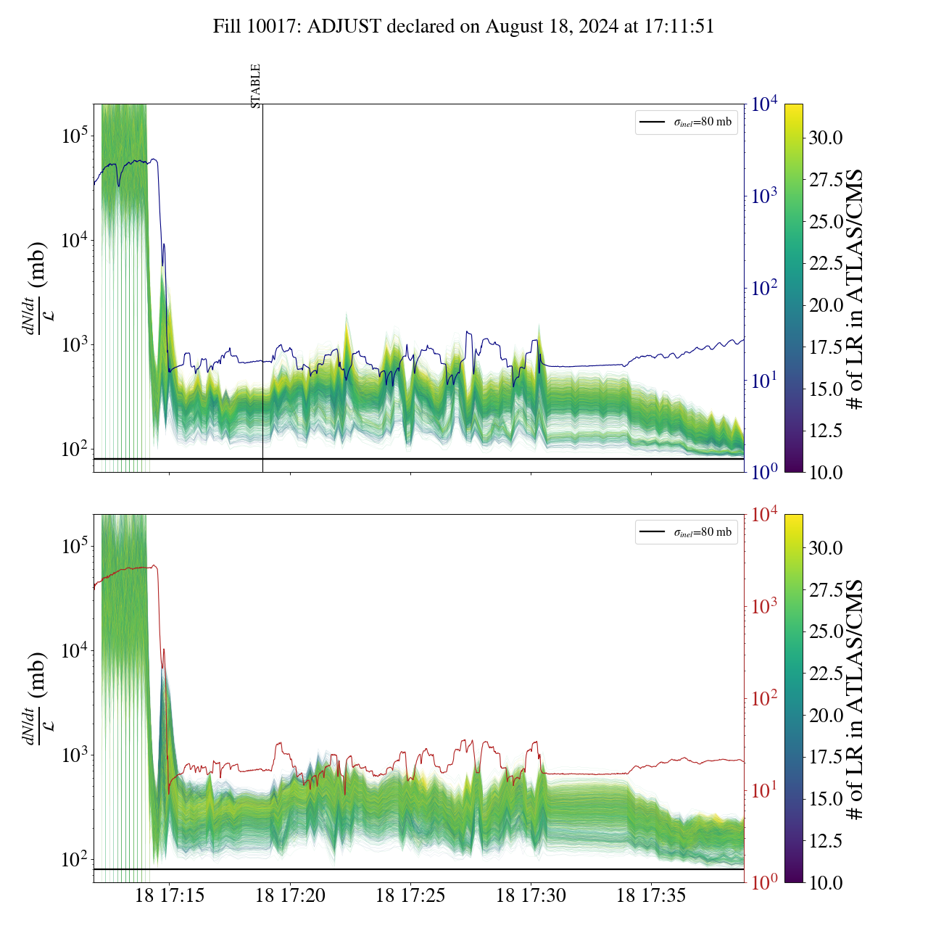
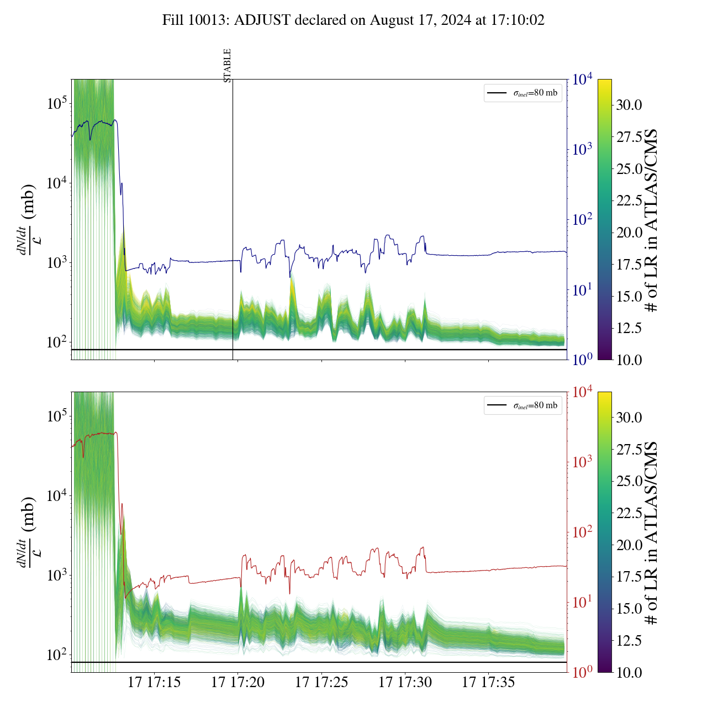
Losses during the collapse of the separation bump & start of collisions
Collisions in IP1/2/5/8
Collisions in IP1/2/5
First year where we also observe impact from LHCb: LHCb luminosity 2e33 Hz/cm² while ATLAS/CMS 2e34 Hz/cm²

Slide 14
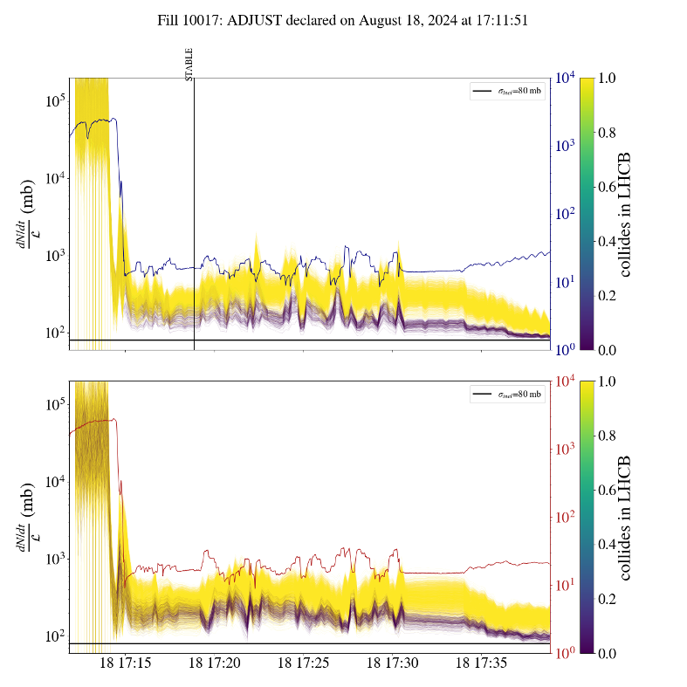
Losses during the collapse of the separation bump & start of collisions
Collisions in IP1/2/5/8
Collisions in IP1/2/5
First year where we also observe impact from LHCb: LHCb luminosity 2e33 Hz/cm² while ATLAS/CMS 2e34 Hz/cm²

Slide 15
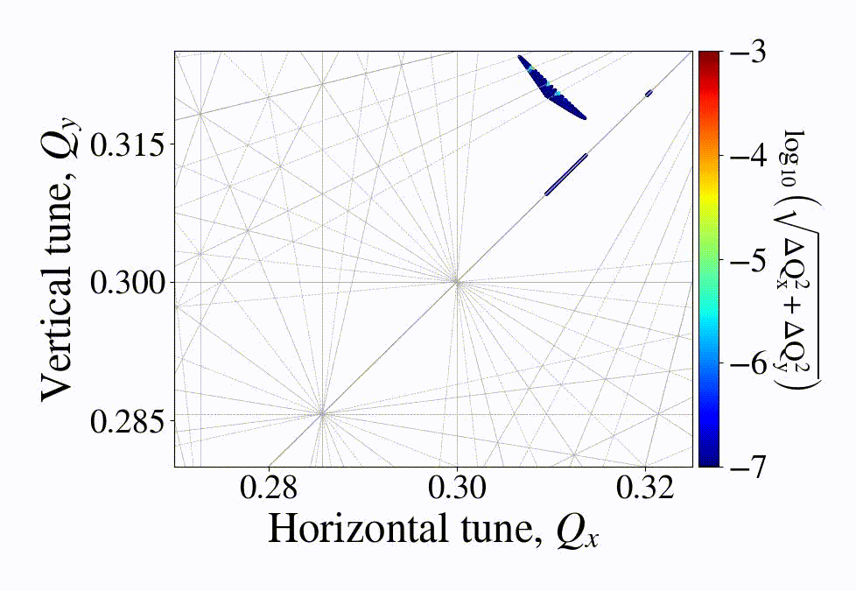
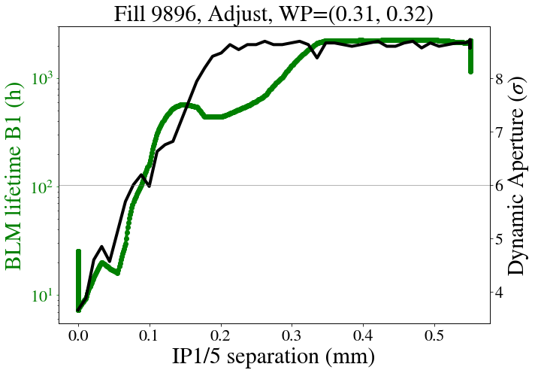
Tracking simulations of the collapse
Weak-strong single particle tracking simulations of the collapse of the separation bumps performed with XSuite

Slide 16
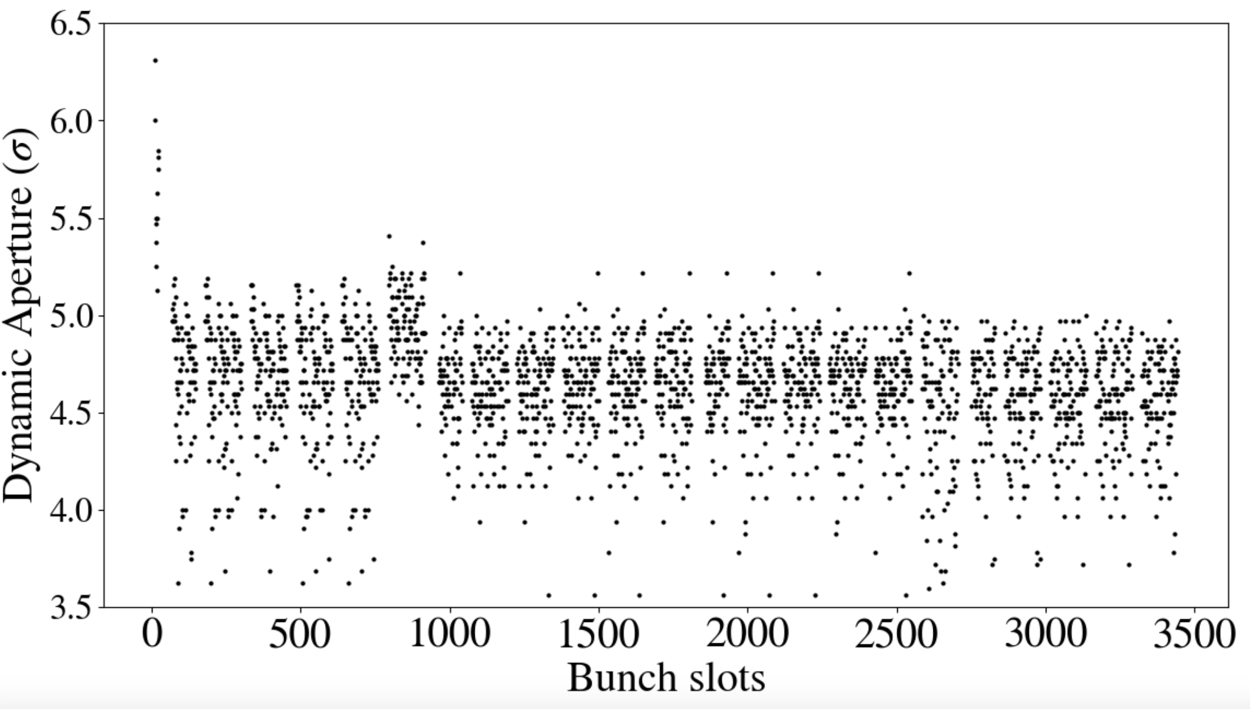
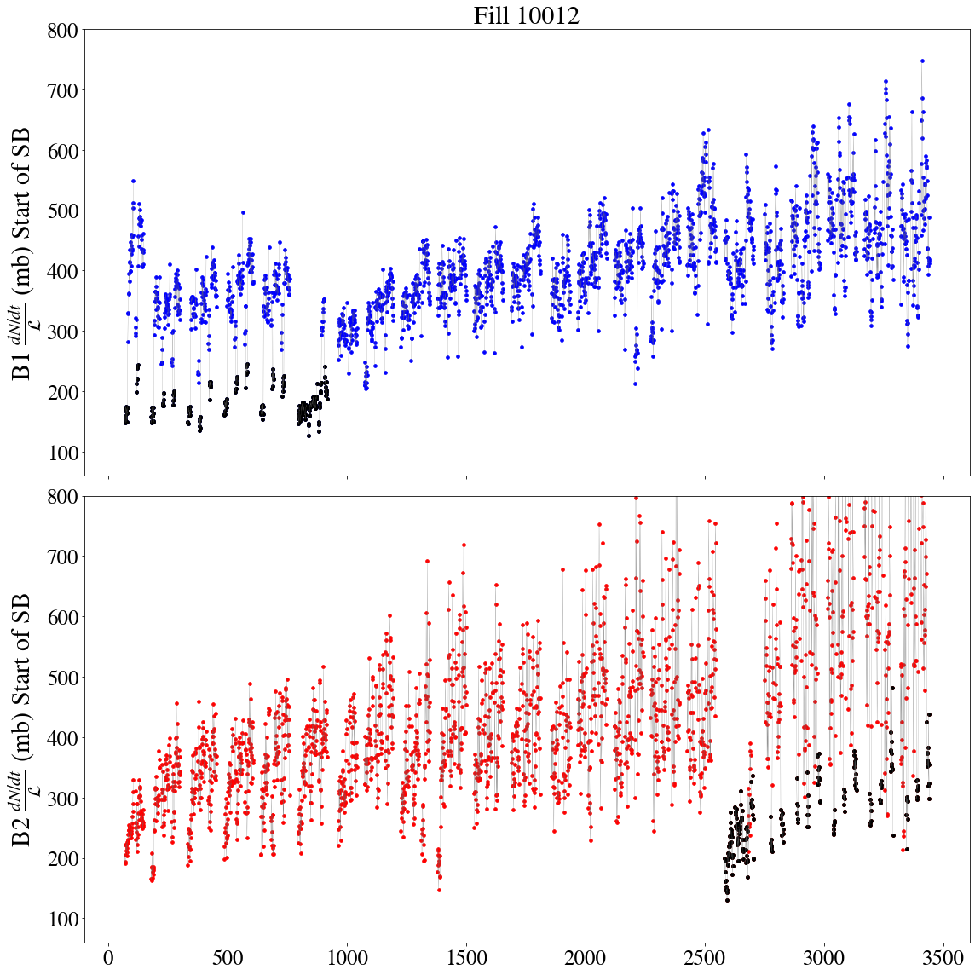
Tracking simulations of the collapse
DA
Beam lifetime

Slide 17
Tails in the tranverse bunch profiles

Slide 18
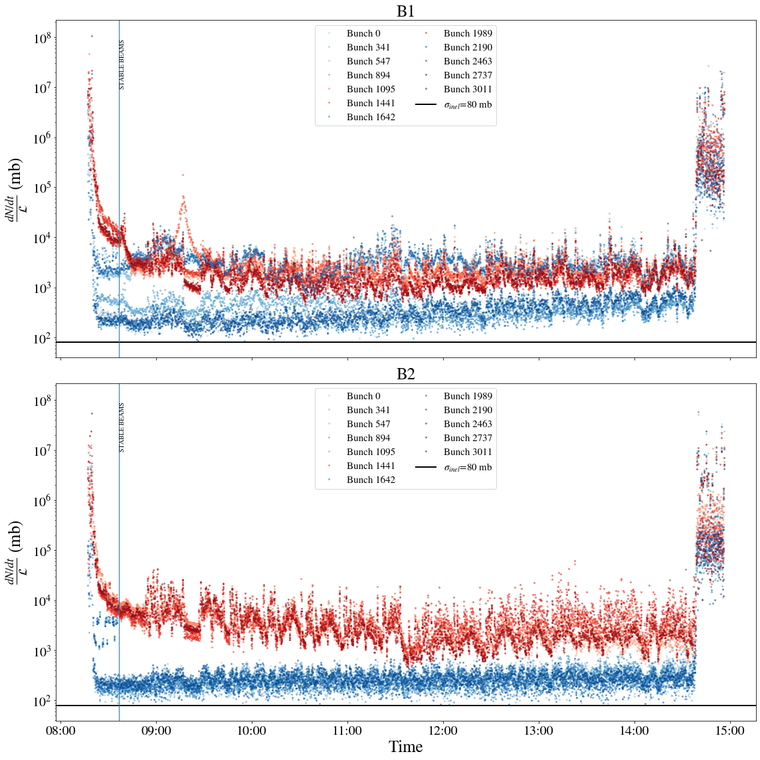
Tails & losses: MD obervations
MD on Non-Factorization of VdM beams E. Lamb & G. Sterbini: 2 groups of bunches injected (low tail q=1 and high tail q=1.6) with the same emittance and intensity.
Effective cross section of bunches with Gaussian profiles closer to the burn-off limit from the start of collisions.
Increased losses for bunches with heavier tails.

Slide 19
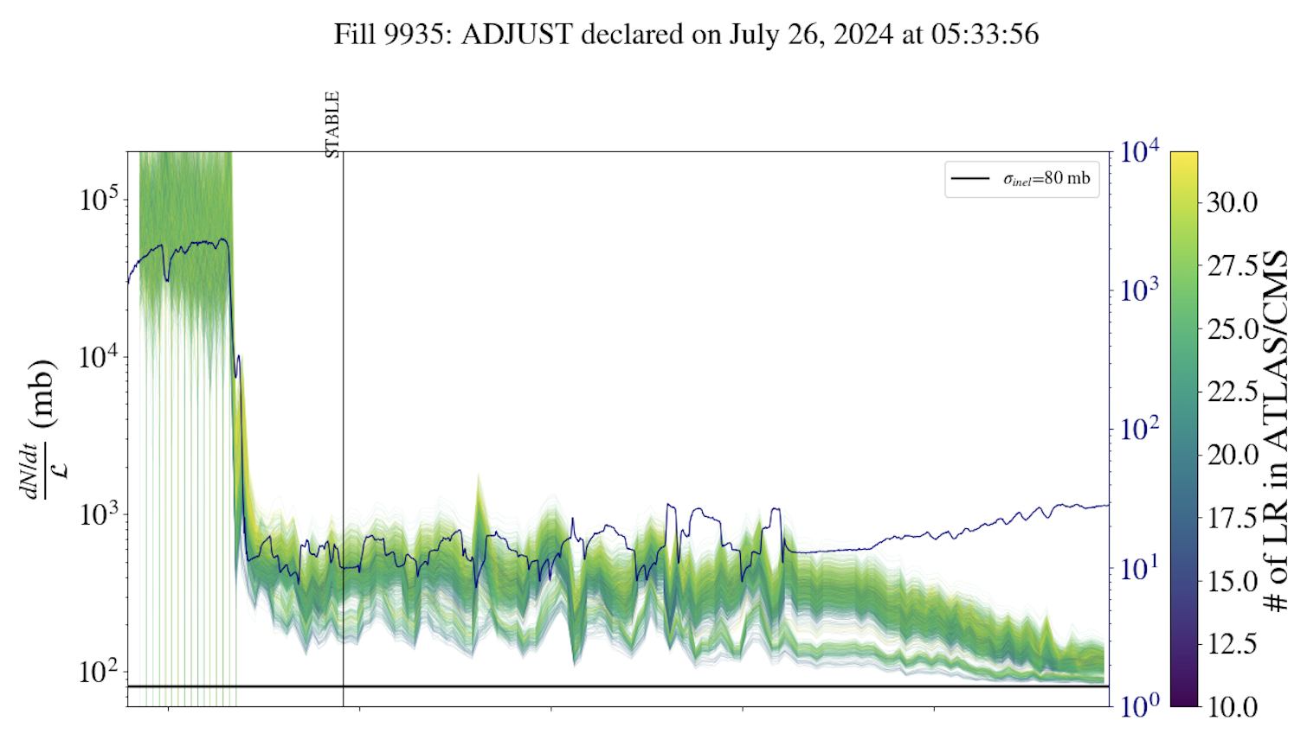
Tails & losses: nominal physics fills
Bunch-by-bunch effective cross section from Adjust to 20 minutes into Stable Beams, color-coded with the bunch-by-bunch q-value (average between H/V) measured by the BSRT at the end of injection.
No clear correlation with beam-beam effects (e.g. number of LR interactions).

Slide 20
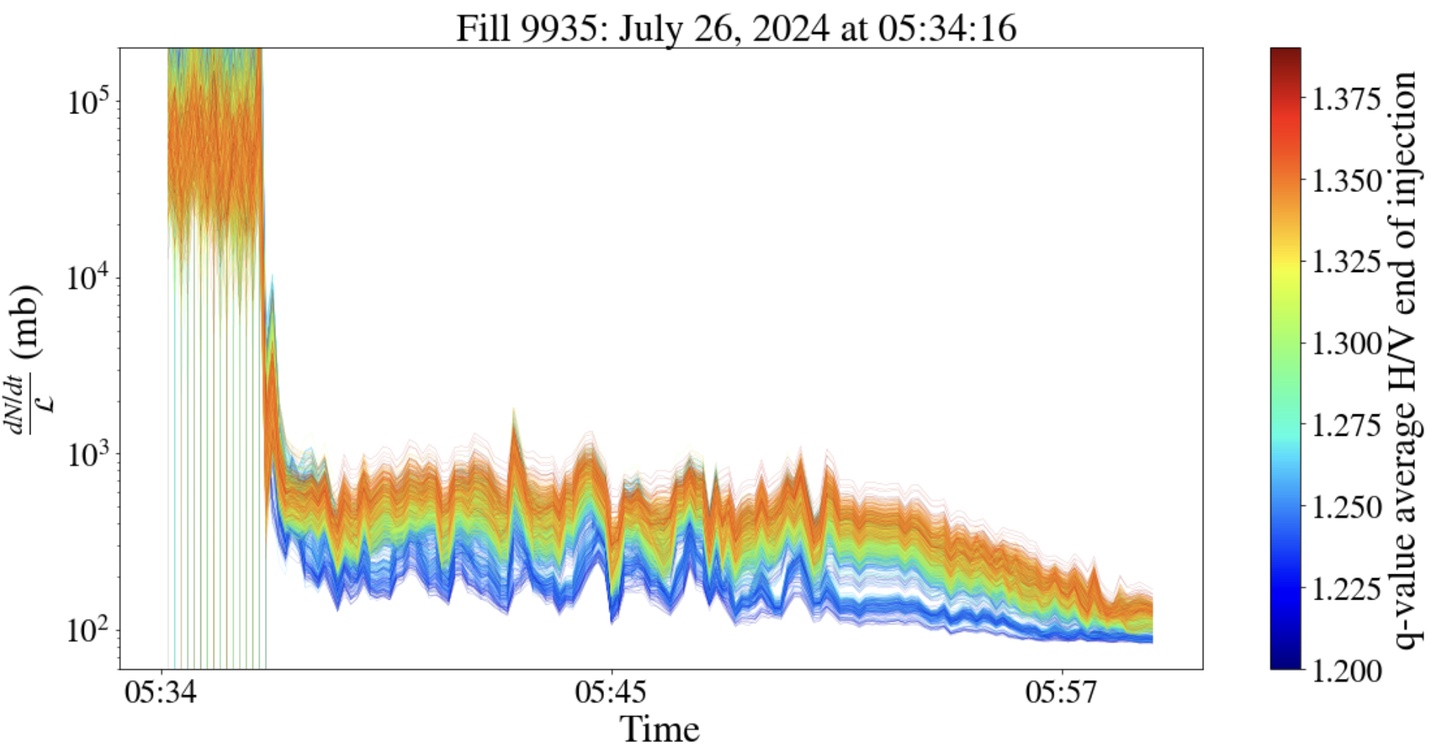
Tails & losses: nominal physics fills
Bunch-by-bunch effective cross section from Adjust to 20 minutes into Stable Beams, color-coded with the bunch-by-bunch q-value (average between H/V) measured by the BSRT at the end of injection.
No clear correlation with beam-beam effects (e.g. number of LR interactions).
Correlation of losses with bunches with heavier tails.

Slide 21
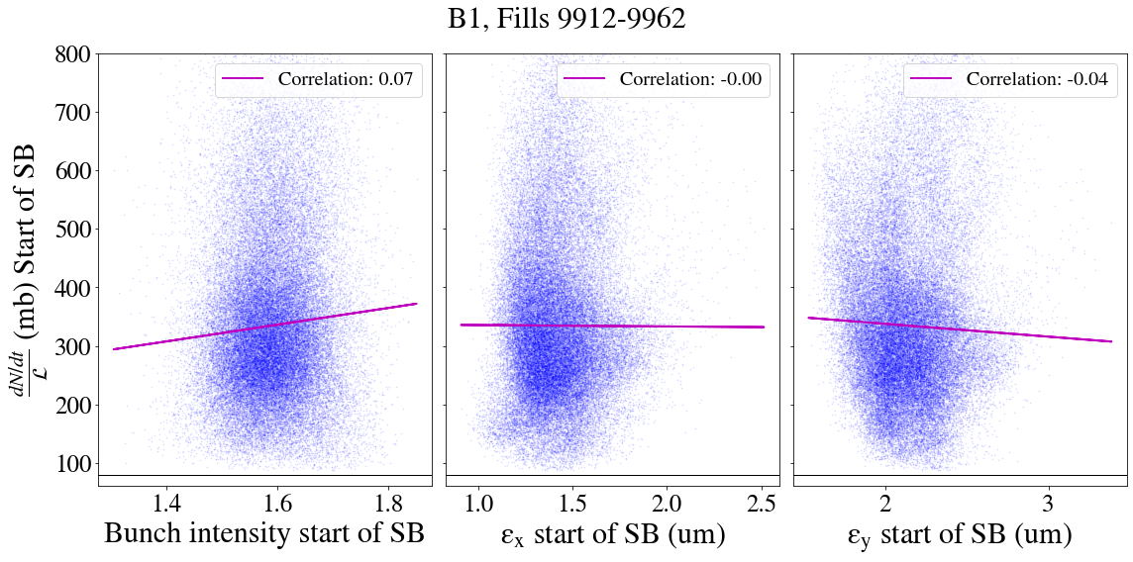
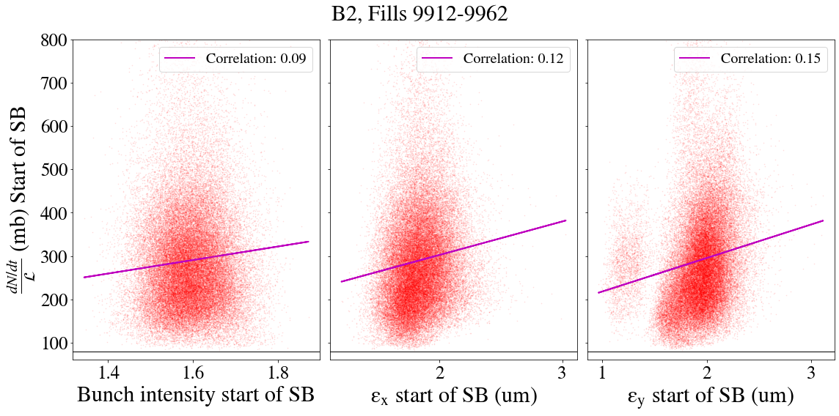
Correlation of bunch intensity & emittance with losses at start of SB
No clear correlation of extra losses with bunch intensity and emittance.

Slide 22
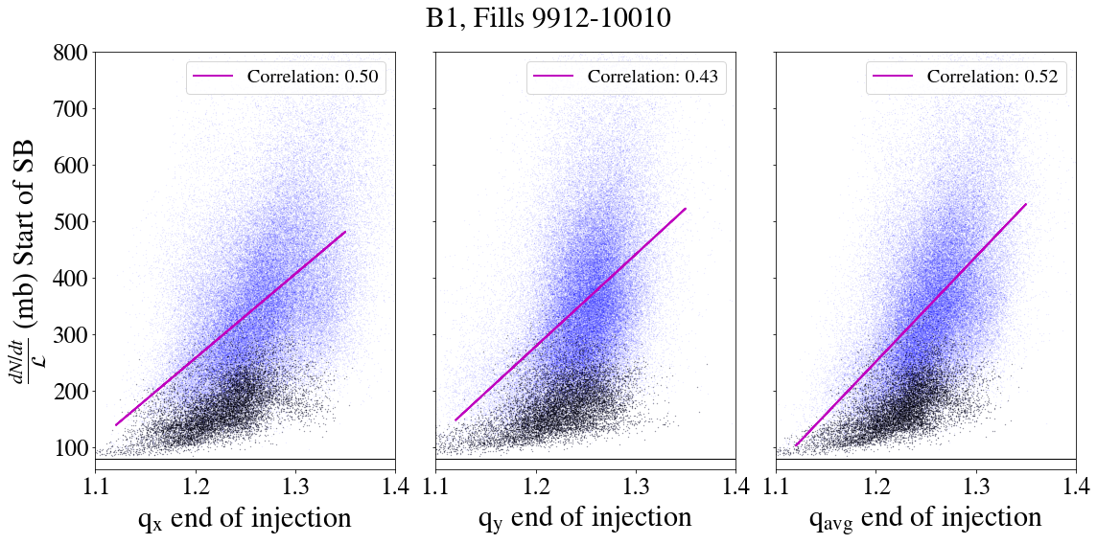
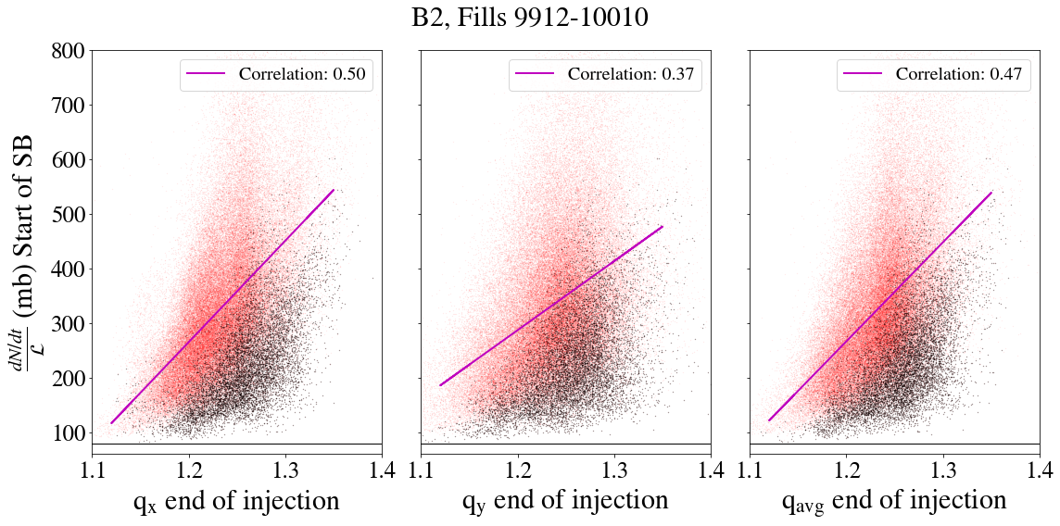
Correlation of tails with losses at start of SB
Correlation of losses at the start of Stable Beams with the q-value measured at the end of injection: Larger tails → Higher losses

Slide 23
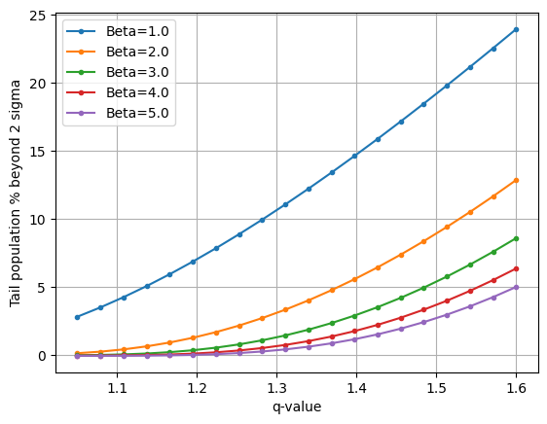
Correlation of tails with losses at start of SB
Correlation of losses at the start of Stable Beams with the q-value measured at the end of injection: Larger tails → Higher losses

Slide 24
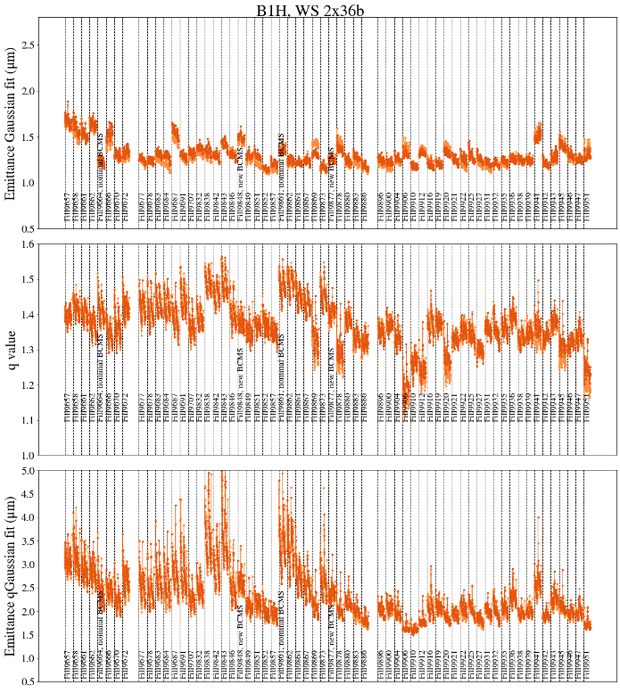
Tails at the start of injection
“Low-tail” BCMS thanks to optimizations of tail population in the PSB and PS.
No clear reduction of tails when these bunches reach the LHC:
  Profile measurements indicate tail population taking place in the SPS.
  Tail content can be controled through SPS scraping at the expense of injecting more bunch intensity from the injectors.
Wire scanners

Slide 25
Luminosity model

Slide 26
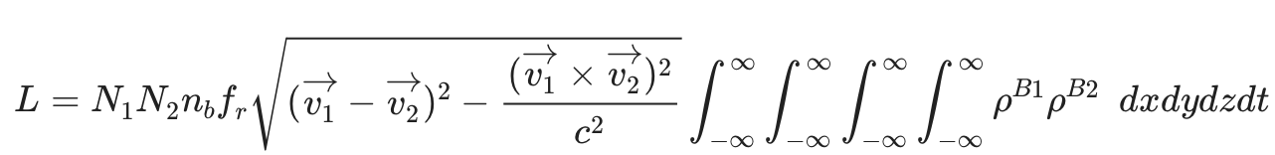
Summary of the luminosity model
Iterative algorithm that calculates evolution of beam & machine parameters every 5 minutes during collisions [1], [2]:
  Emittance evolution:
    IntraBeam scattering
    Synchrotron radiation
    Crab cavity noise for HL-LHC
    Possibility to include extra emittance blowup from unknown source observed in LHC
  Intensity evolution:
    Burn-off decay due to collisions in ATLAS, CMS & LHCb depending on the filling scheme
    Possibility to include additional losses from unknown source based on LHC experience
  Luminosity:
    Analytical and numerical integration of 4 integrals
    q-Gaussian PDF for the longitudinal plane with q=3/5 or Gaussian PDF
  Leveling to maximum pile-up or peak luminosity target:
    β^{*-}leveling for CMS & ATLAS combined with separation leveling with a lumi decay tolerance
    Skew separation leveling in LHCb
G. Sterbini python module

Slide 27
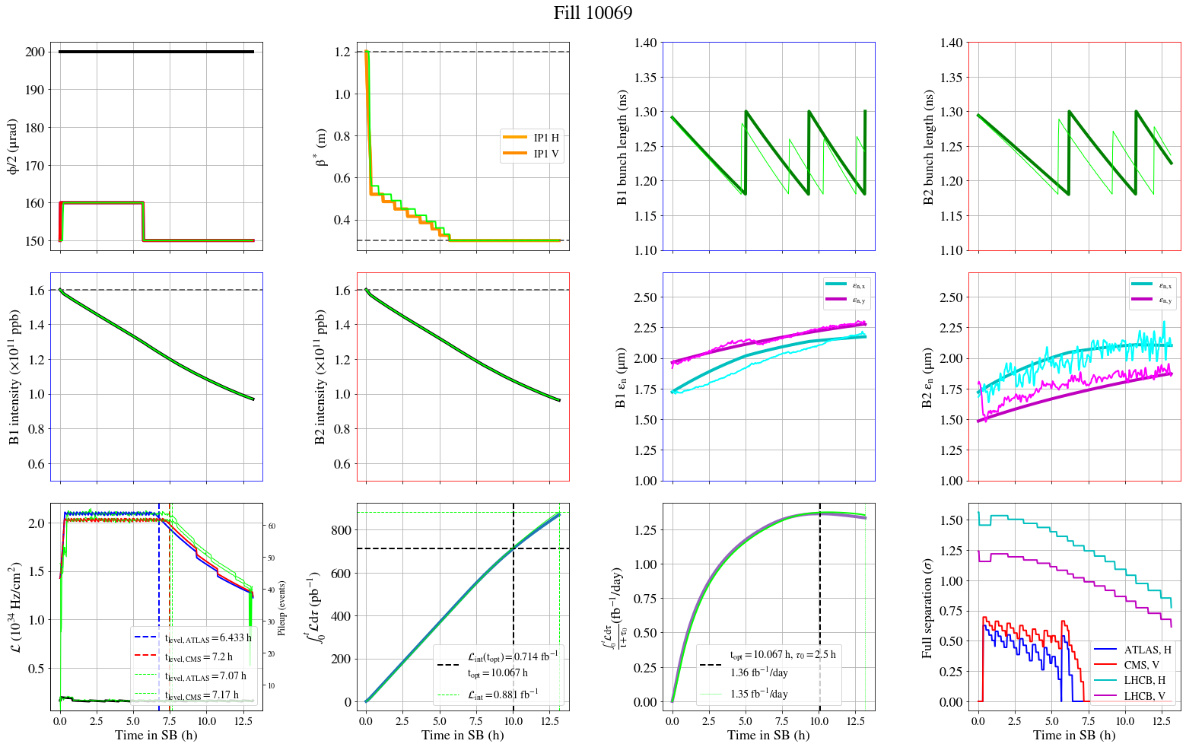
Luminosity model vs experimental data
Including additional loses
Including extra emittance growth

Slide 28
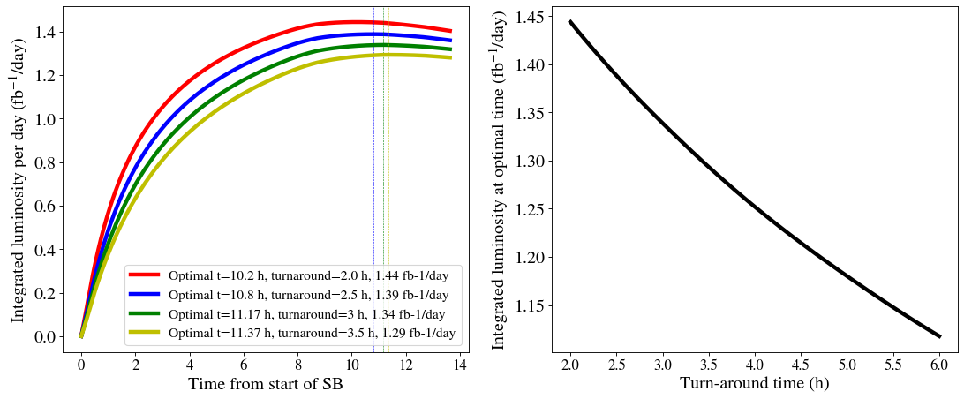
Luminosity model
Used to make predictions for LHC integrated performance and quantify gain from possible optimizations:
  10% reduction of emittance between standard and BCMS beams → 5% increase of integrated luminosity
  Mitigating extra losses: up to 4% increase of integrated luminosity
  Mitigating emittance blowup at collisions: 3% increase of integrated luminosity, strong assymetry between ATLAS & CMS
  Impact of turn-around time

Slide 29
Luminosity model
Used to make predictions for LHC integrated performance and quantify gain from possible optimizations:
  10% reduction of emittance between standard and BCMS beams → 5% increase of integrated luminosity
  Mitigating extra losses: up to 4% increase of integrated luminosity
  Mitigating emittance blowup at collisions: 3% increase of integrated luminosity, strong assymetry between ATLAS & CMS
  Impact of turn-around time
Projections for HL-LHC and define operational scenario along with DA simulations

Slide 30
Conclusions:
Emittance evolution during the LHC cycle:
  Emittance blowup at injection & collisions not fully understood, currently under investigation.
Intensity evolution during collisions:
  Well above the beam-beam limit in 2024 compared to 2023.
  On top of IP1/5, clear impact from IP8 in 2024.
  Correlation of extra losses observed at the start of collisions with tail population.
  Low tail beam types from the injectors not clearly reaching the LHC.
Luminosity model:
  Iterative algorithm that can accurately predict the evolution of luminosity in a fill including important effects such as IBS, SR, burn-off, mechanisms of unknown blowup..

Slide 31
Backup

Slide 32
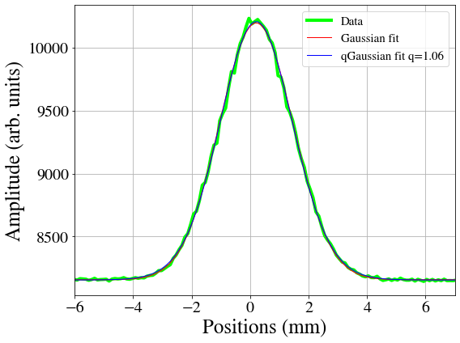
Emittance evolution during extended stay at injection
Dedicated experiments to study emittance growth at injection:
  Extended stay at injection (~3h instead of ~40 minutes)
  As a last step, scrapping of the beams in the vertical plane with collimators:~30% intensity reduction
  Two types of bunches tested: injected low-tail (q~1 from qGaussian fit achieved with aggressive SPS scraping 15%) and high-tail transverse bunch profiles (q=~1.4 nominal bunch profiles injected in the LHC).
q-Gaussian fits:
q=1 Gaussian
q>1 heavy tails

Slide 33
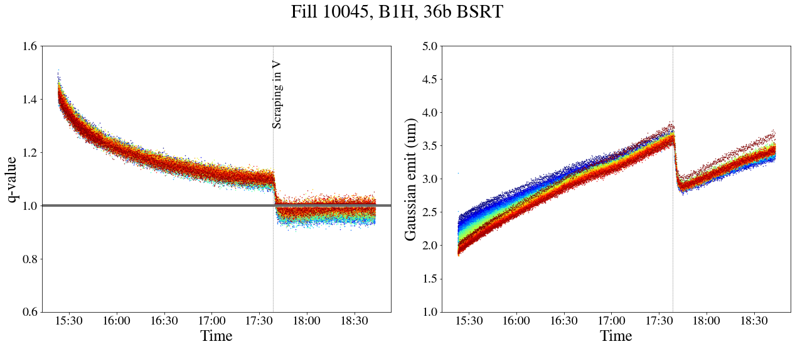
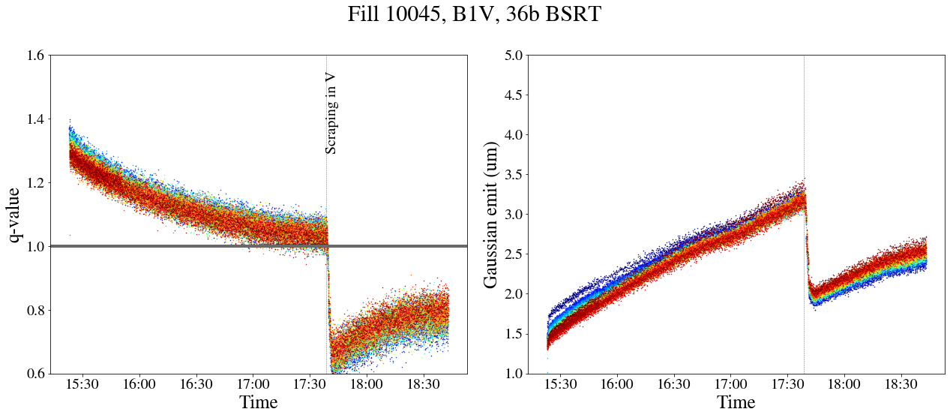
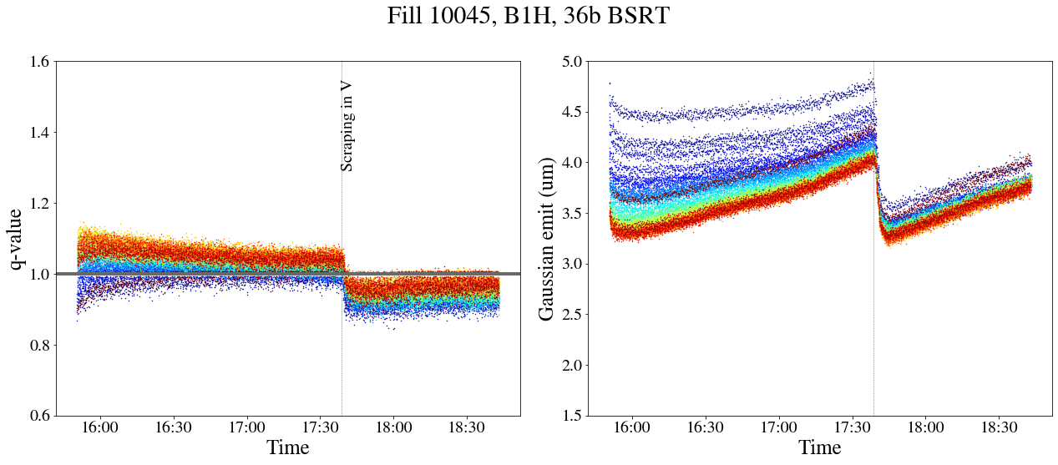
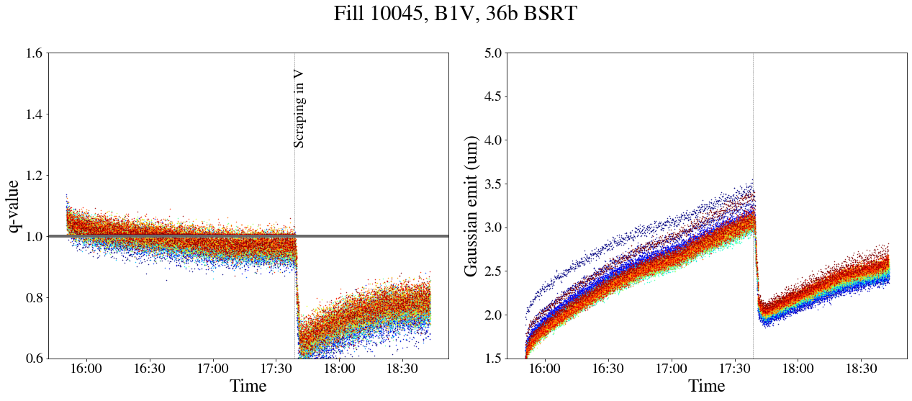
Emittance evolution during extended stay at injection
H-plane
V-plane
Scraping in V plane
High-tail
Low tails can be injected and maintained at the LHC injection
Low-tail

Slide 34
Emittance evolution during extended stay at injection
H-plane
V-plane
Scraping in V plane
High-tail
Low-tail

Slide 35
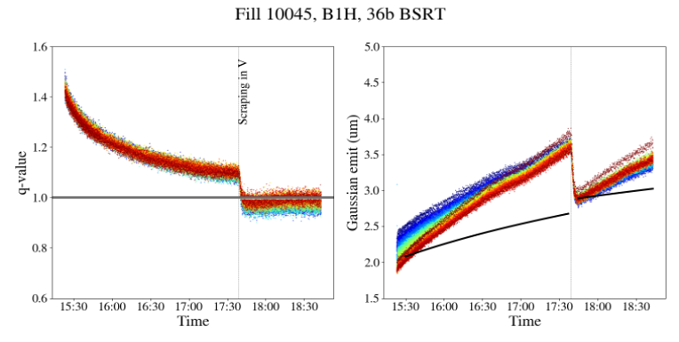
Emittance evolution during extended stay at injection
H-plane
V-plane
Scraping in V plane
IBS model taking into account intensity, emittance & bunch length changes after scraping
High-tail
Low-tail

Slide 36
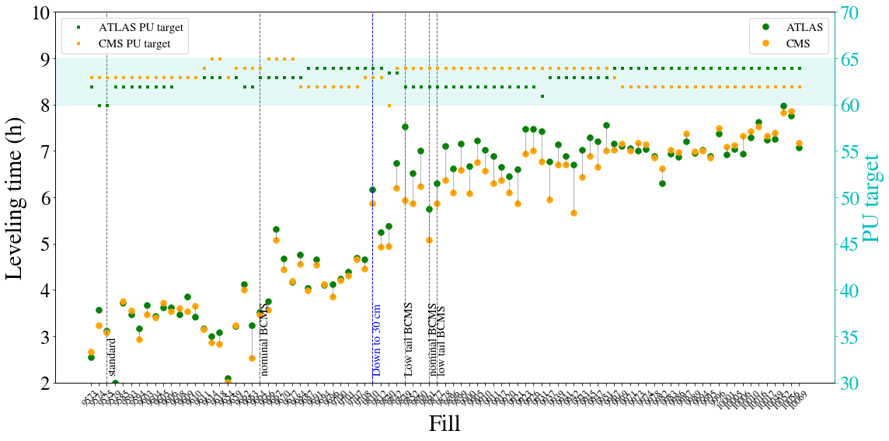
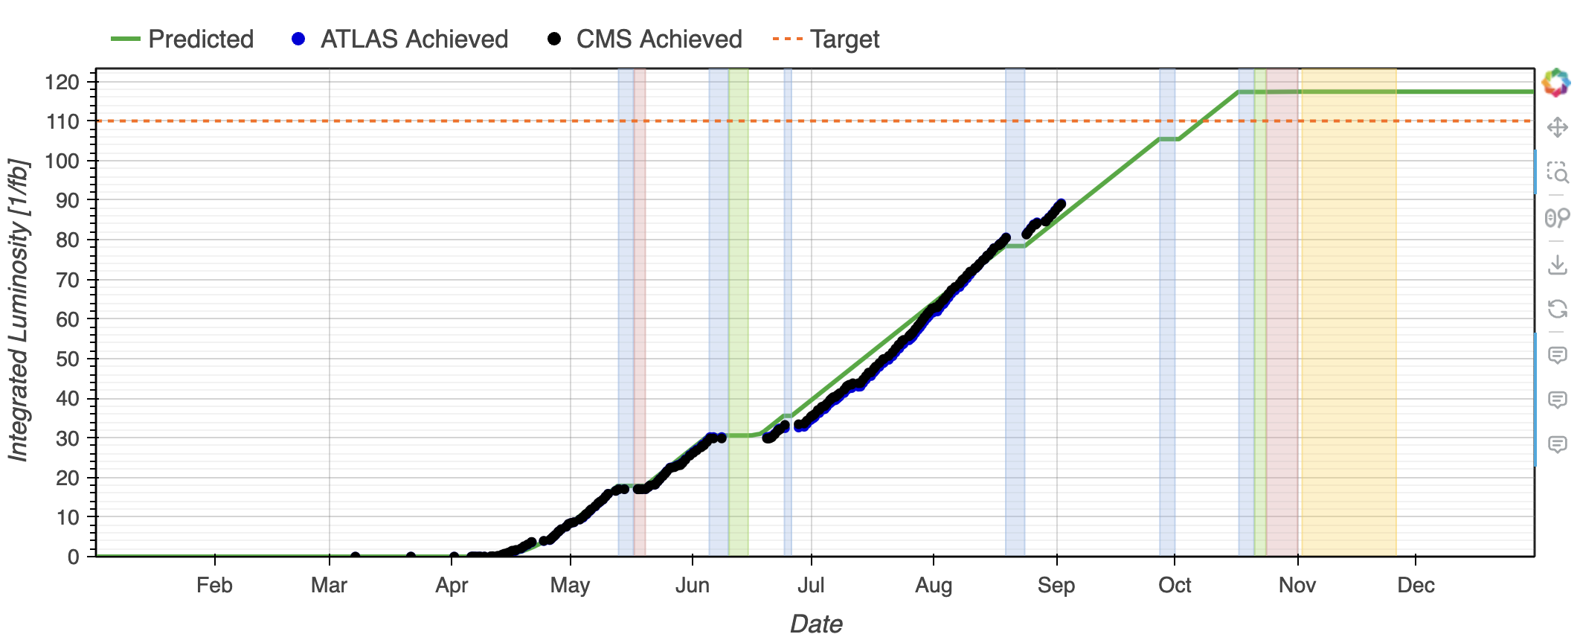
Leveling time & integrated luminosity

