Slide 1


Impact of beam-beam effects on the transverse LHC beam halo
ICFA mini workshop – Beam-Beam Effects in Circular Colliders
02 – 05.09.2024, EPFL, Lausanne, CH
Authors: M. Rakic, P. Hermes, C. E. Montanari, S. Redaelli, G. Sterbini
Thanks to LHC OP for the precious support!

Slide 2
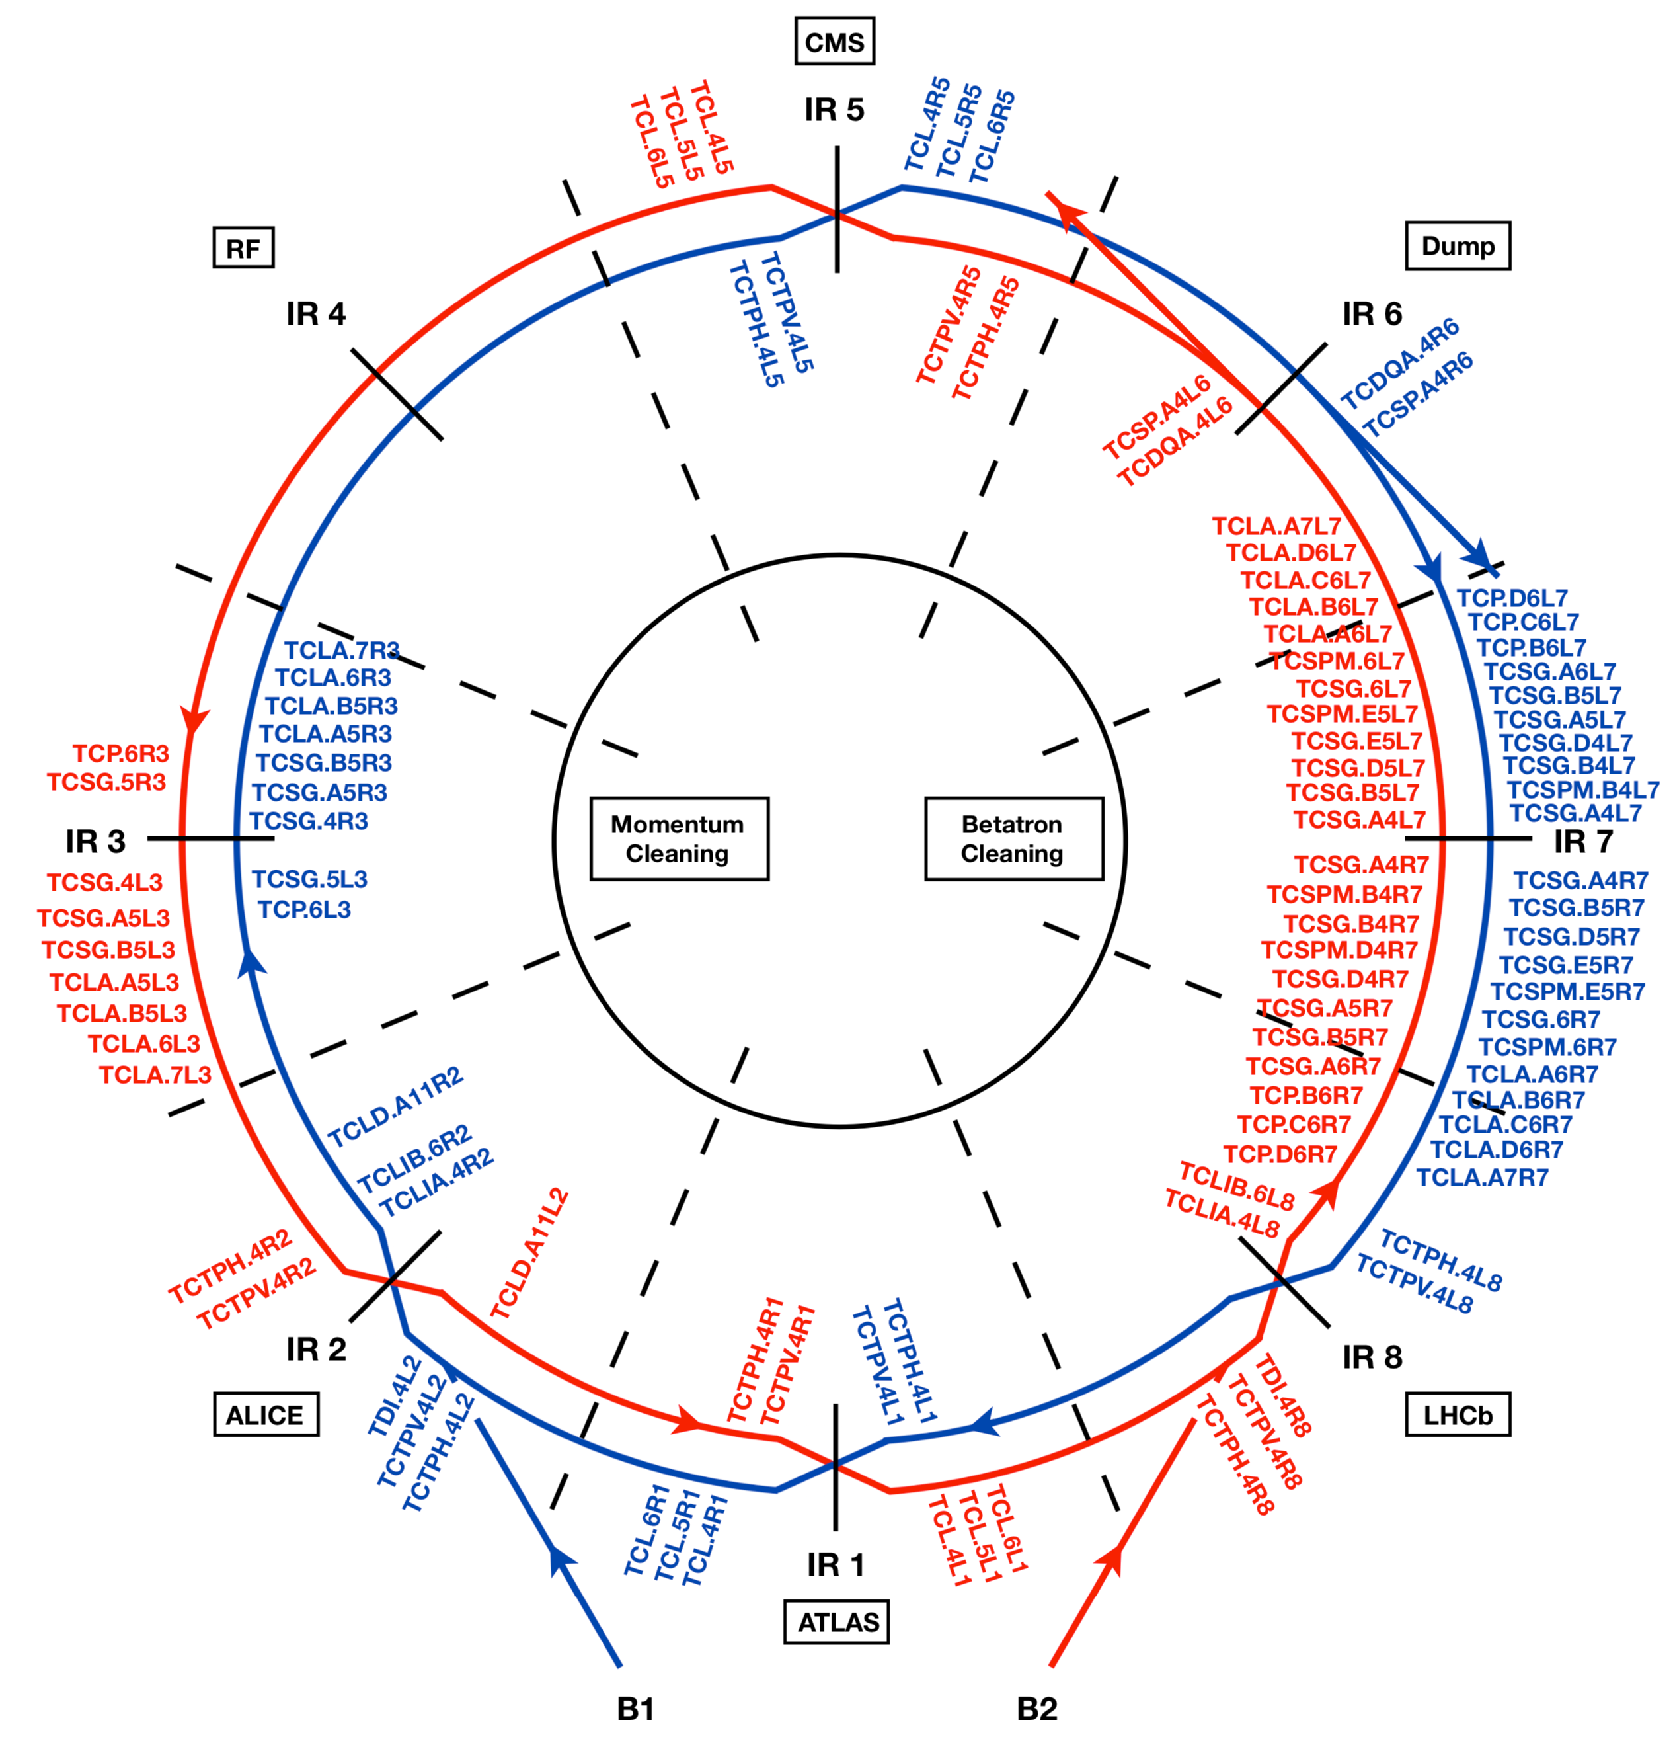
Introduction
High stored energy of LHC particle beams (approx. 700MJ for HL-LHC!)
LHC Collimation system:
  Multi-stage system, mainly located in IR7
  Essential for machine protection
  Different collimation types for different purposes
    TCP: primary collimators – closest to main beam
    Secondary and tertiary collimators – remove particle showers, protect IPs, reduce background
    Collimation Hierarchy to be respected to ensure safe operation
Figure – LHC collimation system layout [1]

Slide 3

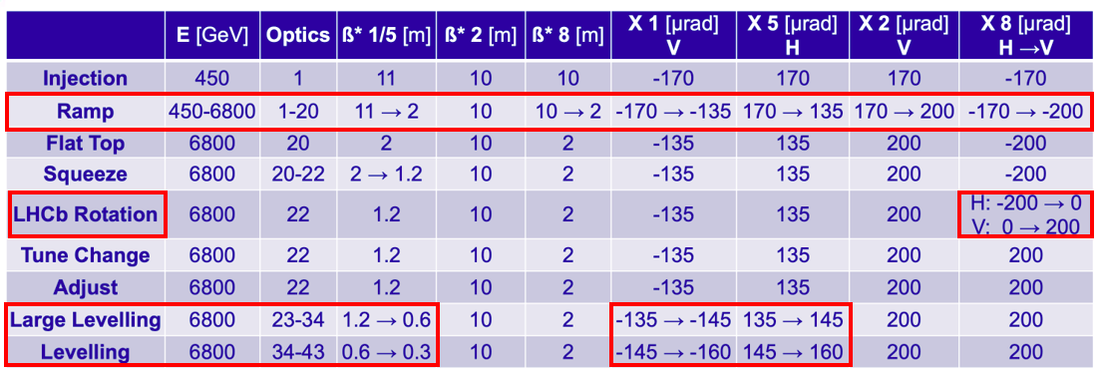
LHC 2023 operation, a complex cycle!
Collision in four Interaction Points (IPs):
  High Luminosity Experiments in IP1 (ATLAS) and IP5 (CMS)
  Lower Luminosities in IP2 (ALICE) and IP8 (LHCb)
Cycling through multiple optics, each yielding different challenges (and BB effects during levelling!)

Slide 4
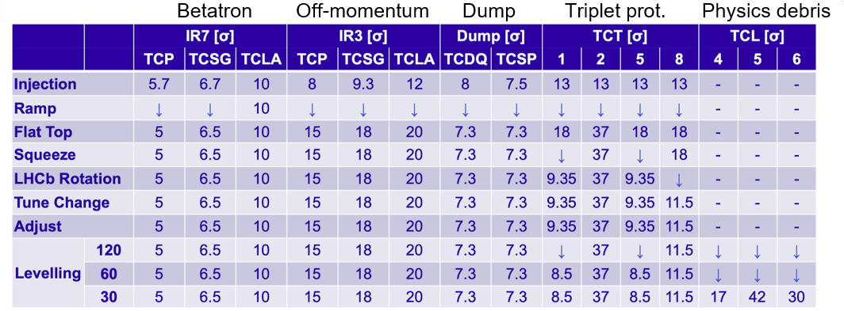
LHC collimation along the cycle
Collimator settings = functions of time synch-ed to the power converters, RF, orbit feedback,…
Regular monitoring to detect early on potential deviations from reference performance
All settings beam-based: dedicated alignment sections in initial commissioning

Slide 5
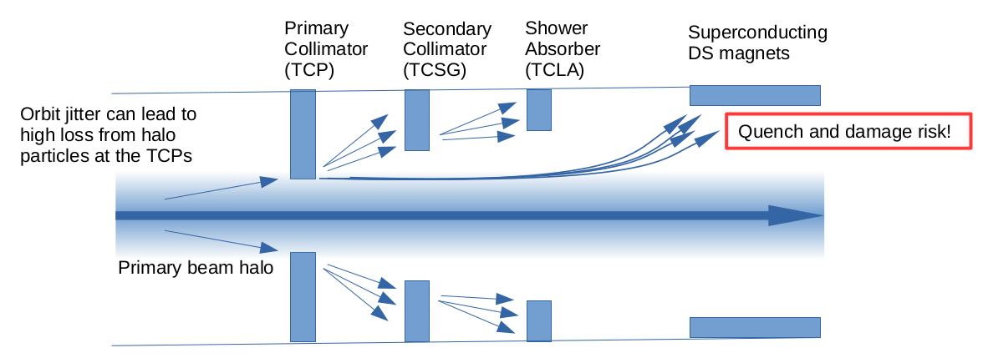
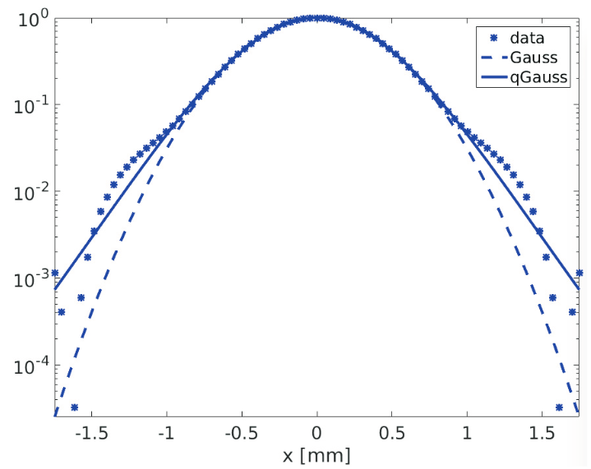
Beam halo and its importance
Transverse beam halo defined as particle population above 3 σ_{N}
Measured since LHC start: heavily populated halo, up to 5% [5]
Halo and fast-failure scenarios:
  Danger to collimation system
  Danger of magnet quench
  General concern on machine availability from loss spikes if halos too populated
Need to understand the mechanisms of halo formation and evolution
Core
Halo
Halo
Figure – Beam halo interaction with collimator hierarchy [2]
Figure – Transverse bunch profile measured by BSRT [3]
σ_{N} ​ Tranverse beam size with nominal emittance

Slide 6
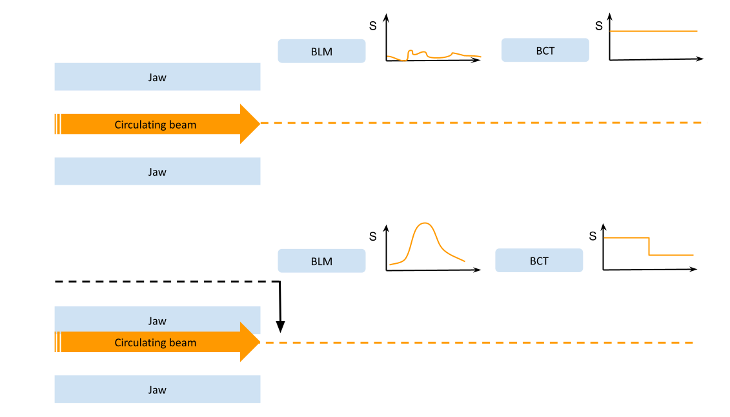
How is the halo measured in the LHC?
1
Beam-based alignment
  Precise collimator measurement of collimator gap when touching the beam
  Important for positioning the beam centre
Destructive scrapings with collimators:
  Inward scraping in steps
  Using TCPs
Instruments used:
  Beam current transformer (BCT) - beam intensity (per bunch or total)
  Beam loss monitors (BLM) - local losses
2
Figure – Illustration of halo scraping with TCPs and responses of BLM and BCT devices.

Slide 7
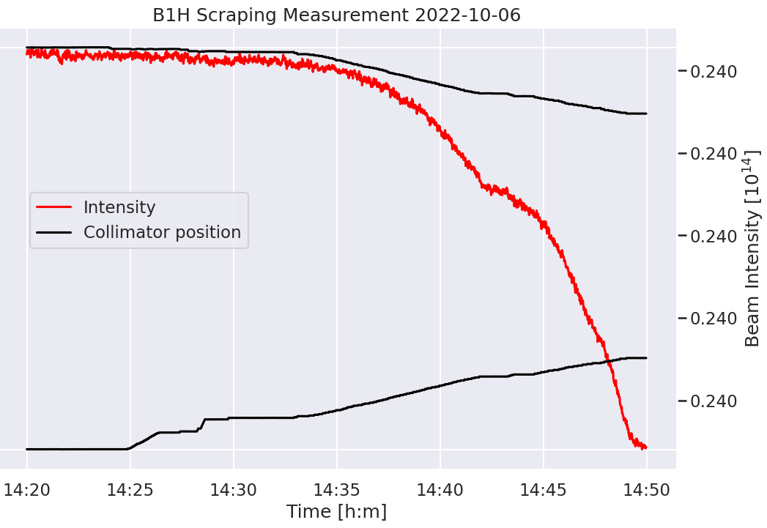
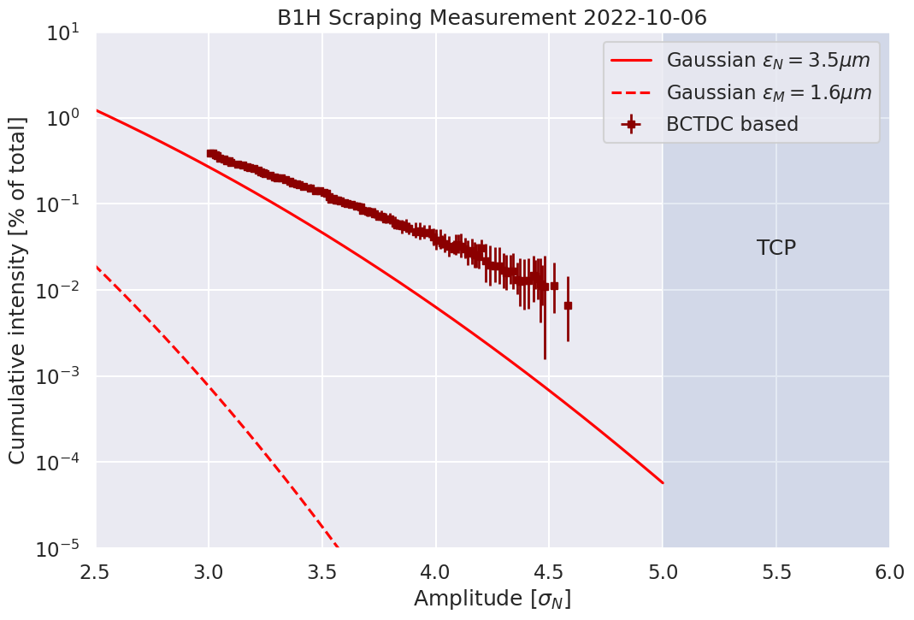
Measurement analysis
Example: data from BCT beam halo [% total] at fixed amplitude [σ_{N}]
Emittances:
  Measured: expected beam size
  Nominal: by convention 3.5 µmrad in LHC and 2.5 µmrad in HL-LHC
Figure – Extracting halo from the raw BCT signal and TCP positions.

Slide 8
Measurement overview
Overview of end-of-fill LHC Run 3 halo measurements:
  Taken after beams spent hours in collision
Range of measured halo populations
Date | Fill | B1H | B1V | B2H | B2V
 |  | halo [% of total intensity] at 3.5σ_{N}
06/10/2022 | 8233 | 0.1% | 0.1% | 0.1% | 0.3%
25/10/2022 | 8313 | 0.4% | 0.6% | < 0.1% | 1.5%
12/11/2022 | 8387 | 0.9% | 0.6% | 0.2% | 0.7%
20/06/2024 | 9808 | 0.2% |  | 0.1%
23/08/2024 | 10048 | 0.5% | <0.1% | 0.2% | 0.2%
This talk: focus on scraping done on Fill No. 8233

Slide 9

Measurement overview
Beam conditions:
  200 bunches, 7 × 10⁹ ppb
  10h in collisions - nominal LHC β*luminosity levelling
  Reached nominal 2022 end of levelling (IP1/5 β*=30cm, IP2 β*=10m, IP8 β*=2m)
  350 A octupole currents
Different collision scheme for different bunches within trains
  Different head-on (HO) and long-range (LR) beam-beam forces
Measurement at end of fill
  FastBCT data for reconstructing bunch-per-bunch halo population
Figure – Fill scheme, 2 trains of 12b (0-1) and 4 trains of 48b (2-5).

Slide 10
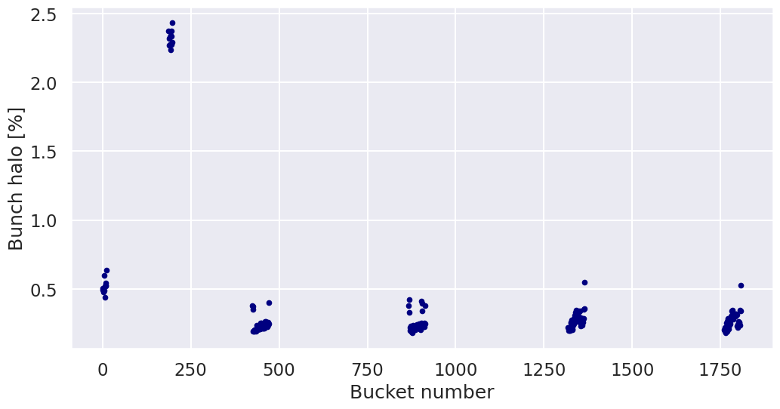
Influence of collisions on halo
B2H halo per bunch above 3.2 σ_{N}
Expected behaviour: colliding vs non-colliding bunches
Intra-train halo differences
Larger halo for the non-colliding bunches
Decrease of halo for bunches which spent hours in collisions

Slide 11
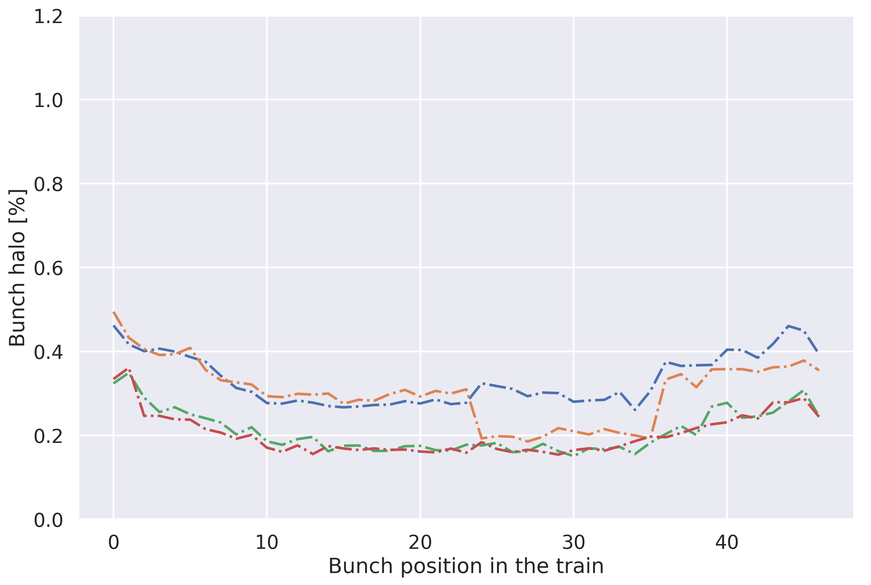
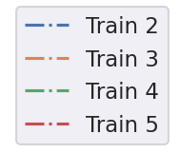
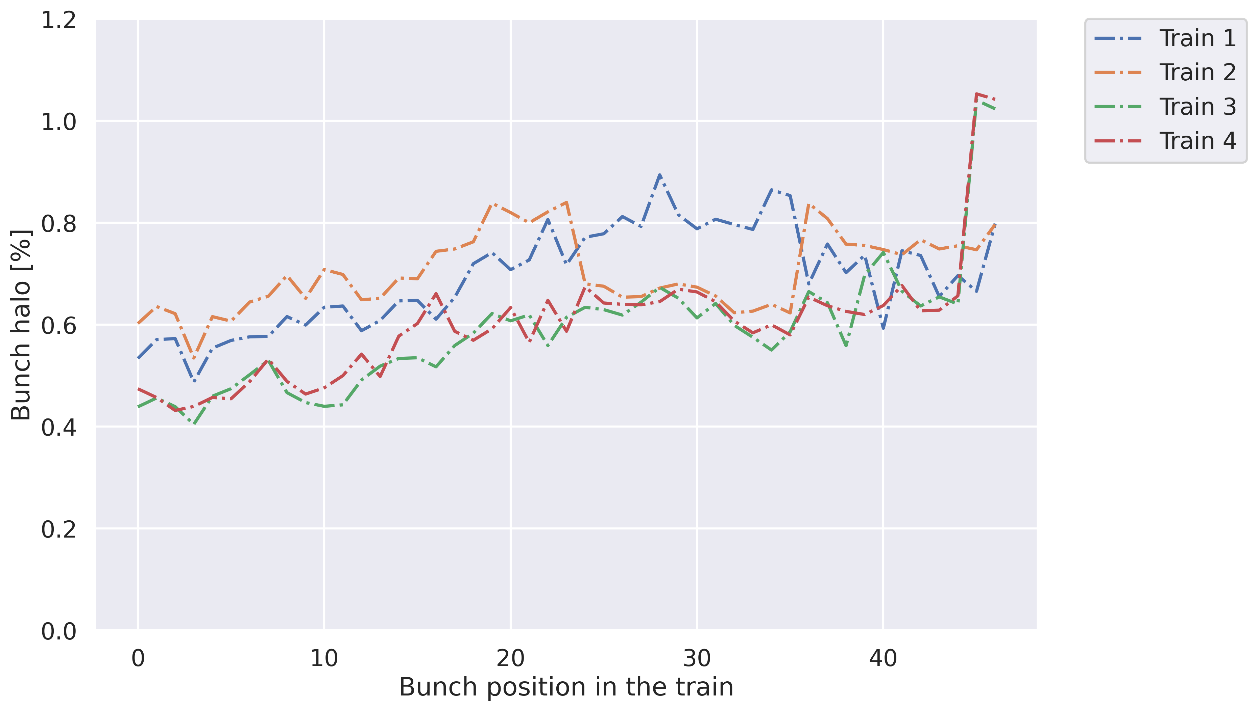
Influence of collisions on halo
Bunch-by-bunch halo above 3.2 σ_{N}
B2H
B2V

Slide 12
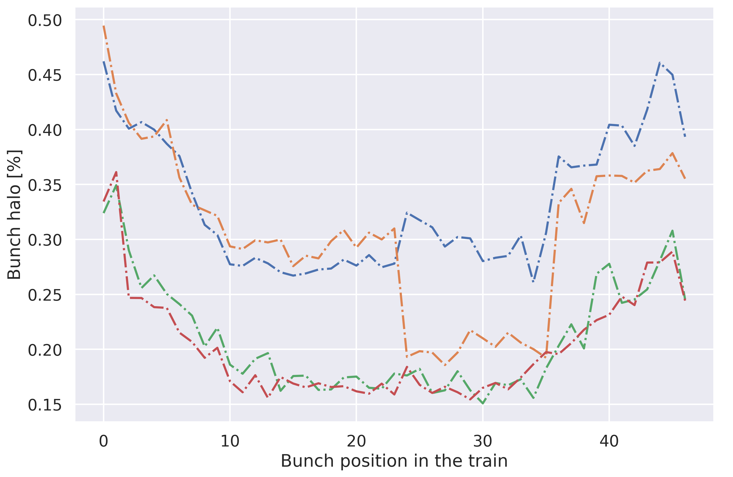
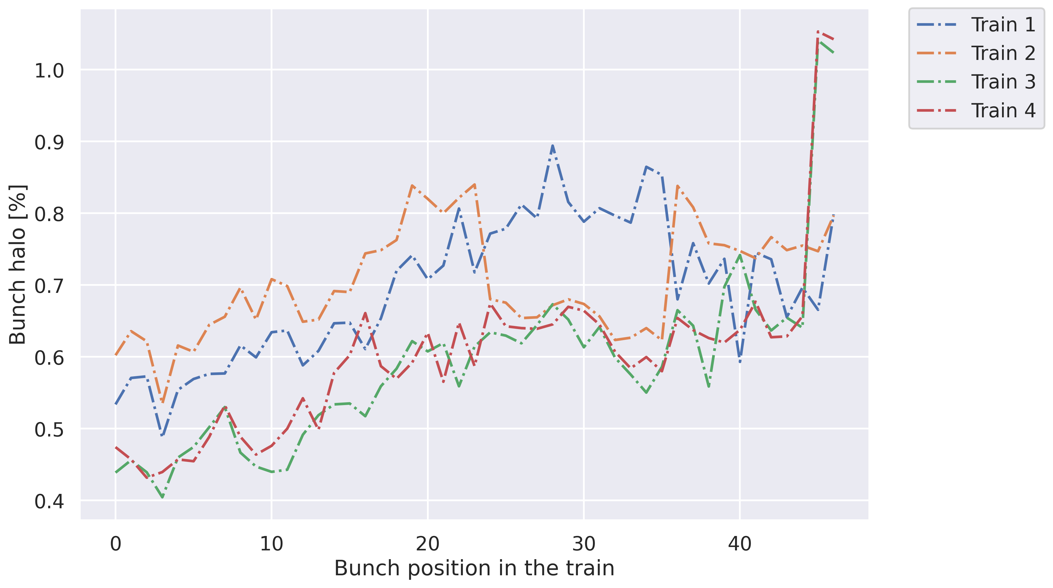
Influence of collisions on halo
Visible decrease of halo when colliding in IP2
Collisions in IP1, 5 and 8
Collisions in IP1, 5 and 2
Collisions in IP1,5, 8 and 2
Figure – Bunch-by-bunch halo left in B2H and right in B2V.

Slide 13
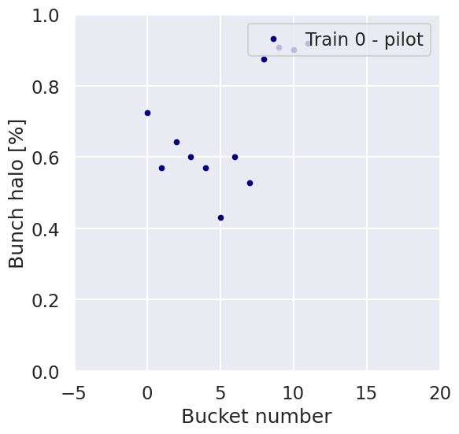
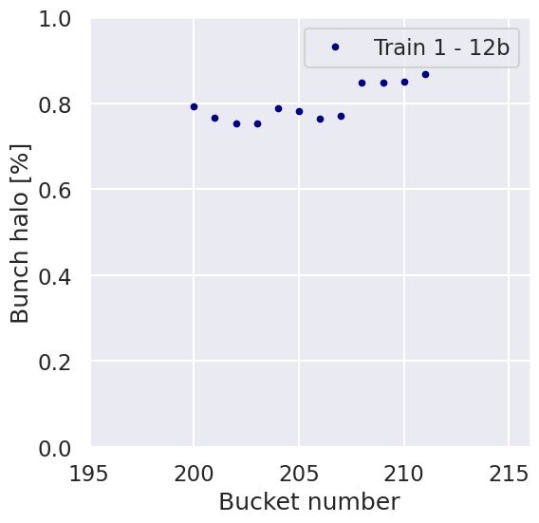
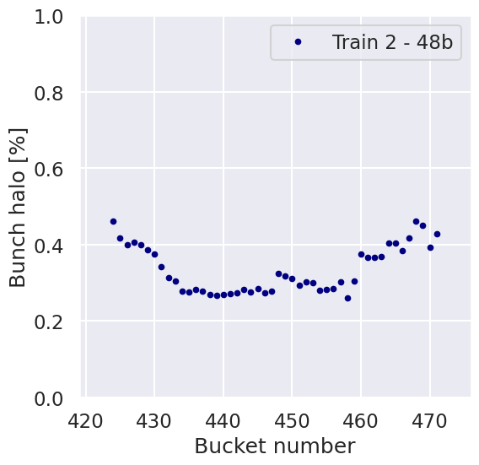
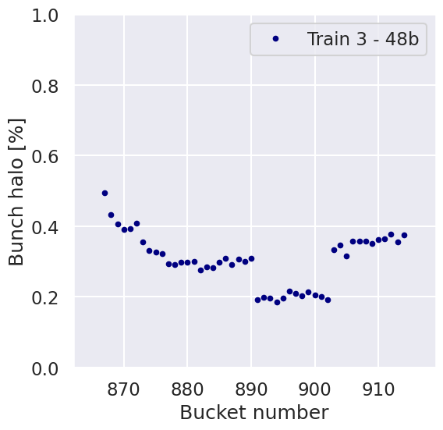
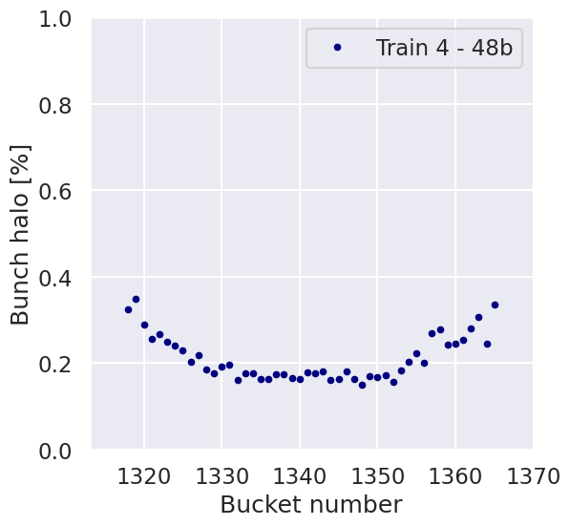
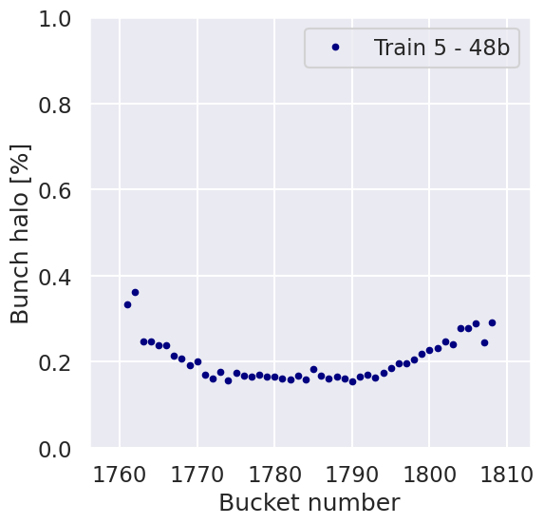
Bunch-by-bunch halo and IP collision pattern - B2H
IP1/5
12b
Non-colliding
IP1/5
IP8
IP1/5
IP1/5
IP1/5
IP8
IP2
IP2
IP2

Slide 14
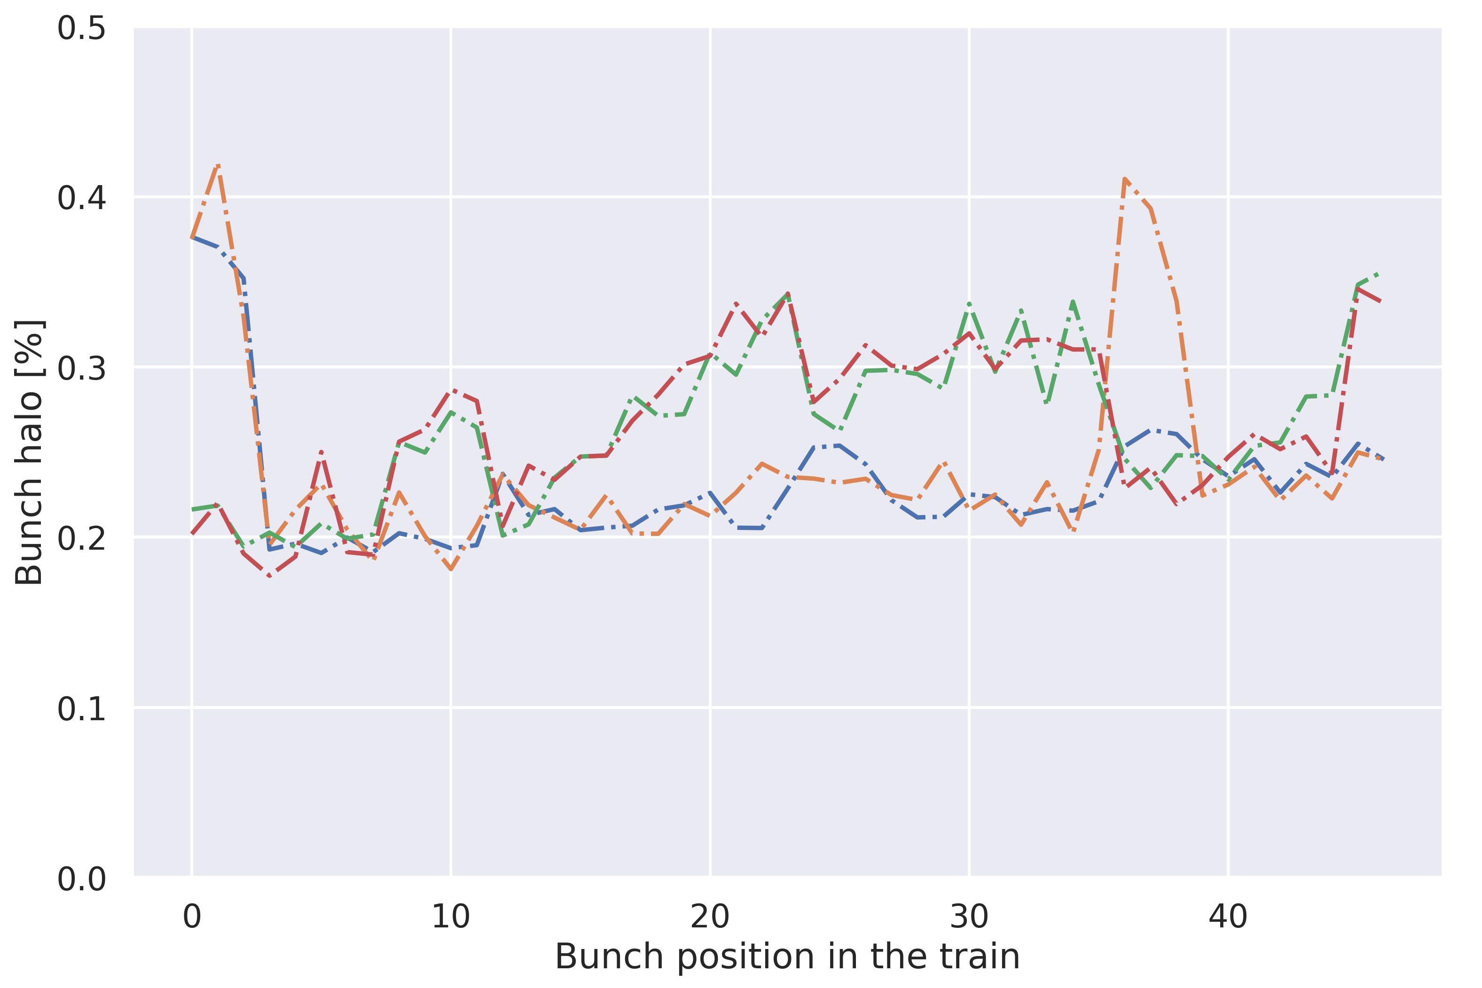
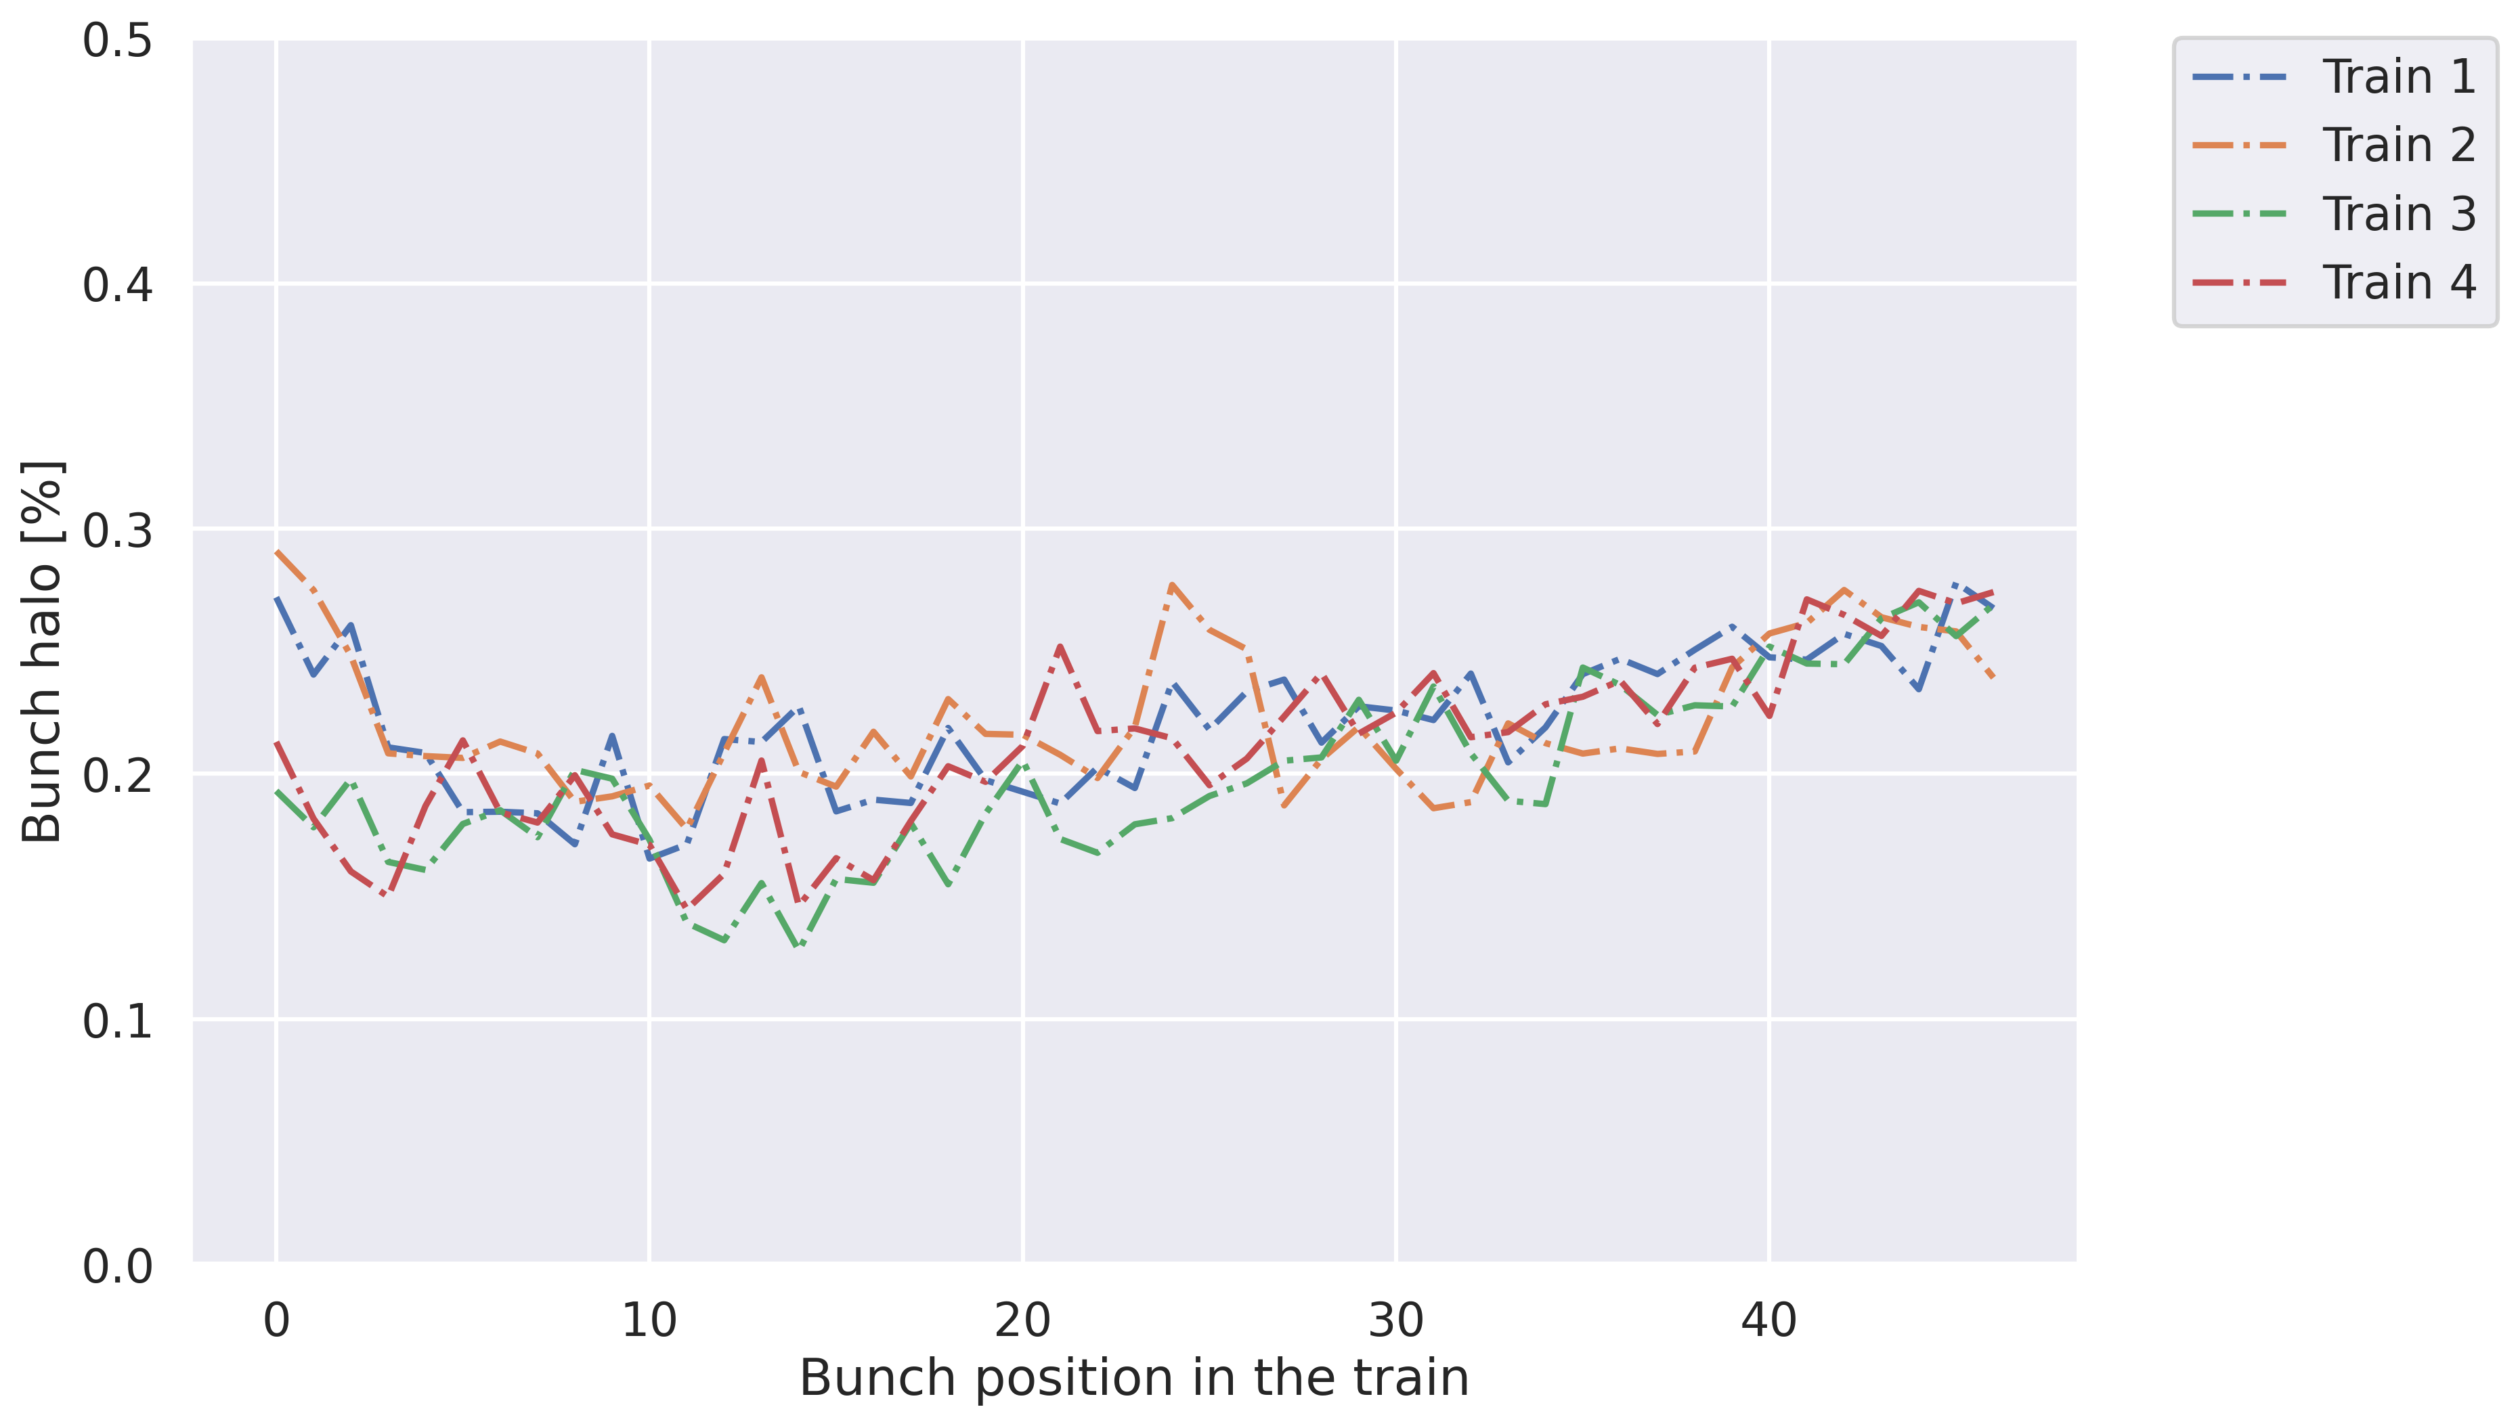
Is this visible also in B1?
Patterns observed in B2 are not present in B1
Source of differences still uncertain
B1H
B1V

Slide 15
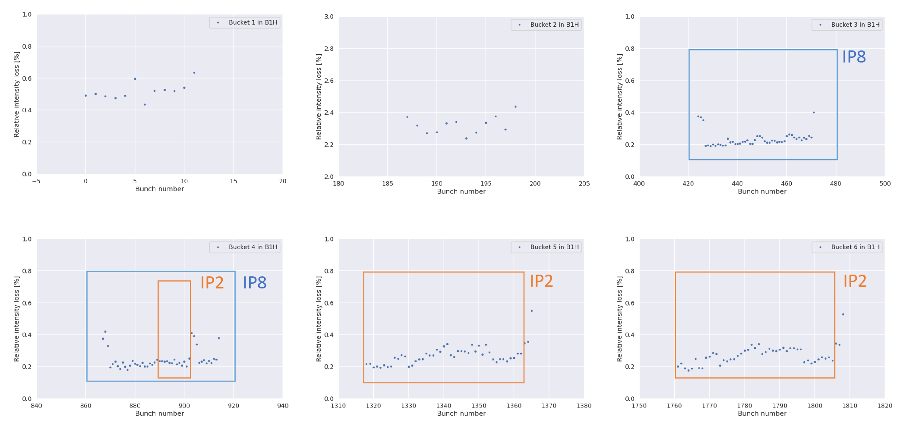
Bunch-by-bunch halo and IP collision pattern - B1H
IP1/5​
Non-colliding
IP1/5​
IP1/5​
IP1/5​
IP1/5​

Slide 16
Summary of key observations
Difference in bunch halo population depending on collision pattern
Unexpected differences between B1 and B2
Possibly caused by different non-linear interaction with magnetic imperfections?
Can we replicate this in simulations?
Figure – Bunch-by-bunch halo left in B2H and right in B2V.

Slide 17

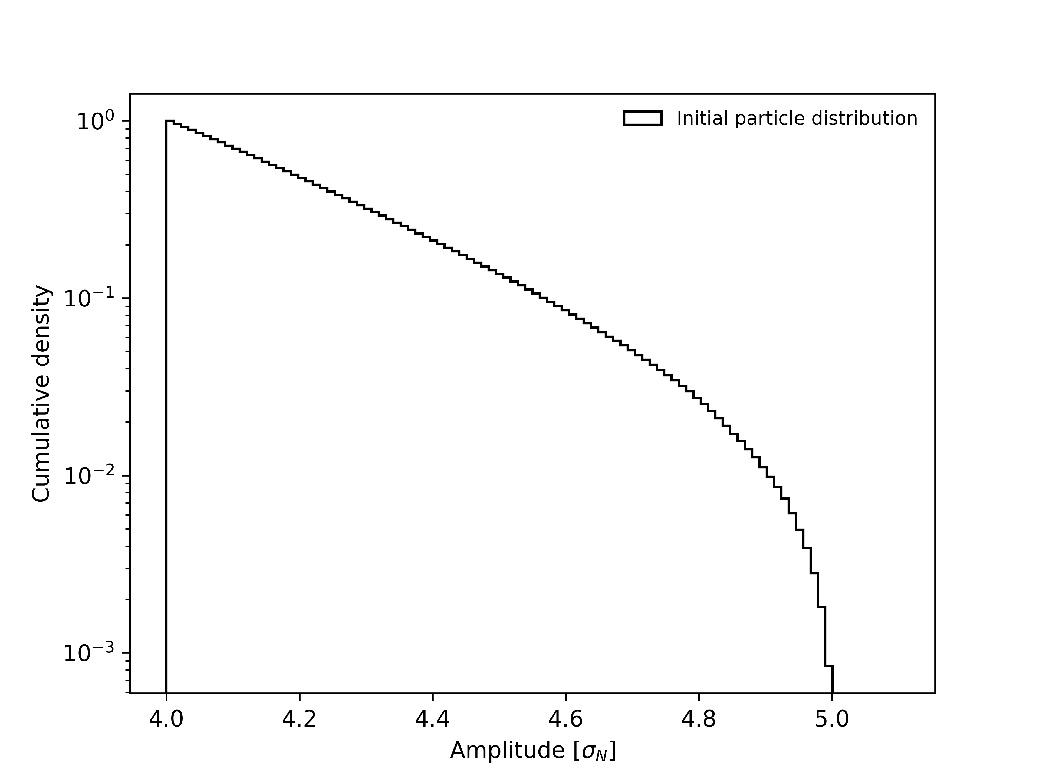
Single-particle tracking with Xsuite
Is the effect of IP2 BB effect in B2 visible in a single-particle tracking simulation?
Xsuite weak-strong model used
2022 LHC optics, end of leveling, β*=30cm
Octupoles @350 A
Machine imperfections not included
Different BB long-range and BB head-on setup
  All IPs except for IP2
  All IPs
Nominal beam halo sampled between 4 and 5 σ_{N} as initial condition
Betatron cut at 5 σ_{N}
GPU tracking of 10⁵ particles up to 10⁶ turns (~90 seconds of LHC operation)
Not shown here: BB integration in full collimation simulations – F. Van der Veken talk

Slide 18
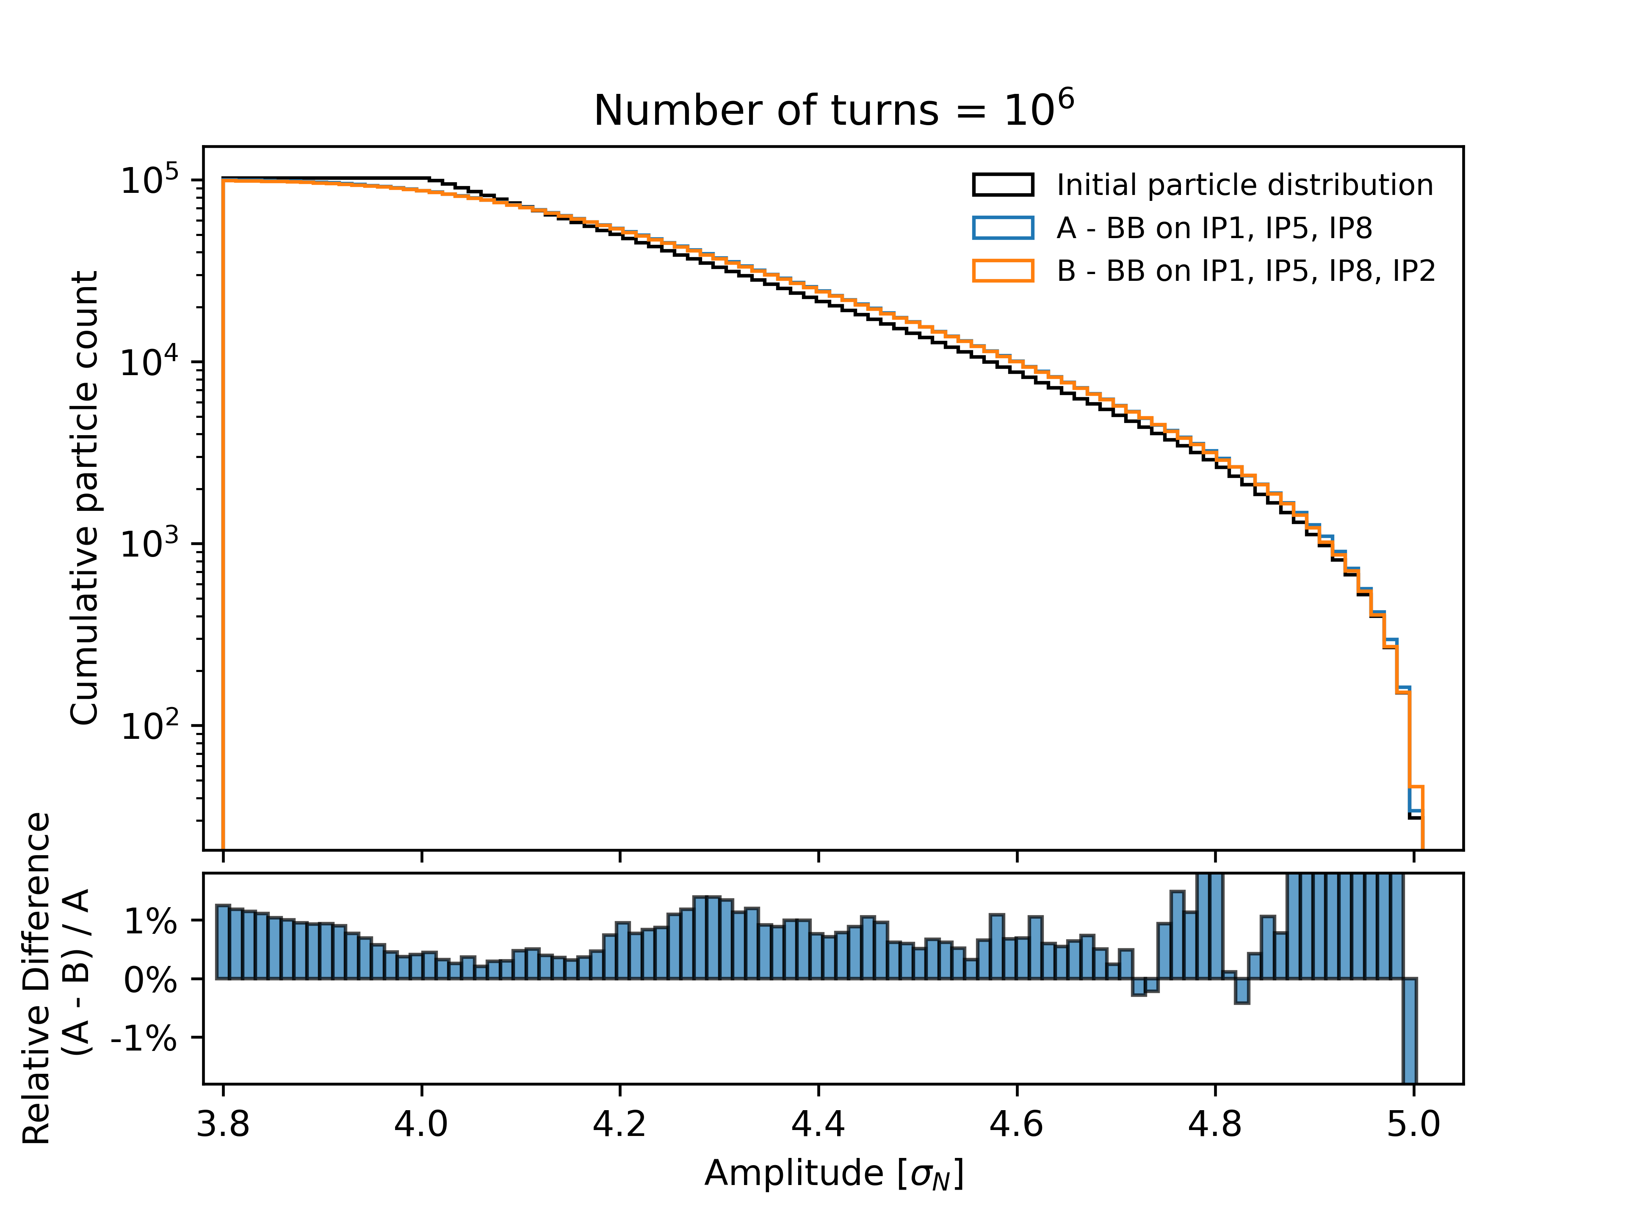
A difficult observation
Beam halo dynamics simulation is an open challenge
High statistics required
  Achievable thanks to XSuite GPU implementation
  Only requires deployment on more GPU hardware
Longer simulation timescales required
  Tracking took almost 2 days on a Nvidia A100
  Scaling up to hours of LHC operation currently unfeasible
Very small change...

Slide 19
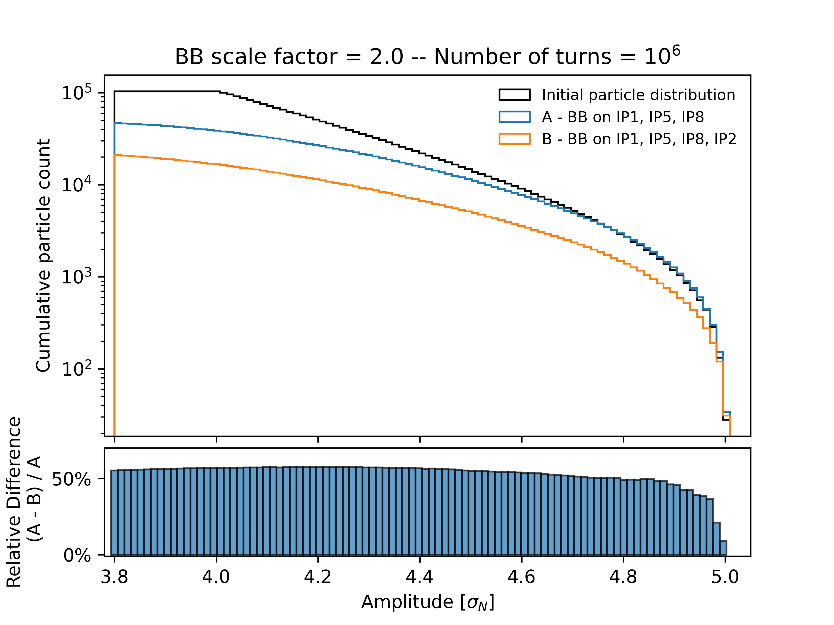
Amplify to observe
Explorative attempt for visualizing IP2 BB effect
Increase of BB intensity by factor 2 on all IPs
Stronger degradation at reachable timescales
Difference between resulting halo populations
Possible next steps:
  Increase number of turns in dedicated campaign
  Focus on understanding differences between B1 and B2
  Use extrapolation models / scale-laws to probe long-term dynamics
Faster depletion of (B)

Slide 20
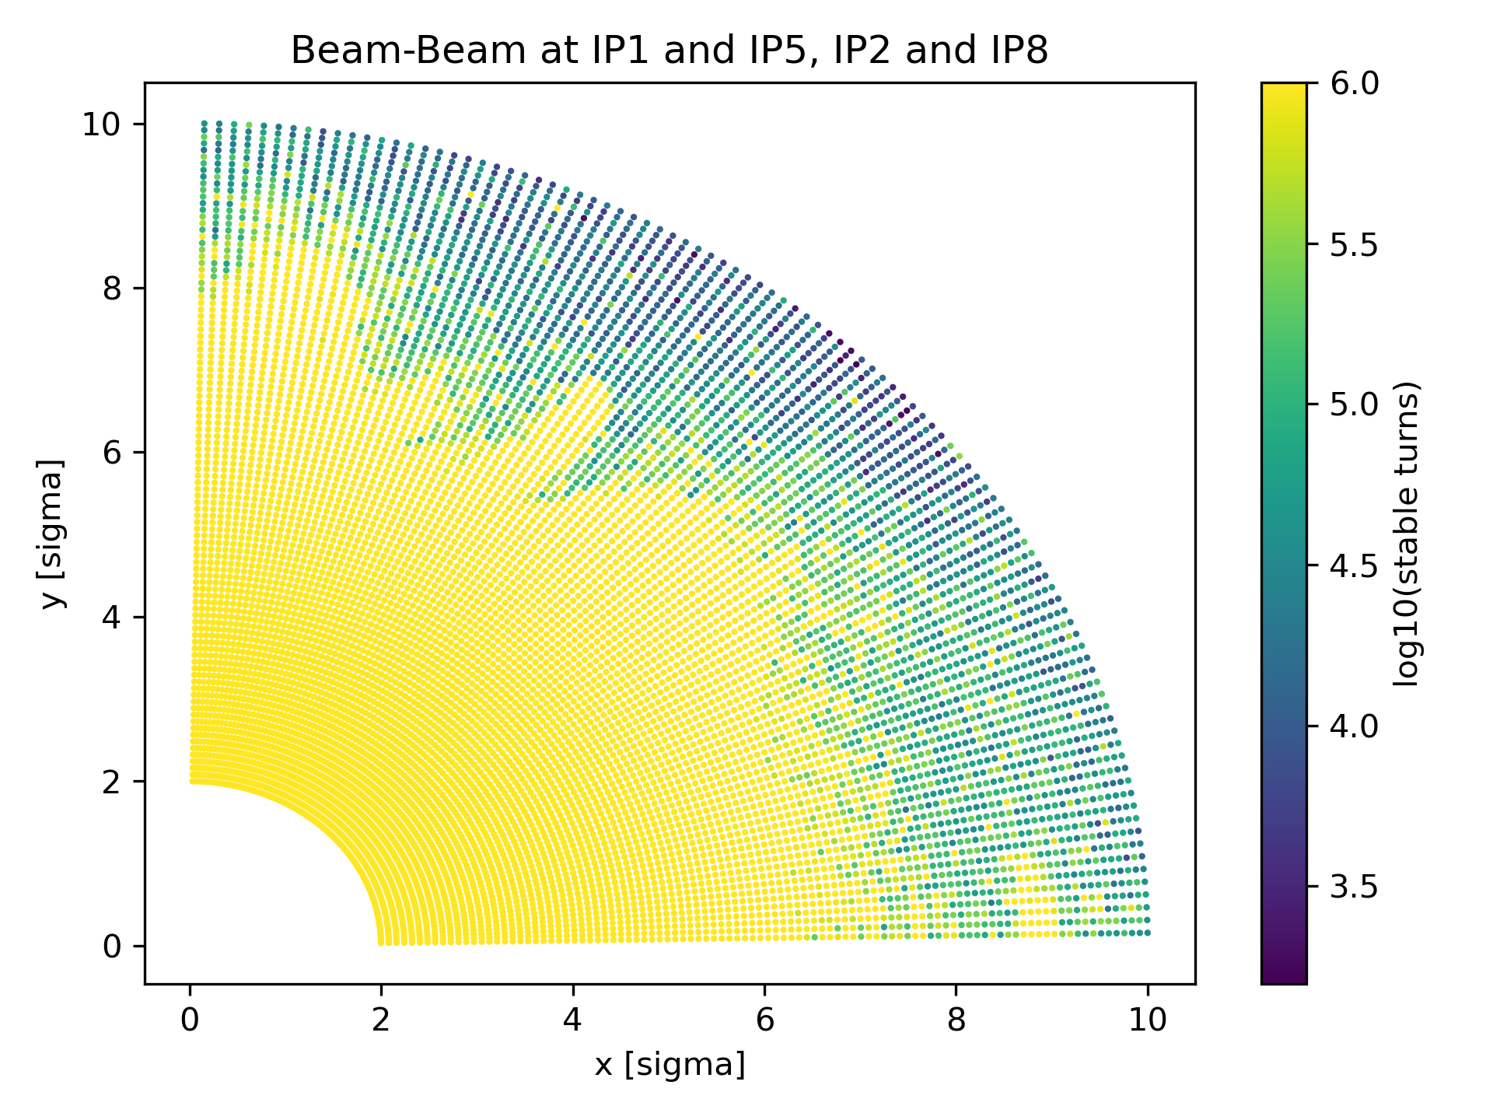
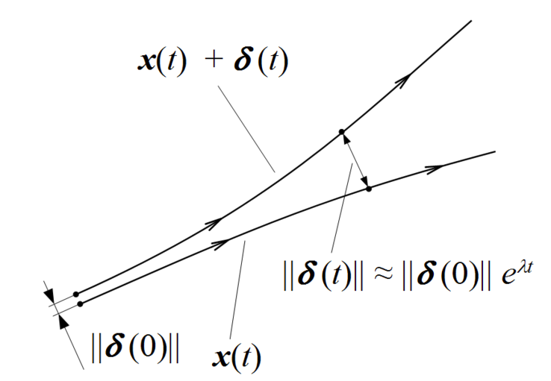
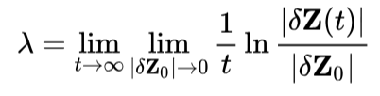
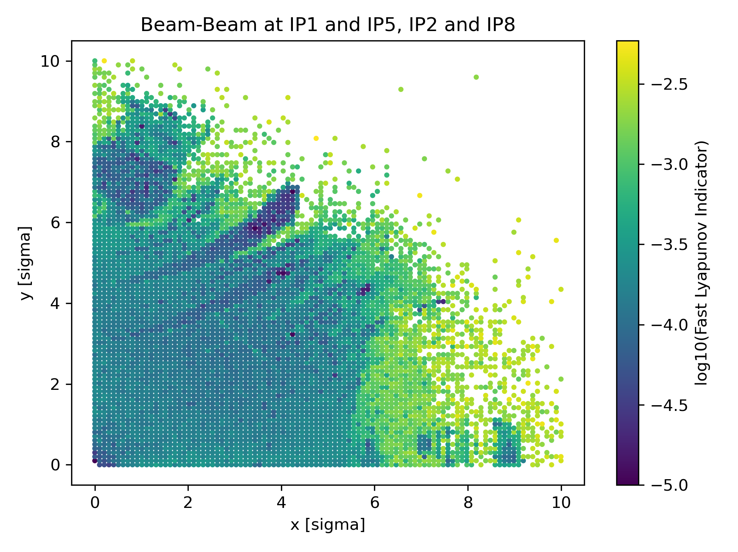
Approaches under consideration:
Chaos Indicators
Dynamic Aperture Tracking
@10⁶ turns
Lyapunov exponent: measurement of an orbit’s reaction to an initial perturbation
    λ = 0 - Non-chaotic
    λ > 0 - Chaotic
Can be probed via Choas Indicators (e.g. Fast Lyapunov indicator FLI)
Possible extension of ''standard'' dynamic aperture simulations
Good observables for constructing extrapolation models
FLI Tracking
@10⁵ turns

Slide 21
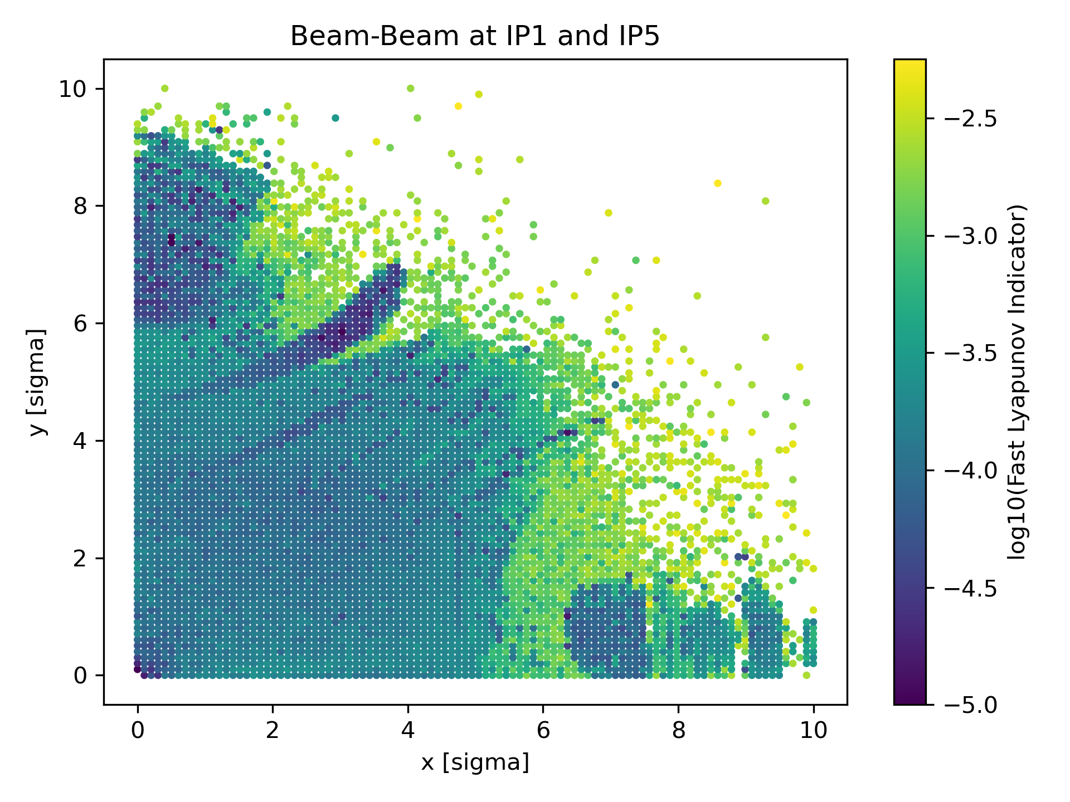
Approaches under consideration:
Chaos Indicators
Small differences in chaotic structures in the phase space may be used as base for long-term extrapolation models/scale-laws
FLI Tracking
@10⁵ turns

Slide 22
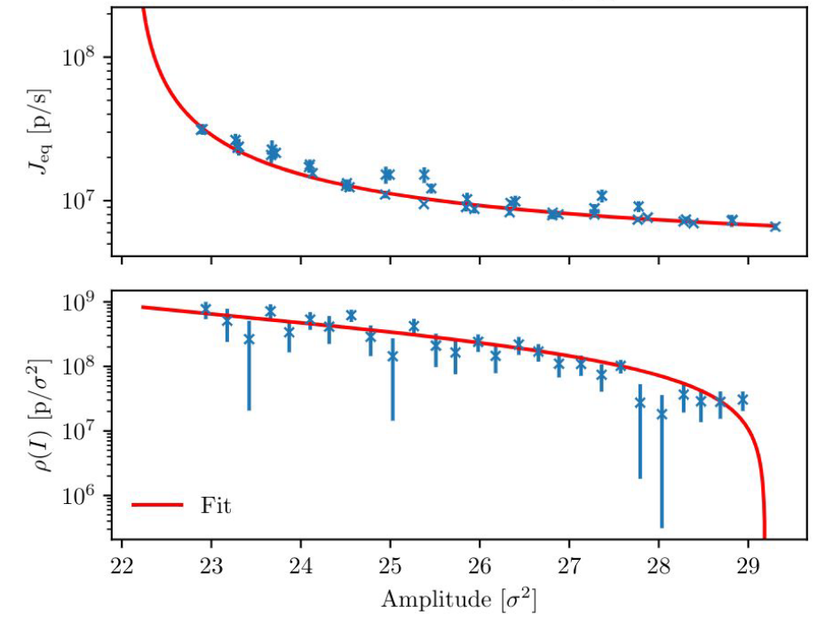
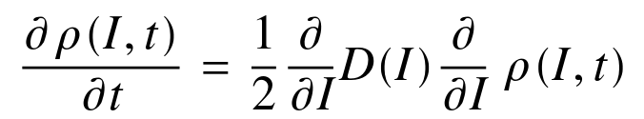
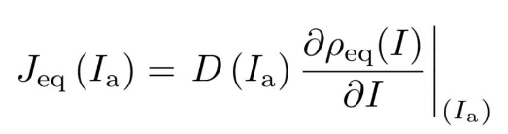
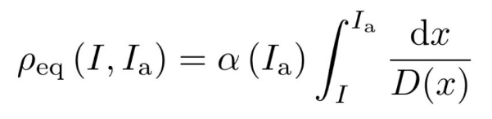
Approaches under consideration:
Non-linear diffusive models
Diffusion Measurements and Fit @Fill 8348
Describe the transverse beam distribution evolution as a Fokker-Plank model:
Physics-based functional shape for the diffusion coefficient
(Ideally) relate the presence of chaoitc regions to diffusion-like dynamics observed in experiments
Steady proton loss at different TCP amplitudes
Beam-halo population

Slide 23
Conclusions
Understanding of beam-halo dynamics is an open problem, critical for present and future LHC operation
Multiple measurements of beam-halo correlate halo depletion to different BB effects
Measurements of halo differences with and without various BB contributions offer great experimental data
BB-halo interaction will become of more interest in HL-LHC when considering, e.g. Crab-cavity failure scenarios
Simulation efforts ongoing, open to suggestions!

Slide 24
References
[1] - Data-driven cross-talk modelling of beam losses in LHC collimators, G. Azzopardi, B. Salvachua and G. Valentino, Phys. Rev. Accel. Beams, 2019.
[2] - Optimization of tail depletion efficiency in pulsed operation of the hollow electron lens, P. Hermes, Non-Linear Beam Dynamics WG Meeting, 24.06.2021.
[3] - Modelling and measurements of bunch profiles at the LHC, S. Papadopoulou et al., J. Phys.: Conf. Ser. 874/1, 2016.
[4] - A study of beam-beam effects in hadron colliders with a large number of bunches, T. Pieloni, Ecole Polytechnique, Lausanne, 2008
[5] - Probing LHC halo dynamics using collimator loss rates at 6.5 TeV. A. Gorzawski, et al., Phys. Rev. Accel. Beams 23, 044802 – Published 27 April 2020.
[6] - Recent measurements and analyses of the beam-halo dynamics at the CERN LHC using collimator scans. C. E. Montanari, et al. in Proc. IPAC'23, Venice, Italy, May 2023
[7]- Performance analysis of indicators of chaos for nonlinear dynamical systems. A. Bazzani, et al. Physical Review E 107.6 – Published 22 June 2023

