Slide 1

Beam-beam effects in the
Muon Collider
D. Amorim, X. Buffat, E. Métral, T. Pieloni, D. Schulte
Thanks to F. Batsch, J. S. Berg, F. Boattini, L. Bottura, C. Carli,
A. Chancé, H. Damerau, M. Gast, A. Grudiev, I. Karpov,
E. Kvikne, L. Soubirou, K. Skoufaris, L. Thiele
Beam-Beam workshop 2024, Lausanne

Slide 2
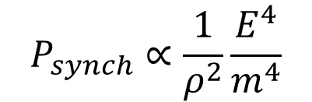
Context of the Muon Collider study
Muons are ~200 times heavier than electrons: energy losses from synchrotron radiation are negligible compared with electrons
$$P_{synch}∝\frac{1}{ρ^{2}}\frac{E^{4}}{m^{4}}$$
First mentioned in the 1960s (Tikhonin et Budker)
Between 2011-2016, US Muon Accelerator Program (MAP) studied a series of colliders at 1.5 TeV, 3 TeV and 6 TeV
In 2021, as part of the European R&D roadmap for accelerators and detectors, the International Muon Collider Collaboration (IMCC) was formed to study a muon collider at 3 TeV, followed by a collider at 10 TeV, with the MuCol European project following in 2023
In 2023 the US P5 recommended strong R&D to establish the feasibility of a 10 TeV muon collider. First US Muon Collider meeting took place on August 7th

Slide 3
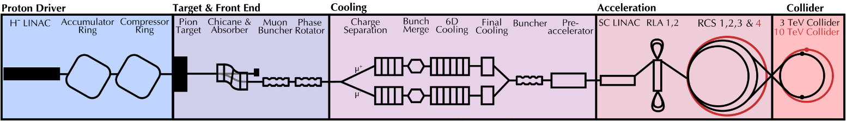
Overview of the Muon Collider complex
Picture from R. Taylor
High power proton beam: space-charge effects, coherent instabilities, beam break-up
Target materials, magnet shielding
Ionization cooling, integration of RF cavities inside solenoids
Fast acceleration of muon and anti-muons bunches, fast ramping magnets
Magnet shielding, machine detector interface, neutrino flux from muon decay
The Muon Collider design is driven by the muon decay $τ_{0}=2.2 μs$

Slide 4
Beam-Beam effects in the Muon Collider complex
Picture from R. Taylor
Operation with two bunches: one muon and one anti-muon
Repetition rate of 5 Hz for the whole complex
Single bunch intensity in the collider must be high to reach the target luminosity
  2.2·10¹² in the 3 TeV collider, 1.8·10¹² in the 10 TeV collider
Beam-beam effects are encountered in the Recirculating Linacs (RLA), the Rapid Cycling Synchrotrons (RCS) and the Collider
Detailed studies of coherent beam-beam effects have just started → this talk will mostly highlight identified study topics
Recirculating Linacs
Rapid Cycling Synchrotrons
Collider

Slide 5
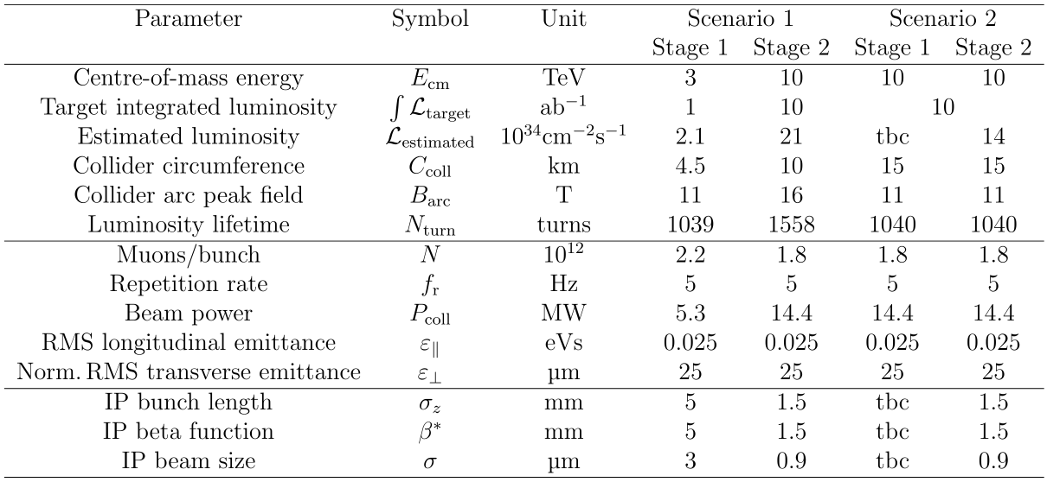
Luminosity target for the Collider
Two scenario variants:
Energy staging or Luminosity staging
Energy staging is the current focus of the study
From IMCC interim report (arXiv:2407.12450)

Slide 6
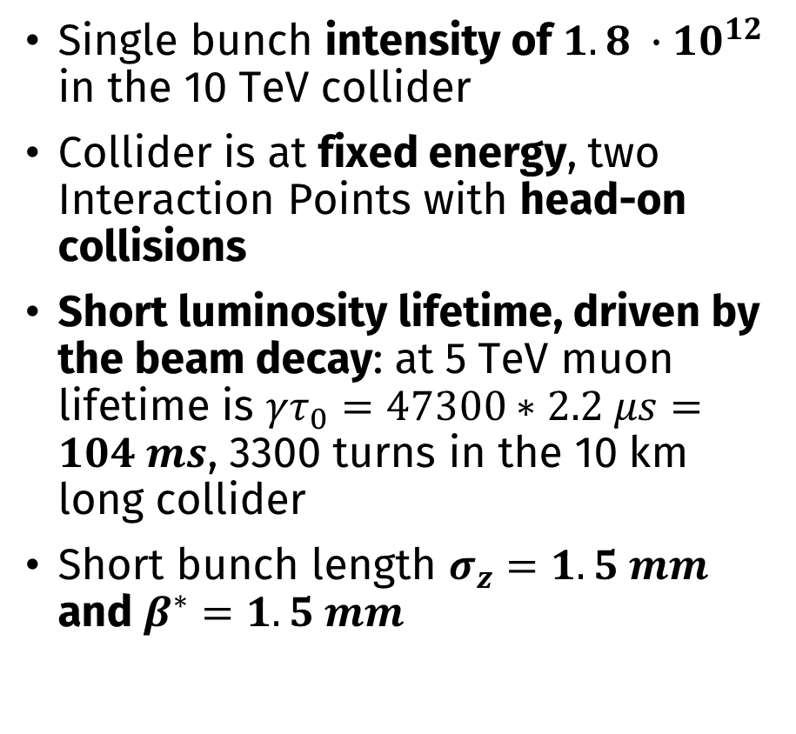
Luminosity target for the Collider
Single bunch intensity of $1.8 ∙{10}^{12}$ in the 10 TeV collider
Collider is at fixed energy, two Interaction Points with head-on collisions
Short luminosity lifetime, driven by the beam decay: at 5 TeV muon lifetime is $γτ_{0}=47300∗2.2 μs=104 ms$, 3300 turns in the 10 km long collider
Short bunch length $σ_{z}=1.5 mm$ and $β^{∗}=1.5 mm$
From IMCC interim report (arXiv:2407.12450)

Slide 7
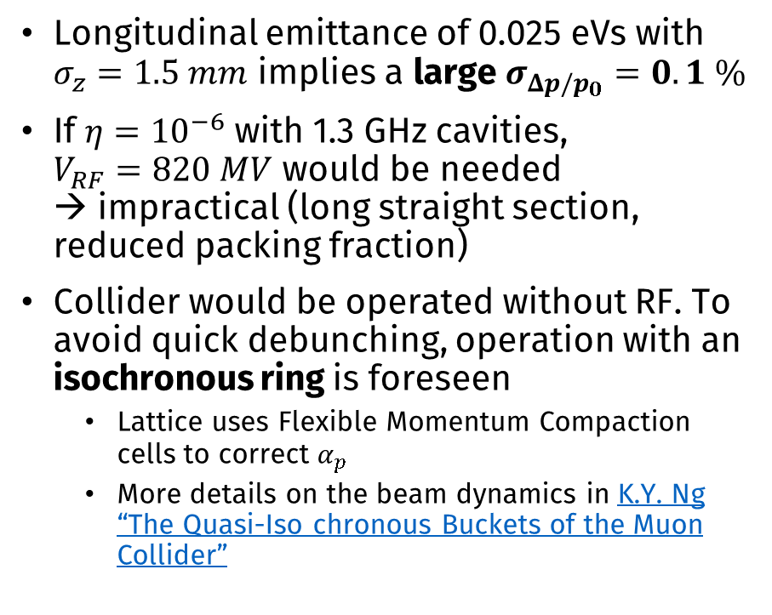
Beam dynamics challenges in the
Collider
Longitudinal emittance of 0.025 eVs with $σ_{z}=1.5 mm$ implies a large $σ_{Δp/p_{0}}=0.1 \%$
If $η={10}^{−6}$ with 1.3 GHz cavities,
$V_{RF}=820 MV$ would be needed
→ impractical (long straight section, reduced packing fraction)
Collider would be operated without RF. To avoid quick debunching, operation with an isochronous ring is foreseen
  Lattice uses Flexible Momentum Compaction cells to correct $α_{p}$
  More details on the beam dynamics in K.Y. Ng “The Quasi-Iso chronous Buckets of the Muon Collider”
From IMCC interim report (arXiv:2407.12450)

Slide 8
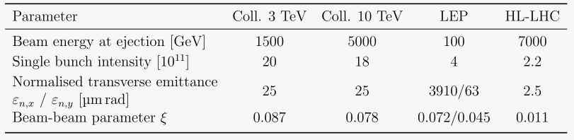
Beam-beam parameter in the
Collider
High bunch intensity at injection in the collider leads to large linear beam-beam parameter
But this will quickly reduce because of beam intensity decay

Slide 9
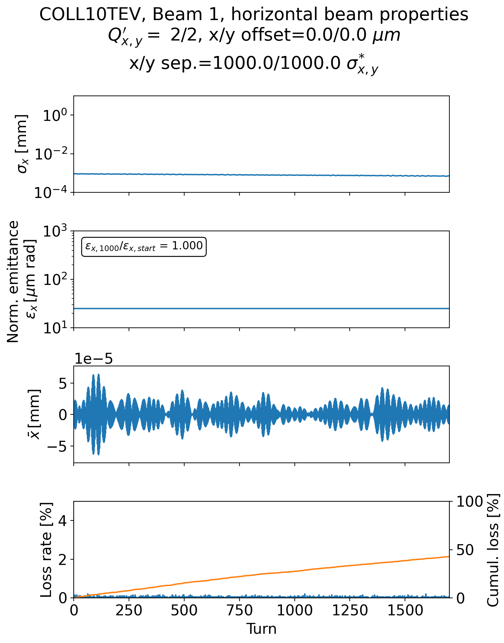
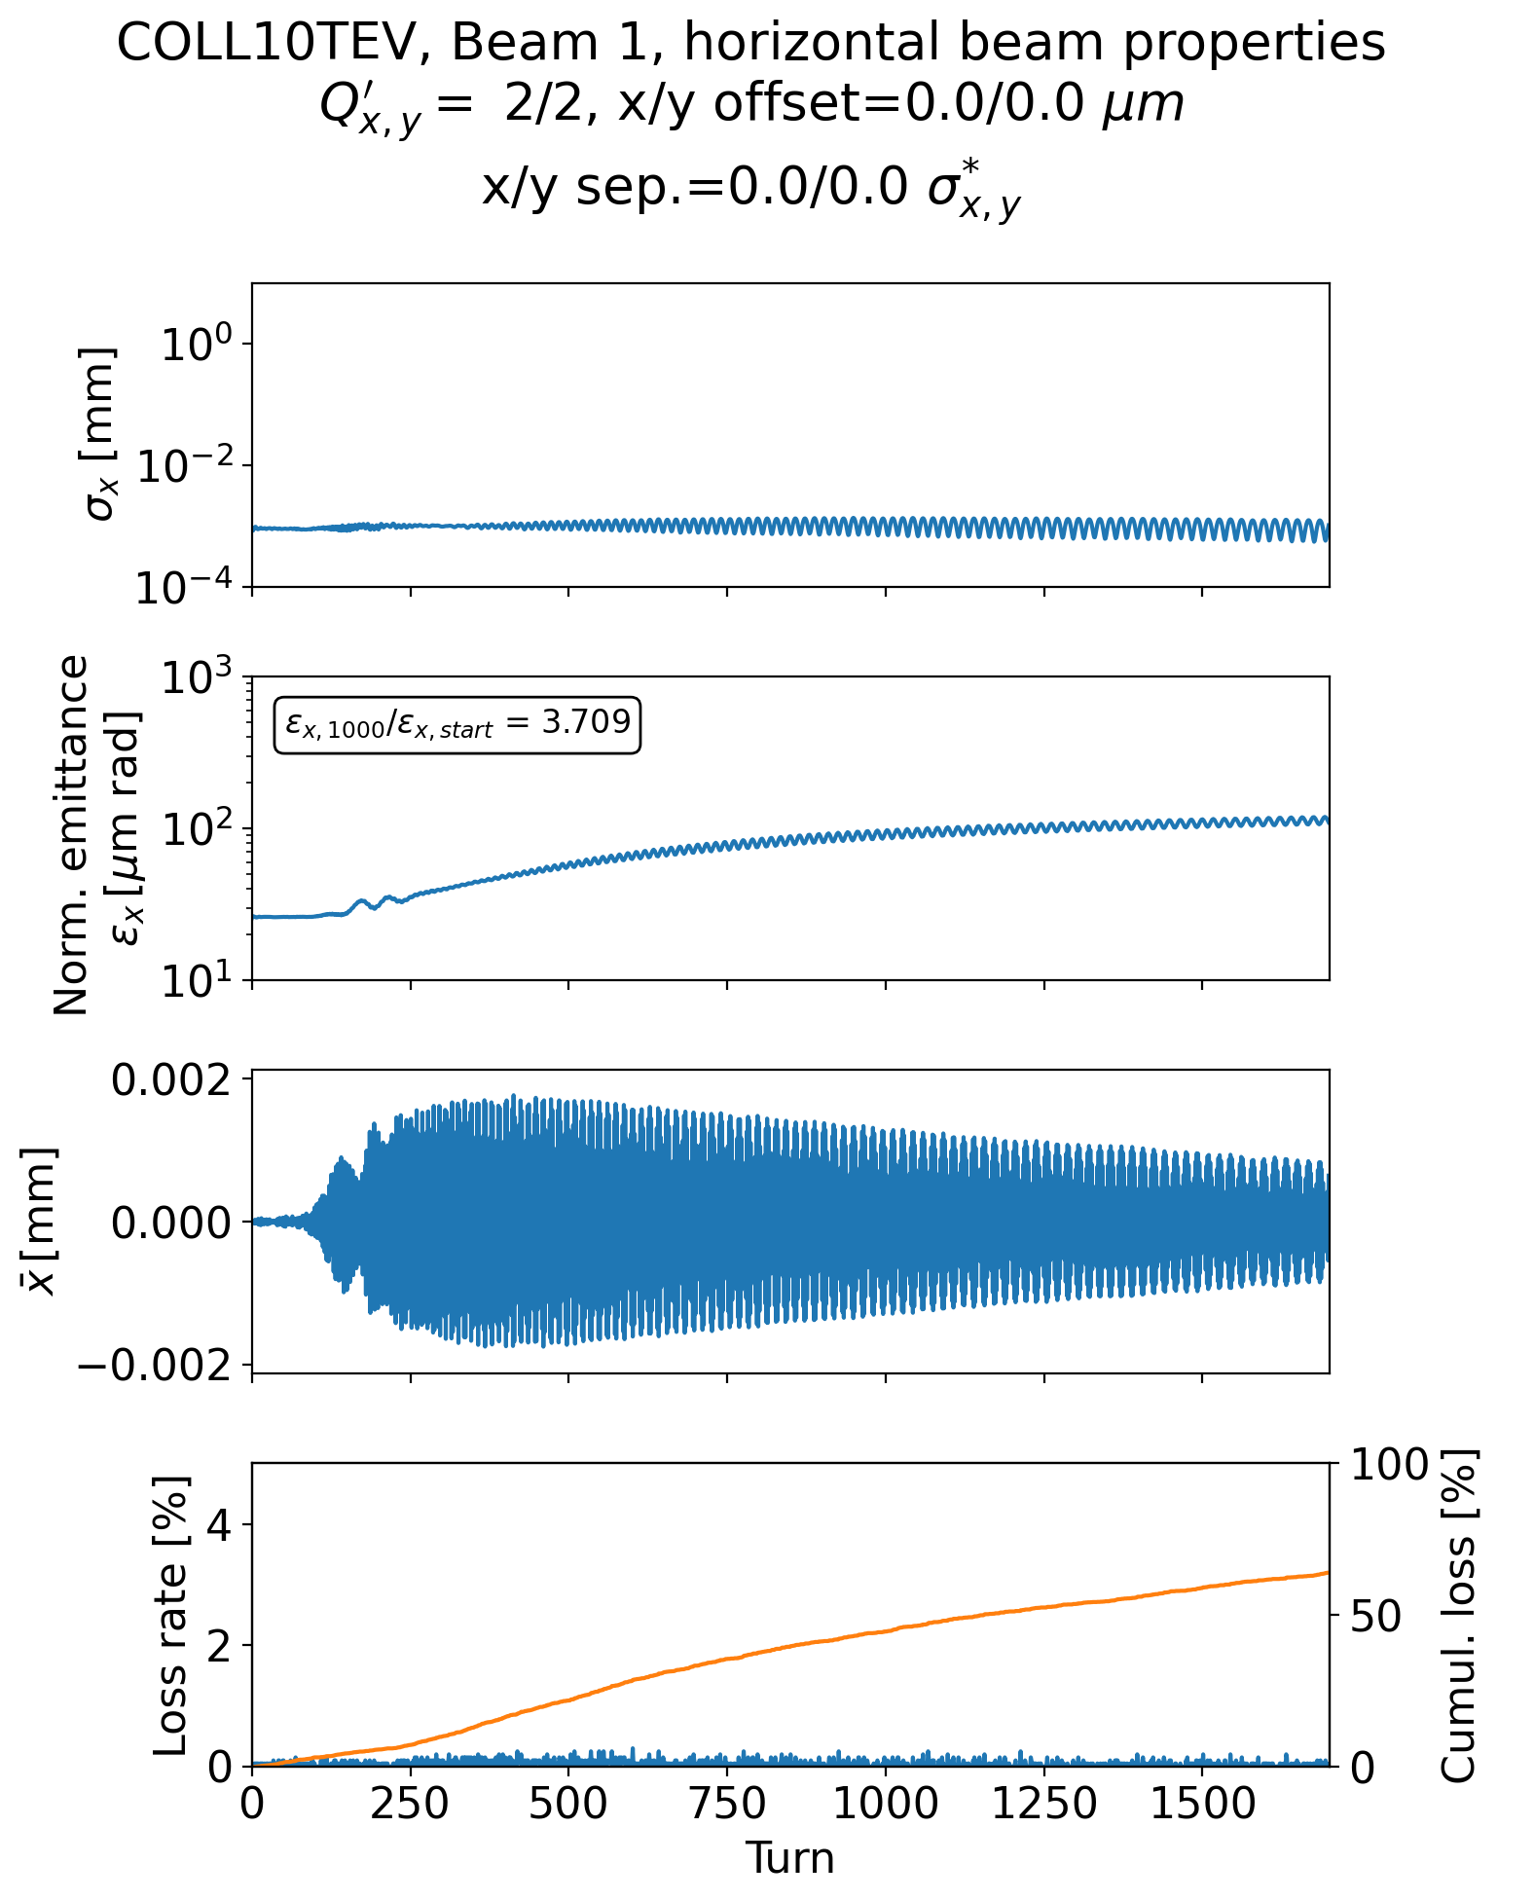
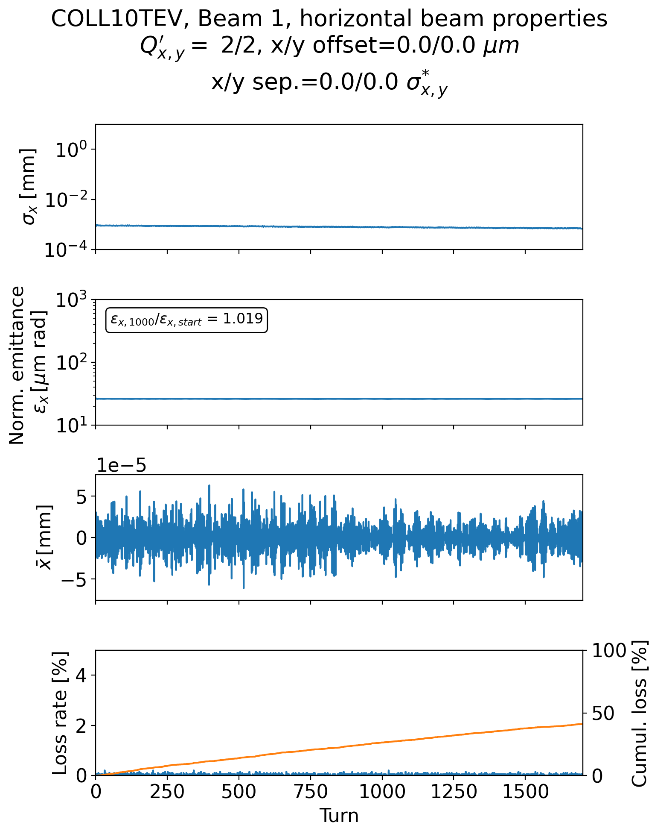
First coherent stability studies with beam-beam effects
First tracking simulation studies for the collider with Beam-Beam effects, using Xsuite (+PyHEADTAIL for wakefield) framework
Instability develops when beam-beam effects with two IPs are included
Adding a transverse damper mitigates the instability
Separated beams
With head-on collision
Adding a transverse damper

Slide 10
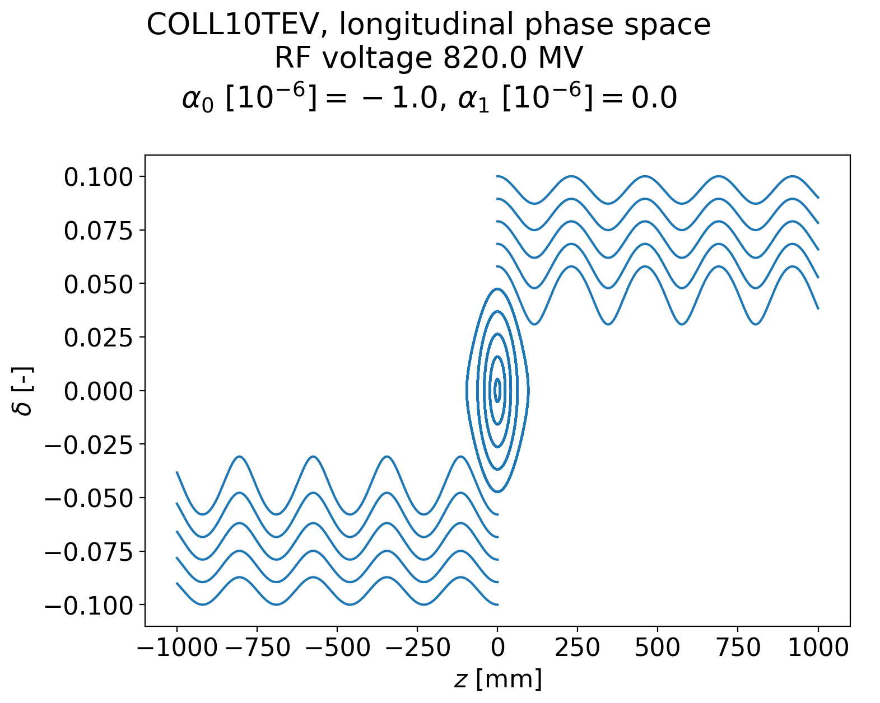
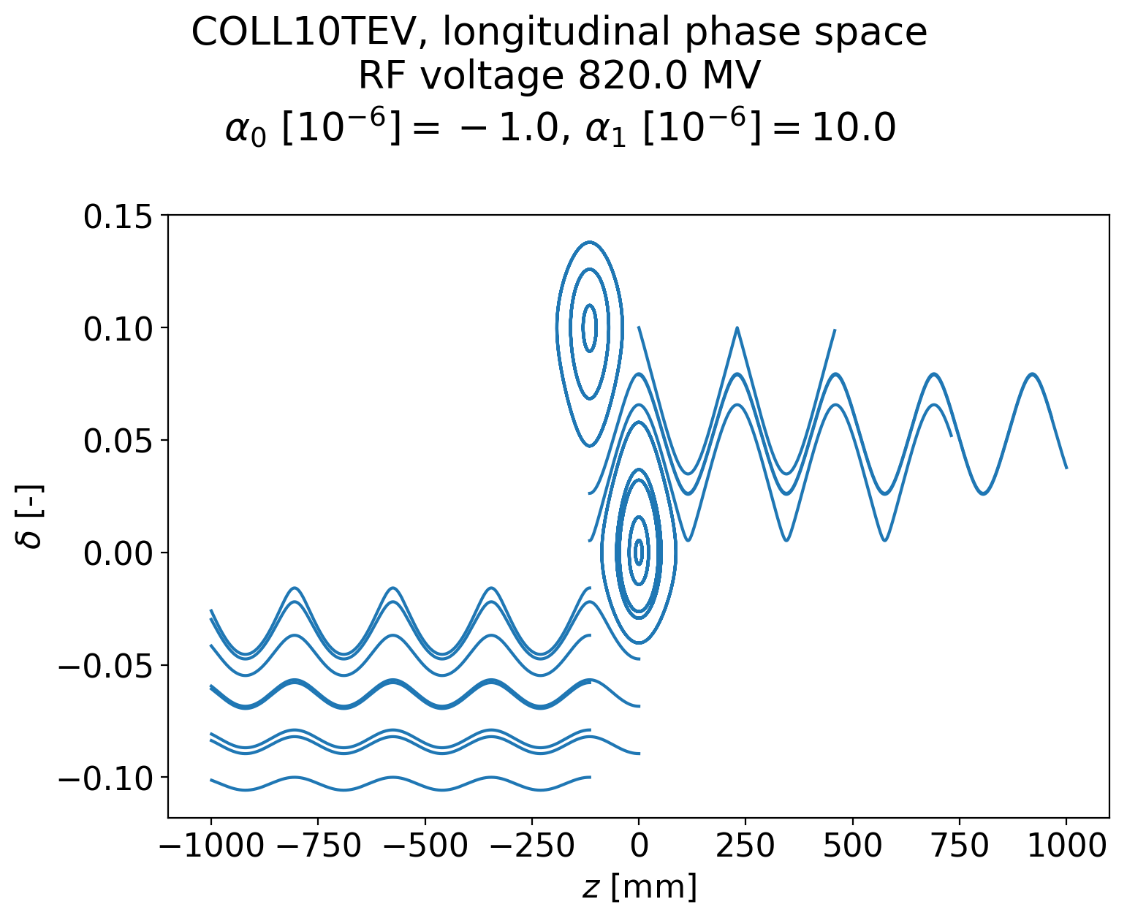
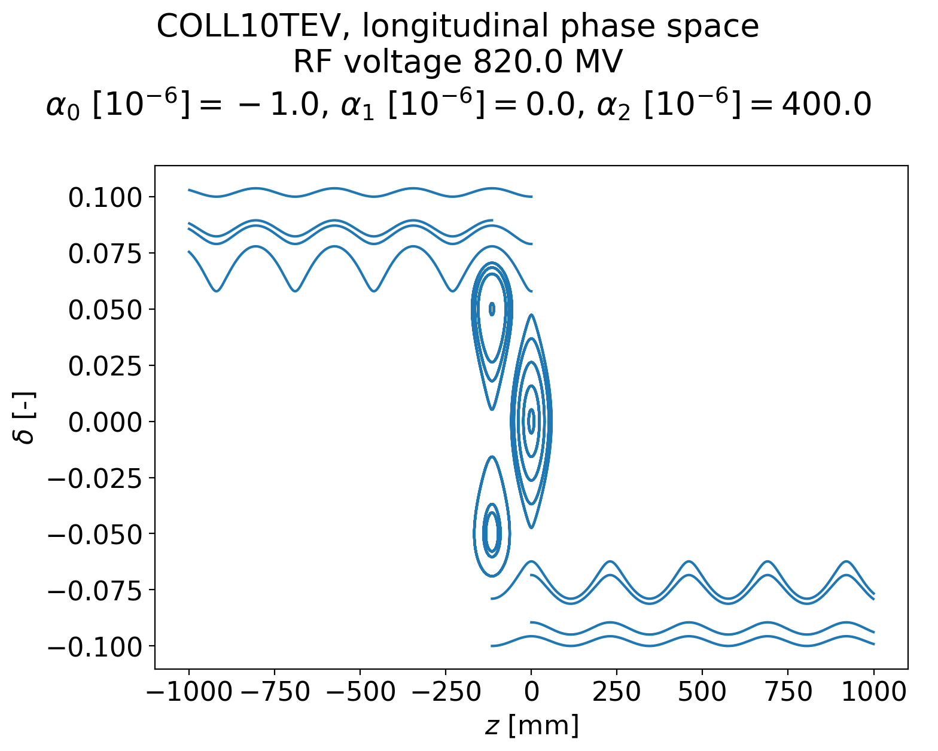
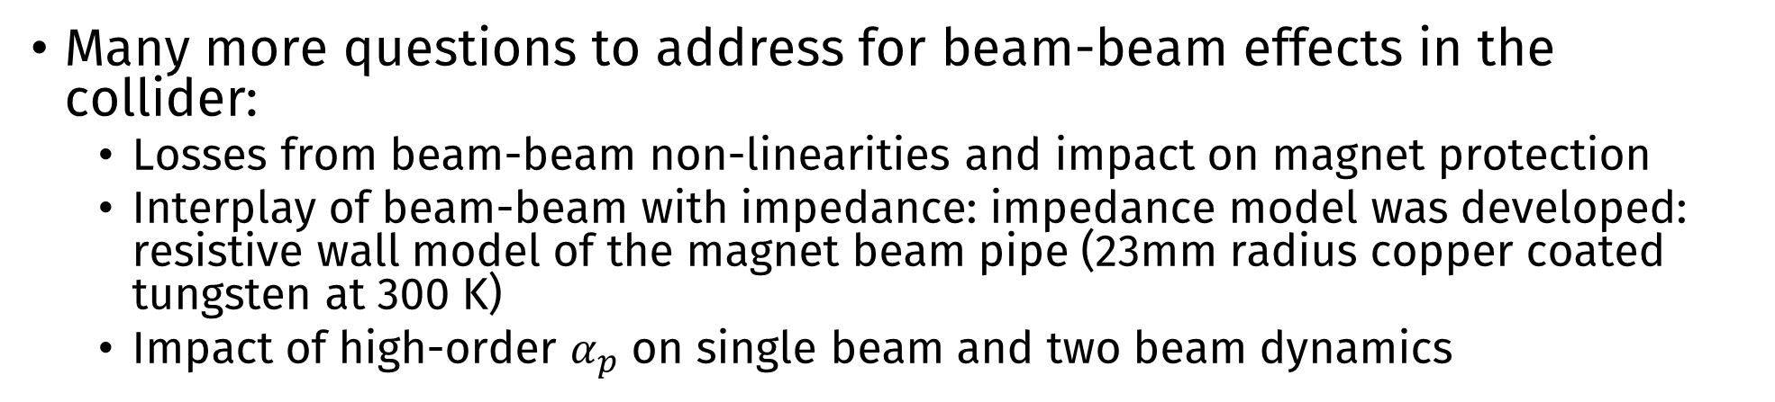
Luminosity target for the Collider
Many more questions to address for beam-beam effects in the collider:
  Losses from beam-beam non-linearities and impact on magnet protection
  Interplay of beam-beam with impedance: impedance model was developed: resistive wall model of the magnet beam pipe (23mm radius copper coated tungsten at 300 K)
  Impact of high-order $α_{p}$ on single beam and two beam dynamics
Example effect of higher order momentum compaction factor on RF bucket

Slide 11
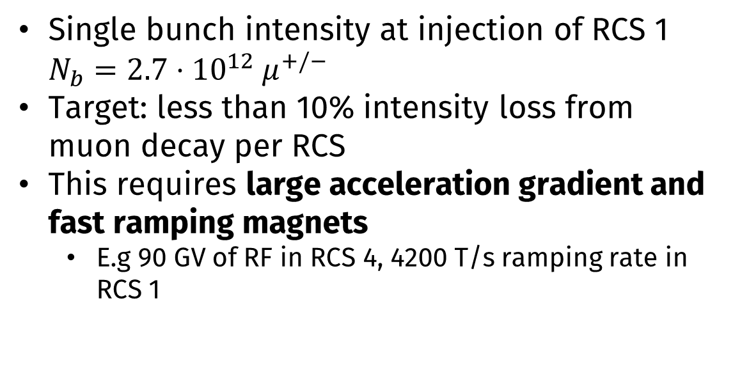
Beam Beam effects in the Rapid Cycling Synchrotrons (RCS)
Three RCS accelerate muons from 63 GeV to 1.5 TeV, a fourth RCS accelerates from 1.5 TeV to 5 TeV
Machine parameters | RCS 1 | RCS 2 | RCS 3 | RCS 4
Circumference [km] | 6 | 6 | 10.7 | 35
Injection energy [GeV] | 63 | 313.8 | 750 | 1500
Energy increase per turn [GeV] | 14.7 | 7.9 | 11.3 | 63.6
Number of turns | 17 | 55 | 66 | 55
Total RF voltage [GV] | 21 | 11 | 16 | 90
Bunch intensity at injection [10¹² muons] | 2.7 | 2.4 | 2.2 | 2.0
Single bunch intensity at injection of RCS 1 $N_{b}=2.7⋅{10}^{12} μ^{+/−}$
Target: less than 10% intensity loss from muon decay per RCS
This requires large acceleration gradient and fast ramping magnets
  E.g 90 GV of RF in RCS 4, 4200 T/s ramping rate in RCS 1
RCS 3
RCS1
RCS 2
Collider
10 TeV
RCS 4
63 GeV
313 GeV
750 GeV
1.5 TeV
5 TeV

Slide 12
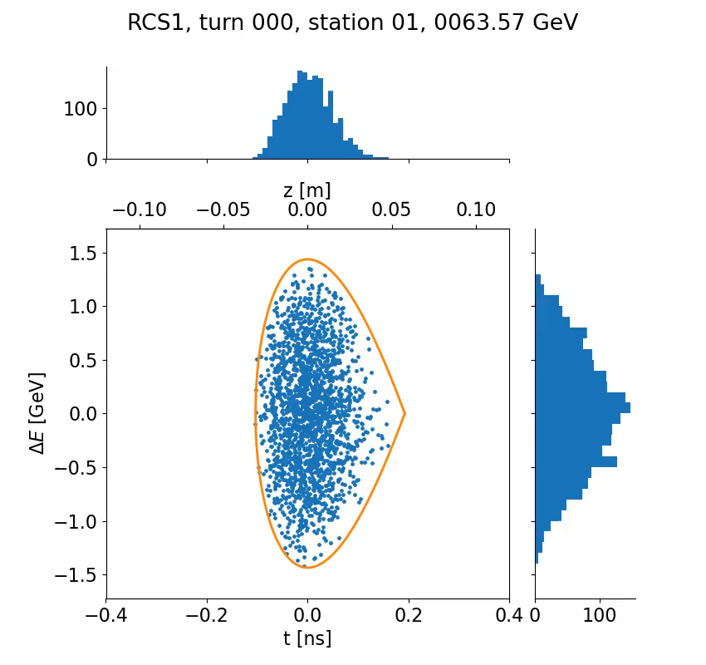
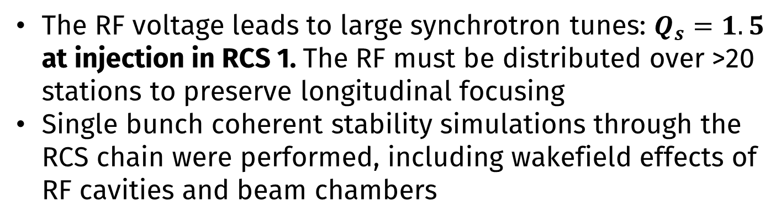
Beam Beam effects in the Rapid Cycling Synchrotrons (RCS)
The RF voltage leads to large synchrotron tunes: $Q_{s}=1.5$ at injection in RCS 1. The RF must be distributed over >20 stations to preserve longitudinal focusing
Single bunch coherent stability simulations through the RCS chain were performed, including wakefield effects of RF cavities and beam chambers

Slide 13
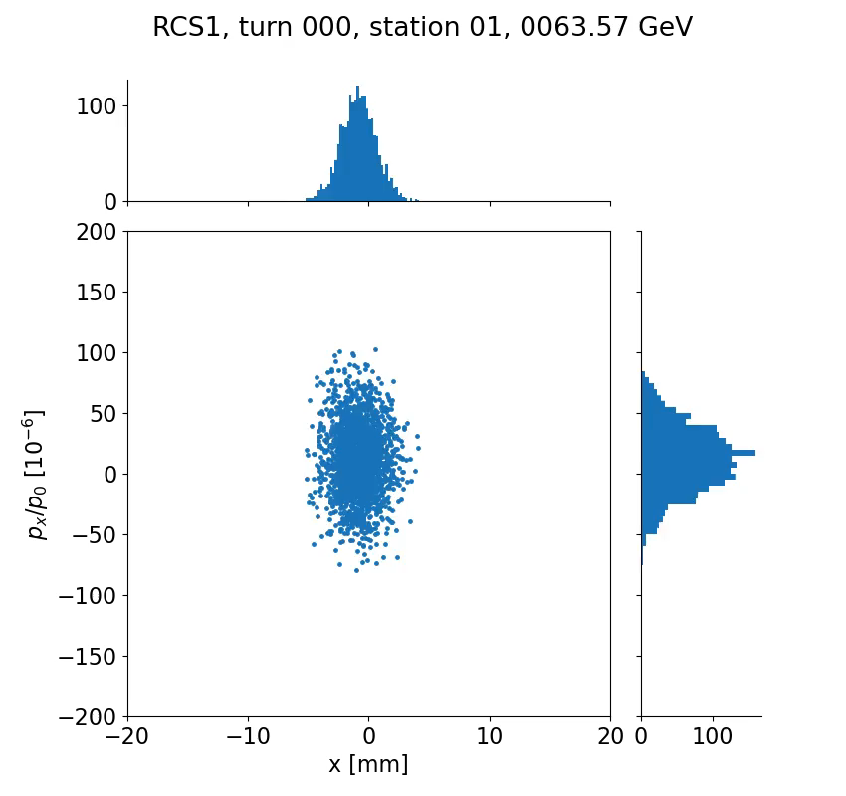
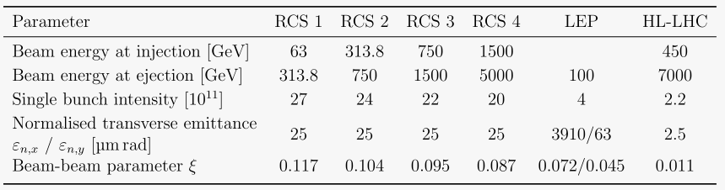
Beam Beam effects in the Rapid Cycling Synchrotrons (RCS)
Strong beam-beam effects to be expected because of the larger bunch intensity
But the beams stay only a short time in the RCS
Questions to investigate:
  Can we keep the head-on beam crossing?
  Do we need a separation scheme?

Slide 14
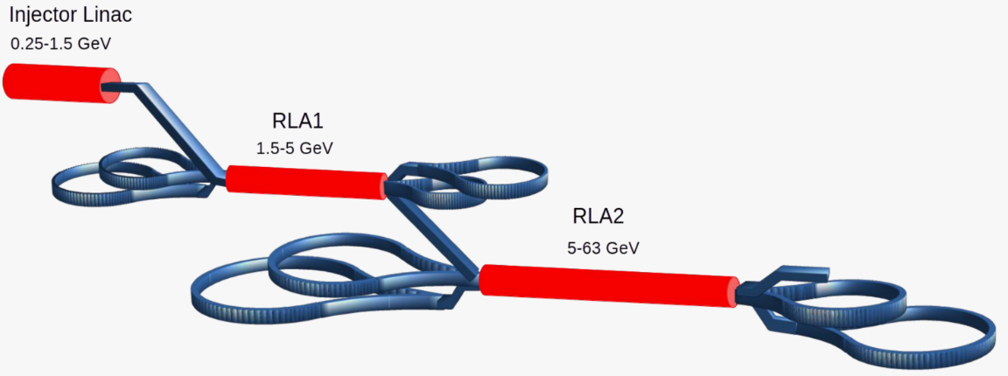
Beam Beam effects in the Recirculating Linacs (RLA)
From Avni Aksoy presentation
From Cooling
To RCS
Two five-pass Recirculating Linacs acceerate the beams from 250 MeV to 63 GeV before the RCS
Four crossing points in the droplet arcs, with different energies

Slide 15
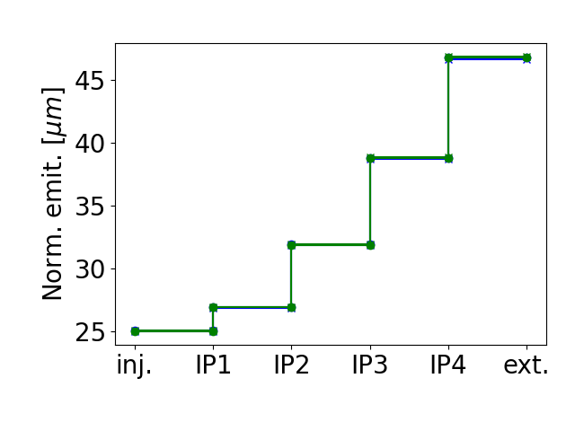
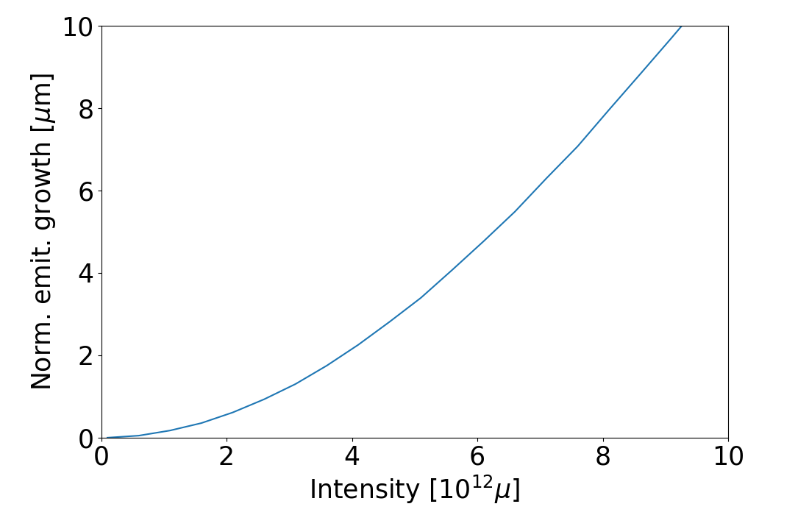
Beam Beam effects in the Recirculating Linacs (RLA)
Tracking with Xsuite, symmetric optics function (H/V and μ⁺/μ-) without dispersion and with a phase advance of 0 between the IPs
Semi-analytical prediction for round beams
Mitigations can be obtained by
  Optimizing the phase advances between IPs
  Increasing the beam size at the IP using dispersion, at the cost of synchrobetatron coupling
Study by Xavier Buffat (see Beam Dynamics meeting)

Slide 16
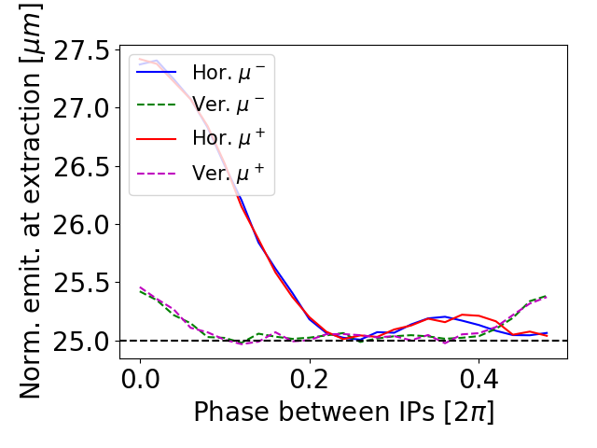
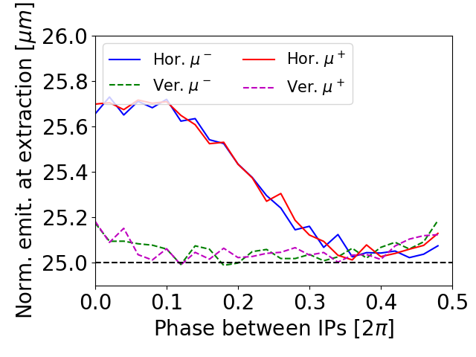
Beam Beam effects in the Recirculating Linacs (RLA)
Longitudinal phase advance: 0.0
Longitudinal phase advance: 0.1 [2π]
Introducing a dispersion of 1m at all IPs, the strength of the beam-beam force is greatly reduced due to the large horizontal beam size
With a proper choice of phase, the emittance growth can be reduced below the percent level
Due to the synchrobetatron coupling introduced, the optimal transverse
phases depend on the longitudinal phase
Study by Xavier Buffat (see Beam Dynamics meeting)

Slide 17
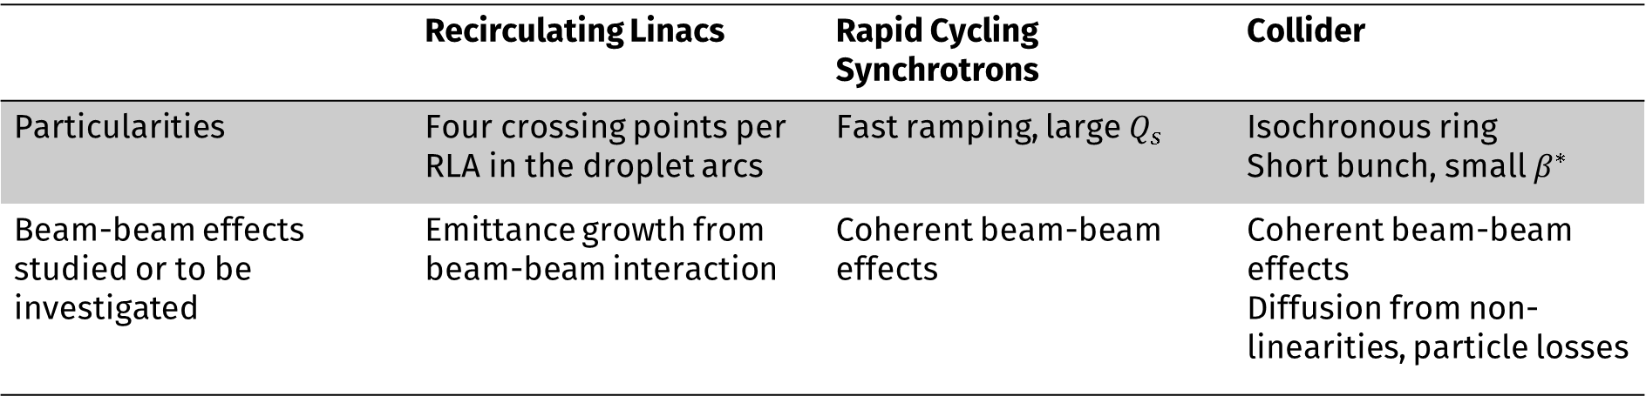
Conclusion
 | Recirculating Linacs | Rapid Cycling Synchrotrons | Collider
Particularities | Four crossing points per RLA in the droplet arcs | Fast ramping, large $Q_{s}$ | Isochronous ring Short bunch, small $β^{∗}$
Beam-beam effects studied or to be investigated | Emittance growth from beam-beam interaction | Coherent beam-beam effects | Coherent beam-beam effects Diffusion from non-linearities, particle losses
Variety of machines with different beam dynamics regime
High bunch intensity are required to reach luminosity target, leading to large beam-beam parameters
Beam-beam effects present in all the acceleration and collider chain, where emittance preservation is critical → many beam-beam effects still to investigate

Slide 18
Thank you!

Slide 19
Beam and machine parameters for the Collider
Machine parameters | Unit | Collider 10 TeV
Circumference | m | 10000
Bunch intensity | 10¹² | 1.8
Beam momentum | GeV/c | 5000.0
Energy increase per turn | GeV | 0
Rev. frequency | kHz | 30
RF frequency | MHz | 1300
Harmonic number | - | 43478
RF voltage | GV | 0
αp | - | 0.0
Avg. beta x/y | m | 85 / 51
Chromaticity Q’x/Q’y |  | Scan Q’x/Q’y=0
Detuning from octupoles x/y | m⁻¹ | 0 / 0
Beam parameters | Unit | Value
Bunch length 1σ | mm | 1.5
Bunch Δp/p0 1σ | - | 1e-3
Bunch intensity at inejction | Particles per bunch | 1.8e12
Longitudinal emittance εl = σzσE | MeV m | 7.5
Transverse emittance εx / εy | μm rad | 25
# of macropaticles | - | 200k
# of turns wakefield | - | 5
# of slices wakefield | - | 2000
Not relevant since RF voltage is set to zero

Slide 20
Beam and machine parameters for the RCS
Machine parameters | Unit | RCS 1 | RCS 2 | RCS 3 | RCS 4
Circumference | m | 5990 | 5990 | 10700 | 35000
Bunch intensity | 10¹² | 2.7 | 2.7 | 2.7 | 2.7
Beam momentum | GeV/c | 63 | 313.8 | 750 | 1500
Energy increase per turn | GeV | 14.7 | 7.9 | 11.3 | 63.6
Rev. frequency | kHz | 50 | 50 | 28 | 8.6
RF frequency | MHz | 1300 | 1300 | 1300 | 1300
Harmonic number |  | 25957 | 25957 | 46295 | 151433
RF voltage | GV | 20.9 | 11.22 | 16.1 | 90.0
αp |  | 0.0024 | 0.0024 | 0.001 | 0.001
Avg. beta x/y | m | 50 / 50 | 50 / 50 | 50 / 50 | 50 / 50
Chromaticity Q’x/Q’y |  | scan | scan | scan | scan
Detuning from octupoles x/y | m⁻¹ | 0 / 0 | 0 / 0 | 0 / 0 | 0 / 0
Beam parameters | Unit | Value
Bunch length 1σ | mm | 5.7
Bunch intensity | Particles per bunch | 2.7e12
εx / εy | μm rad | 25
# of macropaticles |  | 400k
# of turns wakefield |  | 5
# of slices wakefield |  | 2000
Parameters from F. Batsch RCS tables

