Slide 1


Beam-beam dynamics with strong hourglass effect
Lei Wang, wangl@impcas.ac.cn
Accelerator Physics Group
Institute of Modern Physics, Chinese Academy of Sciences
ICFA mini workshop Beam-Beam Effects in Circular Colliders, Sep. 2-5, EPFL, Lausanne
Notes:
Good morning, everyone. My name is Lei Wang, I come from Institute of Modern Physics. My talk will focus on the beam-beam dynamics with strong hourglass effect.

Slide 2


Outline
Hourglass effect in EicC
Simulation model
Head-tail instability of asymmetric colliding beams
Numerical observations
Key parameter scans and instability mechanism
Mitigation methods
Float waist collision scheme
Compensation principles of the hourglass effect
Numerical proofs and application to the head-tail instability
Summary
Notes:
First, I will give a brief introduction to the hourglass effect in EicC.

Slide 3
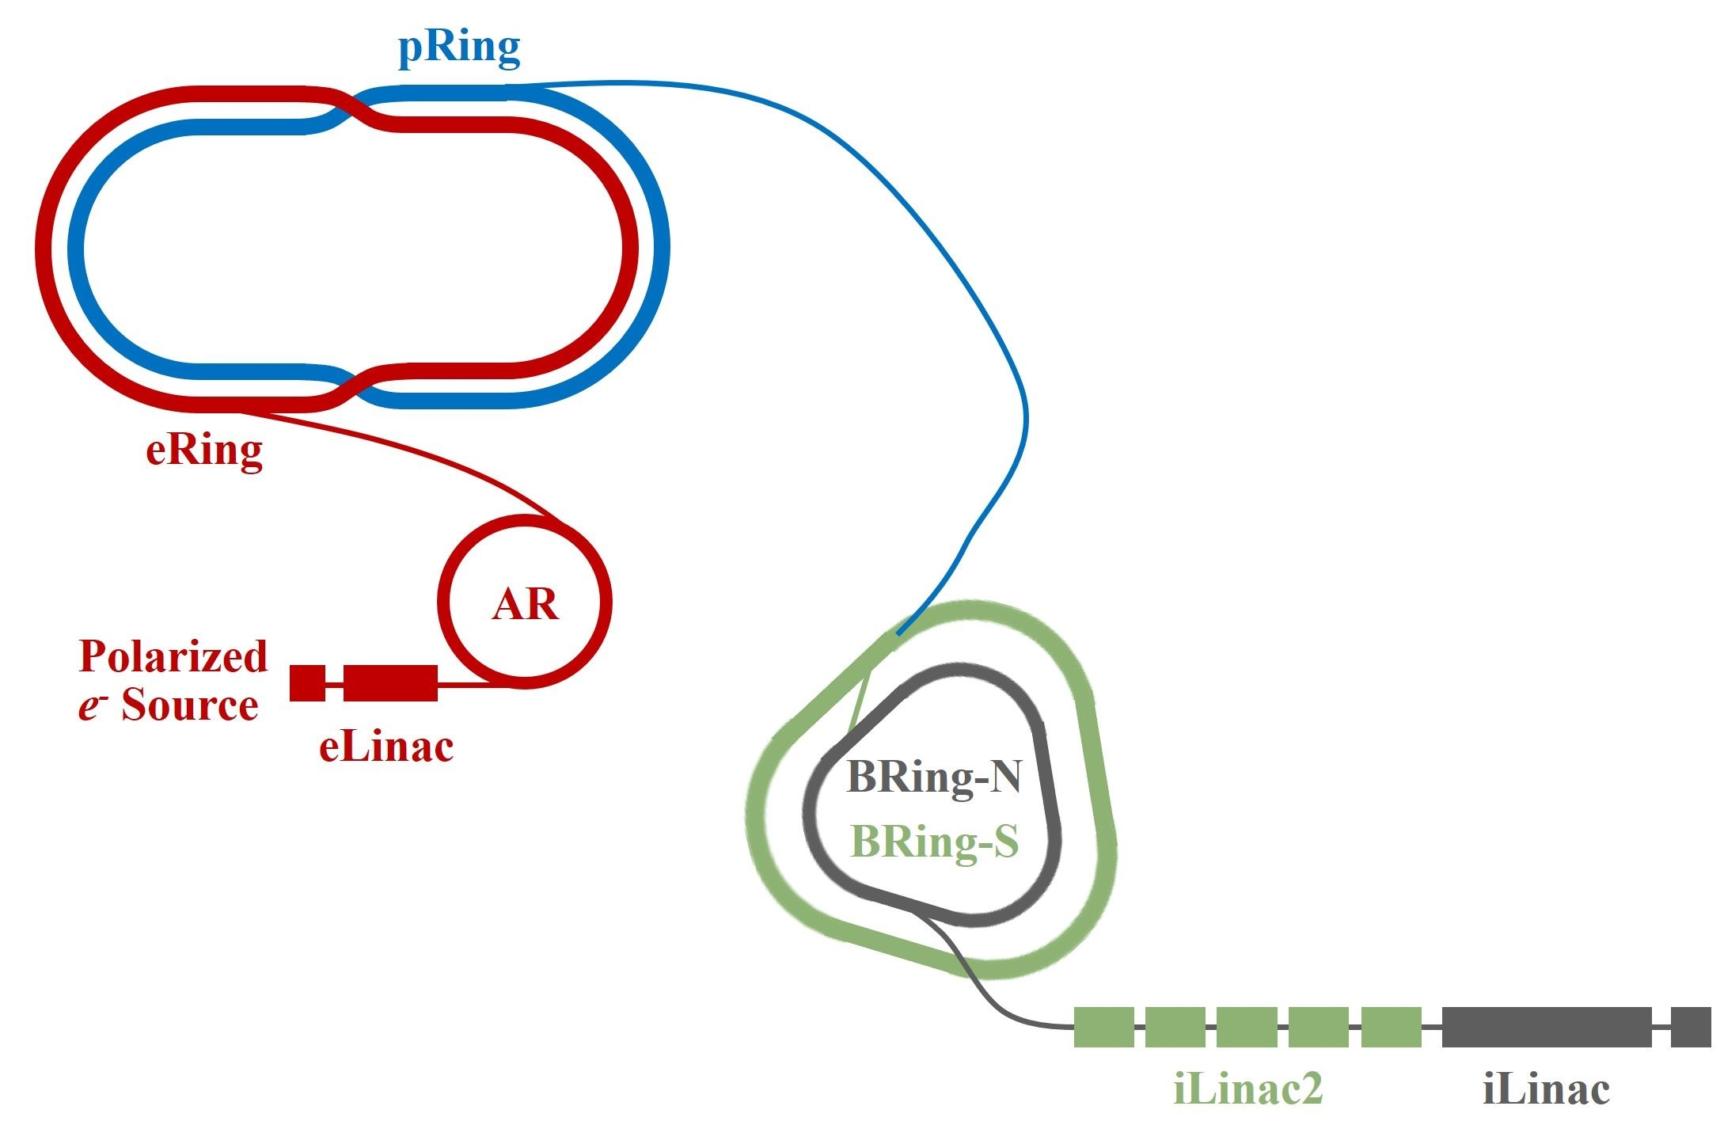
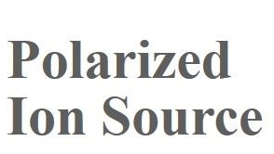
1. Introduction of EicC accelerators
Electron-Ion Collider in China
Collisions of electrons with a large range of light to heavy ion beams in the medium energy region.
Center-of-mass energy is between 12~23 GeV at specific points for electron-proton collisions.
With e@3.5 GeV and p@19.08 GeV (CM energy 16.67 GeV), peak luminosity is (2~4)×10³³ cm⁻²s⁻¹.
High luminosity, high polarization
Quasi-full acceptance for reaction product detections
Rapid cycling operation mode and swap-out injection
HIAF & HIAF-U
Layout of EicC accelerator complex
More details in Jie Liu’s talk.
Notes:
The Electron Ion Collider in China project is proposed by IMP. This figure gives the layout of the EicC complex.
EicC project allows collisions of electrons with a wide range of heavy ions in the medium energy region. At the optimized energy point, the peak luminosity is two to four times ten to thirty-three.
The design target of EicC is to achieve high luminosity and high polarization collisions with quasi-full acceptance for reaction product detections.
The details of the EicC accelerator design have been introduced by my colleague Jie Liu.

Slide 4
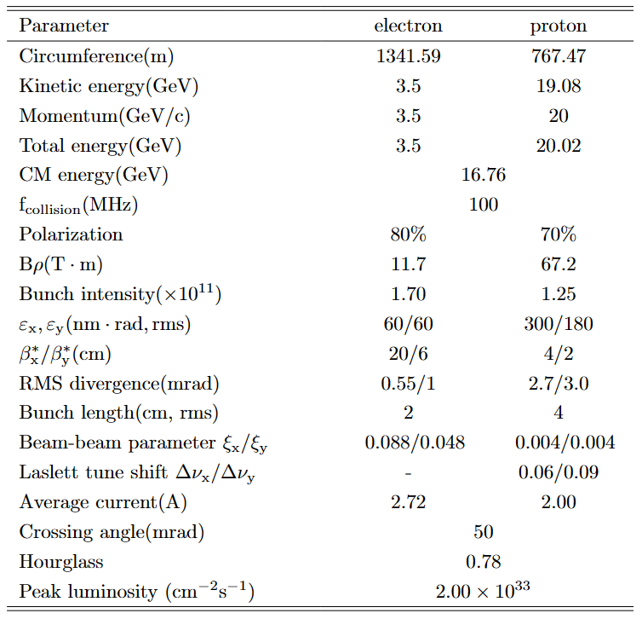
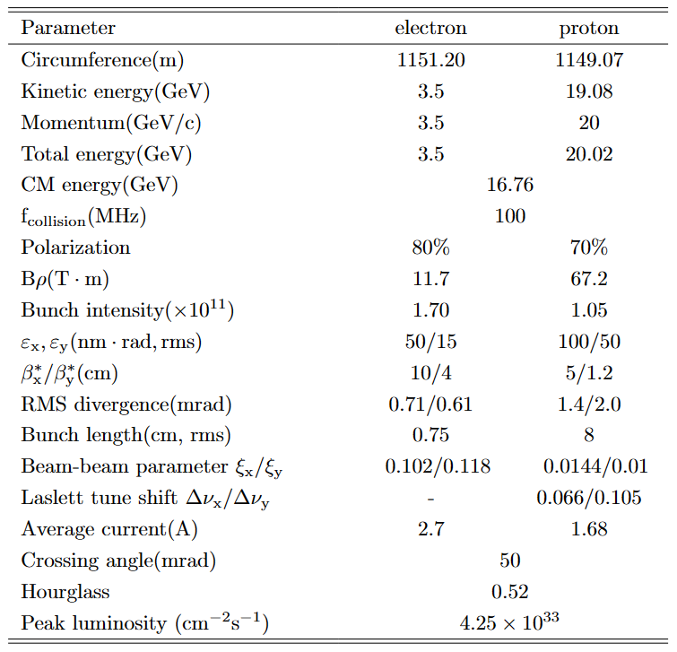
1. Introduction of EicC accelerators
Old parameters
New parameters
Both designs adopt asymmetric beam parameters and feature very strong hourglass effects.
Notes:
Up to now, there have been two designs, based on the HIAF project and the HIAF-U project, respectively.
In both designs, we adopt asymmetric beam parameters, and the proton bunch length is larger than its beta star, so that the hourglass effect will be very severe.

Slide 5
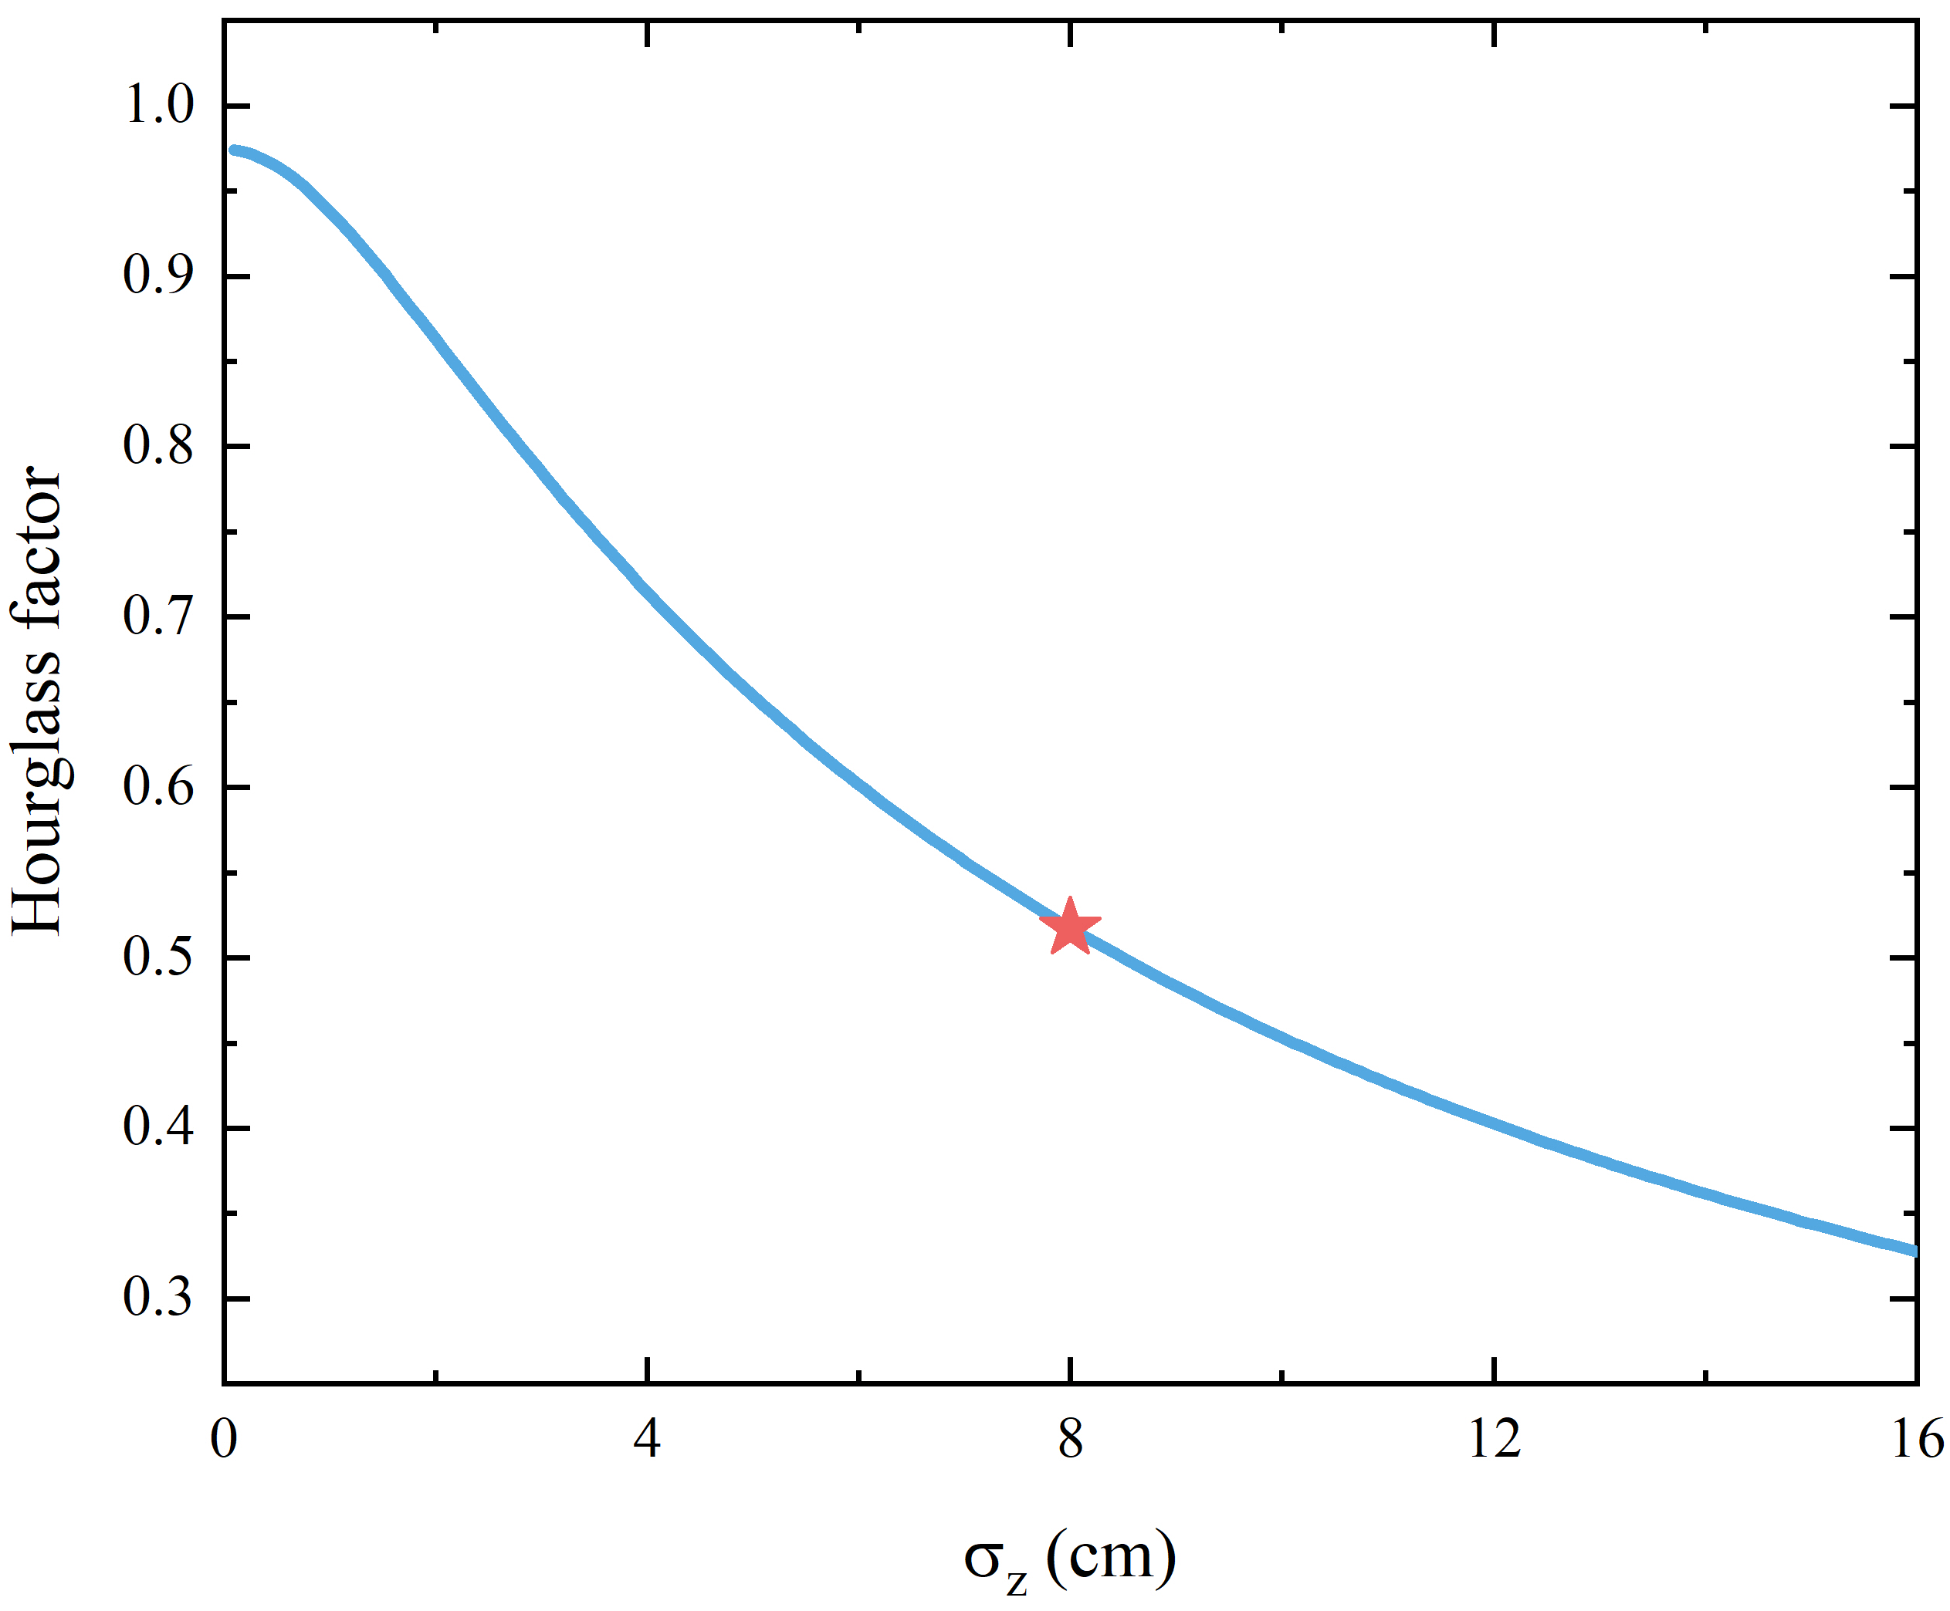
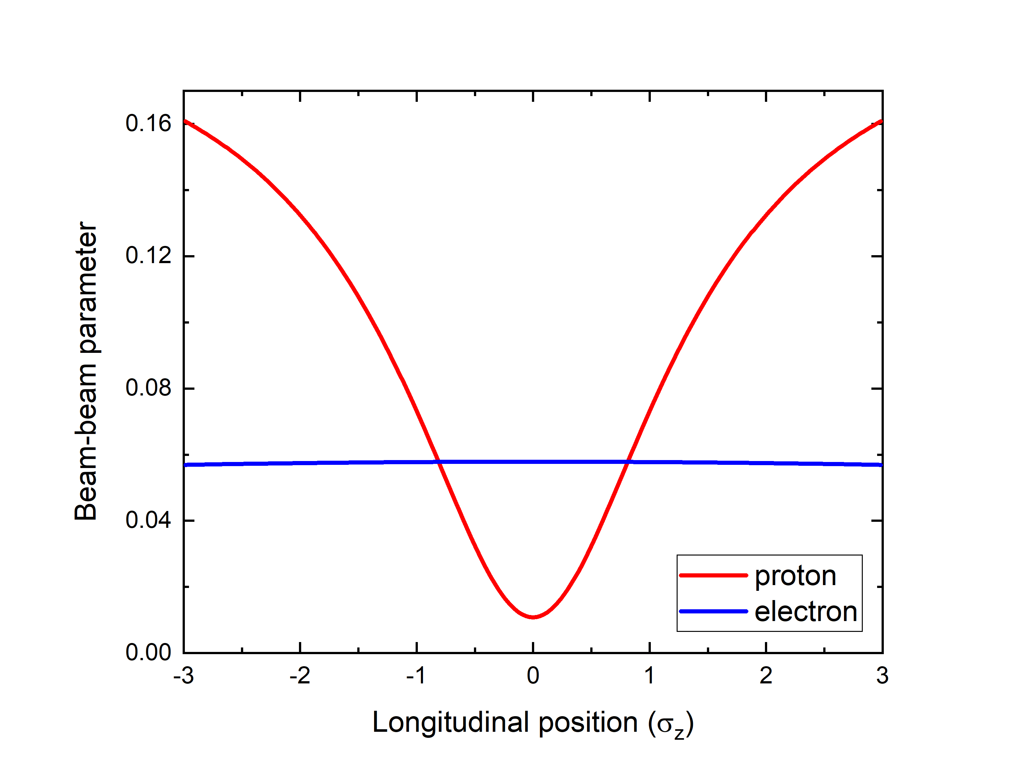
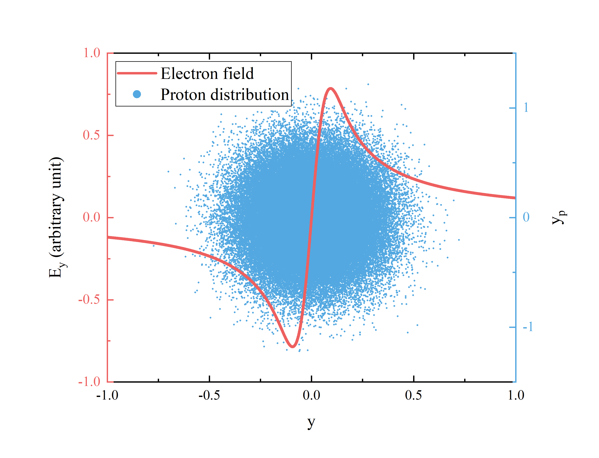
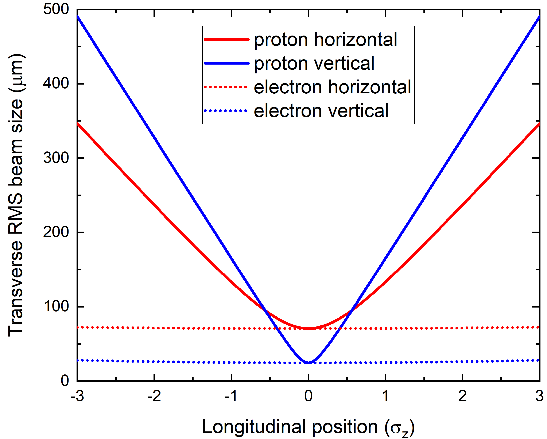
1. Hourglass effect in EicC
Geometric effect: Hourglass effect will lead to beam sizes growth, lower beam density and therefore cause peak luminosity reduction.
Dynamic effect: Beam size mismatch will induce a very strong modulation of proton beam-beam parameters, interplay with transverse wakefield? Most protons will see the nonlinear part of electron beam-beam forces, excite resonances?
Intra-bunch motion is strongly modulated
EicC
H=0.52 @ 4.25×10³³ cm⁻²s⁻¹
Collision at 1σ_{z}
Notes:
The hourglass effect will cause twofold problems in EicC.
First one is the geometric effect. Hourglass effect will lead to beam sizes growth, lowers the beam density and therefore the peak luminosity. With the luminosity of 4.25 times ten to thirty-three, the hourglass factor is 0.52. Almost half of the luminosity is lost.
Second one is the dynamic effect. The beam size mismatch induces a very strong modulation of the proton beam-beam parameter, as shown in the middle figure, so that the intra-bunch motion will be strongly modulated. At this moment, the interplay with the transverse wakefield may become very important.
Besides, most protons will see the nonlinear part of electron beam-beam forces, as shown in the right figure. So, there must be a lot of resonances affecting the luminosity lifetime.

Slide 6
Outline
Hourglass effect in EicC
Simulation model
Head-tail instability of asymmetric colliding beams
Numerical observations
Key parameter scans and instability mechanism
Mitigation methods
Float waist collision scheme
Compensation principles of the hourglass effect
Numerical proofs and application to the head-tail instability
Summary
Notes:
Next, I will introduce the simulation code and model used for beam-beam dynamics and related studies.

Slide 7
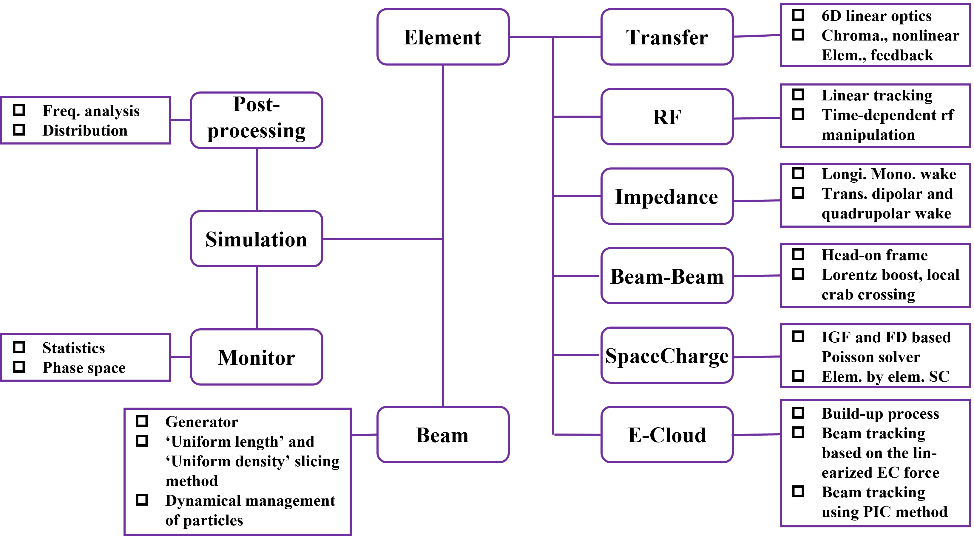
2. GOAT code and numerical model
Developed for interplays of multiple high-intensity single-bunch beam dynamics, including beam-beam, impedance, electron-cloud, and space charge.
Upgrade to GPU version for better performance, extension to cover multi-bunch dynamics are in progress.
Wakefield is lumped at the IP and kicks are applied to the particles once per turn
Arbitrary impedance model
Only strong-strong model, slice-by-slice collisions for hourglass effect, integrated Green function and linear interpolation methods for beam-beam potential
Particles are transferred from IP to IP using 6D linear matrix
Notes:
To study the beam-beam dynamics and possible interplay with other effects, such as impedance, electron-cloud, and space charge. We developed a simulation code GOAT.
This figure shows the framework of the code. For impedance effects, the wakefield is lumped at the IP and kicks are applied to beam particles once per turn.
For beam-beam interactions, the strong-strong model is adopted. The collision is proceeded slice-by-slice to take into account the hourglass effect.
And integrated Green function and linear interpolation are used for beam-beam potential calculations.

Slide 8
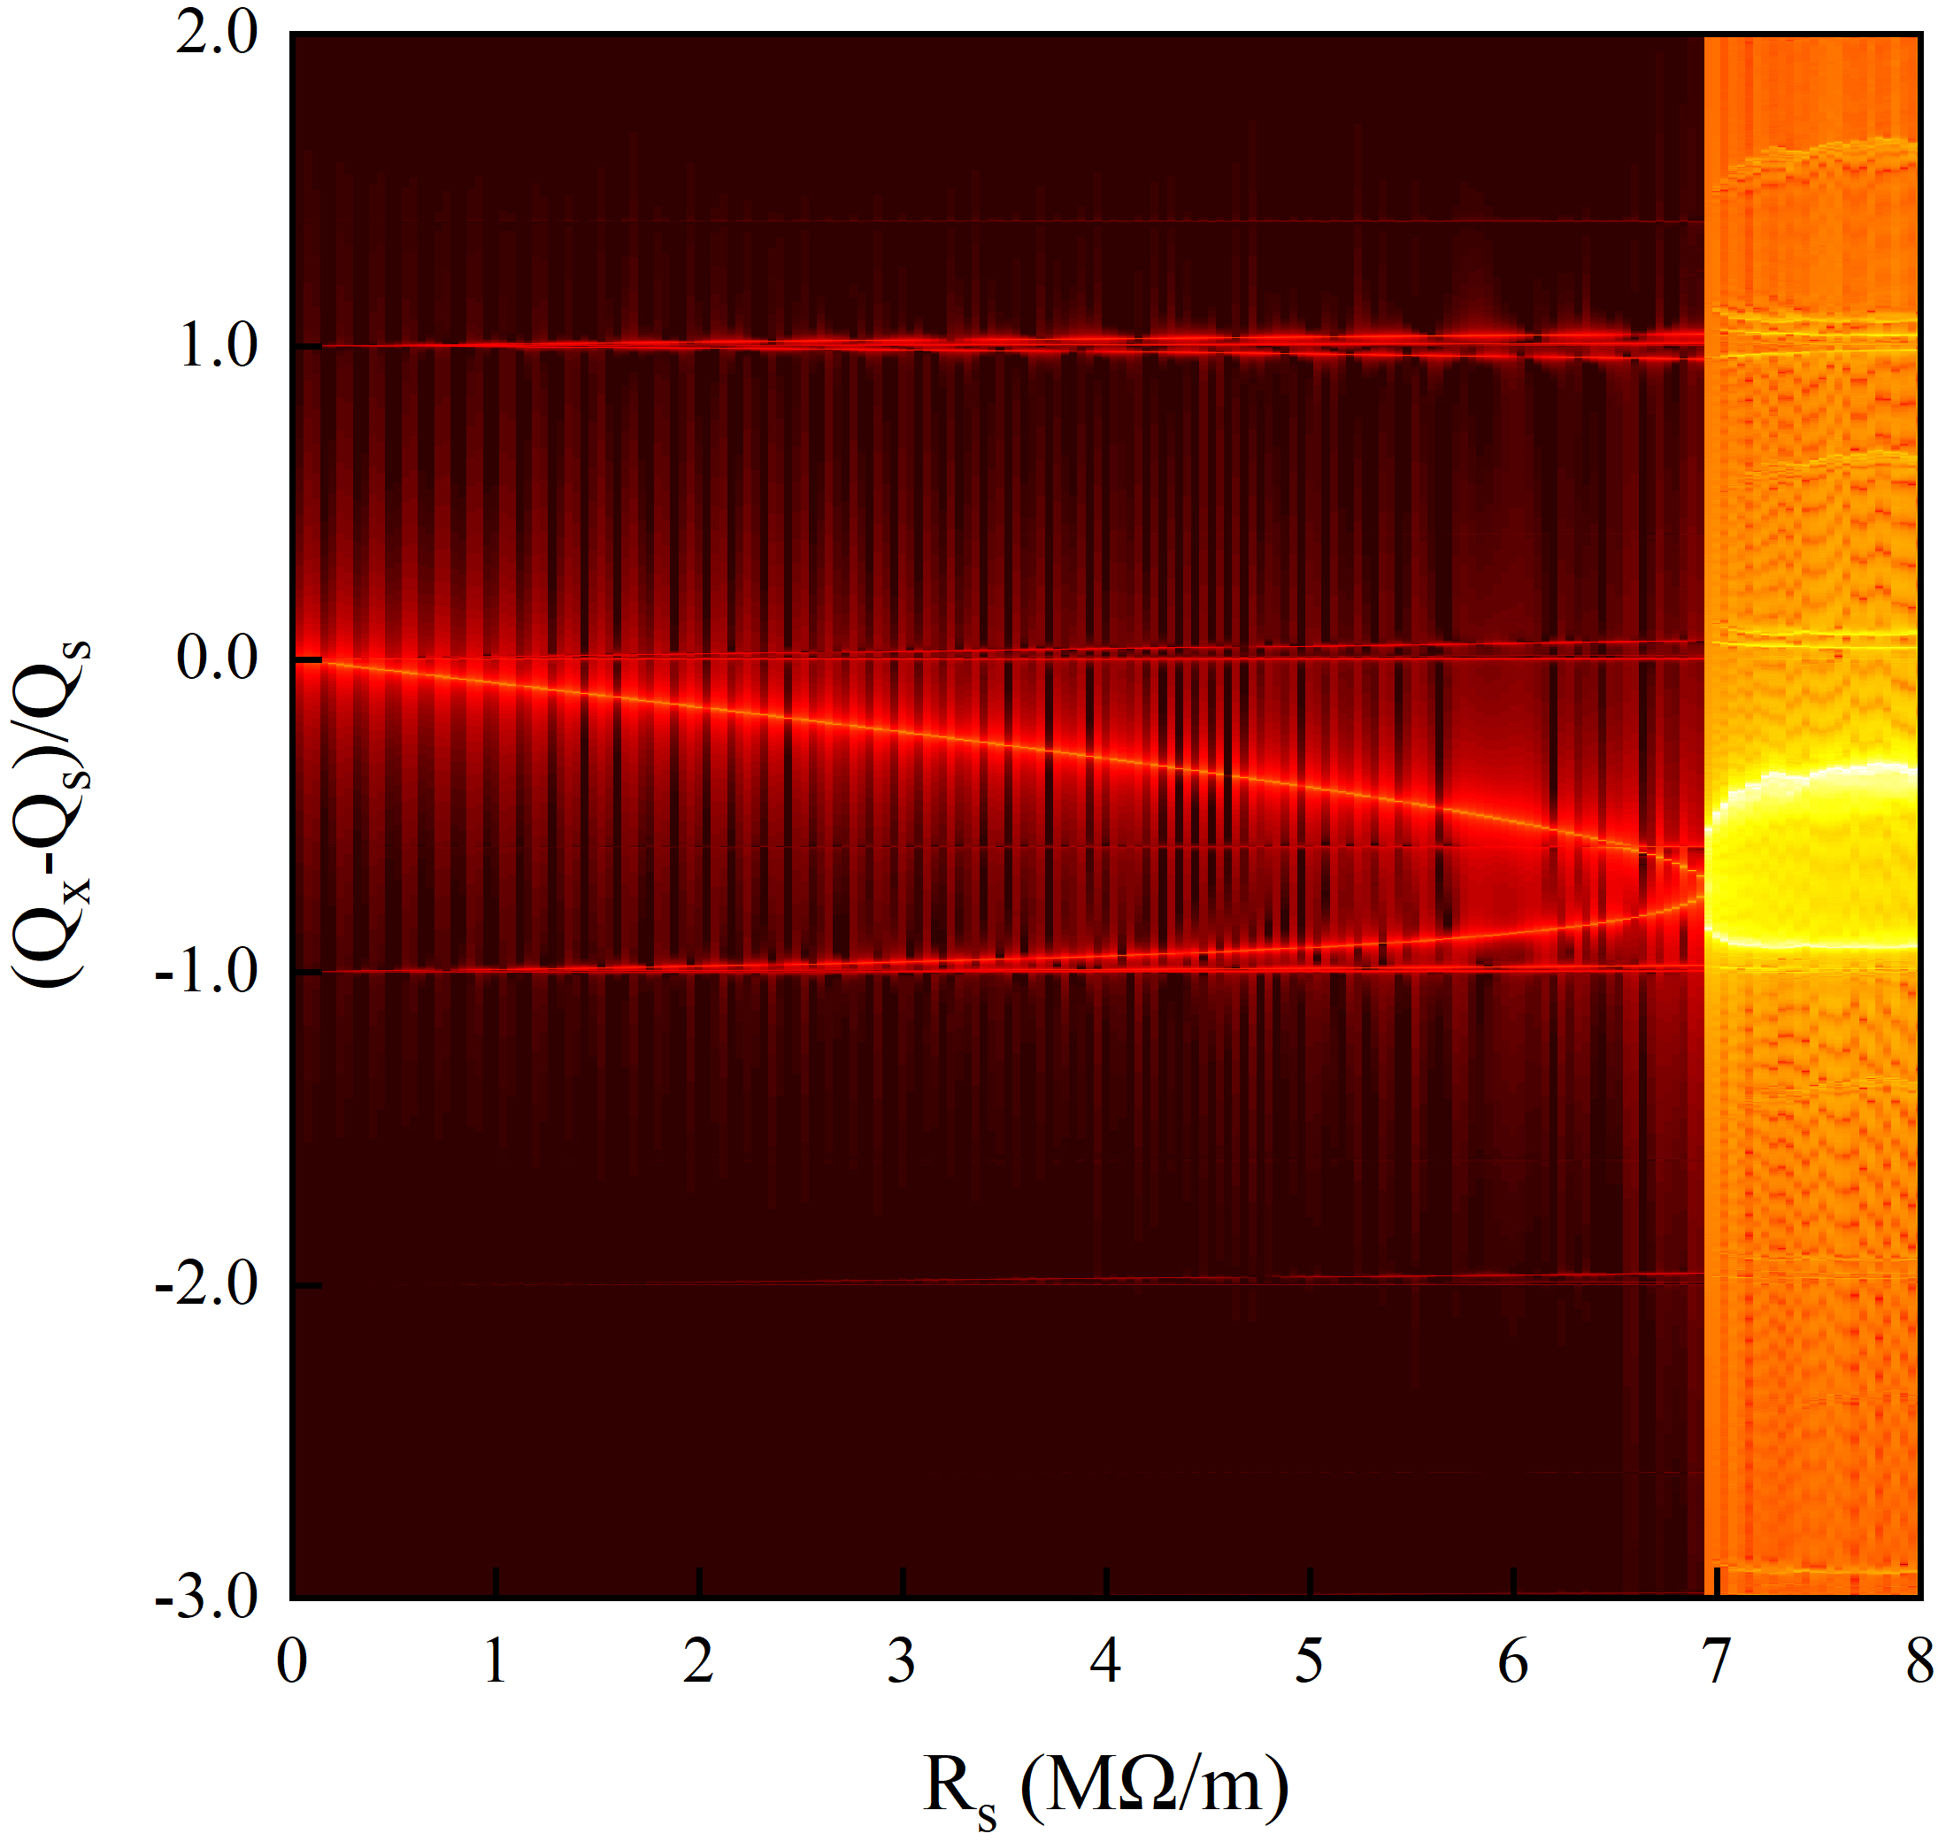
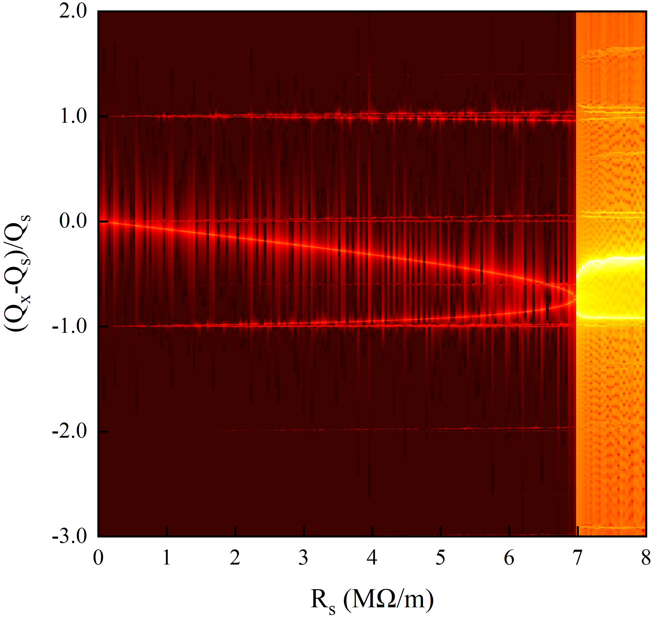
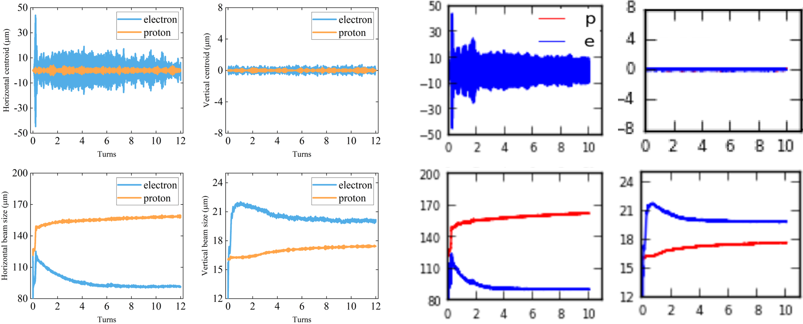
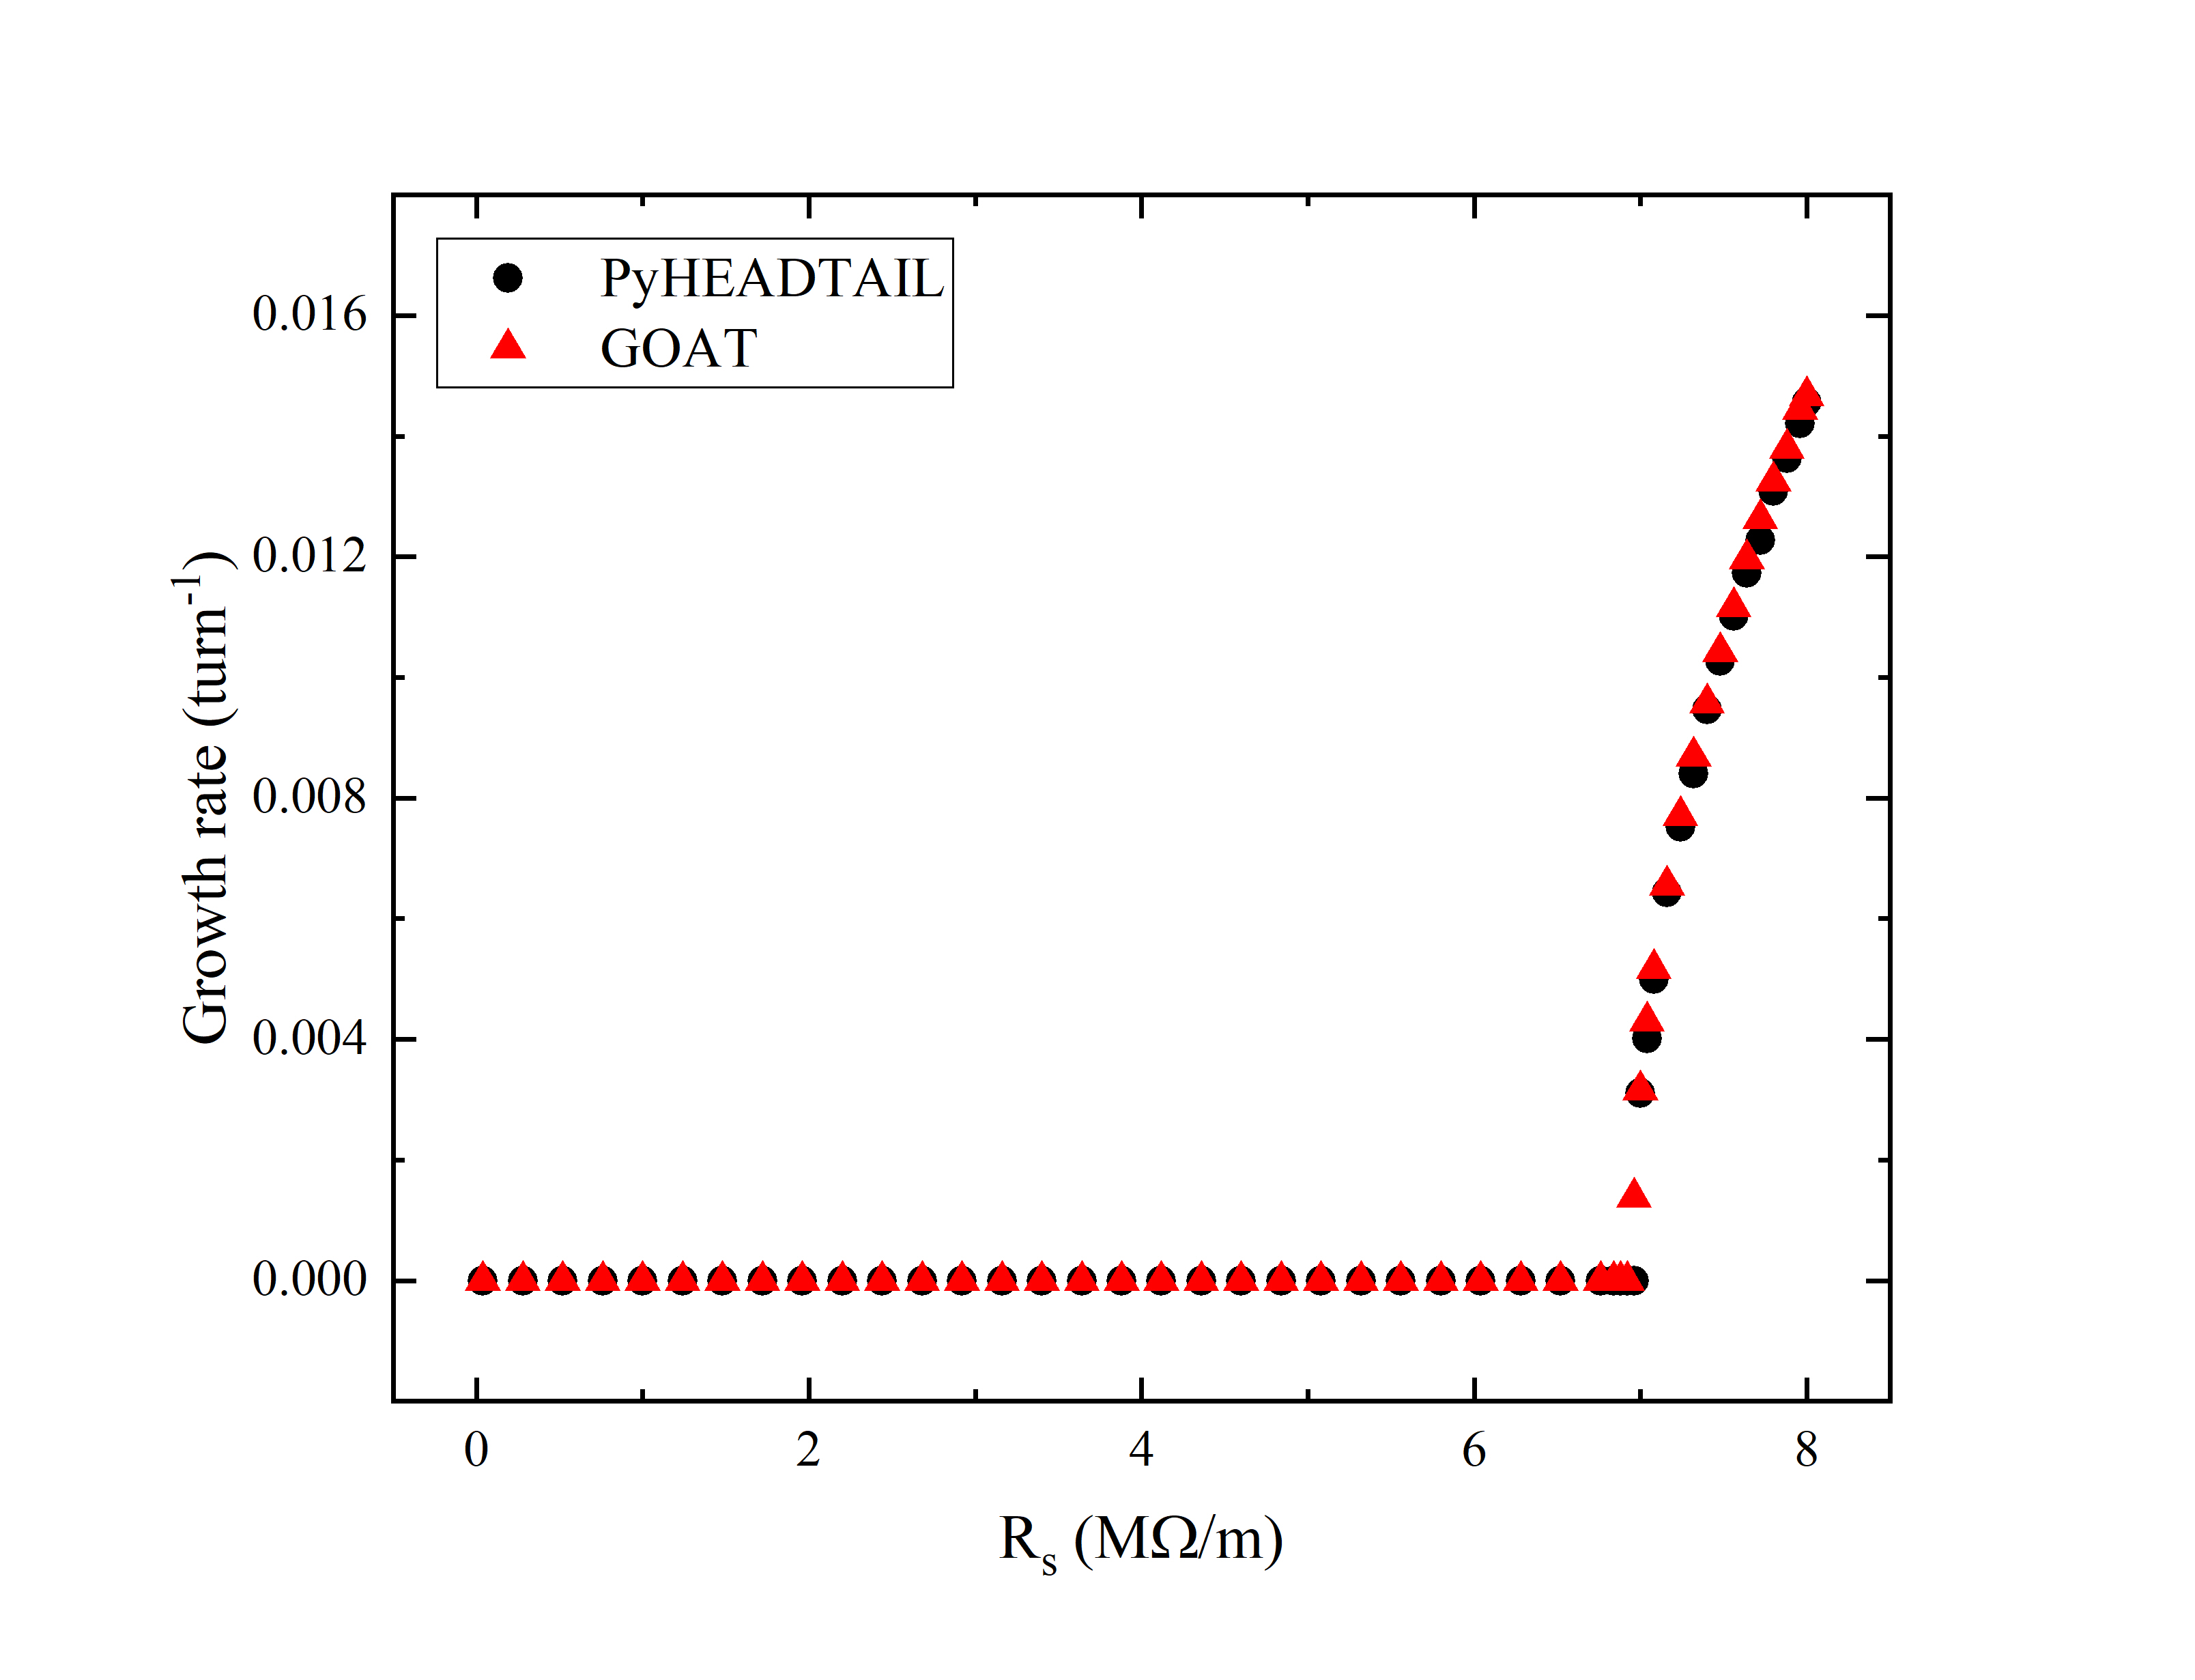
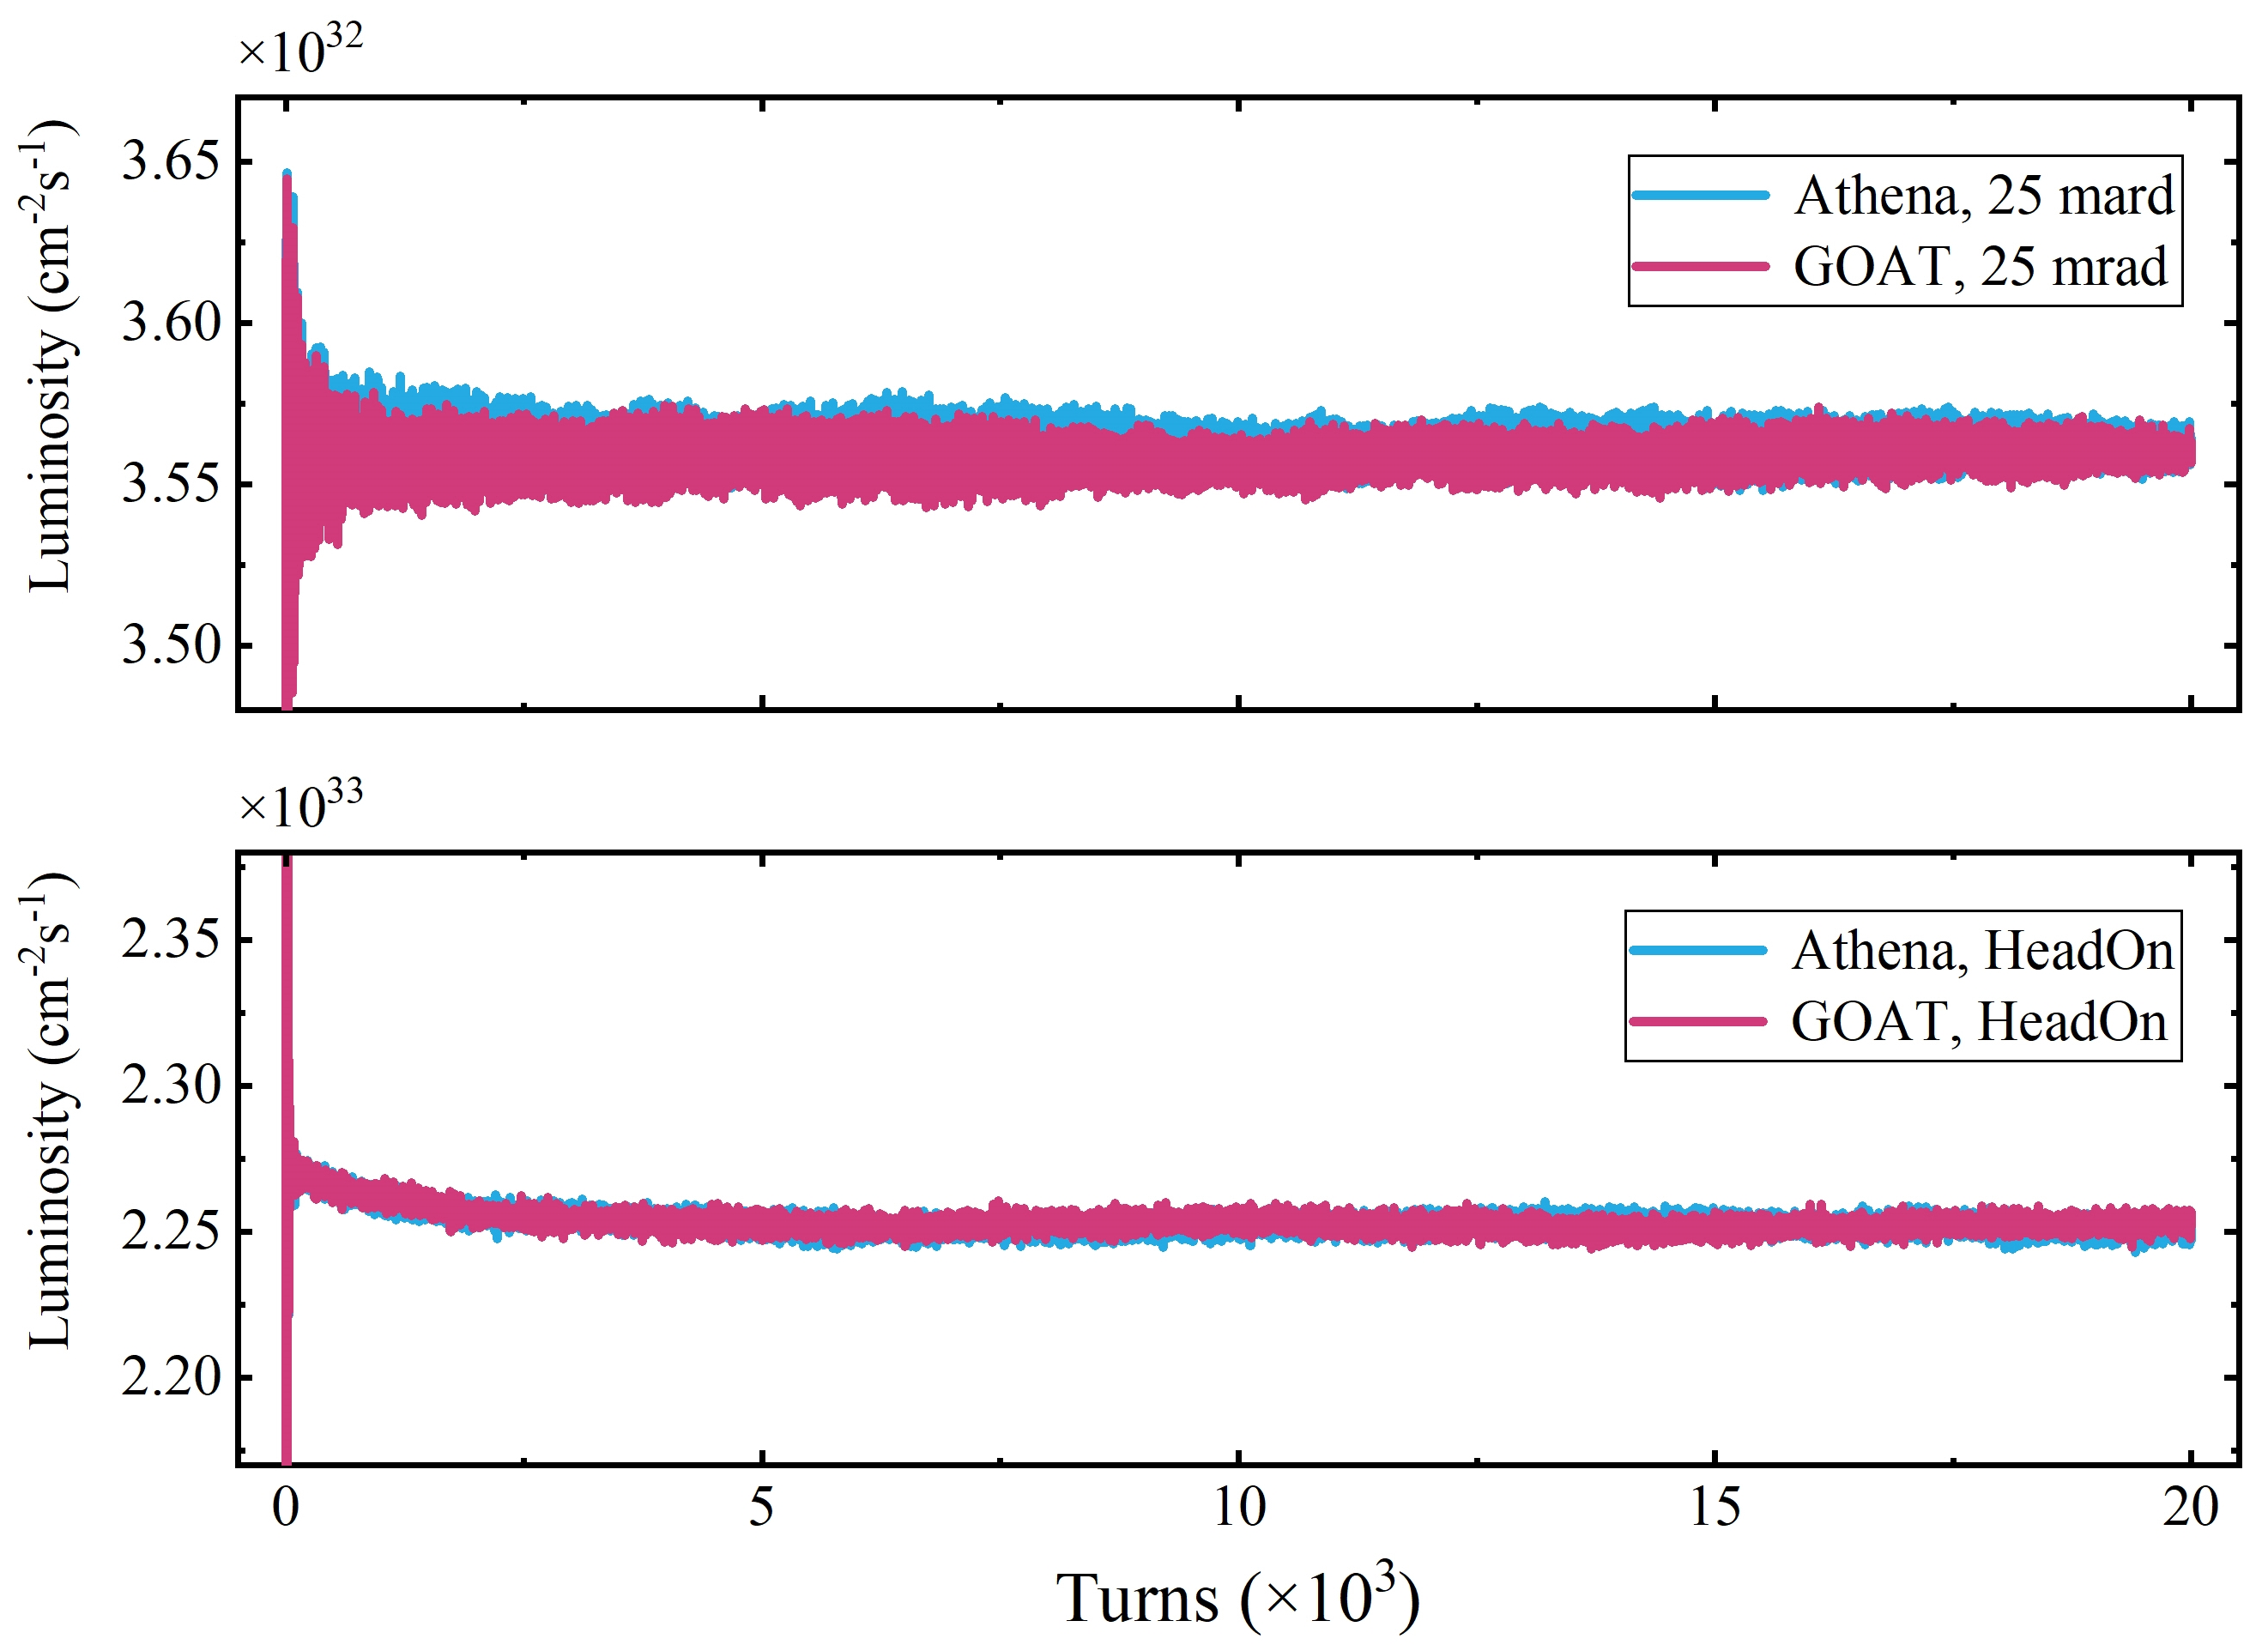
2. GOAT code and numerical model
Benchmarks
GOAT
BBSS
GOAT
PyHEADTAIL
Benchmarks with the PyHEADTAIL using a broadband resonator impedance model
Spectra and growth rates are the same
Benchmarks with BBSS (copy from other slides) and AthenaGPU codes for beam-beam effect
Luminosities and beam motions are the same
Notes:
Here are some benchmarks with other widely used simulation code.
For transverse impedance, we compare the beam spectrum and the instability growth rate with PyHEADTAIL.
For beam-beam effect, the BBSS code and the AthenaGPU code are used.
These benchmark results confirm the correctness of the GOAT code.

Slide 9
Outline
Hourglass effect in EicC
Simulation model
Head-tail instability of asymmetric colliding beams
Numerical observations
Key parameter scans and instability mechanism
Mitigation methods
Float waist collision scheme
Compensation principles of the hourglass effect
Numerical proofs and application to the head-tail instability
Summary
Notes:
Next, I will talk about a newfound coherent head-tail instability simulated by the interplay of beam-beam interactions and transverse wakefields.

Slide 10
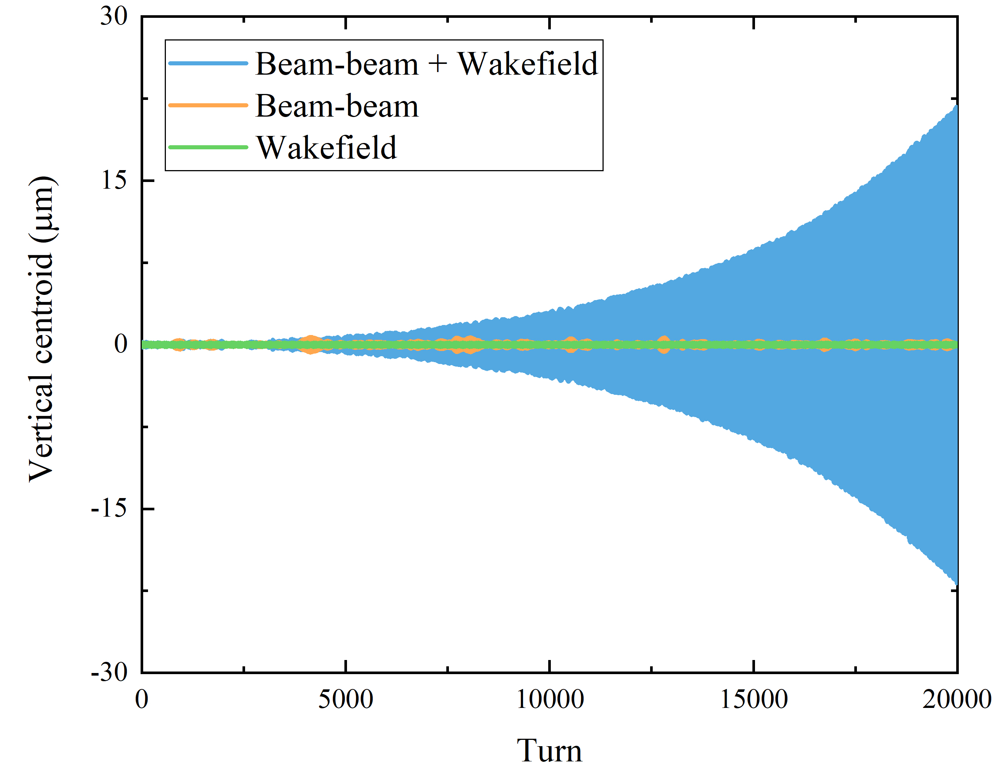
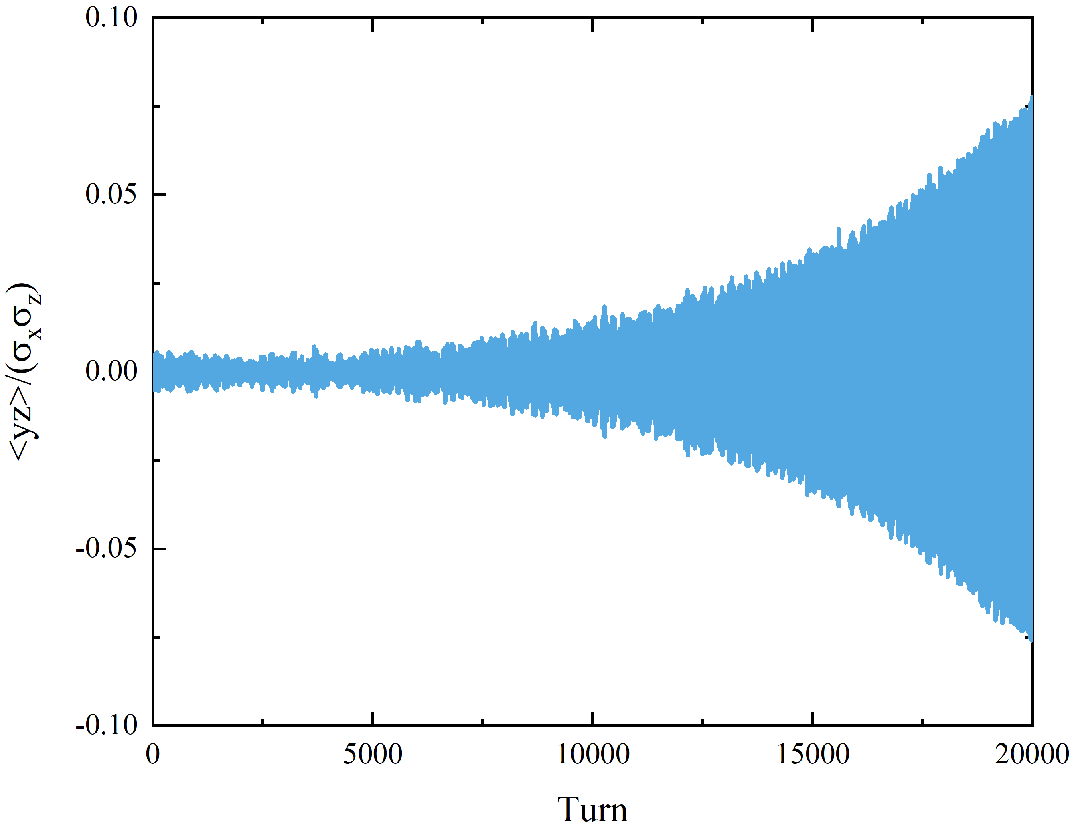
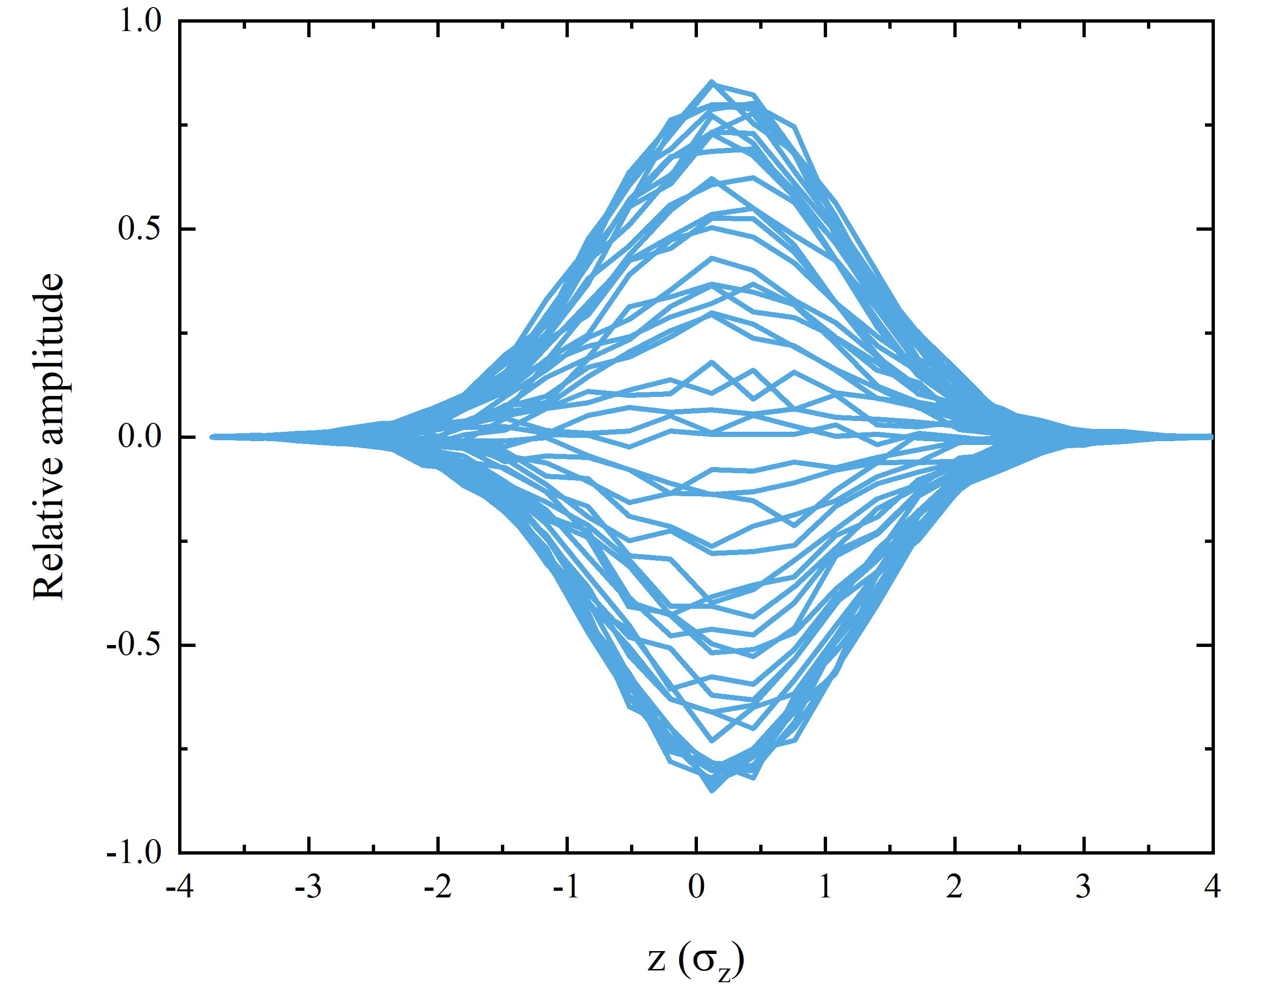
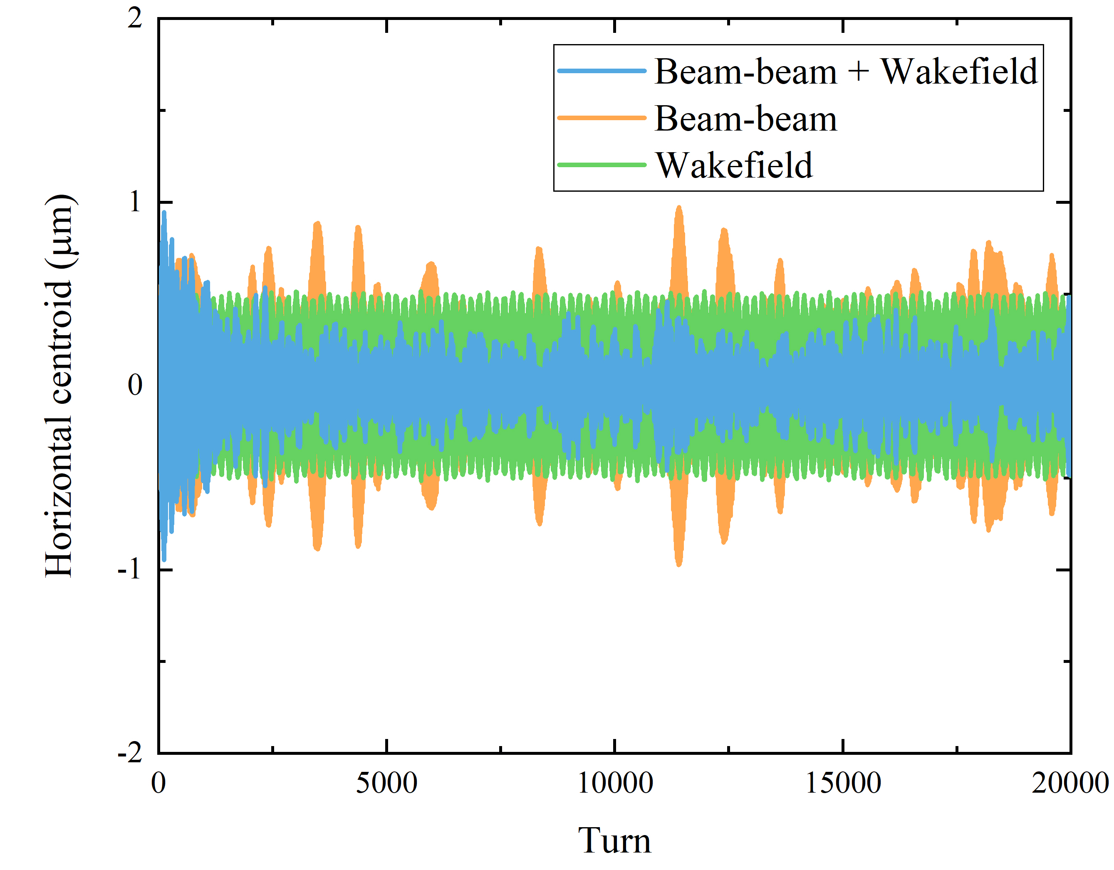
3. Instability observation
Vertical unstable
Head-tail instability
Most unstable mode
Old designs, beam-beam for e+p and wakefield only for p
With beam-beam interactions or transverse wakefields (below TMCI threshold) alone, the beam keeps stable, but a head-tail type instability is stimulated by their interplay.
Under similar conditions (the same ξ and ΔQ_{coh}). The instability occurs only in the vertical plane, but not seen in the horizontal plane (even a damping effect).
Horizontal stable
Notes:
With old design parameters, if we consider the beam-beam interaction or the transverse wakefield alone, the beam is stable in horizontal and vertical directions.
However, a coherent head-tail type instability is stimulated in the vertical direction due to the interplay of these two effects. This figure shows the center of mass oscillations for different simulations. The most unstable mode is zero mode.
With the same beam-beam parameter and the wakefield induced coherent tune shift, this instability does not occur in the horizontal plane. Even a damping effect can be seen in the first 1k turns.

Slide 11
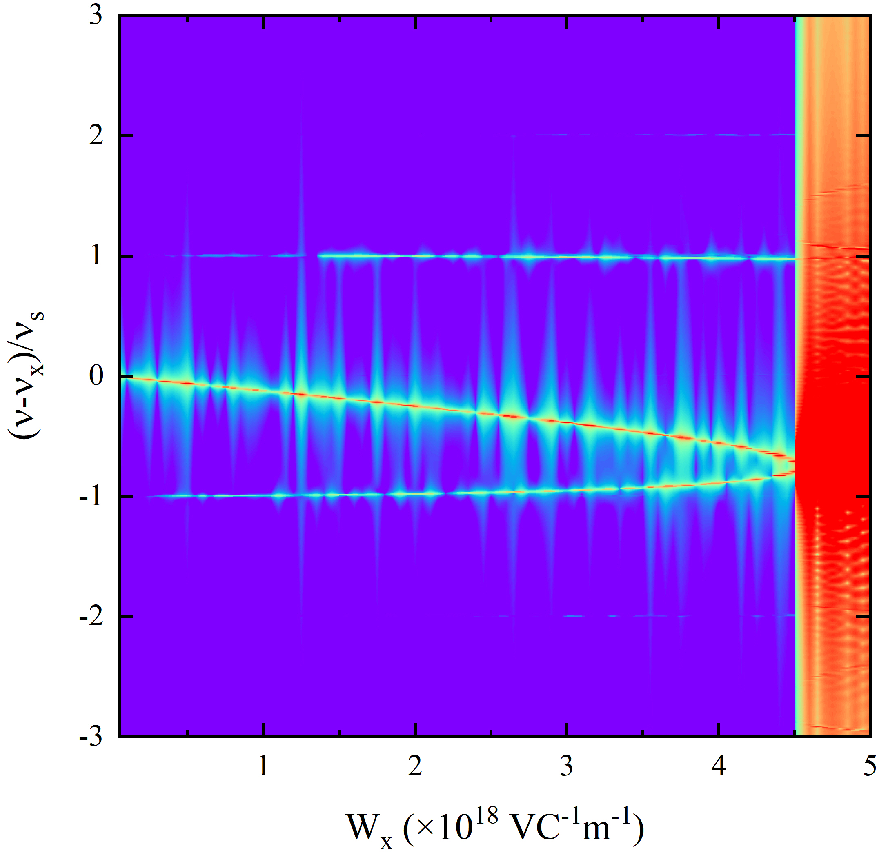
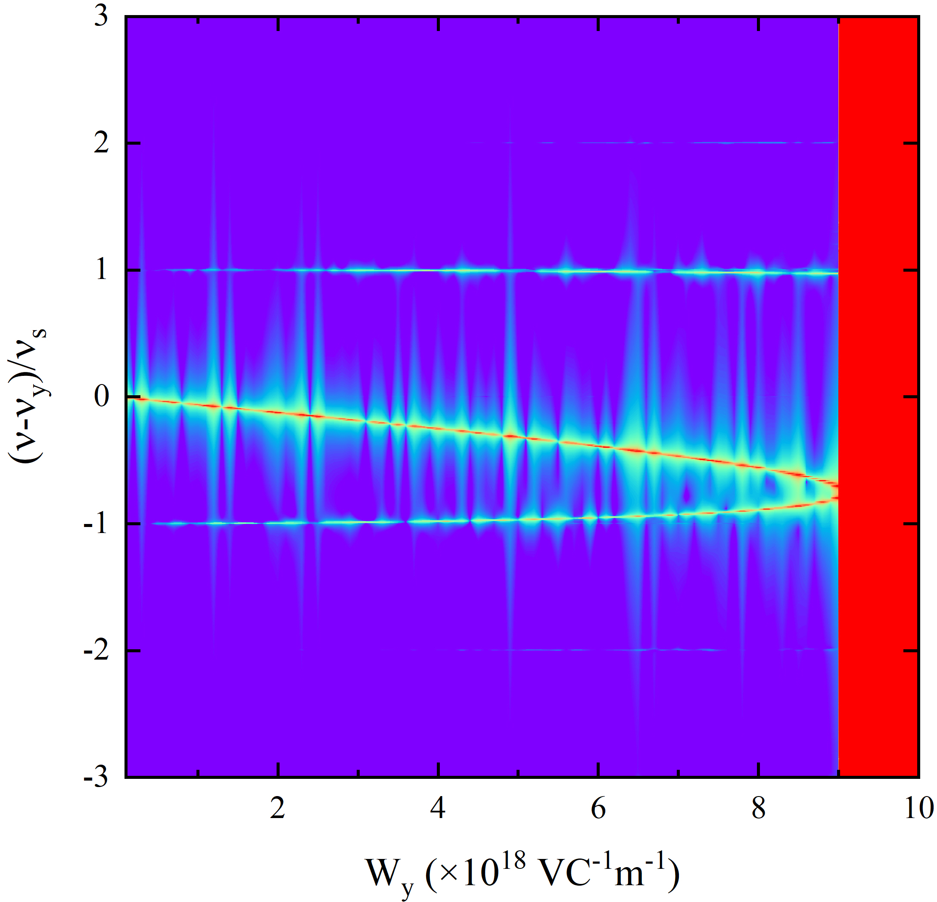
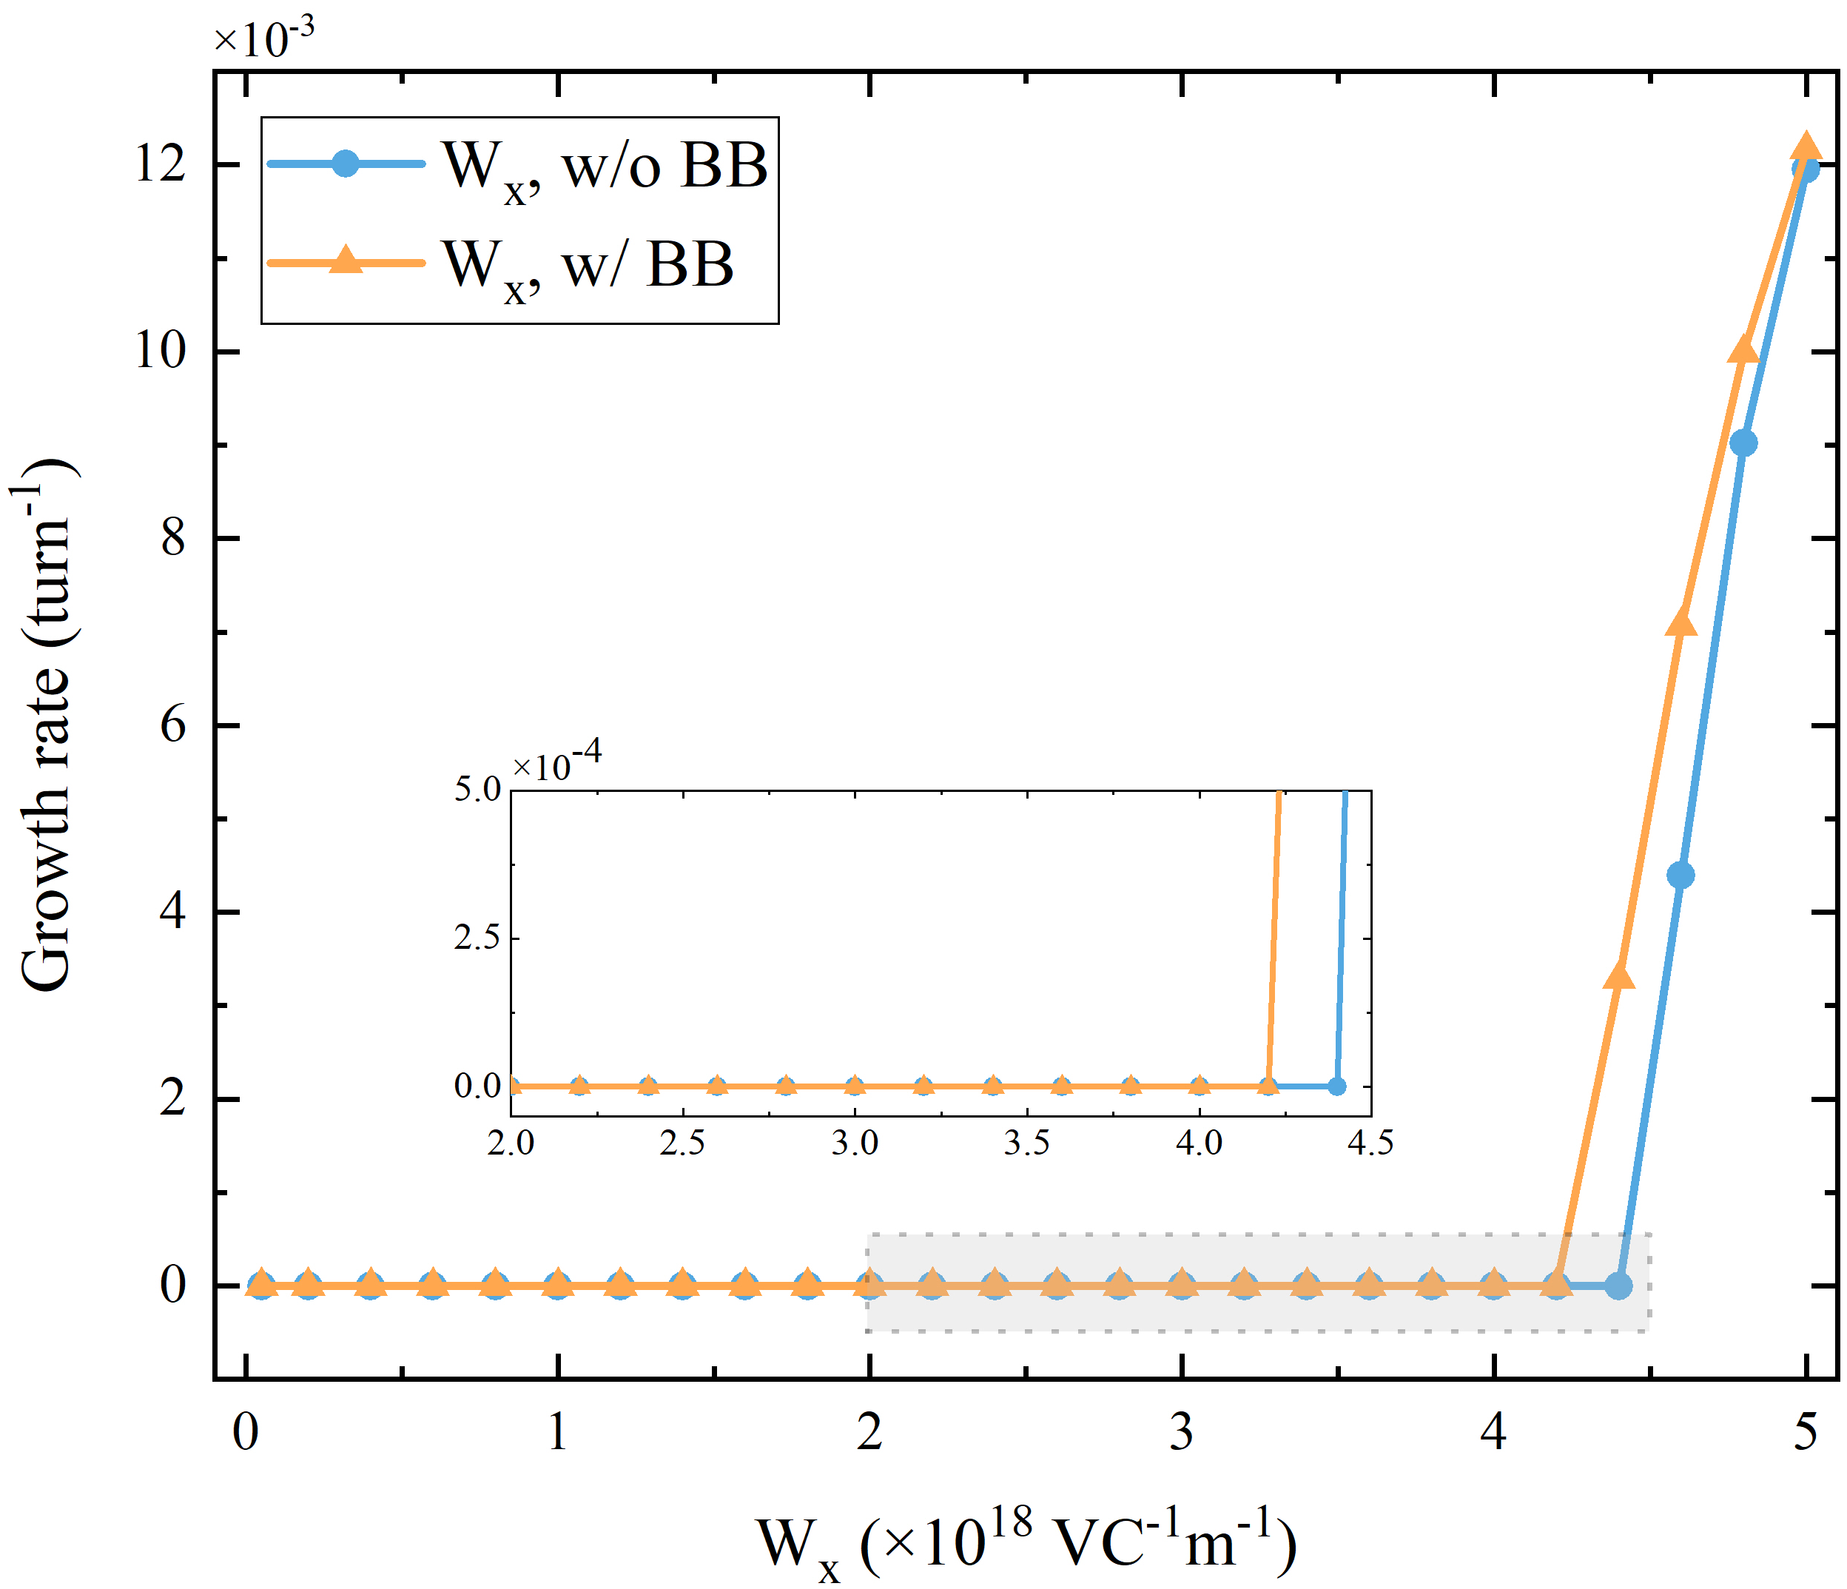
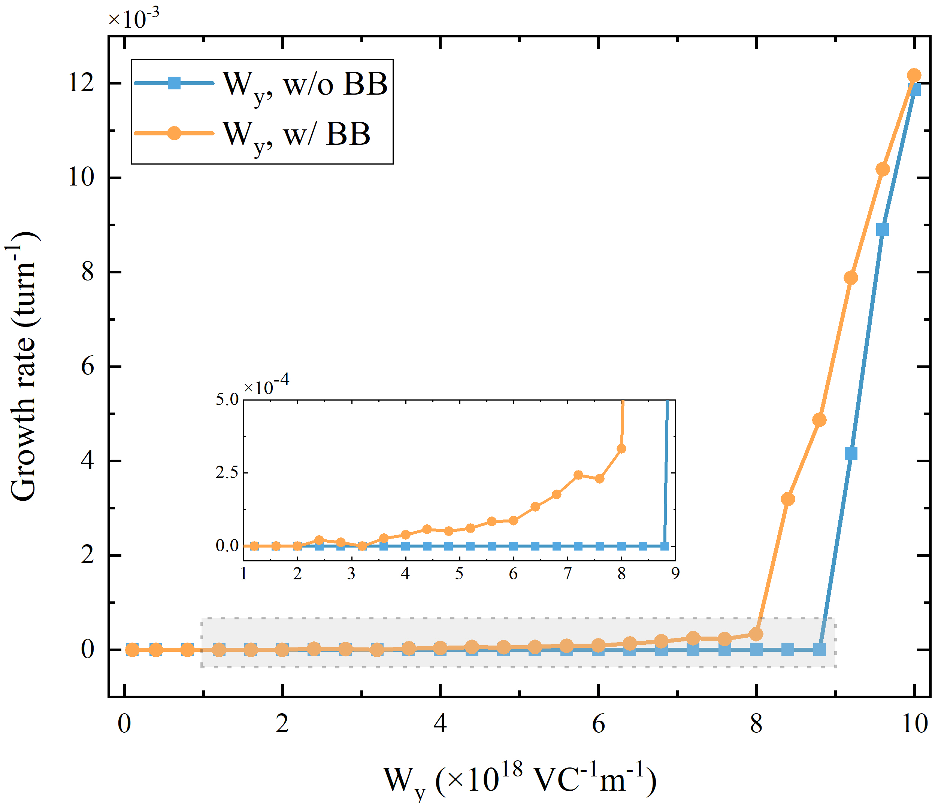
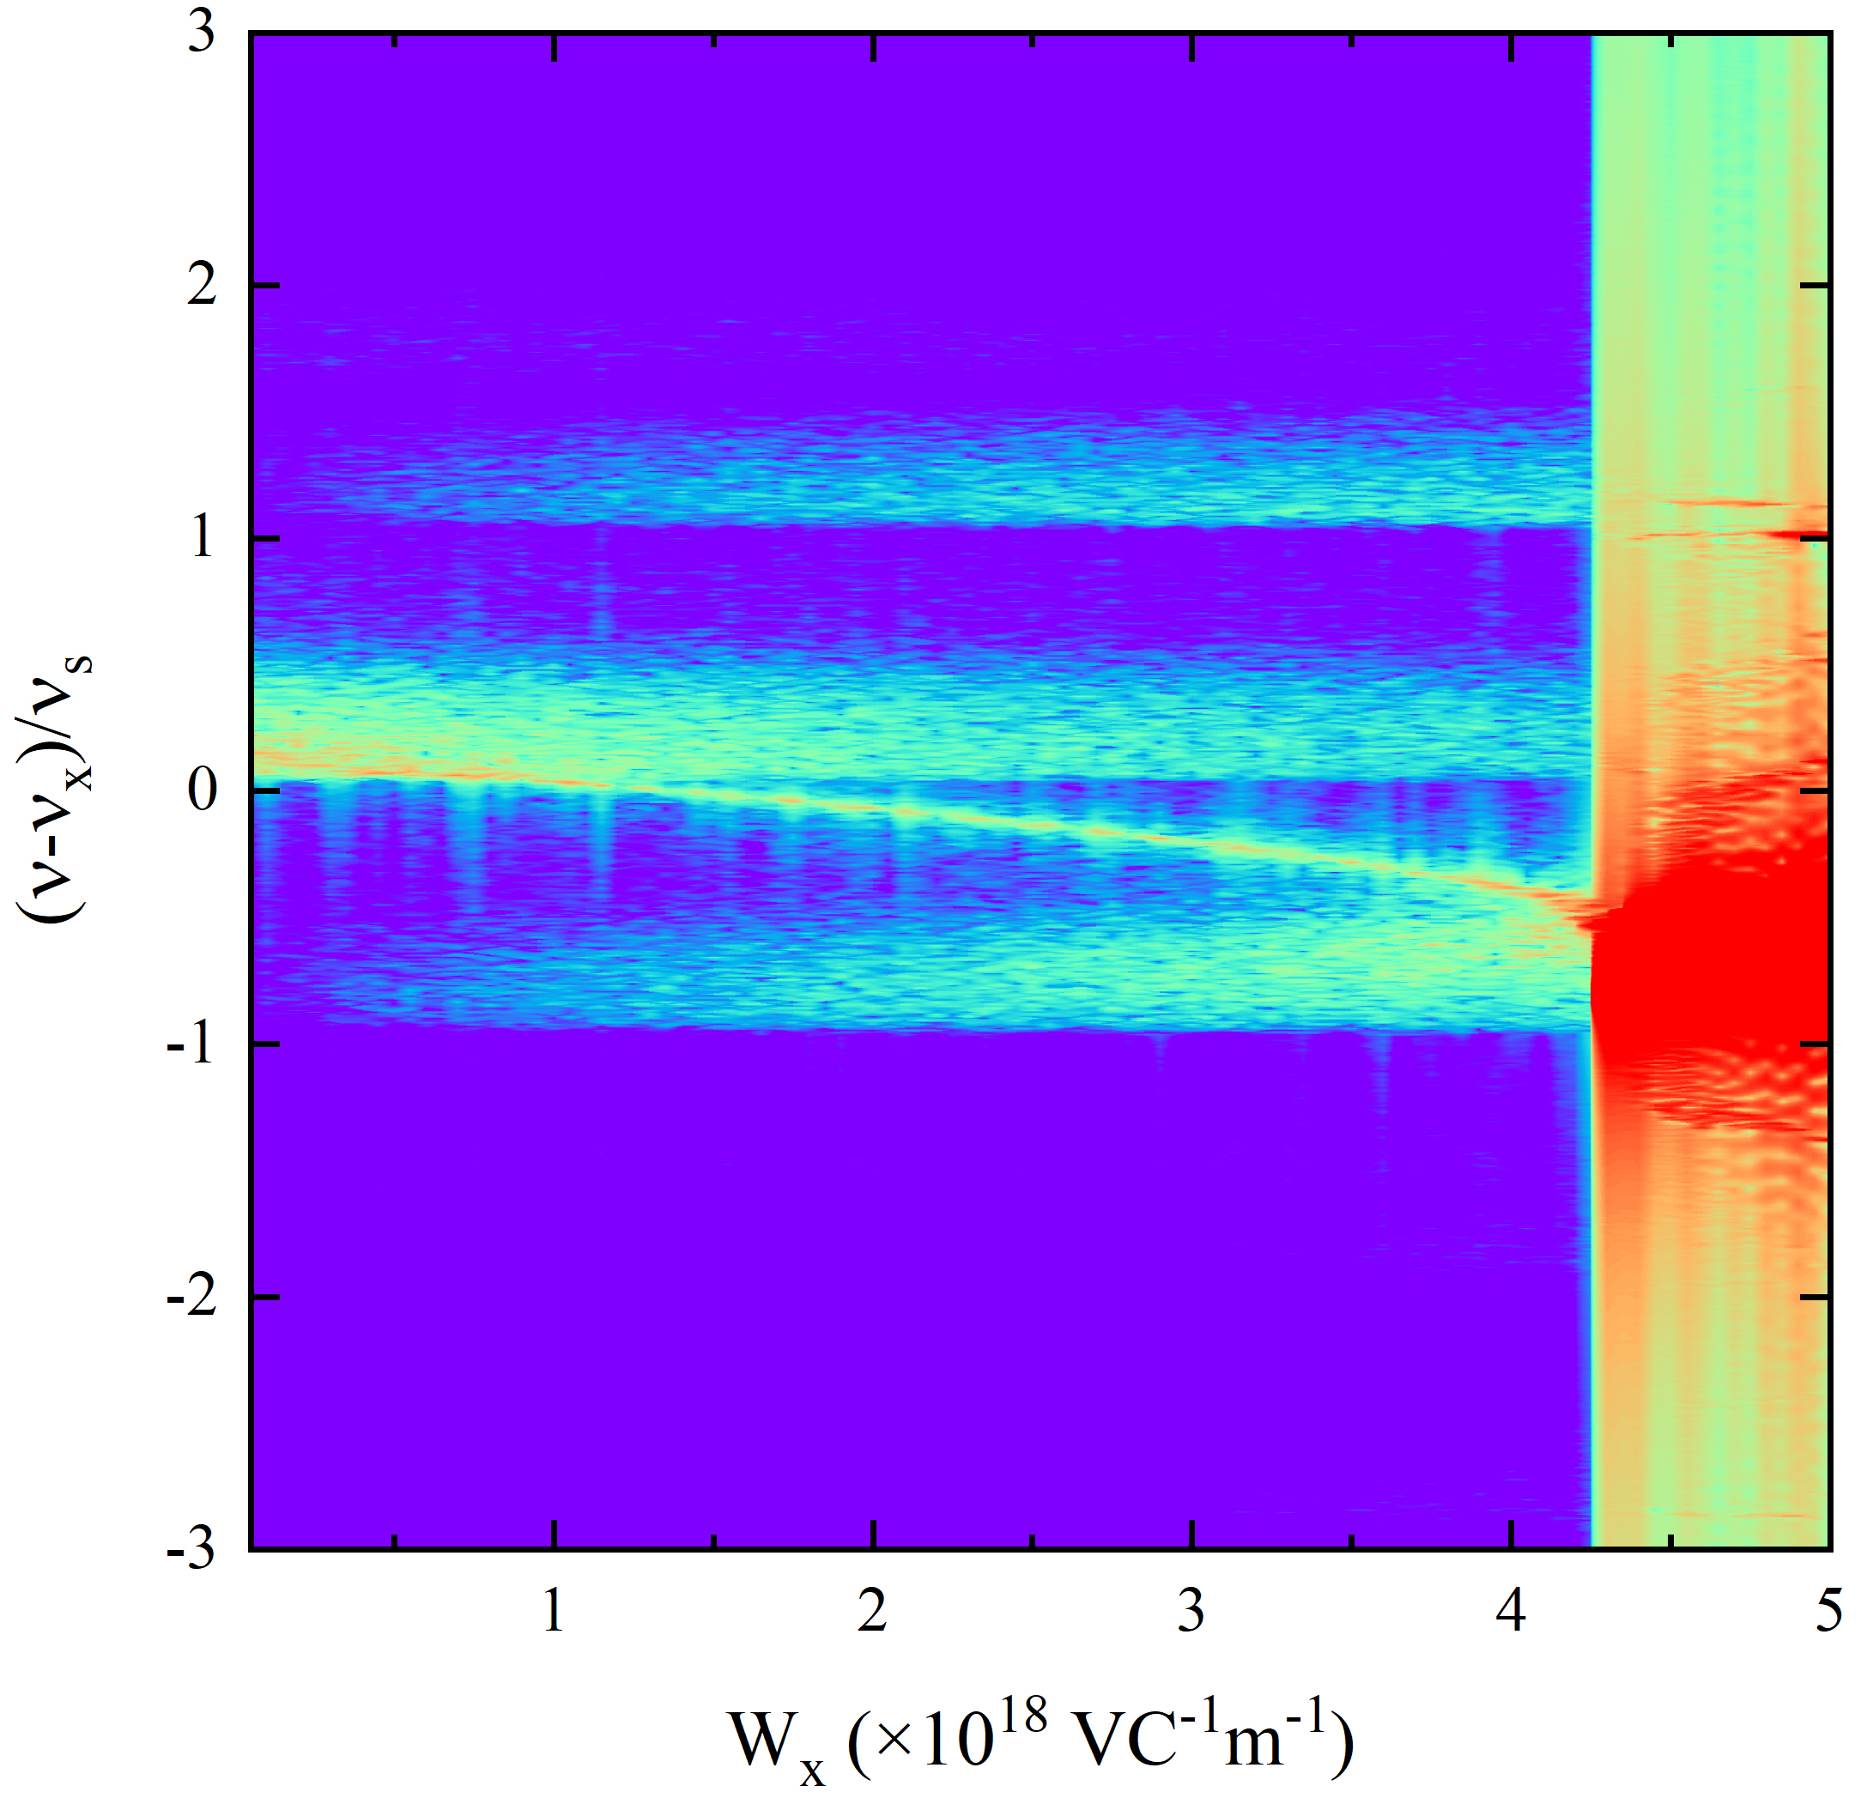
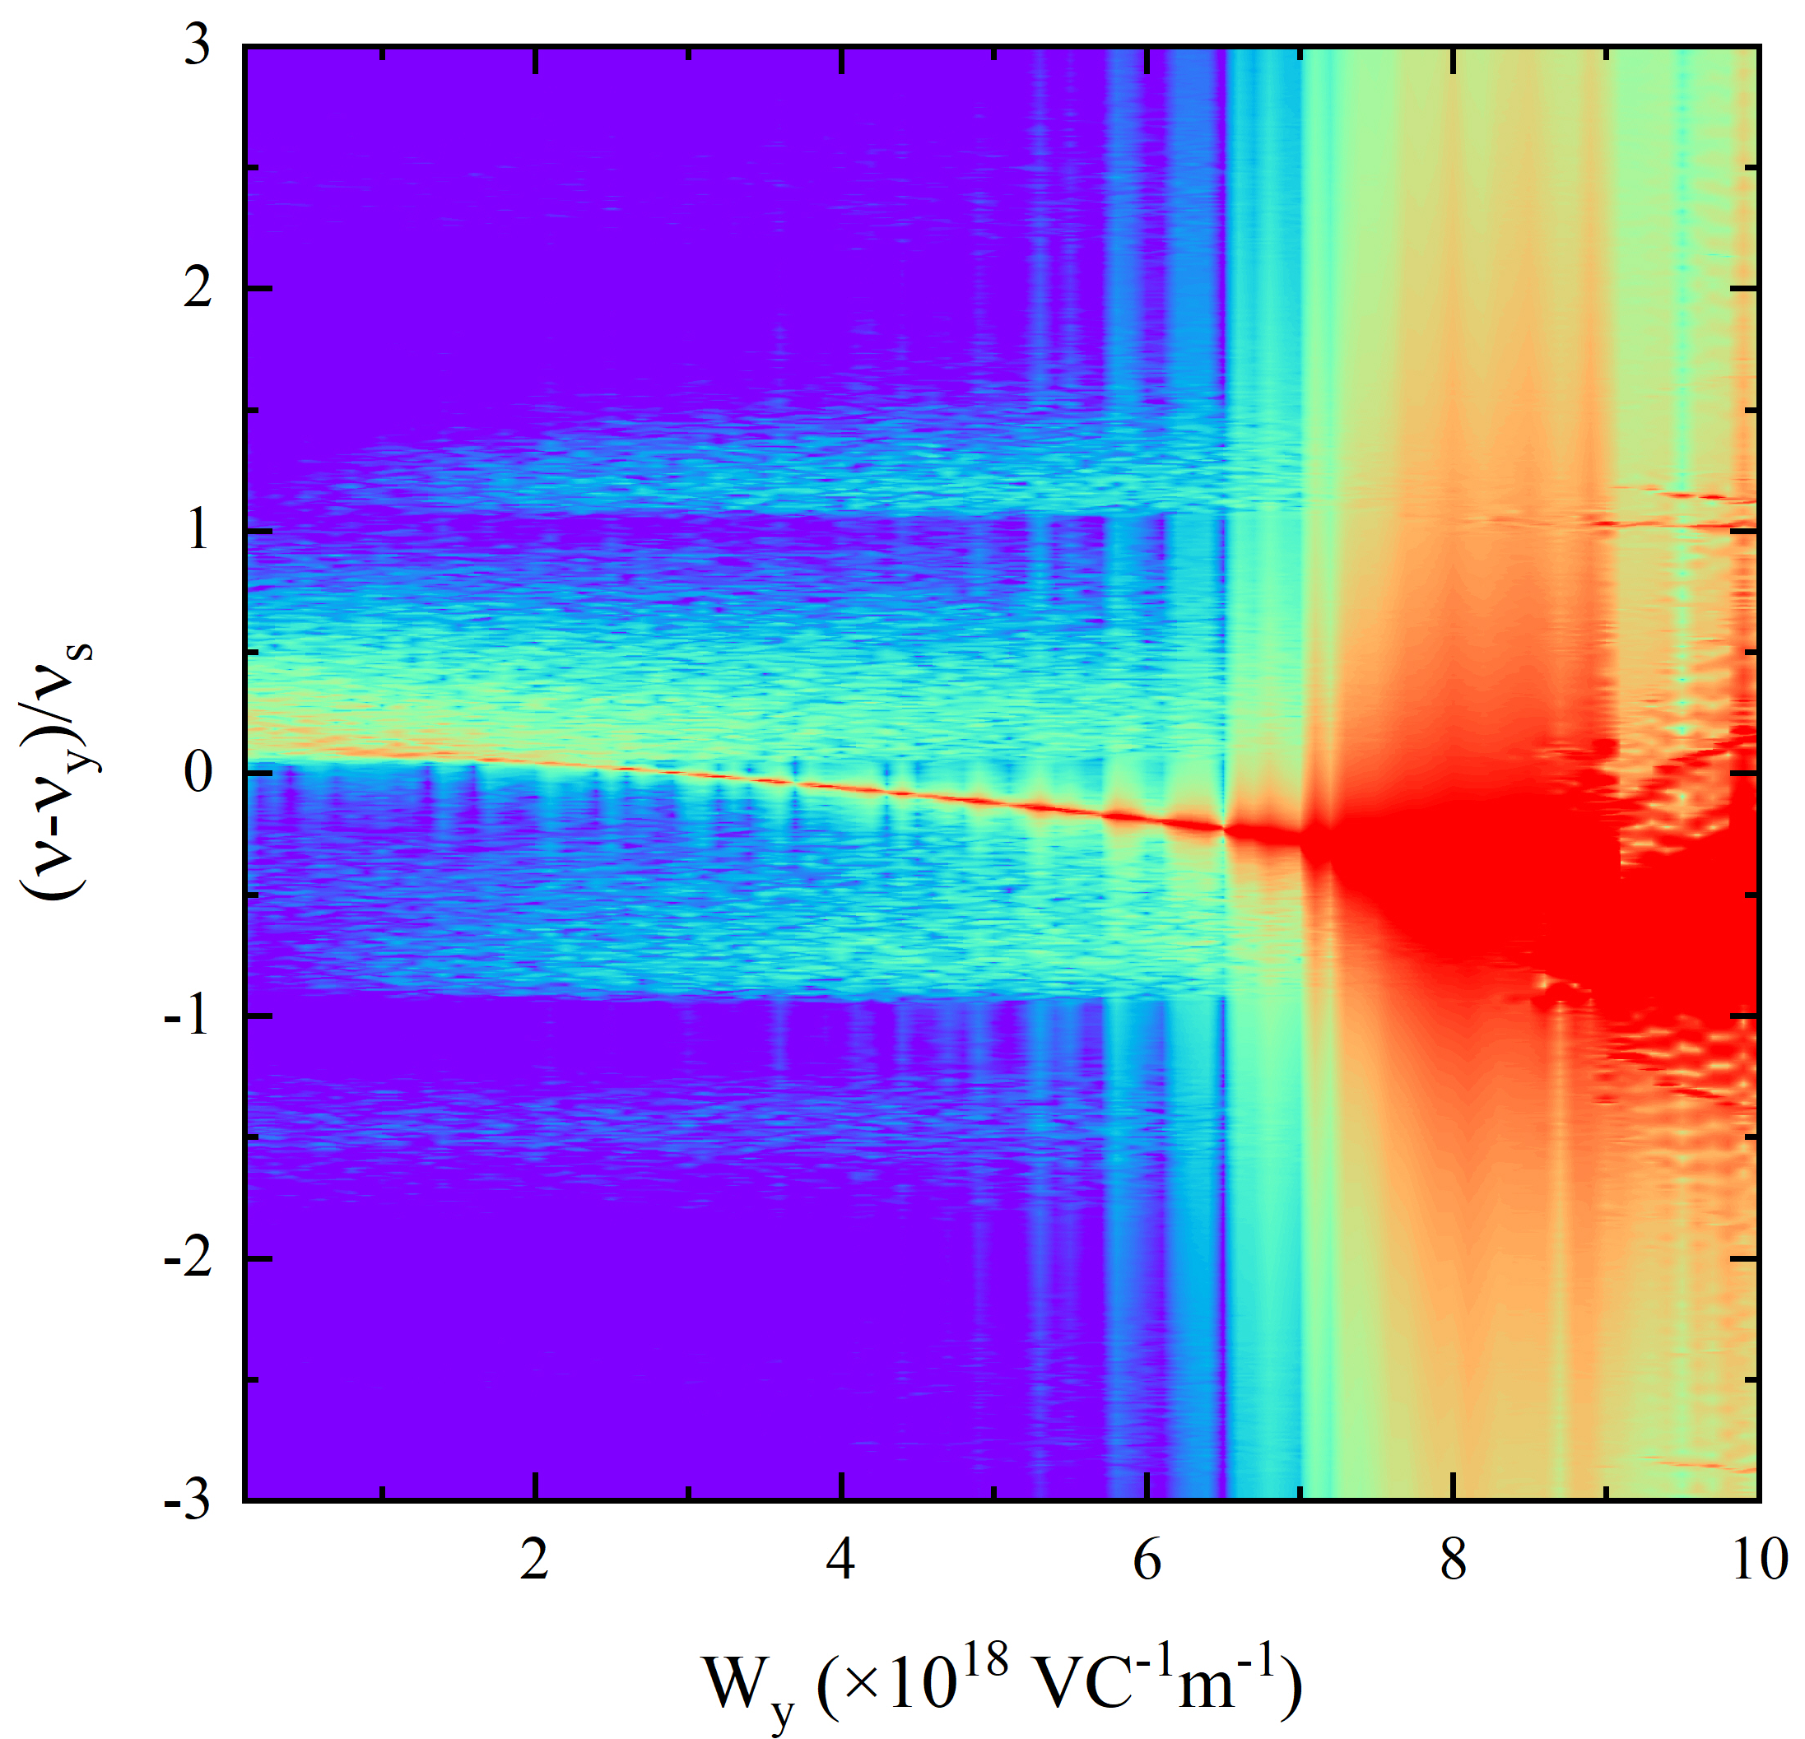
3. Transverse wakefield scan
w/o BB
w/o BB
Still TMCI
threshold ~ 95% w/o BB
Head-tail instability far below TMCI
β_{x} = 4 cm
β_{y} = 2 cm
w/ BB
w/ BB
Constant wakefield is used to exclude the effect of bunch length on TMCI threshold (∝ W_{x,y}×β_{x,y}) same ΔQ_{coh} when W_{y}=2W_{x}.
With beam-beam, longitudinal sidebands become more spread. The widening is more evident in the vertical direction.
Beam-beam is responsible for the difference in the horizontal and vertical directions.
Horizontal
Vertical
Notes:
To understand the observed vertical instability, we first scan the transverse wakefield. Here, we use the constant wakefield to exclude the effect of bunch length on TMCI threshold.
These two figures show the results for TMCI simulations. As the horizontal beta star is two times the vertical beta star. The vertical threshold is two times the horizontal plane. In addition, the coherent tune shift induced by the wakefield should be the same when the vertical wakefield is two times the horizontal one.
When we include beam-beam in simulations, as shown in bottom two figures, we find that the longitudinal sidebands become more spread. At nominal beam-beam parameter of 0.004, the widening is about three times the beam-beam parameter.
As for the instability growth rate, the horizontal instability is still a TMCI, and the threshold is a little smaller. But in the vertical plane, the head-tail instability occurs far below the TMCI threshold.
So, we can conclude that the beam-beam is responsible for the difference in the horizontal and vertical directions.

Slide 12
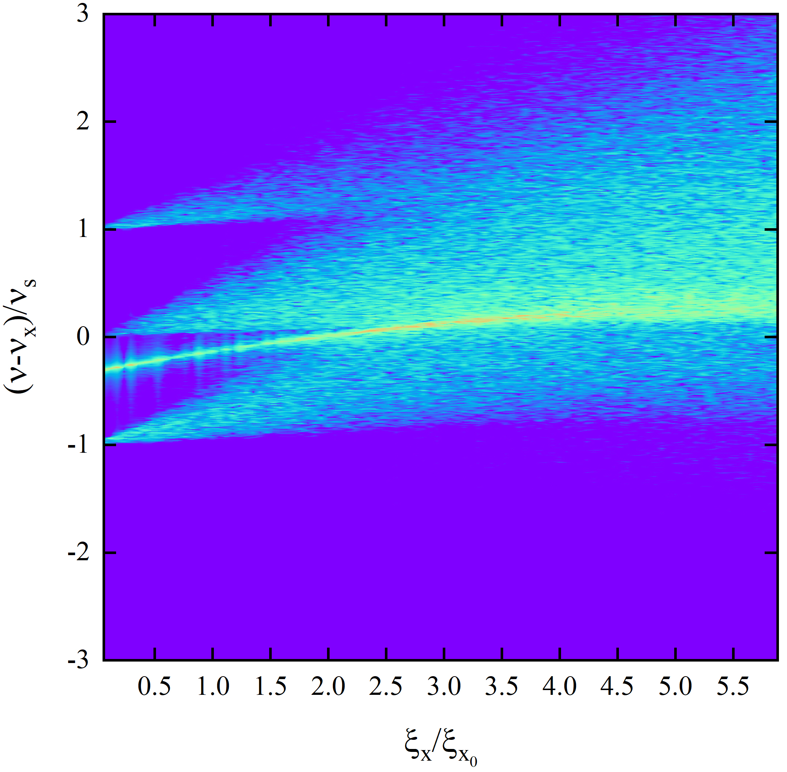
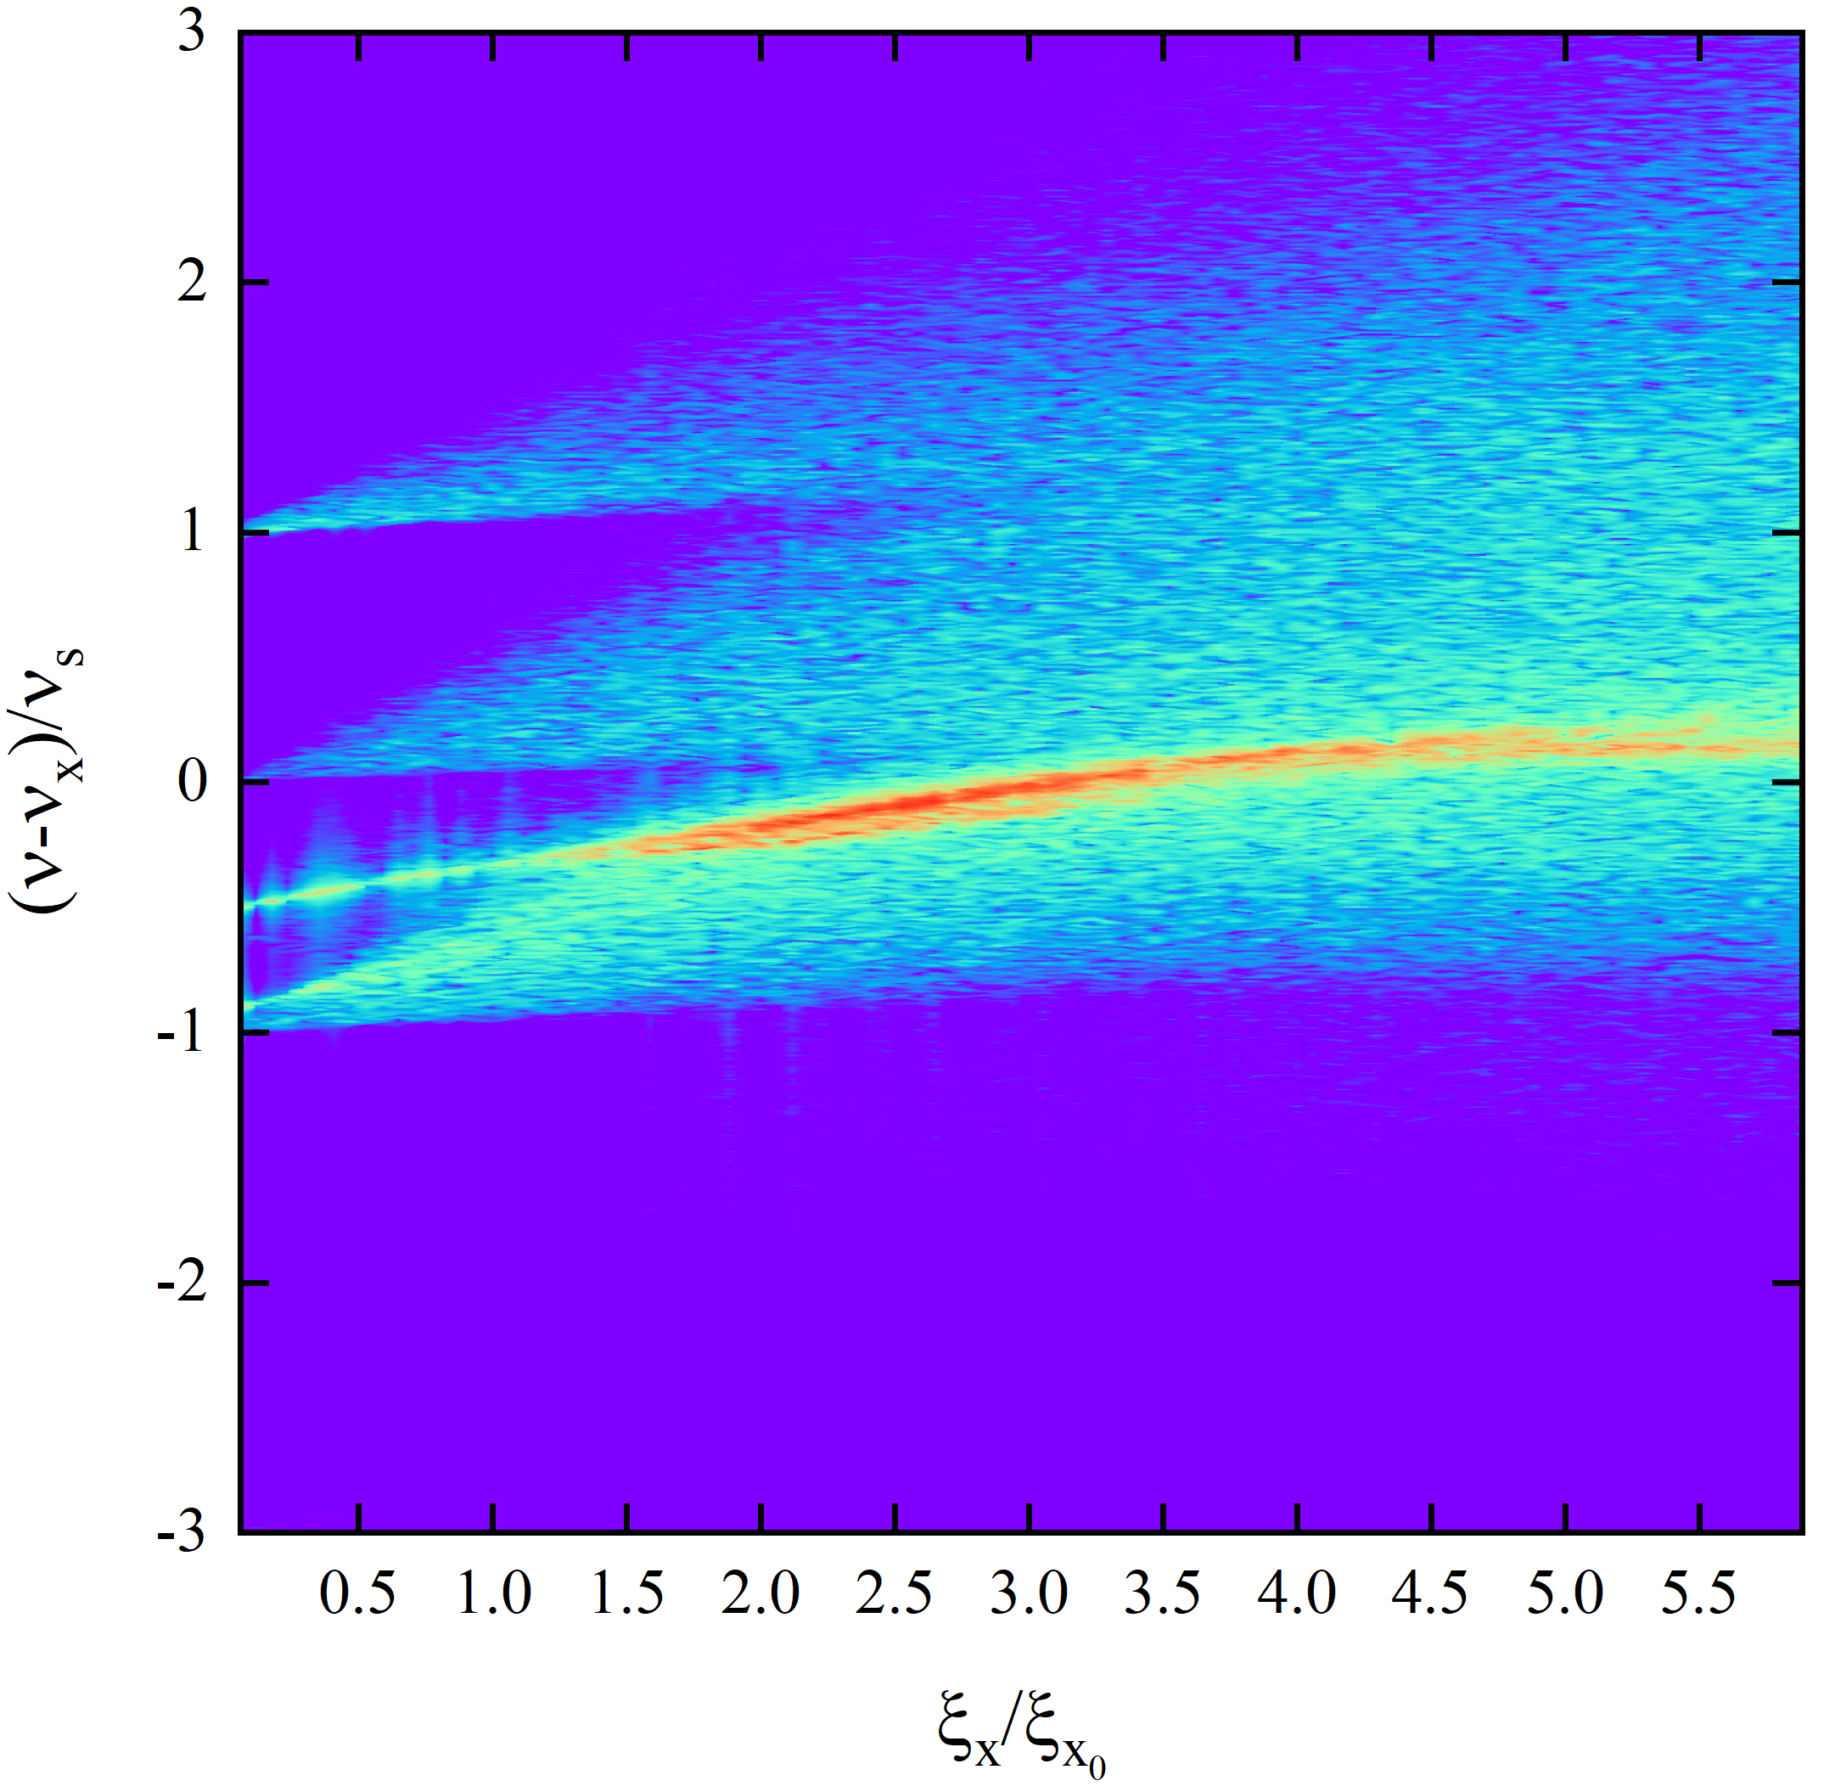
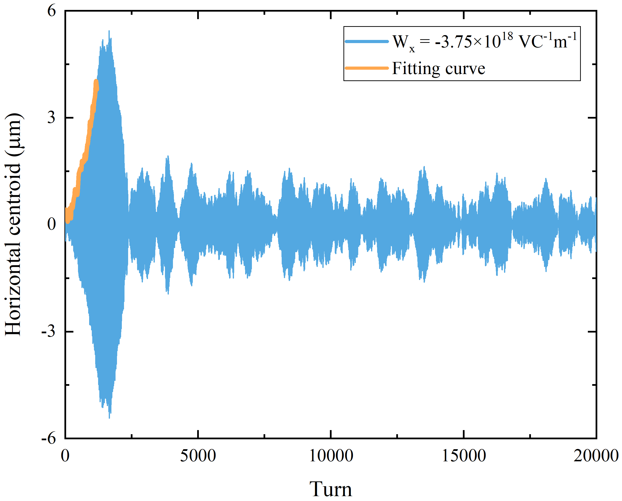
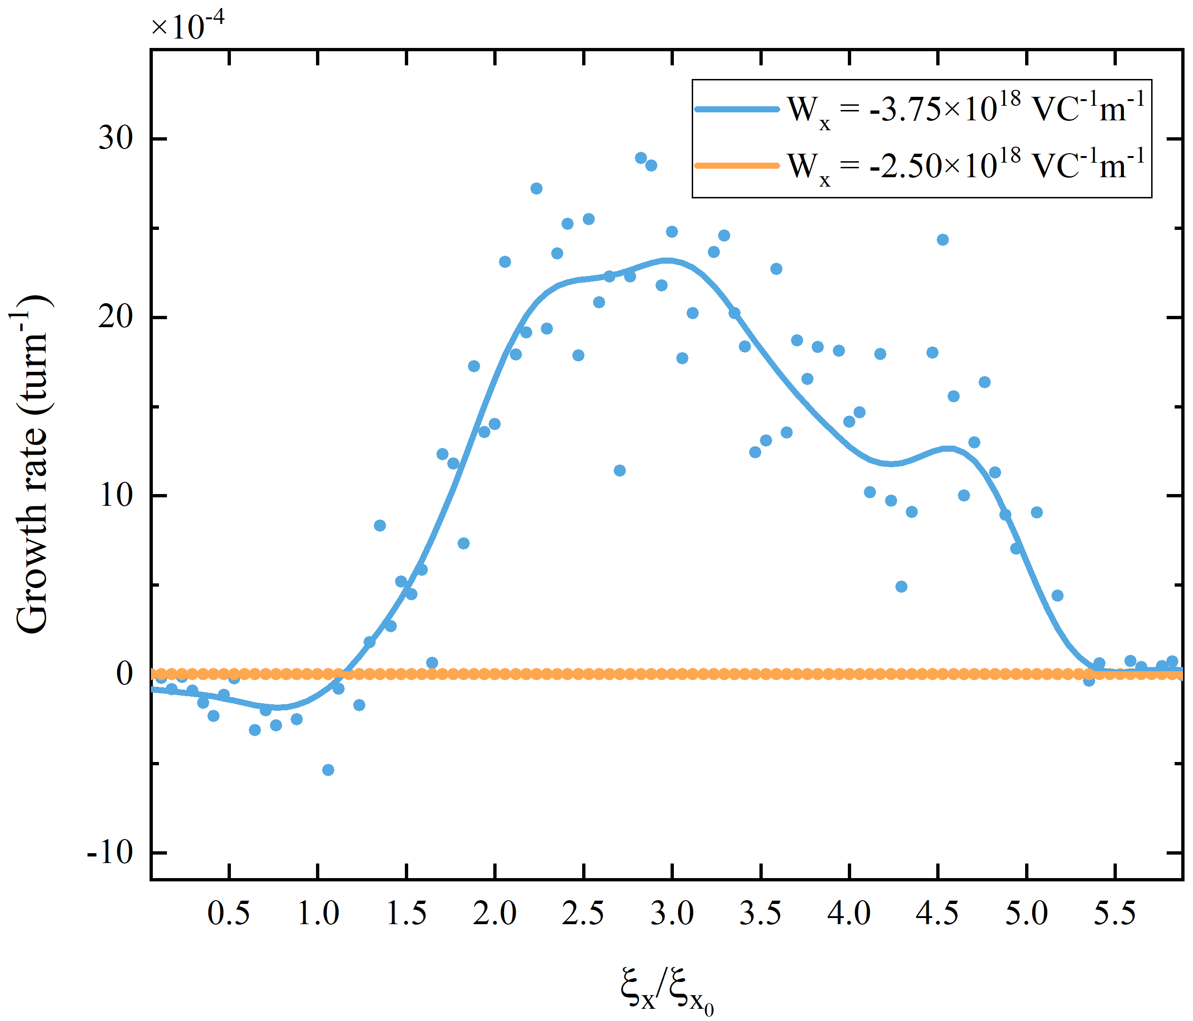
3. Horizontal beam-beam parameter scan
The -1 sideband grows much faster than the coherent mode, very different from the case for symmetric colliding beams
0 mode
0 mode
Mode frequency shift | W_{x}=-2.50E18 V/(Cm) | W_{x}=-3.75E18 V/(Cm)
Coherent mode | 0.56348 ξ_{x} | 0.56537 ξ_{x}
-1 sideband | 1.52035 ξ_{x} | 1.49056 ξ_{x}
-1 mode
W_{x}=-2.50E18 V/(Cm)
55% threshold
-1 mode
W_{x}=-3.75E18 V/(Cm)
83% threshold
Beam is stable at small wakefield, and gets unstable at higher wakefield.
With large wakefield, beam instabilities appear only in the first 2000 turns and then they are self-damped.
Need further understandings.
Damping?
Notes:
In this slide, we first scan the proton beam-beam parameter for two wakefield values in the horizontal direction.
We find that the beam is always stable at small wakefield and gets unstable with higher wakefield. But the instabilities appear only in the first 2k turns and then they are self-damped. This figure shows the instability growth rate versus the beam-beam parameter. The damping effect at small beam-beam parameters needs further studies.
This table gives the fitted mode frequency shifts of the coherent mode and the -1 sideband, we can see that, due to the beam-beam interaction, the -1 sideband grows almost 1.5 times faster than the coherent mode in the horizontal plane. This is very different from the case for symmetric colliding beams.

Slide 13
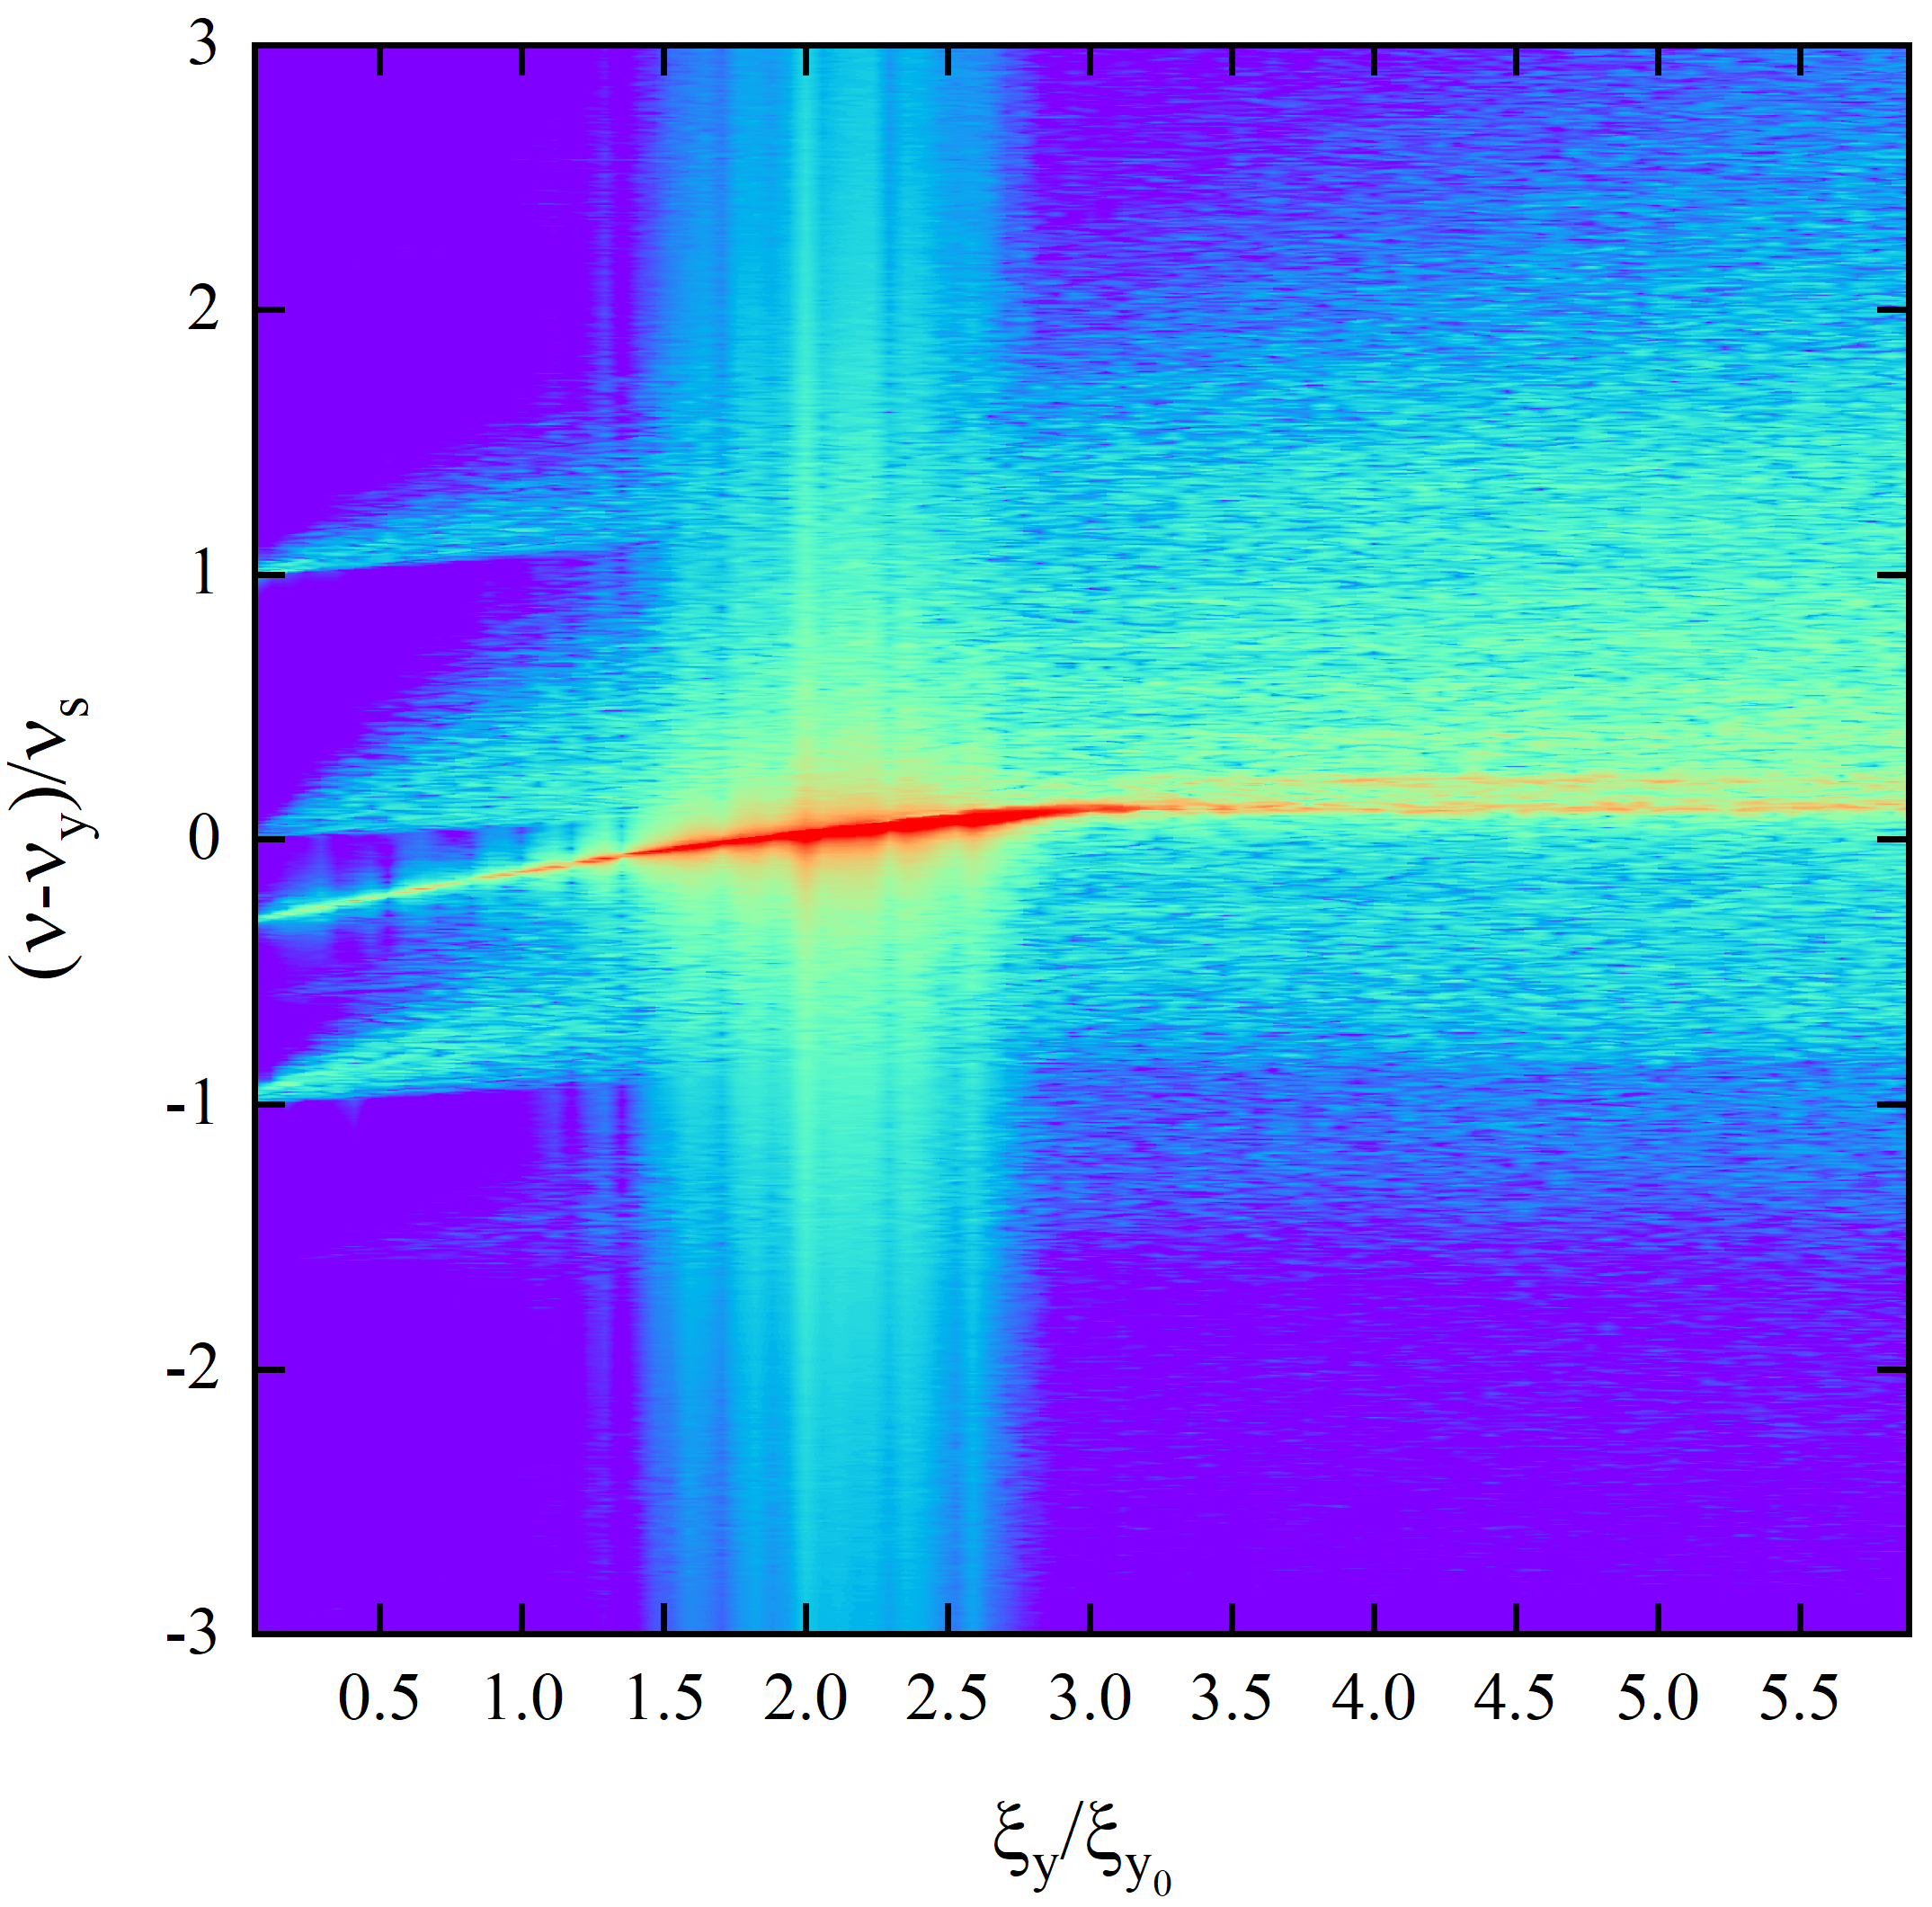
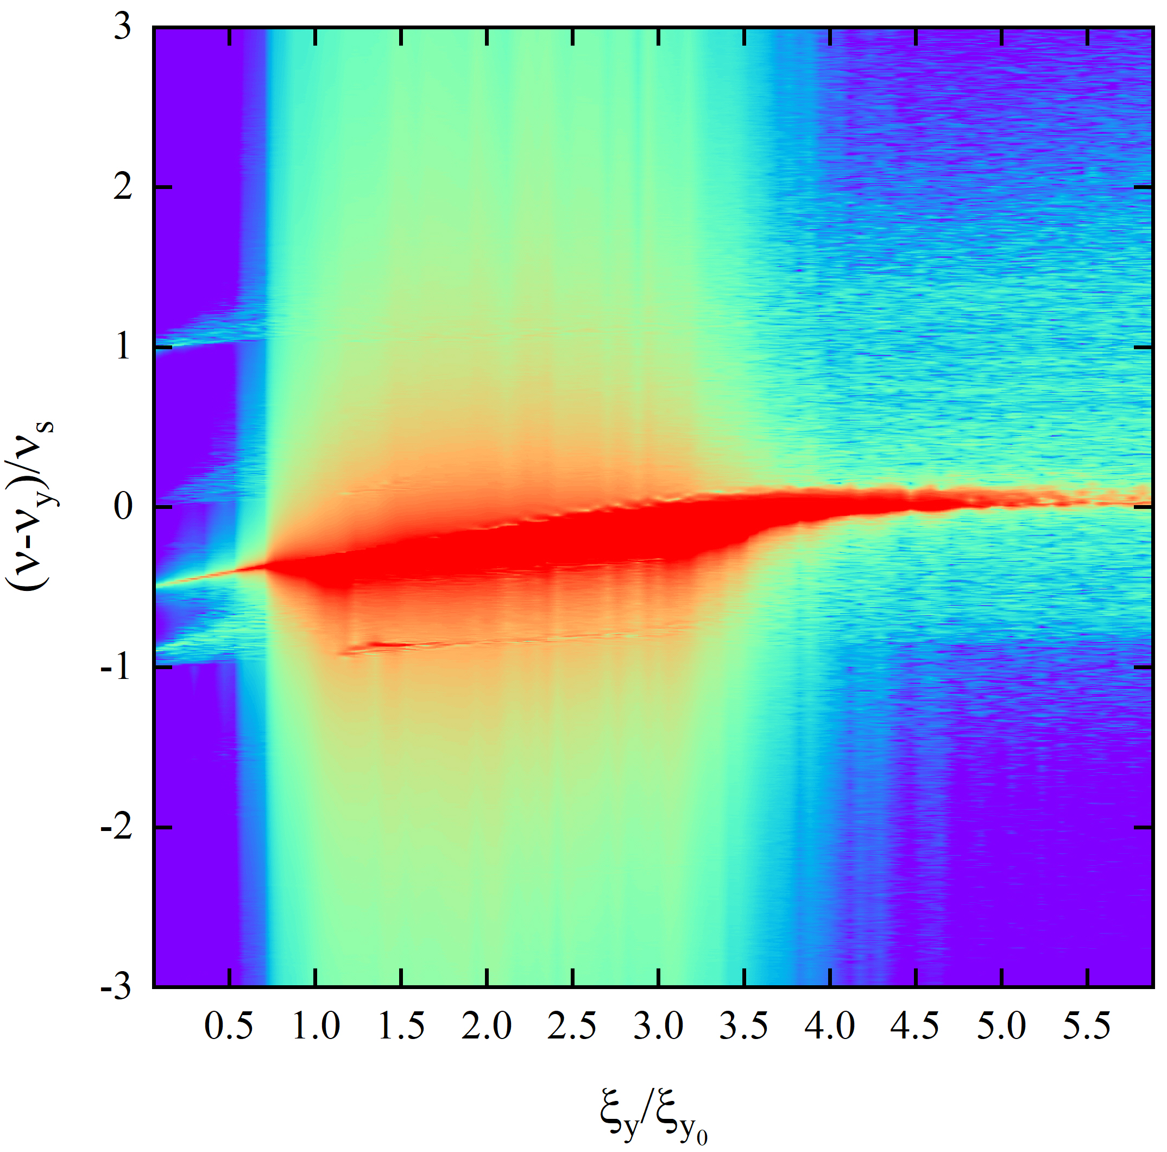
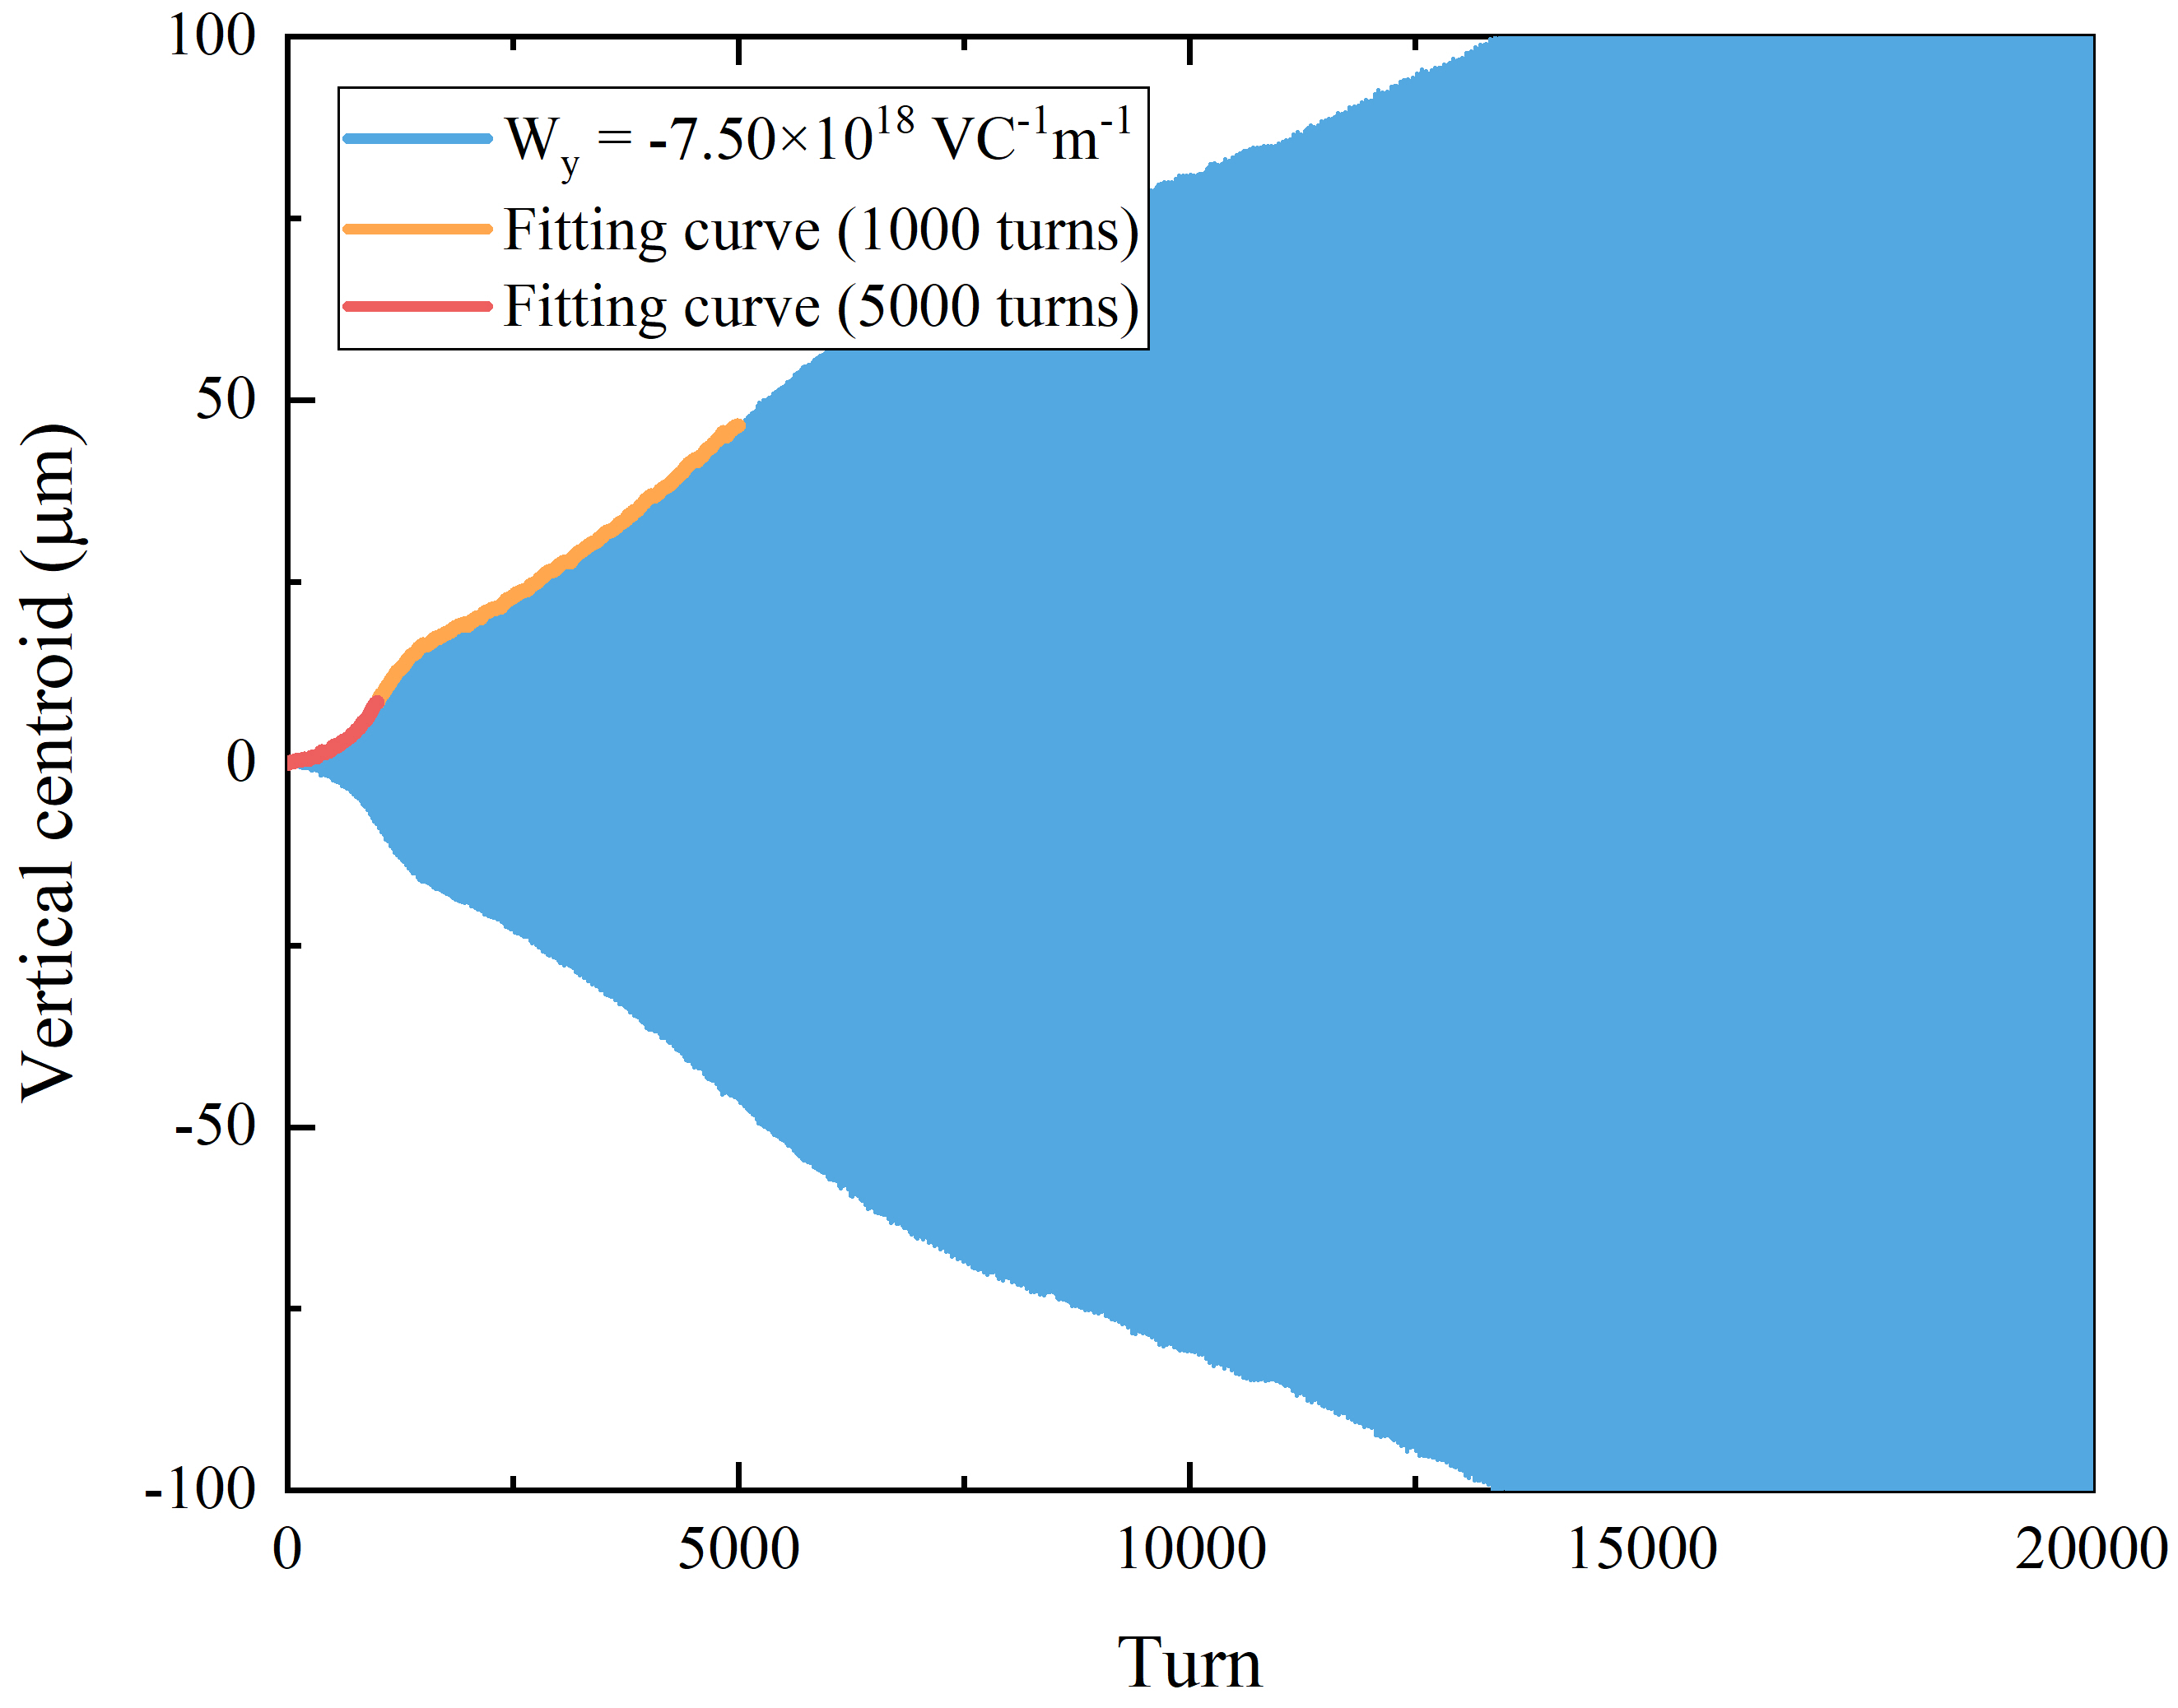
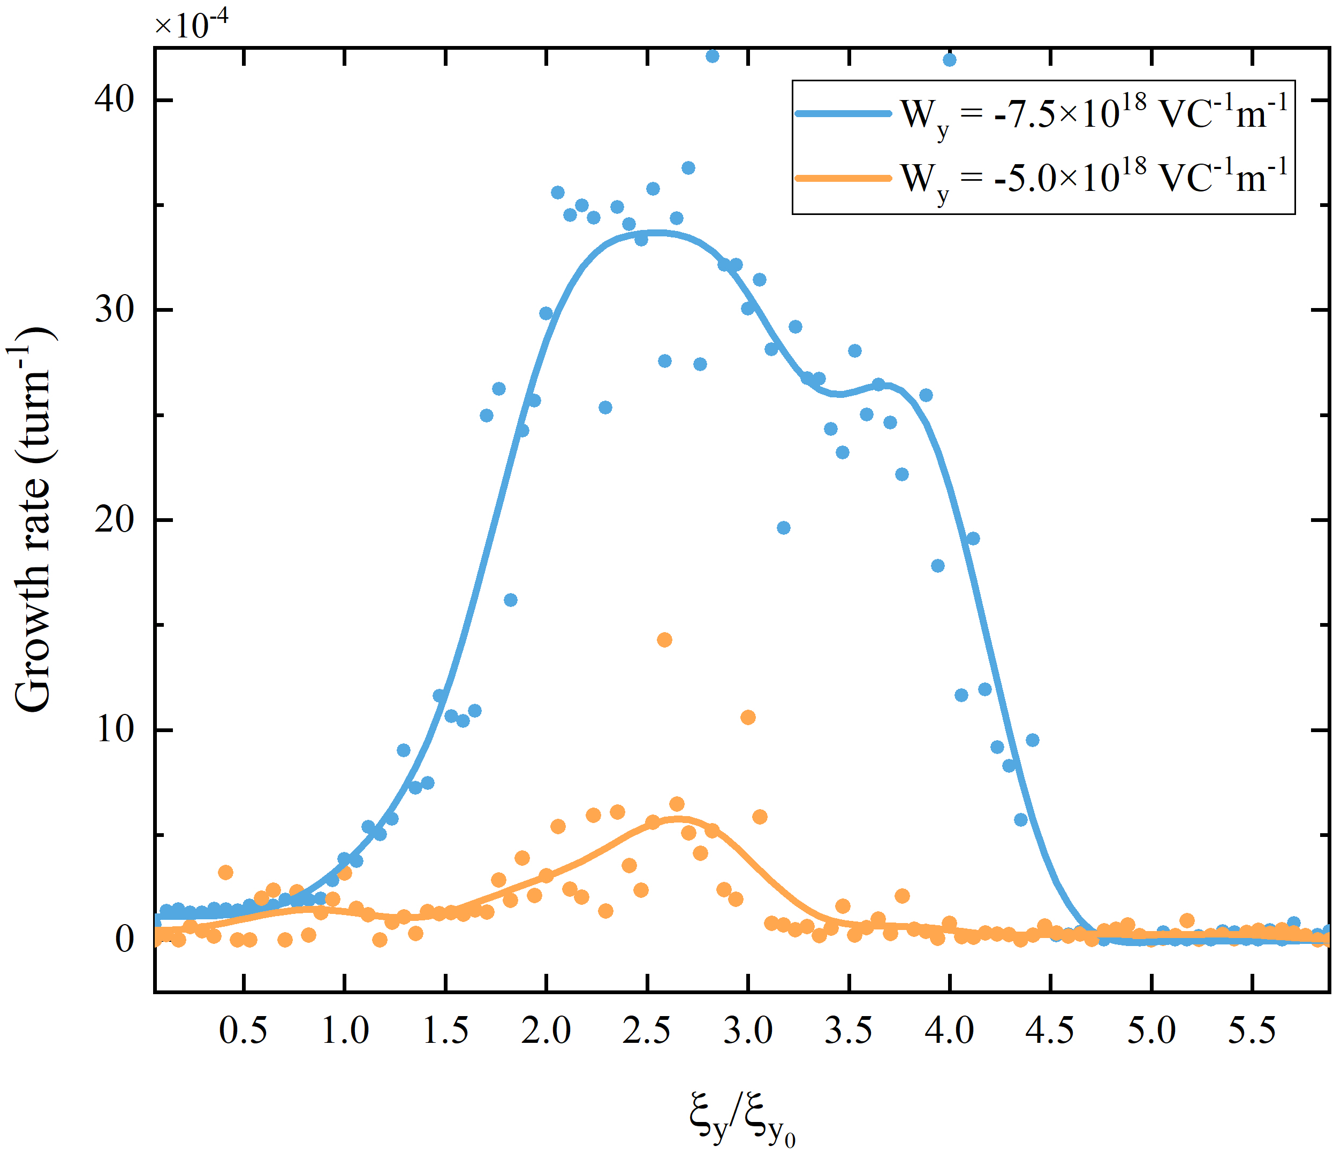
3. Vertical beam-beam parameter scan
The vertical -1 sideband moves 4 times faster than the coherent mode, and the beam stabilities are different
0 mode
0 mode
Mode frequency shift | W_{y}=-5.00E18 V/(Cm) | W_{y}=-7.50E18 V/(Cm)
Coherent mode | 0.60242 ξ_{y} | 0.61566 ξ_{y}
-1 sideband | 2.33555 ξ_{y} | 2.46351 ξ_{y}
-1 mode
W_{y}=-5.00E18 V/(Cm)
55% threshold
-1 mode
W_{y}=-7.50E18 V/(Cm)
83% threshold
The -1 sideband interacts with coherent mode much earlier, and therefore result in head-tail instabilities far below TMCI threshold.
Instability occurs without threshold and weakens as the overlaps of -1 sideband and coherent mode become larger.
Centroid continues to increase until beam loss
Notes:
While for the vertical direction, we also scan the beam-beam parameter with considering the wakefield, as shown by the beam spectra.
Here, the vertical wakefield is chosen to be two times the horizontal ones, so that the coherent tune shifts are the same for horizontal and vertical directions. This means the wakefield has the same impact on both horizontal and vertical motions.
From the figures and this table, we can see that the vertical -1 sideband moves much faster, about four times the coherent mode. So, the -1 sideband will interact with the coherent mode much earlier, and therefore result in head-tail instabilities far below the TMCI threshold.
Different from the horizontal direction, once the vertical instability is stimulated, the bunch center will continue to increase until the particle is lost. Besides, the vertical instability occurs without threshold and weakens as the overlaps of -1 sideband and coherent mode become larger.

Slide 14
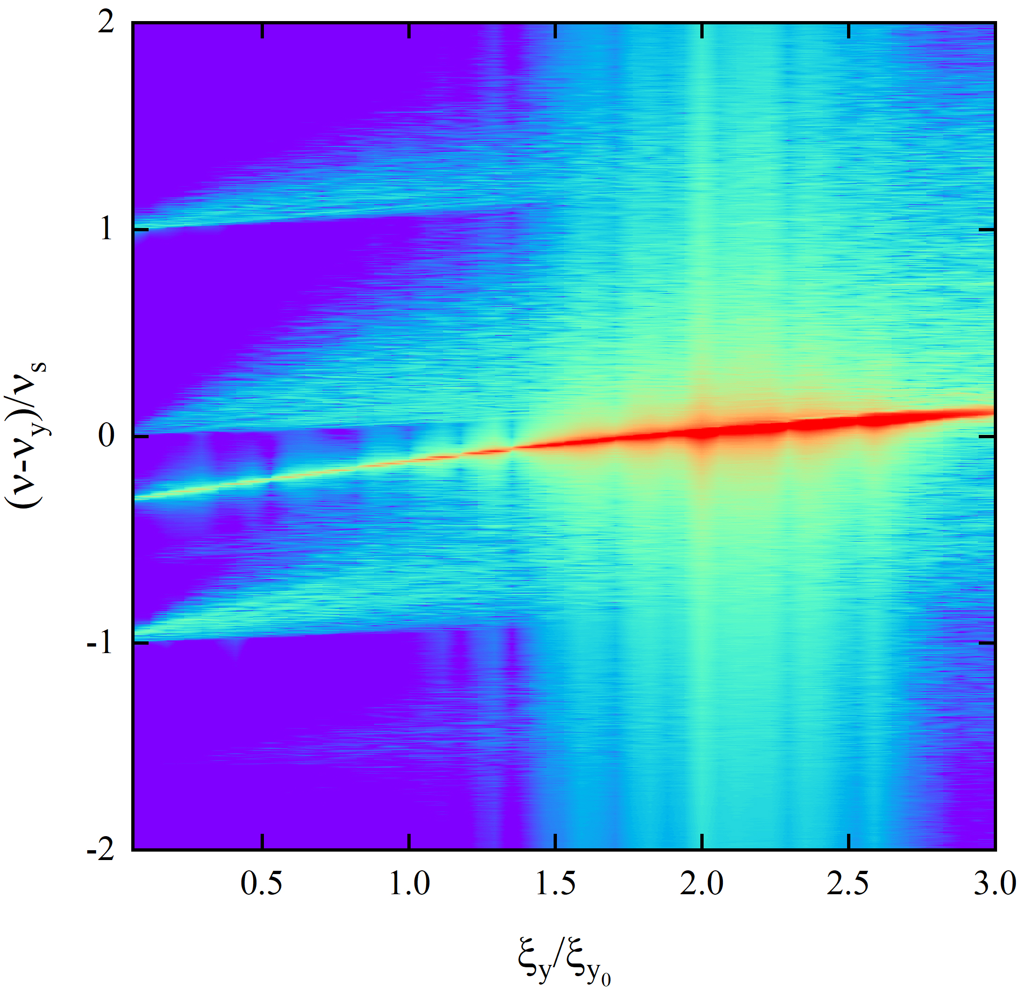
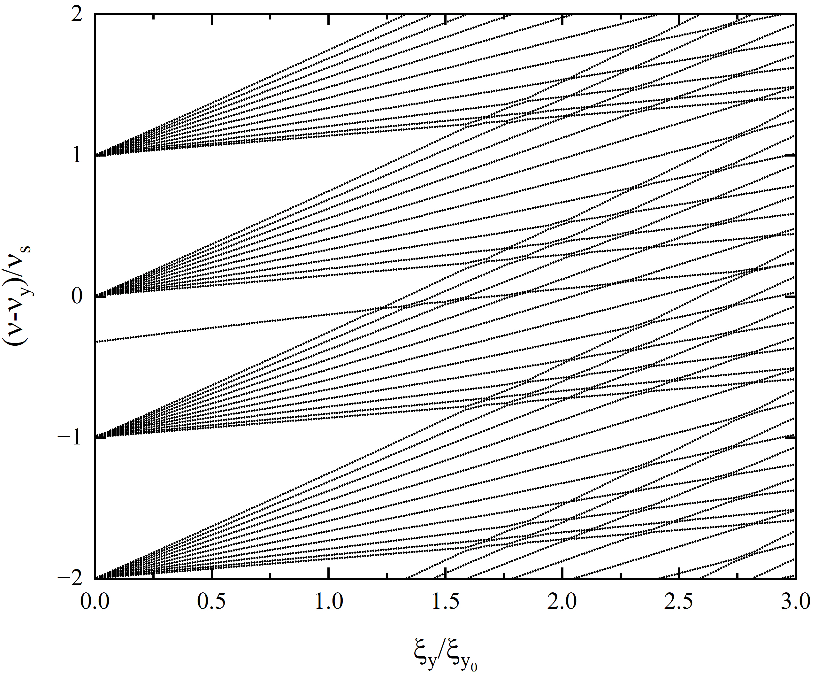
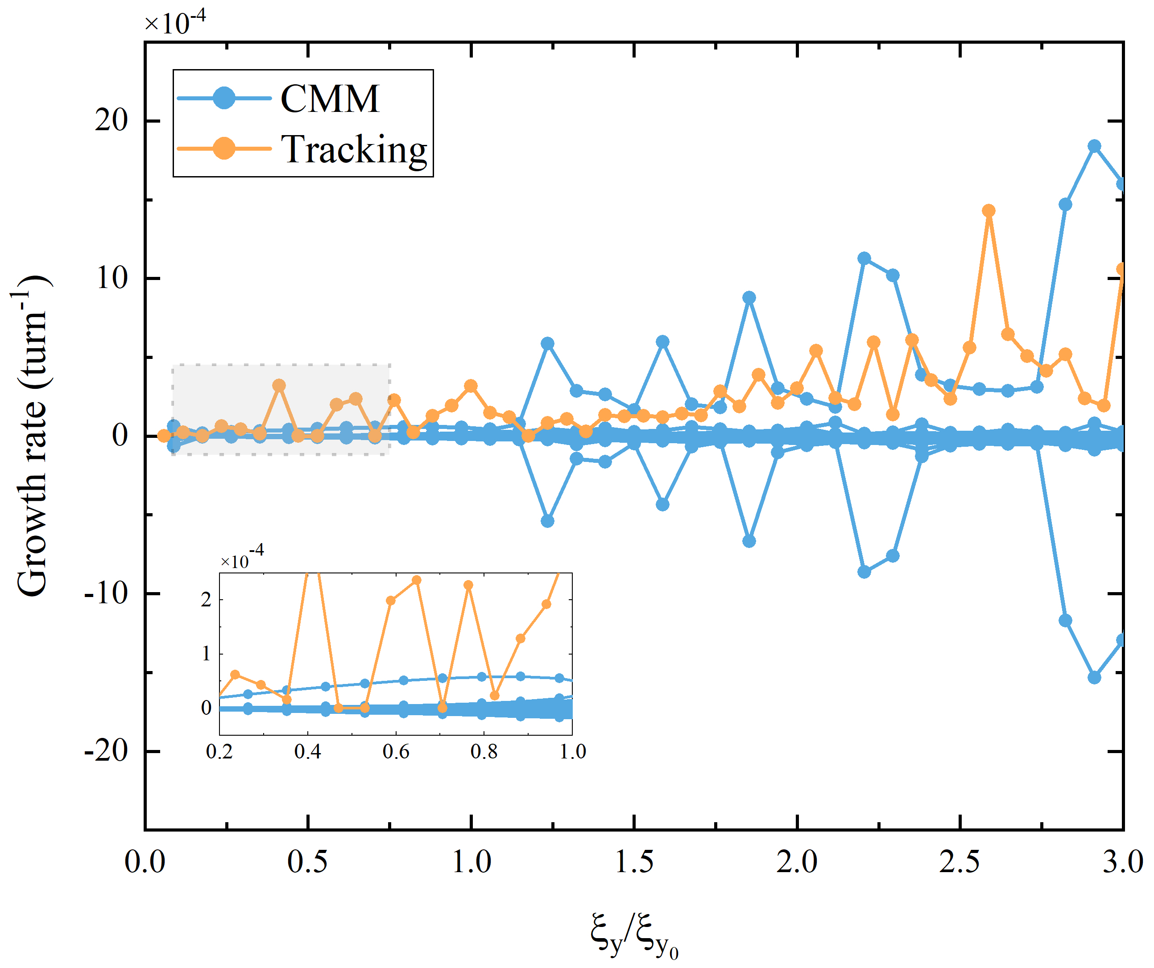
3. Tracking vs circulant matrix model
Successive coupling and decoupling
Mode frequency shift | Simulation | CMM
Coherent mode | 0.60242 ξ_{y} | 0.59746 ξ_{y}
-1 sideband | 2.33555 ξ_{y} | 2.32447 ξ_{y}
Predictions of the beam spectra and the instability growth rates are qualitatively the same for the two methods.
The analytical approach confirms the existence of such a head-tail type instability.
Notes:
Only the tracking simulations are not enough, we should get some support from the theoretical method. Here, we choose the circulant matrix model.
By scanning the beam-beam parameter with these two methods, the left two figures compare the results for beam spectra and the right figure shows the instability growth rates. This table gives the fitted mode frequency shifts for the coherent mode and the -1 sideband. These results agree well with each other.
So, we can conclude that the analytical method confirms the existence of such a head-tail type instability.

Slide 15
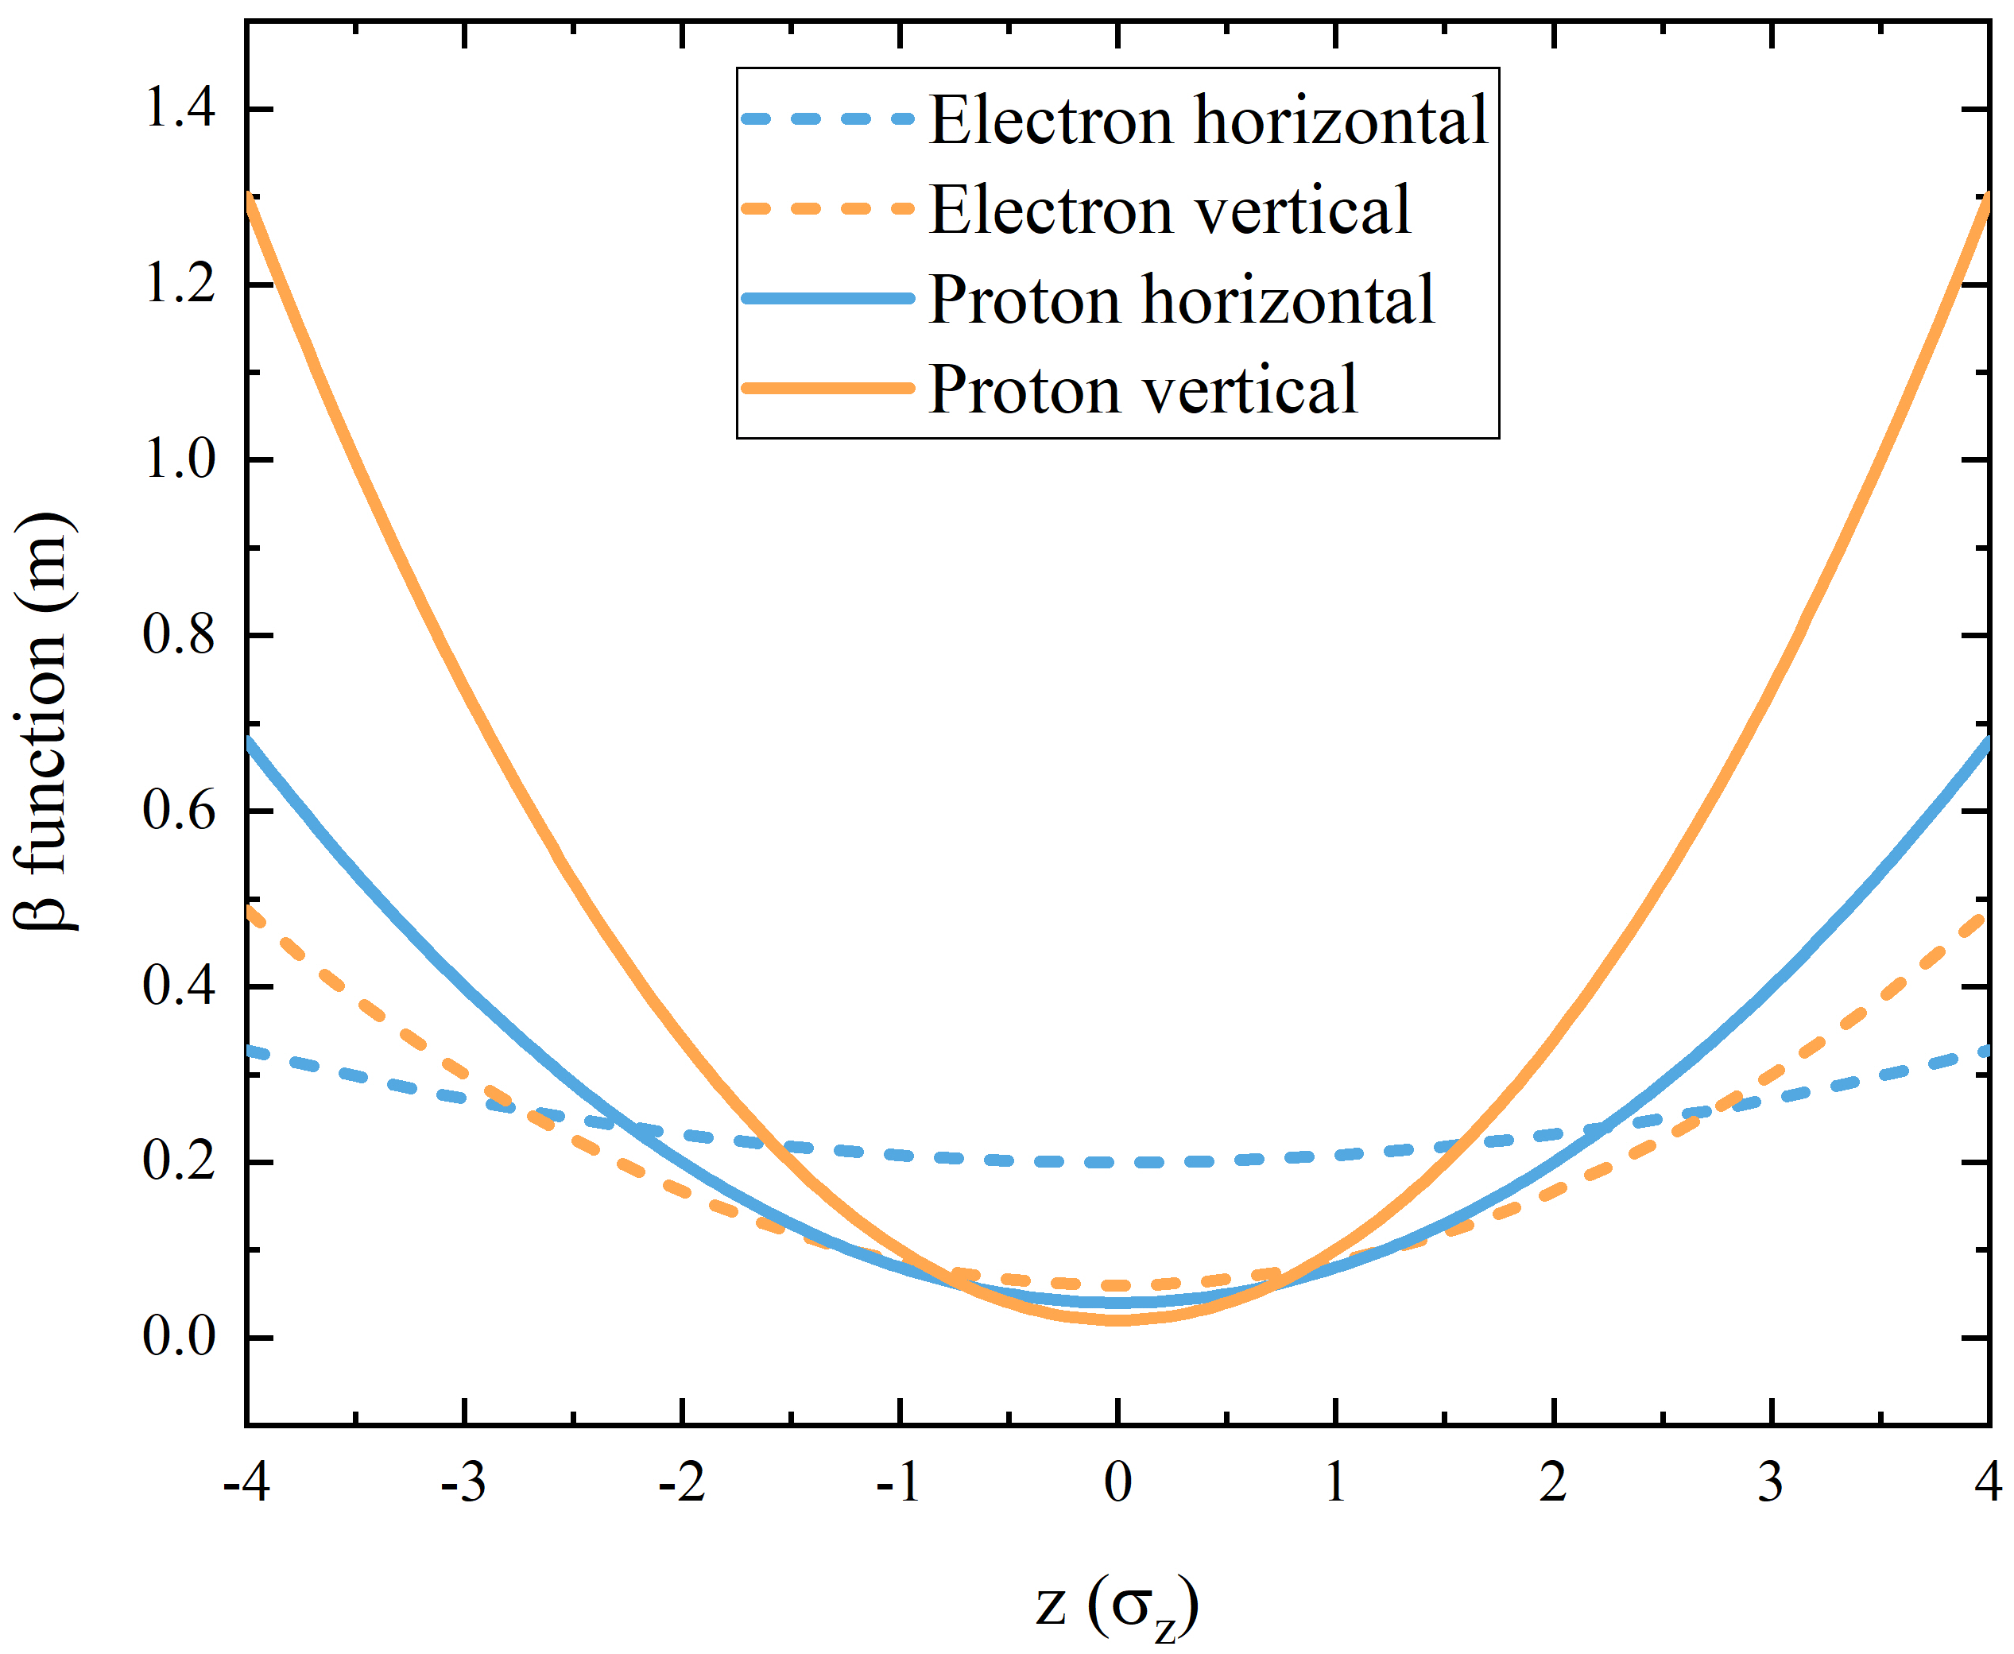
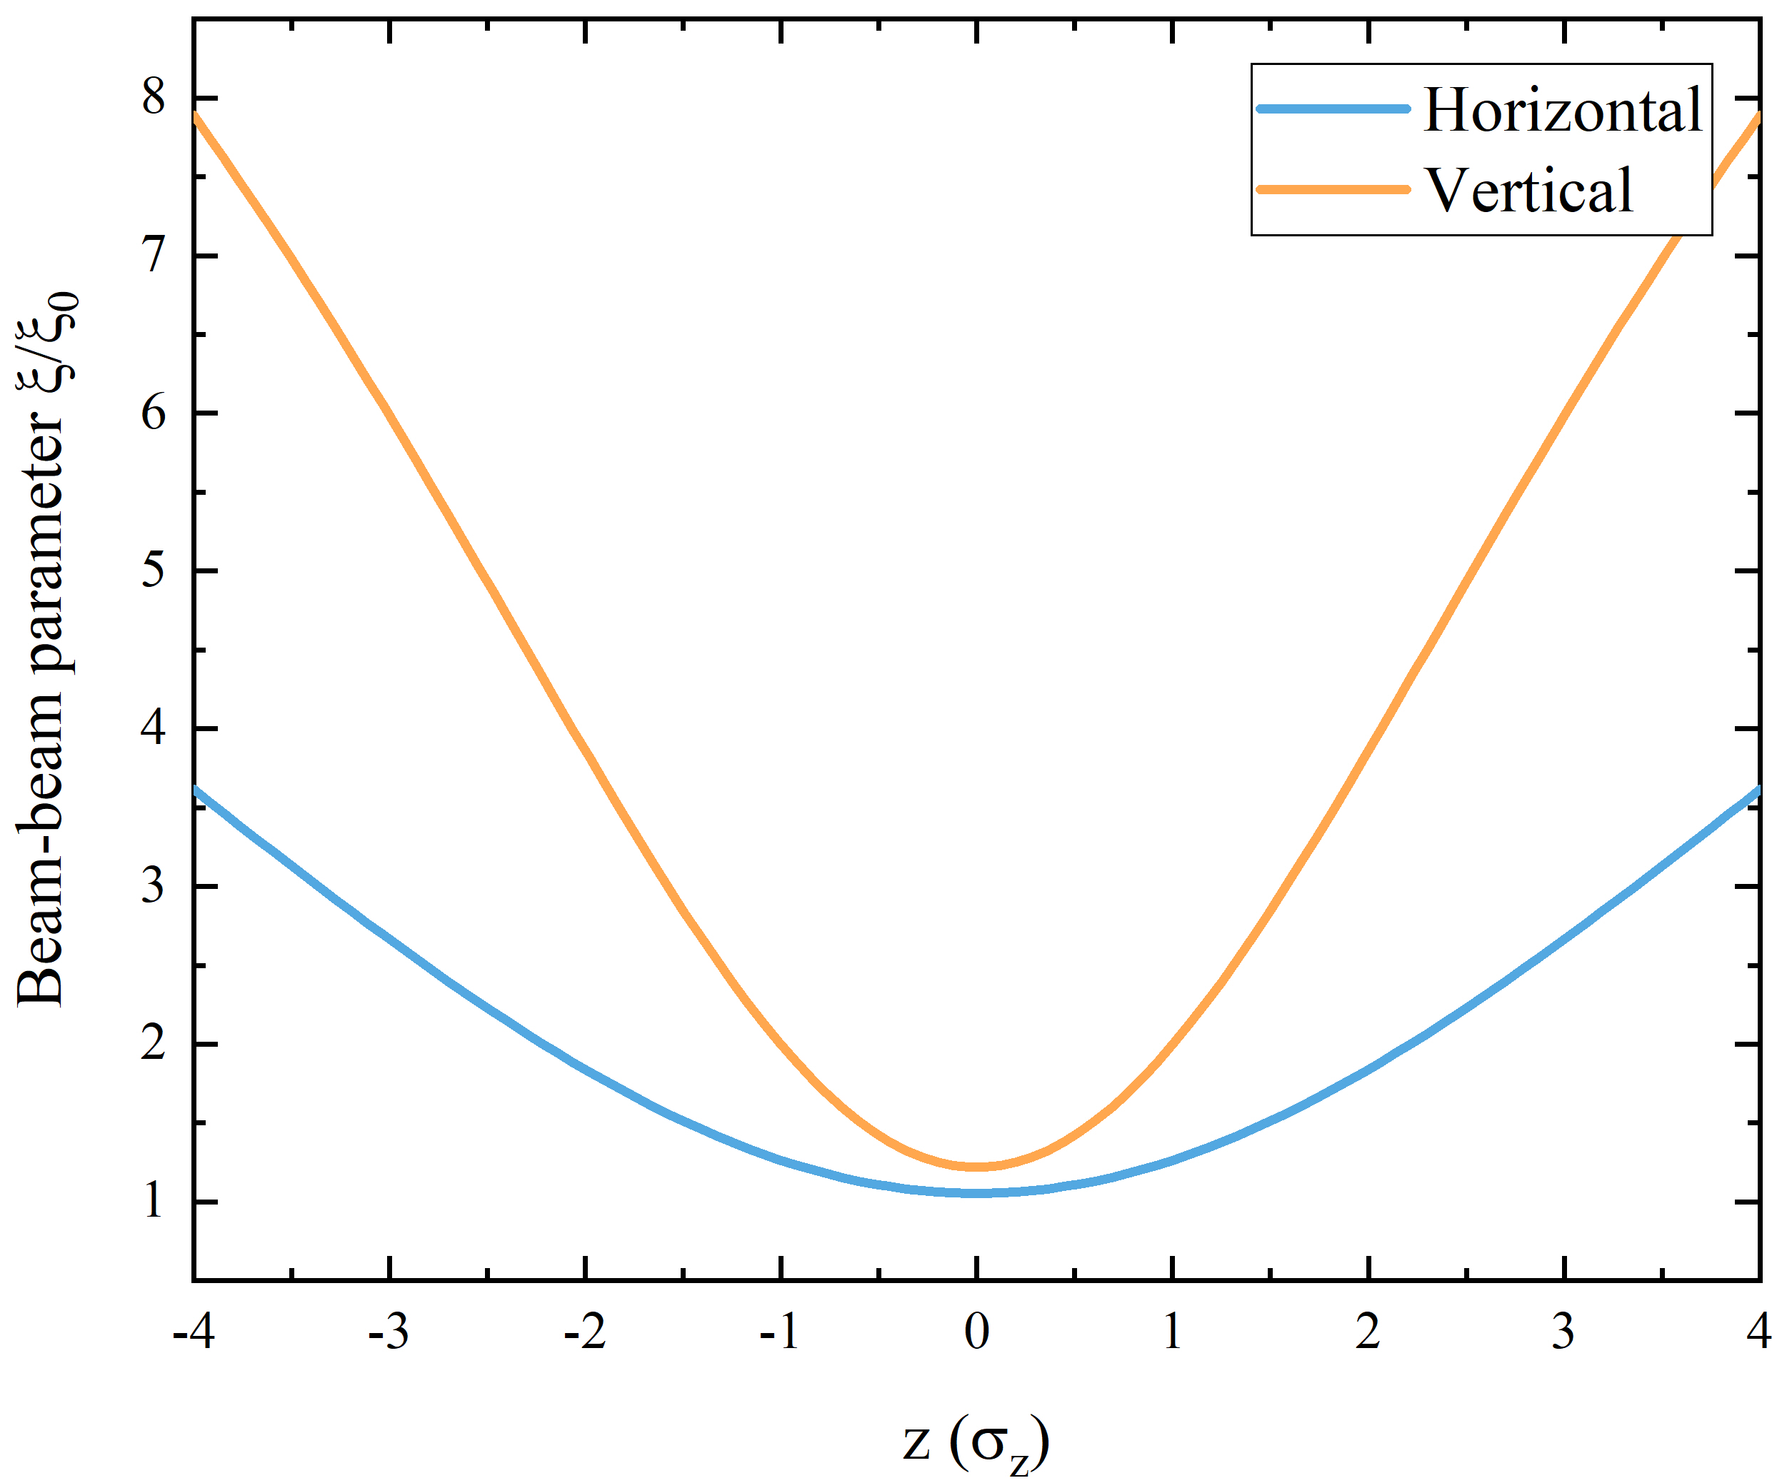
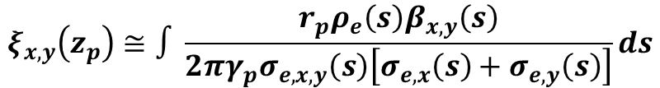
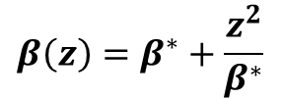
3. Instability mechanism
For flat asymmetric colliding beams, these four β* grow at different rates due to hourglass effect, and beam sizes are no longer matched at CP (NOT IP). This results in a significant growth and modulation of proton beam-beam parameters.
Protons with larger synchrotron amplitude will experience much stronger bb forces.
~ Responsible for the broadening of the longitudinal sidebands.
Vertical bb parameter growth and modulation are more severe.
~ Responsible for beam stability and spectrum differences in two transverse planes.
Hourglass effect is a possible mechanism for this newfound head-tail instability.
$$β\left(z\right)=β^{∗}+\frac{z^{2}}{β^{∗}}$$
$$ξ_{x,y}\left(z_{p}\right)≅∫\frac{r_{p}ρ_{e}\left(s\right)β_{x,y}\left(s\right)}{2πγ_{p}σ_{e,x,y}\left(s\right)\left[σ_{e,x}\left(s\right)+σ_{e,y}\left(s\right)\right]}ds$$
Proton beam-beam parameter growth
Proton grows faster
Notes:
Now, I will discuss the instability mechanism.
The EicC project adopts flat asymmetric colliding beams, the four beta-star grow at different rates due to the hourglass effect, and beam sizes are no longer matched at collision points. The proton beta function is smaller and grows much faster, as shown in this figure. This results in a significant growth and modulation of proton beam-beam parameters.
From the right figure, first, protons with larger synchrotron amplitude will experience much stronger beam-beam forces. This is responsible for the broadening of the longitudinal sidebands. Second, the vertical beam-beam parameter growth and modulation are more severe. This is responsible for beam stability and spectrum differences in two transverse planes.
Based on these qualitative explanations, we can speculate that the hourglass effect is a possible mechanism for this newfound head-tail instability.

Slide 16
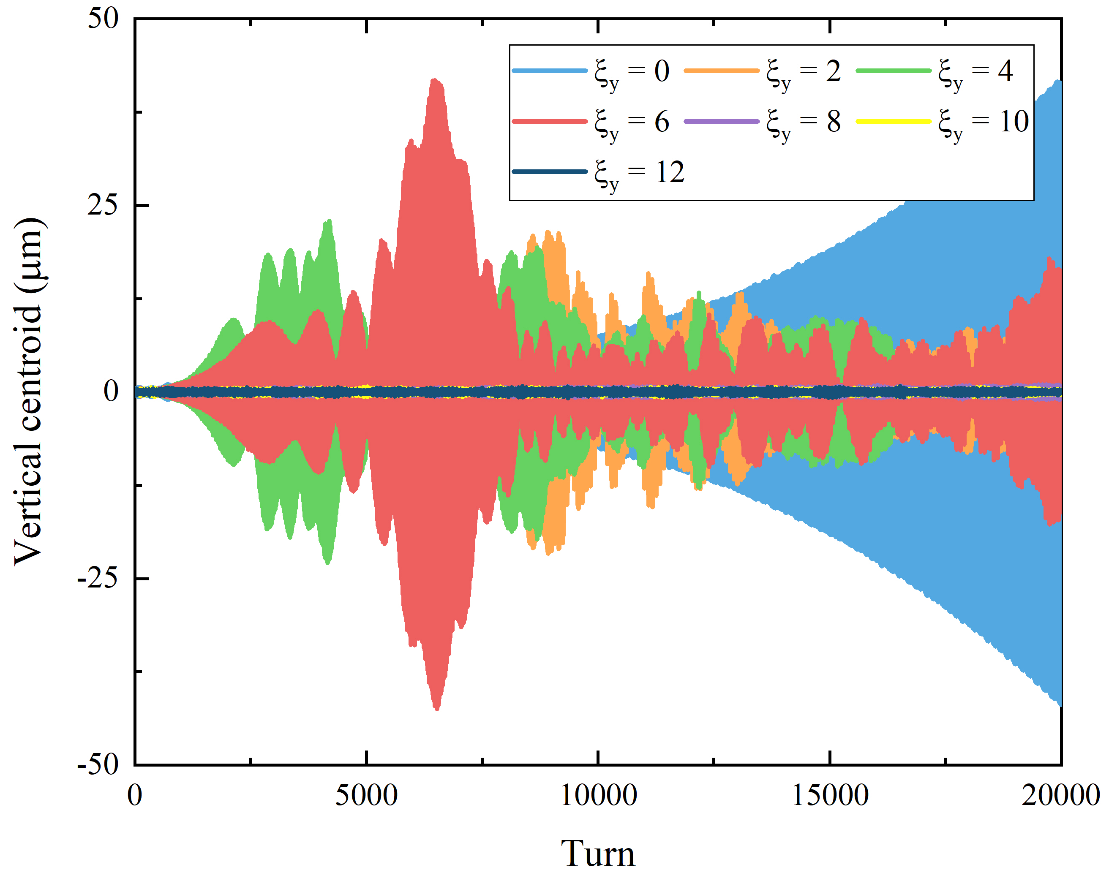
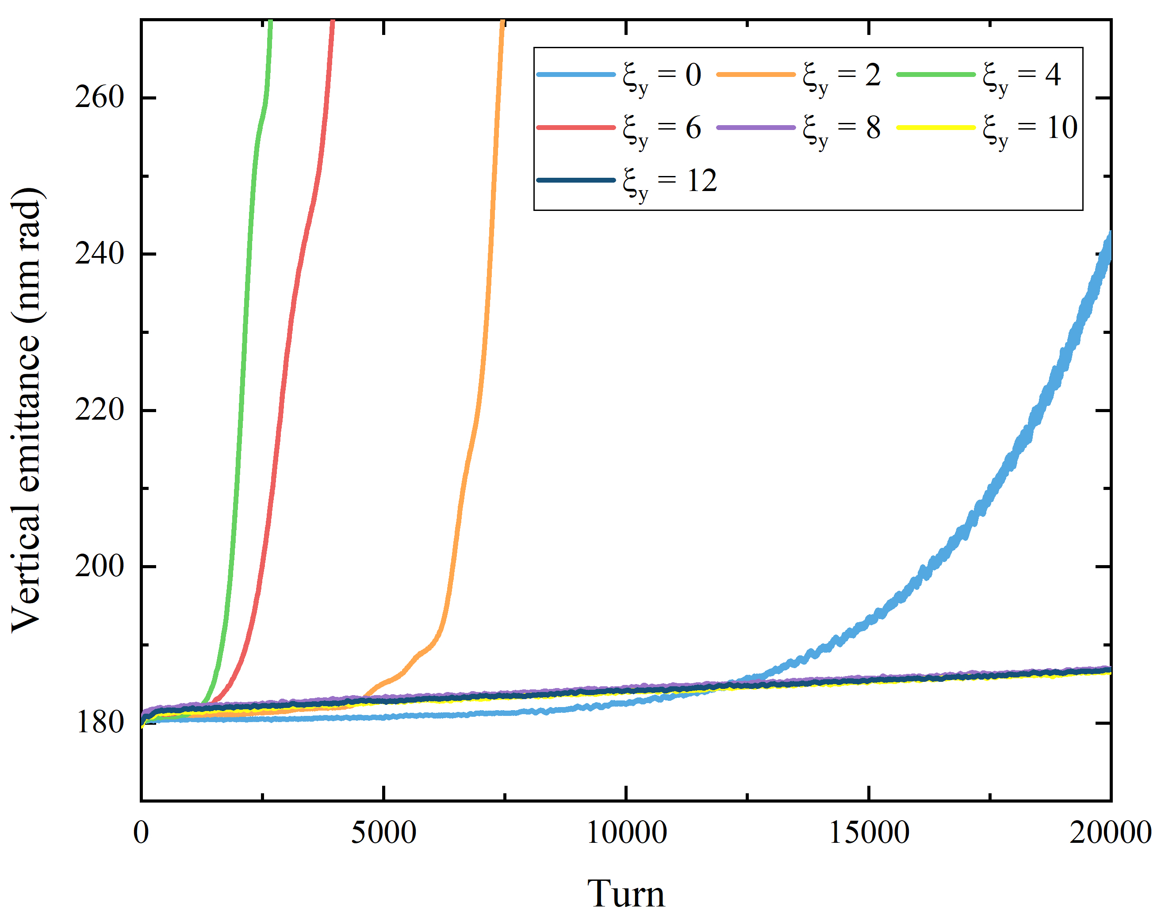
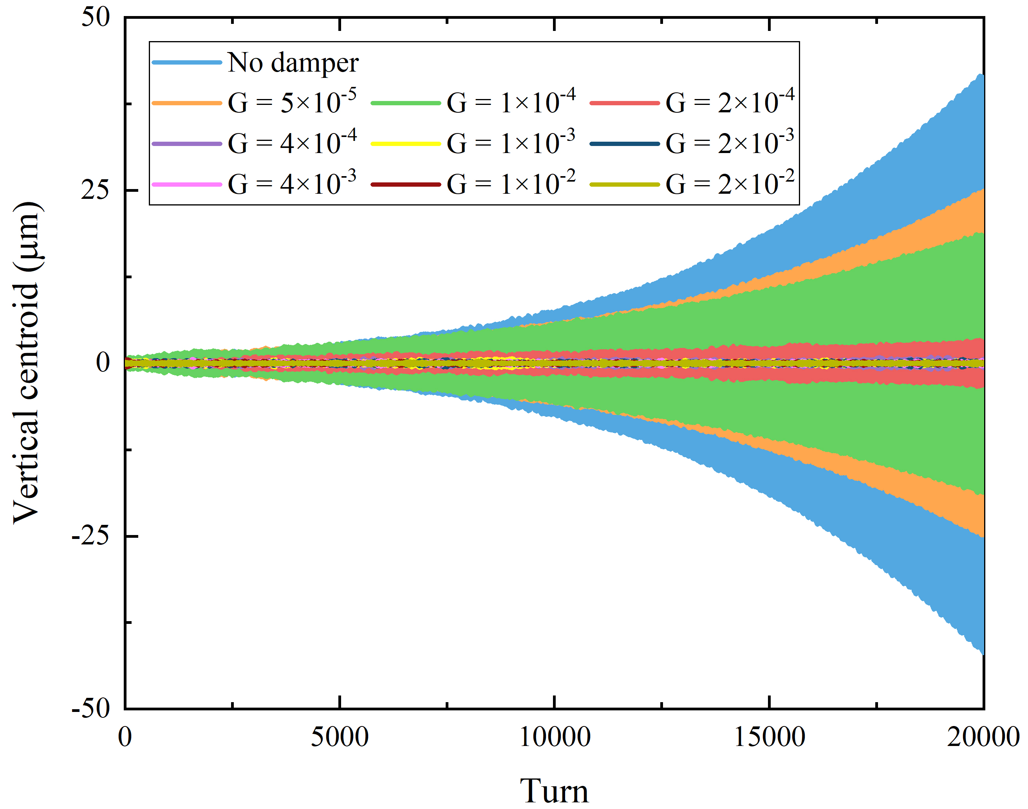
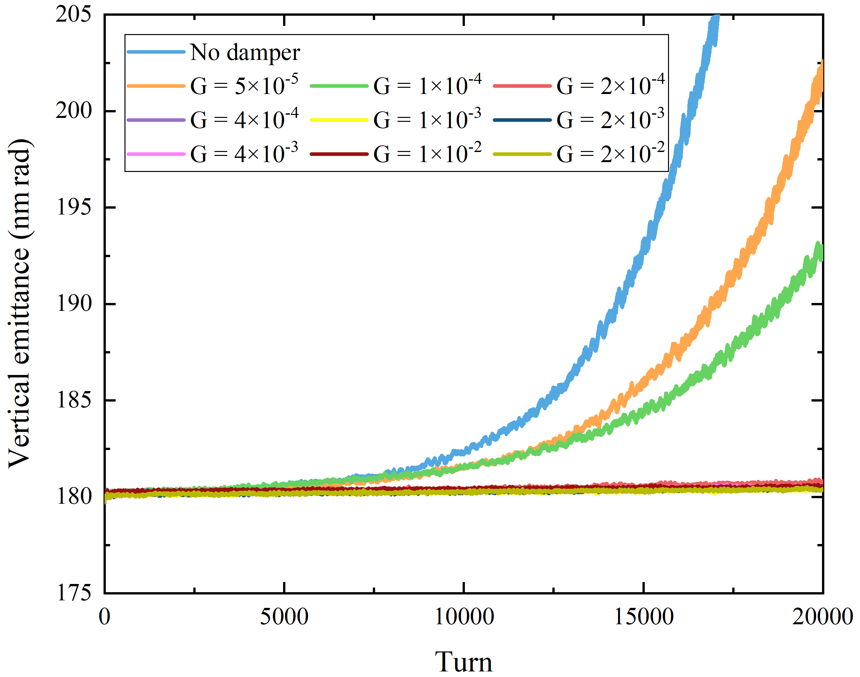
3. Mitigation methods
Chromaticity
Above transition, a positive chromaticity larger than +8 can suppress this head-tail instability
Significant emittance growth is present
Ideal feedback
Exponential centroid motion is mitigated with a feedback gain higher than 4×10⁻⁴
Beam emittance is preserved
A more efficient method
Notes:
In this slide, we study the instability mitigation methods.
With a positive chromaticity higher than 8, the coherent motion can be suppressed, but a significant emittance growth is present.
By using the transverse bunch-by-bunch feedback with a feedback gain of four times ten to minus four, the instability is suppressed, and the emittance is preserved. This method seems more efficient.

Slide 17
Outline
Hourglass effect in EicC
Simulation model
Head-tail instability of asymmetric colliding beams
Numerical observations
Key parameter scans and instability mechanism
Mitigation methods
Float waist collision scheme
Compensation principles of the hourglass effect
Numerical proofs and application to the head-tail instability
Summary
Notes:
In the following, I will talk about the Float Waist collision scheme, which can suppress the hourglass effect for the proton beam.

Slide 18
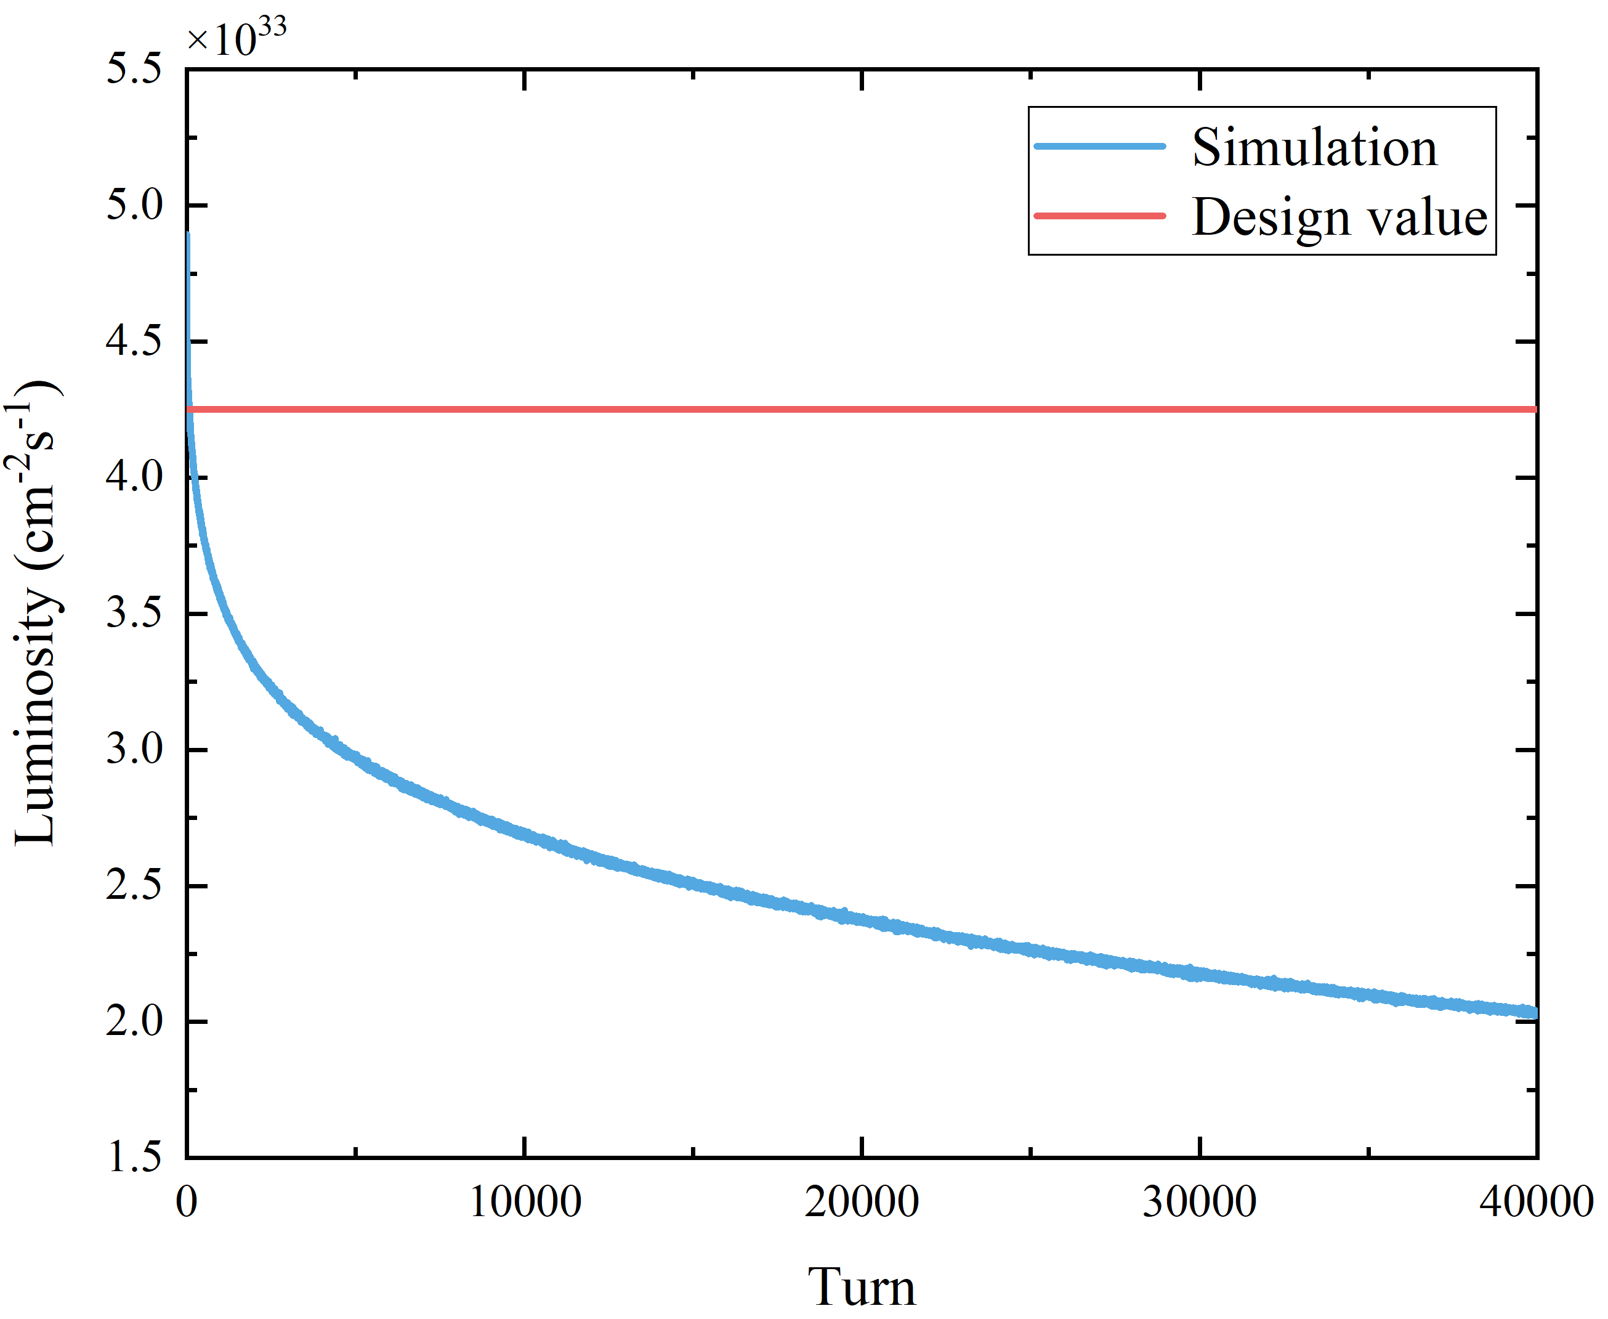
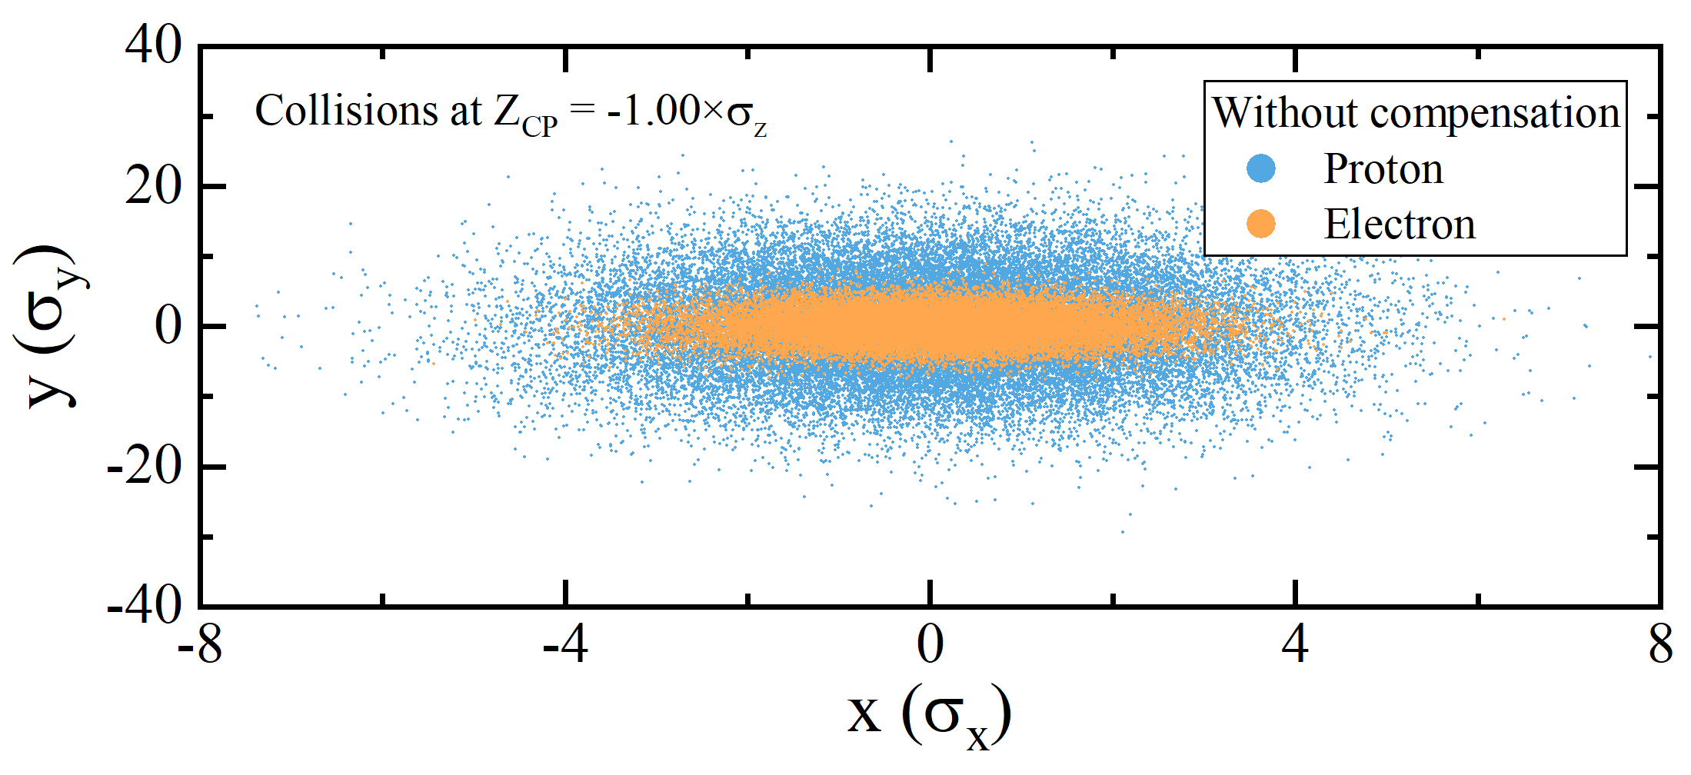
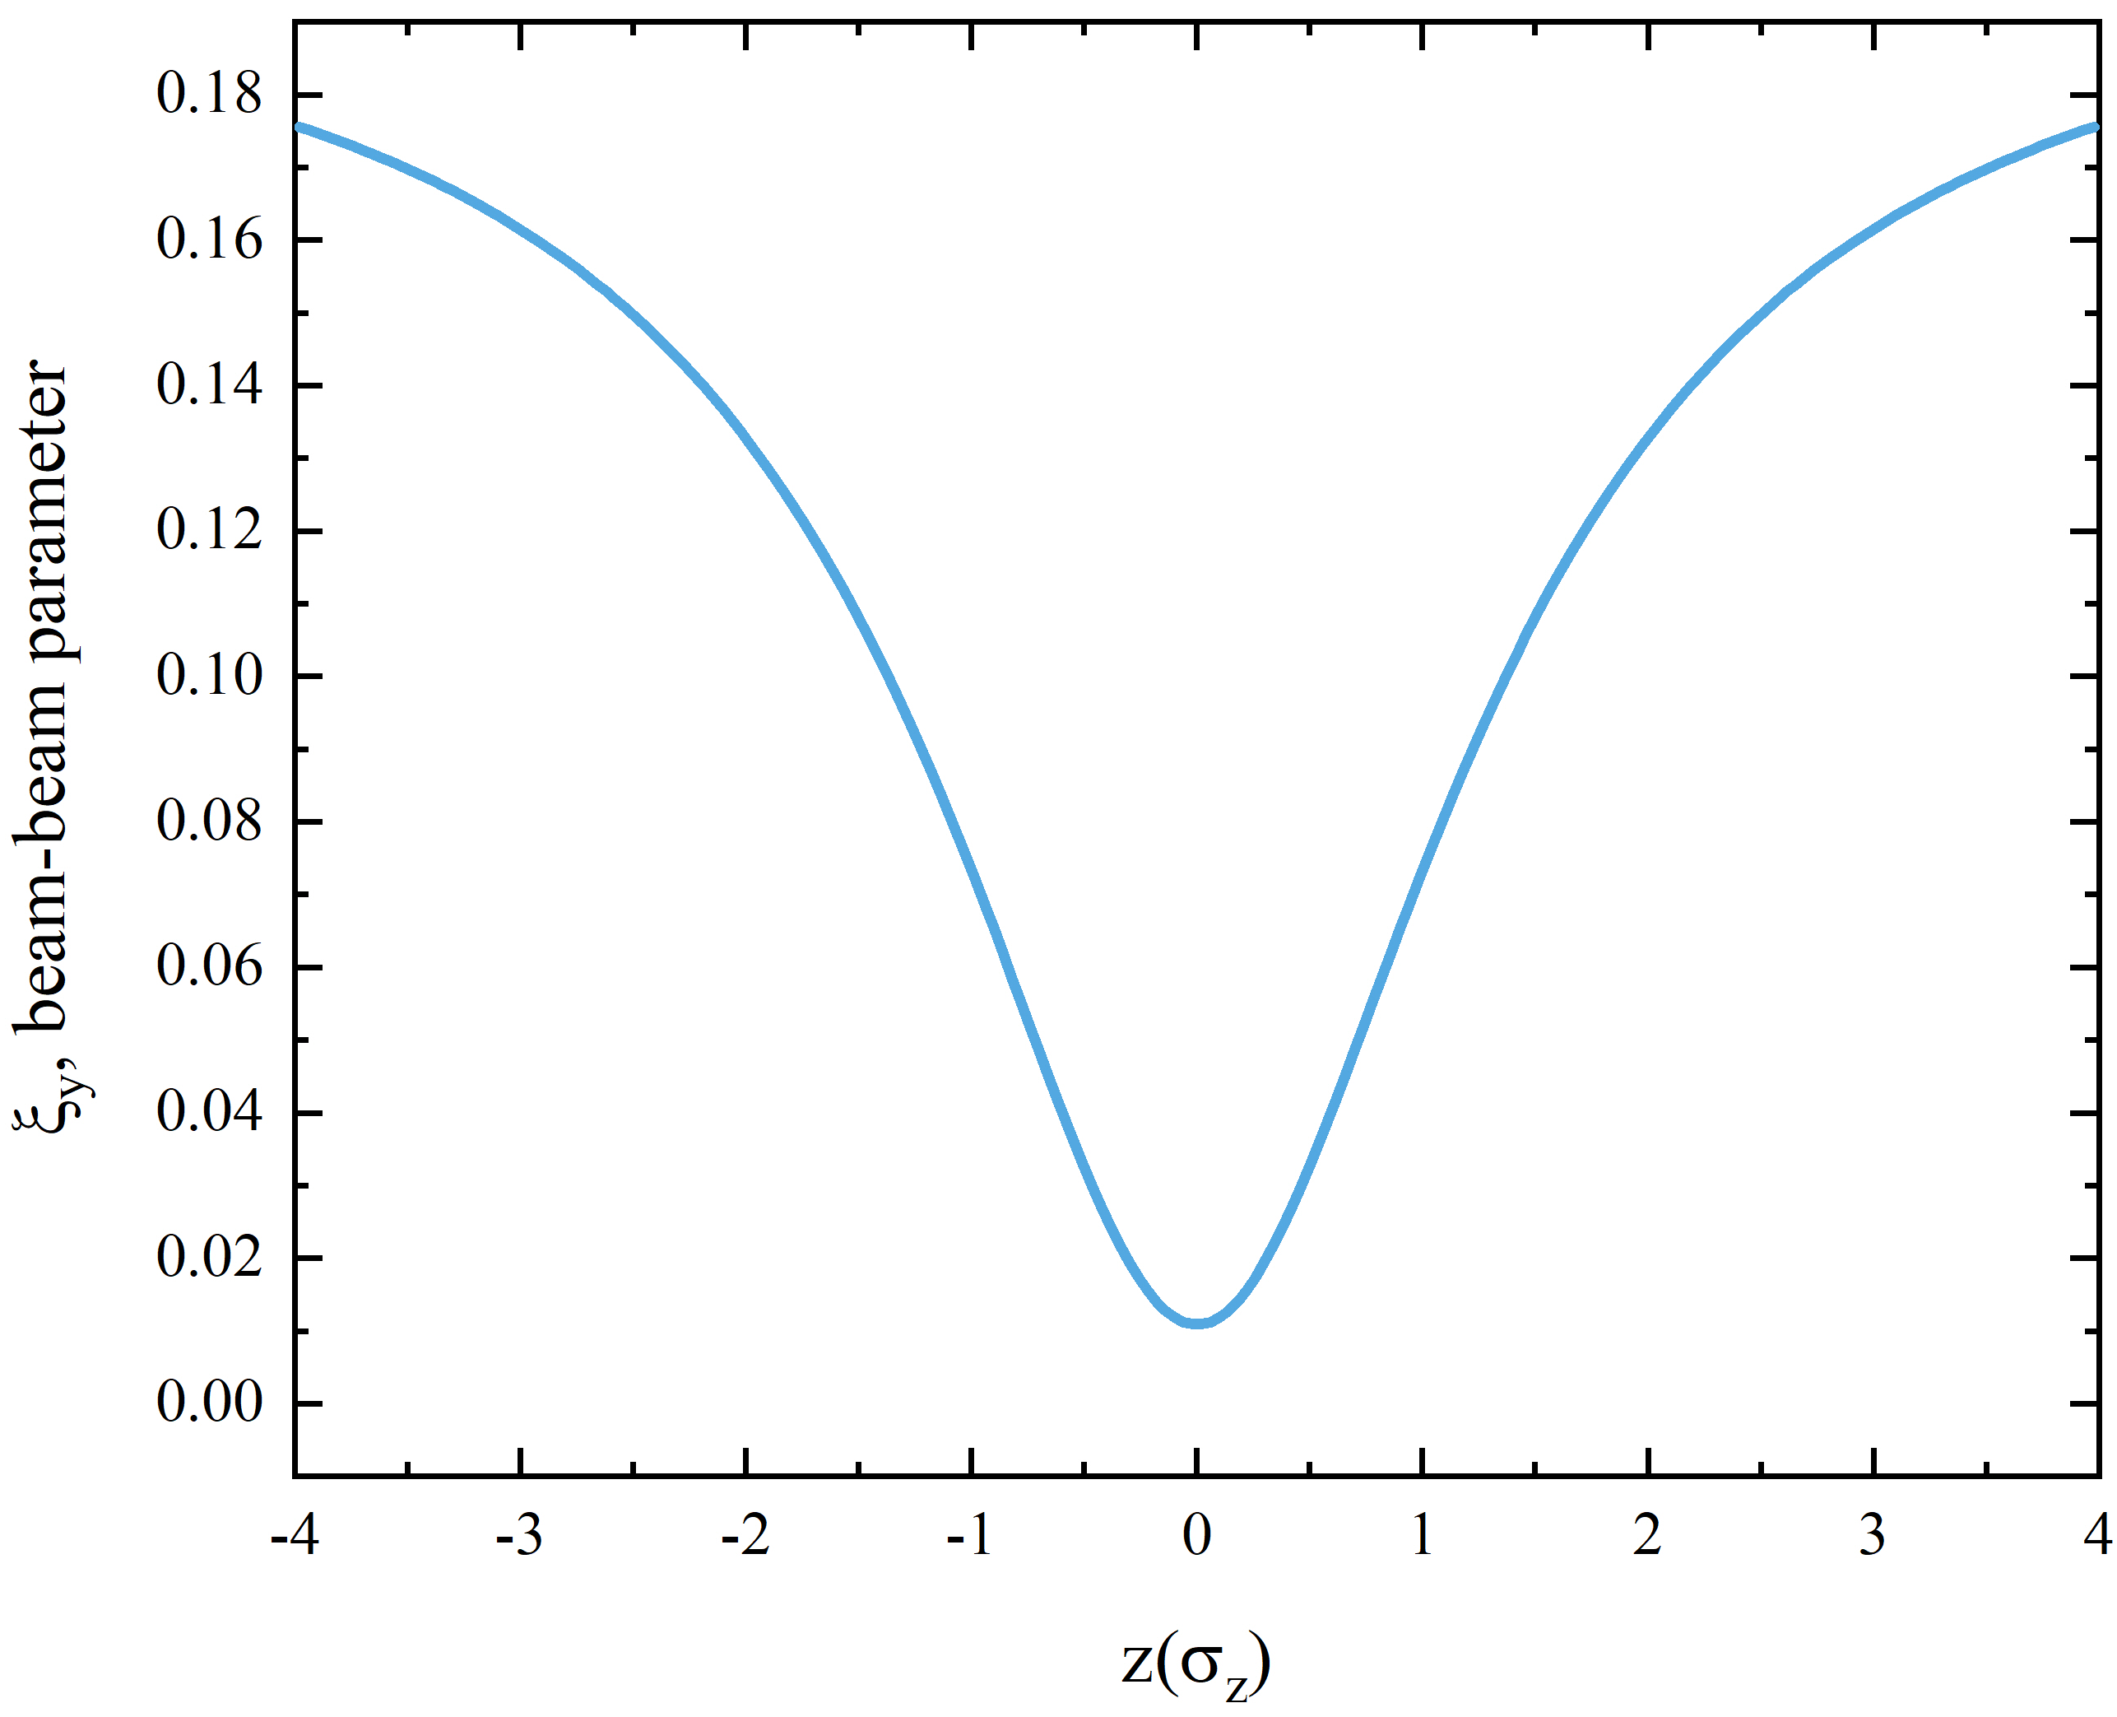
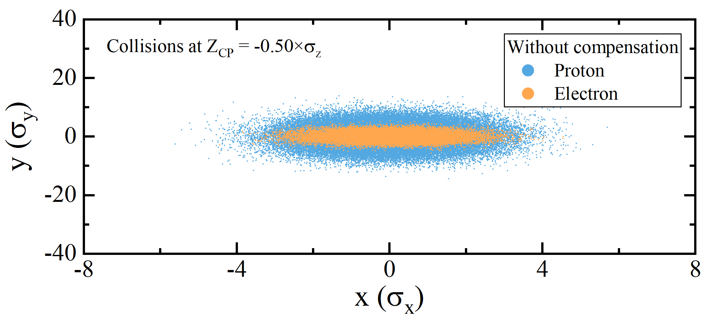
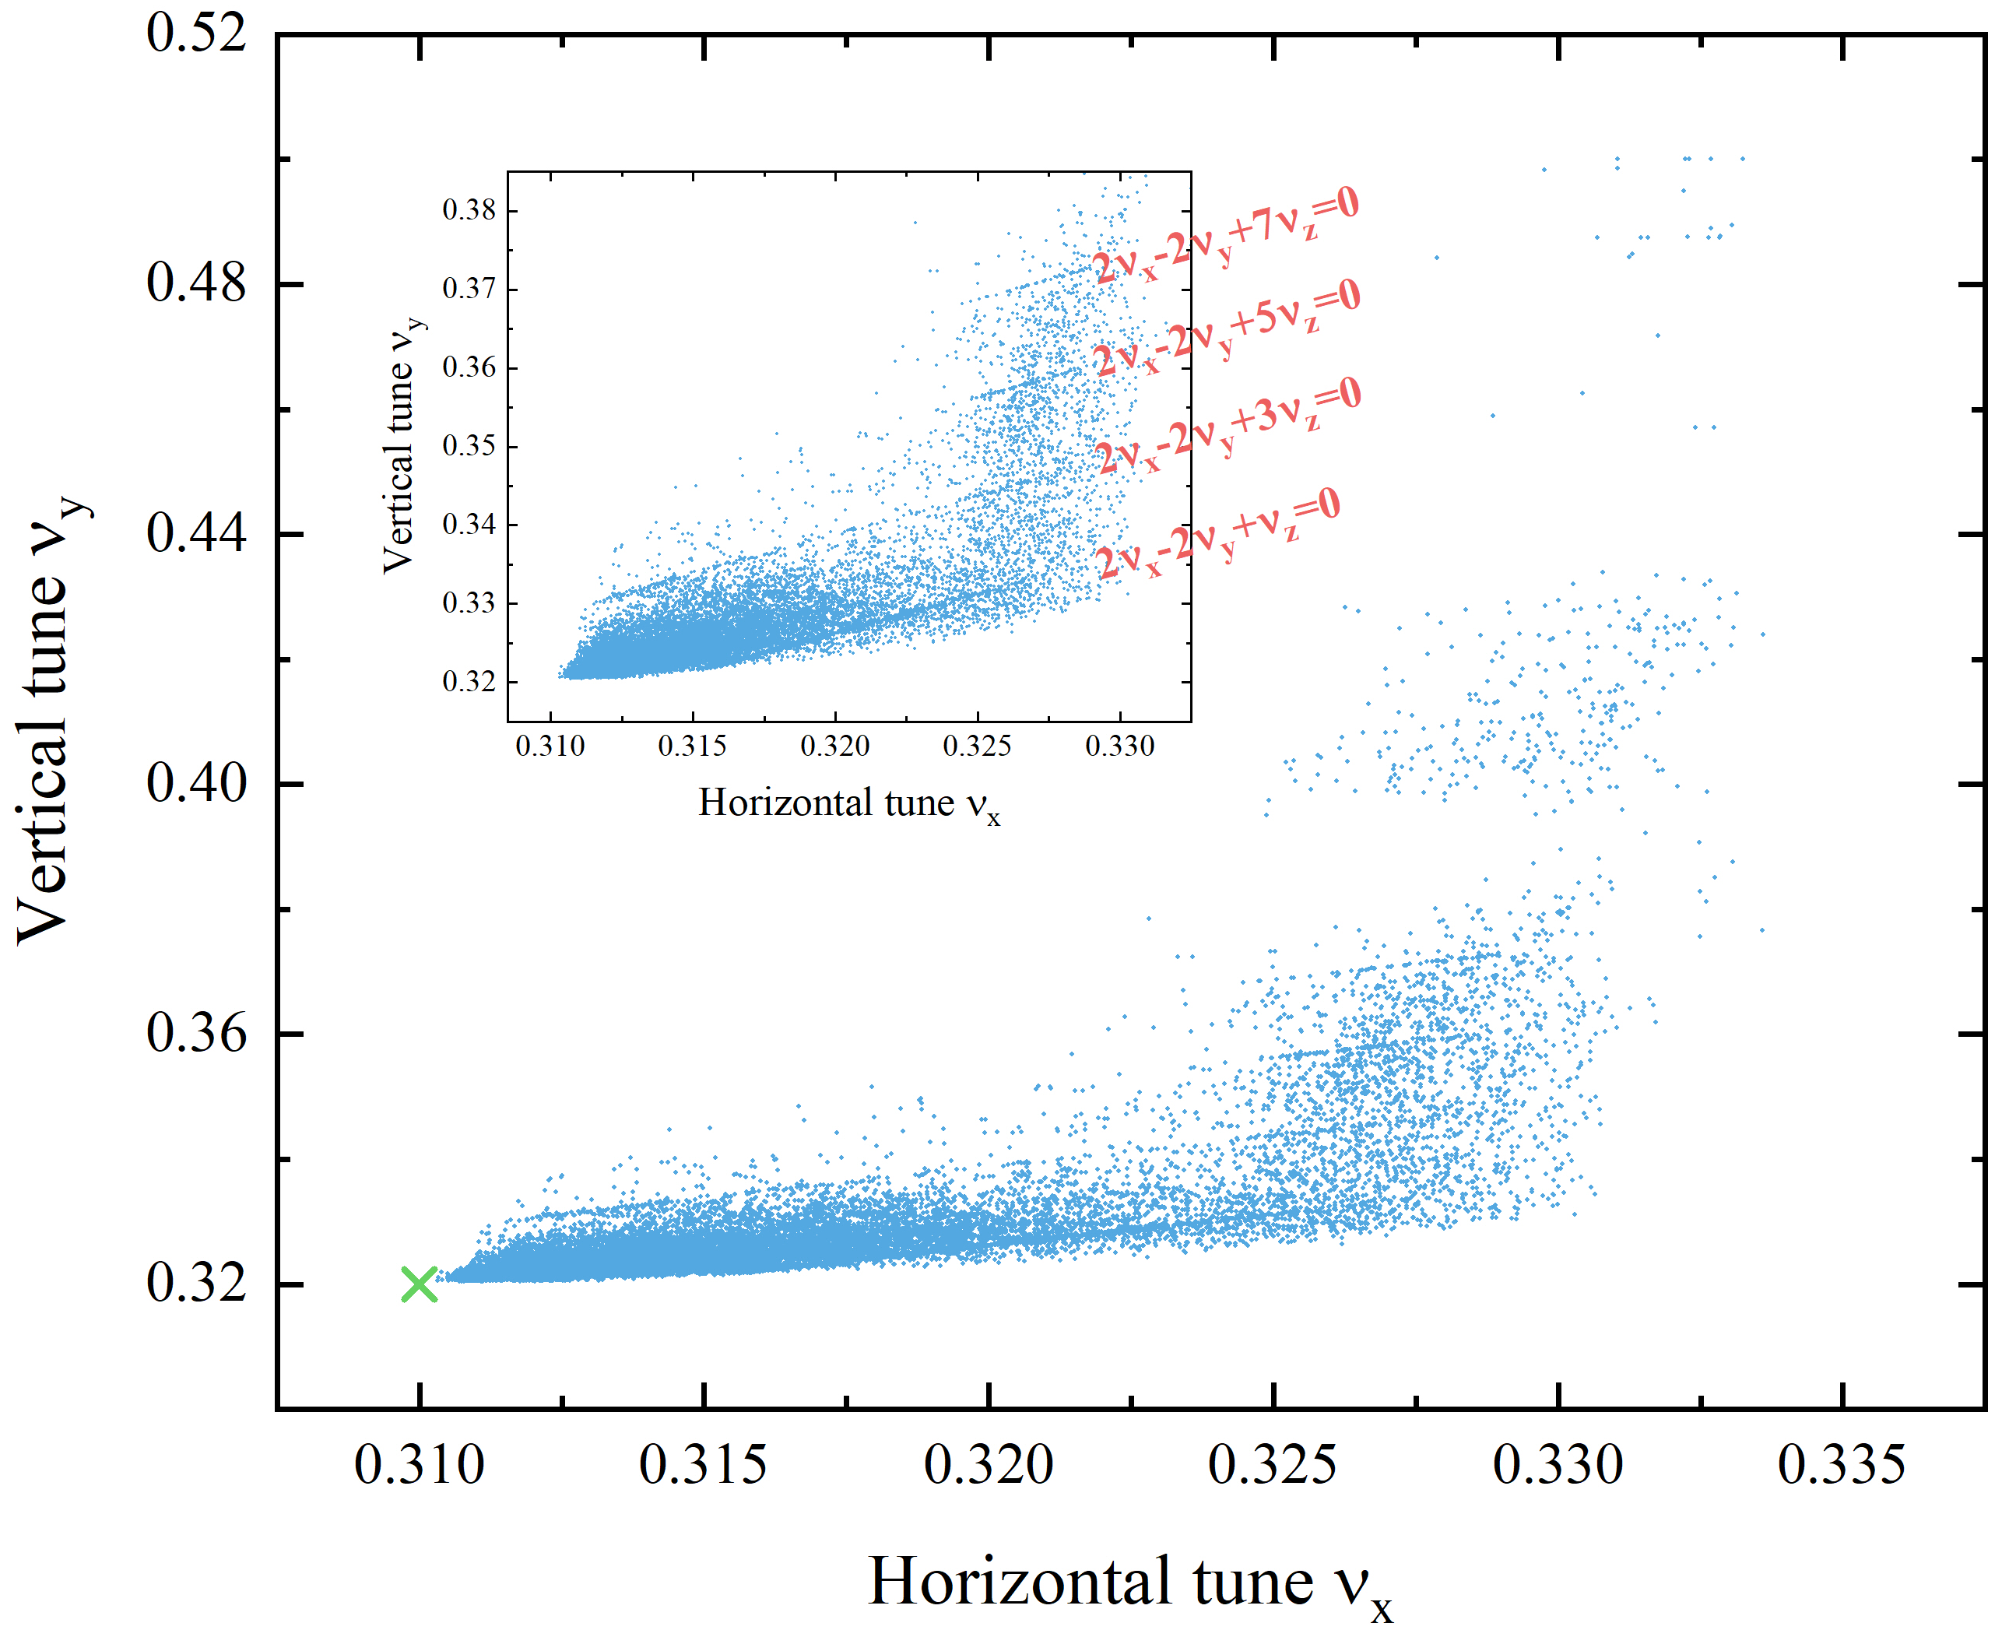
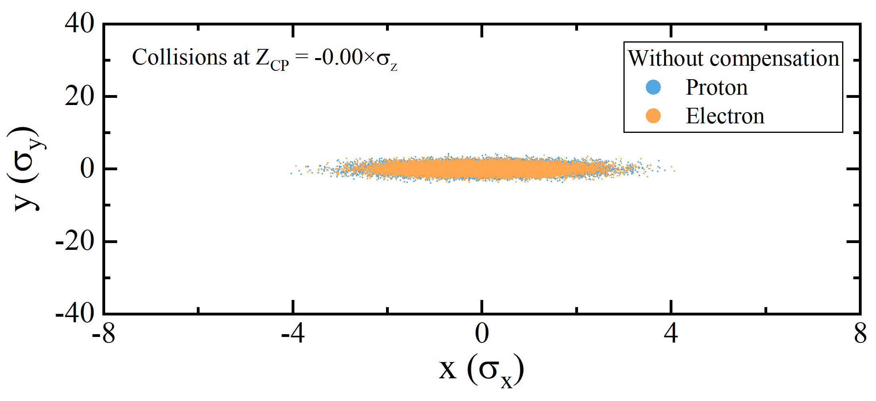
4. Difficulties with new parameters
BB parameter modulation is more severe
S_{CP} = -1.0σ_{z}
Degradation time ~ 200 ms
S_{CP} = -0.5σ_{z}
Simulation predicts very bad luminosity lifetime.
Beam sizes mismatch cause severe BB parameter growth and consequently large tune spread and a fair number of SB resonances.
Synchro-betatron resonances
BB tune spread up to half-integer resonance
S_{CP} @ IP
Beam sizes mismatch in collisions
Notes:
With new design parameters, the hourglass effect becomes more severe, besides the coherent head-tail instability, the EicC project faces another difficulty.
Simulation predicts a very bad luminosity lifetime. This is because the beam sizes mismatch will cause severe beam-beam parameter growth and consequently produce large tune spread of beam particles. A fair number of synchro-betatron resonances are excited, as shown in this figure.
So, the hourglass must be compensated to fulfill the luminosity requirement.

Slide 19
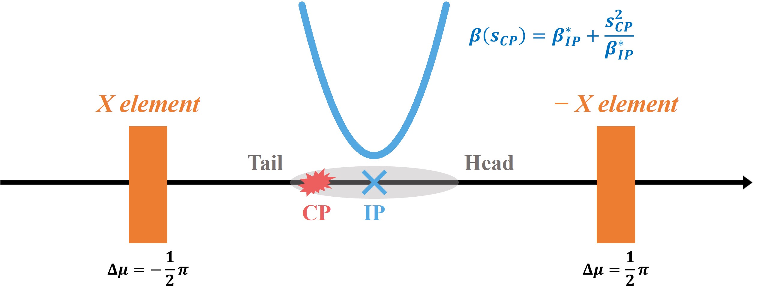








4. Hourglass compensation principles
Theoretical criterion
Without “X-element”, the transfer matrix from IP to CP is,
$M=M4 M3 M1=\left[\begin{matrix}1 & S_{CP} \\ 0 & 1\end{matrix}\right]$
Beam direction
With additional defocusing force from “X-element”, the transfer matrix becomes：
$$M’=M4 M3 M2 M1=\left[\begin{matrix}1 & S_{CP}−Kβ_{X}β^{∗} \\ 0 & 1\end{matrix}\right]$$
$$M1=\left[\begin{matrix}0 & −\sqrt{β_{X}β^{∗}} \\ \frac{1}{\sqrt{β_{X}β^{∗}}} & 0\end{matrix}\right]$$
Step 1: IP → X
$$K=\frac{S_{CP}}{β_{X}β^{∗}}$$
IP is no longer the fixed focusing point, proton beam waist locates at arbitrary CP
Step 2: Kicks @ X
$$M2=\left[\begin{matrix}1 & 0 \\ K & 1\end{matrix}\right]$$
$$M3=\left[\begin{matrix}0 & \sqrt{β_{X}β^{∗}} \\ −\frac{1}{\sqrt{β_{X}β^{∗}}} & 0\end{matrix}\right]$$
Step 3: X → IP
Proton bunch is much longer than electron bunch, K is foreknown:
$$S_{CP}=\frac{1}{2}\left(Z_{p}−Z_{e}\right)=\frac{1}{2}Z_{p}$$
Step 4: IP → CP
$$M4=\left[\begin{matrix}1 & S_{CP} \\ 0 & 1\end{matrix}\right]$$
The idea is initially proposed for HERA-TESLA collider.
Notes:
This slide will discuss the theoretical criterion for hourglass compensation.
Conventionally, the beams will collide at the collision point and the transfer matrix from IP to CP is a drift section.
If we place a pair of X element at both sides of the IP with phase advances of ninety degrees, providing additional defousing forces for beam particles, the transfer matrix from IP to CP should consist of these four steps and becomes this.
Then, if we set the K value of the X element in this form and consider the fact that the proton bunch length is much longer than the electron bunch, the IP is no longer the fixed focusing point and proton beam waist locates at any CP positions. This means the protons should experience additional forces according to their longitudinal coordinates. This formula is the theoretical criterion.

Slide 20




4. Hourglass compensation principles
RF quadrupole magnets
Horizontal compensation
Vertical compensation
Single RFQ curve
$ΔQ_{x,y}^{RFQ}=±β_{x,y}\frac{b^{\left(2\right)}}{4πB_{0}ρ}\cos\left(\frac{ω}{βc}z+\frac{π}{2}\right)$
$=±β_{x,y}\frac{b^{\left(2\right)}}{4πB_{0}ρ}\left[\frac{2πf}{βc}z+Ο(z^{3})\right]=±K_{1}z$
Inverse focusing properties for two planes
Float Waist collision scheme: Two pairs of RFQm with phase advances of π/2*(2n+1), one pair for x direction and one pair for y direction
Similar to chromaticity correction, the hourglass effect is compensated simultaneously in x and y directions if @ ±π/2 over-floating for y direction, and @ ±3π/2 over-floating for x direction
$ΔQ_{x,y}^{theory}=−\frac{z}{8πβ^{∗}}$
Head defocusing, tail focusing for both planes
Notes:
In a real machine, the RF quadrupole magnets can achieve this purpose, as shown in this figure.
This formula gives the tune change produced by RFQ magnet. We can see that delta Q is linearly dependent on the longitudinal coordinates, which is quite similar to the theoretical criterion, like this formula. However, the RFQ magnet has inverse focusing properties for two transverse planes, while the theoretical criterion needs head defocusing and tail focusing for both horizontal and vertical planes.
To address this issue, we can place two pairs of RFQ magnets at both sides of the IP, the outer pair for x direction compensation and inner pair for y direction compensation.
Meanwhile, we can adopt the concept used for chromaticity corrections, using the inner RFQ magnets to produce an over-floating for y direction, and using the outer RFQ magnets to produce an over-floating for x direction, so that the hourglass effect can be compensated simultaneously in x and y directions.

Slide 21


4. Numerical proofs
The theoretical criterion works very well, and two sets of RFQm with frequencies of 100 MHz (up to 300 MHz) can perfectly match the criterion.
With Float Waist collision scheme, luminosity is partially restored (H > 0.8) and luminosity lifetime is significantly improved.
The residual luminosity loss is caused by electron beam size growth at CP (unable to compensate ☹☹).
Luminosity with FW scheme
w/o compensation
Arbitrary unit
w/ compensation
Proton
Electron
Proton
Electron
Fixed IP for all protons
Head defocus, waist after IP; Tail focus, waist before IP
Notes:
This figure shows the simulated luminosity with the Float Waist collision scheme.
We can see that the theoretical criterion works very well, and two pairs of RFQ magnets with frequencies of 100 MHz can perfectly match the criterion.
The peak luminosity is partially restored, the corresponding hourglass factor increases to about 0.8, and luminosity lifetime is significantly improved.
This movie clearly shows the working principle of the FW scheme, with compensation, head protons experience defocusing forces and arrive at beam waist after the IP, tail protons experience focusing forces and arrive at beam waist before the IP. So that the proton waist moves along the collision process.
The residual luminosity loss is mainly caused by electron beam size growth due to the hourglass effect, but it is unable to compensate for.

Slide 22



4. Mitigation of the head-tail instability
Emittance preserved
Bunch centroid motion
With strong hourglass effect, the instability has actually been stimulated, chromaticity just provides tune spread for decoherence and causes emittance growth.
In the Float Waist collision scheme, the hourglass effect is partially compensated, the proton beam-beam parameter modulation is significantly suppressed, so that this head-tail instability is avoided fundamentally.
This verifies the explanation of the hourglass-induced instability mechanism from the side.
Notes:
In addition, as the FW collision scheme can suppress the hourglass effect, we apply this scheme to the suppress the instability stimulated by the interplay of beam-beam interactions and transverse wakefields.
In the left figure, we can see that both FW scheme and chromaticity can mitigate the head-tail instability, but with strong hourglass effect, the instability has actually been stimulated, chromaticity just provides tune spread for decoherence and causes emittance growth.
With FW scheme, the hourglass effect is partially compensated, the proton beam-beam parameter modulation is significantly suppressed, as shown in the right figure, so that this head-tail instability is avoided fundamentally, and the emittance is preserved.
The simulation results verify the explanation of the hourglass-induced instability mechanism from the side.

Slide 23
Outline
Hourglass effect in EicC
Simulation model
Head-tail instability of asymmetric colliding beams
Numerical observations
Key parameter scans and instability mechanism
Mitigation methods
Float waist collision scheme
Compensation principles of the hourglass effect
Numerical proofs and application to the head-tail instability
Summary
Notes:
Finally, there is a summary.

Slide 24
5. Summary
The interplay of beam-beam interactions and transverse wakefields is studied self-consistently for EicC with strong hourglass effect. A coherent head-tail instability is observed.
The coherent head-tail instability is studied by tracking simulations and confirmed by the analytical method. Different growth rates of the coherent mode and the -1 sideband are the main cause of this instability and responsible for the difference between two transverse planes.
The underlying mechanism is the hourglass effect for beam-beam parameters. For flat asymmetric beams, different growth rates of the β-functions result in a strong growth and modulation of proton beam-beam parameters.
The Float Waist collision scheme is developed based on two-sets of RFQm on both sides of the IP. The peak luminosity is partially restored, and the luminosity lifetime is significantly improved. This collision scheme can fundamentally mitigate the newfound head-tail instability.
Thank you for your attention!

Slide 25
Back up

Slide 26







Modifications to coherent beam-beam kicks
Simulation results
$$ΔQ_{coh,x,y}=\frac{N_{e}r_{p}β_{p,x,y}}{2πγ_{p}Σ_{x,y}(Σ_{x}+Σ_{y})}$$
$$ΔQ_{coh,x,y}=Y\frac{N_{e}r_{p}β_{p,x,y}}{2πγ_{p}σ_{e,x,y}(σ_{e,x}+σ_{e,y})}$$
$$Σ_{x,y}=\sqrt{σ_{e,x,y}^{2}+σ_{p,x,y}^{2}}$$
Y is the ratio of coherent tune shifts and incoherent tune shifts, Y is 0.35 in the vertical plane for old designs. Physics? Further studies!
Do not consistent with simulations!

Slide 27


Modifications to coherent beam-beam kicks
Coherent mode frequency shifts obtained by tracking simulations, coherent formula, incoherent formula.
Mode frequencies of the upper bound of -1 sideband obtained by tracking simulations, coherent formula, incoherent formula.

