Slide 1
Beam-beam effect study of crab cavity in EicC
ICFA mini workshop: Beam-Beam Effects in Circular Colliders BB24
Mingxuan Chang
changmx@impcas.ac.cn
Institute of Modern Physics, Chinese Academy of Sciences
EPFL, Lausanne, Switzerland
2 - 5 September, 2024

Slide 2
Outline
EicC layout and parameters
Simulation program: Athena
Self-consistent simulations of crab cavities in EicC
  Effect of crab cavity on luminosity and bunch size
  Crab cavity induced orbit effects
  RF noise of crab cavity
  Phase advance error
Summary

Slide 3
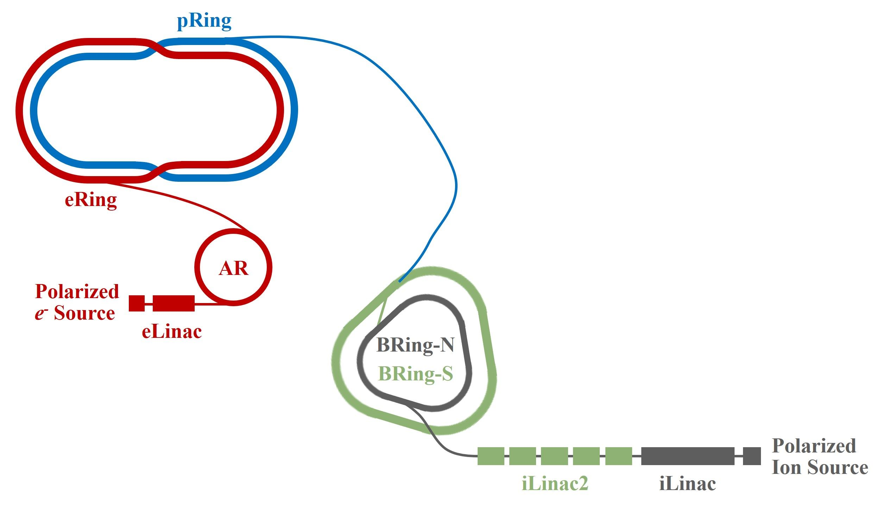
1. Electron-ion collider in China: EicC
EicC
HIAF and HIAF-U
HIAF is under construction (Guang dong province, China).
HIAF-U is an upgrade of HIAF and will provide proton beams with energies up to 25 GeV.
pRing
Full energy swep-out injection
1149.07 m, 12 - 25 GeV
eRing
Full energy swep-out injection
1151.20 m, 2.8 - 5.0 GeV
AR
Accumulate the charge to 28 nC
Accelerate electrons from 300 MeV to 2.8 - 5.0 GeV
287.80 m
eLinac and eSource
Generate a 7-10 nC electron bunch and accelerate it to 300 MeV
IP
BRing-N is normal-conducting
BRing-S is superconducting
(detailed in Jie Liu’s talk)

Slide 4
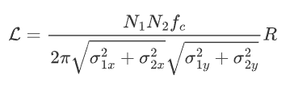

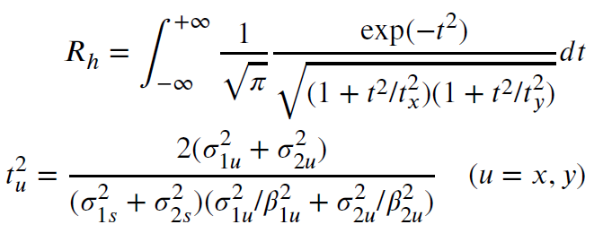
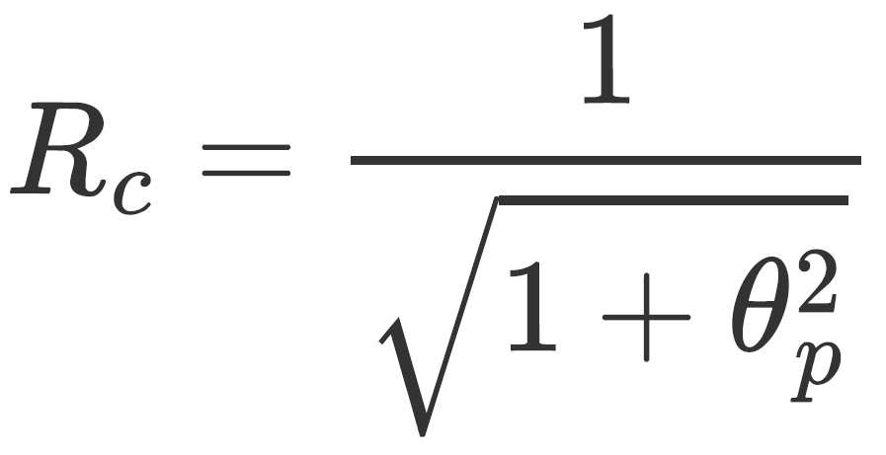

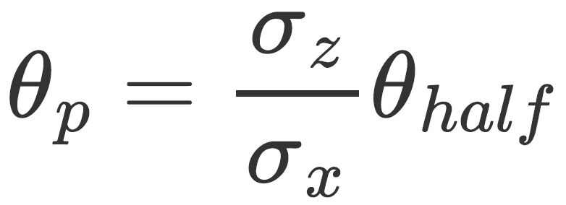
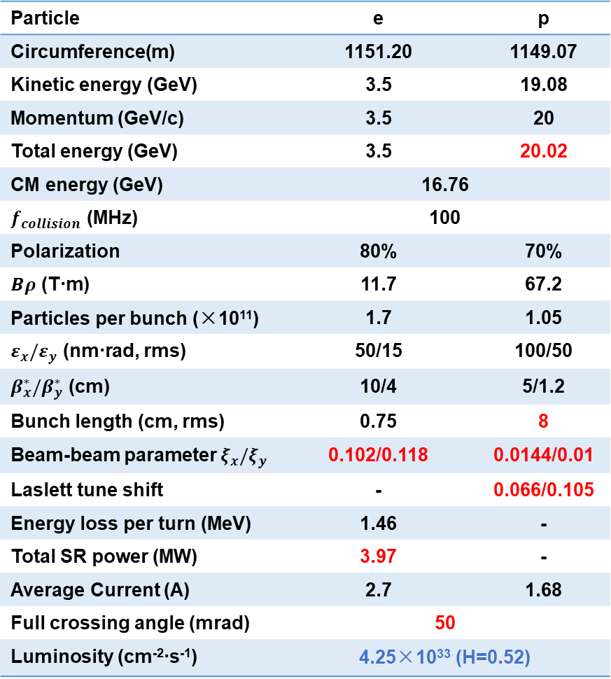
1. Main beam parameters at optimal energy
Particle | e | p
Circumference(m) | 1151.20 | 1149.07
Kinetic energy (GeV) | 3.5 | 19.08
Momentum (GeV/c) | 3.5 | 20
Total energy (GeV) | 3.5 | 20.02
CM energy (GeV) | 16.76
$f_{collision}$ (MHz) | 100
Polarization | 80% | 70%
$Bρ$ (T∙m) | 11.7 | 67.2
Particles per bunch (×10¹¹) | 1.7 | 1.05
$ε_{x}/ε_{y}$ (nm∙rad, rms) | 50/15 | 100/50
$β_{x}^{∗}/β_{y}^{∗}$ (cm) | 10/4 | 5/1.2
Bunch length (cm, rms) | 0.75 | 8
Beam-beam parameter $ξ_{x}/ξ_{y}$ | 0.102/0.118 | 0.0144/0.01
Laslett tune shift | - | 0.066/0.105
Energy loss per turn (MeV) | 1.46 | -
Total SR power (MW) | 3.97 | -
Average Current (A) | 2.7 | 1.68
Full crossing angle (mrad) | 50
Luminosity (cm⁻²∙s⁻¹) | 4.25×10³³ (H=0.52)
From the luminosity viewpoint, there are some important considerations:
  To achieve high luminosity (> 4×10³³)
  But proton is low energy
  To mitigate the SC effect
  σ_{z}↑ makes the luminosity loss caused by hourglass effect and cross-collision stronger
  Rh = 0.52, Rc = 0.035
N ↑, β* ↓, ε ↓
Space charge effect ↑
charge density λ↓, σ_{z} ↑
Hourglass factor Rh
Crossing factor Rc and Piwinski angle θp:
EicC proton: θp=28.3

Slide 5
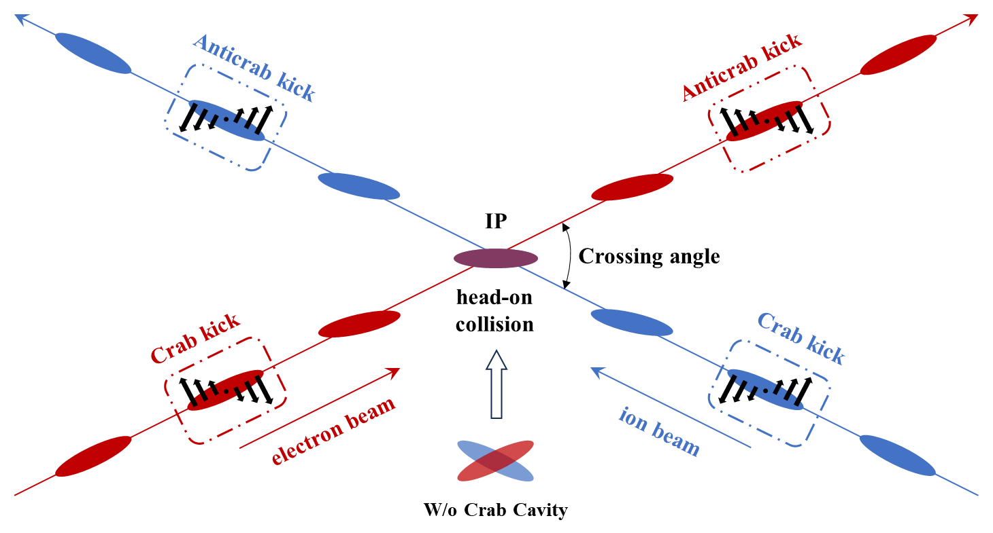
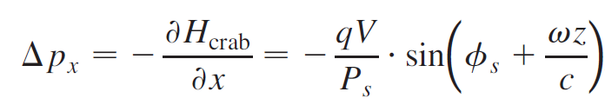
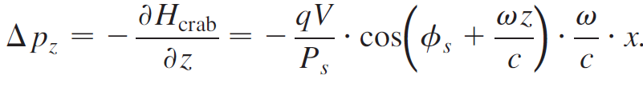
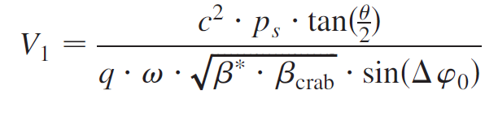

1. Recovery of geometric luminosity loss
Hourglass:
  Use RFQs to modulate the longitudinal position of the beam waist near the collision point
  Lumi.: from ~ 4×10³³cm⁻²s⁻¹ to > 6×10³³cm⁻²s⁻¹ (float waist scheme, detailed in Lei Wang’s talk)
Crossing angle:
  Use local crab cavities (CC) to recover the geometric luminosity loss
Crab cavity kick
Crab cavity voltage

Slide 6
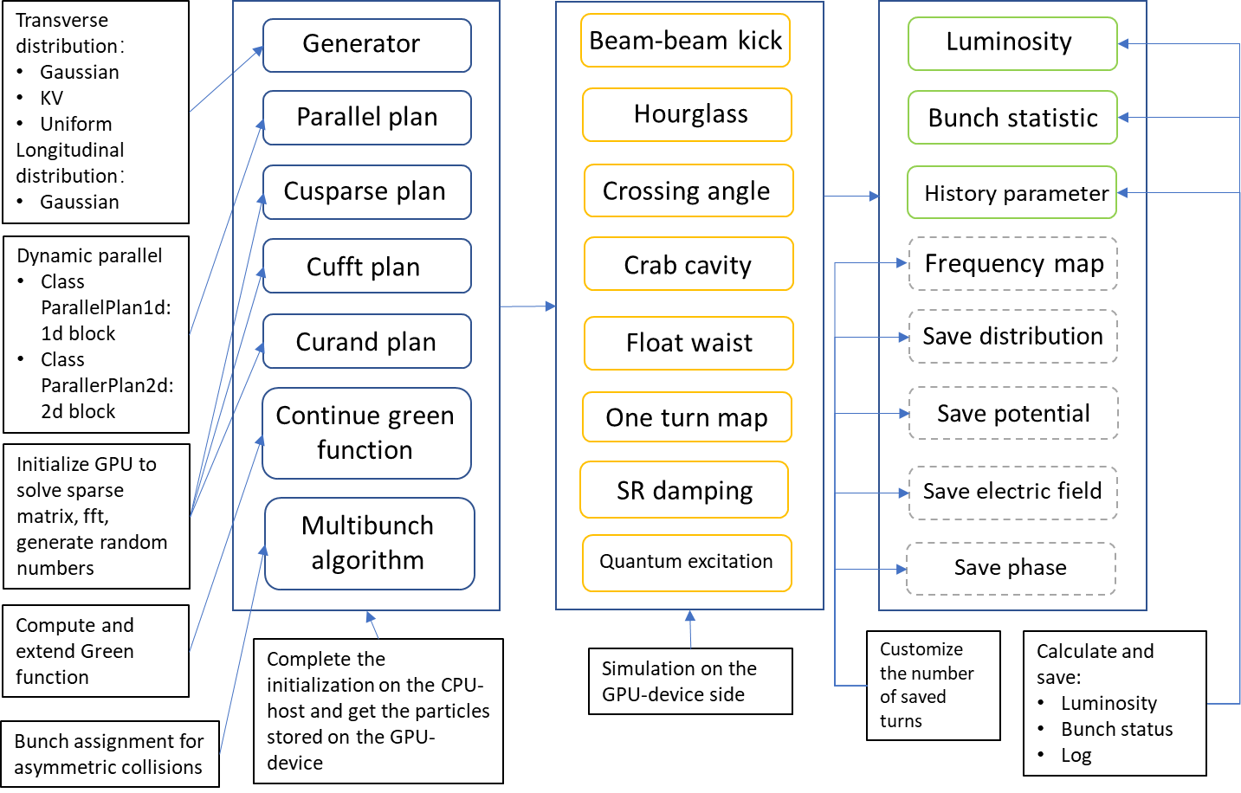
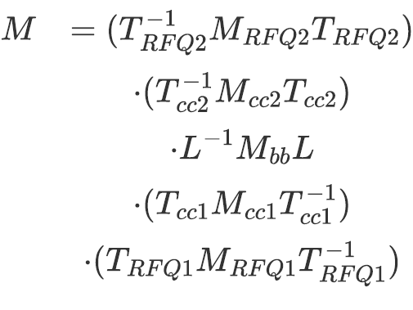

2. Simulation program: Athena
Athena is a gpu-based simulation program
The complete bb map:
$M$: kick maps of beam-beam, crab cavity and RFQ
$T$: transfer maps between IP and cc, IP and RFQ
$L$: Lorentz transfer map
will be open-source later … (https://github.com/changmx)

Slide 7
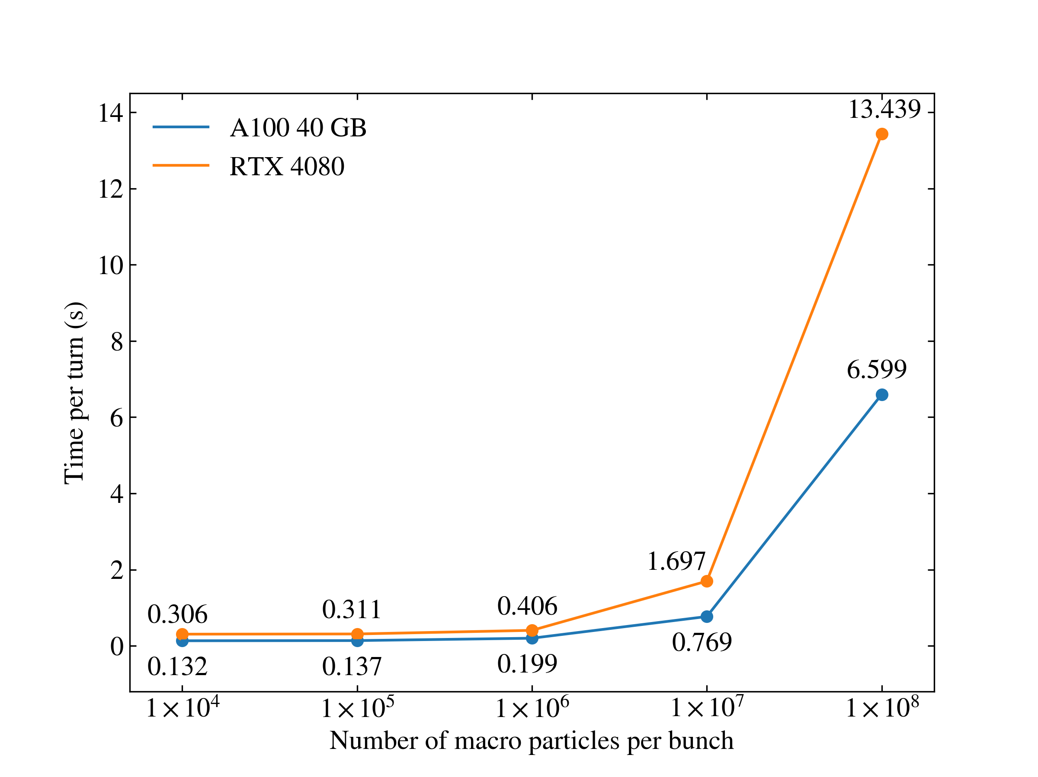
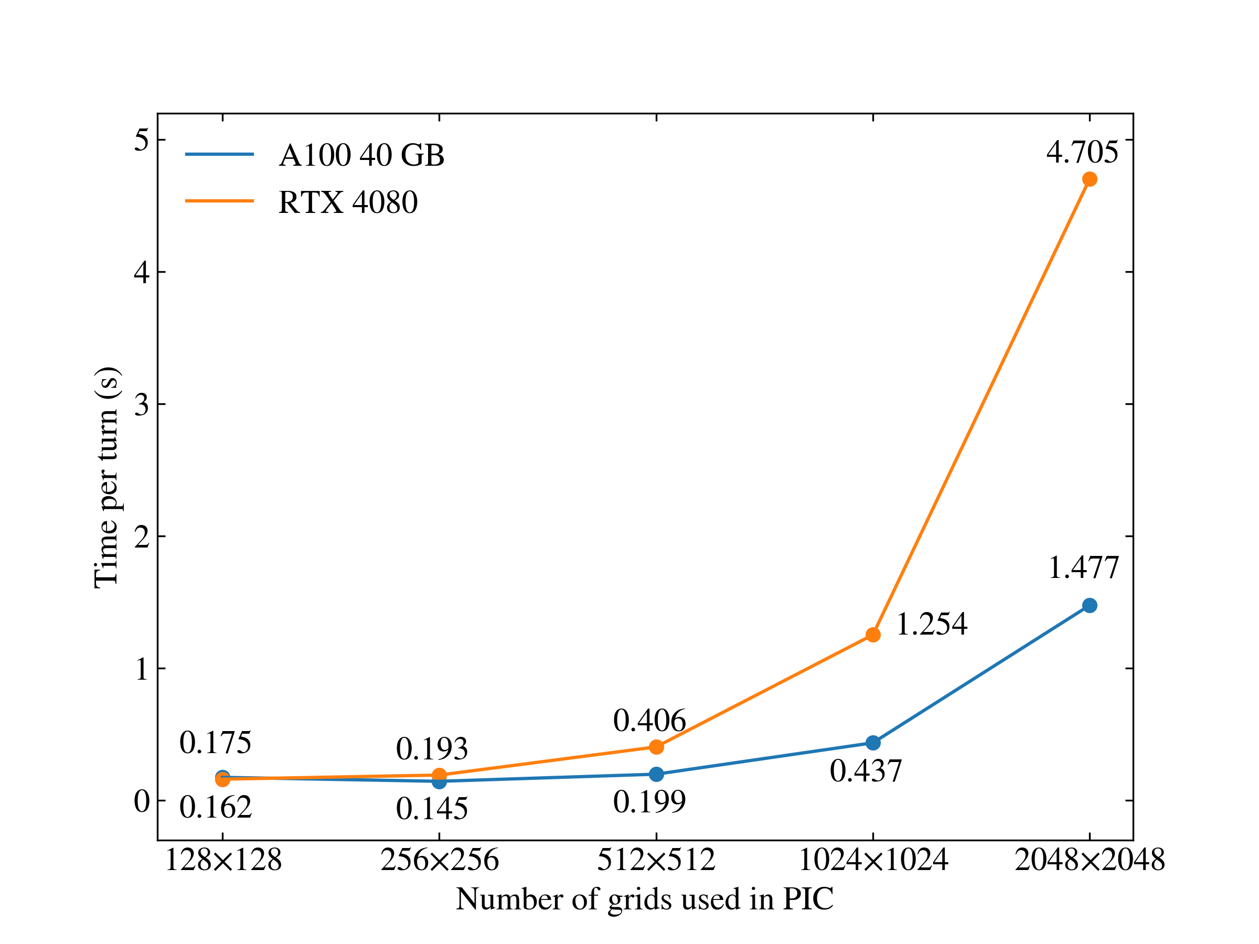
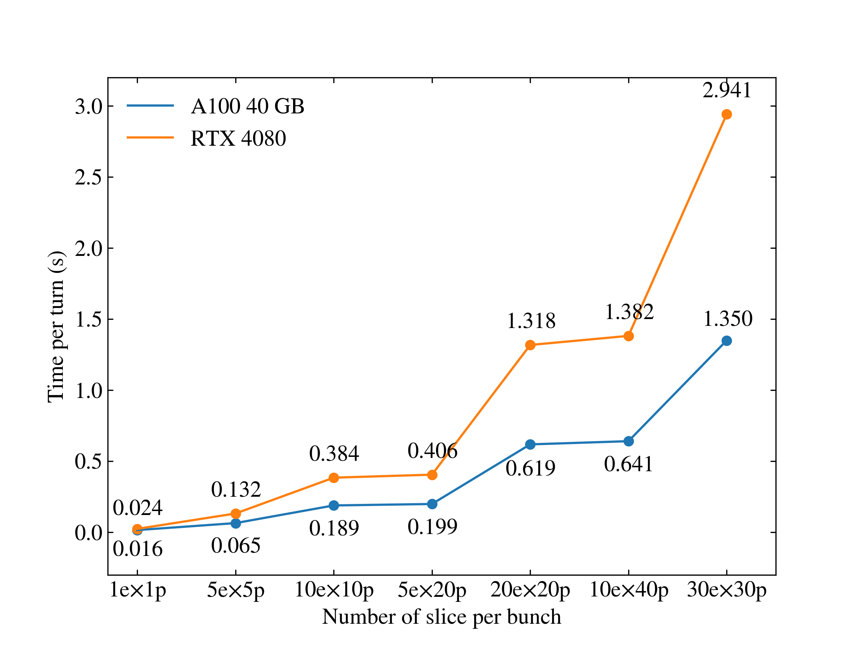
2. Performance test of Athena
In the macro particle number testing, computational performance is limited by double-precision computing speed (Np≤1e7) and bandwidth (Np=1e8).
In the grid number testing, computational performance is limited by double-precision computing speed (Np>1e7).
In the slice number testing, when the number of calculations >100, the performance is mainly limited by the data transmission bandwidth.
Macro particle number testing
Grid number testing
Slice number testing
512x512
5ex20p
Np=1e6
5ex20p
Np=1e6
512x512
Athena shows good computing performance.

Slide 8
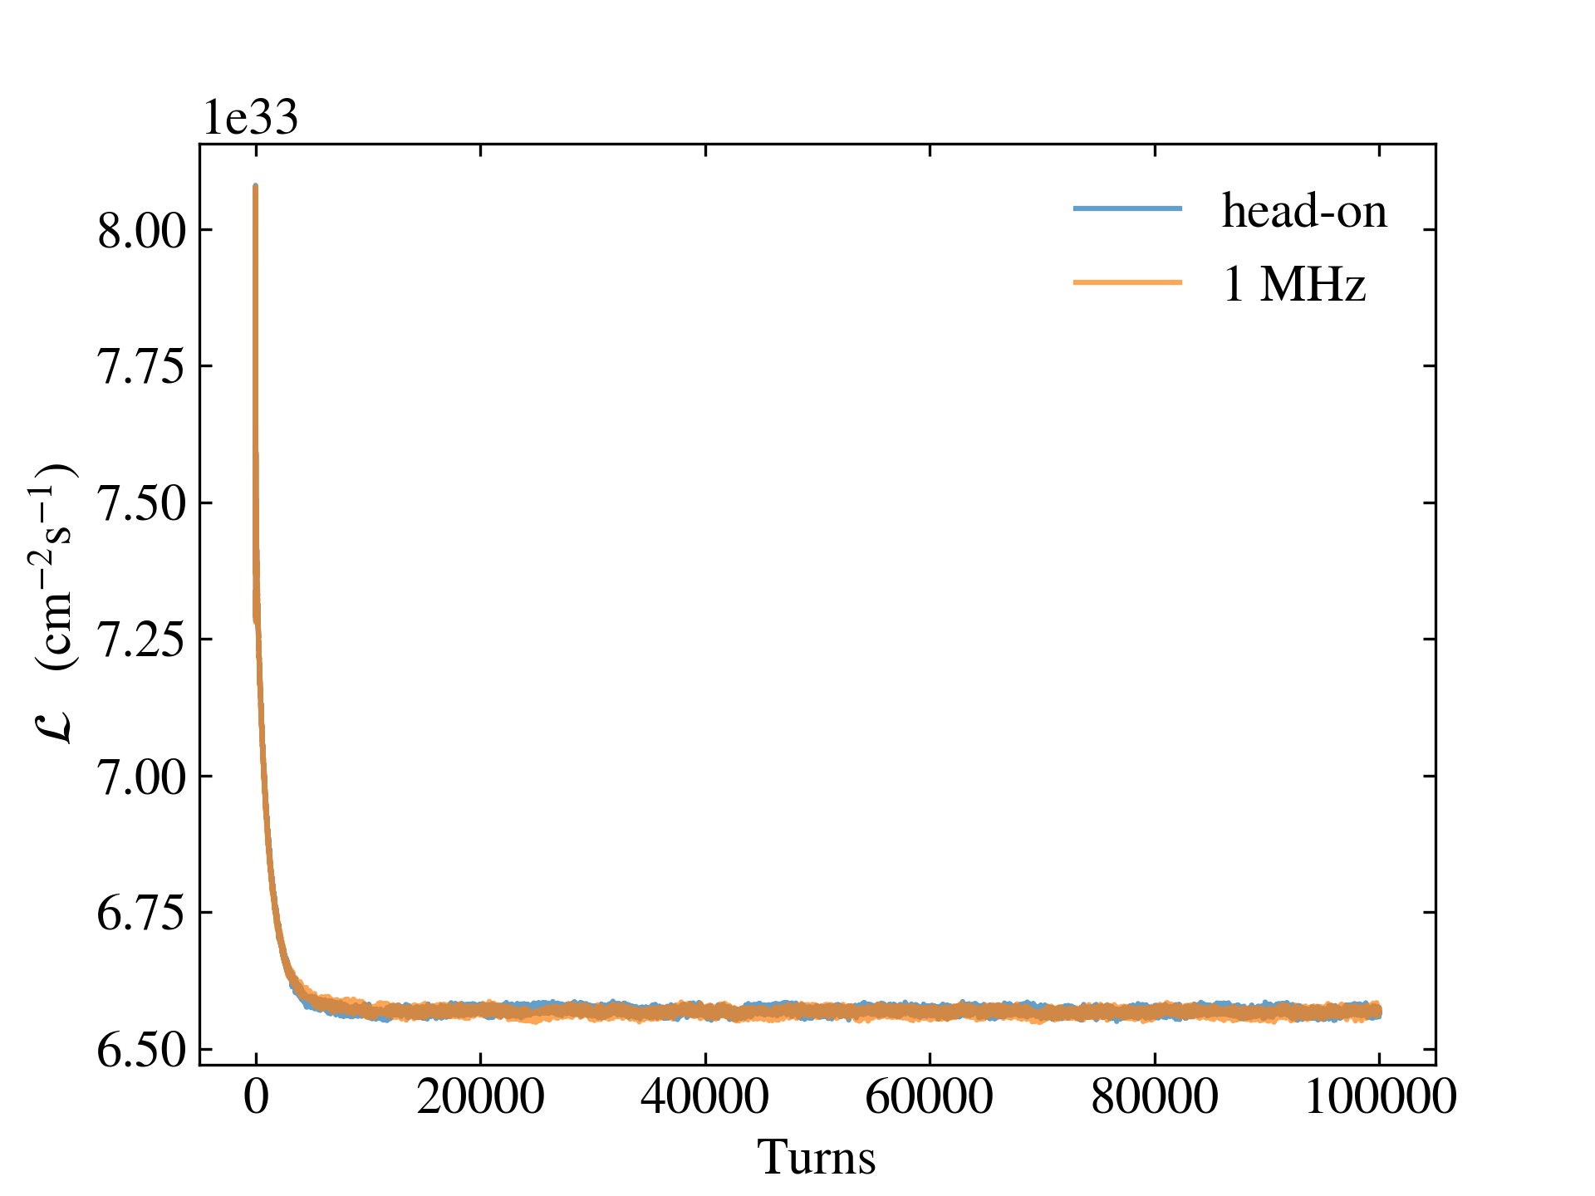
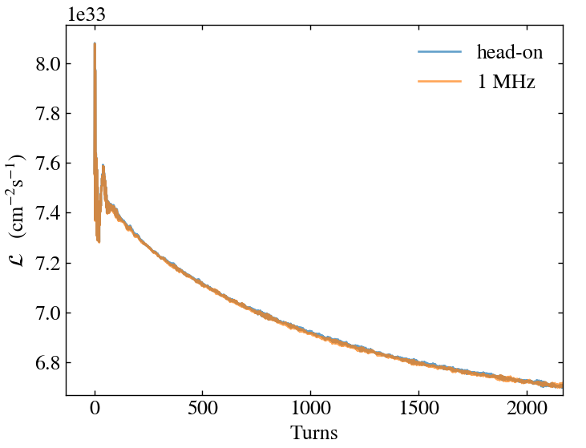
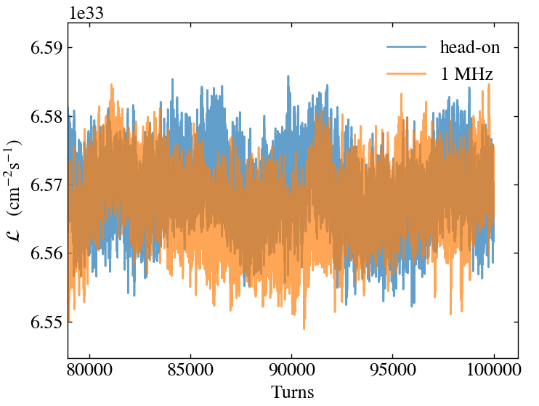
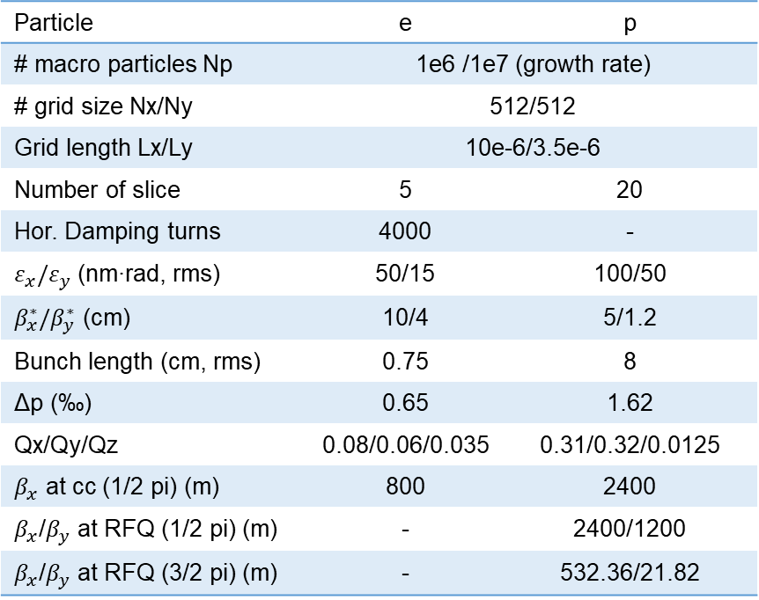
2. Simulation results verification and simulation parameters
When the crab cavity frequencies of both the proton and electron beams are 1 MHz, their effects can be considered linear, and the simulated luminosity is the same as that in the head-on case.
Verify the correctness of crab cavity calculation
Parameters used in strong-strong simulation
Particle | e | p
# macro particles Np | 1e6 /1e7 (growth rate)
# grid size Nx/Ny | 512/512
Grid length Lx/Ly | 10e-6/3.5e-6
Number of slice | 5 | 20
Hor. Damping turns | 4000 | -
$ε_{x}/ε_{y}$ (nm∙rad, rms) | 50/15 | 100/50
$β_{x}^{∗}/β_{y}^{∗}$ (cm) | 10/4 | 5/1.2
Bunch length (cm, rms) | 0.75 | 8
Δp (‰) | 0.65 | 1.62
Qx/Qy/Qz | 0.08/0.06/0.035 | 0.31/0.32/0.0125
$β_{x}$ at cc (1/2 pi) (m) | 800 | 2400
$β_{x}$/$β_{y}$ at RFQ (1/2 pi) (m) | - | 2400/1200
$β_{x}$/$β_{y}$ at RFQ (3/2 pi) (m) | - | 532.36/21.82

Slide 9
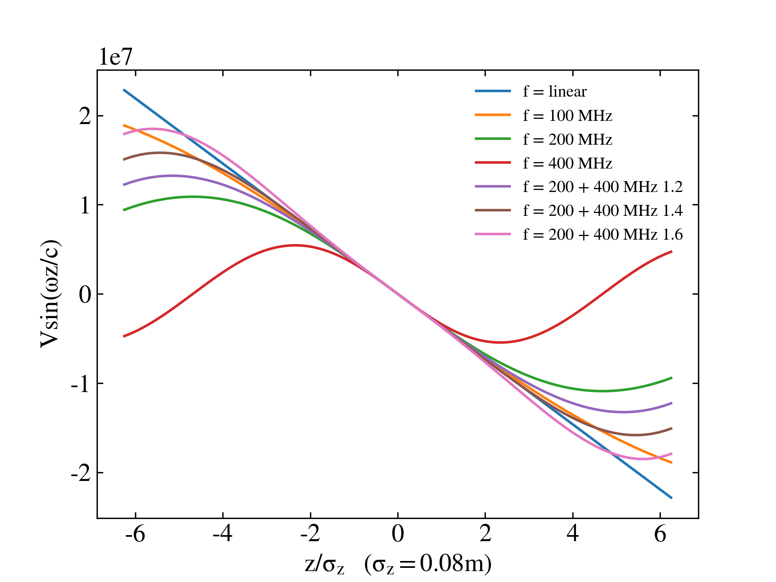
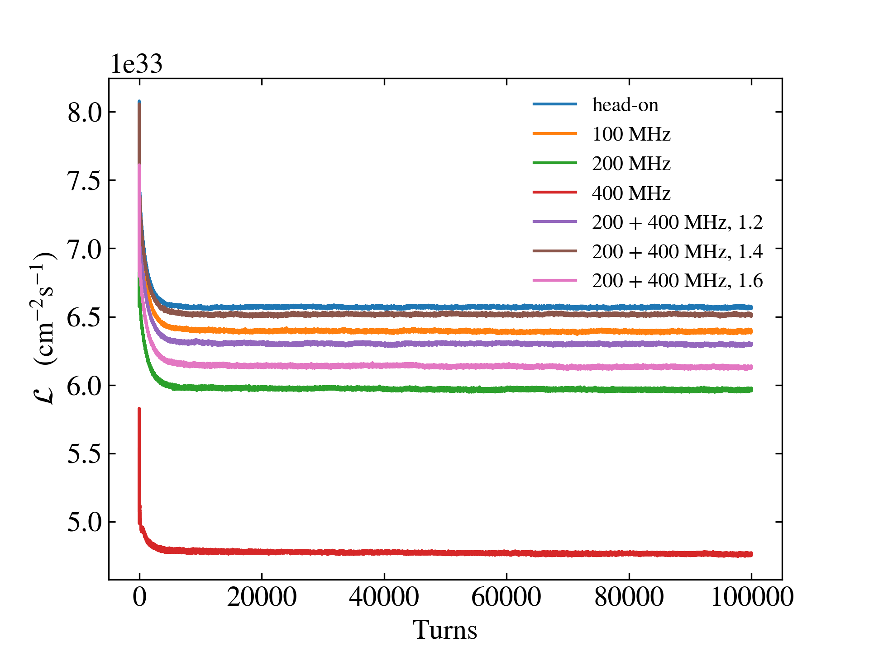
3. Simulation of different proton crab cavity (CCP) frequencies
Due to the long length of proton bunch, the impact of the non-linear crabbing force of the crab cavity is very obvious. The lower the frequency, the better the linearity, but also the larger the cavity size.
Although the beams are stable in these simulations, in order to achieve high luminosity, for CCP, 100MHz and 200+400MHz (1.4) are better.
Voltage waveform at different CCP frequency
Lumi. at different CCP frequencies.
When the second harmonic cavity is used, 1.2, 1.4, 1.6 indicates that the crabbing angles of the 200 MHz crab cavity are 1.2θ, 1.4θ, and 1.6θ, and the crabbing angles of the 400 MHz crab cavity are -0.2θ, -0.4θ, and -0.6θ.
CCE: 400 MHz

Slide 10
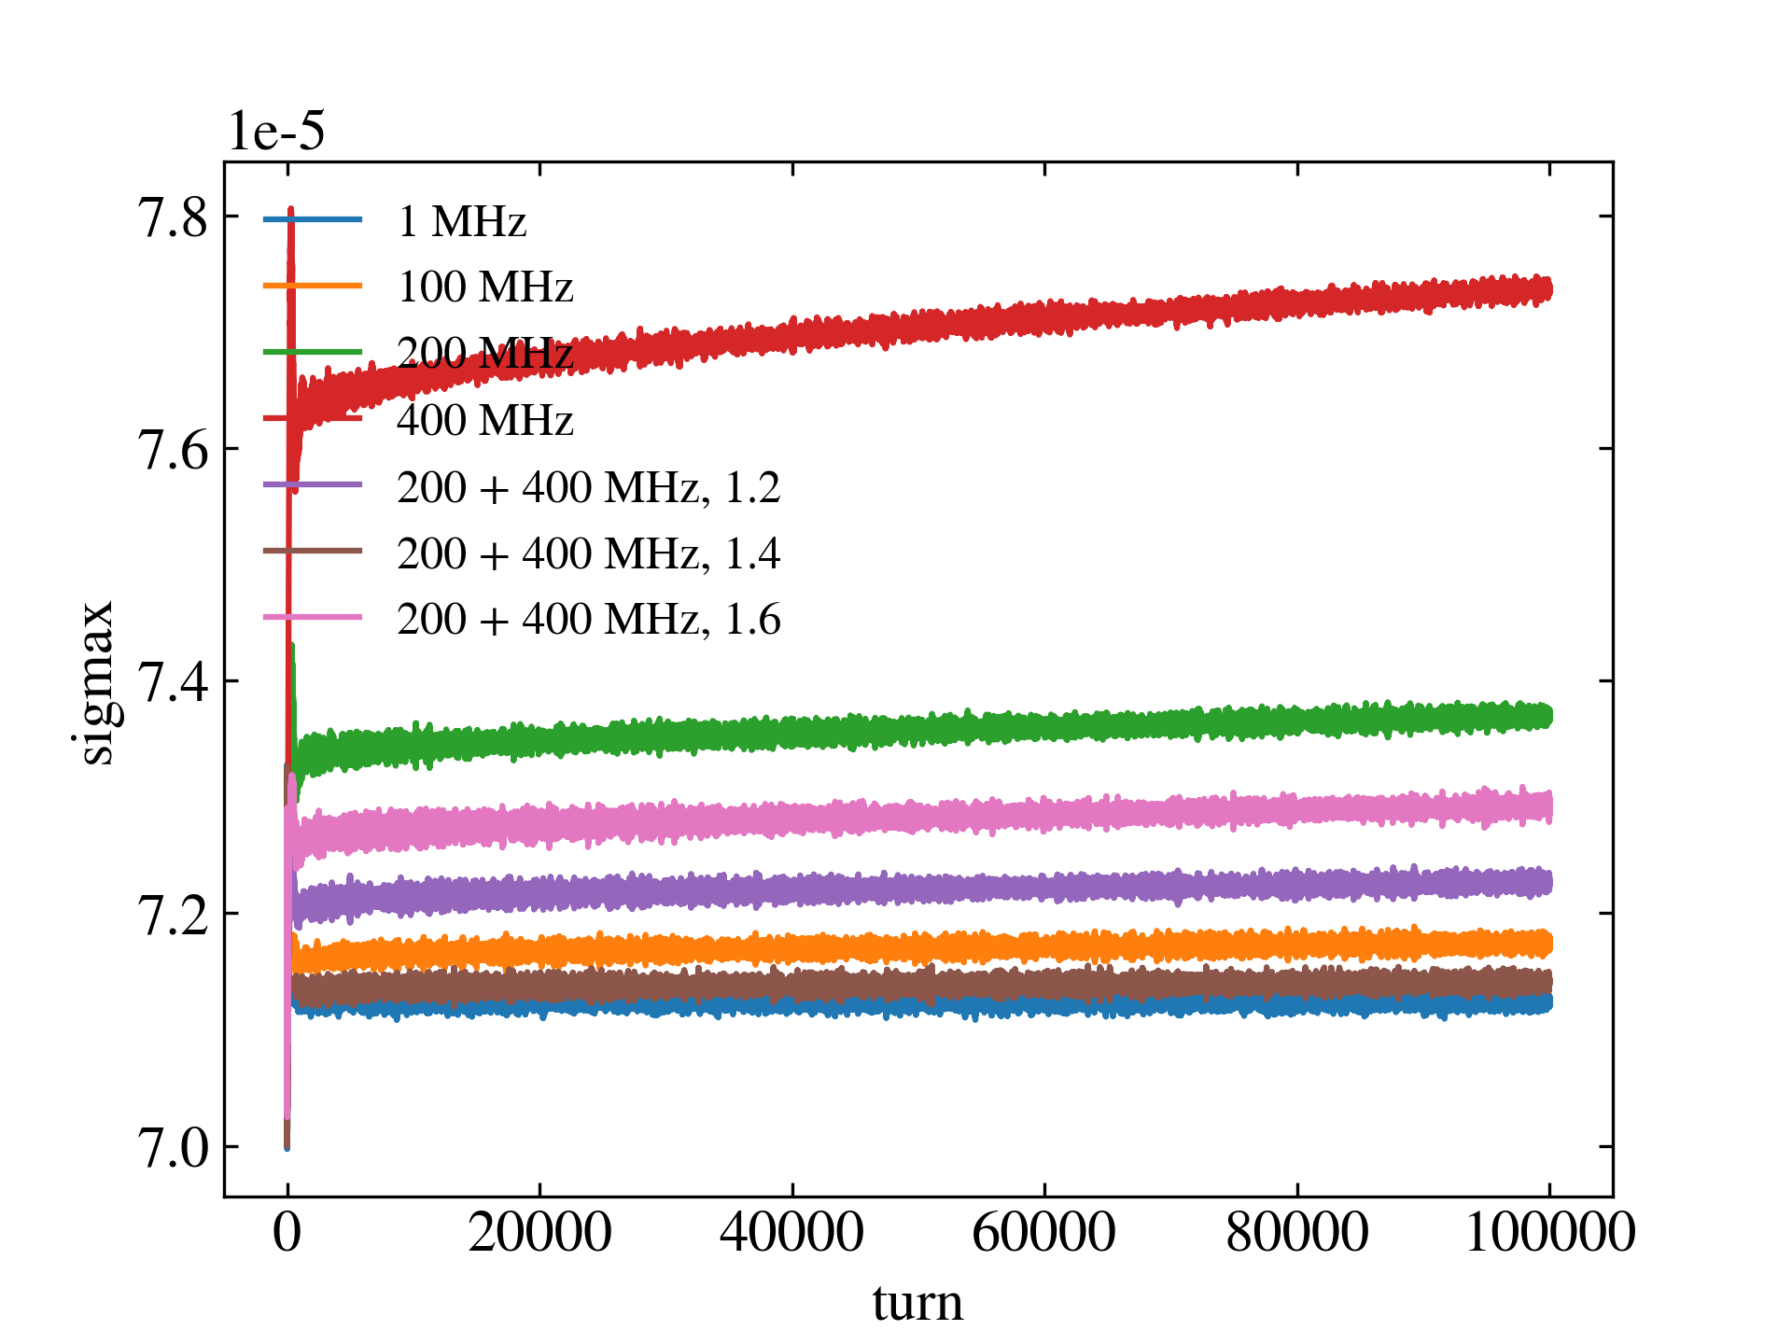
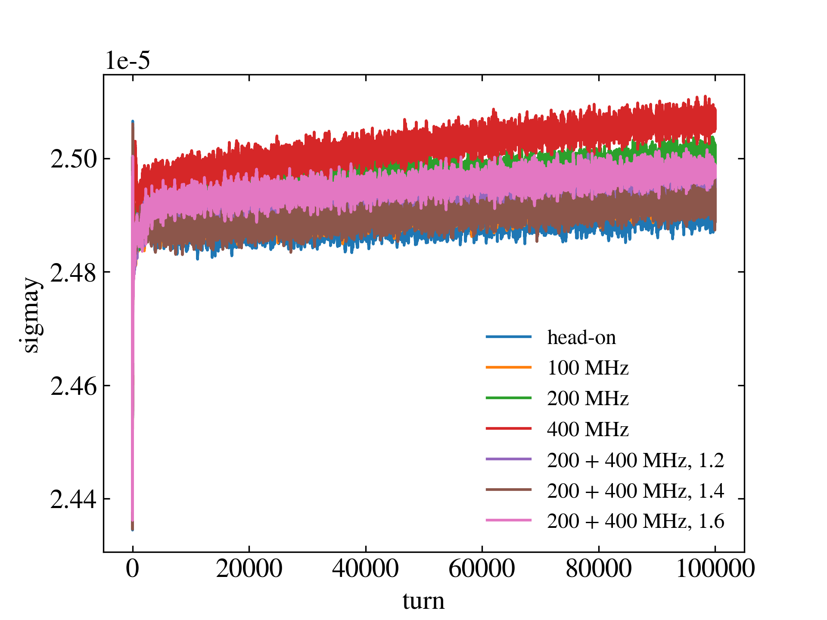
3. Simulation of different CCP frequencies
When the frequency of CCP increases, the horizontal equilibrium size of the proton bunch will increase, and the growth rate will be faster.
Although the crab cavity will not directly affect the particle in the vertical direction, changes in horizontal distribution will eventually change the growth rate of the vertical bunch size.
σx of proton bunch at different CCP frequencies.
σy of proton bunch at different CCP frequencies.
CCE: 400 MHz

Slide 11
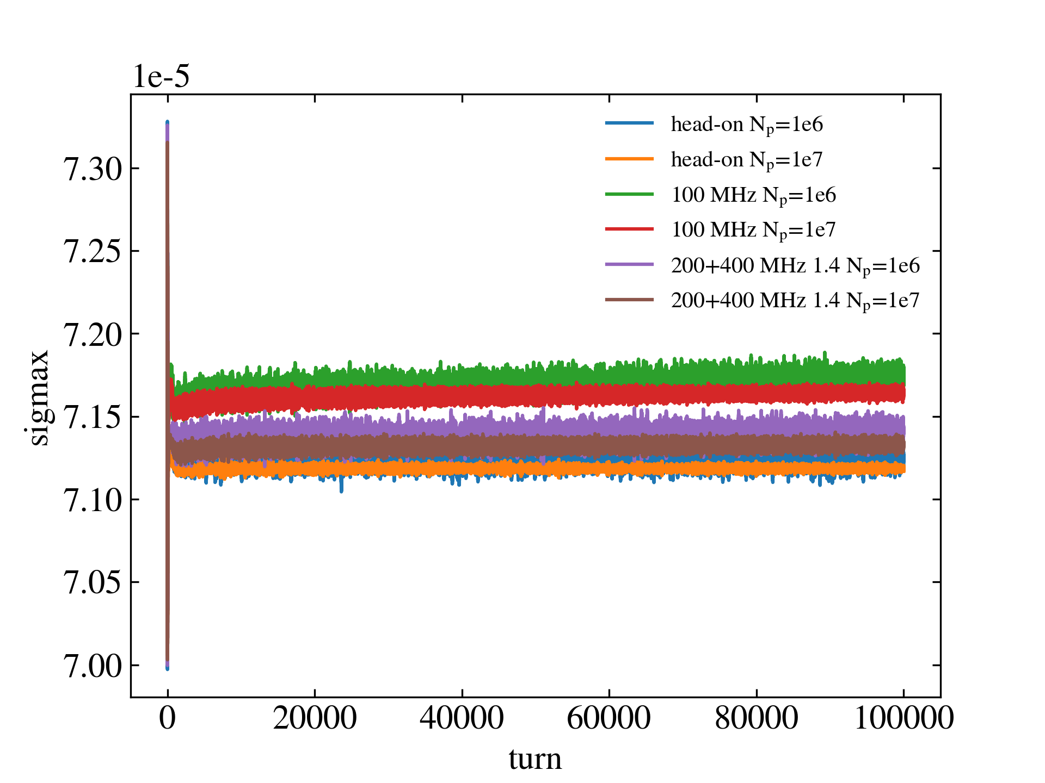
3. Simulation of different CCP frequencies
The effects of numerical noise caused by PIC calculation on bunch size growth rate and luminosity degradation rate are obvious.
Increasing the number of macro particles can reduce the numerical noise (but severely reduce the calculation speed, use the spectral method, etc.).
The impact of macro particle # on numerical noise
Linear fit to data from turns 50k to 100k
Linear fit of bunch size growth
Head-on σx | 0.05%/min
Head-on σy | 4.02%/min
100 MHz σx | 7.69%/min
100 MHz σy | 7.73%/min
200+400 MHz (1.4) σx | 3.51%/min
200+400 MHz (1.4) σy | 6.46%/min
CCE: 400 MHz
EicC adopts rapid cycling mode to replace all proton bunches in ~ minutes

Slide 12
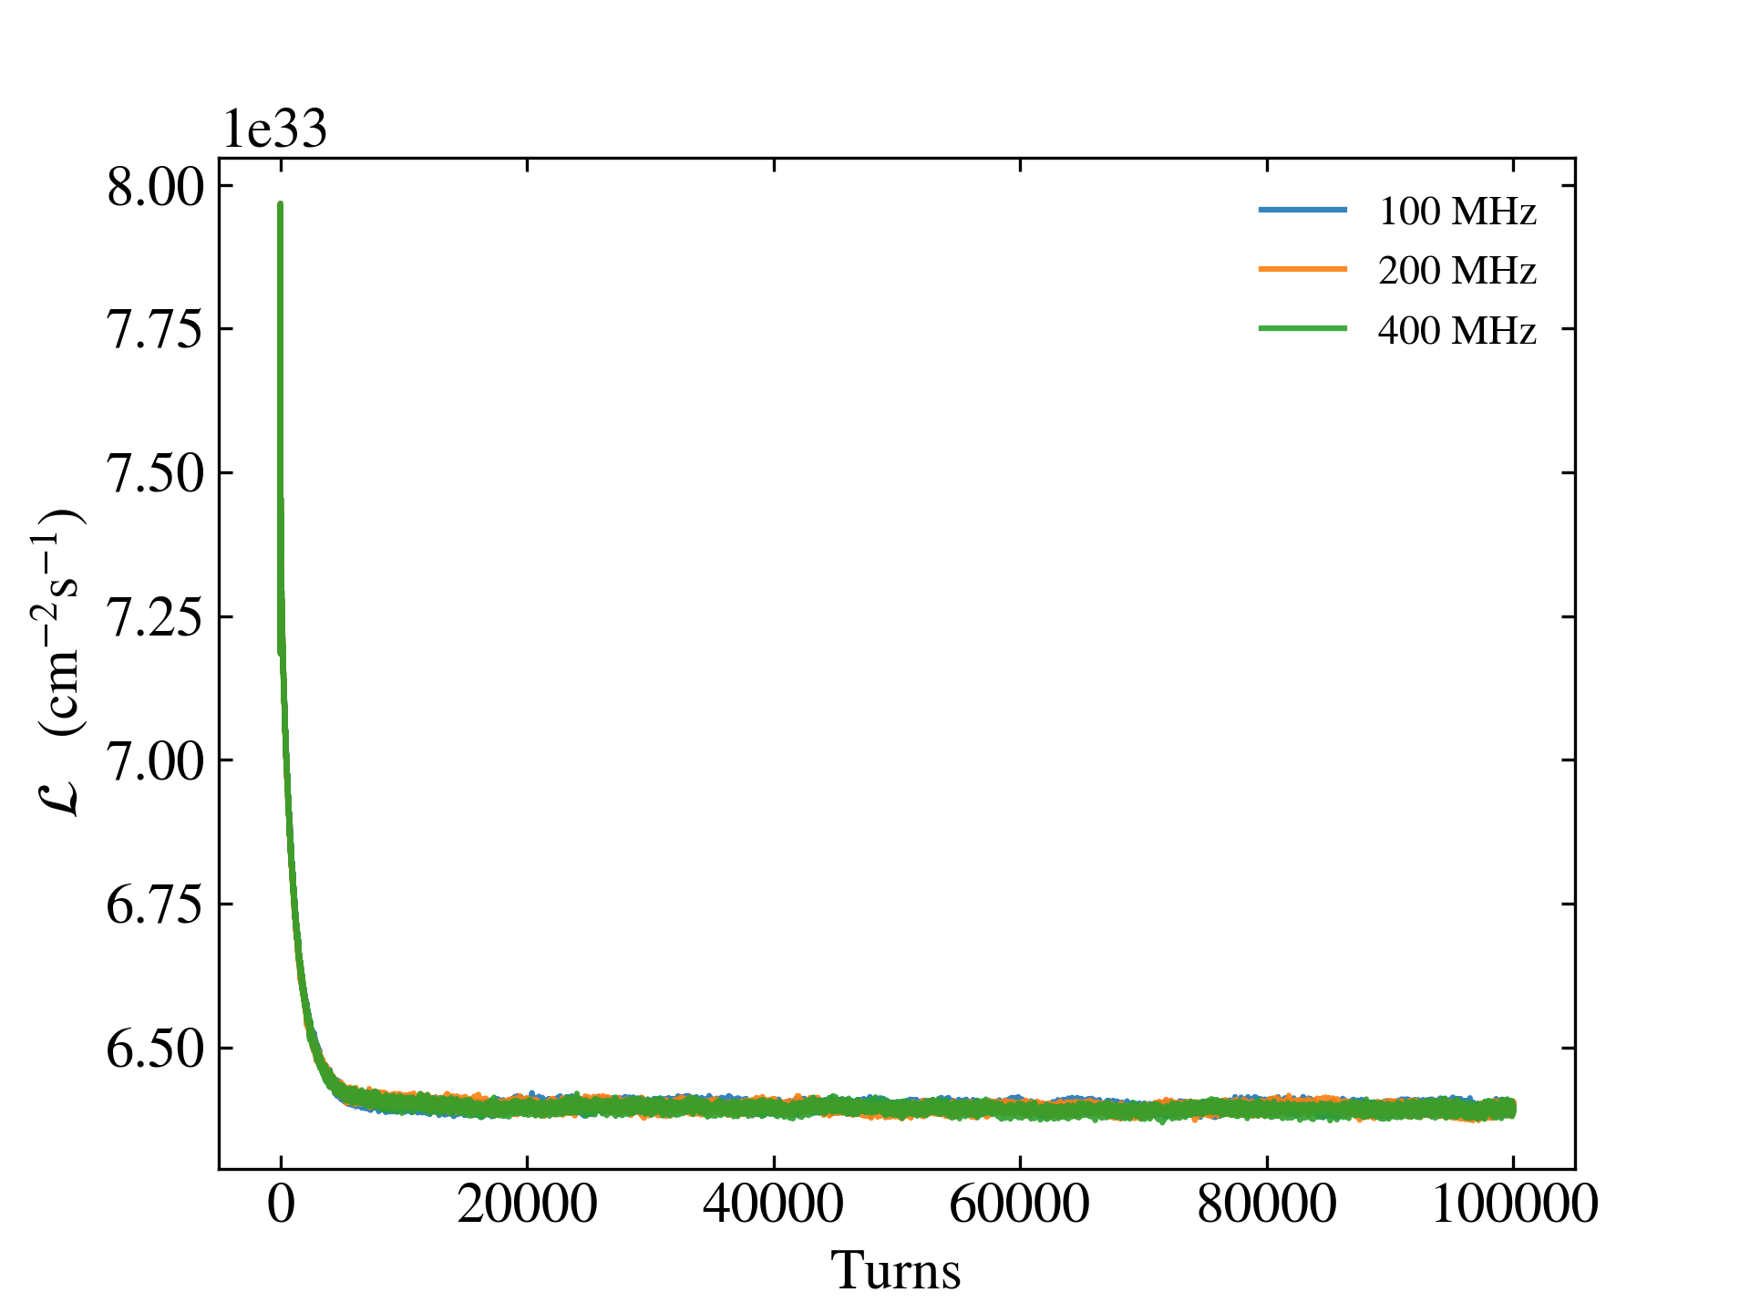
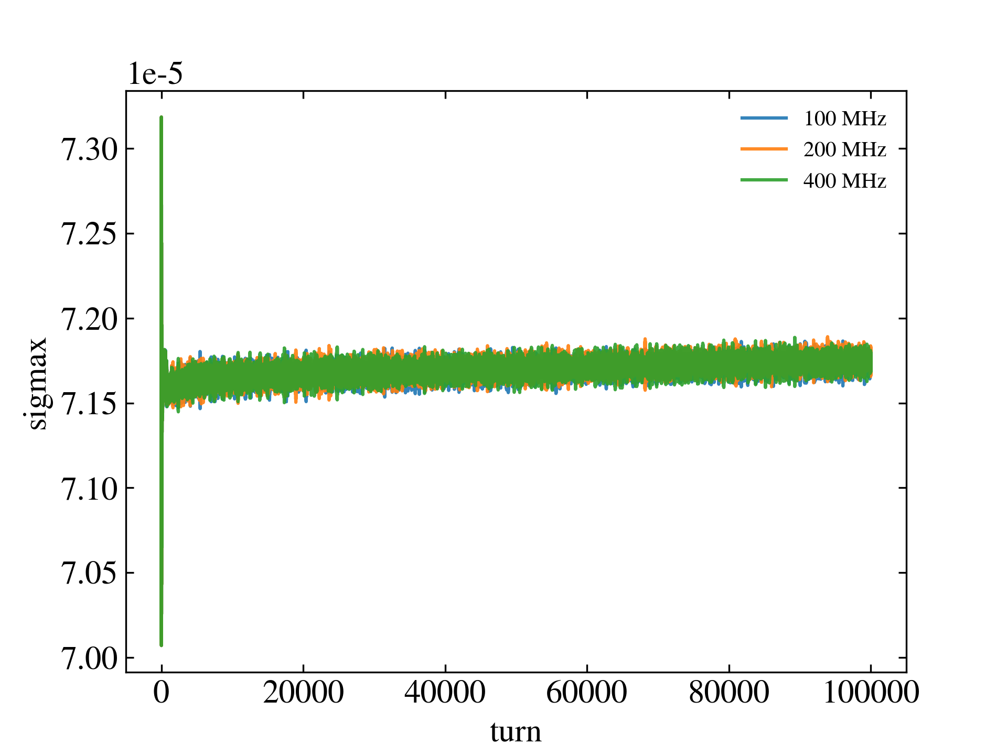
3. Simulation of different electron crab cavity (CCE) frequencies
When the CCP frequency is 100 MHz, the luminosity obtained from the simulations at different CCE frequencies is essentially the same, and the growth rate of the proton bunch size is also similar.
Lumi. at different CCE frequencies.
σx of proton bunch at different CCE frequencies.
CCP: 100 MHz
The crabbing force at 400 MHz is already quasi-linear for electron bunch. In order to reduce the cavity size, the CCE of EicC will adopt a frequency of 400MHz.

Slide 13
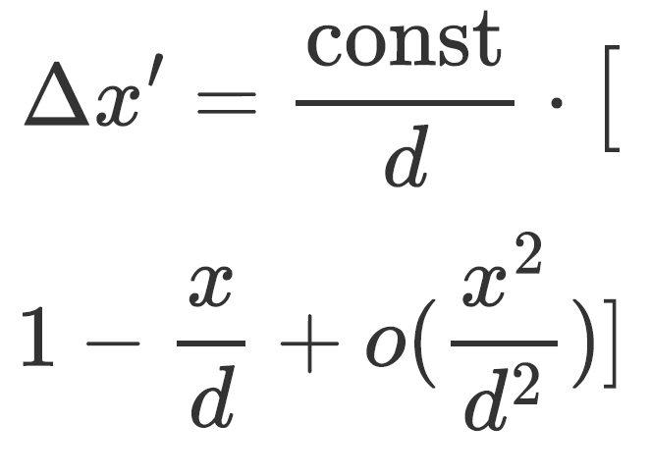
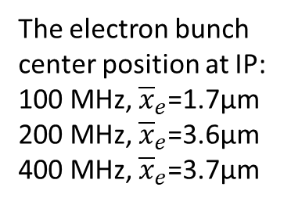
3. Crab cavity induced orbit effects
The particles at the head and tail of the proton bunch that are not completely crabbed will apply a dipole force on the electron bunch, causing the center of mass of the electron bunch to change.
p
e
CCP: 200 MHz
Fig. z-x distribution at different collision points
CCP: 100 MHz
The electron bunch center position at IP:
100 MHz, ${\overline{x}}_{e}$=1.7μm
200 MHz, ${\overline{x}}_{e}$=3.6μm
400 MHz, ${\overline{x}}_{e}$=3.7μm

Slide 14
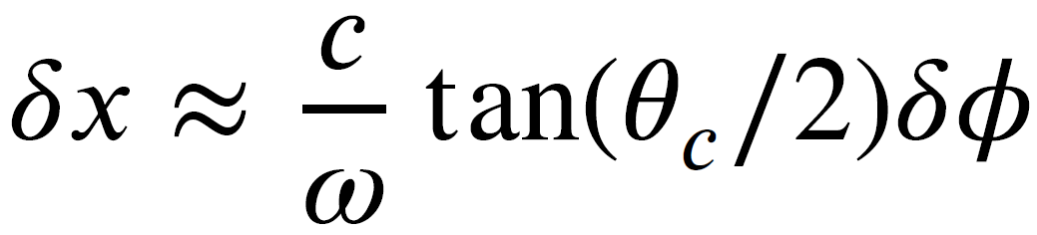
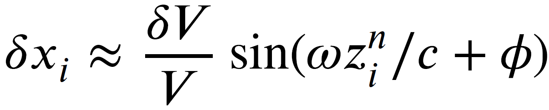
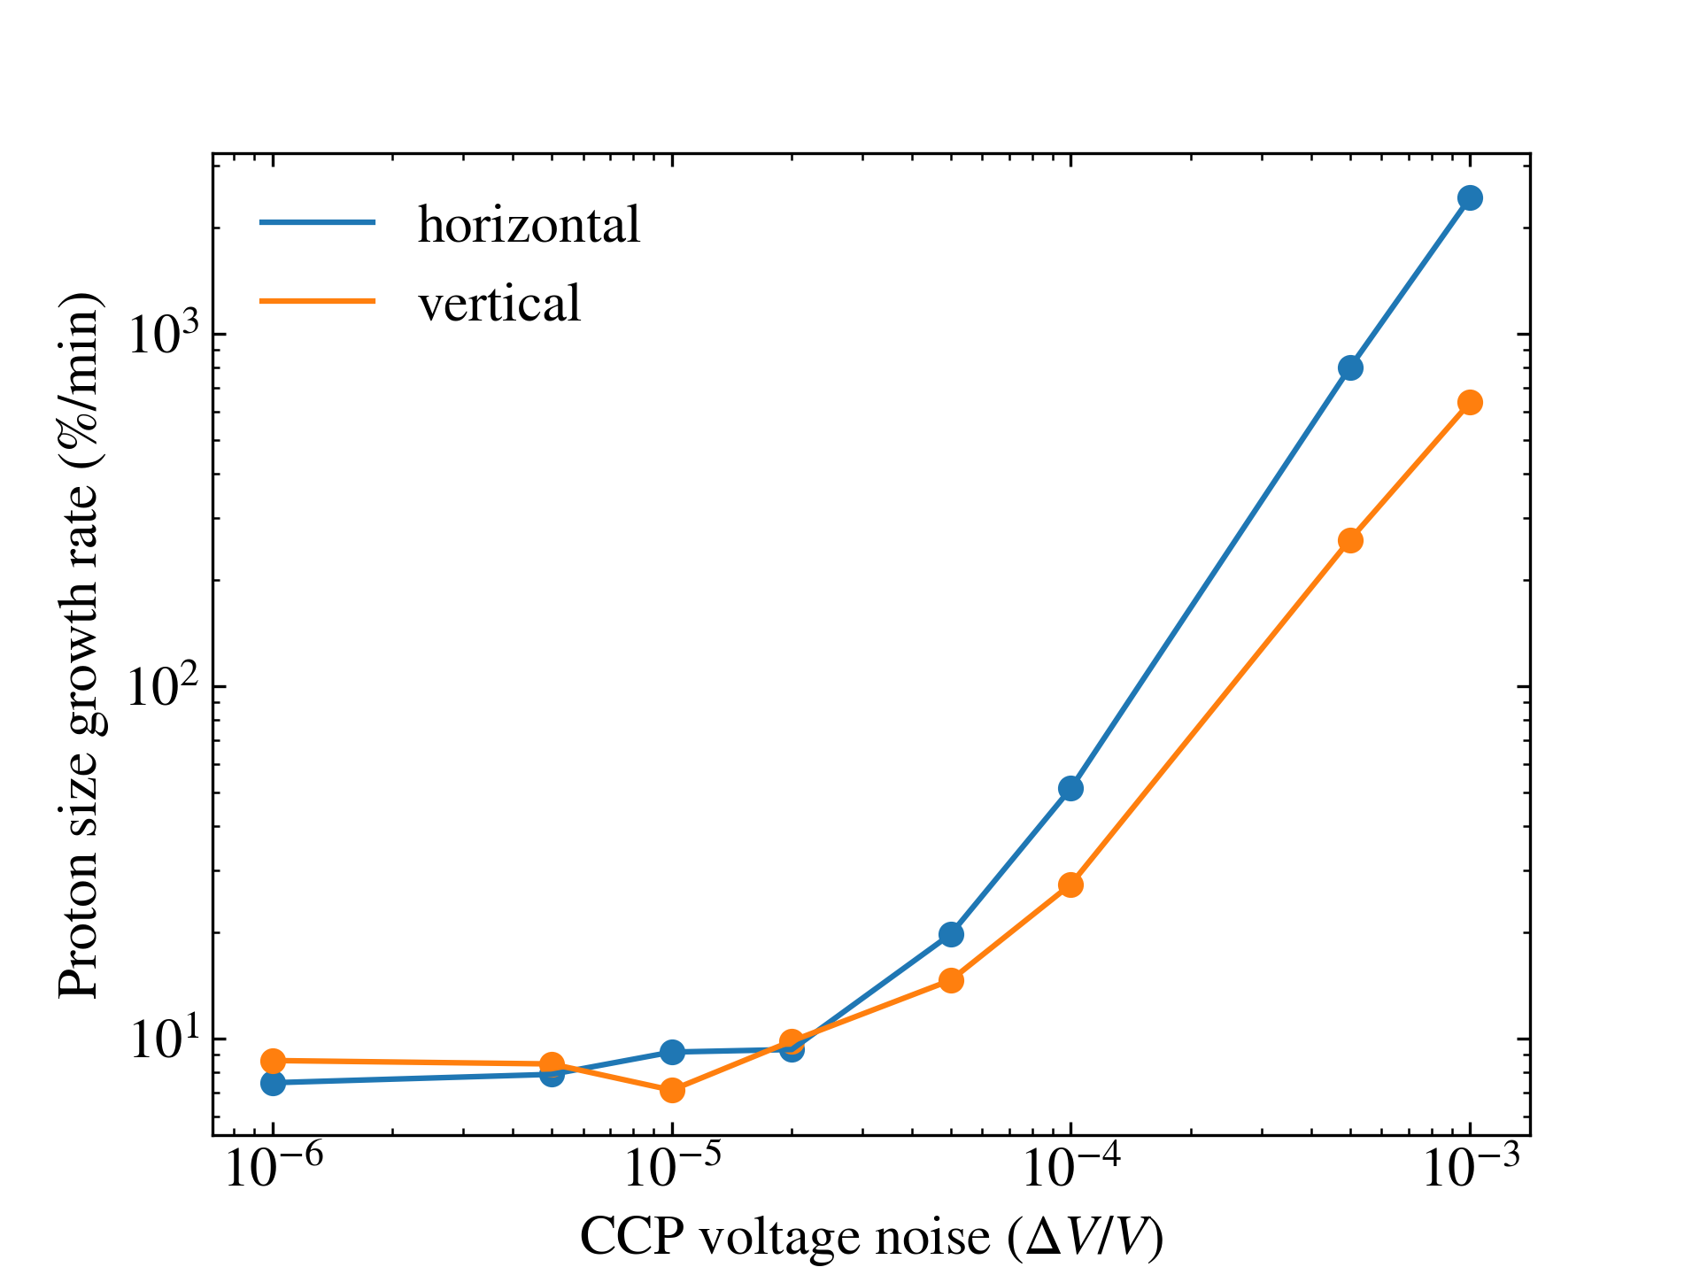
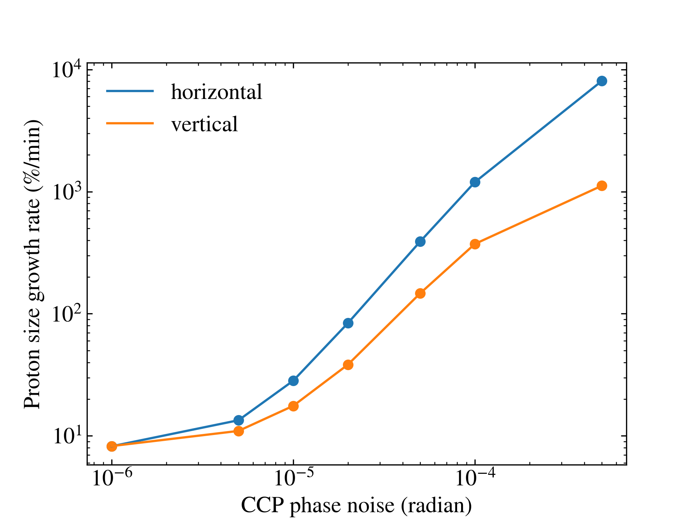
3. White noise of CCP’s RF voltage and phase
Voltage errors cause the bunch distribution to become tilted at the IP, and phase errors cause the bunch center to have a transverse offset at the IP.
Proton size growth rate vs. CCP voltage noise amp.
Proton size growth rate vs. CCP phase noise amp.
CCP: 100 MHz
CCE: 400 MHz
CCP RF white noise tolerance level: voltage ~ 1x10⁻⁵, phase ~ 1x10⁻⁶

Slide 15
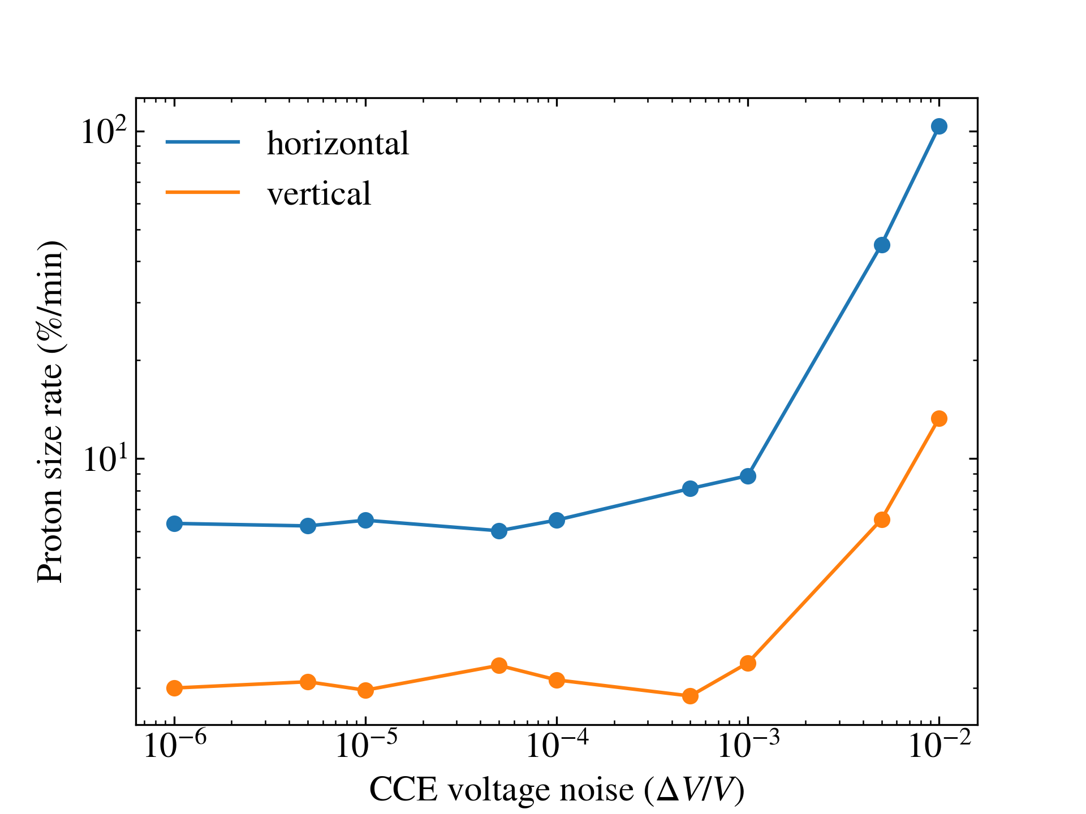
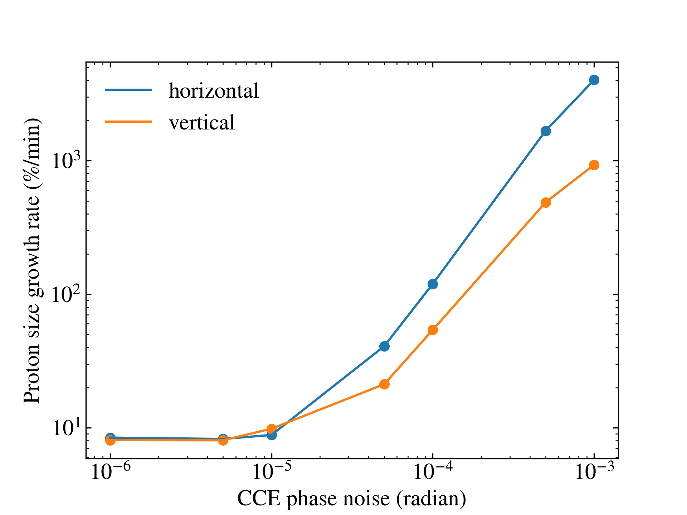
3. White noise of CCE’s RF voltage and phase
Due to the damping effect of synchrotron radiation, the electron beam has a greater tolerance to crab cavity noise.
Proton size growth rate vs. CCE voltage noise amp.
Proton size growth rate vs. CCE phase noise amp.
CCP: 100 MHz
CCE: 400 MHz
CCE RF white noise tolerance level: voltage ~ 1x10⁻³, phase ~ 1x10⁻⁵

Slide 16
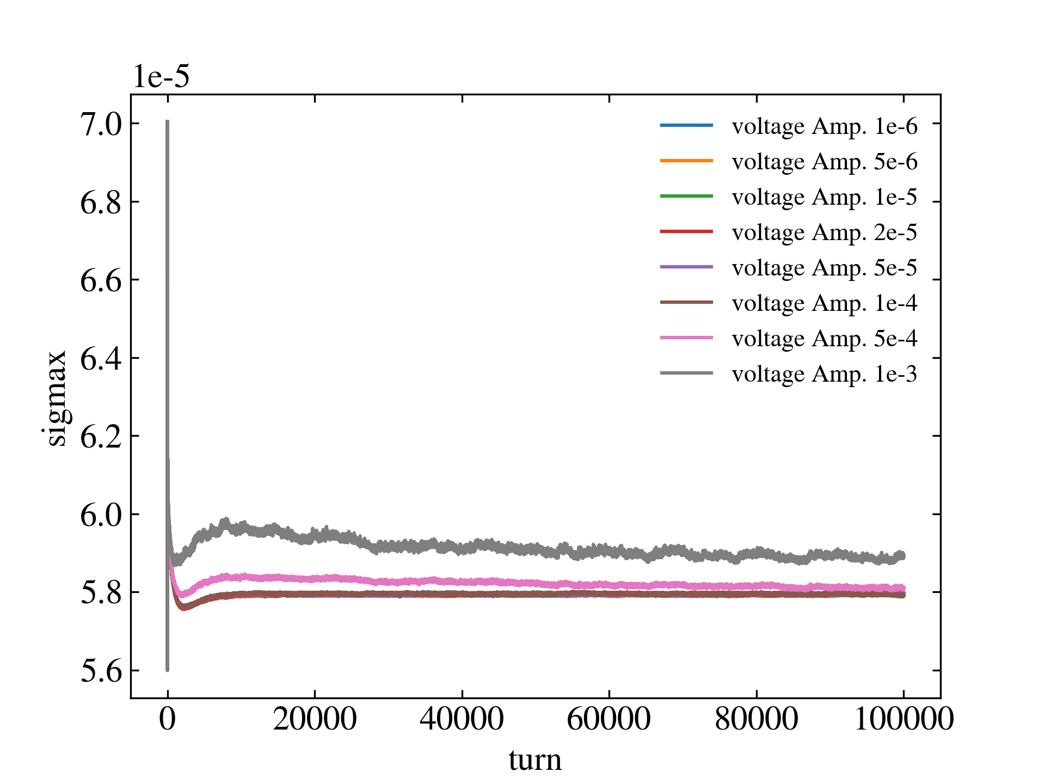
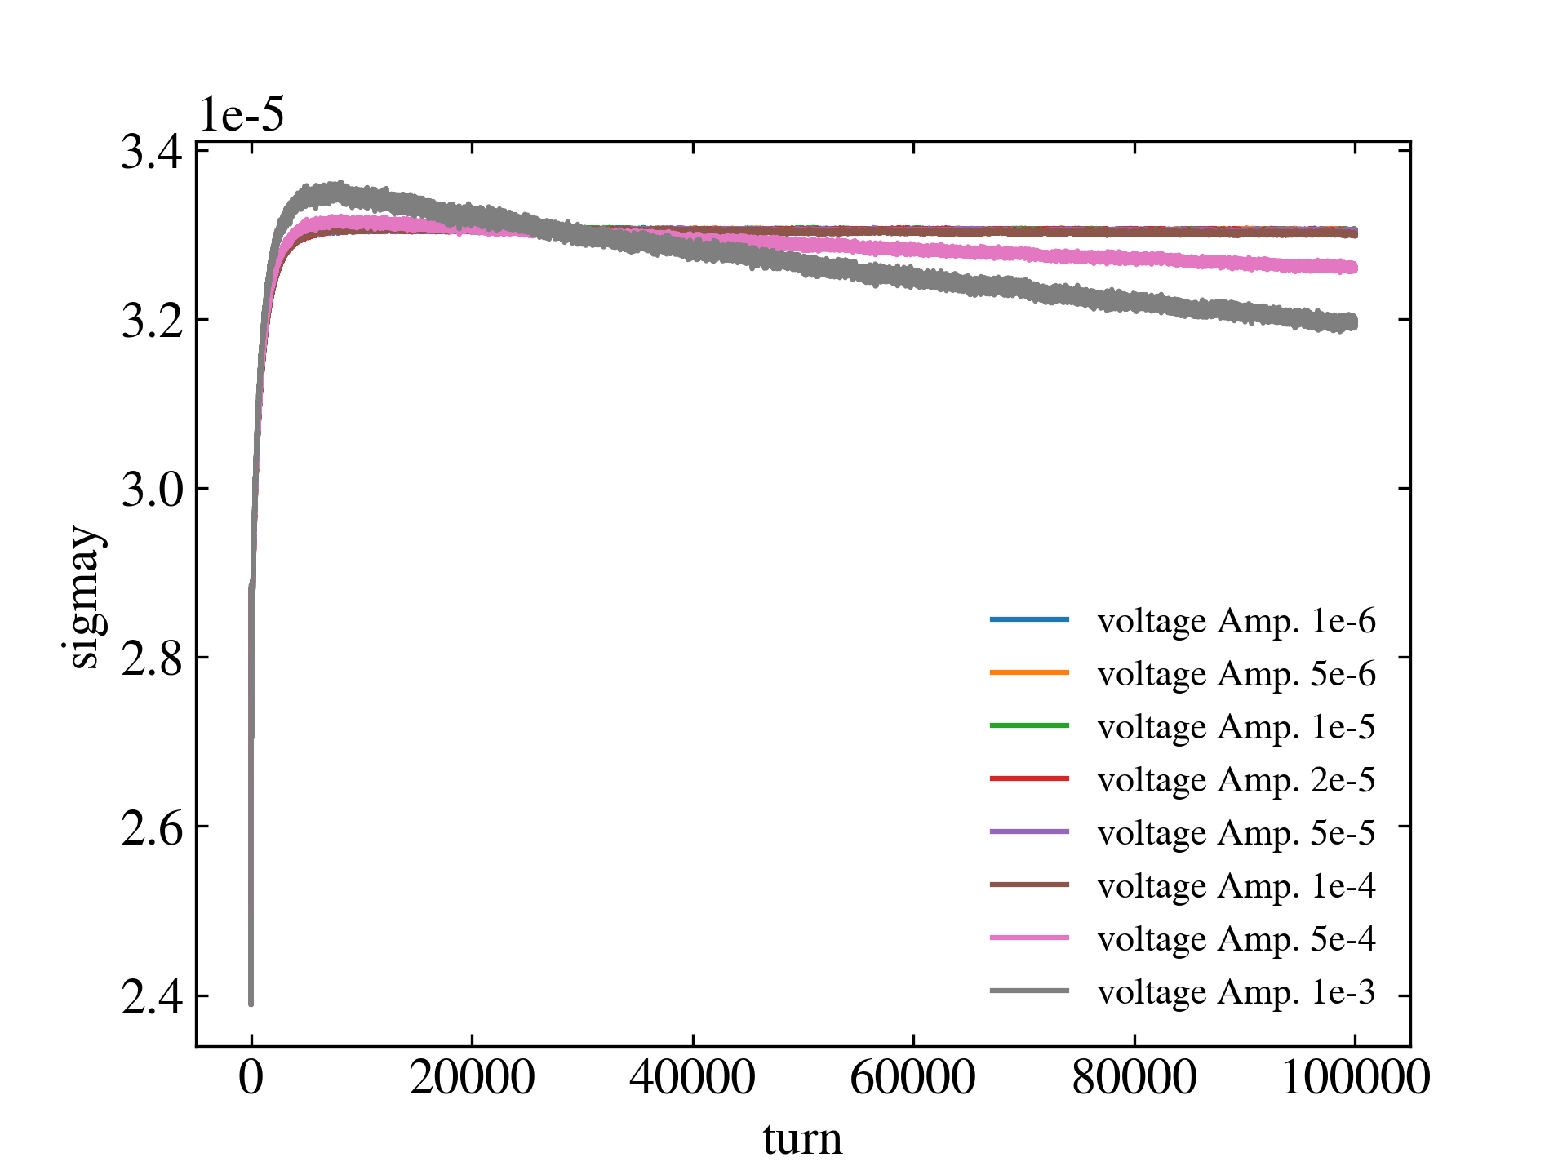
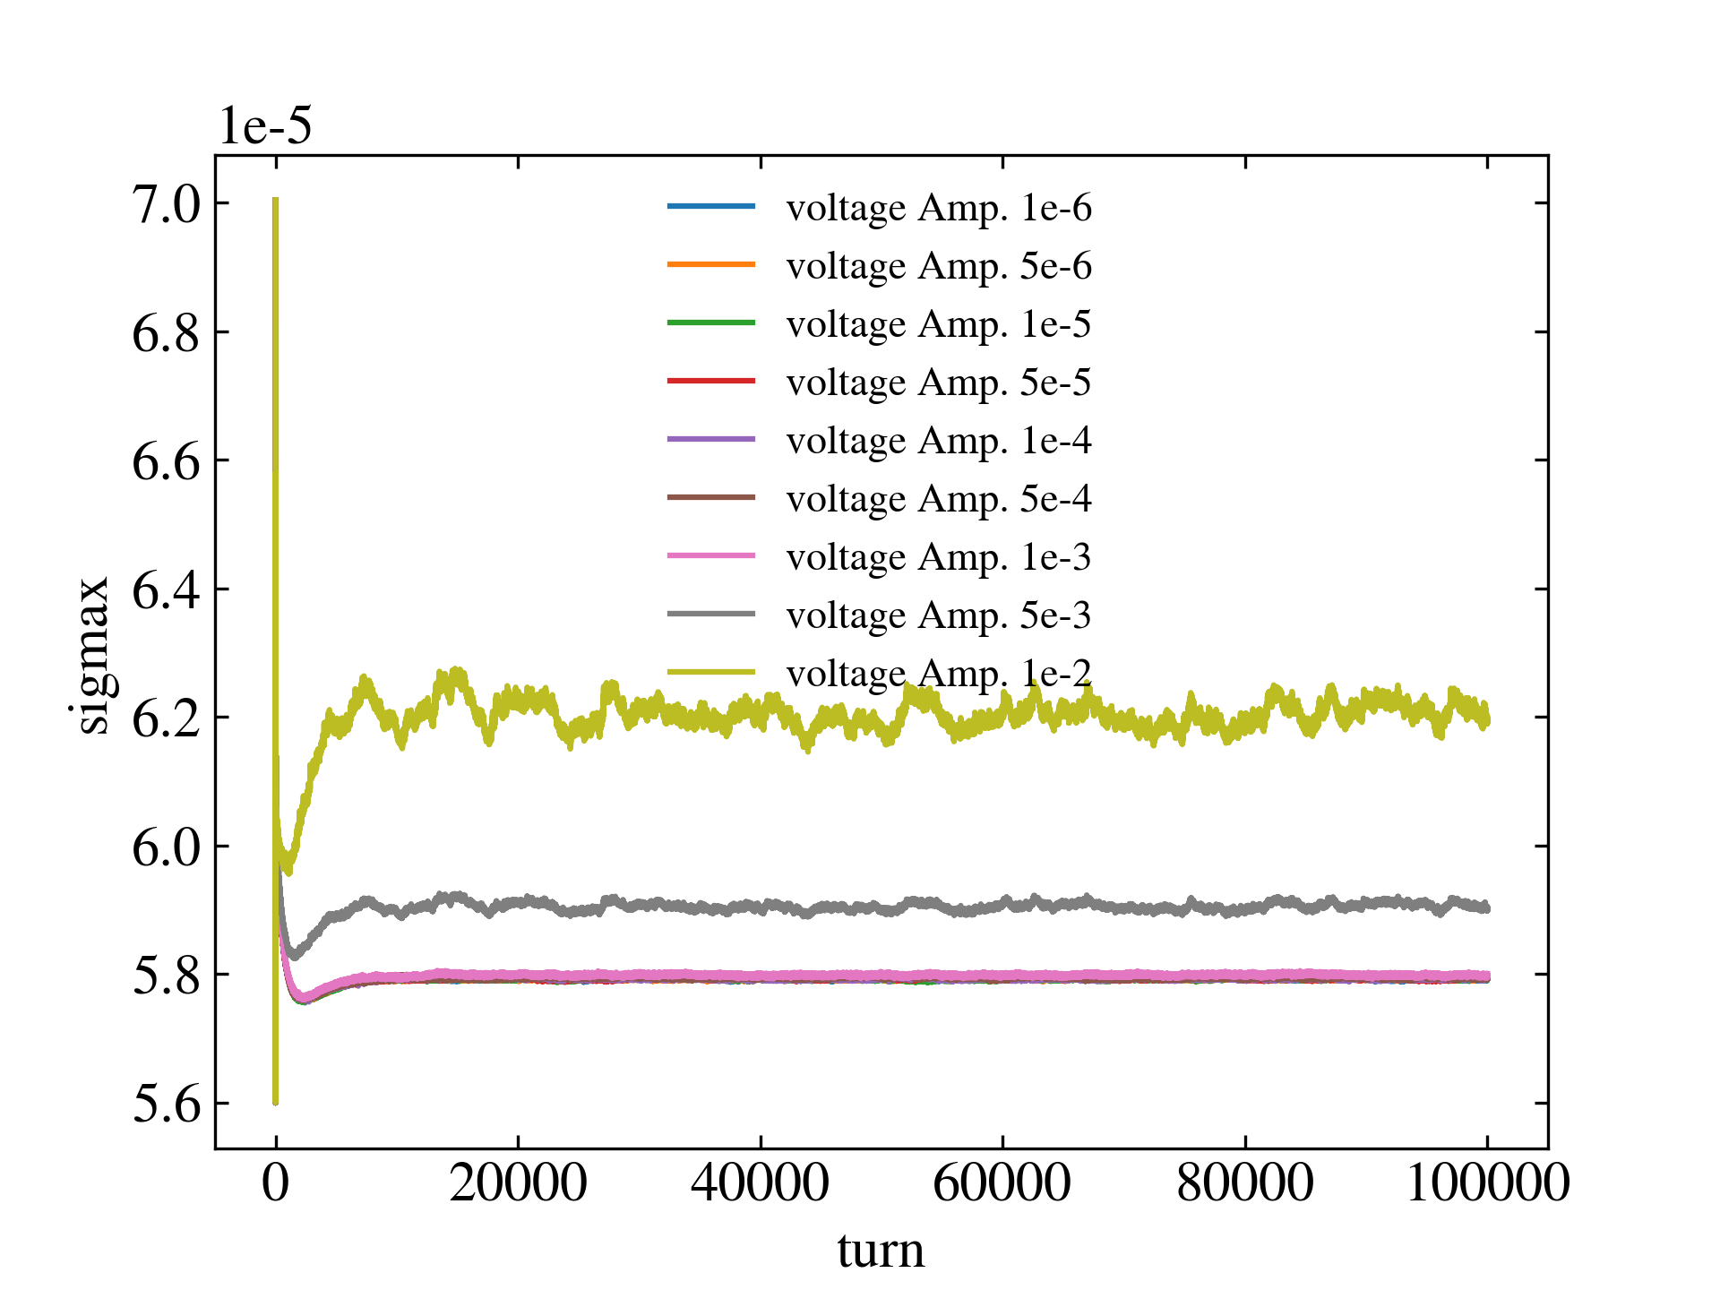
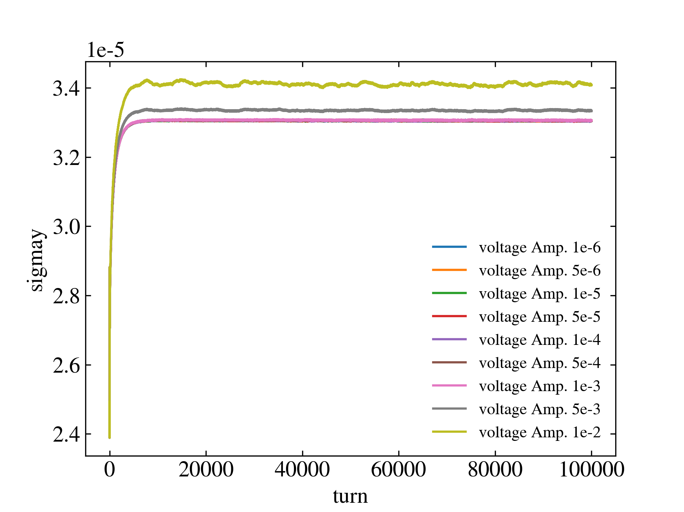
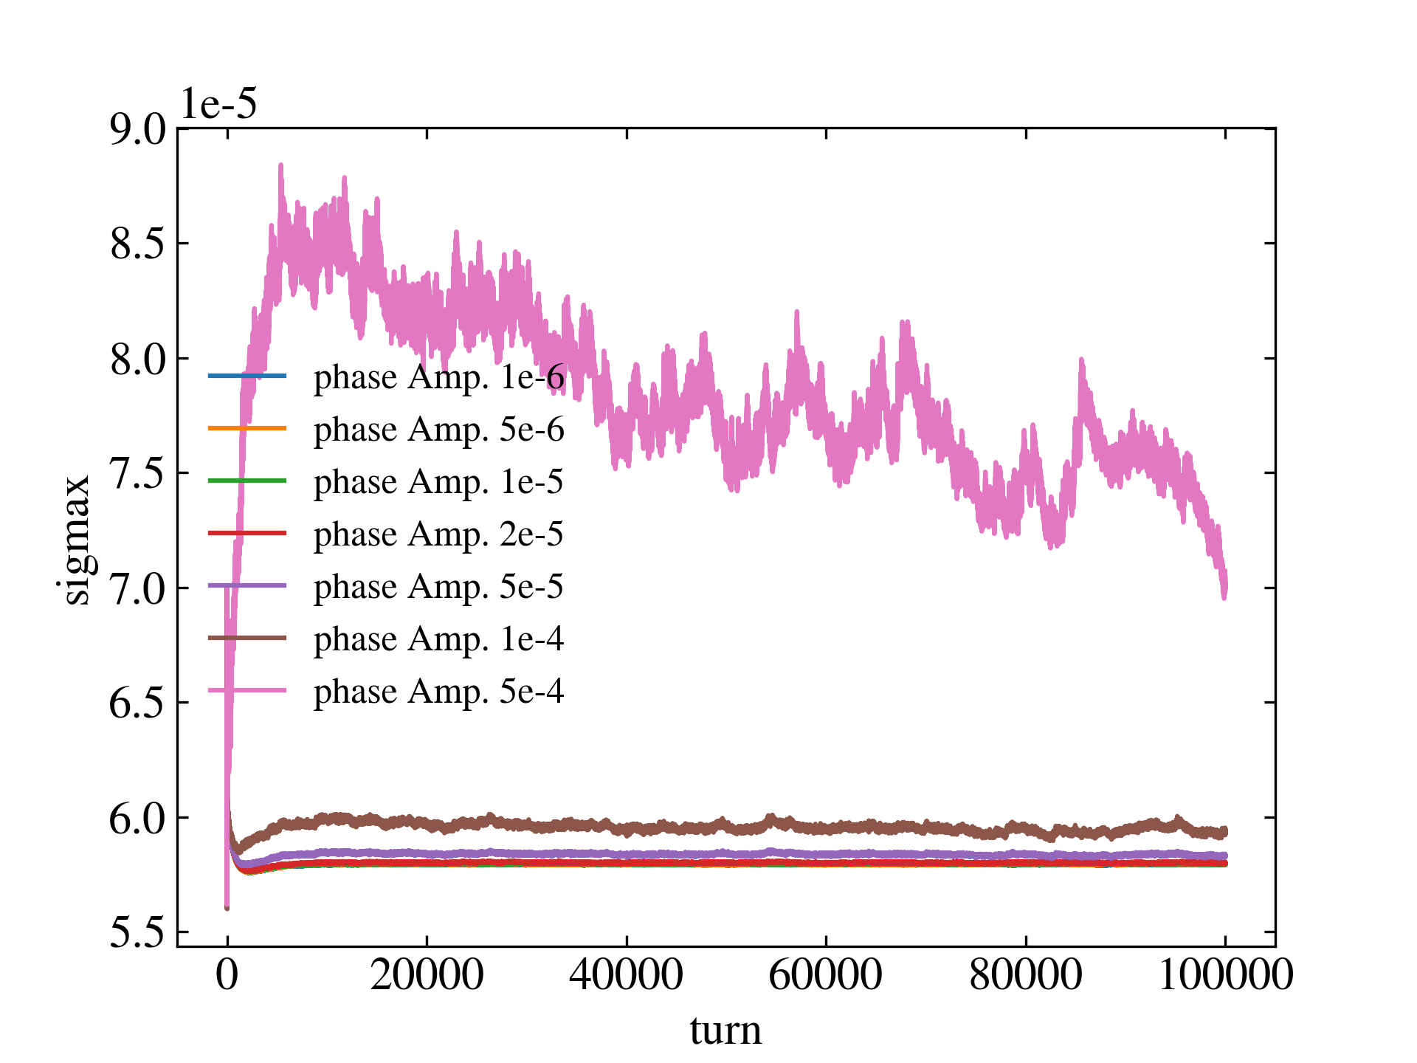
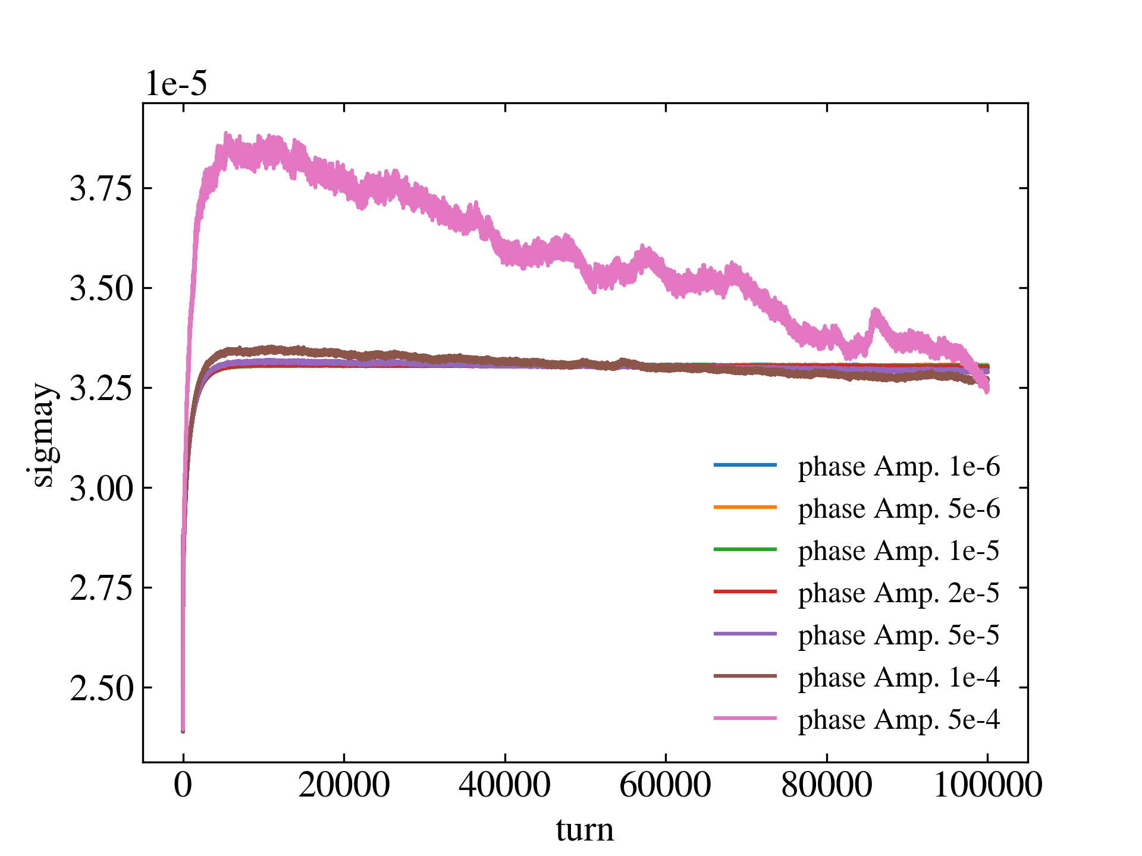
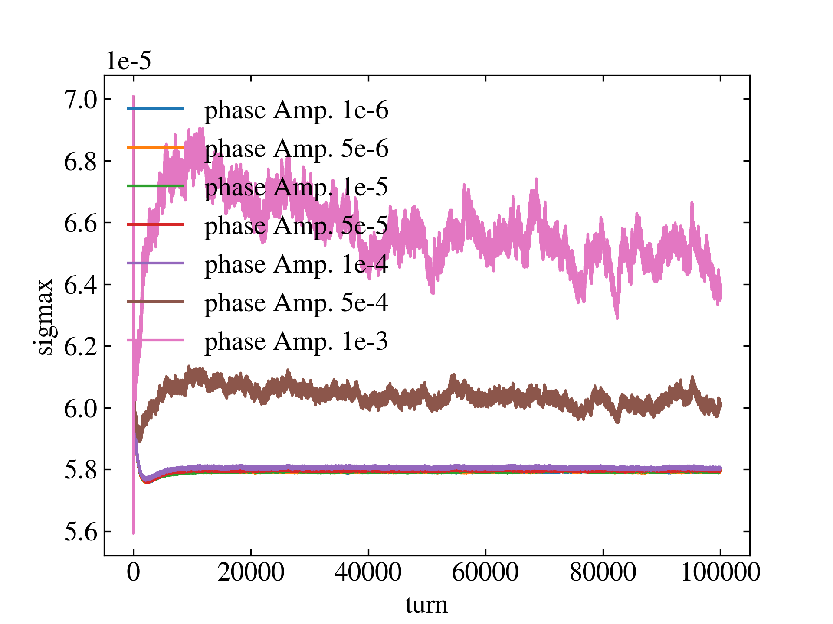
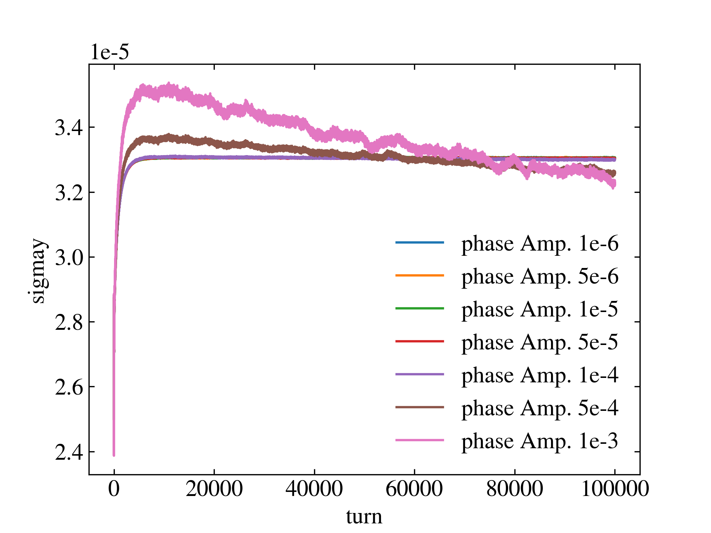
3. White noise of CCP and CCE’s RF voltage and phase
As long as the RF white noise of CCP and CCE does not exceed the threshold we mentioned earlier, the electron bunch size will not increase significantly.
CCP: 100 MHz
CCE: 400 MHz
Electron bunch size at different CCP RF noise
Electron bunch size at different CCE RF noise
Voltage
noise
Phase noise

Slide 17
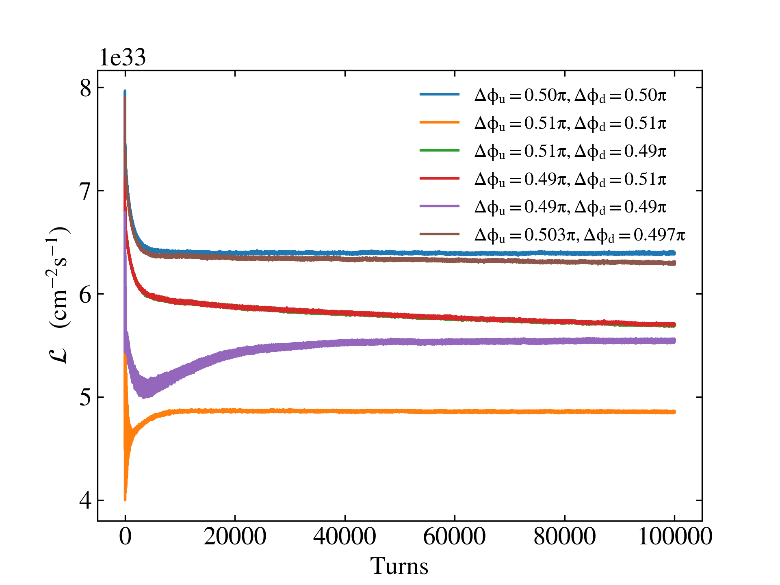
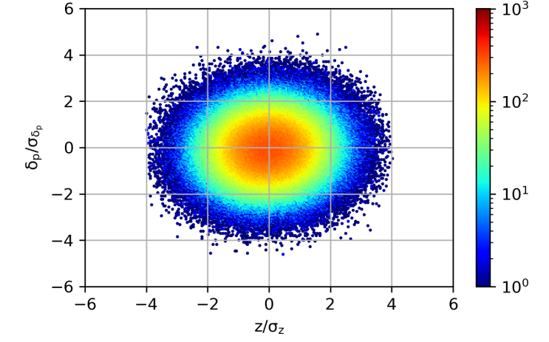
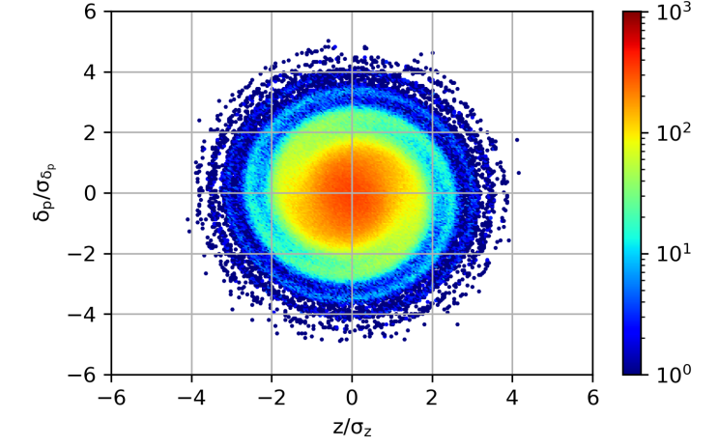
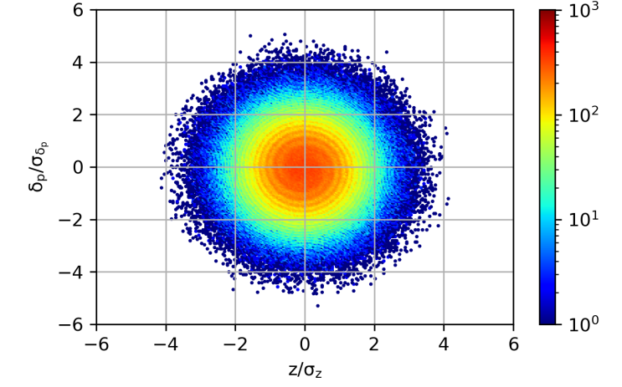
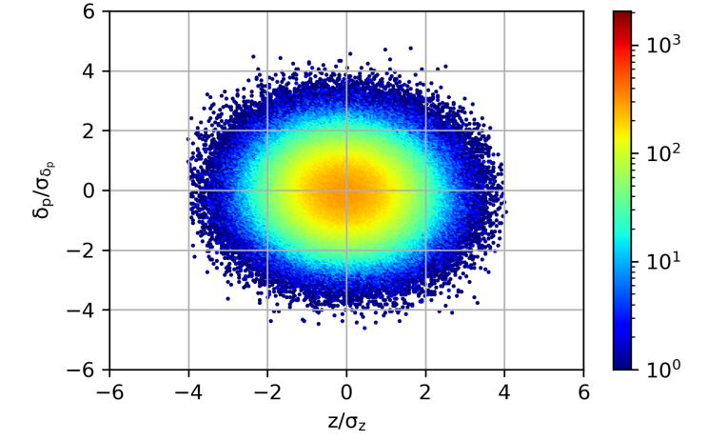
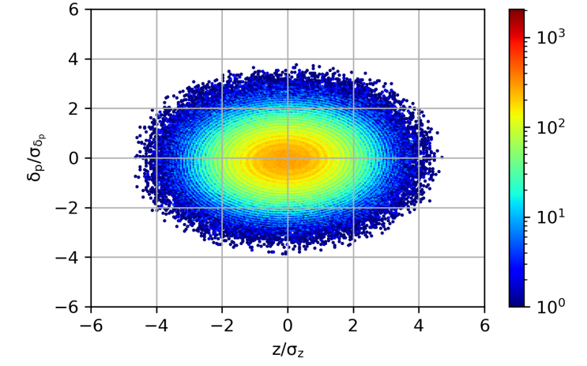
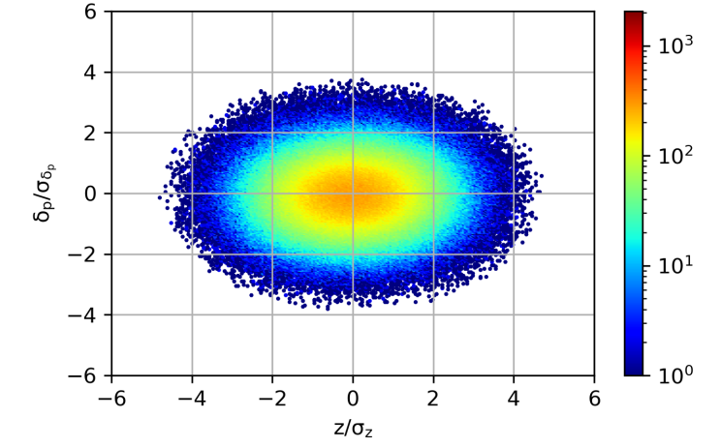
3. CCP phase advance error
When the phase advances between the two crab cavities and IP are less than pi/2, the bunch length will be compressed, otherwise it will be stretched.
When the phase advance between the two crab cavities is pi, the bunch length will not be changed. For CCP, the phase shift error of any crab cavity cannot exceed 0.2°.
Lumi. at different CCP phase advance
Proton z-x dist. at different CCP phase advance
Δφu=0.49pi, Δφd=0.49pi
Proton σz=8.0cm
Δφu=0.51pi, Δφd=0.51pi
Proton σz=7.3cm
Proton σz=9.3cm
Turn 1
Turn 10k
Turn 100k

Slide 18


3. CCE phase advance error
For electron beam, the phase advance error of the crab cavity will also affect the bunch length and luminosity, but the effect is weaker than that of the proton crab cavity.
When the phase advance between the two crab cavities is pi, even if the phase advance error of a single crab cavity is 0.1pi, it will not have a significant effect on the luminosity and proton bunch size.
Lumi. at different CCE phase advance
Proton sigmay at different CCE phase advance
Electron σz=7.50 mm
Electron σz=7.55mm
Electron σz=7.42mm

Slide 19
4. Summary
To separate the two beams quickly, EicC will use a 50 mrad crossing angle for collision. A local crab cavity scheme will be used to restore the geometric luminosity loss.
The proton crab cavity can restore the luminosity to a state close to head-on at frequencies of 100 MHz and 200+400 MHz (1.4θ-0.4θ). The electron crab cavity frequency does not have a significant effect on luminosity, and a frequency of 400MHz is planned to be used.
The proton crab cavity RF white noise tolerance level: voltage ~ 1x10⁻⁵, phase ~ 1x10⁻⁶
The electron crab cavity RF white noise tolerance level: voltage ~ 1x10⁻³, phase ~ 1x10⁻⁵
The phase advance between proton crab cavities and electron crab cavities needs to be equal to pi, where the phase advance error of a single proton crab cavity does not exceed 0.2°, and that of a single electron crab cavity does not exceed 2°.
We need to optimize parameters to reduce the vertical size growth rate of the proton bunch.
Notes:
100MHz and second harmonic cavity

Slide 20
Thanks for your attention!

