Slide 1
Progress in Gear-Changing Research and Prospects for Future Experiments
E. Nissen

Slide 2
Outline
What is gear-changing?
Background on DESIREE
Outline of the DESIREE experimental program
How the experiments are constructed
Initial experiments and changes made
Later experiments
Future experiments
Offshoots
Gear-changing based beam-beam test facility
Conclusions

Slide 3
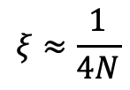
What is Gear Changing?
Gear-changing is a collider synchronization system where different harmonic numbers of bunches collide with each other.
This can be achieved through either different beam velocities or different path lengths
Investigated for use in RHIC, JLEIC, and EicC
Can reduce systematic uncertainties, but can lead to resonances, for an N on N+1 system the limit is*:
3
4
2
$$ξ≈\frac{1}{4N}$$
a
1
b
c
*see https://doi.org/10.1103/PhysRevSTAB.17.041001

Slide 4
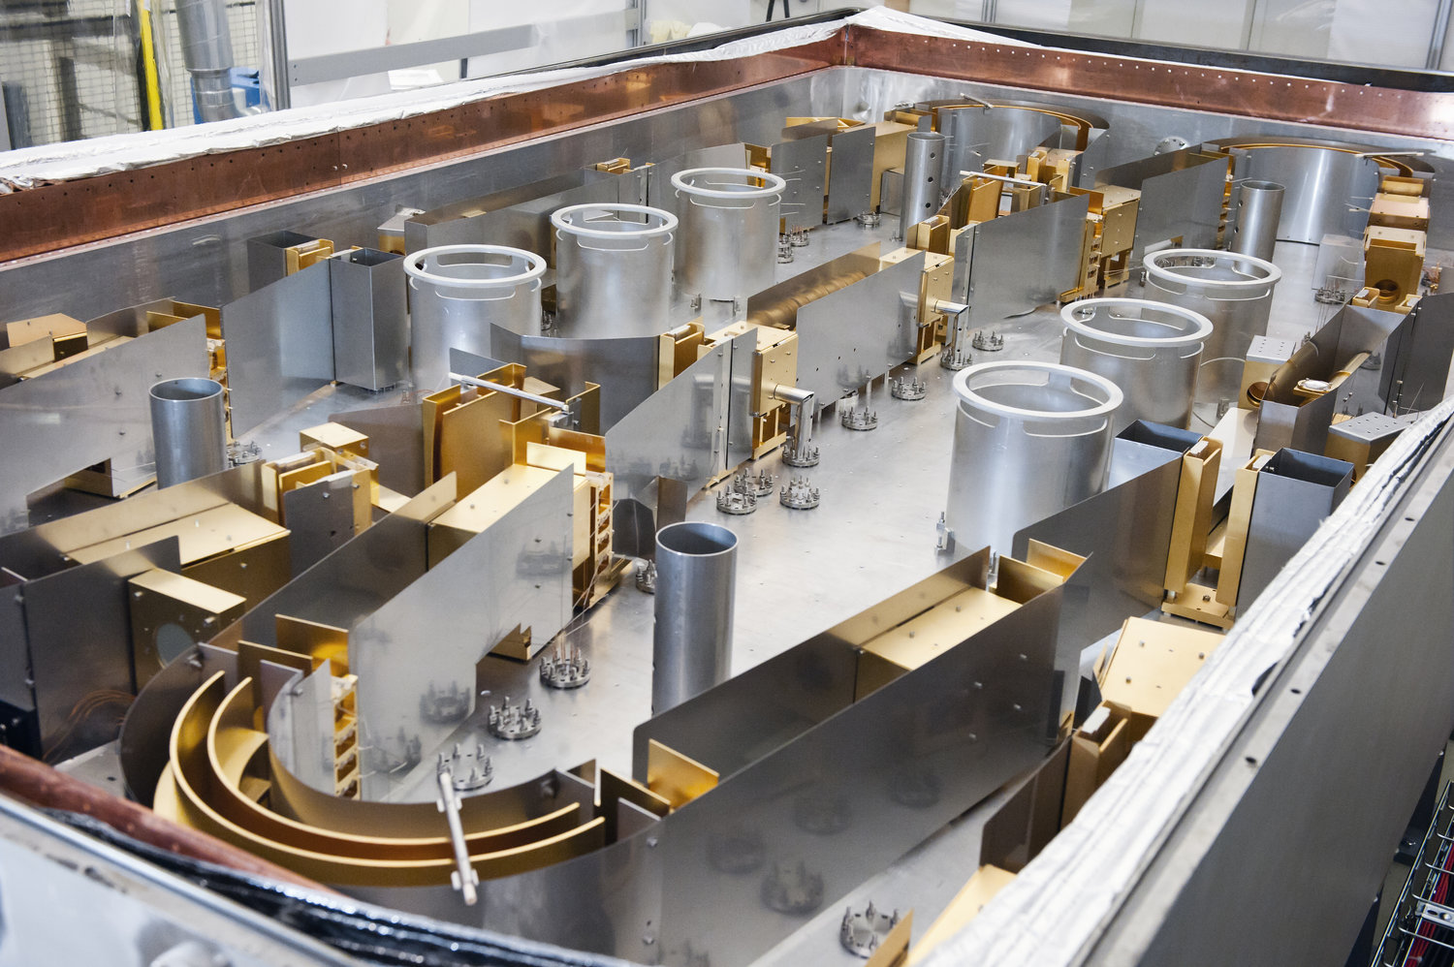
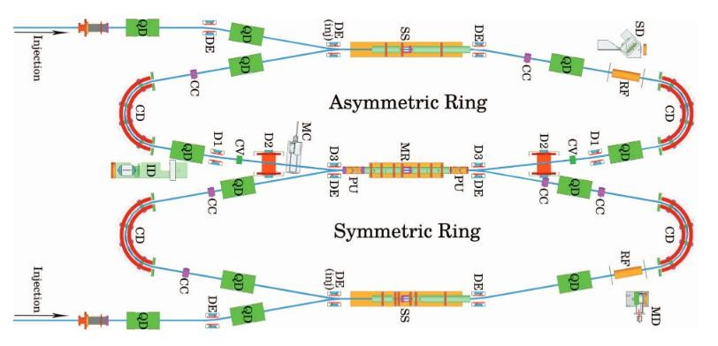
Double ElectroStatic Ion Ring ExpEriment (DESIREE)
  Located at Stockholm University, in Sweden.
  Up to 25 keV on up to 100 keV singly, oppositely-charged, ions.
  Currently matches velocities to study neutralization reactions in the interstellar medium.
  A part of the Swedish national infrastructure.
  Energy Range allows us to “dial in” any desired relative velocity
Pickups (BPMs) on either end of the merger region
RF is handled via a pair of Schottkey cavities

Slide 5
DESIREE Experiments Timeline
At IPAC 2017 in Copenhagen the people at Stockholm University had a poster →
Later that summer, realized it could be used to show Gear-Changing
Several funding avenues were pursued
Go ahead given in Summer of 2019
Initial setup measurements in Fall of 2019
First experiment in May of 2020
Follow up experiments in 2020 and 2021
  https://doi.org/10.18429/JACoW-IPAC2021-TUXA05
  https://doi.org/10.1016/j.nima.2022.166601
  https://doi.org/10.18429/JACoW-IPAC2022-WEPOST050
Also began looking at potential spinoff options for gear changing and comoving beams
  https://doi.org/10.18429/JACoW-IPAC2022-THPOMS057
Large experiment in December of 2022
Received IReNA grant to visit University of Naples/INFN to work on fusion cross section spinoff
  https://doi.org/10.1016/j.nima.2024.169158
Next Large experiment scheduled for December 2024
Informally referred to as DODGE project, (Direct Observations in DESIREE of Gear-changing Events)

Slide 6
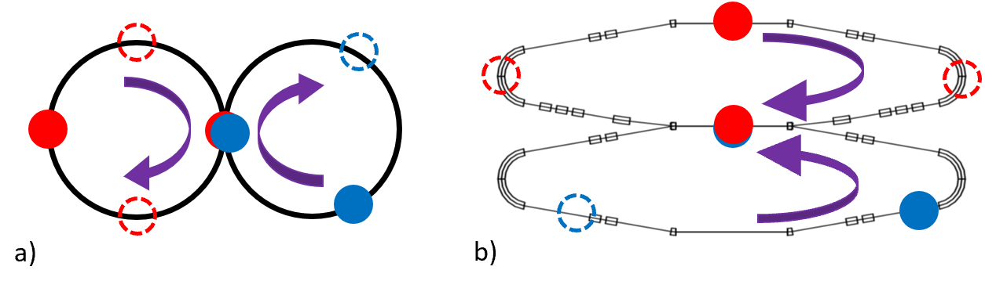
How The Experiments are Constructed
voltage
time
The main diagnostics available in DESIREE are two BPMs/pickups on either end of the merger region
Due to the relatively slow beams, the pickups give us longitudinal current information about the bunches
In order to map the evolution of the bunches, we leave one bucket in each beam empty, this creates a repeating pattern where each bunch will periodically pass through the merger area without colliding. Giving us a snapshot of the beam evolution.
Due to source stability, we used singly charged nitrogen and carbon in a 3 on 4 arrangement for the majority of our experiments. With 4 bunches of 7.04 KeV carbon and 3 bunches of 14.3 KeV nitrogen. We also did 5 on 4 as a proof of concept.
The Carbon beam will experience a tune shift of ~6.37*10⁻⁵ and the Nitrogen 4.14*10⁻⁵

Slide 7
Initial Round of Experiments
Initially we were concentrating on maintaining the calculated pattern over a long period of time
This was done by matching the gaussians double gaussian and measuring the distance between them to show that gear-changing was occurring.
Getting the timing right was more difficult than would normally be imagined. Each Schottkey cavity must drive at the same frequency. We can adjust the phasing and getting it correct is a delicate process.
The two rings don’t have the exact same pathlength, so there are small oscillations within the buckets

Slide 8
Initial Round of Experiments (cont’d)
After the first round of experiments we noticed the bunch length oscillating in the data, and planned a brief backup experiment where we tacked every turn for an extended period and ran an FFT
The initial results of this experiment are shown to the right. We lengthened the nitrogen bunch to get a higher current, since these numbers are performed using a fitting algorithm we got a cleaner signal on the high current nitrogen signal
These initial results are reported in: https://doi.org/10.1016/j.nima.2022.166601

Slide 9
Lessons Learned
We eventually moved from a curve fitting system to a moment based system to measure the bunch length
Differences in the current profile between colliding and uncollided systems showed potential differences in the evolution of the beam over long periods of time
Longer bunches allow us to get stronger signals
Instead of measuring the interactions from the beginning of the collisions, we waited 100ms before beginning our measurements.
We also developed a technique of allowing the bunches to collide for a set period of time before kicking one of the beam out to measure the effects of the collisions without skipping turns, this is what is shown in the following slides

Slide 10
Next round of Experiments (Nitrogen Beam)
4V Cbeam
6V Cbeam
8V Cbeam
10V Cbeam

Slide 11
Next Round of Experiments (Nitrogen Beam continued)
4V Cbeam
6V Cbeam
8V Cbeam
10V Cbeam

Slide 12
Next Round of Experiments (Carbon Beam)
4V Cbeam
6V Cbeam
8V Cbeam
10V Cbeam

Slide 13
Next Round of Experiments (Carbon Beam continued)

Slide 14
Future Experiments
Next round of experiments scheduled for December of 2024
We will be attempting with different ions H and He
New, additional pickups have been added to DESIREE, and will be available to take data without using the missing
New Pickups

Slide 15
Potential Offshoots
Comoving beams have some fundamental differences from head-on colliding beams.
Effects that integrate over time are amplified (such as beam-beam interactions)
Effects not dependent on time are the same (such as luminosity)
The center of mass energy of the collision goes down instead of up
The collisions, and thus the daughter particles will exist in a moving reference frame, taking on the center of mass velocity
These interactions can be used to study the bare nucleon cross sections of fusion reactions
A comoving system at higher energy could be used to create an accelerated beam of particles that couldn’t otherwise be accelerated such as neutrons or antiprotons

Slide 16
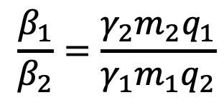
Single Ring Concept
Beam rigidity and gear-changing
$$\frac{β_{1}}{β_{2}}=\frac{γ_{2}m_{2}q_{1}}{γ_{1}m_{1}q_{2}}$$
Timing corrections
RF bunching in a single ring

Slide 17
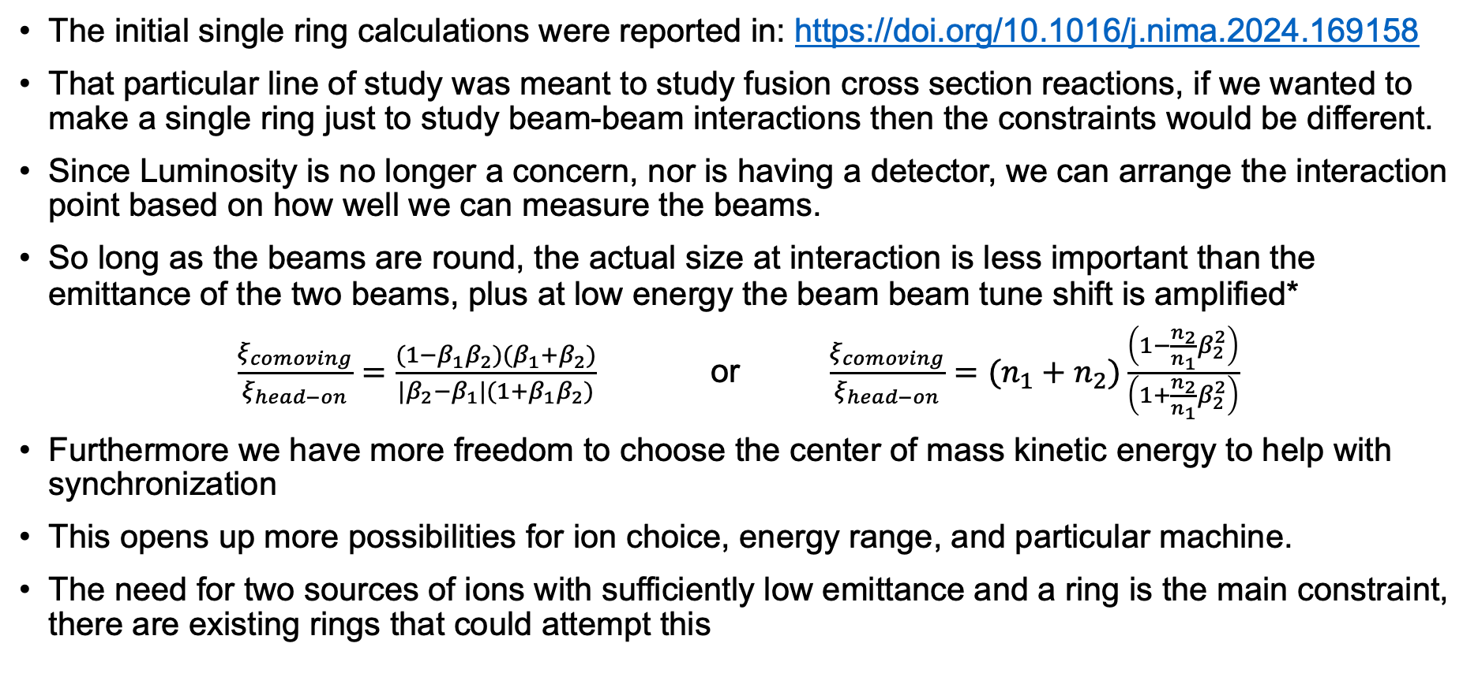
Single Ring Beam-Beam Test Facility
The initial single ring calculations were reported in: https://doi.org/10.1016/j.nima.2024.169158
That particular line of study was meant to study fusion cross section reactions, if we wanted to make a single ring just to study beam-beam interactions then the constraints would be different.
Since Luminosity is no longer a concern, nor is having a detector, we can arrange the interaction point based on how well we can measure the beams.
So long as the beams are round, the actual size at interaction is less important than the emittance of the two beams, plus at low energy the beam beam tune shift is amplified*
$\frac{ξ_{comoving}}{ξ_{head−on}}=\frac{(1−β_{1}β_{2})(β_{1}+β_{2})}{|β_{2}−β_{1}|(1+β_{1}β_{2})}$ or $\frac{ξ_{comoving}}{ξ_{head−on}}=(n_{1}+n_{2})\frac{\left(1−\frac{n_{2}}{n_{1}}β_{2}^{2}\right)}{\left(1+\frac{n_{2}}{n_{1}}β_{2}^{2}\right)}$
Furthermore we have more freedom to choose the center of mass kinetic energy to help with synchronization
This opens up more possibilities for ion choice, energy range, and particular machine.
The need for two sources of ions with sufficiently low emittance and a ring is the main constraint, there are existing rings that could attempt this
* See https://doi.org/10.1016/S0168-9002(99)01298-X

Slide 18
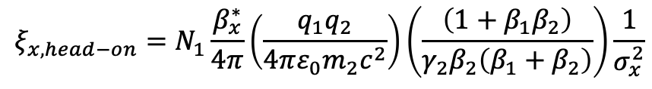
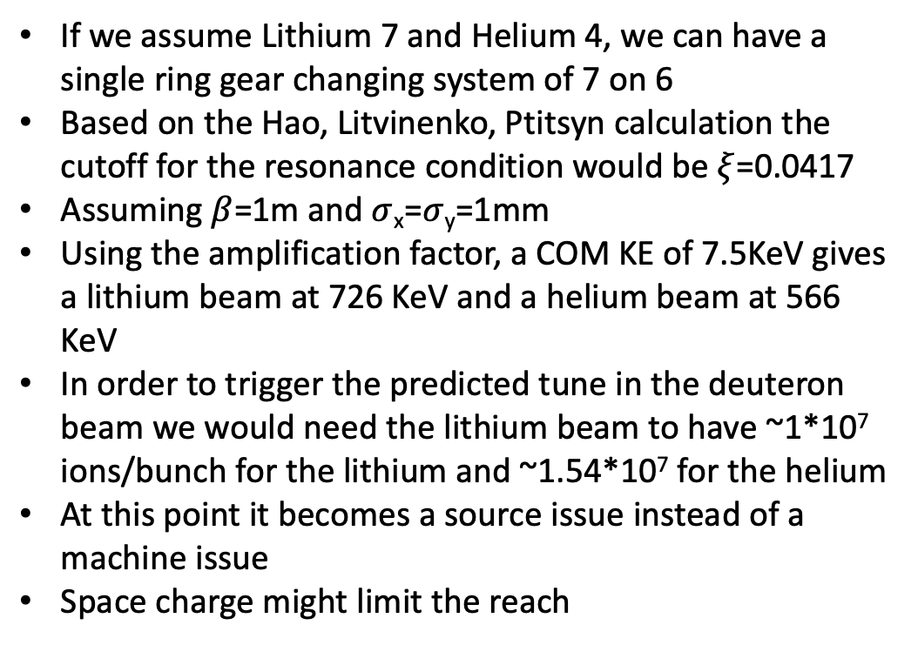
Potential Comoving, Single Ring, Test Facility
$$ξ_{x,head−on}=N_{1}\frac{β_{x}^{∗}}{4π}\left(\frac{q_{1}q_{2}}{4πε_{0}m_{2}c^{2}}\right)\left(\frac{\left(1+β_{1}β_{2}\right)}{γ_{2}β_{2}\left(β_{1}+β_{2}\right)}\right)\frac{1}{σ_{x}^{2}}$$
If we assume Lithium 7 and Helium 4, we can have a single ring gear changing system of 7 on 6
Based on the Hao, Litvinenko, Ptitsyn calculation the cutoff for the resonance condition would be $ξ$=0.0417
Assuming $β$=1m and $σ$_{x}=$σ$_{y}=1mm
Using the amplification factor, a COM KE of 7.5KeV gives a lithium beam at 726 KeV and a helium beam at 566 KeV
In order to trigger the predicted tune in the deuteron beam we would need the lithium beam to have ~1*10⁷ ions/bunch for the lithium and ~1.54*10⁷ for the helium
At this point it becomes a source issue instead of a machine issue
Space charge might limit the reach

Slide 19
Conclusions
Work has progressed, demonstrating a gear-changing system in the Double ElectroStatic Ion Ring ExpEriment (DESIREE)
We have developed a series of techniques to get the collisions synchronized, and to measure the beam as it collides using the missing bunch method, as well as kicking out one of the beams
We have been able to detect traces of longitudinal beam-beam interactions in the synchrotron oscillations of the ion bunches
The unique type of comoving collisions in DESIREE, when combined with gear-changing allows for single ring collisions
This type of single ring collision could be used to study beam-beam interactions
Even with potential resonances, gear-changing can be useful for lower energy, lower number of bunch systems

Slide 20
Thank you for your attention
Special thank you to my collaborators at Stockholm University,
Ansgar Simonsson and Anders Källberg
Also my collaborators at University of Naples/INFN
Gianluca Imbriani and Antonino DiLeva
This material is based upon work supported by the U.S. Department of Energy, Office of Science, Office of Nuclear Physics under contract DE-AC05-06OR23177. This work was supported in part by the National Science Foundation, United States under Grant No. OISE-1927130 (IReNA). Portions of this work was performed at the Swedish National Research Infrastructure, DESIREE (Swedish Research Council Contract No. 2017-00621)

