Slide 1
A Topological Approach to the Problem of Beam-Beam Compensation
P. Bélanger, G. Sterbini
Special thanks to:
D. Kaltchev for his help and vast knowledge on non-linear maps;
T. Planche and R. Baartman for constant support and fruitful discussions on the topic;
Many others for the discussions.

Slide 2
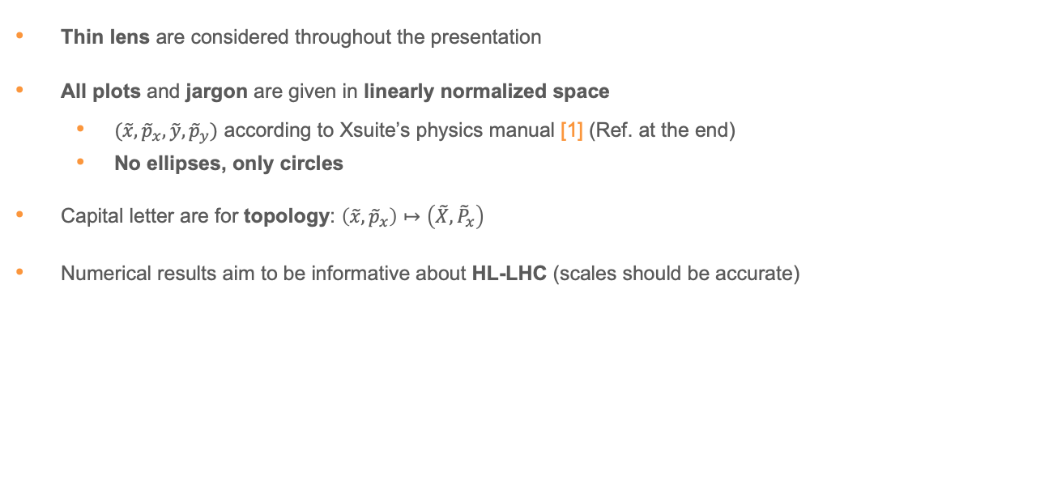
Prelude: basic assumptions
Thin lens are considered throughout the presentation
All plots and jargon are given in linearly normalized space
  $(\tilde{x}, {\tilde{p}}_{x},\tilde{y},{\tilde{p}}_{y})$ according to Xsuite’s physics manual [1] (Ref. at the end)
  No ellipses, only circles
Capital letter are for topology: $\left(\tilde{x}, {\tilde{p}}_{x}\right)↦\left(\tilde{X}, {\tilde{P}}_{x}\right)$
Numerical results aim to be informative about HL-LHC (scales should be accurate)

Slide 3
Introduction
Disconnect between linear and non-linear formalism (à la Newton vs. Relativity)
  Dipoles + Quadrupoles, linear machine: forever stable
  Sextupoles + Octupoles + … + Beam-Beam, non-linear machine: chaos, diffusion, stability?
Let’s try to find a natural extension to describe non-linear dynamics
  Practical consequences:
    DA studies
    Beam losses
    Particle distribution, emittance, etc.
    B1 vs B2 discrepancies?
  Application on the difficult problem of compensation, and most of all, Beam-Beam

Slide 4
Topological description
Transport and compensation
Beam-Beam LR (academic)
Beam-Beam LR (HL-LHC)

Slide 5
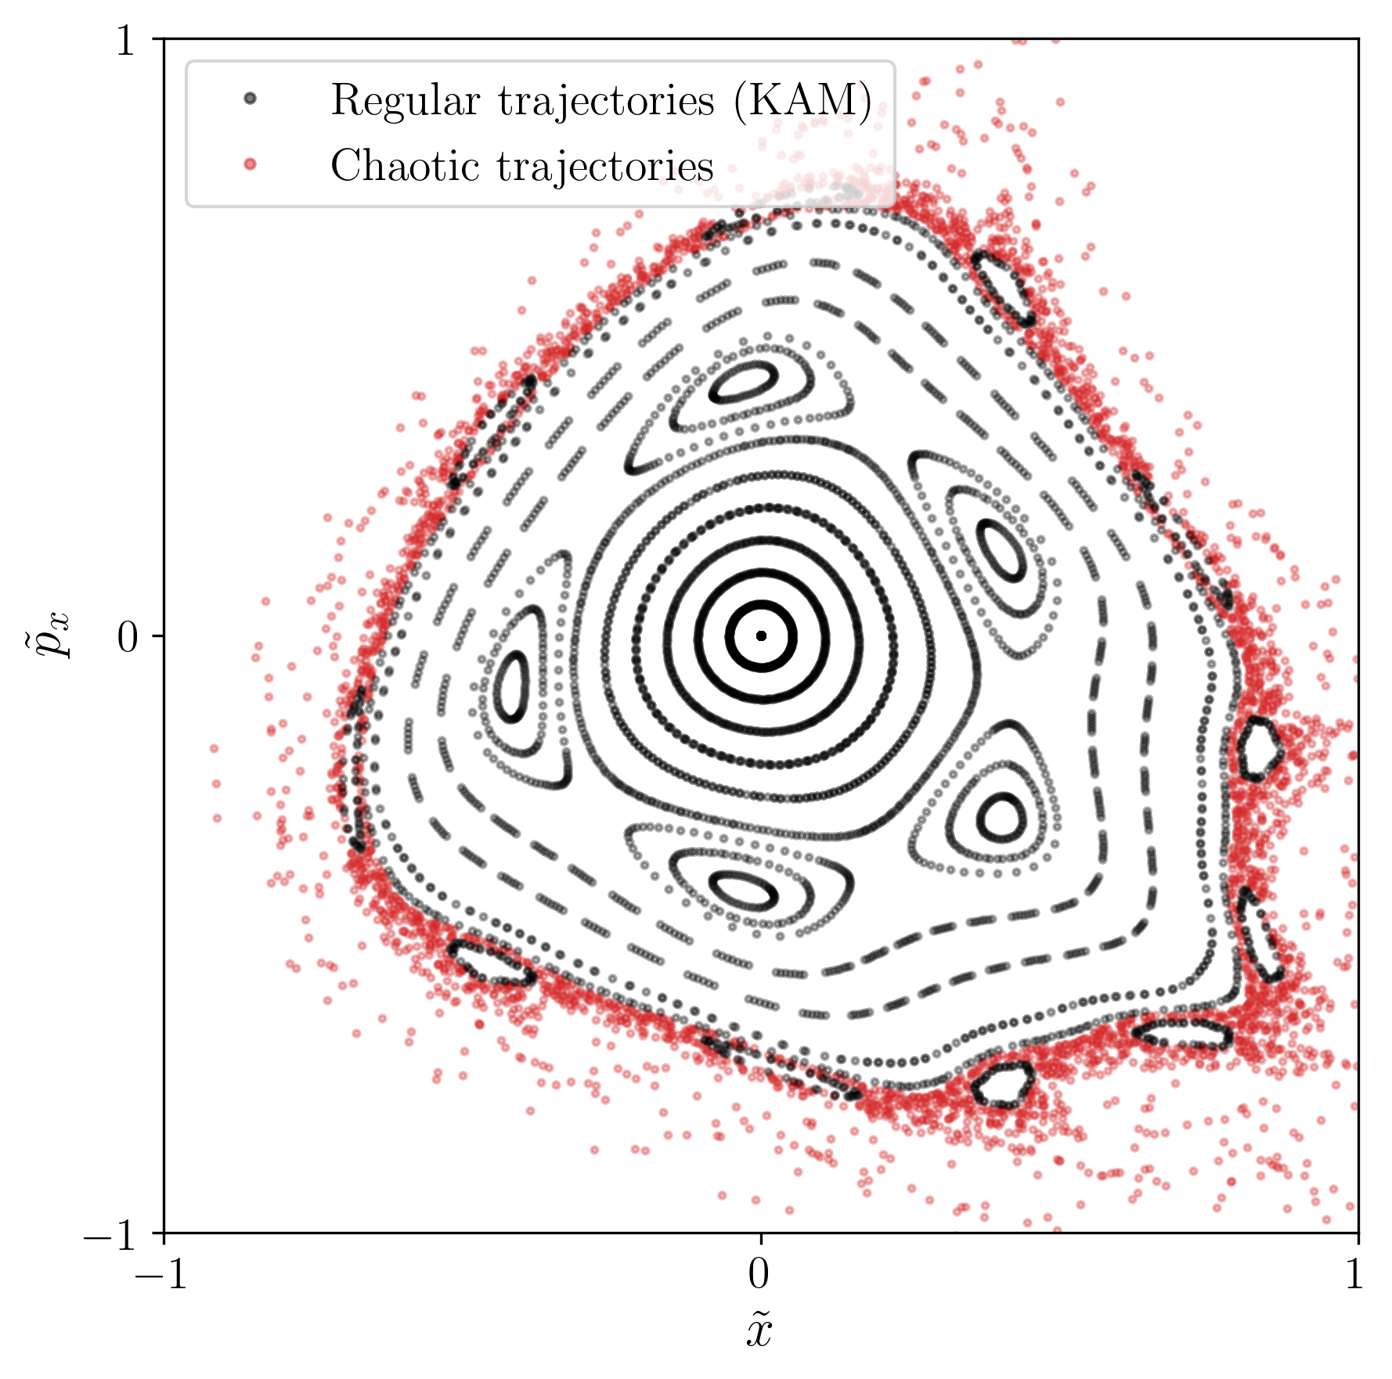
KAM Theorem
Henon map: the solutions are either quasiperiodic, or chaotic
Henon map: simplest 2D non-linear system
“
They seem to lie exactly on a curve. [...] It may be interesting to remark that the successive points rotate regularly around the curve.
— M. Henon
[2] (1964)
Quasiperiodic
”
“
They behave in a completely different way. It is clearly impossible to draw any curve through them. They seem to be distributed at random, in an area left free between the closed curves. Most striking is the fact that this change of behavior seems to occur abruptly...
— M. Henon
[2] (1964)
Chaotic
”
Theorem: For non-integrable conservative systems, some invariant tori (KAM tori) persist close to integrable regions of the system.

Slide 6
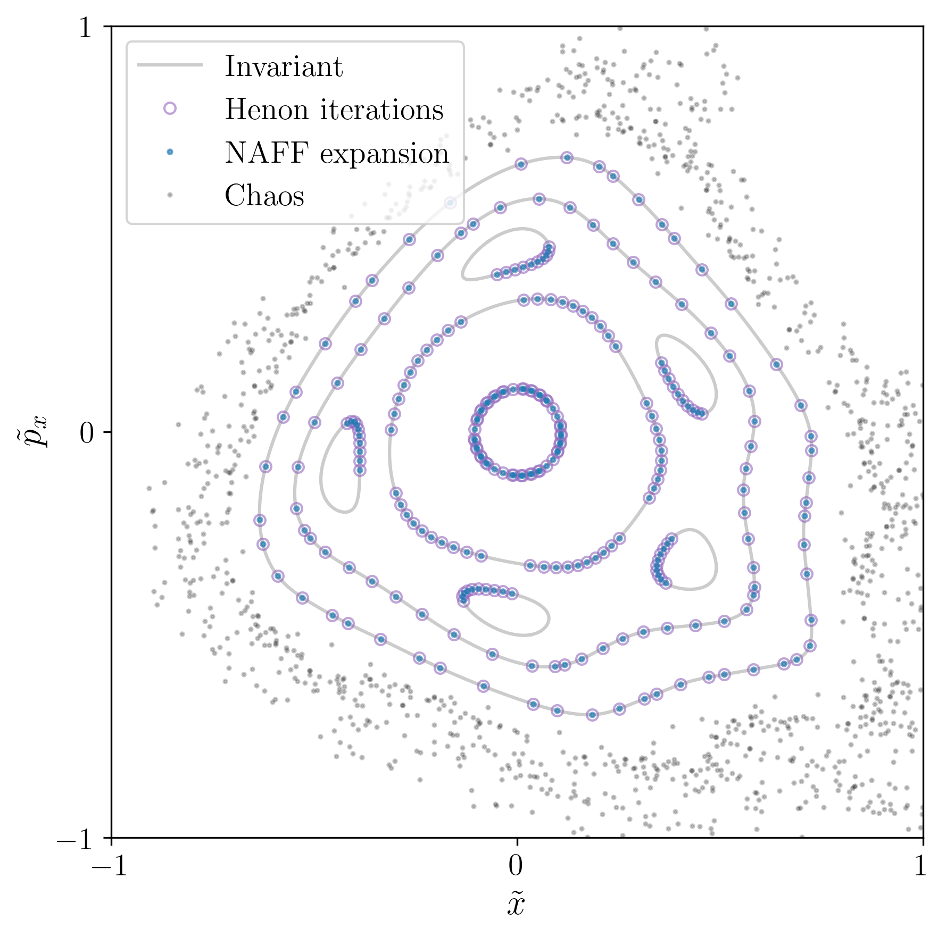
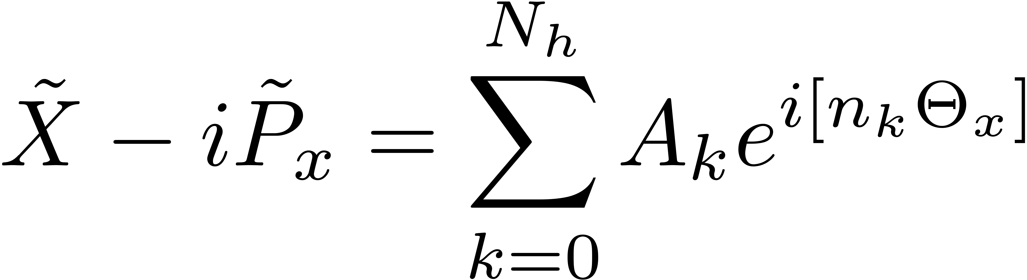
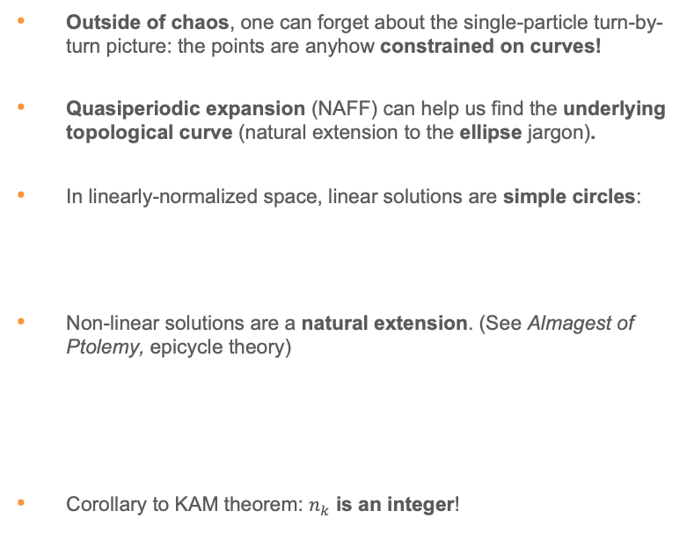
Topological description: non-linear dynamics
Outside of chaos, one can forget about the single-particle turn-by-turn picture: the points are anyhow constrained on curves!
Quasiperiodic expansion (NAFF) can help us find the underlying topological curve (natural extension to the ellipse jargon).
In linearly-normalized space, linear solutions are simple circles:
Non-linear solutions are a natural extension. (See Almagest of Ptolemy, epicycle theory)
Corollary to KAM theorem: $n_{k}$ is an integer!
Notes:
\tilde X - i\tilde P_x = \sqrt{2I_x} e^{i\Theta_x} = r_x e^{i\Theta_x}

Slide 7
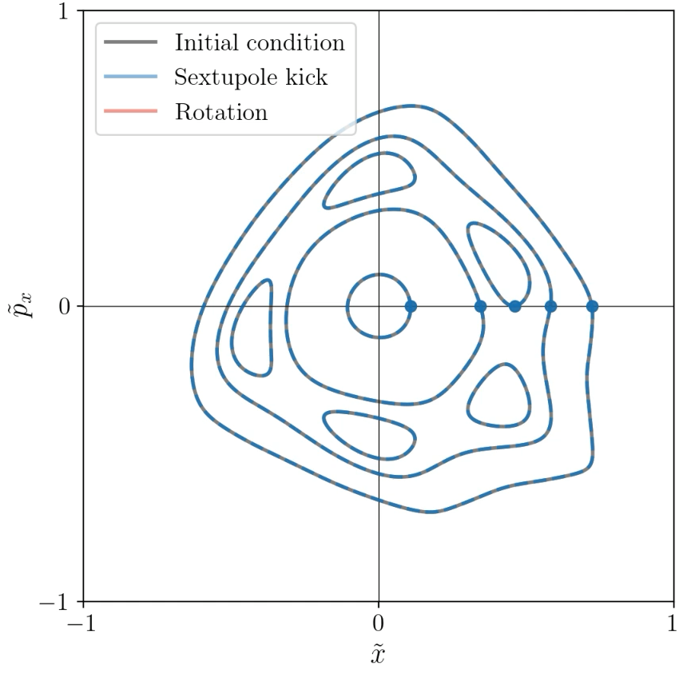
Topological description: eigensolutions
Why the topological jump?
  A fixed point is described by a single point (particle)
  An invariant curve is described by a curve
The phase can advance, but the curve (topology) is unchanged
Exempli gratia: the Henon map, a closed ring containing
  A thin sextupole (shear)
  A linear segment (rotation)
In fact, the invariant curves are the eigensolutions of the transformation
$ω=0.2071$ (video: https://cernbox.cern.ch/s/jhxTpFLn1BrcBQr)
Single parameter:
rotation number

Slide 8
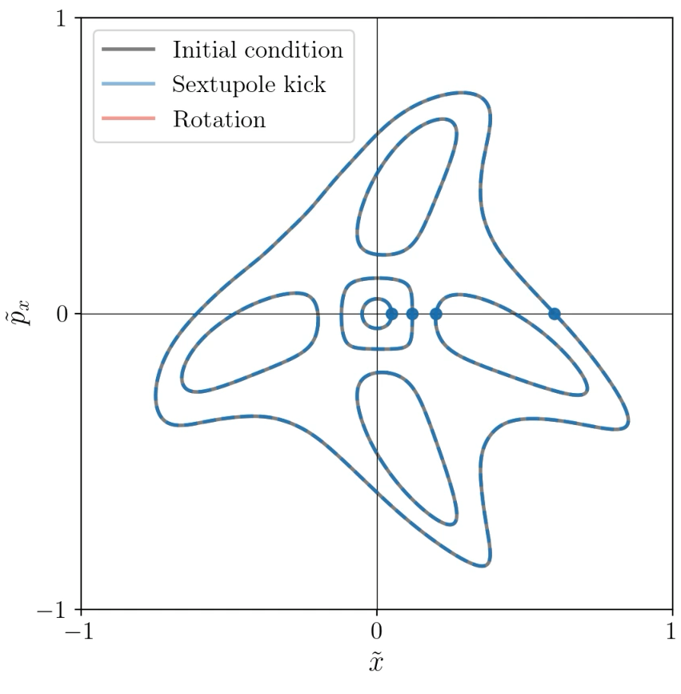
Topological description: eigensolutions
Why the topological jump?
  A fixed point is described by a single point (particle)
  An invariant curve is described by a curve
The phase can advance, but the curve (topology) is unchanged
Exempli gratia: the Henon map, a closed ring containing
  A thin sextupole (shear)
  A linear segment (rotation)
In fact, the invariant curves are the eigensolutions of the transformation
$ω=0.2514$ (video: https://cernbox.cern.ch/s/UZoHtQZZ76jAnke)
Single parameter:
rotation number

Slide 9
Topological description
Transport and compensation
Beam-Beam LR (academic)
Beam-Beam LR (HL-LHC)

Slide 10


Compensation (i.e. linearization)
Accelerator physics transformations can act on topological objects. They are operators.
For undesirable non-linearities (like BB), to compensate is to linearize:
  The eigensolutions of a fully compensated non-linear system are simple circles
  In other words, let’s find a configuration for which the system is equivalent to a simple rotation
In this framework, compensation becomes a transport problem!
$$⇔$$
Total compensation
$$⇔$$
Partial compensation

Slide 11
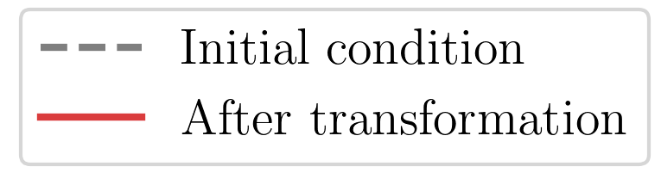
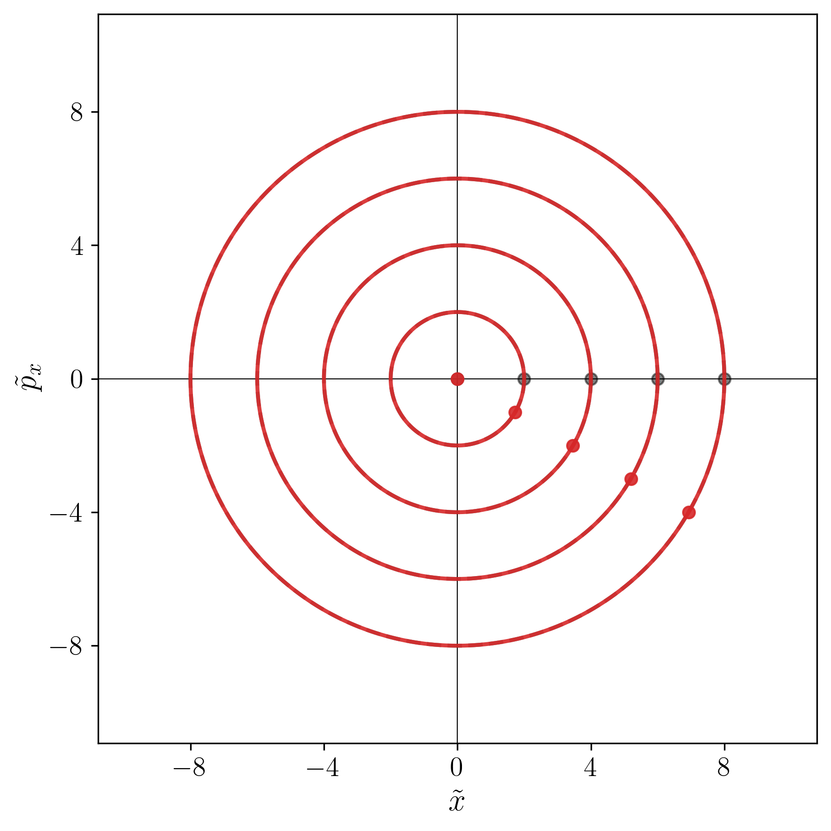
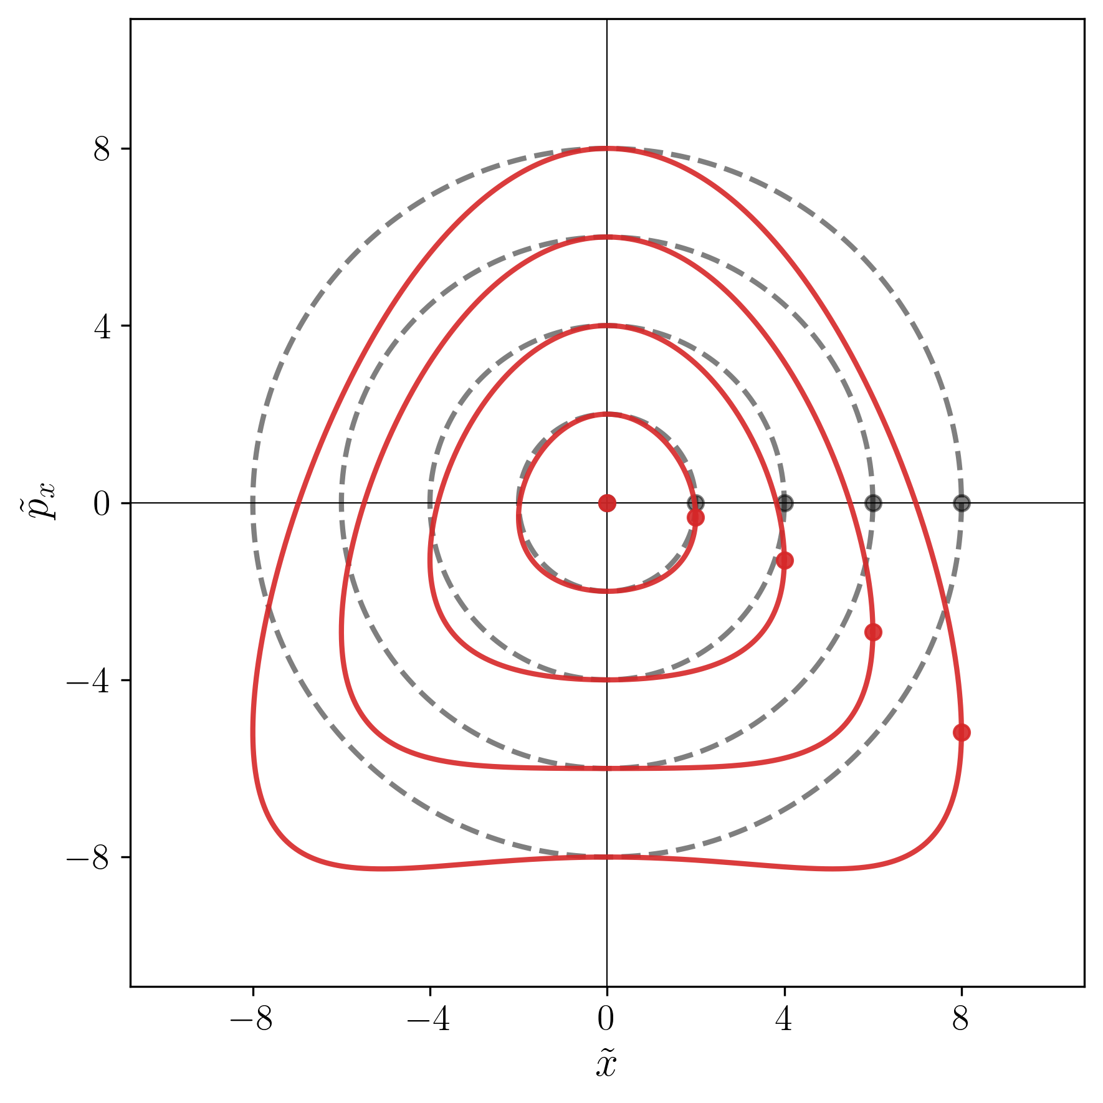
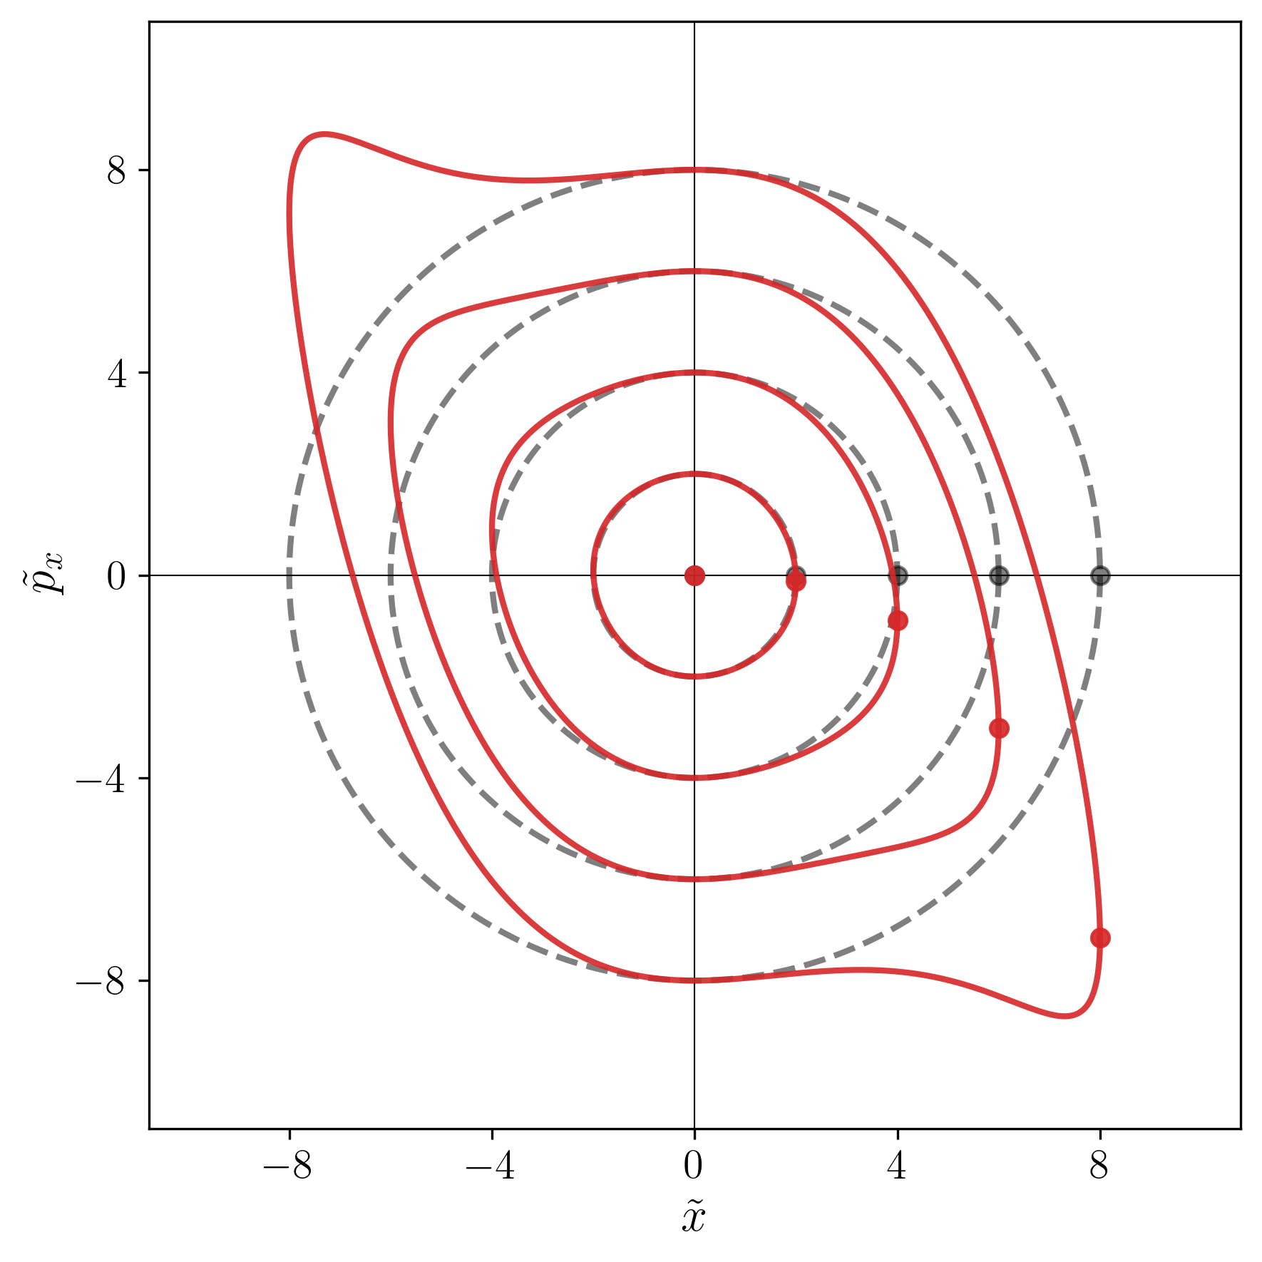
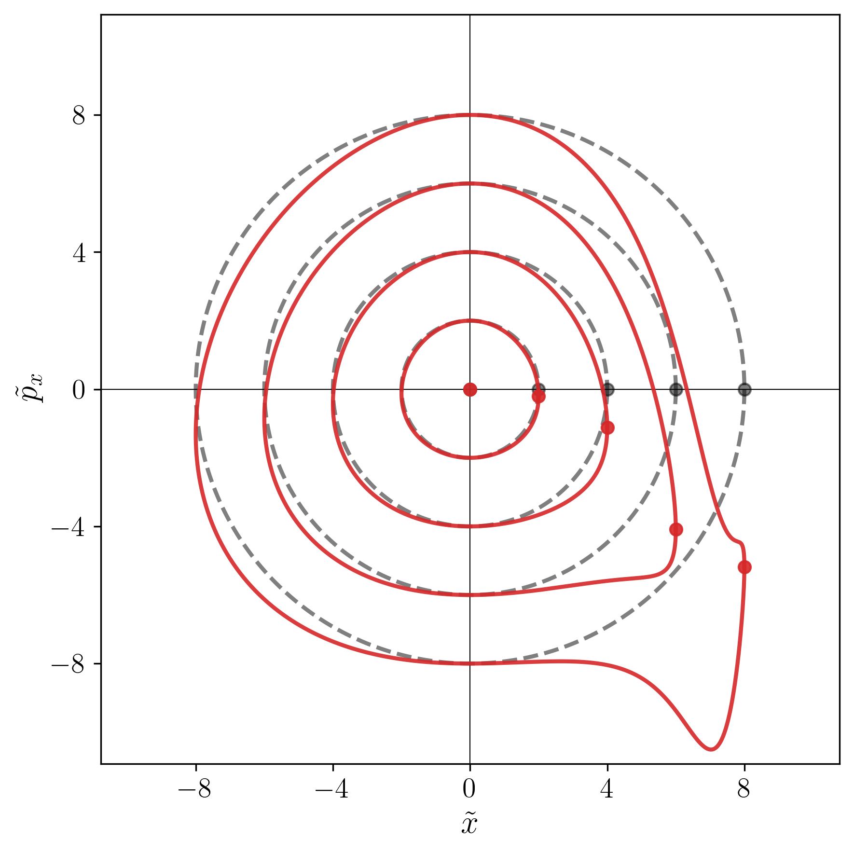

The single-pass transport problem
Analytical: with Lie algebra, one can find the transformed topology for common elements
Numerical: with tracking, one can find the transformed topology for any element, including beam-beam
  This approach is as exact as the tracking (no truncation)
Works in 2D, 4D, 6D, etc.
$$s$$
Rotation
Shear
Linear map
Thin Sextupole
Thin Octupole
4D Beam-Beam Long-Range
* Exaggerated strength for the sake of the argument

Slide 12
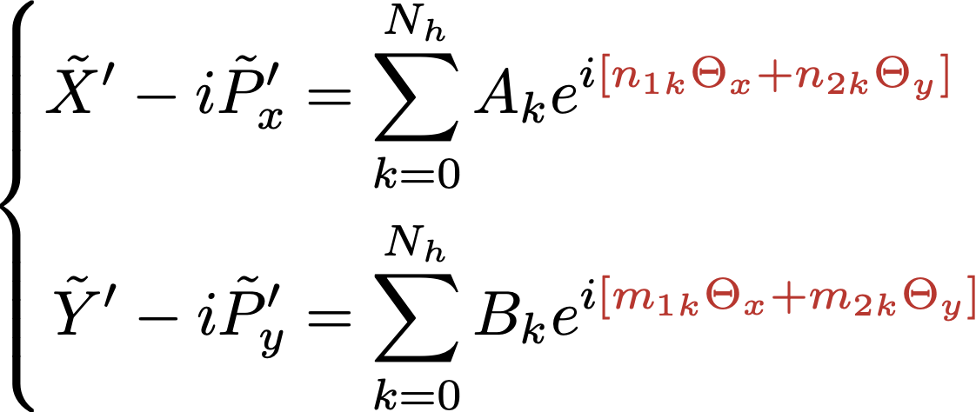
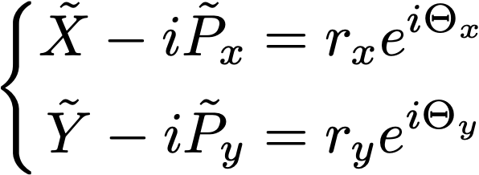
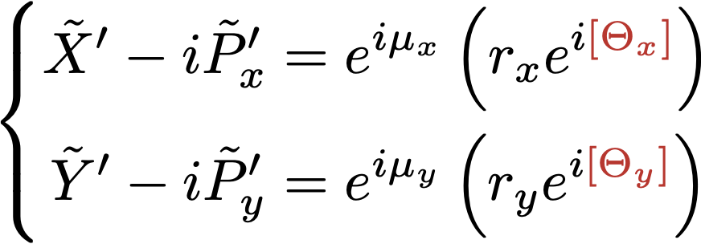
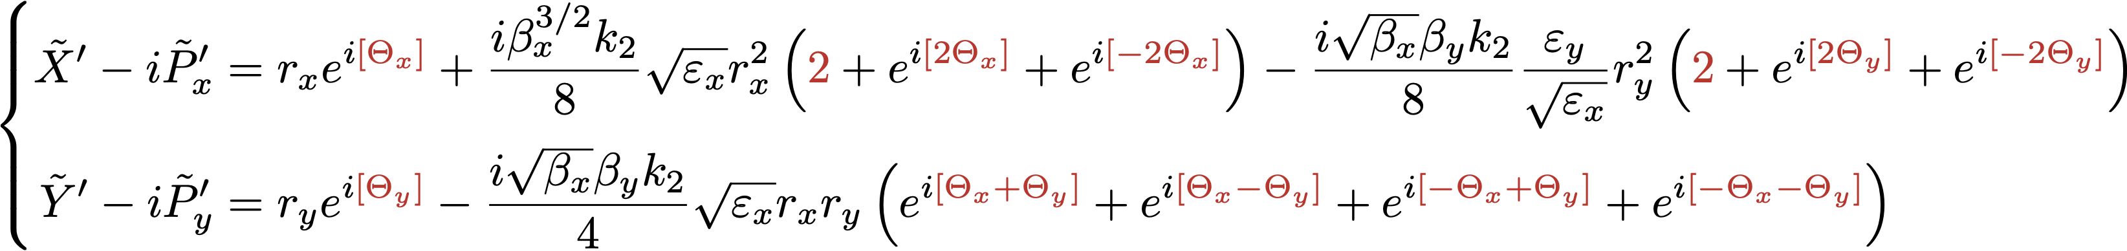

Example: 4D formalism
(Coupling)
General form:
(Coupling)
Rotation
Thin sextupole
For $r_{y}=0$
(Coupling)
(Coupling)
Notes:
\definecolor{myred}{rgb}{0.78, 0.15, 0.15}
*************************************************************************************
\left\{\begin{aligned}
\tilde X' - i\tilde P'_x &= \sum_{k=0}^{N_h} A_k e^{i\color{myred}[n_{1k}\Theta_x + n_{2k}\Theta_y]}\\
\tilde Y' - i\tilde P'_y &= \sum_{k=0}^{N_h} B_k e^{i\color{myred}[m_{1k}\Theta_x + m_{2k}\Theta_y]}
\end{aligned}\right.
************************************************************************************
\left\{\begin{aligned}
\tilde X' - i\tilde P'_x &= e^{i\mu_x}\left(r_x e^{i\color{myred}[\Theta_x]}\right)\\
\tilde Y' - i\tilde P'_y &= e^{i\mu_y}\left(r_y e^{i\color{myred}[\Theta_y]}\right)
\end{aligned}\right.
*************************************************************************************
\left\{\begin{aligned}
\tilde X' - i\tilde P'_x &= r_xe^{i\color{myred}[\Theta_x]} + \frac{i\beta_x^{3/2}k_2}{8}\sqrt{\varepsilon_x} r_x^2\left({\color{myred}2} + e^{i\color{myred}[2\Theta_x]} + e^{i\color{myred}[-2\Theta_x]}\right) - \frac{i\sqrt{\beta_x}\beta_y k_2}{8} \frac{\varepsilon_y}{\sqrt{\varepsilon_x}} r_y^2\left({\color{myred} 2} + e^{i\color{myred}[2\Theta_y]} + e^{i\color{myred}[-2\Theta_y]}\right)\\
\tilde Y' - i\tilde P'_y &= r_y e^{i\color{myred}[\Theta_y]} - \frac{i\sqrt{\beta_x}\beta_y k_2}{4}\sqrt{\varepsilon_x} r_xr_y\left(e^{i\color{myred}[\Theta_x+\Theta_y]} + e^{i\color{myred}[\Theta_x-\Theta_y]} + e^{i\color{myred}[-\Theta_x+\Theta_y]} + e^{i\color{myred}[-\Theta_x-\Theta_y]} \right) \end{aligned}\right.

Slide 13
Topological description
Transport and compensation
Beam-Beam LR (academic)
Beam-Beam LR (HL-LHC)

Slide 14
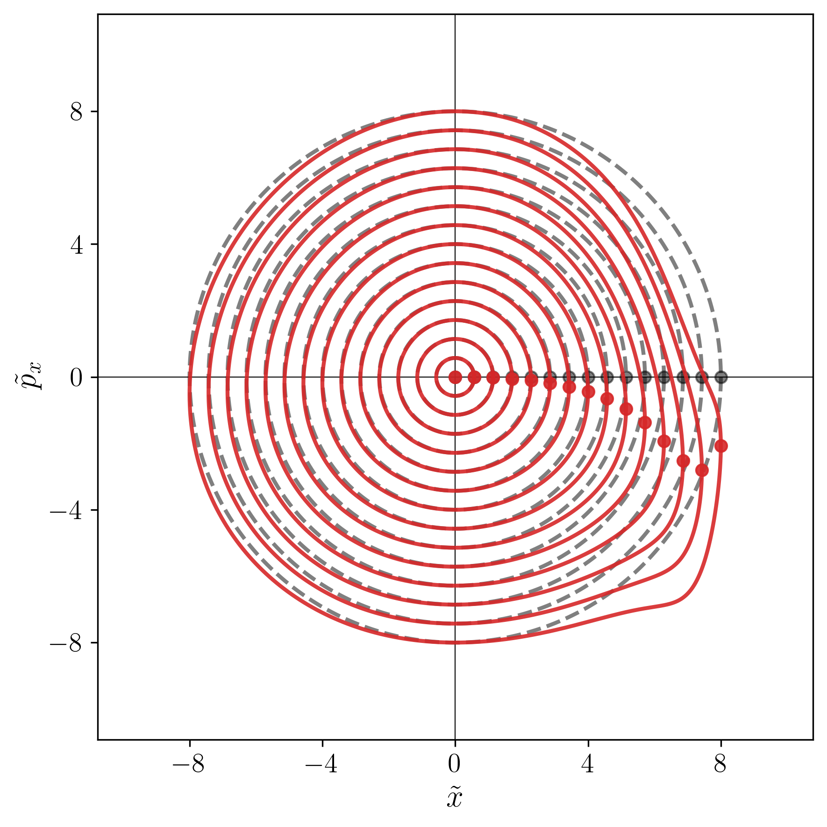
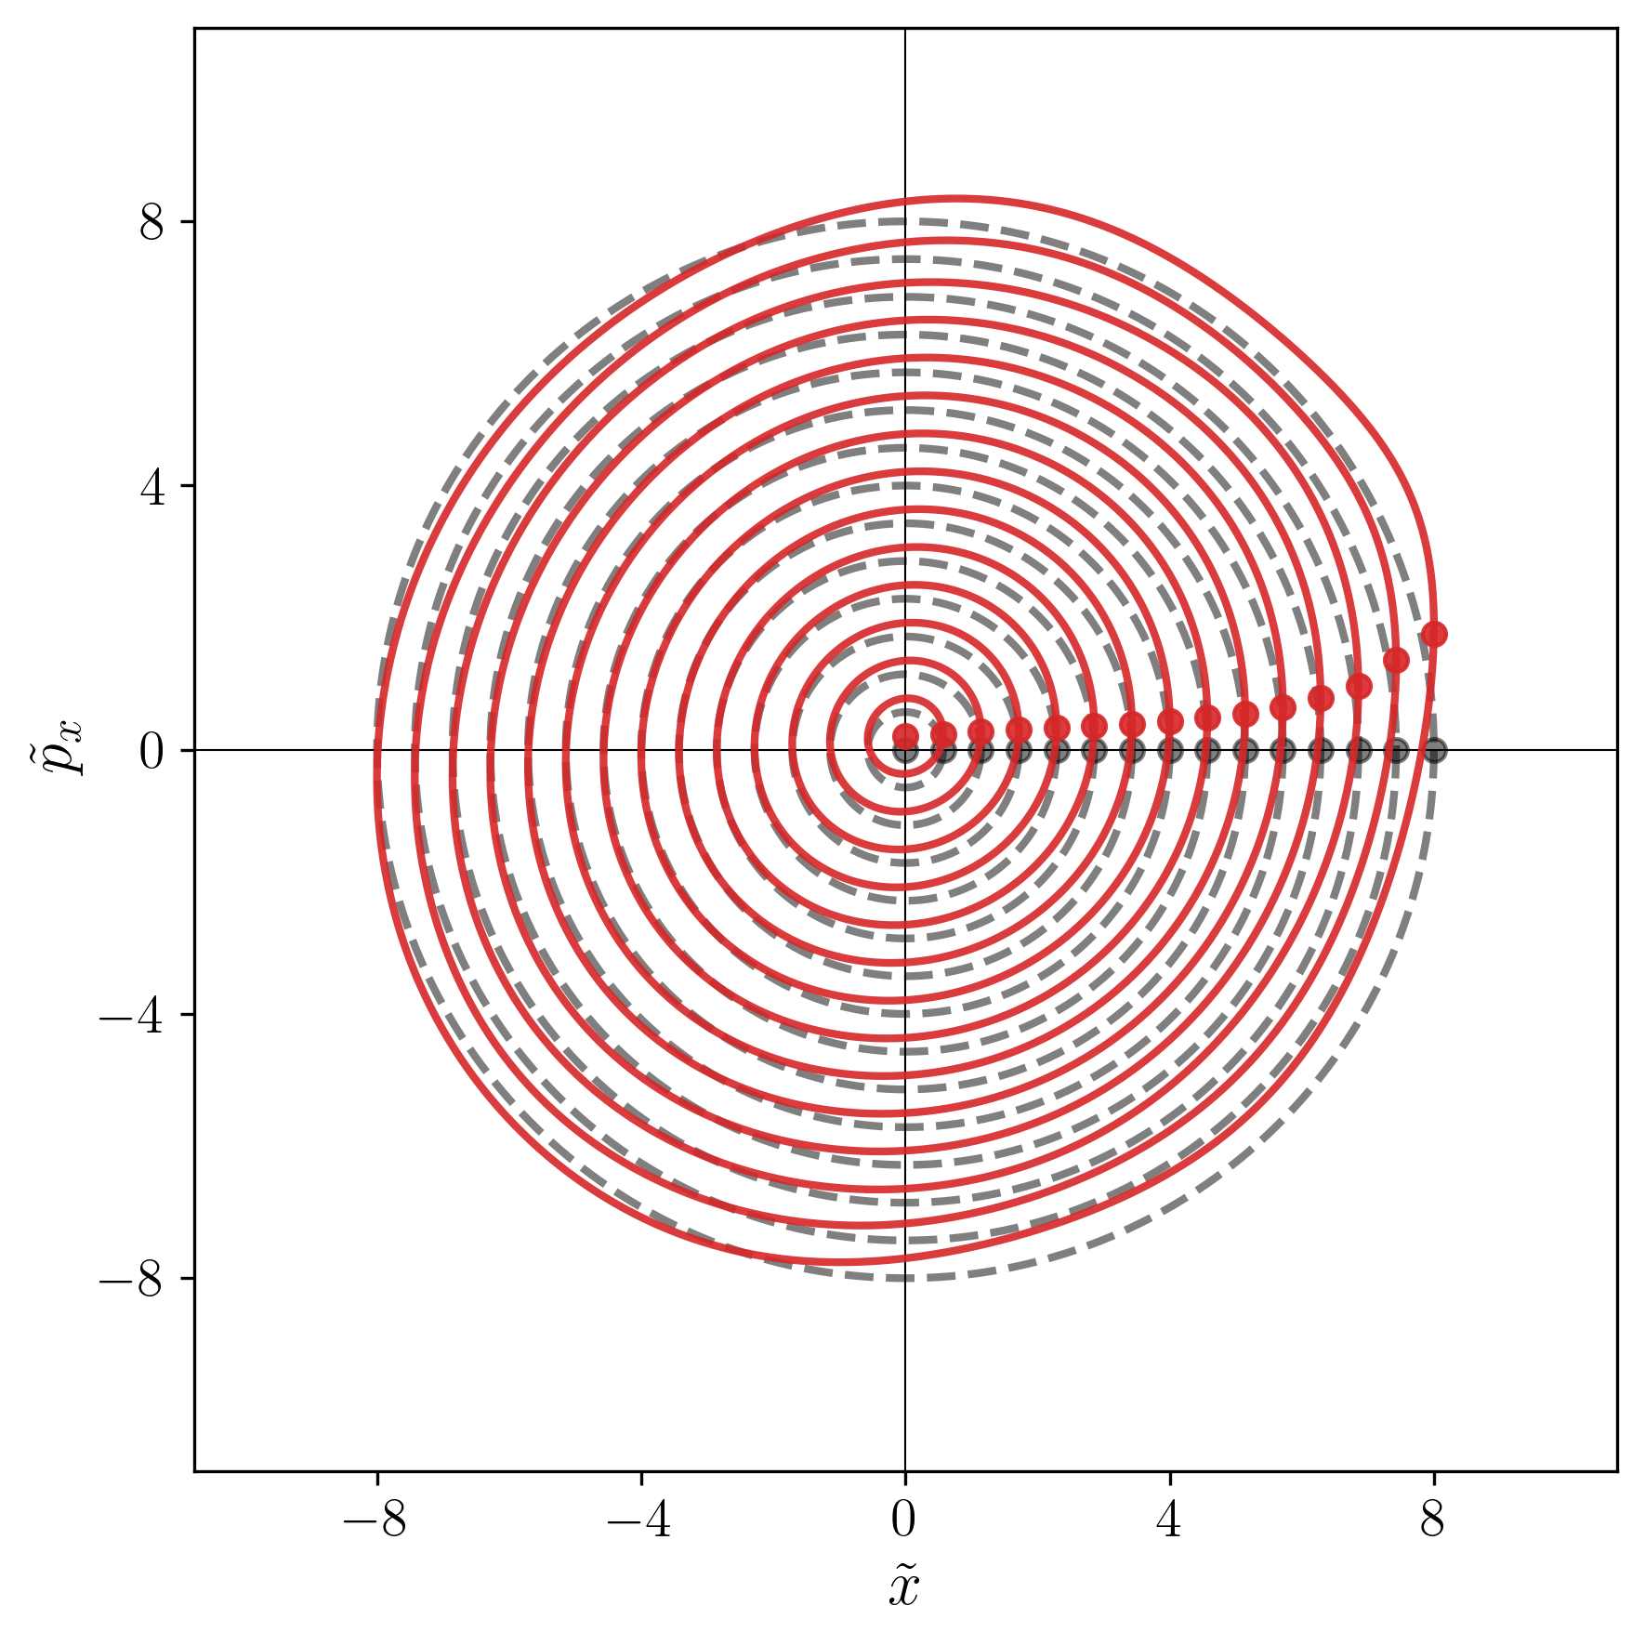
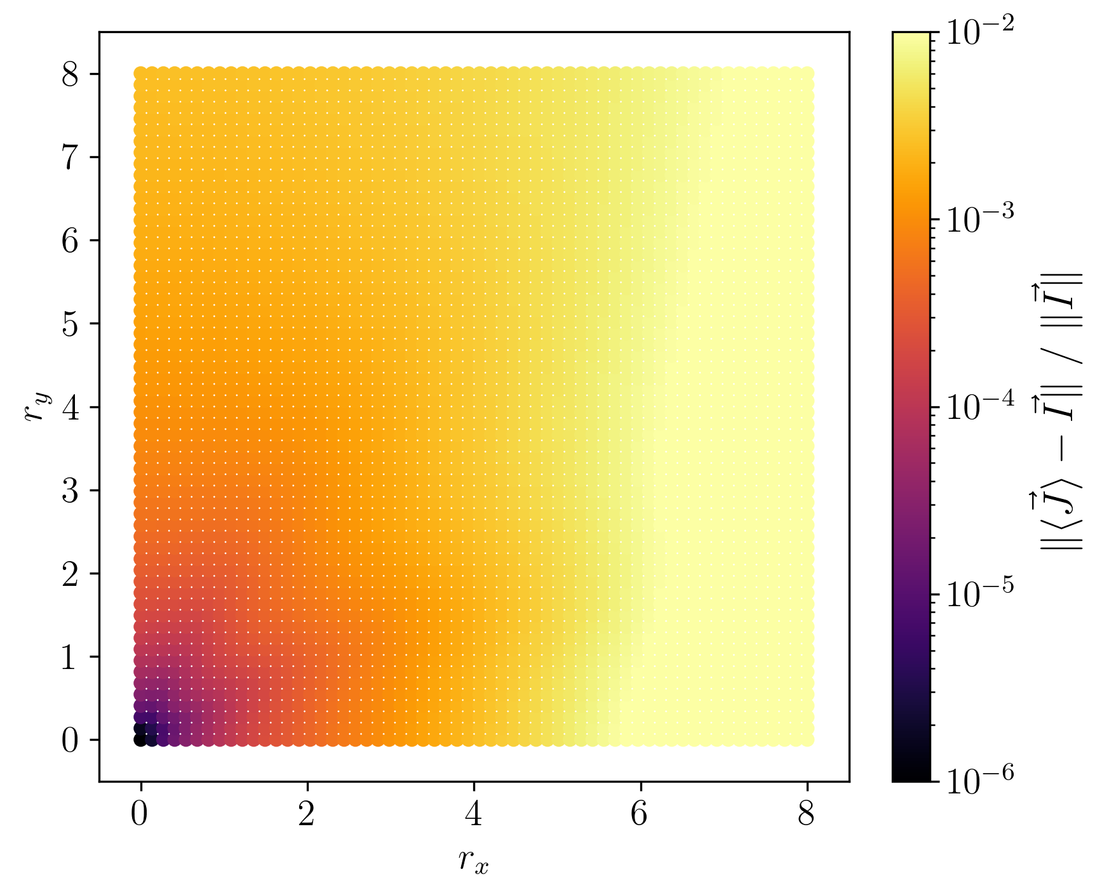
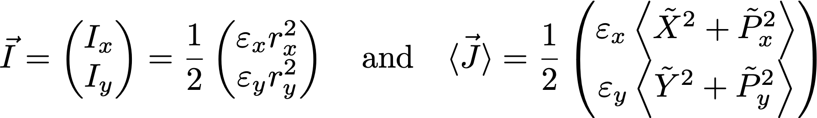
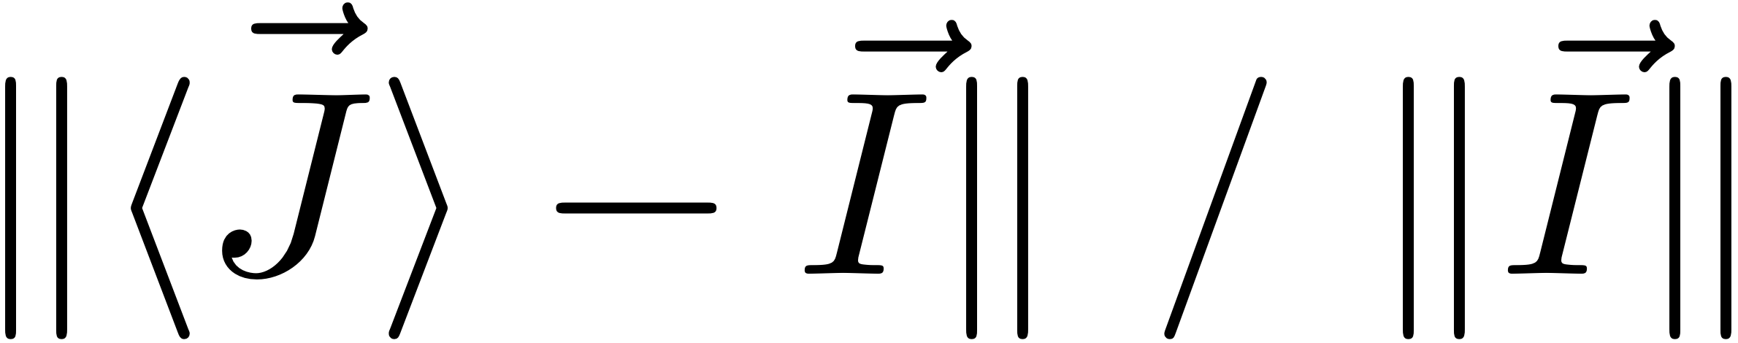



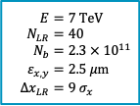


Beam-Beam Long-Range (BBLR)
$$E=7 TeV \\ N_{LR}=40 \\ N_{b}=2.3 × {10}^{11} \\ ε_{x,y}=2.5 μ\text{m} \\ {Δx}_{LR}=9 σ_{x}$$
Transformation from a 4D BBLR:
  Many dimensions to inspect
  Coupling
To assess the non-linear residual, we can define:
For a linear transformation, the Courant-Snyder action is the action:
For $r_{y}=0$ and $Θ_{y}=0$
For $r_{y}=4$ and $Θ_{y}=0$
$$s$$
$$(\tilde{x},{\tilde{p}}_{x})$$
$$(\tilde{x},{\tilde{p}}_{x})$$
Action
C.-S. like action
(Non-linear residual)
(Non-linear residual)
Notes:
**********************************************************************************************************************
\vec I = \begin{pmatrix} I_x \\ I_y\end{pmatrix} = \frac{\varepsilon_x}{2}\begin{pmatrix} r_x^2 \\ r_y^2\end{pmatrix} \quad\text{and}\quad \vec{\ev{J}} = \frac{\varepsilon_x}{2}\begin{pmatrix} \ev{\tilde X^2 + \tilde P_x^2} \\
\ev{\tilde Y^2 + \tilde P_y^2}\end{pmatrix}
*******************************************************************************

Slide 15
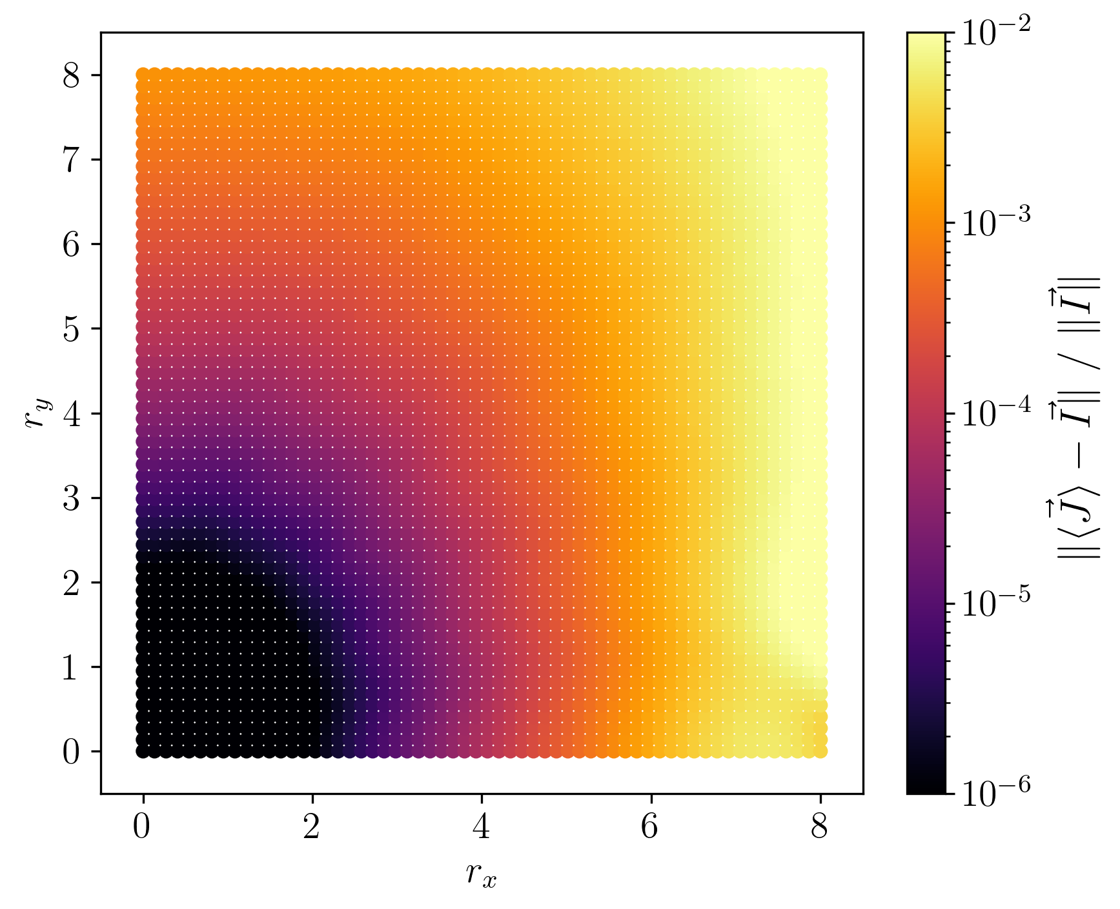
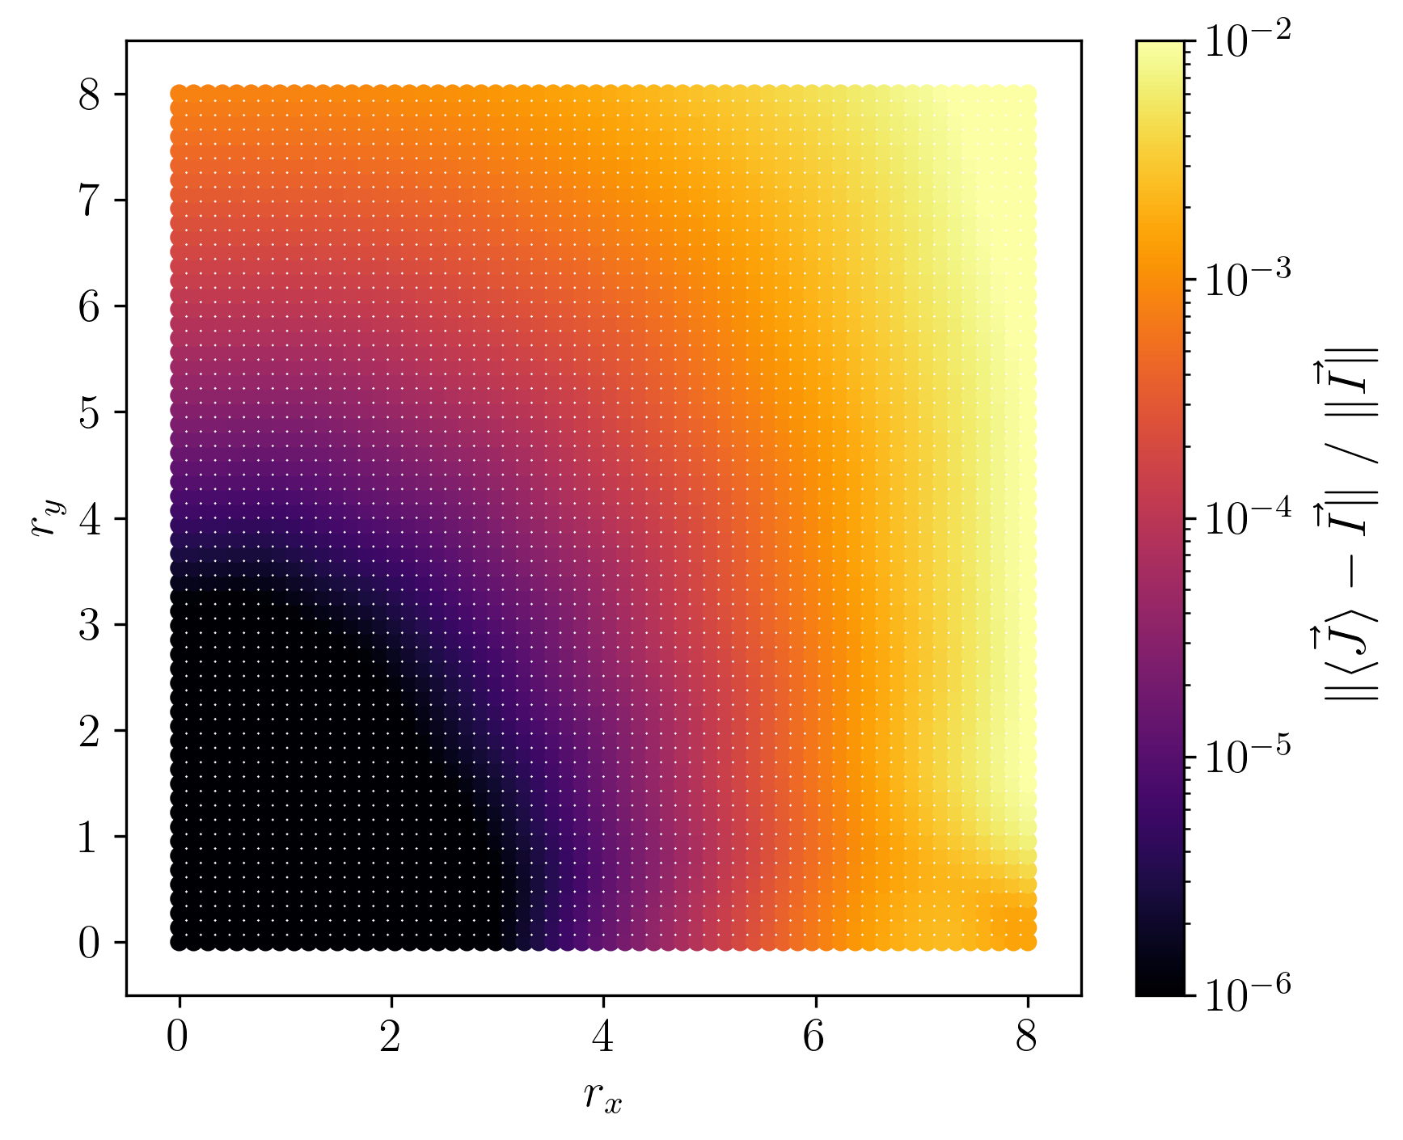
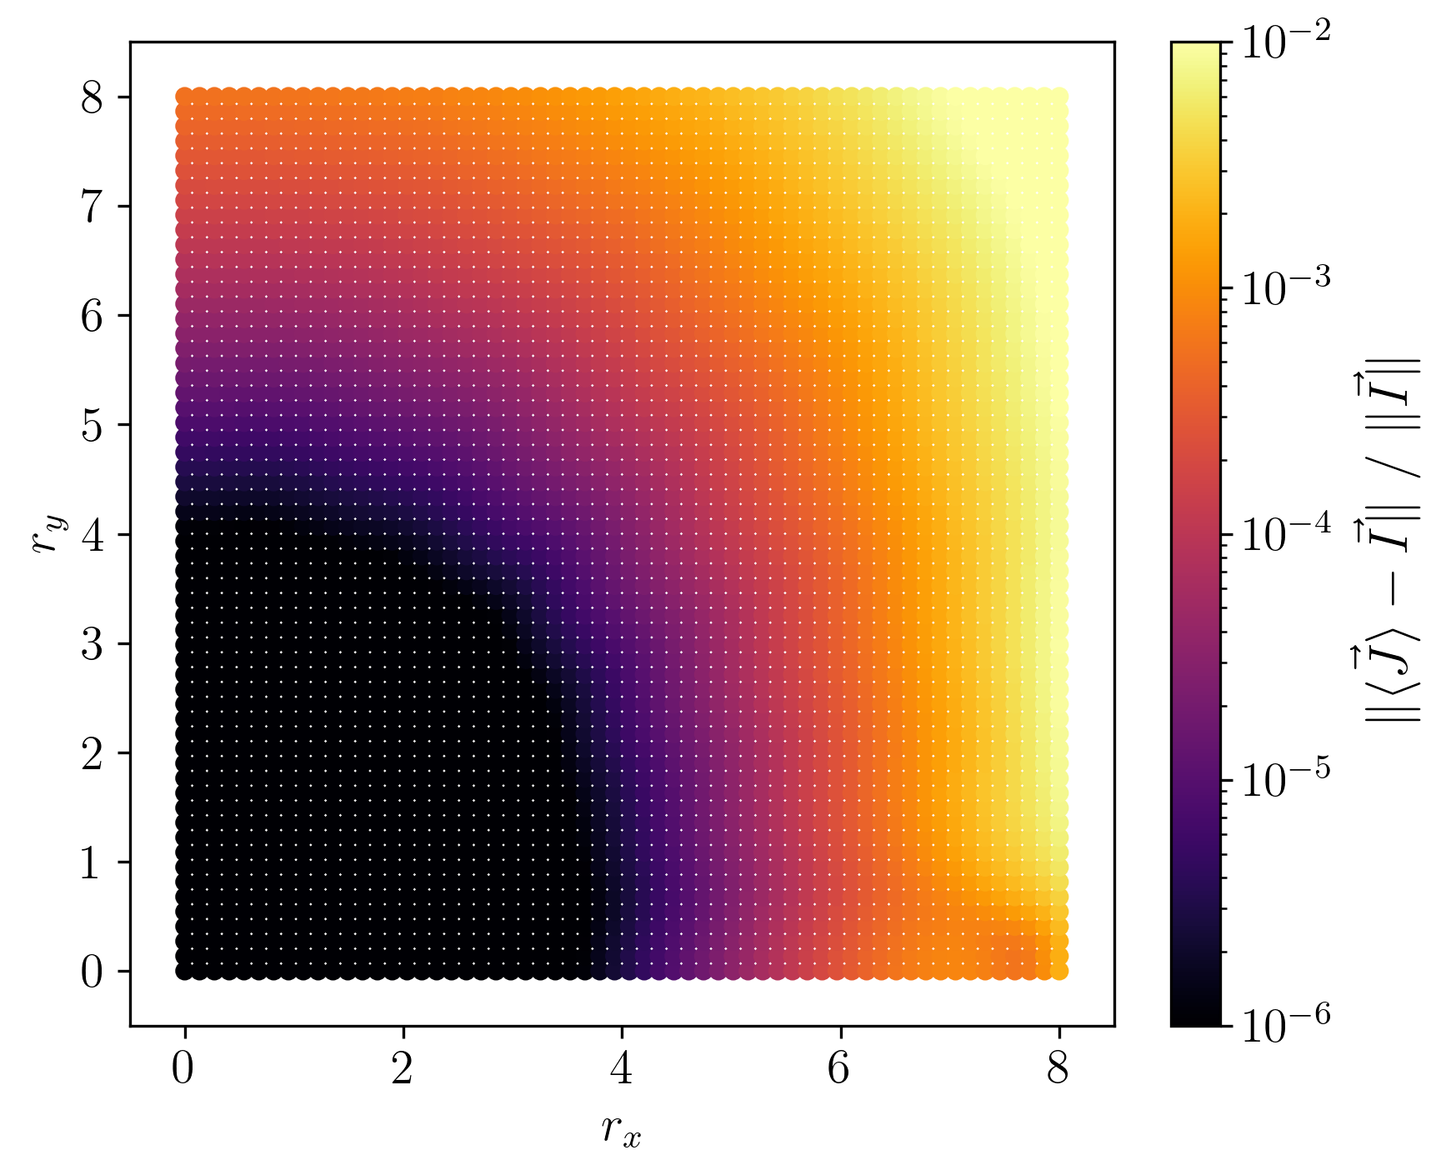
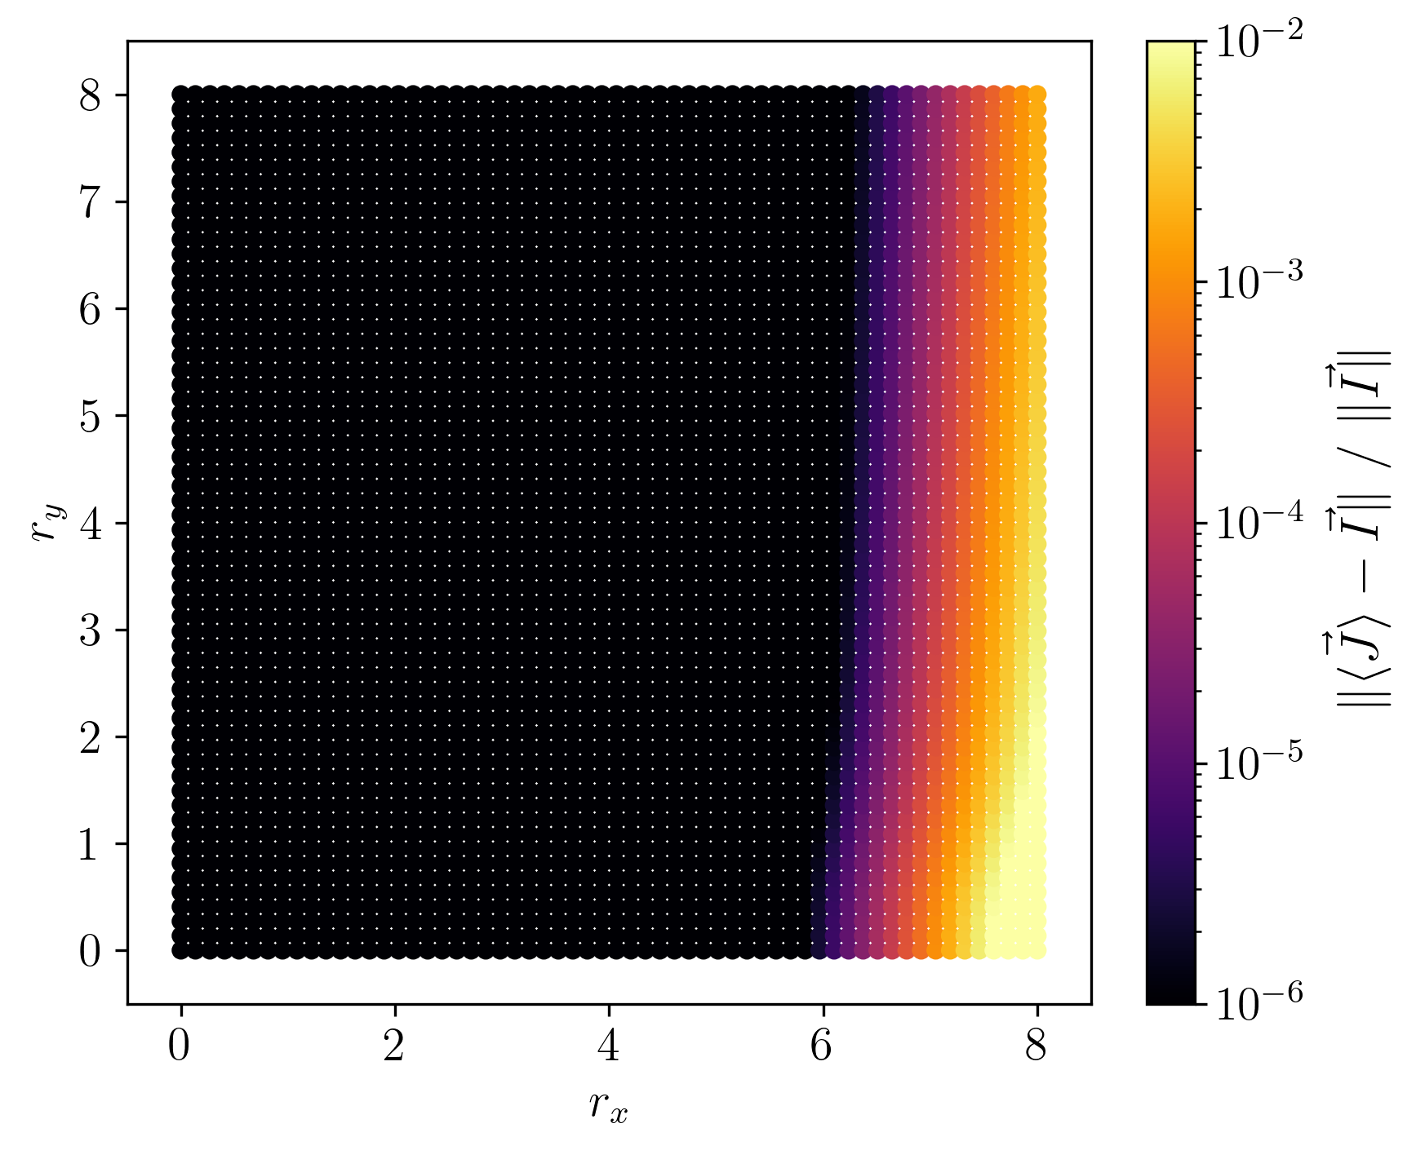

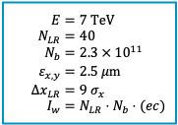

BBLR – Multipole equivalence: compensation
Let’s compensate a single 4D-BBLR with an ideal corrector package:
  Assuming round-beam BBLR
  Multipoles of increasing order
  Wire compensator
$$E=7 TeV \\ N_{LR}=40 \\ N_{b}=2.3 × {10}^{11} \\ ε_{x,y}=2.5 μ\text{m} \\ {Δx}_{LR}=9 σ_{x} \\ I_{w}=N_{LR}⋅N_{b}⋅(ec)$$
$$s$$
BBLR
Corrector
BBLR
BBLR ⎯ Octupole (order 4)
BBLR ⎯ Decapole (order 5)
BBLR ⎯ Dodecapole (order 6)
BBLR ⎯ Wire comp. (order $∞$)

Slide 16
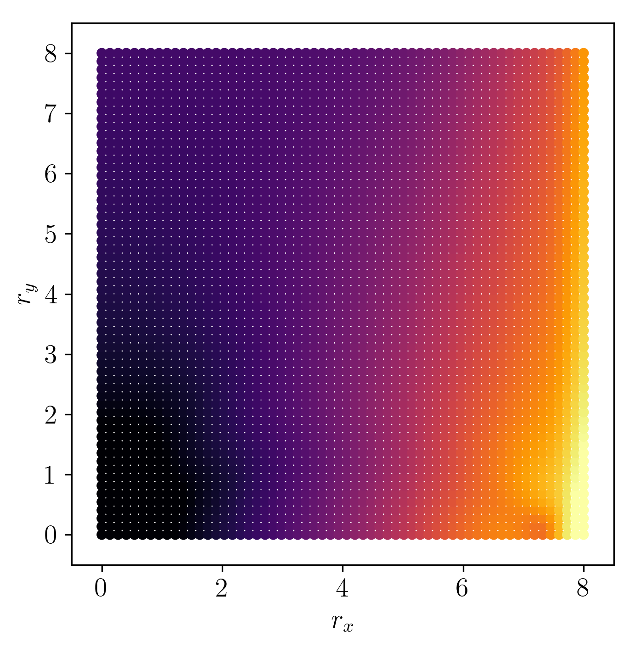
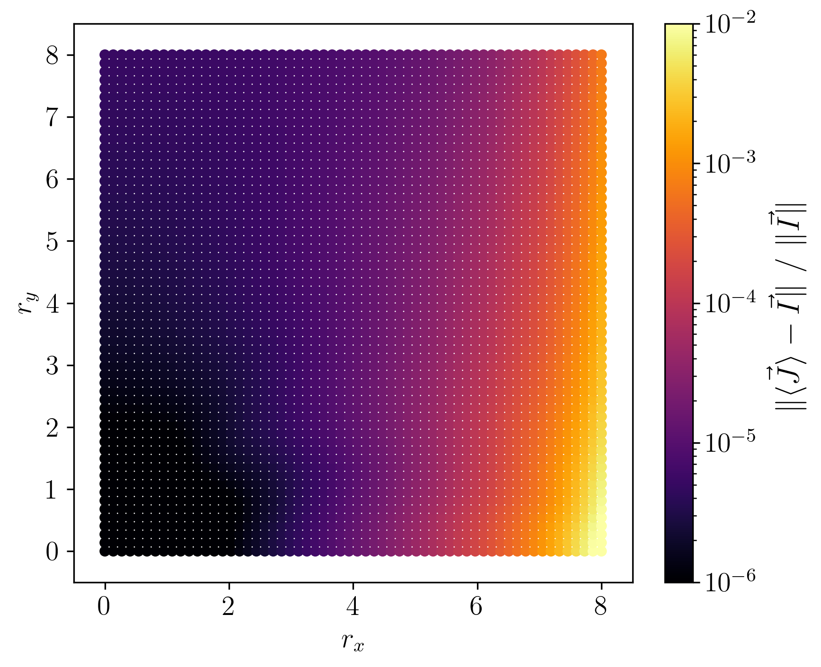

BBLR – Wire equivalence: flatness
Let’s compensate a single 4D-BBLR with a wire compensator:
  H-flat strong beam, Round strong beam, V-flat strong beam
  The equivalence should not be taken for granted!
BBLR
BBCW
$$E=7 TeV \\ N_{LR}=40 \\ N_{b}=2.3 × {10}^{11} \\ ε_{x,y}=2.5 μ\text{m} \\ {Δx}_{LR}=9 σ_{x} \\ I_{w}=N_{LR}⋅N_{b}⋅(ec)$$
$$s$$
Strong Beam
.
.
.
Wire

Slide 17
Topological description
Transport and compensation
Beam-Beam LR (academic)
Beam-Beam LR (HL-LHC)

Slide 18
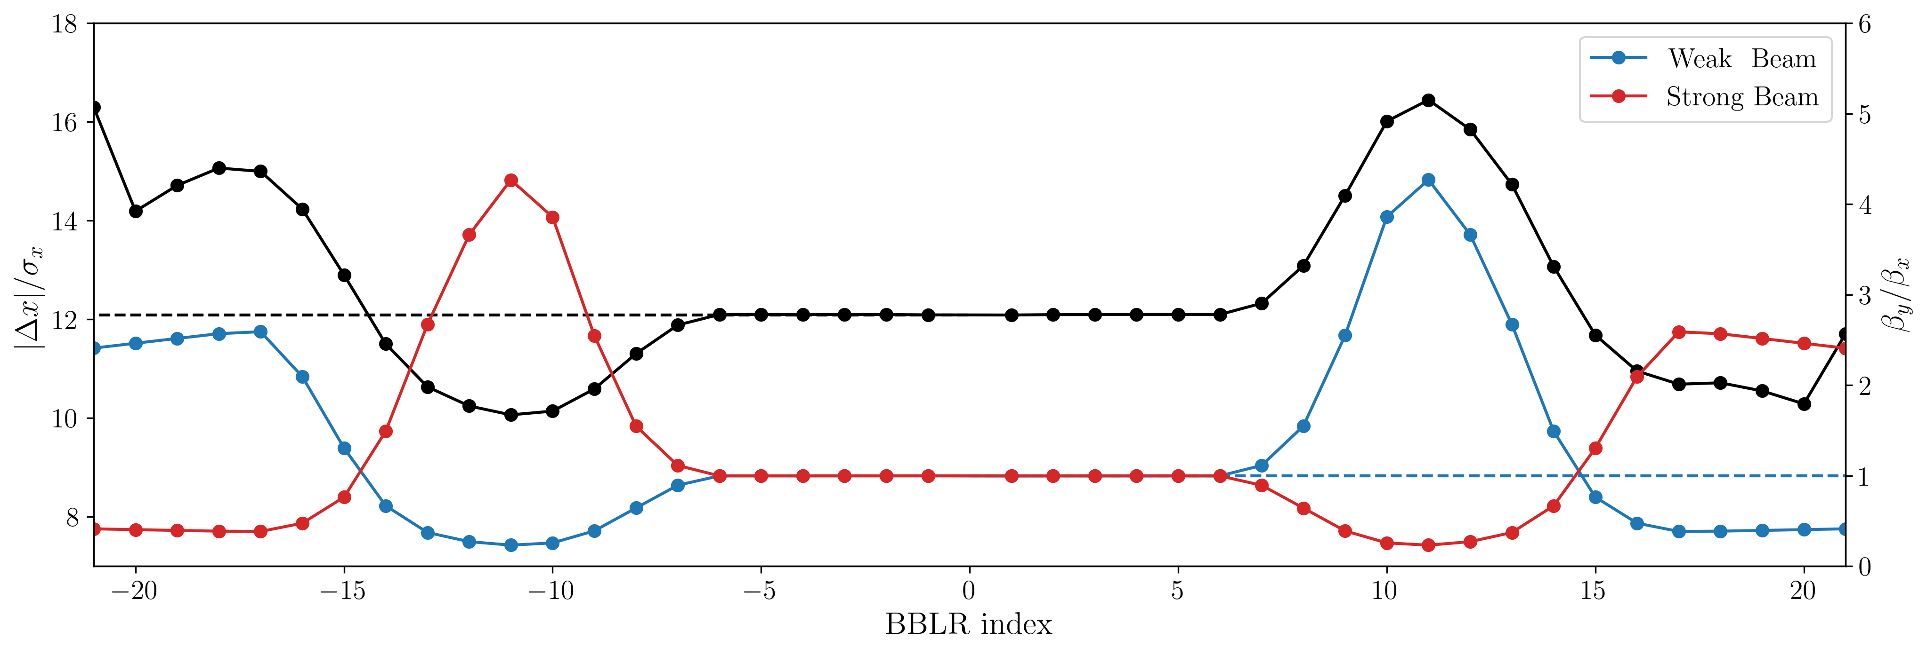
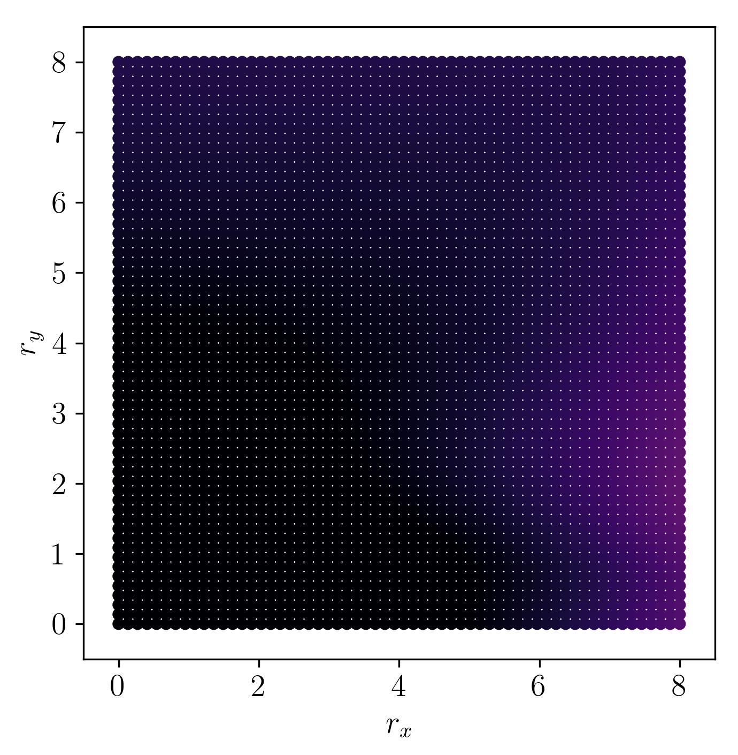
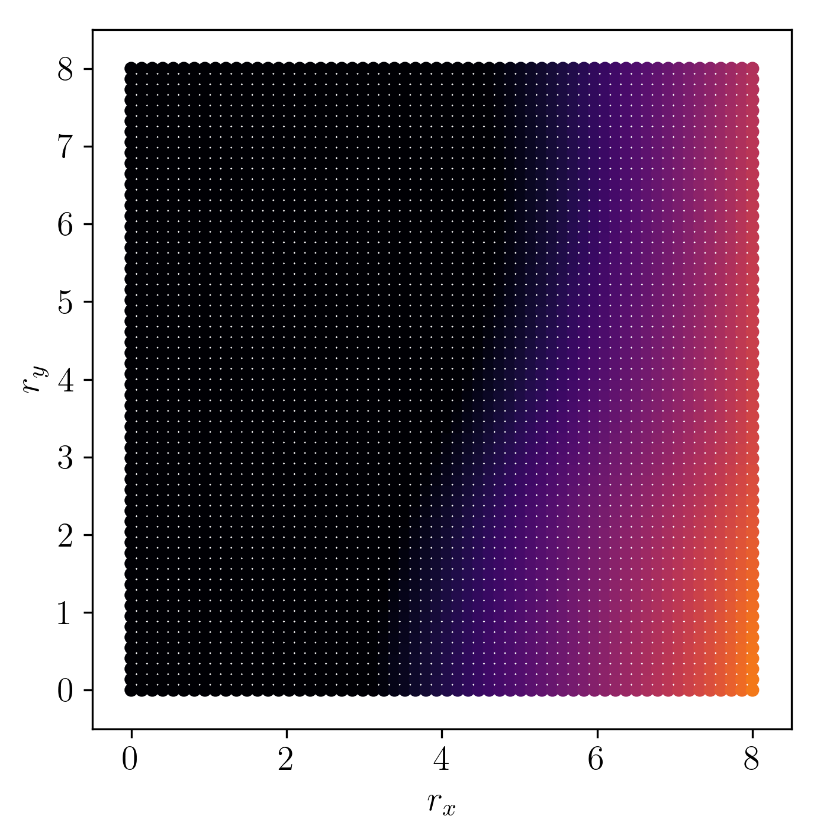
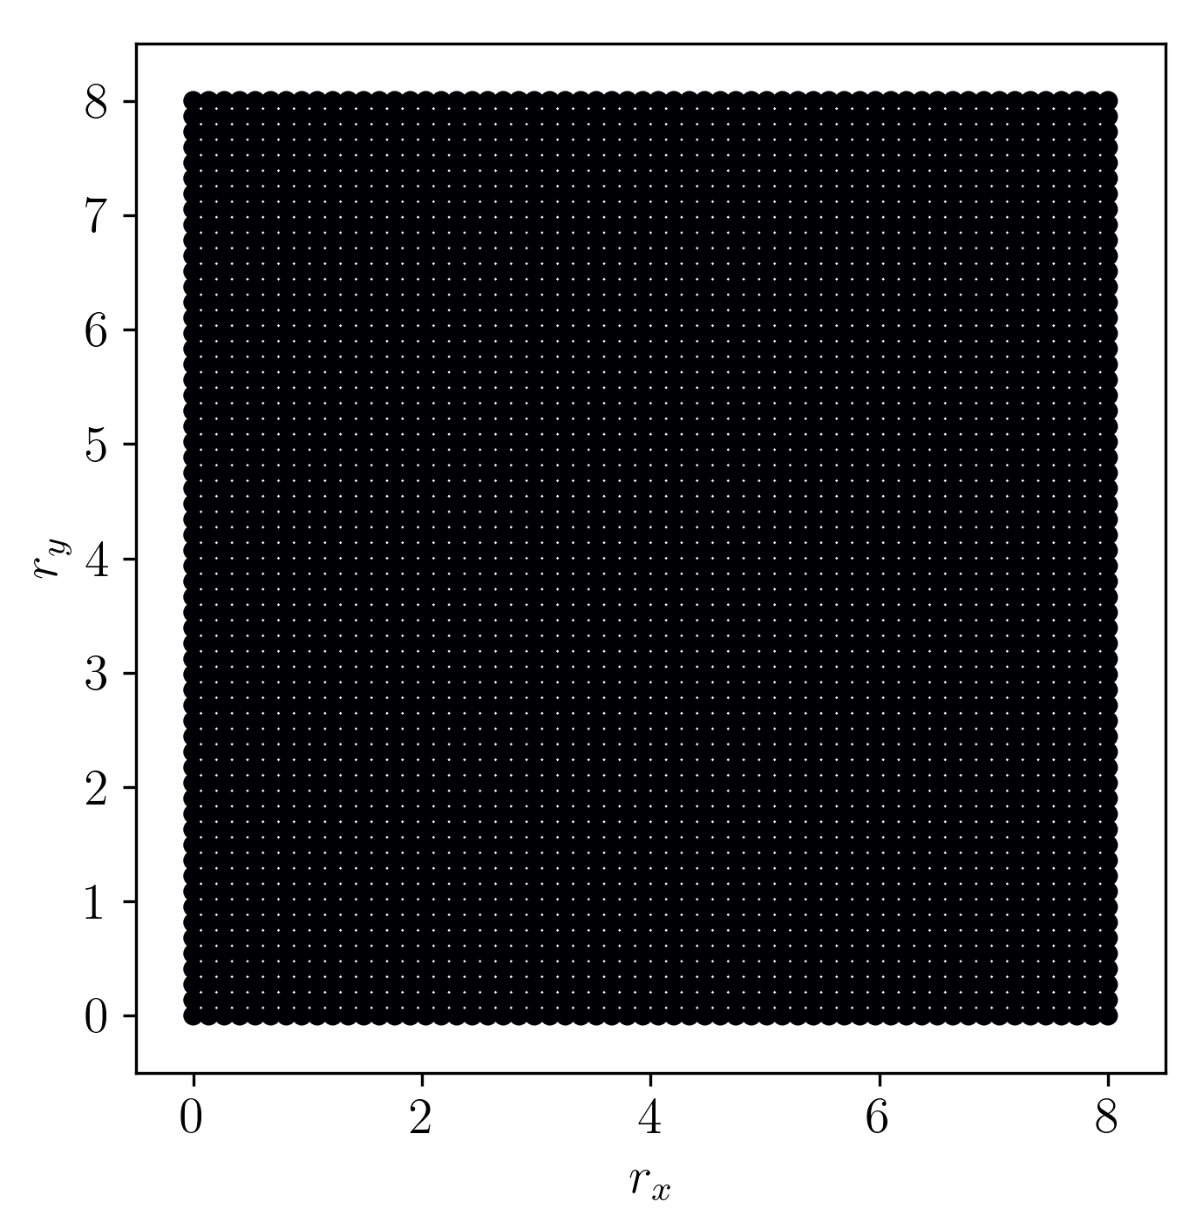
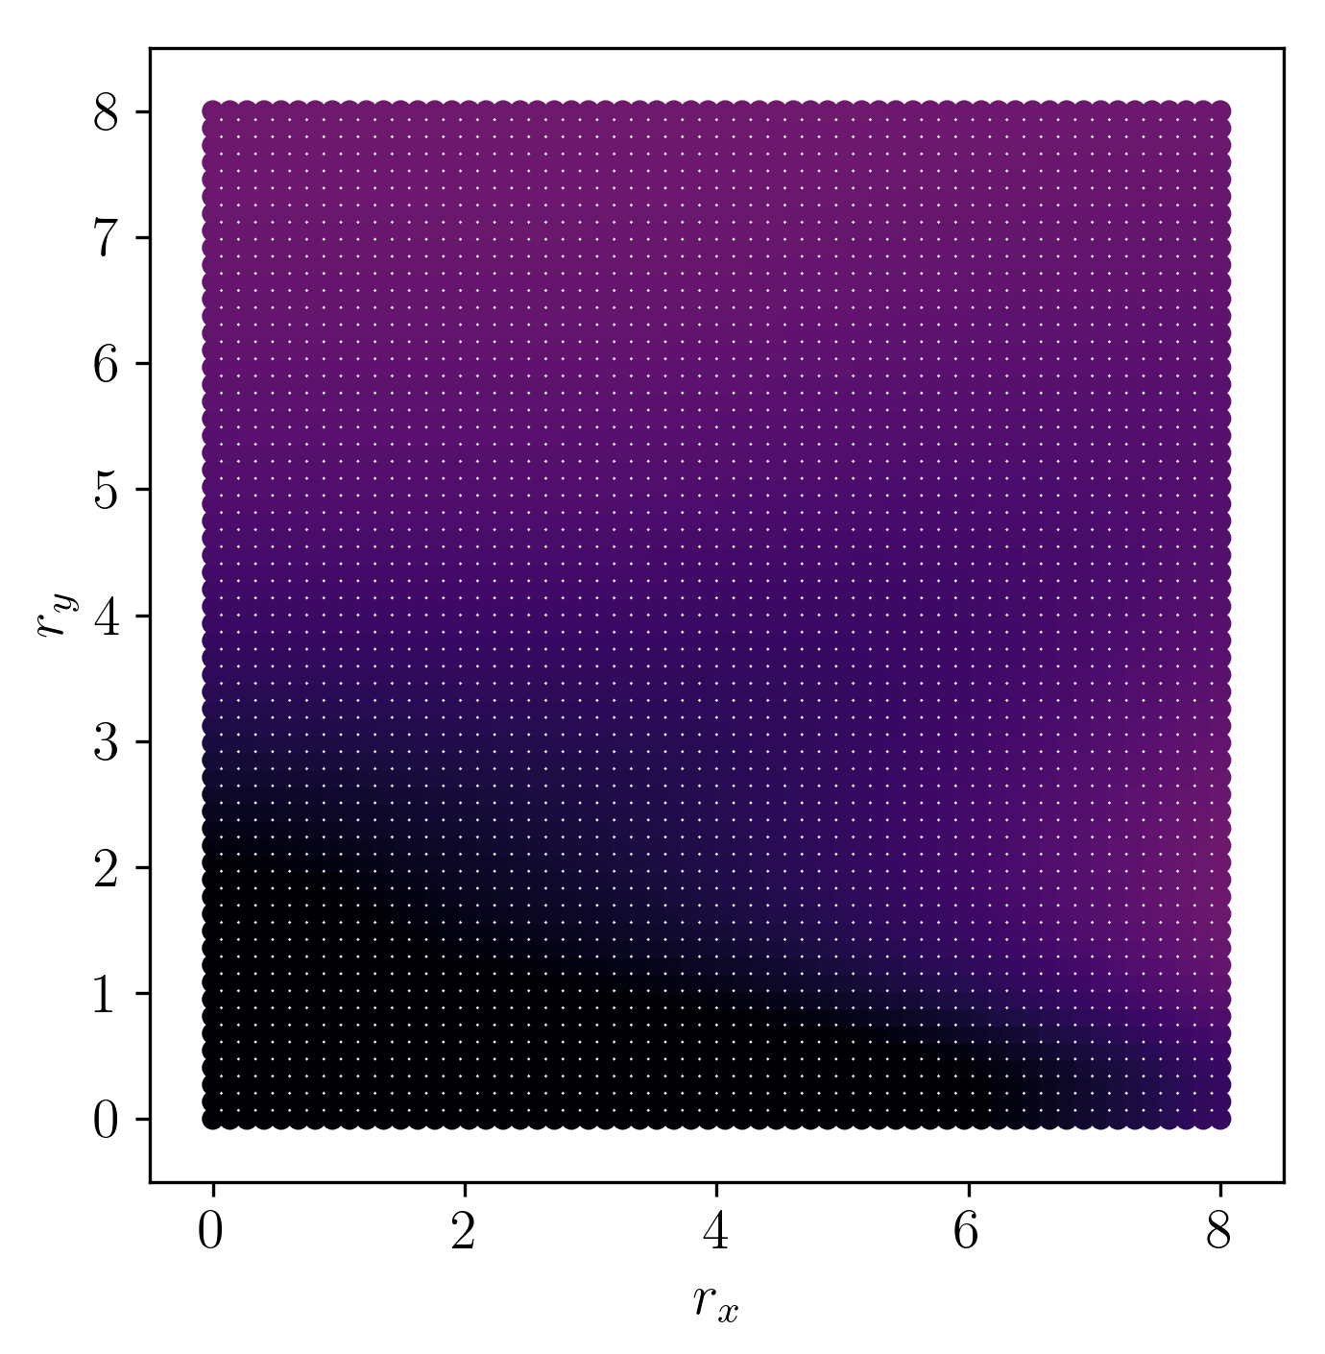
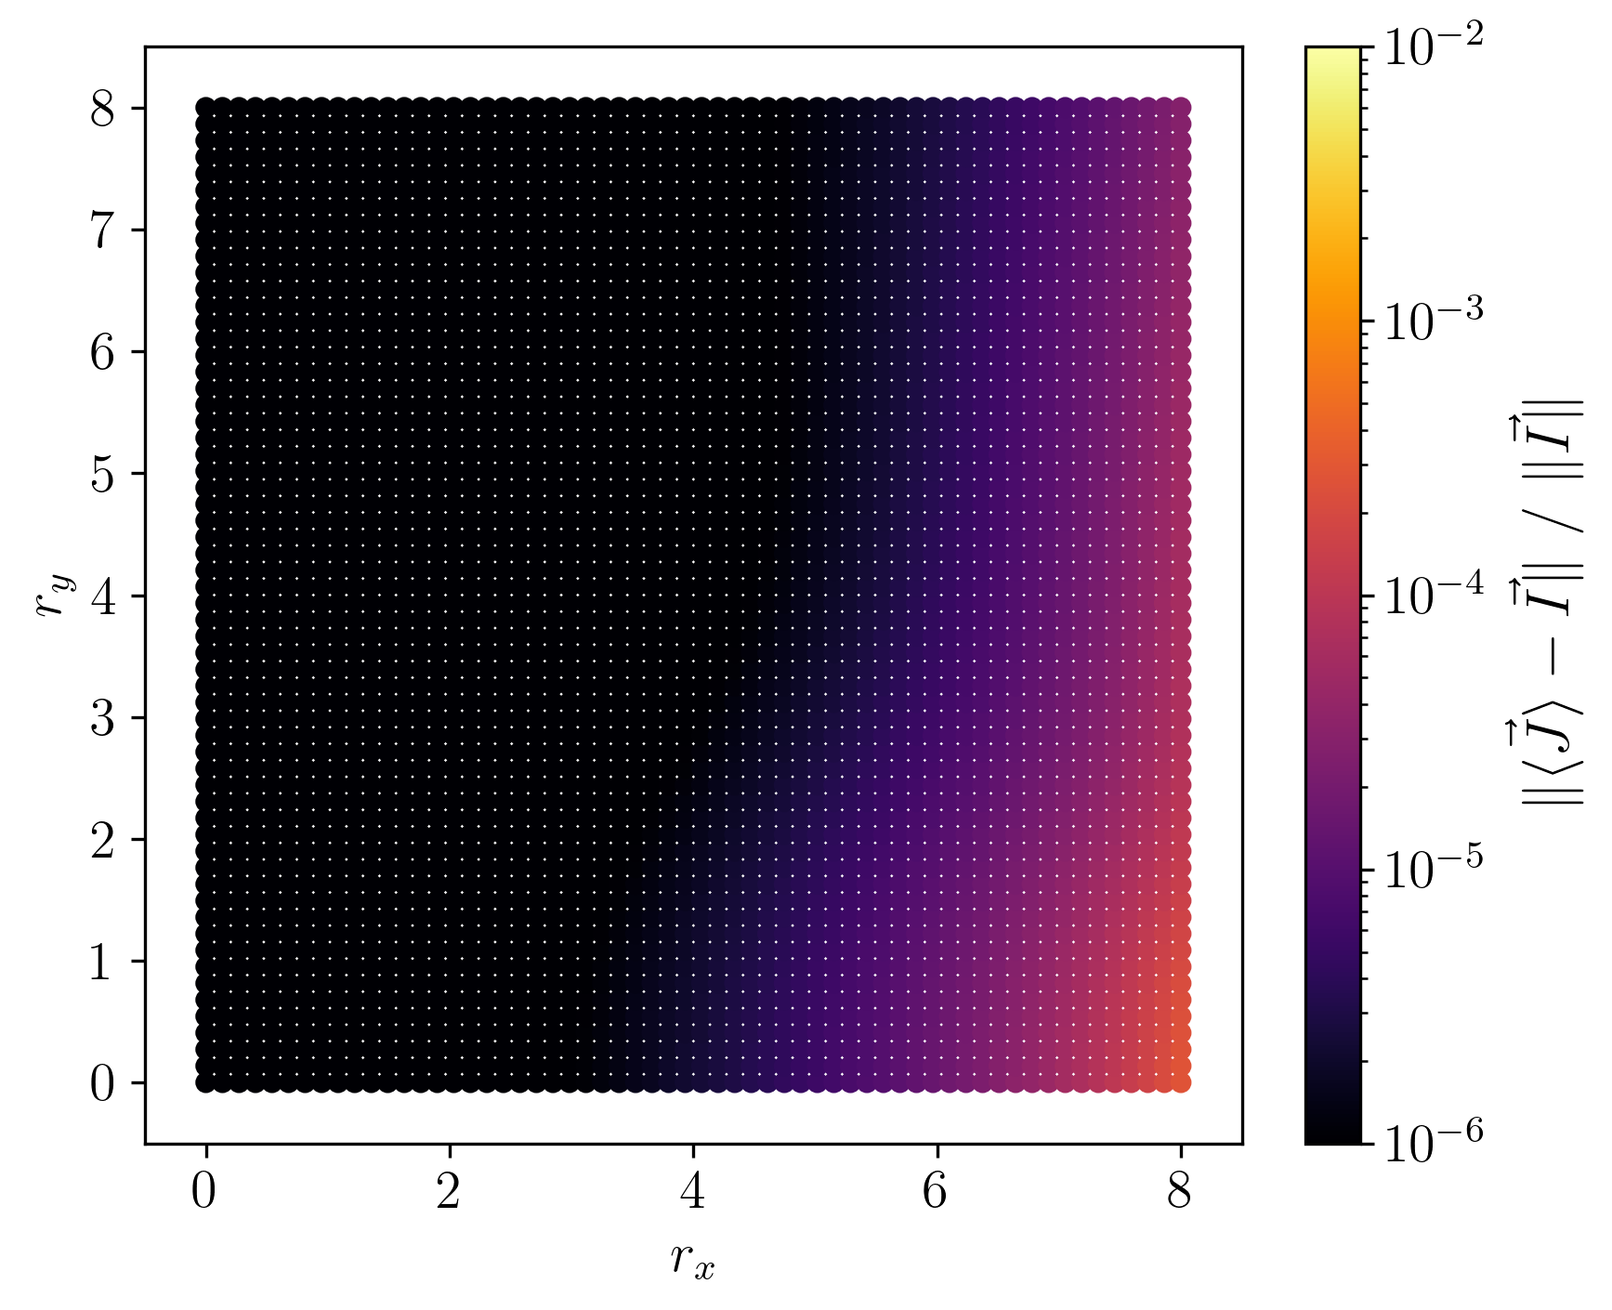

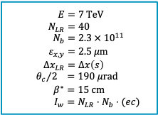
BBLR – Wire equivalence: HL-LHC
$$E=7 TeV \\ N_{LR}=40 \\ N_{b}=2.3 × {10}^{11} \\ ε_{x,y}=2.5 μ\text{m} \\ {Δx}_{LR}=Δx\left(s\right)$$
$${θ_{c}}/2 =190 μrad \\ β^{∗}=15 cm \\ I_{w}=N_{LR}⋅N_{b}⋅(ec)$$
BBLR
BBCW
$$s$$
IP1
* Single BBLR considered
(Parametric study)

Slide 19



4-Wire Problem
A full BBLR ⎯ BBCW compensation scheme will ultimately become an optimization problem
Let’s consider in the meantime the academic formulation of a multi-BBLR compensation scheme:
  BBLR are replaced by pure DC wires
  Practical symmetry considerations are kept (antisymmetric $β$-functions and $π$-phase advance at the IP)
The simplest formulation of the problem contains 2 BBCW compensating 4 DC wires, placed symmetrically:
  Case 1: round optics, $β_{x}=β_{y}$ and constant $Δx$ (trivial case, solution exists)
  Case 2: varying optics ratio, $β_{y}/β_{x}$ and/or varying $Δx$ (optimization case, no perfect solution)
$$s$$
$$π$$
BBCW
Wires
Wires
BBCW

Slide 20
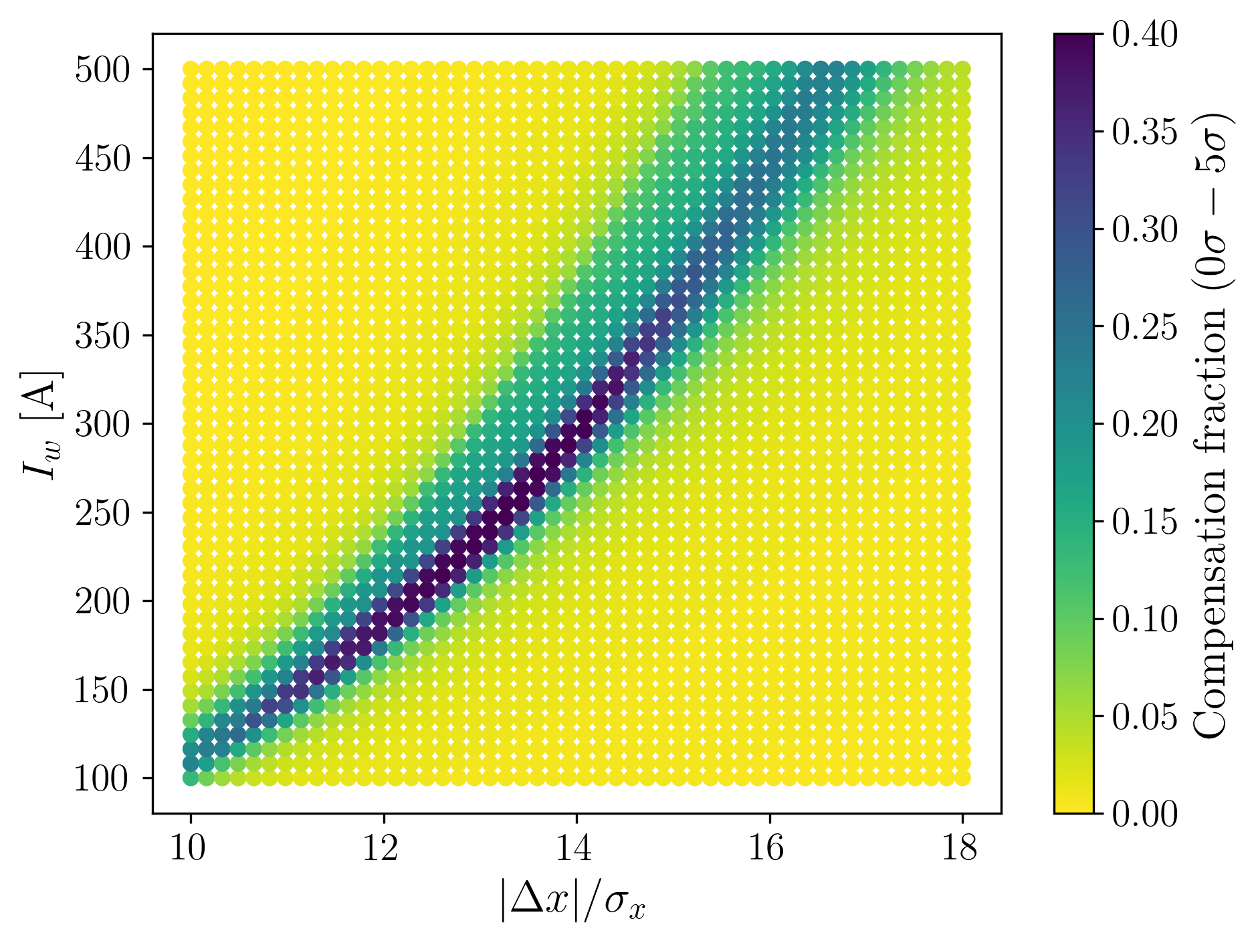
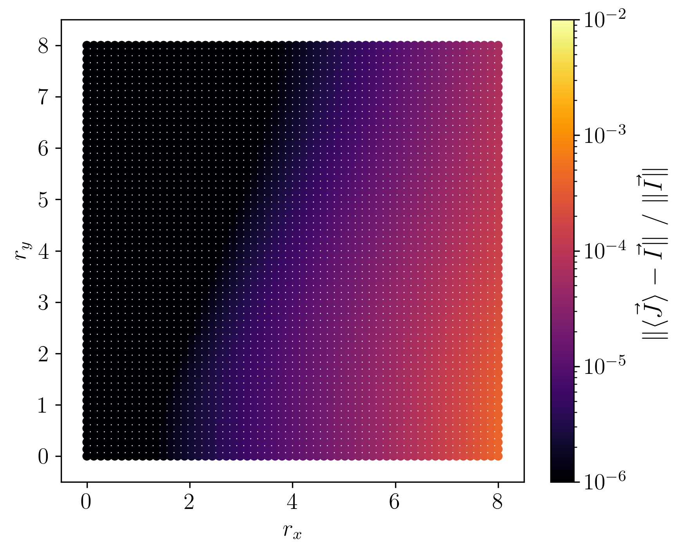
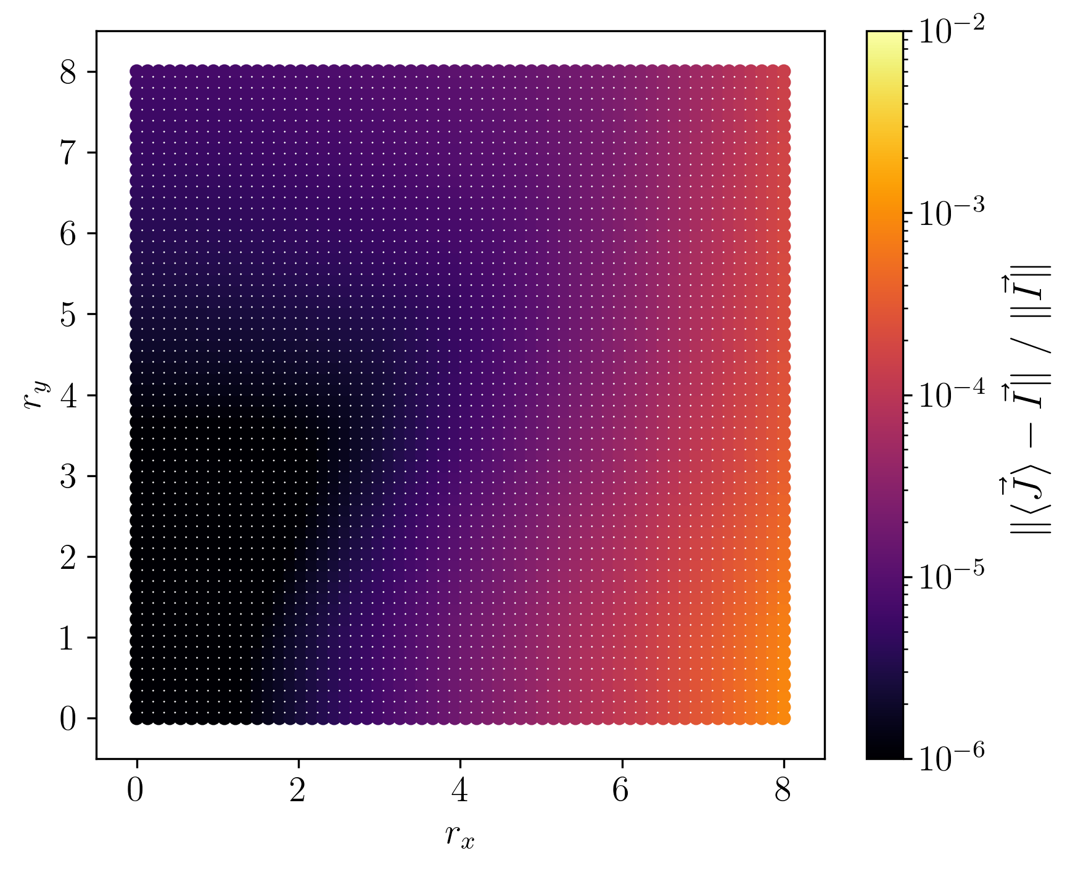

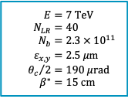



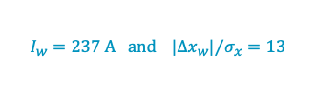


40-Wire Problem (HL-LHC case)
$$E=7 TeV \\ N_{LR}=40 \\ N_{b}=2.3 × {10}^{11} \\ ε_{x,y}=2.5 μ\text{m} \\ {θ_{c}}/2=190 μrad \\ β^{∗}=15 cm$$
Let’s consider the full optics of HL-LHC and compensate the BBLR (as wires) around IP1
  2 antisymmetric BBCWs, constrained to have $\frac{β_{y}^{R}}{β_{x}^{R}}=\frac{β_{x}^{L}}{β_{y}^{L}}=1.75$. Optimization of $I_{w}$ and $|Δx_{w}|/σ_{x}$.
$×$ 20
$×$ 20
$$s$$
$$π$$
BBCW
Wires
Wires
BBCW
$$I_{w}=237 A and {|Δx_{w}|}/{σ_{x}}=13$$
$$I_{w}=441 A and {|Δx_{w}|}/{σ_{x}}=16$$
(Compensation fraction)

Slide 21
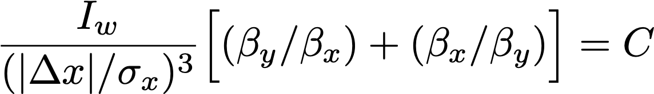
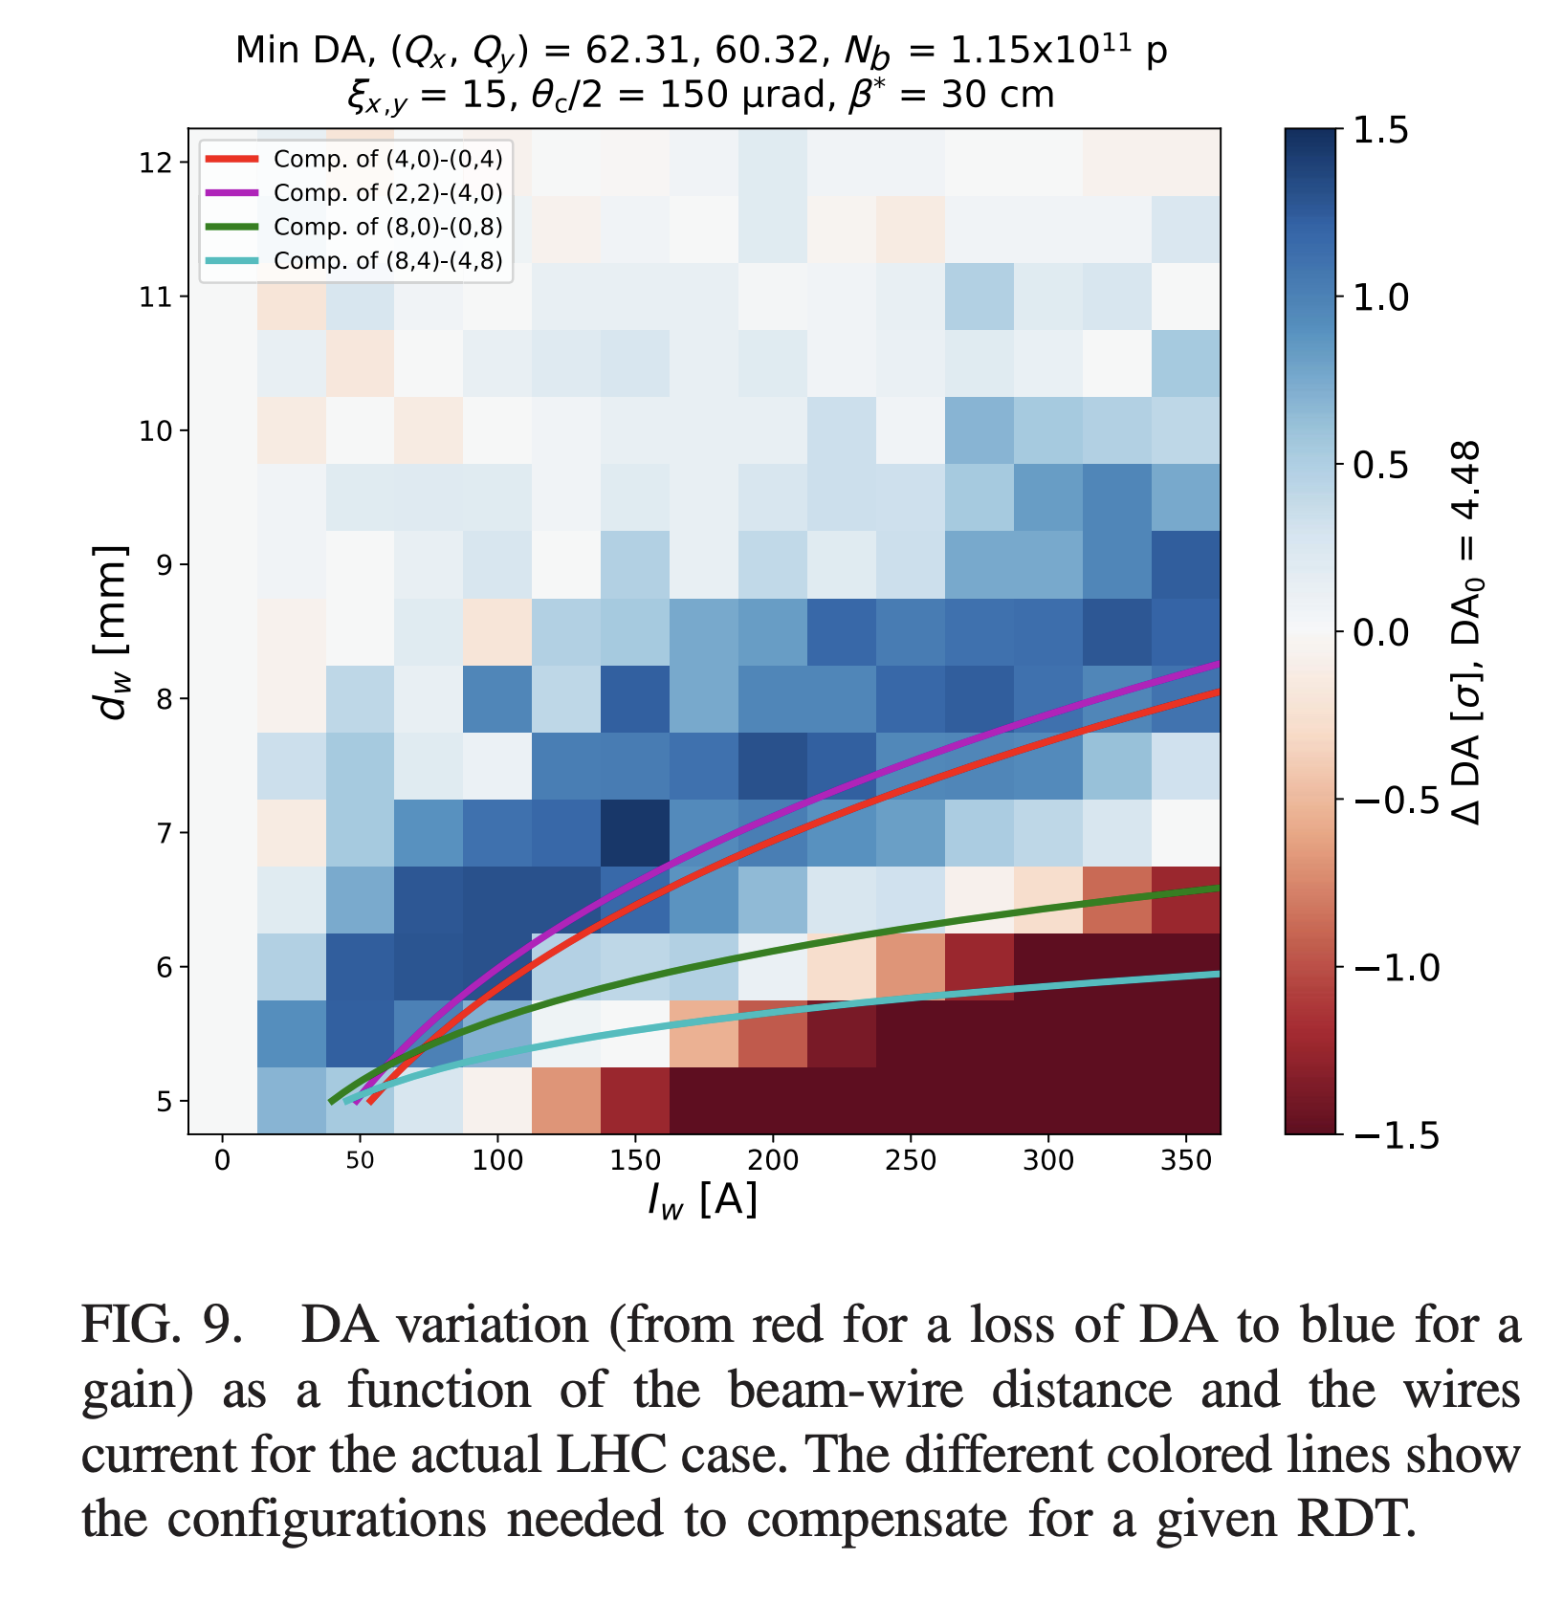
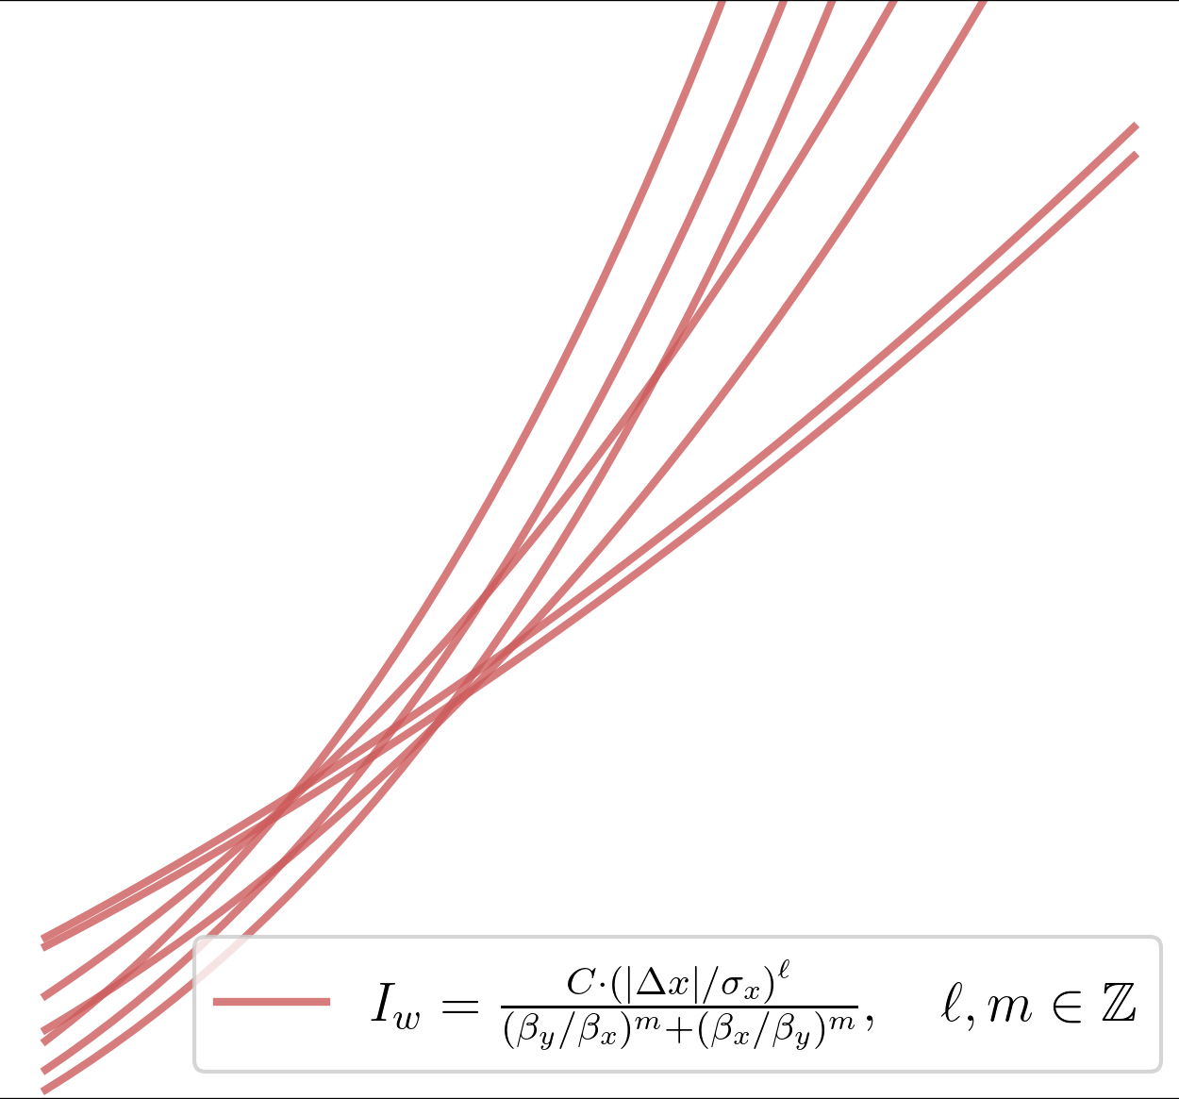
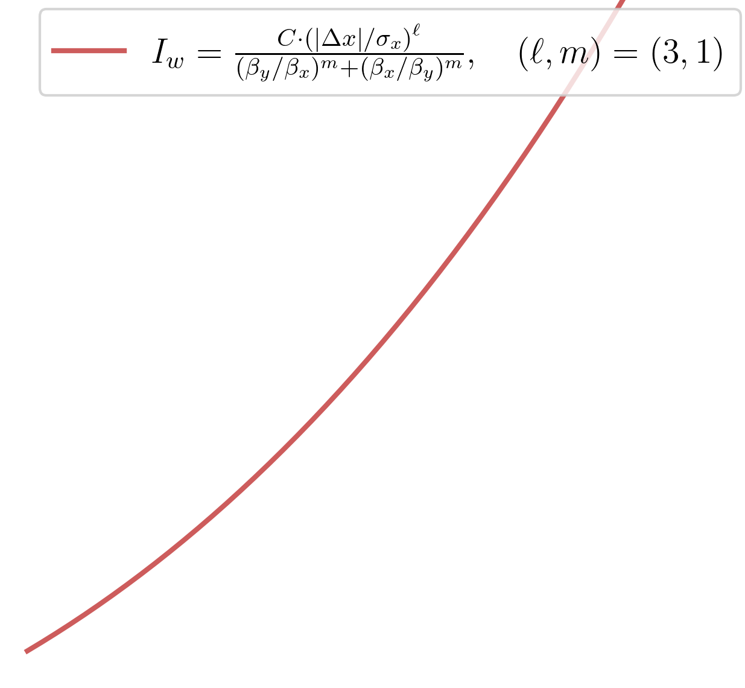
40-Wire Problem (HL-LHC case)
$$E=7 TeV \\ N_{LR}=40 \\ N_{b}=2.3 × {10}^{11} \\ ε_{x,y}=2.5 μ\text{m} \\ {θ_{c}}/2=190 μrad \\ β^{∗}=15 cm$$
Optimal point is found to correspond to analytic predictions:
$×$ 20
$×$ 20
$$s$$
$$π$$
BBCW
Wires
Wires
BBCW
Octupole-like target:
*See [3]
Notes:
\frac{I_w}{(|\Delta x|/\sigma_x)^{\ell}}\Big[(\beta_y/\beta_x)^m + (\beta_x/\beta_y)^m\Big] = \sum_{\text{BBLR}} \frac{N_b\cdot(ec)}{(|\Delta x|/\sigma_x)^{\ell}}(\beta_y/\beta_x)^m= C, \quad \ell,m\ \in \mathbb{Z}
********************************************************
\frac{I_w}{(|\Delta x|/\sigma_x)^{3}}\Big[(\beta_y/\beta_x) + (\beta_x/\beta_y)\Big] = C

Slide 22
Summary and Outlook
Presented a novel and complementary description of non-linear beam dynamics
  Topology is key
  Exact via tracking, no truncation needed
  Invariants are eigensolution of operators
  Non-linear transport problem can be described in an analogous way to Twiss
  Valid in 2D, 4D, 6D
Beam-Beam Long-Range compensation was reviewed using this formalism
  Wire compensation is the only reasonable solution to this problem
  HL-LHC compensation scheme was reviewed
  Results are consistent with previous DA studies
Dedicated DA studies should be carried out to find the correlation with “non-linear residual”
Connection between transport problem and periodic problem should be studied (emergence of chaos)

Slide 23
References
[1] G. Iadarola et al. (2024), “Xsuite physics manual”. https://xsuite.github.io/xsuite/docs/physics_manual/physics_man.pdf
[2] M. Henon and C. Heiles (1964), “The applicability of the third integral of motion: Some numerical experiments”.
[3] A. Poyet et al. (2024), “First experimental evidence of a beam-beam long-range compensation using wires in the Large Hadron Collider”.
[4] A. Bazzani (1994), “A normal form approach to the theory of nonlinear betatronic motion”. http://cds.cern.ch/record/262179
[5] J. Laskar (1999), “Introduction to Frequency Map Analysis”. http://link.springer.com/10.1007/978-94-011-4673-9_1
[6] S. Fartoukh (2015), “Compensation of the long-range beam-beam interactions as a path towards new configurations for the high luminosity LHC”.

Slide 24
Thank you!

Slide 25
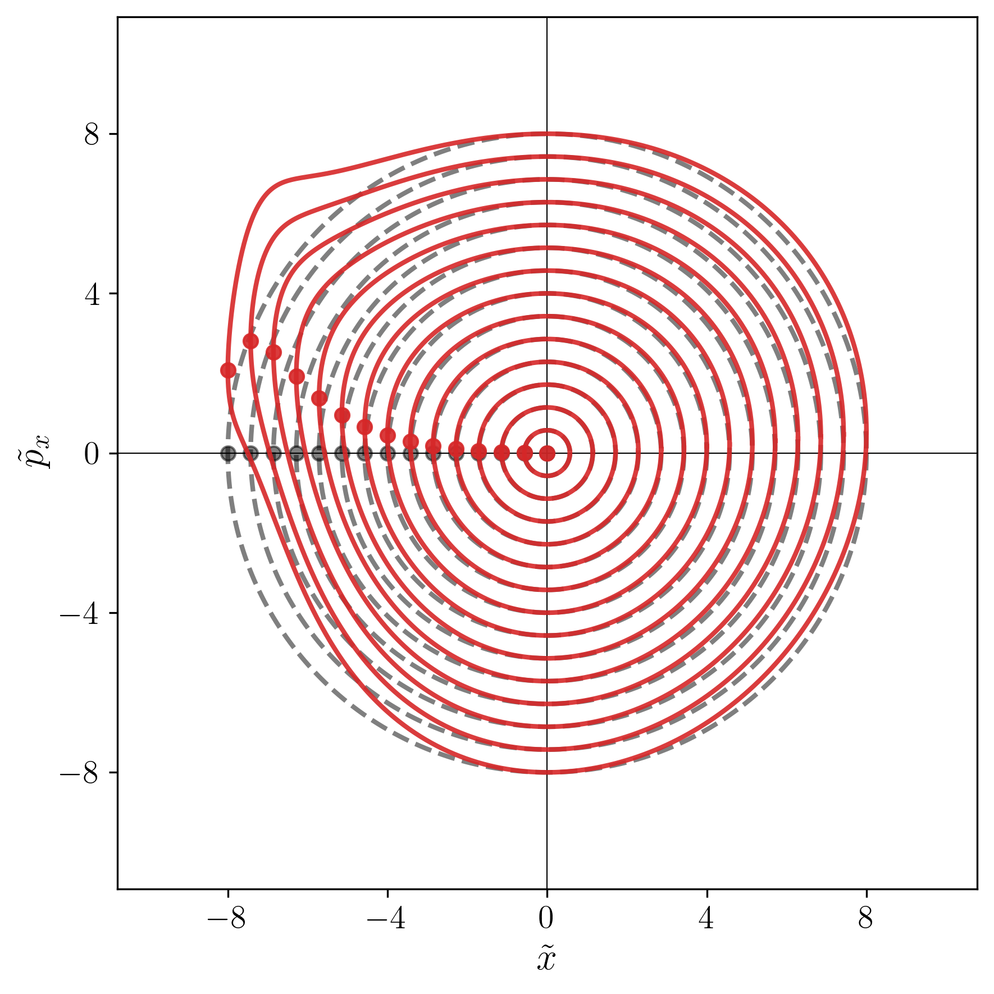
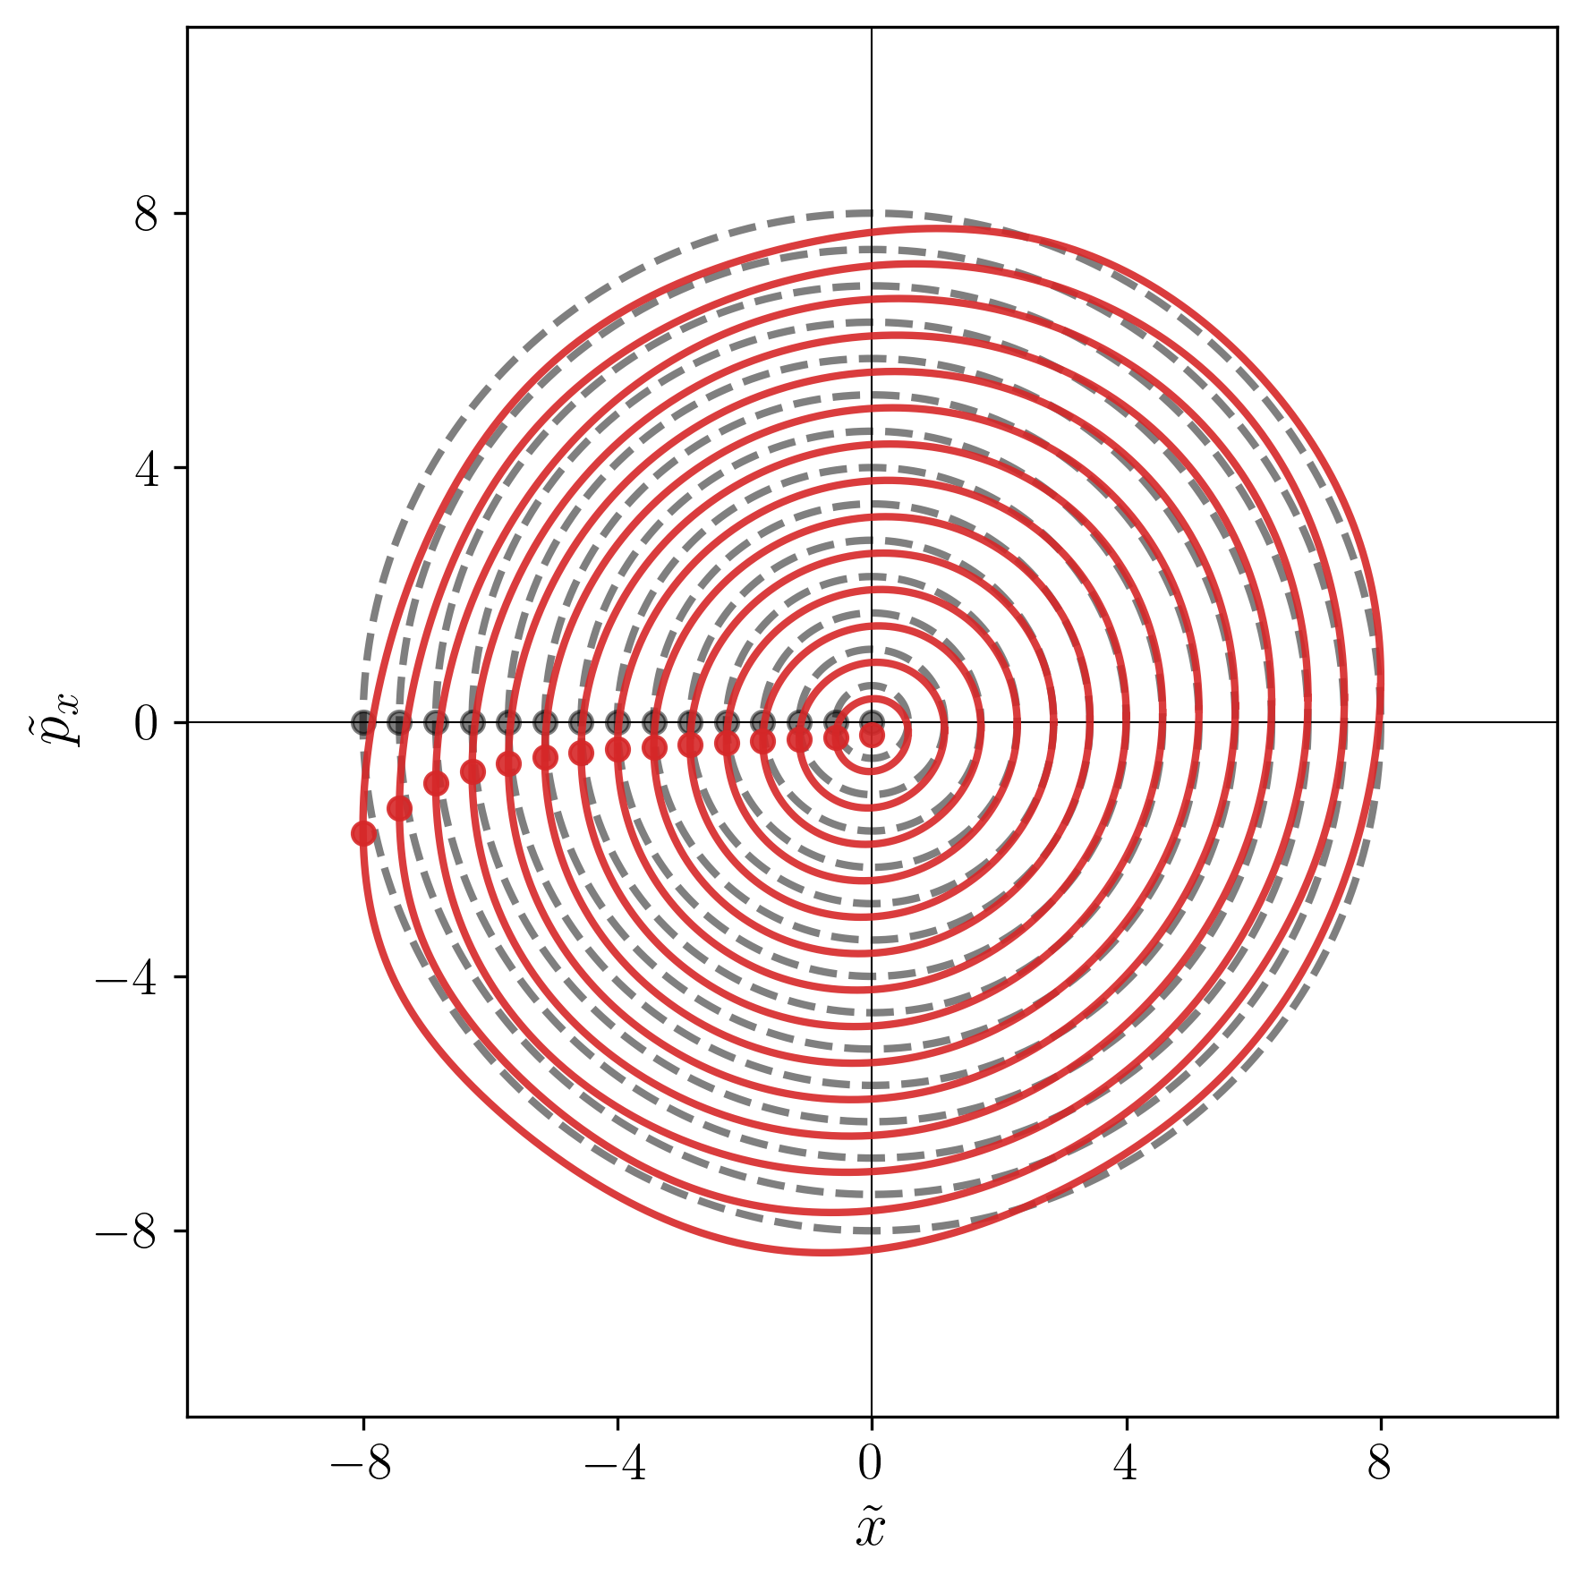














BBLR IP symmetry
For $r_{y}=0$ and $Θ_{y}=0$
For $r_{y}=4$ and $Θ_{y}=0$
$$E=7 TeV \\ N_{LR}=40 \\ N_{b}=2.3 × {10}^{11} \\ ε_{x,y}=2.5 μ\text{m} \\ {Δx}_{LR}=+ 9 σ_{x}$$
$$Δx>0$$
$$(\tilde{x},{\tilde{p}}_{x})$$
$$(\tilde{x},{\tilde{p}}_{x})$$
Fully equivalent!
Fully equivalent!
$$s$$
$$π$$
For $r_{y}=0$ and $Θ_{y}=0$
For $r_{y}=4$ and $Θ_{y}=0$
$$E=7 TeV \\ N_{LR}=40 \\ N_{b}=2.3 × {10}^{11} \\ ε_{x,y}=2.5 μ\text{m} \\ {Δx}_{LR}=− 9 σ_{x}$$
$$Δx<0$$
$$(\tilde{x},{\tilde{p}}_{x})$$
$$(\tilde{x},{\tilde{p}}_{x})$$
Notes:
**********************************************************************************************************************
\vec I = \begin{pmatrix} I_x \\ I_y\end{pmatrix} = \frac{\varepsilon_x}{2}\begin{pmatrix} r_x^2 \\ r_y^2\end{pmatrix} \quad\text{and}\quad \vec{\ev{J}} = \frac{\varepsilon_x}{2}\begin{pmatrix} \ev{\tilde X^2 + \tilde P_x^2} \\
\ev{\tilde Y^2 + \tilde P_y^2}\end{pmatrix}
*******************************************************************************

Slide 26



BBCW symmetry: real space vs normalized?
$$E=7 TeV \\ N_{LR}=40 \\ N_{b}=2.3 × {10}^{11} \\ ε_{x,y}=2.5 μ\text{m} \\ {θ_{c}}/2=190 μrad \\ β^{∗}=15 cm$$
BBCWs installed with symmetric $|Δx|$ (real space)
BBCWs installed with symmetric $\left|Δx\right|/σ_{x}$ (norm. space)
Notes:
**********************************************************************************************************************
\vec I = \begin{pmatrix} I_x \\ I_y\end{pmatrix} = \frac{\varepsilon_x}{2}\begin{pmatrix} r_x^2 \\ r_y^2\end{pmatrix} \quad\text{and}\quad \vec{\ev{J}} = \frac{\varepsilon_x}{2}\begin{pmatrix} \ev{\tilde X^2 + \tilde P_x^2} \\
\ev{\tilde Y^2 + \tilde P_y^2}\end{pmatrix}
*******************************************************************************

