Slide 1
Long Range Beam-Beam investigation using Weak-Strong beams in the LHC
T. Persson,
E.H.Maclean, X. Buffat, M.Hostettler, K. Paraschou, G. Sterbini, R. Tomas, J. Wenninger
and from the OMC team:
Y. Angelis, F. Burkhardt, F. Carlier, J. Dilly, V. Ferrentino, M. Le Garrec, W. Van Goethem, S. Horney, J. Keintzel, E. Kravishvili, K. Skoufaris, F. Soubelet, K. Ujani

Slide 2
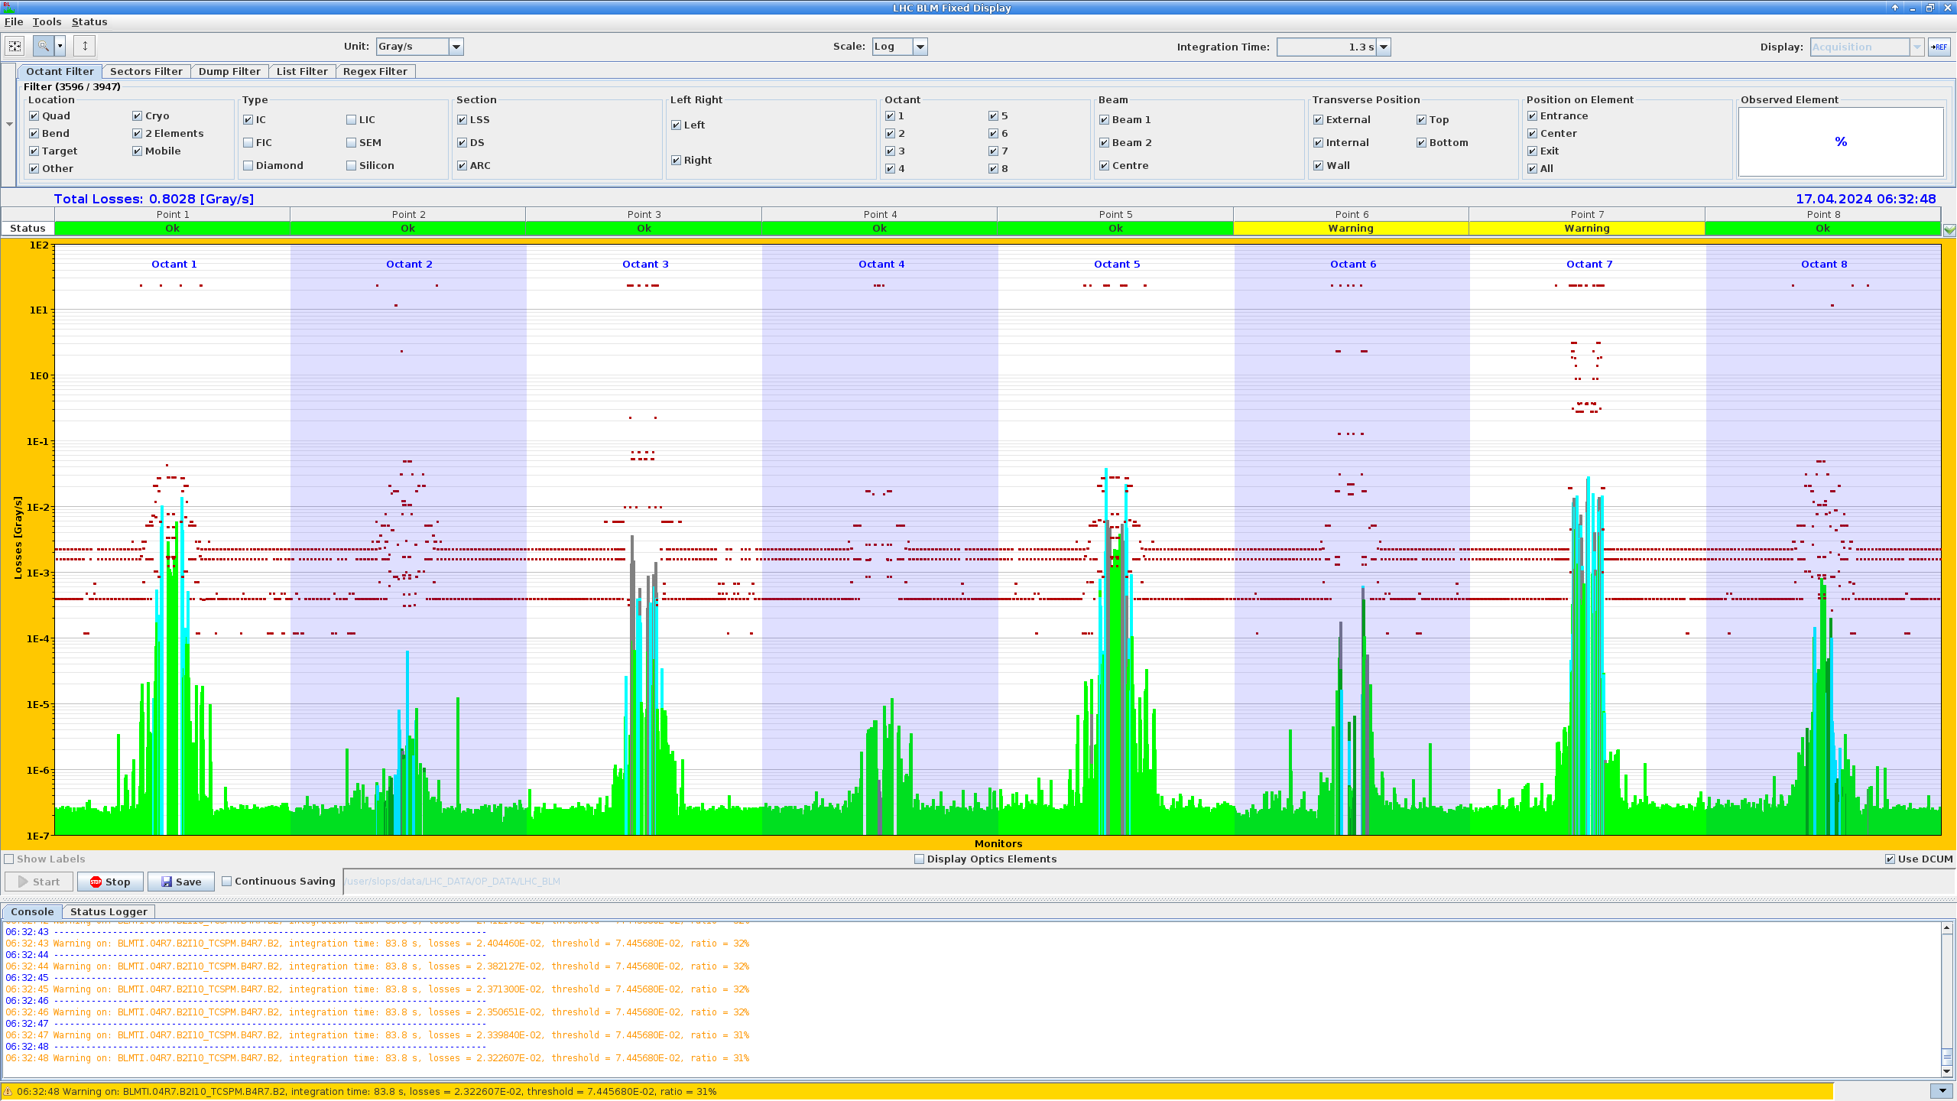
Motivation
After the LHC commissioning there is a phase of intensity ramp up
After we went to bunch trains a hierarchy breakage in the collimation system was observed in beam 2
  Only at β* of 33cm and below (collisions start at 1.2m and around 60cm we start our physics production)
  Only observed when we had trains and two beams in the machine
  It was found that the collimation hierarchy was broken at TCSG.D4R7.B2 (vertical secondary collimator)

Slide 3
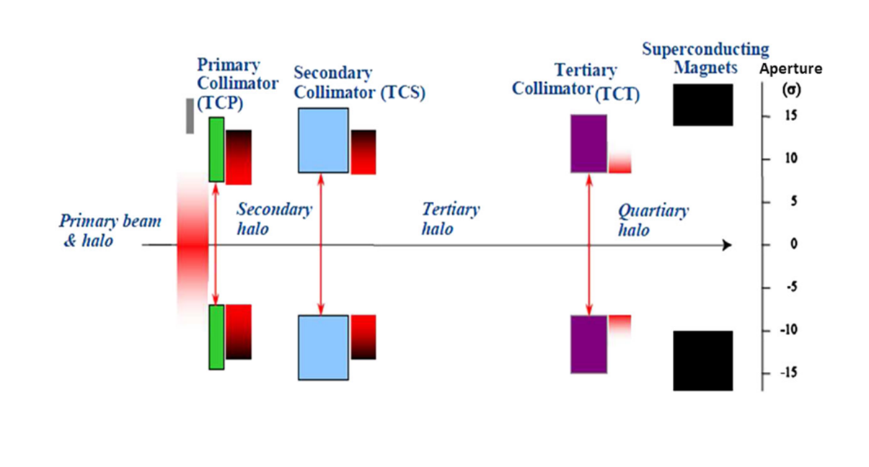
What does it mean that the collimation hierarchy was broken?
LHC has a multistage collimation system
The TCP should be the primary but for beam 2 it was the vertical secondary collimator TCSG.D4R7.B2
  The design difference between the primary and secondary is 1.5 σ
The single beam didn’t show this!

Slide 4
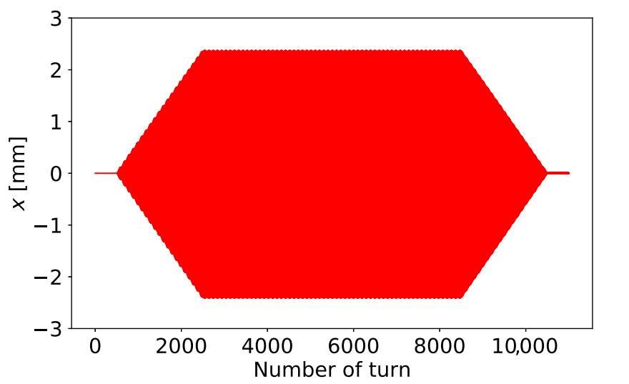
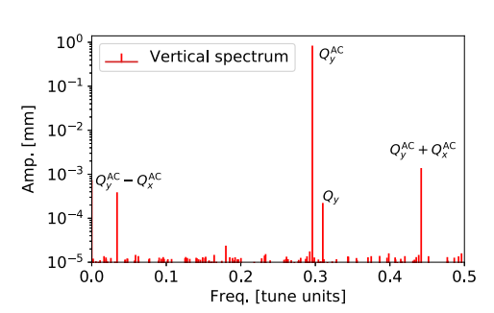
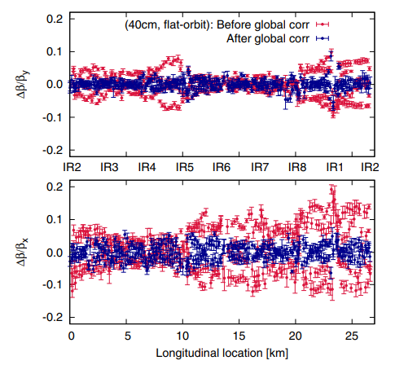
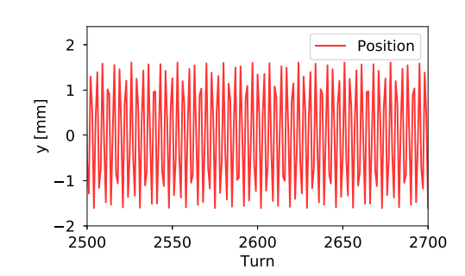
How we measure optics and Resonance Driving Terms (RDTs) in the LHC
We excite the beam with an AC-dipole and record the turn-by-turn data
  Drive at different tunes different compared to the natural
  6600 turns of constant amplitude
  To use the AC-dipole we can have maximum 3 bunches of 10¹⁰
Clean the data and remove bad BPMs
Reconstruct the parameters such as β-beat, coupling and RDTs

Slide 5
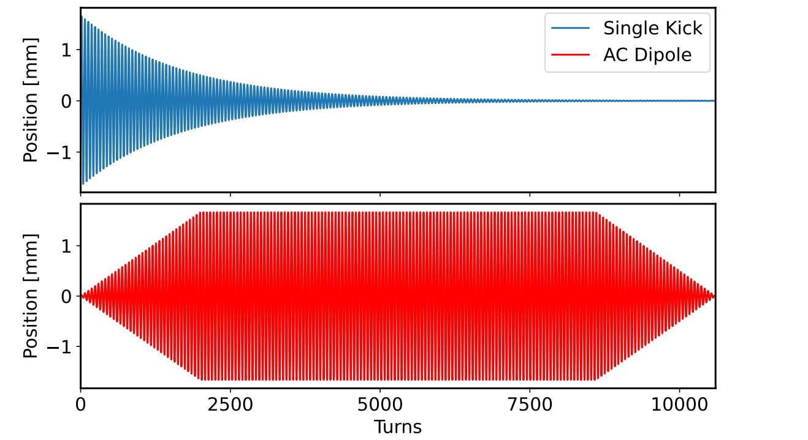
Why an AC-dipole?
The AC-dipole creates a coherent adiabatic oscillation of the beam
No emittance increase
  We can excite with the same bunch many times
The ADT (LHC damper) can create a similar excitation but limited in amplitude

Slide 6
Why do we want to measure the effect of the LRBB?
The linear and nonlinear optics commissioning is based on measurements of pilot bunches (single low-intensity bunches)
The hierarchy breakage prevented us from going to the nominal β* of 30 cm -> Less integrated luminosity
  Need a method to measure these effects and benchmark simulations (mentioned several times during the workshop)!
  Will be even more important in HL-LHC where intensity is higher and β* smaller
    Measuring with two strong beam is very difficult because when you excite on it has a strong impact on the other -> Difficult to measure and model correctly
    Measure with Strong-Weak beam!

Slide 7
Operational setup and experience
The LHC is almost like two separate machines where the beams only see each other close to the IRs
Created a special sequence
  High-intensity only for beam 1 (BPMs, RF-settings etc)
3 pilot bunches for beam 2 (maximum allowed when using AC-dipole)
  1 with no LR, 1 with IR1/2/5/8 and one only in IR1/5
Removed the common BPMs from the orbit feedback since there could be strange effects having a strong and a weak beam
Nominal collimators to 30 cm
  Opened the collimators for Beam 2 using a sequence to the optics measurement settings
Separated the beams by ~5 σ to only have LRBB (no head-on)
Extremely smooth and no technical issues with this new setup!
  Several new MDs proposed following a similar procedure

Slide 8
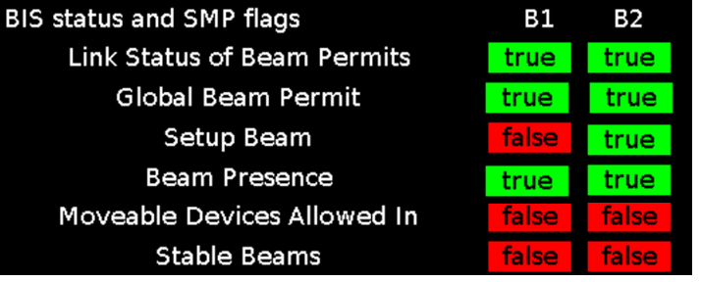
The setup in details
The intensity per bunch was
  Beam 1: 1.6x10¹¹
  Beam 2: 10¹⁰
Normalized emittance:
  Beam 1 around 1.8 um
  Beam 2 around 3 um (some blow up during the measurement)
Crossing angle:
  150urad (both beams)
β*
  IP1 = IP5=30cm
  IP2 = 10m
  IP8 = 2m
We were operating with 36 bunch trains
  LHC can operate with longer trains but even with this configuration we have almost the maximum of long-range.

Slide 9
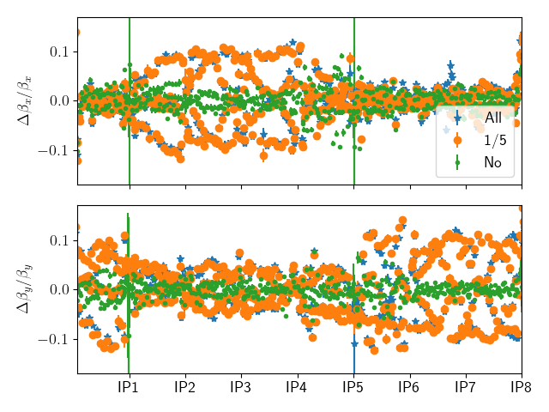
β-beat
The long-range beam-beam has a significant impact on the β-beat
We go from around 5% to more than 10%
  Changes not enough at the collimators to explain the hierarchy breakage

Slide 10
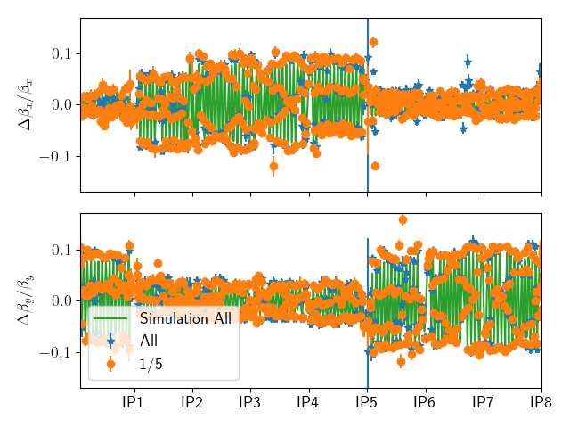
β-beat compared to simulations
The plot shows the β-beat between the bunch with no long range and with
  The green line shows the simulation from MAD-X very similar results from pyTrain (see Michi’s talk on Thursday)
Up to 10% difference in the β-beat

Slide 11
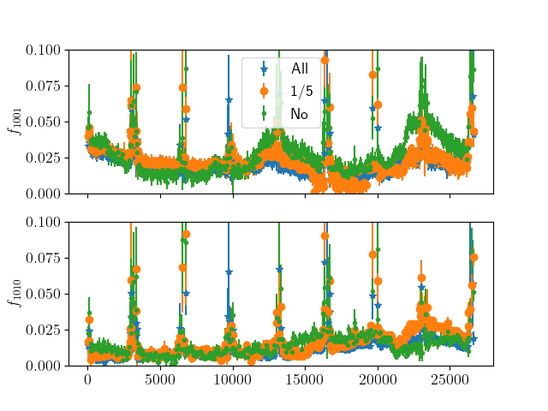
Transverse coupling
Modest impact on the couplings RDTs
  No significant contribution to the hierarchy breakage
If there is a tilt (in IP1 and IP5) in the crossing angle then we would expect a change larger change to the coupling (LHC MD2877: Beam-beam long range impact on coupling measurements)

Slide 12
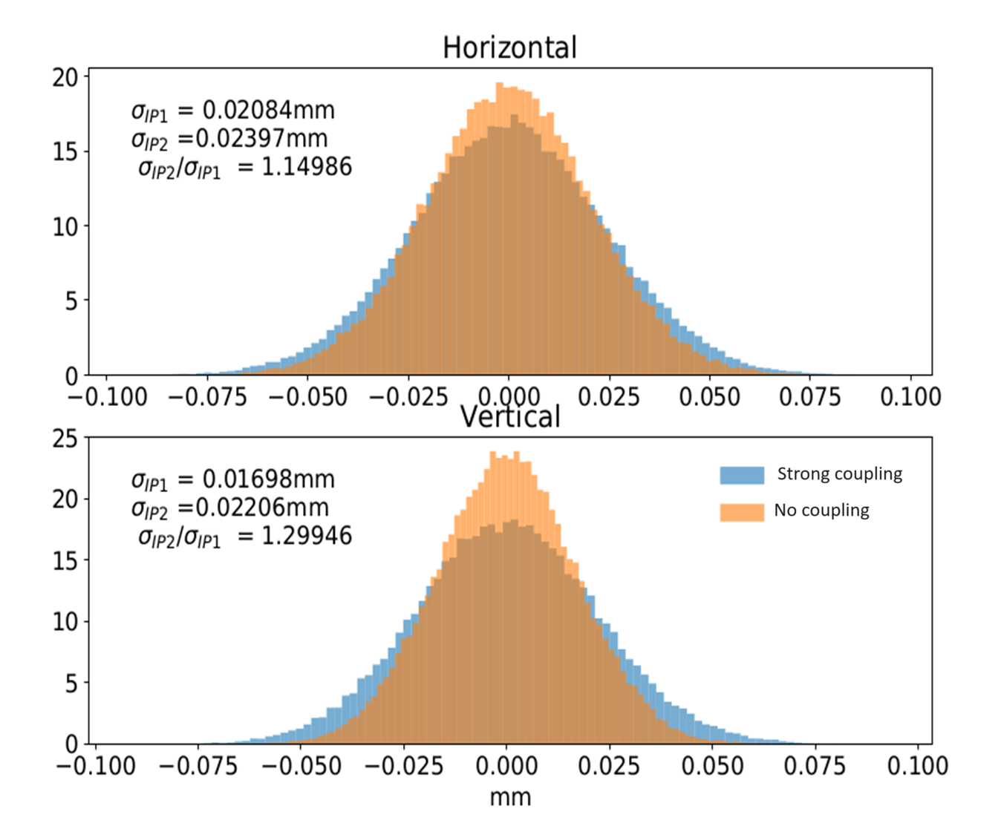
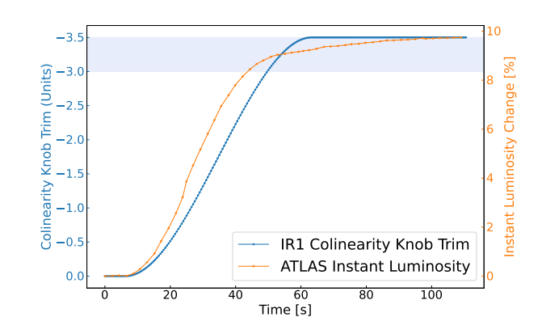
Beam size increase due to coupling
The transverse coupling can increase the beam size
  Normally we care about this at the IPs
  If large it would have the same effect at the collimator
The effect from the LRBB was small
  -> Not the explanation for the hierarchy breakage
M. Hoffer, R. Tomas “Effect of local linear coupling on linear and nonlinear observables in circular
F. Soubelet, “Local Interaction Region Coupling Correction for the LHC”

Slide 13
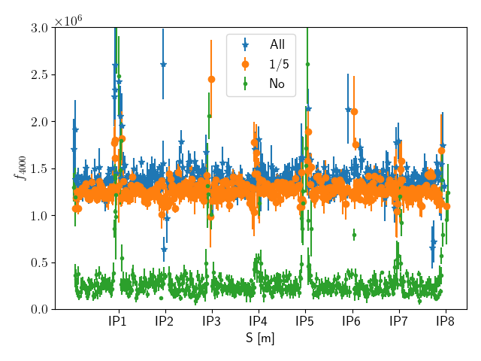
Octupoles RDTs (4Qx)
A clear increase as expected of the octupolar RDT
What is shown here is the driven f4000 (4Qx) meaning the effect of the AC dipole is not compensated for in the reconstruction
  We are currently working to benchmark this in simulation

Slide 14
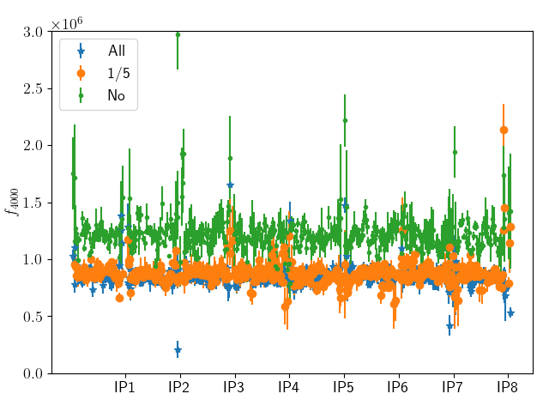
Octupoles RDTs with the LRBB Wire
The LRBB wire is designed to reduce the negative impact of the beam-beam on lifetime (see talk from Guido)
The driven f4000 is reduced from 1.5x10¹⁰ to ~1x10¹⁰
A clear increase of the bunch with no LRBB

Slide 15
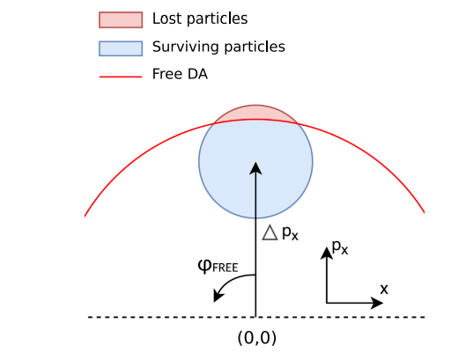
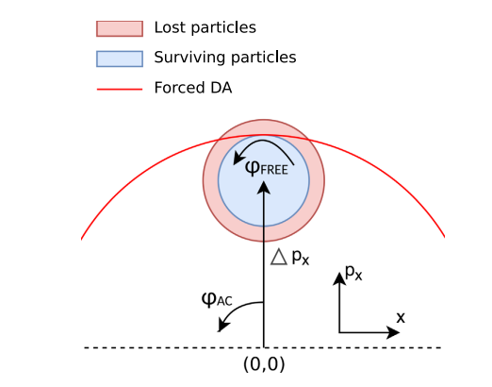
Forced Dynamic Aperture
It is possible to measure a forced dynamic aperture but difficult to relate it to the free
  Possible to compare to tracking simulations
F. Carlier, et al, First experimental demonstration of forced dynamic aperture measurements with LHC ac dipoles

Slide 16
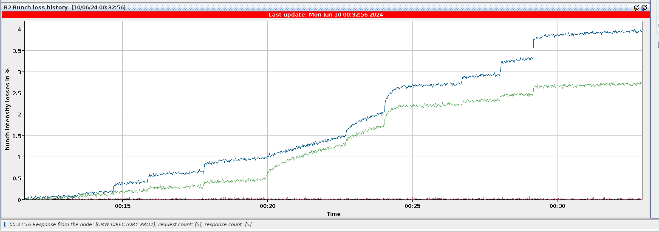
Forced Dynamic Aperture (without LRBB wire)
Quantitatively there is a clear difference between bunches with and without LRBB
Hard to make a quantitative assessment
Clear intensity loss for each kick
No losses for the bunch without LRBB

Slide 17
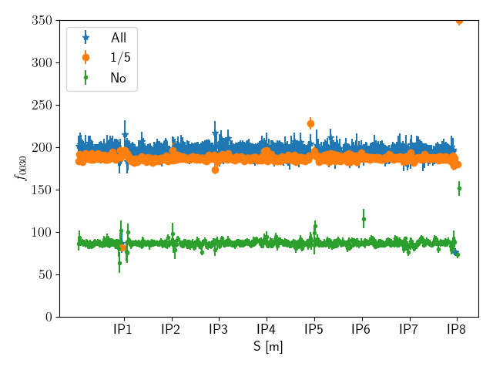
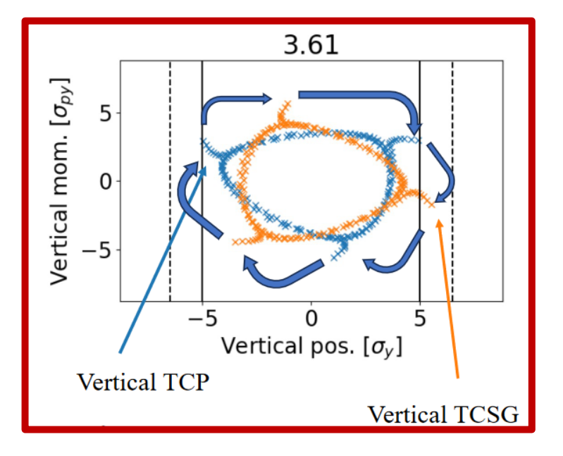
Beam-beam impact on 3Qy
The hierarchy breakage was sensitivity to the tune
  Increasing the vertical tune made the situation worse -> Sign that the 3Qy might play a role
  When we implemented an a3 correction that also had a positive effect (~0.2 σ)
  Simulation by K. Paraschou and X. Buffat showed that the 3Qy is of importance
A clear increase of the 3Qy from LRBB
  Working on a correction strategy, see Ewen’s talk

Slide 18
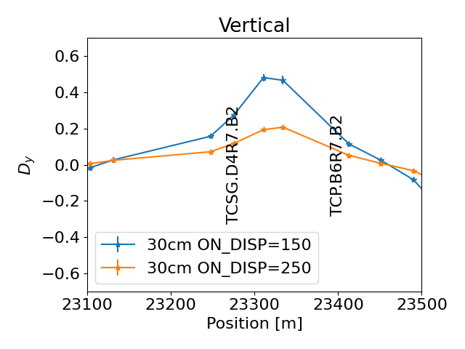
Beam-beam was not the only reason for the hierarchy breakage
Other contributing factors were found to impact the hierarchy breakage (reduced margin)
  Recuing the vertical dispersion at the collimators
  ->Increased the margin between the primary and the secondary with 0.4 σ (see D.Michari, LBOC)
  A contributing effect but not the only one since not seen on loss maps or with a single beam
    Still a two-beam effect is needed

Slide 19
Conclusion/Outlook
A new setup to measure the effect of the LRBB has been demonstrated in the LHC
  Opens up for other weak-strong studies
  Excellent agreement with simulation for the change in β (β-beat)
  The LRBB is already of importance but will be even more important when we go to smaller β* and higher intensities
    Important to benchmark simulations
  The plan is to include the strong-weak measurement for both beams in the next commissioning!
  The 3Qy that was increased by the LRBB
    Directly been linked to the collimator hierarchy breakage both in tests and simulations
    The next step is to try to correct the 3Qy-driven by beam-beam (Next talk!)

Slide 20

Thank you for your attention!

Slide 21
Backup

Slide 22
Vertical dispersion after correction
Increasing the on_disp knob from nominal (150) to 250 reduces the vertical dispersion
  Increased the margin between the primary and the secondary with 0.4 σ (see D.Michari, LBOC)
  A contributing effect but not the only one since not seen on loss maps or with a single beam
    A two-beam effect is need

Slide 23
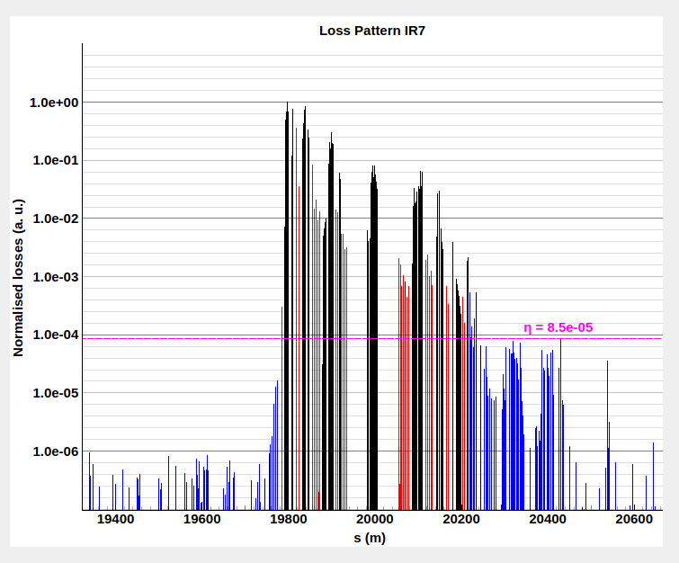
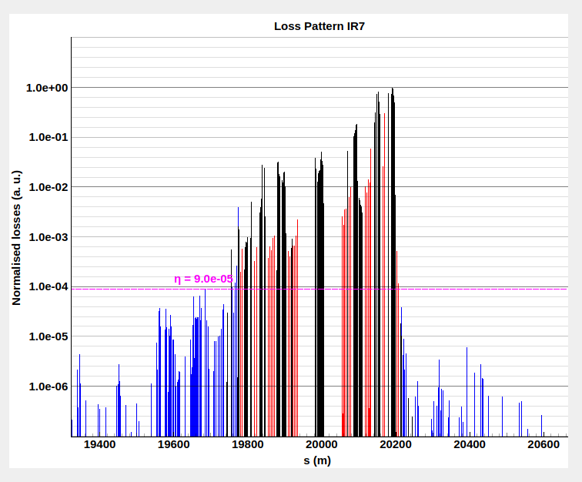
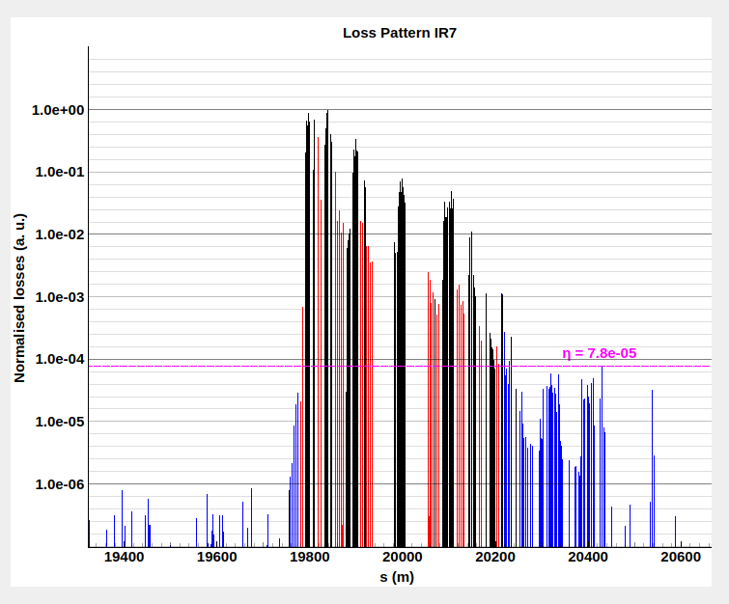
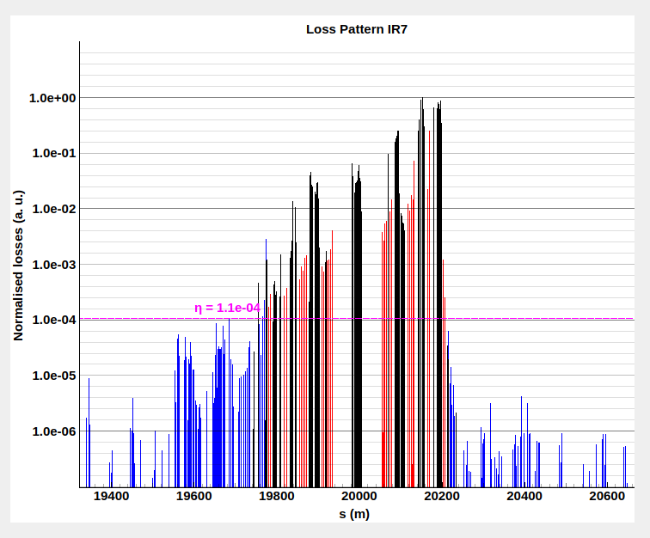
First investigation
TCSPM.B4R7.B2
Perform a cycle to do loss maps with different MO and Q’ settings
MO = -2
Q’ = 20
B1H
B2H
Beam 1
B1V
B2V
Beam 1
Some of the cleanest loss maps ever observed: no hierarchy issues and excellent cleaning

Slide 24
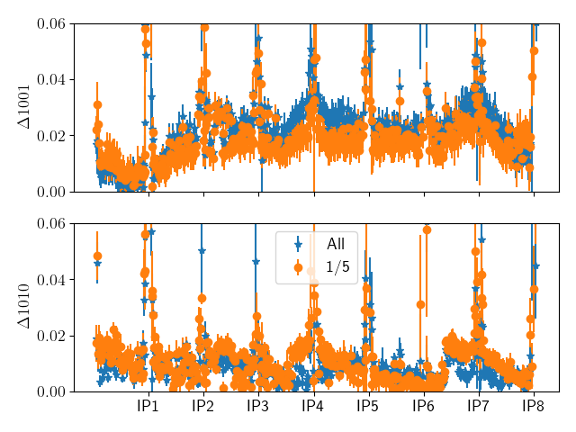
Coupling
The difference between the one without long range

