Slide 1
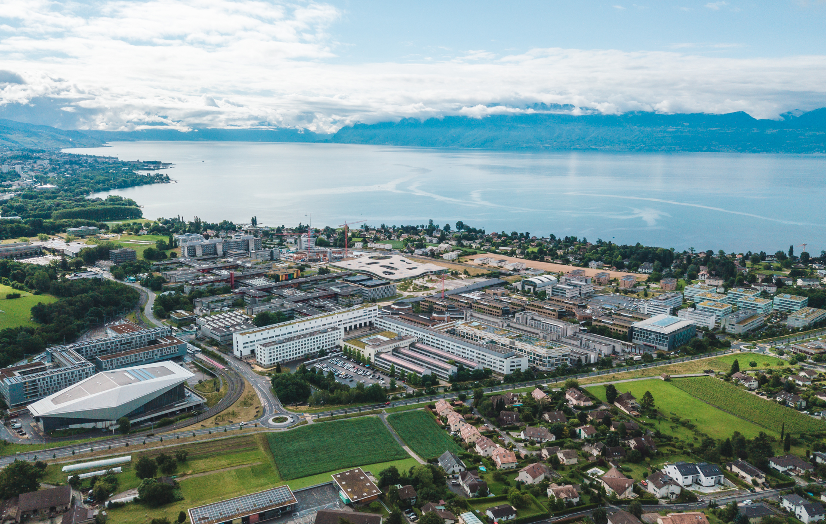

Beam-beam tools and Weak-Strong Studies for the Future Circular Collider
Leon van Riesen-Haupt, Peter Kicsiny, Yi Wu, Anne-Clemence Piveteau, Xavier Buffat, Tatiana Pieloni, Rogelio Tomas
3rd September 2024
Work supported by the Swiss Accelerator Research and Technology (CHART)

Slide 2
Background: Simulation Tools
Xsuite developments allow detailed simulation of FCC-ee
  See talk by G. Iadarola on Thursday
  Simulations including:
    Full description of lattice with errors and radiation
    Beam-beam effects
  Beam-beam module written by P. Kicsiny, talk yesterday
    Used for FCC studies with full lattice description without errors e.g. for dynamic aperture, emittance blow up, lifetimes
EPFL FCC software framework
  Aim to enable comprehensive simulations with multiple effects
  Understand and study their interplay
  Introduce them one at a time

Slide 3
Background : FCC Tuning Studies
FCC tuning studies[1]:
  Simulations with different kinds of lattice errors
  Sensitivities
  Corrections:
    Optics and orbit corrections
    Tuning knobs to control IP optics functions
  Very limited studies with beam-beam effects
Significant achievements with promising results
  Towards acceptable dynamic aperture and optics with realistic errors
  Need to understand impact of beam-beam effects
Studies shown today:
  First studies on interplay of lattice errors and (WS) beam-beam
  Beam-beam perturbation and luminosity with IP parameter scan
[1] 10.18429/JACoW-IPAC2024-WEPR02

Slide 4
Beam-beam and Lattice Errors
Towards comprehensive dynamic aperture studies

Slide 5
Target
First dynamic aperture studies including:
  Beam-beam
  Full lattice with radiation
  Lattice imperfections
Examining one imperfection at a time:
  Excitation of different multipoles
  Different alignment errors
Studies done to
  Understand how different types of imperfections interact with beam-beam and affect dynamic aperture
  Aim to pinpoint behaviour and target corrections
First iterations focuses on transverse dynamic aperture

Slide 6
Simulation Set-up
Load FCC-ee tt lattice without perturbations from MADX
Perturb lattice in MADX and import to Xsuite
Taper lattice – adjust local magnet strength to match local beam energy
Compute 6D Twiss in Xsuite
Install (WS) beam-beam elements in Xsuite
  Two options: B2 same/mirrored parameters as B1, B2 unperturbed
Compute DA metric – Largest Ellipse
Repeat without beam-beam

Slide 7


Dynamic Aperture: Largest Ellipse
Define dynamic aperture as largest possible ellipse (in X,Y plane) that only contains stable particles. Developed with A. Piveteau
Allows get quantifiable dynamic aperture to scan parameters
$$b$$
$$a$$

Slide 8
Controlled Excitation of Multipoles
Install multipole in “RF-insertions” of tt lattice
  Separate studies:
    In one insertion, in all insertions
    B2 mirror B1, B2 unperturbed
Separately excite dipole, quadrupole, sextupole and octupole fields
  Gradually increase multipole strengths (arbitrary units)
  Until dynamic aperture drops to zero without beam-beam
  Repeat with beam-beam
  Repeat with their skew equivalents

Slide 9
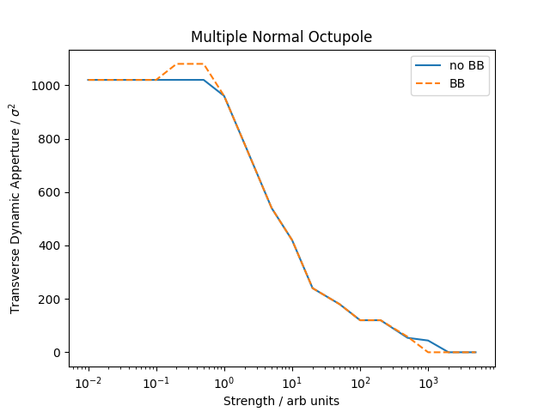
Findings
Beam-beam shown to have a very small impact on transverse dynamic aperture
  Largely follows the same trends irrespective of beam-beam element installed
  True for single perturbation and multiple (rotationally symmetric) perturbations
Symmetric and unperturbed B2 both have a very small impact
  No major difference in behaviour
Example: plot for effect on DA with multiple octupoles

Slide 10
Alignment Errors
Test impact of alignment errors on dynamic aperture
  Focus on vertical alignment errors of:
    Sextupoles - introduction of coupling and optics beating
    Quadrupoles – same as sextupoles + introduction of orbit + dispersion effects
Simulation set up similar as for multipoles
  Tapering and full radiation
  B2 produced symmetric to B1
    Ensure beams actually interact (no orbit offsets)
Random errors with increasing standard deviation
  Applied to quadrupoles or sextupoles
  20 identical errors seeds with and without beam-beam
  Compute average and standard deviation of dynamic aperture for each error size
  Compare individual seeds too

Slide 11
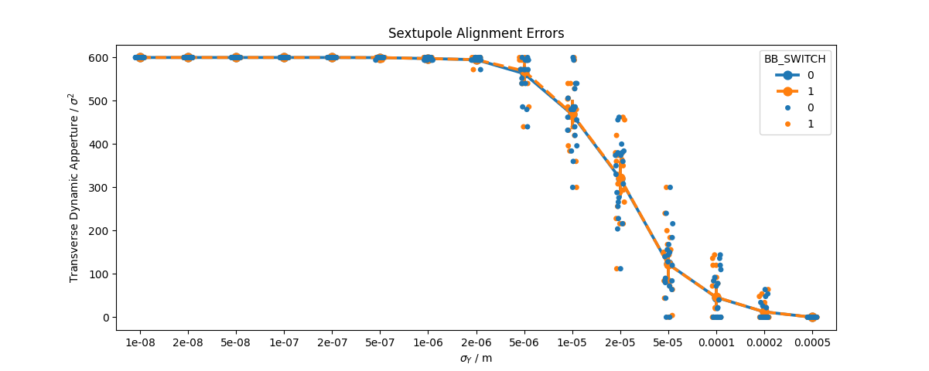
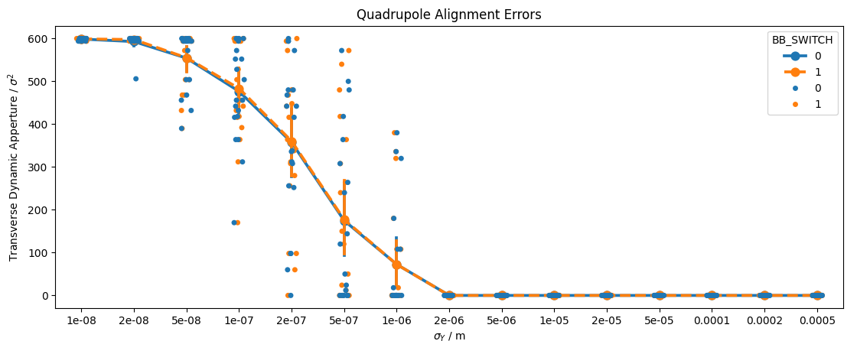
Results

Slide 12
Results
Very small impact of beam-beam element on average dynamic aperture
Most error seeds have very similar dynamic aperture in both cases
  Shown next to each other in plot
  Few cases with differences
    Interesting to study these behaviour of these seeds
    Need to understand how beam-beam interacts with these errors

Slide 13
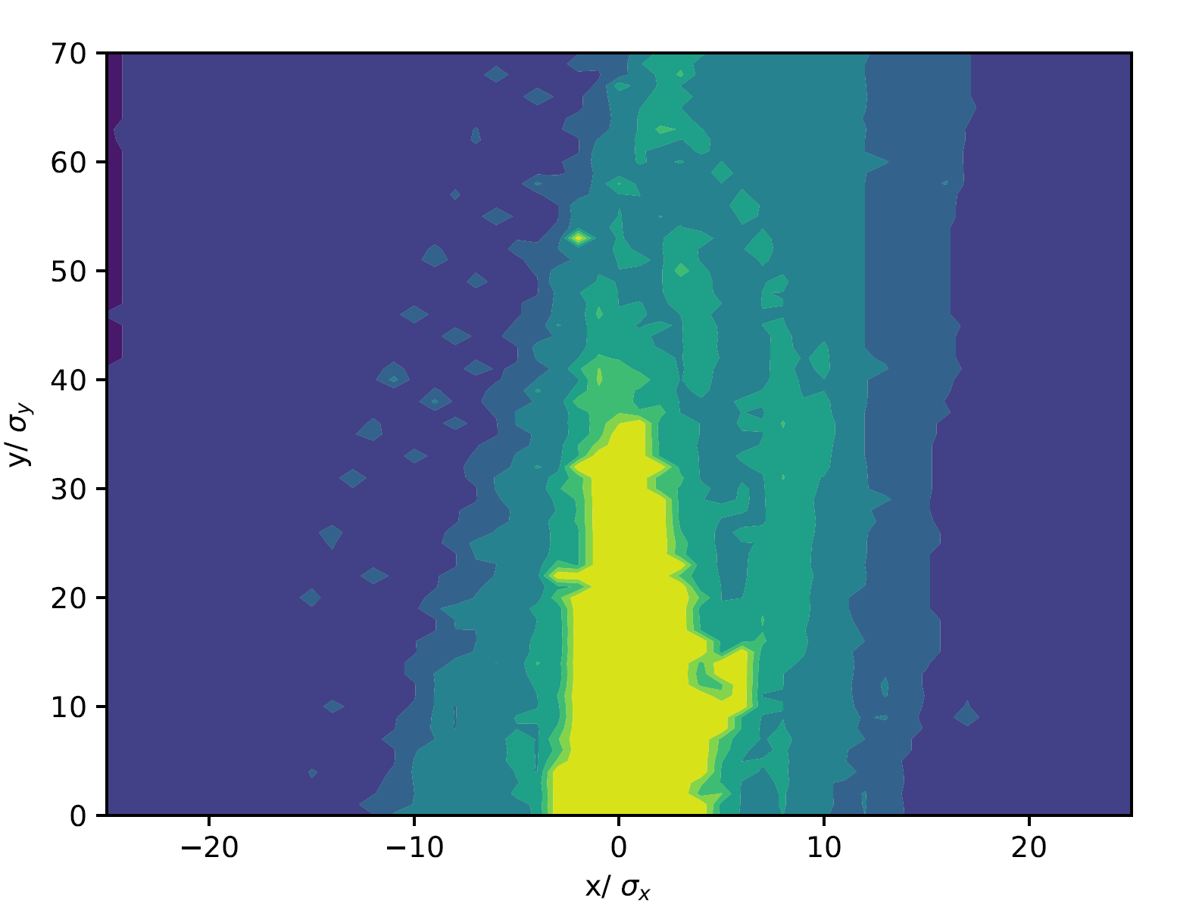
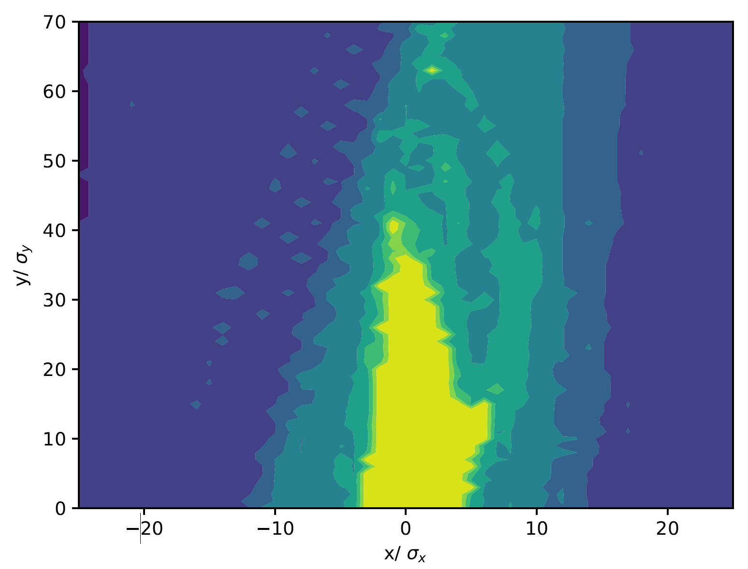
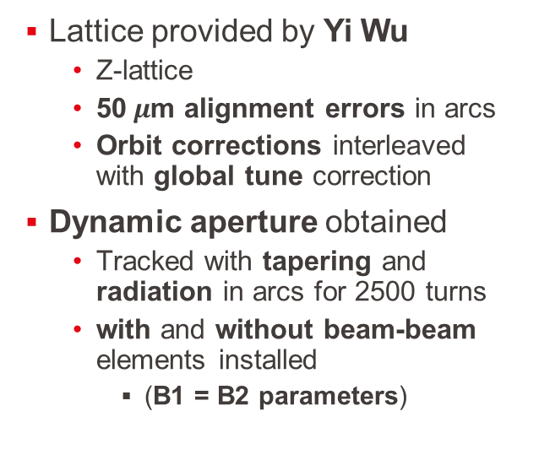
Realistic Errors and Correction
Without Beam-Beam
Lattice provided by Yi Wu
  Z-lattice
  50$μ$m alignment errors in arcs
  Orbit corrections interleaved with global tune correction
Dynamic aperture obtained
  Tracked with tapering and radiation in arcs for 2500 turns
  with and without beam-beam elements installed
    (B1 = B2 parameters)
With Beam-Beam

Slide 14
Conclusions on Errors and Beam-beam
Observe that WS beam-beam perturbations have small impact on transverse dynamic aperture
  Magnetic errors
  Alignment errors – including realistic corrections
Simulations consideration average radiation damping and full lattice
Promising first results indicating low impact after optics tuning
To get a fuller pictures also consider:
  Longitudinal dynamic aperture
  Quantized radiation: synchrotron, beamstrahlung and bha-bha scattering
  lifetime – work towards making these simulations reliable
  Study correlating dynamic aperture with lifetime

Slide 15
IP Parameters

Slide 16
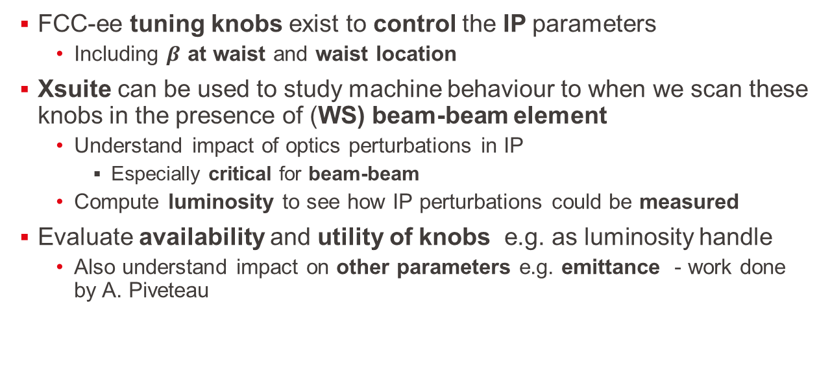
Scanning IP Knobs
FCC-ee tuning knobs exist to control the IP parameters
  Including $β$ at waist and waist location
Xsuite can be used to study machine behaviour to when we scan these knobs in the presence of (WS) beam-beam element
  Understand impact of optics perturbations in IP
    Especially critical for beam-beam
  Compute luminosity to see how IP perturbations could be measured
Evaluate availability and utility of knobs e.g. as luminosity handle
  Also understand impact on other parameters e.g. emittance - work done by A. Piveteau

Slide 17
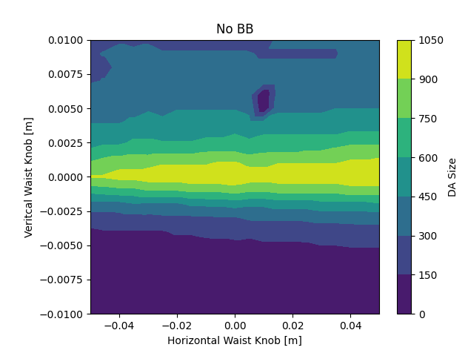
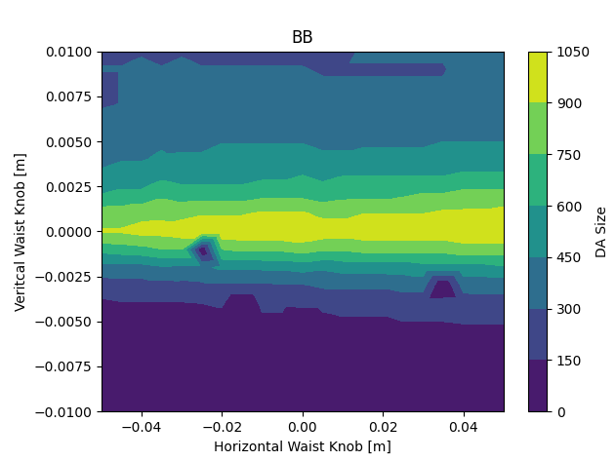
DA with IP Parameter Scan
Change waist location in horizontal and vertical planes of tt lattice using knobs
  In all IPs simultaneously
Radiating lattice and install beam-beam elements in Xsuite
  B2 unperturbed
Scan each setting and track for 200 turns (tt) and establish ellipse dynamic aperture
Repeat without beam-beam

Slide 18
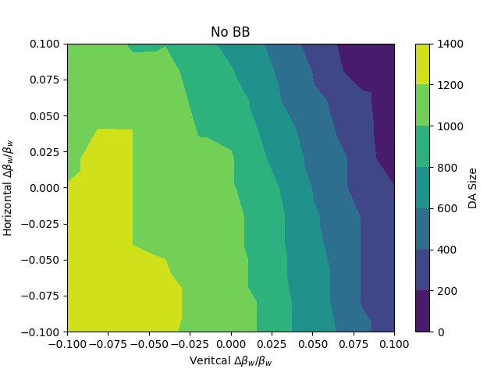

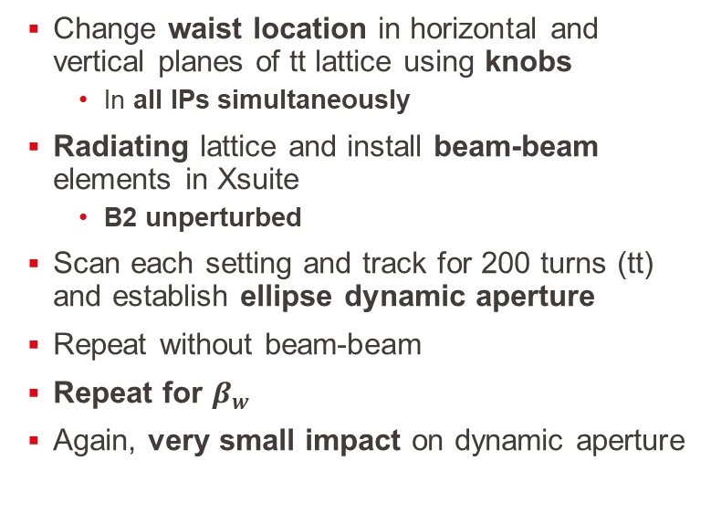
DA with IP Parameter Scan
Change waist location in horizontal and vertical planes of tt lattice using knobs
  In all IPs simultaneously
Radiating lattice and install beam-beam elements in Xsuite
  B2 unperturbed
Scan each setting and track for 200 turns (tt) and establish ellipse dynamic aperture
Repeat without beam-beam
Repeat for $β_{w}$
Again, very small impact on dynamic aperture

Slide 19
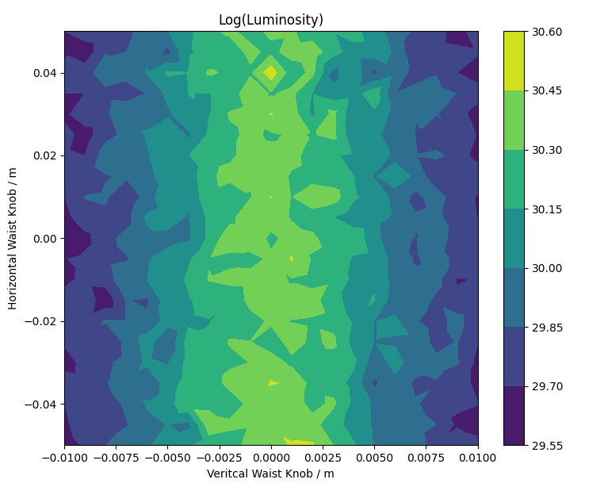
Luminosity Scans
Change waist location in horizontal and vertical planes of tt lattice using knobs
  In single IP
Radiating lattice in Xsuite
Install single beam-beam element in modified IP
Luminosity computed using Xsuite beam-beam
  Compute luminosity over 300 turns with 100,000 macro particles
Behavior as expected
  Future studies with (optics) errors
    Use luminosity to tune optics

Slide 20
Conclusions
Xsuite allows for FCC-ee studies with full lattice description, radiation and beam-beam
  Powerful tool to realistically study FCC-ee in full detail
First studies on the impact of beam-beam on dynamic aperture with errors
  Magnetic errors and alignments errors
  Promising first results towards demonstrating feasibility
  Limited to transverse dynamic aperture – more studies to follow
More focused studies on IP parameters
  Impact of knobs on dynamic aperture with beam-beam
  Beam-beam module for luminosity scans
  Towards understanding availability and utility of knobs

Slide 21
Thank you!
Backup slides

Slide 22
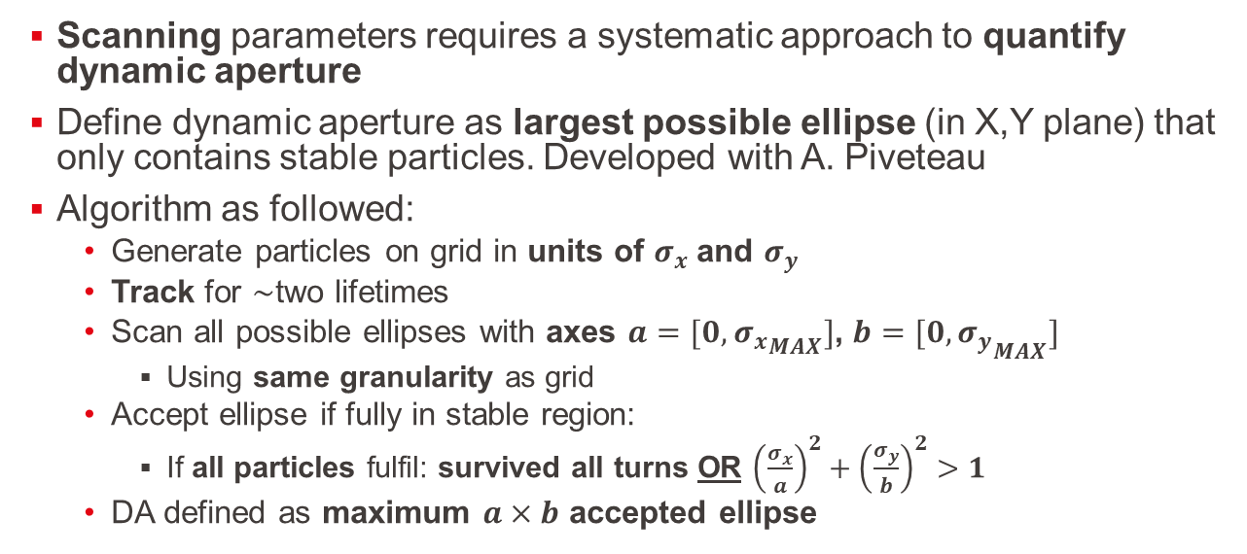
Dynamic Aperture: Largest Ellipse
Scanning parameters requires a systematic approach to quantify dynamic aperture
Define dynamic aperture as largest possible ellipse (in X,Y plane) that only contains stable particles. Developed with A. Piveteau
Algorithm as followed:
  Generate particles on grid in units of $σ_{x}$and $σ_{y}$
  Track for $\sim$two lifetimes
  Scan all possible ellipses with axes $a=[0,{σ_{x}}_{MAX}]$, $b=[0,{σ_{y}}_{MAX}]$
    Using same granularity as grid
  Accept ellipse if fully in stable region:
    If all particles fulfil: survived all turns OR ${\left(\frac{σ_{x}}{a}\right)}^{2}+{\left(\frac{σ_{y}}{b}\right)}^{2}>1$
  DA defined as maximum $a×b$ accepted ellipse

Slide 23
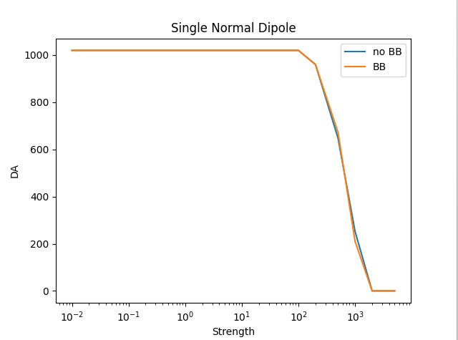
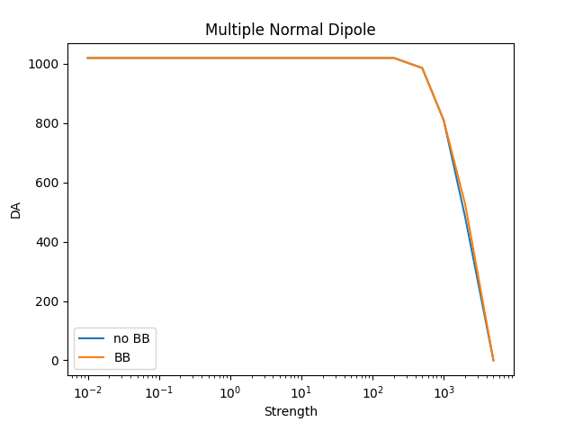
Dipole (Kicker)

Slide 24
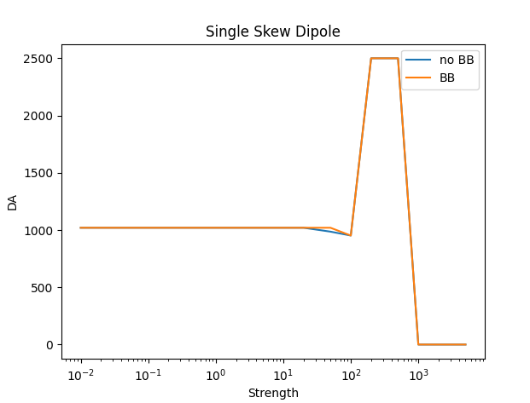
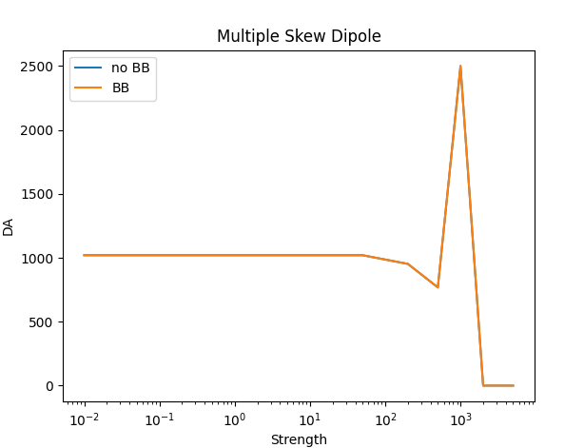
Skew Dipole (Kicker)

Slide 25
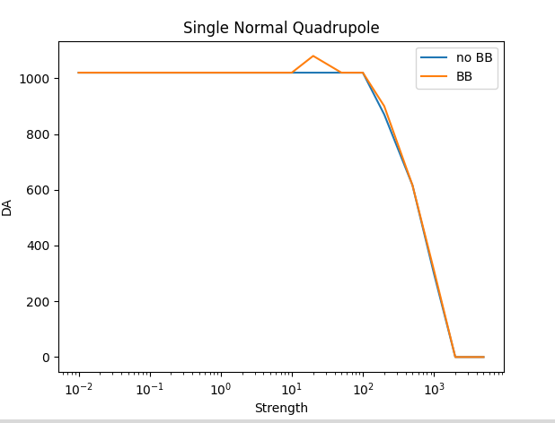
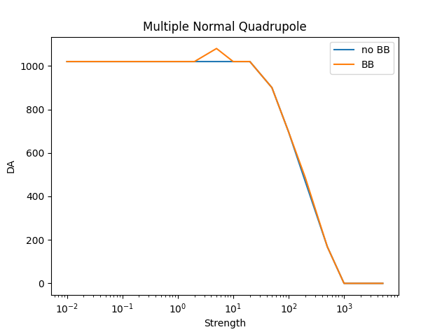
Quadrupole

Slide 26
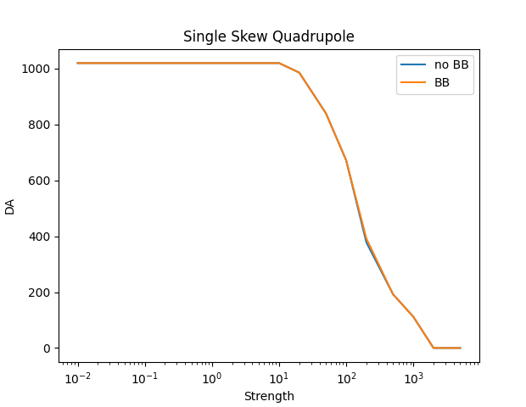
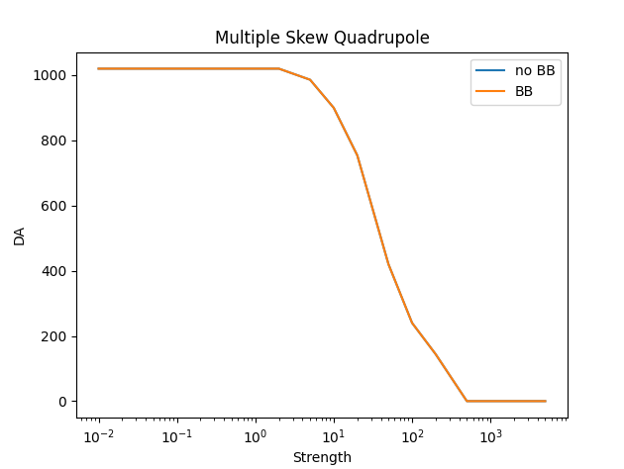
Skew Quadrupole

Slide 27
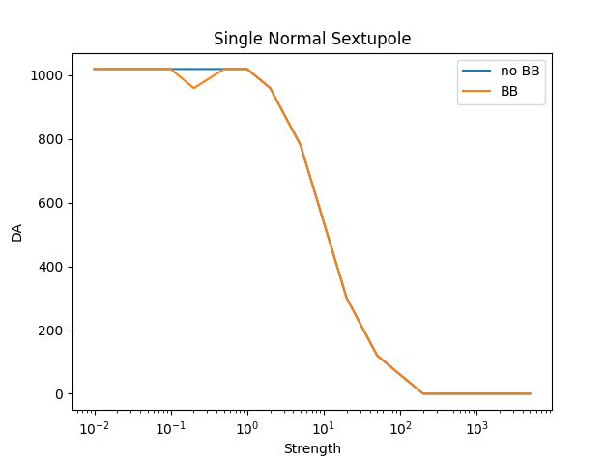
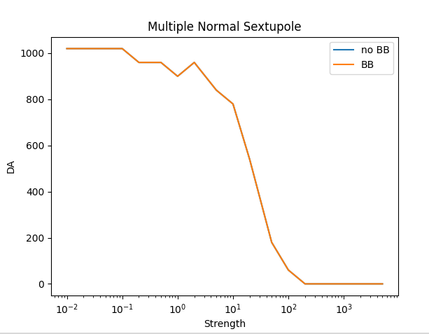
Sextupole

Slide 28
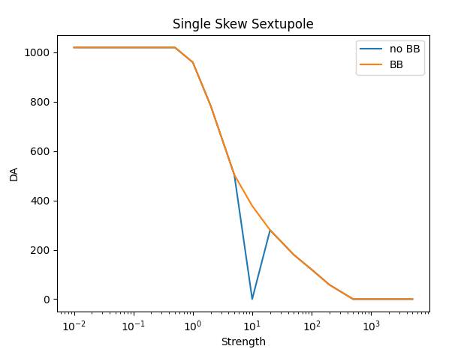
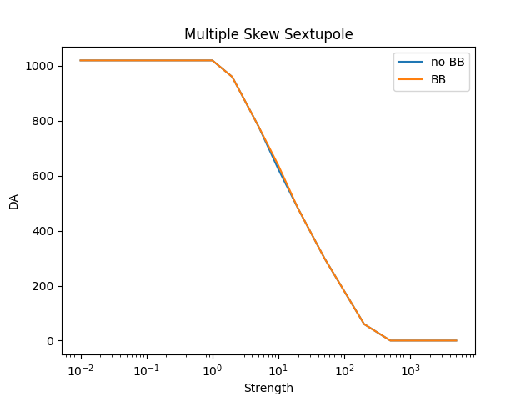
Skew Sextupole

Slide 29
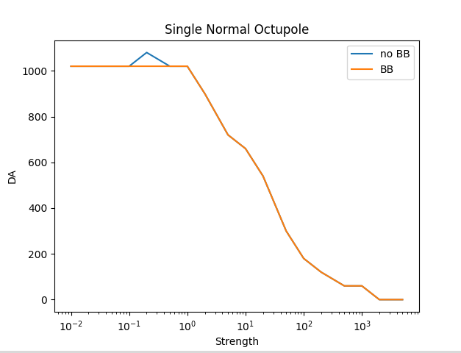
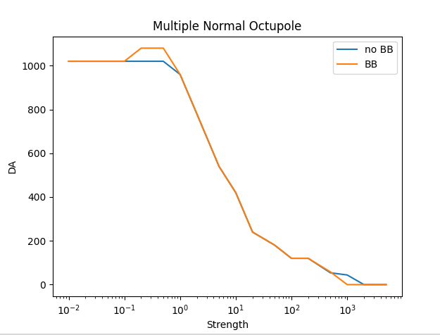
Octupole

Slide 30
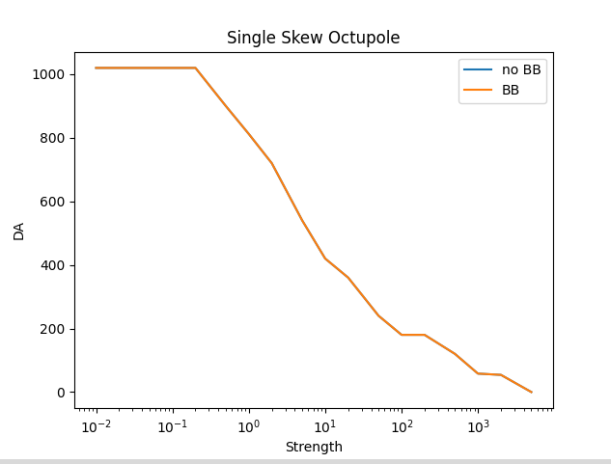
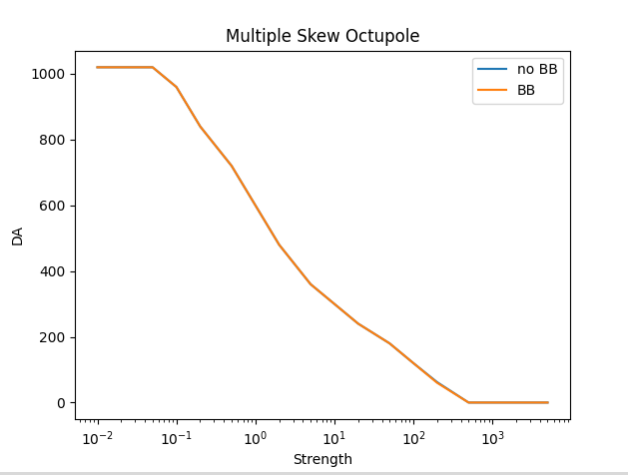
Skew Octupole

